Slide 1
Inverse Mappers for QCD global analysis
By: Manal Almaeen (malma004@odu.edu )
Old Dominion University, Department of Computer Science
Collaborators:
Yaohang Li
Department of Computer Science
yaohang@cs.odu.edu
Nobuo Sato, W. Melnitchouk
Theory Center
nsato@jlab.org, wmelnitc@jlab.org

Slide 2
General overview
The main objective:
Mapping experimental data into quantum correlation functions (QCFs) such as parton distribution functions.

Slide 3
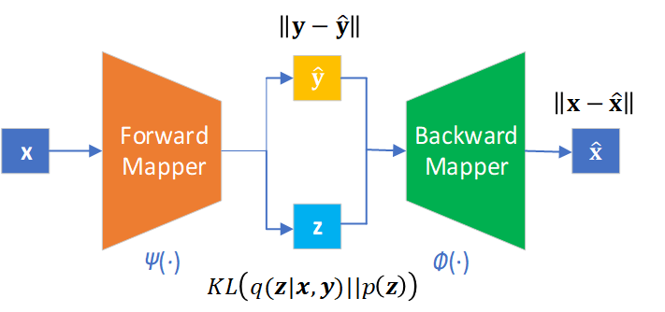
Variational Autoencoder Inverse
Mappers (VAIM)
Predicted Observables
Parameters
Reconstructed Parameters
Latent Variables

Slide 4
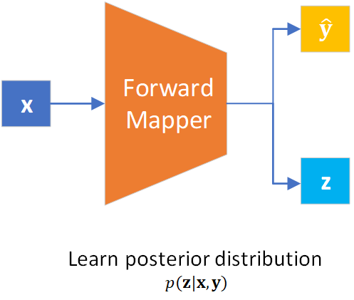
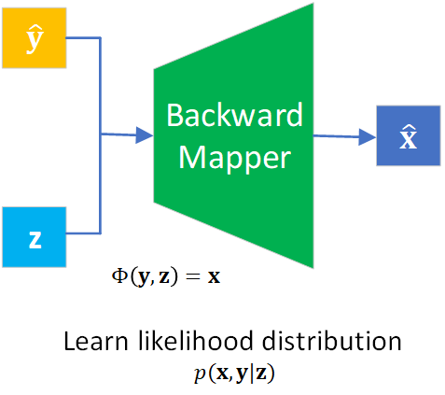
Variational Autoencoder Inverse Mappers (VAIM)
VAIM Training and Production

Slide 5
Variational Autoencoder Inverse Mappers (VAIM)
Approximate
True posterior distribution
Variational Inference
Learn an approximate distribution such that
Minimize the Kullback-Leibler (KL) divergence

Slide 6
Variational Autoencoder Inverse Mappers (VAIM)
Variational Autoencoder Theory
Equivalent to
True prior distribution
Select tractable distribution easy to generate
Gaussian
Uniform

Slide 7
Variational Autoencoder Inverse Mappers (VAIM)
A. Toy Problems
To demonstrate the effectiveness of VAIM we consider the following toy inverse problems with analytical solutions:
f(x)= x² , x ∈[-3, 3]
f(x) = sin x, x ∈ [-2π, 2π]
f(x) = x₀² + x₁², with x=(x₀,x₁) , x_{0,1} ∈ [-2, 2]

Slide 8
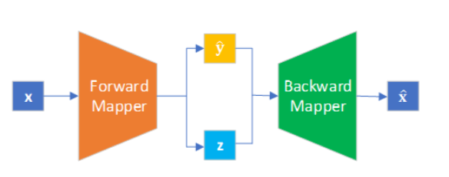
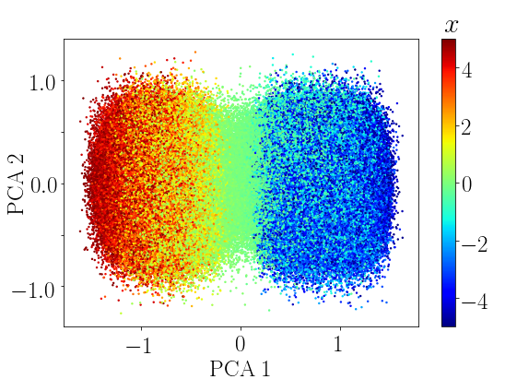
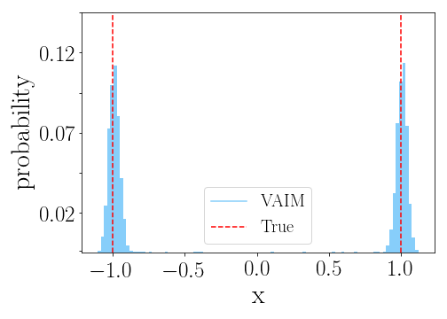
Variational Autoencoder Inverse Mappers (VAIM)
A. Toy Problems
f(x)= x² , x ∈[-3, 3] , Two solutions except x =0
f(x)= 1

Slide 9
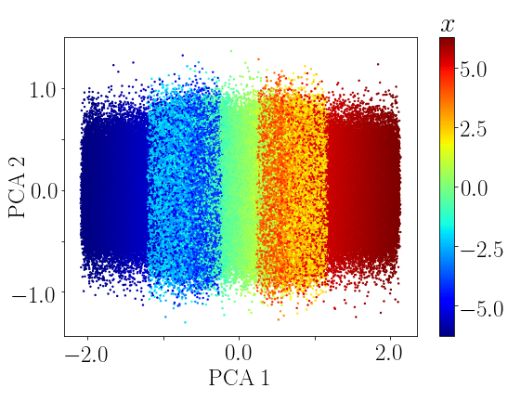
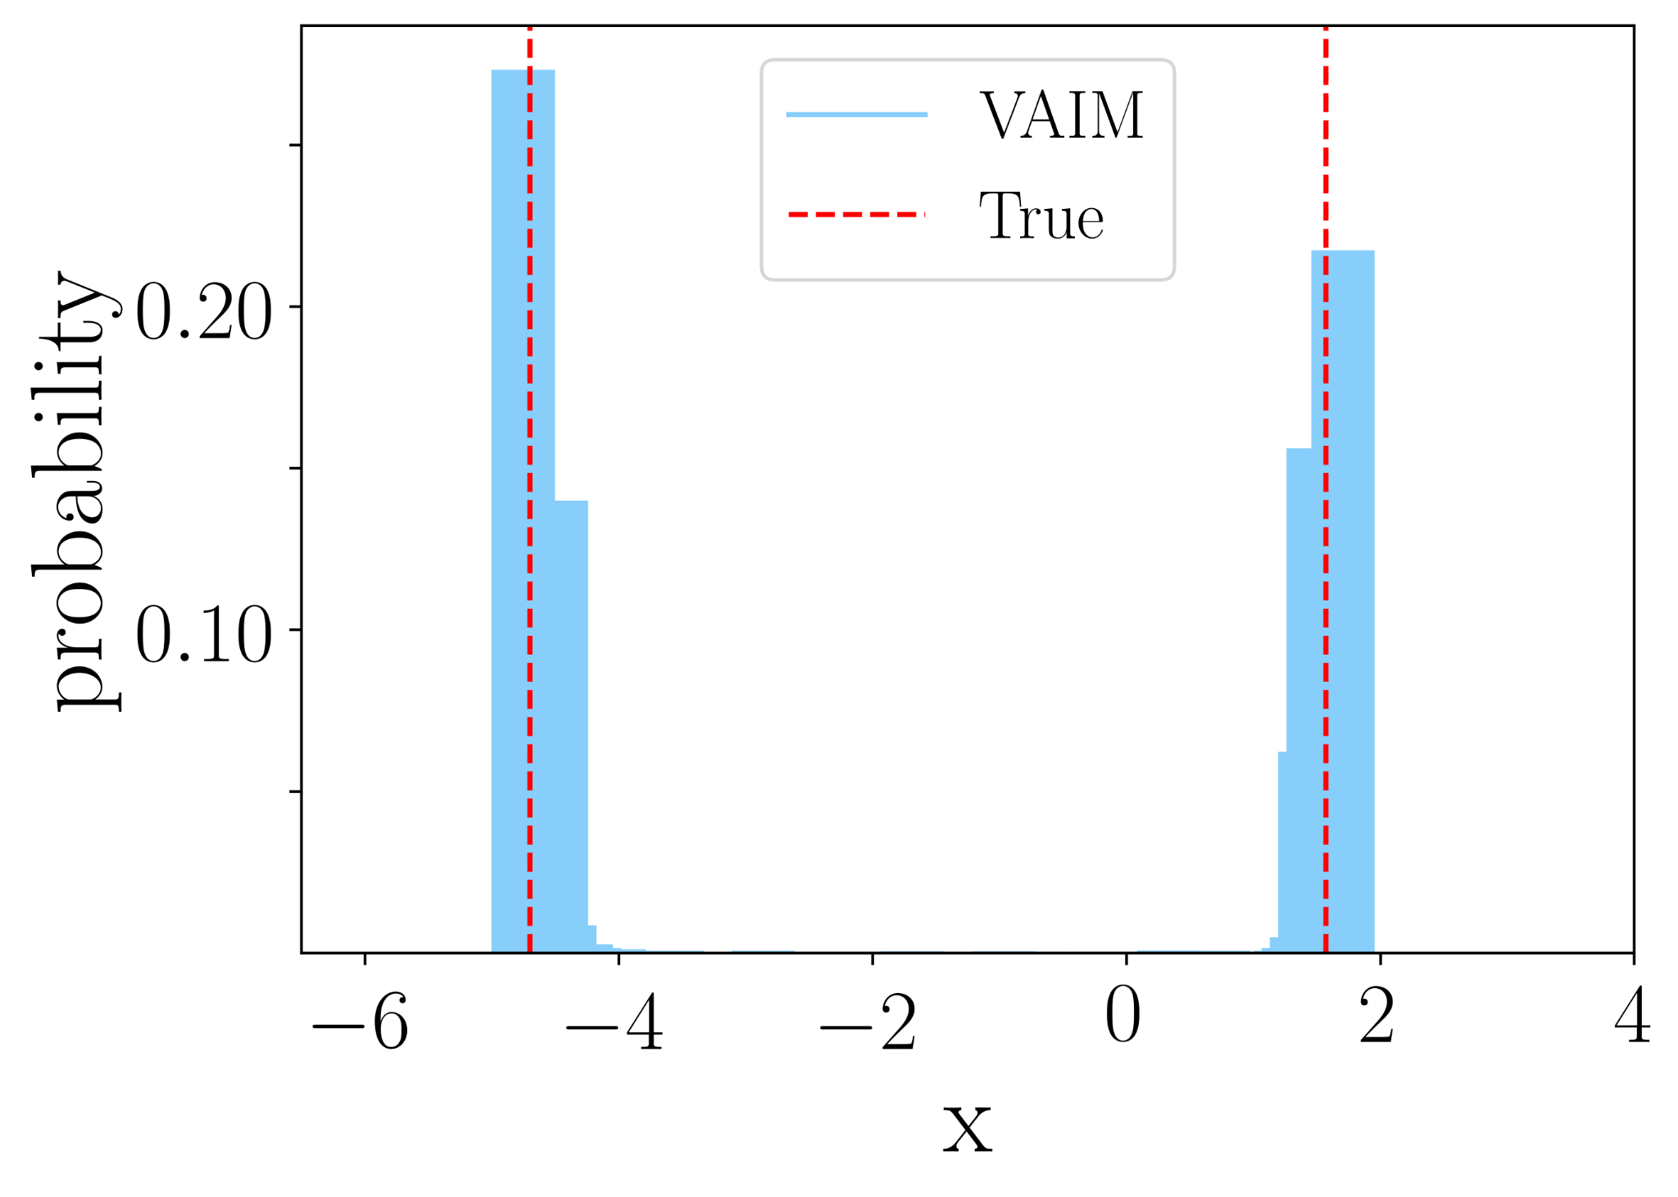
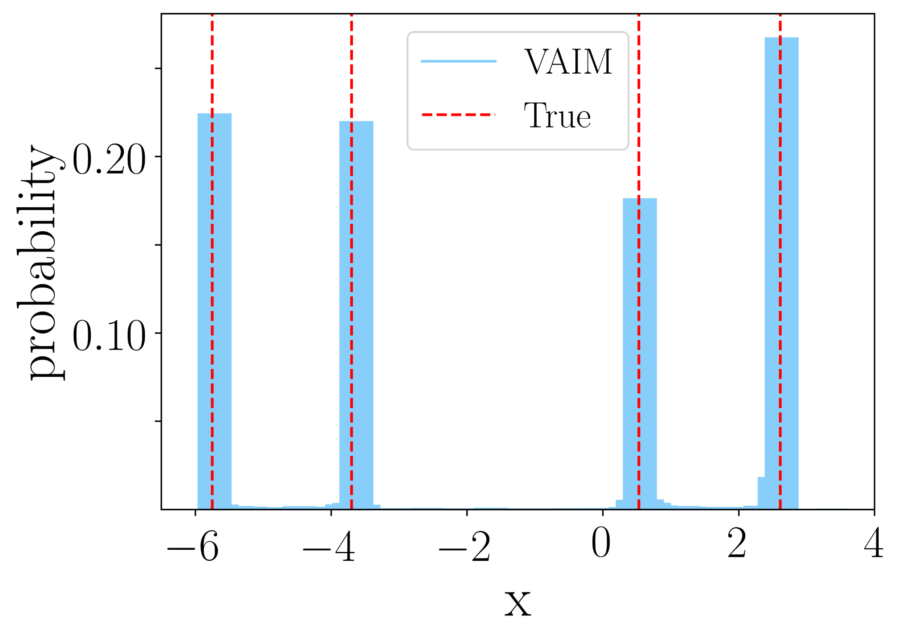
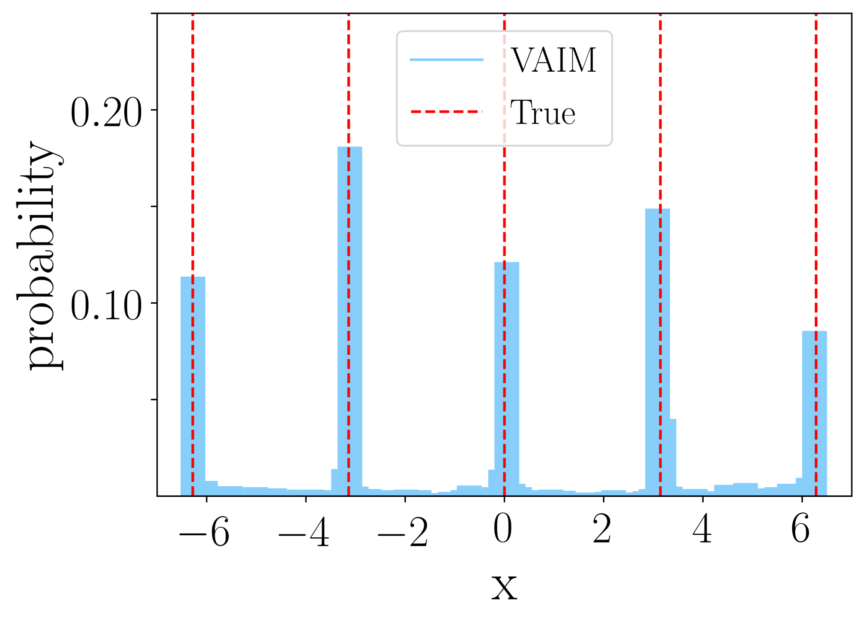
Variational Autoencoder Inverse Mappers (VAIM)
A. Toy Problems
2. f(x) = sin x, x ∈ [-2π, 2π]
Finite but different number of solutions
f(x)= 1
f(x)= -0.5
f(x)= 0

Slide 10
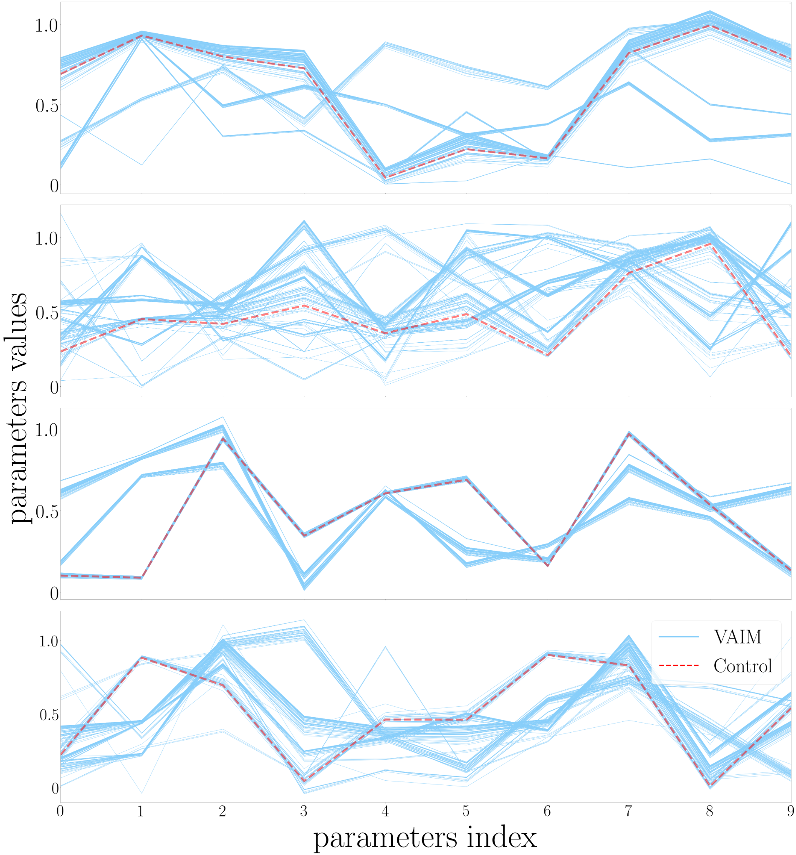
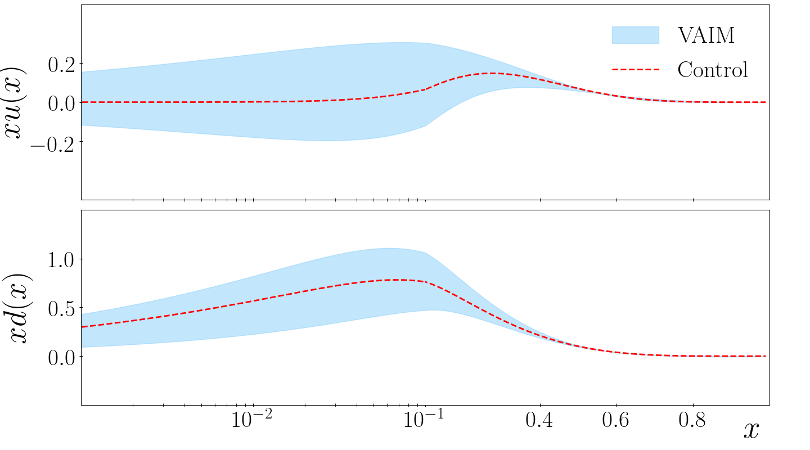
Variational Autoencoder Inverse Mappers (VAIM)
B. Toy DIS problem-1
Parameter distribution generated by VAIM in four control samples
Reconstructed PDF using a control sample

Slide 11
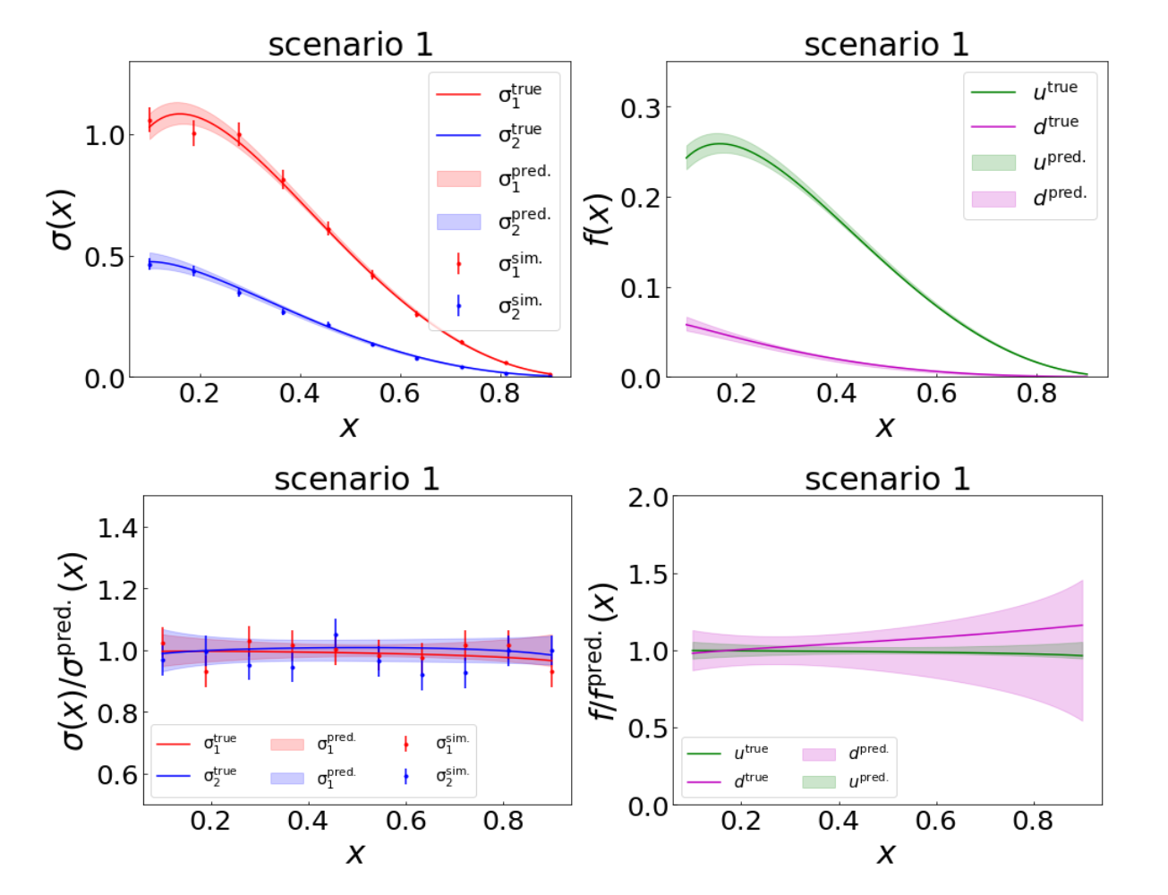
Variational Autoencoder Inverse Mappers (VAIM)
B. Toy DIS problem-2
Reconstructed cross sections and PDF using a control sample

Slide 12
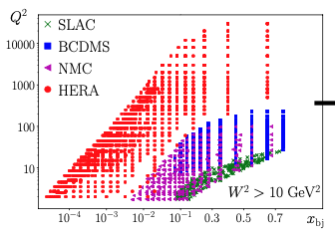
Application to real QCD

Slide 13
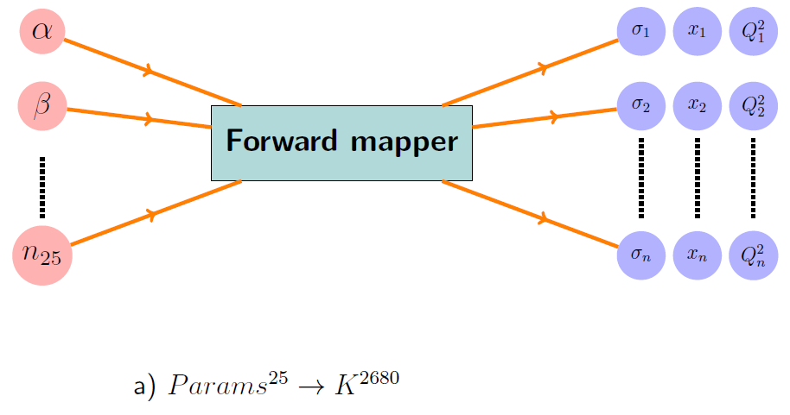
Variational Autoencoder Inverse Mappers (VAIM)
C. Application to real QCD

Slide 14
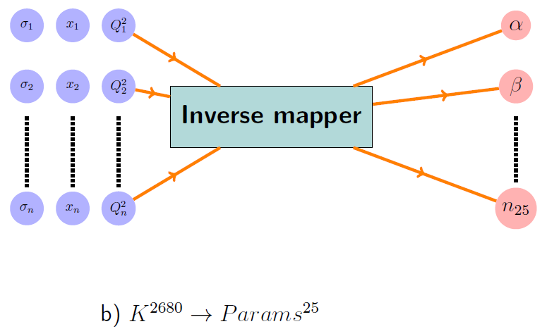
Variational Autoencoder Inverse Mappers (VAIM)
C. Application to real QCD

Slide 15
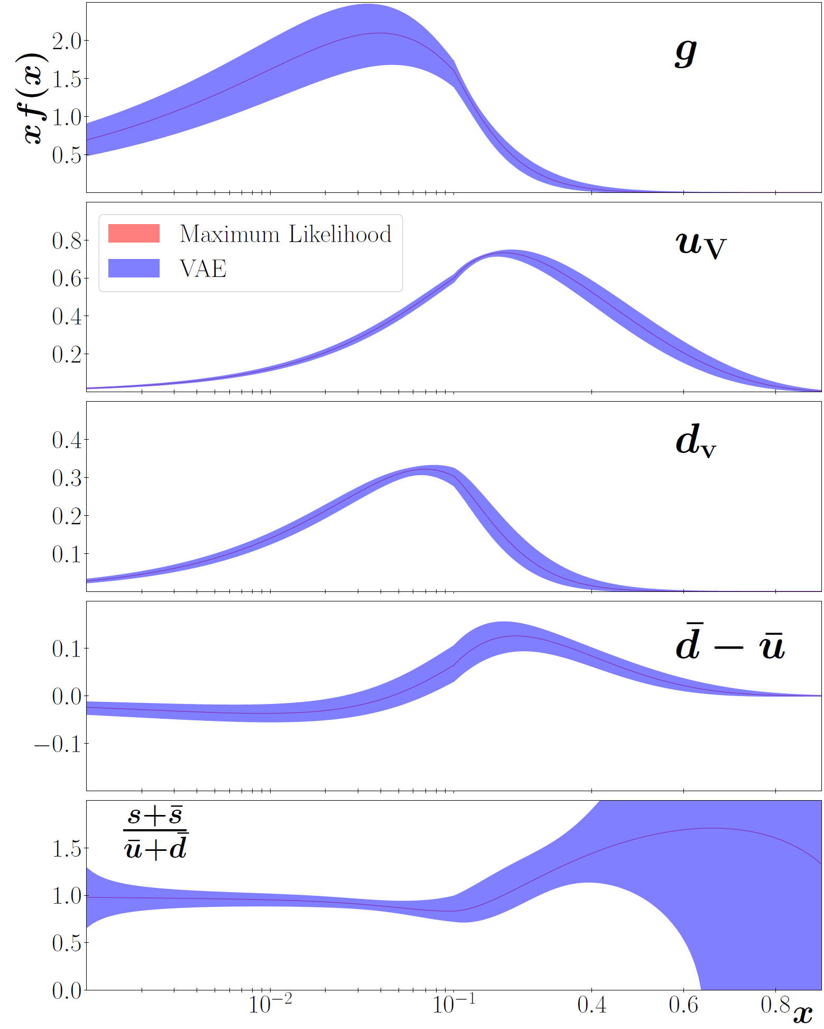
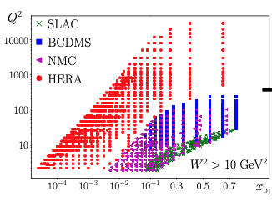
Variational Autoencoder Inverse Mappers (VAIM)
VAIM results

Slide 16
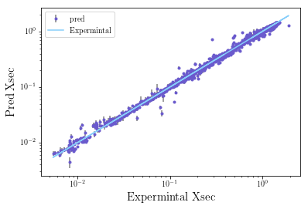
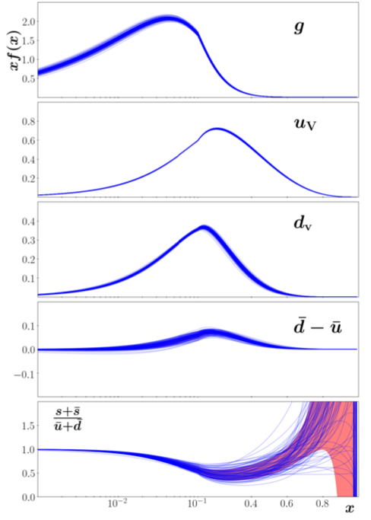
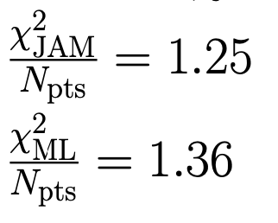
Variational Autoencoder Inverse Mappers (VAIM)
Inverse mapper approach
Preliminary

Slide 17
V. Conclusion
A deep learning framework for Inverse Problems (VAIM) that focuses on learning the solution patterns in an end-to-end manner.
VAIM is further applied to mapping quantum correlation functions (PDFs), to observables in nuclear physics, demonstrating its capability in a more complicated environment.
The software package of VAIM is available at https://github.com/alanaziyasir/VAIM.

Slide 18
Manal Almaeen, Yaohang Li
Department of Computer Science
malma004@odu.edu, yalan001@odu.edu , yaohang@cs.odu.edu
Nobuo Sato, W. Melnitchouk
Theory Center
nsato@jlab.org, wmelnitc@jlab.org
Published at IJCNN 2021
This work was partially supported by the Center for Nuclear Femtography (CNF), administrated by the Southeastern Universities Research Association under an appropriation from the Commonwealth of Virginia and a CNF graduate fellowship CY 2021 to Manal Almaeen.

