Slide 1
INITIAL STUDIES OF CAVITY FAULT PREDICTION AT JEFFERSON LABORATORY
AI in the Accelerator Division
Lasitha Vidyaratne

Slide 2
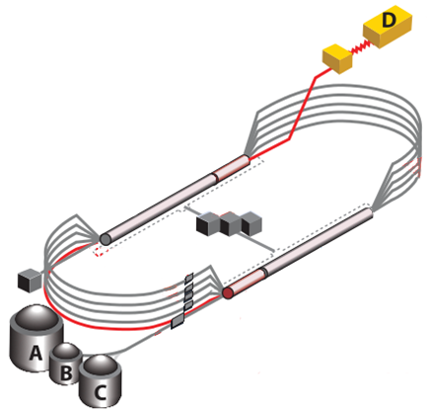
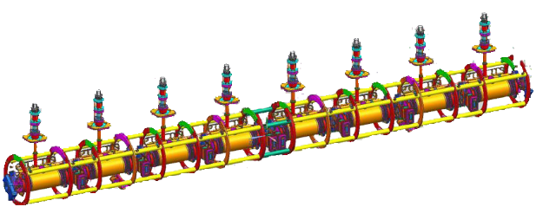
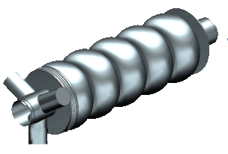
C100 Fault Classification
GOAL: Correctly classify the cavity and the type of RF fault given waveform data
We have the ability to record high-fidelity data from 12 cryomodules
FAULT ISOLATION
Which of the 8 cavities failed first?
FAULT IDENTIFICATION
What type of fault was it?
1 cryomodule = collection of 8 cavities
17 signals/cavity × 8 cavities = 136 signals
17 signals
5
1
5

Slide 3
Benefits of Fault Isolation and Identification
Post-Run Analysis
Use aggregate statistics for data-driven guidance for maintenance and upgrade activities
Data Analysis
Analysis of fall 2018 data indicated three cryomodules in South Linac were prone to microphonics-based faults
Action
Provided justification to perform microphonics hardening (installing tuner dampers)
Outcome
Reduced microphonics-based trip rates
Gradients could be increased in those cryomodules
Post-Fault Analysis
Provides critical feedback to control room operators
Fault types → actions
“if Fault A happens X times within Y minutes, drop gradient in the cavity by Z MV/m”
“if Fault B happens X times within Y minutes, contact a SME”

Slide 4
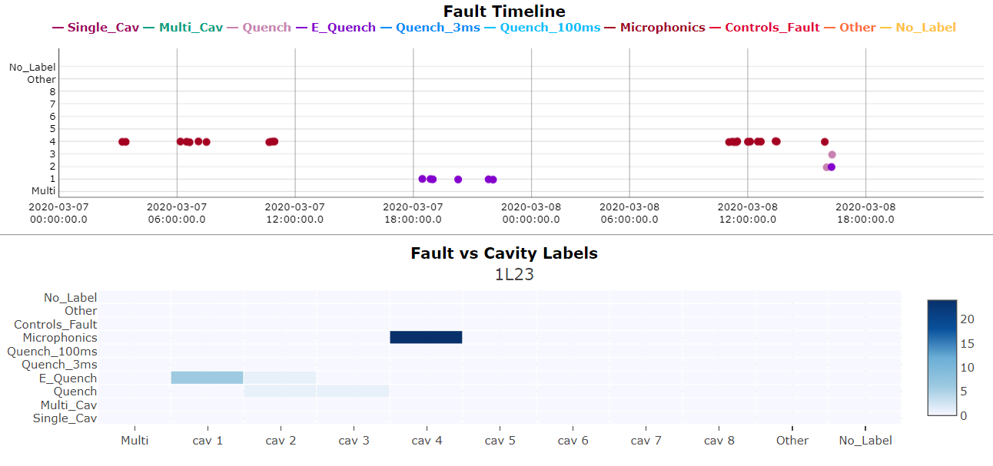
Visualization and Communication
Method to communicate ML output information clearly and concisely
Visualize spatial and temporal nature of model predictions
For operators attention!

Slide 5
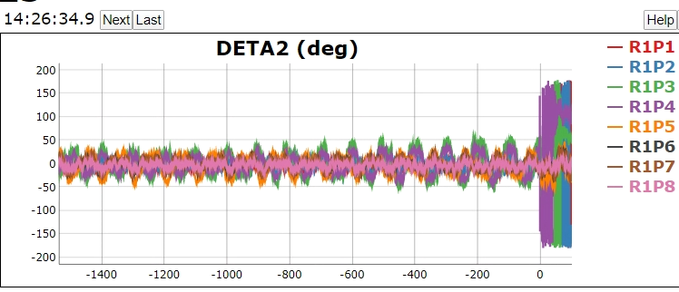
Next step: C100 Fault Prediction
Can data prior to event accurately predict the fault type?
Identifying the type of RF fault w.r.t. lead time before beam trip
Use saved waveforms
Fault onset
F1-score
$$t=−350 ms$$
$$t=−250 ms$$
$$t=−50 ms$$
fault onset: $t=0 ms$
$$t=−450 ms$$
$$t=−150 ms$$

Slide 6
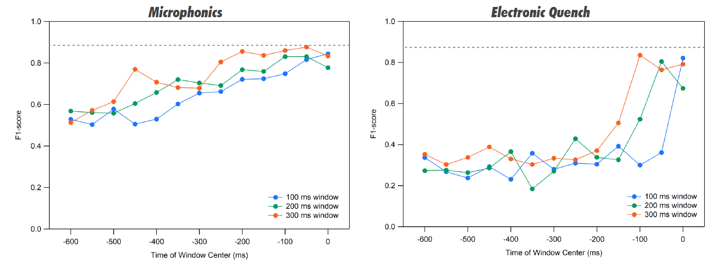
Preliminary results: C100 Fault Prediction
Initial results suggests that for some fault types, prediction is possible
Motivates continued study
What targeted mitigations can be implemented within these time-scales?

Slide 7
Future Work
ML models in the study are trained using static datasets
Alternatively, treat data as a continuous stream
The ability to process each example as it becomes available (inspect once, predict, and discard)
Routinely update models as it is exposed to new data
Upgrades to LLRF underway for data streaming
Preliminary framework for using machine learning models with continuously streaming data

Slide 8
Thank you!
Lasitha Vidyaratne
lasithav@jlab.org
Publications
Journal articles
Tennant, Chris, et al. "Superconducting radio-frequency cavity fault classification using machine learning at Jefferson Laboratory." Physical Review Accelerators and Beams 23.11 (2020): 114601.
L. Vidyaratne et. Al. “Deep Learning Based Superconducting Radio-Frequency Cavity Fault Classification at Jefferson Laboratory,” Frontiers Operational Intelligence (under review), 2021
L. Vidyaratne et al. "Deep Cellular Recurrent Network for Efficient Analysis of Time-Series Data With Spatial Information." IEEE Transactions on Neural Networks and Learning Systems (2021).
Conference articles
L. Vidyaratne†, R. Suleiman, C. Tennant, D. Turner, K. Iftekharuddin, Md. Monibor Rahman, "Initial Studies of Cavity Fault Prediction at Jefferson Laboratory," presented at the 18th International Conference on Accelerator and Large Experimental Physics Control Systems (ICALEPCS 2021), Shanghai, China, October 14-22, 2021, Paper presented.
A. Shabalina et al. “SRF cavity fault classification using machine learning at CEBAF,” 10th Int. Partile Accelerator Conf.(IPAC'19), Melbourne, Australia, 19-24 May 2019. JACOW Publishing, Geneva, Switzerland, 2019.
A. Carpenter et al., “Initial Implementation of a Machine Learning System for SRF Cavity Fault Classification at CEBAF”, presented at the 17th Int. Conf. on Accelerator and Large Experimental Physics Control Systems (ICALEPCS'19), New York, NY, USA, Oct. 2019,
A. Carpenter et al. “Jefferson Laboratory C100 Superconducting Radio-Frequency Cavity Fault Data, 2020, ” Thomas Jefferson National Accelerator Facility (TJNAF), Newport News, VA (United States), 2020.
JLab tech notes
JLAB-TN-20-014: Machine Learning Pipeline for C100 Cavity and Fault Classification
JLAB-TN-20-027: Deep Recurrent Learning for C100 Cavity and Fault Classification
JLAB-TN-20-030: Convolutional Neural Networks for C100 Cavity and Fault Classification
JLAB-TN-20-011: On the Possibility of Using Machine Learning to Predict C100 Cavity Faults

