Slide 1
Core @ 3 Tesla with Hcal and coil mods
Paul Brindza, ODU
August 17, 2021

Slide 2
CORE magnet update
Modify iron on Hcal end
Revise coil from a simple single coil solenoid to a three coil solenoid with the same exterior dimensions
Current density is 2880 amps/cm^2
Model uses 50 % iron density to simulate presence of detectors within
Model CORE is axi-symmetric
CORE is not symmetric about z=0 so investigate axial forces

Slide 3
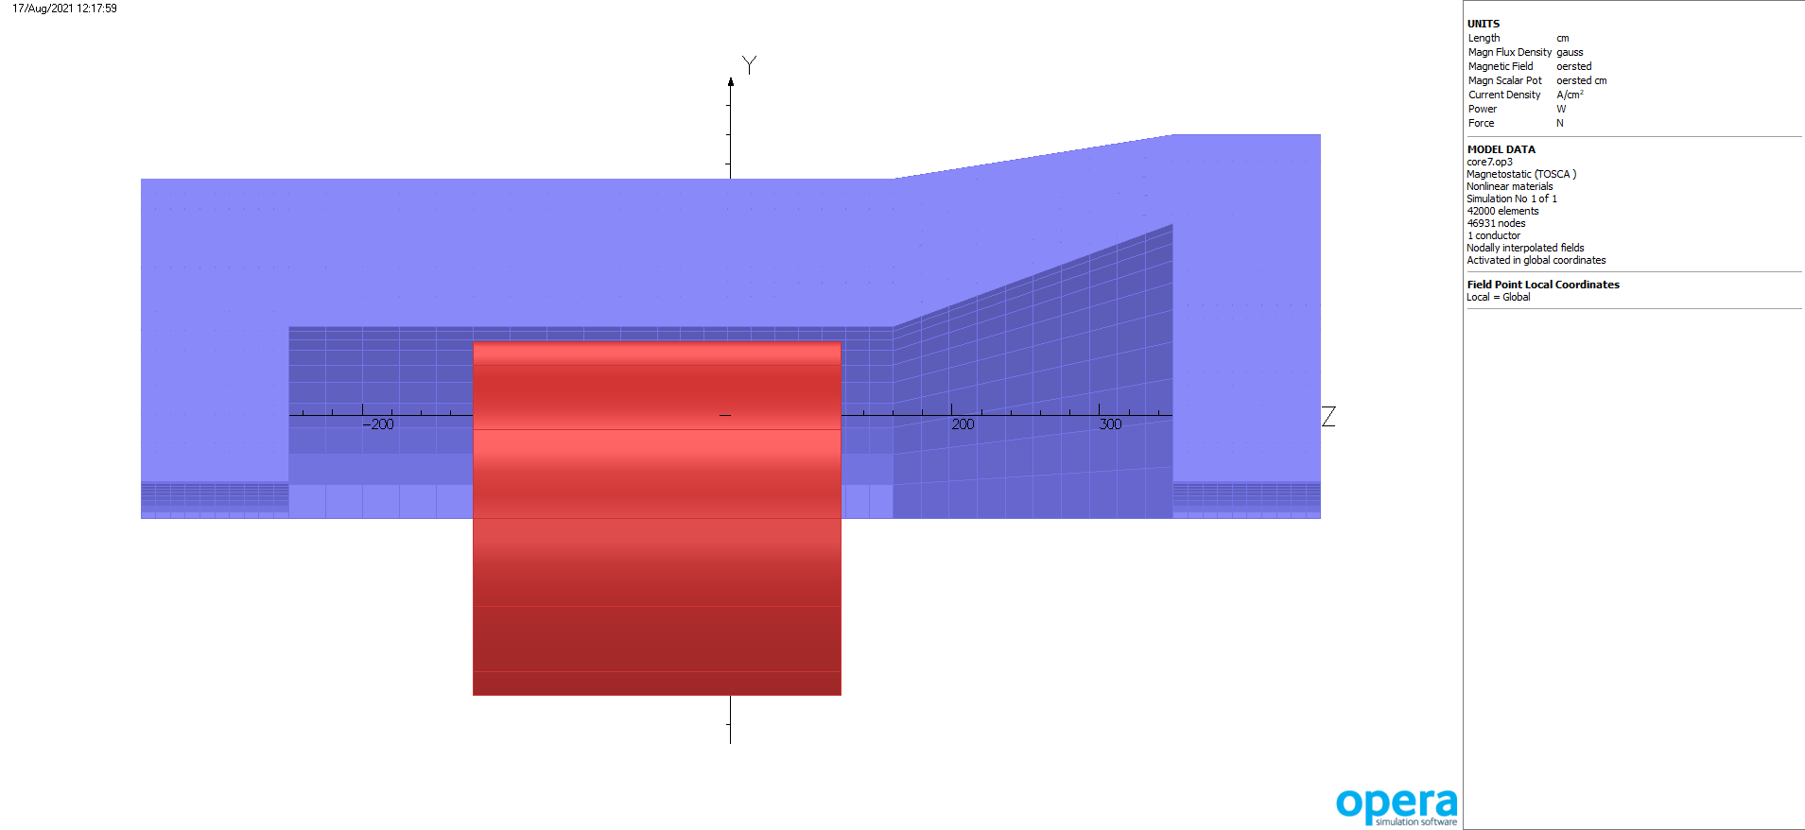
Revised CORE Hcal end @ 3 Tesla

Slide 4
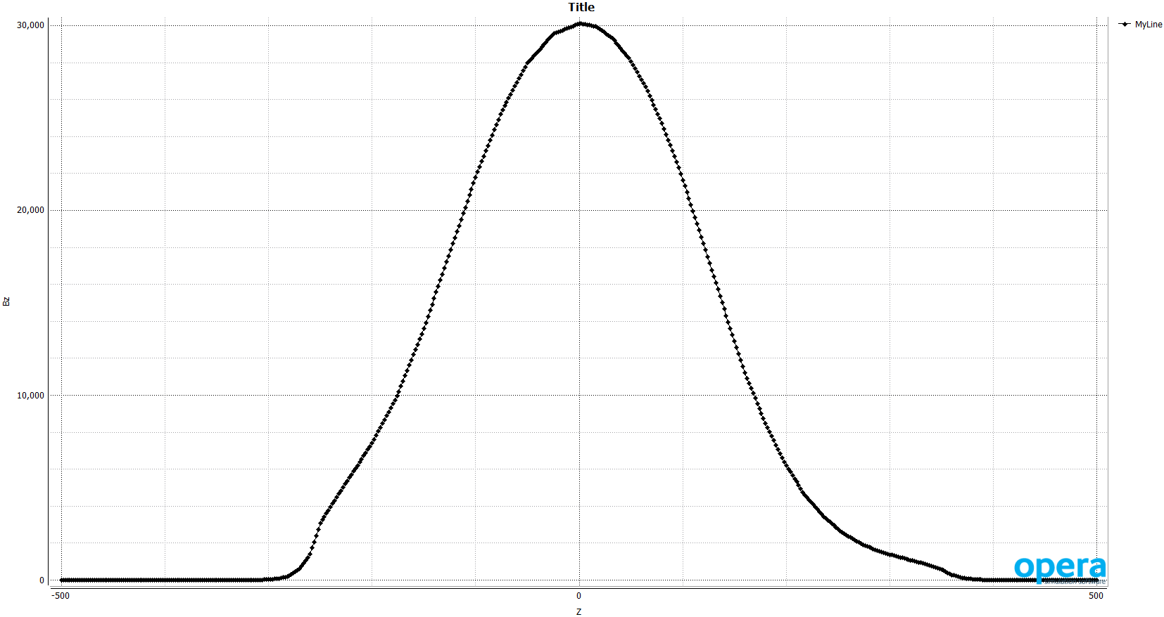
CORE Bz on axis -500 to 500 cm

Slide 5
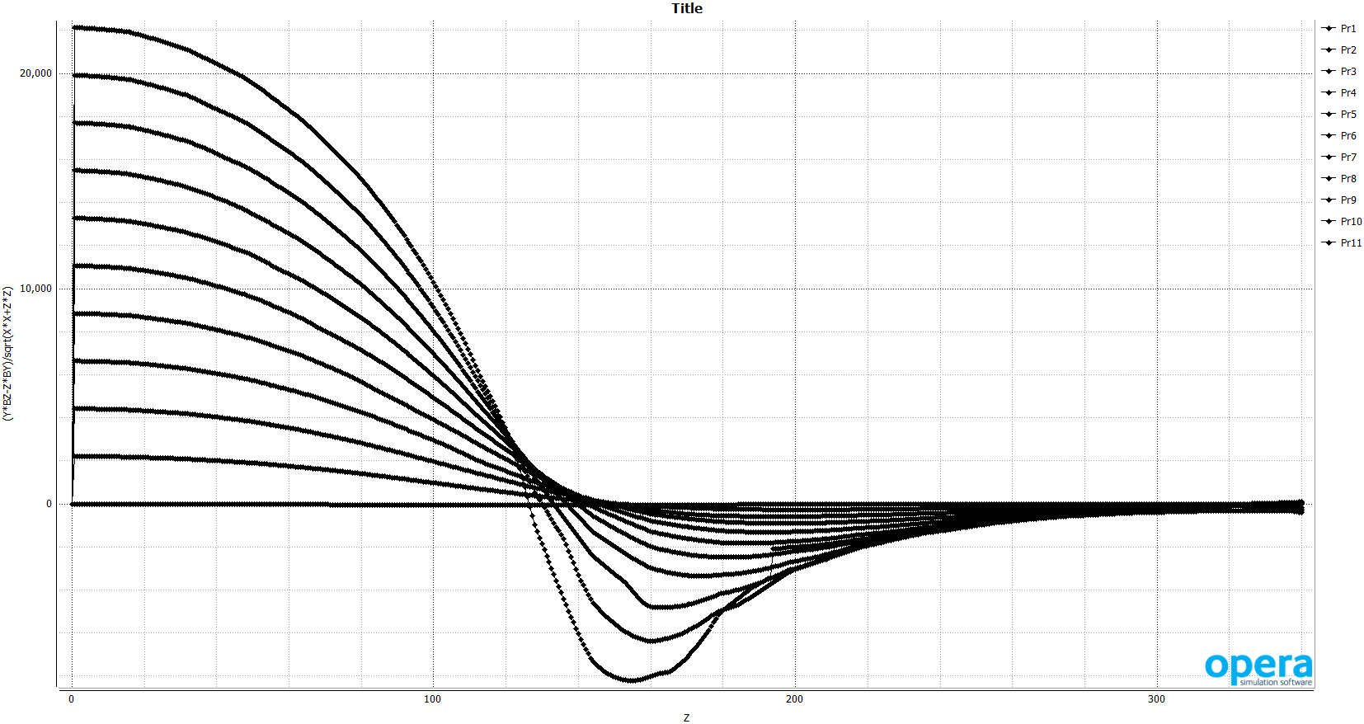
CORE Hcal mod projectivity( 0-250 Y, 0- 300 Z) Note the iron change made larger angles accessible
Pr1 thru Pr7 match previous range

Slide 6
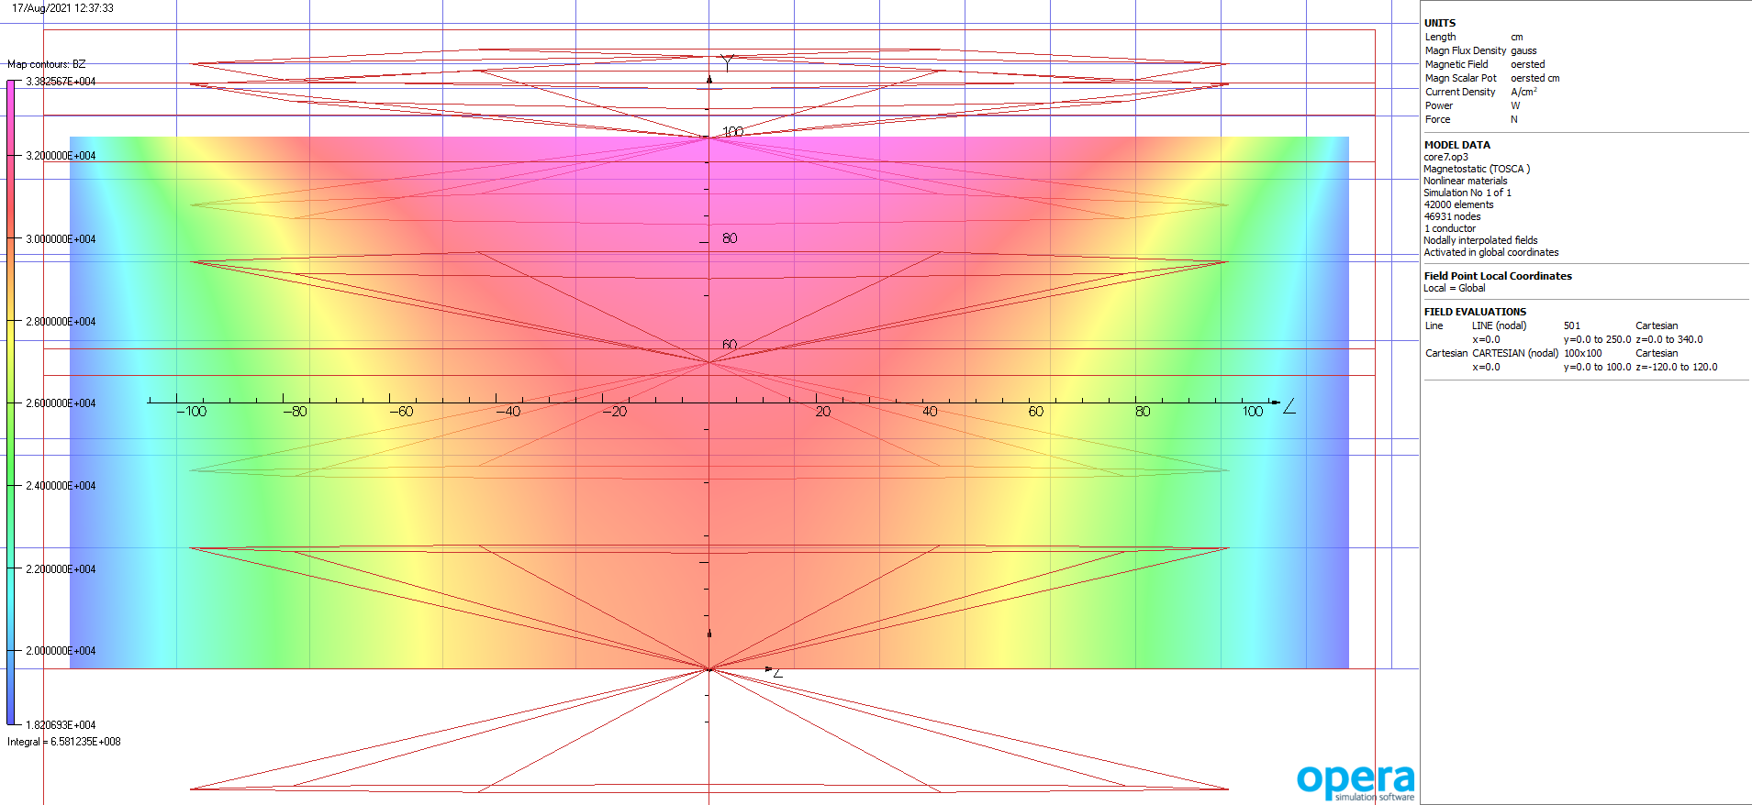
Bz inside solenoid

Slide 7
Some comments
Core is not symmetric along Z and one should expect some coil forces as a result
Trying to passively compensate by manipulating the content of the calorimeters may be possible
A better, lower risk solution would be to subdivide the solenoid coil so we have some adjustability
The original single coil was 10 by 250 cm centered.
This proposal is a center coil 10 by 230 cm and two flanking coils 10 by 10 cm with the capability to be powered independently.

Slide 8
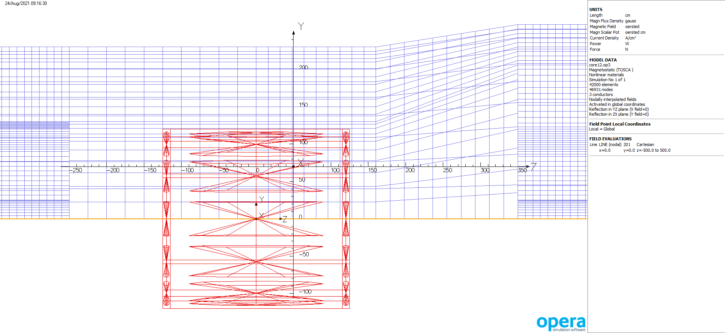
3 coil CORE model

Slide 9
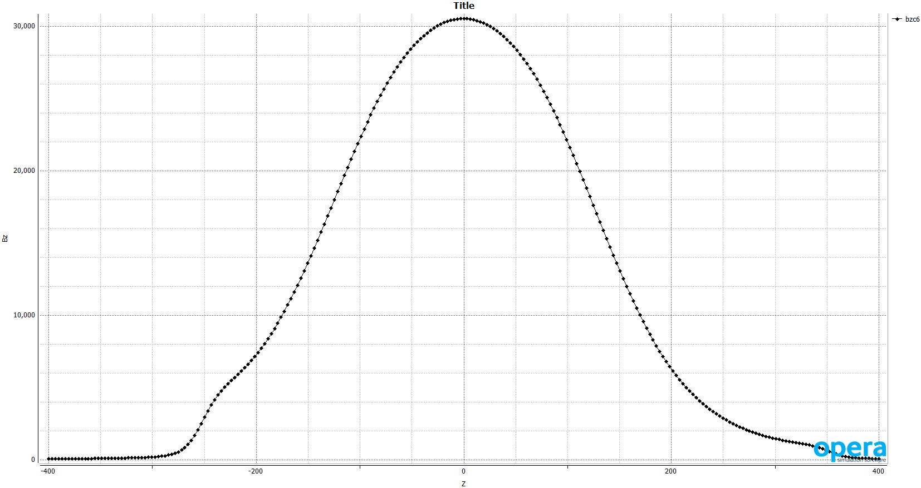
Bz on axis for 3 coil core

Slide 10
Comments on coil forces
The Bz field causes an outward radial force that amounts to a pressure on the coil and coil case, is symmetric and the coil case must support this pressure.
The Br field causes axial forces and in the presence of asymmetric iron can result in a net axial or de-centering force.
The average field in coil 1 is near zero and the result is less than the overall accuracy of the calculation ~ 1.5 %
The difference between the average field of coil 2 and coil 3 is small and about equal to the calculation accuracy
The product of current density, coil area and length for coil 1 is 47E6 and for coils 1 & 2 it is 2E6 amps-meters
Small field asymmetries result in significant forces if real

Slide 11
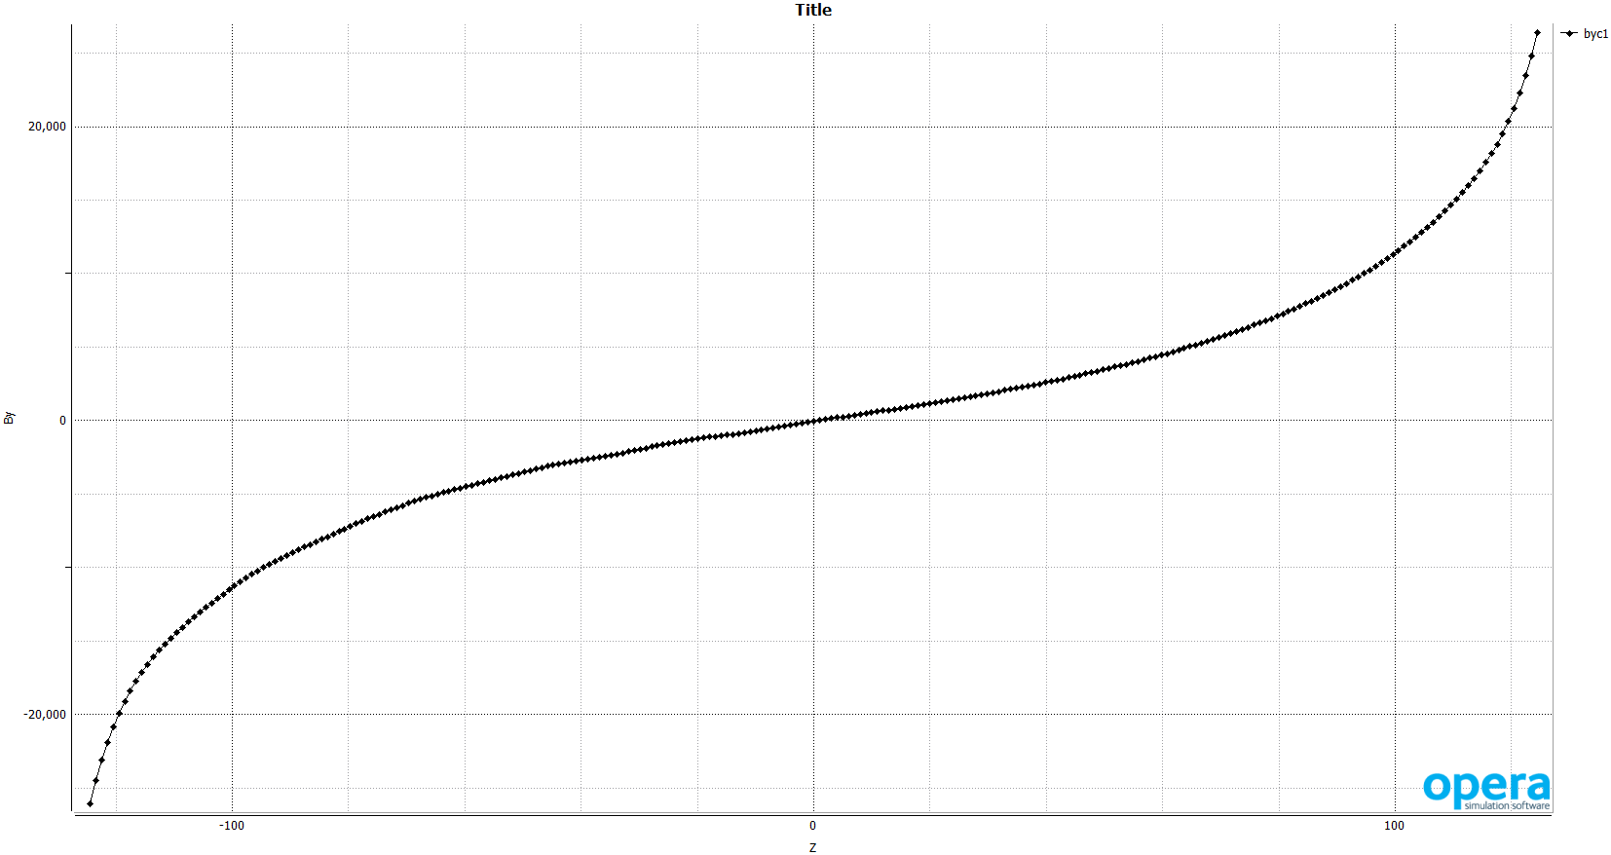
By field in the middle of the coils(may cause axial force)

Slide 12
Force case all coils same current ( 2880 amps/cm^2)
 | Average Br field | J*A*L ( amp meters) | force
Coil 1 | -0.0015 Tesla | -47.87 E 6 | -73,717 Nt
Coil 2 | -1.9579 Tesla | - 2.081E 6 | - 4.075E6 Nt
Coil 3 | +1.9759 Tesla | -2.081 E6 | + 4.112E6 Nt
net |  |  | -36,324 Nt | - 8,166 #

Slide 13
Force case coil 2 has 20 amps/cm^2 less than coils 1 and 3
 | Average Br field | J*A*L ( amp meters) | force
Coil 1 | -0.0021 Tesla | -47.87 E 6 | -98,353 Nt
Coil 2 | -2.085 Tesla | - 2.067E 6 | - 4.309 E6 Nt
Coil 3 | +2.124 Tesla | -2.081 E6 | + 4.421 E6 Nt
net |  |  | + 13,151 Nt | +2,956 #

Slide 14
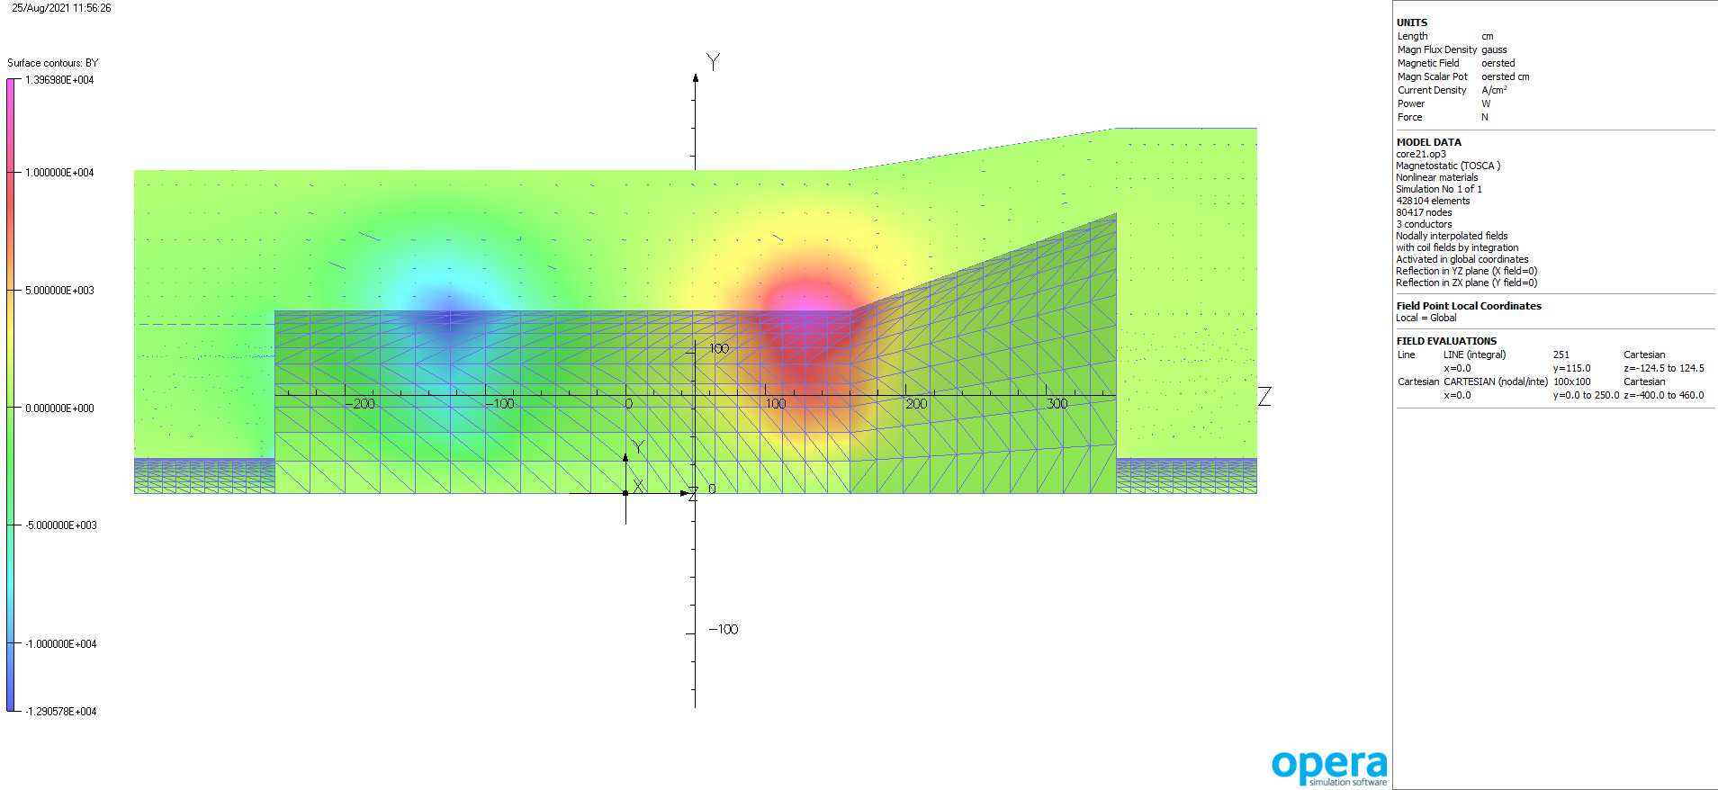
Br in iron- note most Br is at coil ends

Slide 15
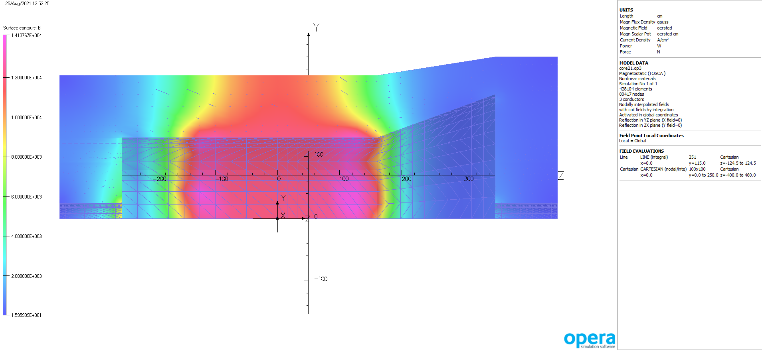
B mag on Iron surface Bmax is 1.41 Tesla

Slide 16
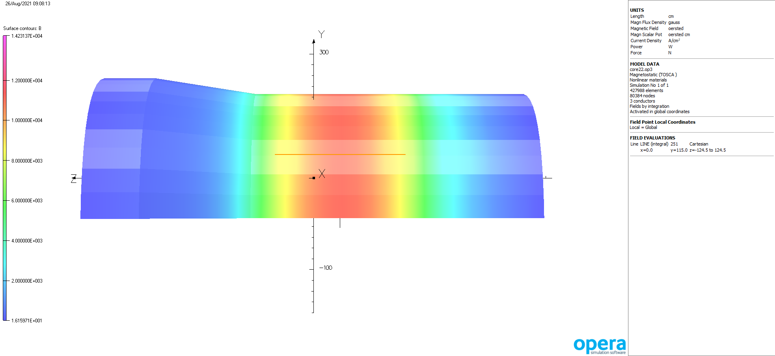
Bmag exterior of iron, Bmax ~ 1.1 Tesla

Slide 17
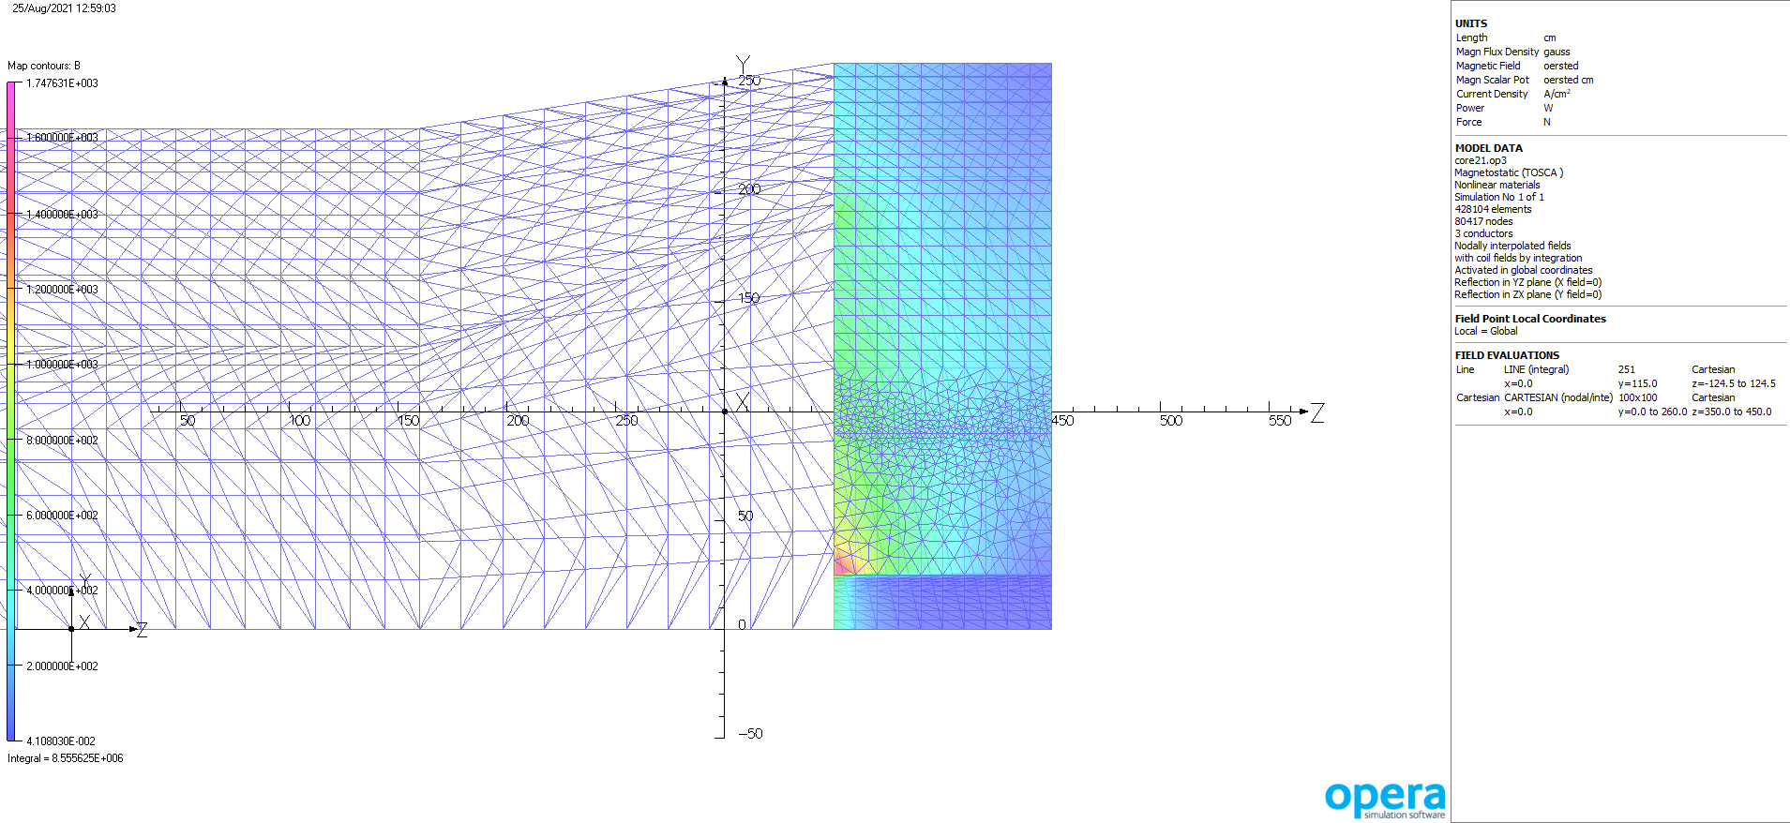
Field in Hcal

Slide 18
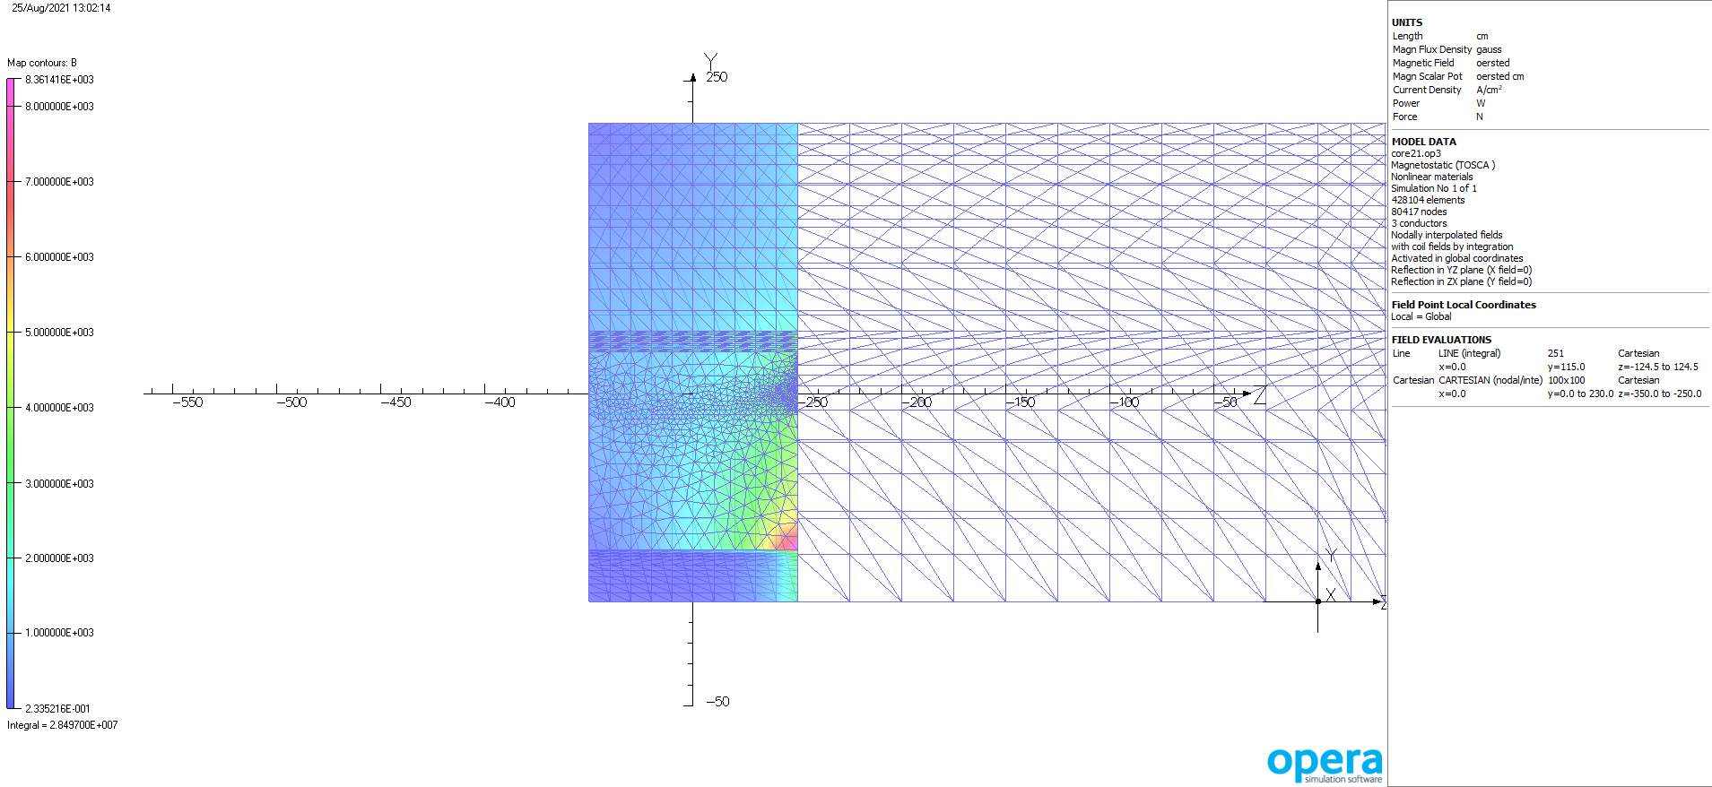
Field in Ecal

Slide 19
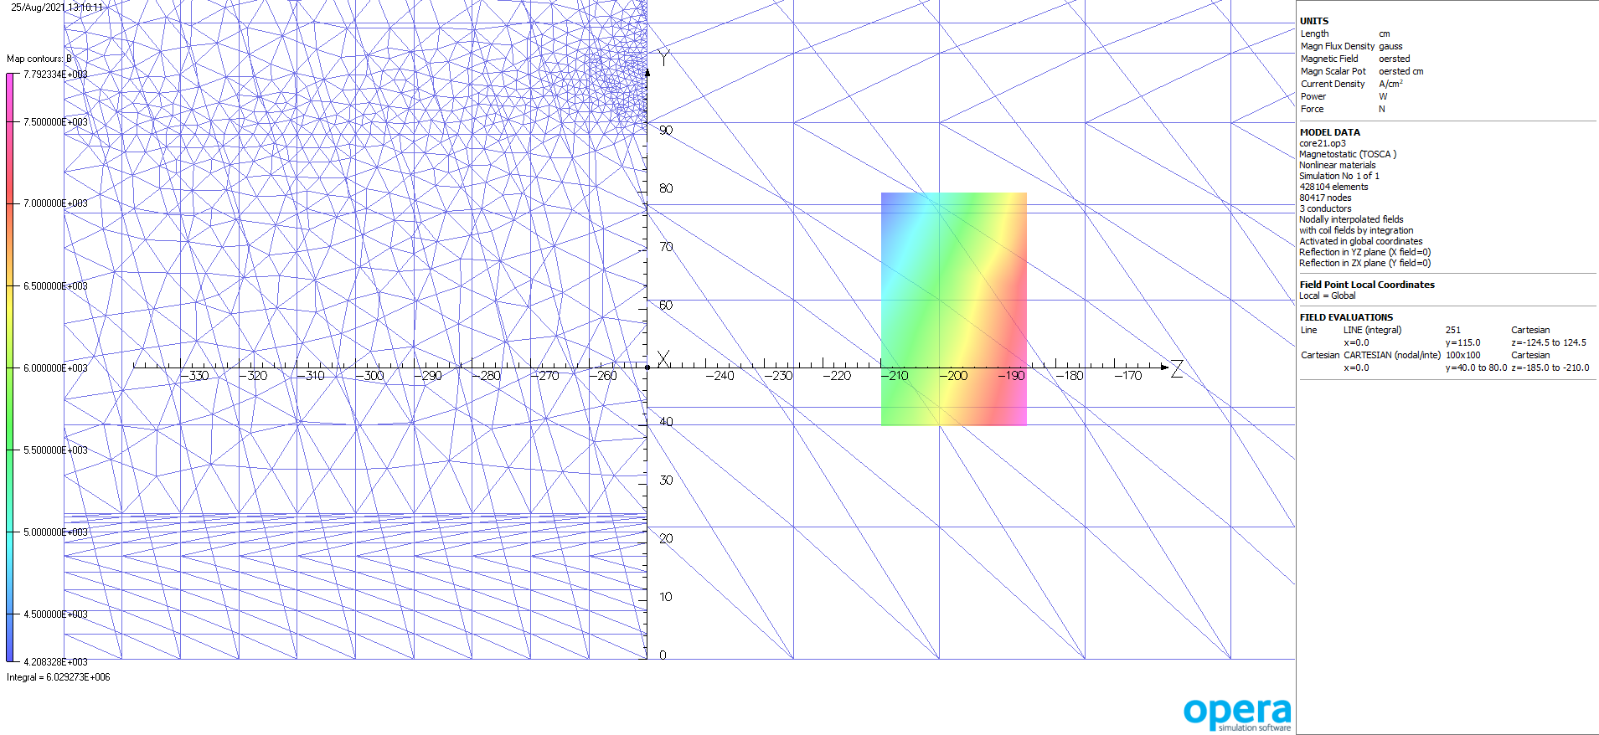
Field magnitude in DIRC

Slide 20
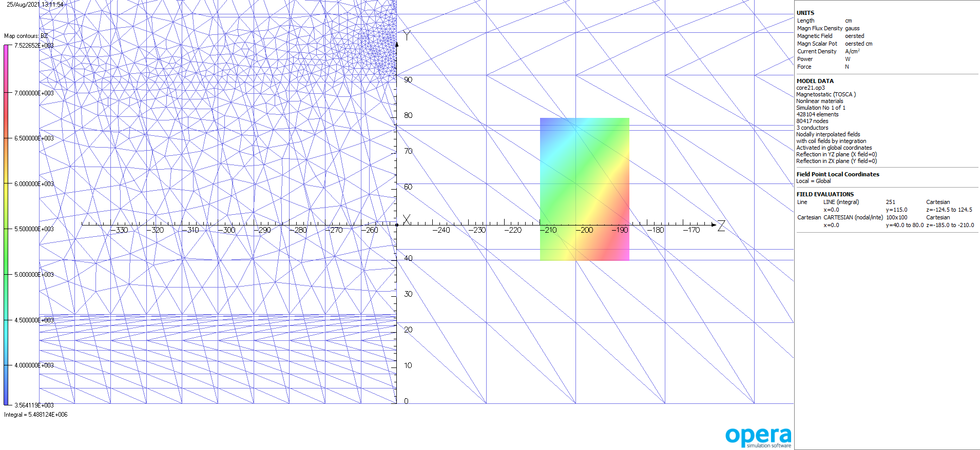
Bz in DIRC

Slide 21
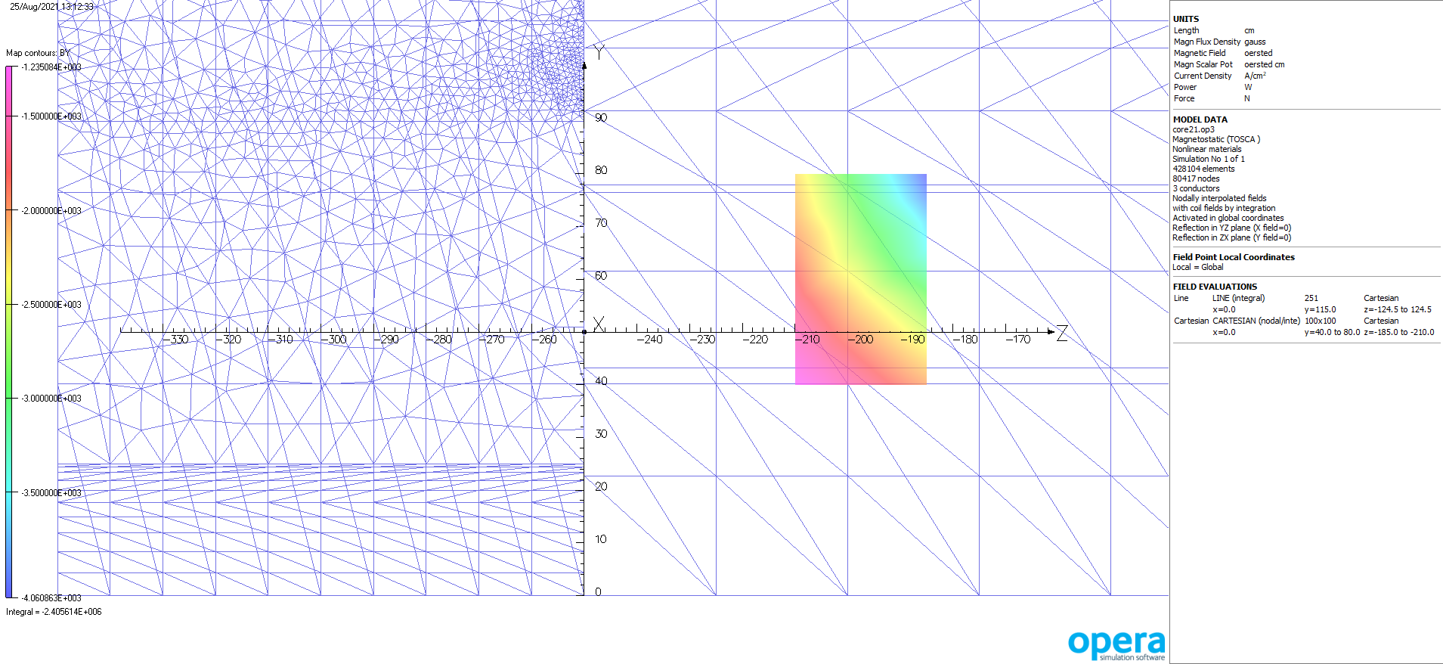
Br in DIRC

Slide 22
Summary on CORE 3 T magnet
This looks OK to me.
Make suggestions
New Field grid file available

