Slide 1
Modern extraction of Compton Form Factors using global fits with artificial neural networks
Zulkaida Akbar & Liliet C. Diaz & Dustin Keller
University of Virginia
AI TownHall and HackaThon
07/26/2021

Slide 2
Generalized-Parton Distributions (GPDs)
How are the spatial and momentum distributions of the quarks and gluons (i.e., the partons) correlated inside the nucleon?
How do the partons contribute to the bulk properties of the proton (mass, spin, charge,...)?
GPDs provide access to the 3-dimensional structure of the nucleon
Courtesy of Frank Sabatie’s presentation

Slide 3
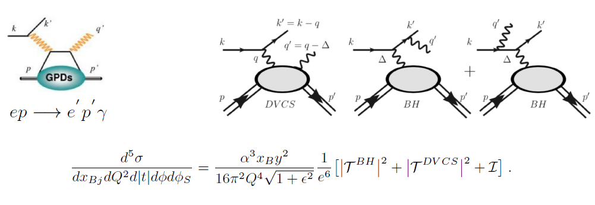
Deep Virtual Compton Scattering (DVCS)
DVCS experiment provide access to the GPDs

Slide 4
Deep Virtual Compton Scattering (DVCS)
The DVCS term contains Compton-Form Factors (CFFs) that we want to extract using Neural network approach
We could access GPDs via CFFs (CFFs are the convolution of the GPDs)
The DVCS Cross section is written in VA formalism
The VA formalism will be described in the next presentation by Liliet

Slide 5
DVCS program at JLAB
Courtesy of Carlos M. Camacho

Slide 6
Courtesy of Carlos M. Camacho

Slide 7
Neural-network approach
CFFs ($ReH, ReE, Re\tilde{H}$) are extracted using Neural network for each kinematic bins (local fit).
Inputs are the kinematics ($k,Q^{2},x,t$) and the output are the CFFs ($ReH, ReE, Re\tilde{H}$) .
The resulting CFFs from each kinematic bins are trained to obtain the CFFs across kinematics (global fit)
The main goal is to obtain a global prediction of the CFFs for a wide kinematic range

Slide 8
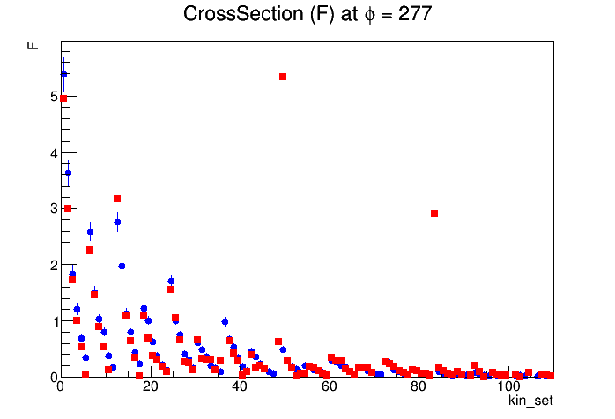
A (Very) Preliminary result
This plot shows the cross-section data at a particular angle for 110 bins (Blue) in comparison with the prediction from the global-fit extraction (Red)
There are plenty room for improvement: Hyperparameter optimization
Data
Global-fit prediction

Slide 9
Summary & Outlook
We are working to extract the CFFs from the Hall B data of the DVCS experiment
The neural-network approach provide prediction for the CFFs across a wide kinematic range
We will include other DVCS data from multiple hall to obtain a more reliable global fit using Neural network

