Slide 1
ML for Transition Radiation Detector
Yulia Furletova ( and eRD22 team )
A.I Town Hall, 26 July 2021

Slide 2
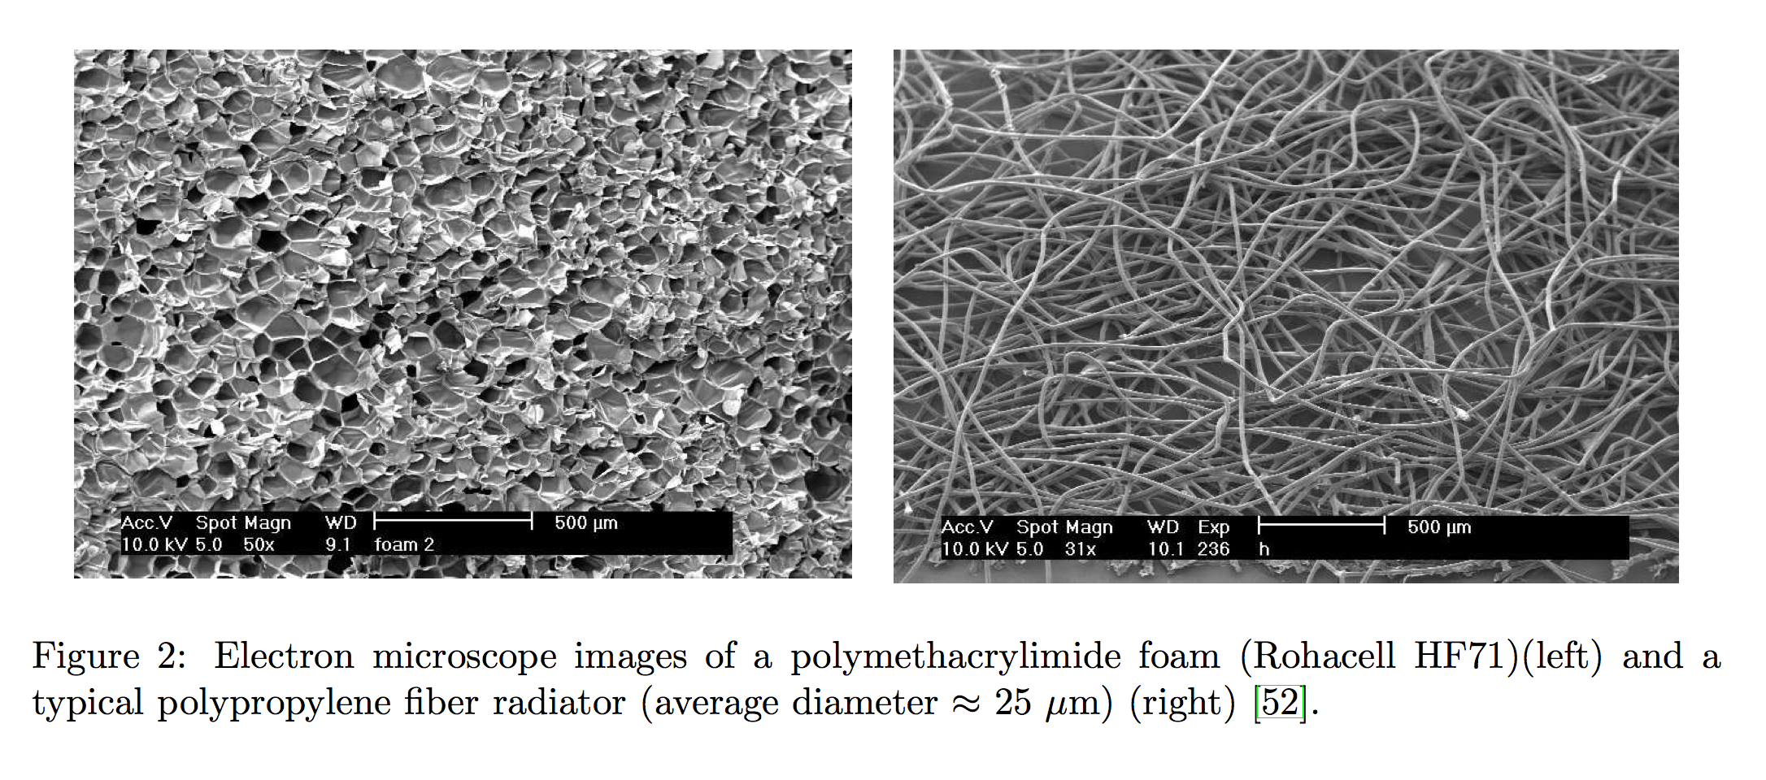

Transition Radiation detector concept
pion
electron
Radiator
Transition radiation is produced by a charged particles when they cross the interface of two media of different dielectric constants
the probability to emit one TR photon per boundary is of order $α$~1/137. Therefore multilayer dielectric radiators are used to increase the transition radiation yield, typically few hundreds of mylar foils.
TR in X-ray region is extremely forward peaked within an angle of 1/γ
Energy of TR photons are in X-ray region ( 2 - 40 keV )
Total TR Energy ETR is proportional to the γ factor of the charged particle
Primary
dE/dx
clusters
TR
photon
Xe gas mixture
Drift region
Readout
pion
electron
High resolution tracker and particle ID detector
Low material budget detector (tracker)
GEM based TRD:
TR radiator in the front of each chamber ( radiator thickness ~5-10cm )
Xenon-based gas mixture ( TRD uses a heavy gas for efficient absorption of X-rays)
Increased drift region up to 2-3 cm (for the same reason).
Number of layers depends on needs: Single layer could provide e/pi rejection at level of 10 with a reasonable electron efficiency (85-95%).

Slide 3
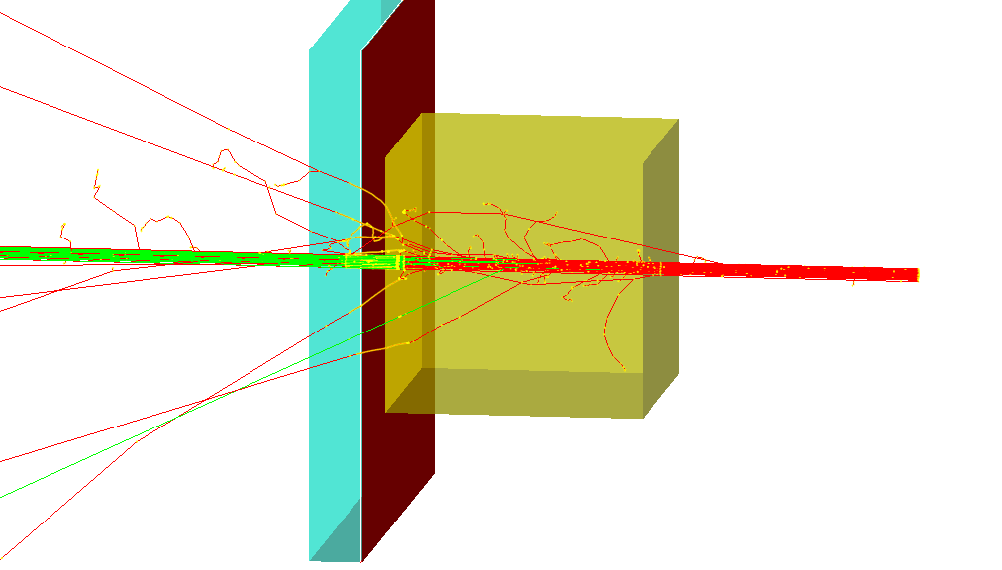
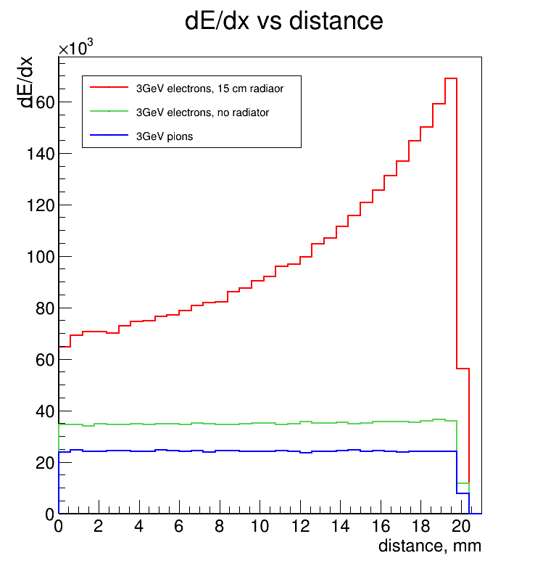

Energy deposition (dE/dx + TR) vs drift distance
dE/dx of electrons + TR
e,$π$ ~3 GeV
dE/dx of electrons
dE/dx of Pions
Only e produce TR photons (E>1GeV)
Pions only start to produce TR at E > 100-150 GeV

Slide 4
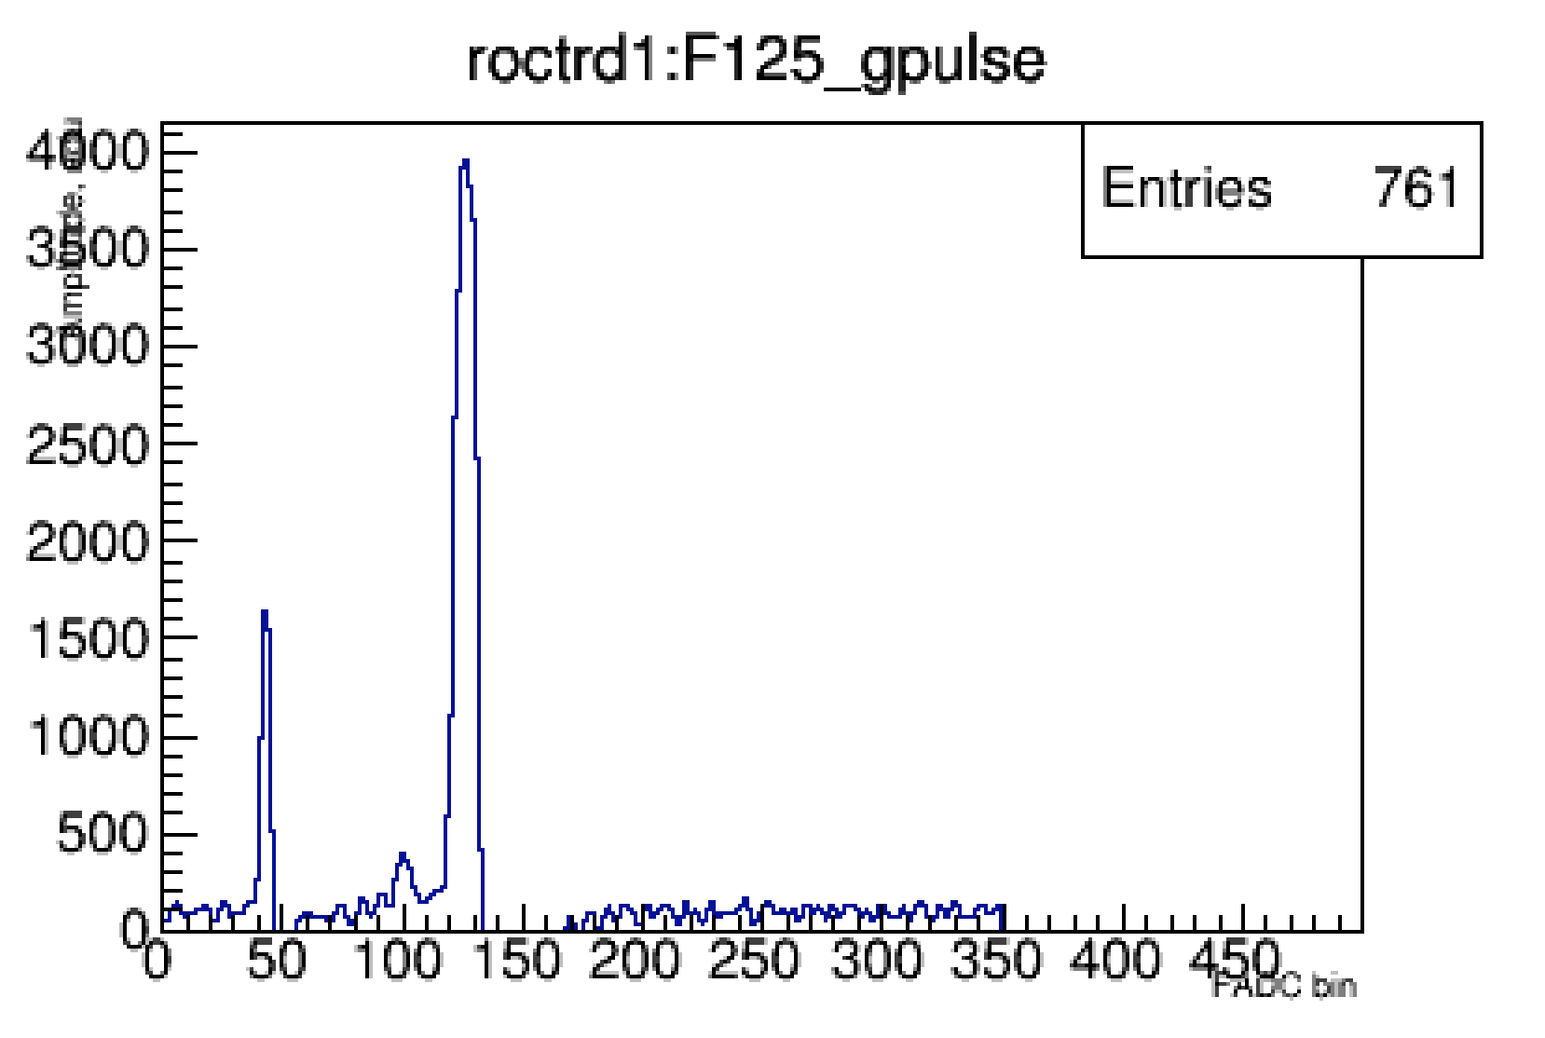
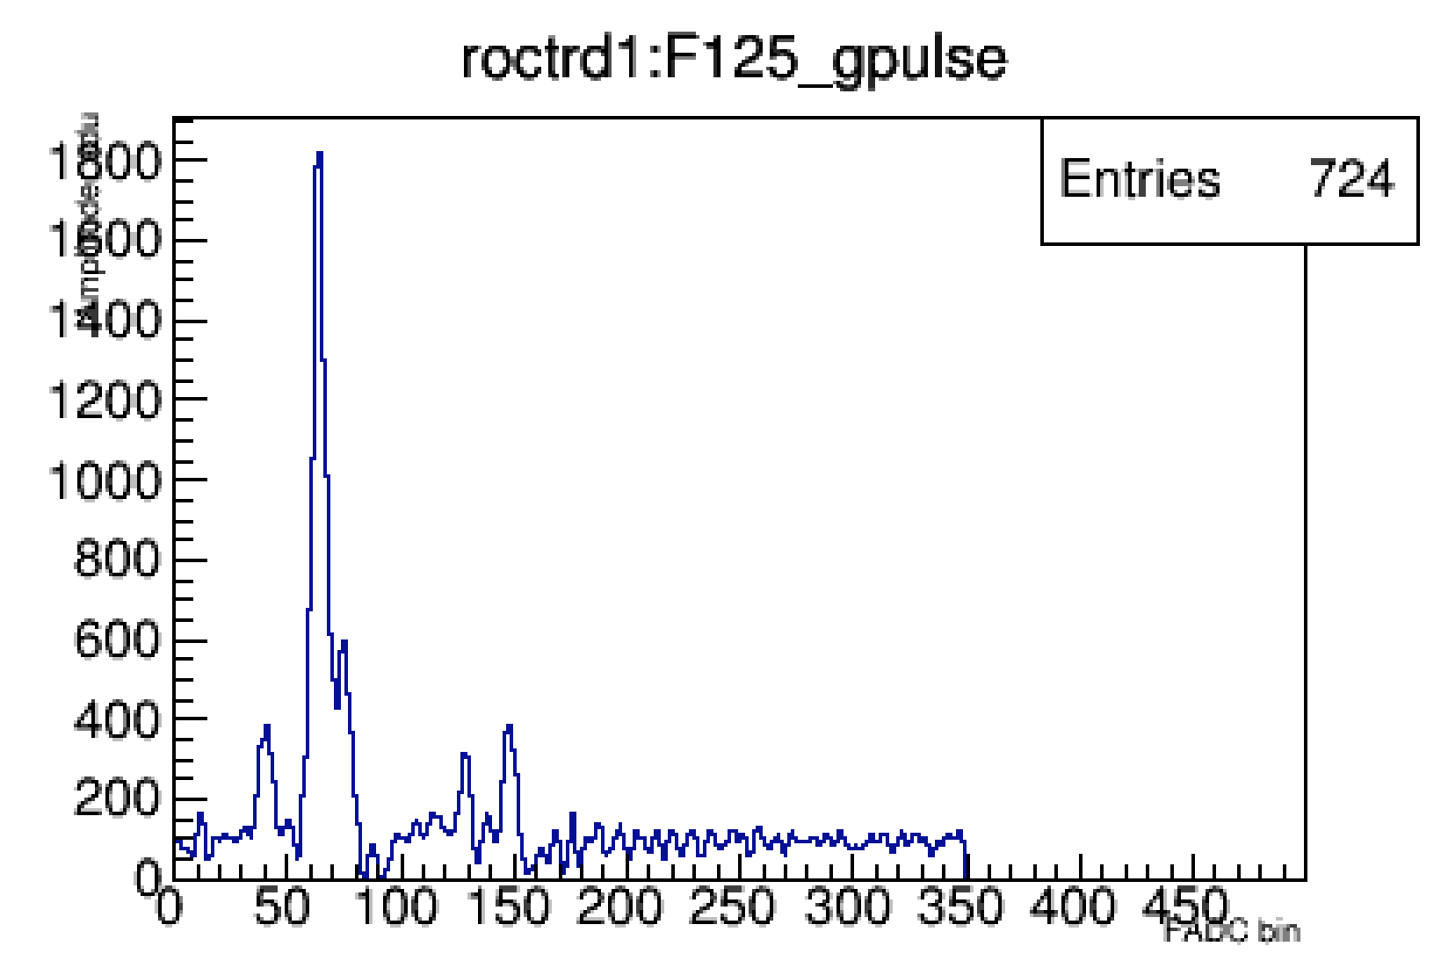
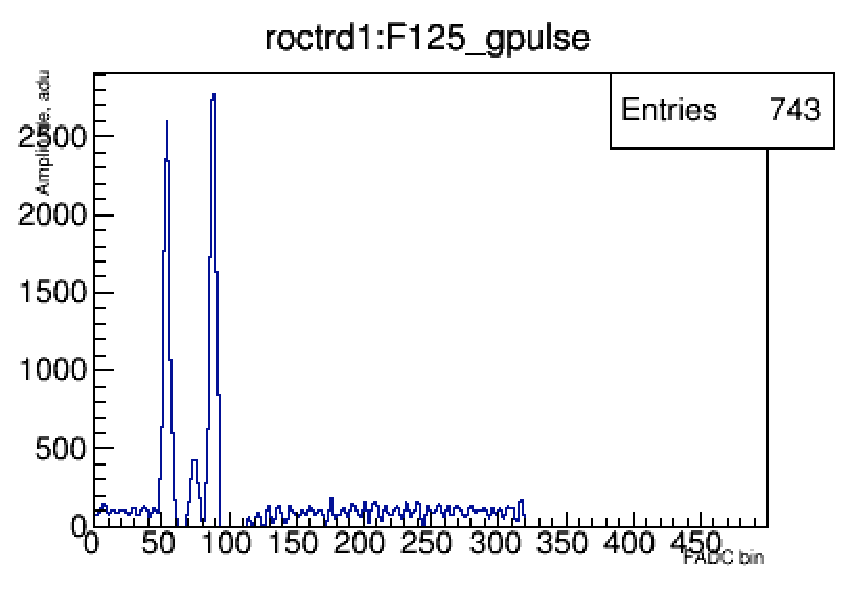
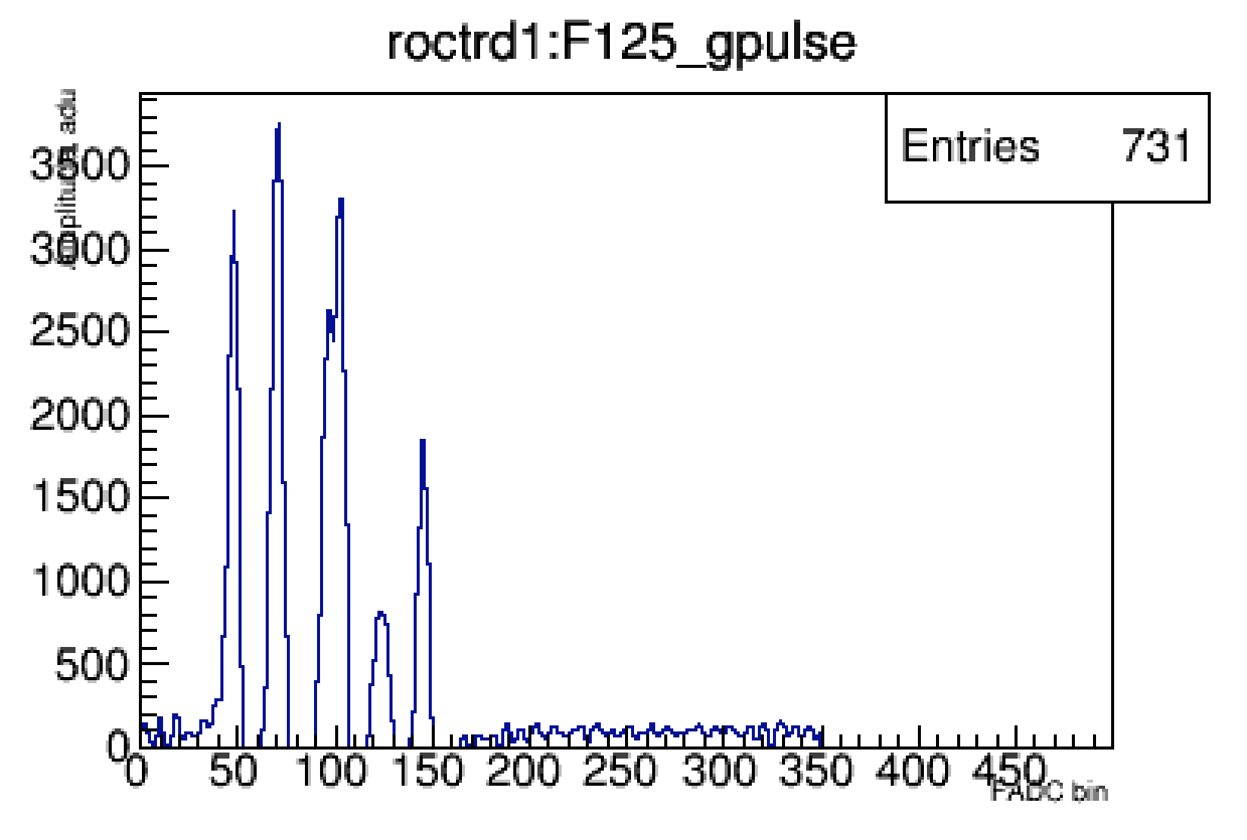
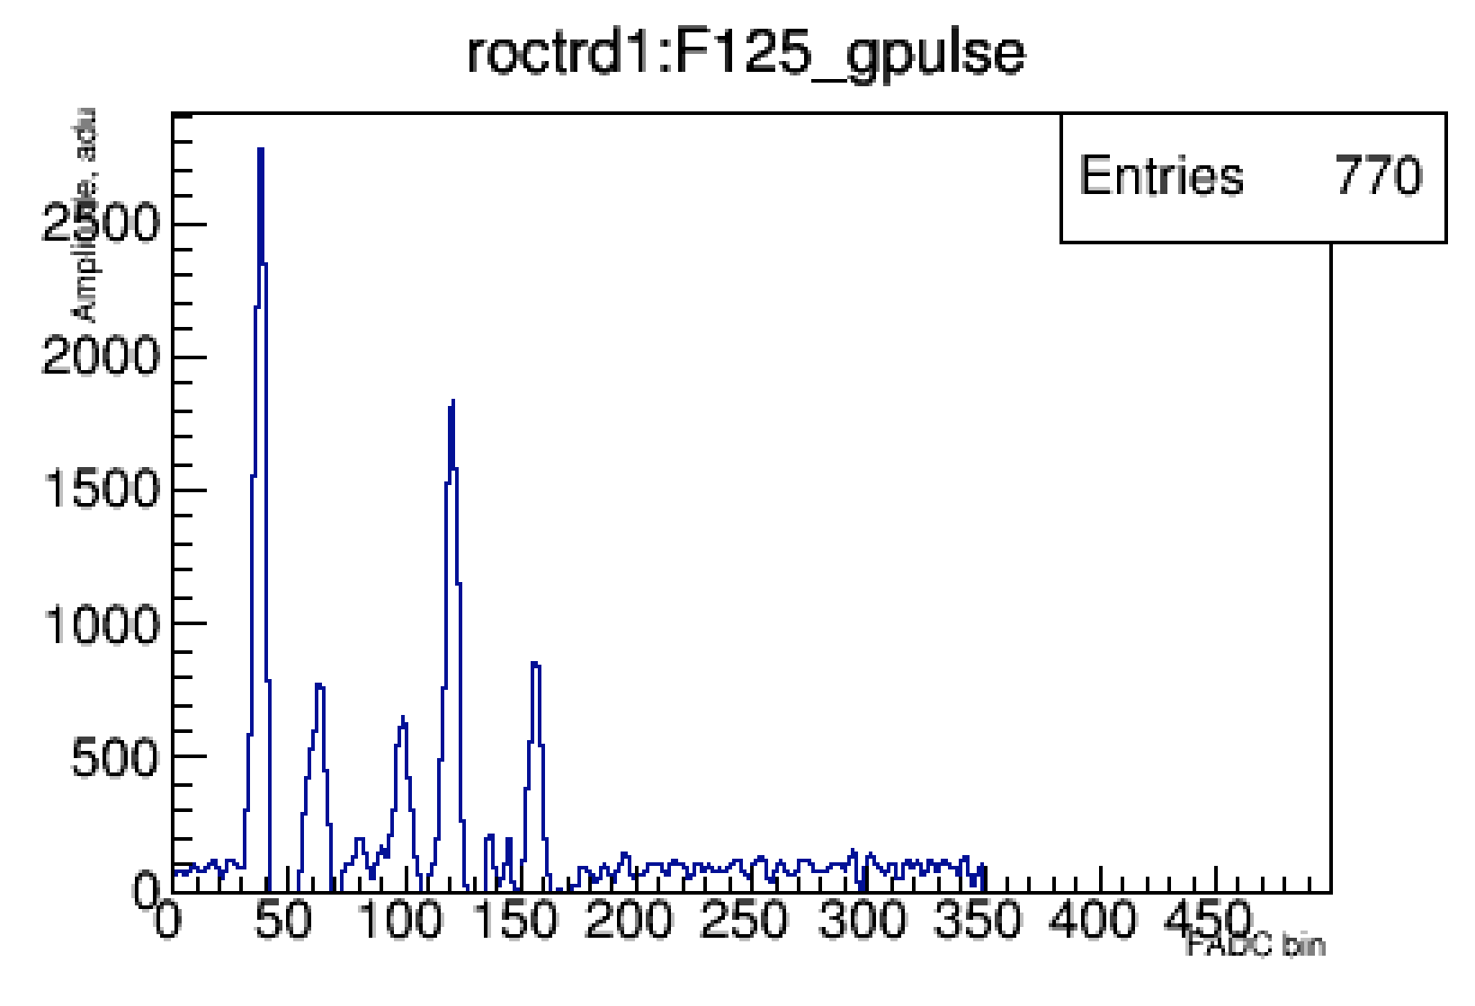
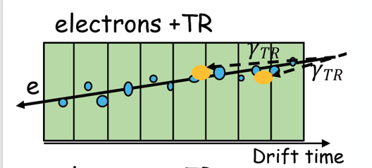
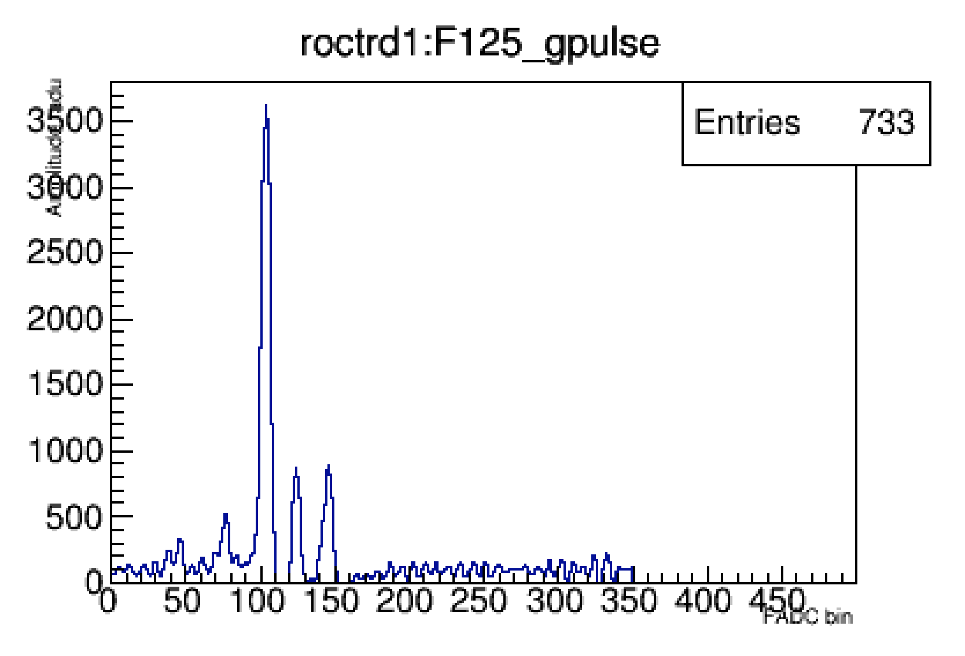
Machine learning technique
Used different methods/programs (JETNET, Root based-TMVA, etc) for cross-check.
Cluster counting method ( Time, Amplitude, number of clusters )
4
4
4

Slide 5
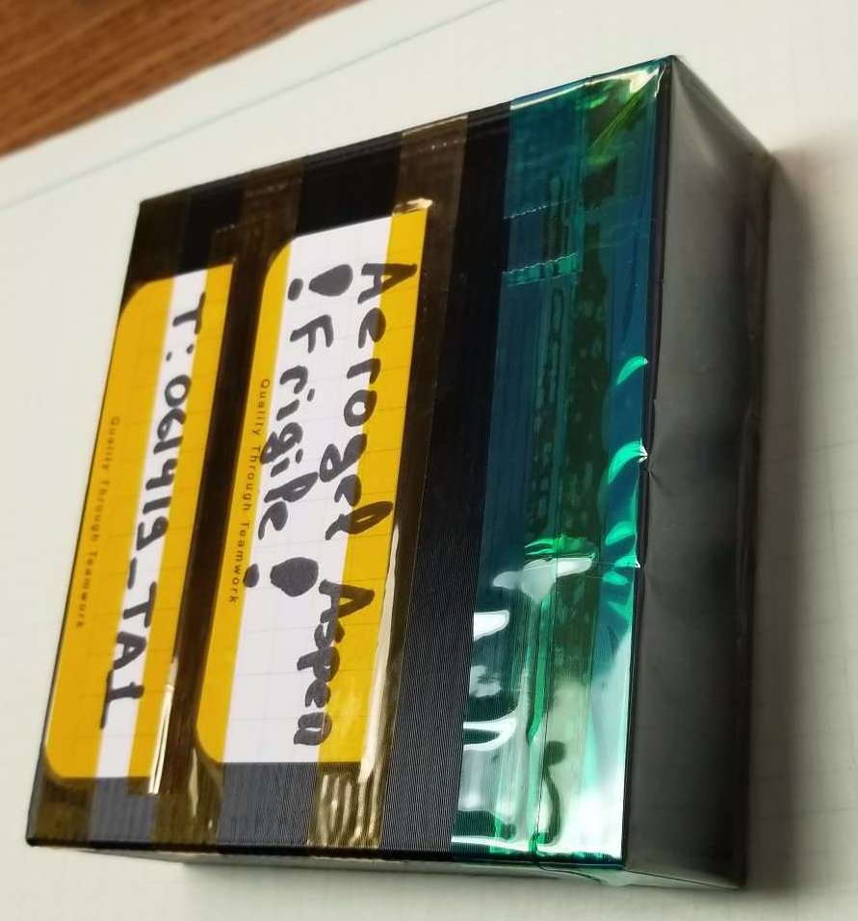
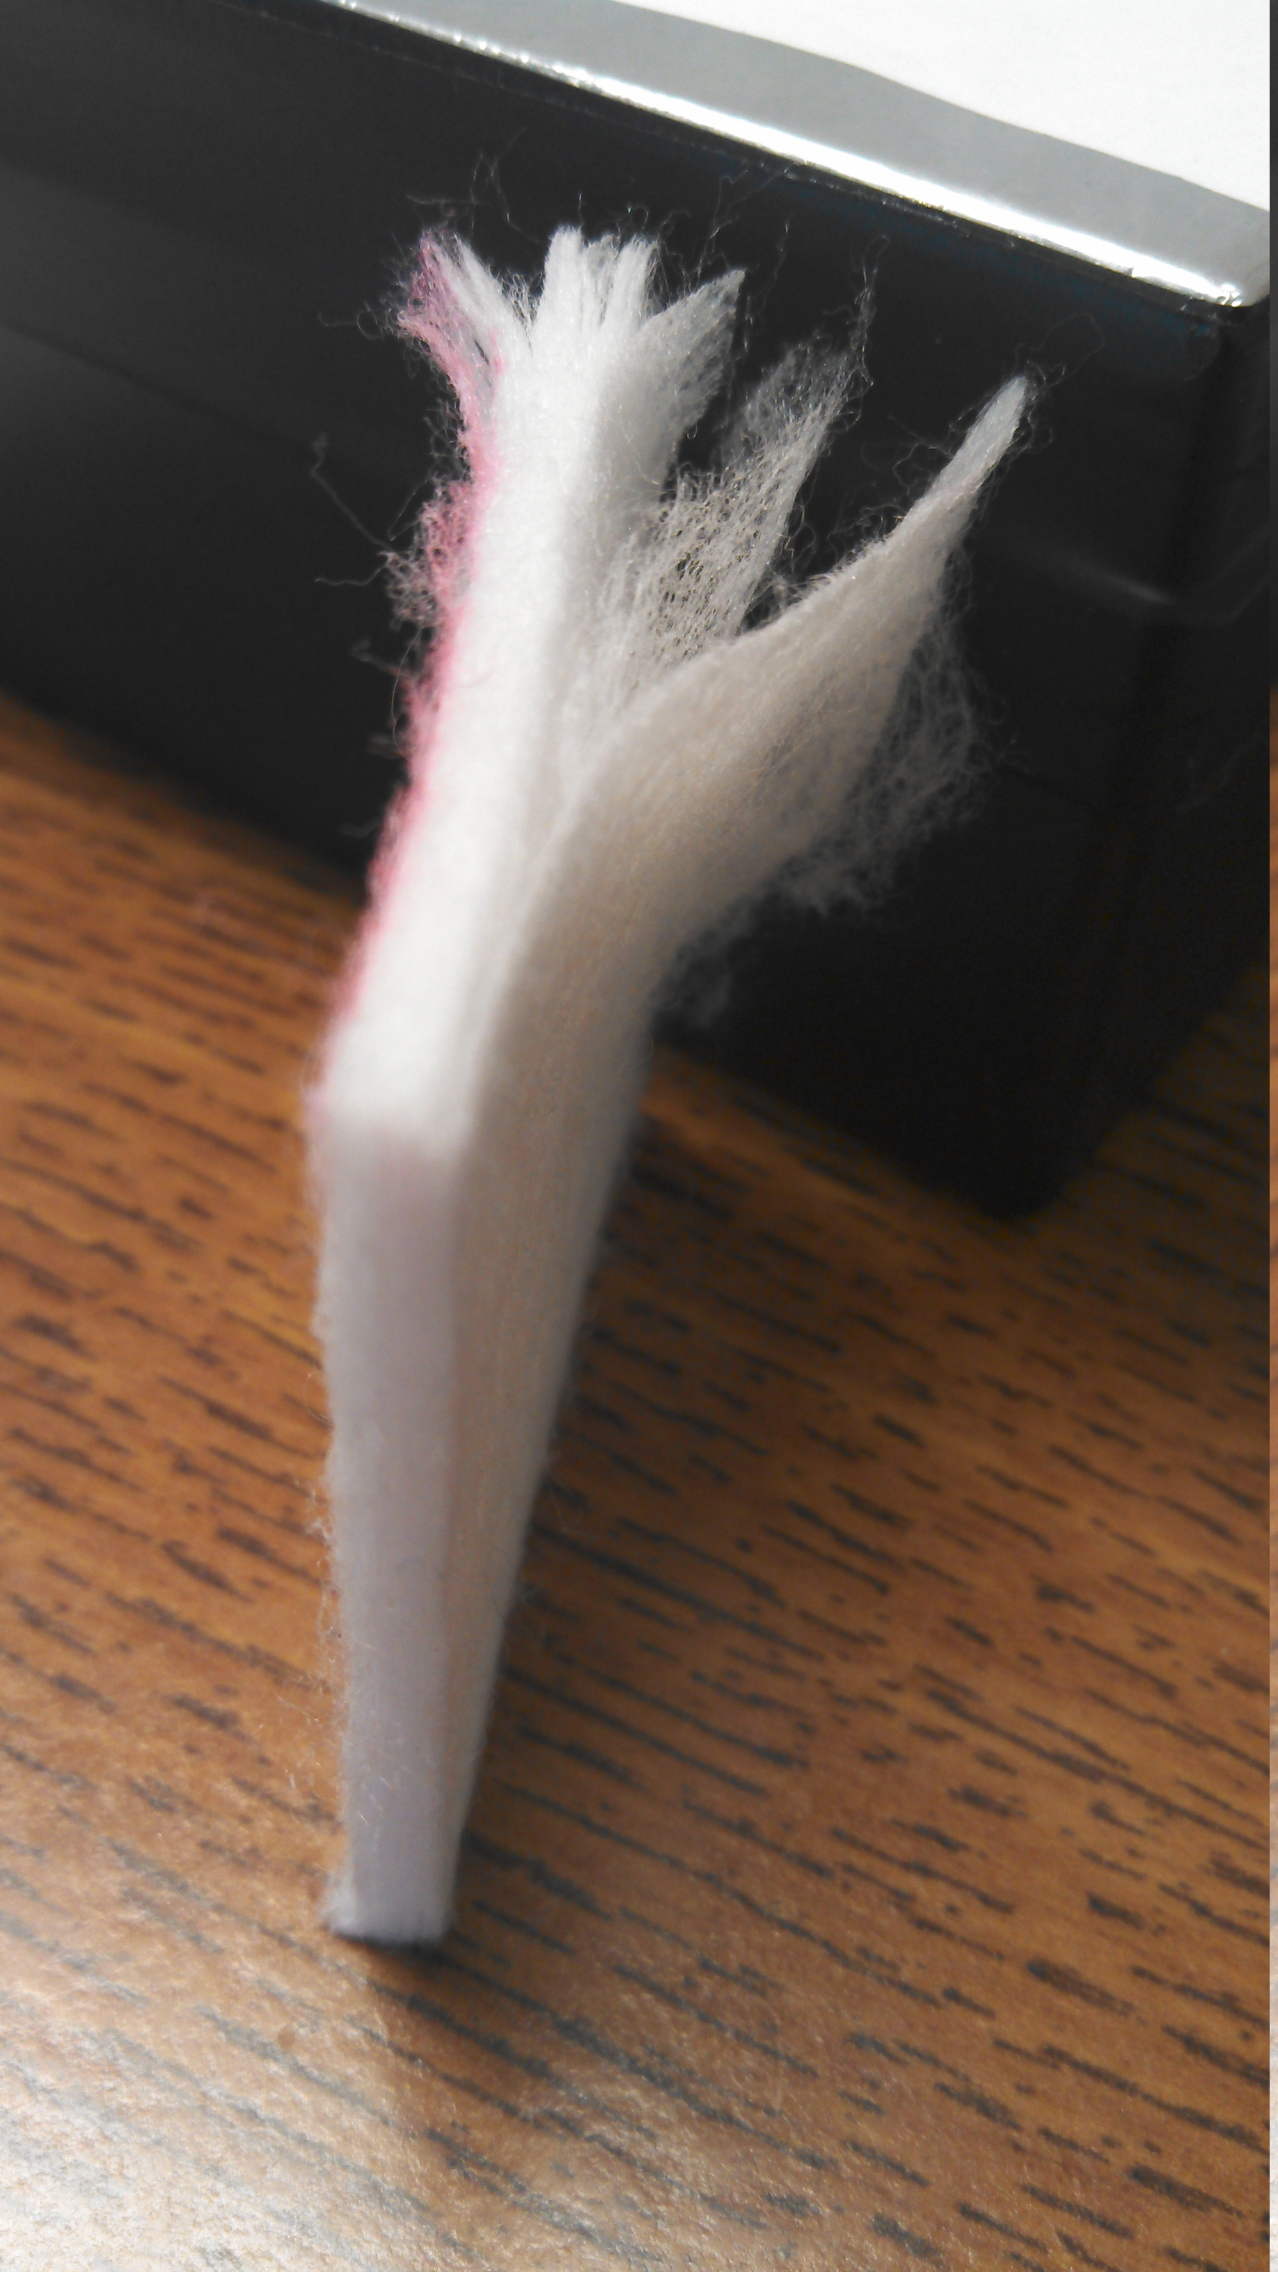
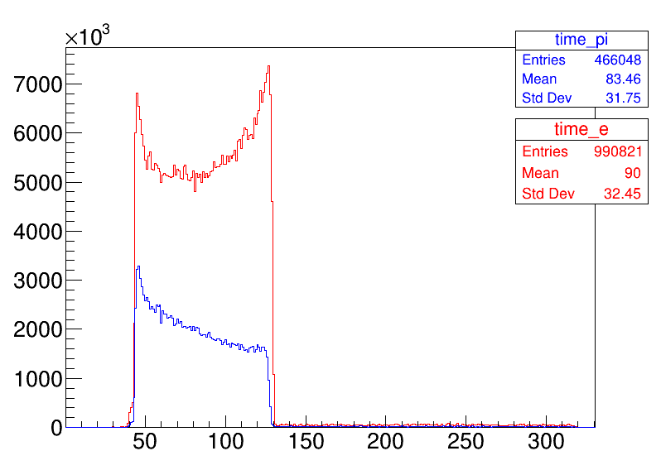
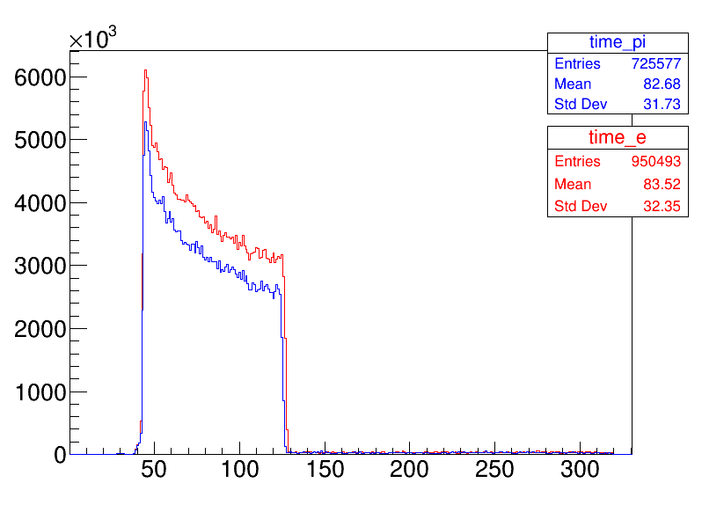
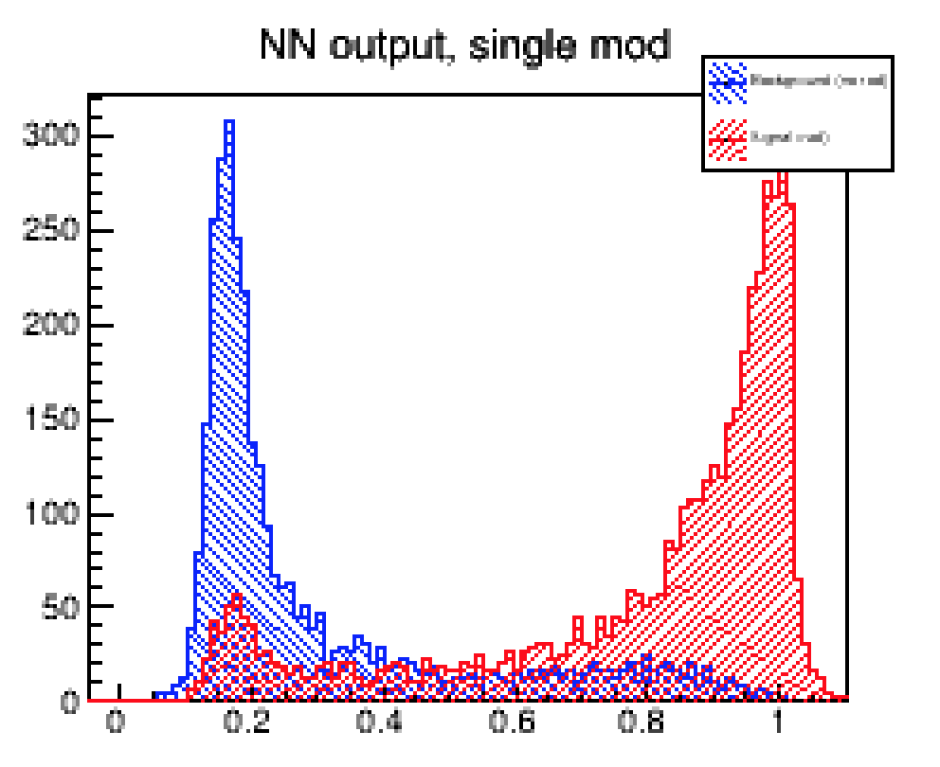
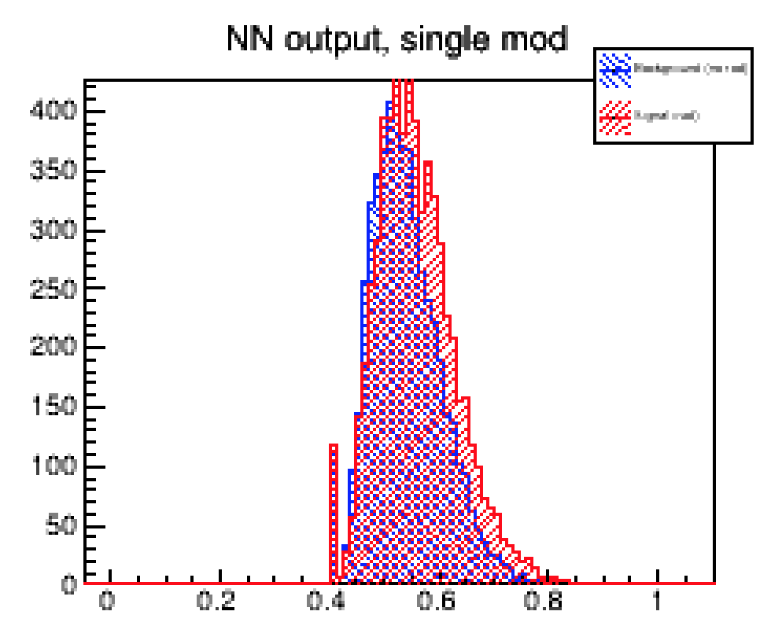


Radiators Tests : Fleece
Aerogel:
No TR yield is seen
Beautiful response, High TR-yield, soft and hard TR photon’s spectrum
e,$π$ ~3 GeV
e,$π$ ~3 GeV

Slide 6
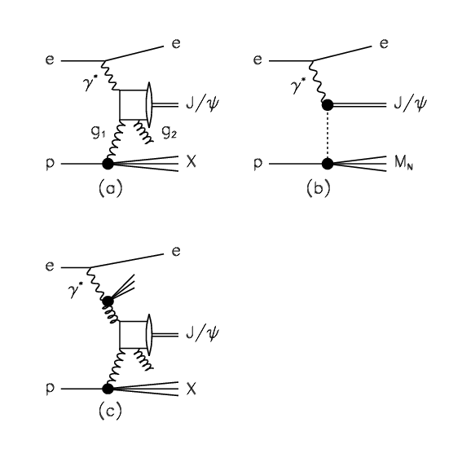
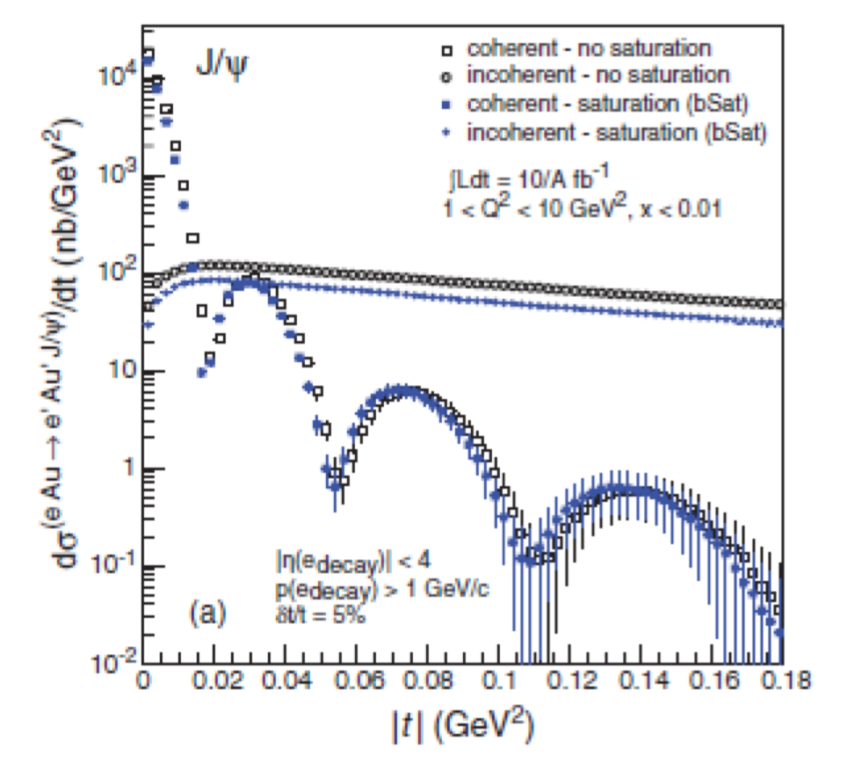
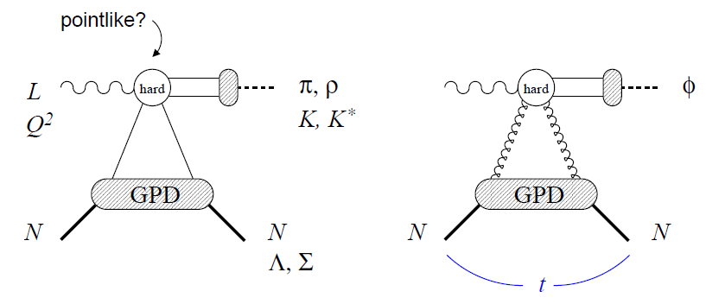
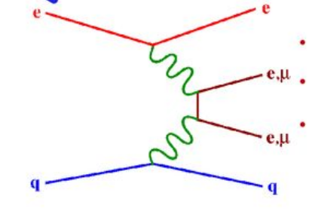
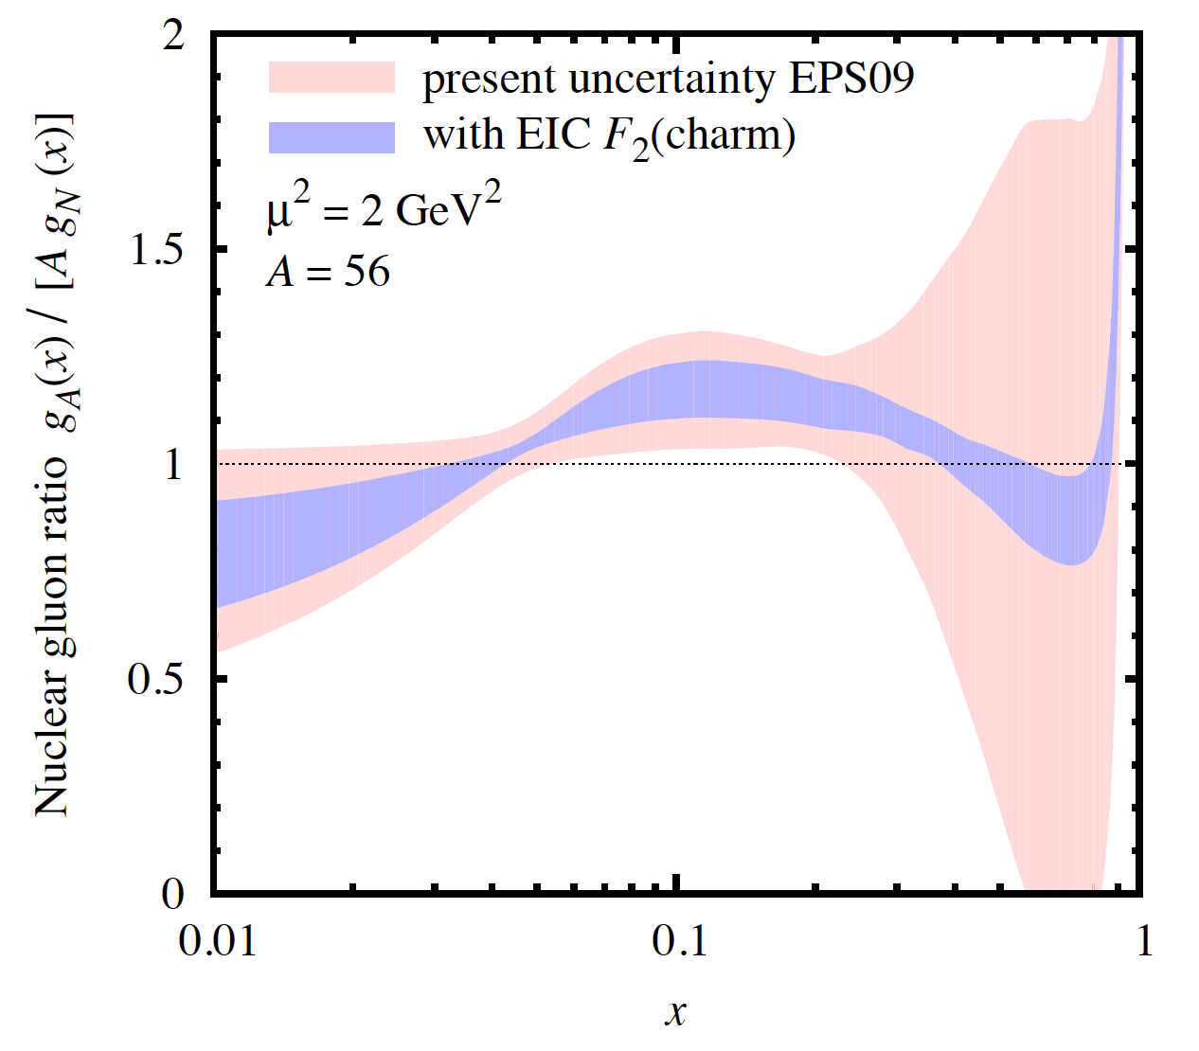
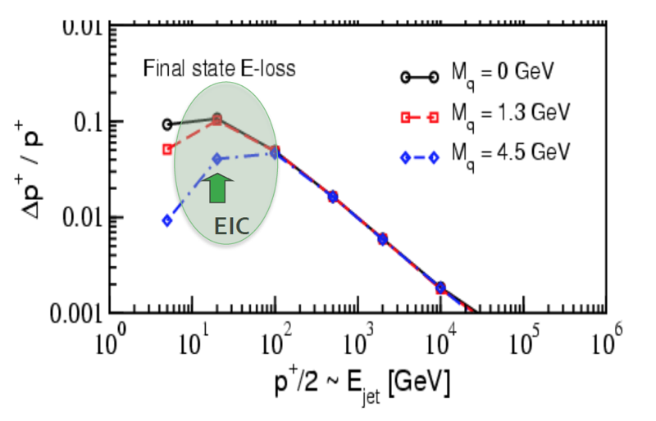
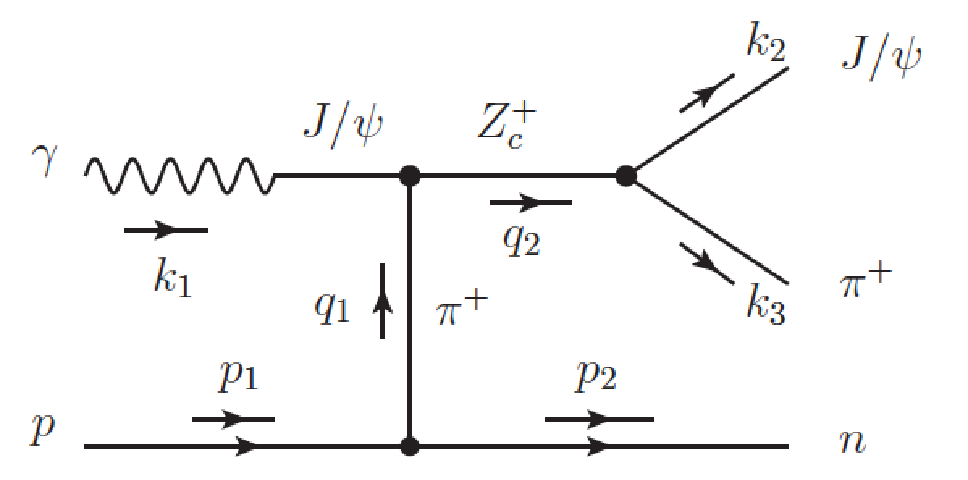
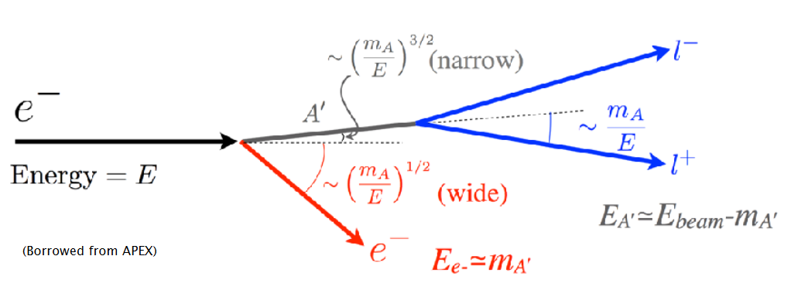
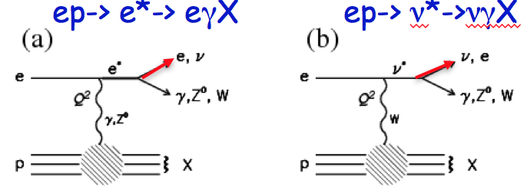





Electron identification (e/hadron separation)
J/$ψ$ identification
Multi-leptons
VM production
J/Ψ, φ
Br (J/$ψ$->e+e- ) ~6%
Br (J/$ψ$->$μ$+$μ$- ) ~6%
Heavy quark tagging
Br (D$±$->e+X ) ~16%
Ivan Vitev
e
е’’
e
$$ν$$
Br (B$±$->e+$ν$+X_{C} ) ~10%
b
W
b
c
Heavy photon
Other BSM physics
Exotic spectroscopy (pentaquarks, tetraquarks, XYZ)

Slide 7
eRD22 team:
Many thanks to the Hall-D and GlueX teams!
( in particular Eugene Chudakov and Tim Whitlatch)
Jefferson Lab:
  Fernando Barbosa
  Cody Dickover
  Yulia Furletova
  Sergey Furletov
  Lubomir Pentchev
  Chris Stanislav
  Beni Zihlmann
University of Virginia
  Kondo Gnanvo
  Nilanga K. Liyanage
Temple University
  Matt Posik
  Bernd Surrow
Old Dominion University
  Lee Belfore
A new Transition Radiation detector based on GEM technology
https://doi.org/10.1016/j.nima.2019.162356

Slide 8
Backup

Slide 9
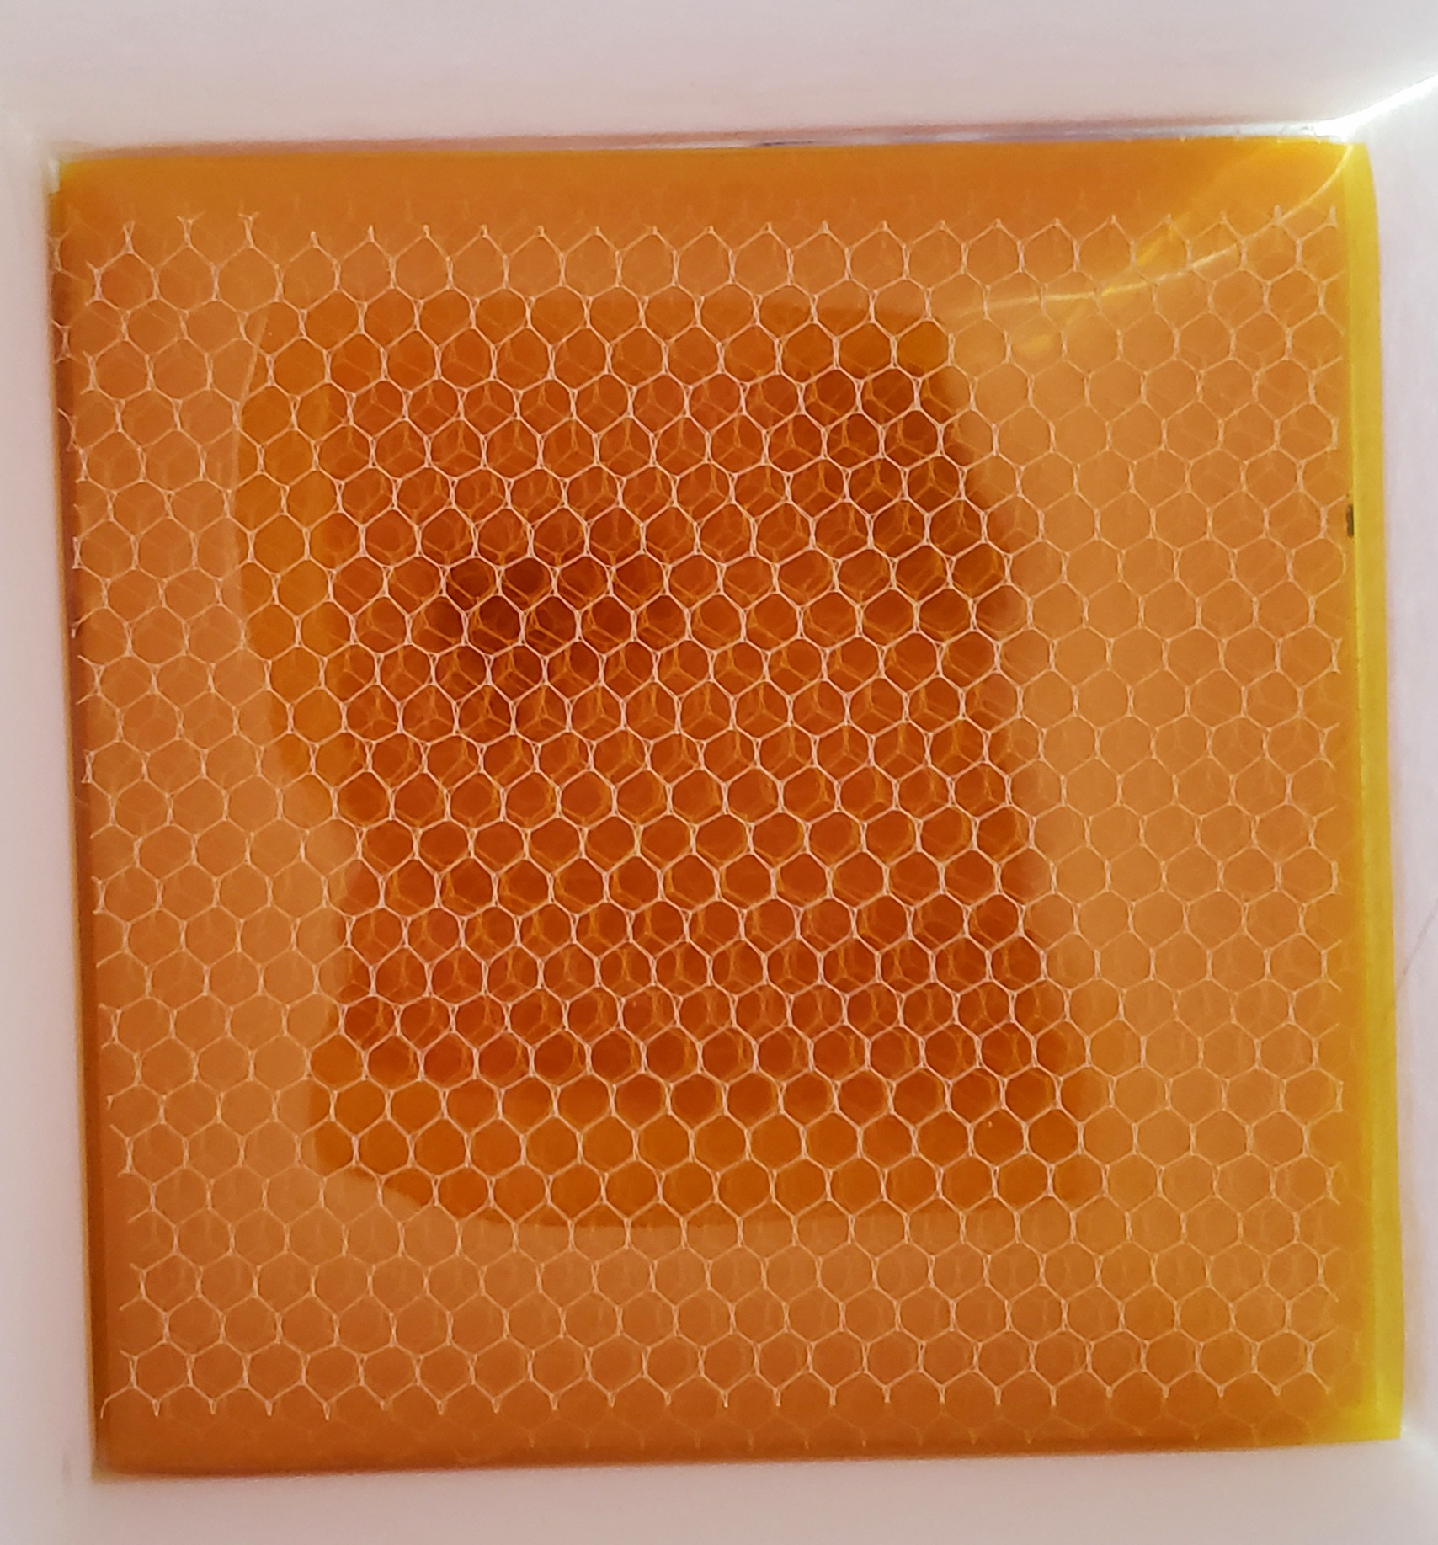
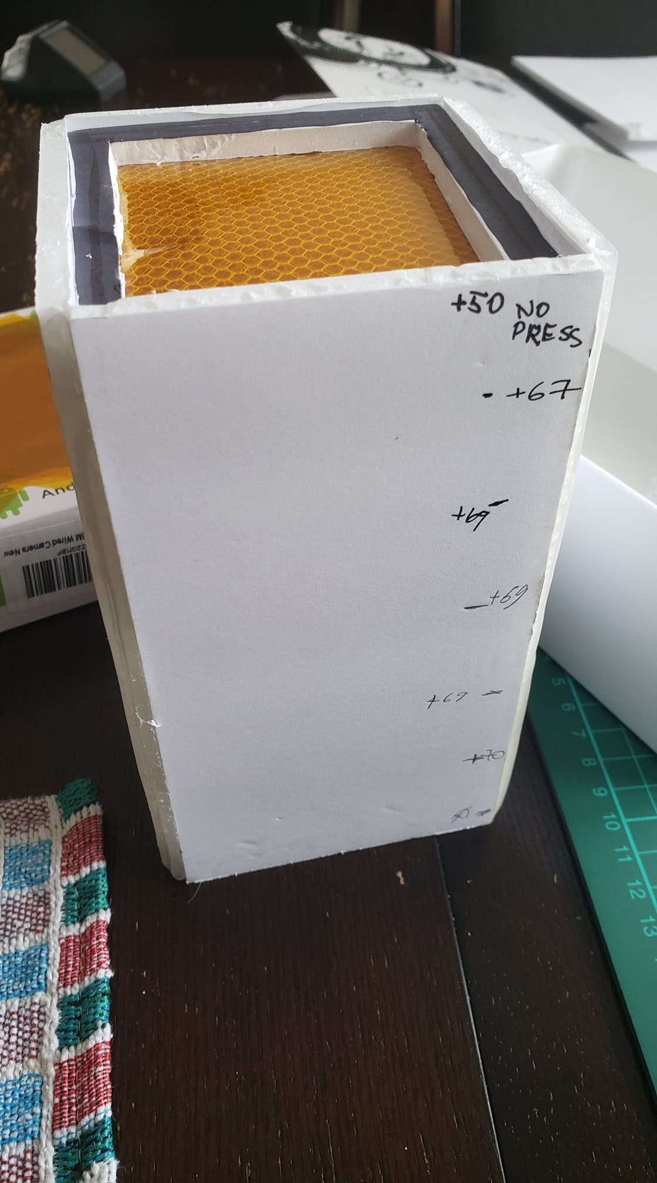
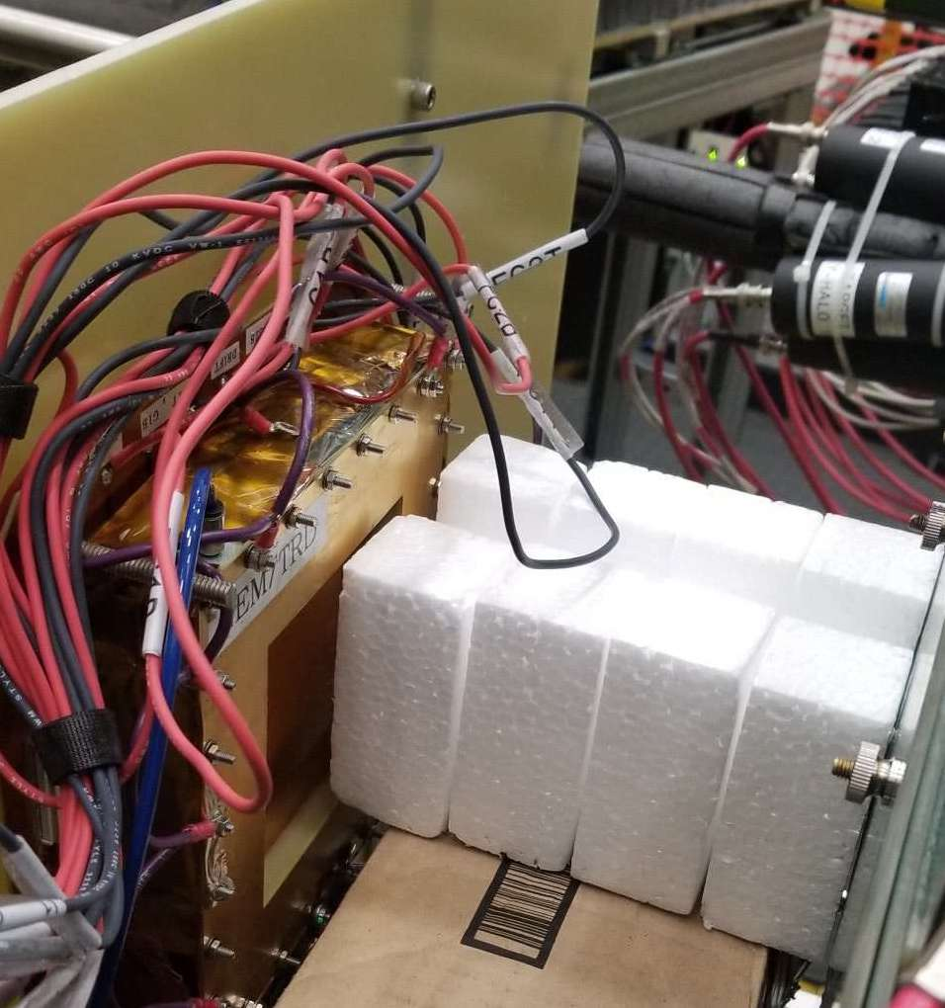
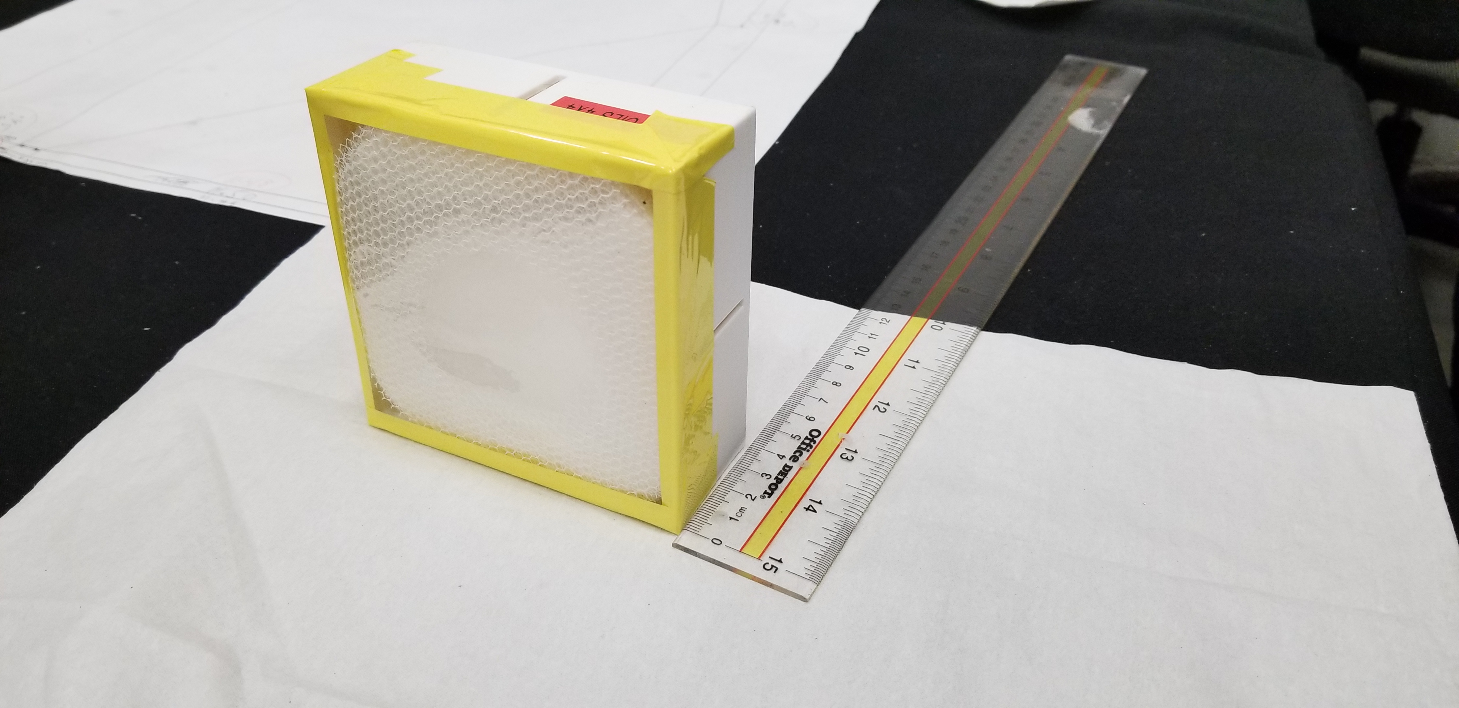
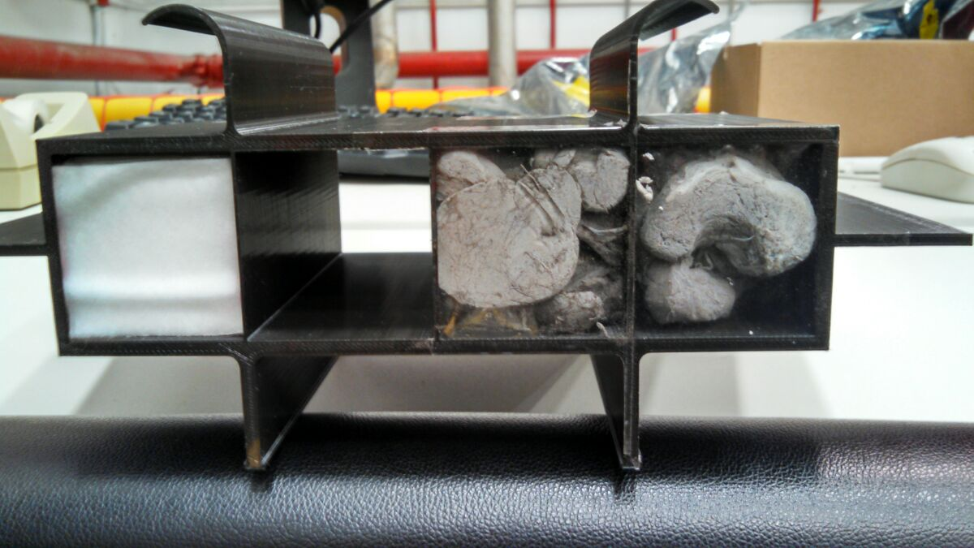
Different TR-radiators.
We continue to search and test different types of radiators
Goal: to find low material budget, but high TR-yield radiators
The TR-energy spectrum is very important
(minimum of self-absorption)
Single module (X/X0) :
Radiator ( 10cm) ~ 1.5 % X₀ for fleece ( could go down with mylar foils )
Xenon gas (2.0 cm) ~ 0.1% X₀
Triple GEM with readout at active area ~ 0.7% X₀
( could go down to 0.4%, see current eRD6 )
9

Slide 10
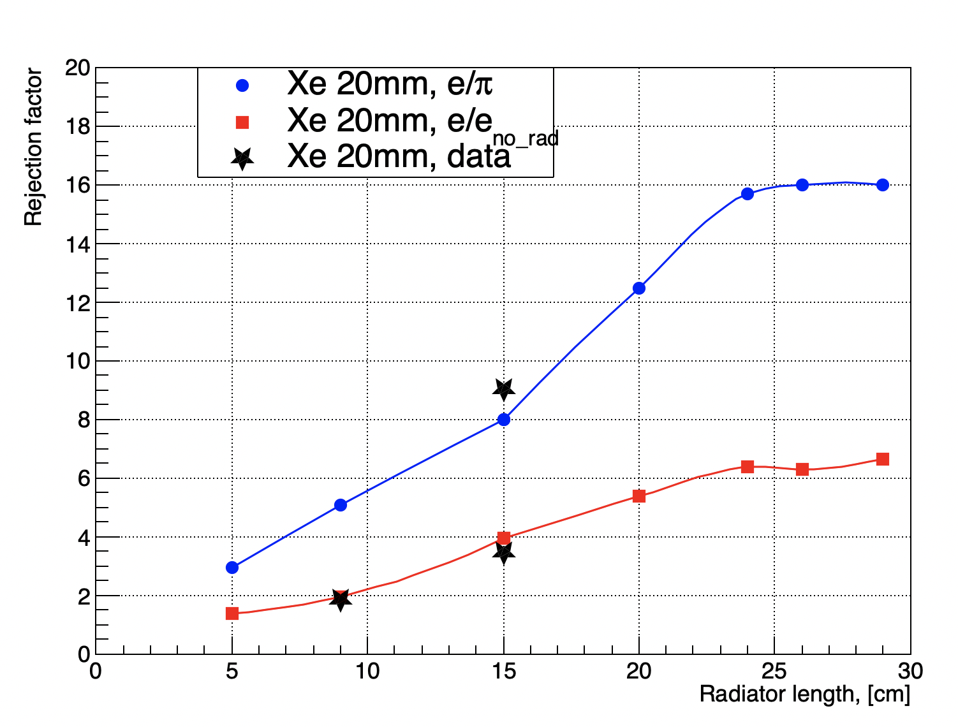
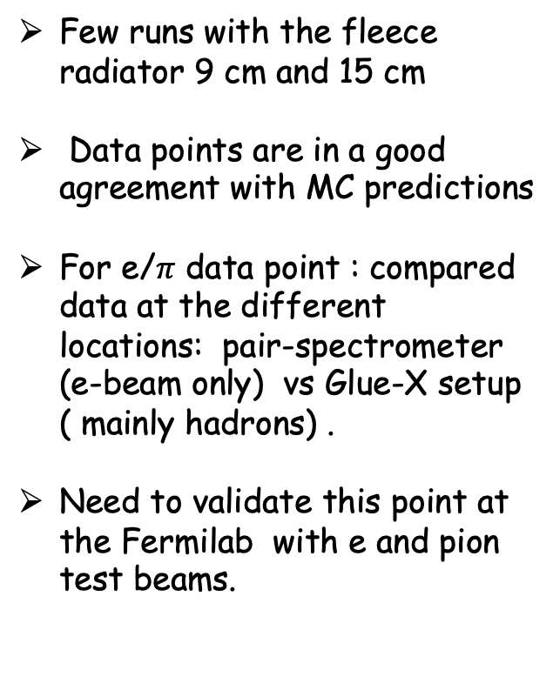
GEMTRD performance
Few runs with the fleece radiator 9 cm and 15 cm
Data points are in a good agreement with MC predictions
For e/$π$ data point : compared data at the different locations: pair-spectrometer (e-beam only) vs Glue-X setup ( mainly hadrons) .
Need to validate this point at the Fermilab with e and pion test beams.
Thickness [cm]

Slide 11
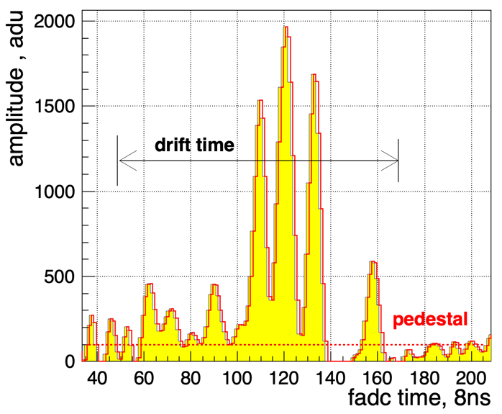
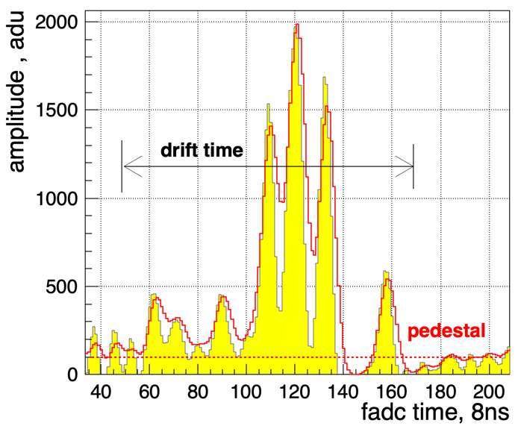
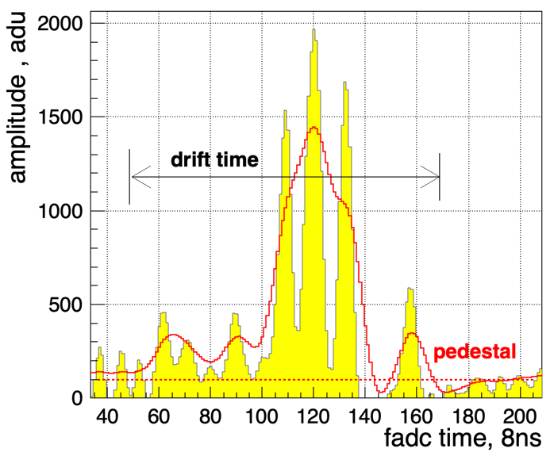
Readout
Current setup: preamplifiers (GAS2 ASIC chip) with shaping times of∼10-12ns.
The flash ADC has a sampling rate of 125 MHz and 12 bit resolution but provides only pipe-lined triggered readout ( price ~50$/channel)
Shaping time:
For TRD applications not only raising time is important, but also full width (tails, return to baseline )
In Xe – high density clusters ( ionization density)
80ns (Sampa) shaping time
~ 20ns shaping time
~ 40ns shaping time
Current setup

Slide 12
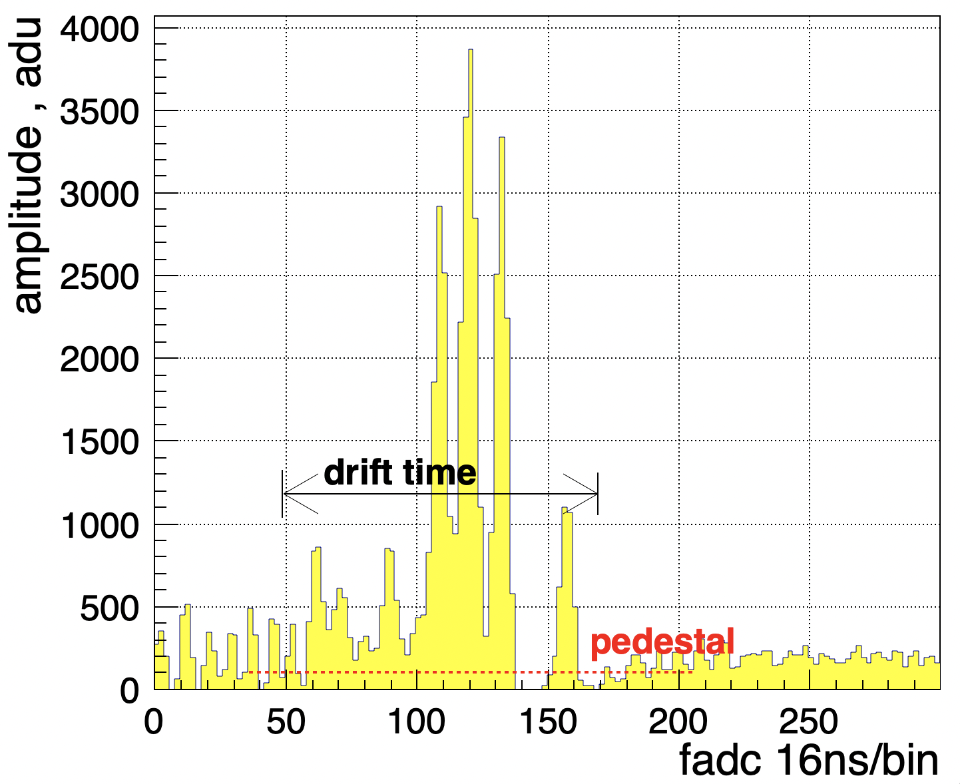
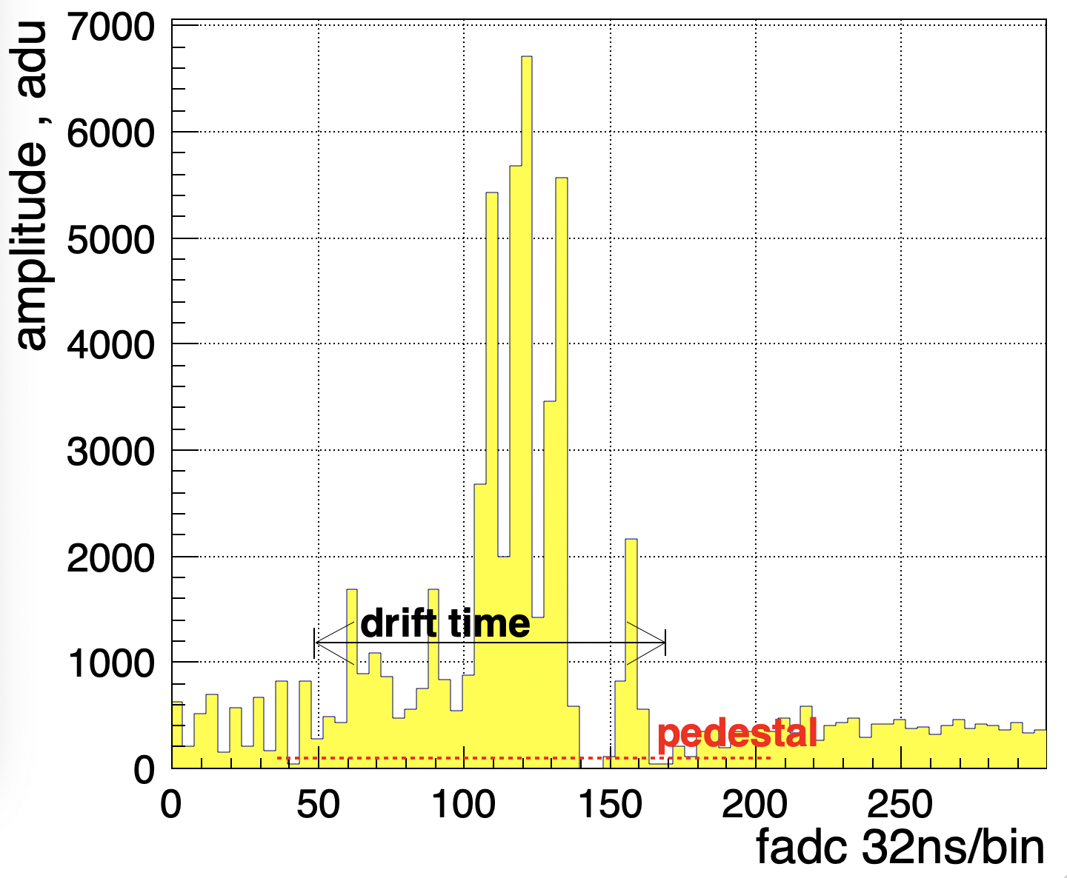
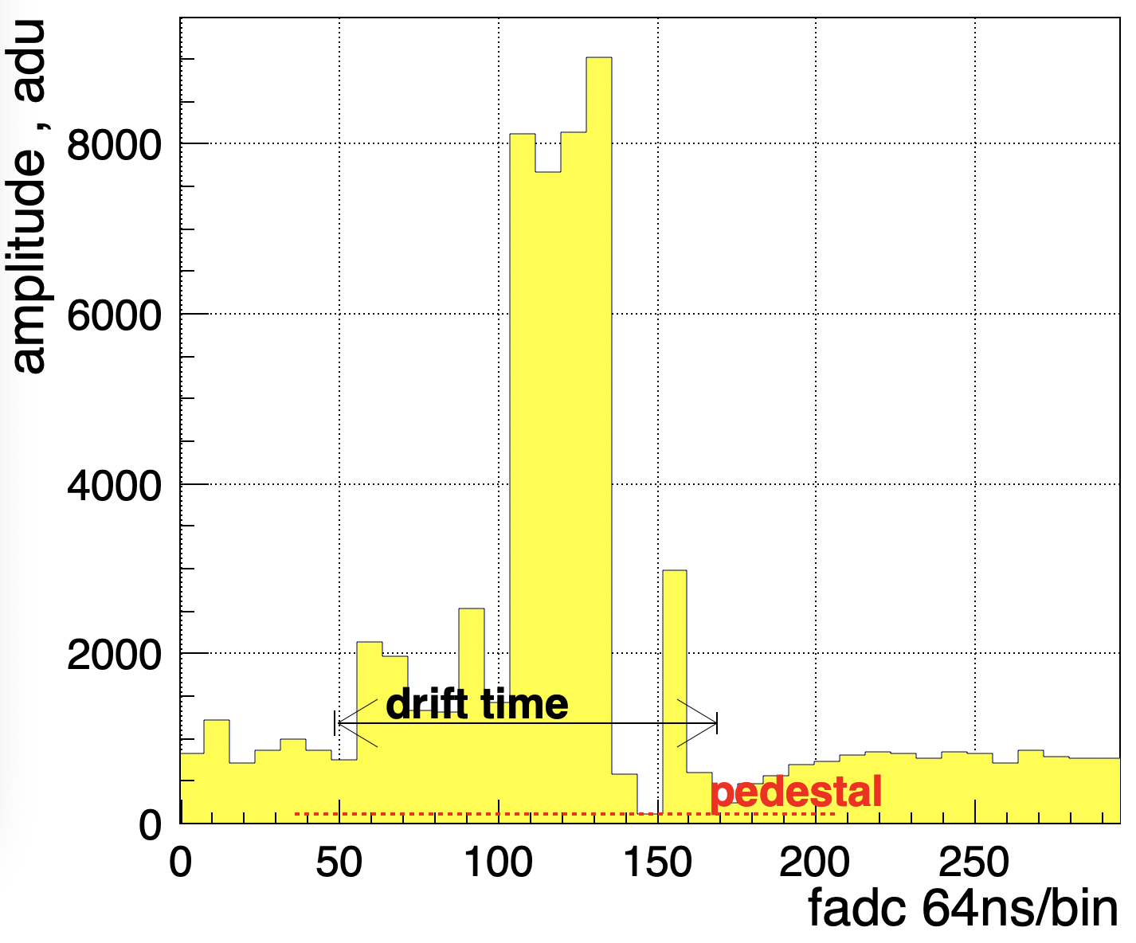
Readout
Current setup
125MHz
a preamplifier (GAS2 ASIC chip) with shaping times of∼10-12ns.
The flash ADC has a sampling rate of 125 MHz and 12 bit resolution but provides only pipe-lined triggered readout ( price ~50$/channel)
Sampling frequency:
62.5 MHz
31.25 MHz
15.6 MHz

Slide 13
GEANT4: electron and pion comparison
Soft TR-photons:
absorbs near entrance window, therefore have large drift time
sensitive to dead volumes, like Xe-gap, cathode material.
Increase of radiator thickness does not lead to increase of number of soft-photons ( radiator self-absorption)
Hard TR-photons:
Depending on energy of TR-photons, could escape detection (depends on detection length)
Increase of radiator leads to increase of hard TR-spectra.
radiator
Separation/ Identification of TR-clusters and dE/dx clusters

