Slide 1
Artificial Intelligence and Machine Learning
Track 9 Highlights
Stefano Dal Pra, Jana Schaarschmidt, Sofia Vallecorsa, Sandro Wenzel

Slide 2
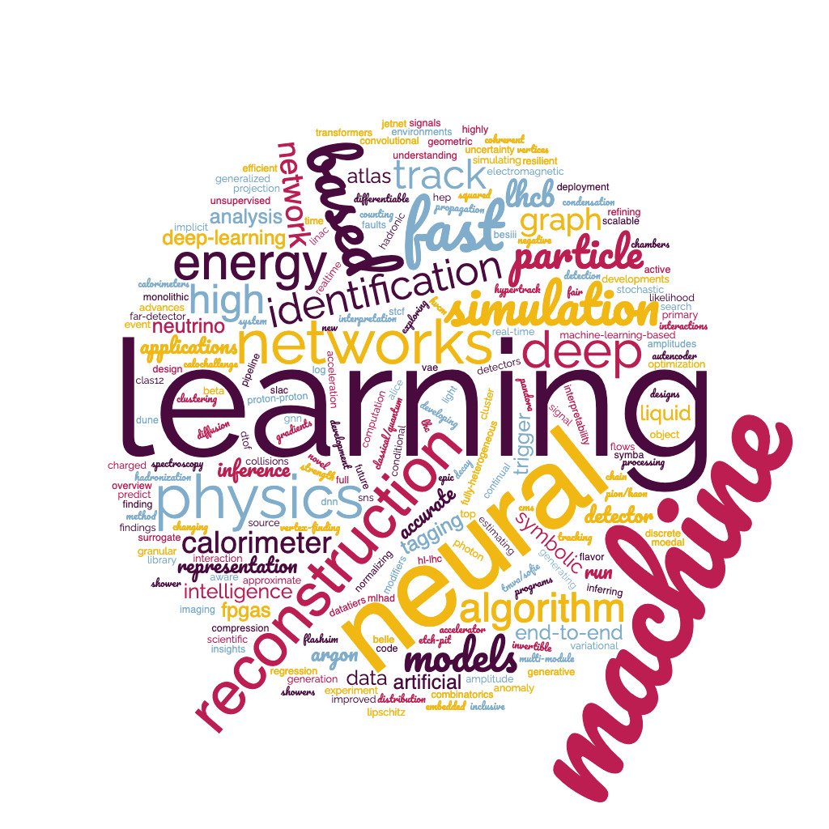
Topics
Reconstruction
Physics Analysis
Online Processing
General Methods and ML Tools
Applications
Shared session with Track3 (Offline Computing) on Fast Simulation
48 Talks in 8 sessions … some of them done “parallel within parallel” …
sorry to not being able to do justice to all of your excellent contributions !
Fri 12th May Plenary Session - Conference Highlights: Track 9

Slide 3
Highlights
New (or renewed.. or imported!) architectures
Fast simulation beyond GANs!
ML shouldn’t be a black box
…but GAN are in production @ATLAS! 😉
New learning patterns and loss functions
Graph Neural Networks are ubiquitous

Slide 4
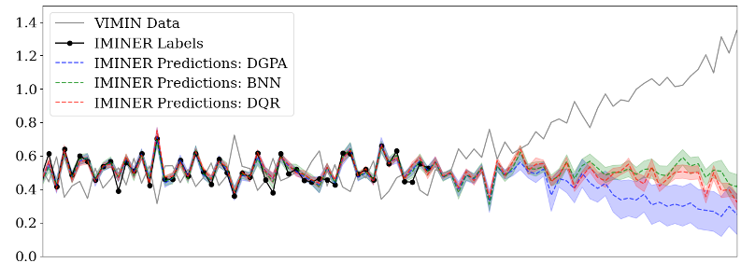
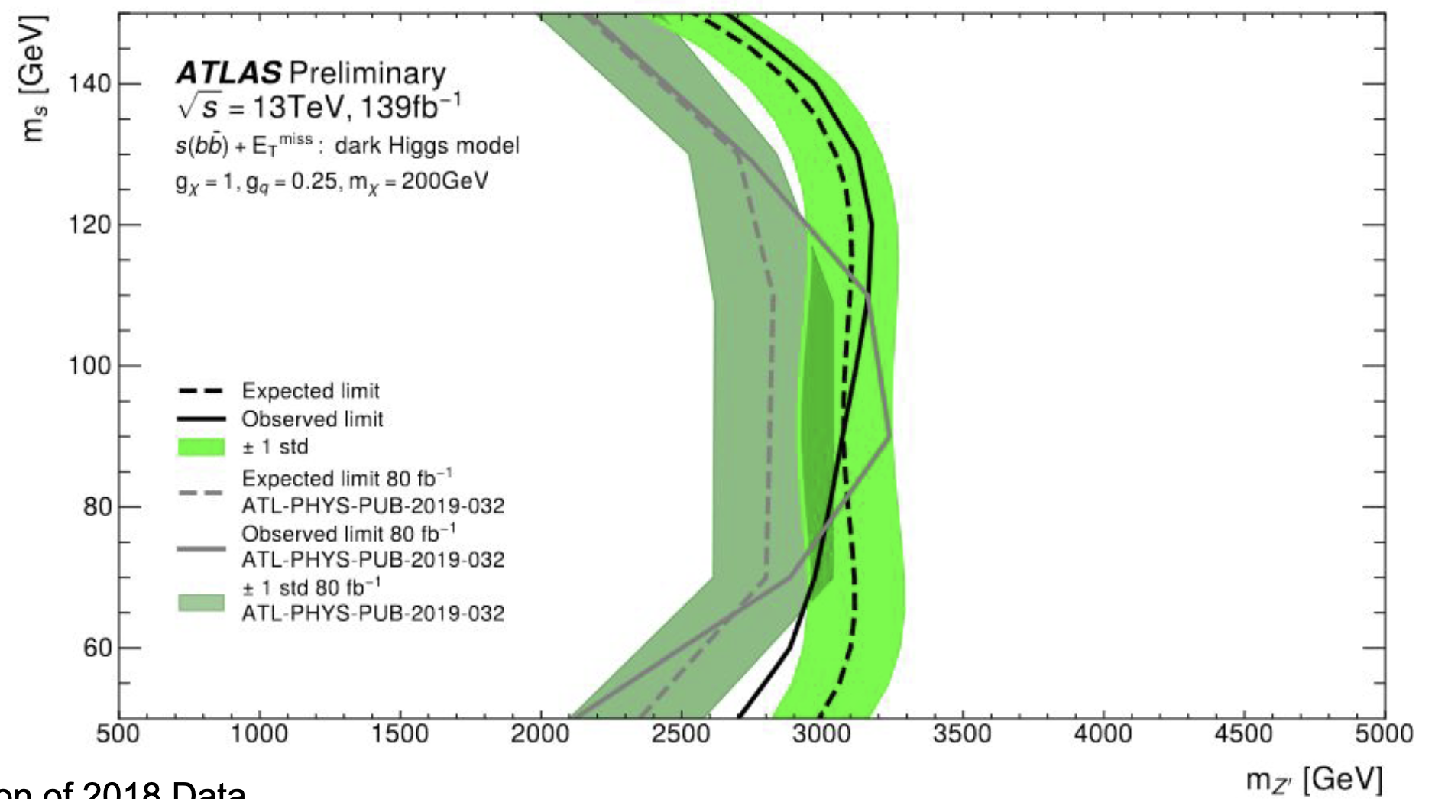
ML shouldn’t be a black box!
Interpretability
Helps to improve performance
→ Analyse eg. feature importance, neuron activation patterns, latent space distributions
Uncertainty modelling
Interpretability Inspires: Explainable AI for DNN Top Taggers, Tue 09/05
Uncertainty Aware Machine Learning Models for Particle Physics Applications , Tue 09/05
Limit setting and analysis reinterpretation
FAIR: Findability, Accessibility, Interoperability, and Reuse of digital assets
FAIR4HEP: Fair AI models in High Energy Physics, Thu 11/5
Efficient search for new physics using Active Learning in the ATLAS Experiment , Tue 09/05

Slide 5
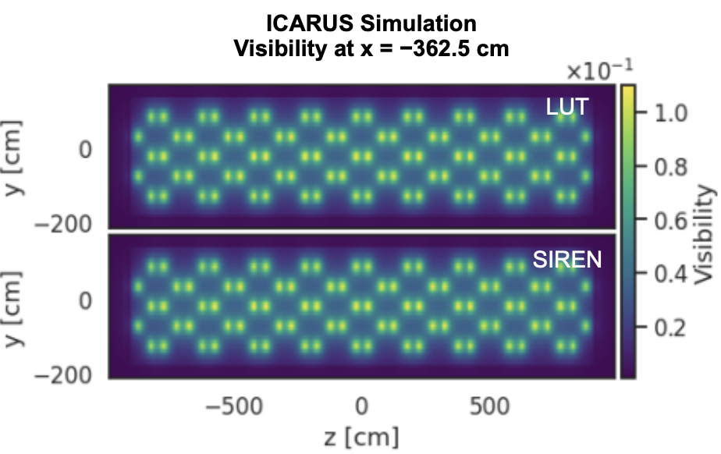
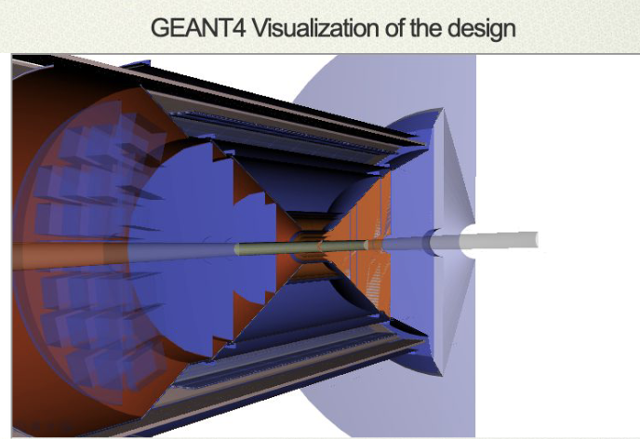
Differentiable programming
On Estimating Gradients of Discrete Stochastic Programs for Detector Design Optimization, Mon 08/05
Extend automatic differentiation to discrete stochastic problems by calculating gradients of expectation values through smoothed perturbation analysis
Sinusoidal Representation Network (SIREN) provides accurate photon-visibility simulation for DUNE, uses much less resources than traditional models
Implicit Neural Representation as a Differentiable Surrogate for Photon Propagation in a Monolithic Neutrino Detector Tue 09/05
Simplified material-induced particle shower :
First large scale experiment designed using AI/ML (ePIC)!
Artificial Intelligence and Machine Learning for EPIC: an Overview, Thu 11/05

Slide 6
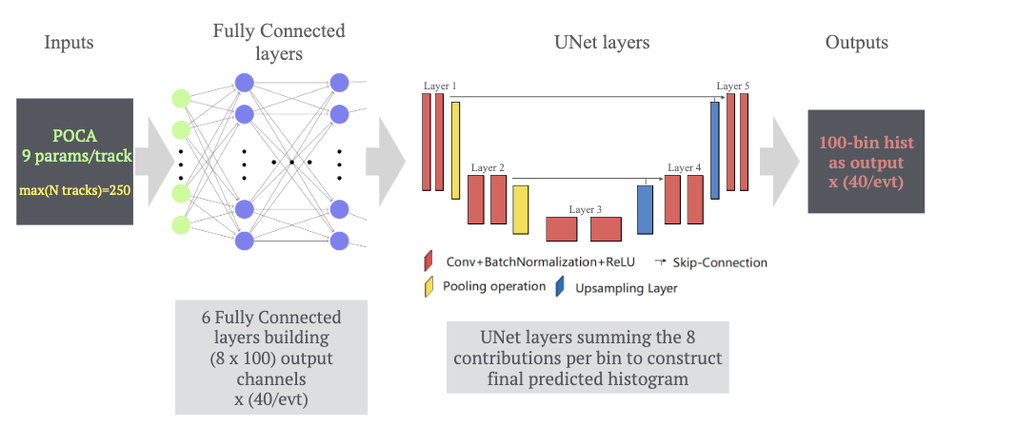
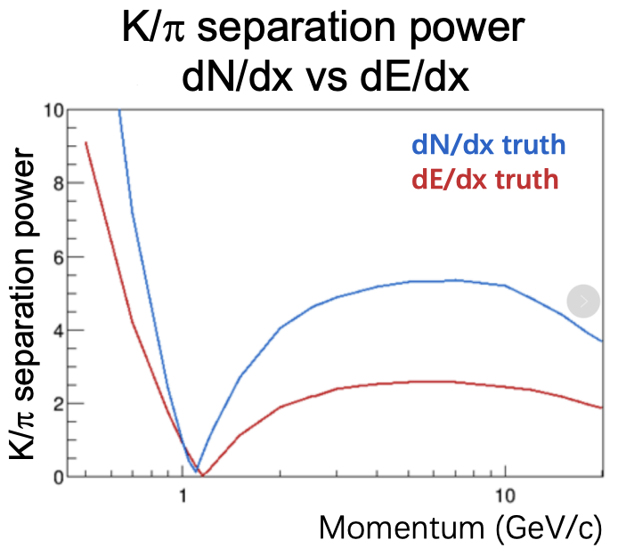
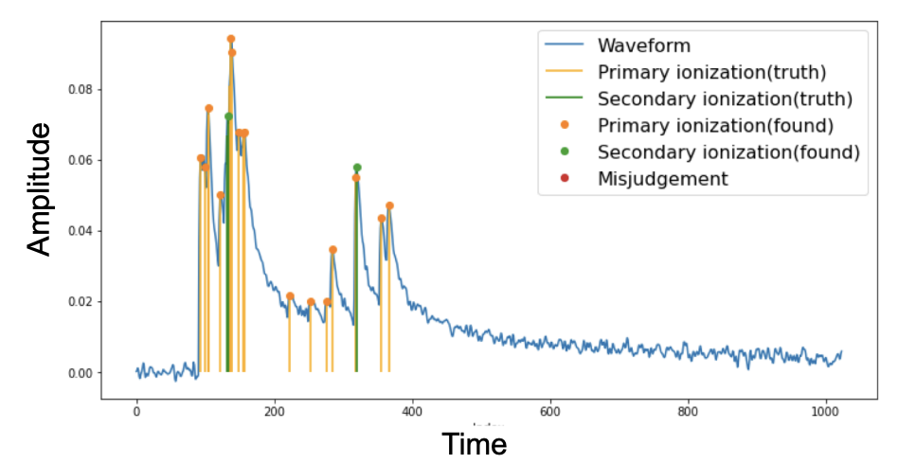
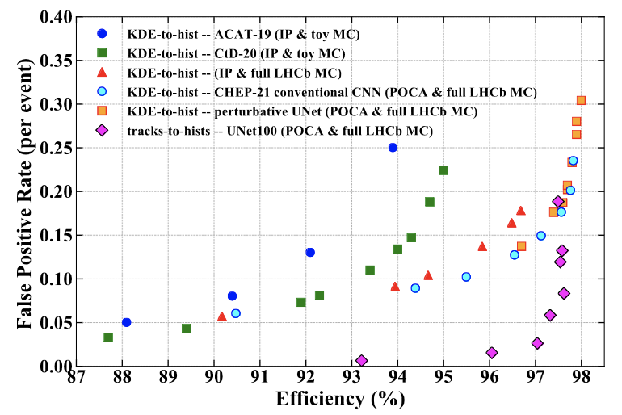
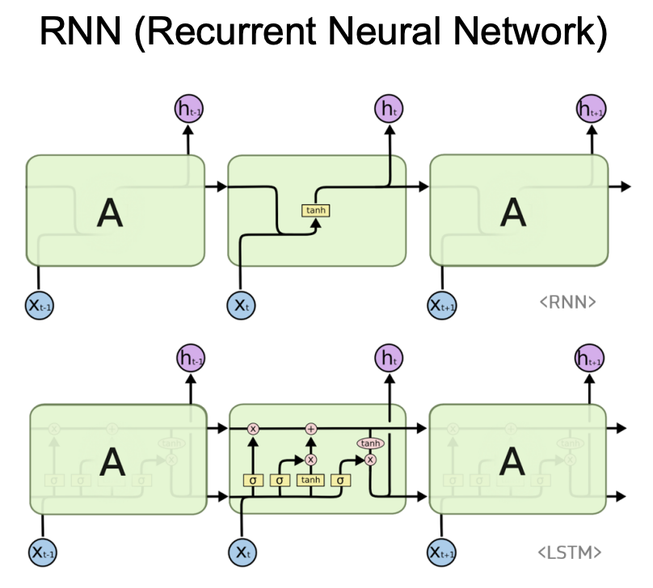
Reconstruction
Improved Primary Vertex finding @ATLAS and LHCb
Hybrid RNN/CNN for robust PID based on dN/dx cluster counting in drift-chambers
Advances in developing deep neural networks for finding primary vertices in proton-proton collisions at the LHC. Tue 09/05
A Deep-Learning Reconstruction Algorithm for Cluster Counting, Tue 09/05
RNN for peak finding and CNN for peak clustering determine the number of clusters per particle trajectory.
UNet based architecture in LHCb

Slide 7
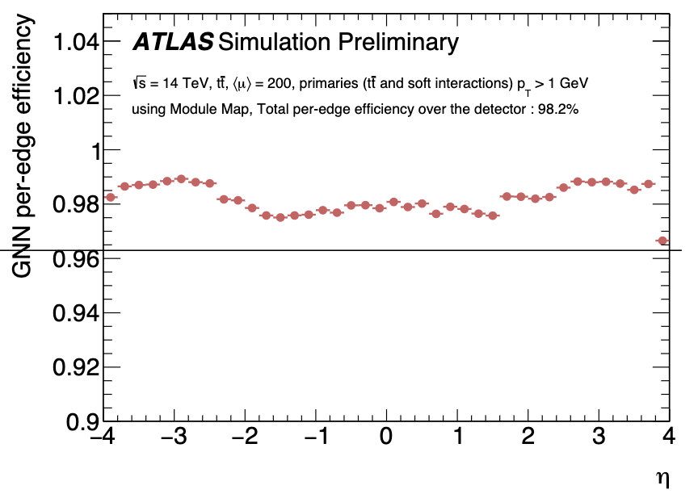
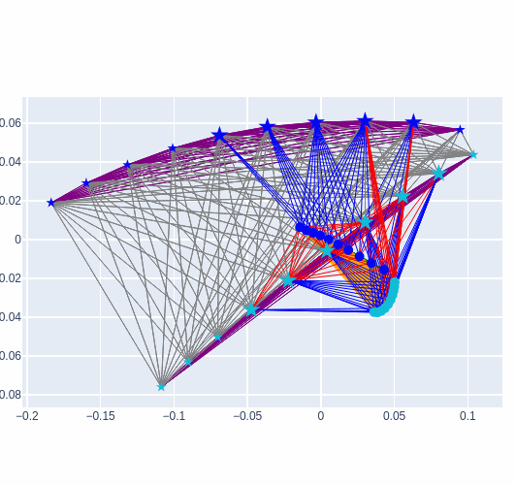
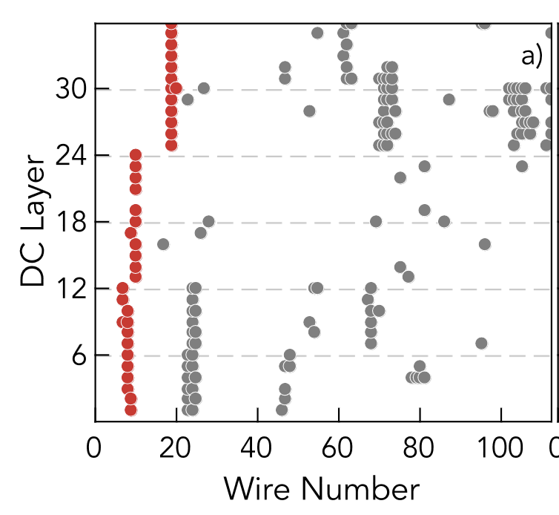
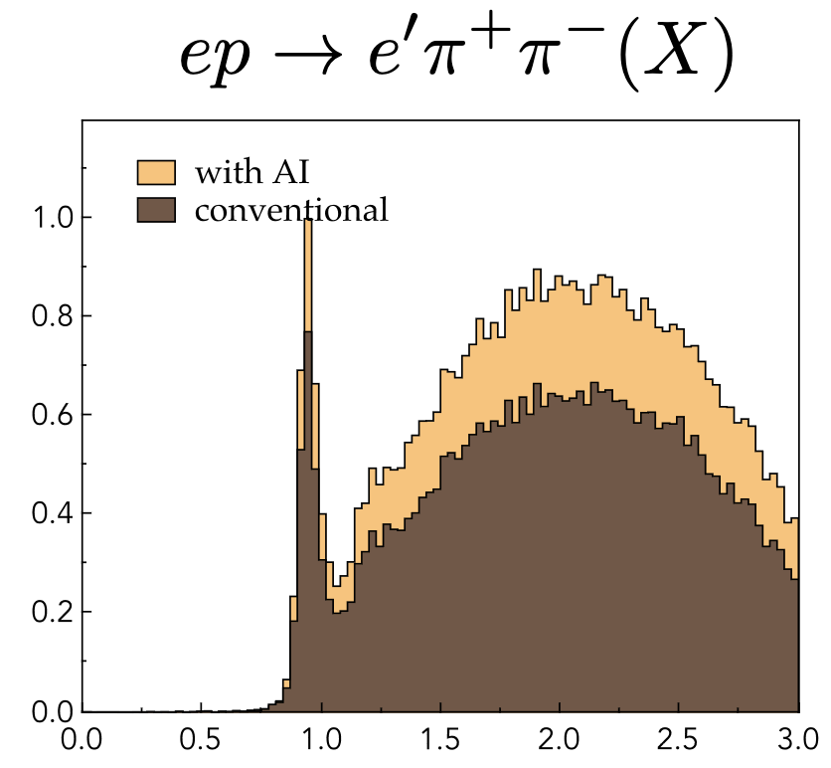
Tracking
Graph Neural Networks
Novel fully-heterogeneous GNN designs for track reconstruction at the HL-LHC, Tue 09/05
Tracking as object condensation
+ BESIII track reconstruction algorithm based on machine learning
An Object Condensation Pipeline for Charged Particle Tracking Tue 09/05
Simultaneously learn embedding similarity space and condensation score per hit (a higher score is a more “attractive” point charge in similarity space
Full ML pipeline for CLAS12 @JLAB
A new twitter inspired loss: the influencer loss !
Tracking represents 80% of CLAS12 processing time
Train a MLP to classify tracks and and AE to account for missing hits
35% improvement
Track Identification for CLAS12 using AI Tue 09/05
End-to-End Geometric Representation Learning for Track Reconstruction Tue 09/05
Develop denoising AE for high luminosity runs

Slide 8
LAr TPC imaging
End-to-end model comprising all stages of reconstruction through integration of various state-of-the art ML architectures.
Pandora reconstruction framework has new hybrid Deep Learning and algorithmic pattern recognition approach, which outperforms previous binary decision tree algorithm.
2nd generation of hit-labeling GNN. Performance boosted through application of Nexus convolutions / message passing.
End-to-end, ML-based Reconstruction Chain for Particle Imaging Detectors Tue 09/05
Neutrino interaction vertex-finding in a DUNE far-detector using Pandora deep learning Tue 09/05
NuGraph2 A Graph Neural Network for 3D Reconstruction in Liquid Argon Time Projection Chambers Tue 09/05

Slide 9
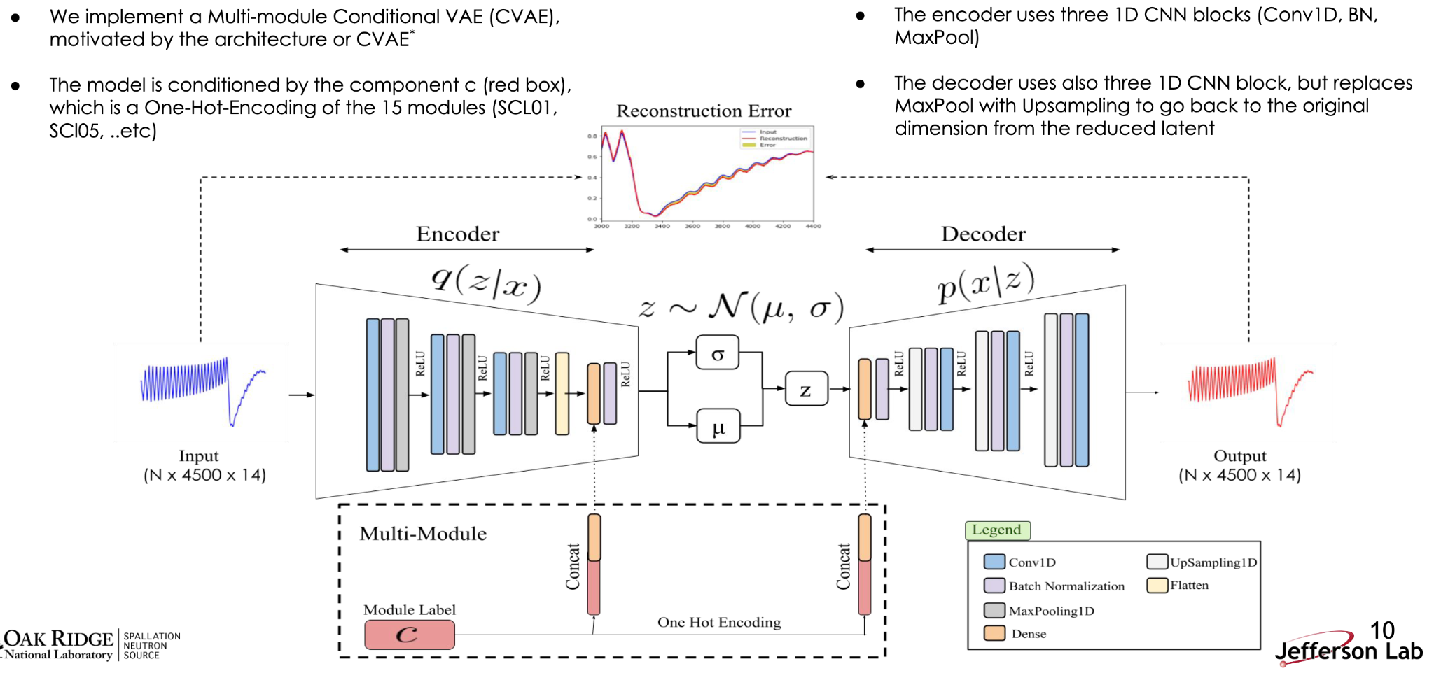
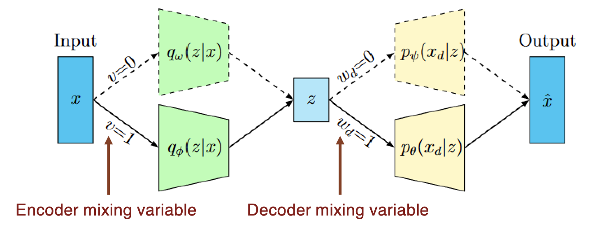
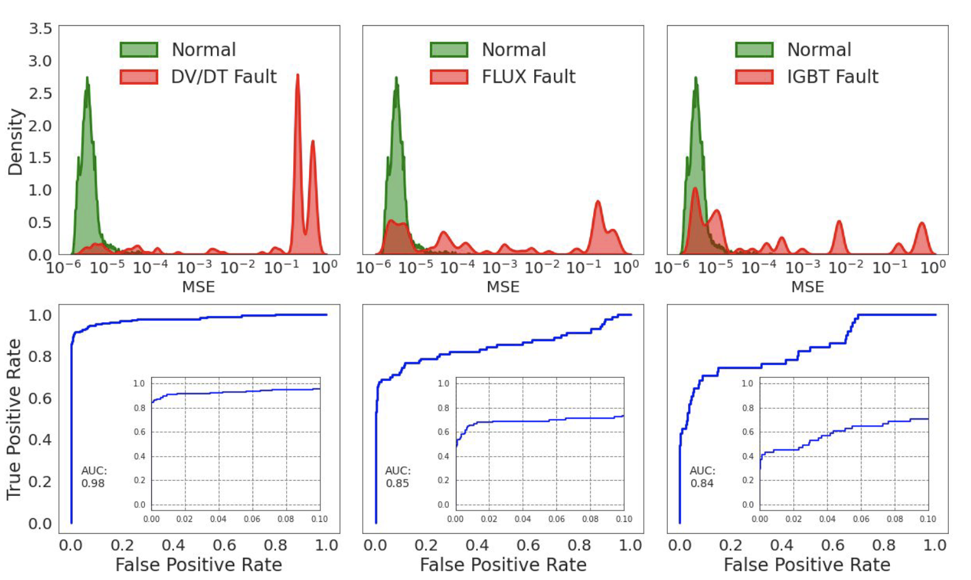
Anomaly Detection for hardware
Resilient Variational Autencoder for Unsupervised Anomaly Detection at the SLAC Linac Cohrerent Light Source, Mon 08/05
RF cavities of FEL@SLAC : Create “outlier” path through the network and decide according to probabilistic inference
High Voltage Converter Modulators for SNS Linac: a multi-module AE performs better than dedicated separate modules
Multi-Module based VAE to predict HVCM faults in the SNS accelerator, Mon 08/05

Slide 10
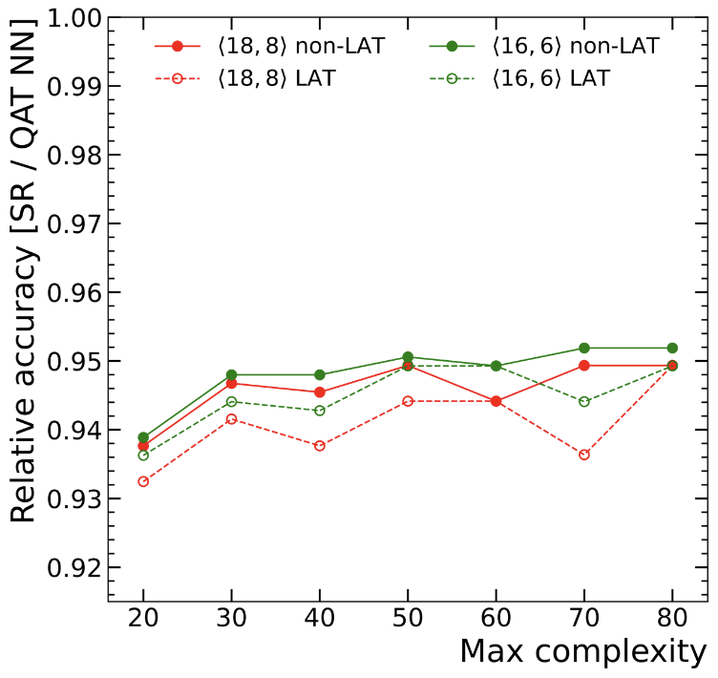
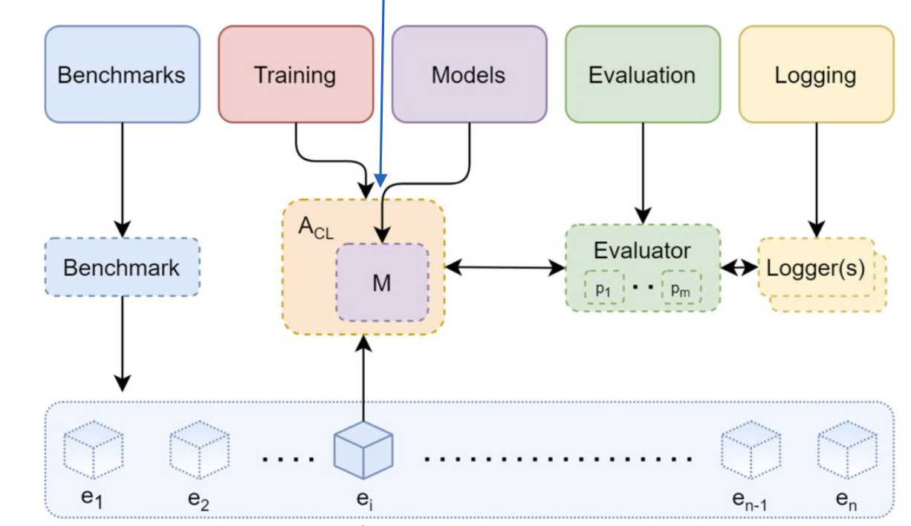
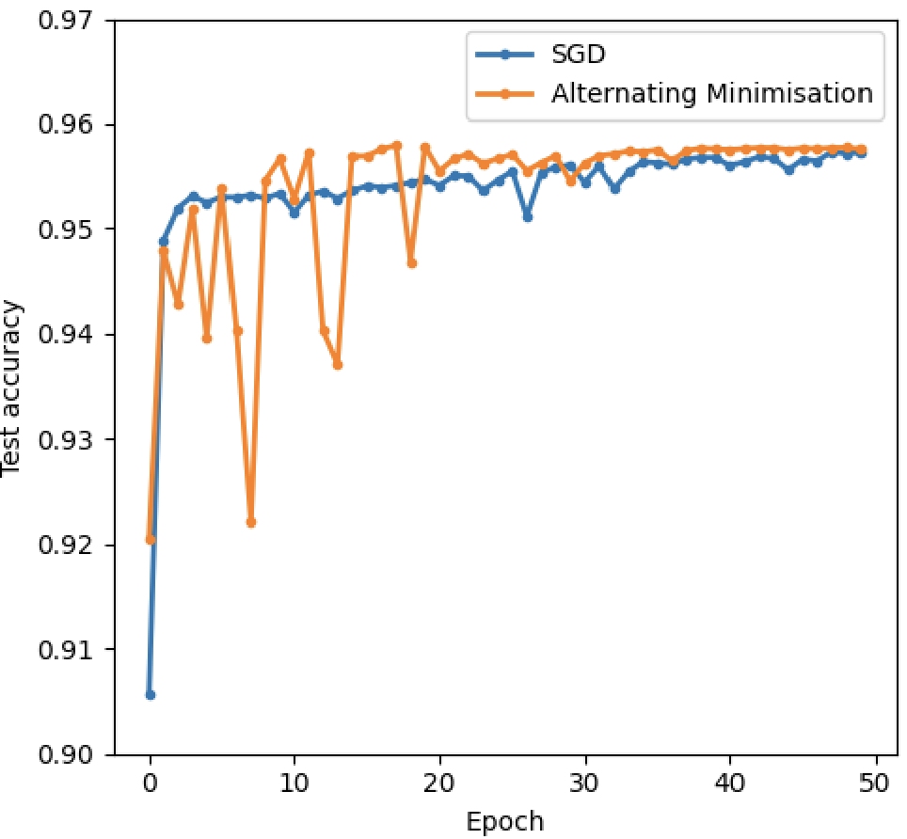
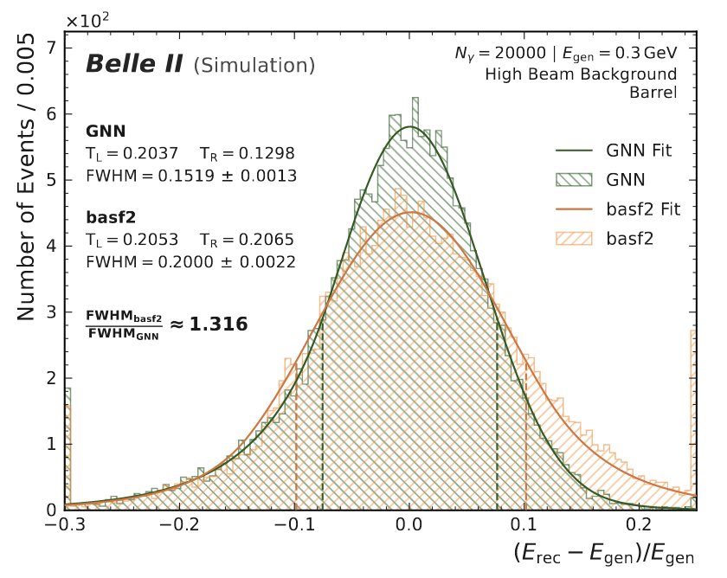
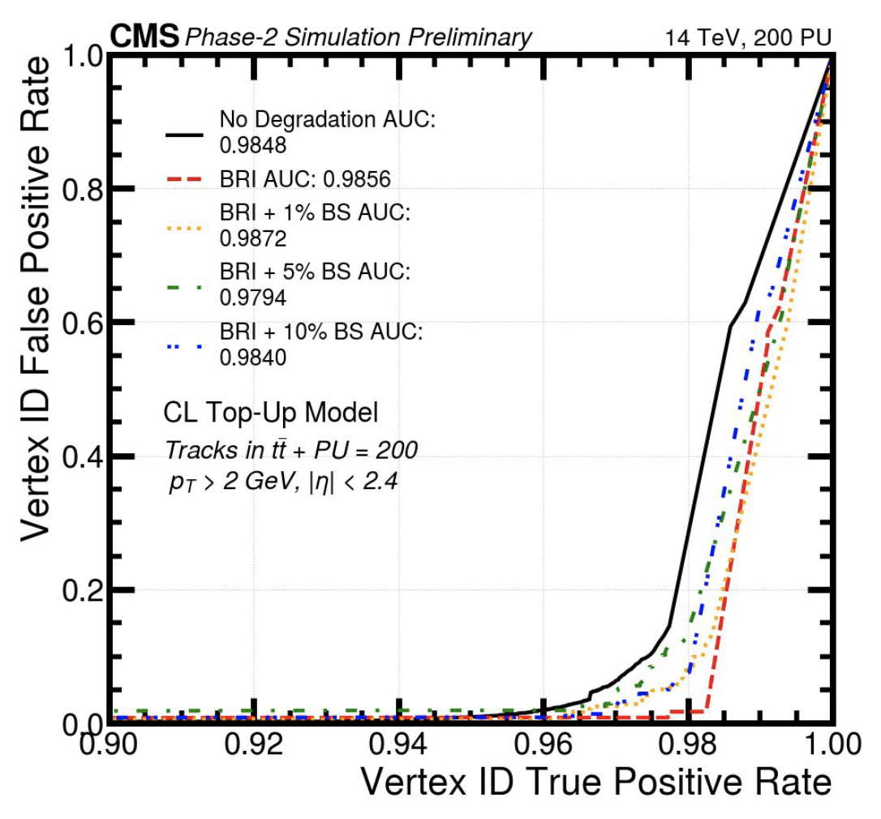
Online applications
Symbolic regression
Continual learning
Useful in online environment and changing conditions. Avoid retraining. Strong computational constraints. Proposed lightweight alternative to SGD.
SR models dramatically reduce latency and resources compared to NN
Embedded Continual Learning for HEP, Thu 11/05
Symbolic Regression on FPGAs for Fast Machine Learning Inference, Thu 11/05
T tagger
Improved Clustering in the Belle II Electromagnetic Calorimeter with Graph Neural Networks, Thu 11/05
The Deployment of Realtime ML in Changing Environments, Thu 11/05
More GNN, Object condensation and Fuzzy Clustering in Belle II!
← CMS L2 trigger Vertex finding

Slide 11
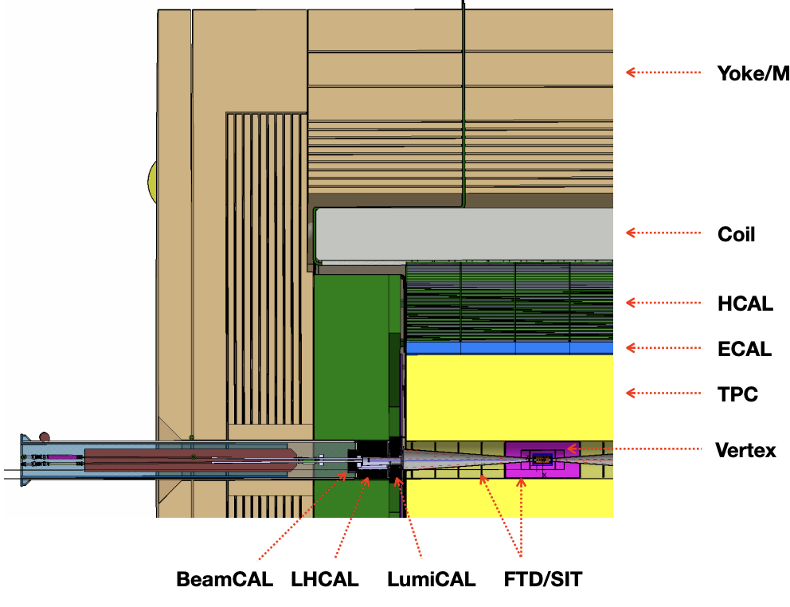
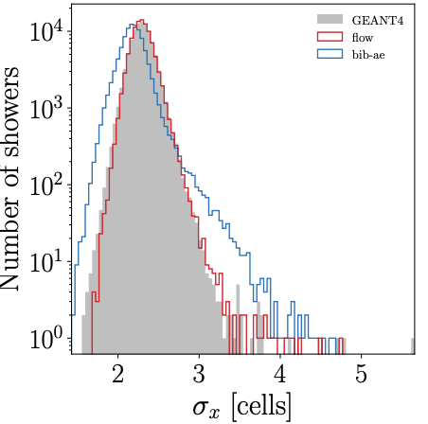
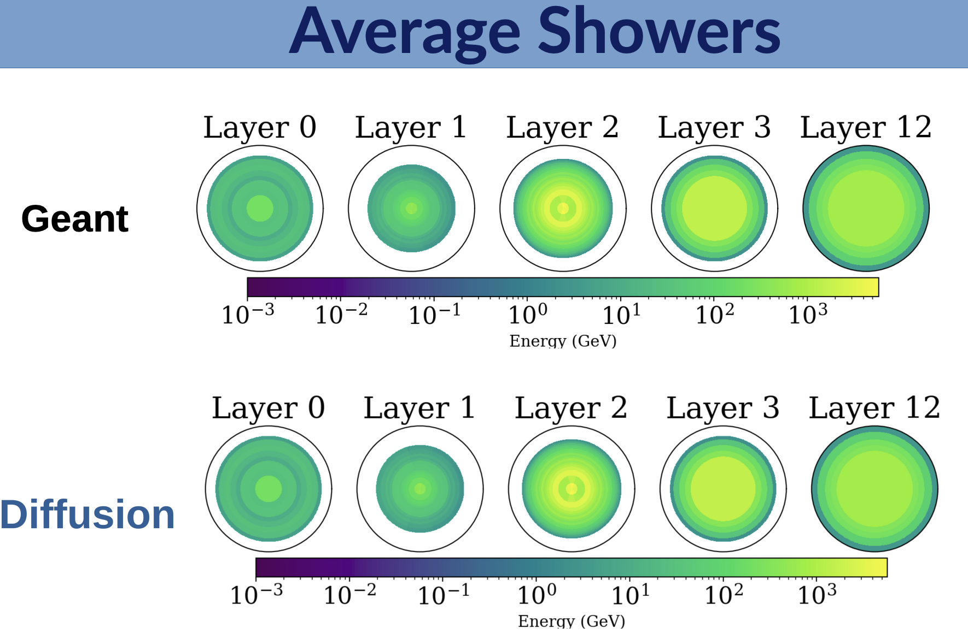
Fast simulation
State-of the-art non-HEP models enter the game: Introduction and adaptation of diffusion models for the Calo-Challenge with promising results
Several new models and trends for fast calorimeter simulations
Generative normalized flows considerably improves first-generation fast calo sim for ILC ECAL
Fast & Accurate Calorimeter Simulation With Diffusion Models, Thu 11/05
Generating Accurate Showers in Highly Granular Calorimeters Using Normalizing Flows, Thu 11/05

Slide 12
Fast simulation (II)
#calochallenge as a further driver for comparable ML developments for fast calorimeter simulation
Many models, datasets, performance metrics…
Toward foundation models!
Transformer based architectures for shower generation
May 30th-31st
Transformers for Generalized Fast Shower Simulation, Thu 11/05
The CaloChallenge, Thu 11/05

Slide 13
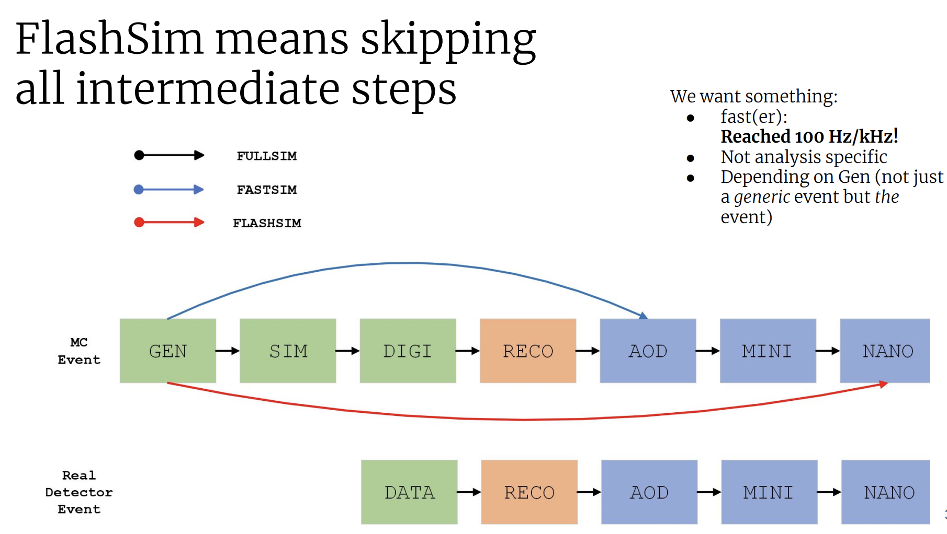
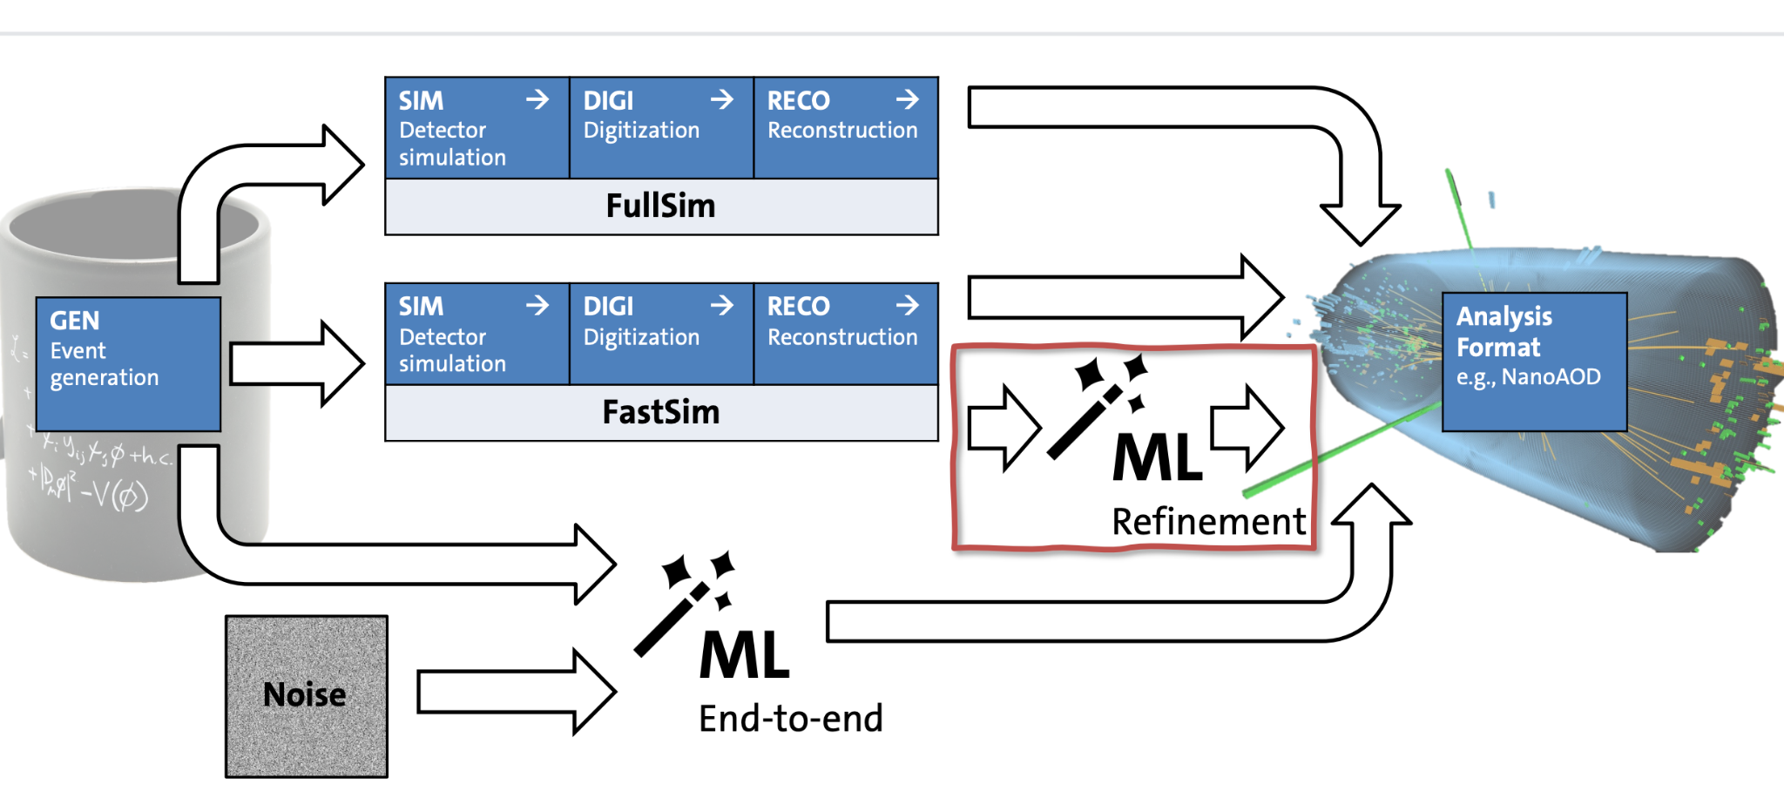
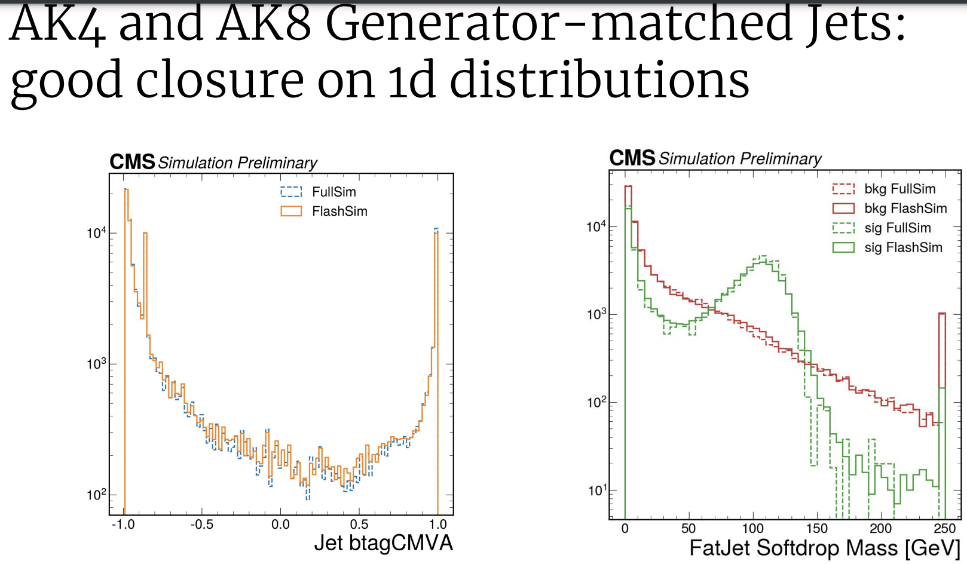
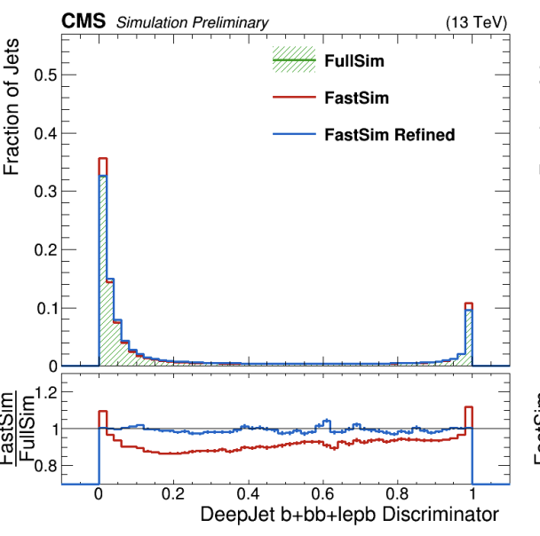
More Simulation
A normalized-flow based end-to-end super-fast-sim, transforming Monte Carlo events directly into high-level analysis objects.
Deep learning for post-processing match fast-sim to full-sim at analysis level Increases fidelity of fast-sim
Flashsim: a ML based simulation for analysis datatiers Mon 08/05
More interesting developments in constructing ML models for event generation (hadronization) or to have fundamental data-driven ML representation for hadronic physics models in Geant4
Refining fast simulation using machine learning Thu 11/05
Simulation of Hadronic Interactions with Deep Generative Models Thu 11/05
MLHad: Simulating Hadronization with Machine Learning Mon 08/05

Slide 14
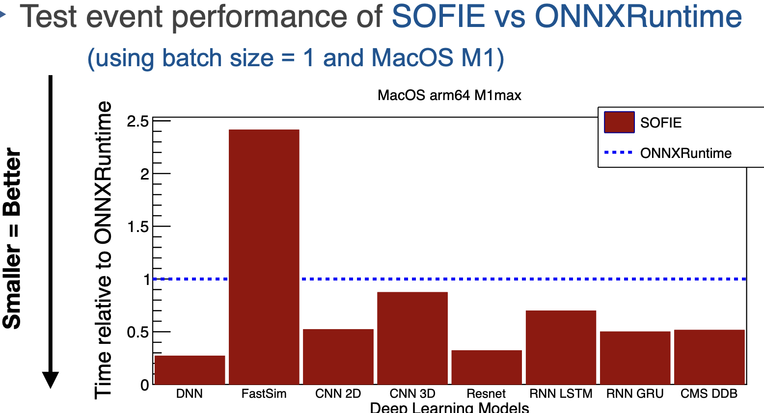
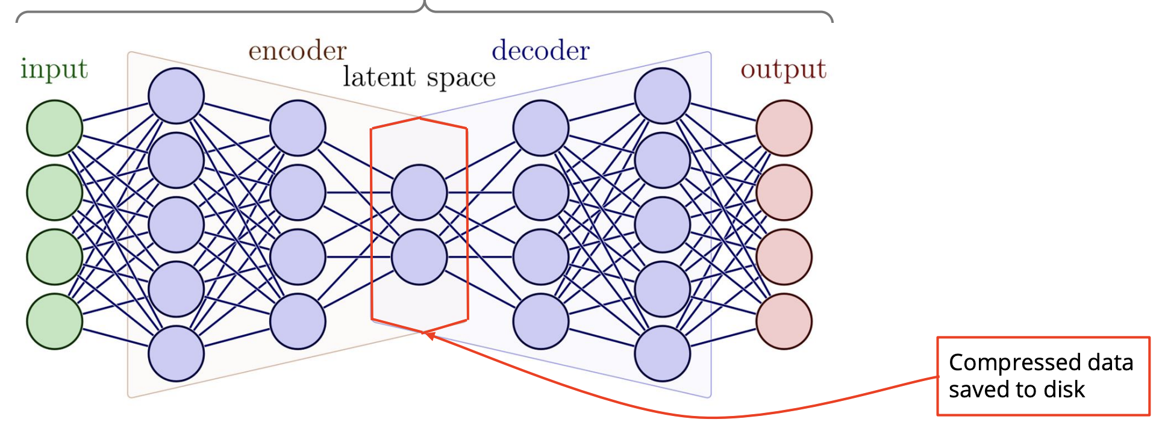
Tools
Improvements in ROOT/SOFIE to offer C++ inference support for GNN and compute performance going beyond what is available in industry solutions.
Baler: Auto-encoder-based compression of scientific datasets (where losses may be permitted). Promising direction for HEP data.
New developments of TMVA/SOFIE: Code Generation and Fast Inference for Graph Neural Networks, Thu 11/05
JetNet: Python package with easy-to-access datasets, standardised evaluation metrics, and more utilities for improving accessibility and reproducibility in ML + HEP
JetNet library for machine learning in high energy physics, Thu 11/05
Machine learning based compression for scientific data, Mon 08/05

Slide 15
Thank you!

