Slide 1
Massive-scale Data Analytics at the Linac Coherent Light Source
CHEP 2023, Norfolk
Jana Thayer/LCLS Data Systems Division Director
May 11, 2023
Many thanks to the people doing all the honest work:
Ric Claus, Dan Damiani, Chris Ford, Mikhail Dubrovin, Victor Elmir, Wilko Kroeger, Xiang Li, Valerio Mariani, Silke Nelson, Ariana Peck, Frederic Poitevin, Chris O’Grady, Julieth Otero, Omar Quijano, Murali Shankar, Monarin Uervirojnangkoorn, Matt Weaver, Seshu Yamajala, Chuck Yoon, Cong Wang, Zhantao Chen

Slide 2
Outline
New infrastructure and analysis methods that leverage massive data quantities will maximize the science output from LCLS
About LCLS
Challenges for LCLS Data Analytics
Patterns for workflows
On-the-fly data reduction: Data Reduction Pipeline
Heterogeneous pipelines: Building intelligent, adaptable detector systems
Quasi-real-time workflows with results within minutes
Compute-intensive streaming analysis of Tb/s data streams
Adaptable real-time ML workflows
The future: Integrated Research Infrastructure and HPDF
Conclusions

Slide 3
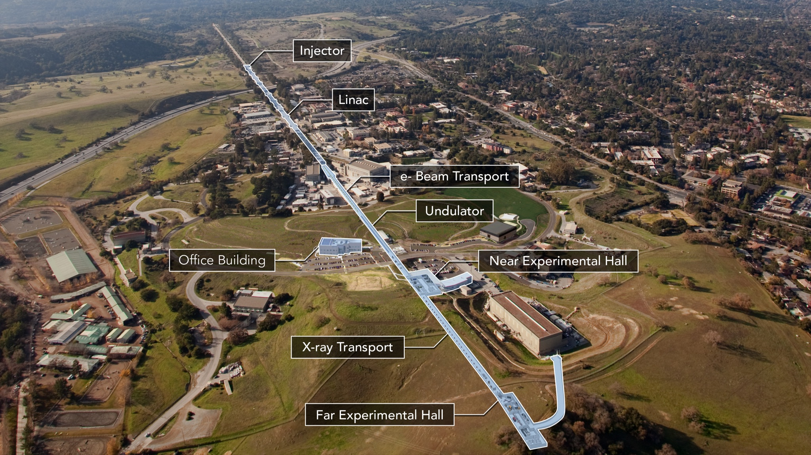
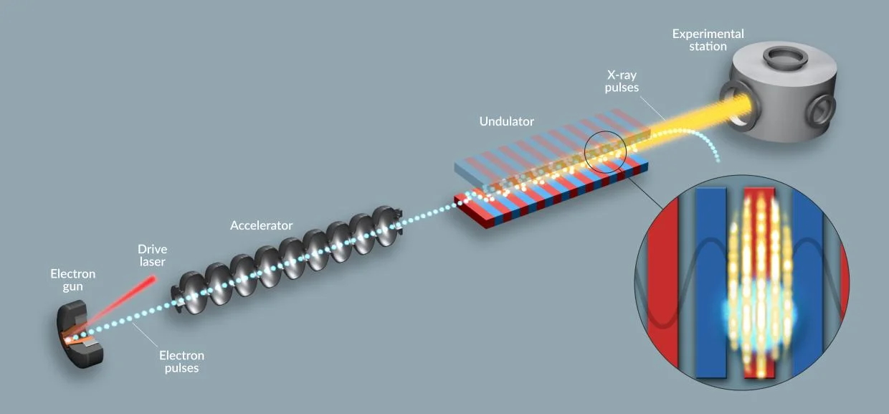

Slide 4
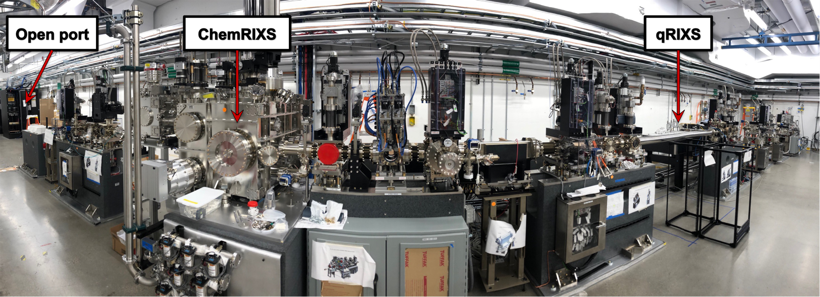
LCLS-II: SLAC’s largest data and computing challenge
Ultrafast x-ray pulses from LCLS are used like flashes from a high speed strobe light, producing stop action movies of atoms and molecules.
Both data processing and scientific interpretation demand intensive computational resources.
Characterized by time-sensitive and data integration-intensive workflows
ChemRIXS instrument (NEH 2.2)
TMO instrument (hutch 1)

Slide 5
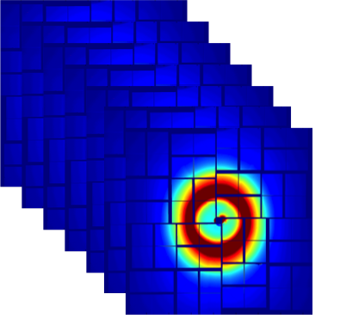
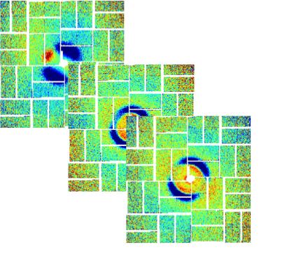
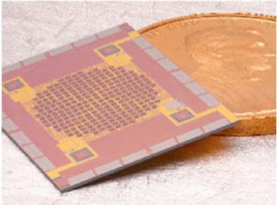
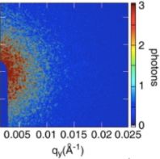
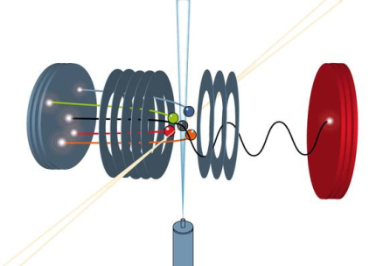
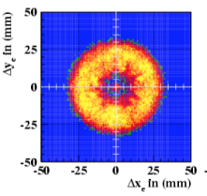
Many compute-intensive workflows, one scalable data system
Coherent Scattering
Liquid scattering
Resonant Inelastic Scattering
XPCS
XSVS
t₄
t₃
t₂
t₁
2023: 20 GB/s, 4 TF (reduction), 34 TF (analysis)
2026: 80 GB/s, 34 TF (reduction), 270 TF (analysis)
2023: 40 GB/s, < 1 TF (reduction), 20 TF (analysis)
2026: 320 GB/s, <1 TF (reduction), 50 TF (analysis)
2023: 20 GB/s, 4 TF (reduction), 1 TF (analysis)
2026: 200 GB/s, 40 TF (reduction), 2 TF (analysis)
X-ray Emission Spectroscopy (XES)
Coincidence Spectroscopy
Nonlinear Spectroscopy
energy
loss
hν_{in}
hν_{in}
hν_{out}
2023: .1 GB/s, < 1 TF (reduction), .2 TF (analysis)
2026: 10 GB/s, <1 TF (reduction), 20 TF (analysis)
2023: 20 GB/s, 3 TF (reduction), <1 TF (analysis)
2026: 80 GB/s, 16 TF (reduction), <1 TF (analysis)
2021: 200 GB/s, <1TF (reduction), <1TF (analysis)

Slide 6
Data Life Cycle and the Compute Needs of the Typical User
A Day in the Life of a User
Typical experiments last 5 days of 12 hour shifts.
During data collection:
Must be able to get real-time (~1 sec) feedback and the quality of data-taking, e.g.
Are we getting all the required detector contributions for each event?
Is the hit rate for the pulse-sample interaction high enough?
Must be able to get feedback about the quality of the acquired data with a latency lower (~1 min) than the typical lifetime of a measurement (~10 min) in order to optimize the experimental setup for the next measurement, e.g.
Are we collecting enough statistics? Is the S/N ratio as expected?
Is the resolution of the reconstructed electron density what we expected?
During off shifts: must be able to run multiple passes (> 10) of the full analysis on the data acquired during the previous shift to optimize analysis parameters and code in preparation for the next shift
During the 4 months after the experiment, must be able to analyze the raw and intermediate data on fast access storage in preparation for publication
After 4 months, must be able to restore archived data to test new ideas, new code, new parameters

Slide 7
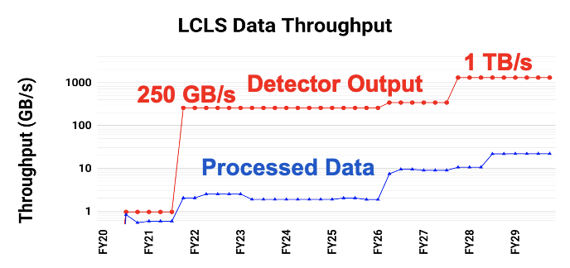
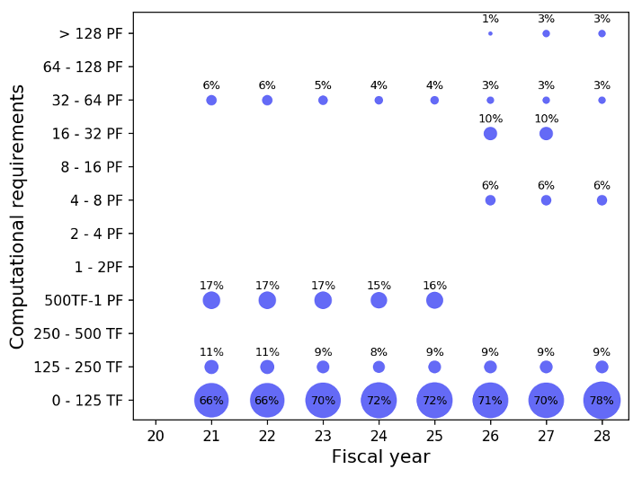
LCLS Data Challenges
LCLS-II Upgrade: greater data velocity and volume
Data Rates: 120 Hz to 1 MHz (10000x)
Raw Data Volumes: 2 GB/s to 200 GB/s (100x)
Recorded Data Volumes: 2 GB/s to 20 GB/s (10x)
Computational Requirements: 80% ~1 PF, 20% ~1 ExaFLOP
Fast Feedback: real-time analysis (seconds/minutes) is essential to the users’ ability to make informed decisions during an LCLS experiment.
Variability:
Wide variety of experiments with turnaround ~days
Large dynamic range: device readout 0.01 Hz - 1 MHz
Data Complexity: Variable length data (raw, compressed)
Access patterns to data vary by experiment and detector
Analysis is a mix of tried-and-true & innovative techniques
Time to Science: Development cycle must be fast & flexible
No user left behind: alleviate the pressure on users to gather resources to mount a significant computing effort.
LCLS Data Throughput
LCLS Computational Requirements
Surge to offsite – NERSC, LCF
Notes:
Fast feedback reduces the time to complete the experiment, improves data quality, and increases the success rate.

Slide 8
LCLS Data System, a scalable, adaptable system
LCLS facility provides stewardship of core hardware/software infrastructure for data acquisition, data reduction, online monitoring, data storage and management, and offline analysis processing and framework.
Users provide the last mile: develop their own analysis on top of this stack.
Data Management System (eLog, ARP, Data Movers, File Manager)
New for LCLS-II
SLAC Shared Science Data Facility (S3DF)
Onsite - Petascale Experiments
Offsite – Exascale Experiments
(NERSC, LCF)
Onsite

Slide 9
LCLS Data Reduction Pipeline (DRP)
All experiments reduce data during processing → Data Reduction Pipeline does it in real time
Data reduction toolbox of parameterized algorithms runs on DRP compute layer: compression, feature extraction, trigger/veto, multi-event reduction
Software Trigger Nodes perform online event-build collecting data from multiple detectors from the same event. Two decisions per event, per shot: Store or not? Send data to online monitoring?
100 Hz stream of “leaked”, unreduced events accompanies reduced data.
CPU and FPGA available in DRP .
Status: Successfully acquiring 200 GB/s at 1 MHz with data reduction
Data Reduction Pipeline
Compressor Nodes
Software Trigger Nodes
Fast Feedback Layer (nVRAM)
PGP
Optical switch
PGP
PGP
Infiniband
PGP
Online Monitoring Nodes
PGP
BLD
10GE
EPICS
10GE
ZMQ
Control
AMI
PVA
EPICS
2022 LDAC - Data Systems

Slide 10
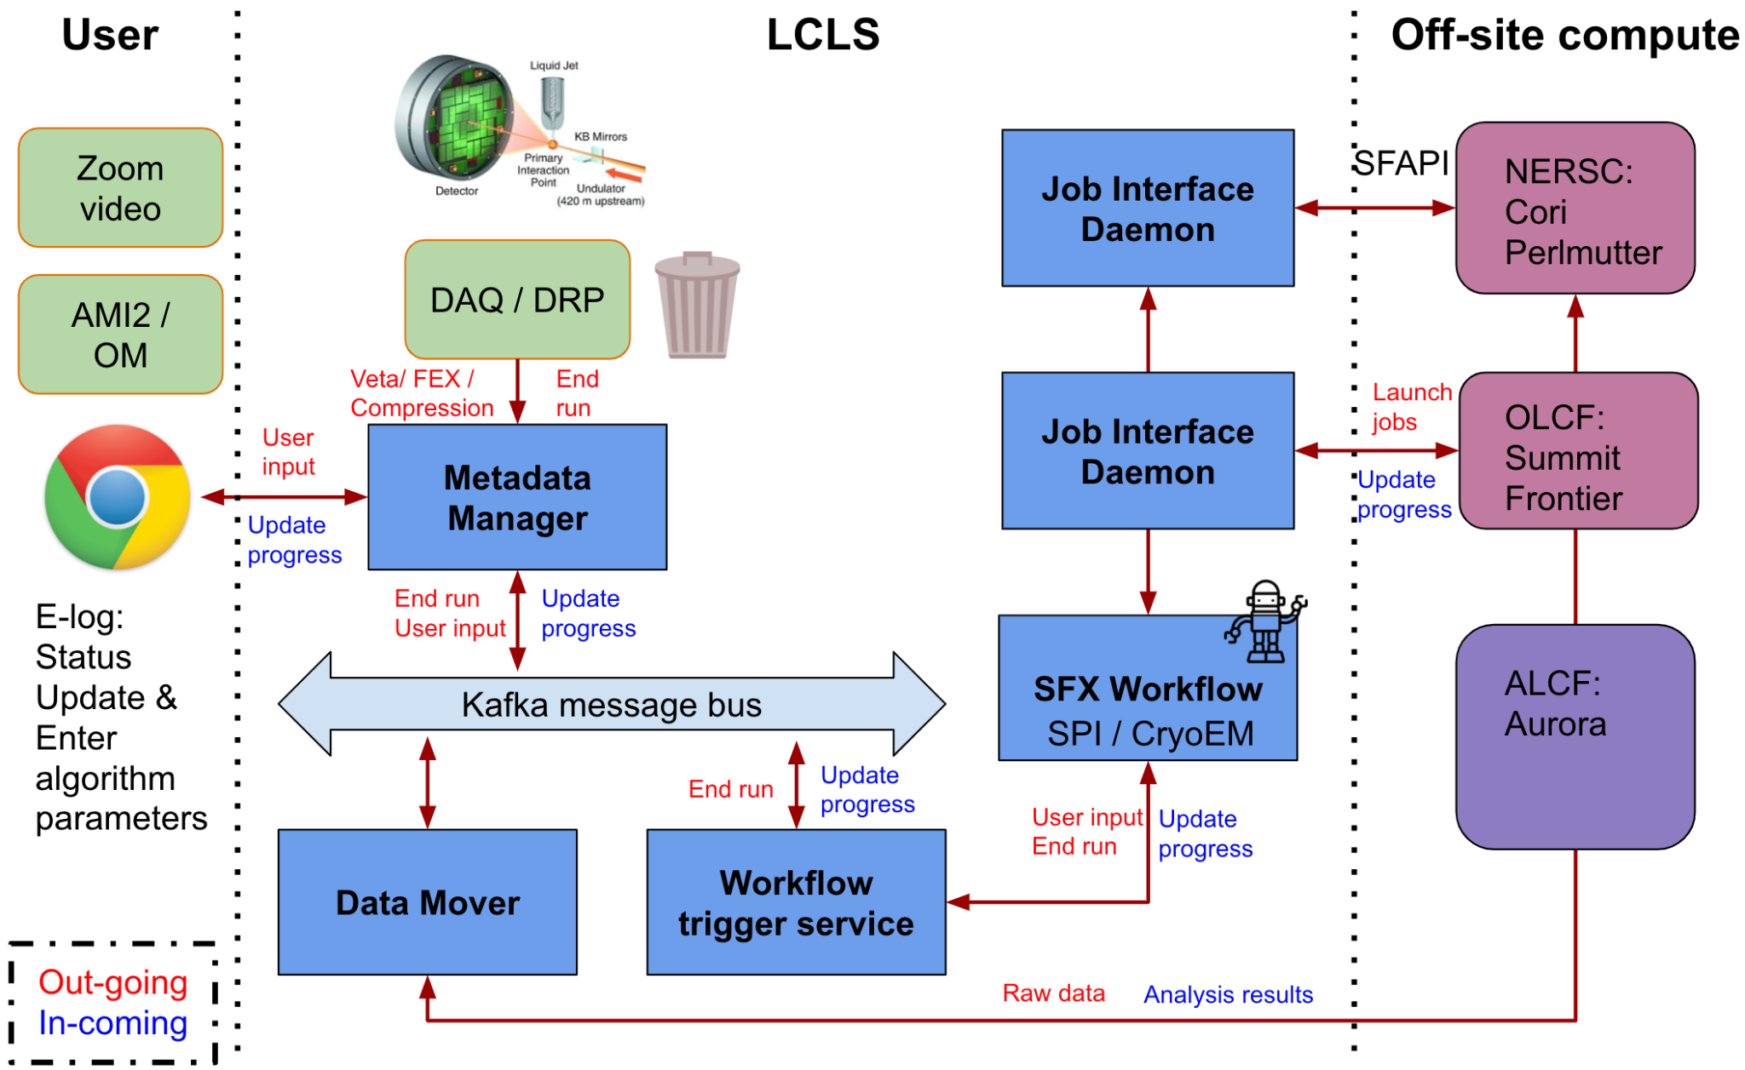
Automated Data Movement and Run Processing
Automated data/metadata capture and movement; configurable and automated workflows
2022 LDAC - Data Systems

Slide 11
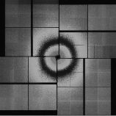
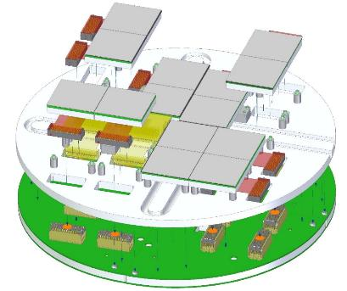
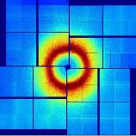
SparkPix-RT: Intelligent Detector Systems for 1 MHz readout
https://doi.org/10.1107/S160057752000425
Triggering/Compression within ASIC reduces data volume, alleviates data transport bottleneck
Rate reduction
LCLS needs streaming feature extraction on high rate data from large imaging detectors to enable smart, autonomous experiments
Fast readout of the desired data
Alleviate downstream network, storage, and computing bottlenecks
Enabling data reduction/feature extraction at the ASIC/FPGA level is challenging because ASICs/FPGAs may only see a fraction of the image (potentially uncorrected) while the offline analysis sees fully calibrated, complete images.
Develop intelligent auto-correction techniques
Provision for buffering and deadtime
Develop triggering capability
Determine what kind of information extraction is feasible
Provide for data validation and model training
ASIC Level
FPGA Level
EDGE Computing
on camera
Farm of FPGAs
CPUs/GPUs
Data System
Versatility

Slide 12
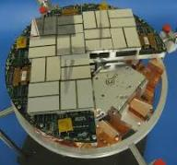
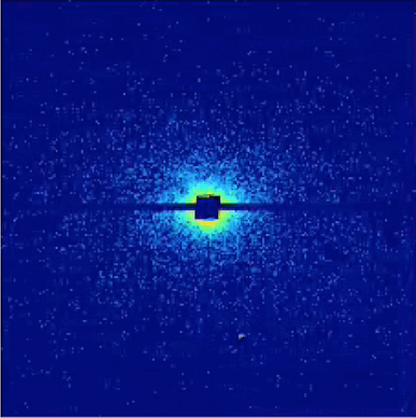
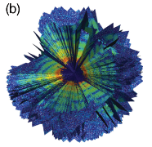
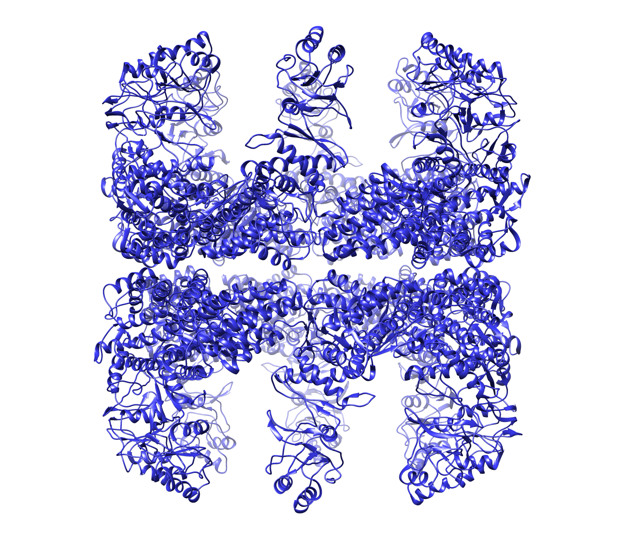
Single Particle Imaging High Rate Analysis
Determine the 3D molecular structure of nanoparticles (time-resolved, at room temperature)
Three key steps for high rate analysis workflow:
DRP: Fast Data Reduction using Veto. Hit or Miss? (> 10x reduction)
Accurate classification: Identify single hits
Reconstruction: Orientation recovery: phase retrieval
Multi megapixel detector
Coherent scattering image
Intensity map from multiple pulses
Interpretation of system structure / dynamics
Individual particles are injected into the focused LCLS pulses
Scattering patterns are collected pulse-by-pulse
Particle concentration dictates “hit” rate
60 GB/s
6 GB/s
1 TB/s
100 GB/s
8 kHz in 2024 (4 MP)
40 kHz in 2027 (16 MP)
Data Reduction
Remove”no hits”
>10x reduction
3 TFlops
16 TFlops
Data Analysis
Orient patterns
3D intensity map
Phase retrieval
270 PFlops
1340 PFlops
2022 LDAC - Data Systems

Slide 13
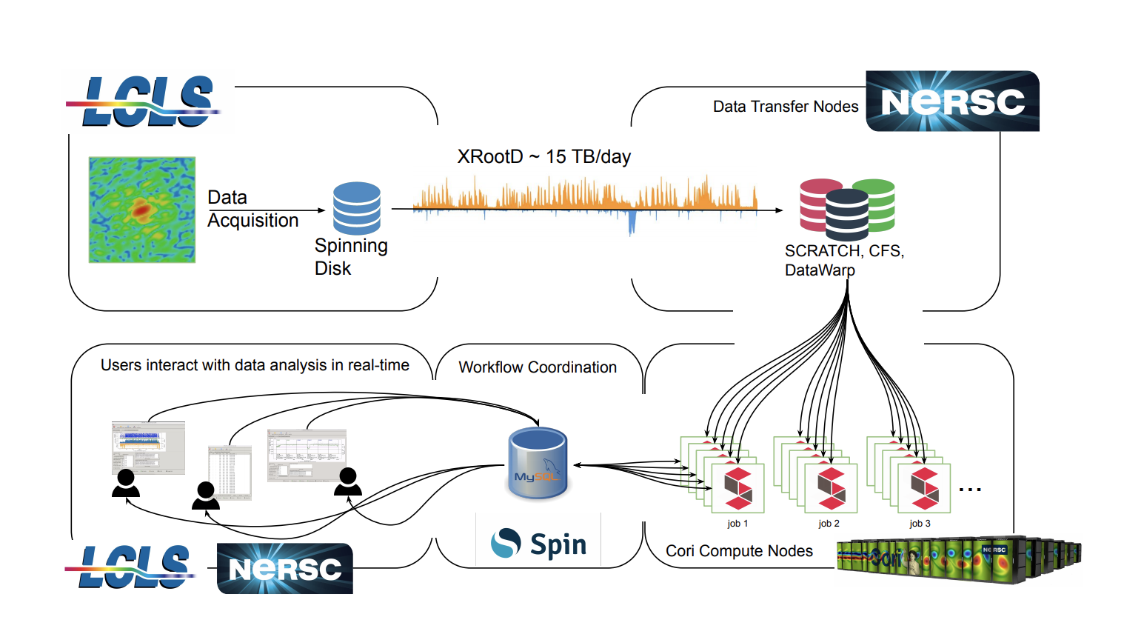
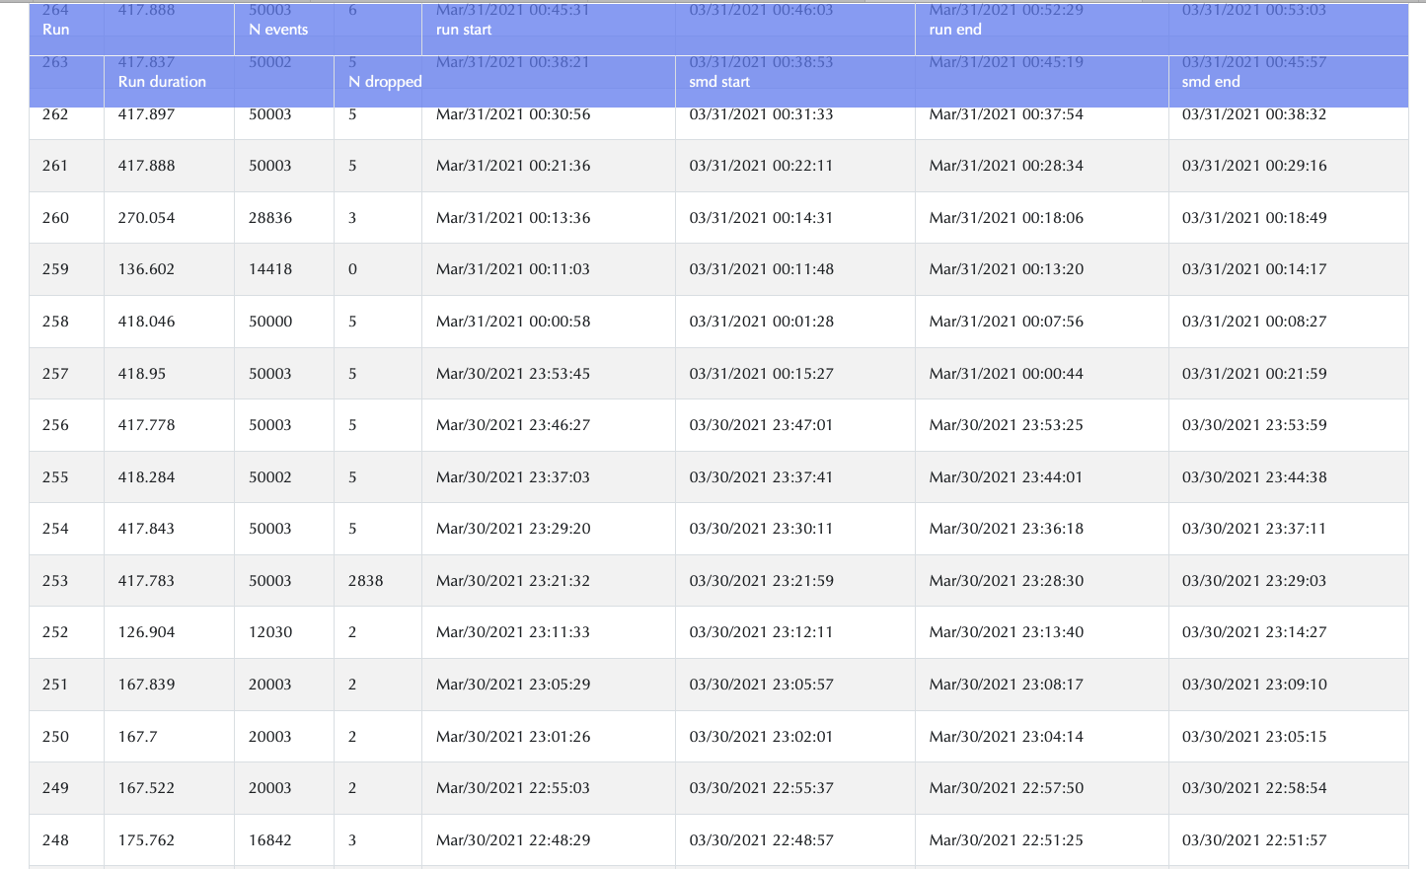
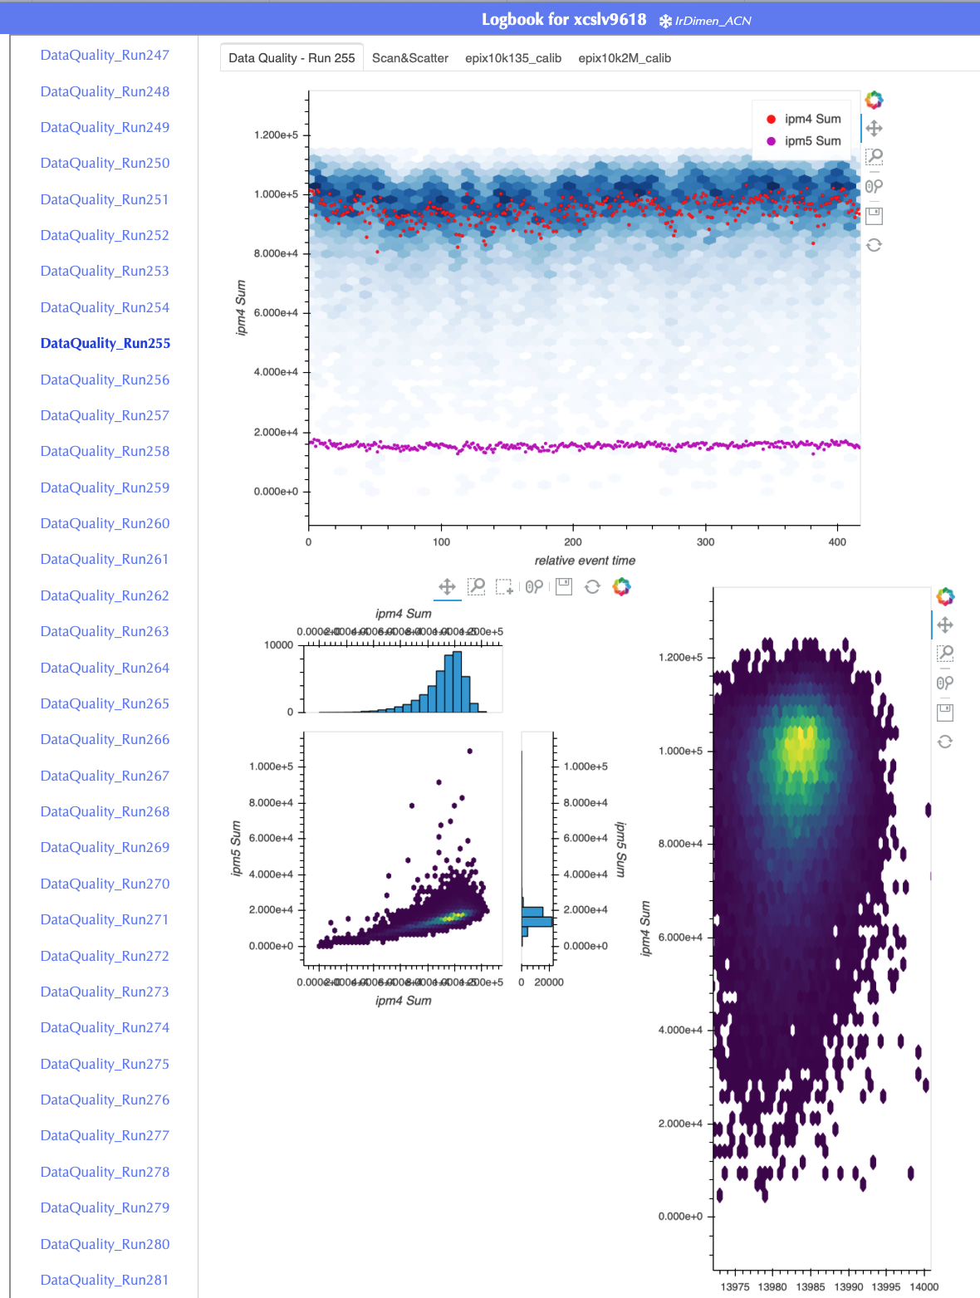
Quasi-real-time analysis using NERSC
https://doi.org/10.48550/arXiv.2206.11992
ExaFEL project streams data to NERSC for analysis results within minutes
Testing data transfer to other facilities
Transparent data movement
File management
Automated Run Processing
Monitor Results

Slide 14
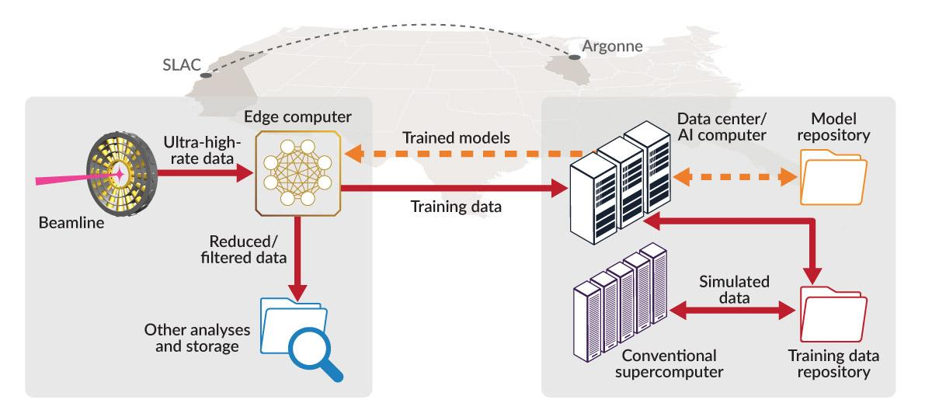
Actionable Information from Sensor to Data Center (AISDC)
https://doi.org/10.48550/arXiv.2105.13967
Providing Actionable Information by linking AI/ML at the Edge with HPC
Implement AI/ML at the Edge; develop workflows that stream data to a specialized data center at Argonne to achieve a turnaround time between initialization and model delivery to Edge host of < 10 minutes
This material is based upon work supported by the U.S. Department of Energy, Office of Science, Office of Basic Energy Sciences under Award Number FWP-100643 and FWP-35896.

Slide 15
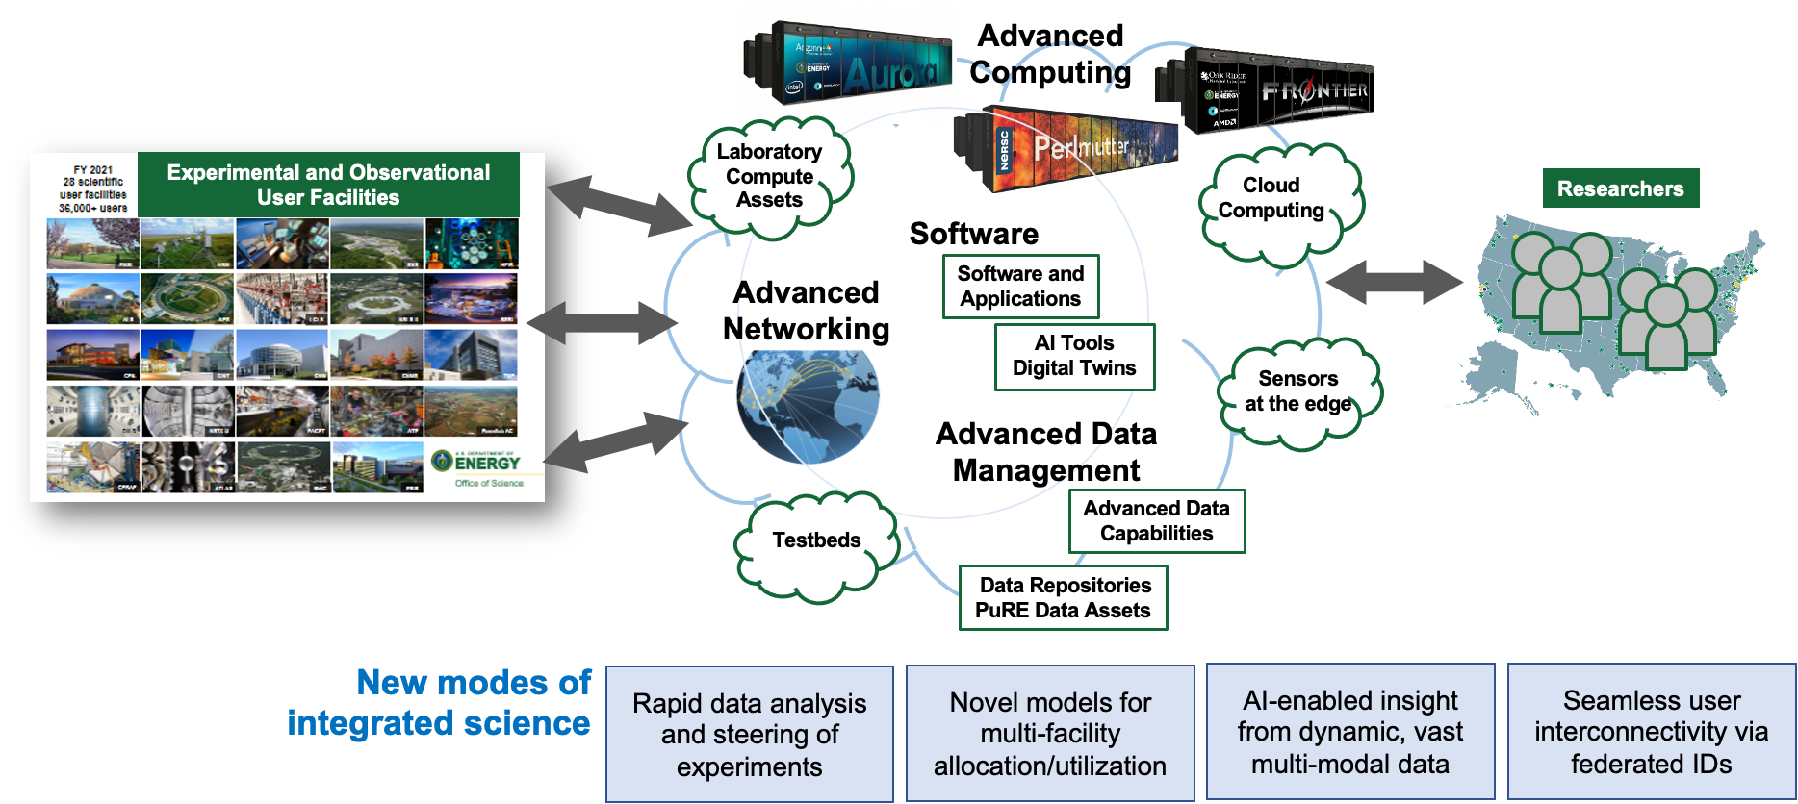
ASCR Defines a Unified Vision for Scientific Computing for Facilities
ASCR: IRI-ABA - Integrated Research Infrastructure Architecture Blueprint Activity
Vision: A DOE/SC integrated research ecosystem that transforms science via seamless interoperability.
LAB 23-3020: The High Performance Data Facility (HPDF) will serve as a foundational element enabling the DOE Integrated Research Infrastructure.
S3DF would like to participate in IRI ecosystem as both a source of data and a compute facility serving 80% of LCLS experiments
Notes:
HPDF will provide crucial resources to Office of Science programs to attack fundamental problems in science and engineering that require nimble shared access to large data sets, increasingly aggregated from multiple sources.”

Slide 16
Summary
LCLS Data Systems infrastructure scales to meet high-throughput, compute-intensive demand:
Real-time data analysis capabilities (data reduction, complex workflow orchestration)
On-demand utilization of super-computing environments
Pipeline spans from Detector Edge to HPC
Strategically developing AI/ML for targeted applications
Intelligent detectors and real-time analysis enable autonomous experiment steering
Lessons learned:
Modularity is key for rapidly adaptable workflows
Seamless access to computing with transparent data movement is crucial for users
Ease-of use is important: hide the computing complexity where possible
ML at the edge is hard and creates new compute-intensive workflows
A common software ecosystem is greatly desired, but difficult to achieve; users will always need some experiment-specific software
Notes:
Working example of superfacility concept: integration between light source facility and supercomputer facility for quasi-real-time data analytics

Slide 17
Backup
More details

Slide 18
LCLS and ATLAS: Similar but very different
Courtesy of Richard Mount (circa 2017)
 | LCLS-II 2022 | LCLS-II 2029+ | ATLAS Today | ATLAS 2026+
Wanted fraction of collisions | 0.01 to 1.0 | 0.01 to 1.0 | < 10⁻⁶ | < 10⁻⁵
Typical experiment duration (same data-taking conditions) | 3 days | 3 days | 3 years | 3 years
24x7 availability of offline computing | Essential | Essential | Desirable | Desirable
Required turnround for data-quality checks | Seconds to minutes | Seconds to minutes | Hours to days | Hours to days
Raw digital data rate | 200 GB/s | 1000+ GB/s | 160 GB/s | 1,000 GB/s
Zero-and-Junk-suppressed rate | 10 GB/s | 100+ GB/s | 1.5 GB/s | 20 GB/s
Storage need dominated by | Mainly raw data |  | Mainly simulated and derived data
Role of Simulation | Growing in science analysis Growing in experiment design |  | Vital in physics analysis Vital in experiment design
Analysis, Simulation and Workflow Software development community | Individuals (in the past) → Organized effort |  | ~100 organized collaborators (mainly research physicists)

Slide 19
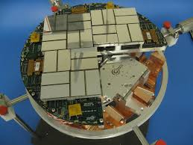
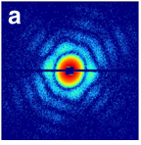
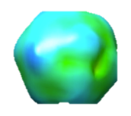
LCLS-II data challenge
Megapixel detector
X-ray diffraction image
Intensity map from multiple pulses
Interpretation of system structure / dynamics

Slide 20
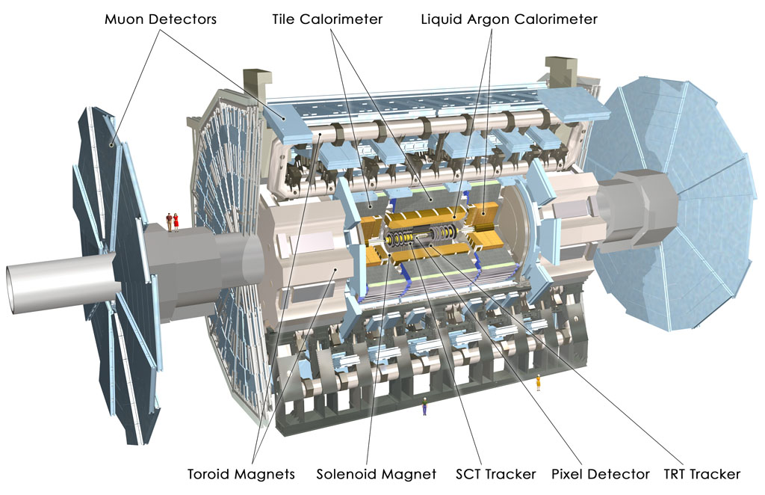
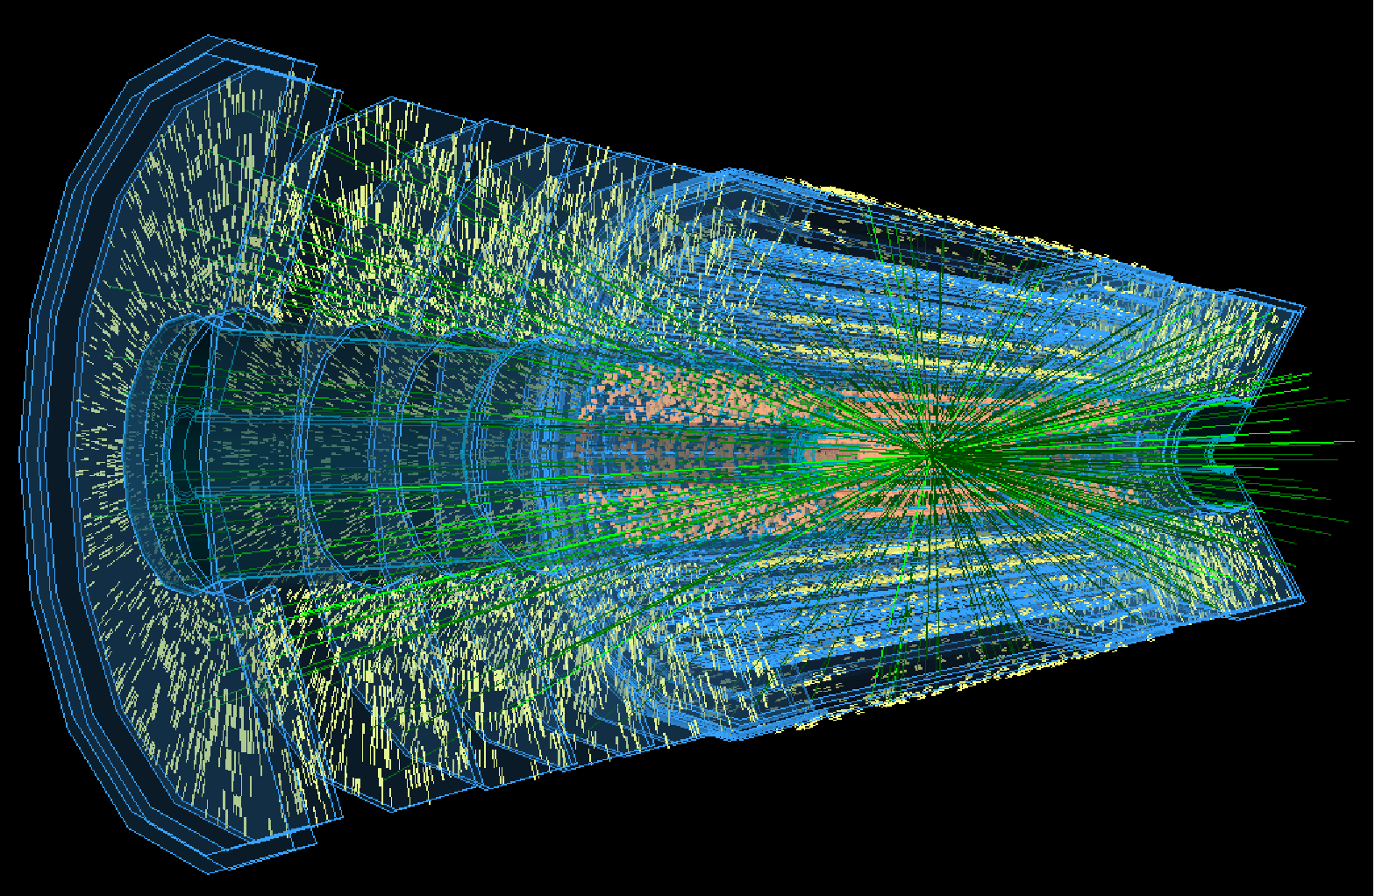
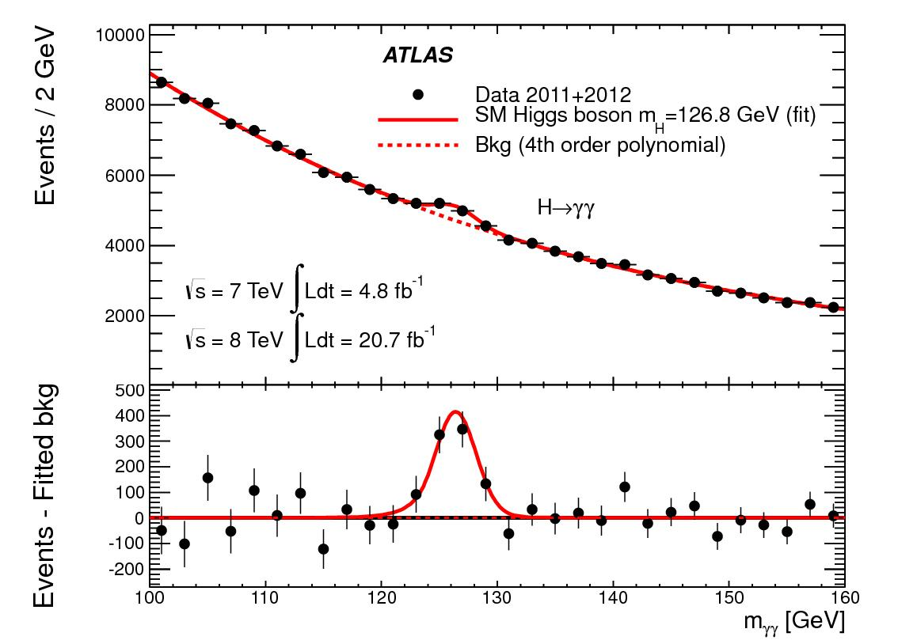
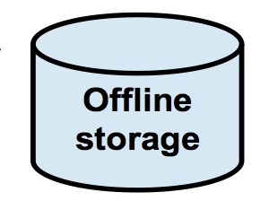
Compare with HL-LHC (2029+)
Requires ~2000 PB storage, ~1M+ cores and expects Tbps networking
Gigachannel detector
Readout of collisions
Multiple selected datasets
Discoveries and Measurements
?
Real Data
Simulated Data
~10⁵ reduction
~1 TB/s
Specialized Hardware + 40,000+ Cores
~20 GB/s
Pledged Clusters + HPC
[>1 PB/s Analog]
Dedicated/Pledged resources, 100+ centers
(Reconstruction, Analysis, Simulation)
HPC + Clusters
Prompt Rec-
onstruction
~ minutes
~ hours to days
Opportunistic Resources
(Simulation etc.)
Courtesy Richard Mount, circa 2017

Slide 21
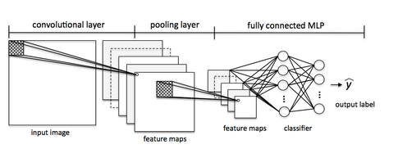
Progress: Actionable Information to reconstruct attosecond pulses
SLAC NeuralNet Library (SNL) framework enables deployment of AI inference in FPGAs
Developed a structured AI inference library in High-Level Synthesis which enables high rate data processing & low latency feedback by deploying AI inference in FPGAs.
Target AI networks with 10+ layers
Implement CookieNet feature extraction to reconstruct time-energy distribution of an attosecond FEL pulse in real-time (at 1 MHz) in FPGA to reduce 100 GB/s →1 GB/s
Support rapid deployment of weights and biases → networks to adapt to changing experimental conditions
Feature extraction followed by classification
Deployment will consist of PCIE based FPGAs in rack mount servers
2022 LDAC - Data Systems
This material is based upon work supported by the U.S. Department of Energy, Office of Science, Office of Basic Energy Sciences under Award Number FWP-100643 and FWP-35896.

