Slide 1
Experimental Physics Software and Computing Infrastructure
Streaming Readout and Remote Compute
David Lawrence
Thomas Jefferson National Accelerator Facility
Notes:
This talk is scheduled for 30+6 minutes
https://meetings.aps.org/Meeting/APR23/Session/C15

Slide 2
Triggered Data Acquisition
hit rate of det. A is proportional to Luminosity
A
storage
Network bandwidth and storage will limit how high you can go in luminosity

Slide 3
Triggered Data Acquisition
hit rate of det. A is proportional to Luminosity
A
B
C

Slide 4
Triggered Data Acquisition
hit rate of det. A is proportional to Luminosity
correlated
accidental
A
&&
B
trigger
C

Slide 5
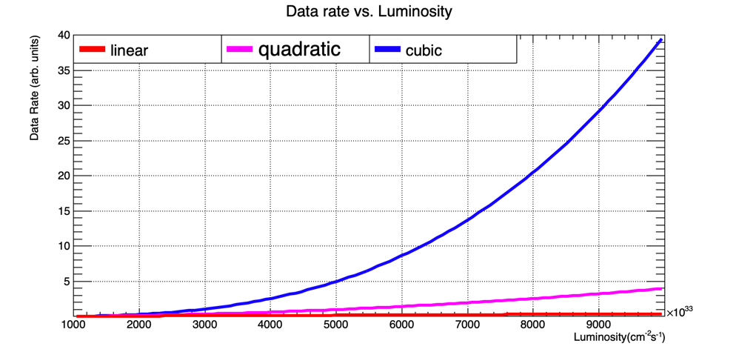
Triggered Data Acquisition
hit rate of det. A is proportional to Luminosity
A
&&
B
trigger
+
storage
C
Data rate is proportional to hit AND trigger rates

Slide 6
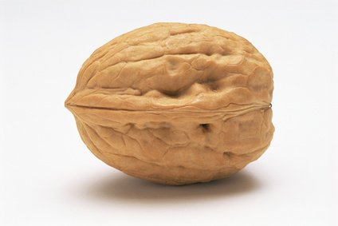
What is Streaming Readout?
In a nutshell:
Continuously read whole detector and filter hits based on holistic view
Continuously calibrate data in (near) real time
Reconstruct data in (near) real time
Traditional Triggered DAQ System
Front End Electronics
Limited to portion of detector for readout decisions
Trigger Bias
Custom trigger hardware needed
backpressure
Detector
STORAGE
Trigger System
Streaming Readout DAQ System
filter
Front End Electronics
Full detector available
Seamless connection with “offline”
Reduced time-to-analysis
Detector
CPU
GPU
FPGA
calibration
recon
STORAGE

Slide 7
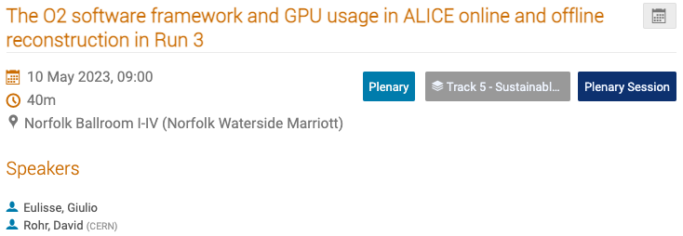
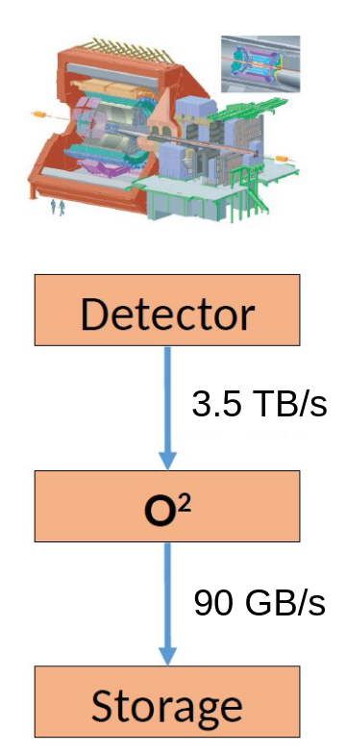
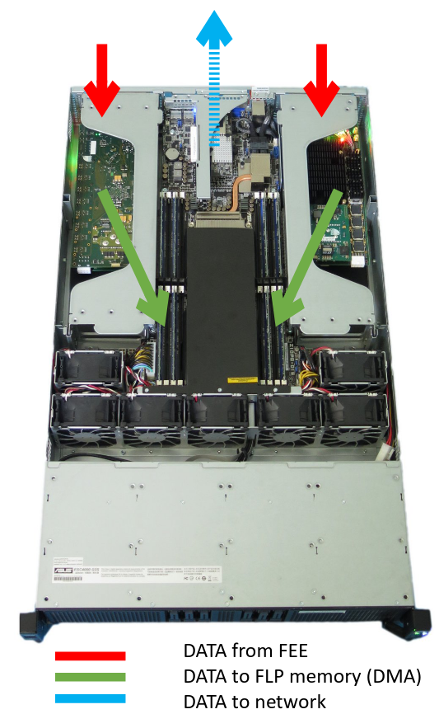
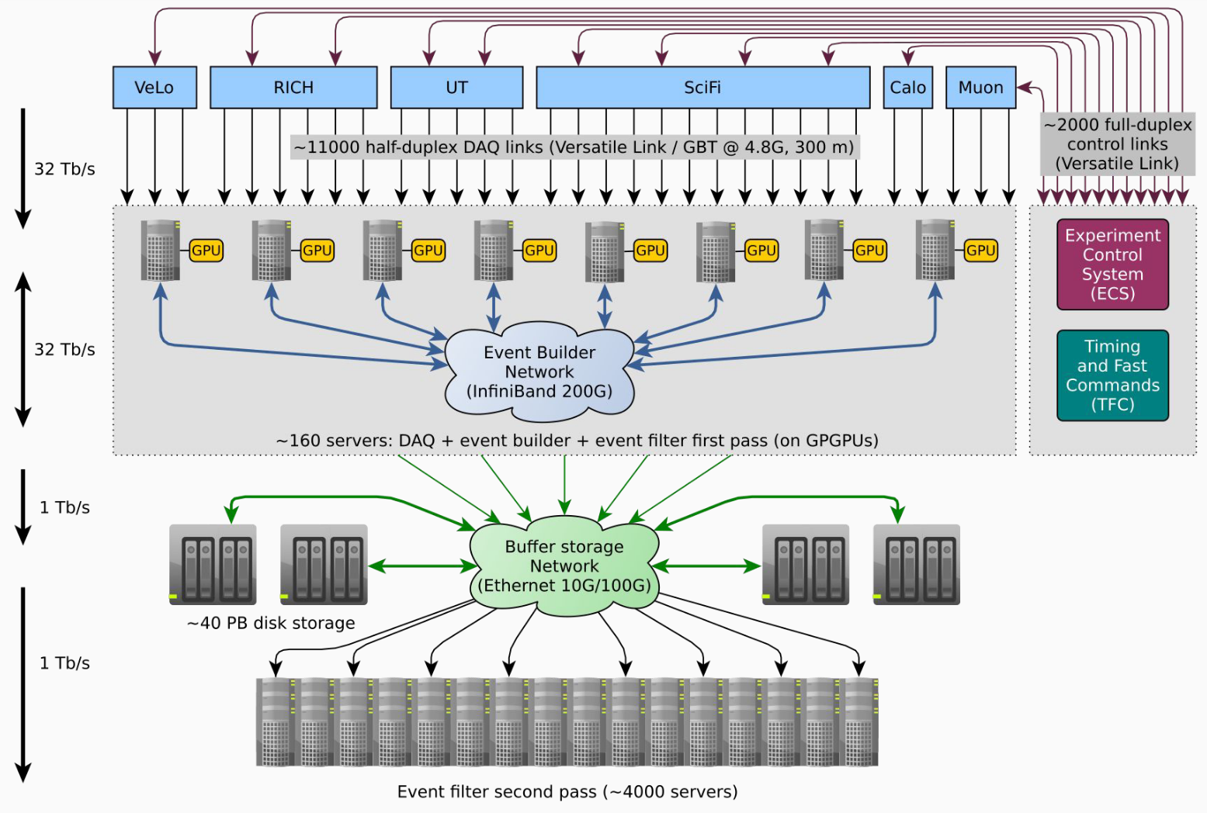
Streaming systems in production
LHCb Allen
ALICE O² (= online + offline)
https://allen-doc.docs.cern.ch/index.html
From talk by Aristeidis Fkiaras @ Workshop IX on Streaming Readout Dec. 2021
https://indico.phy.ornl.gov/event/112/contributions/479/attachments/489/1337/LHCb__Trigger-less_Readout_at_40Mhz_1.pdf
From talk by Sylvain Chapeland @ The 2022 International Workshop on the High Energy Circular Electron Positron Collider
https://indico.ihep.ac.cn/event/17020/contributions/119139/attachments/64254/75019/20221027_ihep_daq_v02.pdf
Notes:
ALICE: O2 reduces data in 2 steps: The FLP (First Level Processors) reduces by factor of ~5.5. The EPN(Event Processing Nodes) reduces by a factor of ~7.
LHCb CHEP Talks:
https://indico.jlab.org/event/459/contributions/11394/
https://indico.jlab.org/event/459/contributions/11817/
ALICE CHEP Talks (too many to list):
https://indico.jlab.org/event/459/contributions/12432/
https://indico.jlab.org/event/459/contributions/11299/

Slide 8
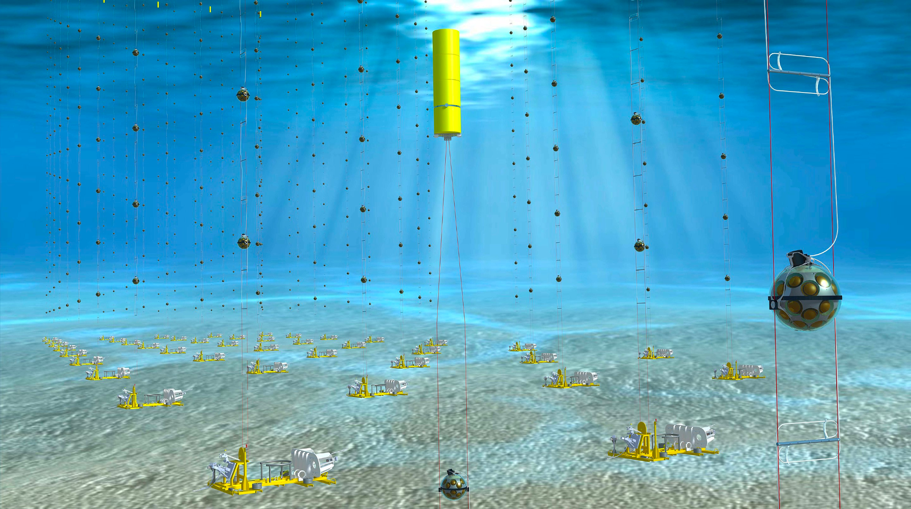
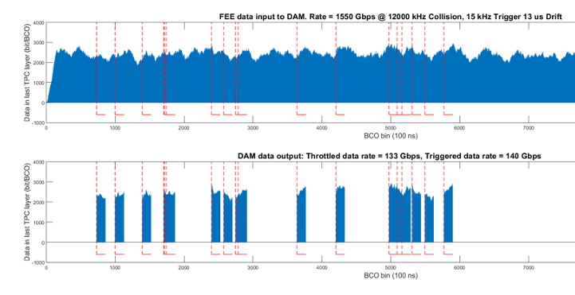
More Streaming DAQ Systems
TriDAS (Trigger and Data Acquisition System)
https://inspirehep.net/files/26390da0ea937dddc80fbabde70c07ab
KM3NeT = Cubic Kilometre Neutrino Telescope “all-data-to-shore” concept
Hybrid triggered and streaming
@BNL
1.5Tbps read from front end into
compute hosted FPGA (DAM) boards
40Gbps avg.
120Gbps max.
additional 20Gbps for acoustic stream
Times corresponding to trigger are sent to storage
Additional opportunistic events identified in stream are saved
wikipedia: https://en.wikipedia.org/wiki/KM3NeT
Streaming Readout for Next Generation Electron Scattering Experiments
https://link.springer.com/article/10.1140/epjp/s13360-022-03146-z
Notes:
TriDAS and sPHENIX
From TriDAS paper, bottom of section3: https://inspirehep.net/files/26390da0ea937dddc80fbabde70c07ab - Total bandwidth is ~120Gbps
KM3Net is deployed in the Mediterranean Sea.

Slide 9
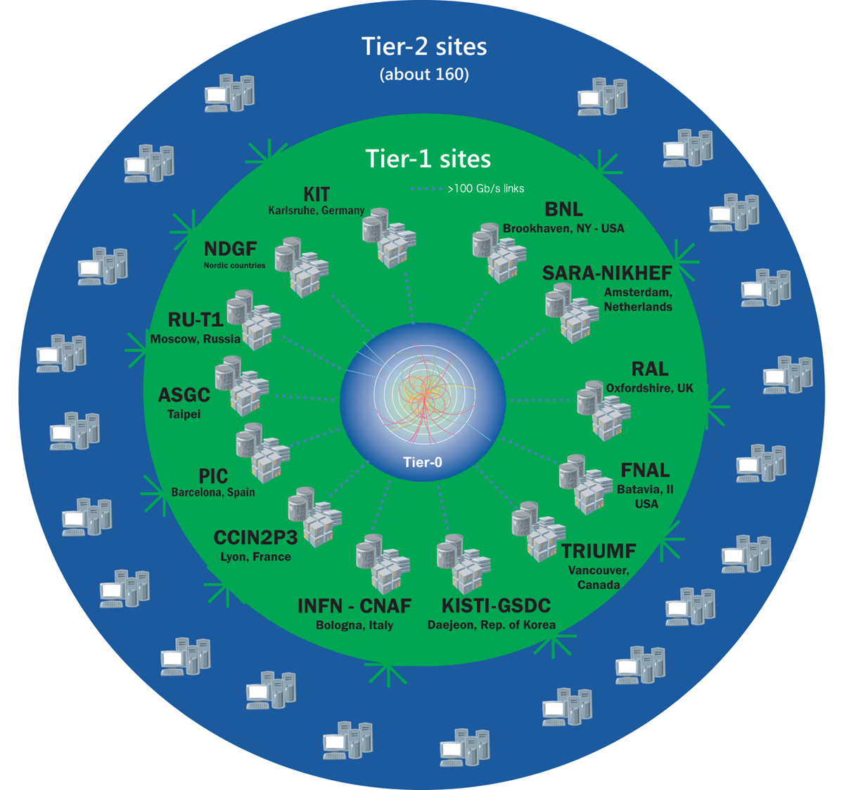
Worldwide LHC Computing Grid (WLCG)
Tier 0 - LHC
Store all raw data
20% of LHC computing
Initial reconstruction
Distribute raw data and initial recon to all Tier 1 sites
Tier 1 - multiple sites(13)
Store subsets of raw data
Compute for large scale reprocessing
Distribute data to Tier 2 sites
Store simulated data from Tier 2 sites
https://wlcg-public.web.cern.ch/tiers
Notes:
Image pulled from https://wlcg-public.web.cern.ch/tiers on Apr. 25, 2023

Slide 10
EIC Butterfly Model
Echelon 0
University
EIC
University
University
University
JLAB
Echelon 1
SDCC
University
University
BATES
University
NERSC
University
OSG
Echelon 3
Echelon 3
ORNL
n.b. Echelon 1-3 exercised during EIC proposals development
Echelon 2
Nearly all storage (raw data, reconstructed data, simulated data) is stored across Echelon 1 sites

Slide 11
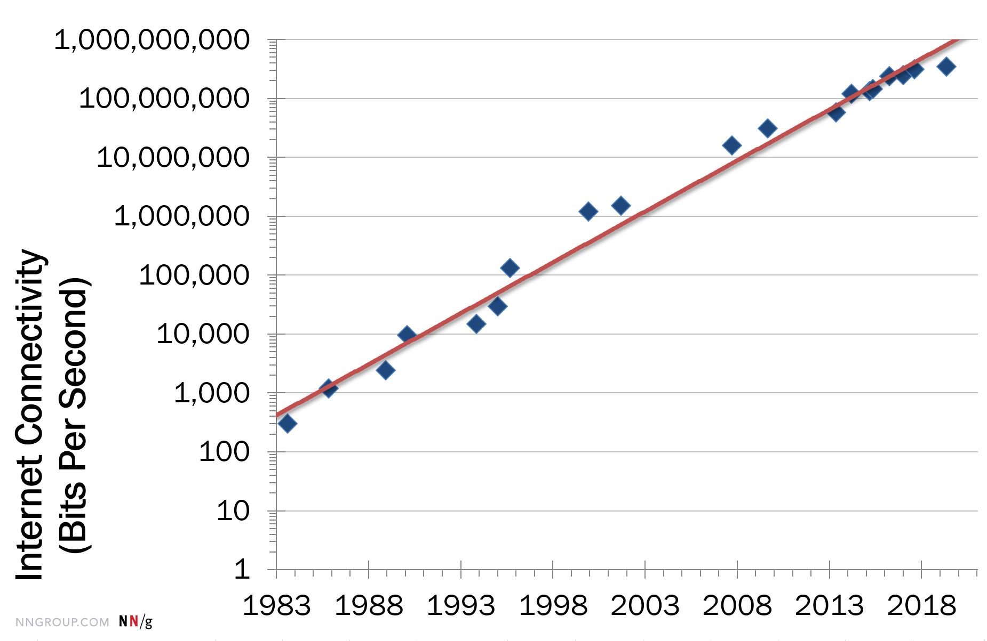
Network bandwidth
Current BNL ESnet bandwidth is 2x200Gbps. If EIC produces 100Gbps, it would take 25% of the total while the experiment is running.
If high-end internet bandwidth grows by roughly 50% per year, then in 10 years, bandwidth should grow by a factor of ~1.5¹⁰ = 58
(i.e. marketplace should provide required technology)
https://www.nngroup.com/articles/law-of-bandwidth/#:~:text=Nielsen's%20law%20of%20internet%20bandwidth%20states%3A,grows%20by%2050%25%20per%20year
Nielsen’s law of internet bandwidth:
~50% per year (high end)
Thus, if the BNL bandwidth grows at a rate consistent with Nielsen’s Law, a 100Gbps experiment would use less than 0.5% of the total offsite bandwidth.
A 1Tbps data stream would use ~5% of the total offsite bandwidth.
Network upgrades must be motivated by requirements.
They tend to happen in big steps, not continuously.
Major network upgrades require planning with long lead times.
nota bene!
Notes:
50%/year means (1.5)^1.5 = 1.83 growth every 18 months. Slightly lower than Moore’s law of ~2 every 18 months.

Slide 12
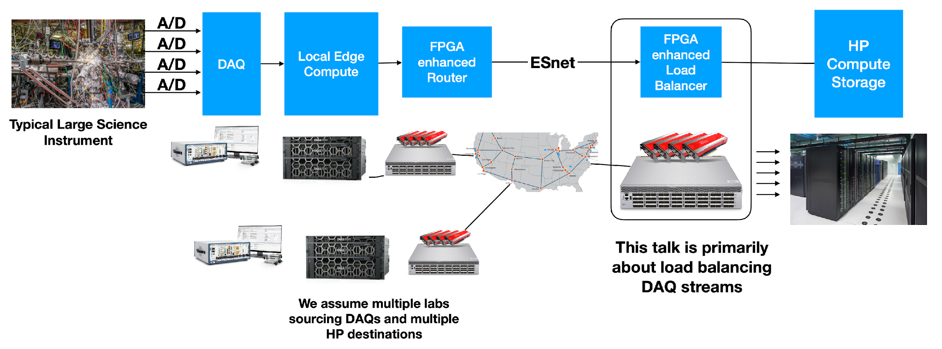
EJFAT = ESnet/JLab FPGA Accelerated Transport
Loss-less UDP Streaming
Opportunistic FPGA Based Network Acceleration
FPGA
Enhanced
NICs
(LB)
Indirection to Large
Compute Resource
Geographic / Network Independence
AI/ML Directed Dynamic Compute Resource Load Balancing
slide courtesy of Michael Goodrich

Slide 13
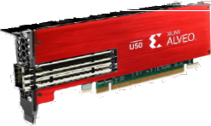
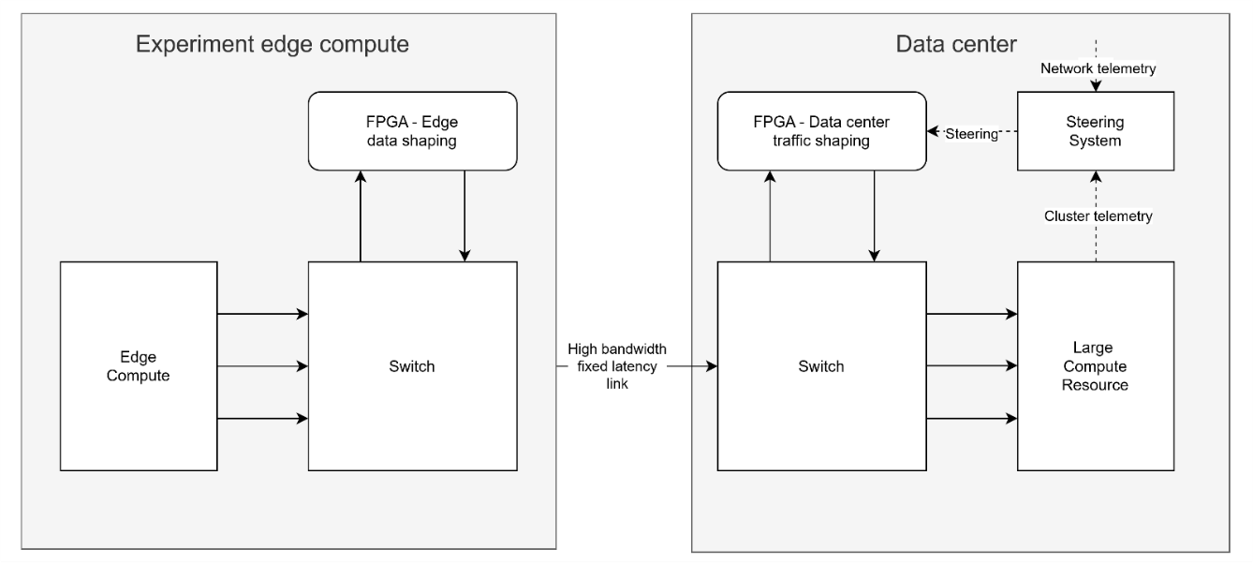
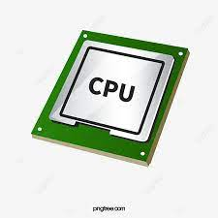
EJFAT
Channel Aggregation + Three Tier Horizontal Scaling
Colors → Events
Shapes → Channels (ROCs)
Load Balancer
μSec
Tier 2: Channel Distribution
Across CPUs
(Fixed)
Event Sequence
Event Sequence
Host₁
Host_{N}
See talk by Michael Goodrich May 11, 2023, 11:15 AM (Track X)
https://indico.jlab.org/event/459/contributions/11804/

Slide 14
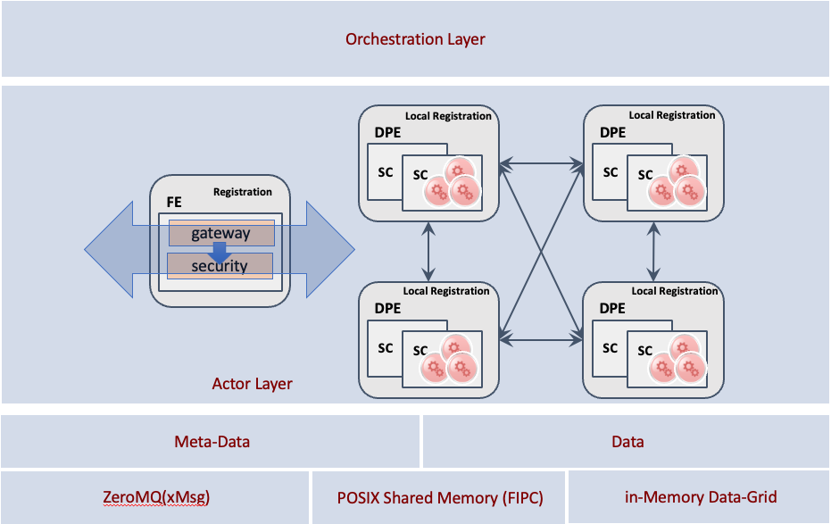
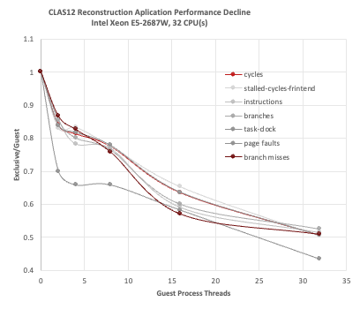
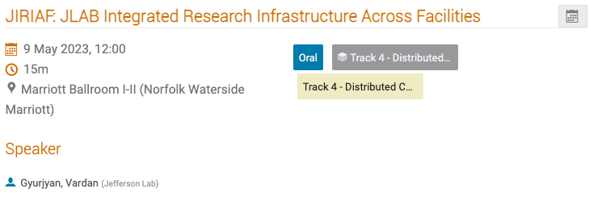
Supporting tools on both sides of EJFAT
ERSAP = Environment for Real-time Streaming, Acquisition and Processing
JIRIAF = JLAB Integrated Research Infrastructure Across Facilities
Mixed-language support (C++, Python, Java, ..)
Workflow Colocation and Interference Detection
ERSAP 3-layer structure
migrate jobs over dynamically from one facility to another
See talk by Vardan Gyurjyan May 11, 3:00 PM (Hampton Roads II )
https://indico.jlab.org/event/459/contributions/11397/
See talk by Vardan Gyurjyan May 9, 12:00 PM
https://indico.jlab.org/event/459/contributions/11501/

Slide 15
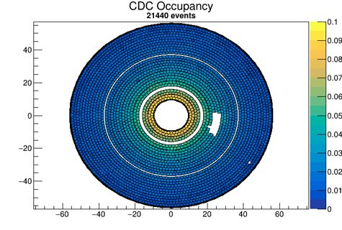
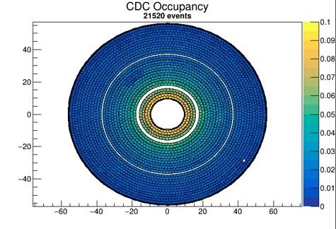
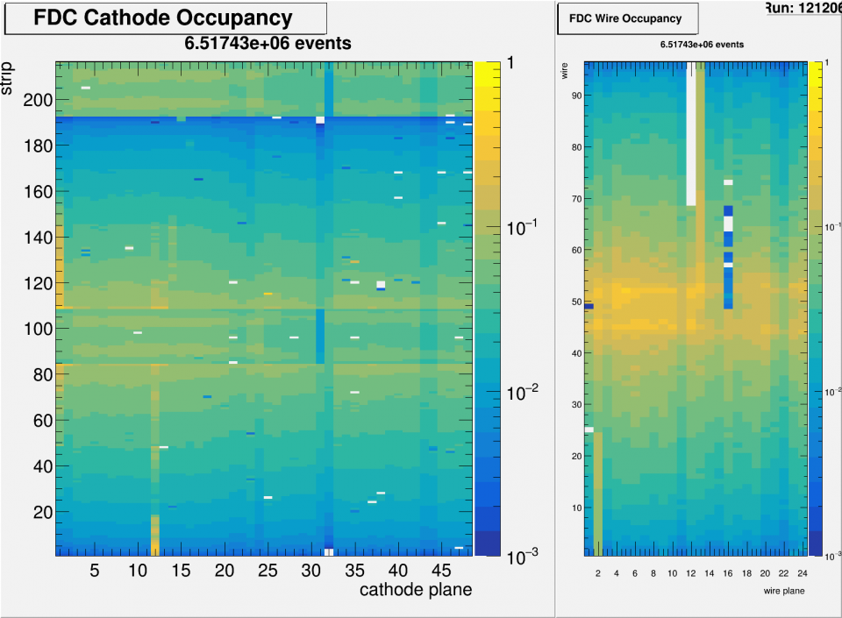
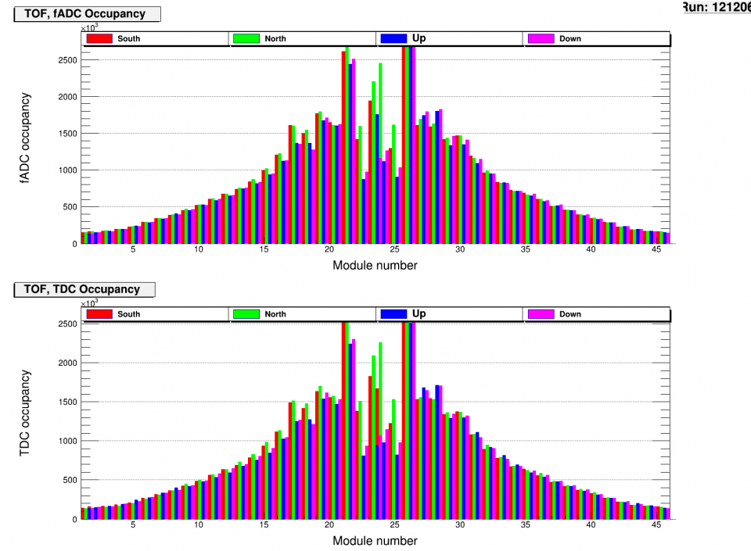
Data Quality Monitoring
Machine Learning Based Anomaly Detection for Online Data Quality Monitoring of the
CMS Electromagnetic Calorimeter
Computer Vision for Data Quality Monitoring with Hydra
May 9, 2023, 11:45 AM https://indico.jlab.org/event/459/contributions/11393/
Augment human shift takers with AI monitoring of plots
Use existing image classification models (e.g. Inception-v3)
Each plot has dedicated model with any number of classifications
Gradcam integration
courtesy Kyungmin Park et al.. Shown at April 15, 2023 @ APS April Meeting 2023
see also: http://cds.cern.ch/record/2855338/files/CR2023_020.pdf?version=1
Talk by Torri Jeske May 9, 2023, 11:45 AM Hampton Roads II
https://indico.jlab.org/event/459/contributions/11393/
Notes:
Point to CMS work
Point to Hydra Talk

Slide 16
Summary and Outlook
Streaming Readout is motivated by the need for higher luminosity experiments to explore increasingly rare reactions
Multiple experiments are already using streaming readout in various forms
The line between “online” and “offline” is being blurred
The availability of high bandwidth, high reliability networks will allow for (near) real time utilization of compute resources far from the experiment
A huge compute farm does not necessarily need to be built right next to every experiment!
Multi-architecture compute resources (GPUs, FPGAs, …) are expected to play a large role in the processing of streamed data.
In particular for AI/ML

Slide 17
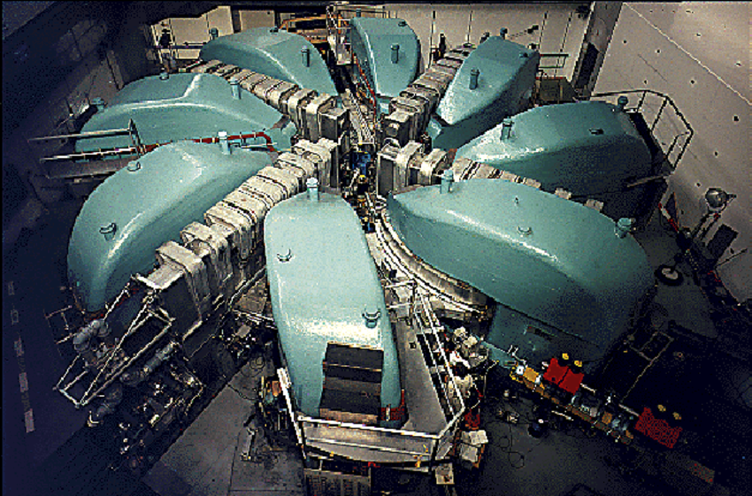
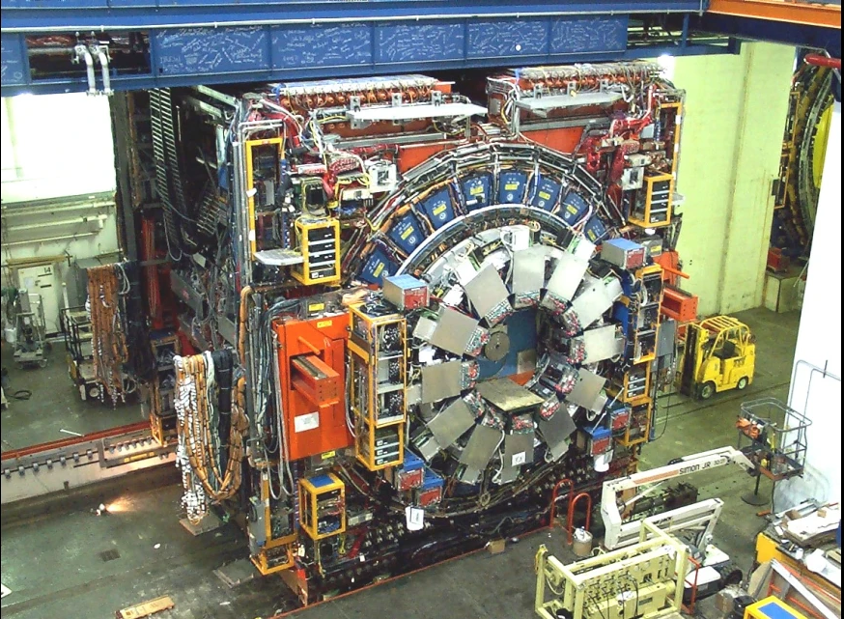
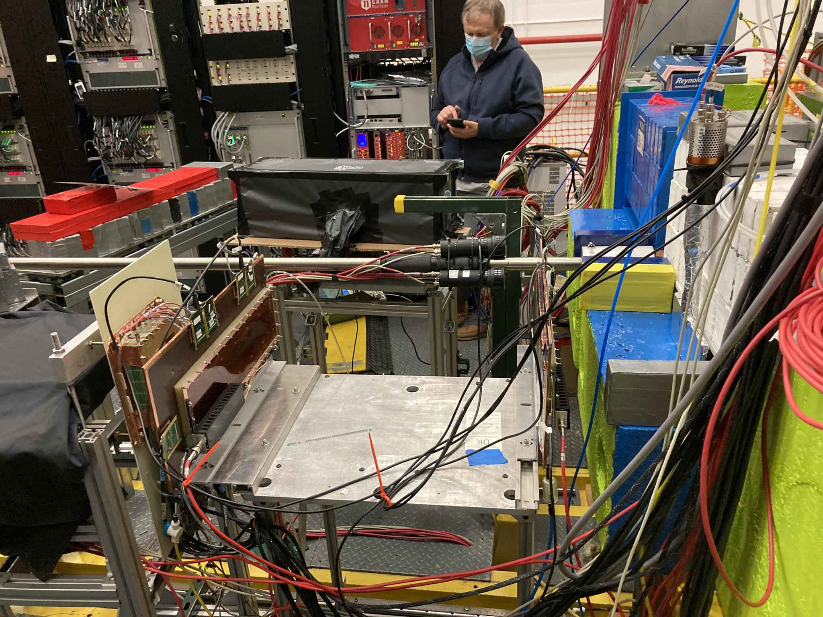
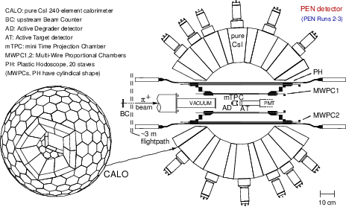
Final Thought
Particle physics experiments cover a wide range of scales
PSI cyclotron
CDF at Fermilab. https://bigthink.com/starts-with-a-bang/hole-in-the-standard-model/
recent small-scale detector tests at Jefferson Lab
pi-beta detector http://cds.cern.ch/record/2824583
They are all technically difficult because the resources available generally match the scale
It can be just as difficult to scale a large system down to a small budget as a small system up to a large scale
Notes:
Relay fermilab experience w/ CAMAC

Slide 18
Backups

Slide 19
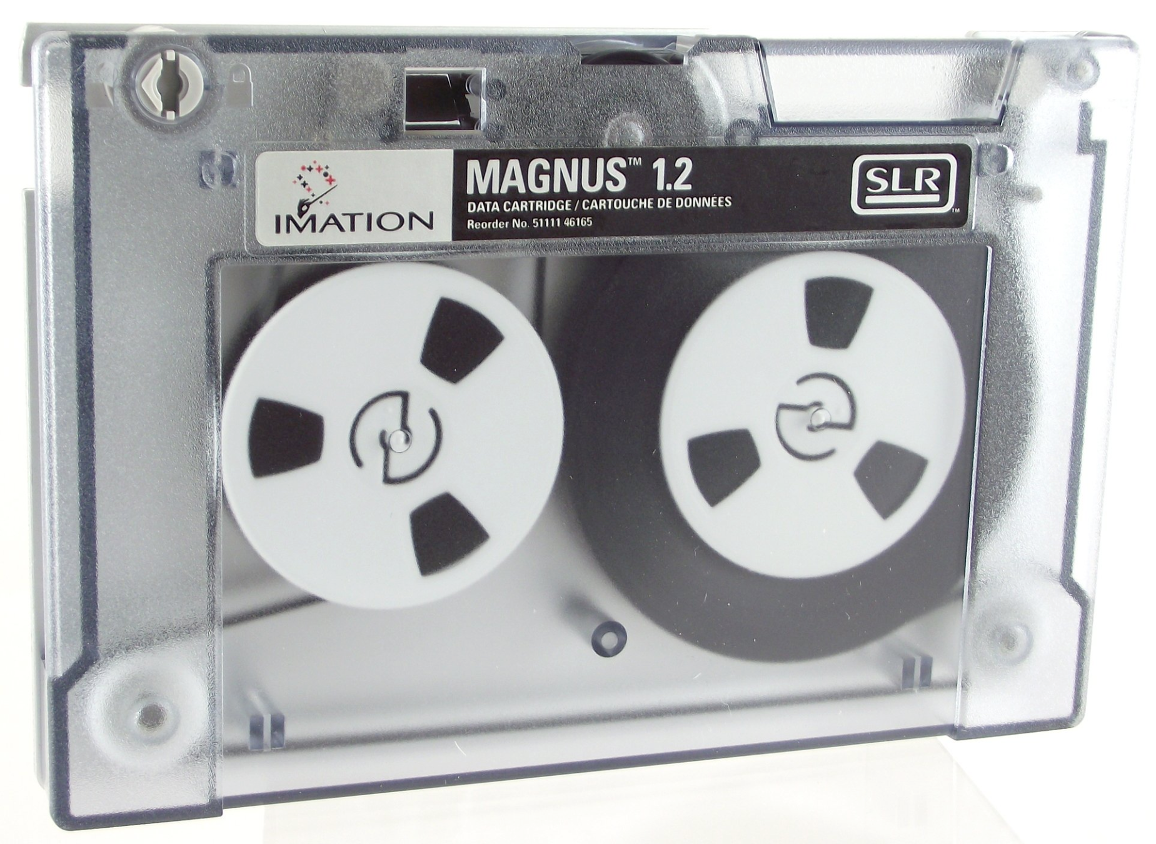
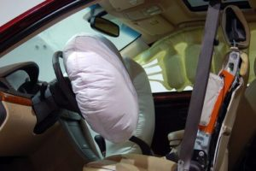
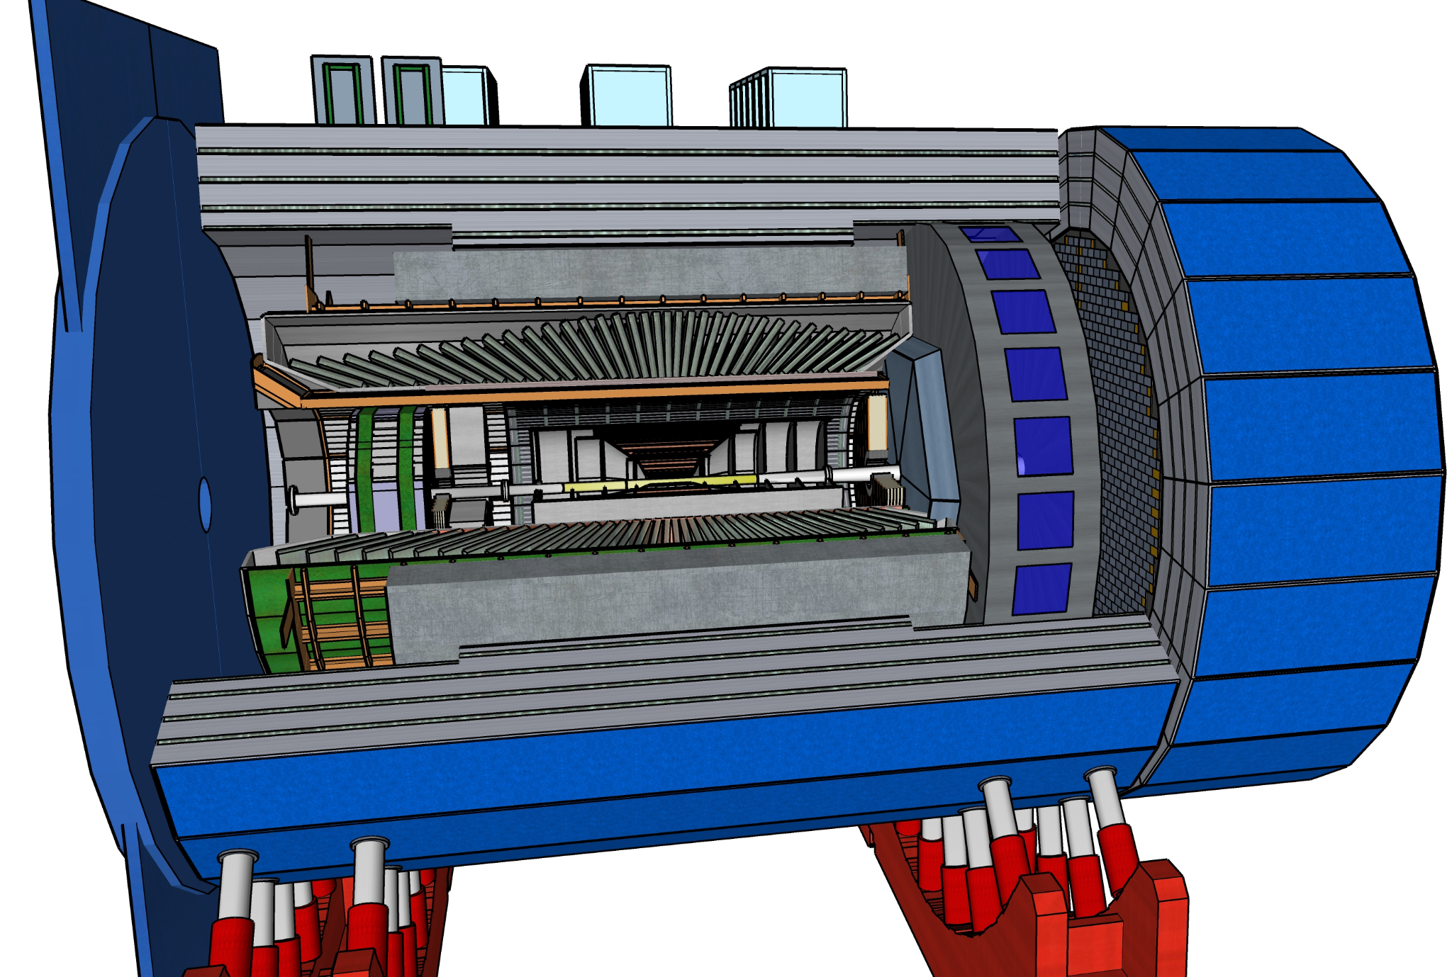
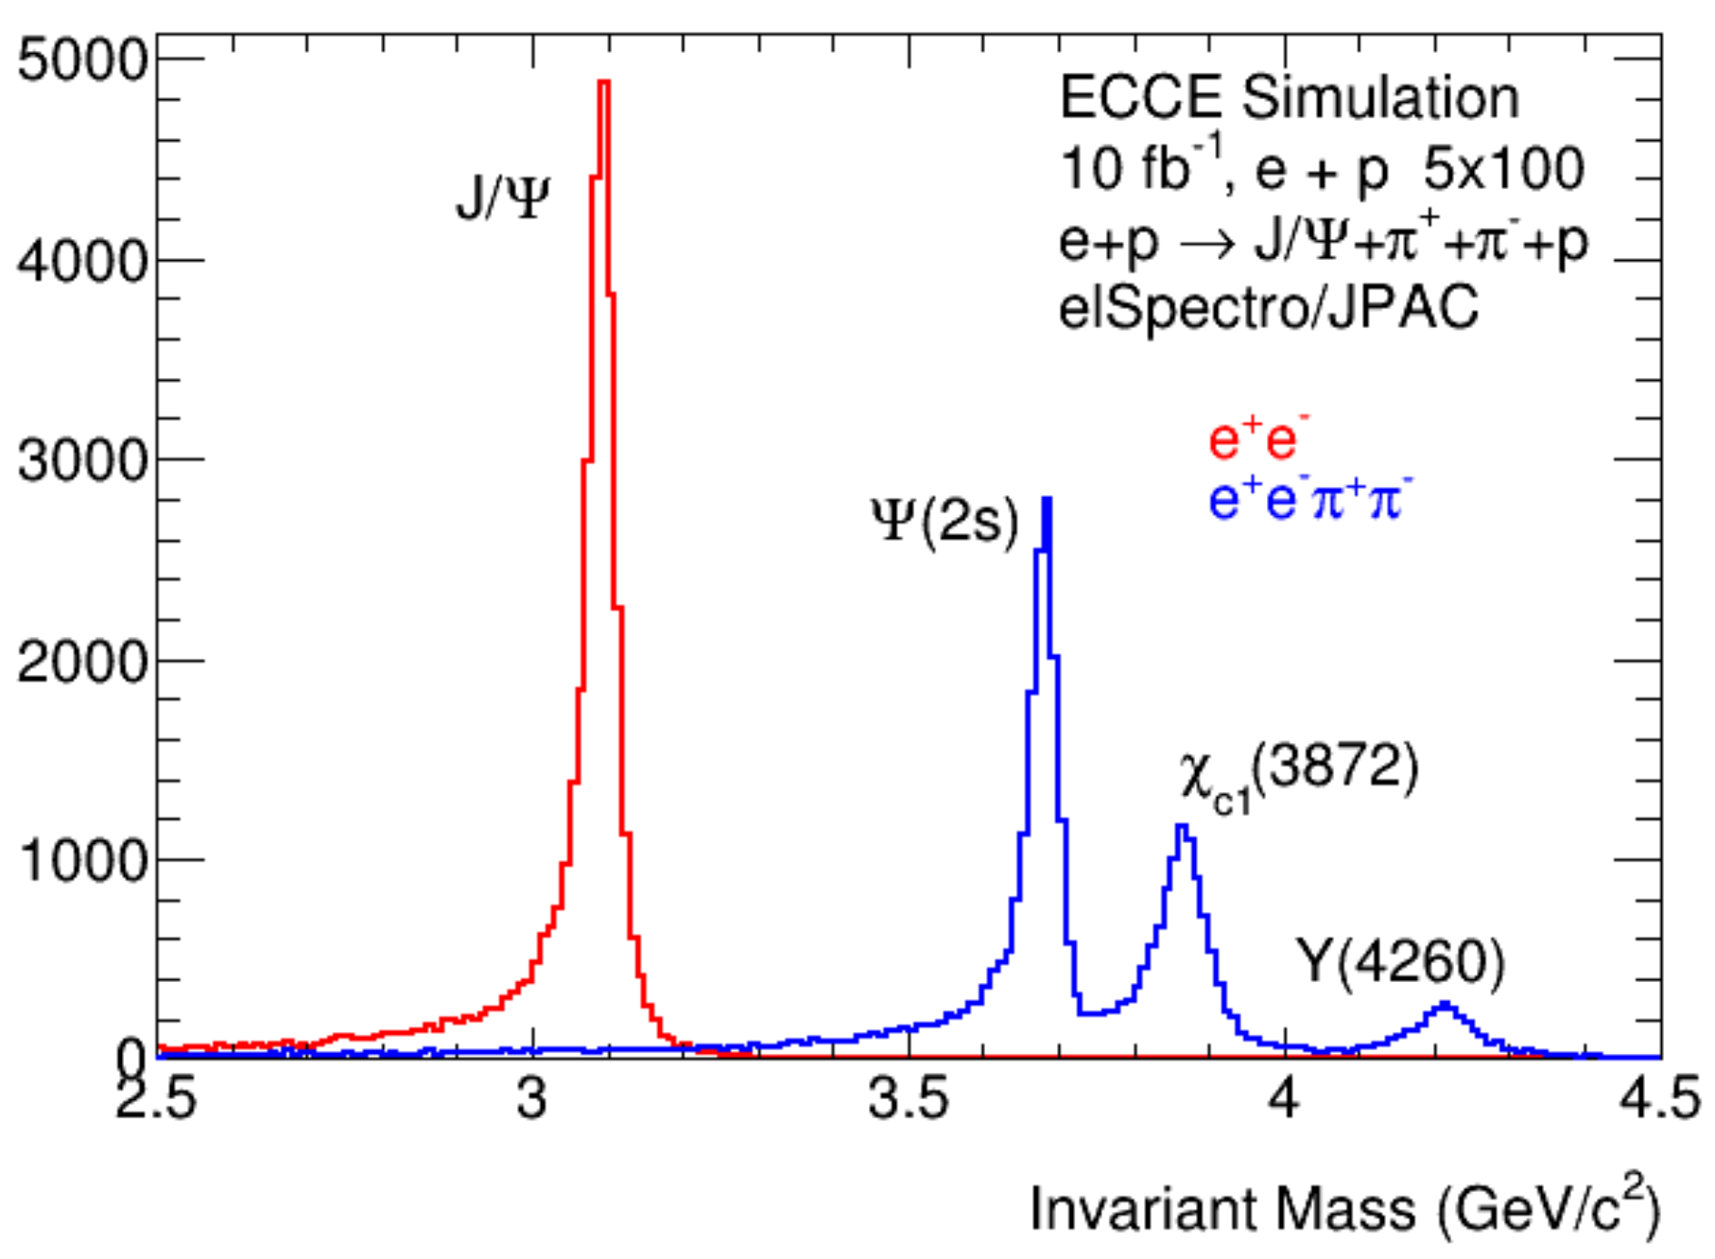
EIC Computing: Online to Offline Stream
reduce ~x2
mitigate risk of network failure
FEE = Front End Electronics
DAM = Data Aggregation Module
EBDC = Event Buffer / Data Compressor
O(100Tbps)
O(10Tbps)
O(1Tbps)
O(0.1Tbps)
Calibration
Offline Buffer
recon
storage
Reconstruction
Detector
FEE (digitization)
~3 weeks
DAM / EBDC
FEP (zero suppression)
Online Data Filter
CPU, FPGA, GPU
Online Buffer
“Buffer Box” (few days)
Offline Data Filter
raw
storage
Multiple Sites
air bag
=
Raw data will be written to tape as a safety mechanism. We hope to never need to read it!
in project
out of project
DAQ, buffering, filtering, calibration, reconstruction, analysis

Slide 20
AI/ML Use in Streaming Systems
Notes:
Look to Jin’s talk.
ML4FPGA?

Slide 21
PHASM
Notes:
Point to Cissie Poster

Slide 22
Abstract
Streaming Readout Data Acquisition systems coupled with distributed resources spread over vast geographic distances present new challenges to the next generation of experiments. High bandwidth modern network connectivity opens the possibility to utilize large, general-use, HTC systems that are not necessarily located close to the experiment. Near real-time response rates and workflow colocation can provide high reliability solutions to ensure efficient use of beam time. This talk will focus on a few technologies currently being developed at Jefferson Lab and in collaboration with ESnet to support fully streaming DAQ systems.
https://indico.jlab.org/event/459/contributions/11457/
9:40 - 10:05 (20 + 5)

Slide 23
Outline (4/26)
Introduction (4/29)
SRO vs. Triggered (4/29)
SRO Examples
LHCb and Allen (5/1)
ALICE O2 (5/1)
SPHENIX, TriDAS (5/2)
WLCG (4/28)
Butterfly Model (4/28)
Example EIC Streaming system with full calib and recon (4/28)
Bandwidth extrapolation (4/28)
Distributed Computing tools: EJFAT, JIRIAF (5/2)
A.I.
General (5/3)
Surrogate Models (PHASM) (5/3)
DQM: CMS, Hydra (5/4)
Summary (5/5)

