Slide 1
Evolutions and Revolutions in Computing: Science at the Frontier
David J. Dean
Deputy Director
Presented To:
CHEP 2023
May 8, 2023

Slide 2
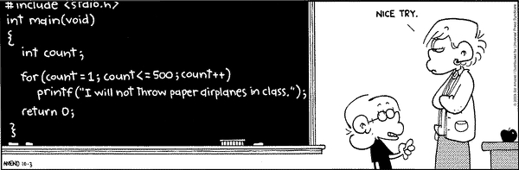
Why do we compute?
Saves time
Solves equations
Analyzes data
Generates science
Performs logistics
Runs Excel
Plays movies
Talks to you (Chat-GPT)

Slide 3
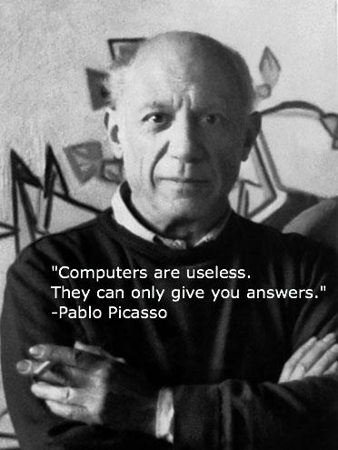
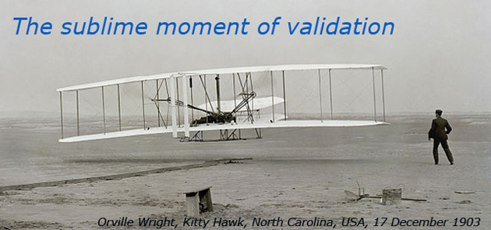
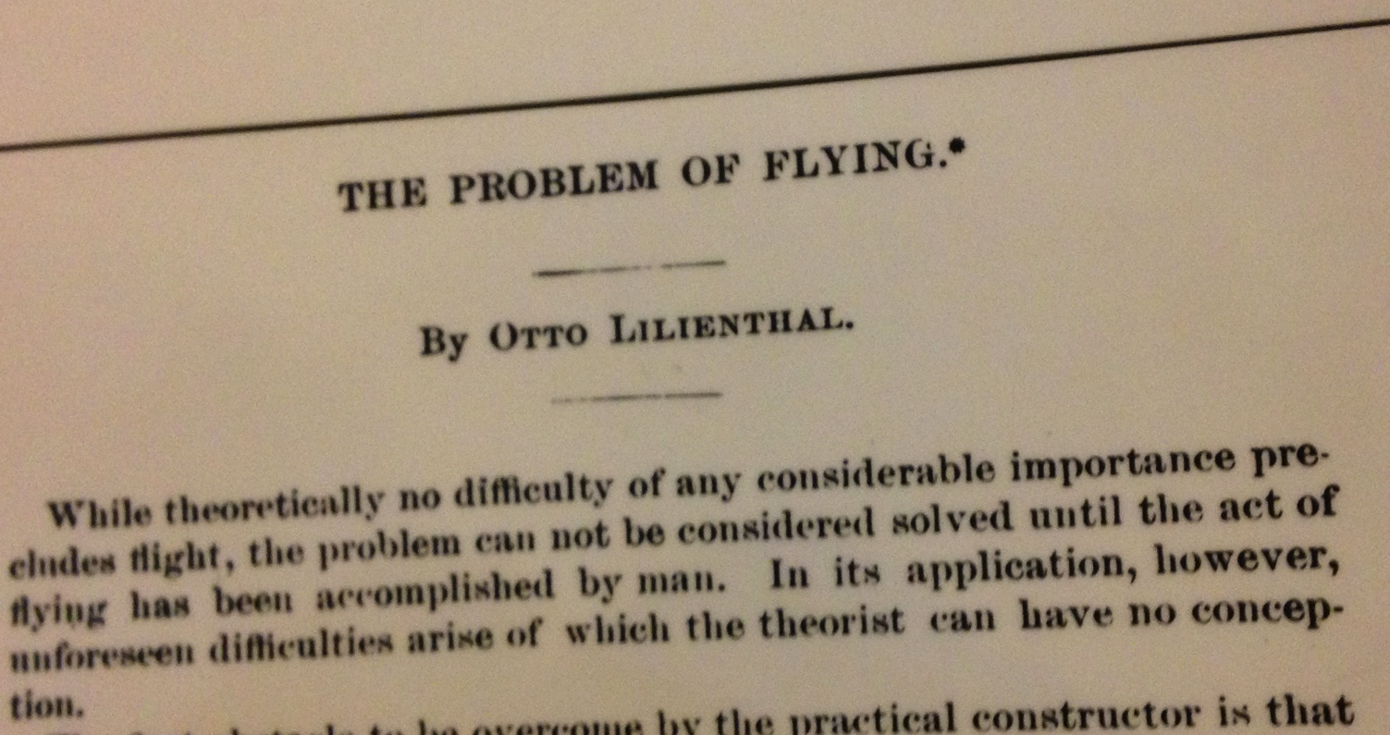
Questions drive science…and lead to discovery tools

Slide 4
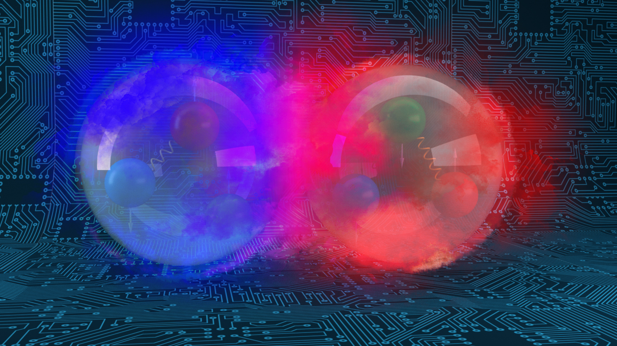
Outline
Computing: reaching maturity, and…
Data: Explosive growth continues
Artificial Intelligence: the new toolset
Impacts on Science

Slide 5
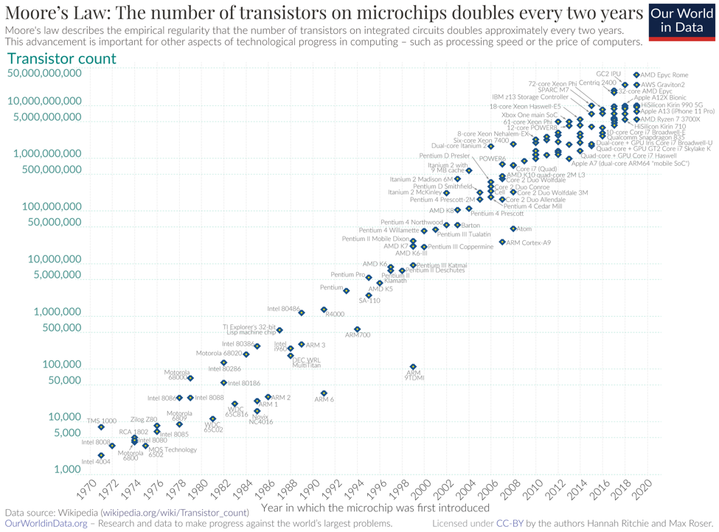
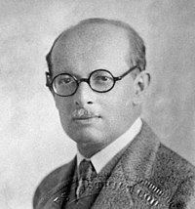
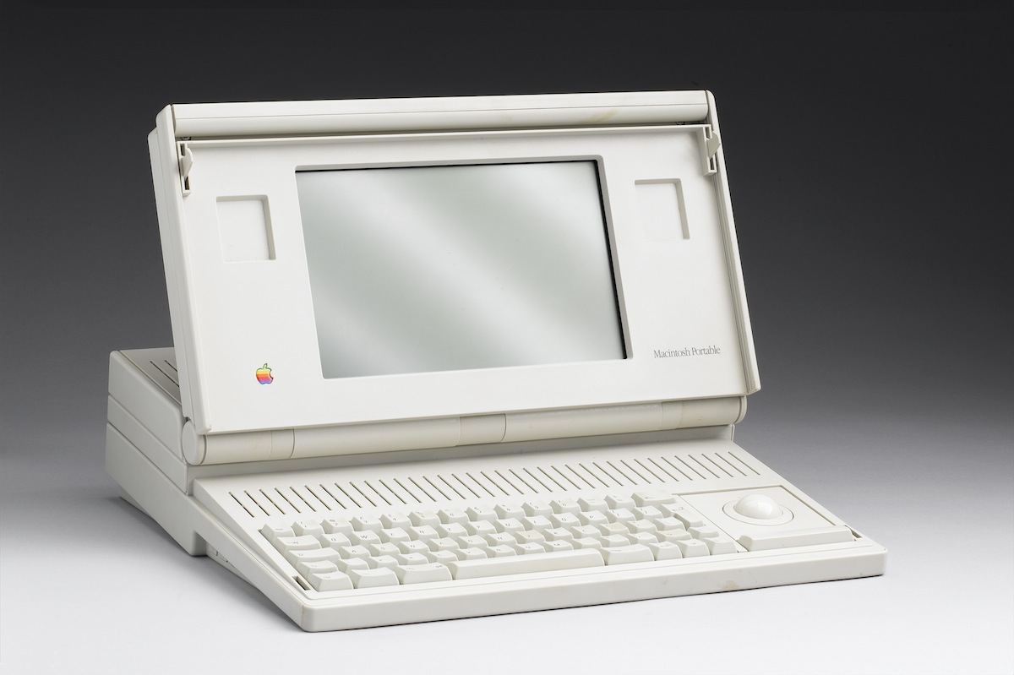
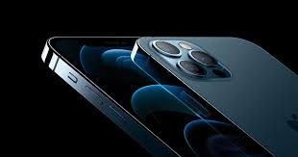

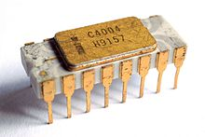
Lillenfeld
Transistor theory
1926
Bell labs
1947
16 MHz
200k transistors
9 MB ram
16 pounds
$15k (today)
Bardeen, Shockley, Brattain
First Si IC
Fairchild
A14, 3.1 GHz 6 core, neural engine; 11.8 billion transistors; 256 GB ram
4.76 ounces; ~$1,000.00
A16: 16 billion transistors; 5 nm; 16 core neural engine
Robert Noyce
1957
2,250 transistors

Slide 6
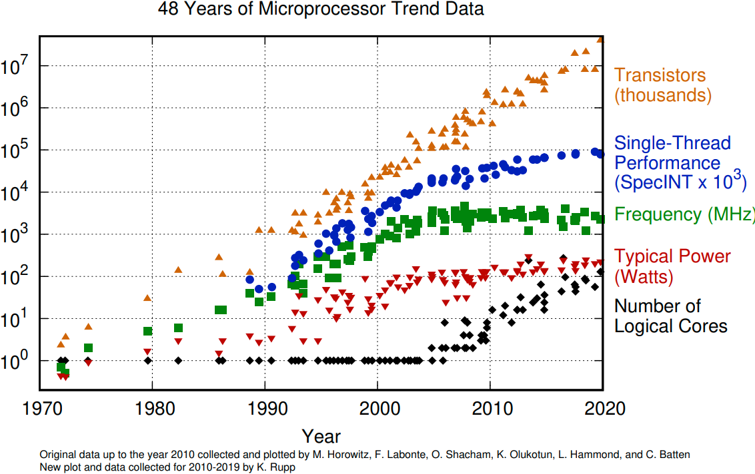
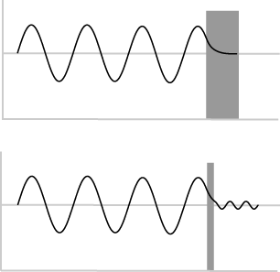
Moore’s Law and other trends
Moore’s Law must end…
free Si diameter is 0.2 nm
Quantum tunneling increasingly hampers transistor density below about 5 nm.
2020: 5nm
2025: 2nm
Dennard Scaling ends in the mid-2000s (as transistors get smaller their power density stays constant…)

Slide 7
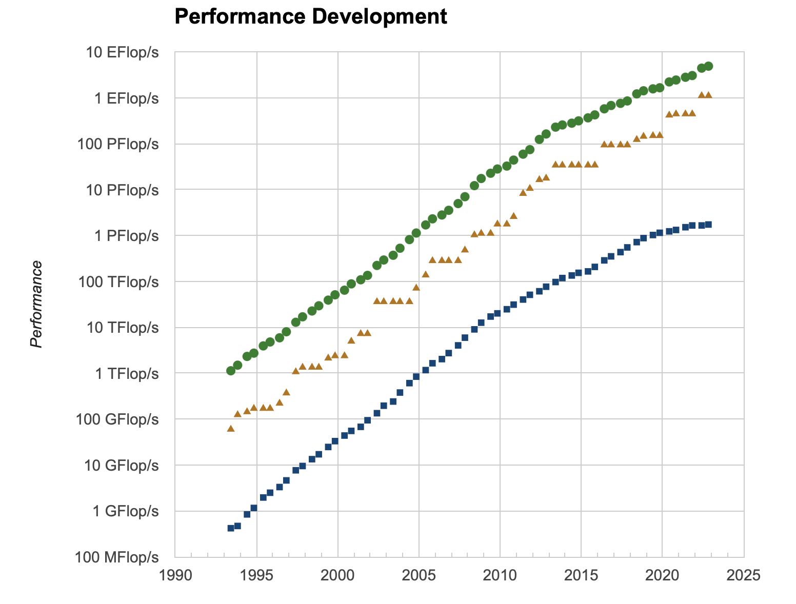
The world’s fastest computers do amazing work
Rank | System | Rmax (PFlop/s) | Power (kW)
1 | Frontier (DOE ORNL) United States | 1,102.00 | 21,100
2 | Fugaku - RIKEN Japan | 442.01 | 29,899
3 | LUMI - HPE Cray Finland | 309.1 | 2,942
4 | Leonardo, Italy | 174.7 | 5,610
5 | Summit (DOE ORNL) United States | 148.60 | 10,096
6 | Sierra - IBM DOE LLNL United States | 94.64 | 7,438
7 | Sunway TaihuLight - China | 93.01 | 15,371
8 | Perlmutter UCB United States | 70.87 | 2,589
9 | Selene NVIDIA Corporation United States | 63.46 | 2,646
10 | Tianhe-2A - China | 61.44 | 18,482
Curves appear to go linear around position 100…
Compute intensive: solving PDEs (requires fast FLOPs)
Most of the execution time goes to floating-point operations

Slide 8
Computer saturation
Systems 100-500 indicate linear increase in capability
The ‘top’ system lifetime is about 5 years
Limits to Top500 analysis
  China no longer submits information
  Workflows on machines are changing with time
Overall interesting article: Reed, Gannon, Dongarra, “Reinventing HPC: Challenges and Opportunities”

Slide 9
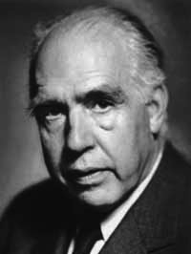

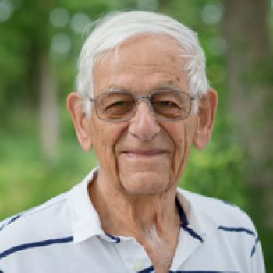
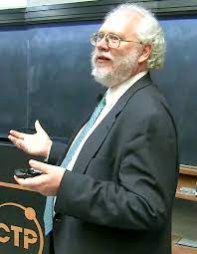
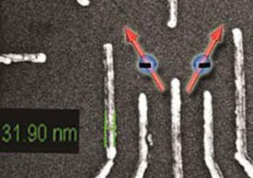
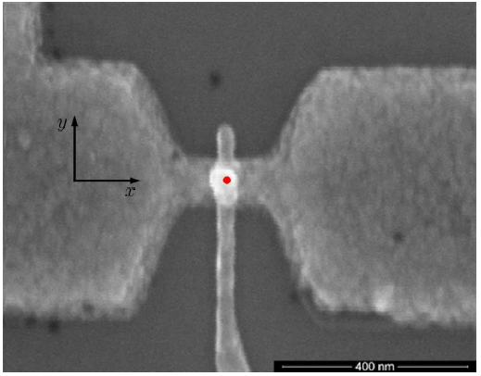
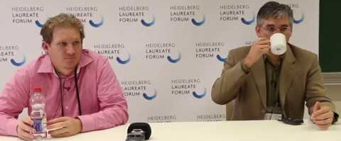
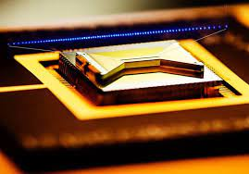
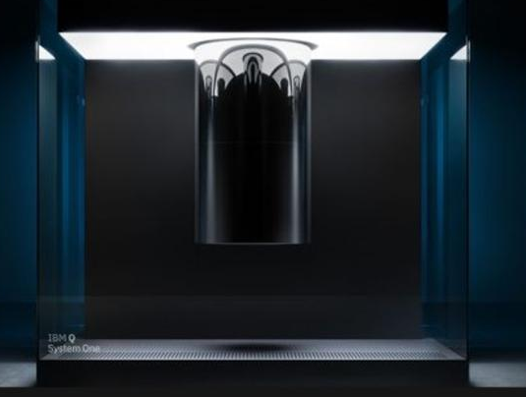
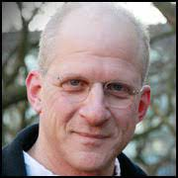
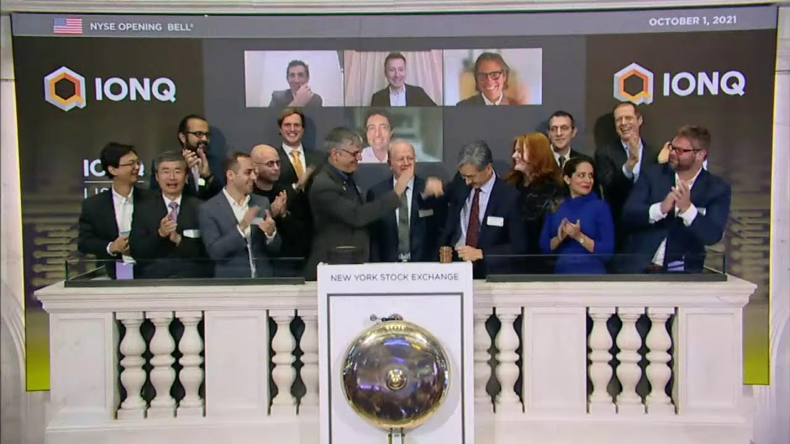
Using Quantum to affect a Revolution
In the sciences
If quantum mechanics hasn’t profoundly shocked you, you haven’t understood it yet. – Niels Bohr
1980s– 1990s
  A curious idea; first quantum algorithms
2000s
  Proof-of-principle demonstrations
  Initial QC hardware
  Error correction and control theory
2010s
  Focus on practicality and improving quality and control
  Circuit synthesis
Si Ge qubits
Julich
Phosphorous donor
Sydney
2015s
  Qubit fragility presents tremendous challenges; first commercial systems
  Attempt to broaden suite of applications
Significant increases in federal funding for R&D…leading to the NQI Act in December 2018, and the establishment of the National Quantum Information Science Research Centers.
Significant development of Noisy Intermediate Scale Quantum Algorithms
Significant development of hardware (IBM, Google, Honeywell, IonQ, ColdQuanta, Rigetti…)

Slide 10
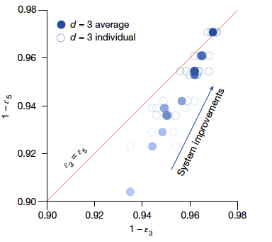
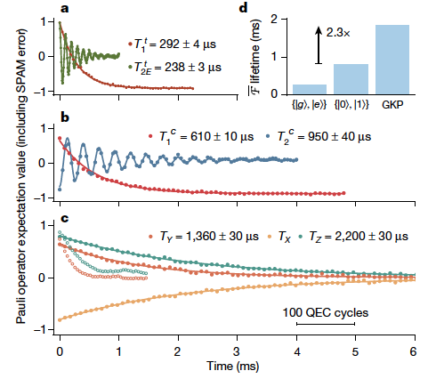
From NISQ to Quantum Error Correction
Google Quantum AI (Acharya et al.), Suppressing quantum errors by scaling a surface code logical qubit, Nature 614 (2023)
Sivak et al., Real-time quantum error correction beyond break even, Nature 616 (2023) G=2.27+/-0.07 [gain beyond natural qubit lifetime]
Experiment: QEC begins to improve performance with increasing qubit number
Component performance must improve by at least 20% to move below threshold, and substantially improve beyond that to achieve practical scaling

Slide 11
Data: explosive growth continues

Slide 12
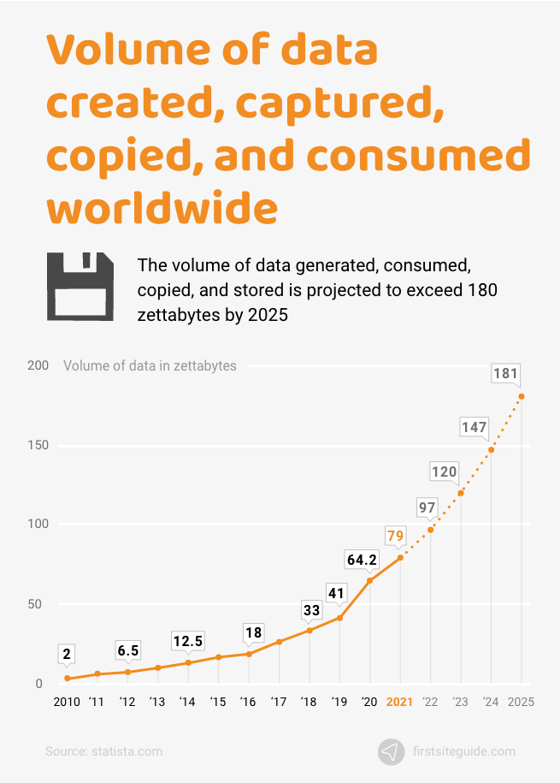
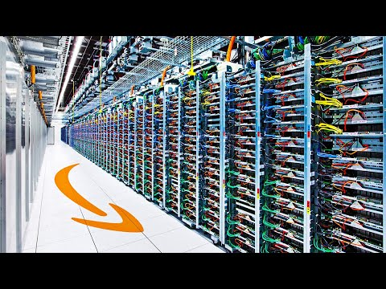
Data movement growth and data storage growth are different
2% of data produced and consumed in 2020 was retained into 2021
2020 installed base of storage capacity: 6.7 zettabytes
Growth anticipated at 19.2% per year (2020-2025)
statista.com

Slide 13
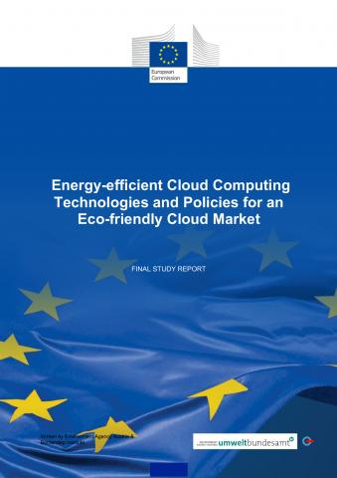
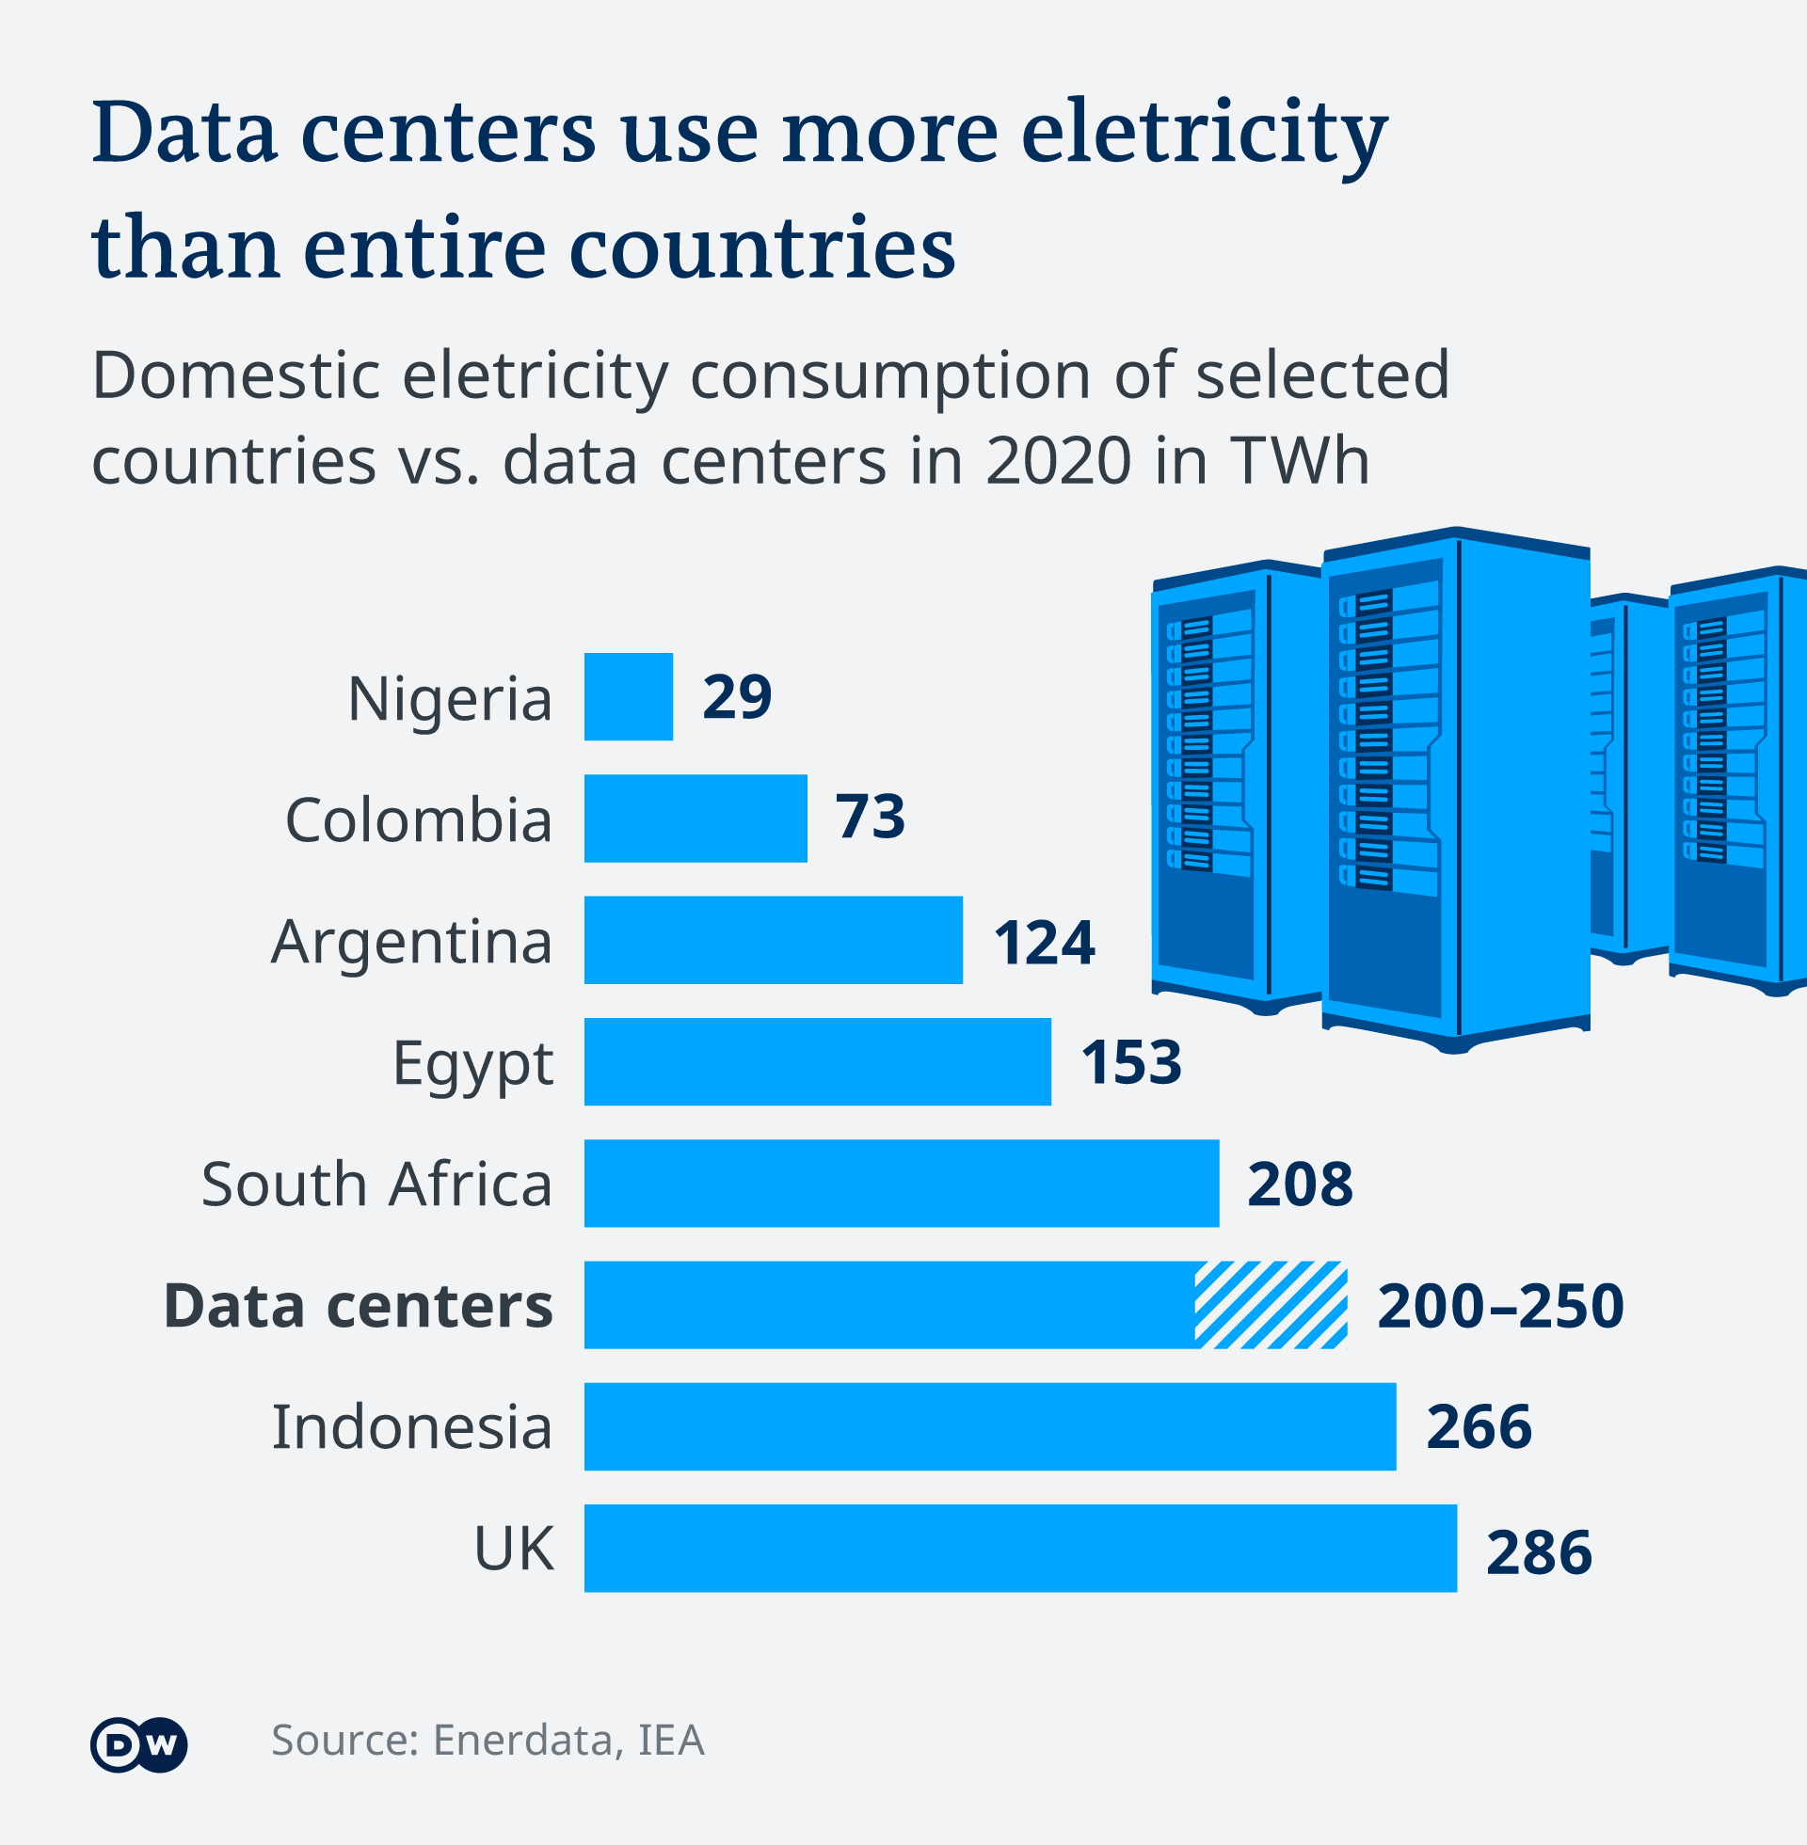
Significant Data Energy Demands
EU 2020 study:
  2018 energy consumption of data centers: 76.8 TWh
  2030 projection: 98 TWh
  2018: 2.7% total electricity → 3.2% in 2030
Estimated world-wide electricity consumption: 1%
5th largest economy
in the world

Slide 14
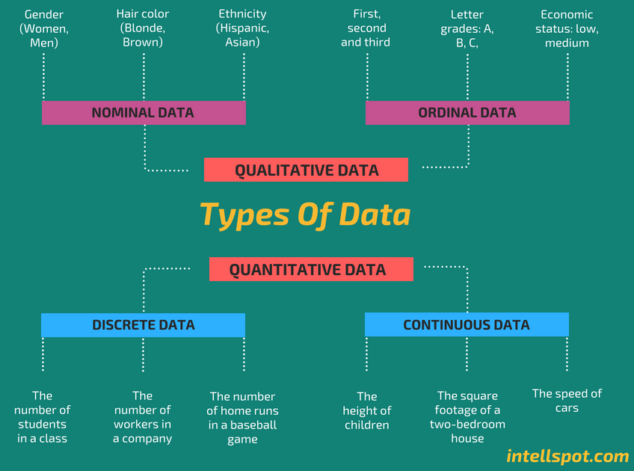
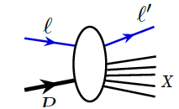
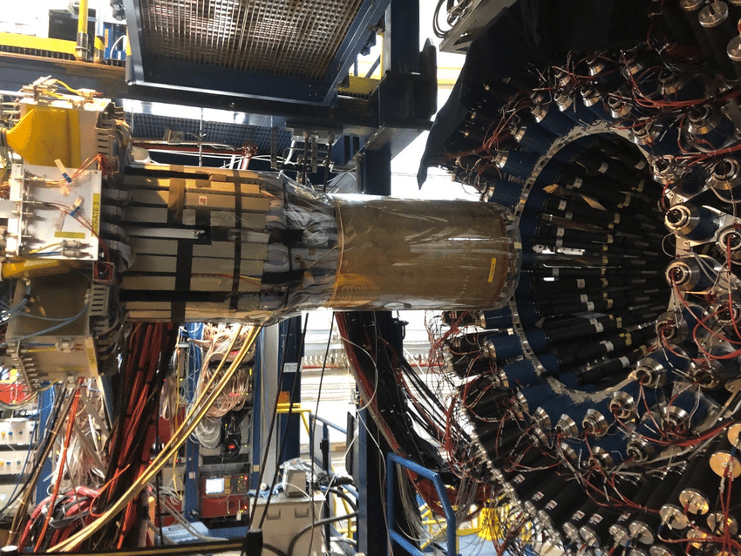
Types of data
Scattering data is more or less discrete (digitized)
It is also similar (splat-on-splat, Venton Cerf)
It is usually not complete

Slide 15
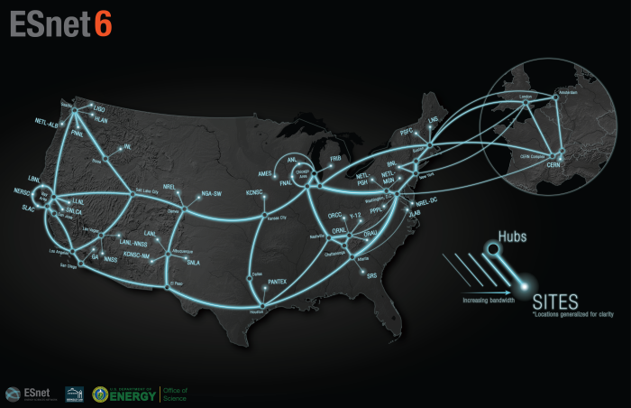
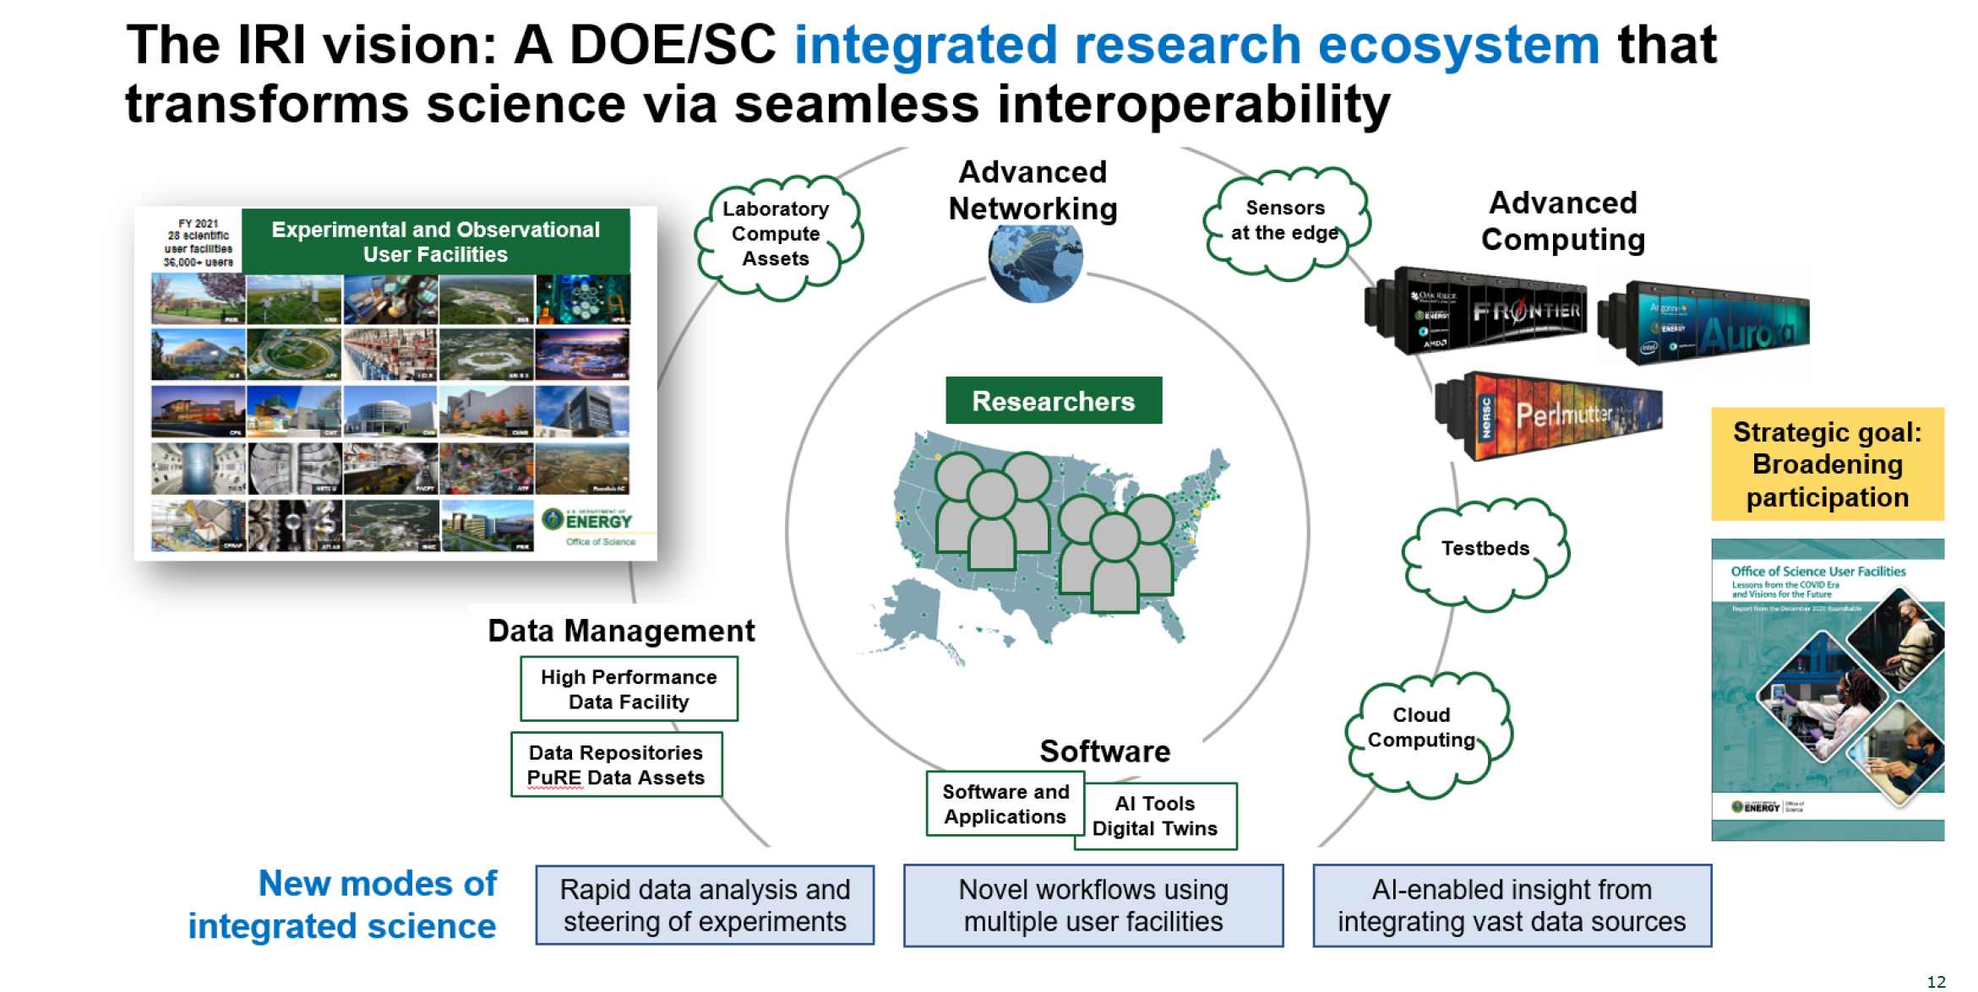
DOE provides a great scientific data network to enable IRI
The next era of DOE labs as an open innovation ecosystem:
Accelerating discovery and innovation
Democratizing access
Drawing new talent
Advancing open science
ESNET annual cost: $80-90M
In 2021, ESNet moved 8.8 exabits of data…
15,000 times faster than a home network
Optimized for the Elephants

Slide 16
Artificial Intelligence: the new toolset

Slide 17
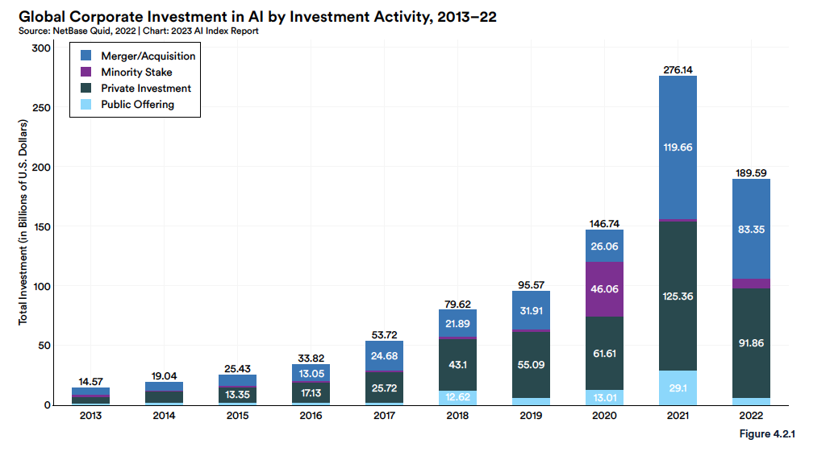
Huge AI investments globally
Increasing computer power means AI/ML runs faster and can help industry…thus industry invests!!
AI Index Report 2023

Slide 18
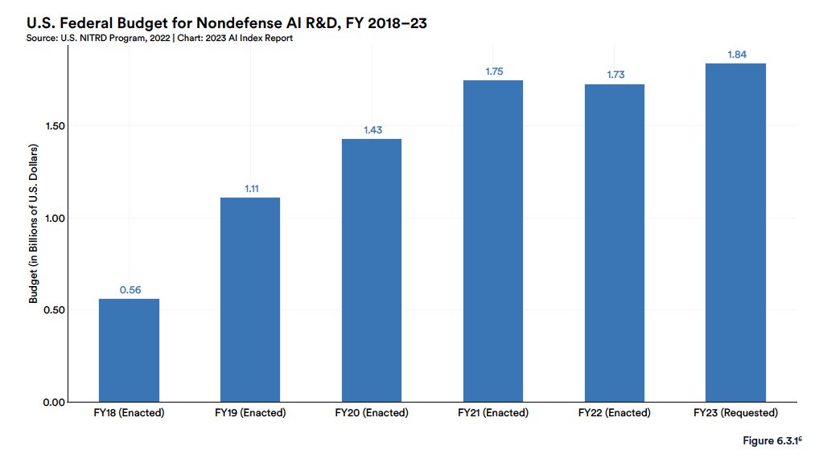
…and in the federal government
DOE SC AI/ML FY23: $165.9M

Slide 19
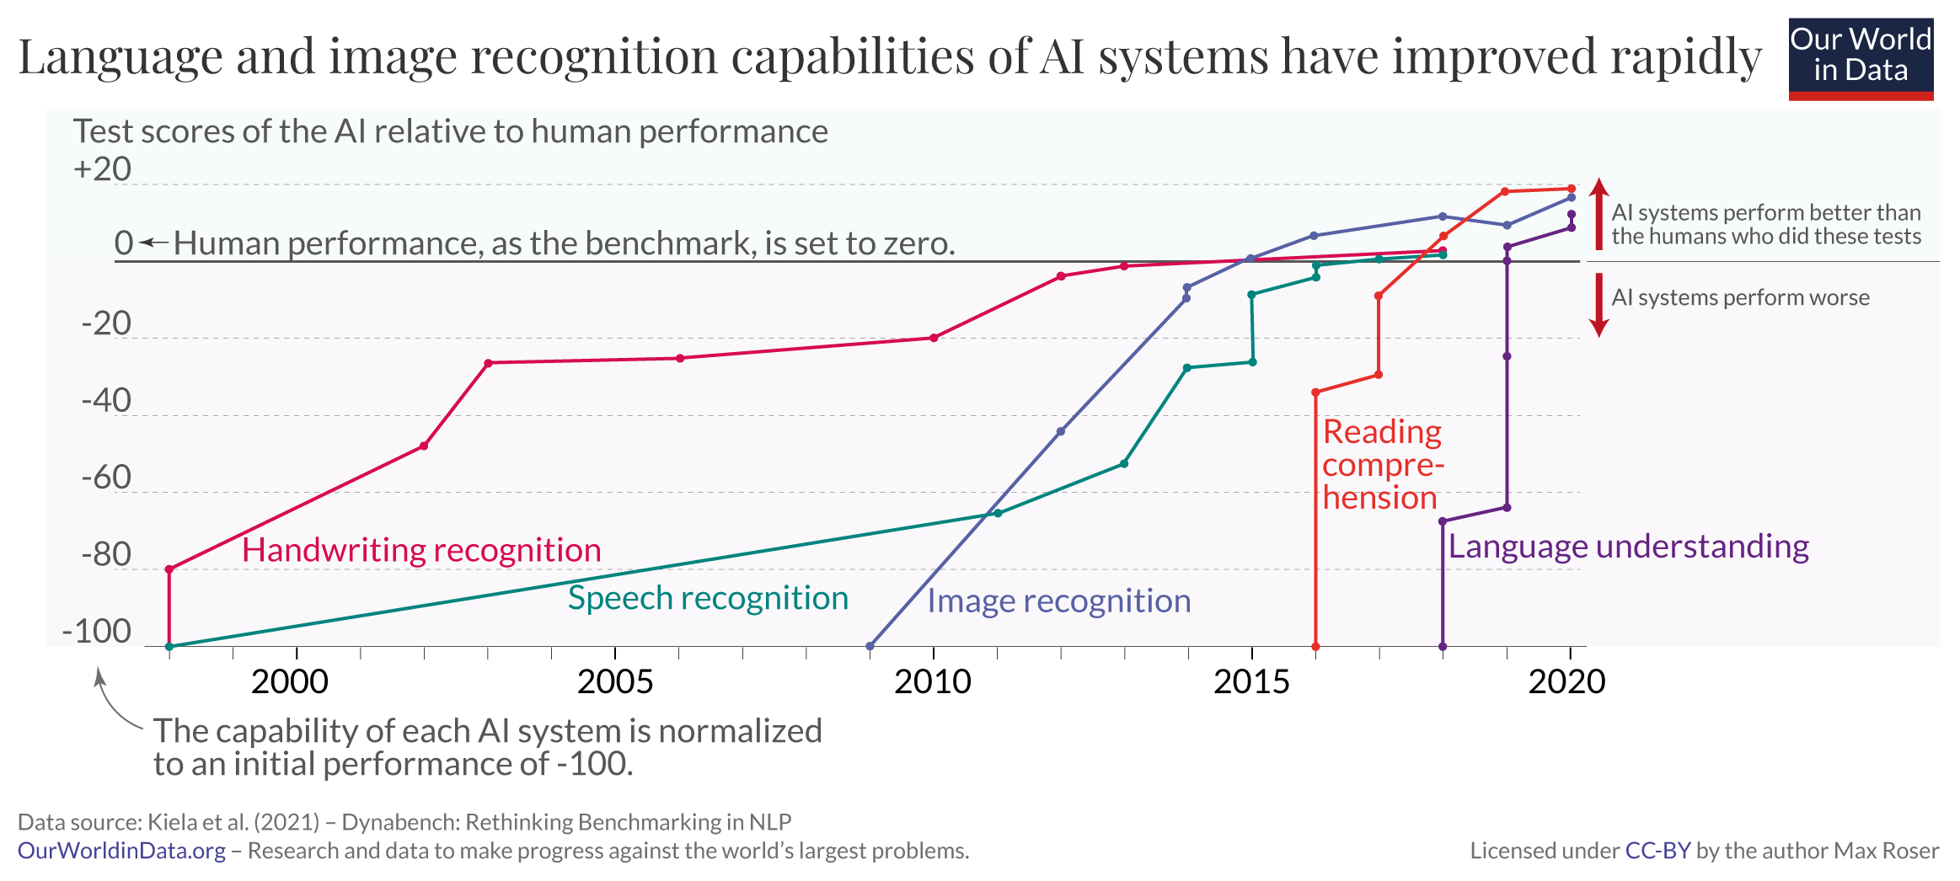
AI systems performance rapidly increasing
AI continued to post state-of-the-art results, but year-over-year improvement on many benchmarks continues to be marginal. Moreover, the speed at which benchmark saturation is being reached is increasing. However, new, more comprehensive benchmarking suites such as BIG-bench and HELM are being released. -- AI index report 2023 (Stanford)

Slide 20
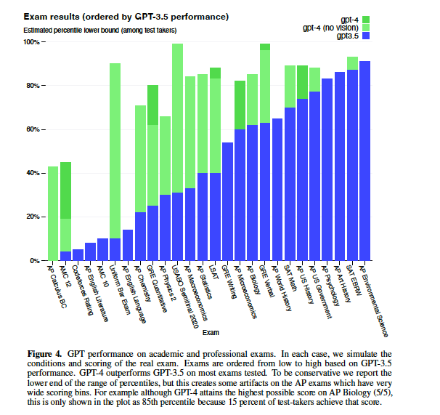
Can gpt4 do physics?
“As noted above in 2.2, despite GPT-4’s capabilities, it maintains a tendency to make up facts, to double-down on incorrect information, and to perform tasks incorrectly. Further, it often exhibits these tendencies in ways that are more convincing and believable than earlier GPT models (e.g., due to authoritative tone or to being presented in the context of highly detailed information that is accurate), increasing the risk of overreliance. “
“Despite its capabilities, GPT-4 has similar limitations as earlier GPT models. Most importantly, it is still not fully reliable (it ‘hallucinates’ facts and makes reasoning errors)”
~75% accuracy across disciplines (figure 6)
OpenAI (2023)
https://arxiv.org/pdf/2303.08774.pdf

Slide 21
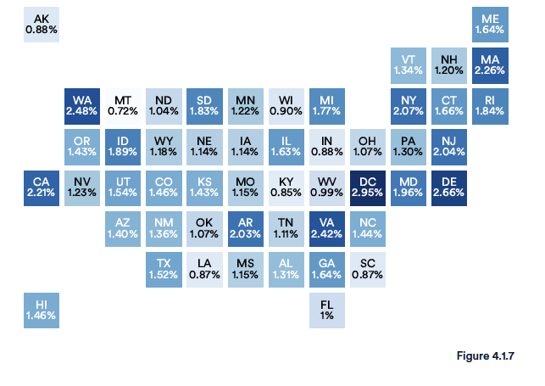
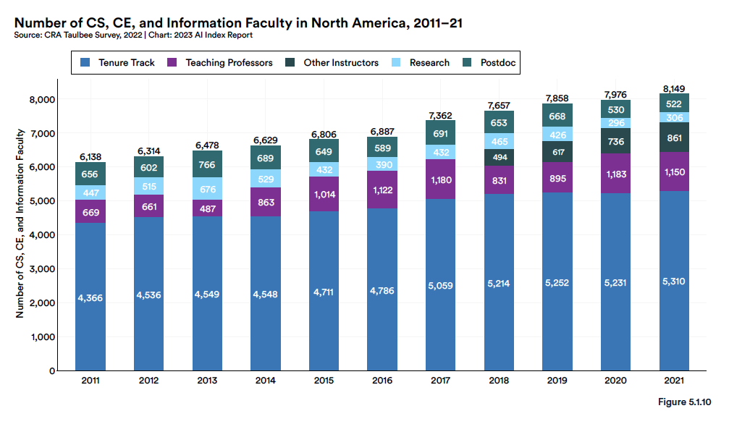
Difficulty finding an AI person?
2021 statistics
CS AP Exams: 181,004
CS BS: 33,059
CS MS: 15,068
CS PhD: 1,893 (20% in AI)

Slide 22
Summary and Outlook
Computing technology, built on silicon, has enabled a revolution in almost every facet of life and science; this 70-year trend will continue although the underlying technology is reaching maturity (linear growth)
Physics requires experiments, data, and theory…working hand in hand to explain phenomena…
  there is a valid, proven, way to practice science: ask a falsifiable question, construct a hypothesis, perform an experiment, refine hypothesis…repeat…
  There is also an incorrect way to practice science which leads to alchemy: collect data, find patterns magically, forget theory, repeat
Poincare’: Science is built of facts the way a house is built of bricks: but an accumulation of facts is no more science than a pile of bricks is a house.

