Slide 1
DUNE database development
Ana P. Vizcaya Hernandez and Lino Gerlach for the DUNE collaboration
CHEP 2023
8 – May – 2023

Slide 2
Content
Brief introduction to DUNE and ProtoDUNE
Introduction to ProtoDUNE’s databases
Database architecture
Metadata and Conditions data
Run History Database
Versioning, workflow, and schema
Conditions Database
HSF recommendations, performance optimization, and deployment

Slide 3
DUNE (Deep Underground Neutrino Experiment)
DUNE is a next generation neutrino experiment that uses LArTPC technology
High-intensity (MW-scale) neutrino beam is produced at Fermilab as part of LBNF
Travels $\sim$1300 km to the far detectors located at the Sanford Underground Research Facility
Measured by the near detectors about 0.5 km from the neutrino production
Physics: neutrino oscillation, detection of solar and supernova neutrinos, beyond the standard model physics.

Slide 4
ProtoDUNE at CERN
ProtoDUNE-SP and -DP are DUNE’s large scale prototypes of its far detector modules.
Located at CERN Neutrino Platform
Critical to demonstrate viability of LArTPC technology
770 tons LAr mass each
Exposed to test beams H4(SP) and H2(DP)
Also take cosmic ray data

Slide 5
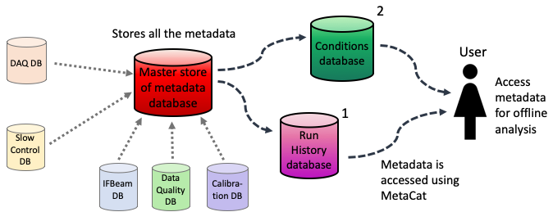
Architecture of DUNE’s offline databases
DUNE will produce vast amounts of metadata, which describe the data coming from the read-out of the primary DUNE detectors.
The subset of all metadata that is accessed during offline data reconstruction and analysis is referred to as conditions data and it is stored in a dedicated database (1,2).

Slide 6
Run History Database
Master Store of Metadata (UconDB)
Purpose
Centralized place to store all the conditions data
Purpose
Identify runs which fulfill specific configurations, like a chosen high voltage setting, with the aim of file discovery.
Goals
Avoids a priori schema
Implementation
PostgreSQL database with python API interface
Implementation and challenges
Changes in time
Schema
Correct granularity
Data can change because of improvements or corrections
Needs version control
Which information is needed and how or where to access it
Store the data in run granularity and not with time index

Slide 7
Run History Database - Workflow
After each run, the metadata is extracted from the different databases and sent to the Master Store of Metadata.
A subset of metadata is sent to the Run History DB where it is stored with run granularity.
Users access the metadata in the database via the File Metadata Catalog (MetaCat). An example query is given.
metacat filter dune_runsdb_incondb () (files from dune:all) where runs_history.hv = 120

Slide 8
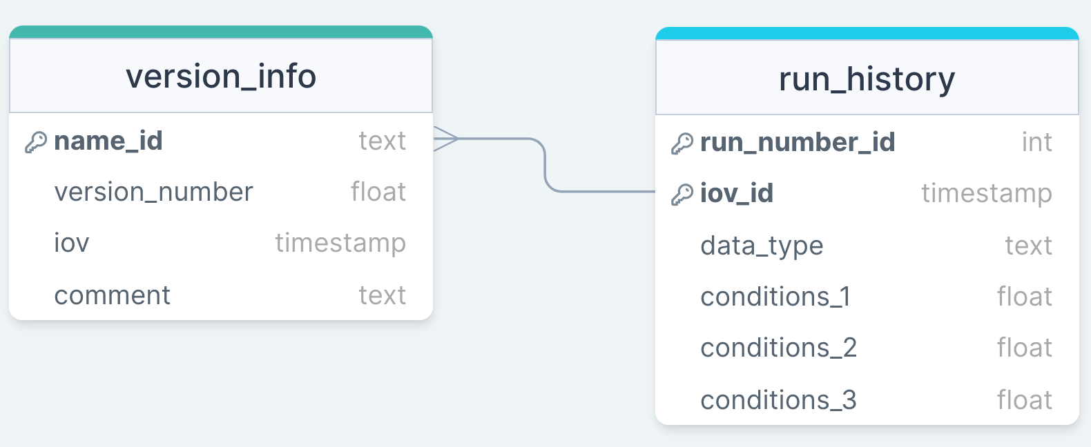
Run History Database - Schema
The chosen schema has run number and iov as key parameters
Handles versioning:
Changes of a single condition parameter in a run require a new entry in the database, the newest entry of each run is return, except otherwise specified.
New condition type can be added to the Run History Database, they will be treated as a new version.
Database schema, where the conditions_# payloads represent all the conditions parameters in the database

Slide 9
Conditions Database - Introduction
Purpose: provide all of the non-primary data stream needed for offline data processing
Changes over time
High access rates
Heterogenous data
Repeat detector calibration with larger cosmic dataset
Improve calibration algorithms
Distributed computing jobs access same conditions data simultaneously
Access rates up to ~kHz
Granularity varies (time indexed, run-indexed, constant)
Structure of payload varies (3D map, single number, …)
Versioning & configuration
Fast DB queries & effective caching
Payload agnostic by design
Similar challenges for various HEP experiments

Slide 10
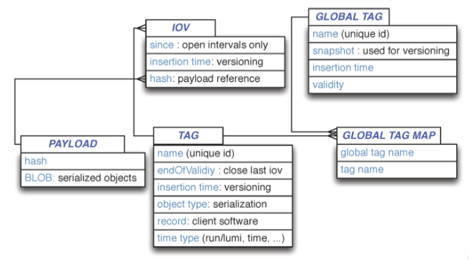
Conditions Database – HSF Recommendations
Dedicated HEP Software Foundation (HSF) conditions data activity: https://hepsoftwarefoundation.org/activities/conditionsdb.html
Key recommendations for conditions data handling
Separation of payload queries from metadata queries
Schema below to enable appropriate configuration
HEP Software Foundation Community White Paper Working Group – Conditions Data
10

Slide 11
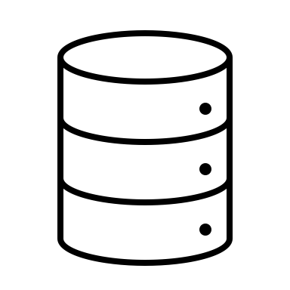
Conditions Database - Implementation
nopayloadclient: client-side stand-alone C++ tool
Experiment unspecific
Communicates with server-side nopayloaddb*
Local caching
Handling of payloads
remote payload store
client side
server side
payload
Experiment- agnostic lib
nopayloadclient
DUNE- specific lib
dunenpc
sPHENIX- specific lib
sphenixnpc
nopayloadclient
nopayloaddb
*See Ruslan’s talk:
‘The HSF Conditions Database reference Implementation’

Slide 12
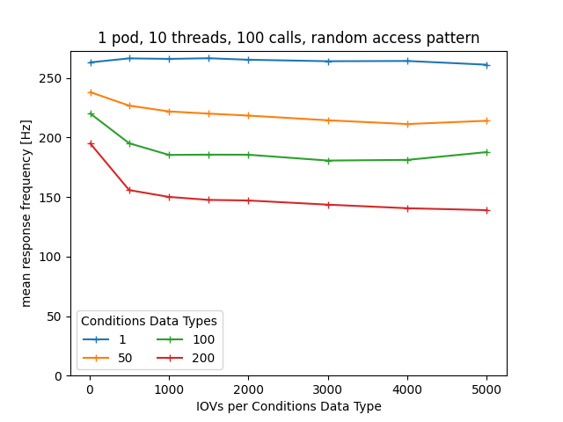
Conditions Database – Performance
Simulate expected DB occupancy
Vary number of Condition Data Types & IOVs
Simulate access patterns:
Parallel requests using HTCondor or Multithreading
Response times and -frequencies as performance metrics
12
Notes:
Two

Slide 13
Conclusions
We are developing two databases, run history DB and conditions DB, that will help users access all the data files and conditions data they need for offline analysis
The Run History Database which consists of just a subset of metadata from the Master Store of Metadata will allow users to select runs/files of runs with specific characteristics
Experiment-agnostic conditions database with DUNE-specific client-side library
Conditions database performance has been investigated, looks good

Slide 14
Thank you!
We acknowledge the support of the US Department of Energy.

Slide 15
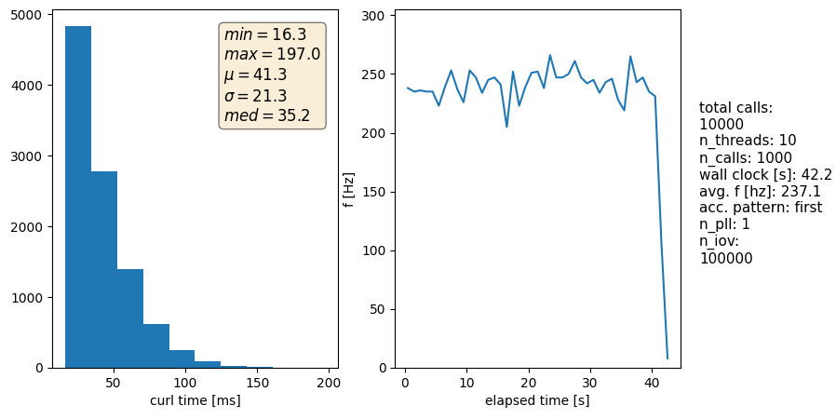
Conditions Database – Performance
mean response time
mean response frequency
no caching
Example results of a test campaign (absolute values don’t matter here)
Scaling tests: single number as metric of whole campaign
Notes:
Two

Slide 16
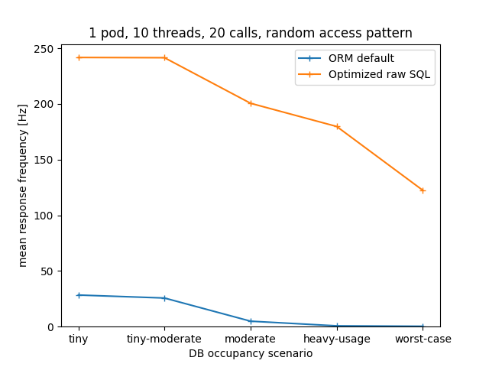
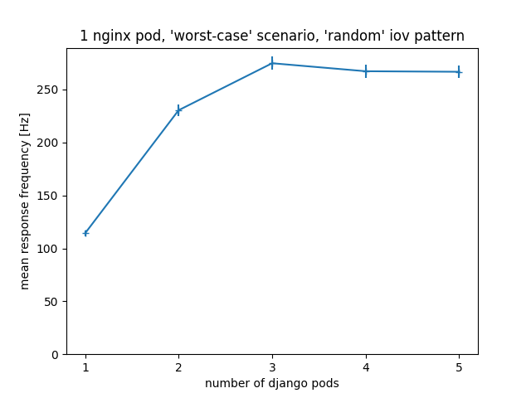
Conditions Database – Performance
Compared default Django ORM and optimized raw SQL query
Horizontal scaling (deployment): response frequency plateaus around 3 pods
>250 Hz for worst-case (>5M) occupancy, random access, no caching
16

