Slide 1


Hybrid actor-critic scheme for quantum reinforcement learning
M. Grossi, V. Kain, K. Li, M. Schenk, S. Vallecorsa
CERN, Switzerland
E. F. Combarro
University of Oviedo, Spain
M. Popa
Politehnica University of Bucharest, Romania
26th International Conference on Computing in High-Energy & Nuclear Physics
Jefferson Lab, Norfolk, Virginia, USA 08. - 12. May 2023

Slide 2
Contents
Introduction
  Reinforcement learning (RL) in a nutshell
  What is free-energy based RL (FERL) and why use it?
  Quantum Boltzmann machines
Results I: AWAKE beam line
  Hybrid actor-critic RL algorithm
  Excursion: quantum fuzzy logic controller
Results II: Cartpole environment with FERL
Conclusions & outlook

Slide 3
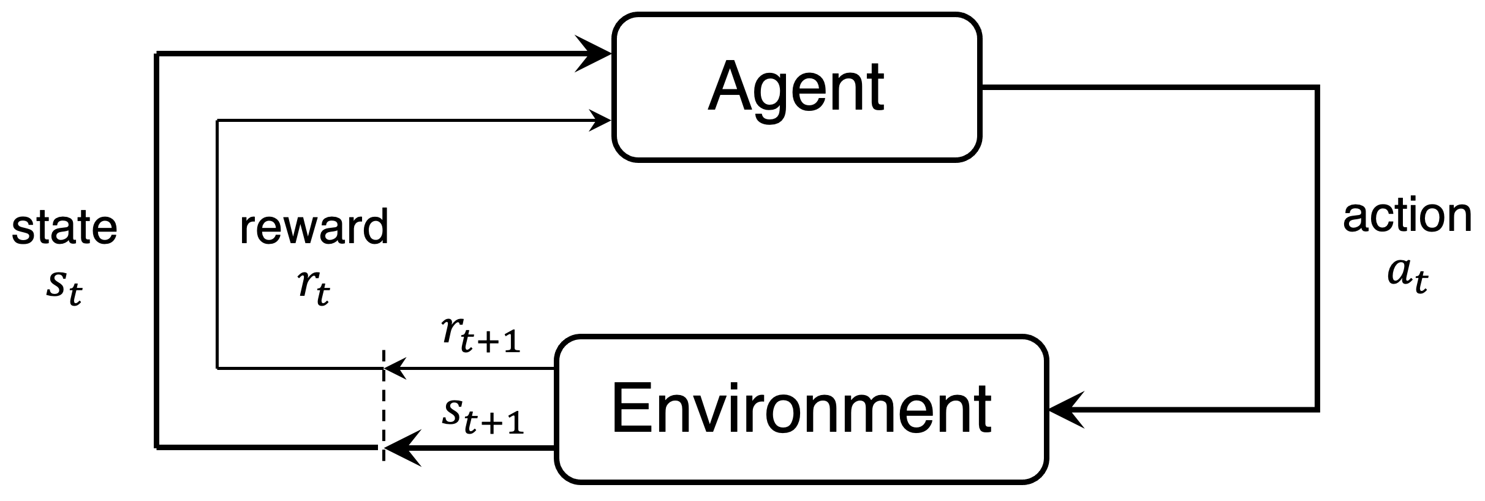
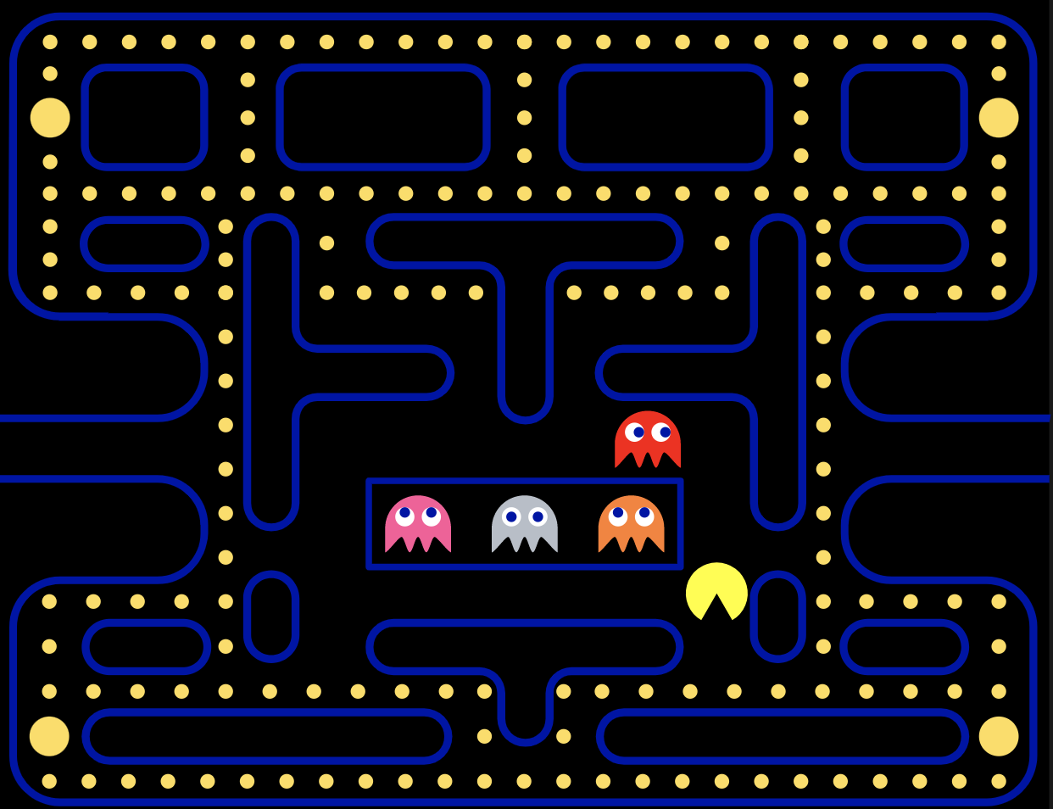
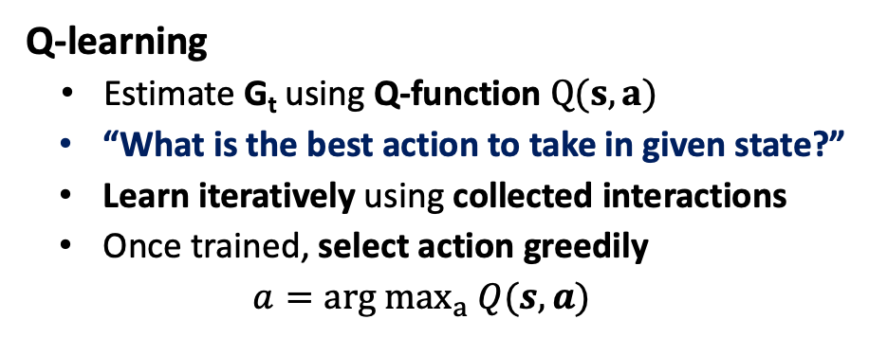
Reinforcement learning (RL)
… in a nutshell
Trial-and-error learning
Agent takes actions in environment and collects rewards
Goal: learn optimal behaviour ⬄ maximize return G_{t}
G_{t}: sum of future rewards
Many different algorithms exist
RL book: Sutton & Barto
Q-learning
Estimate G_{t} using Q-function $Q(s, a)$
“What is the best action to take in given state?”
Learn iteratively using collected interactions
Once trained, select action greedily
$$a=arg max_{a} Q(s,a)$$
Example: Pacman
State
where am I? Where are ghosts, snacks, cookies?
Actions
up, down, left, right
Reward
food (+), ghosts (-)
Return
how much food am I going to eat over time

Slide 4
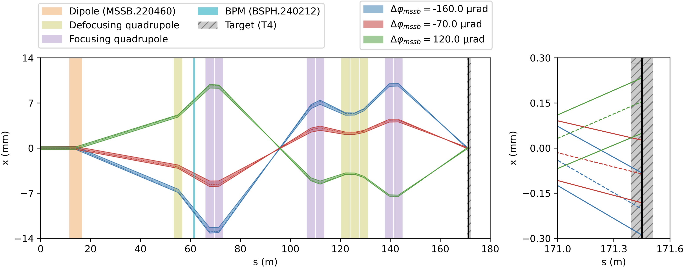
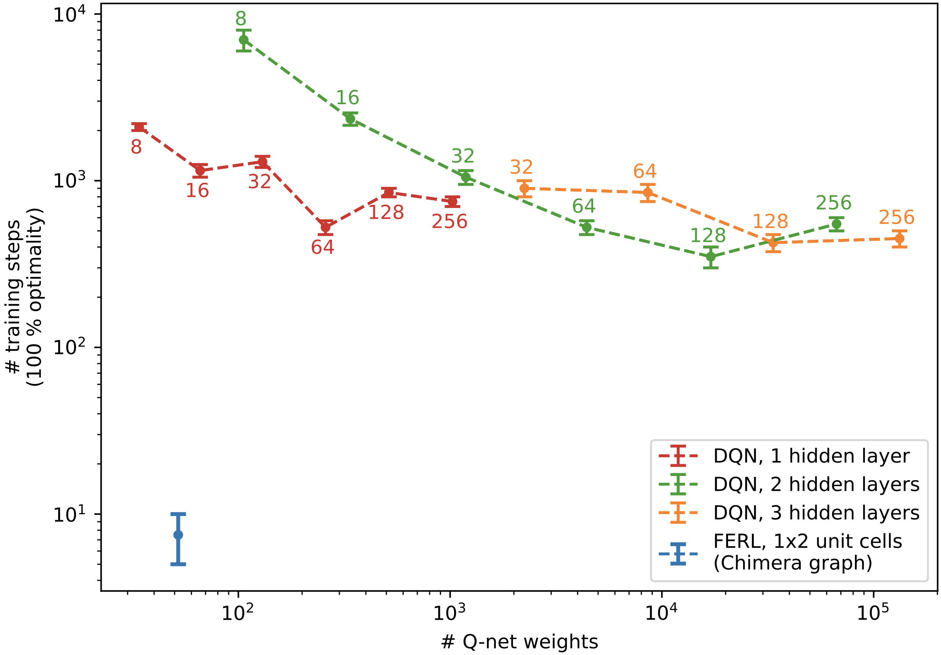
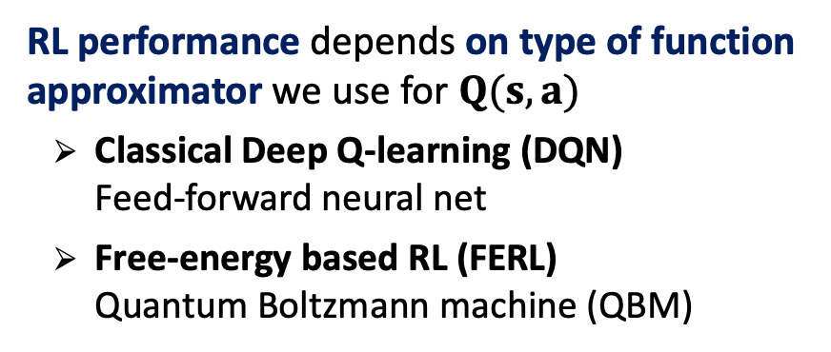
Free-energy based RL (FERL)
Motivation
1st study: 1D beam steering
CERN North Area transfer line (discrete action space)
    RL performance depends on type of function approximator we use for $Q(s,a)$
      Classical Deep Q-learning (DQN)
      Feed-forward neural net
      Free-energy based RL (FERL)
      Quantum Boltzmann machine (QBM)
DQN
    Key concept: sample-efficiency
    How many interactions are required between agent and environment?
    Relevant for particle accelerator control given cost of beam time (online training): FERL a potential solution?
300x fewer network parameters
50x fewer training steps
FERL

Slide 5
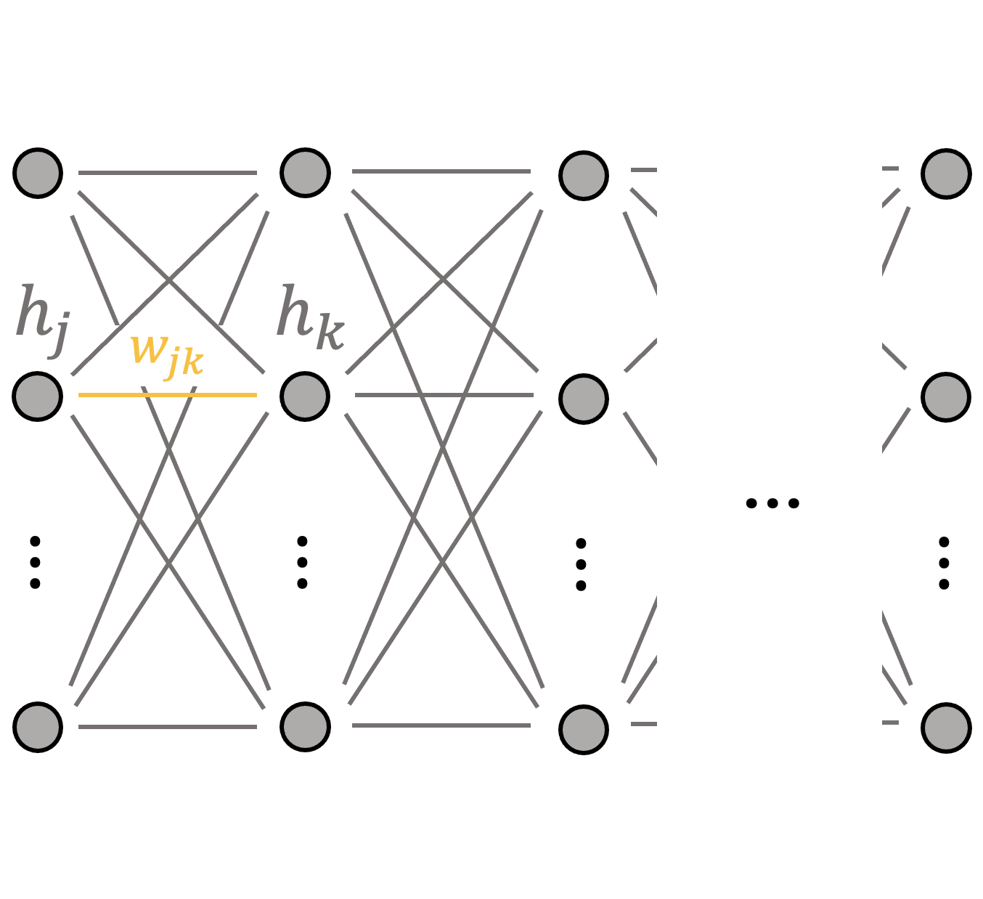
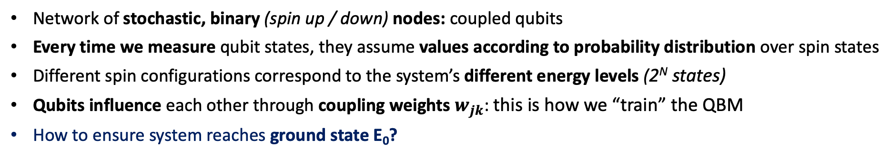
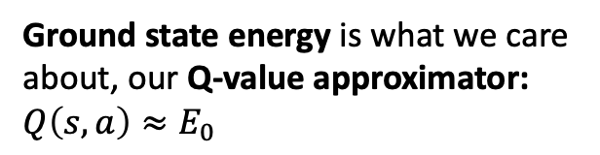
Quantum Boltzmann Machine
System of coupled qubits
E
…
E₃
…
E₂
Ground state energy is what we care about, our Q-value approximator: $Q\left(s,a\right)≈E_{0}$
E₁
E₀
c
Network of stochastic, binary (spin up / down) nodes: coupled qubits
Every time we measure qubit states, they assume values according to probability distribution over spin states
Different spin configurations correspond to the system’s different energy levels (2^{N} states)
Qubits influence each other through coupling weights $w_{jk}$: this is how we “train” the QBM
How to ensure system reaches ground state E₀?
(simulated) quantum annealing

Slide 6
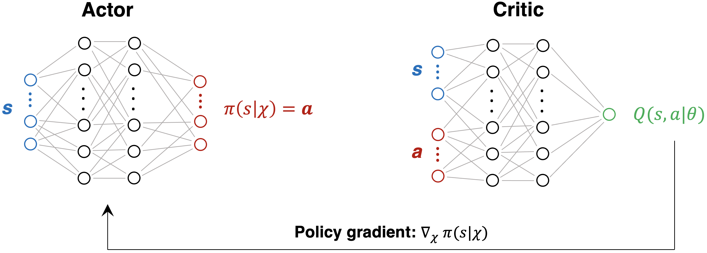

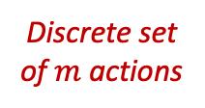




Developing a hybrid actor-critic scheme
… for continuous action-space problems
Q-learning: only discrete action-space environments
Accelerator optimization requires continuous action space develop hybrid actor-critic algorithm
Based on Deep Deterministic Policy Gradient family: DDPG, TD3, etc.
  QBM replaces classical critic net
  Can we exploit high QBM learning efficiency?
  Intuitively: if critic learns faster, should benefit actor training via policy gradient
Q-learning
DDPG family
$$Q(s, a_{1})$$
QBM
Classical
$$∈ℝ^{n}$$
$$Q(s, a_{m−1})$$
$$Q(s, a_{m})$$
Discrete set of $m$ actions

Slide 7
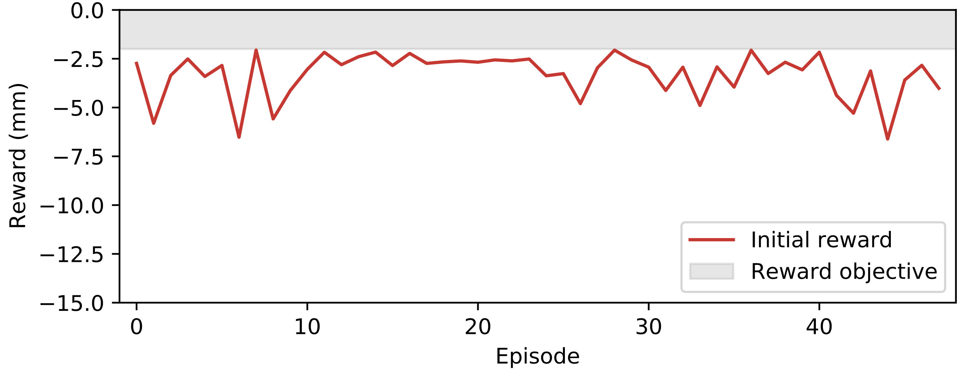
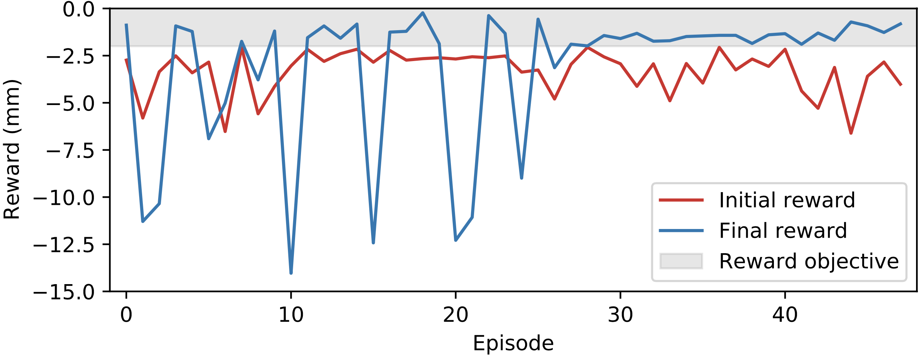
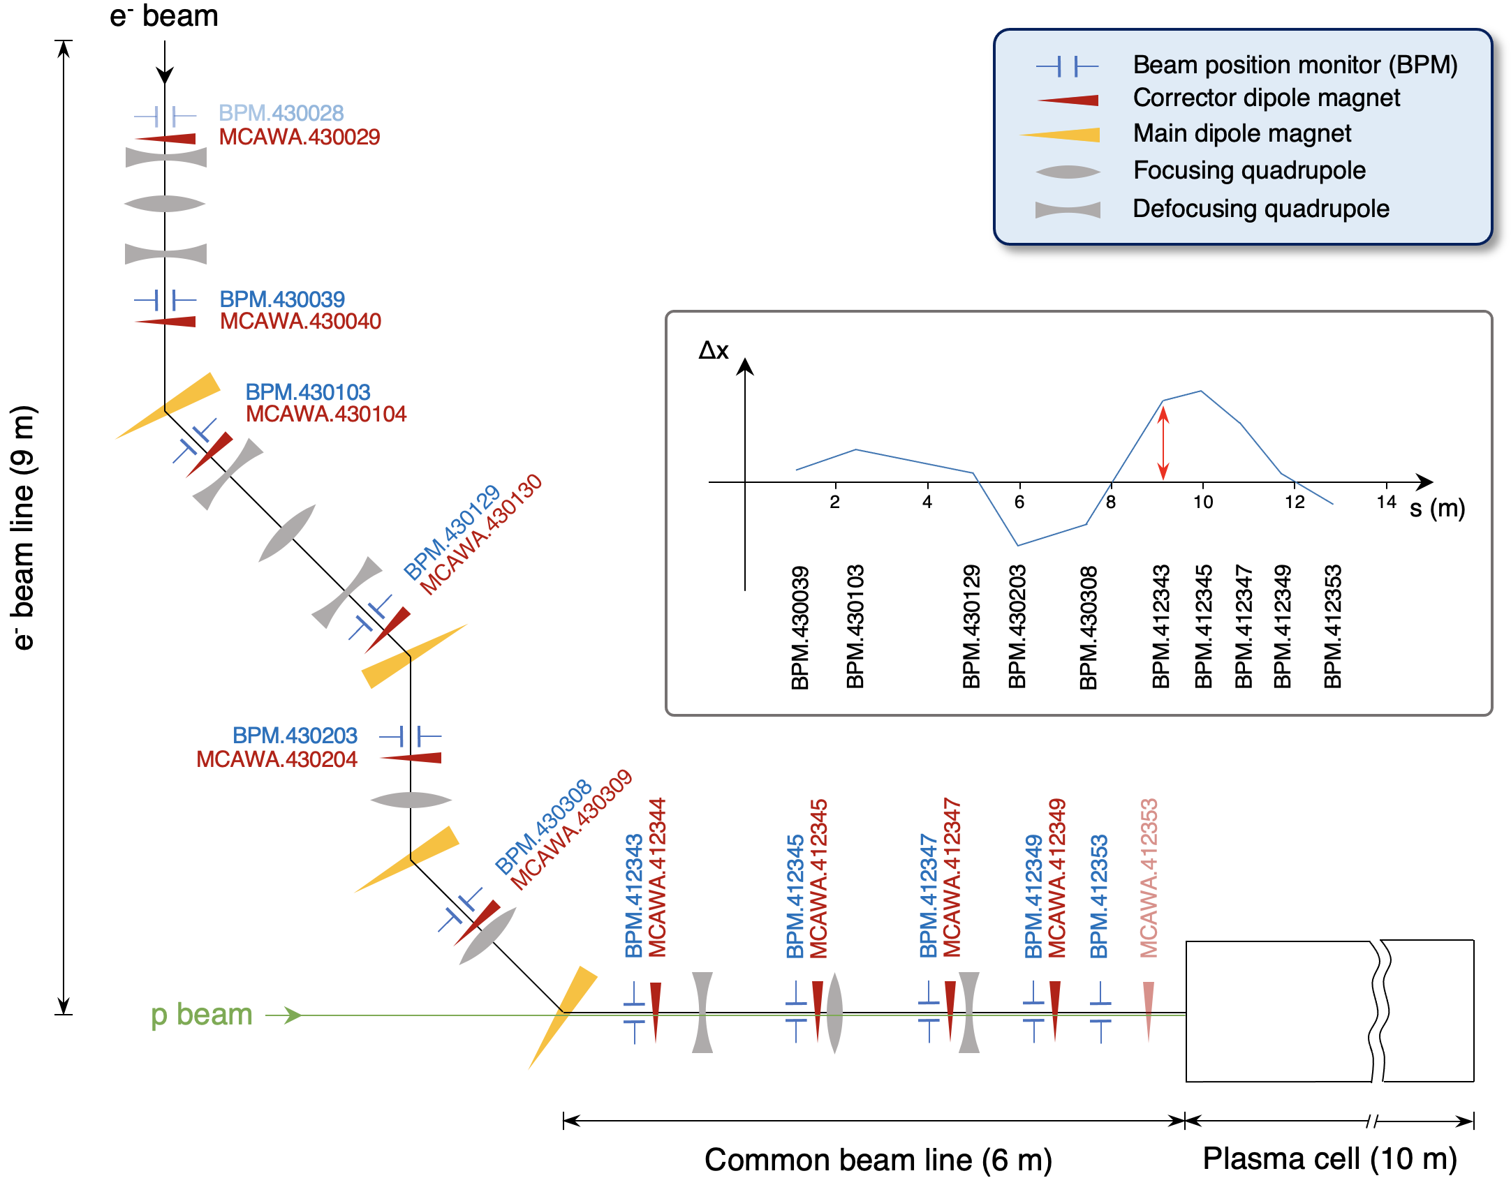
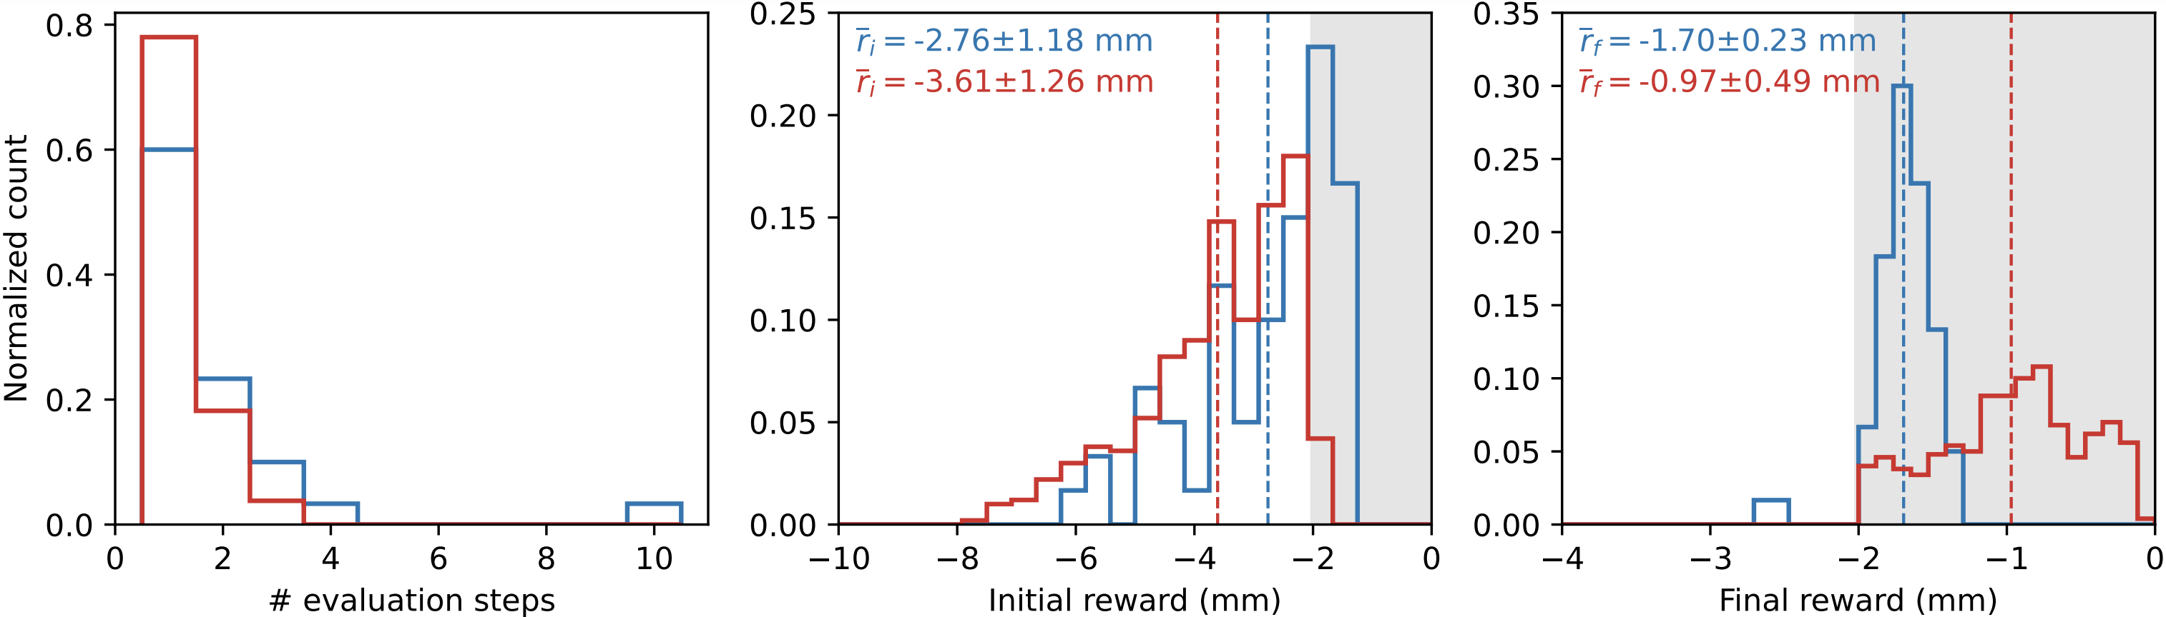
2nd study: 10D continuous beam steering
Training on quantum annealer & evaluation on beam line
Training: on D-Wave Advantage quantum annealer (QA)
Environment: e⁻ beam line of AWAKE
Action: deflection angles at 10 correctors
State: beam positions at 10 BPMs
Objective: minimize beam trajectory rms
reward: negative rms from 10 BPMs
Objective
Exploring & learning
Success
Evaluation: on actual beam line
Real vs. simulated QA
AWAKE: Advanced Proton Driven Plasma Wakefield Acceleration Experiment
Agent minimizes rms in 1 step in 60 % cases
Hyperparameter tuning with simulated QA

Slide 8
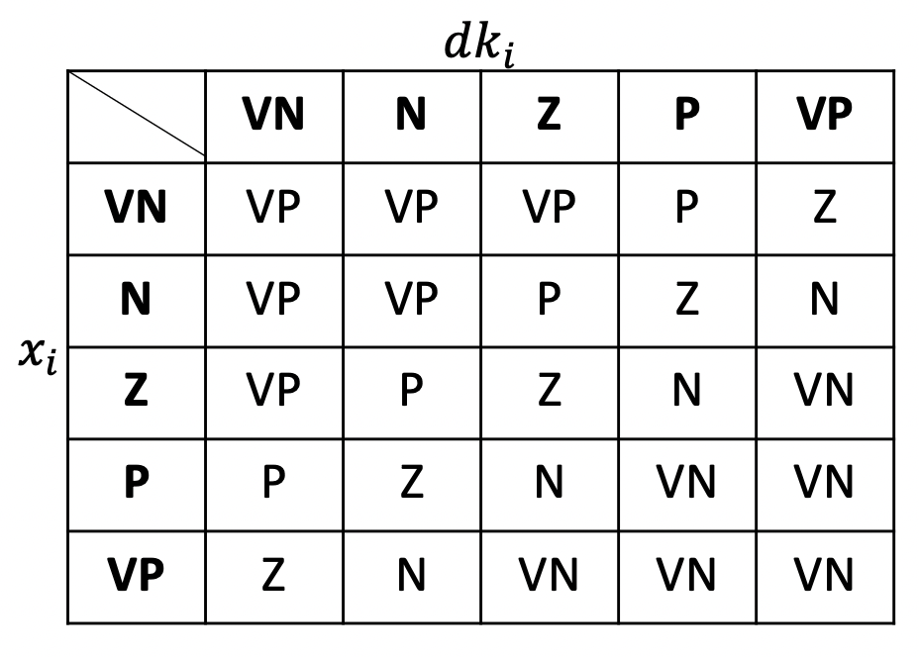
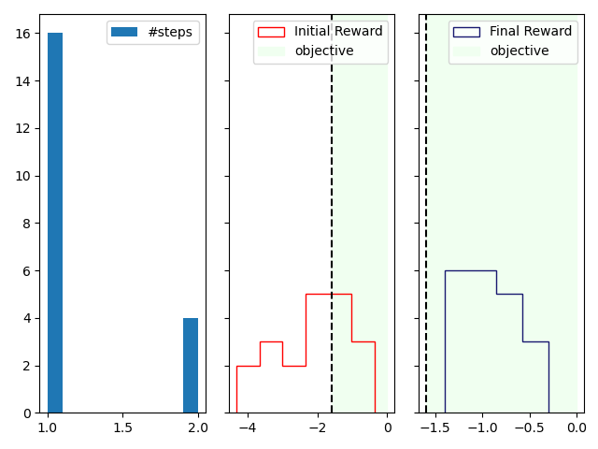
1-slide excursion: quantum fuzzy logic controller
Evaluation on AWAKE beam line
Alternative control algorithm to RL
Fuzzy Logic is used to develop control systems based on linguistic rules highly interpretable
Quantum Fuzzy Control System (G. Acampora, R. Schiattarella, A. Vitiello)
Exploit exponential advantage in computing fuzzy rules on quantum computers
Successfully evaluated on AWAKE beam line, no training required
Evaluation: on AWAKE beam line
Objective reached typically in 1 step

Slide 9
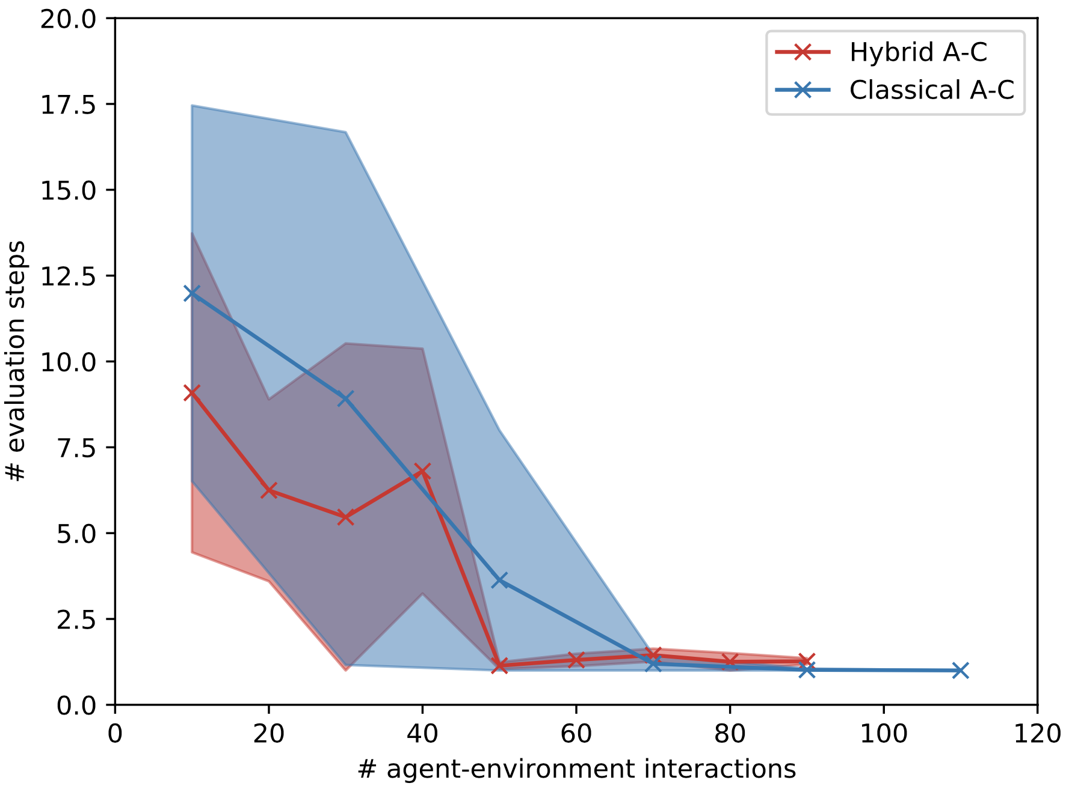
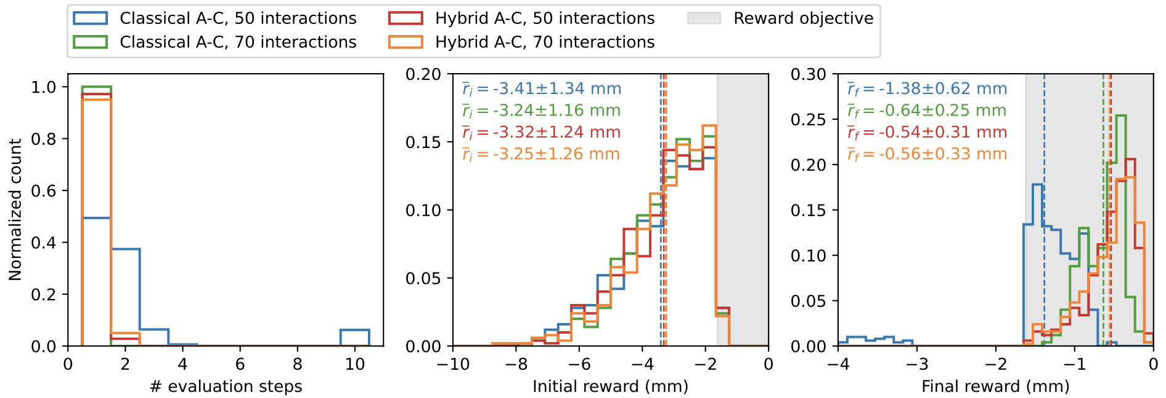
2nd study: 10D continuous beam steering
Comparison to classical actor-critic RL
Hybrid actor-critic (A-C) works
Minor improvement in terms of sample efficiency
50 vs 70 interactions
Very few interactions sufficient for both approaches
Dynamics potentially too simple (linear)
Move towards more complex RL benchmarks

Slide 10
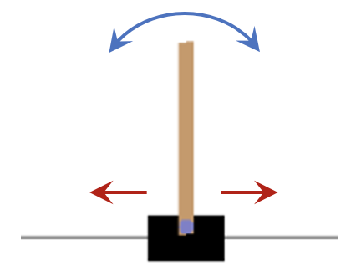
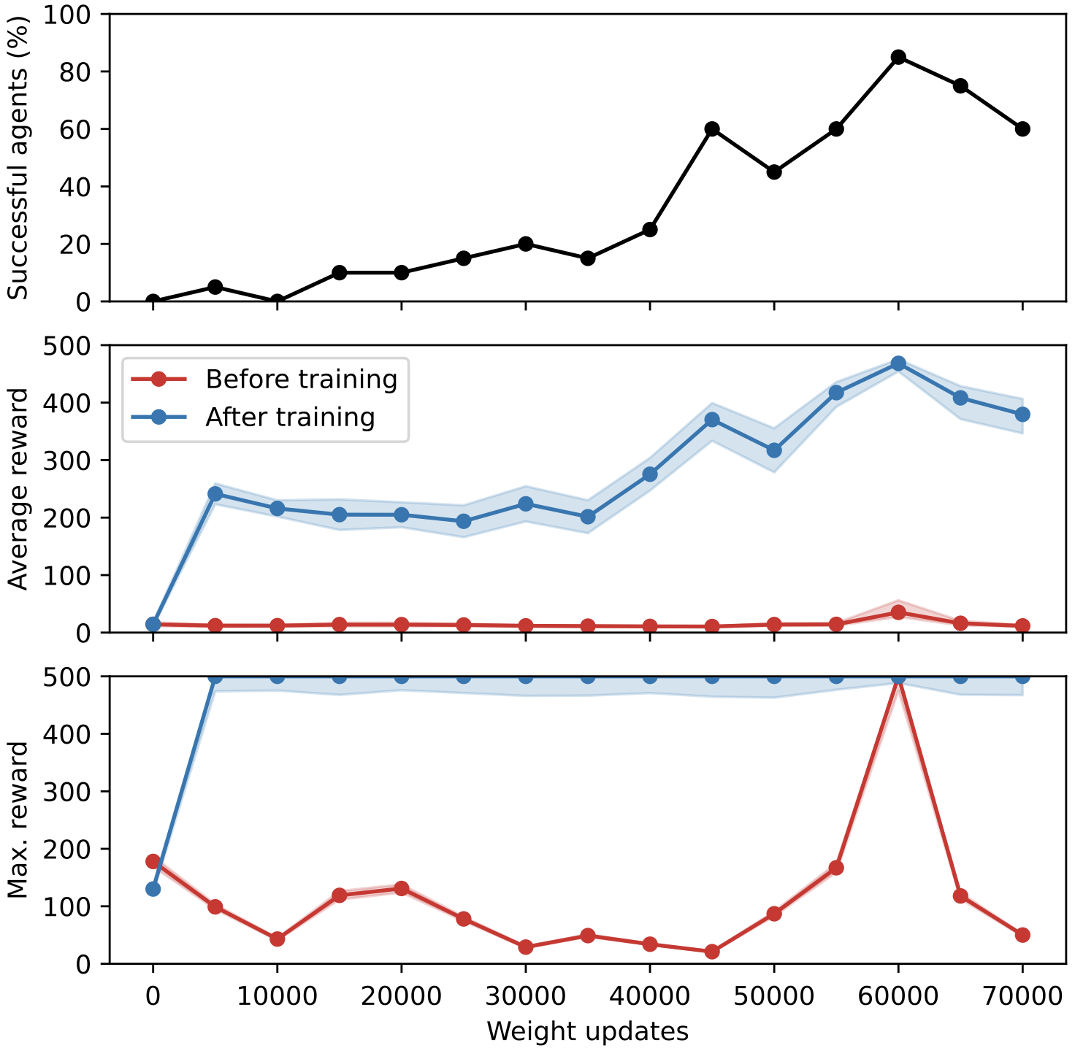
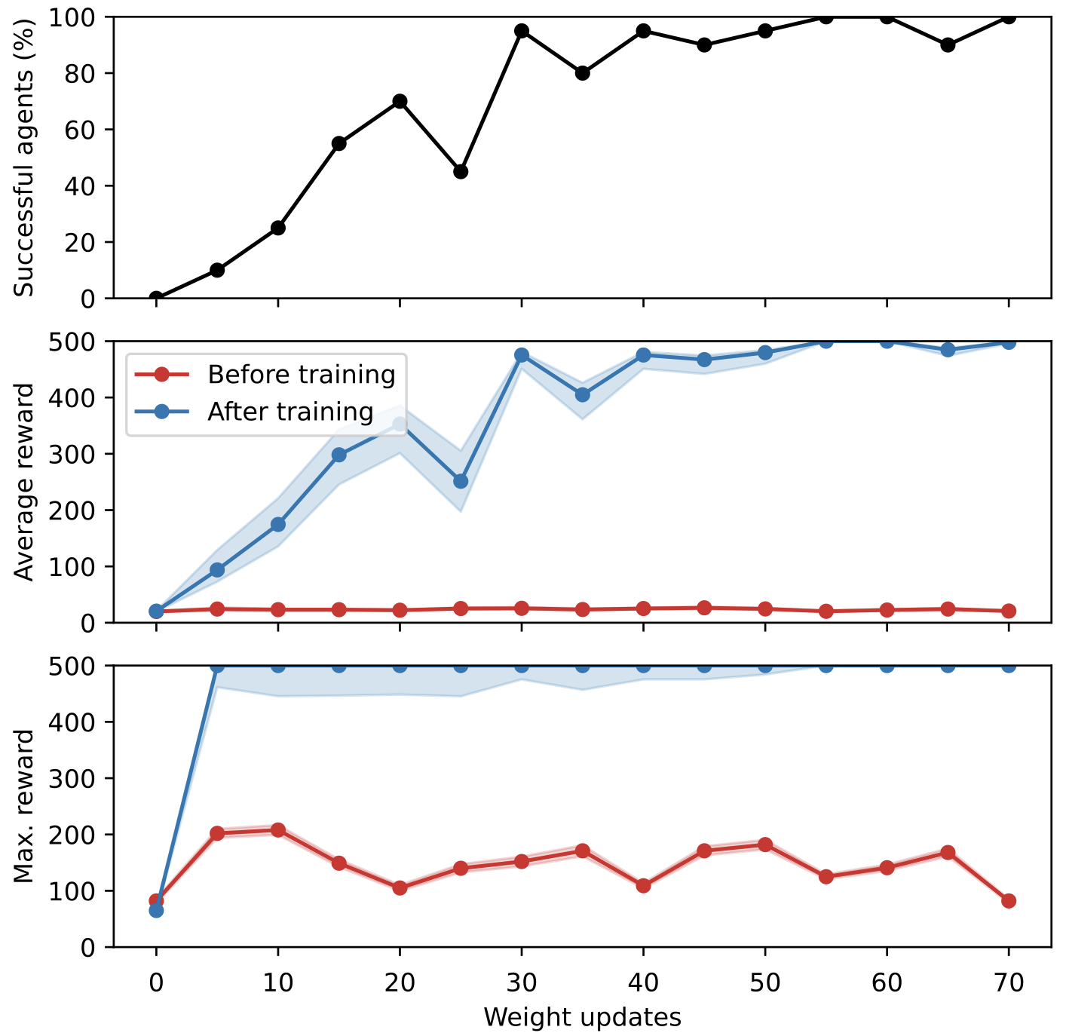
3rd study: Cartpole-v1
Discrete action problem, non-linear dynamics
Cartpole-v1: official OpenAI gym env from classic control problems domain
Continuous state (4D), discrete action (right, left) problem with non-linear dynamics
Terminate episodes after max. 500 steps
DQN
FERL (simulated QA)
Preliminary

Slide 11
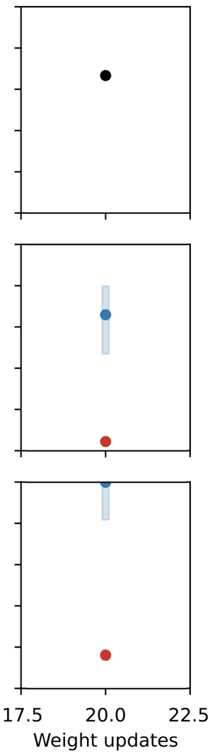
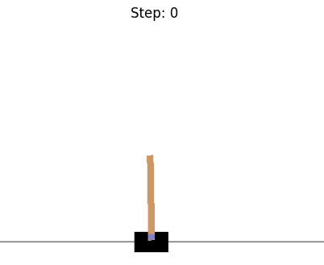
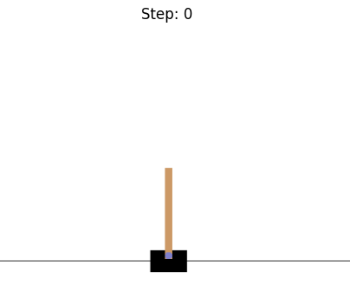
3rd study: Cartpole-v1
Discrete action problem, non-linear dynamics
Cartpole-v1: official OpenAI gym env from classic control problems domain
Continuous state (4D), discrete action (right, left) problem with non-linear dynamics
Terminate episodes after max. 500 steps
Big gain in sample-efficiency and robustness for FERL vs DQN
DQN
FERL (simulated QA)
FERL (trained on D-Wave)
Preliminary
before
after

Slide 12
Conclusions and outlook
Free-energy based RL has potential for high sample efficiency
Developed hybrid actor-critic agent to solve continuous state-action problems
Successfully trained on simulated & real quantum annealer and evaluated on simulated & real CERN beam lines
Minor improvement in sample efficiency for continuous action problem
Study environments with non-linear dynamics
Potential alternative: quantum fuzzy logic controllers
Outlook: attempt training hybrid actor-critic on Pendulum-v1 gym env
Thank you

Slide 13
Backup

Slide 14
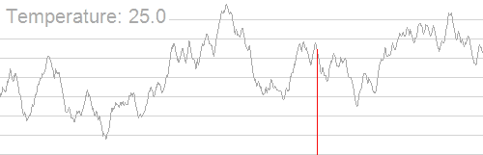
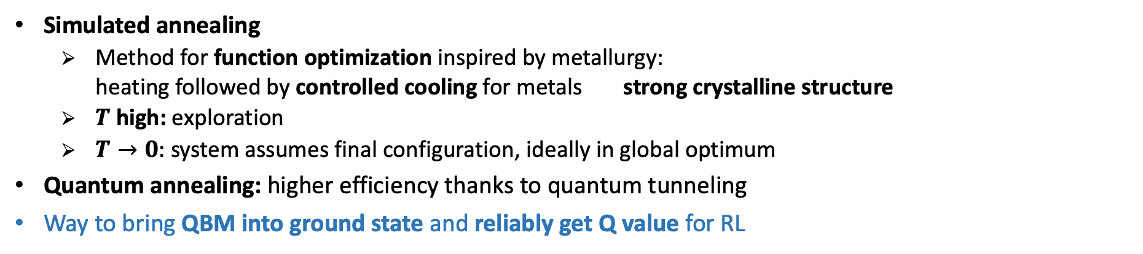
Annealing
Looking for the system’s ground state
Simulated annealing
  Method for function optimization inspired by metallurgy:
  heating followed by controlled cooling for metals strong crystalline structure
  $T$ high: exploration
  $T→0:$ system assumes final configuration, ideally in global optimum
Quantum annealing: higher efficiency thanks to quantum tunneling
Way to bring QBM into ground state and reliably get Q value for RL
Energy E
  Think of objective function as landscape with hills and valleys
Thermal annealing
Quantum annealers
Different type of quantum computer: non-gate based
More qubits, but not as generic as gate-based QPUs
Suited for quadratic minimization problems
quantum annealing
(tunneling allowed)
Spin configuration c

Slide 15
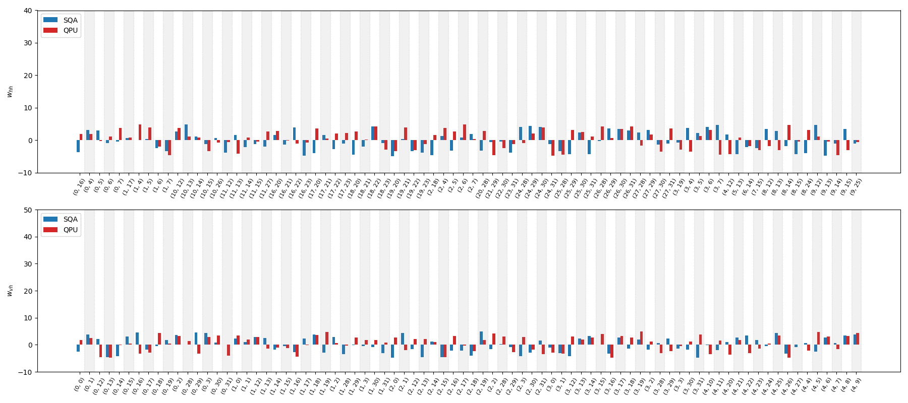
3rd study: Cartpole-v1
Coupling weights evolution: simulated vs real QA

