Slide 1
Fast, high-quality PRNG for heterogeneous computing
Marco Barbone, Georgi Gaydadjiev, Alexander Howard, Wayne Luk, George Savvidy,
Konstantin Savvidy, Andy Rose, Alexander Tapper
m.barbone19@imperial.ac.uk

Slide 2
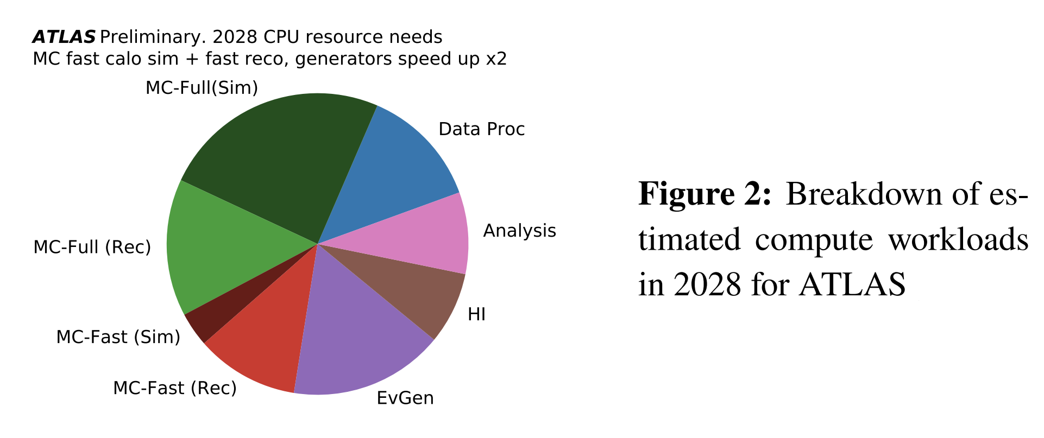
Monte Carlo simulations
Over 50% is required by Monte Carlo related workloads
https://doi.org/10.22323/1.390.0009

Slide 3
Motivation
GPUs/FPGAs RNGs are:
Slow and high-quality
Fast and low-quality
In the GPU case, closed-source
There is no middle-ground
https://docs.nvidia.com/cuda/curand/index.html

Slide 4
MixMax RNG
It is a high-quality generator suitable for MC simulations
Quality, speed tunable based on state-size
Even small state size offers high quality numbers
It offers a seeding mechanism that guarantees no collisions between streams
Used in CLHEP & Geant4 (default)
https://doi.org/10.1051/epjconf/201921402012

Slide 5
Goal
Accelerate MixMax and compare the performance against state-of-the-art RNGs
Provide a reliable RNG for Monte Carlo simulations

Slide 6
FPGA-VHDL design
VHDL-2008
62 SLOC
Clear interface
Fully pipelined, 100% duty-cycle

Slide 7
Experimental Setup
Xilinx Ultrascale+ FPGA
Vivado 2020.2
Default settings

Slide 8
Performance
Achieves 300 MHz
Requires 550 LUTs
c.f. 523k available in KU15P, 1.75M available in VU13P
This is 50% of the Mersenne Twister resources
or 25% of the Mersenne Twister resources per output bit
https://doi.org/10.1145/272991.272995

Slide 9
GPU C++/CUDA design
Each thread contains an RNG, state is not shared
GPU is seeded with 128 bits, the thread id is concatenated to generate different streams
Only 128 bits needs to be transferred to the GPU
The user can change this behavior
Clear C++ interface

Slide 10
Experimental setup
NVIDIA 3090 Ti
nvcc 11.8
g++ 9.4.0

Slide 11
Validation
Compared against the original implementation
Test took ~3 months (server crashed due to blackout....)
Results never diverged

Slide 12
Performance
Parameters:
iteration = generating 125,952 numbers
Threads | Blocks | Parallelism
128 | 984 | 125,952
Algorithm | time (ms) | time/it (ns) | % vs mixmax8 | Throughput (GB/s)
Philox4_32_10 | 23144 | 10.78 | -7.03 | 87074
MRG32k3a | 15203 | 7.08 | -38.93 | 132555
XORWOW | 23206 | 10.81 | -6.78 | 86841
MixMaxGPU<240> | 55294 | 25.75 | 122.11 | 36446
MixMaxGPU<17> | 30800 | 14.34 | 23.72 | 65430
MixMaxGPU<8> | 24895 | 11.59 | 0 | 80949
[ref]
[ref]
[ref]
[ref]
[ref]
[ref]

Slide 13
Against Mersenne twister for GPU (MTGP32)
iteration = generating 32768 numbers
Parameters
Threads | Blocks | Parallelism
256.00 | 128.00 | 32,768
Algorithm | time (ms) | time/it (ns) | % vs mixmax8 | speedup | Throughput (GB/s)
MTGP32 | 81161 | 37.79 | 1341.84 | 1 | 6459
Philox4_32_10 | 7803 | 3.63 | 38.62 | 10 | 67190
MRG32k3a | 5092 | 2.37 | -9.54 | 16 | 102963
XORWOW | 7731 | 3.60 | 37.34 | 10 | 67816
MixMaxGPU<240> | 15996 | 7.45 | 184.17 | 5 | 32776
MixMaxGPU<17> | 6075 | 2.83 | 7.92 | 13 | 86302
MixMaxGPU<8> | 5629 | 2.62 | 0 | 14 | 93140

Slide 14
Conclusion
MixMax is 14 times faster than Mersenne Twister on GPU
25% of the Mersenne Twister resources per output bit on FPGA
Seeding is easier and faster (128 bits, compared to O(KB))
MixMax has the potential to become de-facto the standard RNG on any platform
Suitable for ML & MC due to parallelism, efficiency and quality
Future work: Delivered via CLHEP or standalone repository
Notes:
Add ML and CLHEP references. Link to repo & talk to Alex H.

Slide 15
Backup

Slide 16
What is MixMax?
The MIXMAX generator is a family of pseudorandom number generators (PRNG) and is based on Anosov C-systems (Anosov diffeomorphism) and Kolmogorov K-systems (Kolmogorov automorphism).
https://doi.org/10.1016/j.cpc.2015.06.003

Slide 17
What is MixMax?
The MIXMAX generator is a family of pseudorandom number generators (PRNG) and is based on Anosov C-systems (Anosov diffeomorphism) and Kolmogorov K-systems (Kolmogorov automorphism).
It is a very good PRNG
Used in CLHEP & Geant4 (default)
https://doi.org/10.1051/epjconf/201921402012

