Slide 1
CaTS: Integration of Geant4 and Opticks
Hans Wenzel
Soon Yung Jun Krzysztof Genser
FERMILAB-CONF-23-101
1
Hans Wenzel Integration of Geant4 and Opticks / CHEP 2023 May 8 to 12, 2023

Slide 2
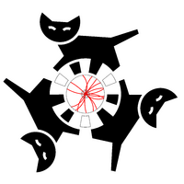
Outline
Motivation:
The computational challenge for TPCs based on liquid Argon (LArTPCs).
Simulation of optical photons: an ideal application to be ported to GPU’s.
Opticks.
CaTS is an advanced example Geant4 application.
CaTS workflow.
Performance.
artg4tk/larg4: making Opticks available to the LArTPC experiments.
Summary.
CaTS: Calorimetry and Tracking Simulation
2
Hans Wenzel Integration of Geant4 and Opticks / CHEP 2023 May 8 to 12, 2023

Slide 3
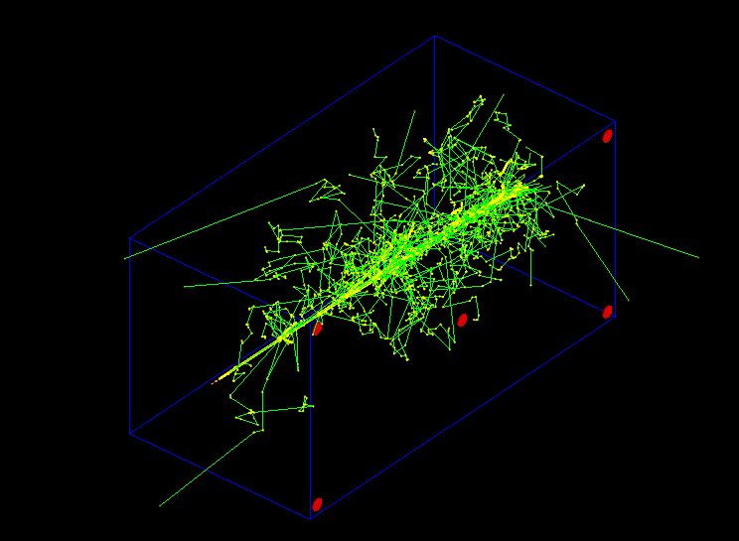
The computational challenge for TPCs based on liquid Argon (LArTPCs):
Test Detector Geometry:
Liquid Argon: x y z: 1 x 1 x 2 m (blue)
5 photo detectors (red)
photon yield (no E-field): 50000 γ/MeV single 2 GeV electron (shower not fully contained)
(low Z=18, low ρ = 1.78 g/cm³).
~ 7x10⁷ VUV scintillation photons are produced/event.
Using Geant4 (11.1.p01) to simulate photon generation and propagation o using a single core on an Intel® Core i9-10900k@ 3.7Ghz takes :
~ 10 minutes/event
(Compared to 0.034 seconds/event without optical photon simulation) → LArTPC-Experiments use look up tables and parameterizations instead of full simulation for photon response.
Shown are only steps and particle tracks handled by Geant4,
no optical photons.
2 GeV e⁻
Photodetectors
3
Hans Wenzel Integration of Geant4 and Opticks / CHEP 2023 May 8 to 12, 2023

Slide 4
Simulation of optical photons: an ideal application to be ported to GPU’s.
Only one particle type is involved (optical photon), but many of them (~10⁷/event)→ allows for massive parallelism (low latency, no big fluctuations in computing time).
No new particles types besides optical photons are produced.
Only a few physics processes need to be implemented on the GPU. The processes are:
G4Cerenkov (generate photons),
G4Scintillation (Reemission) (generate photons),
G4OpAbsorption,
G4OpRayleigh,
G4OpBoundaryProcess,
G4OpWLS (not yet implemented, need it for LArTPCs).
These processes don’t need a lot of input data (collected in so called GenSteps for the Cerenkov and Scintillation processes)→ little data transfer from host to device.
Only a small fraction of photons reach the Photodetectors and produce a PhotonHit → so very little data to transfer from device to host.
Optical ray tracing is a well-established field → benefit from available efficient algorithms (OptiX®).
Use NVIDIA® hardware and software (NVIDIA® CUDA, NVIDIA® OptiX ® ).
4
Hans Wenzel Integration of Geant4 and Opticks / CHEP 2023 May 8 to 12, 2023

Slide 5
Opticks
Opticks is an open-source project developed by Simon Blyth: https://bitbucket.org/simoncblyth/Opticks/
See also talk at this conference. There are 2 major versions: legacy Opticks based on OptiX ® 6 using the G4Opticks API and reengineered Opticks based on OptiX ® 7 using the G4CXOpticks API.
Opticks accelerates optical photon simulation by:
Translating the Geant4 geometry to OptiX ® without approximation.
Implementing the Geant4 optical processes on the GPU.
Integrating NVIDIA GPU ray tracing (accessed via NVIDIA OptiX ®).
G4(CX)Opticks provides an API to interface Geant4 and Opticks. The Geant4 advanced example CaTS (Calorimetry and Tracking Simulation) uses this API to implement a hybrid workflow:
Geant4 on the CPU/host handles all particle types but the optical photons.
The Geant4 Cerenkov and Scintillation processes are still used to calculate the number of optical photons to be generated at a given step and to provide all necessary quantities to generate the photons on the GPU.
The information collected is the so called GenStep which are different for Cerenkov (needs e.g betainverse) and Scintillation (needs e.g. scintillation time constants).
Copying GenSteps to the GPU→ more efficient than e. g. copying optical photons.
Generation and tracing of optical photons is offloaded to Opticks (GPU/device) at stepping level whenever a certain number of photons is reached.
Figure from Simon Blyth’s presentation
5
Hans Wenzel Integration of Geant4 and Opticks / CHEP 2023 May 8 to 12, 2023

Slide 6
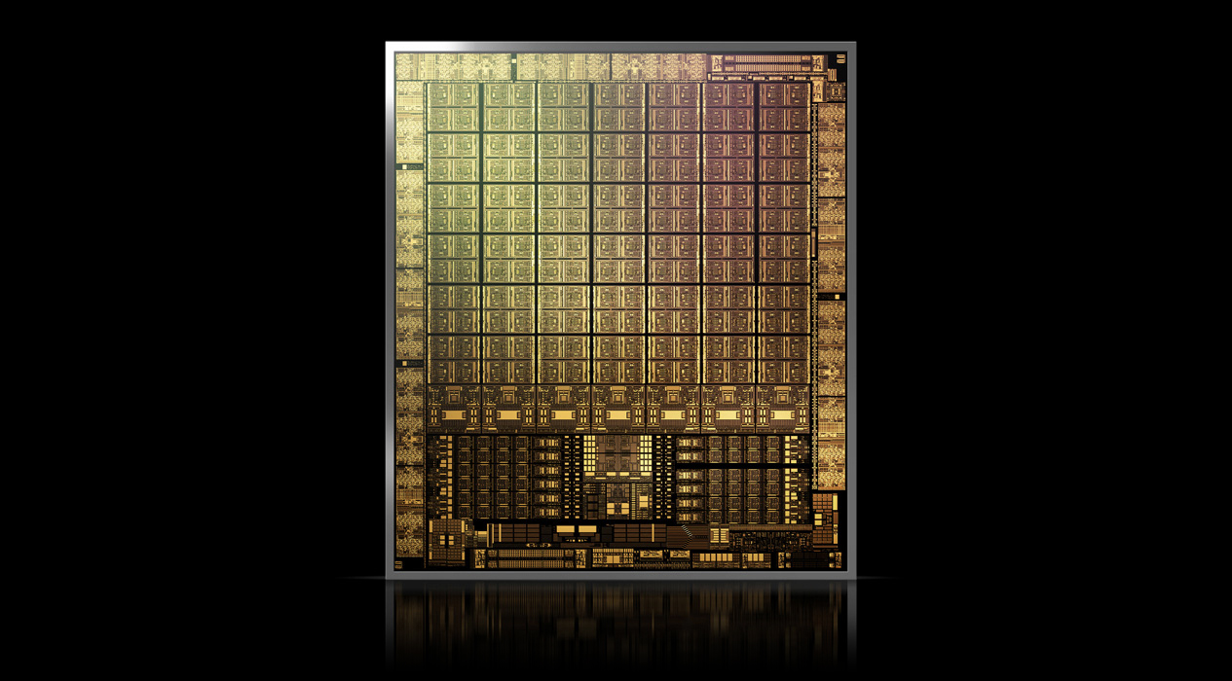
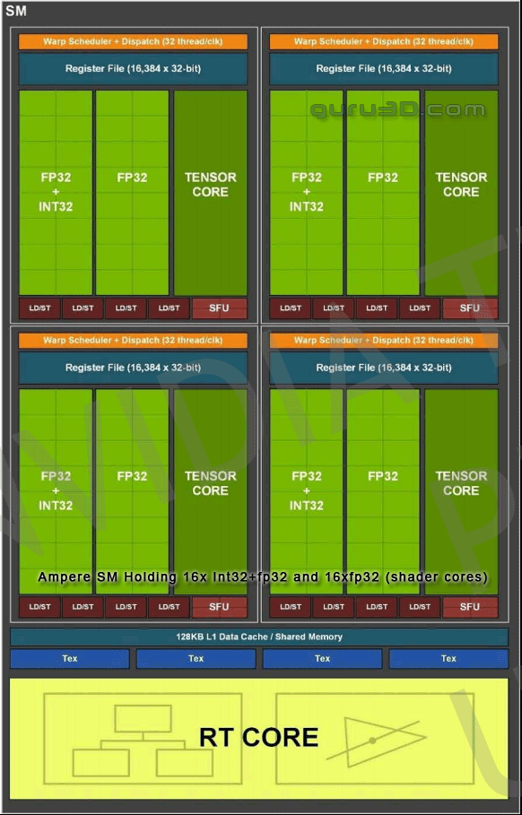
Opticks will only run on:
NVIDIA® hardware and NVIDIA® software
Software: NVIDIA® CUDA, OptiX
OptiX 6: allows to select/deselect RTX
OptiX 7: RTX cores are used when present
(RTX is not usually available on HPC systems)
 | Graphics card | Data center GPU
 | GeForce RTX 3090 | A100
architecture | NVIDIA Ampere | NVIDIA Ampere
Compute capability | 8.6 | 8.0
CUDA cores | 10,496 | 8192
Boost Clock | 1,7 GHz | 1.41 GHz
Memory | 24 GB | 40GB
Memory bandwidth | 936 GB/sec | 1555 GB/sec
RT cores | 82 (2nd-gen) | none
Tensor cores | 382 (3rd-gen) | 432 (3rd-gen)
Shared Memory size | 64kB | up to 164 kB
RT core: based on bounding volume hierarchy (BVH), a commonly used acceleration structure in ray tracing, ray-triangle intersection.
6
Hans Wenzel Integration of Geant4 and Opticks / CHEP 2023 May 8 to 12, 2023

Slide 7
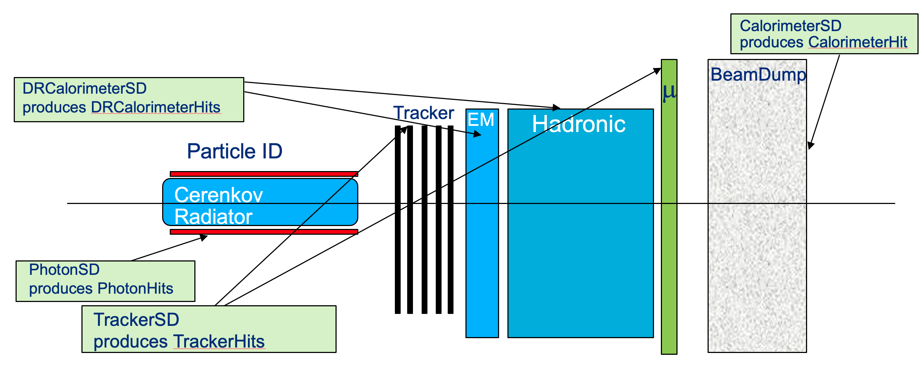
CaTS: Calorimeter and Tracker Simulation
Advanced Geant4 example application (introduced with Geant4 11.0).
No changes to Geant4 required to integrate Opticks! Only make use of provided interfaces: UserActions, Sensitive Detectors...
Modular and extendible, allows to build detector setups from predefined components.
Use GDML with extensions for flexible Detector construction. GDML extensions are used to:
Assign sensitive detectors to logical Volumes. A library of various sensitive detectors is provided.
Assign step-limits and energy cuts to logical Volumes.
Assign visualization attributes.
Creation of Hit collections and ROOT IO based IO thereof is automated.
Currently supports legacy/new Opticks interface.
Uses G4PhysListFactoryAlt to define and configure physics at runtime via command line option
../CaTS -g simpleLArTPC.gdml -pl 'FTFP_BERT+OPTICAL+STEPLIMIT' -m time.mac
G4(CX)Opticks/Geant4 is a runtime/build time option.
Collection of Scintillation and Cerenkov Gensteps by Geant4.
https://geant4.kek.jp/lxr/source/examples/advanced/CaTS/,
https://github.com/hanswenzel/CaTS (development)
Detector setup example:
7
Hans Wenzel Integration of Geant4 and Opticks / CHEP 2023 May 8 to 12, 2023

Slide 8
Recent developments
Re-implementing Opticks for OptiX ® 7 required huge changes due to the new and very different OptiX ® 7 API → This gave an opportunity to redesign the Opticks code. Goals of re-implementation: flexible, modular GPU simulation, easily testable, less code. For details see previous presentation.
CaTS has been modified to use the new Opticks API. The CaTS workflow has been adjusted accordingly. User Actions were utilized → no changes to Geant4 itself required.
CaTS/Opticks were modified to work with Geant4 API changes introduced in 11.1.
With legacy versions of Opticks (based on Optix 6) we observed speed ups in the order of 2x10² . Evaluation and optimizing the performance with recent updates is in progress.
Figure from Simon Blyth’s presentation
8
Hans Wenzel Integration of Geant4 and Opticks / CHEP 2023 May 8 to 12, 2023

Slide 9
CaTS workflow using the new version of Opticks based on OptiX®7:
CaTS/Geant4 (host/CPU)
G4CXOpticks (host/device)
.mac G4 macro
Main: Configuration
call
CPU context:
.gdml
(subset of Geant4 shapes)
Detector Construction
SeventConfig: set Opticks Parameters
call
Stepping Action:
Genstep harvesting
#Photons > MaxPhotons → simulate
Add Hits to Geant4 Hit Collections
G4CXOpticks::SetGeometry(world): translate Geometry to one that’s optimized for ray tracing.
GenSteps
Hits
GPU context:
End of Event Action:
Simulate the remaining Photons
Add Hits to Geant4 Hit Collections
Write Hits to root file
G4CXOpticks::simulate()
GenSteps
Generate and propagate
Cerenkov and Scintillation photons
Hits
Rootfile: TTree
Event 1: PhotonHits. ……
Event 2: PhotonHits. ……
Event 3: PhotonHits. ……
Figure from Simon Blyth’s presentation

Slide 10
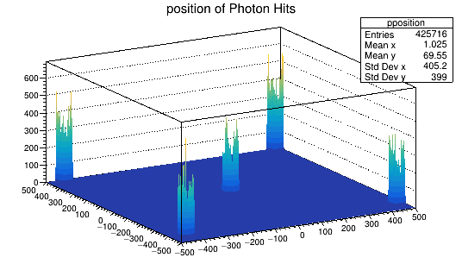
Performance:
Hardware:
CPU | Intel® Core i9-10900k@ 3.7 GHz, 10 CPU cores
GPU | NVIDIA GeForce RTX 3090 @ 1.7 GHz, 10496 cores
Software:
Geant4: 11.0, Opticks based on OptiX® 6
Number of CPU threads | Geant4 [sec/evt] | Opticks [sec/evt] | Gain/speed up
1 | 330 | 1.8 | 189x
Figure from Simon Blyth’s presentation
→It becomes feasible to run full optical simulation event by event!
10
Hans Wenzel Integration of Geant4 and Opticks / CHEP 2023 May 8 to 12, 2023

Slide 11
artg4tk/larg4: making Opticks available to the LArTPC Experiments
LArSoft
artg4tk:
General Geant4 module for the art Event Processing Framework used by various Fermilab experiments: https://github.com/art-framework-suite/art-g4tk
Very flexible. Geant4 User Actions (Stacking, Stepping, Tracking, Event, Run…) are implemented as Art Framework Services which can be selected and configured at run-time.
Physics and Detector configuration is identical to CaTS.
Geant4 data objects (e.g. Hits) are added to the RootIO based art event record.
LArG4
artg4tk
Opticks
Geant4
art
CLHEP
larg4: is based on artg4tk. It is a module for LArSoft: https://larsoft.org/about-larsoft/. All LArSoft dependencies (e.g. lardata objects) are encapsulated here: https://github.com/LArSoft/larg4
In the process of integrating Opticks with artg4tk/larg4,
Figure from Simon Blyth’s presentation
Figure from Simon Blyth’s presentation
11
Hans Wenzel Integration of Geant4 and Opticks / CHEP 2023 May 8 to 12, 2023

Slide 12
Summary
Geant4 advanced example CaTS was made available.
It demonstrates a Geant4 hybrid workflow where the generation and tracing of optical photons is offloaded to a GPU using Opticks, while the rest of the simulation is done on the CPU.
Modified Opticks to work with the latest version of Geant4 (v11.1.p01).
In the process of integrating Opticks with artg4tk/larg4 to make it available to the LArTPC based experiments.
Figure from Simon Blyth’s presentation
Figure from Simon Blyth’s presentation
12
Hans Wenzel Integration of Geant4 and Opticks / CHEP 2023 May 8 to 12, 2023

