Slide 1
The ESCAPE Collaboration: long-term perspective
Giovanni Lamanna
LAPP, Laboratoire d’Annecy de Physique des Particules, CNRS-IN2P3
CHEP 23– 8th May 2023

Slide 2

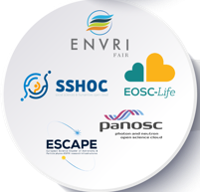

Rationale for ESCAPE
The H2020 cluster concept introduced by the European Commission, in 2018 was aimed at supporting:
“Open-science data-intensive research” in order to “rise productivity of researchers and to lead to new insights and innovation”
Commit in Open Science that means implement the FAIRness of scientific data
Connecting ESFRI and other world-class RIs to EOSC – European Open Science Cloud
ESCAPE is one of the five Science-Cluster projects that resulted from the H2020 topic call INFRAEOSC-04-2018
Other Science Clusters: ENVRI-FAIR (Environment and Earth Sciences), EOSC-LIFE (Biomedical Science),
PANOSC (Neutron and light sources facilities) and SSHOC (Social Science and Humanities).
Recognising synergies between HEP, Nuclear Physics, Astronomy, Cosmology, …:
Common Data Centres
Common Funding agencies
Overlapping community
Good experience with the precursor cluster ASTERICS
between Astroparticle physics and Astronomy (without HEP)
Giovanni Lamanna

Slide 3

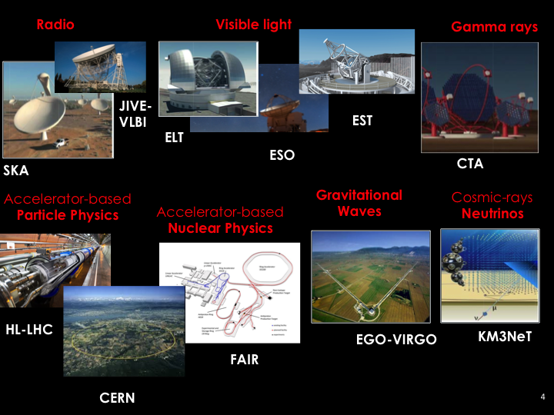
ESFRI and other large RIs in ESCAPE

Slide 4
ESCAPE: Astronomy and Particle Physics ESFRIs
Aligned expectations
  Large volume data generators (up to multi-Exabyte scale level).
  “Observatory” and “Facility” type of operation require global open access and long-term sustainability of research data.
  The astrophysics and the accelerator-based particle/nuclear physics ESFRI facilities join in a multi-probe approach towards the understanding of the Universe:
    addressing expectations of new generation of researchers for a “virtual space” - sharing workflows and interoperable data;
    acknowledging commitment of scientists (on transversal research).
  Engage with society and citizens.
Enhance coordination
  Leveraging two major complementary excellences in data stewardship:
    the astronomy Virtual Observatory infrastructure;
    long-standing expertise of the HEP community in large-scale distributed computing and big-data management.
  Operating a shared open innovation environment, adopting and enhancing FAIR/Open-Science principles.
Giovanni Lamanna

Slide 5
Common challenges
Management of Exabyte-scale science data (and associated tools, networks, infrastructure).
Move from “simple” x86-like clusters to very heterogenous resources:
  Use of HPC and Exascale computing resources.
Infrastructures & centres likely to be common between HEP & Astronomy, Astroparticle, GW, Cosmology, etc.
Software challenge (associated with the above):
  How to easily move code between various compute resources, validate correctness, adapt to new architectures, etc.
  HSF as a collaborative mechanism (also for cross-fertilization) –> lots of interest
Develop and retain skills in software and computing:
  In the scientific community – as well as with specialists.
  Issue of recognition in academic environments.
Giovanni Lamanna

Slide 6































ESCAPE H2020 consortium
31 partners including 2 SMEs
10 ESFRI projects & landmarks: CTA, EST, FAIR, HL-LHC, KM3NeT, SKA, LSST, VIRGO, ESO, JIVE
2 pan-European International Organizations: CERN, ESO with their world-class established infrastructures, experiments and observatories
2 European Research Infrastructures: EGO and JIV-ERIC
1 involved initiative/infrastructure: EURO-VO
4 supporting European consortia: APPEC, ASTRONET, ECFA and NuPECC
Budget: 15.98 M€
Started: 1/2/2019
Duration: 48 months (end date 31/1/2023)
Coordinator: CNRS-LAPP
Giovanni Lamanna

Slide 7
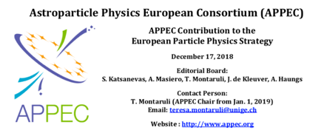
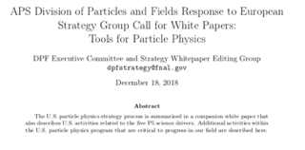
The 2020 European Strategy
ESCAPE acknowledged as an example of a real synergistic cooperation scheme in the 2020 European Strategy for Particle Physics
Giovanni Lamanna
7

Slide 8
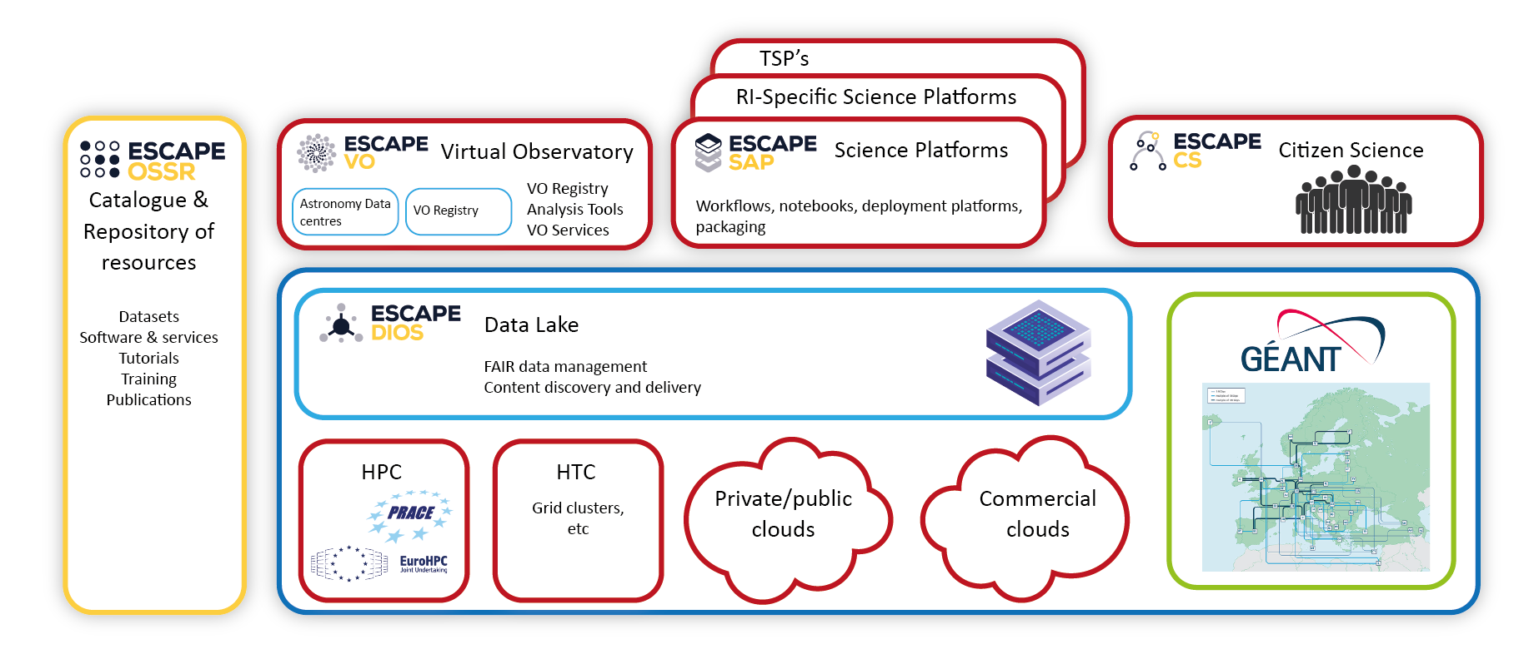
ESCAPE work programme aimed at building a
domain-based implemetation of EOSC
Science Platforms:
Flexible science platforms to enable the open data analysis tailored by and for each facility as well as a global one for transversal workflows.
Virtual Observatory:
Extend the VO FAIR standards, methods and to a broader scientific context; prepare the VO to interface the large data volumes of next facilities.
Citizen Science:
Open gateway for citizen science on ESCAPE data archives and ESFRI community
ESAP
Data Lake:
Build a scalable, federated, data infrastructure as the basis of open science for the ESFRI projects within ESCAPE.
Software Repository:
Repository of "scientific software" as a major component of the “data” to be curated in EOSC.
Giovanni Lamanna

Slide 9
High Level Key project results
Prototyped a full Exabyte-scale Data Management (Storage, Transfer and Access) Service with common AAI framework for distributed scientific computing;
  validated by ESFRIs through Data Challenges
Developed a catalogue to publish digital scientific products of ESCAPE communities;
  onboarded into EOSC portal
Developed interoperability standards for astronomical data services as well as tools and services based on IVOA standards
  VO services prepared to be integrated with EOSC
Produced a reusable analysis toolkit for integrating diverse service offerings, and a Virtual Research Environment prototype that integrates ESCAPE services
  A number of RI’s using tools in their analysis frameworks
Developed and produced training materials/schemes, and ran a number of highly successful schools and workshops
Several Citizen Science projects built upon ESCAPE developments, and attracted significant interest/involvement
Dark Matter and Extreme Universe Science Projects as demonstrations of Open Science in ESCAPE
  and integration with EOSC platform through EOSC-Future
Giovanni Lamanna

Slide 10
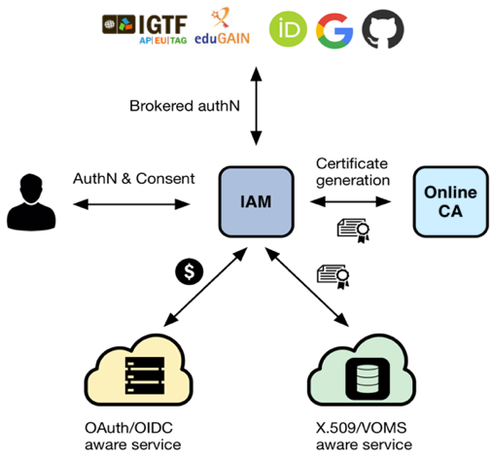
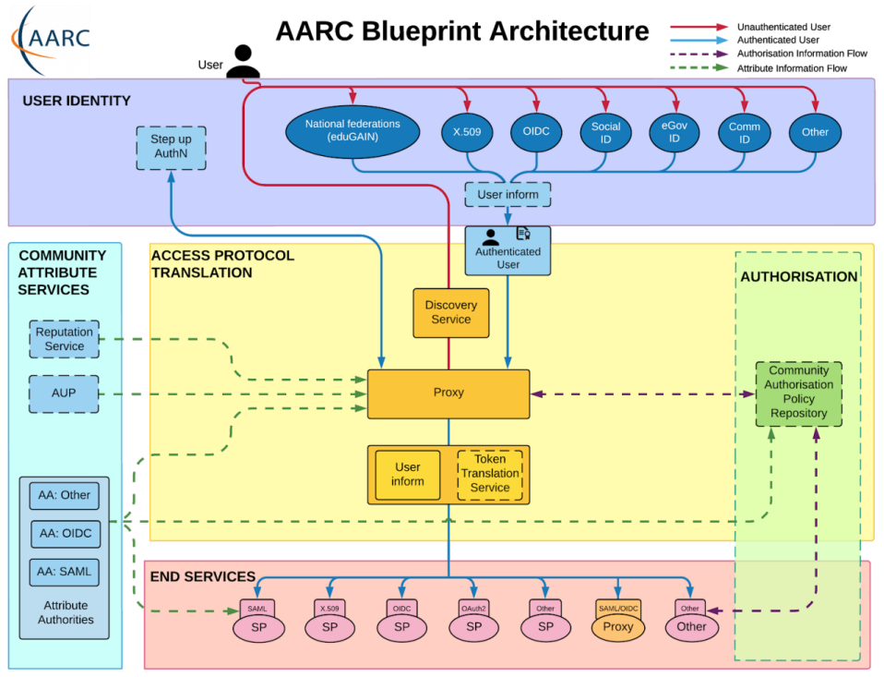
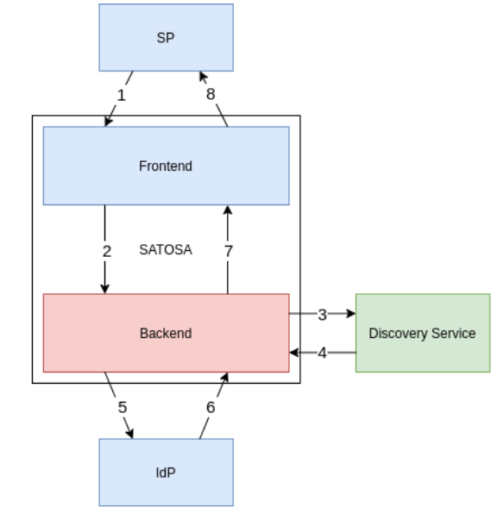
ESCAPE AAI – part of EOSC AAI Federation
ESCPE AAI
Hybrid – supports legacy infrastructure while migrating
ESCAPE AAI (IAM) is now part of the EOSC AAI federation
An additional proxy was required, now in place and tested – model for other communities that may need similar
ESCAPE has also demonstrated interoperation with FENIX HPC –
Step towards complex workflows using cloud, clusters, and HPC
Eventually should be part of the overall Federation
Building the AAI Federation is complex and takes time
Proxy to translate between OID/OAuth2/SAML
10
Giovanni Lamanna
Notes:
AAI follows the blueprint of the FIM4R/AARC working groups
being implemented across e-infrastructures globally
Migration to token-based AAI
Migration will take time; translation will be needed for some time
EOSC/EOSC-Future integrate the same model (as do other cyber- and e-infrastructures)
Important to maintain the existing trust networks

Slide 11
Next generation Data Infrastructure for Open Science (DIOS) - key concepts
➔ Help ensure FAIRness of scientific data
Idea is to localize bulk data in a cloud service:
  minimize replication, assure availability, minimize costs
  Hide complexity – transparent access to data – users see single entry point
Policy-driven data replication and distribution → Manage the data life-cycle
Distributed (federated) storage for reliability, accessibility, sustainability
  Think of a “RAID” configuration across storage sites, with QoS
  Allows to integrate private and commercial storage – if a storage goes away data is automatically (by policy) replicated
Federation through token-based AAI
Secure – AAI & policy allows embargoed or private data as well as public/open
Serving data, remote, cached, streaming, to heterogeneous compute facilities
  remote (or local) compute – grid, cloud, HPC, etc.
  Simple caching is all that is needed at compute site – data is local when it is needed
Works at national, regional, global scales
➔ Designed to support Exabyte scale, but model
applies to all volumes
➔ No special services needed at cloud or HPC sites
11
Giovanni Lamanna

Slide 12
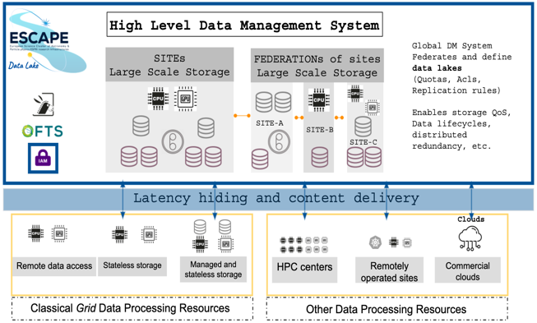








Federated data infrastructure: Data Lake concept
See talk 09/05, M. Lassnig - Extending Rucio with modern cloud storage support: Experiences from ATLAS, SKA and ESCAPE
See talk 11/05, M. Wadenstein - Nordic Data Lake Success Story
Storage Orchestration Services
Storage
Asynchronous
Data Transfer
Services
Storage
Minimize cost of storage (hw+ops)
Benefit from the network capabilities
Data (Lake)
Infrastructure
Distributed Storage
Storage
Storage
Volatile
Storage
Storage
Content Delivering and Caching Services
Data Center
Data Center
Grid Compute
Grid Compute
Cloud Compute
HPC
Compute
@HOME
Grid Compute
Compute
Infrastructure
Compute Provisioning
Followed by a full scale Data and Analysis Challenge performing production-like Data Management, Processing and Analysis workloads including interplay possibilities using large scale resources (batch systems and clouds) and user-analysis oriented platforms (online notebooks and analysis platforms).
Giovanni Lamanna

Slide 13
Open Science Software Repository (OSSR)
  Deployment of the Open-source ESCAPE catalogue of resources (data and software)
Shared domain-based open science software and services based on FAIR principles
Objectives:
  Facilitate and support continuous development, deployment, exposure and preservation of partners’ software/tools/services
  Foster interoperability, software re-use and cross-fertilisation between ESFRIs (e.g. simulation)
  Offer an open innovation environment for open standards (e.g. workflows, data-formats), common regulations and shared (novel) software for multi-messenger & multi-probe data
eOSSR library https://gitlab.in2p3.fr/escape2020/wp3/eossr
  incorporates all OSSR developments, based on the commonly defined practices and standards
  python-based
  OSSR API : send request to the OSSR, find and filter software and services, upload new entries, update existing entries
  CI : automated upload / update using gitlab CI
  Metadata : schema definition, crosswalk between CodeMeta and Zenodo, generator and validator available
Giovanni Lamanna

Slide 14
Work programme and key results: Science Platforms
Development of the ESFRI Science Analysis Platform: a toolkit for building platforms through which users can discover and interact with the data products, software tools, workflows, and services that are made available through ESCAPE.
Preparing ESFRI services, data products, and tools for integration with ESAP and their subsequent use within ESCAPE and EOSC.
Giovanni Lamanna

Slide 15
Work programme and key results: Science Platforms
Demo system
https://sdc-dev.astron.nl/esap-gui
Giovanni Lamanna

Slide 16
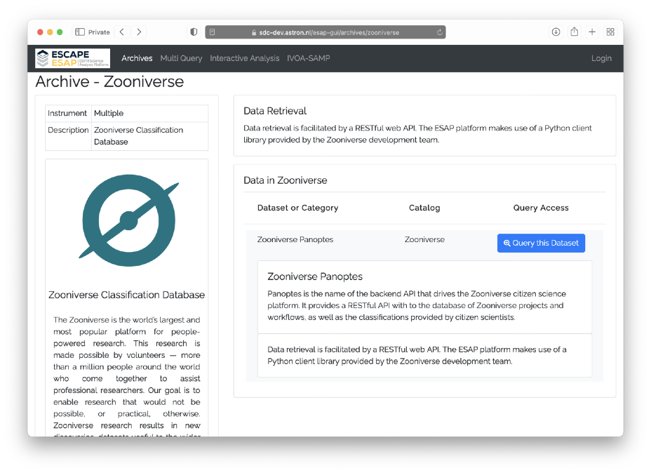
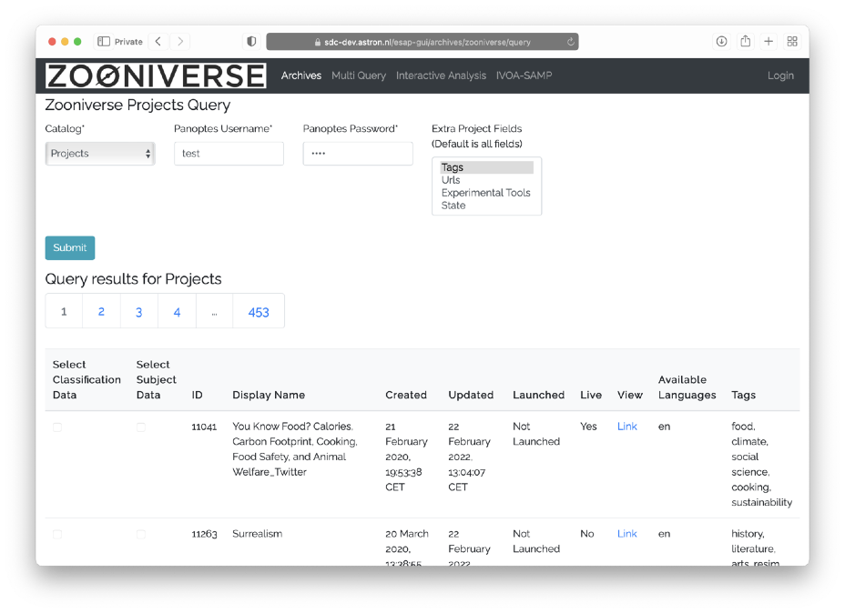
Work programme and key results: Citizen Science
Several Citizen Science projects built upon ESCAPE developments.
Full integration of ESAP with the ESCAPE Zooniverse “Panoptes” system.
Giovanni Lamanna
16

Slide 17
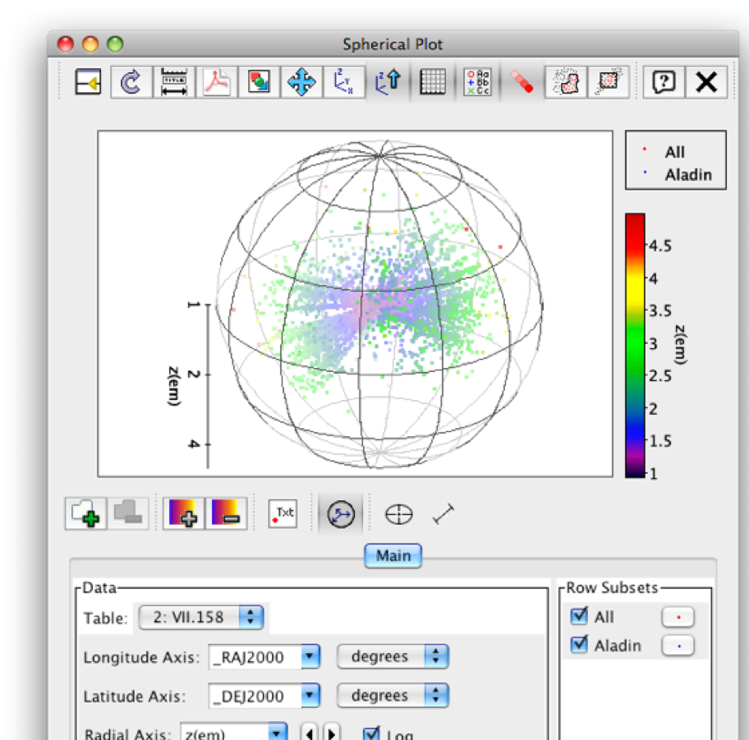
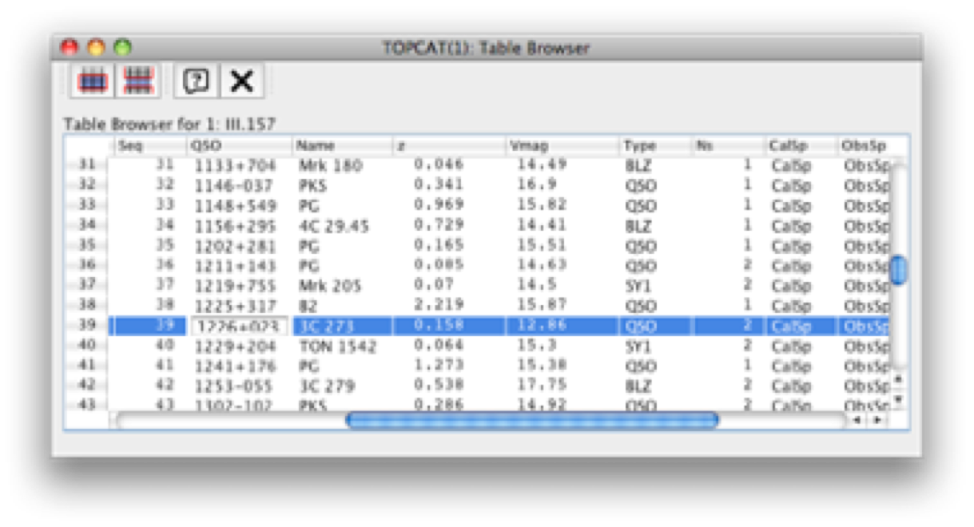
Work programme and key results: VO
Enables a Virtual Research Environment of interoperable tools and services based on IVOA standards, including ESO Science Archive and ESO Science Portal
Giovanni Lamanna

Slide 18

Broader synergies with other research clusters
Five thematic
Science Clusters
created under
INFRAEOSC-04-2018
(80% of ESFRI RIs)
https://www.projectescape.eu/sites/default/files/Escape_position_statement_web.pdf
https://zenodo.org/record/3675081 - .X2R2PJNLhTY
https://indico.in2p3.fr/event/24327/
https://zenodo.org/record/4889503
Giovanni Lamanna

Slide 19


European Landscape
Giovanni Lamanna

Slide 20
ESCAPE, for Open Science Projects
Strengthening multidisciplinary collaborations
among young researchers on open-science projects
First set of Open Science Pilot Projects proposed to demonstrate multi-domain science integration across ESCAPE
  demonstrate new cutting edge open science capabilities, making use of the services implemented within ESCAPE
  benefit real science goals in exploring synergies between the ESFRIs and largely among three scientific communities Astrophysics/Astroparticle, accelerator-based Particle and Nuclear Physics (supported by consortia of EU member states research agencies and institutes within JENAA)
1. Dark Matter Science Project
2. Extreme Universe (& Gravitational waves) Science Project
ESCAPE part:
about 2 M€
250 PMs
10 institutes
Giovanni Lamanna

Slide 21
Implementing the ESCAPE disciplinary EOSC-cell
The ESCAPE “EOSC-cell” for a three-fold impact:
  a FAIR digital environment dedicated to scientists at large to interoperate data and workflows for fundamental science;
  data management solutions mutually adopted by a large fraction of RIs and potentially extendible to further disciplines;
  the “EOSC Web of FAIR Data and Services for Science” for our disciplines
A Virtual Research Environment (VRE): thematic collaborative digital environment used by scientists, which enables FAIR community-based scientific research, training, innovation, cross-fertilisation and open science.
Evolving practices on the assessment of research giving increasing value to open science contributions and outputs beyond publications. A wide range of digital objects beyond publications, including data, software, code, workflows, and processes, such as open peer-reviews (requiring an enhanced traceability, coherent and comprehensive metrics and FAIRness of a wide range of digital objects).
Digital content added in order to :
Perform, explore, repeat, modify data-analysis; upload analysis results; publish new results
Rewarding scientists
The ESCAPE Virtual Research Environment prototype
to host the Test Science Projects
(and part of the EOSC Future project […])
Giovanni Lamanna

Slide 22

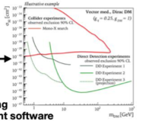
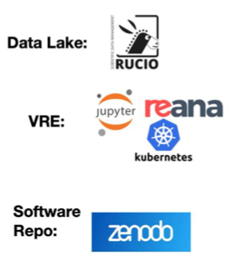

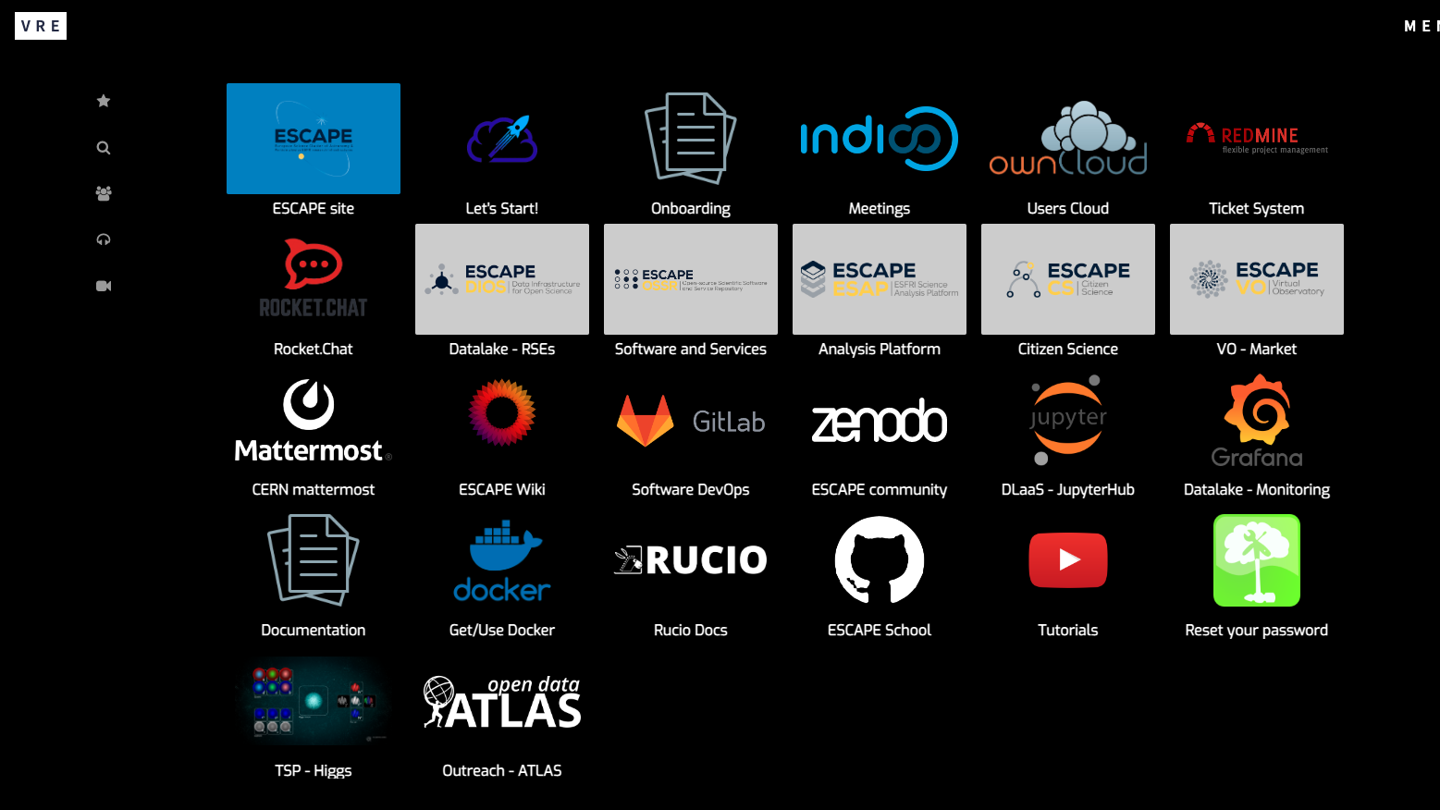
VRE: ESCAPE service composability and EOSC integration
See talk, 09/05, E. Gazzarrini - The Virtual Research Environment: towards a comprehensive analysis platform
ESCAPE AAI
AAI Federated with EOSC
Publish results to Zenodo
ESCAPE Data Lake (Federated storage)
Virtual Research Environment (VRE)
Hosts/ingests open data sources into a common store;
Includes EOSC Exchange provisioned storage
Virtual Research Environment
Cloud computing using EOSC Exchange provisioned compute, & HPC
Software Repository
Archive of reusable pipelines:
Onboarded to EOSC marketplace
EOSC Core:
+ Helpdesk as a service
(+monitoring)
(+accounting)
Giovanni Lamanna

Slide 23
Outlook for Science Clusters
The 5 Science Cluster projects are ending
However, synergies between them have been significant, and collaborative activity is increasing
Recently, all of the 5 have put in place long-term structures – through MoU or Collaboration Agreement
  E.g. ESCAPE has Collaboration Agreement signed by
  Directors of all the partner RIs
    → ESCAPE Open Collaboration
The Clusters have a common position and agree: they want to have effective mechanisms to enable cross cluster/cross-domain collaborations
  but not an additional layer of governance
Giovanni Lamanna

Slide 24
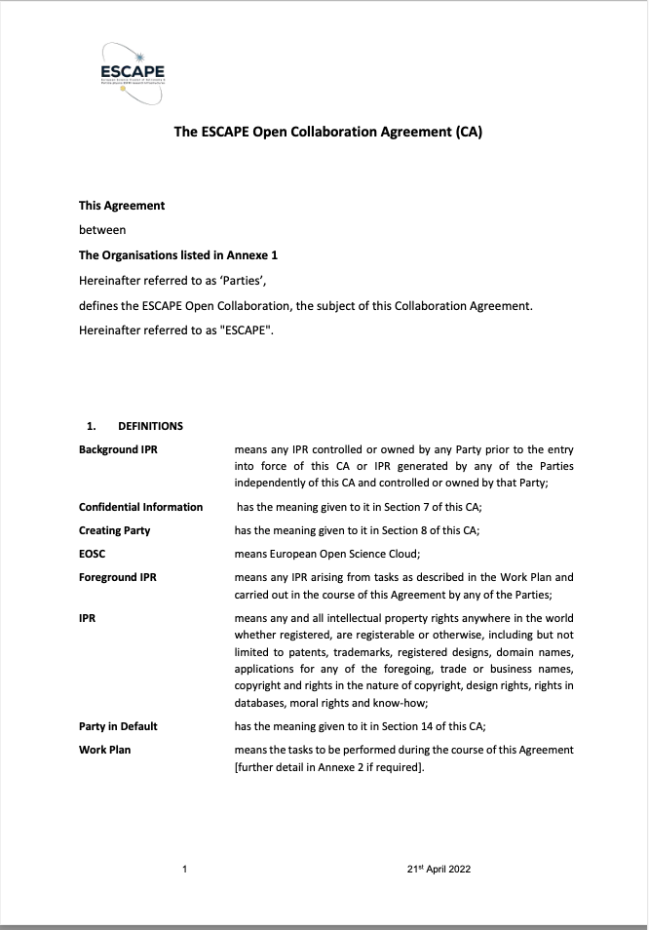
ESCAPE sustainability
From 1st Feb 2023 ESCAPE is an Open Collaboration
ESCAPE has a Collaboration Agreement signed by Directors of all the partner RIs
  The agreement came into effect at the end of ESCAPE project → ESCAPE Open Collaboration
  Recognises many synergies: communities, technical, coordination, political, funding …
  Common facilities (data centres, networks, etc.)
  OPEN: RI’s will join because they see a value in collaborating
  Synergies in tools used and requirements (e.g. large data) but recognise differences (metadata)
  Common science goals and challenges: (EU, DM, etc → JENAS)
  Imagine common future needs: AI technologies, Quantum etc., and how we apply them
  Political force towards EOSC, EC, etc. ⇒ representing a single/integrated community
Giovanni Lamanna

Slide 25
What will partners work on?
On topics that they would anyway work on, but now as a collaborative activity
  Better and more use cases → robustness, bigger user community, testing, support, …
  Don't invent new tasks - unless there is a clear overall benefit to the community
Share and build expertise
Pool resources for developments, training, support, etc.
Software artefacts should follow normal open source model,
  collaborative and open, no particular support implications
Don’t expect all RIs to run services for each other,
  perhaps AAI, OSSR could be community services, otherwise most likely separate instances.
  Use common tools, but not same instance of services
Giovanni Lamanna

Slide 26
Outlook & Opportunities
Anticipated funding calls in Horizon Europe; highly relevant and potentially important to us
  Building on the science cluster approach to ensure uptake by RIs and research communities
    Consolidation and new Science projects;
    Clusters expected to work together; bring in new world-class RI, and others via open calls and cascading grants
  Development of community-based approaches for ensuring and improving quality of scientific software and code
    Framework for community curation across disciplines
    Limited scope for innovation or development
    But highly relevant to all clusters: examples of previous work HSF, SIDIS, software carpentries, training materials and schools, career development of young scientists specialising in software and computing
Also anticipated tender from EC for procurement of EOSC services
  Operation of core and exchange services, provision of resources, etc.
  PIN was issued, calls for tender in September/October?
Giovanni Lamanna

Slide 27
Where do we go now?
Set up the ESCAPE Collaboration as a long term sustainability mechanism for the cluster
  Continue to support and develop the ESCAPE project outcomes
Work with other clusters to guide the EOSC in a direction that fulfils the needs of science in Europe:
  Adds value to scientific RIs
  Enables and facilitates Open Science and exploitation of FAIR data
Prepare new collaborative ventures – across clusters – to help build and develop the EOSC ecosystem
Giovanni Lamanna

Slide 28
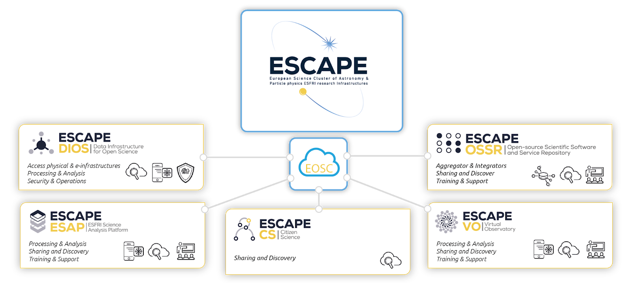

The new ESCAPE Collaboration work programme
Instances
CC
Operating the community-based “Competence Center” for EOSC-alignment, train and support, extended outreach, financial model for services and networking with other SCL-CCs
EVSI
R&I for an “European Virtual Institute for Research Software” for advanced technologies
VRE services
Programmes
COSO
Challenging “Open Science Objectives” by RI commitments in Open Science Projects (OSP) as well as Cross-Cluster Open Science Projects (COSP)
TECH
Bring the FAIRness within technology, R&D and innovation projects as well as explore new “close-to-sensors” low-latency open-data science
CARS
Career development and rewarding for researcher committing in Open Science. Planning, tracking, and assessing scientific knowledge production
SDSS
Building synergies on “Sector Data Spaces” for Society: Green deal, Health, Manufacturing, Education and Skills
Giovanni Lamanna

Slide 29
Conclusions
In HEP and through ESCAPE a next generation data infrastructure is being developed and deployed
  Strong collaborations with other scientific domains
Based on 20 years of experience with >100-PB scale data,
  it is designed for the Exascale era, but suitable for all data scales
It will help support the FAIRness and openness of scientific data
EOSC deployment is progressing in parallel with policy and governance development
  Science Clusters together with EOSC-Future and associated infrastructure projects
Essential that science RIs and organisations engage and ensure the direction is appropriate and useful
  Experience shows that science must be the driver and infrastructure must be able to respond to changing needs
  We must also help define the long term funding model that is appropriate for our funding mechanisms and communities
EOSC is a complex landscape, but the benefits can be significant
Giovanni Lamanna

Slide 30
Thank you
Giovanni Lamanna

Slide 31






ESCAPE OSSR Workflow
publishes source code
(updates your existing record with new versions)
long term archived
findable
citable
publishes
image
develop/maintain software
tag a version(release)
add metadata
let the CI do the rest
registers
image
integrates into ESCAPE EOSC cell
builds a
container image
Giovanni Lamanna

Slide 32
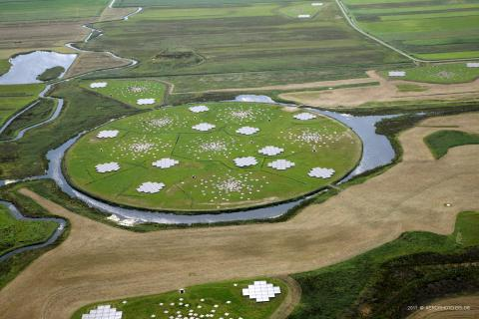
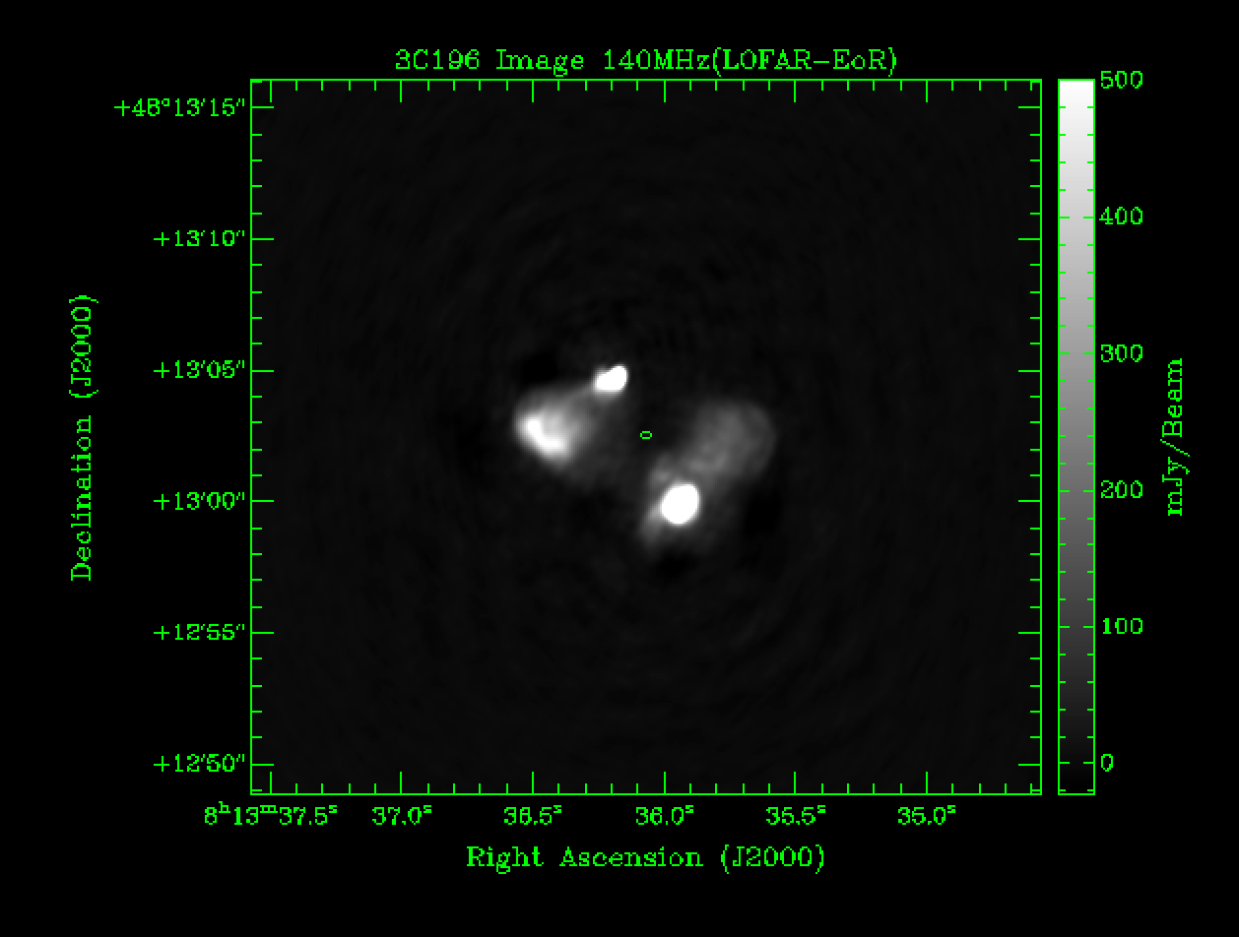
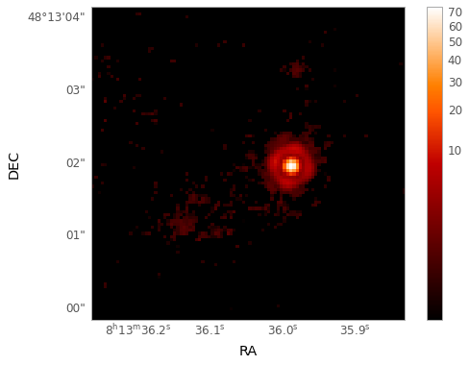
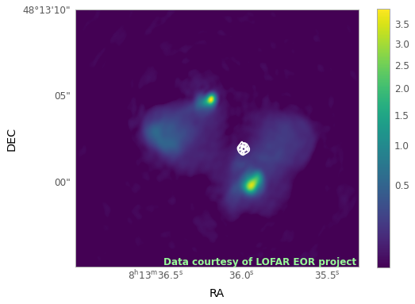
First functional Data Lake implementation
Followed by a full scale Data and Analysis Challenge performing production-like Data Management, Processing and Analysis workloads including interplay possibilities using large scale resources (batch systems and clouds) and user-analysis oriented platforms (online notebooks and analysis platforms).
Full-cycle scientific data management and data processing
1. Data injected to the DL from three radio source observations
in external locations
2. User in external
location download
the data, process and store results back to the DL
3. User interested in combining results
stored with other public data to cover also visible spectrum
5. Optical and radio data aggregate in via the ESAP (WP5), combined analysis done. Results uploaded back to the DL.
4. Combined optical data from the Hubble
located via the VO (WP4)
From left to right: Radio image, Optical image and the Combined image (LOFAR with optical contours)
Giovanni Lamanna

Slide 33
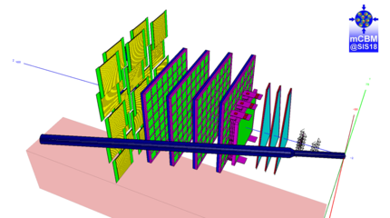
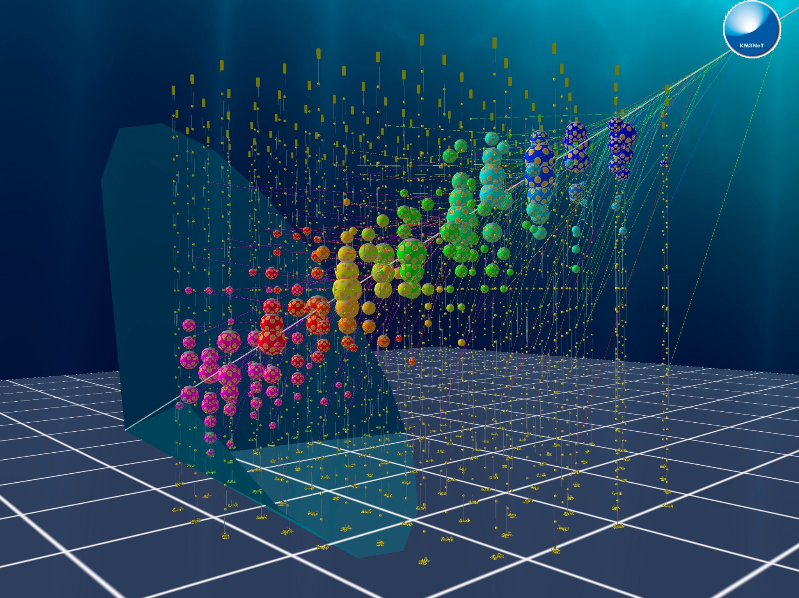
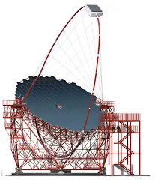
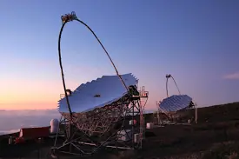
First functional Data Lake implementation
Followed by a full scale Data and Analysis Challenge performing production-like Data Management, Processing and Analysis workloads including interplay possibilities using large scale resources (batch systems and clouds) and user-analysis oriented platforms (online notebooks and analysis platforms).
Raw data injected, stored and preserved in the DL. Data processed by users, results are stored back in the DL.
Offload data from the storage buffer in the coast, replicate across sites, run data calibration, store back. Data product ready for user consumption
Distributed data re-processing taken at remote locations (La Palma)
Giovanni Lamanna

Slide 34
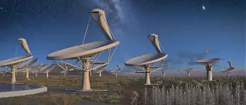
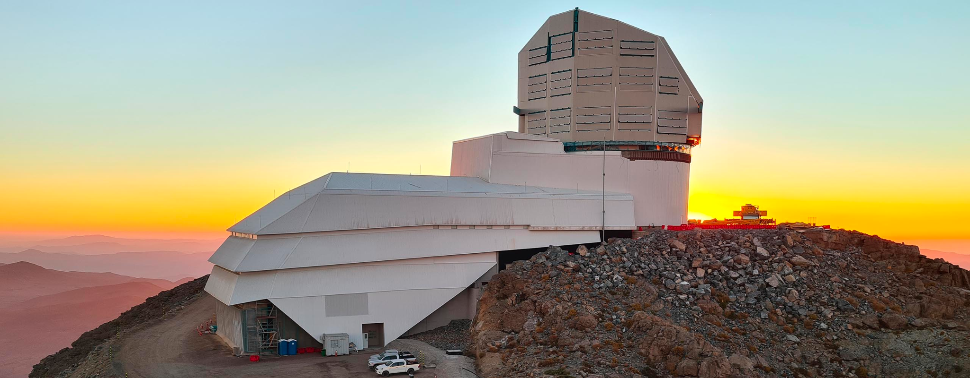

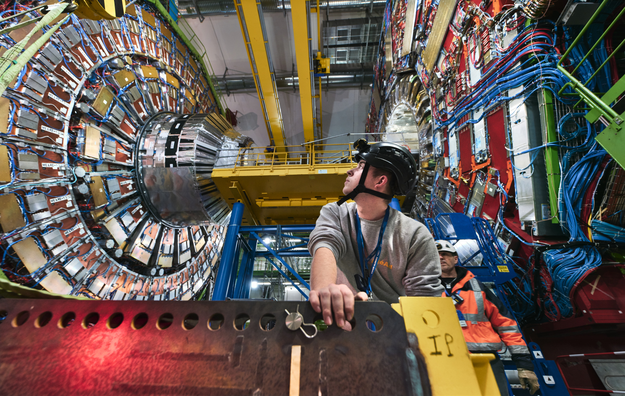
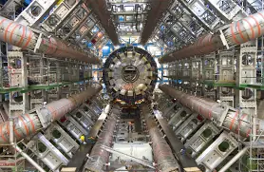
First functional Data Lake implementation
Followed by a full scale Data and Analysis Challenge performing production-like Data Management, Processing and Analysis workloads including interplay possibilities using large scale resources (batch systems and clouds) and user-analysis oriented platforms (online notebooks and analysis platforms).
Global-scale (Australia, South-Africa and Northern hemisphere sites )Data Management
Simulate observations and leverage telescope local storage data replication to fulfil daily data management cycles (incorporating SLAC in the data replication chain)
DL interface with local and heterogeneous resources (HPC), control access, caching and analysis
Large experiment demonstrating open data capabilities (with ad-hoc ATLAS open-data software)
Giovanni Lamanna

Slide 35
ESCAPE and the other Science Clusters in Europe
Acknowledged as a successful approach in “Making Science Happen”,
“Consolidation of The European RI Landscape” as well as an example of scheme for new coordinated focus by ESFRI.
Giovanni Lamanna

Slide 36
What should ESCAPE collaboration agree to support
ESCAPE IAM
  Need a common instance, for common infrastructure & testing
  Expect most RI’s to operate their own (& federate to EOSC)
    Communities will need to manage their own memberships
Data Lake testbed
  Agree to continue to operate a development service
  Need commitment from few sites to provide modest resources & support
OSSR service
  This is the ESCAPE software and service entry portal to EOSC
  Must foresee to maintain and operate for the community
Repository of software and tools
  Is this just github or …
Assume RI’s or experiments will run their own services
  Or use EOSC ones
Giovanni Lamanna

