Slide 1
Â
Michael Goodrich*, Carl Timmer*, Vardan Gyurjyan*,
David Lawrence*, Graham Heyes*,
Yatish Kumar⁺, Stacey Sheldon⁺
*JLAB
⁺ESnet

Slide 2
EJFAT: ESnet-JLab FPGA Accelerated Transport
What Problem Are We Solving?

Slide 3
EJFAT: ESnet-JLab FPGA Accelerated Transport
What Problem Are We Solving?
Process Experiments / Workflows with
Minimal Latency / Storage
Provide Timely Feedback to Source.

Slide 4
EJFAT: ESnet-JLab FPGA Accelerated Transport
What Solution Are We Pursuing?

Slide 5
EJFAT: ESnet-JLab FPGA Accelerated Transport
What Solution Are We Pursuing?
Decoupled Edge / Cluster(s) Environments
In-Network Acceleration
Intelligent Traffic Shaping / Data Steering
Horizontal Scaling / Dynamic Load-Balancing

Slide 6
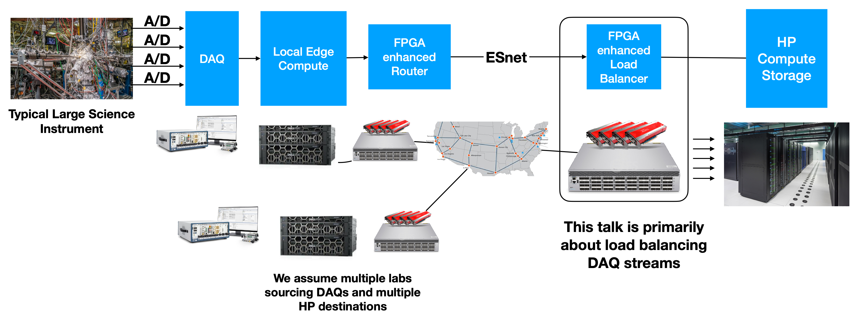
EJFAT: Accelerated Edge to Core Workflow Steering
Loss-less Tagged UDP Streaming
FPGA
Enhanced
NICs
(LB)
6

Slide 7
EJFAT: Accelerated Edge to Core Workflow Steering
Loss-less Tagged UDP Streaming
FPGA
Enhanced
NICs
(LB)
Geographic / Network Independence
7

Slide 8
EJFAT: Accelerated Edge to Core Workflow Steering
Loss-less Tagged UDP Streaming
Compression
FPGA Based Network Acceleration
Decompression
FPGA
Enhanced
NICs
(LB)
Geographic / Network Independence
8

Slide 9
EJFAT: Accelerated Edge to Core Workflow Steering
Loss-less Tagged UDP Streaming
Compression
FPGA Based Network Acceleration
Decompression
FPGA
Enhanced
NICs
(LB)
Indirection to Cluster
Geographic / Network Independence
9

Slide 10
EJFAT: Accelerated Edge to Core Workflow Steering
Loss-less Tagged UDP Streaming
Compression
FPGA Based Network Acceleration
Decompression
FPGA
Enhanced
NICs
(LB)
Indirection to Cluster
Geographic / Network Independence
Dynamic Compute Resource Load Balancing (PID/AI/ML)
10

Slide 11
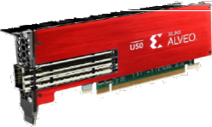
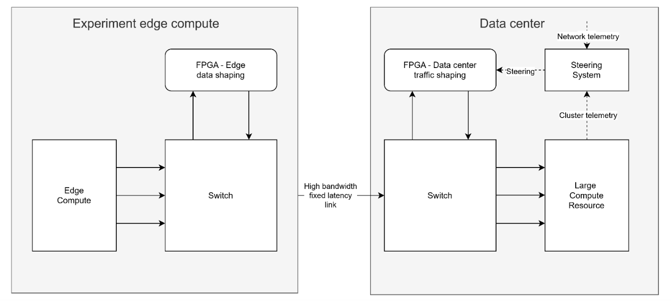
Layer 3 Load Balancer
Data Plane
Control Plane
Load Balancer
Edge Target
μSec
Host1
HostN
Uncoupled LAN,IT, ...
11

Slide 12
Layer 3 Load Balancer
Compress, UDP Fragment,
Tag (Events/Channels)
Load Balancer
Edge Target
μSec
Host1
HostN
Uncoupled LAN,IT, ...
12

Slide 13
Layer 3 Load Balancer
Compress, UDP Fragment,
Tag (Events/Channels)
Rewrite UDP Packet Header
Load Balancer
Edge Target
μSec
Host1
HostN
Uncoupled LAN,IT, ...
13

Slide 14
Layer 3 Load Balancer
Compress, UDP Fragment,
Tag (Events/Channels)
Rewrite UDP Packet Header
Load Balancer
Edge Target
μSec
Host1
Decompress, Reassemble, Process
HostN
Uncoupled LAN,IT, ...
14

Slide 15
Layer 3 Load Balancer
Compress, UDP Fragment,
Tag (Events/Channels)
Rewrite UDP Packet Header
Load Balancer
Dynamically
Load Balance
Edge Target
μSec
Host1
Decompress, Reassemble, Process
HostN
Uncoupled LAN,IT, ...
15

Slide 16
Steering/Scaling: Data Event -> Host Rotation
Colors → Events
Shapes → Channels (ROCs)
Load Balancer
μSec
Event Sequence
Event Sequence
Host1
HostN
Round Robin
Distribution
Across Hosts
16

Slide 17
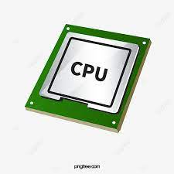
Steering/Scaling: Data Channel -> Host Port
Colors → Events
Shapes → Channels (ROCs)
Load Balancer
Channel Distribution
Across CPUs
(Fixed)
Event Sequence
Event Sequence
Host1
HostN
Host_{K}
17

Slide 18
Horizontal Scaling: Multiple LB Instances
Colors → Events
Shapes → Channels (ROCs)
Multiple Load Balancer FPGAs
Load Balancer
μSec
Event Sequence
Event Sequence
Host1
HostN
18

Slide 19
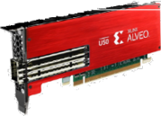
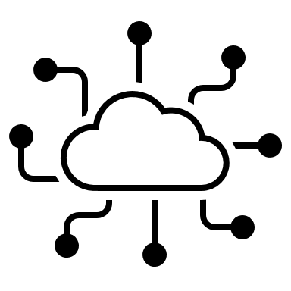
LB Control: CLAS12 Control Plane (CP) Simulation
FPGA
LB
CP
Schedule
µSec
Tagged UDP
Feedback
Switched UDP
Data
Source
Data Events
Switched UDP
Tagged UDP
Network

Slide 20
LB Control: CLAS12 Control Plane (CP) Simulation
FPGA
LB
CP
Schedule
µSec
Tagged UDP
Feedback
Switched UDP
M/M/1 Queue:
Needs 20% Spare Rate
Data
Source
Data Events
Switched UDP
Tagged UDP
Network

Slide 21
LB Control: CLAS12 Control Plane (CP) Simulation
FPGA
LB
CP
PID vs. RL/QL
Schedule
µSec
Tagged UDP
Feedback
Switched UDP
M/M/1 Queue:
Needs 20% Spare Rate
Data
Source
Data Events
Switched UDP
Tagged UDP
Network

Slide 22
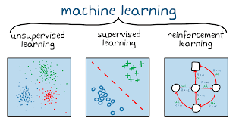
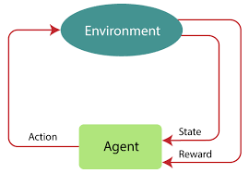
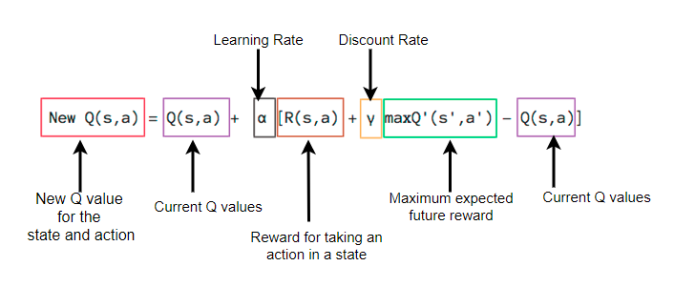
Schedule: Q (Reinforcement) Learning
Q Learning:
Many Variants
Exploration / Exploitation
Exploration → Learning
Exploitation → Control

Slide 23
Schedule: Q (Reinforcement) Learning
Q Learning:
Many Variants
Exploration / Exploitation
Exploration → Learning
Exploitation → Control
100%
FIFO Empty %

Slide 24
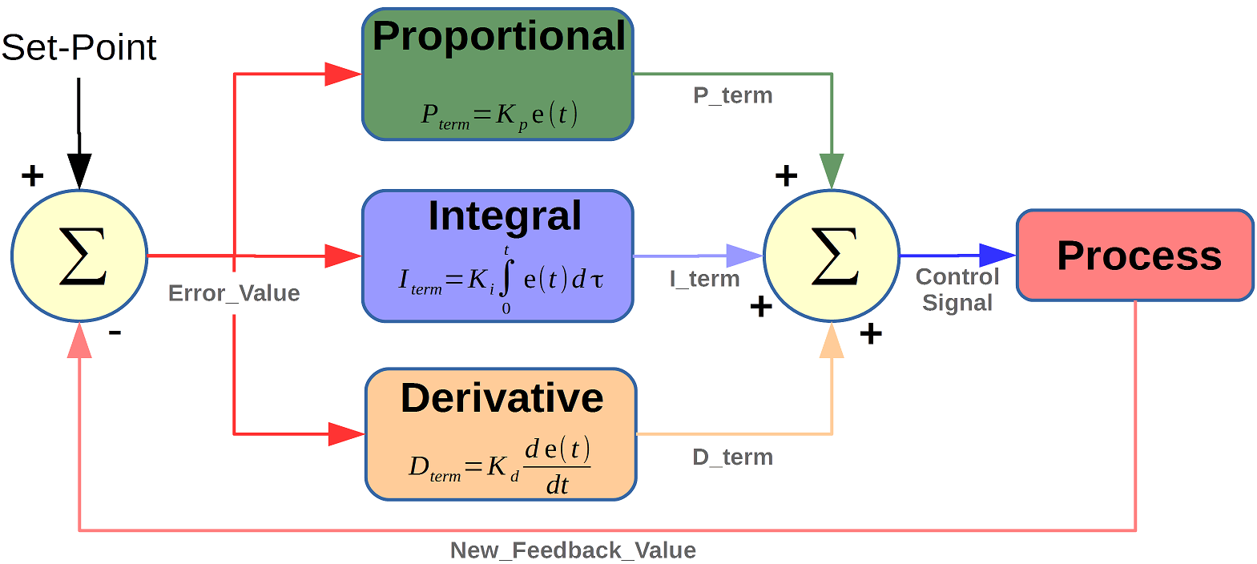
Schedule: PID Control

Slide 25
Schedule: PID Control
FIFO Full = 0%
Node Event Rate

Slide 26
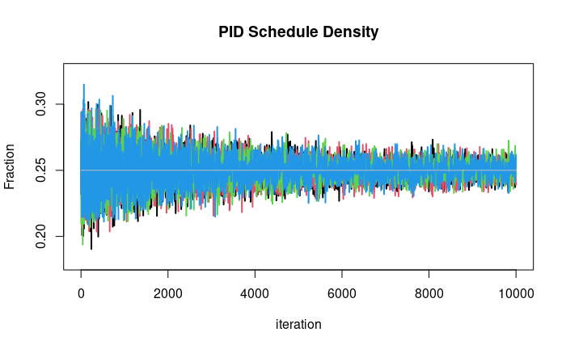
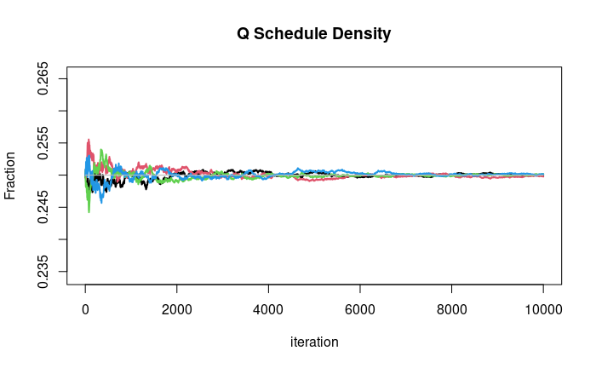
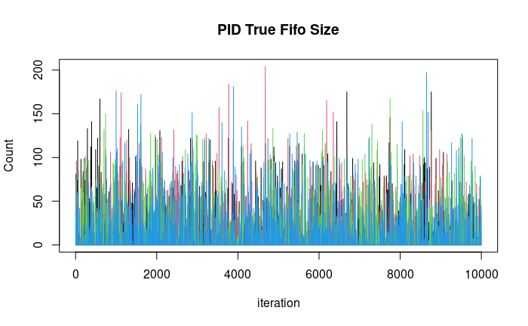
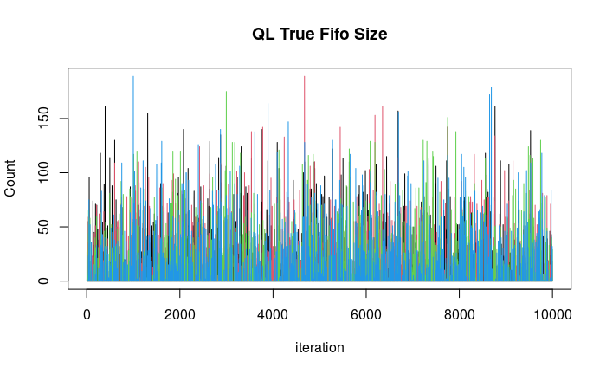
LB : Control Plane Simulation – Symmetric

Slide 27
LB : Control Plane Simulation – Symmetric
Sym | N1 | N2 | N3 | N4
EPR | 500 | 500 | 500 | 500
FEPR | 25% | 25% | 25% | 25%
PID | N1 | N2 | N3 | N4
SD | 25% | 25% | 25% | 25%
Db | 400 | 400 | 400 | 400
FIFO | 3.4 | 3.4 | 3.4 | 3.4
QL | N1 | N2 | N3 | N4
SD | 25% | 25% | 25% | 25%
Db | 400 | 400 | 400 | 400
FIFO | 3.2 | 2.9 | 2.9 | 3.0
EPR=Event Processing Rate
Db=Event Disbursement Rate
SD=Schedule Density

Slide 28
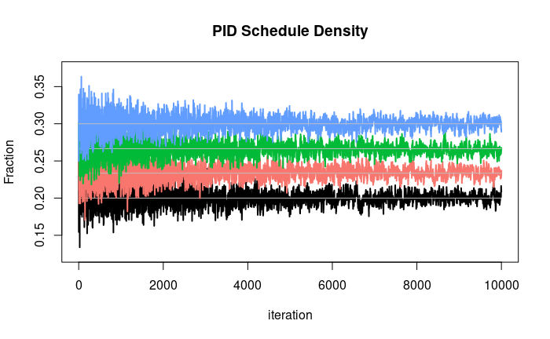
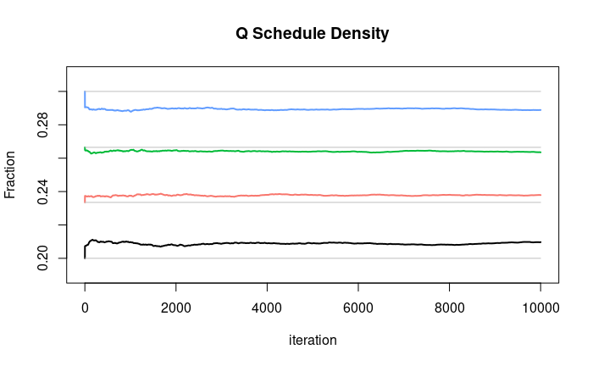
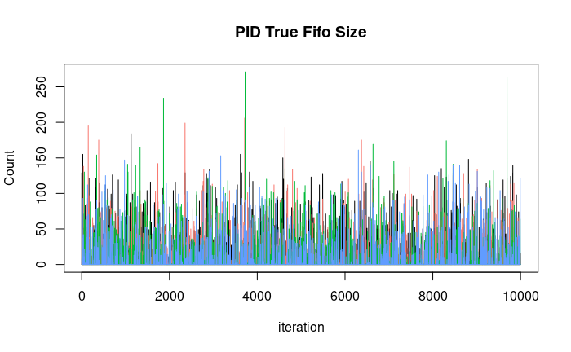
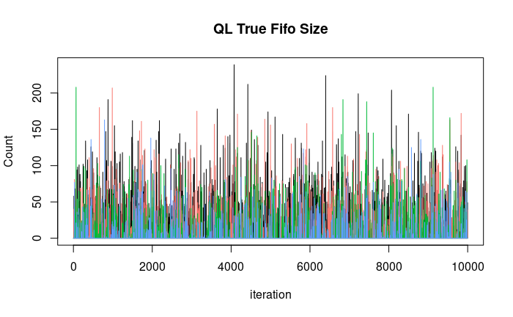
LB : Control Plane Simulation – Asymmetric

Slide 29
LB : Control Plane Simulation – Asymmetric
ASym | N1 | N2 | N3 | N4
EPR | 400 | 467 | 533 | 600
FEPR | 20% | 23% | 27% | 30%
PID | N1 | N2 | N3 | N4
SD | 20% | 23% | 27% | 30%
Db | 320 | 373 | 426 | 480
FIFO | 4.6 | 3.7 | 3.1 | 2.7
QL | N1 | N2 | N3 | N4
SD | 21% | 24% | 26% | 29%
Db | 334 | 380 | 422 | 463
FIFO | 7.4 | 3.9 | 2.2 | 1.2
EPR=Event Processing Rate
Db=Event Disbursement Rate
SD=Schedule Density

Slide 30
EJFAT
Questions?

