Slide 1
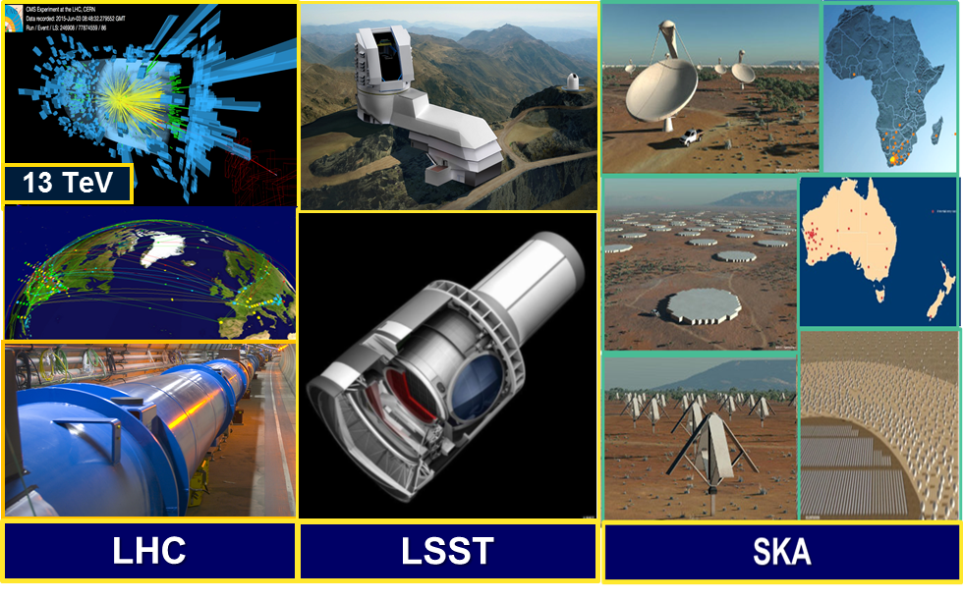
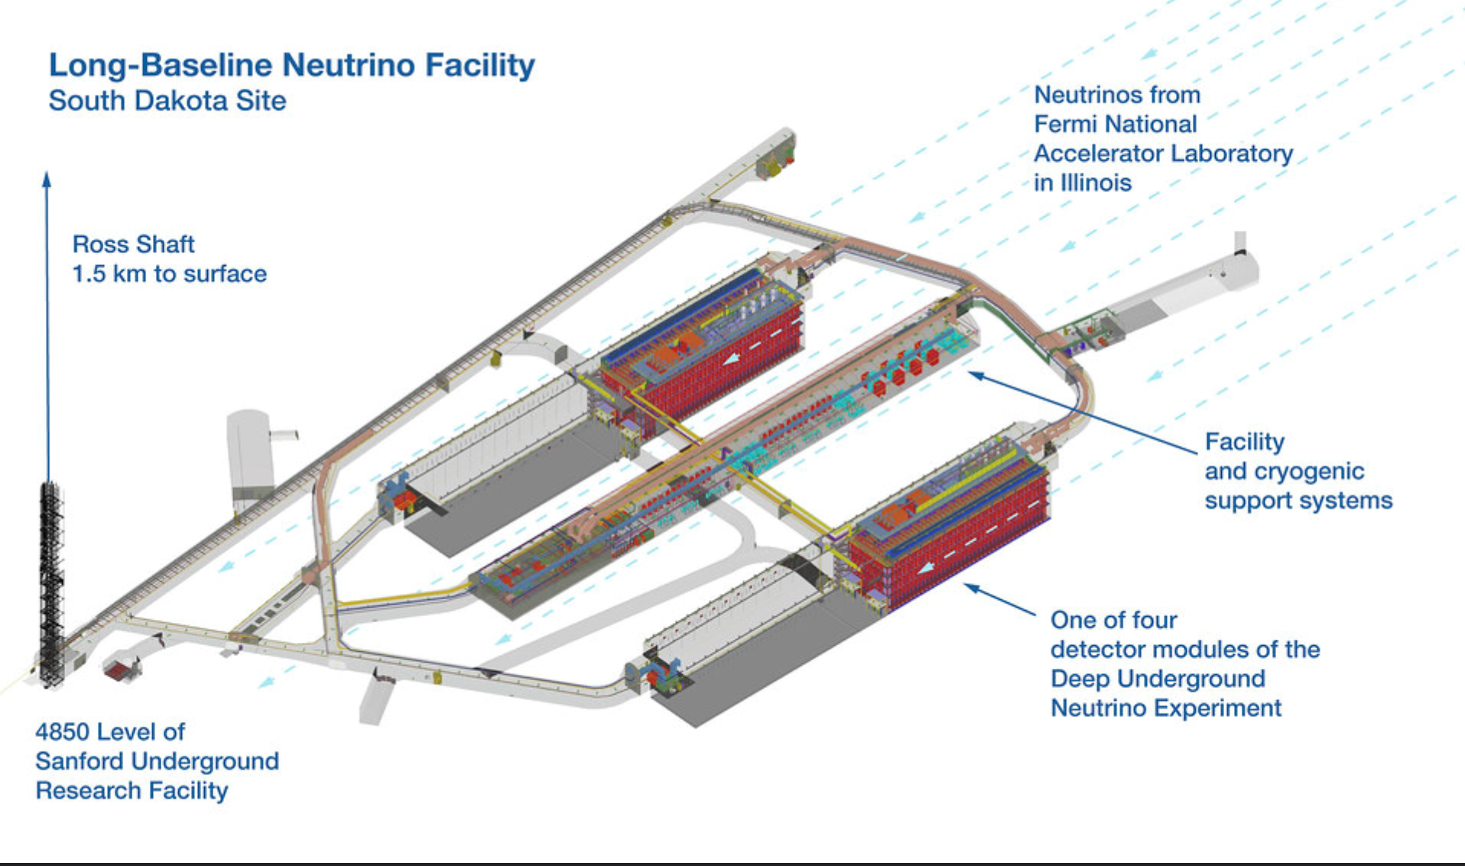
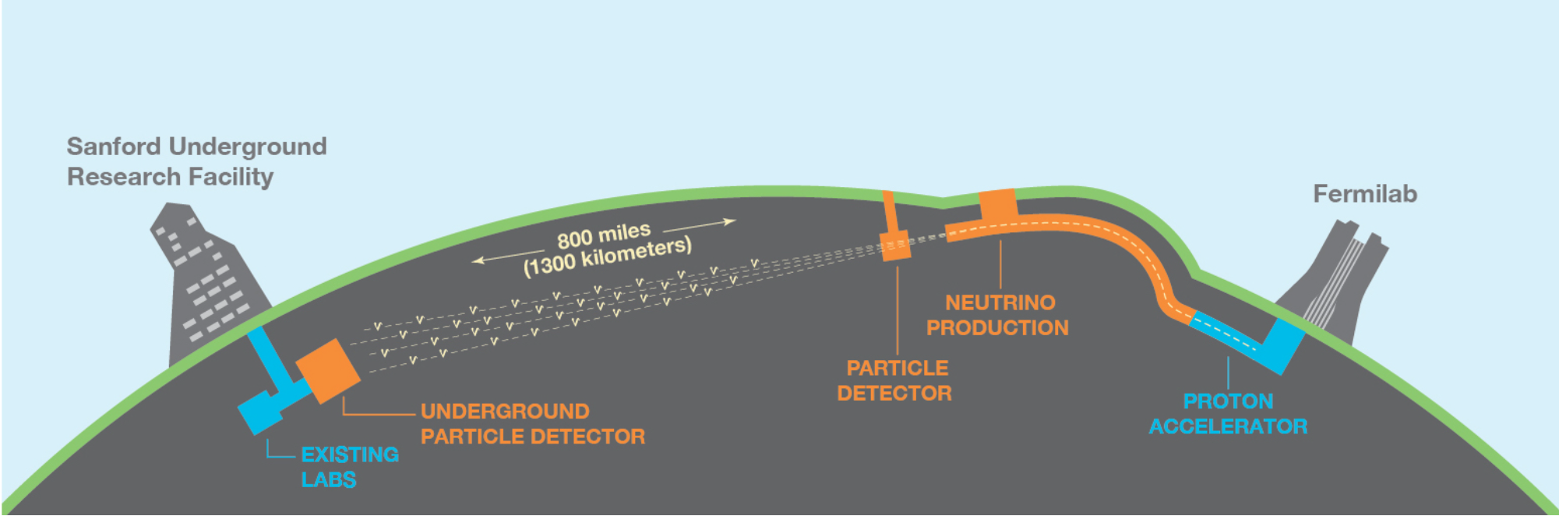



The Global Network Advancement Group: A Next Generation System for the LHC and Data-Intensive Sciences
LHC Run3
and HL-LHC
DUNE
VRO SKA
BioInformatics
Earth Observation
LSST
Gateways
to a New Era
LBNF/DUNE
Harvey Newman, Caltech
On Behalf of the GNA-G DIS Working Group
May 9, 2023

Slide 2
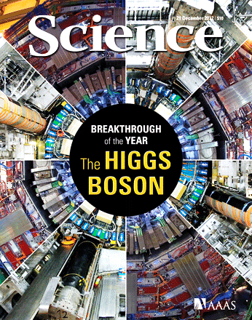
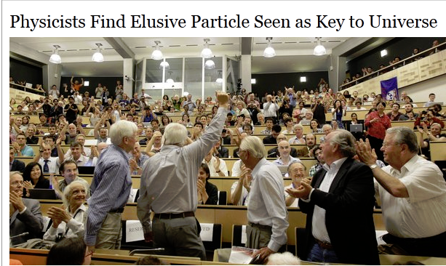
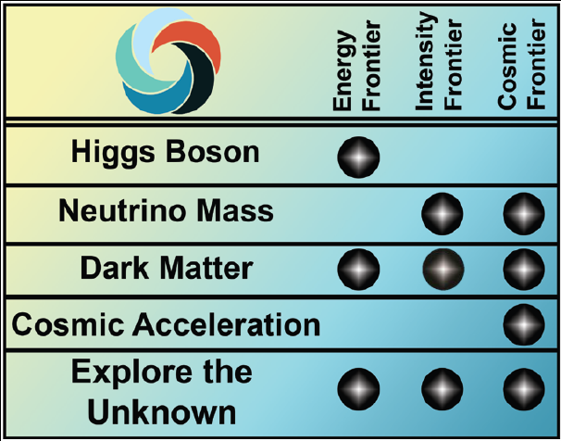
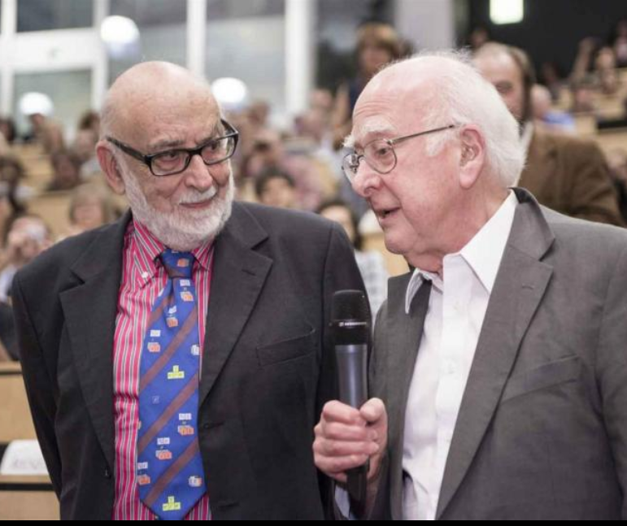

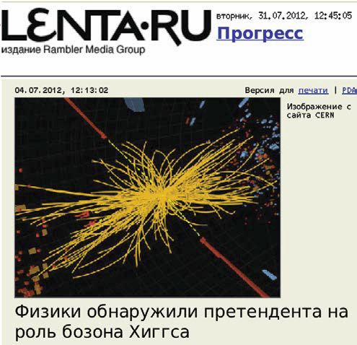



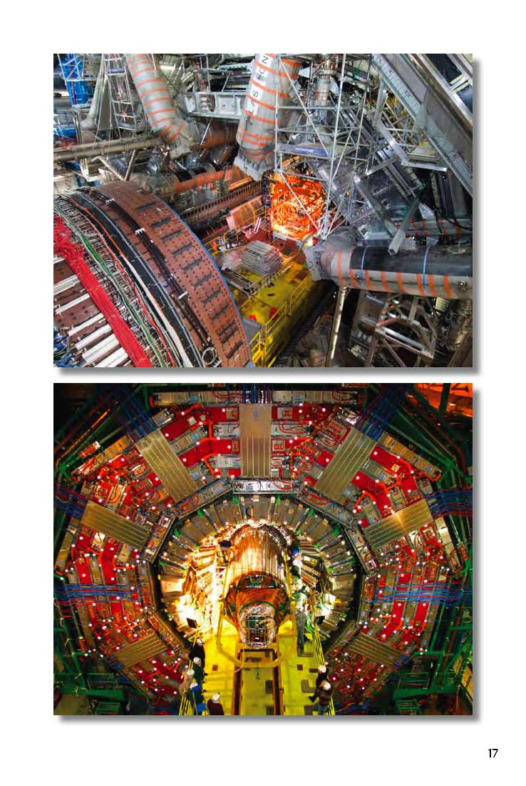
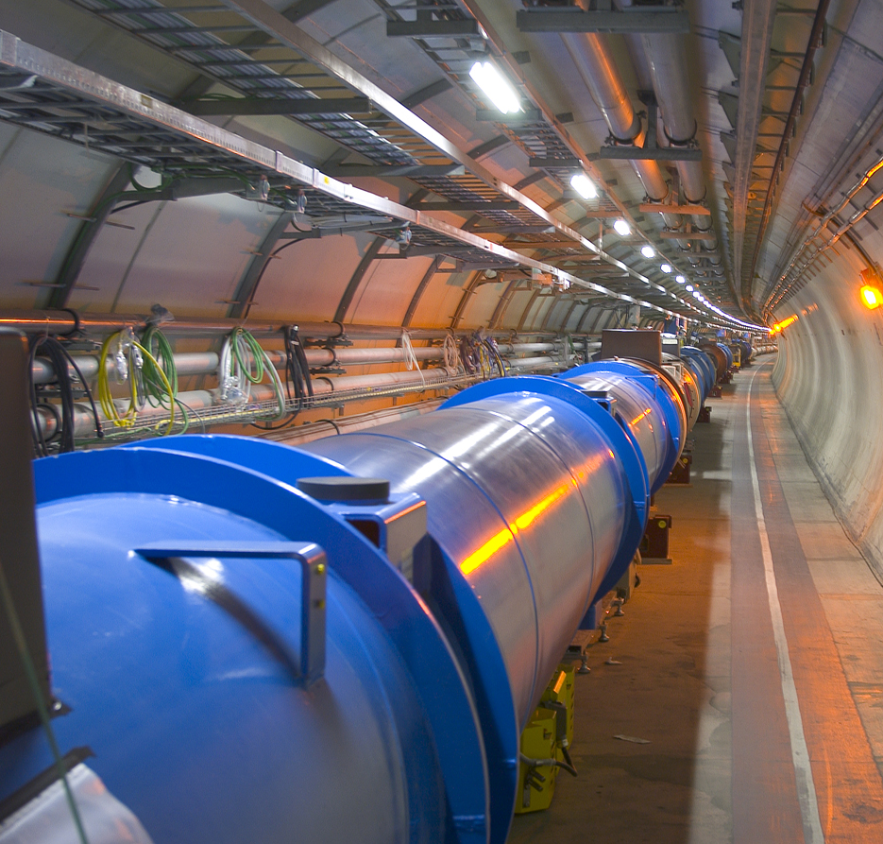
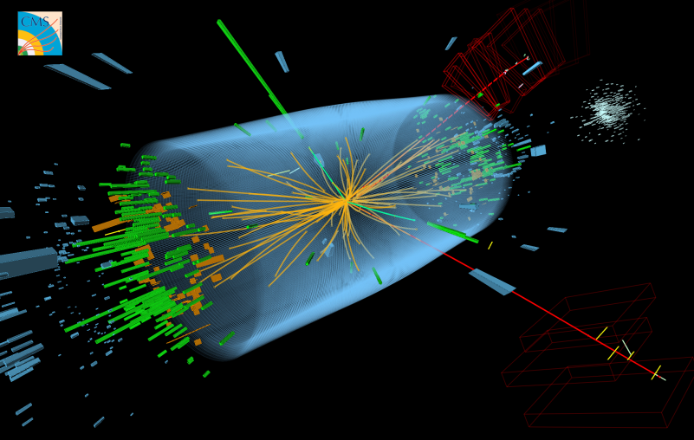
LHC: Discovery of the Higgs Boson and Beyond; 75+ Years of Exploration !
2013 Nobel Prize
Englert
Higgs
✴
48 Year Search; 75 Year Exploration
Theory (1964): 1950s – 1970s;
LHC + Experiments Concept: 1984
Construction: 2001; Operation: 2009
Run1: Higgs Boson Discovery 2012
Run2 and Going Forward:
Precision Measurements and BSM Exploration: 2013 - 2042
Advanced Networks Were Essential to Higgs Discovery and Every Ph.D Thesis; They will be Essential
to All Future Discoveries
NOTE: ~95% of Data Still to be Taken
Greater Intensity: Upgraded detectors for more complex events
To 25X Data to Storage Rate in 2029-40

Slide 3
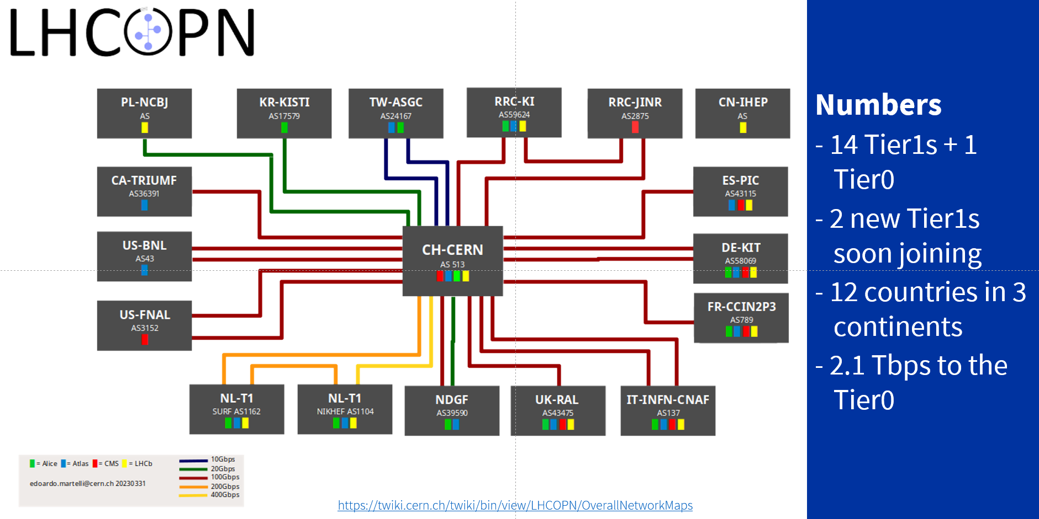
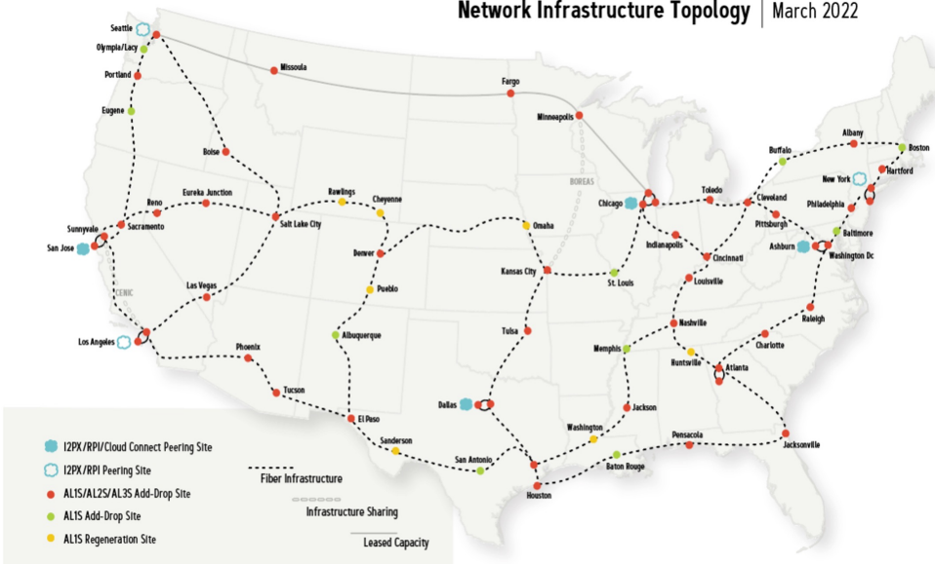
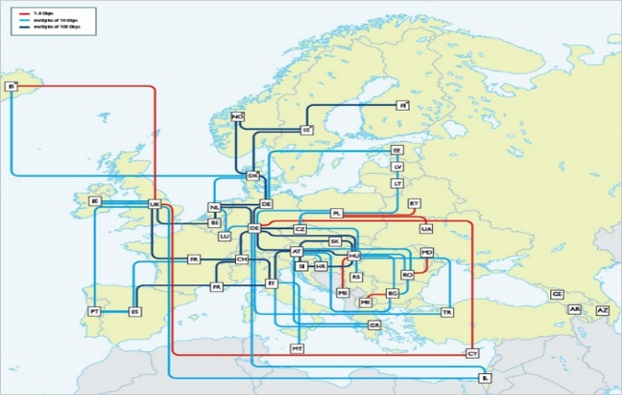
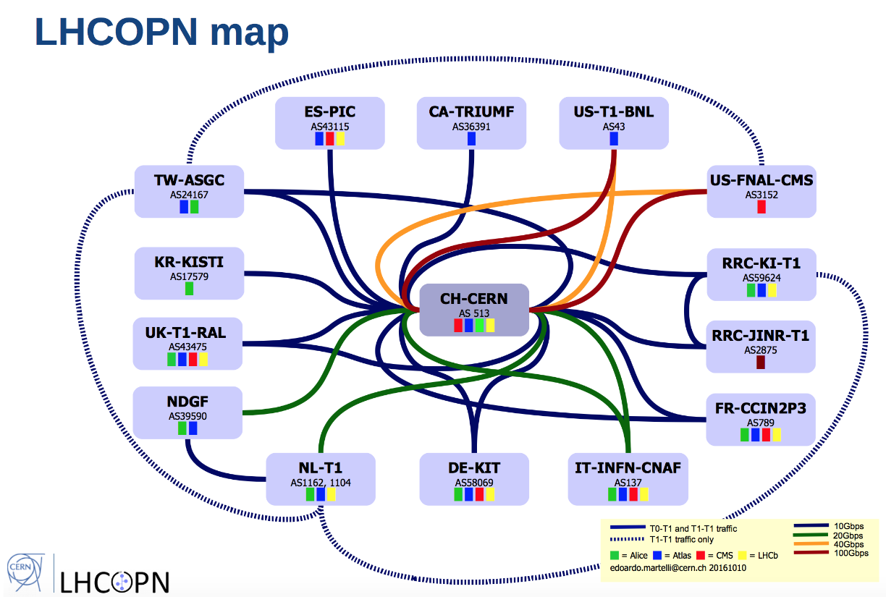
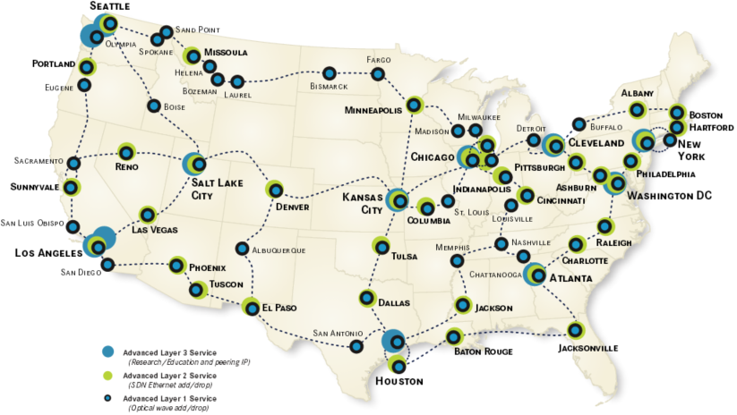
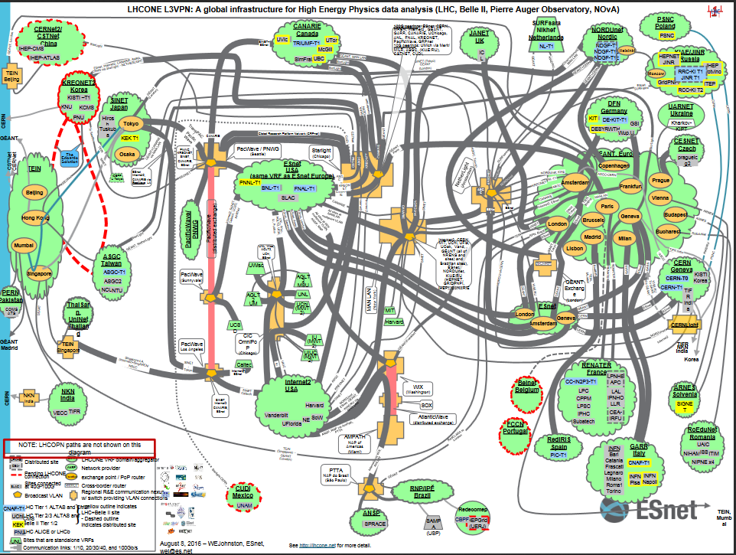
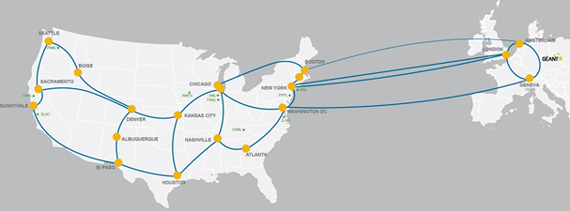
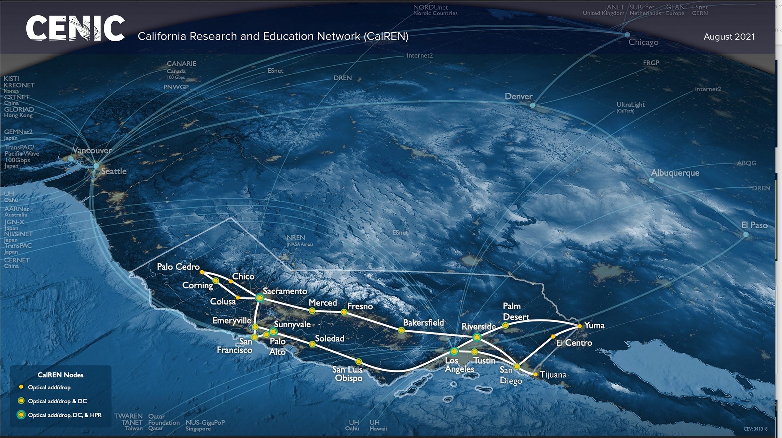
Core of LHC Networking LHCOPN, LHCONE, GEANT, ESnet, Internet2, CENIC…
LHCOPN: Simple & Reliable Tier0+1 Ops
Internet2
GEANT
LHCONE VRF: 170 Tier2s ++
ESnet (with EEX)
CENIC and NRP
+ NRENs in Europe, Asia, Latin America, Au/NZ; US State Networks

Slide 4
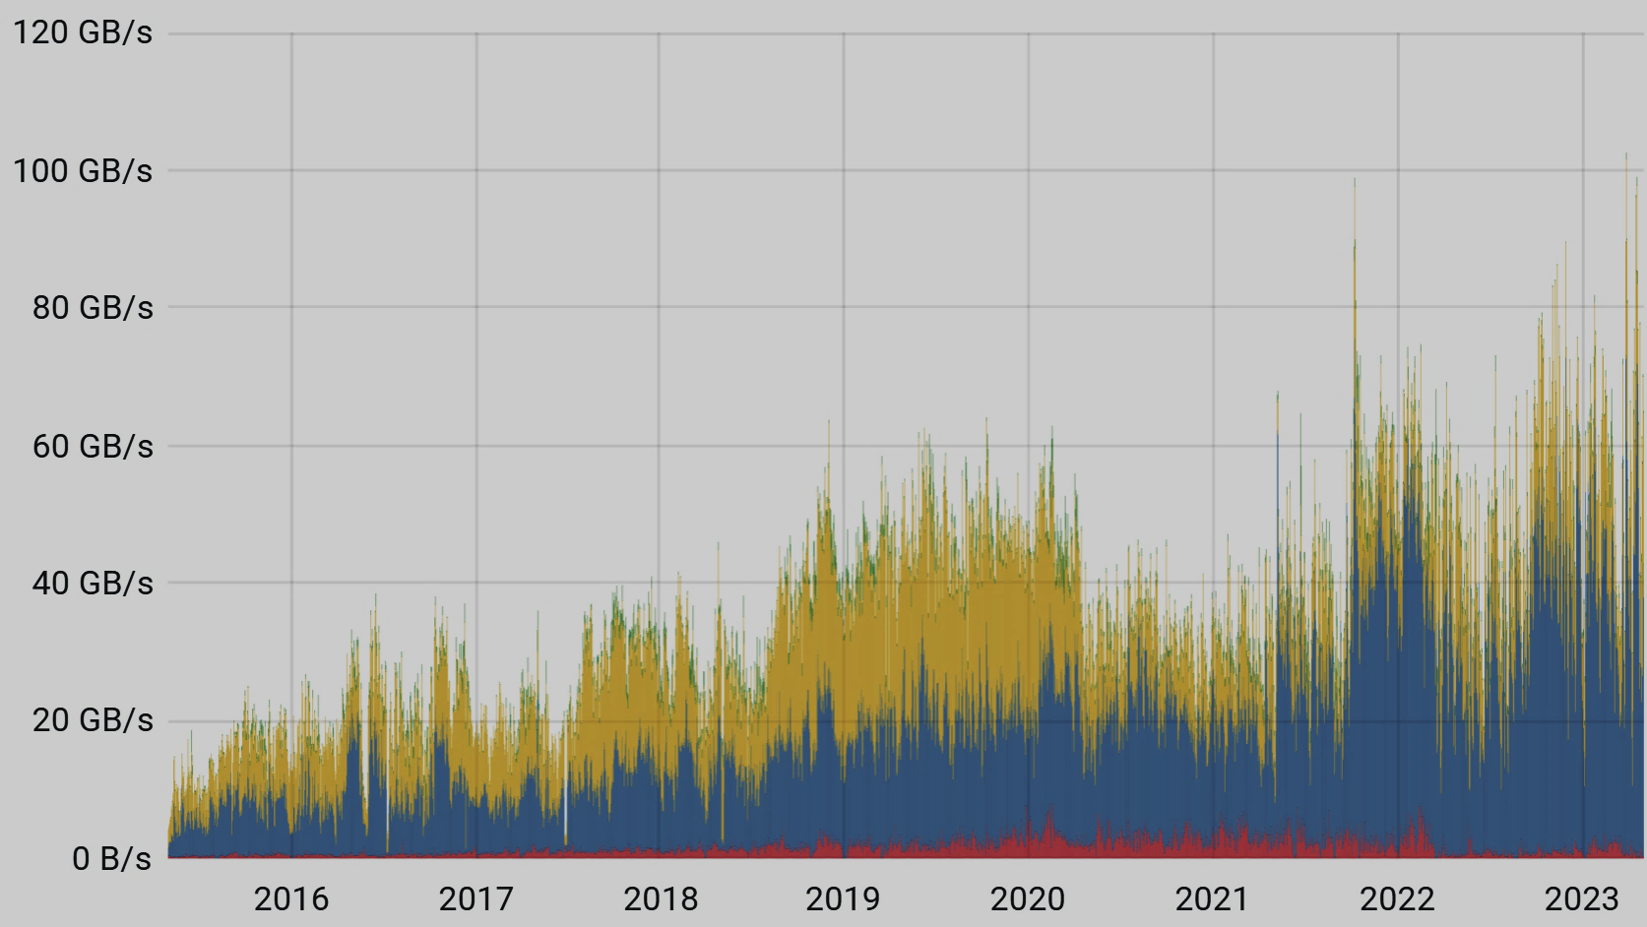
LHC Data Flows Have Increased in Scale and Complexity since the start of LHC Run2 in 2015
WLCG Transfers Dashboard: Throughput April 2015 – April 2023
30-85 GBytes/s Weekly Avg
To 100+ GBytes/s Daily Avg
Complex Workflow
To ~1.3 M jobs (threads) simultaneously
Multi-TByte to Petabyte Transfers
To ~25 M File Transfers/Day
100ks of remote connections
Effects of Covid from Spring 2020 are evident
Fast recovery also evident
100G
80G
60G
LHCb
40G
CMS
ATLAS
20G
3/15 Level
ALICE
0
2016
2017
2018
2019
2020
2021
2022
2023
~12X Growth in Throughput 2015-2023: +36%/Yr; + Much Faster Growth Bursts
https://monit-grafana.cern.ch/d/AfdonIvGk/wlcg-transfers?orgId=20&from=now-8y&to=now

Slide 5
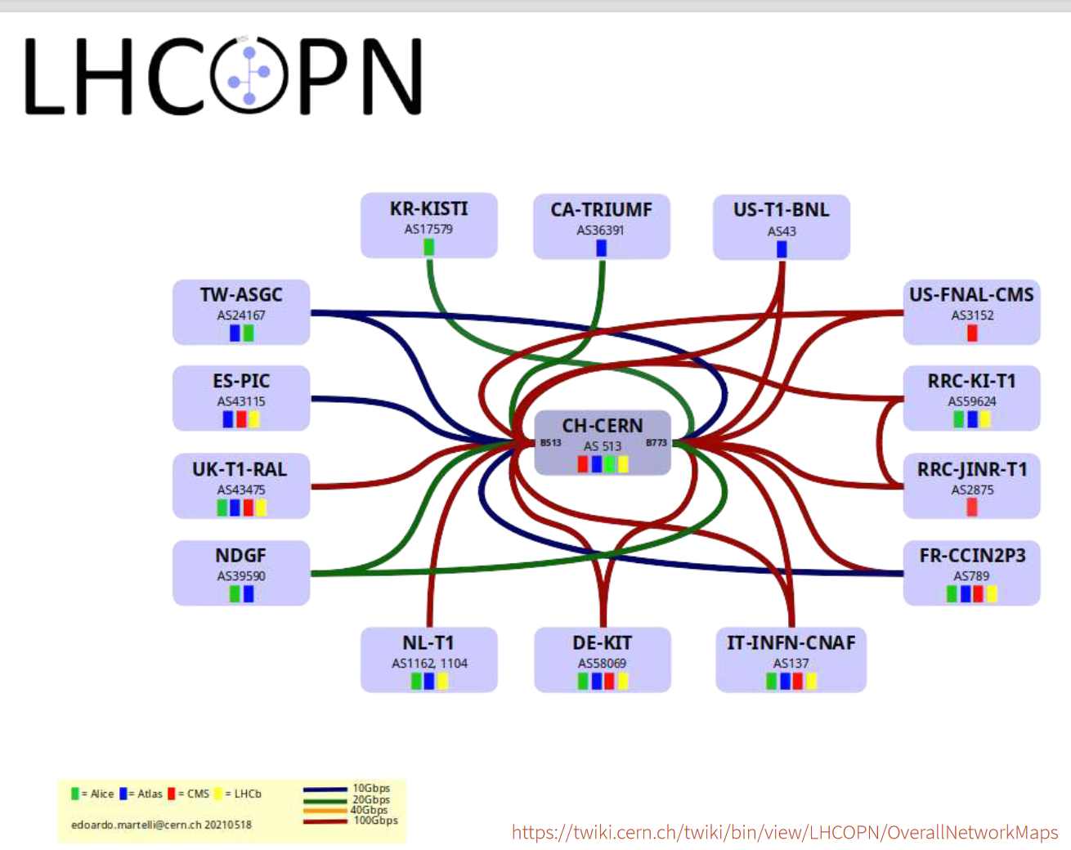
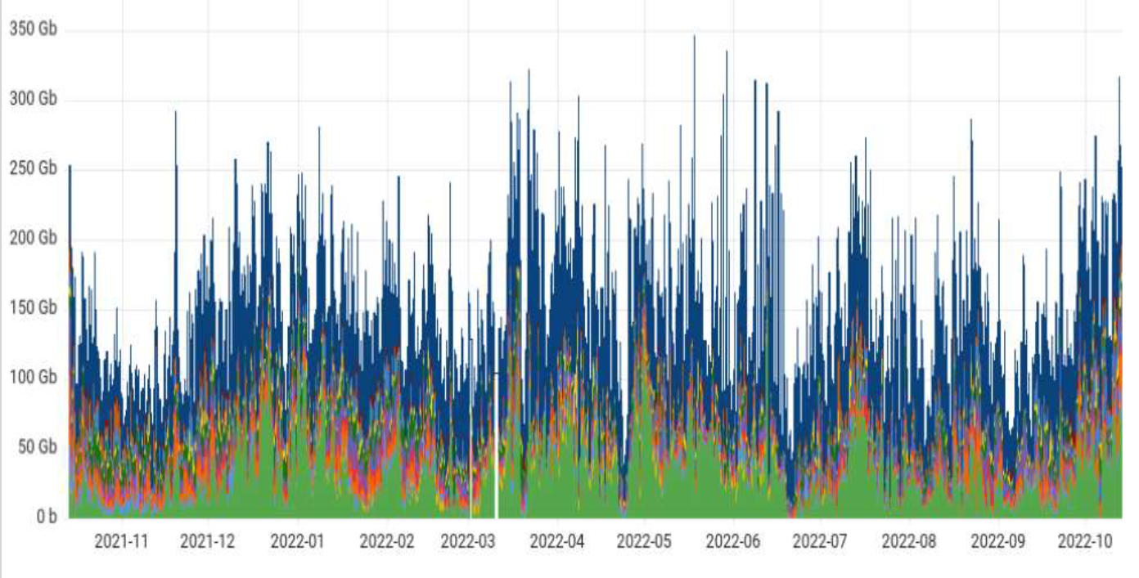
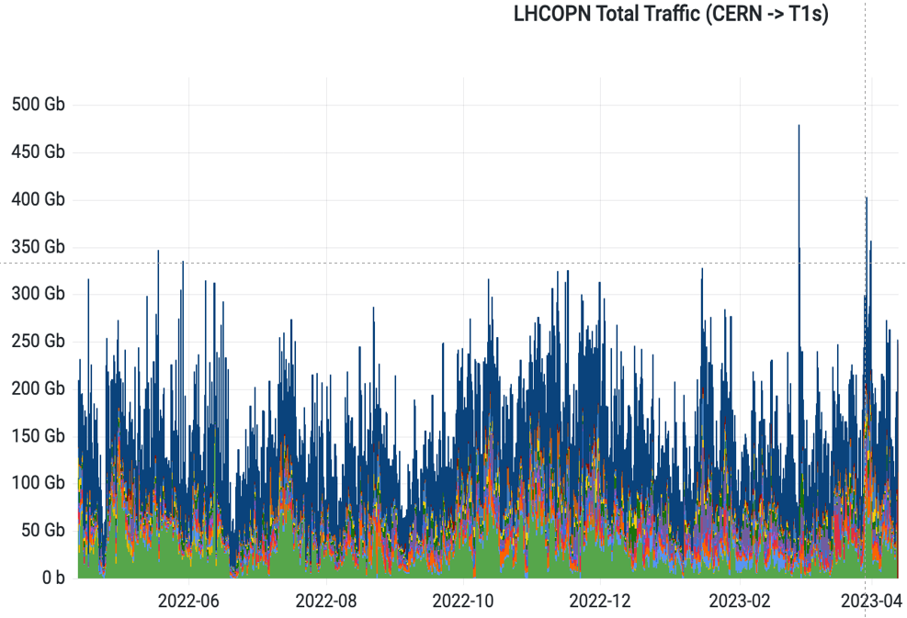
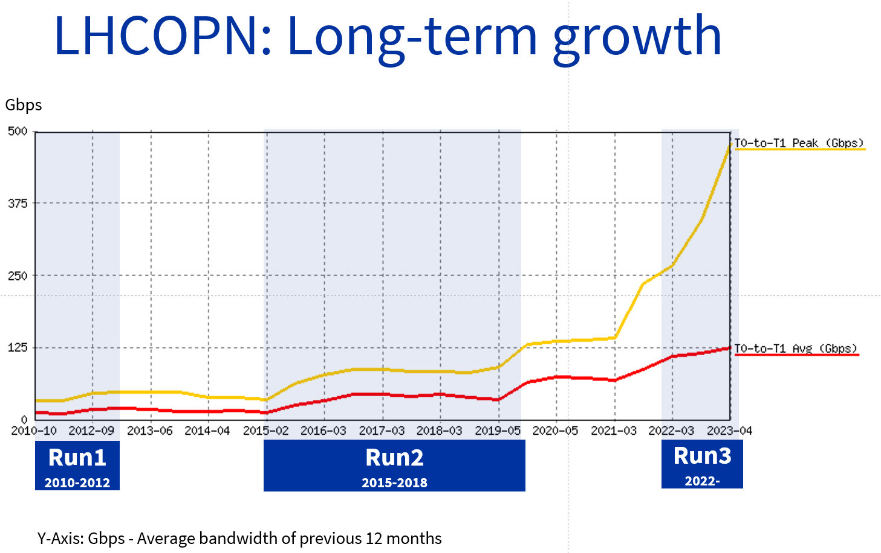
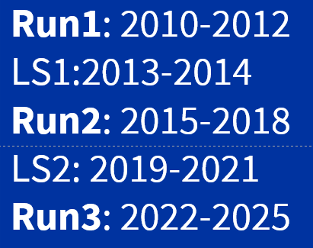
Network Traffic Evolution from CERN: 2022-2023 and Long Term
E. Martelli, CERN/IT
LHCOPN Traffic CERN to Tier1s
Moved 488 PB in 12 Months
+ 48% wrt 2021; Peak at 479 Gbps
LHCOPN Long Term Traffic Growth: T0 to T1 Peak and Average
Since 2021:
Average Traffic Doubled
Peak Traffic 3.5X
500G
Peak
375G
In
250G
Average
125G
0

Slide 6

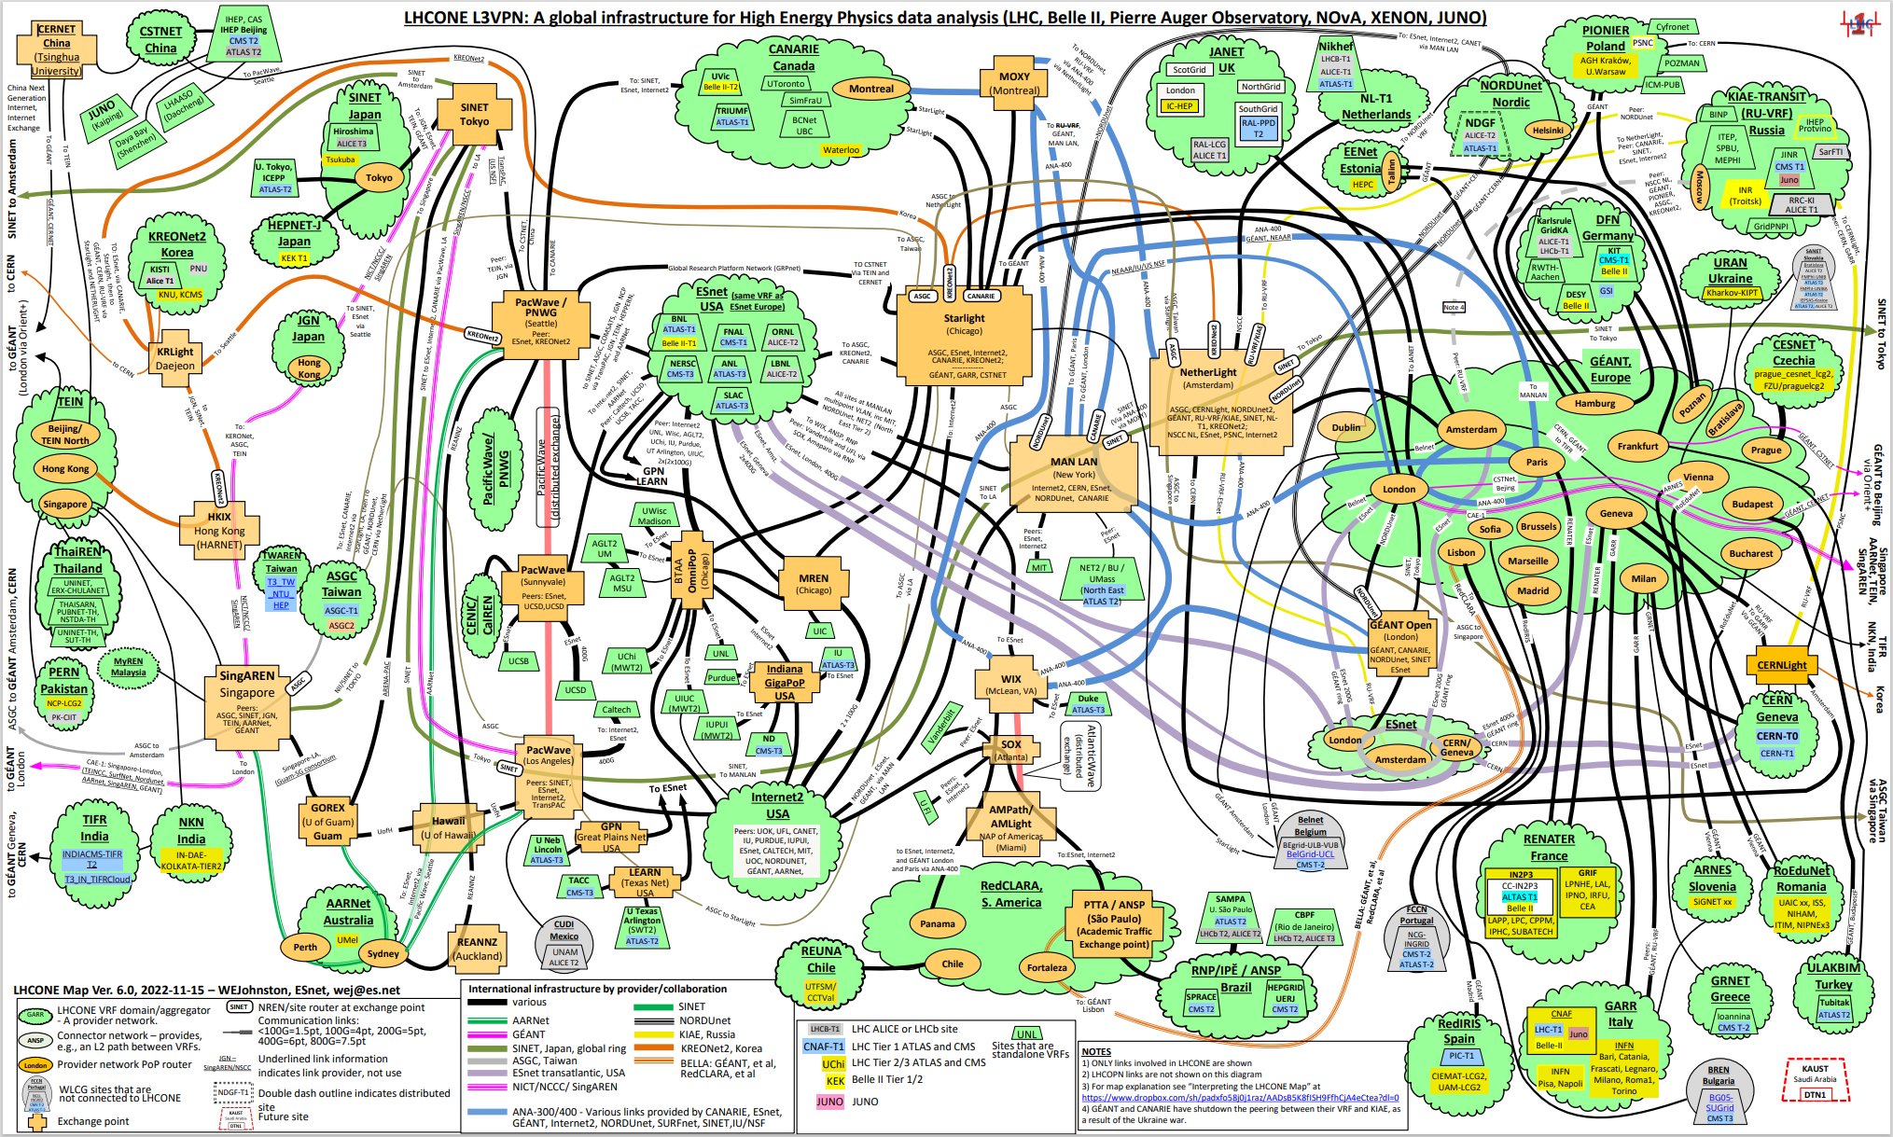
LHCONE: a Virtual Routing and Forwarding (VRF) Fabric
Global infrastructure for HEP (LHC, DUNE, Belle II, NOvA, Auger, Xenon, JUNO…)
W. Johnston ESNet 3/22
Good News: The Major R&E Networks Have Mobilized on behalf of HEP
A complex system with limited scaling properties. So: Multi-ONE ? New Mode of Sharing ?
LHCONE traffic bursts to 70%/Yr: a challenge already possible in LHC Run3

Slide 7
Towards a Computing Model for the HL LHC Era Challenges: Capacity in the Core and at the Edges
Programs such as the LHC have experienced rapid exponential traffic growth,
at the level of 35-60% per year, plus growth bursts
  At the January 2020 LHCONE/LHCOPN meeting at CERN, CMS and ATLAS
  expressed the need for Terabit/sec links on major routes,
  by the start of the HL-LHC in 2029
  Projected to outstrip the affordable capacity
  Needs are further specified in “blueprint” Requirements documents
  by US CMS and US ATLAS, as part of ESnet Requirements Review in August 2020, captured in a comprehensive report for HEP:
  https://escholarship.org/uc/item/78j3c9v4
  Three areas of particular capacity-concern by 2029 were identified:
  (1) Exceeding the capacity across oceans, notably the Atlantic
  (2) Tier2 centers at universities requiring 100G 24 X 7 X 365 average
  throughput with sustained 400G bursts (a petabyte in a shift), and
  (3) Terabit/sec links to labs and HPC centers (and edge systems)
  to support multi-petabyte transactions in hours rather than days

Slide 8
HL-LHC Network Needs Requirements Study 2020-22
Export of Raw Data from CERN to the Tier1s (350 Pbytes/Year):
400 Gbps Flat (24 X 7) each for ATLAS and CMS Tier1s;
+100G each for other data formats; +100 G each for ALICE, LHCb
“Minimal” Scenario [*]: 4.8 Tbps Aggregate: 1.4 Tbps Across the Atlantic
for ATLAS and CMS alone
Includes 1.2 Tbps Flat (24 X 7) Tier0 – Tier1, x2 to Accommodate Bursts,
and x2 for operational headroom for both other LHC use, and non-LHC use
In the Minimal Scenario: the network is treated as a scarce resource,
unlike LHC Run1-Run3 experience in 2009-23 so far.
In a “Flexible Scenario” [**]: 9.6 Tbps, including 2.7 Tbps Across the Atlantic.
This Leverages the network to enable more flexible workload scheduling,
improved turnaround time for production & analysis; improved efficiency
Tier1 Provisioning: ~1 Tbps to Larger Tier1s (some more);
~500 Gbps to Other Tier1s
Tier2 Provisioning: 400Gbps bursts, 100G Yearly 24 X 7 Avg.
Typical operation: ~1 PB in a shift to refresh ~10 petabyte caches
Need to work with campuses, regionals to accommodate this in time
[*] NOTE: Matches numbers at ESnet Requirements Review (Summer 2020) [**] NOTE: Matches numbers at the 2020 LHCONE/LHCOPN Meeting

Slide 9
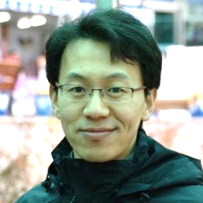
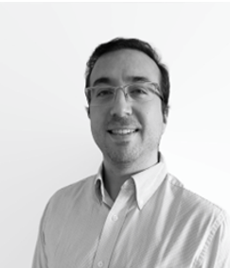

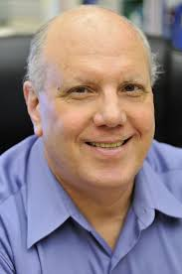
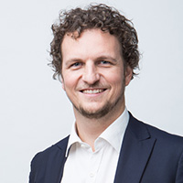
Global Network Advancement Group (GNA-G)
Leadership Team: Since September 2019 leadershipteam@lists.gna-g.net
Buseung Cho KISTI (Korea)
Marco Teixera RedCLARA (Latin America)
Ivana Golub
PSNC, GEANT (Europe)
Harvey Newman Caltech (US)
David Wilde, Chair
Aarnet (Australia)
  An open volunteer group devoted to developing the blueprint to make using the Global R&E networks both simpler and more effective
  Its primary mission is to support global research and education using
  the technology, infrastructures and investments of its participants.
  The GNA-G is a data intensive research & science engager that facilitates and accelerates global-scale projects by (1) enabling high-performance data transfer, and (2) acting as a partner in the development of next generation intelligent network systems that support the workflow
  of data intensive programs
  See https://www.dropbox.com/s/qsh2vn00f6n247a/GNA-G%20Meeting%20slides%20-%20TechEX19%20v0.8.pptx?dl=0

Slide 10
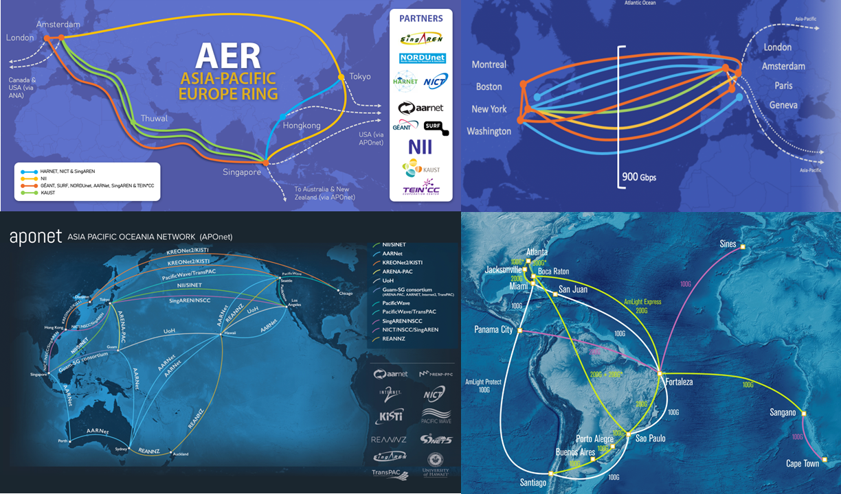
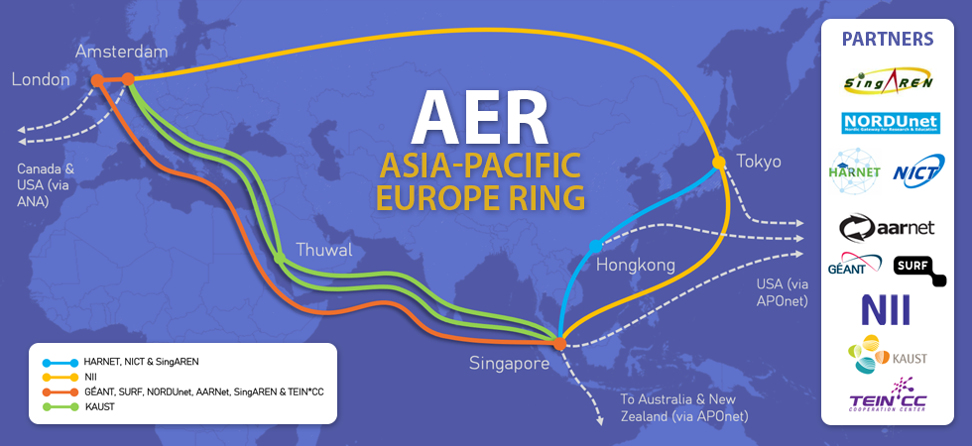
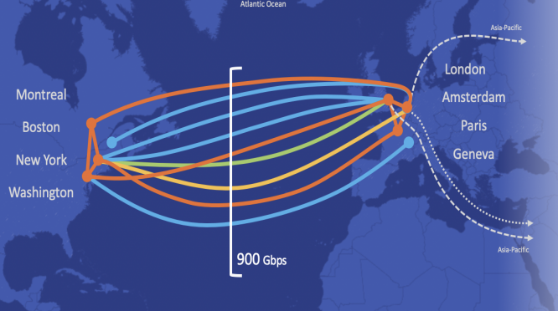
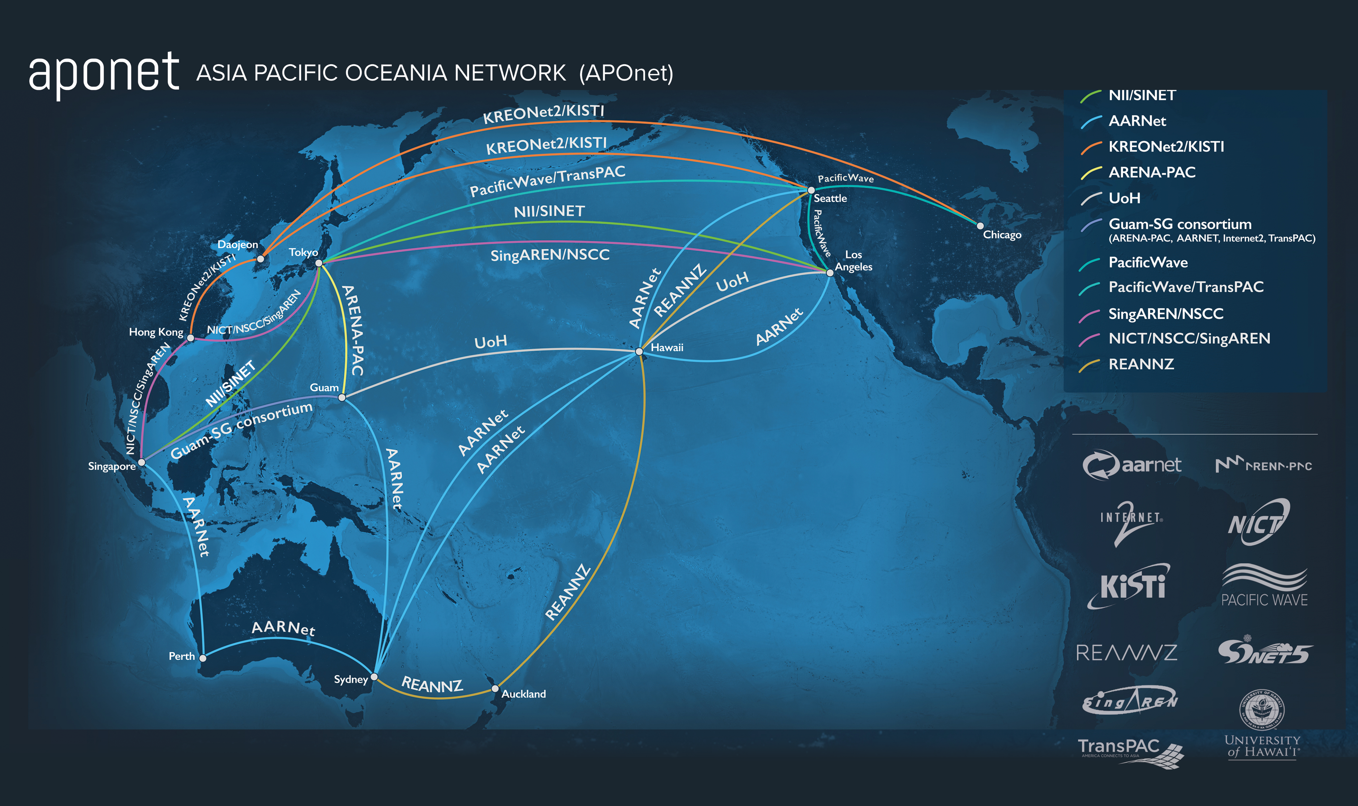
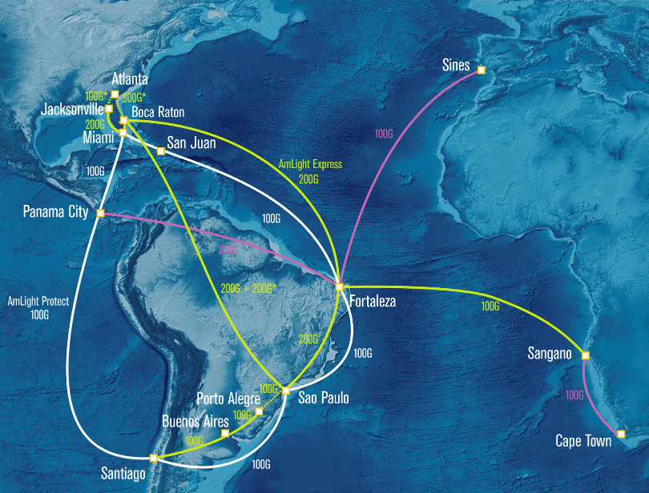
Mission: To Support global research and education using the technology, infrastructures and investments of its participants
https://www.gna-g.net/
The GNA-G exists to bring together researchers, National Research and Education Networks (NRENs), Global eXchange Point (GXP) operators, regionals and other R&E providers, in developing a common global infrastructure to support the needs.

Slide 11
GNA-G overview and Vision
GNA-G participant CEOs etc
Global NREN CEO Forum
Strategic Security Focus Group
GNA-G Executive Liaison
GNA-G Leadership Team
Research & Development
Production Operations
Data Intensive Science
Connecting Offshore Students
Securing the GREN
GREN Mapping
AutoGOLE
/SENSE
Telemetry
Routing Anomalies
Network Automation
GNA Architecture v2.0
GXP Architectures & Services
GREN: Collaboration on the
intercontinental transmission layer
Link Consortia
AER
APONet
ANA
AmLight
…

Slide 12
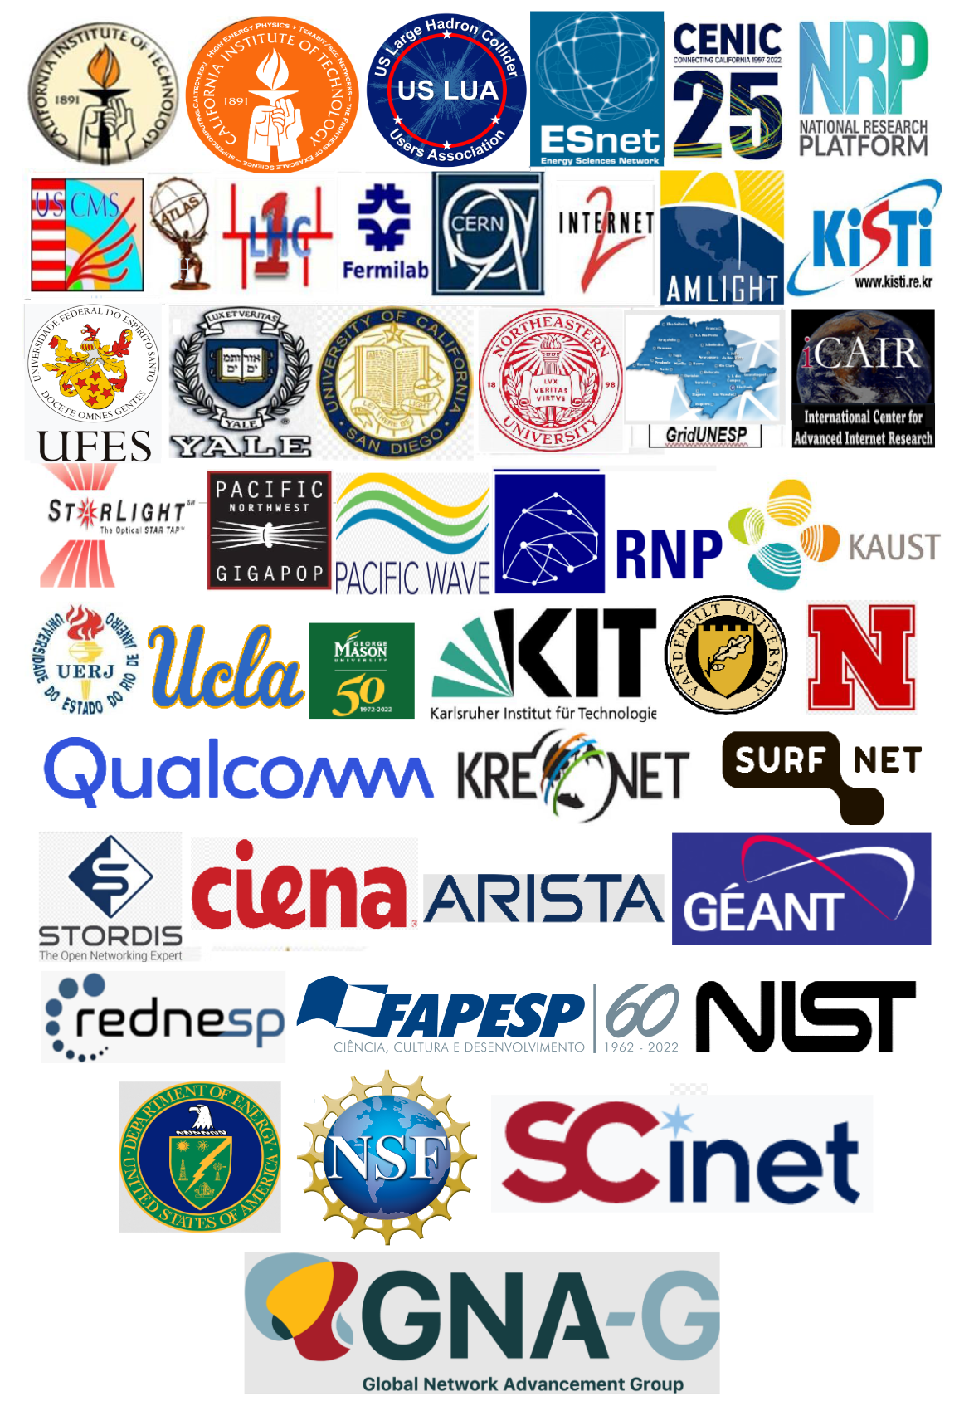
The GNA-G Data Intensive Sciences WG
Charter: https://www.dropbox.com/s/4my5mjl8xd8a3y9/GNA-G_DataIntensiveSciencesWGCharter.docx?dl=0
A Vast Worldwide Partnership of R&E networks, physics programs, advanced network R&D projects, scientists and engineers in multiple disciplines
Members:
Alberto Santoro, Alex Moura, Azher Mughal, Bijan Jabbari, Brian Yang, Buseung Cho, Caio Costa, Carlos Antonio Ruggiero, Carlyn Ann-Lee, Chin Guok, Ciprian Popoviciu, Dale Carder, David Lange, David Wilde, Dima Mishin, Edoardo Martelli, Eduardo Revoredo, Eli Dart, Eoin Kenney, Frank Wuerthwein, Frederic Loui, Harvey Newman, Heidi Morgan, Iara Machado, Inder Monga, Jeferson Souza, Jensen Zhang, Jeonghoon Moon, Jeronimo Bezerra, Jerry Sobieski, Joao Eduardo Ferreira, Joe Mambretti, John Graham, John Hess, John Macauley, Julio Ibarra, Justas Balcas, Kai Gao, Karl Newell, Kaushik De, Kevin Sale, Lars Fischer, Liang Zhang, Mahdi Solemani, Maria Del Carmen Misa Moreira, Marcos Schwarz, Mariam Kiran, Matt Zekauskas, Michael Stanton, Mike Hildreth, Mike Simpson, Ney Lemke, Phil Demar, Raimondas Sirvinskas, Richard Hughes-Jones, Rogerio Iope, Sergio Novaes, Shawn McKee, Siju Mammen, Susanne Naegele-Jackson, Tom de Fanti, Tom Hutton, Tom Lehman, William Johnston, Xi Yang, Y. Richard Yang
Participating Organizations/Projects:
ESnet, AARNet, AmLight, KAUST, KISTI, SANReN, GEANT, RNP, CERN, Internet2, CENIC/Pacific Wave, StarLight, NetherLight, SURFnet, Nordunet, Southern Light, Pacific Research Platform, FABRIC, RENATER, ATLAS, CMS, VRO, SKAO, OSG, Caltech, UCSD, Yale, FIU, UERJ, GridUNESP, Fermilab, Michigan, UT Arlington, George Mason, East Carolina
Working Closely with the AutoGOLE/SENSE WG
Meets Weekly or Bi-weekly
All are welcome to join.

Slide 13
The GNA-G Data Intensive Sciences WG
Charter: https://www.dropbox.com/s/4my5mjl8xd8a3y9/GNA-G_DataIntensiveSciencesWGCharter.docx?dl=0
  Principal aims:
  To address the challenges faced by major data intensive science programs
  and meet their needs
    In a manner consistent and compatible with supporting the needs
    of smaller groups and individuals in the at large A&R communities
(2) To provide a forum for discussion, a framework and shared toolset
for both short and long term developments meeting the needs
To develop a persistent global testbed as a platform, to foster
ongoing developments among the science and network communities
While sharing and advancing the (new) concepts, tools & systems needed
  Members of the WG partner in joint deployments and/or developments of generally useful tools and systems that help operate and manage R&E networks with limited resources across national and regional boundaries
  A special focus of the group is to address the growing demand for
    Network-integrated workflows
    Comprehensive cross-institution data management
    Automation, and
    Federated infrastructures encompassing networking, compute, and storage
  Working Closely with the AutoGOLE/SENSE WG

Slide 14
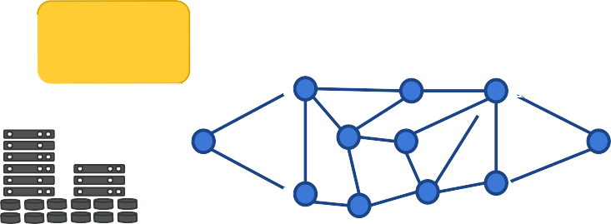





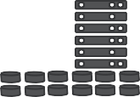
SENSE and Rucio/FTS/XRootD Interoperation
SENSE: SDN Enabled Networks for Science at the Exascale
ESnet, Caltech, Fermilab, LBNL https://arxiv.org/abs/2004.05953
Creates Virtual Circuit Overlays. Site and Network RMs, Orchestrator
●Rucio identifies groups of data flows (IPv6 subnets) which are "high priority"
●SENSE takes flows from the site edge and "Traffic Engineers" paths across the WAN and End Sites
Scientific Data Management and Movement Suite
Rucio
●Enables use of "multiple paths between sites" and provisioning "deterministic" network resources to workflows
SENSE
Orchestrator
Primary system for LHC and others
FTS
SENSE
Network RM
NSI PA
SENSE
Site RM
SENSE
Site RM
End Site
XRootD (Data Transfer
System)
End Site
XRootD
(Data Transfer
System)
Tom Lehman, Esnet LHCOPN/LHCONE Meeting April 2022

Slide 15
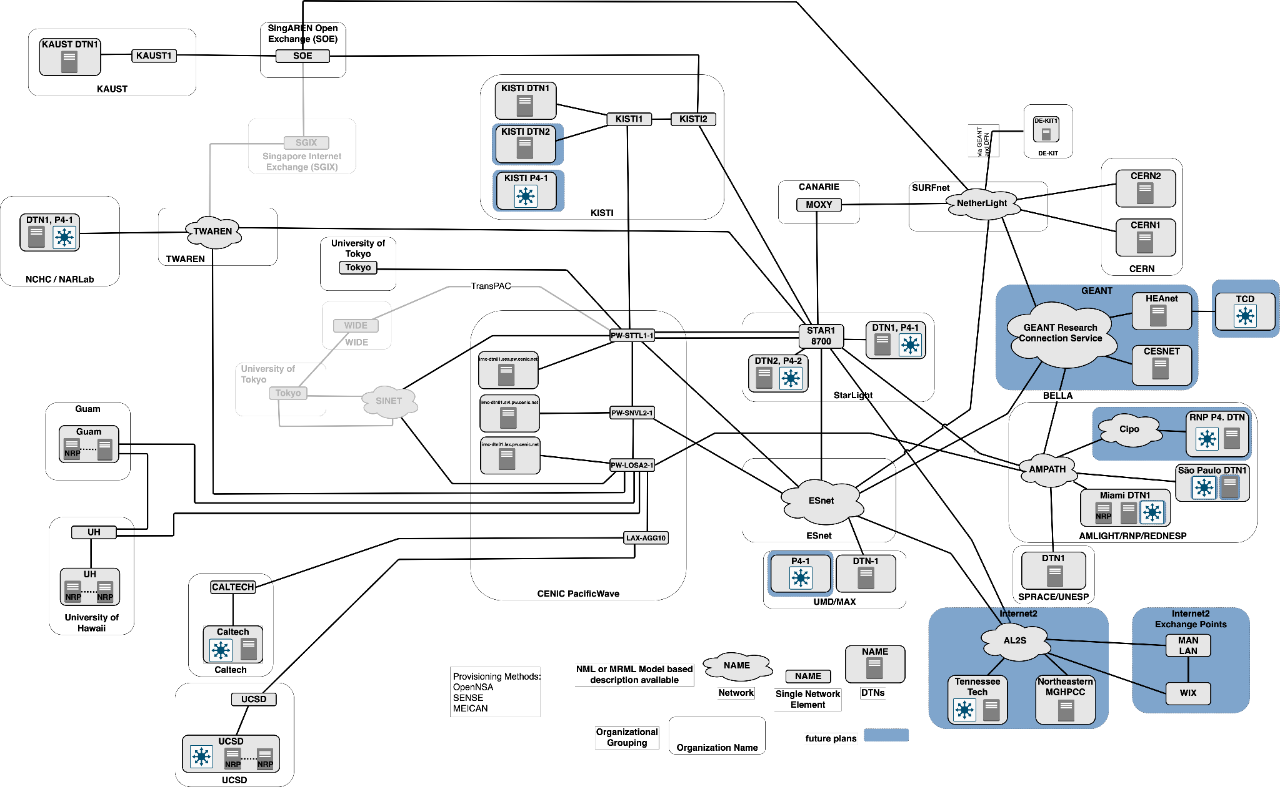
GNA-G AutoGOLE/SENSE WG Global Persistent Testbed
Tom Lehman, ESnet
Software Driven Network OSes; Programmability at the Edges and in the Core

Slide 16
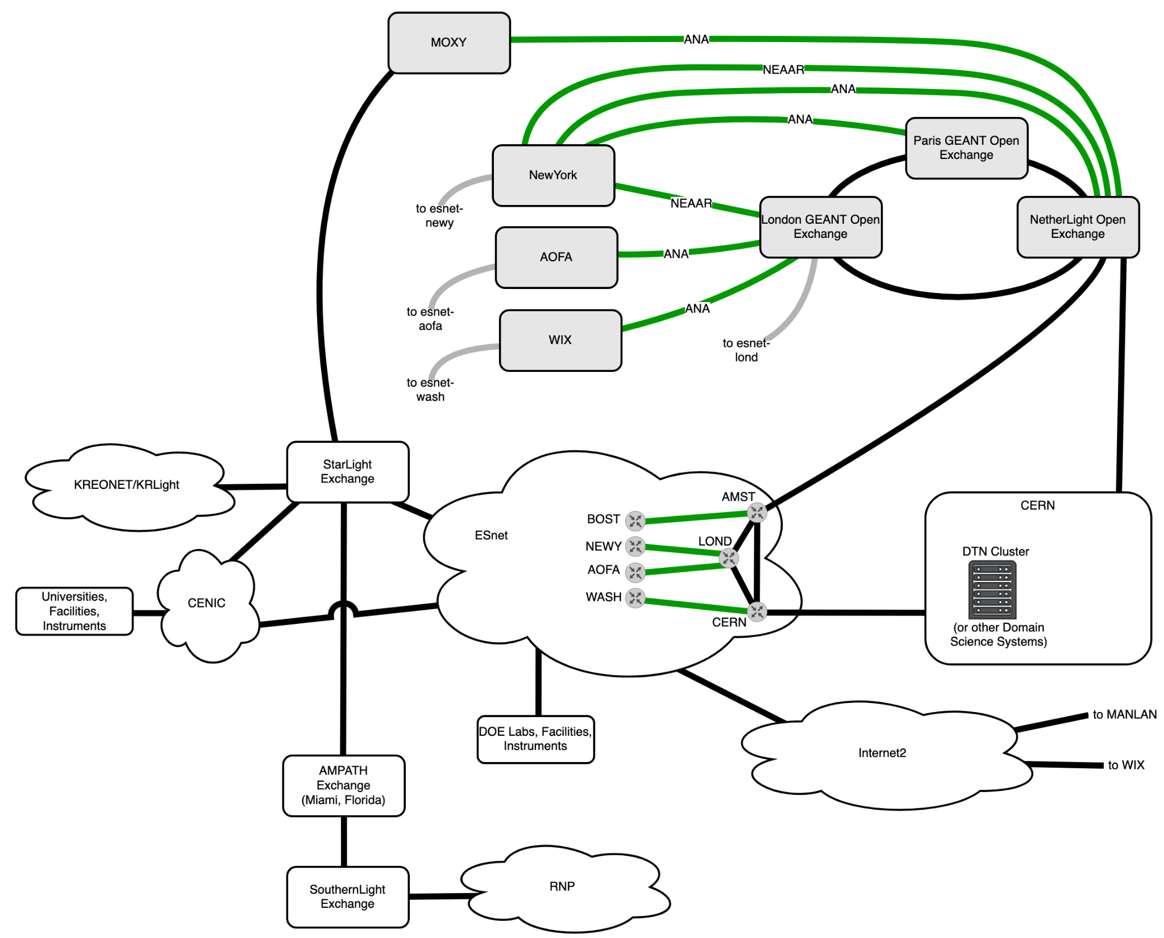
Important Link Management
There are multiple transatlantic
and transpacific links, operated
by multiple organizations
Goal is to more flexibly control how these are utilized on
a per flow, group, or use basis
Do not want to manage "every" flow in the network; but we should be able to manage
"any" flow in the network
An equally important goal is to understand the load vs capacity
and leave room
for other traffic
Remain compatible
with other network operations
transatlantic links
Two timescales: SENSE overlay network of virtual circuits
with BW guarantees is relatively stable; IPv6 subnets and
Directors provide more dynamic flow handling

Slide 17
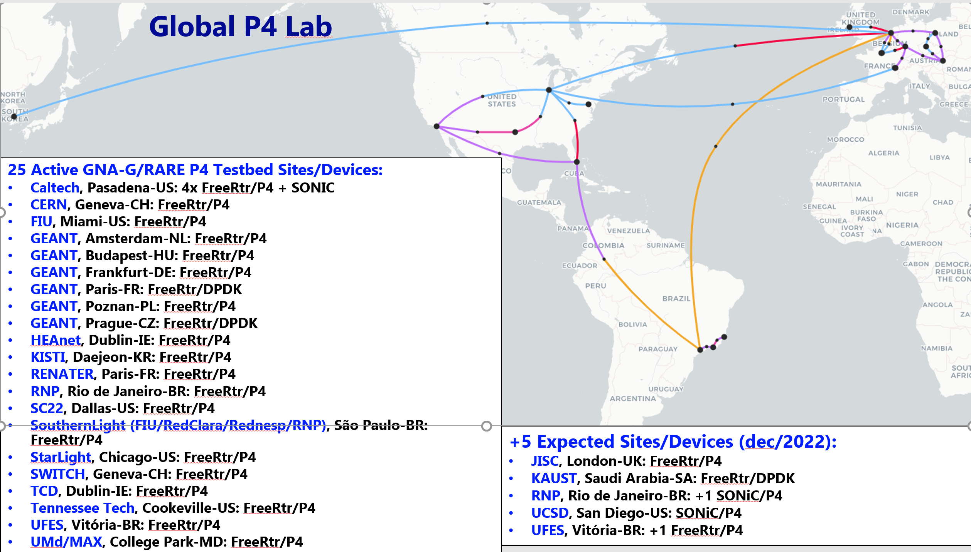
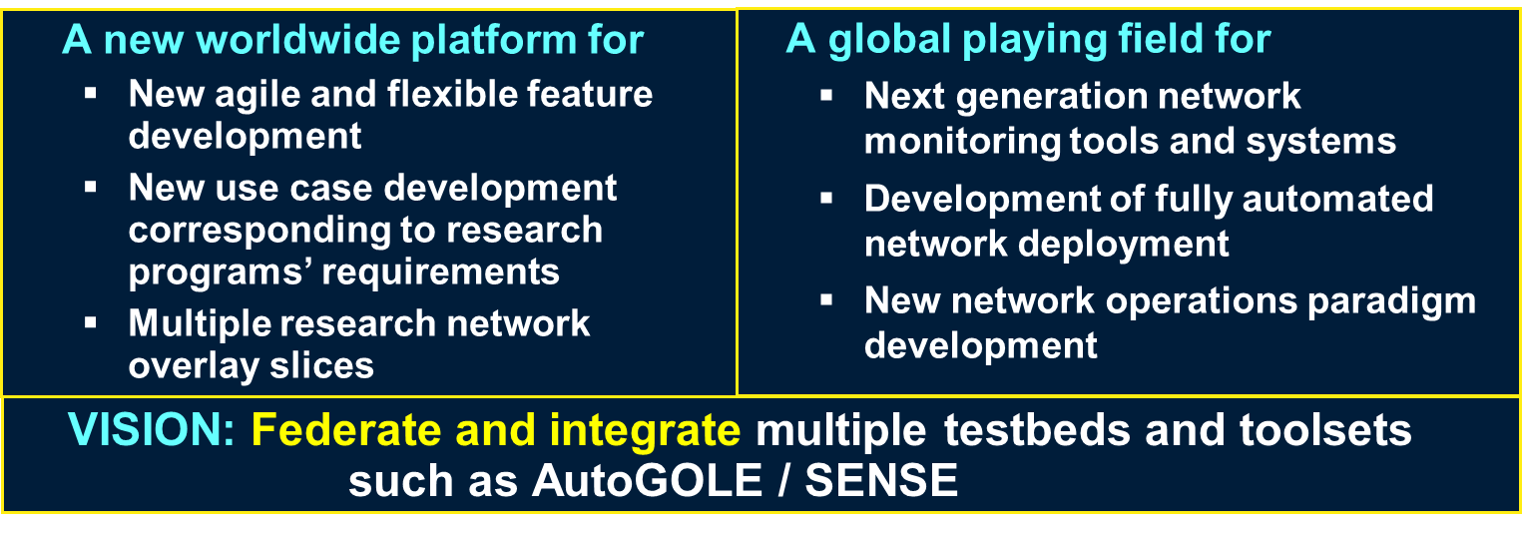
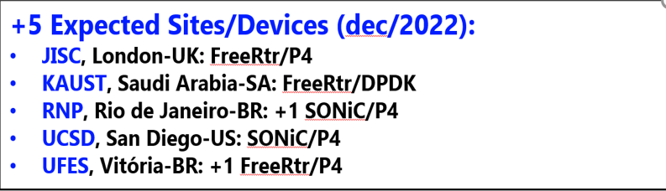
Global P4 + SONIC Lab:
Programmable Global Persistent Testbed
19 Active GNA-G/RARE P4, SONIC Testbed Sites
Caltech, Pasadena-US: 4 FreeRtr/P4 + SONIC
CERN, Geneva-CH: FreeRtr/P4
FIU, Miami-US: FreeRtr/P4
GEANT, Amsterdam-NL: FreeRtr/P4
GEANT, Budapest-HU: FreeRtr/P4
GEANT, Frankfurt-DE: FreeRtr/P4
GEANT, Paris-FR: FreeRtr/DPDK
GEANT, Poznan-PL: FreeRtr/P4
GEANT, Prague-CZ: FreeRtr/DPDK
RENATER, Paris-FR: FreeRtr/P4
SouthernLight (FIU/RedClara/Rednesp/RNP),
São Paulo-BR: FreeRtr/P4
StarLight, Chicago-US: FreeRtr/P4
SWITCH, Geneva-CH: FreeRtr/P4
TCD, Dublin-IE: FreeRtr/P4
Tennessee Tech: FreeRtr/P4
+ 9 Expected sites (by SC22):
HEAnet, Dublin-IE: FreeRtr/P4
JISC, London-UK: FreeRtr/P4
KAUST, Saudi Arabia: FreeRtr/DPDK
KISTI, South Korea: SONiC/P4
RNP, Rio de Janeiro-BR: FreeRtr/P4,
SONiC/P4
SC22 Caltech Booth, Dallas-US:
FreeRtr/P4
UCSD, San Diego-US: SONiC/P4
UFES, Vitória-BR: 2x FreeRtr/P4
UMd, College Park, Maryland-US:
FreeRtr/P4
GEANT + RNP
Frederic Loui
Marcos Schwarz
et al.
00

Slide 18

Global Petascale to Exascale Workflows for Data Intensive Sciences
Advances Embedded and Interoperate within a ‘composable’ architecture of subsystems, components and interfaces, organized into several areas:
  Visibility: Monitoring and information tracking and management including IETF ALTO/OpenALTO, BGP-LS, sFlow/NetFlow, Perfsonar, Traceroute, Qualcomm Gradient Graph congestion information, Kubernetes statistics, Prometheus, P4/Inband telemetry
  Intelligence: Stateful decisions using composable metrics (policy, priority, network- and site-state, SLA constraints, responses to ‘events’ at sites and in the networks, ...), using tools from: NetPredict, Hecate, RL-G2, Yale Bilevel optimization, Coral, Elastiflow/Elastic Stack
  Controllability: SENSE/OpenNSA/AutoGOLE, P4/PINS, Segment routing with SRv6, MPLS and/or PolKA, BGP/PCEP
  Network OSes and Tools: GEANT RARE/freeRtr, SONIC, Calico VPP, Bstruct-Mininet environment, ...
  Orchestration: SENSE, Kubernetes (+k8s namespace), dedicated code and APIs for interoperation and progressive integration

Slide 19
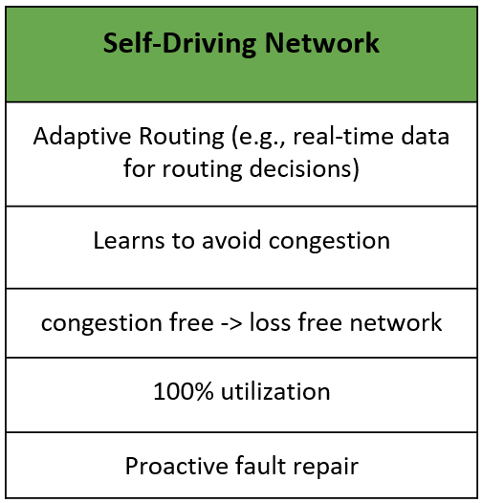
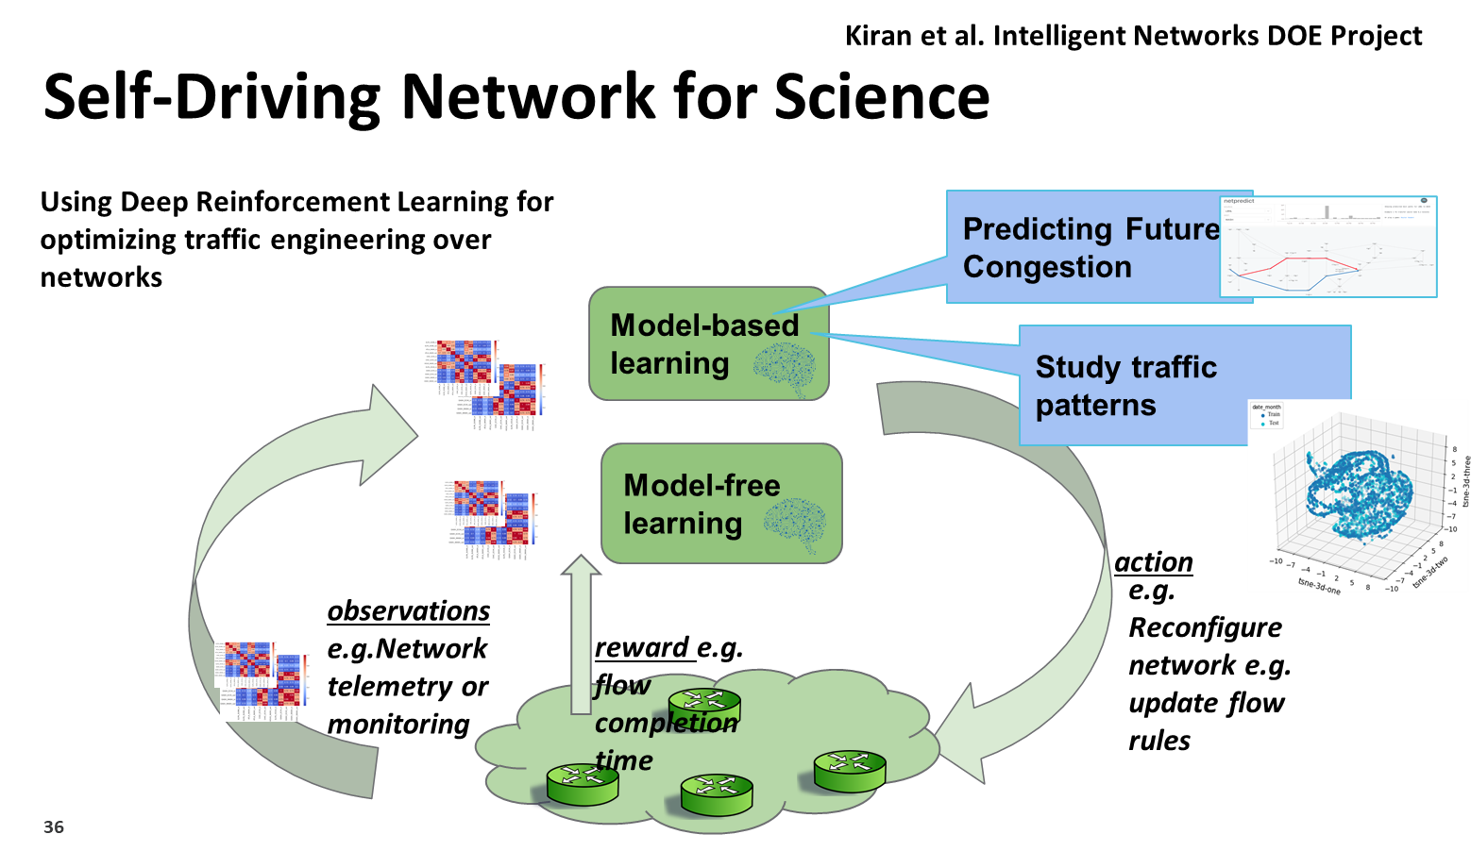
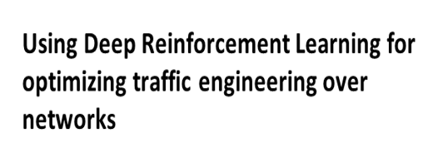
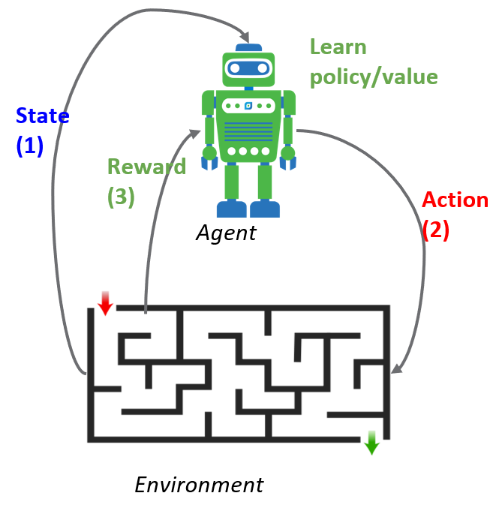
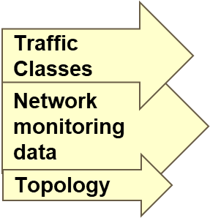
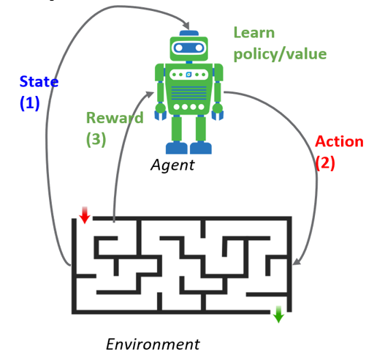
M. Kiran, C, Guok et al (ESnet)
Self Driving Network
Adaptive Routing (e.g. Real
time data for routing decisions)
Mariam Kiran (ESnet) et al. Intelligent Networks DOE Project
Learns to Avoid Congestion
Use Deep Reinforcement Learning to Optimize network traffic engineering
Congestion Free  Loss Free
Towards 100% Utilization
Proactive Fault Repair
Intelligent Controller (HECATE)
Case Studies:
1. Model free: Path selection for large data transfers: better load balancing
2. Model Free: Forwarding decisions for complex network topologies:
Deep RL to learn optimal packet delivery policies vs. network load level
3. Model Based: Predicting network patterns with Netpredict

Slide 20
Next Generation System for Data Intensive Sciences
Architectural Model: Data Center Analogue
Classes of “Work” (work = transfers, or overall workflow),
defined by VO, task parameters and/or priority and policy
Adjusts rate of progress in each class to respond to network
or site state changes, and “events”
Moderates/balances the rates among the classes
Optimizes a multivariate objective function with constraints
Overarching Concept: Consistent Network Operations:
Stable load balanced high throughput workflows cross optimally
chosen network paths
Provided by autonomous site-resident services dynamically
interacting with network-resident services
Responding to (or negotiating with) site demands from the science
programs’ principal data distribution and management systems
Up to preset or flexible high water marks: to accommodate
other traffic serving the at-large academic and research community

Slide 21
Next Generation Network-Integrated System
Top Line Message: To realize the physics discovery potential and meet
the challenges of the HL LHC era, we need a new dynamic system which:
    Coordinates worldwide networks as a first class resource along
    with computing and storage, across and among world regions
    Follows a systems design approach: A global fabric that flexibly allocates, balances and makes best use of the available network resources
    Negotiating with site systems that aim to accelerate workflow
  Builds on ongoing R&D projects: from regional caches/data lakes
  to intelligent control and data planes to ML-based optimization
  Leverages the worldwide move towards a fully programmable ecosystem of networks and end-systems (P4, PINS; SRv6), plus operations platforms
  (OSG, NRP; global SENSE Testbed)
  Simultaneously supports the LHC experiments, other data intensive programs and the larger worldwide academic and research community
  The LHC experiments together with the WLCG, the GNA-G and its Working
  Groups, and the worldwide R&E network community, are the key players
    Working together with other major programs: LBNF/DUNE, VRO, SKA

Slide 22
Acknowledgements
This ongoing work is partially supported by the US National Science Foundation (NSF) Grants OAC-2030508, OAC1841530, OAC-1836650, MPS-1148698, and PHY-1624356, along with research grants from many international funding agencies and direct support from the many regional, national, and continental network and industry partners mentioned. The development of SENSE is supported by the US Department of Energy (DOE) Grants DE-SC0015527, DESC0015528, DE-SC0016585, and FP-00002494.
Finally, this work would not be possible without the significant contributions and the collaboration of the many HEP, network and computer and research teams partnering in the Global Network Advancement Group, in particular the GNA-G Data Intensive Sciences and AutoGOLE/SENSE Working Groups and the Global P4 Lab led by GEANT and the RNP Brazilian National Network.

Slide 23
Related Work: CHEP2023 Talks and Poster
58. J. Balcas (Caltech) et al., Track 1, Monday 2 PM:
“Automated Network Services for Exascale Data Movement”
125. S. Shannigrahi (Tennessee Tech) et al., Track 1, Monday 2:15 PM: “A Named Data Networking Based Fast Open Storage System Plugin for XRootD”
584. Y. Richard Yang (Yale) et al., Track 1, Monday 2:30 PM:
“ALTO/TCN: Toward an Architecture of Efficient and Flexible Data Transport
Control for Data-Intensive Sciences using Deep Infrastructure Visibility”
32. A. Sim (LBL) et al., Track 4, Tues. 11:15 AM: “Predicting Resource Usage
Trends with the Southern California Petabyte Scale Cache”
450. P. Bhat (Caltech) et al., Poster Session Tues. 3:30 PM:
“Scientific Community Transfer Protocols, Tools & Their Performance Based
on Network Capabilities”
60. C. Guok (ESnet) et al., Track 7, Tues. 5:15 PM: “Complete End-to-End Network Path Control for Scientific Communities with QoS Capabilities”
59. J. Balcas (Caltech) et al., Track 1, Thurs. 11:45 AM:
“Job CPU Performance Comparison Based on MiniAOD Reading Options:
Local vs. Remote”
614. A. Arora (UCSD) et al., Track 1, Thurs. 2:45 PM:
“400 Gbps Benchmark of XRootD HTTP-TPC”

Slide 24
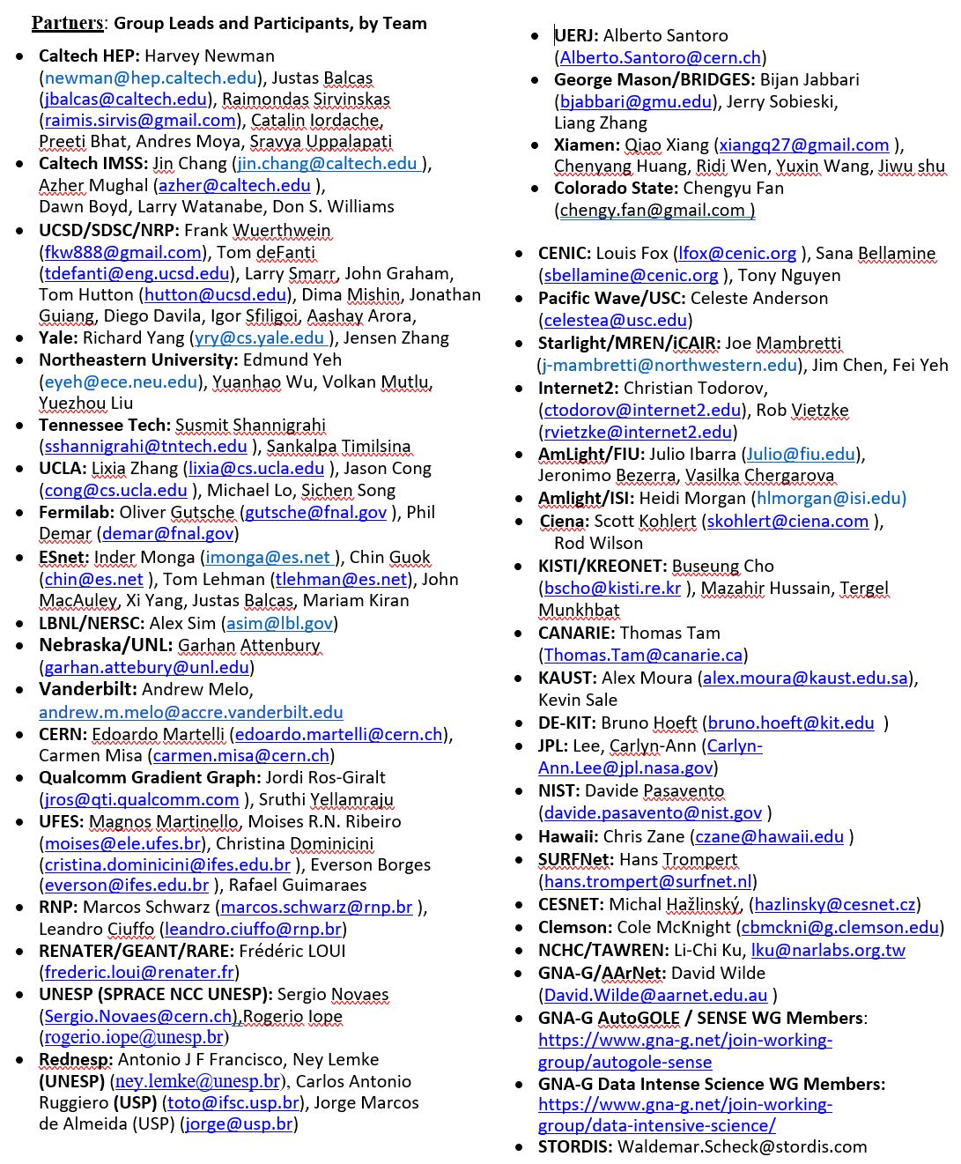
GNA-G DIS WG: Worldwide Partnerships

Slide 25
Extra Slides Follow

Slide 26





Global Data Flow: LHC Grid Hierarchy
A Worldwide System (Caltech 1999)
Online System
12-14 Tier1, 170 Tier2
+ 300 Tier3 Centers:
1k to N X 10k Cores
~1000 MBytes/sec
Experiment
~PByte/sec
CERN Center
100 PBs of Disk;
Tape Robot
Tier 0
Tier 1
N X100 Gbps
Bologna
London
Paris
Taipei
Chicago
10 to 100 Gbps
Tier 2
CACR
Tier2 Center
Tier2 Center
Tier2 Center
Tier2 Center
Tier0: Real Time Data Processing
Tier1 and Tier2: Data and Simulation
Production Processing
Tier2 and Tier3: Data Analysis
Tier 3
Institute
Institute
Institute
Institute
Physics data cache
10 to 100 Gbps
Tier 4
Increased Use as a “Cloud” Resource (Any Job/Data Anywhere)
Increased “Elastic” Use of Additional HPC and Cloud Resources
A Global Dynamic System: Fertile Ground for Control with ML
Workstations

Slide 27

WLCG Transfers Dashboard: 3/2017 to 3/2022
https://monit-grafana.cern.ch/d/AfdonIvGk/wlcg-transfers?orgId=20
HL LHC “10%” Data Challenge in October 2021 exceeded 100 Gbytes/sec for >1 Day
The “25%” Challenge Scheduled for 2024 will be a real challenge
General WLCG Traffic is again at or above the pre-pandemic level

Slide 28



Data Lake Concept: Site and In-Network Caches in California; US and Europe
Roughly 30,000 cores across Caltech & UCSD … half typically used for analysis
A 2+ Pbyte Working Example in Production
Site Caches: Plan to include other Tier3s; Tier2s across the US; and at CERN
In-Network Caches: ESnet and Internet2 across US; AMS and London exchange points
Scaling to HL LHC: ~30 Pbytes Per Tier2, ~10 Pbyte Caches, 1 Pbyte Refresh in a Shift Requires 400G Link. Still relies on use of compact event forms,
efficiently managed data transport

Slide 29
Annual CMS Data Volume
“Data Use by the CMS Experiment at the LHC” ESnet Frank Wuerthwein, ESnet Seminar
 | # of collisions | # of events simulated | RAW event size [MB] | AOD event size [MB] | Total per year [PB]
Today | 9 Billion | 22 Billion | 0.9 | 0.35 | ~20
HL-LHC | 56 Billion | 64 Billion | 6.5 | 2 | ~600
The beams get “brighter” by x4
Data taking rate goes up by x6
Simulations go up by x3 (++)
Primary Data volume
per year goes up by x30
Conclusion: CMS Data ~Exabyte/Year by ~2029 at HL-LHC

Slide 30

HL-LHC CMS Online System Needs:
Phase 1 Versus Phase 2 [*]
Event Network Throughput: 32x
Computing Power: 53x
Storage Throughput: 26x
Storage Capacity Per Day: 16x (3.3 Pbytes)
[*] The Phase-2 Upgrade of the CMS Data Acquisition and High Level Trigger Technical Design Reporthttps://cds.cern.ch/record/2759072/files/CMS-TDR-022.pdf
Not Just a future issue:
  Greater luminosity and pileup in 2023 compared to 2022:
  More CPU, more storage, greater network required
  Plan for ~50% greater CPU from external HPCs in 2023

Slide 31




International Bandwidth Pricing Trends https://www2.telegeography.com/hubfs/2022/Presentations/2022%20PTC%20Workshop.pdf
Weighted Median 100G Monthly Lease Prices 2018-21
Weighted Median 100G/10G Price Multiples 2018-21
Prices relatively flat since Q4 2018
Compressing Price Multiples Over Time
Price Multiples 100G/10G by Region in 2016 and 2021
Price Evolution 2018-21 + Future
    -17% Price CAGR Average
    Only -11 to -12 % CAGR
    NYC – London and LA-Tokyo
    To -6% 2019-20 due to COVID
    100G/10G Price Multiple:
    Still ~4X, from 6.4X in 2015
    400G/100G Price Multiple Evolution Expected to be Similar:
    When: from 2025-28 ?

Slide 32




400G Transatlantic Plans: ESnet, Internet2 and Canarie
ESnet Transatlantic
and EU Ring Upgrades
In Production:
400G NYC-London
Underway (by the fall):
  400G Boston – London
  400G Boston – CERN
  400G European Ring
  Transatlantic Capacity Targets
  1.5T in advance of DC24
  ... To 3.2T well in advance of Run4
  (if funding is as expected)
Eli Dart, ESnet
LHCOPN/LHCONE Meeting April 2022
Christian Todorov, Internet2 LHCOPN/LHCONE Meeting April 2022
Exchange Points with Automation in Boston, Washington, NYC
Provide support to the community for 400G diversity
among Internet2, ESnet, ANA, FIU/AmLight, APONet et al.

Slide 33

Shared Network Infrastructure: GLIF Map (2017)
+ R&D Links: BRIDGES from 2021; FABRIC from 2022
The Rising Transpacific and Asia Pacific Network Community
In a Global Context

Slide 34
SENSE Services for LHC and Other Open Science Grid (OSG) Workflows: Rucio, FTS, XRootD Integration
Goals center around SENSE providing key network-related
capabilities to LHC + 30 other science programs
Primary Motivations:
  Developing mechanisms for an application workflow to obtain information regarding the network services, capabilities, and options;
  to a degree similar to what is possible for compute resources
  Giving applications the ability to interact with the network:
  to exchange information, negotiate performance parameters,
  discover expected performance metrics, and receive status/
  troubleshooting information in real time, during long transactions.
Key pathways:
(1) Interfacing and interaction with RUCIO, FTS and XRootD data federation
and storage systems, through Engagement:
with CMS, ATLAS and those development teams
(2) Enabled by the ESnet6 plan: with up to ~75% of link capacity
on key routes available for policy-driven dynamic provisioning
and management by ~2027-28
4 Phase 1 Year Schedule, Completing in 2023:
from system evaluation to design, to prototype deployments and tests,
to a plan for the transition to operations and the additional R&D needed

Slide 35
AutoGOLE / SENSE Working Group
Worldwide collaboration of open exchange points and R&E networks interconnected to deliver network services end-to-end in a fully automated way. NSI for network connections, SENSE for integration
of End Systems and Domain Science Workflow facing APIs.
Key Objective:
  The AutoGOLE Infrastructure should be persistent and reliable,
  to allow most of the time to be spent on experiments and research.
Key Work areas:
  Control Plane Monitoring:
  Prometheus based, deployments now underway
  Data Plane Verification and Troubleshooting Service:
  Study and design group formed
  AutoGOLE related software: Ongoing enhancements to facilitate deployment and maintenance (Kubernetes, Docker based systems)
  Experiment, Research, Multiple Activity, Use Case support:
  Including NOTED, Gradient Graph, P4 Topologies, Named Data Networking (NDN), Data Transfer Systems integration and testing.
WG information
https://www.gna-g.net/join-working-group/autogole-sense

Slide 36

SENSE: SDN Enabled Networks for Science at the Exascale
ESnet, Caltech, Fermilab, LBNL https://arxiv.org/abs/2004.05953
Creates Virtual Circuit Overlays. Site and Network RMs, Orchestrator

Slide 37
Integration of End-Site Resources and Science Workflows
Automated provisioning and traffic engineering of paths across wide area networks and
exchange points is important
However to really add value to science applications integration of these services is needed with:
  End Site network, compute, and storage infrastructure
  Science workflow agents and middleware

Slide 38


Slide 39

Key Takeaways: See J. Balcas, “Automated Network
Services for Exascale Data Movement”
Track 1, Monday May 8 11:15

Slide 40

A New Generation Persistent 400G/100G Super-DMZ: CENIC, Pacific Wave, ESnet, Internet2, Caltech, UCSD, StarLight ++
To StarLight
To SC22 Dallas
and Beyond
400G
I2 Optical
ESnet6
Fabric
I2 Packet
Starlight
400G
ESnet/Fabric
818 W 7th
10th Floor
Pending Connections
to CENIC/PacWave
Internet2
818 W 7th
10th Floor
Cisco NCS 1K4
Caltech
Campus
100GE
400G
CENIC LA
818 W 7th
10th Floor
Arista 7060 DX4
400GE & 100GE
Caltech IMSS
Waveserver Ai
SEA
Pacific Wave
Seattle 1-1
200G
CENIC/
Pacific
Wave
100GE
Caltech IMSS
Waveserver Ai
200G
100G of 500G
100GE
Riser Panel
To Juniper QFX
after SC22
Pacific Wave
Sunnyvale 2-1
SNVL
SDSC
LAX Agg10
LA
4 X 100GE
Riser Panel
Pacific Wave
LosA 2-1
4 X 100GE
NCS/Ciena
Transponders
CENIC LA
818 W 7th
6th Floor
4 X 100GE
NCS/Ciena
Transponders

Slide 41



Working toward operation at 400Gbps between sites
UCSD to Caltech XRootD Transfers at 300 Gbs, working thru several issues: XRootD push vs pull, host level QoS configuration
200G
CENIC LA 818 W 7th
10th floor
Riser panel
200G
2 x 400G
CENIC/
Pacific Wave
Riser panel
4 x 100G
2 x 200G
CENIC LA 818 W 7th
6th floor
17

Slide 42


Slide 43


Slide 44

ESNet 400G Transatlantic Plans
Eli Dart, ESnet
LHCOPN/LHCONE Meeting April 2022

Slide 45























Interfacing to Multiple VOs With FTS/Rucio/XRootD
LHC, Dark Matter, ν, Heavy Ions, VRO, SKAO, LIGO/Virgo/Kagra; Bioinformatics
OSG Data Federation
European Science
Data Center
Vera Rubin Observatory

Slide 46

Global P4 Lab
Dataplane of P4 and Other Programmable Switches
GEANT + RNP
Frederic Loui
Narcos Scwarz
et al.
LATEST: Rapidly Deployable Network Digital Twin
with high fidelity (Container Lab) for complex network topologies
Plan: Smooth Transition from Simulation to Real-World Global Operations

Slide 47
Global P4 Lab: Motivation – Marcos Schwarz, RNP
Frederic Loui, GEANT
Can we increase the rate of evolution without interfering
with production networks?
To develop and operate end-to-end / multi-domain
orchestration services:
Resource reservation (guaranteed bandwidth)
Resource provisioning (Circuits, VRFs)
Underlay observability
Dynamic traffic steering/engineering
Dynamic creation of L3 VPNs
Closed loop multi-domain visibility/intelligence/controllability
How can we create/sustain an integration initiative/platform
to propose and validate next generation protocol and services?
Proposition: Use programmable P4 devices to experiment on pre-production networks leveraging industry/R&E open ecosystems

Slide 48
Global P4 Lab Goals
Current (Q1 2023)
Persistent global L3 overlay network based on P4 switches
Intercontinental high capacity transfers (100G and over) exploring
multiple source routing solutions (Segment Routing and PolKA)
Management infrastructure and tools used to operate this
global network
Core network based on RARE/FreeRtr and edge networks based
also on SONiC
Future (2023-4)
Capability to support multiple virtual networks that implement different choices of routing stacks, traditional and SDN based:
on the same devices
Integration with initiatives for visibility, controllability & intelligence
Work as a reference state of the art / next generation R&E network

Slide 49

Why P4 ?

Slide 50

Integration Path Among Initiatives

Slide 51







Self-Driving Network for Science
Kiran et al. Intelligent Networks DOE Project
Using Deep Reinforcement Learning for optimizing traffic engineering over networks
Predicting Future Congestion
D-DCRNN: Spatiotemporal forecasting with applications in neuroscience, climate,
traffic flow, smart grid, logistics, supply chain: https://arxiv.org/pdf/1707.01926.pdf
Model-based learning
Study traffic patterns
Model-free learning
action
observations e.g.Network telemetry or monitoring
e.g. Reconfigure network e.g. update flow rules
reward e.g. flow completion time
Future: Hooks for a Richer, More Stateful Objective Function
(Policy, Priority, Deadlines, Path Quality, Co-Flows...);
Event Response; Applications to 5G and Quantum Networks
Mariam Kiran (ESnet)
mkiran@lbl.gov et al

Slide 52
Next Generation System
for Data Intensive Sciences
The development of effective ML optimization methods,
and multidimensional, real-world metrics
Are themselves challenging, groundbreaking activities
A new area of application in multidomain distributed systems
Strategic Aim: Compatible coexistence of programmable
goal-oriented networks, and production networks
Simultaneously meeting the needs of the leading edge science programs and the at-large A&R communities

Slide 53





SC15-22: SDN Next Generation
Terabit/sec Ecosystem for Exascale Science
supercomputing.caltech.edu
SDN-driven flow steering, load balancing, site orchestration
Over Terabit/sec
Global Networks
SC16+: Consistent Operations with Agile Feedback
Major Science Flow Classes
Up to High Water Marks
Preview PetaByte Transfers to/
from Site Edges of Exascale Facilities With
100G -1000G DTNs
LHC at SC15: Asynchronous Stageout (ASO) with Caltech’s SDN Controller
Tbps Rings for SC18-22: Caltech, Ciena, Scinet,
StarLight + Many HEP, Network, Vendor Partners
45

Slide 54


Global Petascale to Exascale Workflows for Data Intensive
Sciences Accelerated by Next Generation Programmable
Network Architectures and Machine Learning Applications
Network Research Exhibition NRE-19. Abstract: https://www.dropbox.com/s/qcm41g7f7etjxvy/SC22_NRE_GlobalPetascaleWorkflows_V8072022.docx?dl=0
A Vast Partnership of Science and Computer Science Teams, R&E Networks
and R&D Projects
  Convened by the GNA-G Data Intensive Sciences WG
Mission
  Meeting the challenges faced by leading edge data intensive experimental programs in high energy physics, astrophysics, genomics and other fields
  of data intensive science
  Clearing the path to the next round of discoveries
Demonstrating a wide range of the latest advances in:
  Software defined and Terabit/sec networks
  Intelligent global operations and monitoring systems
  Workflow optimization methodologies with real time analytics
  State of the art long distance data transfer methods and tools,
  local and metro optical networks and server designs
  Emerging technologies and concepts in programmable networks
  and global-scale distributed system

Slide 55

SC22 NREs: AutoGOLE / SENSE and NOTED (Draft)
SC21: Global footprint. Multiple 400G Optical Wide Area Links
Bill Johnston 9/23/22
SC22: Global footprint. Terabit/sec Triangle Starlight – McLean – Dallas; 400G to LA;
4 X 100G to Caltech and UCSD/SDSC; 3 X 400G to the Caltech Booth

Slide 56

Caltech, StarLight, NRL and Partners at SC22
Microcosm: Creating the Future of SCinet and of Networks for Science

