Slide 1
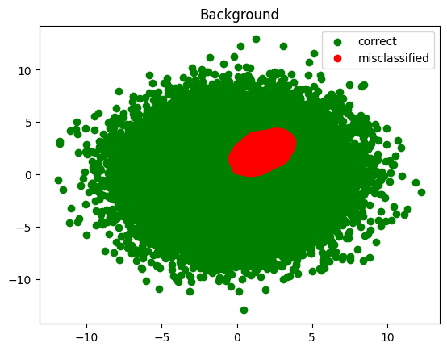
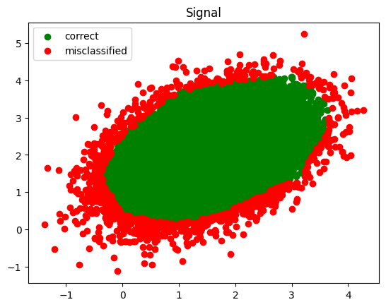
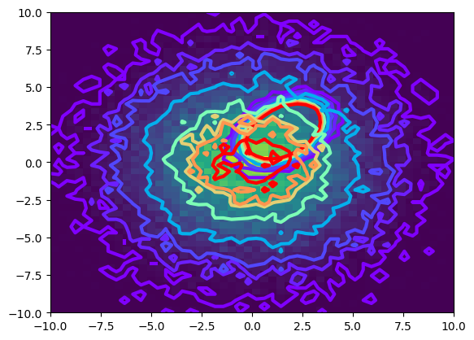
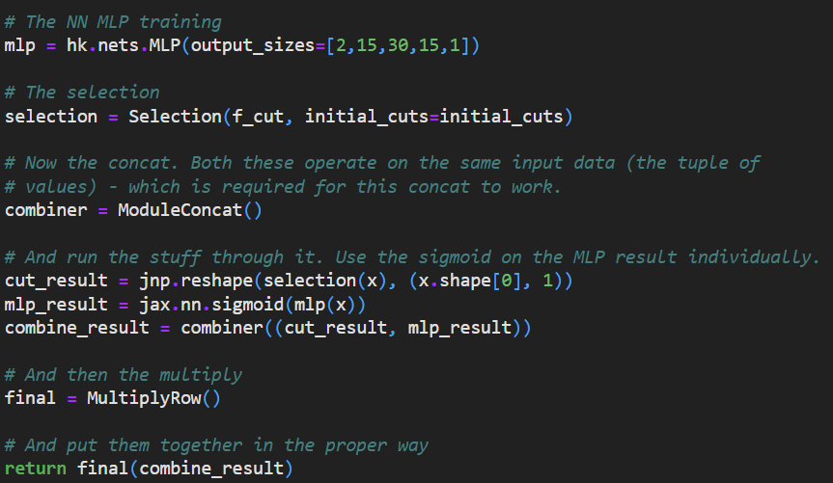
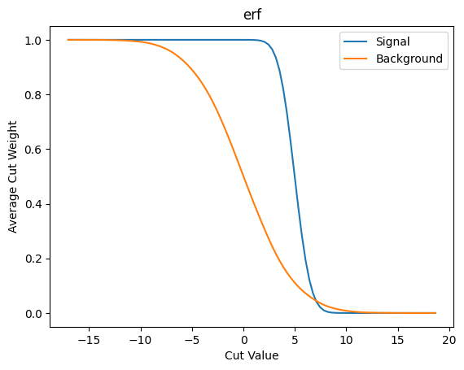
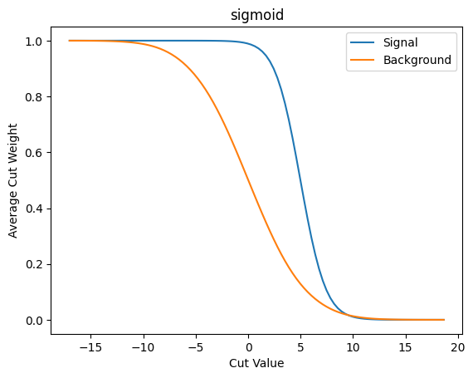
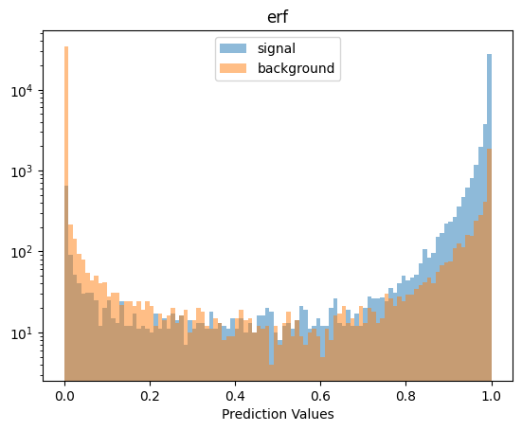
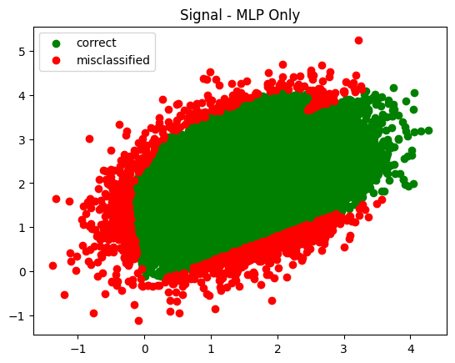
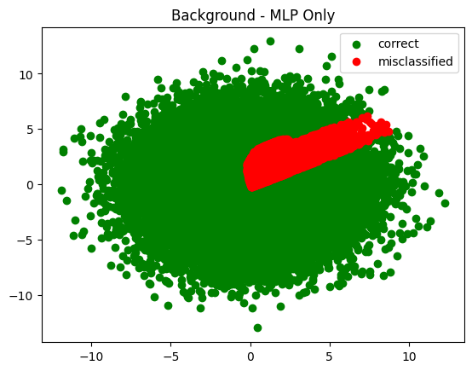
Differentiable Programming: Neural Networks and Selection Cuts Working Together
Gordon Watts
Goal: Minimize data flow along this arrow without compromising results (minimizing caching, networking, etc.)
Data Storage Facility
Analysis Facility
Large Data Sample
Neural Network
Simple Query Processor
Train Simultaneously
Toy Test MC
JAX & Haiku
Train & Cut: Could train the NN first, and then adjust cuts till they affected signal region. Does not work will with large number of cuts.
Simultaneously Train: Use gradient descent techniques to train the simple query cuts and the NN
Two Axes
Data centered at (0,0) and signal centered at 1.5, 2.0
Data width is (9,9) with no correlation and signal width is (0.5, 0.5) with 20% correlation
JAX is a Deep Learning framework from Google
Encourages python idioms to construct networks
Designed as a Toolkit
Makes it very easy to try new ideas
P1: Cuts aren’t Differentiable
P2: NN Design
NN
Cuts, like $p_{T}>30$ GeV, are discontinuous and differentiable training techniques do not work. We need a continuous weight, not a True/False.
The Error Function & Sigmoid were examined. Sigmoid functions trained slightly more quickly and resulting weight distributions were better behaved.
Each cut and the NN output are weights
Treat a weights
Multiply them together
Normalize the NN with a sigmoid function only
Do not normalize the whole thing by a sigmoid – the cut weights need to be cut weights
Cut 1
Cut 2
Sigmoid
Note flat behavior here: gradient will be zero, no hints to how to train the cut!
Trained along a single axis, fraction of sample surviving cut.
P3: Loss
Next Steps
Typical Loss functions all work.
Do not use the softmax function of the output of the combined NN
This works at low dimension and small test data
Try higher dimensional data
Try an actual analysis
Use JAX features to modify the gradient of the selection functions, so we don’t have to pre-specify them
Test this with multidimensional space
Add loss function term that is related to size of cached data
There are other forms of cuts available in the AI community – expectation values, for example.
$$\frac{e^{x_{i}}}{∑e^{x_{i}}}$$
Will cause the selection cuts to drift down towards very negative numbers!
https://github.com/gordonwatts/diff-prog-intro
Next Steps

