Slide 1
FastCaloGANV2 for fast simulation in Run3
FastCaloGAN: a fast simulation of the ATLAS Calorimeter with GANs
Michele Faucci Giannelli
On behalf of the ATLAS collaboration

Slide 2
FastCaloGAN v1
Extensively documented: PUB note, AltFast3 paper
Used in to produce 2B events in ATLAS for Run2 reprocessing
See the talk in track 3 parallel session
Use single particle samples
Electrons, photons and charged pions
Detector divided in 100 η slices
15 energy points (256 MeV – 4 TeV, in powers of 2)
Voxelisation
Training of the GANs
Simulation in Athena

Slide 3
New voxelisation: more bins!
AF3 paper
(2x bins thanks to sim in phi)
New binning
Better to map the cells when inverting the voxelisation in the service
More difficult to learn for the GANS as there are more voxels (also more memory)
Better to parametrise the shower shape

Slide 4
FastCaloGAN optimisations
Most GAN code was rewritten in TensorFlow2
the FastCaloGAN framework and scripts improved significantly
Changed the FastCaloGAN v1 simplification of having identical GANs for all particles in all detector regions
It was good for a prototype!
Split e/gamma showers in high and low energies samples,
2 GANs are trained for each eta (for a total of 500 GANs)
The detector regions were optimised to better group similar η slices
New Training strategy: pre-train one GAN in each detector region and then train all other GANs in that region from the best iteration of that GAN
Pre-Train 6h pion, 16h e/gamma x 10 eta regions
Production 3h pions, 8h e/gamma x 100 eta slices
Full detector training time ~2 weeks on CERN HTCondor GPUs
V1 required 3 months, now we can easily retrain!

Slide 5
FastCaloGAN optimisations
Several hyper parameters were optimised for each GAN:
Generator size (low energy photons are bigger than high energy photons, pions networks are significantly bigger than in v1) → driven by new voxelisation, requires more memory
Discriminator size (doubled for high energy photons, different structure for pions) → higher training time
Activation functions (swish for e/gamma)
Lambda
Batchsize
Learning rate
Interestingly, the particle and energy range have more impact than the detector region
FCAL region is an exception, relu works better for photons

Slide 6
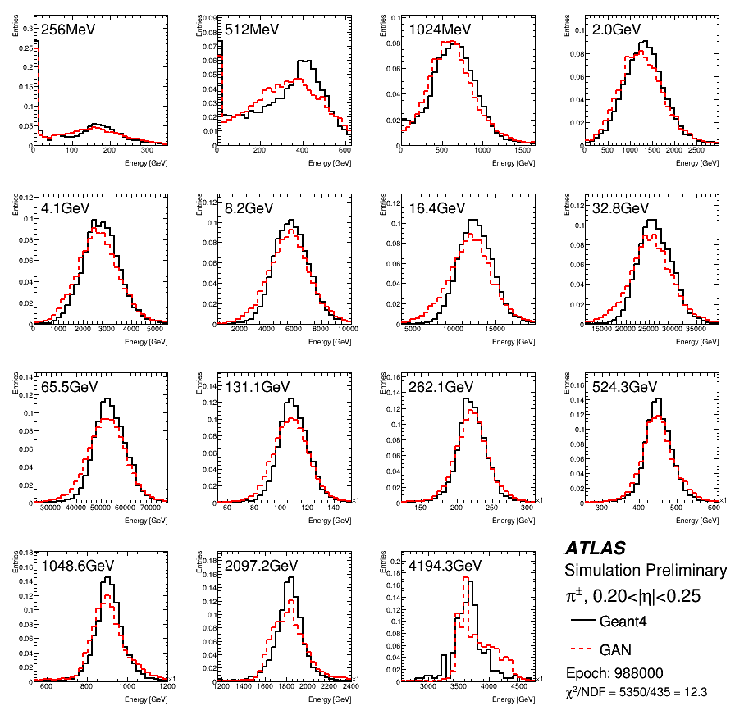
Best GAN for pions: v1 vs v2
V1
V2
Chi2 = 12.3
Chi2 = 3.1

Slide 7
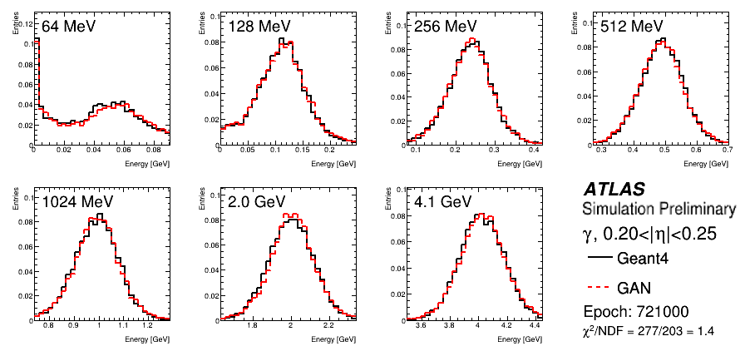
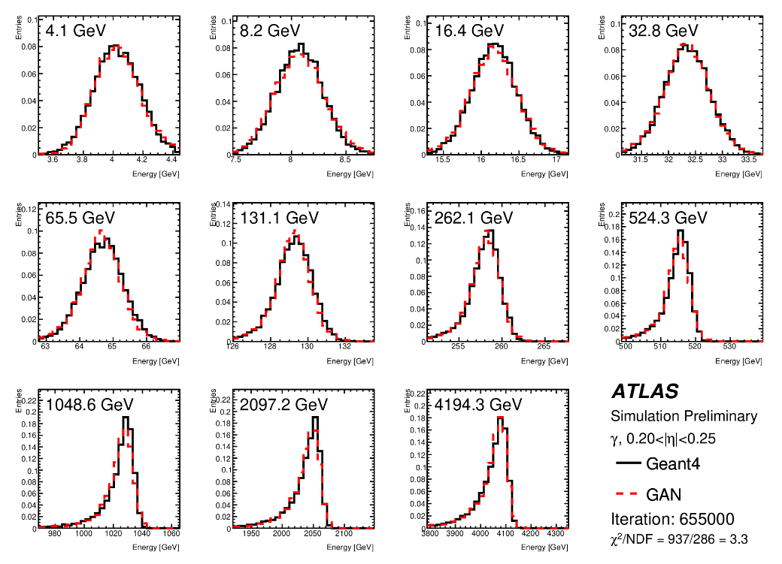
Best GAN for photons
V1
Chi2 = 13.4

Slide 8
Simulation in Athena
Improved voxel-to-cell energy assignment; hits are no longer generated in a grid, instead:
the alpha direction is randomised
Along the radial direction hits are generated according to a pdf taken from input GEANT4 samples
The inference is done in LWTNN but we are working on an ONNX implementation to reduce the memory
More and bigger networks than in V1 resulted in a tenfold increase in memory requirement
Reducing memory will allow to add GANs for other hadrons that are currently simulated as “pions+energy correction”
Speed at inference should also increase but we are not limited by inference time

Slide 9
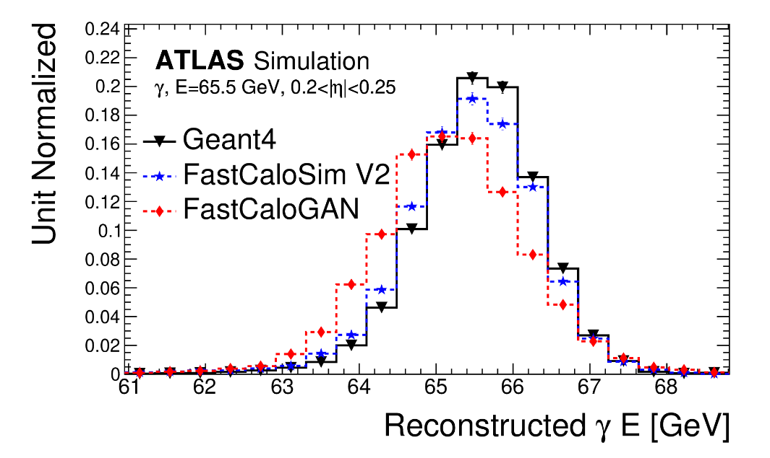
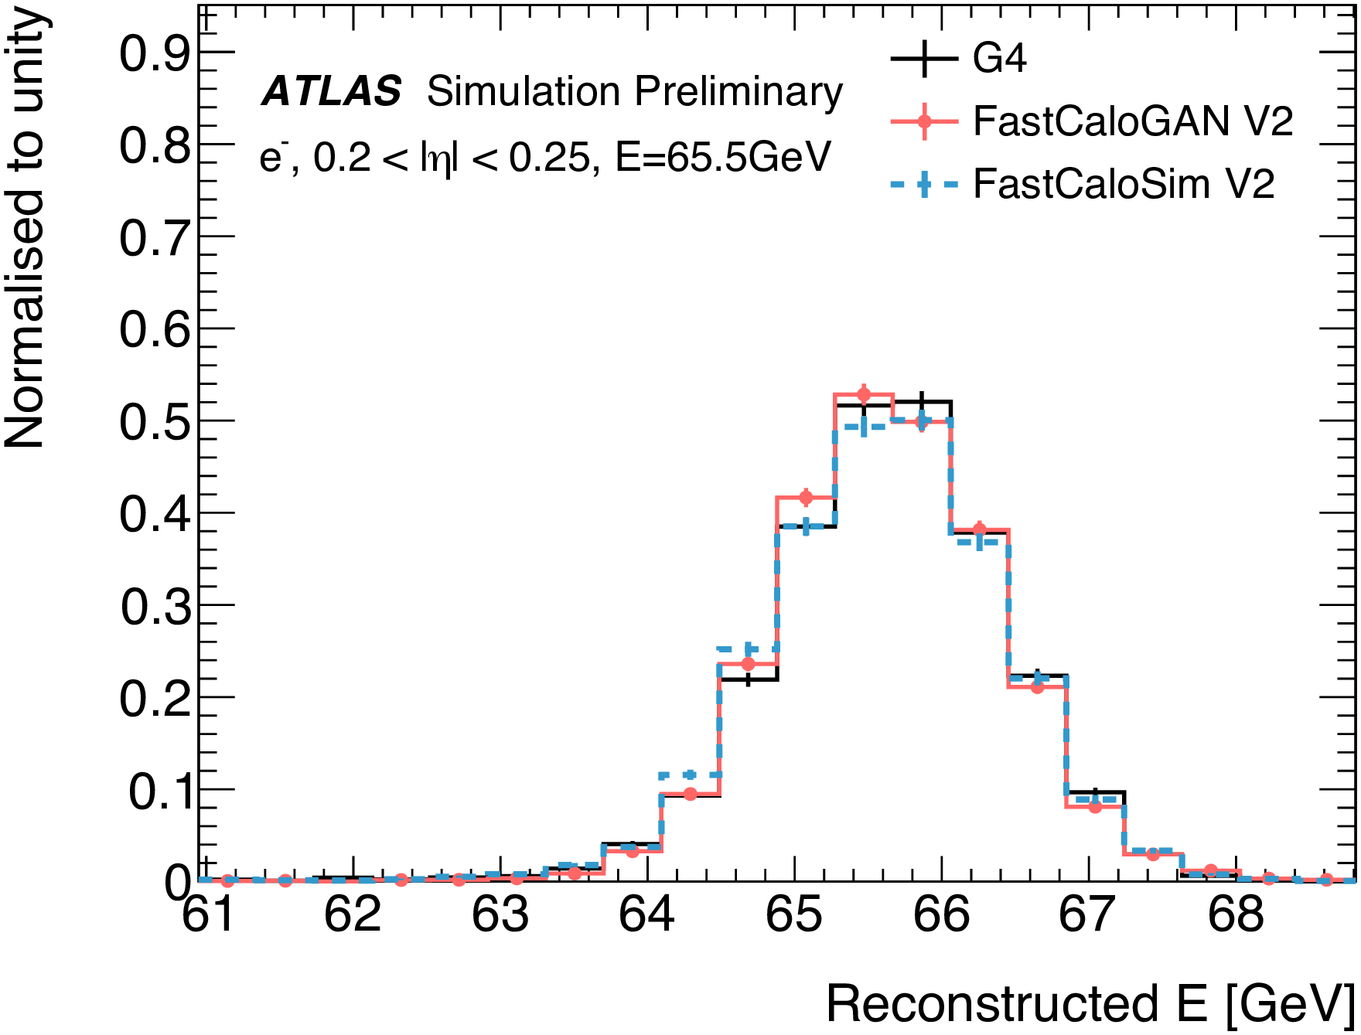
FastCaloGAN v2 performances

Slide 10
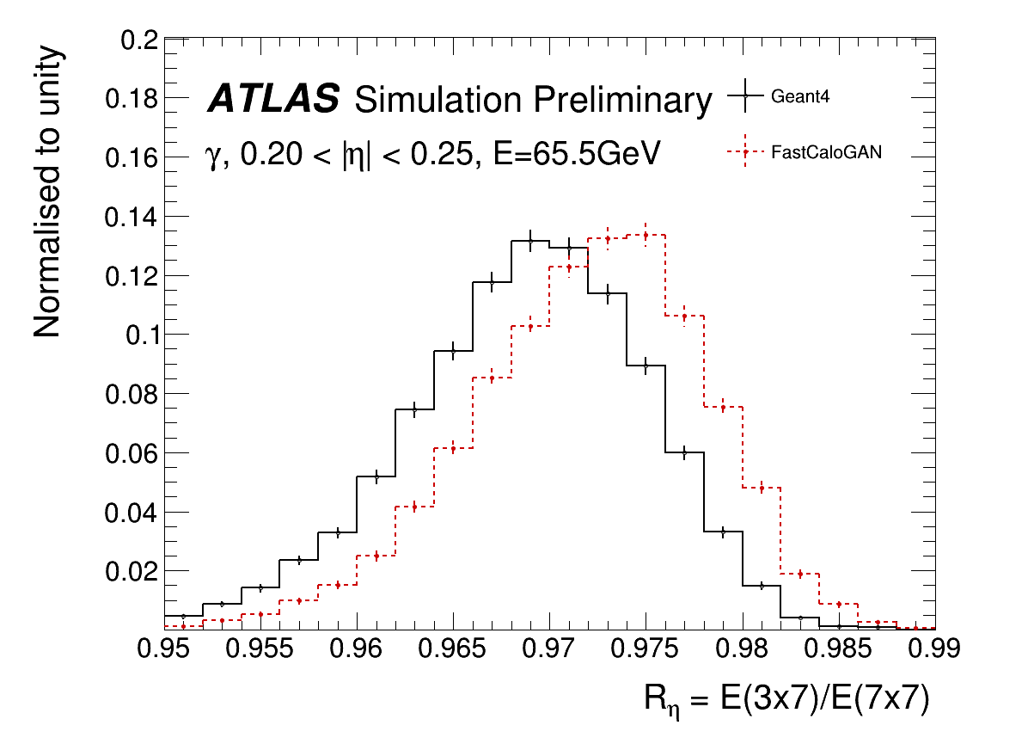
Photon shape

Slide 11
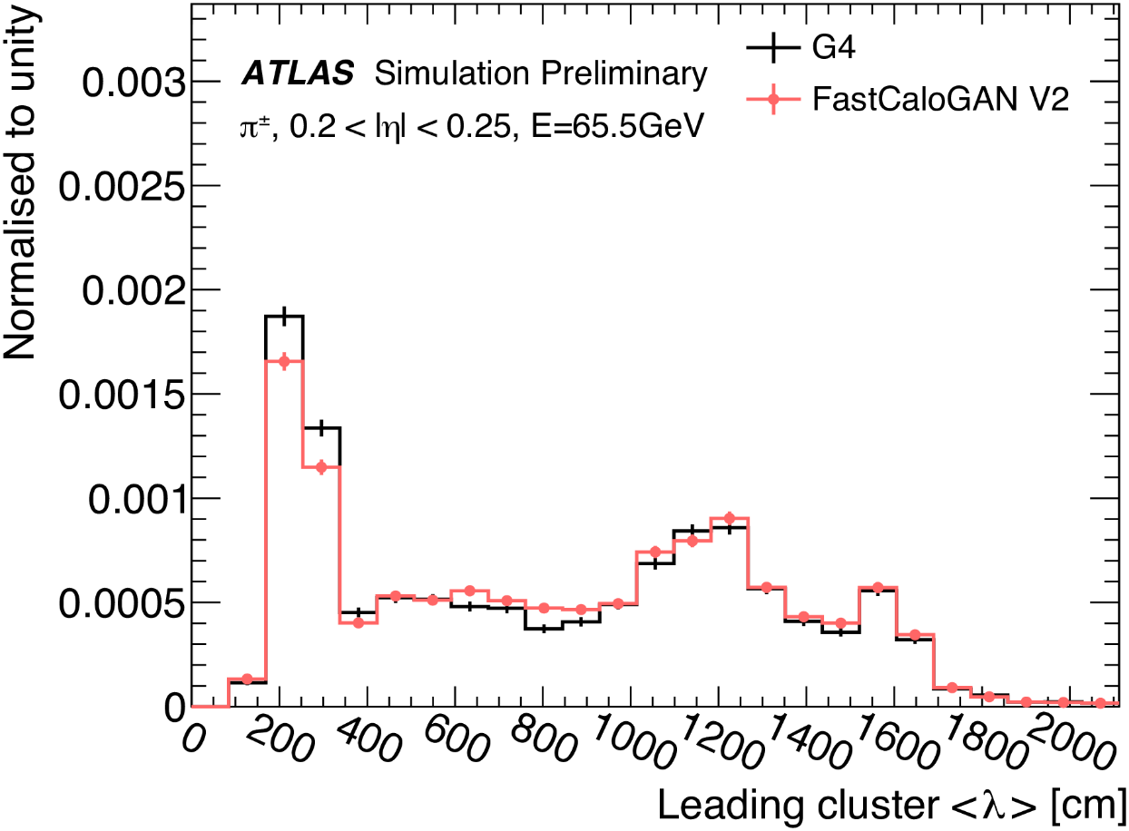
Pions

Slide 12
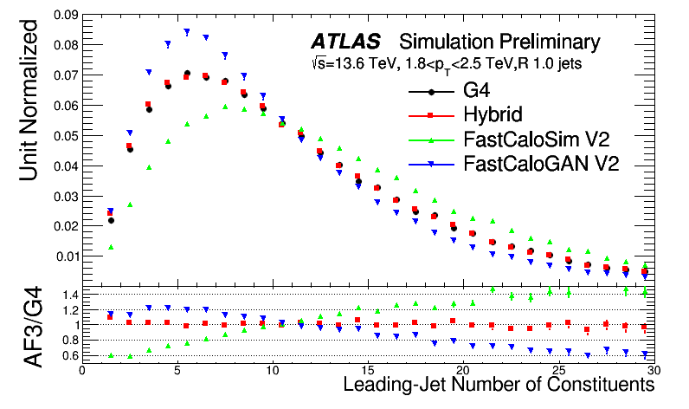
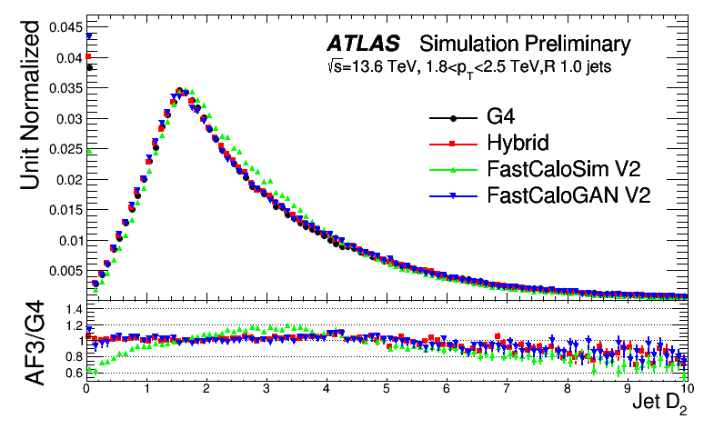
Jet performance in Run3

Slide 13
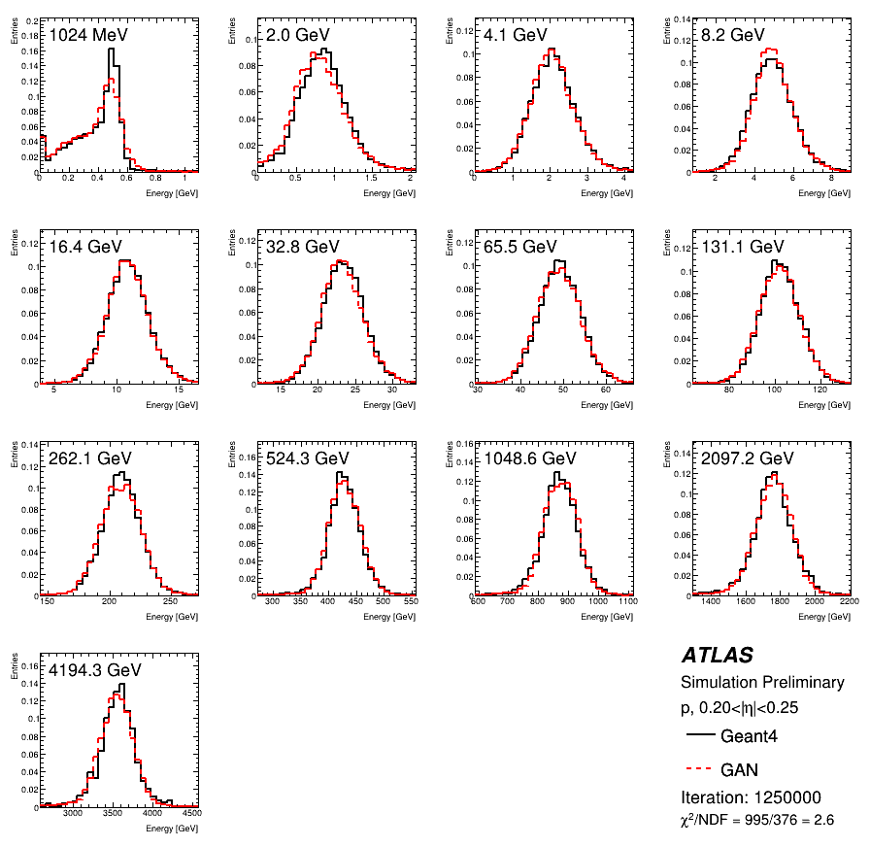
Protons
Training of a new GAN on protons to simulate all baryons
Fewer samples are used as they are produced by momentum
The same voxelisation and HP used for pions was used for protons

Slide 14
Performance: low energy protons
Simulating protons with a dedicated GAN provide a better performance wrt the FCSV2 approach that use pions and a correction on energy

Slide 15
Conclusion
FastCaloGAN was born as a prototype and even at that early stage was able to have great performance for pions, so much as to be used in AF3
FastCaloGAN V2 is a mature tool that is now very accurate for all particles and will be extensively used in Run3 fast simulation
Additional ML tools are also being deployed that will further enhance the Run3-AF3 performance
A new muon punch through tool
A DNN-based tool to predict the longitudinal correction in each layer which is essential to improve GAN e/gamma shower shapes
Further optimisations and the implementation of new model for calorimeter simulation are scheduled for later releases

Slide 16
Backup

Slide 17
The training sample
The single-particle samples have
detailed hits to better map ATLAS cells
without z-vertex spread
without noise
without parts of the electronic cross talk
Events generated by momentum
But used the Ekin for the simulation
The statistics in the high energy region is lower than at low energies
10k events up to 256 GeV
Drop to 1k events for 4 TeV samples

Slide 18
FastCaloGAN, more than just GANs
FastCaloGAN is a tool that perform the simulation of showers in the whole ATLAS calorimeter system using Genenerative Adversarial Networks
The tool is far more than the GANs, it handles the voxelisation and pre-processing of the input samples before they are used by the GANs
It also handles the complex task of assigning the energy from the voxels to the ATLAS calorimeter cells

Slide 19
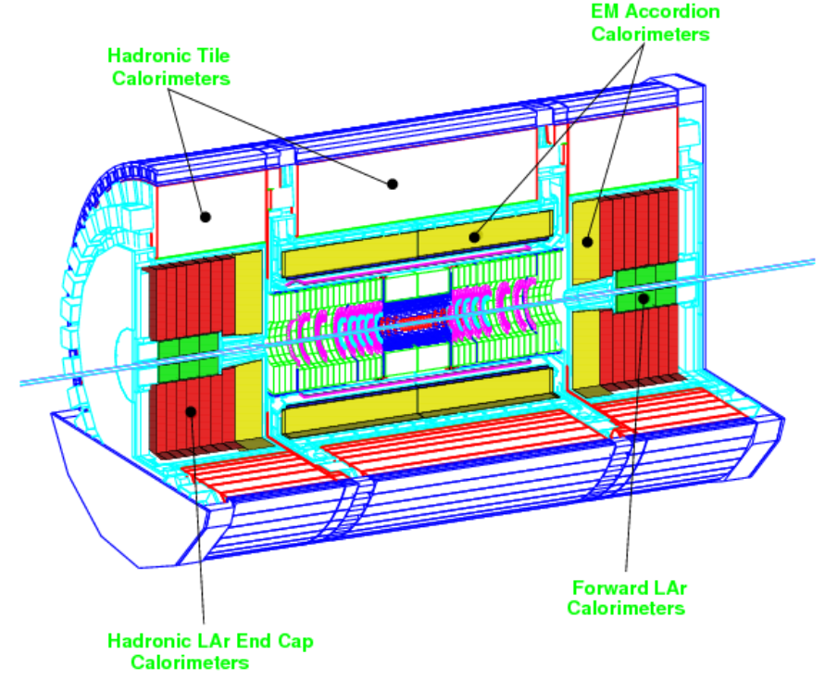
The ATLAS calorimeters
From ATLAS Calo TDR
Complex geometry

Slide 20
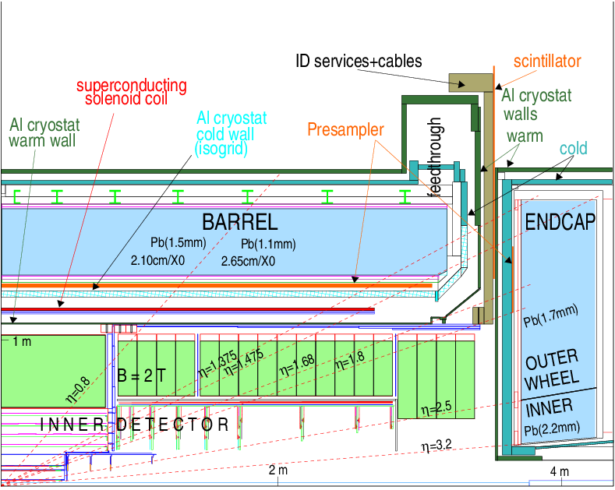
The ATLAS EM calorimeters
From ATLAS Calo TDR
Each line represent a discontinuity

Slide 21
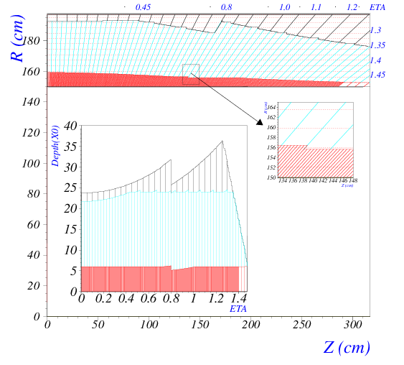
The barrel
4 layers:
Pre-sampler
EMB1
EMB2
EMB3
Non-omogeneus even in barrel
From ATLAS Calo TDR

Slide 22
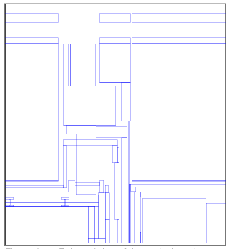
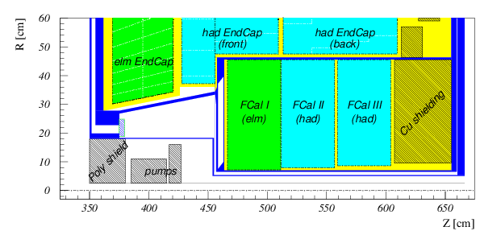
The hadronic calorimeter system
Complex transition region between barrel and endcap
Forward region
From ATLAS Calo TDR

Slide 23
Strategy to handle geometry
Parametrise the fast simulation using single particle samples produced at the calorimeter surface
To get a perfect detector response
Three particles: photons, electrons and pions
Simulate all hadrons based on pions and correct for difference in energy response, but not shape
Segment the detector in 100 small (0.05) η slices
In each eta slice, produce samples at 17 discrete energy points logarithmically separated
From 64 MeV to 4 TeV
Not ideal for ML, but good for parametric approach

Slide 24
Strategy of FastCaloGAN
For each particle and η slice we define a GAN
FastCaloGAN has 300 GANs!
Train each GAN on voxelised hits
Because cell structure is not homogeneous and would require different GAN architectures, the voxelisation reduces the differences and allows for a single, generic, GAN structure
Select best epoch based on total energy distribution of each sample
Convert the selected generator into LWTNN
Simulate hits in Athena inverting voxelisation
Compare with Geant4 using high-level observables for single-particle and di-jet samples after reconstruction

Slide 25
Voxelisation
Hits are transformed from ATLAS (x,y,z) coordinates to cylindrical (r, α, R) coordinates
R is not use, as hits are grouped in layers
GAN cannot be trained on hits, so they are grouped in areas in the (r, α) plane in each layer
each volume in the (r, α, layer) space defines a voxel
Voxels are optimised to:
Have enough energy to avoid large event-by-event fluctuations
Binning in α only for layers with a large energy deposits (i.e. EMB1 and EMB2)
Contain all the energy in a shower
Reproduce the Energy Centroids in η and φ
$$EC_{η}=\frac{\sum_{i}{E_{i}η_{i}}}{E}$$

Slide 26
Voxelisation: different binning
Layers with binning in α (10 bins used)
Layers with low energy
have no binning in α
Hits in layer

Slide 27
Full detector parametrisation
For E/gamma, 6 regions are defined
Barrel
Barrel/EC
EC
EC/FCal
FCal
For pions 9 regions are defined
More regions since EM and Had layers have different transitions
In each region the voxelisation is identical
This means that the GANs have the same structure

Slide 28
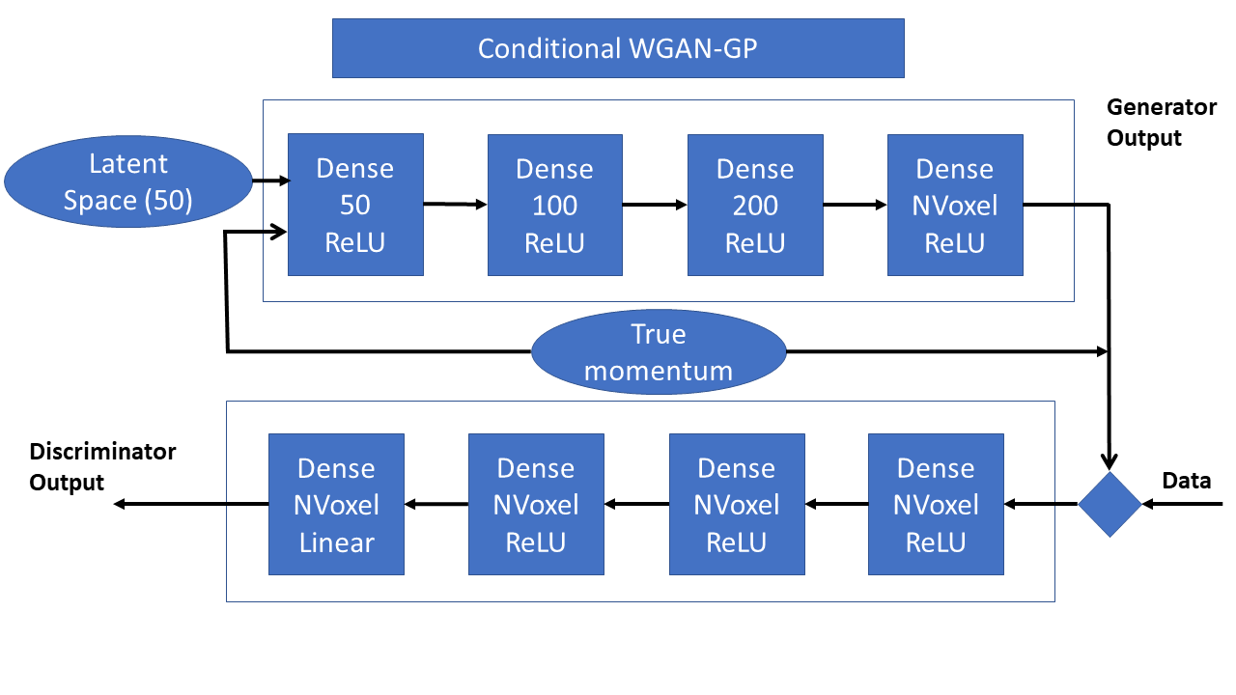
The GAN
NVoxel depends on PID and η

Slide 29
Additional training information 1/1
Normalised all events by the true momentum
Normalised all labels by the highest momentum
Momentum is used as conditioning label
Training using all samples together was not producing good results
But we could train a GAN on a single sample
We decided to use a training strategy in which a single sample is trained for 50k epoch and then additional samples are added to the training mix every 20k epochs
Training order:
32 GeV, 64 GeV, 16 GeV, 128 GeV,…

Slide 30
Additional training information 2/2
Training is carried out for 1M epochs
Checkpoints are saved every 1k epochs
Allows the selection of the best epoch in a second step for a flexible selection criteria
We used the GPUs on HTCondor and the training time was ~8h per GAN → 100 day GPU time to train the full detector

Slide 31
Training

Slide 32
Choice of best epoch
The training of a GAN is not a minimisation process, so there is no assurance that a later epoch will give a better result than an earlier one
You could see “fluctuations” during the training
Choosing an epoch is non-trivial, we have to compromise on many distributions
For this version of FastCaloGAN, we used the total energy of the 15 samples. The χ² between G4 and the generated events is calculated for all sample. The sum of the χ² is used as figure of merit.
The epoch with the smallest χ² is used

Slide 33
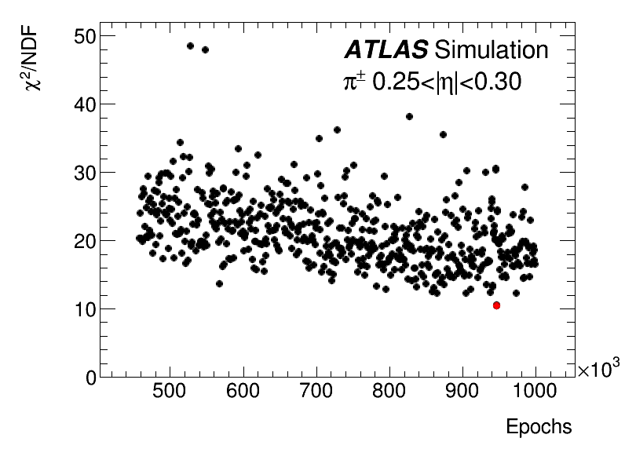
A summary of the training
Chosen epoch

Slide 34
Pions in barrel

Slide 35
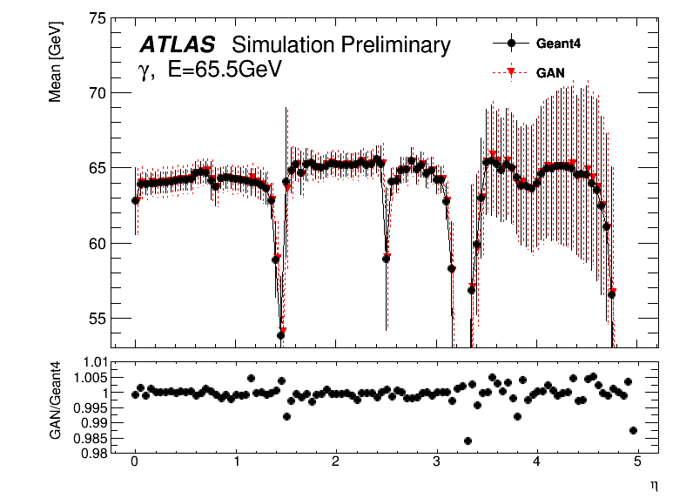
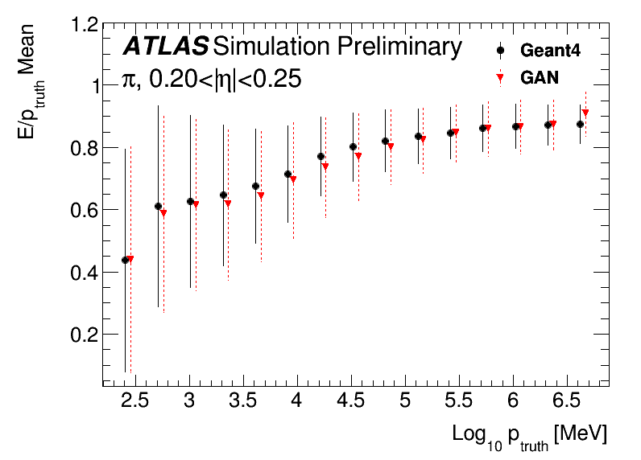
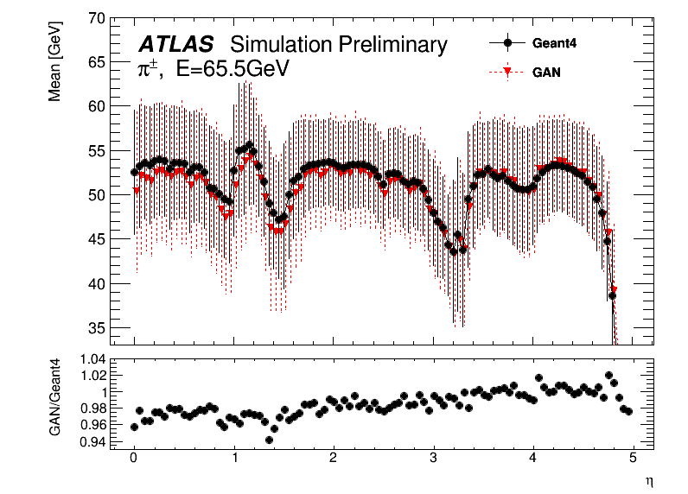
Performance of the GANs
Differences within a few %

Slide 36
Integration in Athena
NB: All figures until now are done at voxel level
To assess the real performance of FastCaloGAN, integration in the ATLAS Athena is required
This is done through a conversion of the generators from TF to Keras and then LWTNN
The LWTNN inputs are open by the FastCaloGAN simulation service
Simulation time for a pion at the calo surface is 2-3 orders of magnitude smaller than Geant4
70ms vs 6s for 65 GeV or 162s for 2 TeV
Memory consumption is small
We could easily add more GANs, i.e. other hadrons

Slide 37
Voxel to hit
The voxelisation must be inverted in the Athena service by producing hits
Hits are generated by sampling the area of each voxel
Depending on the layer, the areas is divided in step of 1 or 5mm along both r,α coordinates
A maximum of 100 hits are produced to reduce the simulation time
The energy in the voxel is divided uniformly among the different hits

Slide 38
Voxelisation inversion
The total energy in a voxel is divided in grid so that it is better mapped to the cells of the calorimeter
ATLAS Calorimeter cells

Slide 39
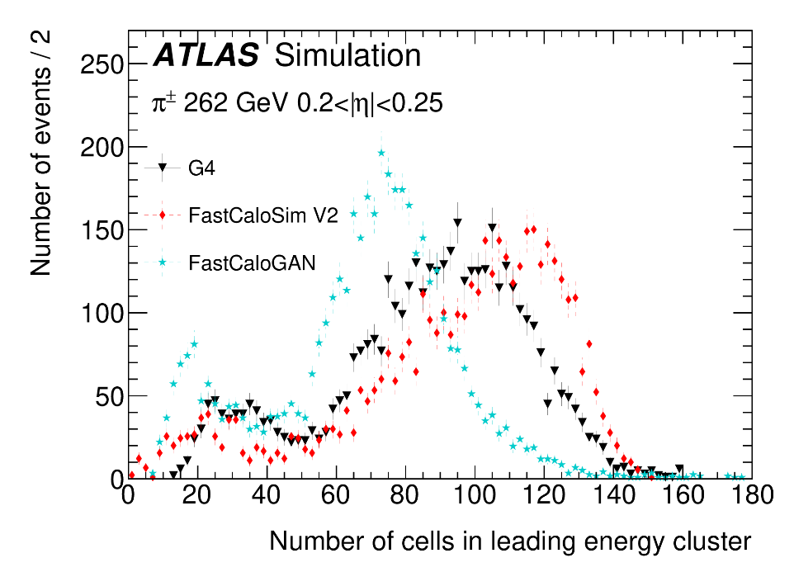
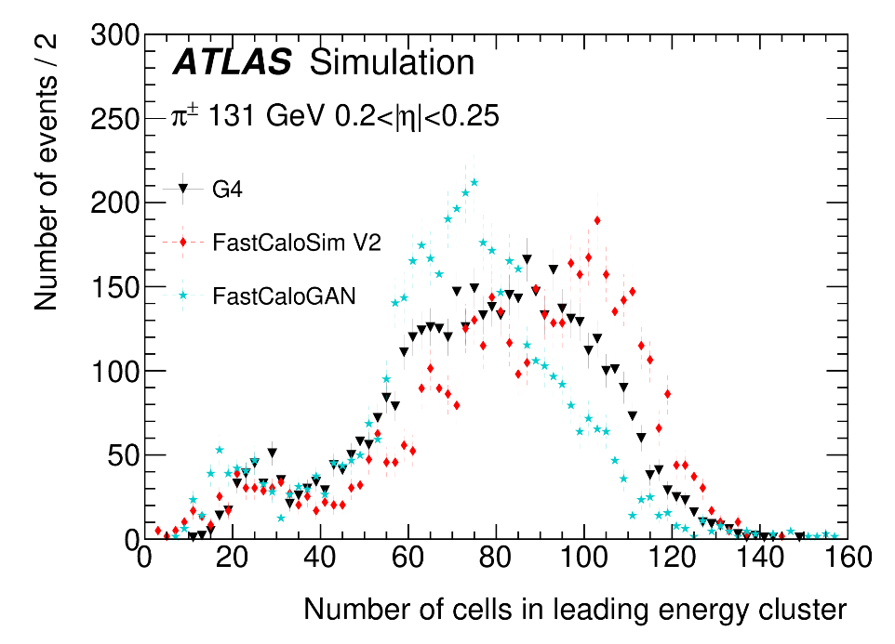
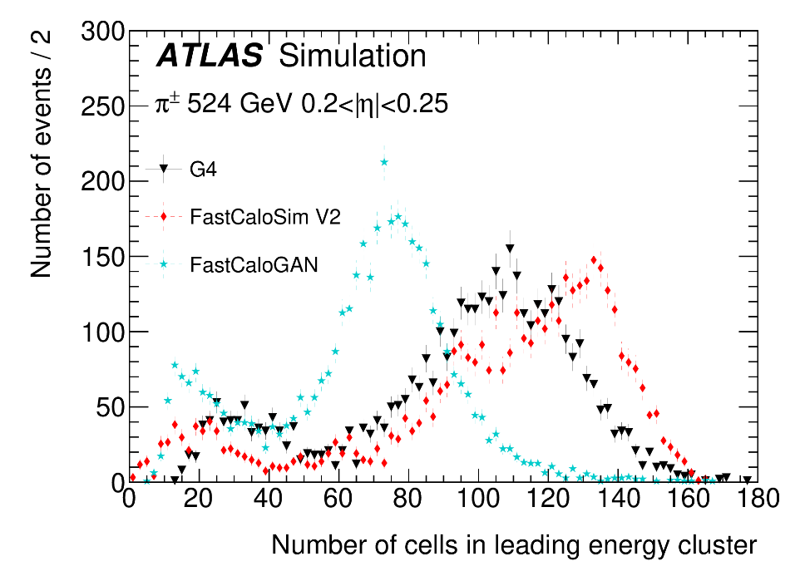
High energy pions

