Slide 1
On Estimating Gradients of Discrete Stochastic Programs for Detector Design Optimization
CHEP 2023
Lukas Heinrich, TUM Michael Kagan SLAC

Slide 2
Differentiable Programming
A major enabler of large-scale Machine Learning:
Ability to compute gradients of numeric programs
$$x$$
$$φ$$
$$x$$
$$φ$$
Program
Program
$$f_{φ}(x)$$
$$f_{φ}(x)$$
$$∇_{φ}f_{φ}(x)$$
To deal with hyper-planes in a 14-dimensional space, visualize a 3D space and say 'fourteen' to yourself very loudly.
-G. Hinton

Slide 3
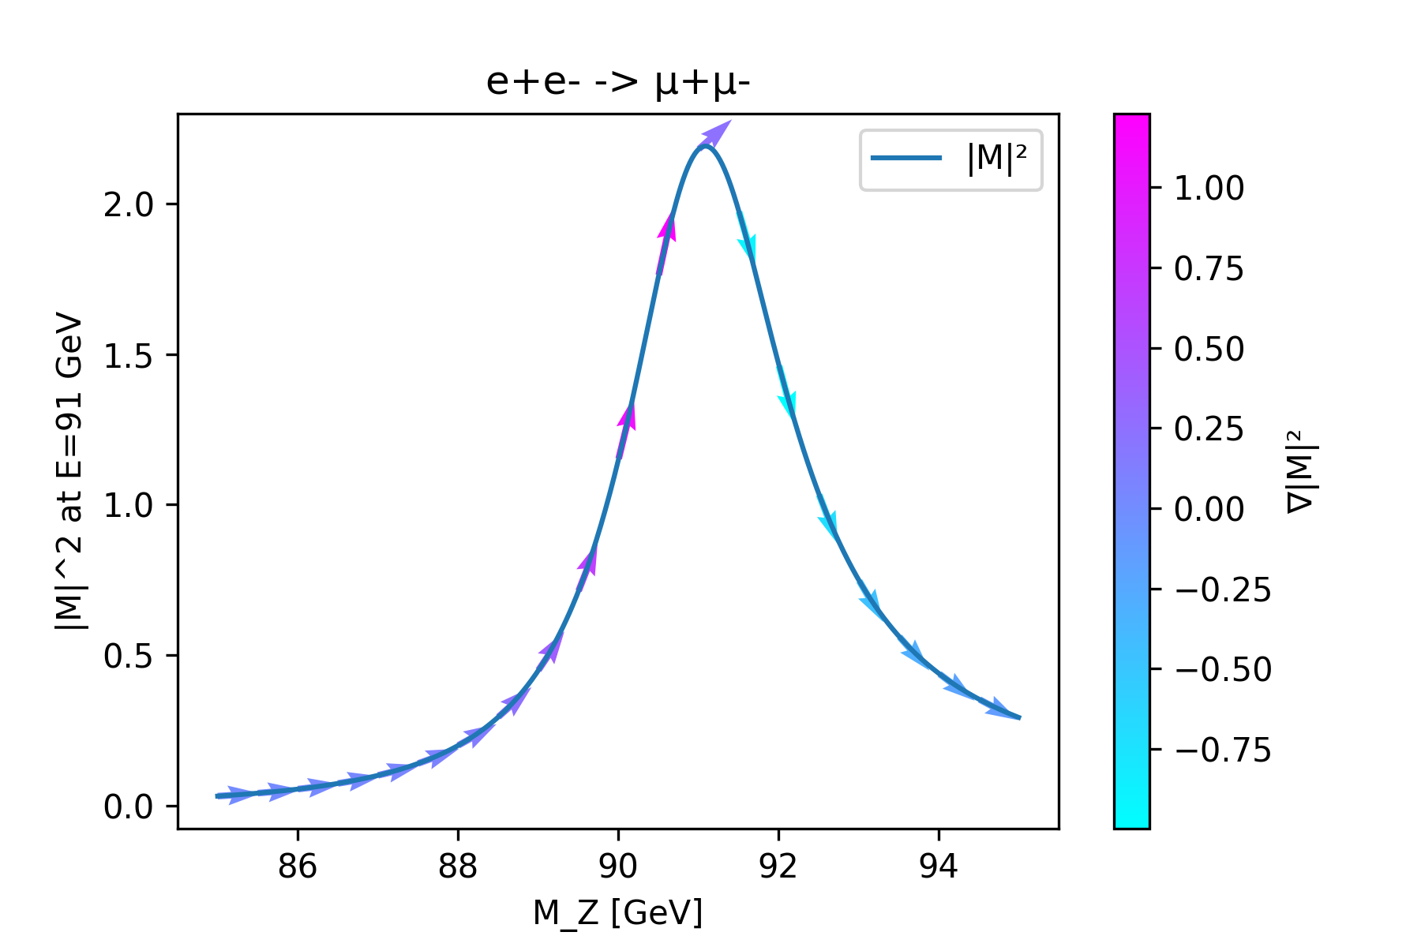
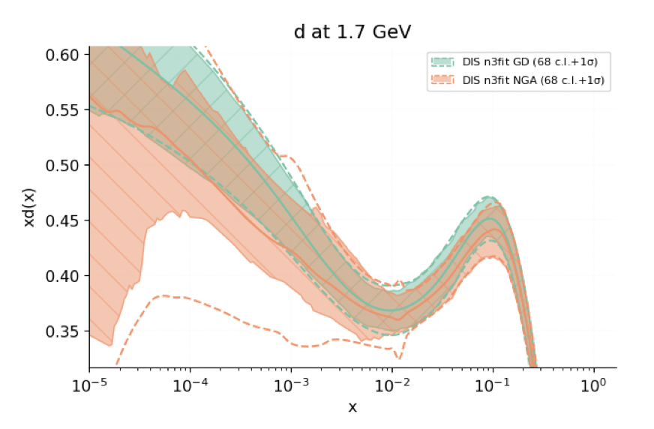
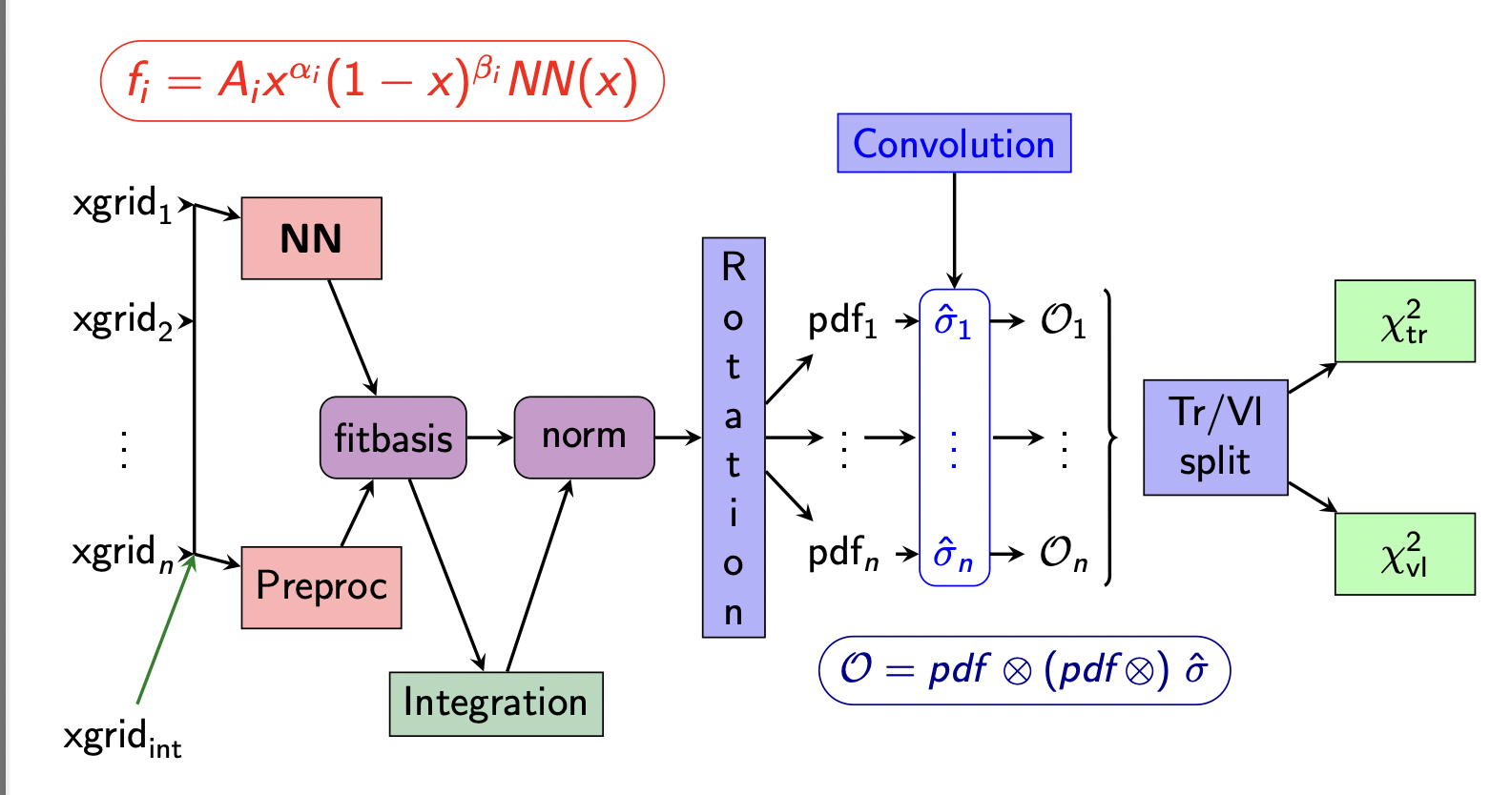
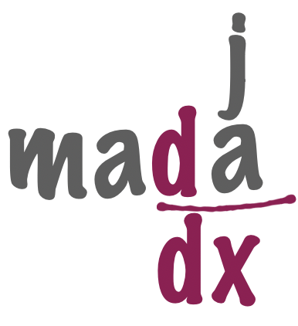
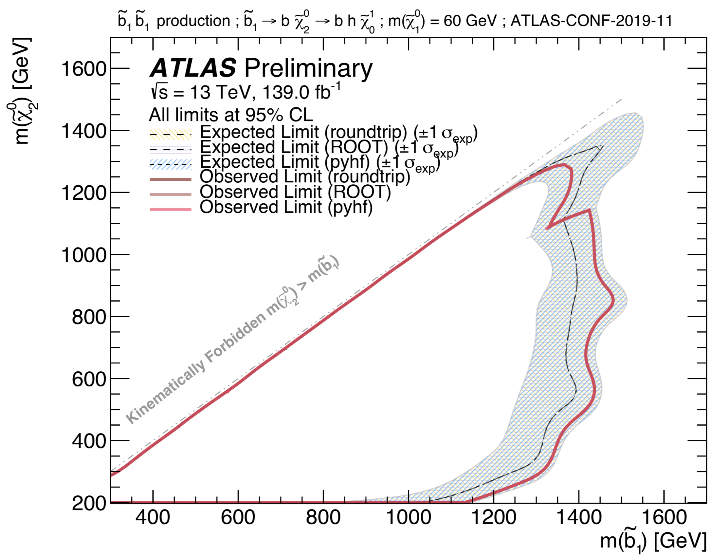
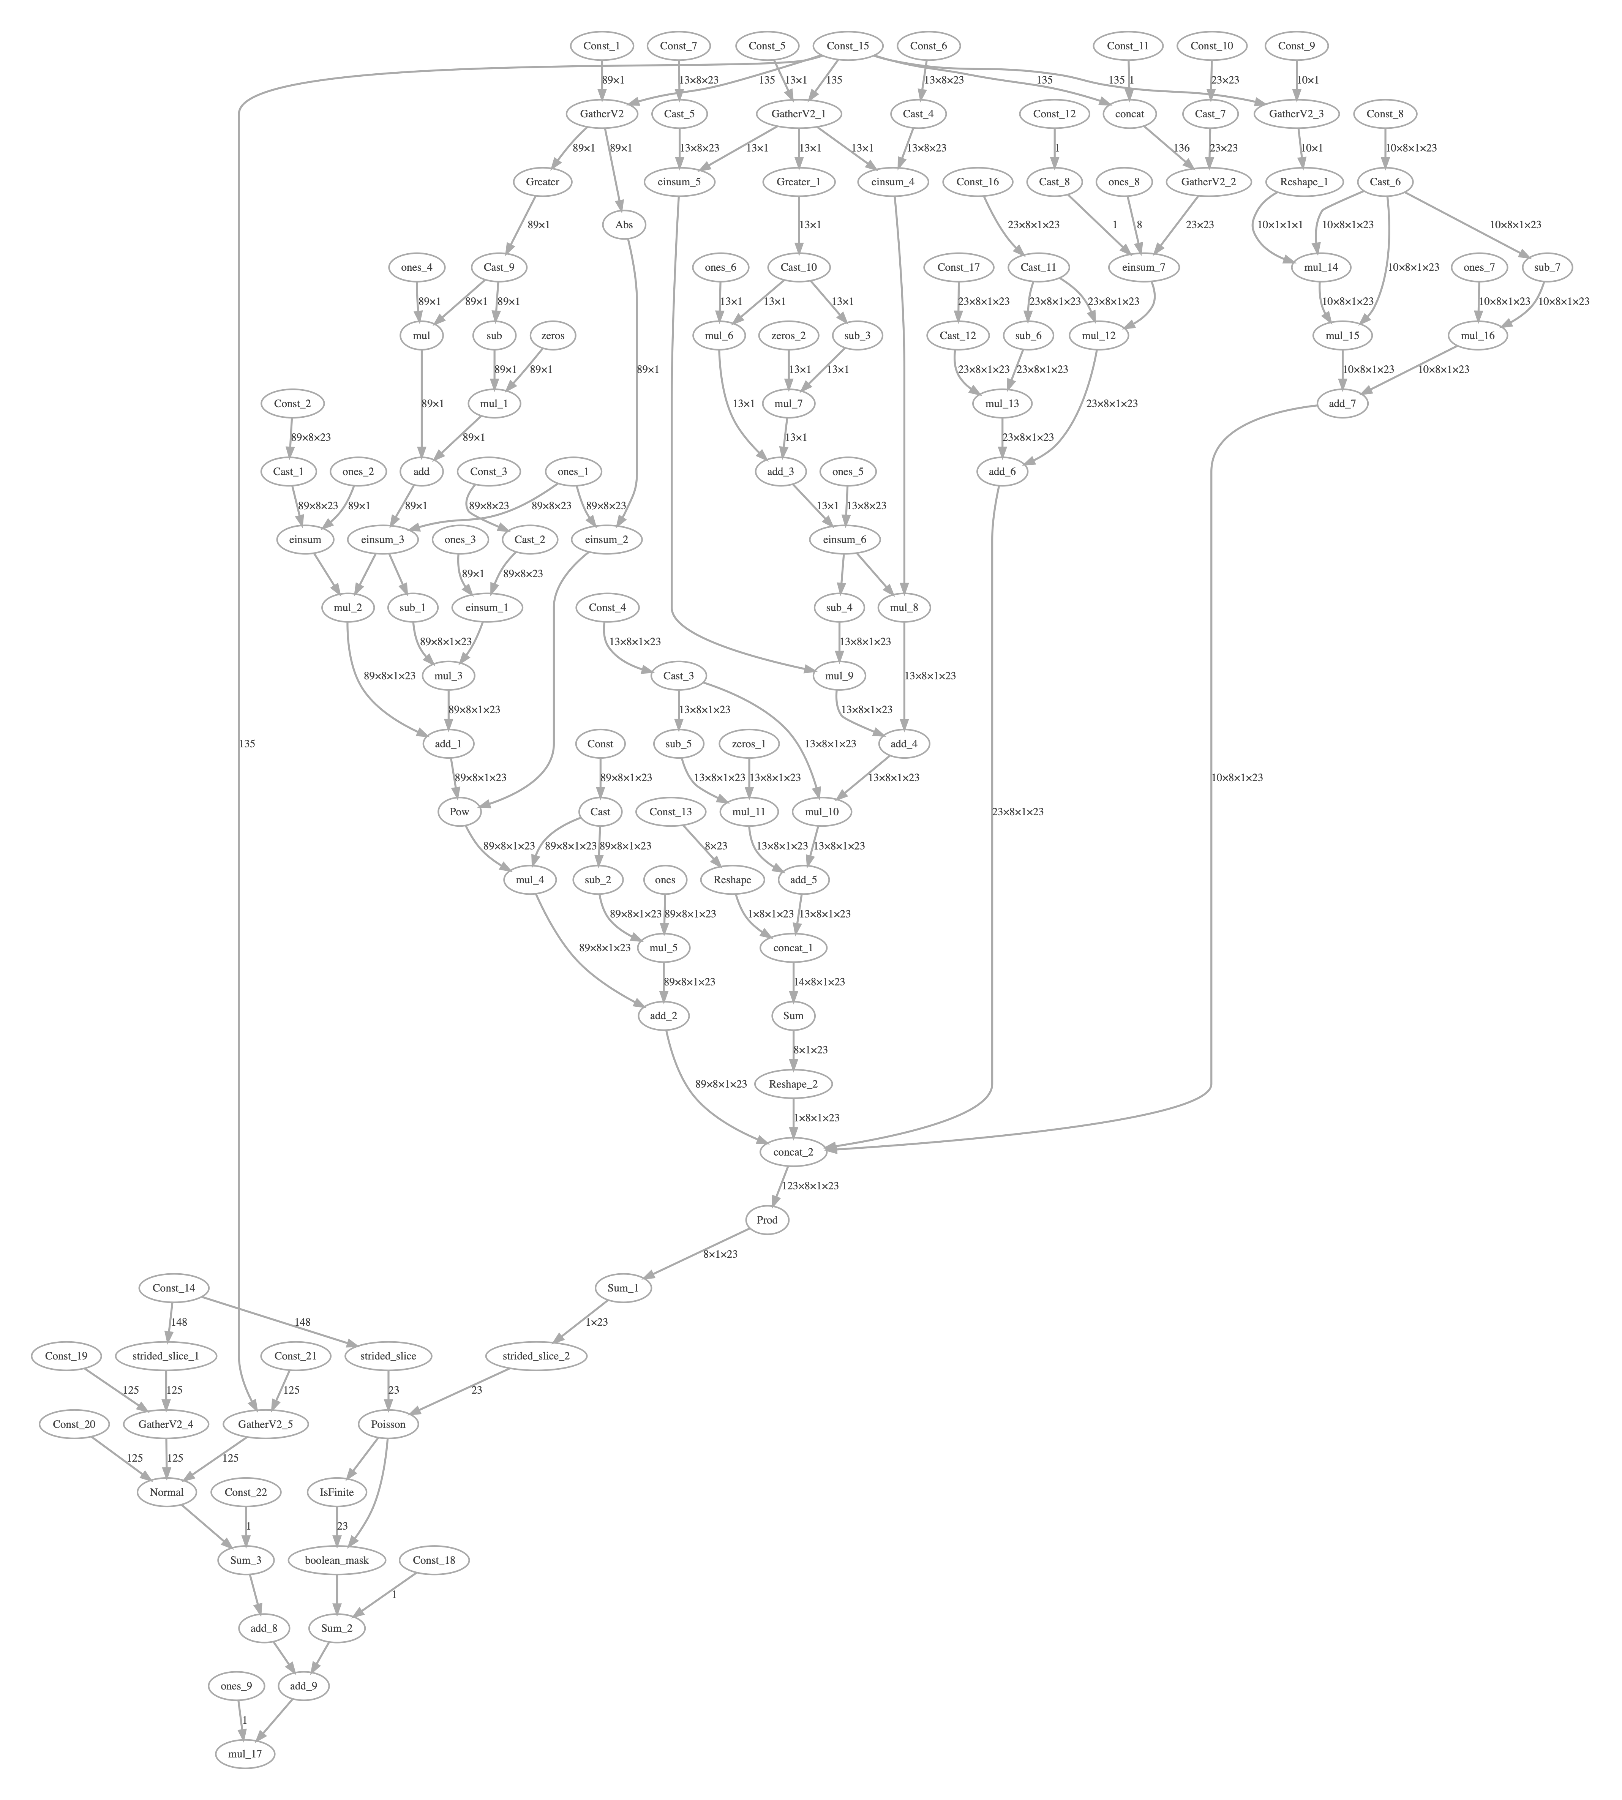
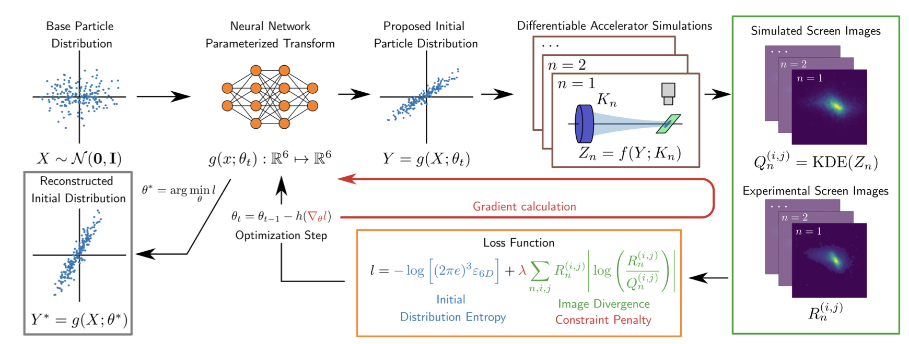
Gradients Beyond ML
Interest in applying DP to programs that are not NNs:
powerful method to combined physics + ML
Differentiable Matrix Elements
Differentiable Proton Structure
2203.00057
1907.05075
Differentiable Accelerator Simulation
Differentiable Calabi-Yau Manifolds
Differentiable Inference
2211.09077
2211.12520
10.21105/joss.02823

Slide 4
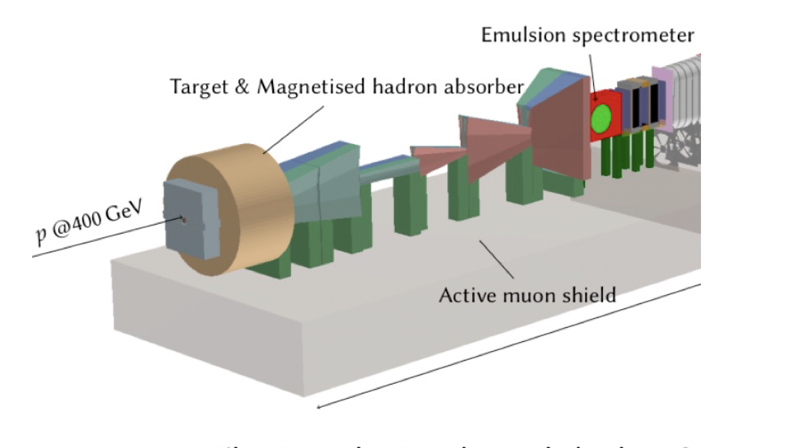
Emerging Usecase: Design Optimization
One of the most consequential high-dim. optimizations:
find a good detector design
arXiv:2002.04632 […, MK, …]
before
after
arxiv:2202.00728

Slide 5
A Requirement:
For a gradient-based design optimization, one needs both: a differentiable simulation and reco/analysis
Design Parameters
Theory
Simulation
Events
Analysis / Objective
Design Rating

Slide 6
A Small Problem
To first order, most of simulation is stochastic branching, while most of analysis is iterative clustering with many discrete choices
Simulation
Data
Analysis
HEP: fundamentally incompatible with differentiable programming?

Slide 7
Not necessarily
The gradients we need are gradients of expectation values over probability distributions & observables with discrete aspects
probability density
discrete data $x$
non-differentiable evaluation function
In many cases, the expectation value is differentiable (just not via standard automatic differentiation)

Slide 8
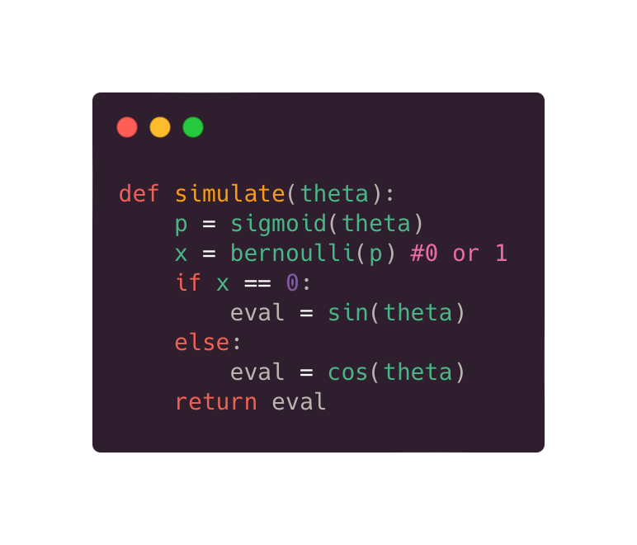
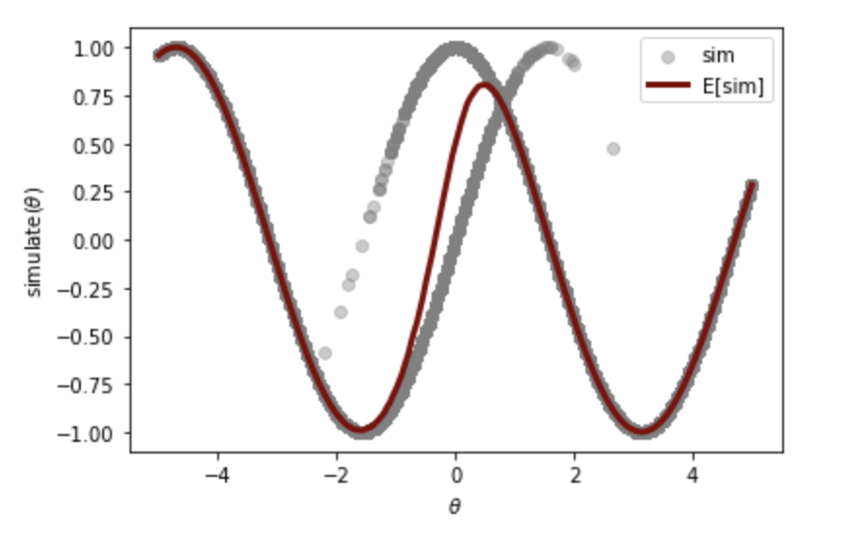
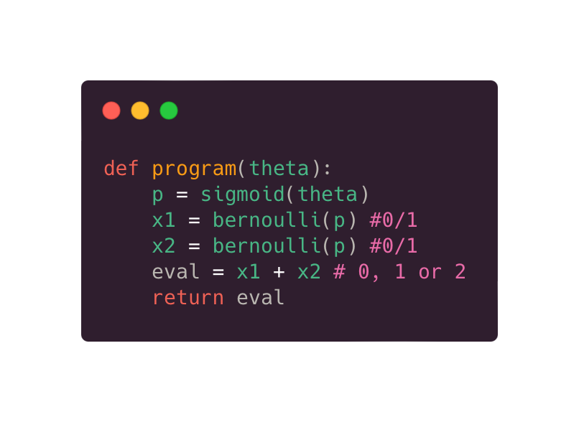
Simple Examples
Discrete Jumps
Smooth Expectation Value

Slide 9
Differentiating Expectation Values
The best known algorithm for gradient estimation is used a lot in Reinforcement Learning - score function estimation
$$∇\overline{f}(φ)=𝔼_{p_{φ}}[f(x)∇_{φ}logp_{φ}(x)]$$
requires tracking probabilities (and their gradients) while running code → probabilistic programming
HEP Simulator: discrete processe
Atari Games discrete actions

Slide 10
Differentiating Expectation Values
More recently, renewed interest in approaches based on “smoothed pertubation analysis”
Extend fwd-mode AD to discrete-stochastic environments
$$(x,δ)→(x,δ,w,y)$$
$$∇_{φ}\overline{f}(φ)=𝔼_{p_{φ}}[δ+w(x−y)]$$
Dual Numbers in Standard AD
Quadruplets in Stochastic AD
arxiv: 2210.08572

Slide 11
Key Questions in HEP
Gradients Estimation in Stochastic Programs can suffer from very high variance → unstable optimization
HEP is in an interesting corner:
a lot of tiny stochastic steps
branching processes, many independently, variable-length processes
Standard AD
e.g. naive score function
Q: Will these methods work in a HEP setting?

Slide 12
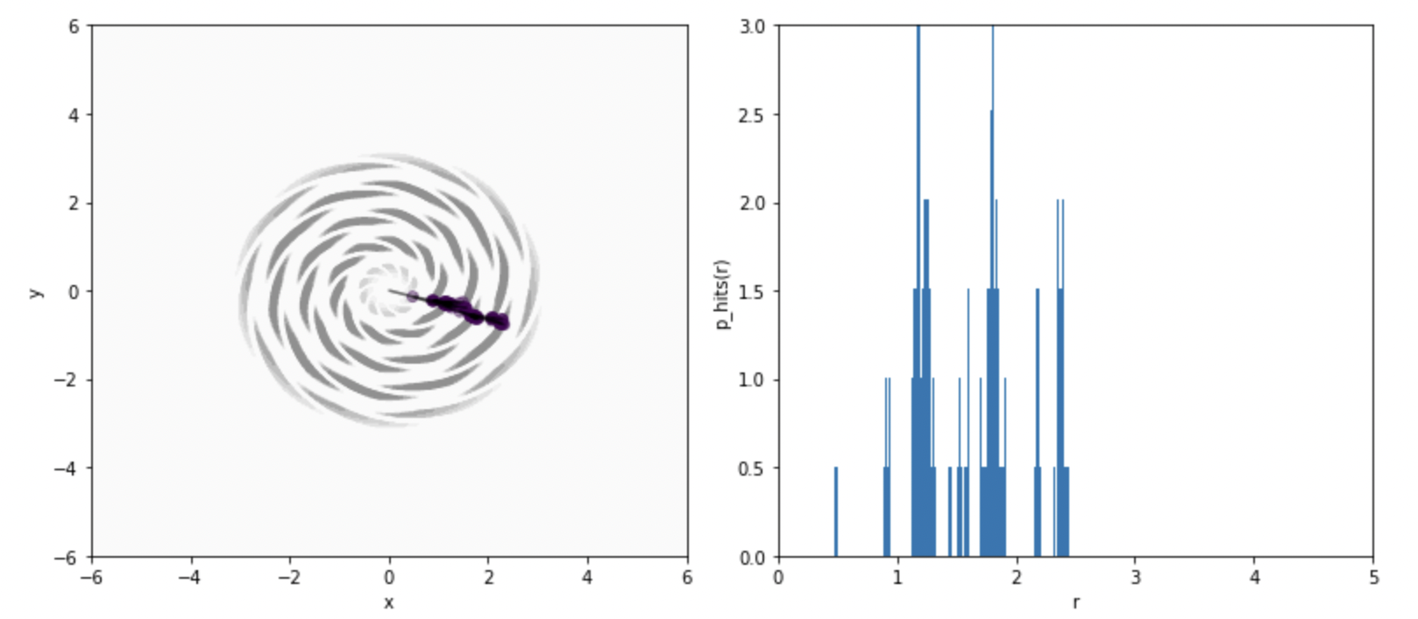
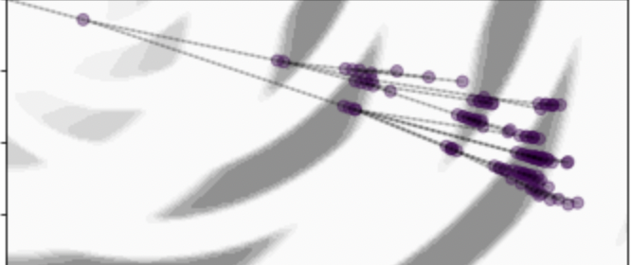
Example Application
Material Distribution
Radial Hit Distribution
We consider a simplified material- induced particle shower
High Density: E-loss and splitting Low Density: linear propagation
Design Parameter: Radial Distance of Material
Design Goal: Shower Depth
Shower

Slide 13
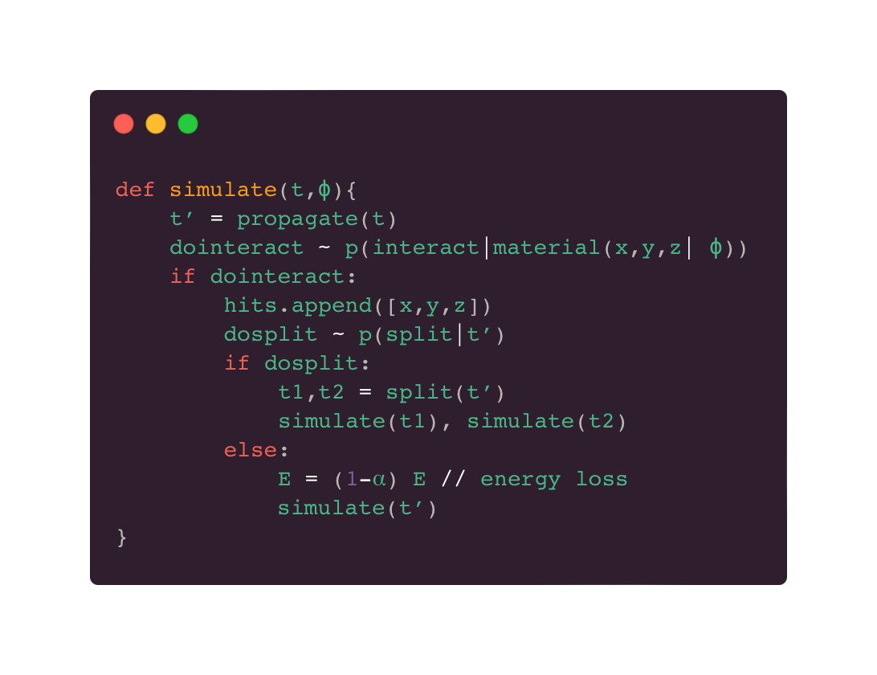
Example Application
Material Distribution
Radial Hit Distribution
Shower

Slide 14
Optimizing Material Distribution
At least for this toy model, optimizing material for hits properties works
Objective: Mean Hit Radius → 2.0
Loss Function
initial
final
Gradient Estimate
Evaluated Parameters
We do see noisy gradients, but: as long as direction is OK (in expectation), minimization works

Slide 15
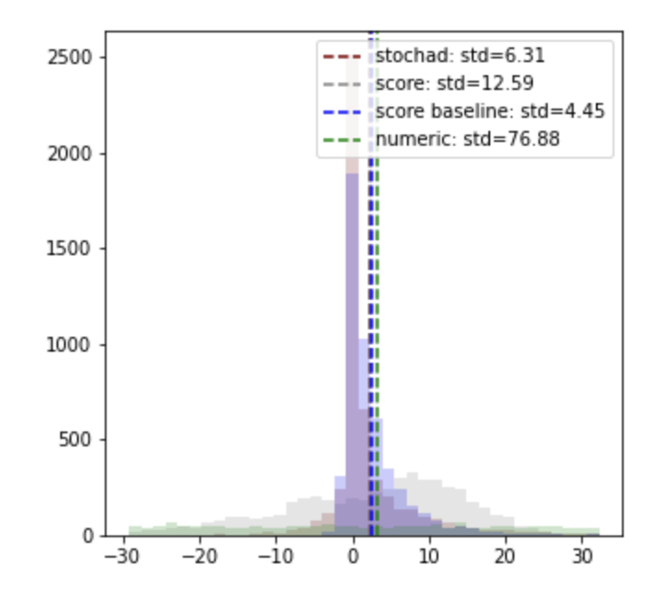
Comparison
Both score function and Stochastic AD gradient estimates massively reduce variance and optimization is possible
$$∇_{φ}L|_{φ=2.5}$$
$$=∇_{φ}$$

Slide 16
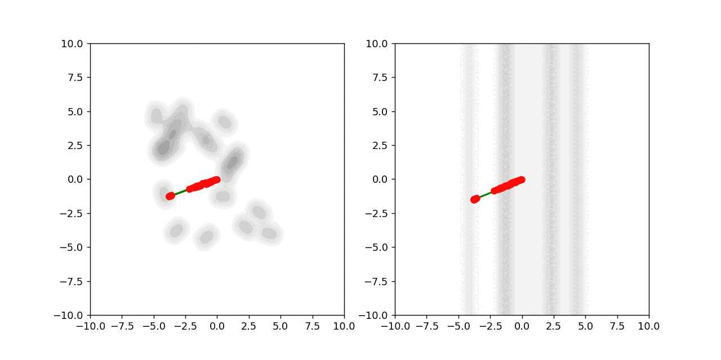
A fun experiment:
Alternatively: 20 free-floating blocks of detectors.
Self-assembly into a circular shell to contain showers
y
z
x
x

Slide 17
Next Steps & Outlook
Takeaway message: The presence of discrete stochastic randomness makes differentiable programming difficult …
But not impossible. With appropriate techniques, we can differentiate the seemingly undifferentiable But, may require integration of more complex programming constructs than just AD.

