Slide 1
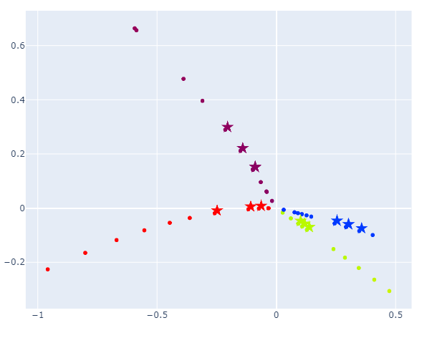
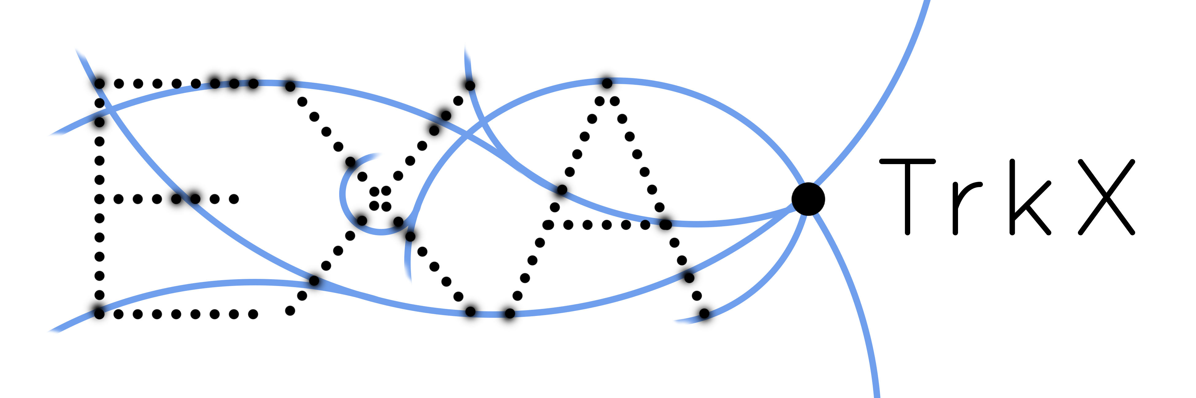
End-to-End Geometric Representation Learning for Track Reconstruction CHEP, northfolk VA, may 9th 2023
Paolo Calafiura for Daniel Murnane
on behalf of the Exatrkx project
Thanks to the SCIDAC4-HEP project HEP DATA Analytics on HPC

Slide 2
The tracking problem
Labels on hits
Protons collide in center of detector, “shattering” into thousands of particles
The charged particles travel in curved tracks through detector’s magnetic field (Lorentz force)
A track is defined by the hits left as energy deposits in the detector material, when the particle interacts with material
In this study, we use the TrackML Dataset [link], with variable-sized subsets of tracks selected
The goal of track reconstruction: Given set of hits from particles in a detector, assign label(s) to each hit.
1
2
3
1
2
3
4
1
4
3
4
5
1
5
6,7
3
5
4
6
5
6
6
7
7
7
8
8
8
8
9
9
9
9
1
2
3
4
5
Can reframe the problem of assigning label → hits
Assume the existence of some uniquely labelled “representative point” in each track object
Then our task is to assign hits → representative point
7
6
8
9
Hits to labels

Slide 3
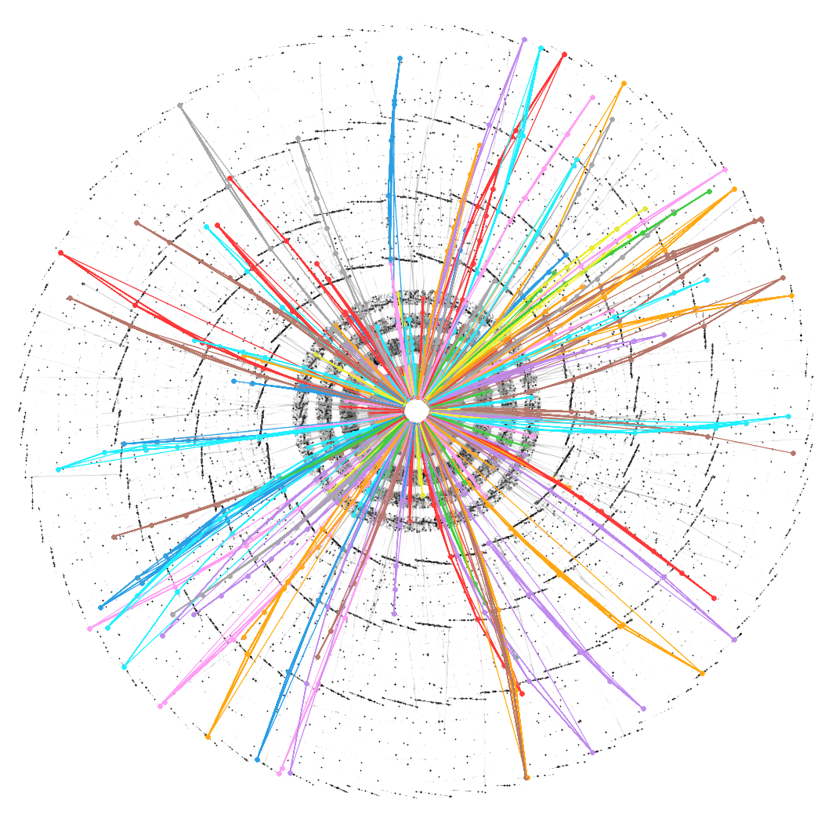
Tracking as Object detection
?
A well-studied problem in computer vision: Given an image, can we identify all discrete objects of interest and predict information about them?
Popular approach is to draw a bounding box as the representative label
Can’t directly use this approach for tracking: tracks are not localized in 3D space
The “You Only Look Once” (YOLO) approach to detection: draw a bounding box and predict the object in a single step.
Redmond et al, arXiv: 1506.02640

Slide 4
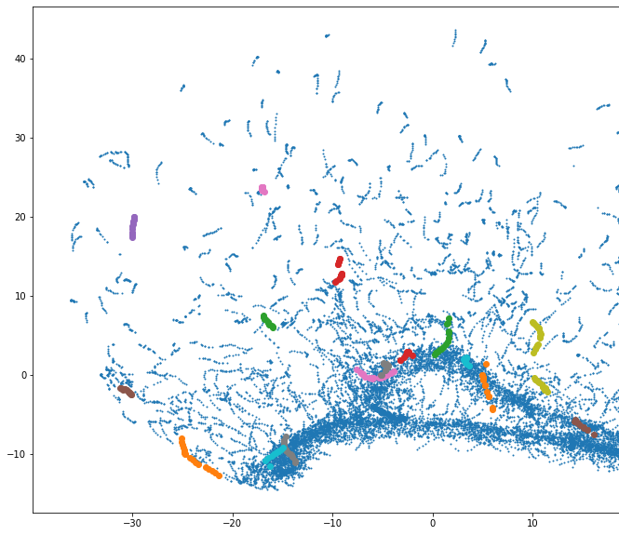
Object detection as metric learning
We consider a “naïve” solution to the object detection problem
Using a transformer or graph neural network (GNN), embed each hit $x_{i}$ in a latent space $𝒰(x_{i})$
Use a hinge loss to encourage hits from the same particle ($y_{ij}=1)$ to be close, hits from different particles ($y_{ij}=0$) to be distant:
$$L=\left\{\begin{matrix}Δ_{ij}, when { y}_{ij}=1 \\ \max\left(0, 1−Δ_{ij}\right), when { y}_{ij}=0\end{matrix}\right.$$
To create representative points, we use a “greedy condensation” approach. For all points:
Randomly select a point
Find all neighbors (within radius R)
If none of the neighbors are already a representative, then convert the point to a representative, and attach all neighbors to that representative
Latent $ℝ^{12}$ projected to $ℝ^{2}$
Random hit 2
Random hit 1
Works quite well, but some points are clearly better candidates for representative than others. Can we learn which points are good representative points?

Slide 5
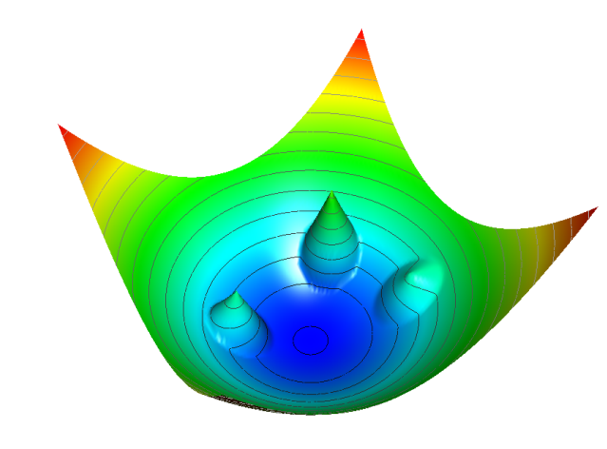
Object condensation: learning Representative points
Idea from particle flow reconstruction: Object condensation: one-stage grid-free multi-object reconstruction in physics detectors, graph, and image data, Kiesler 2020 [link]
Simultaneously learn an embedding similarity space and a condensation score for each hit, where a higher score is a more “attractive” point charge in similarity space
All hits with learned condensation score $β$ above some threshold are considered candidates for representation points, then we apply greedy condensation to the representatives sorted by $β$
Shortcomings:
Having this “hard cut” charge threshold requires fine-tuning
Inference requires sorting likely condensation points and sequentially considering each condensation point based on all previous condensation points
Training (as a simplification) only considers maximum-scoring condensation point in each class, which neglects global optima
The potential function of members of the same class relative to the representation point of that class (Kiesler 2020)

Slide 6
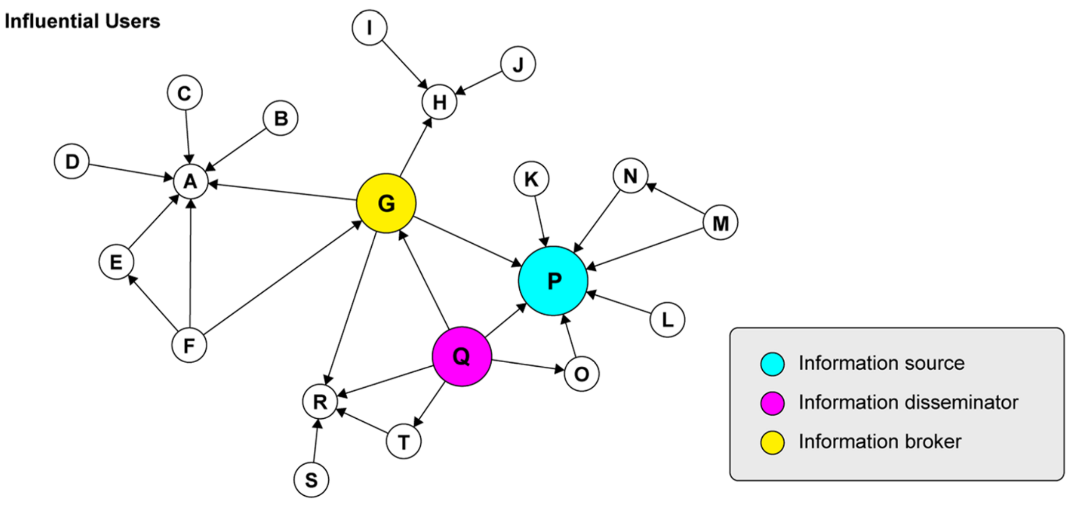
Desired loss function behaviour: a twitter inspiration
Idea: We can represent a social network as a directed graph of influence flow
Recuero et al, 2019, and Kim & Valente 2020 used network analysis to identify several types of user based on in-degree and out-degree of information flow
Let’s simplify: All members of network can be users (receive information from incoming edge) and influencers (send information to outgoing edge)
We can build a directed graph by learning for each member of the point cloud two embeddings in the same space: a user-embedding and an influencer-embedding
Kim & Valente 2020, COVID-19 Health Communication Networks on Twitter: Identifying Sources, Disseminators, and Brokers
Goal 1 We would like users of each class to crowd around exactly one influencer that represents their class
Goal 2 We want influencers to be distant from each other
Notes:
TODO: Make slide less busy
X? Highlight key points more clearly
X Crop image?
X Users vs. points vs. …

Slide 7
Desired loss function behaviour
Given each of $N$ points $x_{i}$ in track $T_{a}$ embedded into $ℝ^{M}$ with two models: a user-embedding $𝒰$ and an influencer-embedding $ℐ$
We want a minimum in the loss when all hits $x_{i}∈T_{a}$ have $𝒰\left(x_{i}\right)$ inside neighbourhood $𝒩\left(ℐ\left(x_{i}\right)\right)$ for at least one influencer (and preferably only one influencer)
$$ℝ^{M}$$
$$𝒩\left(ℐ\left(x_{i}\right)\right)$$
$$𝒰\left(x_{i}\right), ℐ(x_{i})$$
$T_{a}$, $N=5$
In this case, 4 out of 5 users are in the neighbourhood
of an influencer
Position of user-embeddings
Position of influencer-embeddings

Slide 8
Desired loss function behaviour
Given each of $N$ points $x_{i}$ in track $T_{a}$ embedded into $ℝ^{M}$ with two models: a user-embedding $𝒰$ and an influencer-embedding $ℐ$
We want a minimum in the loss when all hits $x_{i}∈T_{a}$ have $𝒰\left(x_{i}\right)$ inside neighbourhood $𝒩\left(ℐ\left(x_{i}\right)\right)$ for at least one influencer (and preferably only one influencer)
We can achieve this by taking $L_{u}(T_{a})=\sqrt[N]{\prod_{j}{\frac{1}{N}}\sum_{i}{{\left|𝒰\left(x_{i}\right)−ℐ\left(x_{j}\right)\right|}^{2}}}$
Consider loss $L$ in simple example of two points in three different cases:
Position of user-embeddings
Position of influencer-embeddings
$$Δ=1$$
$$Δ=1$$
$$Δ=2$$
$$Δ=2$$
$$L∝\left(Δ_{00}^{2}+Δ_{01}^{2}\right) \\ ×\left(Δ_{10}^{2}+Δ_{11}^{2}\right)=4$$
$$L∝\left(Δ_{00}^{2}+Δ_{01}^{2}\right) \\ ×\left(Δ_{10}^{2}+Δ_{11}^{2}\right)=16$$
$$L∝\left(Δ_{00}^{2}+Δ_{01}^{2}\right) \\ ×\left(Δ_{10}^{2}+Δ_{11}^{2}\right)=0$$
Case A
Case B
Case C
Note: Noise is given a class label $NaN$ and handled like all other data points

Slide 9
The Influencer loss
The attractive Influencer-User loss is actually the geometric mean across influencers of the arithmetic mean across users of the distance between each positive pair across all $n$ tracks, so we can rewrite it for numerical stability:
$$L_{𝒰}^{+}\left(T_{a}\right)=\exp\left(\frac{1}{N}\sum_{j}{\ln{(\frac{1}{N}\sum_{i}{Δ_{ij}^{2}}}})\right), L_{𝒰}^{+}=\frac{1}{n}\sum_{a}{T_{a}}, y_{ij}=1$$
We include a repulsive Influencer-User hinge loss to punish users condensing towards an influencer from a different class:
$$L_{𝒰}^{−}={mean}_{ij}(\max\left(0, 1−Δ_{ij}\right)), y_{ij}=0$$
And finally, we encourage influencers being a distance of at least $Δ^{ℐ}$ from each other, to avoid users being “overrepresented” by multiple influencers:
$$L_{ℐ}={mean}_{ij}(\max\left(0,Δ^{ℐ}−Δ_{ij}^{ℐ}\right)), y_{ij}=0$$
We take this combination as the Influencer Loss $L=L_{𝒰}^{+}+aL_{𝒰}^{−}+bL_{ℐ}$, where the weights $a$ and $b$ can be used to tune the efficiency-purity rate and the efficiency-duplicate rate, respectively
$$Δ_{00}=Δ_{01}=0$$
$$Δ_{01}^{ℐ}>3$$
The total Influencer Loss is at a minimum in this case
Notes:
Explain magic number 3

Slide 10
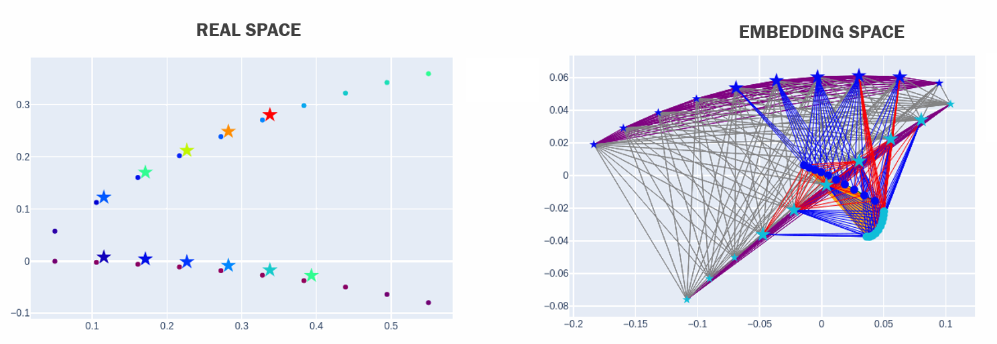
A training montage
We can see the Influencer Loss working on two tracks above, across training epochs
In Real Space, we show only Users (circles) and Influencers (stars) when they are associated with an Influencer or User (respectively)
The color in Real Space is a projection in 1D of the location in Embedding Space
In Embedding Space, we should edges created, and connected Influencers are large stars, unconnected Influencers are small stars

Slide 11
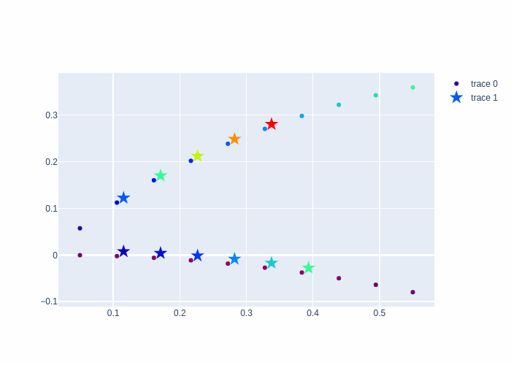
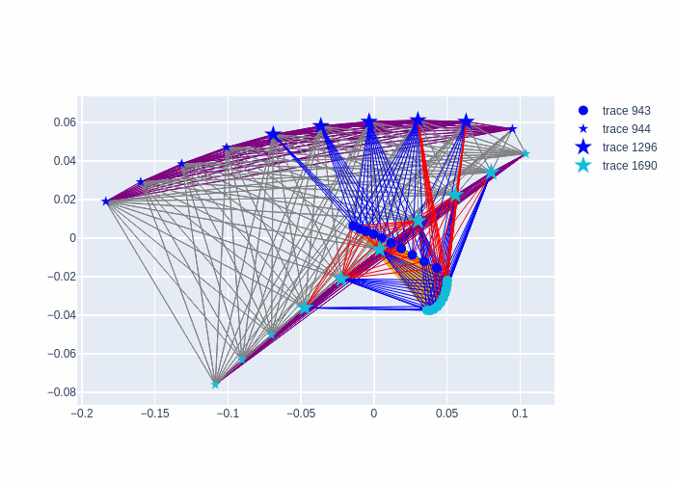
A training montage
Real Space
Embedding Space
We can see the Influencer Loss working on two tracks above, across training epochs
In Real Space, we show only Users (circles) and Influencers (stars) when they are associated with an Influencer or User (respectively)
The color in Real Space is a projection in 1D of the location in Embedding Space
In Embedding Space, we should edges created, and connected Influencers are large stars, unconnected Influencers are small stars

Slide 12
A training montage
Real Space
Embedding Space
We can see the Influencer Loss working on two tracks above, across training epochs
In Real Space, we show only Users (circles) and Influencers (stars) when they are associated with an Influencer or User (respectively)
The color in Real Space is a projection in 1D of the location in Embedding Space
In Embedding Space, we should edges created, and connected Influencers are large stars, unconnected Influencers are small stars
Notes:
A backup slide for PDF

Slide 13
Influencer Inference
To construct track candidates,
Embed hits with $𝒰\left(x_{i}\right), ℐ(x_{i})$ into $ℝ^{M}$
Perform fixed-radius nearest neighbour (FRNN) search, with $𝒰\left(x_{i}\right)$ as database, $ℐ(x_{i})$ as query
All non-empty Influencer neighbourhoods are track candidates of user hits $\left\{x_{i} | 𝒰\left(x_{i}\right)∈𝒩(ℐ\left(x_{i}\right))\right\}$, each represented by an influencer hit. No further processing is required
$$𝒩\left(ℐ\left(x_{i}\right)\right)$$
Track candidates:
$$𝒰\left(x_{i}\right), ℐ(x_{i})$$
$$( , )$$
$$( , )$$
Position of user-embeddings
Position of influencer-embeddings

Slide 14
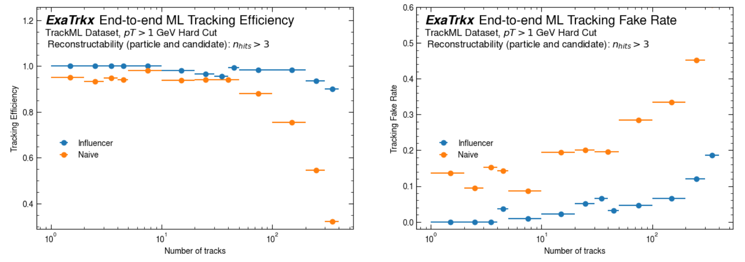
Physics Performance
Comparison of track reconstruction of naïve condensation and influencer condensation event size
Unfortunately, was not able to get performance results of Learned Object Condensation loss (Kiesler 2020) for this study, but see Killian Lieret & Gage deZoort’s talk for tracking results with this model (it’s right after this one!)
Influencer loss is able to condense tracks much more efficiently, and with far fewer fake track candidates

Slide 15
Computational performance
Influencer loss is currently an expensive calculation and a slow function to minimize, compared with the Naïve Hinge Loss
However, this cost is only incurred during training and is amortized in inference
The Naïve model’s greedy condensation creates tracks sequentially, while the Influencer condensation occurs in parallel and on a significantly more sparse neighbourhood structure (c.f. the training montage to see this at work)

Slide 16
Conclusion
A sample of Influencer condensed tracks with high duplicate rate
Influencer Condensation is a direct mapping of the Tracking Problem onto geometry: one representative per track, with no post-processing step
We see favourable performance of Influencer Condensation across event size, compared with the Naïve Condensation approach
Future work
Training of Influencer contains an expensive loop over each track – to replace this with a tensor implementation of User-Influencer loss
Still running on simplified tracking problem (subset of TrackML) – to study performance in realistic LHC-like conditions
Influencer can create high duplicate rate (see figure): Investigating ways to tune loss for lower duplication
Use Influencer representatives as way to regress and classify track properties

Slide 17
Thank you! Previous work & References
Object condensation: one-stage grid-free multi-object reconstruction in physics detectors, graph, and image data, Kiesler 2020 [link]
Multi-particle reconstruction in the High Granularity Calorimeter using object condensation and graph neural networks, Qasim et al 2021 [link]
End-to-end multi-particle reconstruction in high occupancy imaging calorimeters with graph neural networks, Qasim et al 2022 [link]
Learning representations of irregular particle-detector geometry with distance-weighted graph networks, Qasim et al 2019 [link]
Point Cloud Instance Segmentation using Probabilistic Embeddings, Zhang et al 2019 [link]
Instance Segmentation by Jointly Optimizing Spatial Embeddings and Clustering Bandwidth, Neven et al 2019 [link]
Representation Learning for Object Detection from Unlabeled Point Cloud Sequences, Huang et al 2022 [link]
Object Condensation for GNN-Based Particle Tracking, De Zoort 2022 [link]

