Slide 1

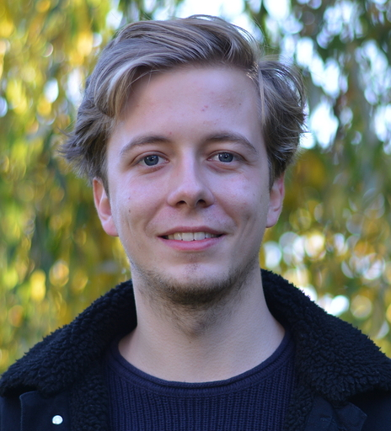



Object Condensation Tracking
Gage DeZoort¹
@gageDeZoort
Kilian Lieret^{1,2}
@klieret
¹Princeton University, ²IRIS-HEP
With contributions from
Javier Duarte, Peter Elmer,
Isobel Ojalvo, Savannah Thais

Slide 2
Tracking
Point cloud
(coordinates of hits in detector)
Different colors = different particles
noise

Slide 3
Tracking as an edge classification task
Thicker line =
higher assigned probability
Edge construction
(geometric constraints, module map, latent space)
Edge Classifier (EC)
Graph neural network
Postprocessing
(e.g., “graph walking”)
Fitting

Slide 4
Tracking with Object Condensation: Vision
Learnt latent space
Hits already clustered by particle;
Clusters can be collected trivially
Point cloud
p_{T}=1.1
p_{T}=0.9
p_{T}=1.5
p_{T}=1.0
Repulsion & attraction
of points in latent space
Condensation point
Represents the track, can learn track parameters like pT (WIP)

Slide 5
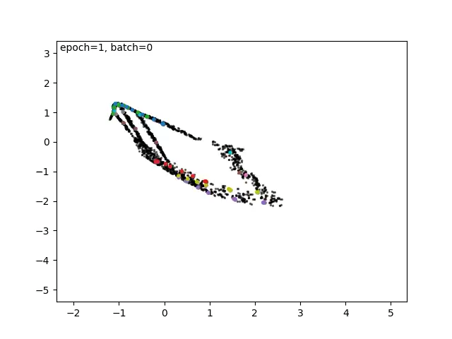
Object condensation in action
2D latent space; random selection of particles colored
Early simplified study (much fewer hits than in real life)
Click here if video doesn’t play
Latent space dim 2
Latent space dim 1

Slide 6
Object condensation: Our current pipeline
STAGE 1: EC
→ Working on replacing this with dynamic edge creation “Point cloud network”
Graph construction based on geometric cuts
EC GNN
EC score
threshold
Orphan node
mask
Loss fct = focal loss for pt > 0.9 hits
STAGE 2: OC
STAGE 3: Collect clusters
OC GNN
DBSCAN
Learnt latent space
All three stages have their own hyperparameters
Can be trained/optimized separately (fixing the previous stage)

Slide 7
Object condensation: Training losses
Repulsive loss function
penalizes hits close to other CP
hinge loss: no more repulsion after certain distance
repulsion stronger for strong CP CLs
Latent space
before training
GNN predicts condensation likelihoods (CL) for every hit. Hit with max CL for particle* is condensation point (CP)
*during inference: for cluster
Attractive loss function
rewards hits close to their CP
quadratic potential
Attraction stronger if CP’s CL is high
Background loss function
noise hits should have low CL
Loss functions implemented from Kieseler 2020 (2002.03605)

Slide 8
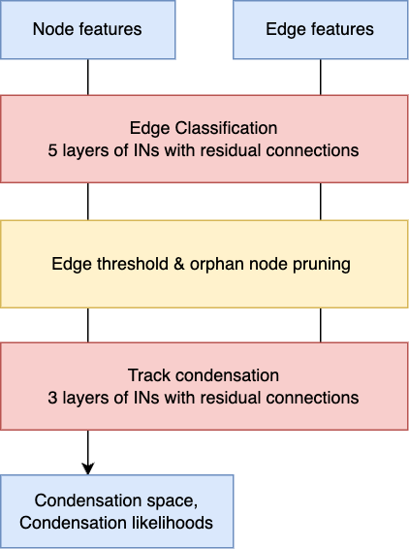
Some details
Detailed sketch in backup
Full event is sectorized in 32 sectors (see 2103.16701); 5 random sectors per batch
Graph construction
  Currently: Geometric cuts only (see 2103.16701)
  Soon: Comparison to module map
  Mid term: transitioning to a point cloud network
Main building block: Interaction Networks (1612.00222)
Edge classification (EC) performance is vital:
  Using FocalLoss (https://arxiv.org/abs/1708.02002) for class imbalance
  Ignoring false negatives for edges connecting p_{T} < 0.9 GeV hits
  EC threshold is around maximum attainable MCC (and this is used to rank different ECs)
Track condensation network starts from
edge classification latent space
Condensation space dimension is ~10
IN: Interaction Network

Slide 9
Metrics
Perfect
Cluster contains only hits from one particle
and
no hits outside of cluster
LHC
Cluster contains >= 75% hits from one particle
Double Majority
Cluster contains >= 50% hits from one particle
and
This particle has < 50% of its hits outside
Clusters with < 3 hits or non-reconstructable majority particle are discarded
#clusters with >= 3 hits & majority particle reconstructable
#reconstructable particles
#reconstructable particles
Perfect efficiency = 1/5
Perfect fakes = 5/5
LHC efficiency = 2/5
LHC fakes = 4/6
DM efficiency = 2/5
DM fakes = 4/5
We also evaluate these metrics at pT thresholds: pT cut is applied to majority particle of cluster or particle (this is not a truth cut on the data, but simply a efficiency vs pT study)
Reconstructable: >= 3 hits

Slide 10
Most recent result
Regarding 🍏 to 🍎 comparisons for HL-LHC benchmarking:
Evaluated on trackML 2.0 dataset (generated with the ACTS geometry)
Pixel layers only: This might be a harder problem than using the full detector (very dense regions)!
Full trackML detector results very soon
No truth cut on pT or other simplification
Perfect
(“cluster = particle”)
LHC
(“homogeneous clusters”)
Double Majority
(“1:1 match cluster <> particle”)
fake: 2.9%
fake: 3.4%
fake: 2.7%
fake: 3.4%
EC FocalLoss currently set to ignore low p_{T} false negatives → lower performance for low p_{T}

Slide 11
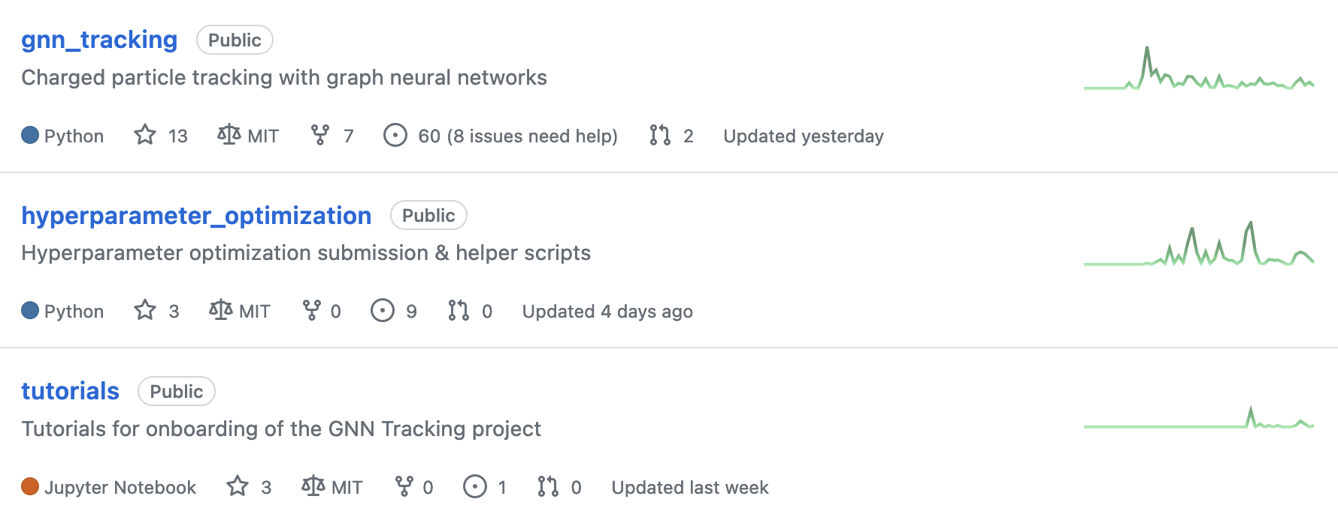




Summary
Proof of concept for object condensation applied to the HL-LHC tracking challenge without truth cuts
Promising performance on trackML pixel layer: > 90% of particles with pT > 0.9 GeV are uniquely (double majority) matched to a cluster
Currently working on on applying to full detector geometry
Much to be explored: Point cloud networks and more
Fully open-source framework: Let’s make prototyping new architectures for tracking accessible to everyone
github.com/gnn-tracking

Slide 12
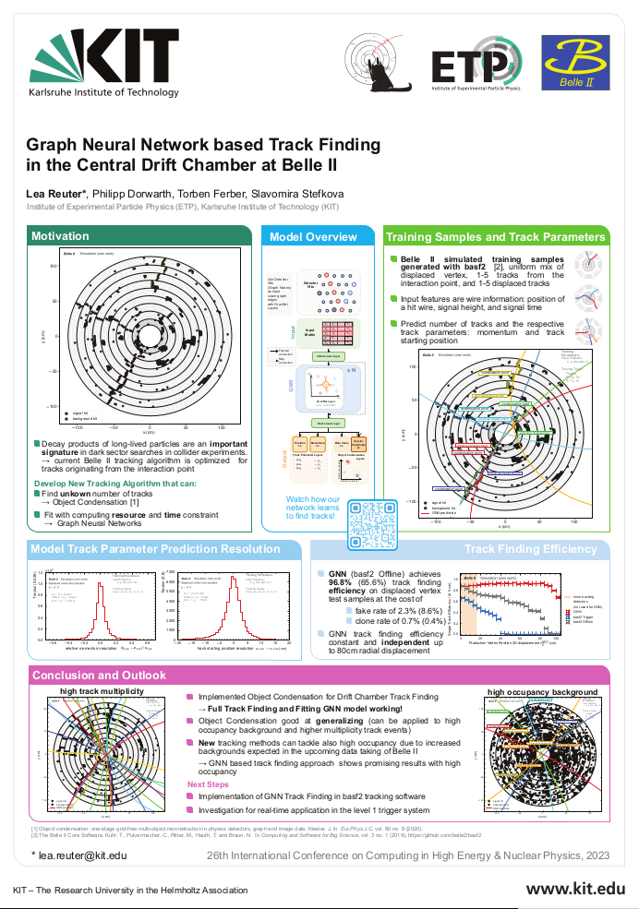
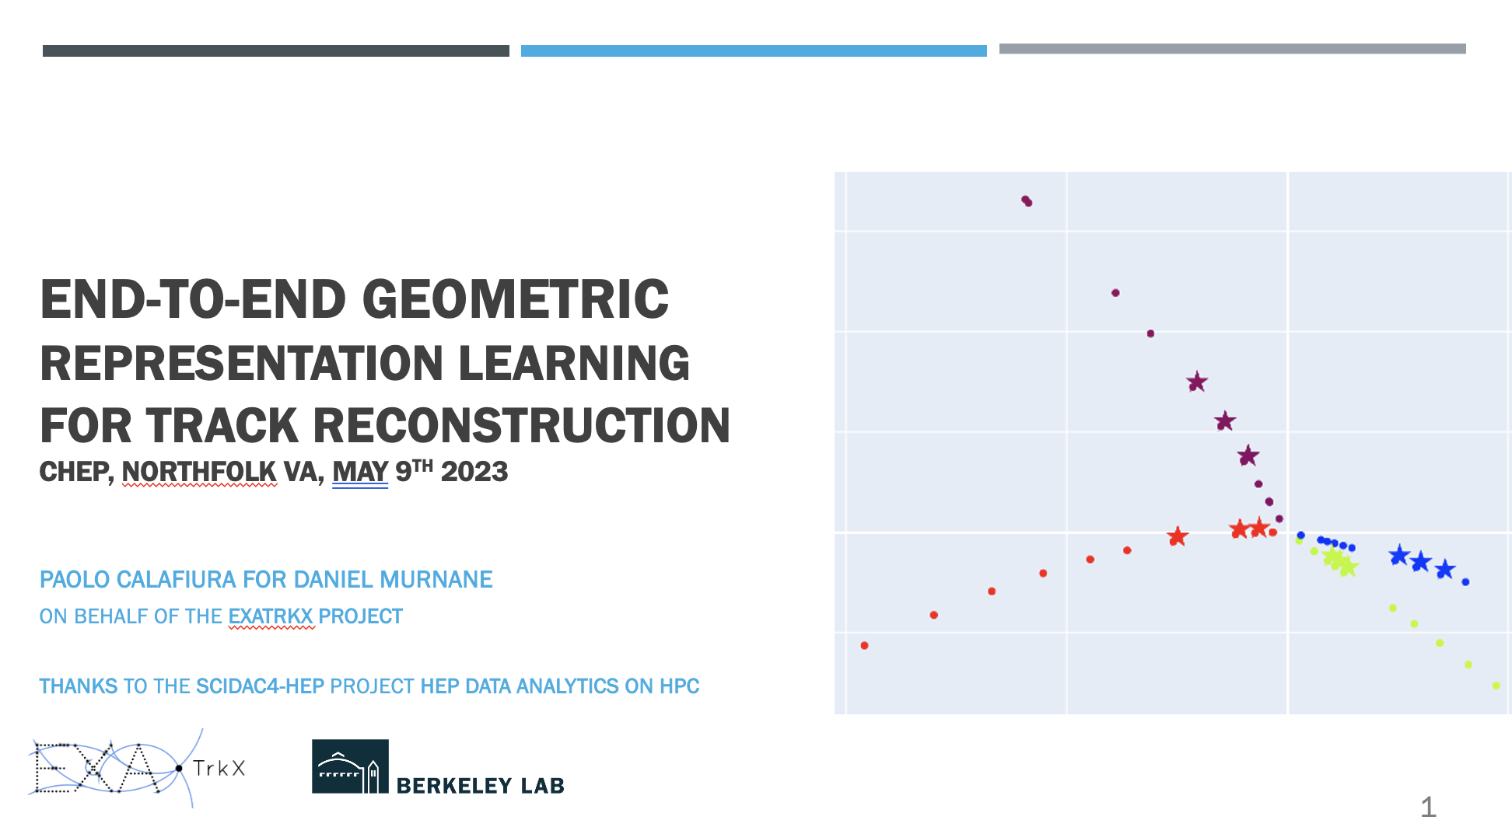
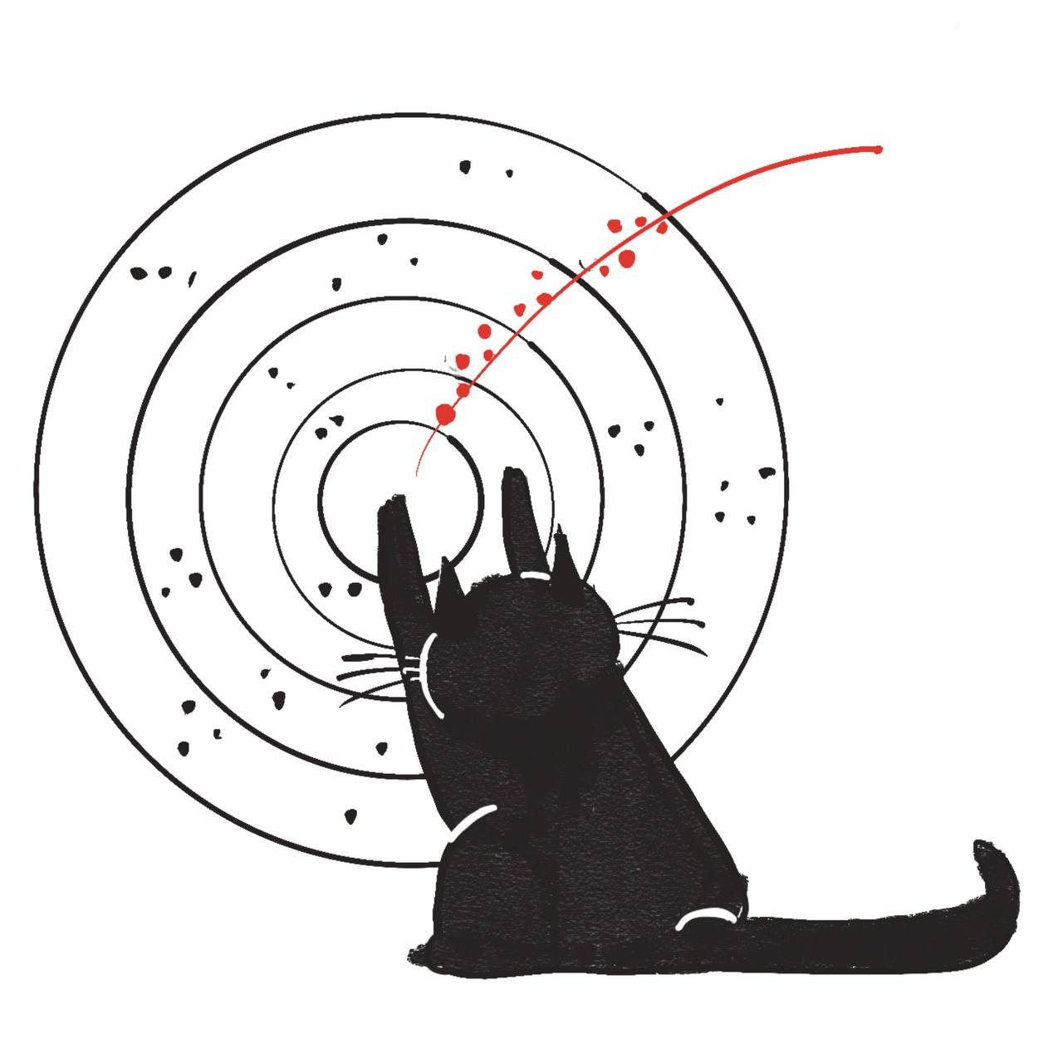
Shoutouts: More object condensation
Lea Reuter
Object condensation
tracking at Belle II
Daniel Murnane/Paolo Calafiura
Object Condensation with “Influencer” approach
Poster #10

Slide 13
Backup

Slide 14
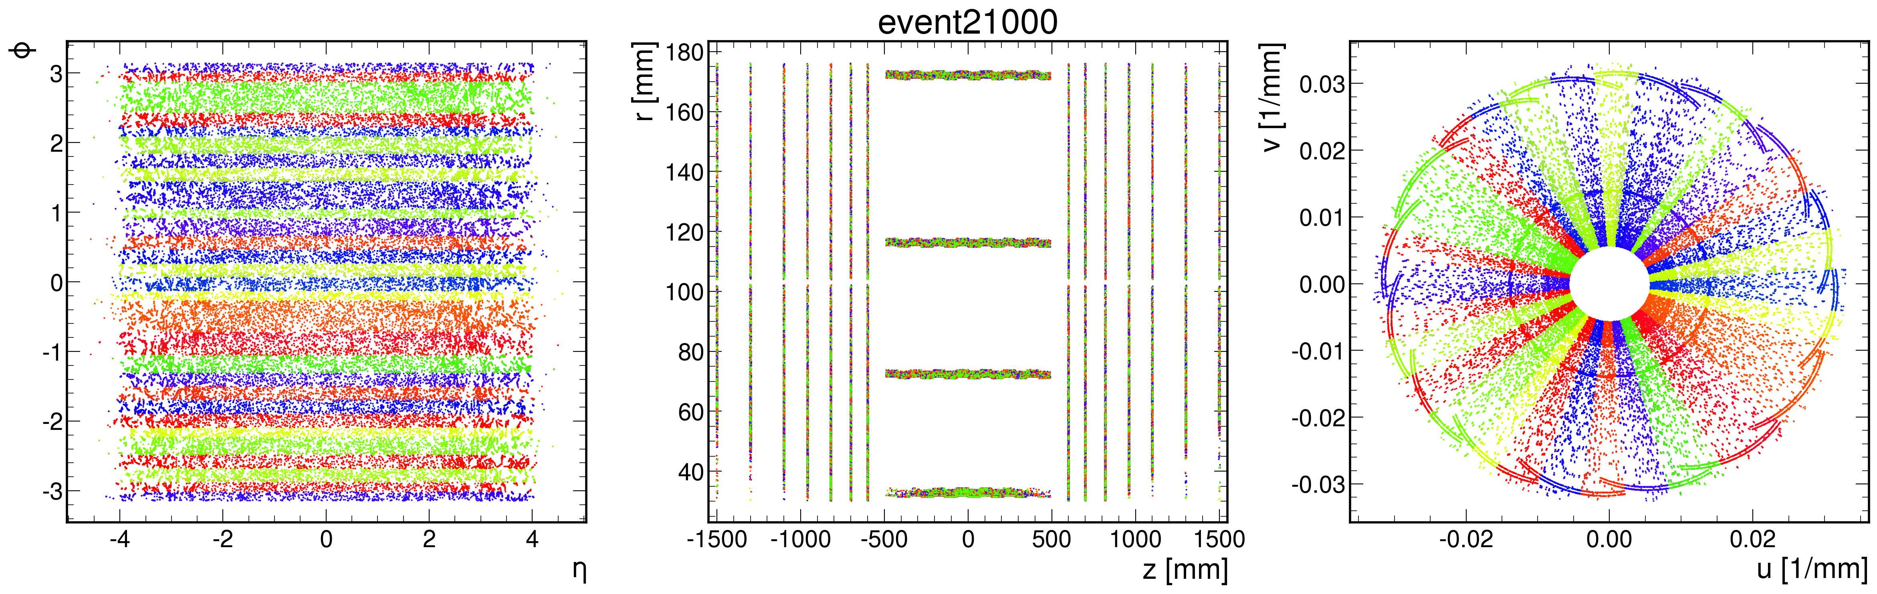
Point cloud sectorization

Slide 15
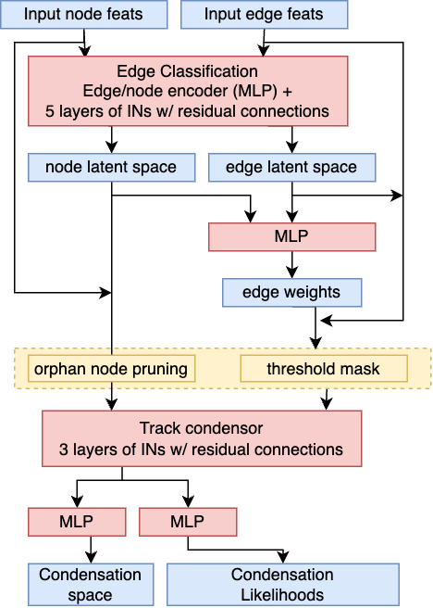
Architecture

