Slide 1
Uncertainty Aware Machine Learning Models for Particle Physics Applications
Kishansingh Rajput
Diana McSpadden, Malachi Schram
Thomas Jefferson National Accelerator Facility
Karthik Somayaji, Peng Li
University of California, Santa Barbara
Willem Blokland
Oak Ridge National Laboratory
Zhiwen Zhao
Duke University

Slide 2
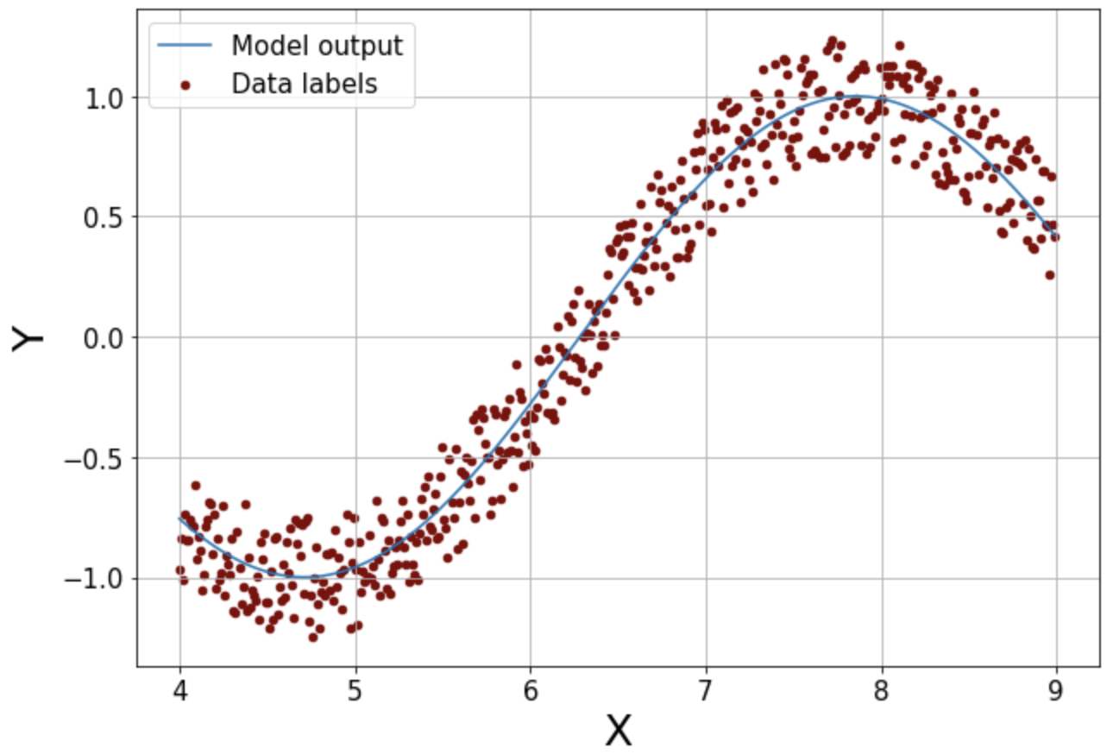
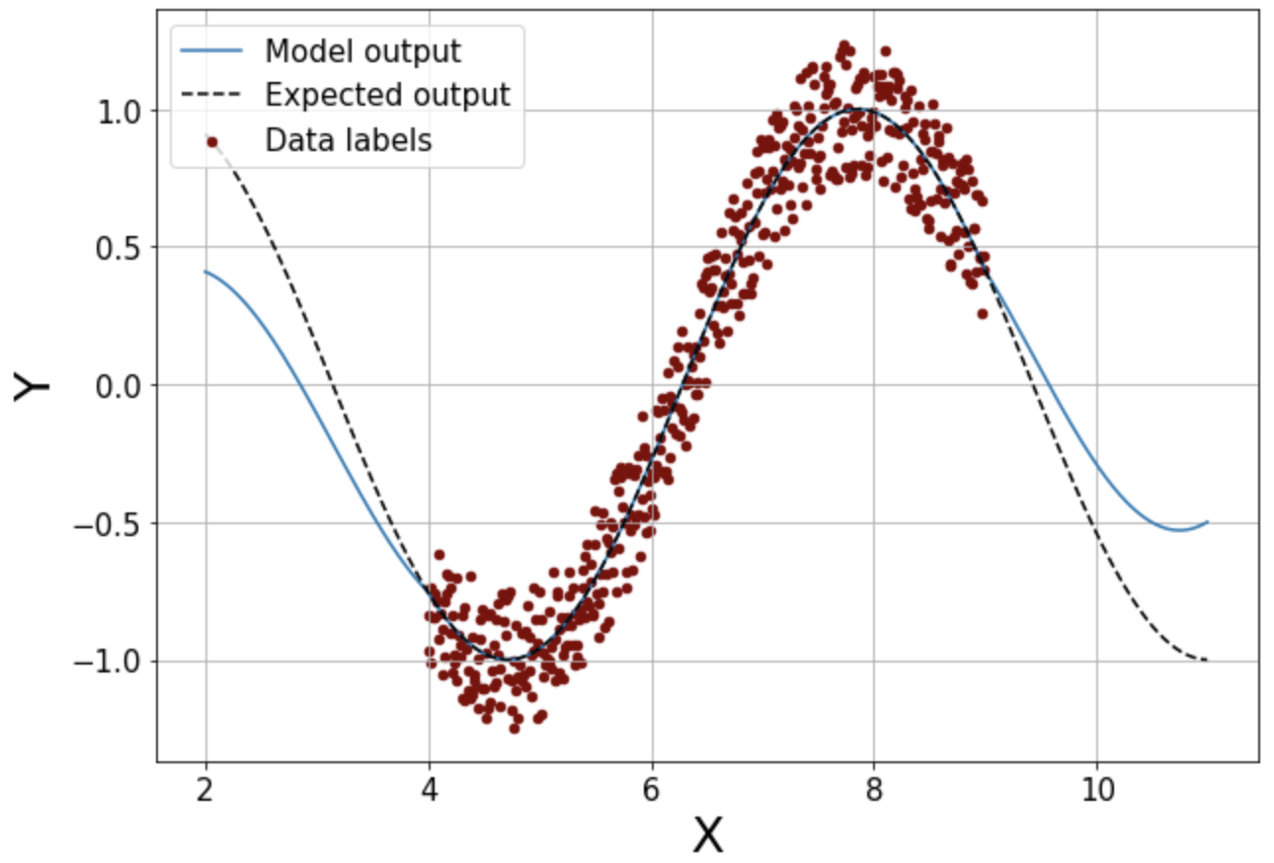
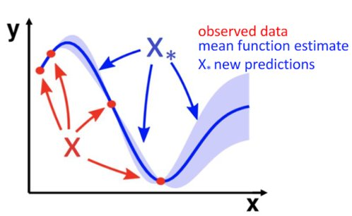
Uncertainty Quantification in Machine Learning
Deterministic transformation functions
ML model
Input(s)
Output(s)
Decision making based on predictions from ML models
Uncertainty Quantification is required to make an informed decision
Uncertainty Types: Aleatoric vs Epistemic uncertainties
Aleatoric → Data uncertainties
Epistemic → Model or Out of training distribution uncertainty (OOD)
Aleatoric
OOD
Gaussian Process (GP) provide robust uncertainty quantification
Epistemic

Slide 3
Outline
Traditional application of Gaussian Process (GP):
Uncertainty aware experiment control at GlueX with GP
Scaling limitations of GP and UQ for Deep Neural Networks (DNN):
Uncertainty aware anomaly prediction at SNS
Uncertainty aware particle identification for SoLID
Uncertainty aware surrogate model for FNAL booster
Conclusion

Slide 4
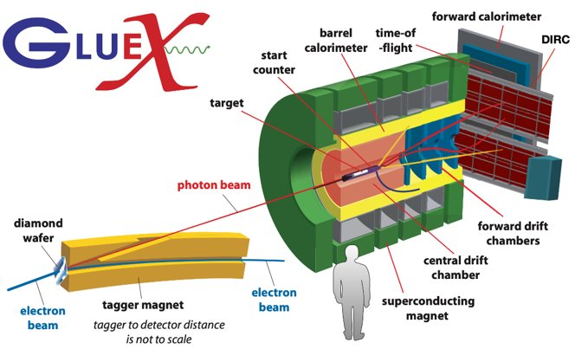
Gaussian Process (GP) for Calibration of the Central Drift Chamber (CDC)
Requires two calibrations: gain and drift time-to-distance
Gain Correction Factor (GCF) [variation +/- 15%]
Has one control: operating voltage
CDC is gas filled, sensitive to
Atmospheric pressure
Temperature
Experimental conditions change, i.e. beam current
model uses high voltage board current as a proxy for beam current
Motivation: Online calibration to save time and computing resources required for post calibration
Conventional
Calibrate: calibration values iteratively produced after the experiment
No Control: CDC operating voltage is fixed at 2125 V
Online and ML
Online. calibration and Control: Stabilize detector response to changing environmental/experimental conditions by adjusting CDC HV

Slide 5
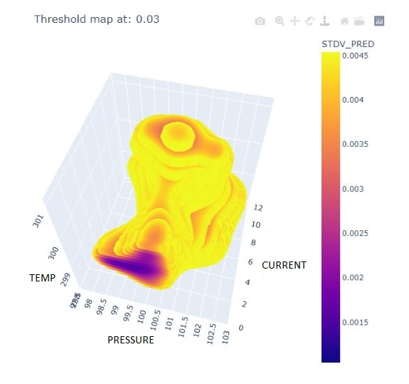
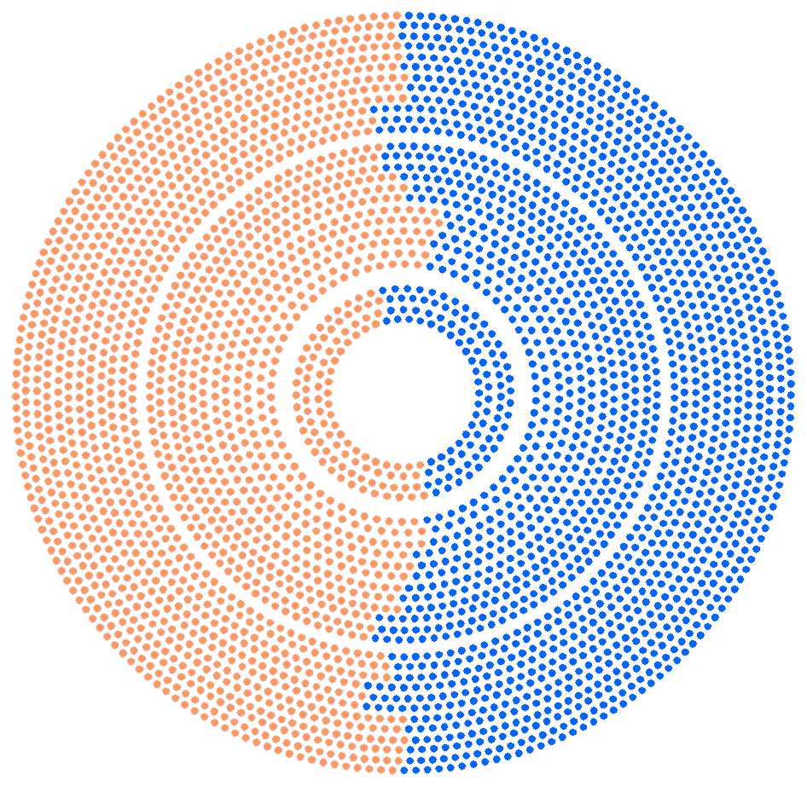
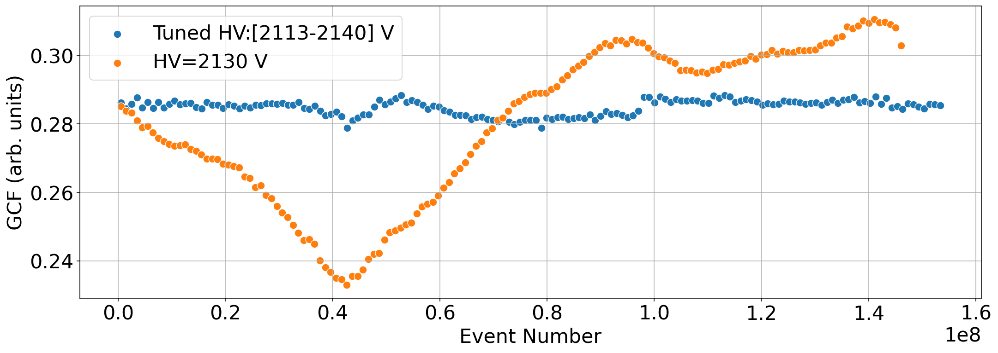
GP for Calibration of the Central Drift Chamber (CDC)
Cosmic Ray Experiment
Sorted the CDC into 2 halves
Leave one side at a fixed HV (conventional)
Let the ML control the other
Autonomously adjust HV every 5 min
Experimental Control Requires Uncertainty Quantification
Training data rarely has complete coverage: 601 runs, 2 run periods
Do experts trust model predictions?
Uncertainty Surface Mesh:
Threshold of standard deviation, visualize feature space
Conventional in orange
ML-tuned in blue
Uncertainty > threshold
Approach-1: use prediction for the closest point on the surface
Approach-2: return CDC to traditional high voltage setting, 2125 V and collect more data to train

Slide 6
Large data sets with higher dimensions and GP
GP provides robust UQ but scales poorly with increase in data samples (O($n^{3}$))
For large datasets and/or in large feature space, GP approximation is required
Deep Neural Networks (DNN) are very expressive and scales with size of dataset
DNN can deal with different types of data including images, text, and timeseries
What about UQ for DNN?

Slide 7
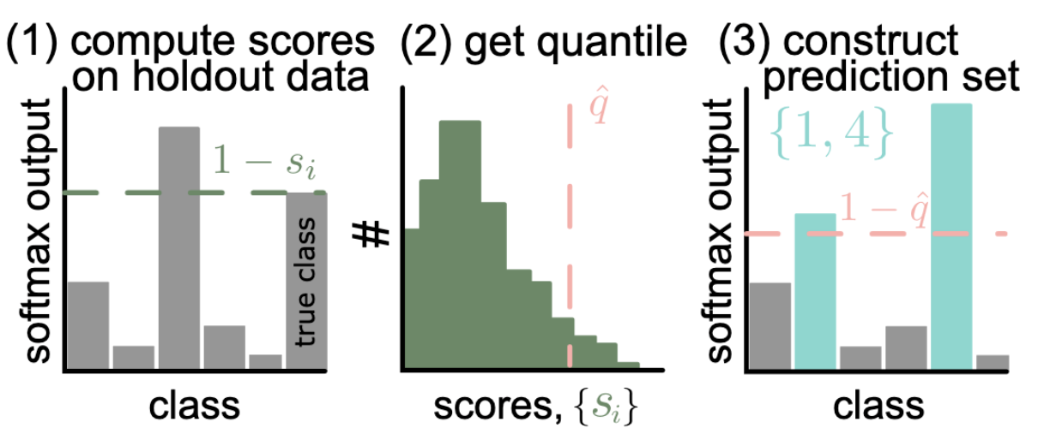
UQ in Deep Learning
Q₁
Q₂
Q₃
Q_{n}
$$σ$$
Spectral Neural Gaussian Process
(c) Quantile Regression
Distance preservation via Spectral Norm on each hidden layer
Reduced expressivity, harder to learn
Distance preservation via bi-lipschitz
$L_{1}$ and $L_{2}$ are hyper-parameters, $h_{x_{1}}$, $h_{x_{2}}$are hidden layer outputs corresponding to inputs $x_{1}$, $x_{2}$ respectively
(a) MC Dropout
(b) Ensemble
GP takes into account distance between input samples explicitly
https://arxiv.org/abs/2107.07511
(d) Conformal Predictions

Slide 8
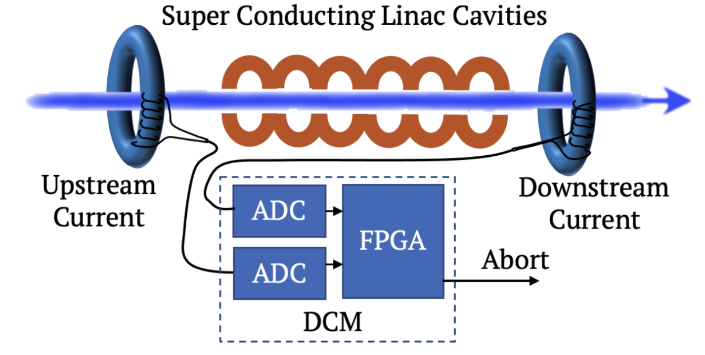
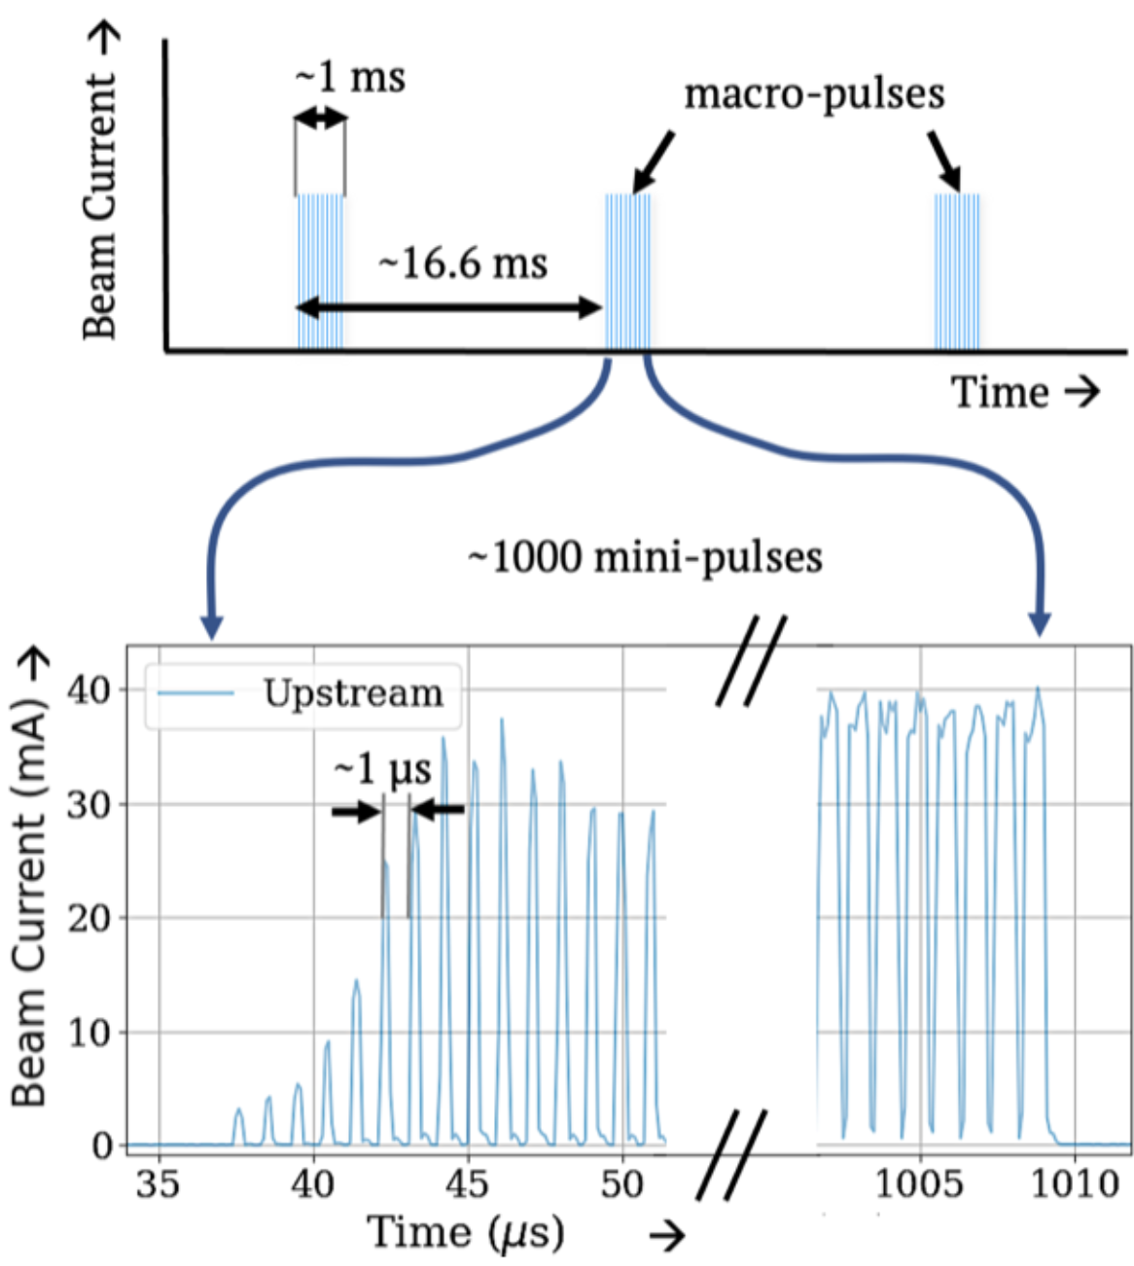
Anomaly Prediction at SNS Accelerator
Accelerators are complex multi-system machine
Failure in any equipment can cause errant beams
Fault prediction is beneficial in many ways including reduced downtime
Goal: To predict errant beam pulses (with uncertainty quantification) before they occur to avoid potential damage to the equipment(s) and reduce the downtime
Dataset:
We used the macro-pulse before an errant beam pulse (and labeled it as anomaly) and macro-pulses from the normal operation (and labeled them as normal) for our studies
Our hypothesis: there is a sign about upcoming anomaly in macro-pulses even before it happens
We also need to forecast the fault within a short time window to be actionable

Slide 9
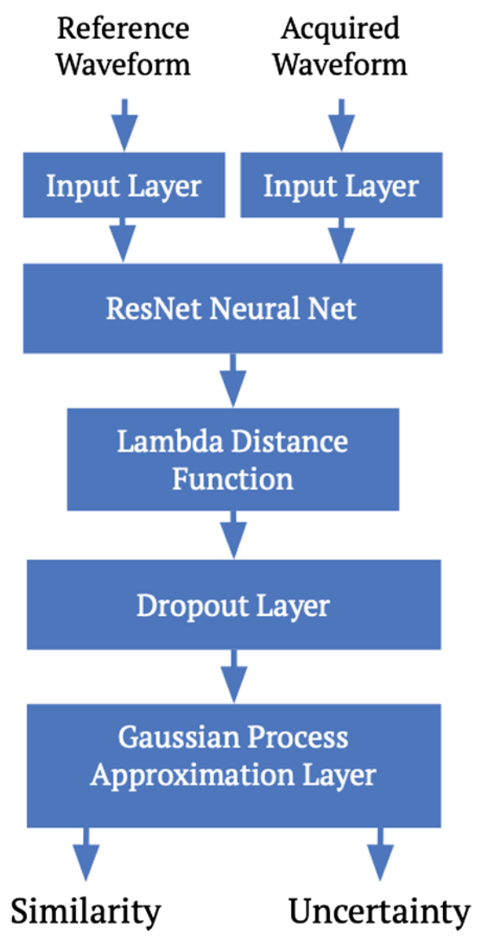
Uncertainty Aware Siamese Model and Results
We use Siamese Model to predict similarities with normal reference waveforms
Attached GP approximation layer at the end to provide UQ
The ROC curves bands are produced by smearing the predictions with uncertainty
To evaluate the OOD uncertainty robustness
Introduced a different anomaly type (not included in training)
The model predicts OOD anomaly reasonably well with higher uncertainty
Maximize TPR at FPR < 0.5%

Slide 10
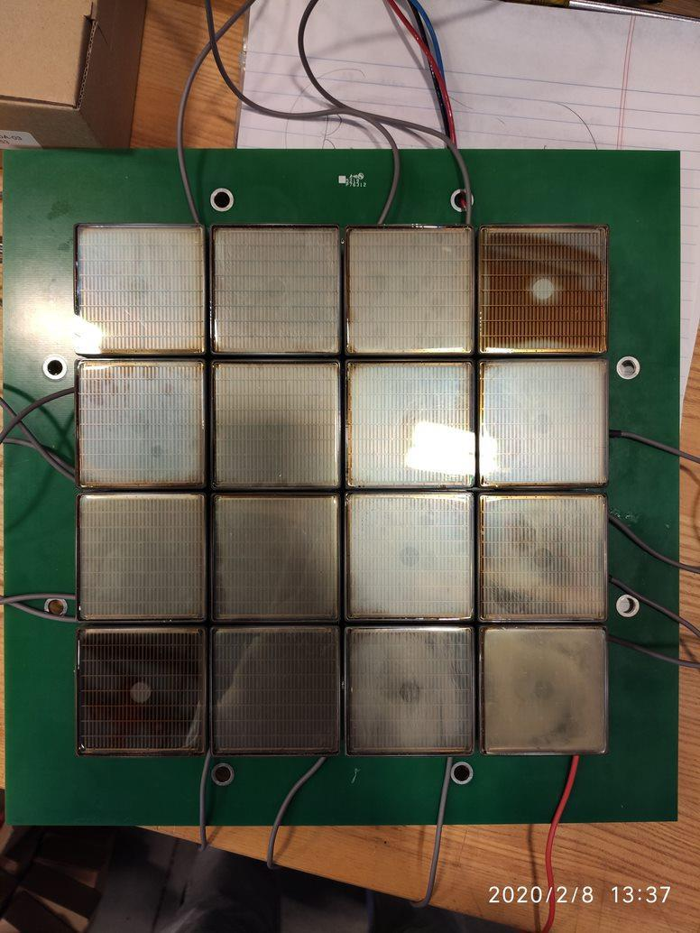
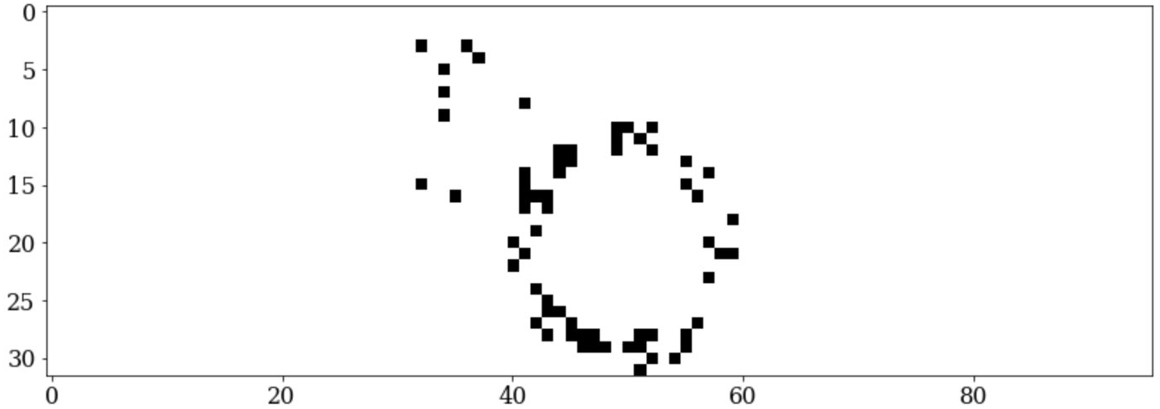
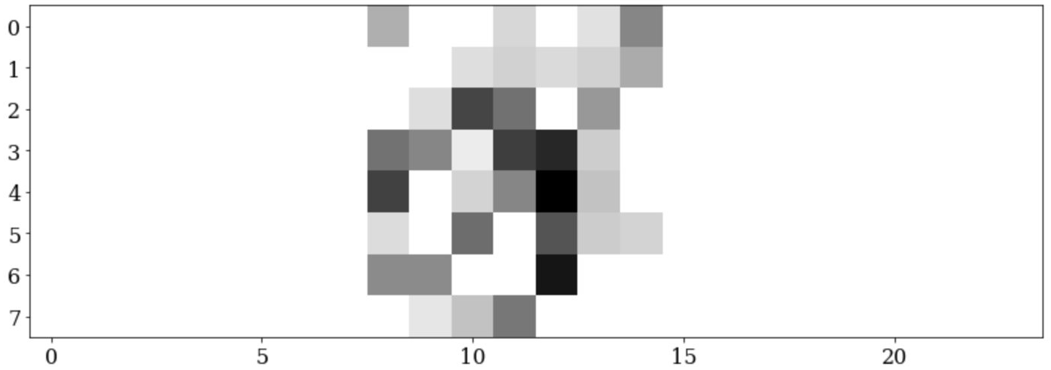
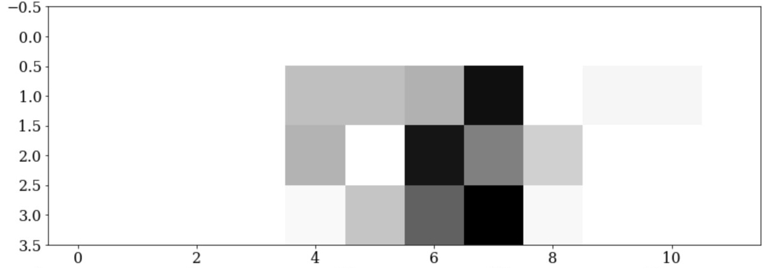
Uncertainty Aware PID for SoLID
Goal: Use ML to understand what level of readout is needed to achieve desired performance
Cherenkov Readout: each 5cmx5cm MAPMT can have
1 pmt sum output with Number of photoelectrons (Npe)
4 2.5cm x 2.5cm quad sum output with Npe
64 6mm x 6mm pixels with 0/1
Cost increase with more readout channels and increasing resolution
Dataset:
Readout hits on the sensors from PMT having the lowest to Pixel readout having the highest resolution
Pixel
Quad
PMT

Slide 11
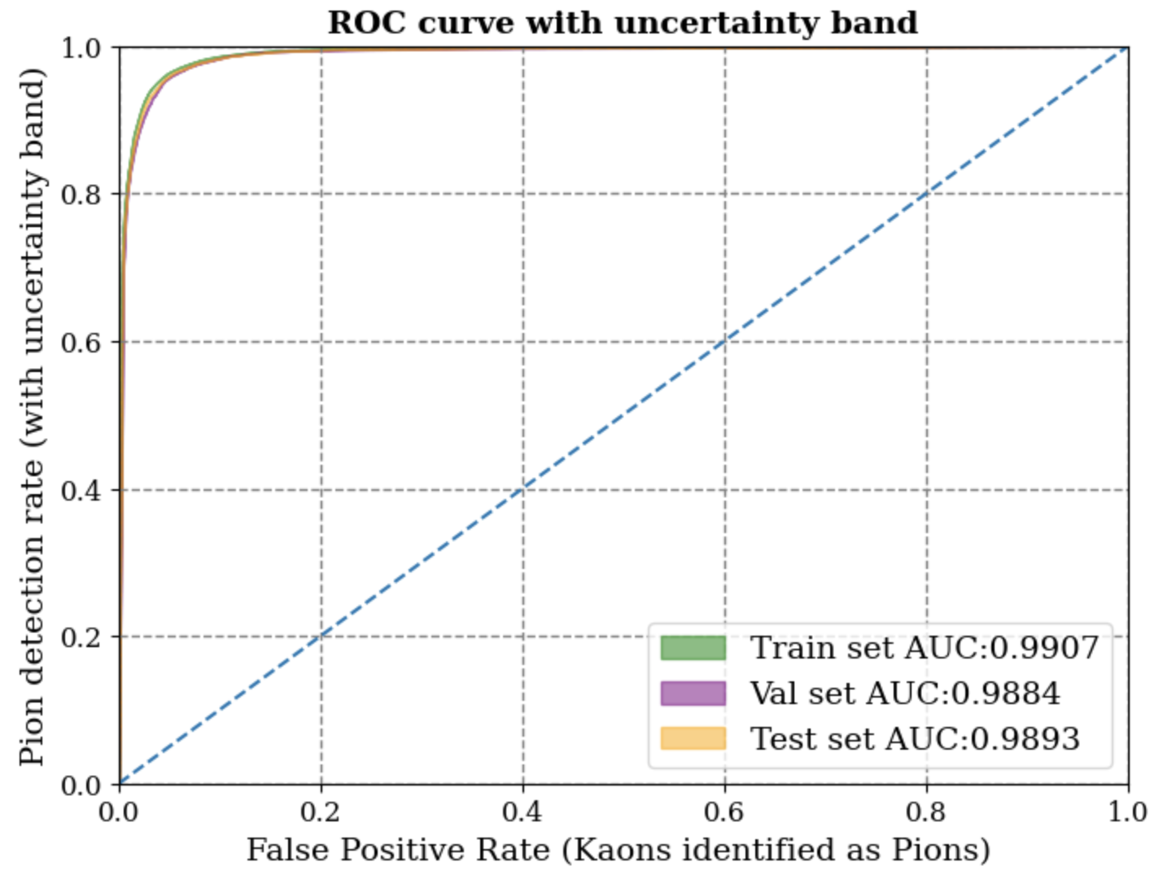
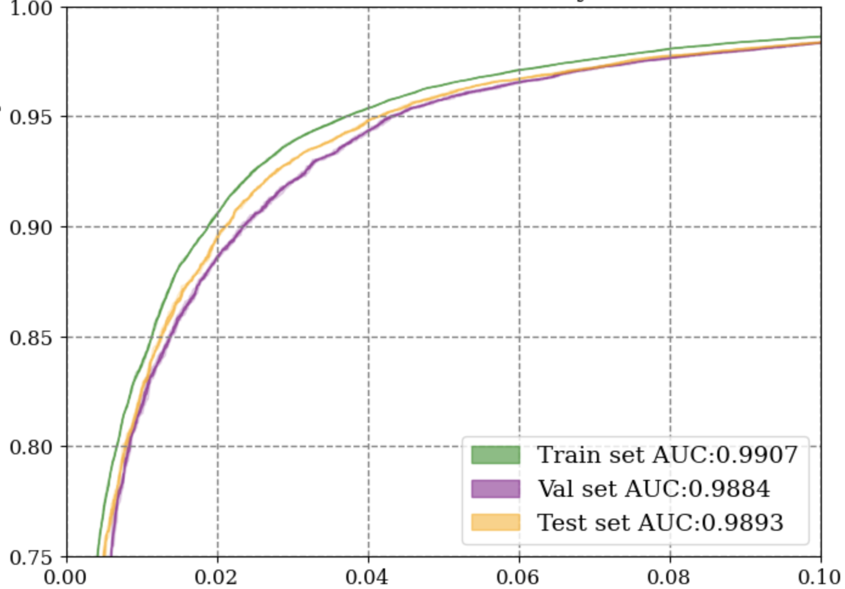
Uncertainty Aware PID for SoLID
Pion vs Kaon
The PID data is converted to images
The deep learning model is designed using conv2D layers to learn the patterns
GP approximation layer to provide UQ
Simulation data is used with higher background noise to mimic the realistic scenario
DNN based PID model has shown much better performance than traditional cuts
Next Step: Evaluate the UQ robustness by introducing third/ noise particle
True prediction rate at False Positive rate of 5%
Section | PMT | Quad | Pixel | Npe cut
P 2.5 GeV theta 8.0 degree (most difficult for pion acceptance) | 0.978 | 0.991 | 0.994 | 0.5
P 7.5 GeV theta 14.0 degree (most difficult for kaon rejection) | 0.991 | 0.995 | 0.997 | 0.6

Slide 12
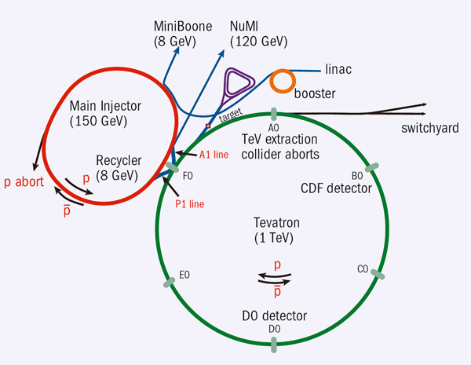
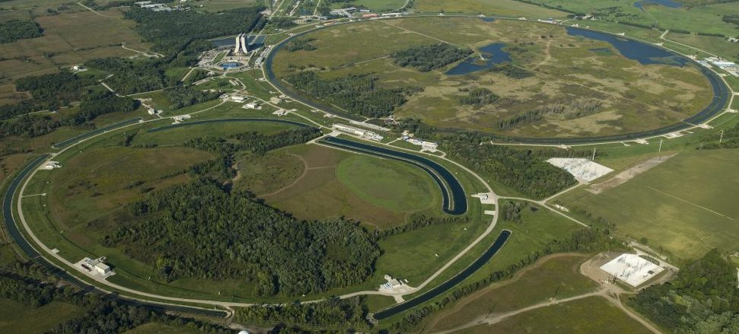
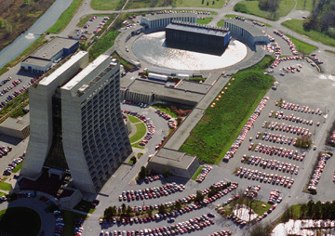
Uncertainty Aware Surrogate Model for FNAL Booster
Fermilab Site
The Booster accelerates 400 MeV beam to 8GeV with the help of booster cavities and Combined-function bending and focusing electromagnets known as gradient magnets.
These magnets are powered by the gradient magnet power supply (GMPS)
Booster ring
Fluctuations in GMPS electrical current due to neighboring electrical loads and thus fluctuations of the magnetic field in the Booster gradient magnets
A GMPS regulator is required to stabilize the accelerating magnetic field
Courtesy: Christian Herwig
Problem definition:
Develop a surrogate model of the GMPS that can be leveraged to train a modern control system such as reinforcement learning agent to stabilize the GMPS power supply

Slide 13
Uncertainty Aware Surrogate Model for FNAL Booster
Surrogate model is developed using ResNet Conv1D blocks followed by fully connected layers
UQ is important to know which areas are not well modeled by the surrogate model
We evaluated three different methods of UQ for DNN regression
DQR provide robust UQ in-distribution but not on OOD
BNN method does a better job at estimating OOD uncertainty
GP approximation model provide the best OOD estimation and is calibrated by design
The high frequency with higher fluctuation in amplitude are removed from training to make it OOD
One of the input variable is monotonically increased manually to make it go OOD
In distribution data
https://arxiv.org/pdf/2109.10254.pdf

Slide 14
Conclusion
GP provides robust uncertainty quantifications for both in-distribution and OOD samples
Presented application of GP to autonomously calibrate CDC in GlueX detector
With larger datasets and higher dimension, GP does not scale; approximation required
DNN can handle large multi-model datasets with ease
GP can be attached to DNN models to provide UQ
Distance between input samples need to be preserved through hidden layers
Presented uncertainty aware anomaly prediction for SNS accelerator with GP approximation
Presented comparison of PID in SoLID with different readout resolutions
Presented uncertainty aware surrogate model for FNAL booster
Acknowledgement This work was supported by the DOE Office of Science, United States under Grant No. DE-SC0009915 (Office of Basic Energy Sciences, Scientific User Facilities program) and DE-FG02-87ER40315. ORNL is managed by UT-Battelle, LLC for the US Department of Energy (DOE) under contract DE-AC05-00OR22725 . Jefferson Laboratory is managed by Jefferson Sc. Assoc., LLC for the US Department of Energy (DOE) under Contract No. DE-AC05-06OR2317. This research used resources at the Spallation Neutron Source, a DOE Office of Science User Facility operated by the Oak Ridge National Laboratory, resources at GlueX experiment, and upcoming SoLID experiment at Jefferson lab, and open sourced data from Fermi National Accelerator Laboratory.

Slide 15
References
Willem Blokland et. al. Uncertainty aware anomaly detection to predict errant beam pulses in the Oak Ridge Spallation Neutron Source accelerator
- https://journals.aps.org/prab/abstract/10.1103/PhysRevAccelBeams.25.122802
Malachi Schram et. al. Uncertainty aware machine-learning-based surrogate models for particle accelerators: Study at the Fermilab Booster Accelerator Complex - https://journals.aps.org/prab/abstract/10.1103/PhysRevAccelBeams.26.044602
Kishansingh Rajput et. al. Uncertainty Aware Deep Learning for Particle Accelerators -https://ml4physicalsciences.github.io/2022/files/NeurIPS_ML4PS_2022_182.pdf
Torri Jeske et. al. AI for Experimental Controls at Jefferson Lab - https://arxiv.org/abs/2203.05999
Jeremiah Zhe Liu et. al. Simple and Principled Uncertainty Estimation with Deterministic Deep Learning via Distance Awareness - https://proceedings.neurips.cc/paper/2020/file/543e83748234f7cbab21aa0ade66565f-Paper.pdf

