Slide 1
#CaloChallenge
Michele Faucci Giannelli, Gregor Kasieczka, Claudius Krause,
Ben Nachman, Dalila Salamani, David Shih and Anna Zaborowska

Slide 2
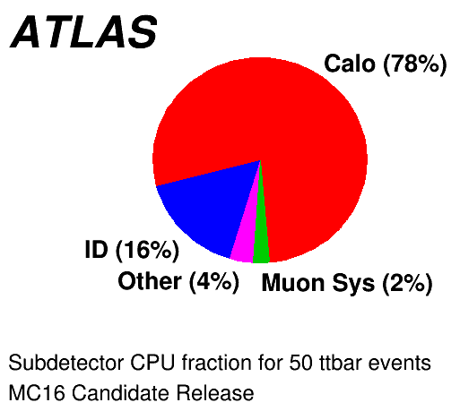
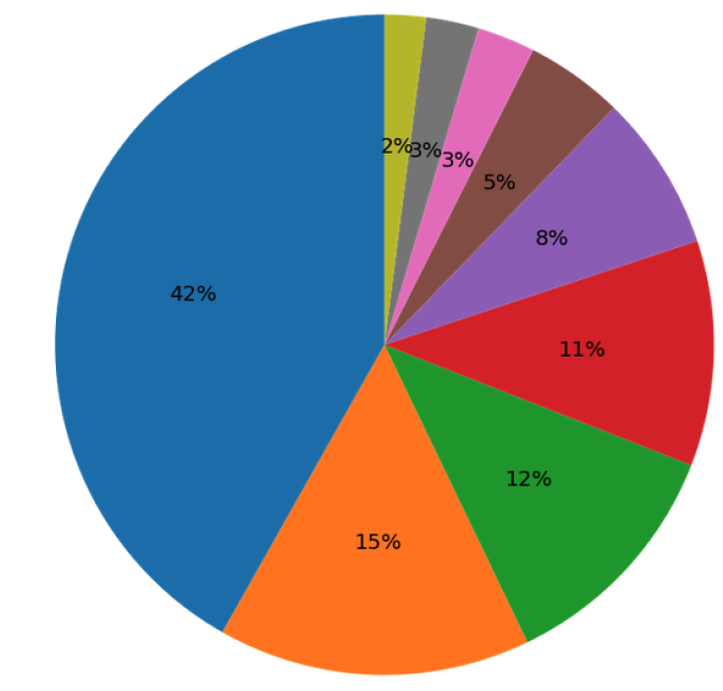
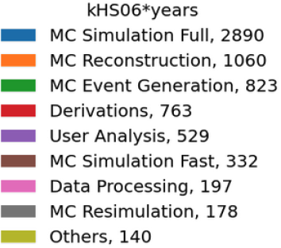
Motivation
We need it for HL-LHC experiment to keep up with luminosity
but also to reduce the environmental impact of our MC production
Speeding up the calorimeter simulation is the obvious first task to speed up the MC production
This is not the only approach, more radical solution have been proposed and presented this week

Slide 3
The current landscape
Many methods exists on the market and several were presented during this week
GANs, VAE, Normalised Flows, Diffusion,…
Which one is the best that experiment should use?
Maybe a combination? Different particles may be best simulated by different methods
So far different datasets have been used
CaloGAN, ILD, ATLAS,…
Each approach use a different metric to asses the performance
χ², classifiers, W1, W2, …
The only option is to compare these methods on the same dataset(s) and use the same metrics
This is what we prepared in the #CaloChallenge

Slide 4
Why a challenge?
Previous challenges (top tagging, anomaly detection) were very successful
The datasets we prepared will remain the benchmark for this topic long after this challenge is over
Comparing the methods is the main goal, but we can also evaluate the impact of different pre-processing, training strategies, hyper parameters, and other details to improve each others methods
Ultimately we can summarise the status of the field and propose the best directions for those experiments that want to implement these tools ~now.

Slide 5
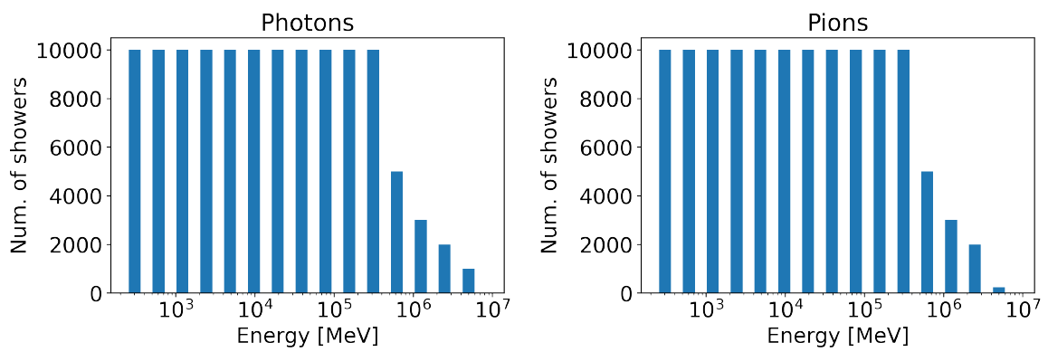
Datasets 1, the ATLAS dataset
ATLAS voxelised data used in AF3 that was released on open data.
Two samples, photons and pions, in 0.2<|η|<0.25
368 voxels (in 5 layers) for photons and 533 (in 7 layers) for pions
15 energy points (256 MeV – 4 TeV) generated by momentum

Slide 6
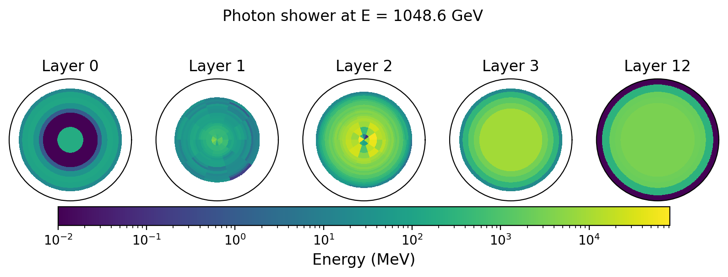
Photon example
L1, L2
L0, L3, L12

Slide 7
Pion example

Slide 8
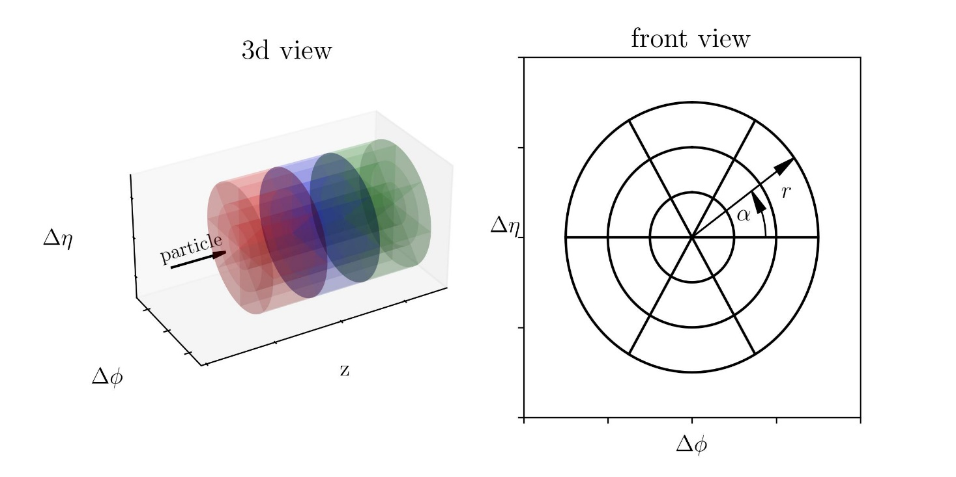
Dataset 2 and 3, a SiW high granularity calorimeter
100k Electrons produced a log-uniform distribution in the energy range 1 GeV - 1 TeV
Generic SiW calorimeter with 45 layers
Different voxelisation between the two datasets
Dataset | # Voxels | Layers | Nα | Nr
2 | 6480 | 45 | 16 | 9
3 | 40500 | 45 | 50 | 18

Slide 9
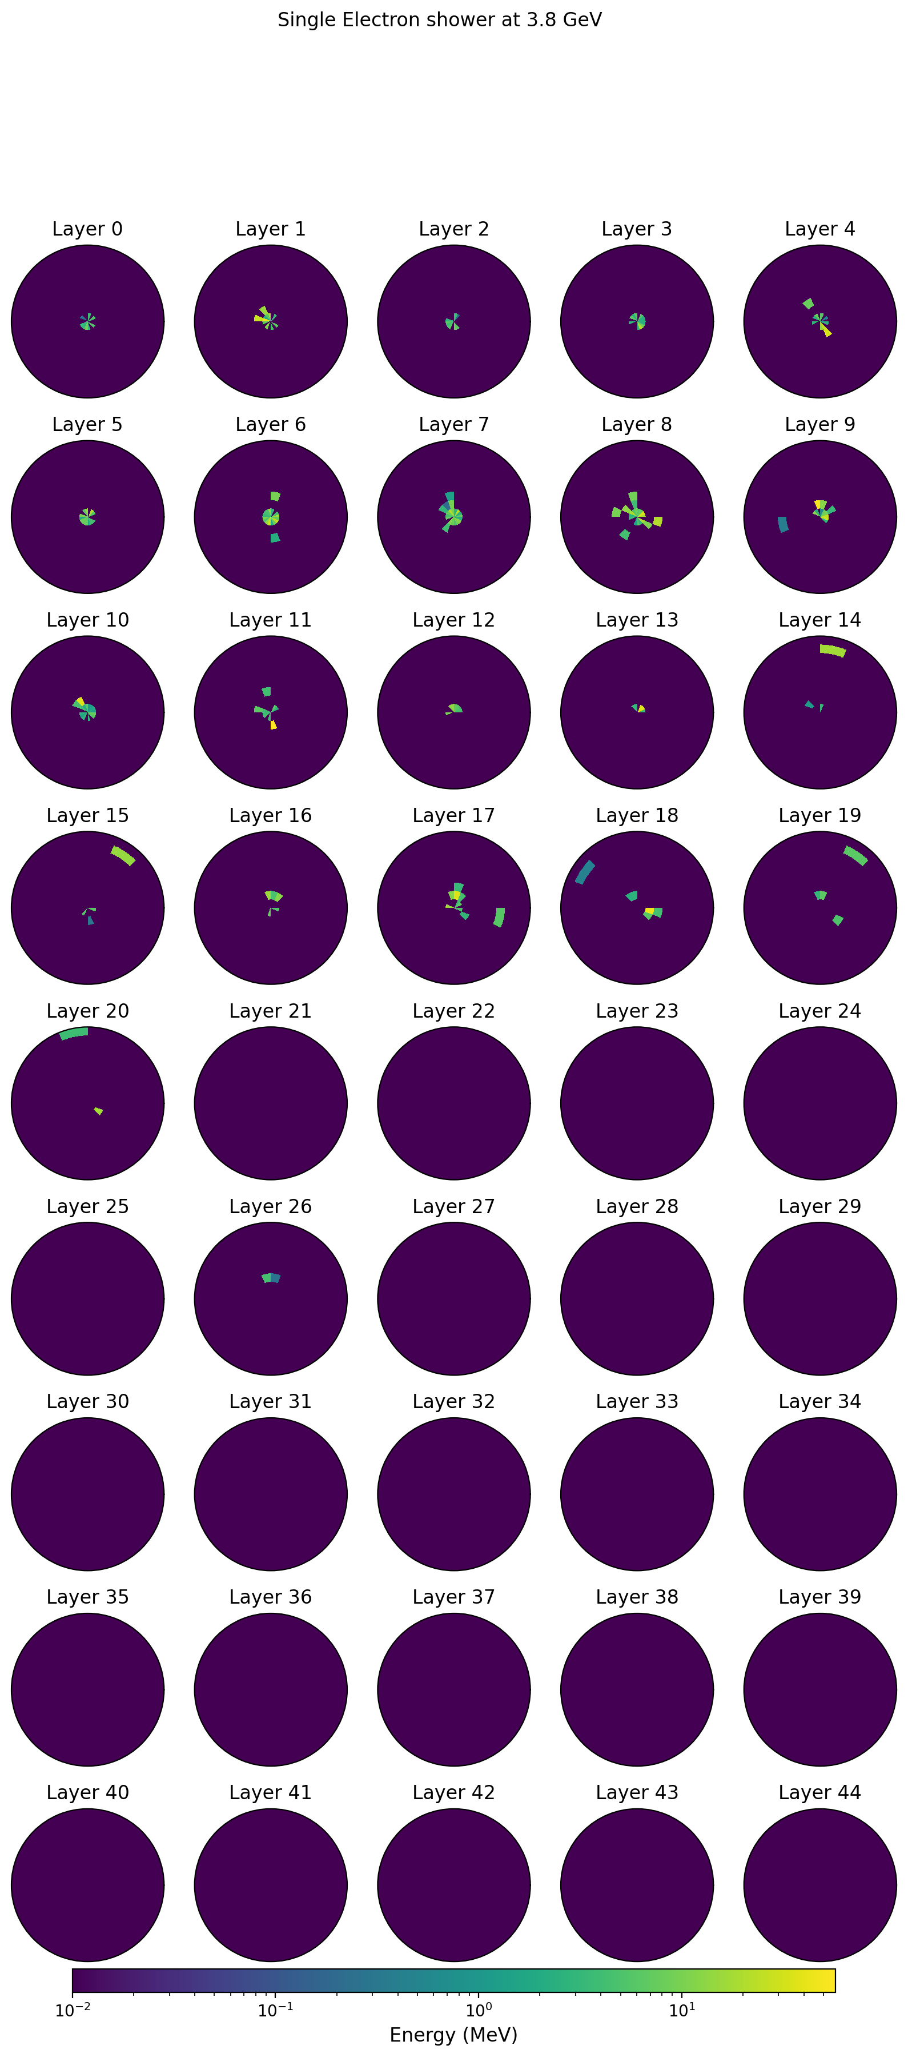
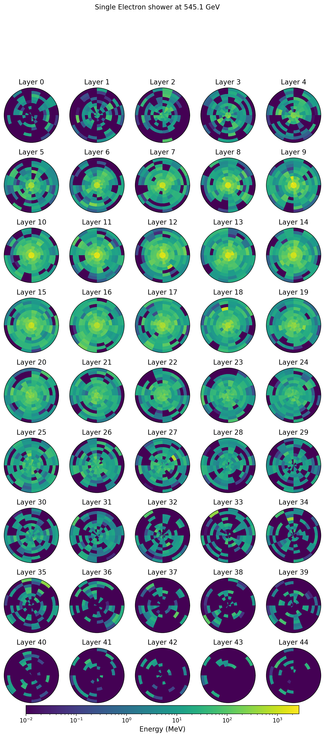
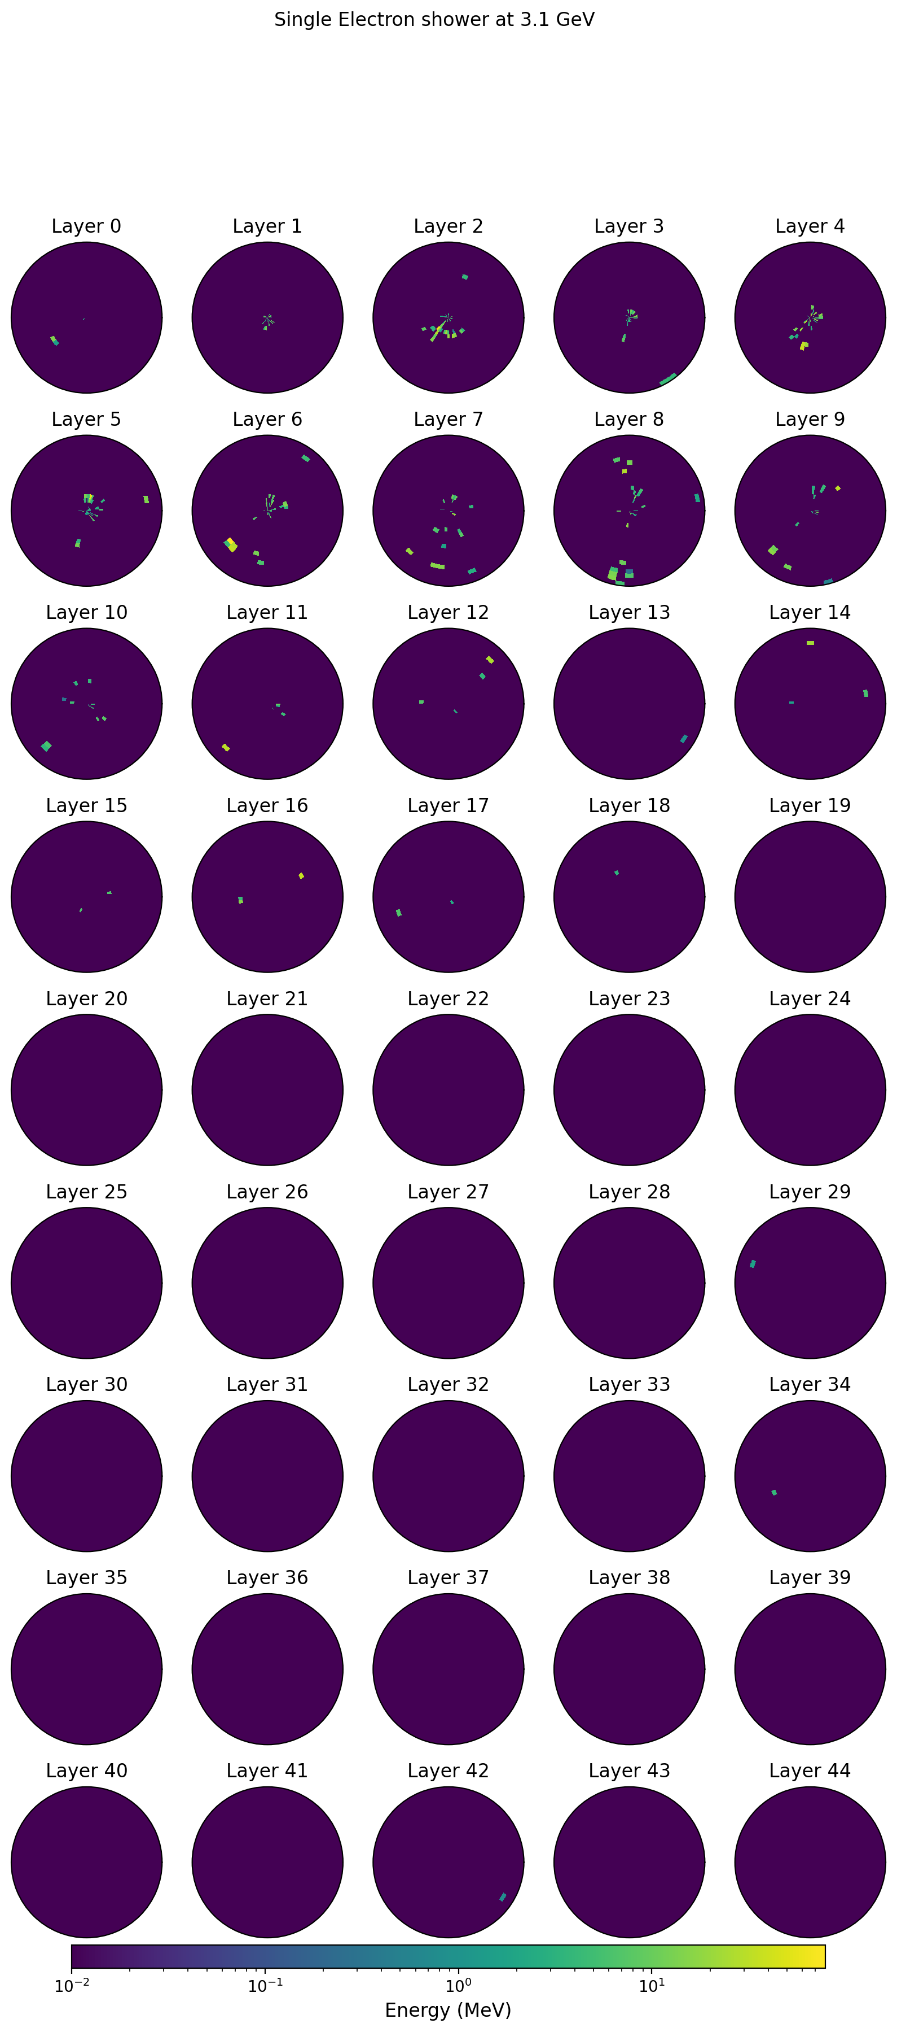
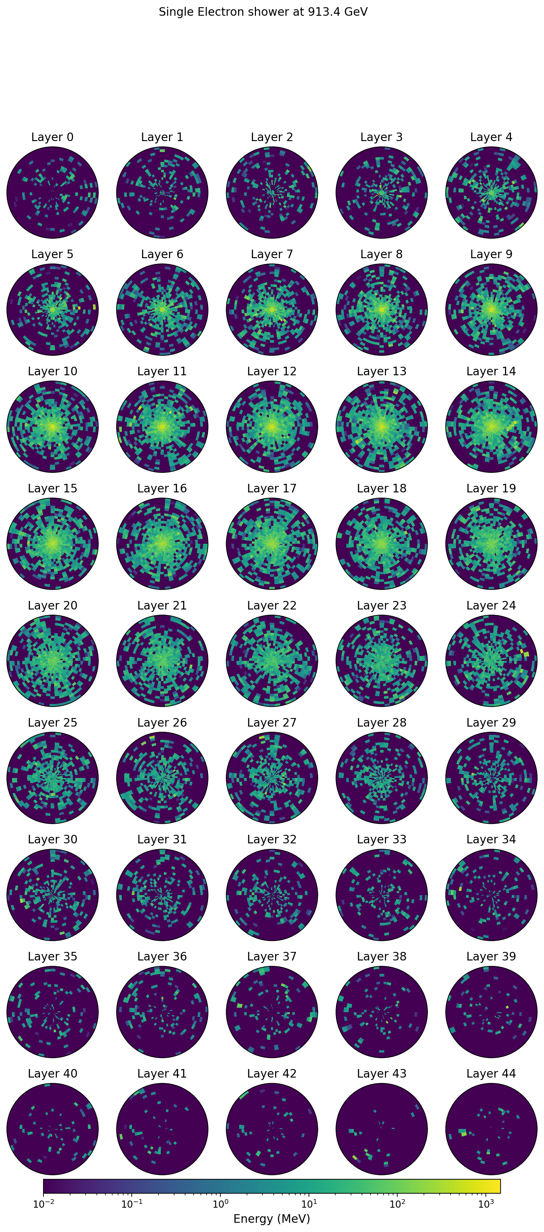
Example
D2: 3.1 GeV
D2: 545 GeV
D3: 3.1 GeV
D3: 913 GeV

Slide 10
The metric
For each dataset, we have a test sample with identical statistics to the training sample that will be use to evaluate all models
Several metric will be used:
Chi2 for energies as in FastCaloGAN
Include additional shape information
Use other test variable
Train a classifier
Finding the best metric is in itself a major challenge, maybe we will define the new standard for this topic

Slide 11
The other metrics
While accuracy is clearly the main metric, we cannot forget that other parameters are also crucial for a production system
Training time: these are narrow detector regions, can we afford a x100 training time like in FastCaloGAN? Conditioning on η can help, but the model will be more complex
Memory consumption: The GRID typical node has 1-2 GByte of Ram/core
This put a constraint on larger models
Inference time: normally not a problem, but large models can be slow

Slide 12
#CaloChallenge workshop @ Frascati

Slide 13
Workshop information
30th and 31st of May in Frascati
Webpage
13 abstracts with GANs, VAEs, Diffusion and NF
41 participants
Still some room for in-person attendance and definitively for remote participation
please approach me if you want to attend in person

Slide 14
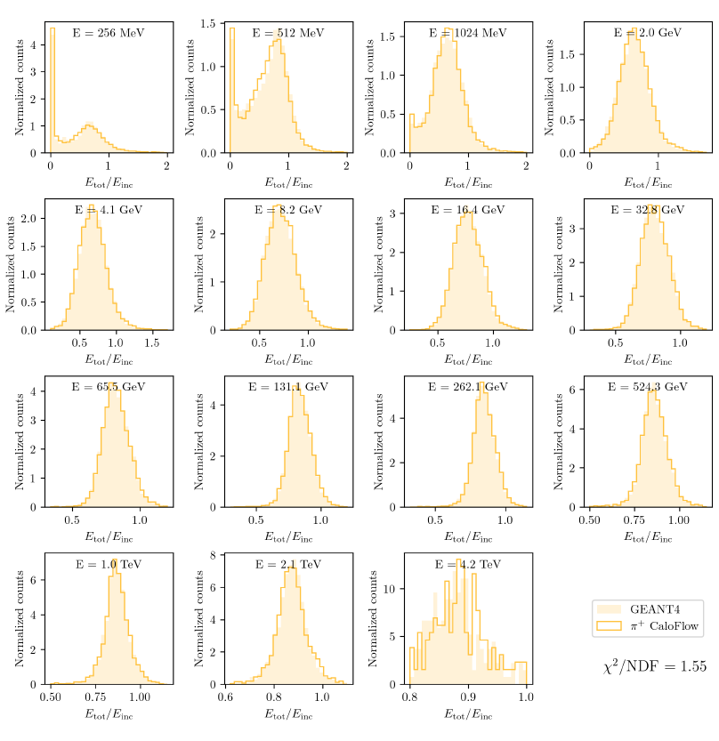
CaloFlow: a NL model
https://arxiv.org/abs/2210.14245

Slide 15
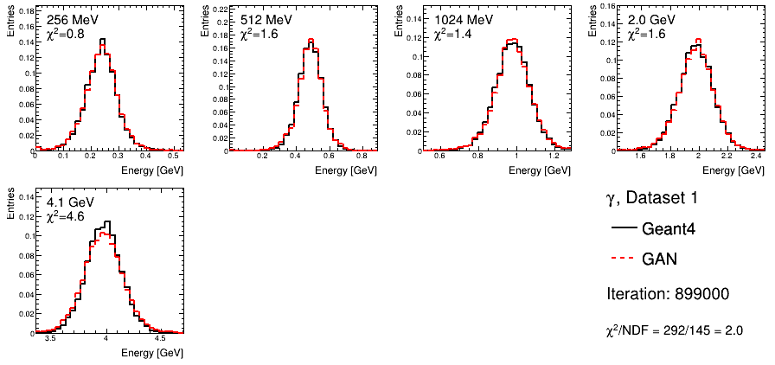
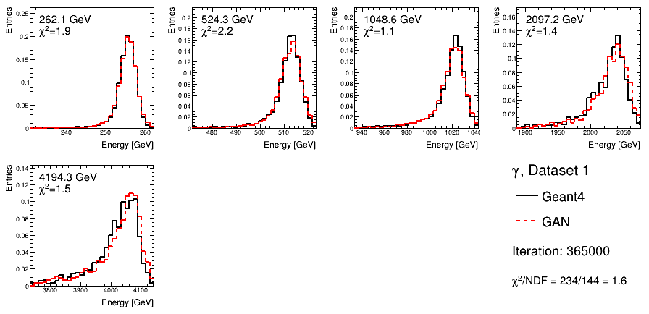
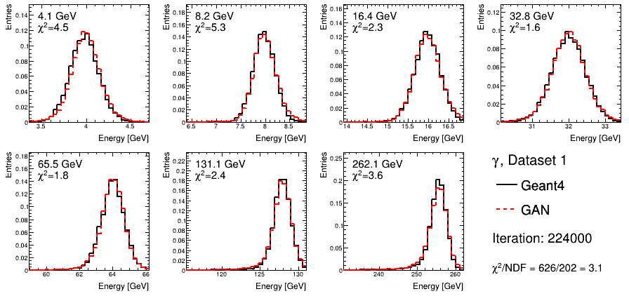
CaloShowerGAN: an evolution of FastCaloGAN
Exploiting physics knowledge and train 3 GANs
Low energy dominated by EMB1
Medium energies dominated by EMB2
High energies dominated by leakage
Train a GAN with 3 times the parameters does not achieve the same results!
χ²/NDF=1173/491=2.39

Slide 16
CaloShoweGAN on pions

Slide 17
CaloMan: density estimation on learned manifolds
Two-step approach:
Learn the data manifold with a VAE
Perform density estimation on the manifold using a NL
https://arxiv.org/abs/2211.15380
A binary classifier achieved 0.78 AUC, meaning that most generated showers are not distinguishable from input ones

Slide 18
CaloScore: diffusion model
https://arxiv.org/abs/2206.11898
There is not an absolute best stochastic differential equation; it depends on the complexity of the dataset

Slide 19
Conclusions
Fast calorimeter simulation is a hot topic and it will continue to be in high demand by the LHC experiments
Many models have been proposed but there is not yet a common benchmark
The CaloChallenge provides such benchmark for different particles and detectors
We will have a dedicated workshop in Rome where we will assess the current state of the art, discuss the best solutions and encourage further development
The results will be summarised in a paper

