Slide 1
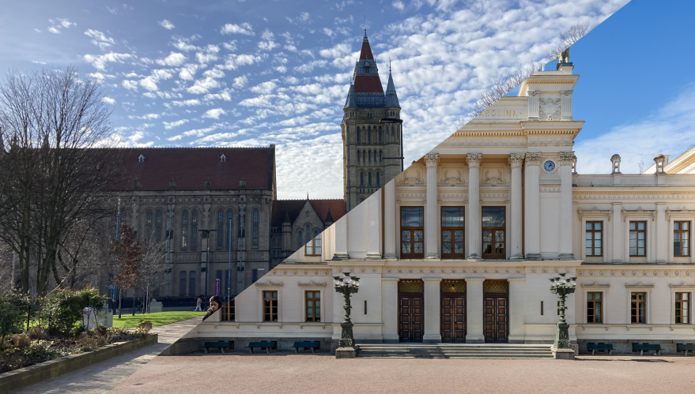
Baler: A tool for machine learning based data compression
Alexander Ekman & Axel Gallén
Notes:
Hello everyone, we are Alex and Axel from Lund University and Today we will present “Baler”, which is a tool our team has developed to perform machine learning based data compression

Slide 2
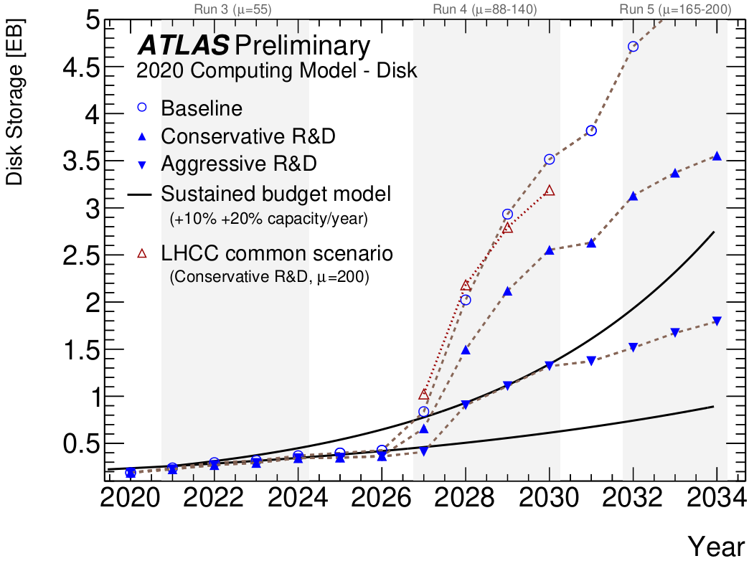
The problem
Problem: Too much data, too little storage
Not unique to LHC Experiments
High demand for compression
ATLAS HL-LHC Computing Conceptual Design Report
Calafiura, P ; Catmore, J ; Costanzo, D ; Di Girolamo, A
http://cds.cern.ch/record/2729668/
Notes:
Many different fields in science and industry struggle with having too much data and too little storage
We know this too well at the ATLAS experiment where the estimated resources needed for the High luminosity LHC vastly exceed the storage projections
But this issue is not unique to the ATLAS experiment and it is not unique to particle physics
The Square Kilometre Array experiment is expected to record 8.5EB of data over its 15-year lifespan [4]
And in fields like computational fluid dynamics the TB-sized simulations often have to be deleted after results are published
It’s easy to say that there is a high demand, Inside and outside particle physics, to effectively compress data more than conventional loss-less methods do

Slide 3
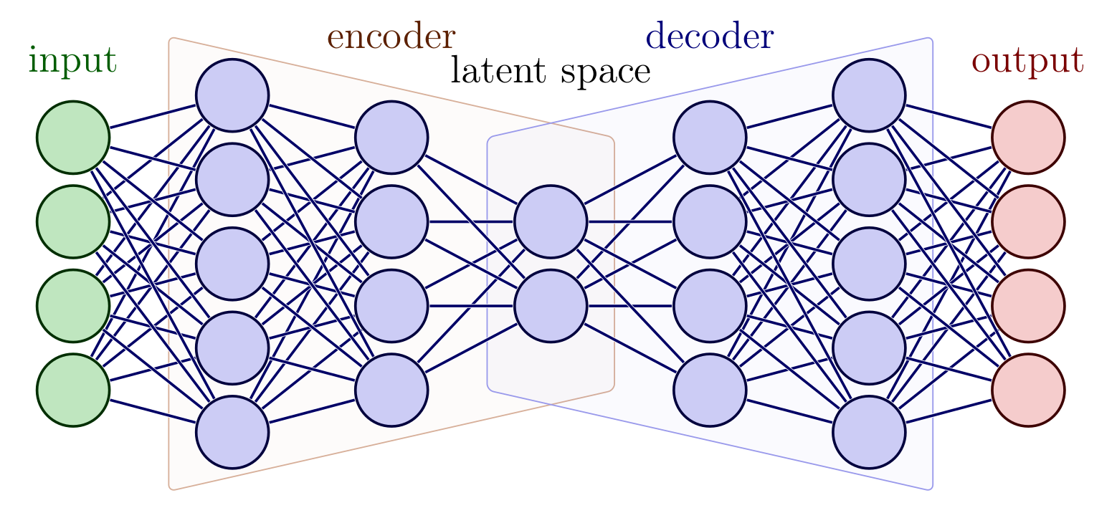
A Solution
One approach: Lossy compression
One problem: Lossy compression needs to be tailored
Solution: Lossy Machine Learning based compression
Autoencoder
Compressed data saved to disk
Figure modified from: https://tikz.net/neural_networks/
Notes:
One way to approach this is to investigate different methods of lossy compression
In lossy compression some information is lost, but it provides much greater data reduction than loss-less methods
The catch is that too have a good lossy compression with a large data reduction, it needs to be tailored for your data type. We can't just compress our particle physics data into an mp3 audio file. Because mp3 compression uses clever techniques applied specifically to audio frequencies.
So how do I get a lossy compression method tailored for my data?
One contender is a neural network called an Autoencoder which is trained to compress and decompress the dimensionality of data. And it it is this bottleneck, called latent space, which we can save as a compressed file to disk

Slide 4
Lossy compression
Works well in cases where more data is better
Particle physics: where more events compensate for the loss in precision
Works well where the only option is to delete the data
Computational Fluid dynamics: No infrastructure to store generated data for long times after publication
Notes:
However, Lossy compression comes with a price:
The decompressed data is not equal to the original data
And the question is, does this mean that lossy compression is inherently bad?
Not necessarily, it works well in cases where more data is better
For example: Particle physics, where more data compensate for the loss in precision
Or for in cases where the only option is to delete the data.
Fore example, in Computational Fluid dynamics, or if you dare to dream, at trigger level

Slide 5
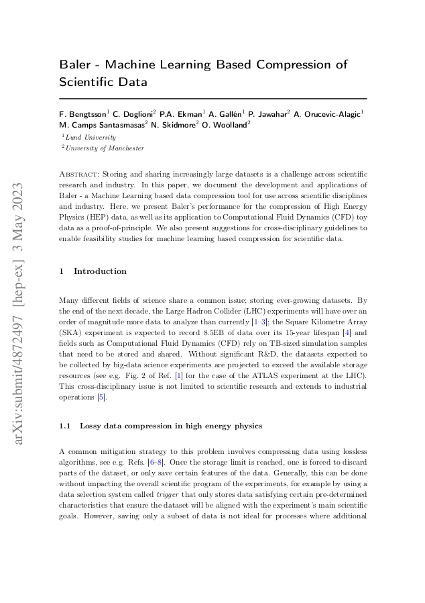
Our Tool: “Baler”
We have created a tool called “Baler” to help investigate the viability of this compression
Multidisciplinary tool
Distributed and developed as an open source project
https://github.com/baler-collaboration/baler
Simple to run with python through Poetry
Docker implementation also available
Docker-Sponsored Open Source program
https://arxiv.org/abs/2305.02283
Notes:
We have created a tool called “Baler” to helps us investigate the performance of this compression
Baler is a multidisciplinary tool, created to help researchers from vastly different fields to try autoencoder based compression on their data
It is distributed and developed as an open source project, so please feel free to give it a try
It is very simple to run, we’ve packaged it with poetry, but you can run it with any environment of your choice
We also provide a docker implementation for running it on computing clusters
And we are currently part of the docker-sponsored open source program

Slide 6
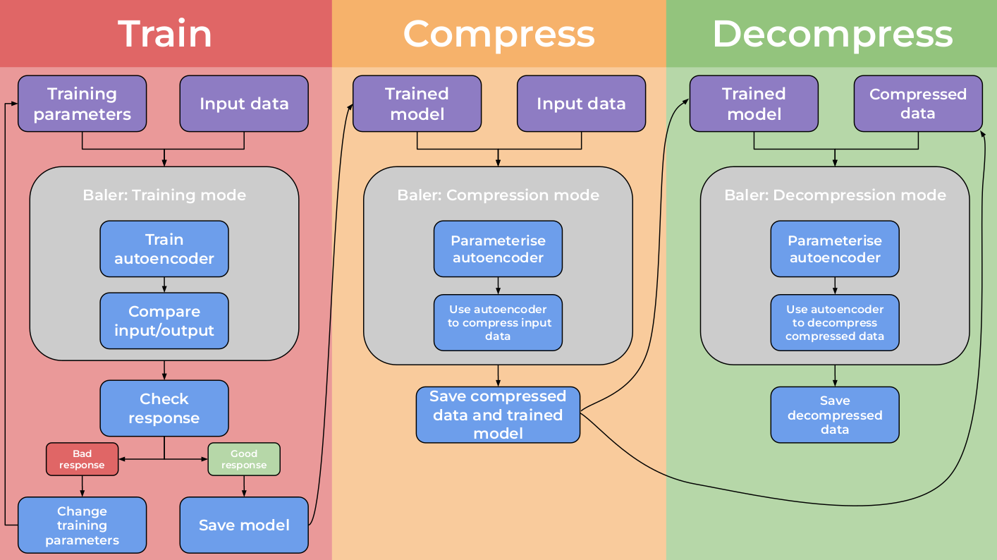
Baler Workflow
Notes:
Baler has 3 main running modes
Training
Compression
Decompression
For the training the user provides an input file in the form of a numpy array, and a configuration file with training parameters such as number of epocs, compression ratio, learning rate, and a model.
The user can then evaluate the performance of the process and run again or move on to compression
In the compression, baler takes the input data together with the recently trained model and saves a compressed file, together with the model, headers, and normalization constants to disk. We call these other files auxiliary files
After this, you can run the decompression at a later stage
Given the model and the compressed file baler decompresses the file to its original shape

Slide 7
Computational Fluid Dynamics
Data consists of 2D slice of the x-velocity component for a liquid flowing over a cube
The compressed file is 0.5% the size of the input
We present:
Data before and after compression+decompression
Difference between before and after

Slide 8
Methodology
HEP Data
Open CMS Data (DOI:10.7483/OPENDATA.CMS.KL8H.HFVH)
~ 600 000 jets
24 variables per jet compressed to 14 variables -> 58% original size
Evaluation Metrics:

Slide 9
Results in HEP: Transverse Momentum

Slide 10
Results in HEP: Transverse Momentum

Slide 11
Results in HEP: Transverse Momentum

Slide 12
Results in HEP: Transverse Momentum

Slide 13
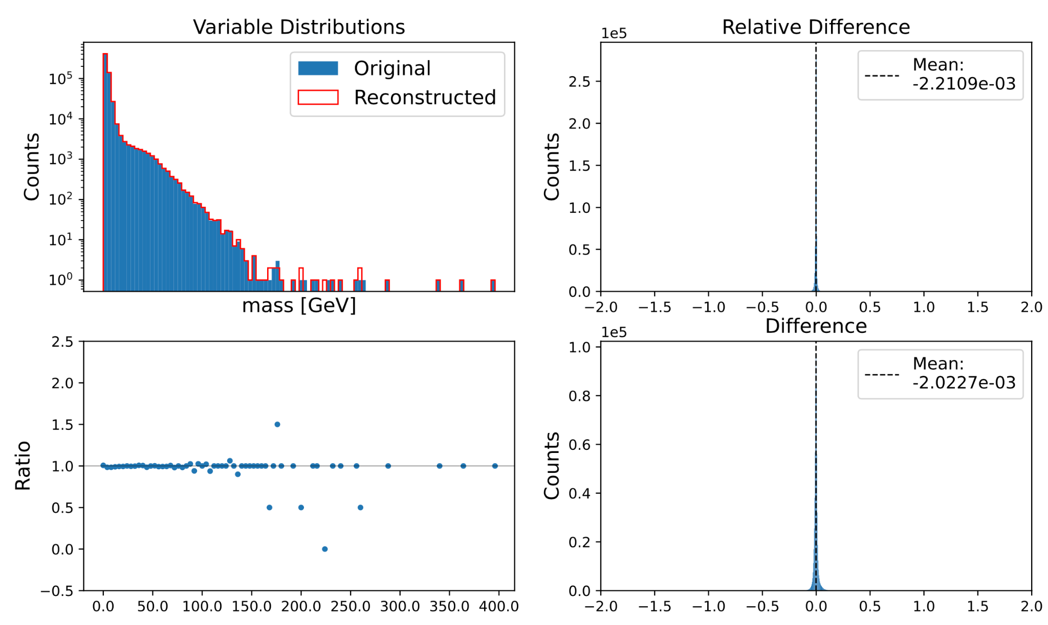
Results in HEP: Mass

Slide 14
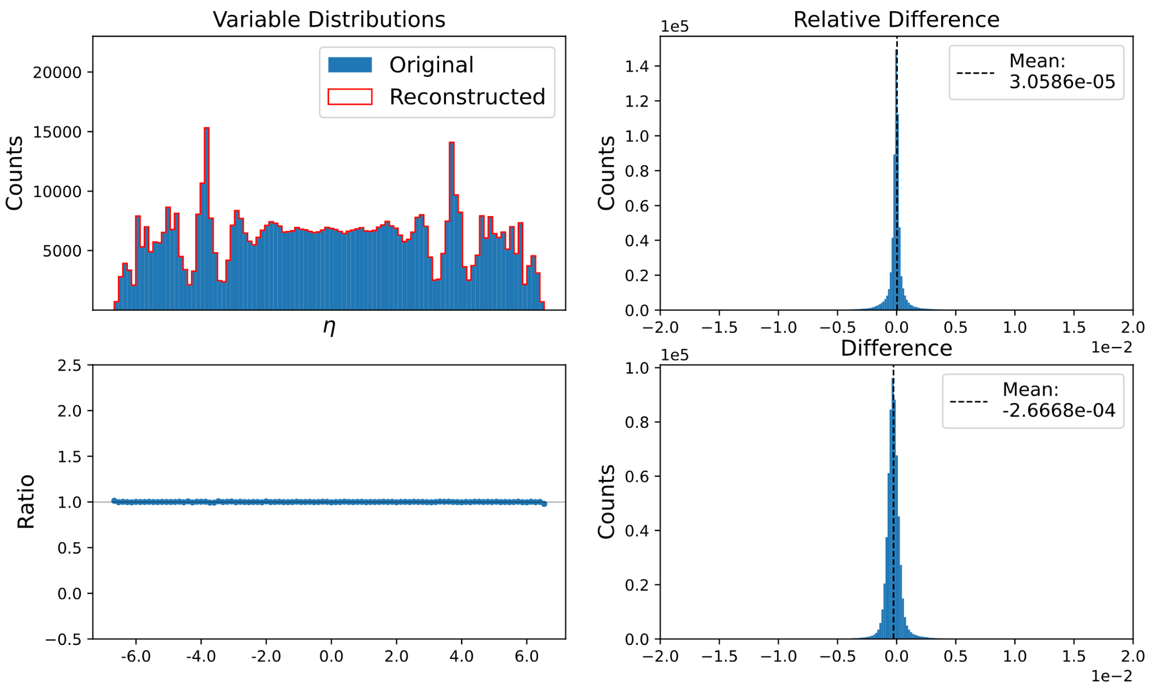
Results in HEP: Pseudorapidity, η

Slide 15
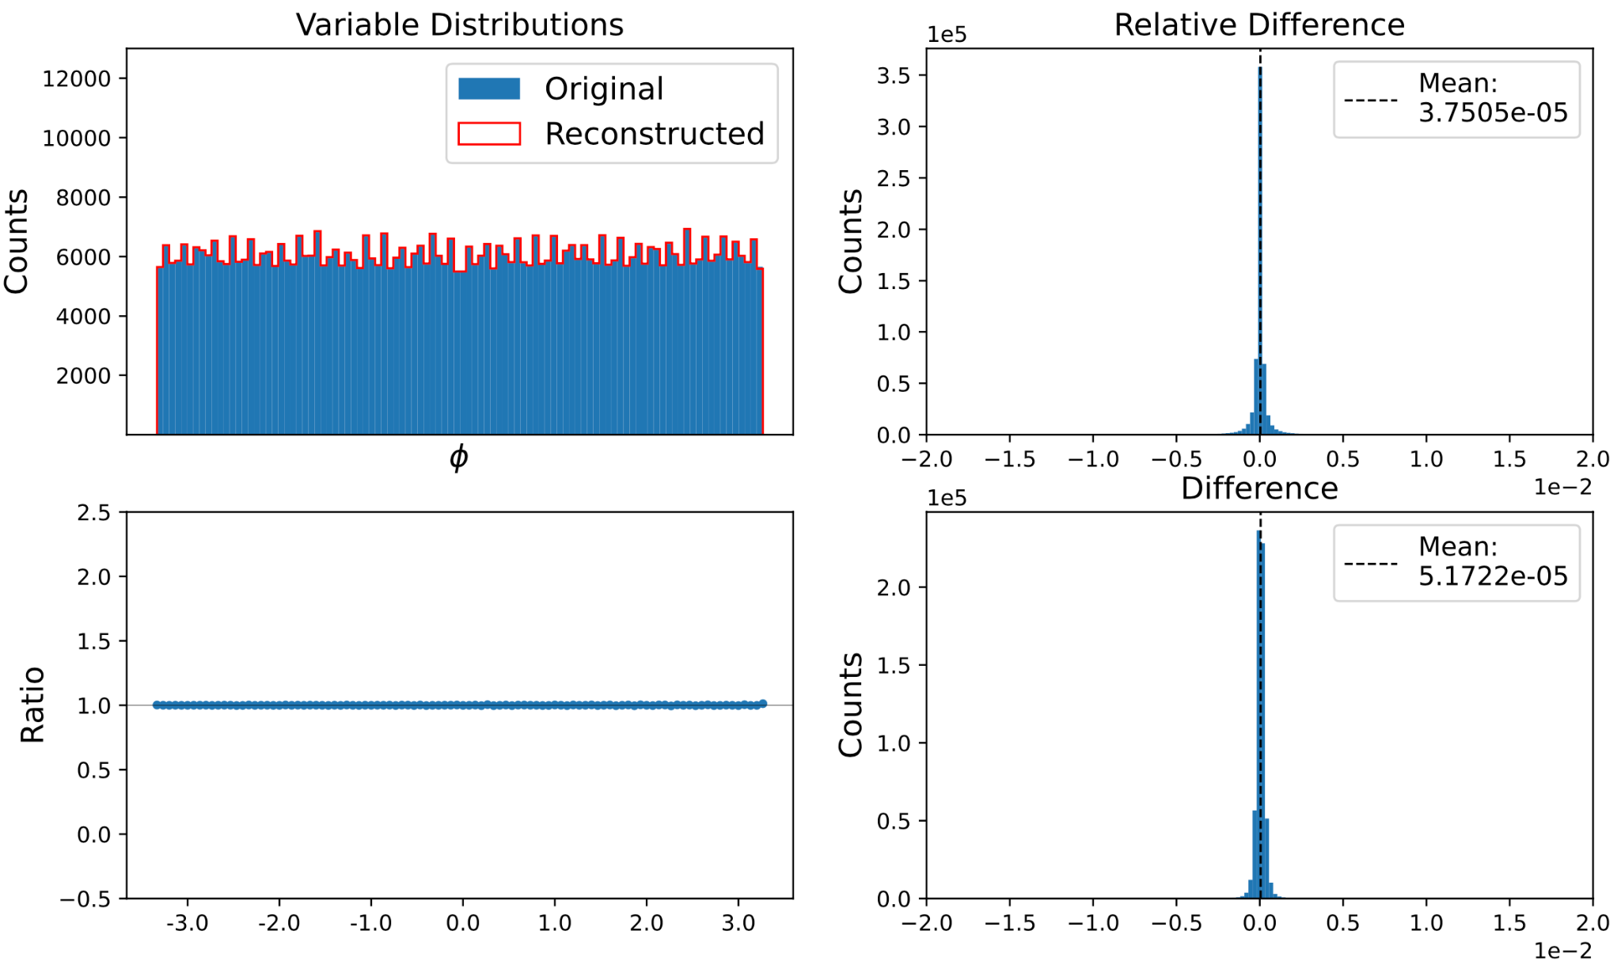
Results in HEP: Polar Angle, ɸ

Slide 16
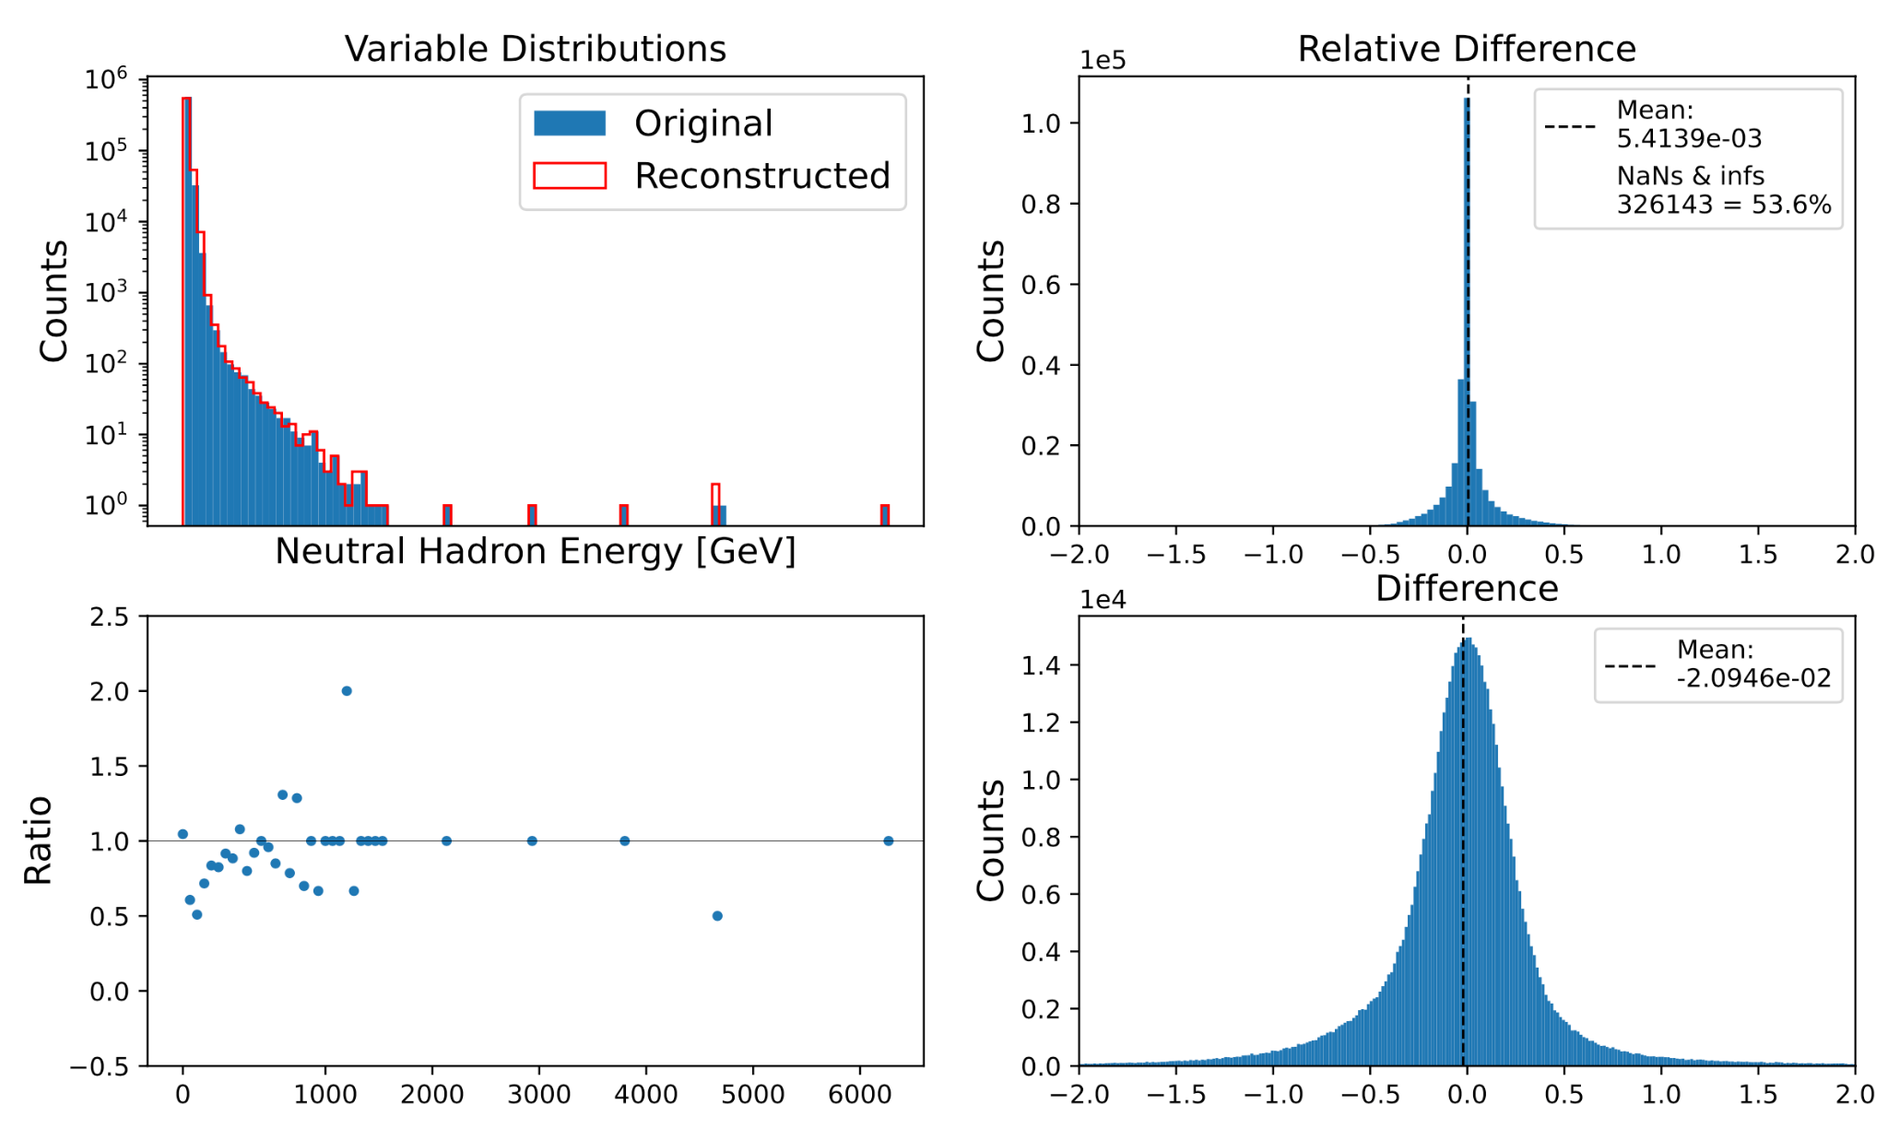
Results in HEP: Neutral Hadron Energy

Slide 17
HEP gzip dilemma
HEP
Baler -> OK reconstruction 58% original file size
gzip -> Perfect reconstruction 25% original file size
Reason for the big difference:
A lot of repeating values in HEP data is beneficial for methods like gzip
Future work:
Run on other datasets
Evaluate impact on full physics analysis
Notes:
Thank you Axel
So now we have shown you cross-disciplinary results, both in computational fluid dynamics and in particle physics
But when working with lossy compression we cannot only look at the loss in precision of our variables
We also have to actually compare the compression factor to other methods
In this case, we will compare it to gzip, which is a common loss-less compression method
Utilising Duplicate string elimination and Bit reduction

Slide 18
CFD Auxiliary file dilemma
CFD
Baler -> Good reconstruction 0.5% original file size
gzip -> Lossless reconstruction 50% original file size
Reason for the big difference:
Few repeating values in CFD data
One problem… Auxiliary files
Input CFD data size: ~1.2 MB
Decoder: ~600 MB
Future work:
Run on large 3D time series datasets
Notes:
Thank you Axel
So now we have shown you cross-disciplinary results, both in computational fluid dynamics and in particle physics
But when working with lossy compression we cannot only look at the loss in precision of our variables
We also have to actually compare the compression factor to other methods
In this case, we will compare it to gzip, which is a common loss-less compression method
Utilising Duplicate string elimination and Bit reduction

Slide 19
Summary
Open-source tool for machine learning based compression
HEP results:
Compression to 58% of input size
On average jet pT and mass differ on order of 0.2%, eta and phi 0.003%
Other 20 variables have varying performance
CFD results:
Huge compression to 0.5% of input size, small error, but large auxiliary files
Future improvements:
Try more “suitable” input files
Apply methods employed by the other 4 “major” AE-compression research groups

Slide 20
Further reading
Read our Arxiv paper: https://doi.org/10.48550/arXiv.2305.02283
Leading AE compressor: https://doi.org/10.48550/arXiv.2105.11730
Others:
https://doi.org/10.1109/TBDATA.2021.3066151
https://doi.org/10.1103/PhysRevFluids.5.114602
https://doi.org/10.48550/arXiv.2210.09262

Slide 21
The Baler Team
Big thank you from the Baler team!
For more details see: https://arxiv.org/abs/2305.02283
Try our working examples at our GitHub repository
https://github.com/baler-collaboration/baler
Marta Camps Santasmasas (UoM, CFD)
Nicole Skidmore (UoM, HEP)
Caterina Doglioni (UoM, HEP)
Pratik Jawahar (UoM, HEP)
Oliver Woolland (UoM, RSE)
Alma Orucevic-Alagic (Lund, CS)
Fritjof Bengtsson (Lund, CS)
Axel Gallén (Lund, HEP)
Alexander Ekman (Lund, HEP)
Notes:
Lastly, a big thank you from the baler team, thank you for listening
And please try our working examples at our Github repository
Before we show you the results, I just will take the opportunity to present our team of contributors
The Baler team is a mixture of students and researchers from Lund University and the University of Manchester
It is truly A cross-disciplinary collaboration, we come from particle physics, computational fluid dynamics, and computer science
And We are very keen on having more collaborators joining

Slide 22
Backup slides

Slide 23
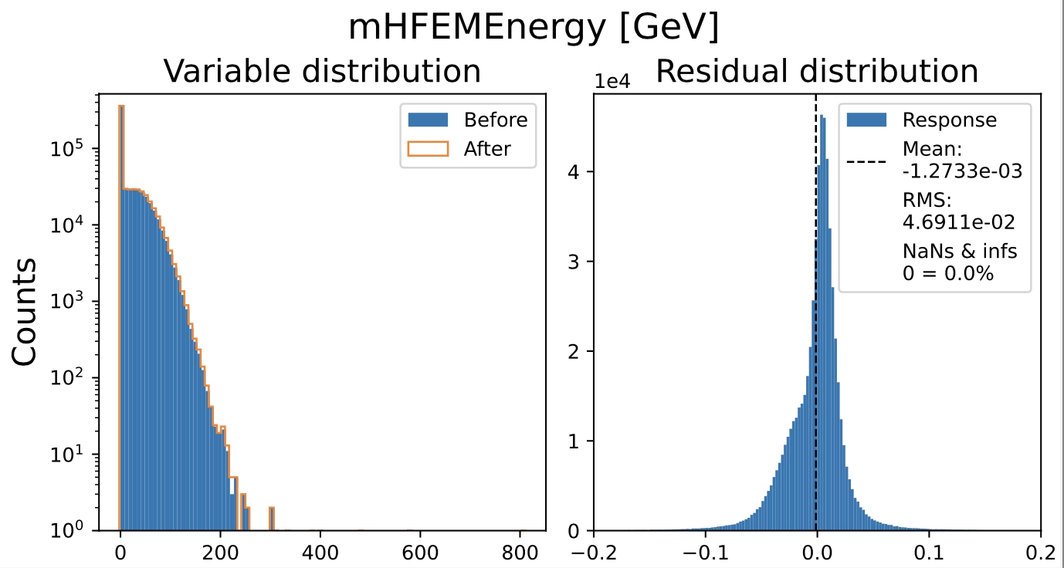
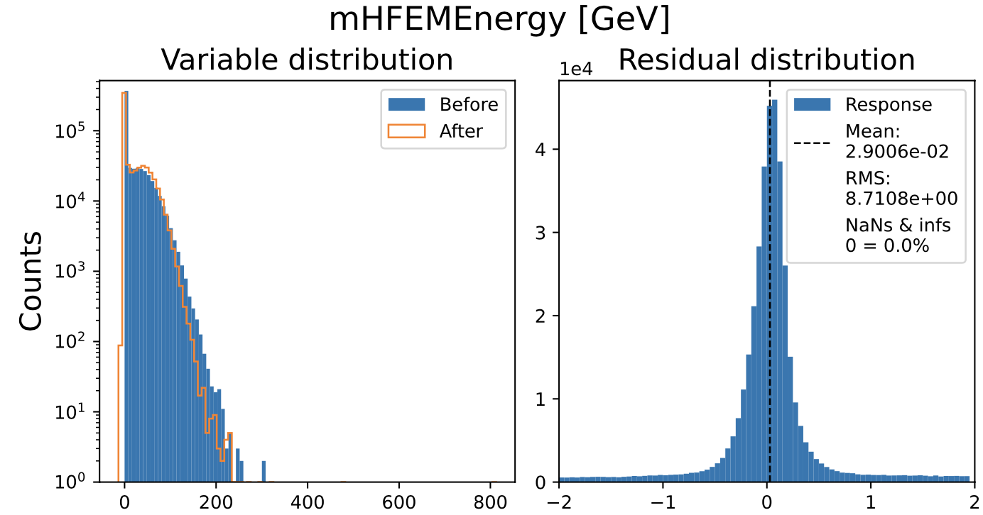
1.7x vs 6x compression
1.7x compression
6x compression

Slide 24
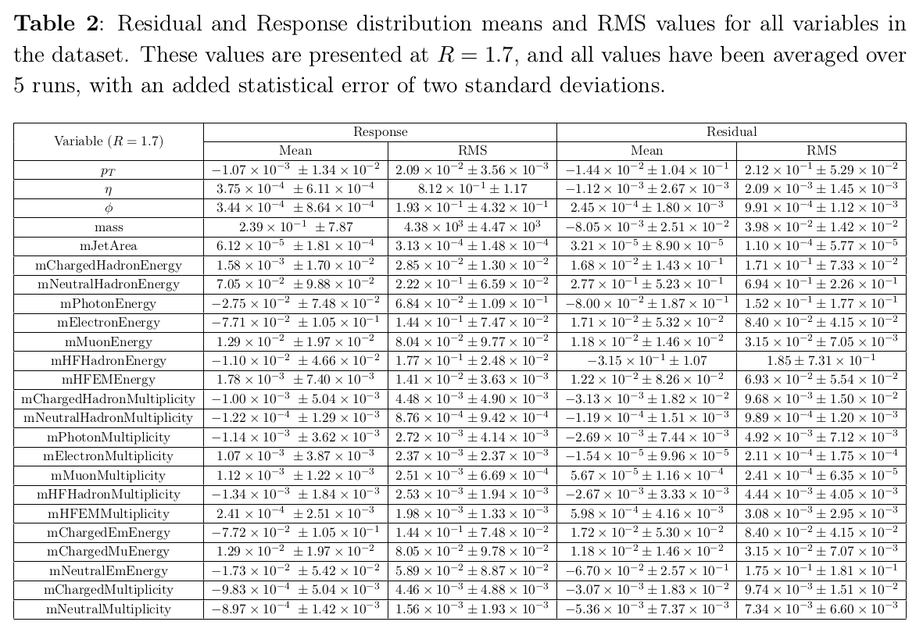
Full variable list (see https://arxiv.org/abs/2305.02283)

