Slide 1


Using ZOOM-events for Scientific Conferences:
the ICHEP2022 Experience
Conferences in Post-Pandemic Times
Lorenzo Rinaldi, Lorenzo Bellagamba, Paolo Giacomelli, Roberto Giacomelli, Stefano Zani
BOLOGNA & CNAF

Slide 2

The International Conference on High Energy Physics, ICHEP2022,
Bologna (Italy), 6-13 July 2022
https://www.ichep2022.it
ICHEP is the largest and most important conference in HEP
ICHEP 2022 first big HEP conference post-pandemic
→ fully hybrid (in-presence and online participation)
ZOOM-events platform for online connection,
broadcasting and video-recordings

Slide 3
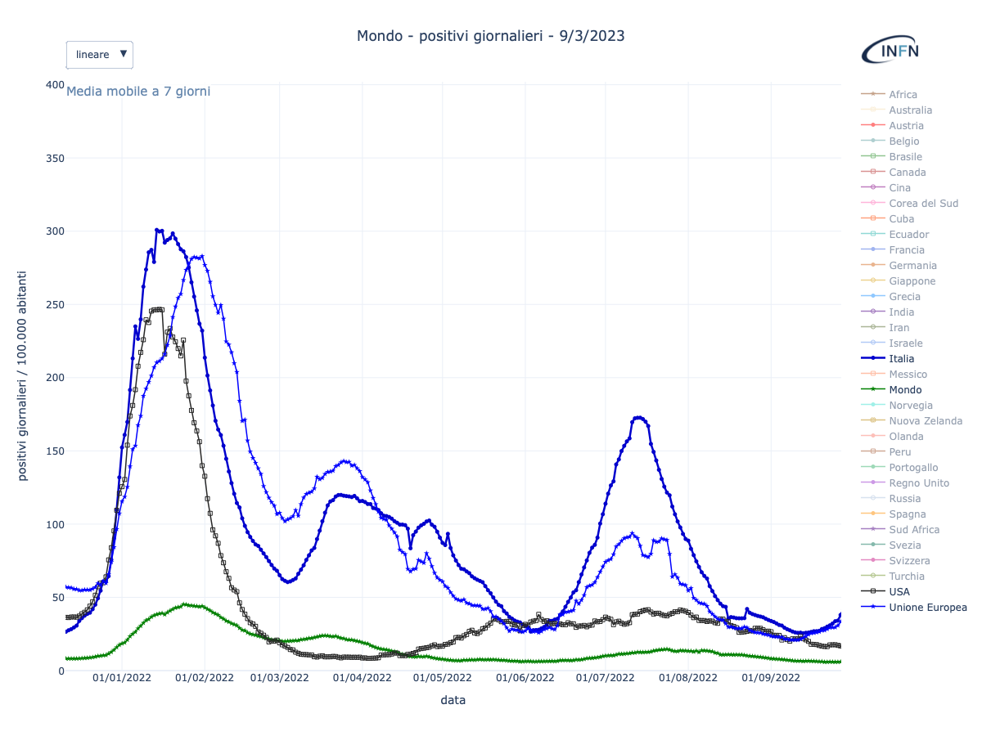
2022 pandemic timeline
Number of daily cases/100k inhabitants
(7-days average)
Dec. 2021: high Omicron.1 peak
first contacts with ZOOM
Italy
Europe
USA
World
March-May 2022:
Omicron.2 peak
Mid-March 2022: decision for the fully hybrid conference
June 2022:
Contract with ZOOM-Events
July 2022: a new infection peak…
Covid Data: https://covid19.infn.it

Slide 4
2022 pandemic timeline
Luckily a relatively small number of hospitalizations and deaths (thanks to large-scale vaccination and immunization) but…
Number of daily cases/100k inhabitants
(7-days average)
At that time, still restrictions for infected:
no travel
isolation/quarantine
Italy
Europe
USA
World
Covid Data: https://covid19.infn.it

Slide 5
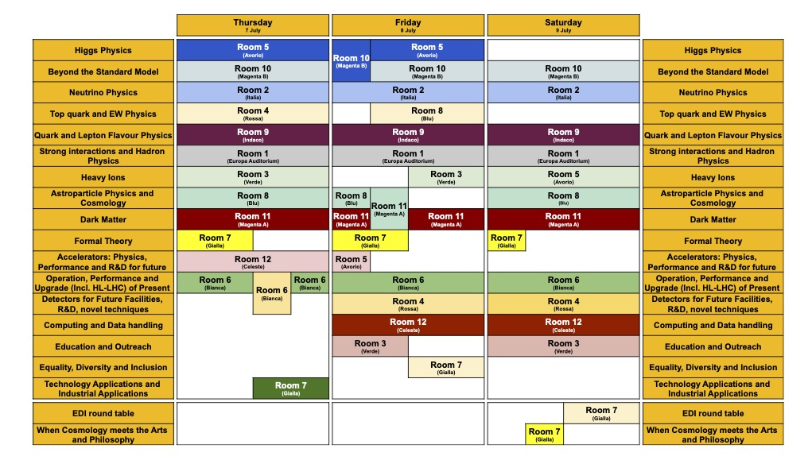
Conference timetable
Days 1 – 2 – 3 (7th – 9th July)
17 parallel sessions + 2 special events
12 rooms for parallel at every given time
Day 4 (Sunday 9th July)
Excursion and satellite meetings
Days 5 – 6 – 7 (11th – 12th July)
Plenary sessions (in the main Auditorium)
+ poster, sponsor, lunch and coffee break areas…

Slide 6


Zoom-Events layout
Session 1
(parallel session)
Session 2
(parallel session)
Conference Lobby
  Main view
  Calendar view
  Speakers
Session 3
(plenary session)
Event registration and ticket management
(at first access only)
Sign-in panel (username+pwd or SSO or other)
Session N
(…)
Sponsor gallery
Zoom-events INFN license
Cost: 5500 € for 6 months
Event duration: 6 days
Max 12 parallel sessions
Working with ZOOM-app or WEB
Sessions have the ZOOM views we use every day!

Slide 7
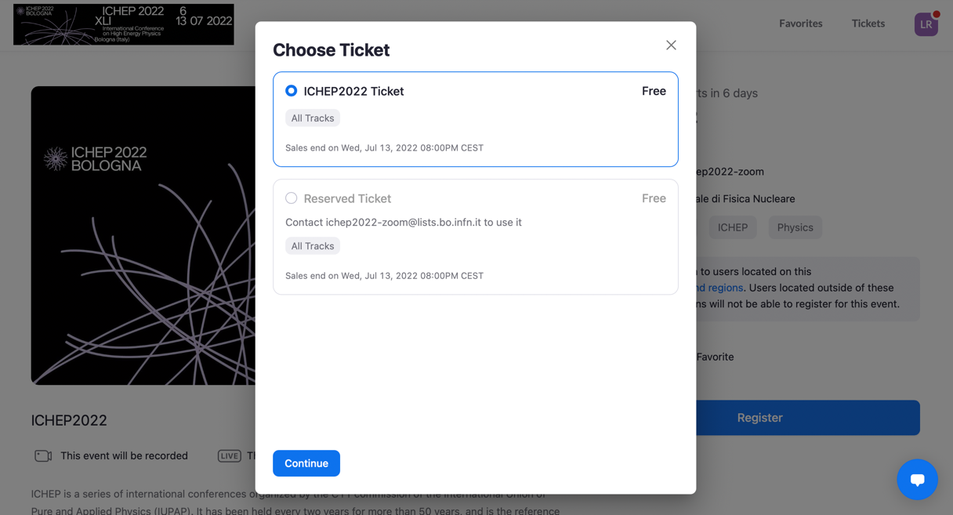
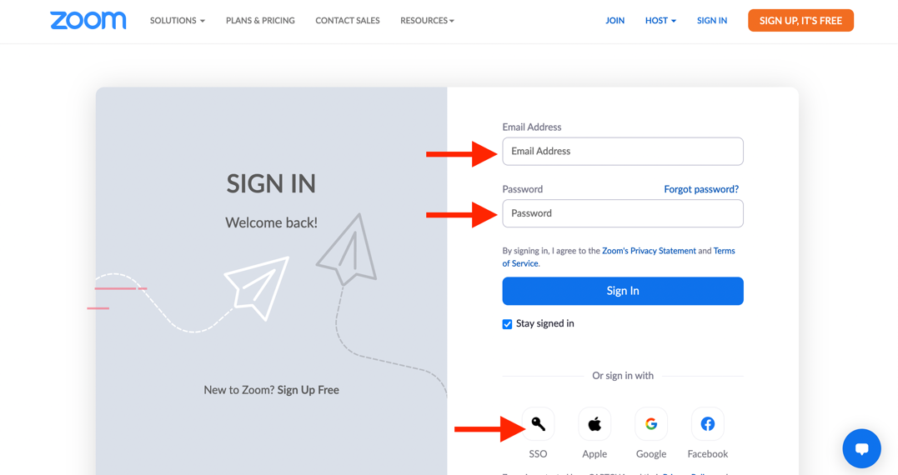
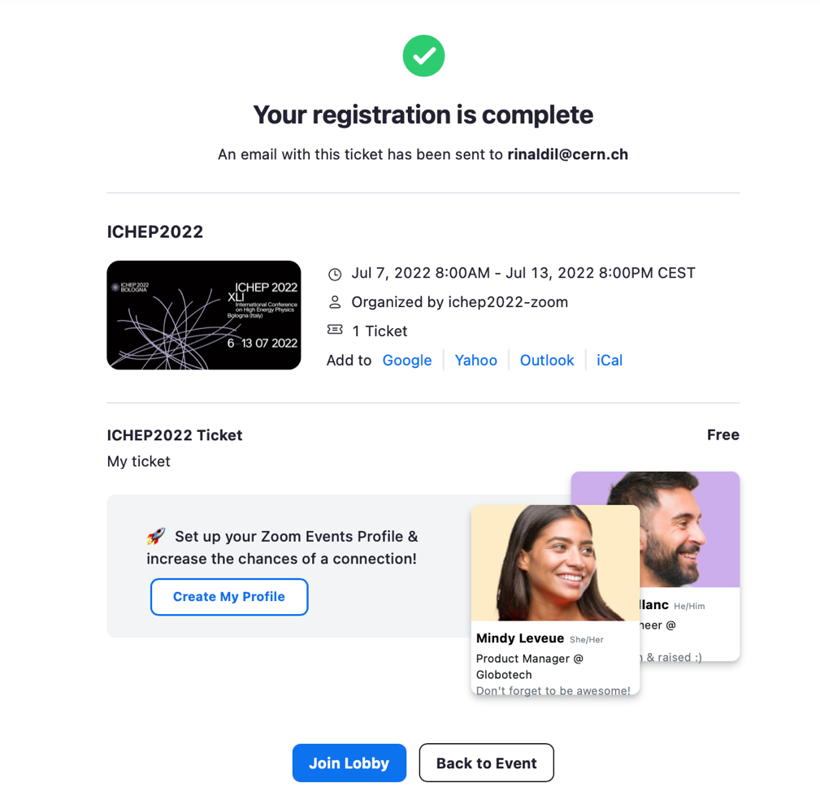
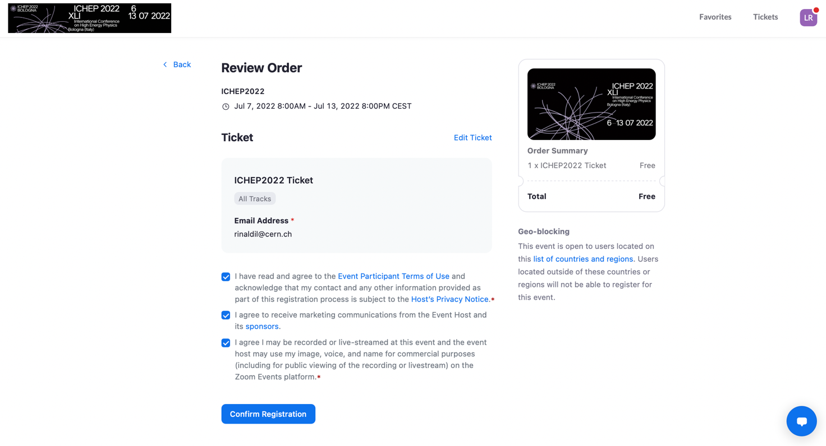
Event registration and ticket management
Registration and tickets
Sign-in panel

Slide 8
Event registration
Access was restricted to conference participants only (CSV with the list of emails)
All participants received an invitation by email and detailed instructions for signing in
Sign-in panel
The problem:
Conference registration with INFN-INDICO account (email)
In many cases, INDICO and ZOOM credentials DID NOT match (also CERN username-email mismatch)
In that cases, it was asked to participants to communicate their usual ZOOM account to be added to the access list
That was hard work!
(more than 600 emails promptly handled in one week…)
Maybe a ZOOM/INDICO authentication integration would have helped a lot! (ZOOM devs notified)

Slide 9
Ticket management
Conference Fee | Regular (half price for students)
Early registration | 500 €
Late registration | 600 €
On site registration | 700 €
Online participation | 200 €
ZOOM-events ticket: FREE for all registered participants
Several attendees registered or changed their plans at the last minute (or even during the conference…): fee difference refunded
Periodical check of accesses (if attendees did actually pay!)
Daily, ~50 free RESERVED tickets for special/problematic cases
NO geo-blocking (remote connection from everywhere)

Slide 10
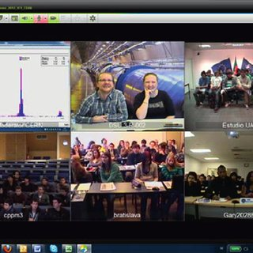
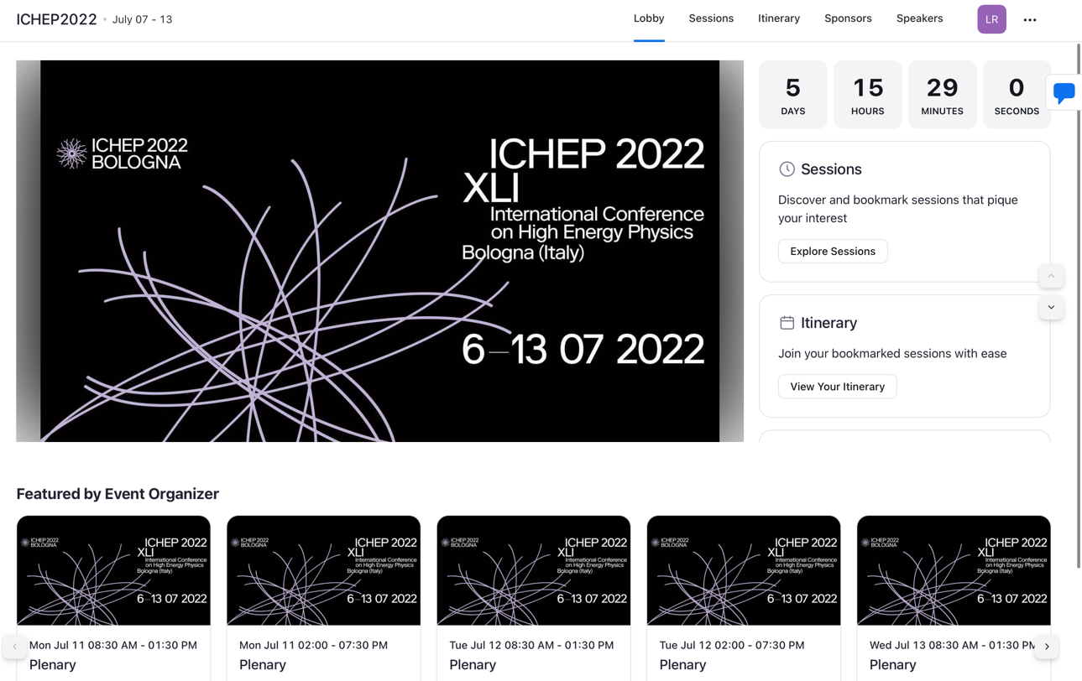
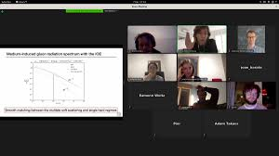
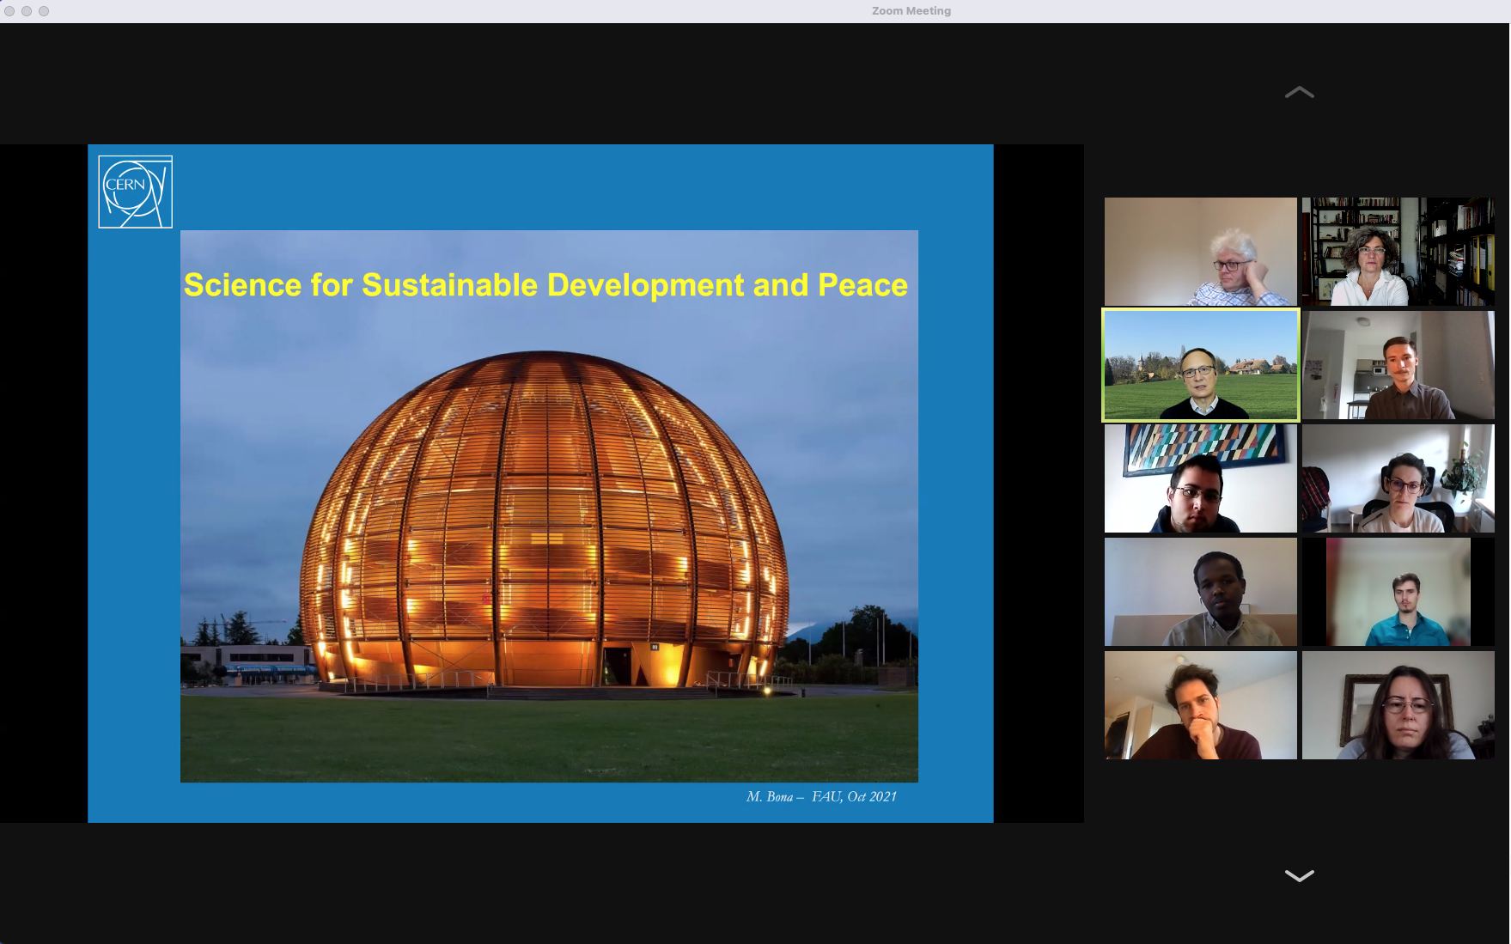
The Lobby and the Sessions
Higgs Physics
Conference Lobby
Neutrino Physics
Plenary

Slide 11
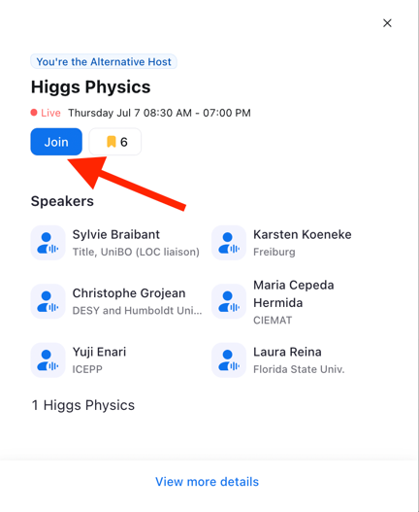
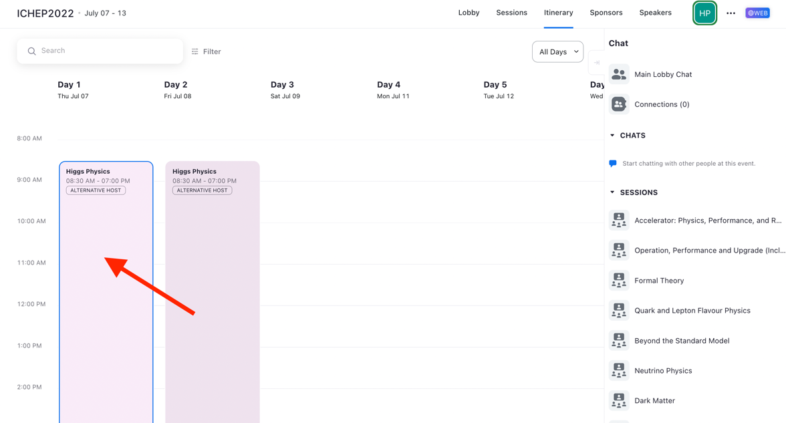
The Lobby and the Sessions
Conference Lobby
(calendar view)
Higgs Physics

Slide 12
Parallel sessions configuration
A dedicated ZOOM-events session was created for each active parallel session in a given time window
Common account (ichep2022_XX) created for ZOOM session management (i.e. session start→delicate operation)
ZOOM-speaker role assigned to the parallel session convenors and to the common account. Convenors did know the credentials to access and manage their rooms
(instruction check-list provided to convs)
All other participants entered the sessions with muted microphone and camera off
Convenors invited remote speakers to unmute, slide shows driven by the convenors from real rooms

Slide 13
Plenary sessions configuration
Plenary sessions
Dedicated ZOOM-events sessions were created for the 6 plenary sessions (morning-afternoon of 11th – 12th July)
Common account created for ZOOM session management (ichep2022_00).
Plenary configured in broadcast modality (no possibility for connected people to use the microphone, possibility to write questions on the chat
Speaker role granted to remote speakers

Slide 14
Survey
More than 500 attendees answered the survey distributed soon after the conference
In general very positive feedback (here reported answers on online participation)

Slide 15
Outlook and conclusions
ICHEP2022 conference was held in Bologna (in presence) with the possibility of remote attendance with the ZOOM-events platform
Due to the covid19 pandemic trend, several in-presence participants switched to on-line modality (last minute!)
Intense amount of work for configuring and managing the ZOOM-events platform and for user support
Excellent performance of the online participation, very high satisfaction level from participants

Slide 16

Thank you!
lorenzo.rinaldi@unibo.it

Slide 17
backup

Slide 18
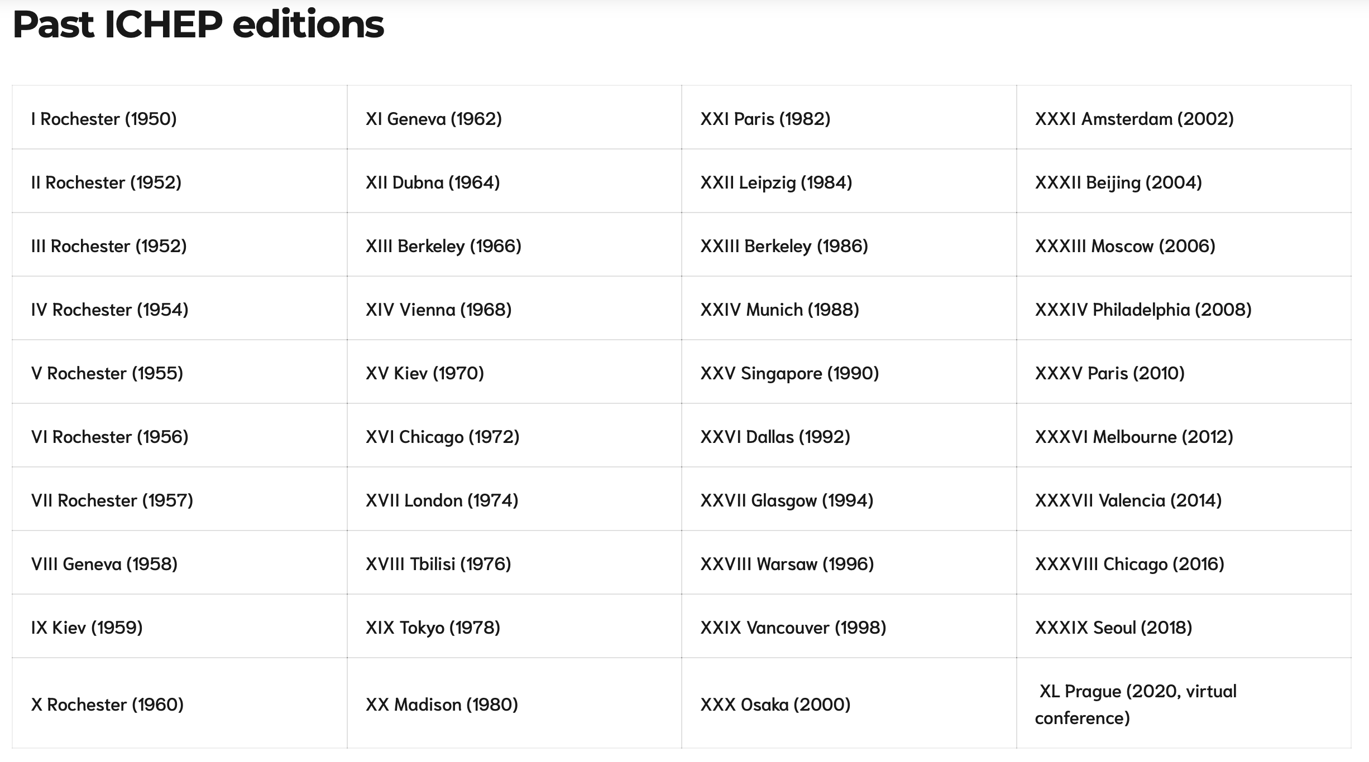
Past ICHEP editions

Slide 19
Parallel sessions

Slide 20
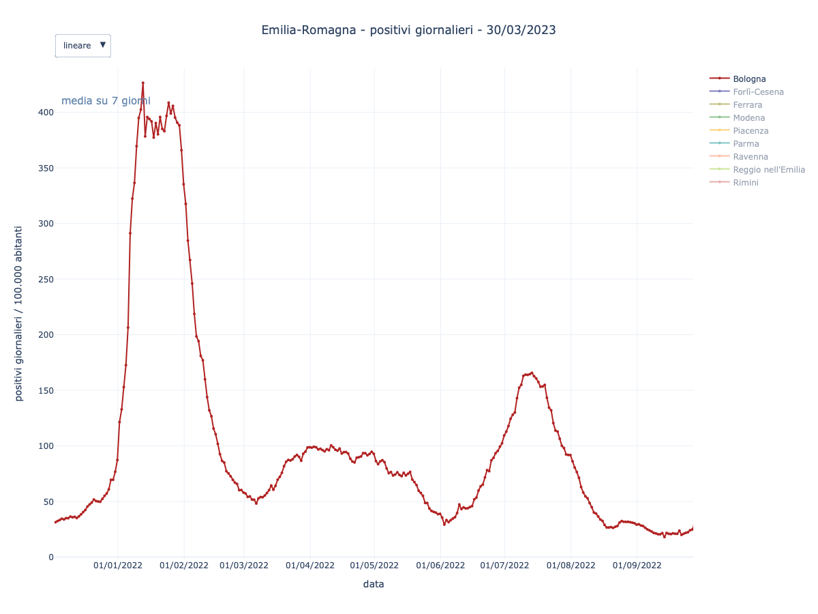
2022 Pandemics trend: around the world and in Bologna

Slide 21
TER

