Slide 1
XAS Curve Match Application based on Larch
JIANLI LIU
Institute of High Energy Physics, CAS
9-May-2023

Slide 2
Contents
Introduction to XAS
XASCurveMatch Application
PCA/LCF Application
Summary and Further Plans

Slide 3
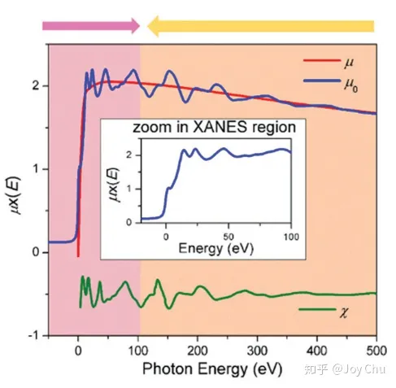
What is XAS
X-ray Absorption Spectroscopy(XAS) is a technique that involves scanning selected materials with specific X-ray photon energy. When atoms absorb energy and undergo scattering, a series of oscillating structures emerge.
XAS curves consist of absorbing edge(Red) and oscillating structures(Green), which contains rich structure information of the material.
Absorption edge(e0) is related to specific atoms present in the material.
What can we do with XAS?
Quickly evaluate the quality of an experiment.
Quickly obtain analysis results and plan experiments.
Assist users in detailed data analysis.
XAS is an effective method for material structure analysis.
The purpose of XAS curve matching is to compare unknown samples with the known standard samples in the database, so as to determine the composition and structural information of the unknown samples.

Slide 4
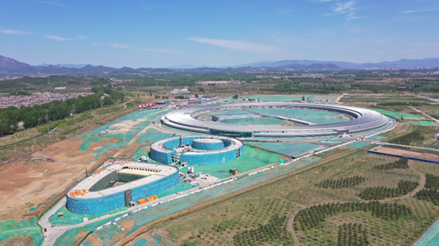
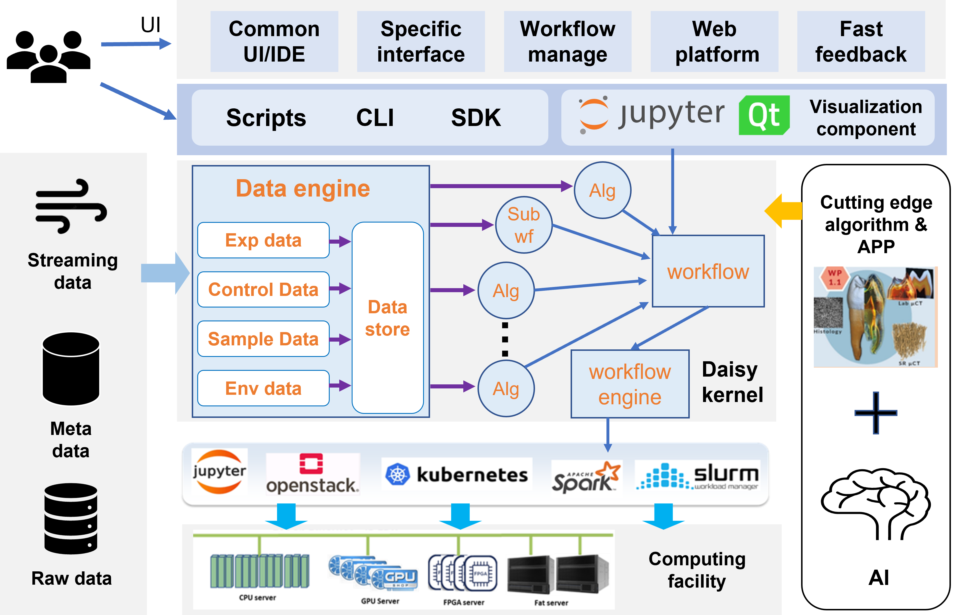
The
The Research Background
HEPS(High Energy Photon Source)
Daisy(Data analysis integrated software system)
The High energy synchrotron radiation photon source (HEPS), a fourth generation photon source device currently under construction, is located in Huairou, Beijing. It is expected to begin trial operation in 2025.
The Daisy software framework supporting HEPS provides a rich interface and hardware and software resources support, which can efficiently provide an algorithm integration environment for users.

Slide 5
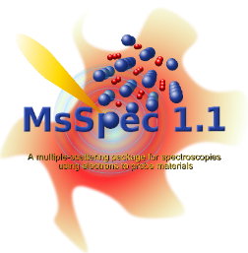
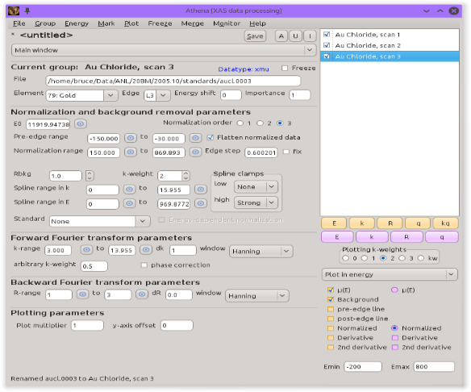
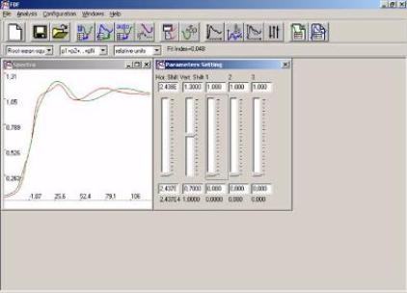
The
The analysis software for XAS
WinXAS(Online)
Athena(Online)
HEPS: Massive real-time data
Users: Simple, customized and automatic operation, batch execution
pyfitit
Challenges:
Inability to stay online continuously;
Lack of batch data processing and automation capabilities;
Inability to customize optimization based on line stations and user needs;
Current XAS (online/offline) data processing software cannot be integrated into the Daisy computing framework of HEPS.
Offline

Slide 6
Framework
User Interaction
Larch
(xraylarch, Larch is a open-source library and set of applications for processing and analyzing X-ray absorption )
UI
Database
normalization;
pca train, pca fit;
lcf fit;
Experimental
database
e0 judgment
Locally built
XASCurveMatch
PCA/LCF
Match
The Materials Project
Interfaces
The Materials Project is an open-access database offering thousands of materials and dozens of properties. (both real and hypothetical）
Daisy
(Provide rich interfaces and software and hardware resources, such as memory, high-speed I/O, GPU, CPU, etc)
Notes:
Larch is a open-source library and set of applications for processing and analyzing X-ray absorption and fluorescence spectroscopy data and X-ray fluorescence and diffraction image data from synchrotron beamlines.

Slide 7
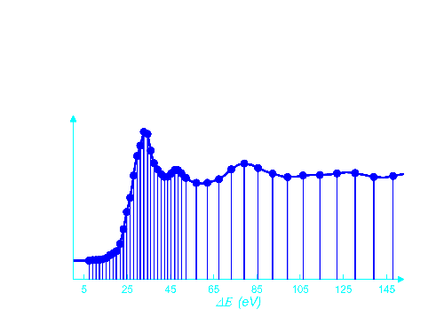
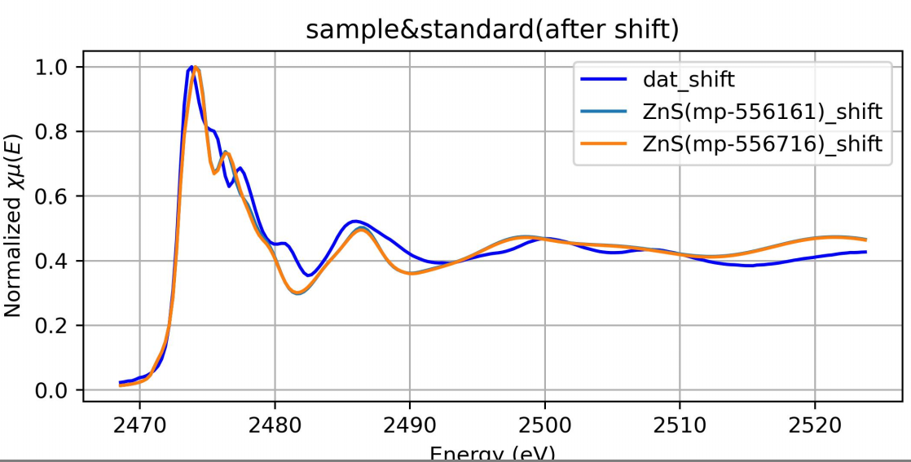
XASCurveMatch-daisy
Functions: It provide the spectral lines in the database which are most similar to the input spectral lines.
Absorption spectrum matching technology route
Real time data input
Matching data acquisition
Spectrum matching
Results save and display
Determine absorption atoms by e0
Energy shift processing
Select a database to obtain data(local or mp)
Energy grid point selection
Select overlapping areas
(range of energy)
Matching algorithm selection

Slide 8
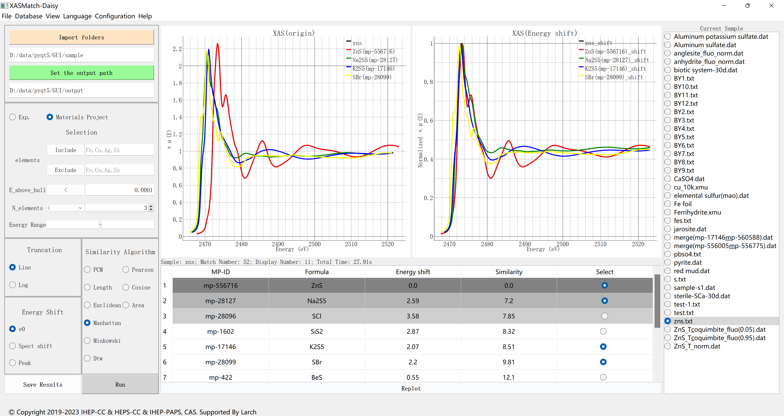
XASCurveMatch-UI
Quick matching of experimental spectra in the database.
Results display
Sample selection
Input
Filters
Algorithm selection

Slide 9
XASCurveMatch-daisy
Quick matching of experimental spectra in the database.
Advantages
Multiple matching algorithms: PCM, Cosine, Area, Length, etc.
Batch data processing;
Energy shift processing: E0、Peak、Spectrum shift(6%);
Energy grid point selection: line, log;
Provide matching time and performance ranking;
Database filtering: elements(in and out), number of elements, energy range, Structural stability(e_above_hull)
Database
Experimental database: Iron(Fe), Sulfur(S) and Phosphorus(P) included now, produced from ESRF; (Future)
Materials Project: All elements filterable.
url: https://api.materialsproject.org/

Slide 10
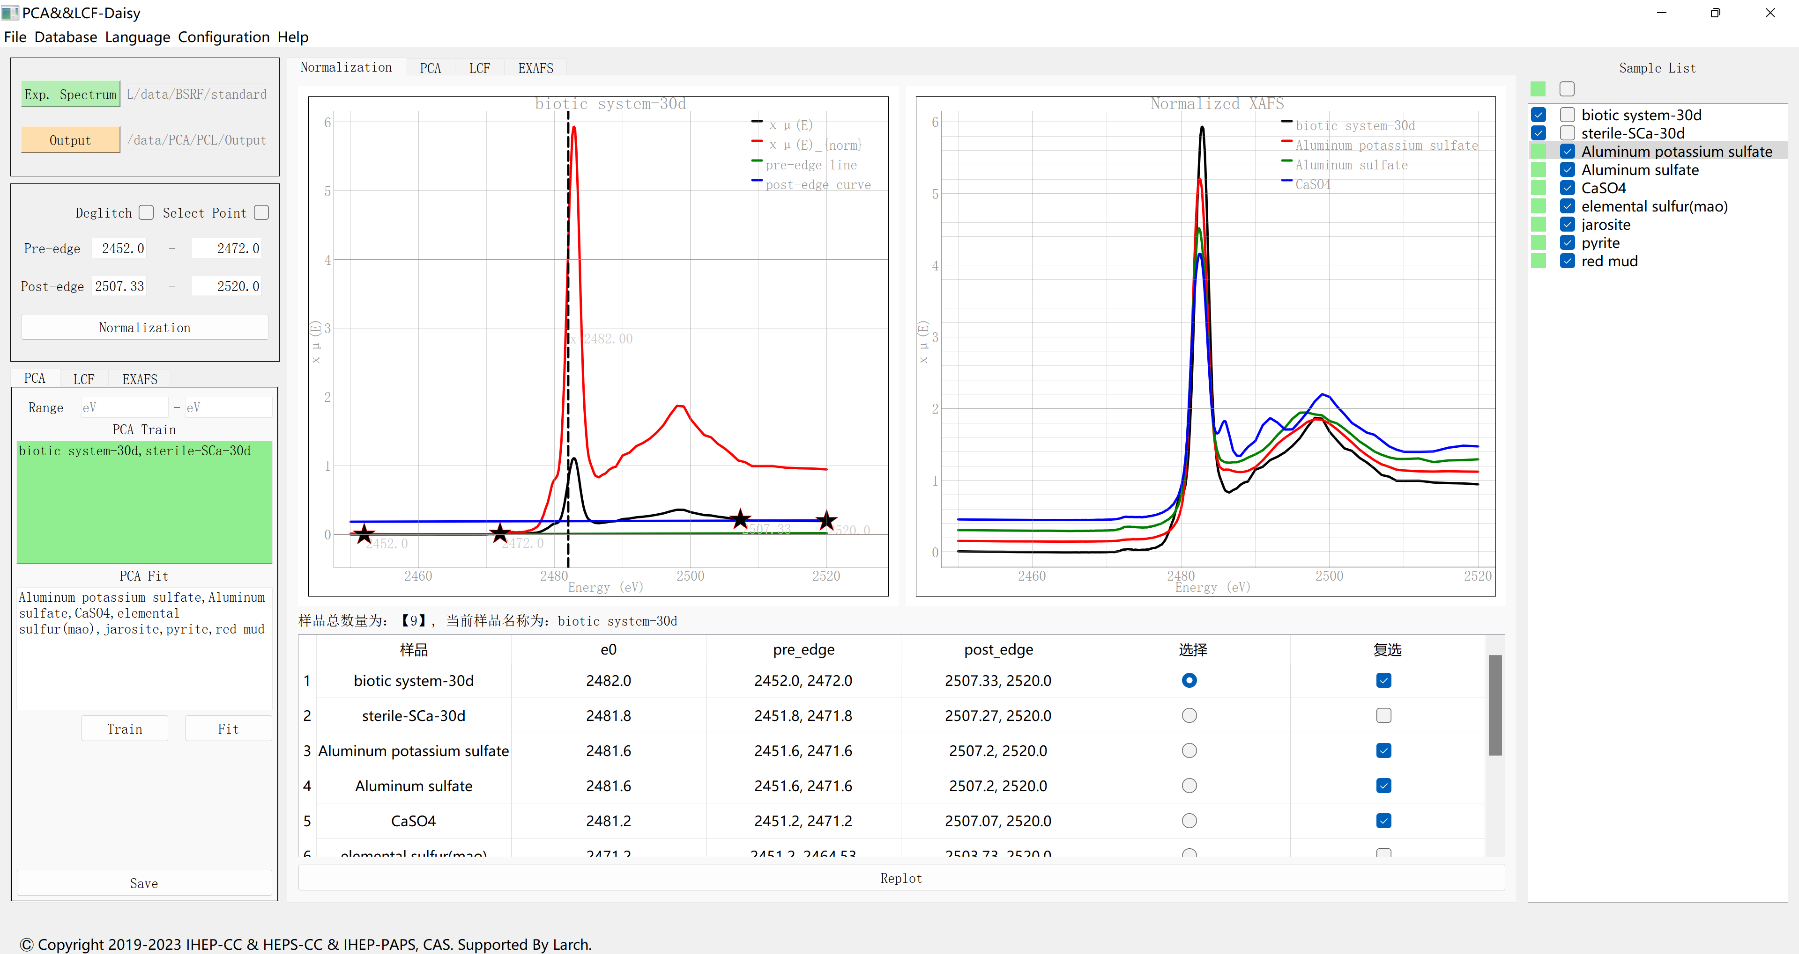
PCA/LCF-UI
Functions: XAS basic processing; Principal component analysis(PCA); Linear component fitting(LCF);
Component analysis suitable for identifying phase transitions in catalytic and battery reactions.
Results display
Sample selection
Input
Normalization
PCA、LCF、EXAFS
Data selection area

Slide 11
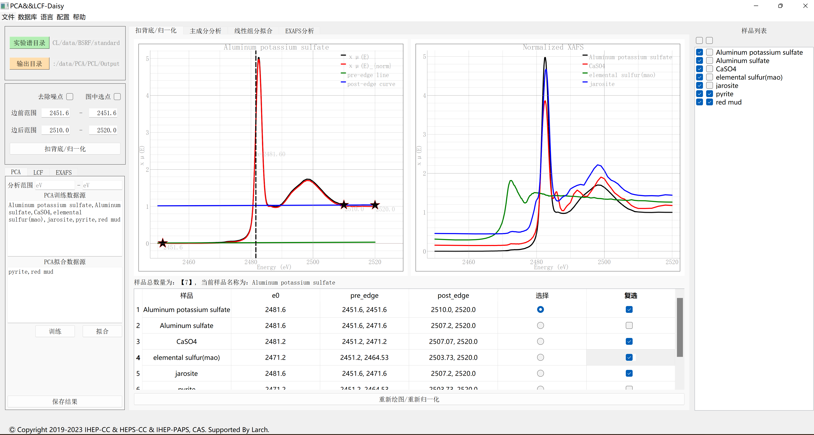
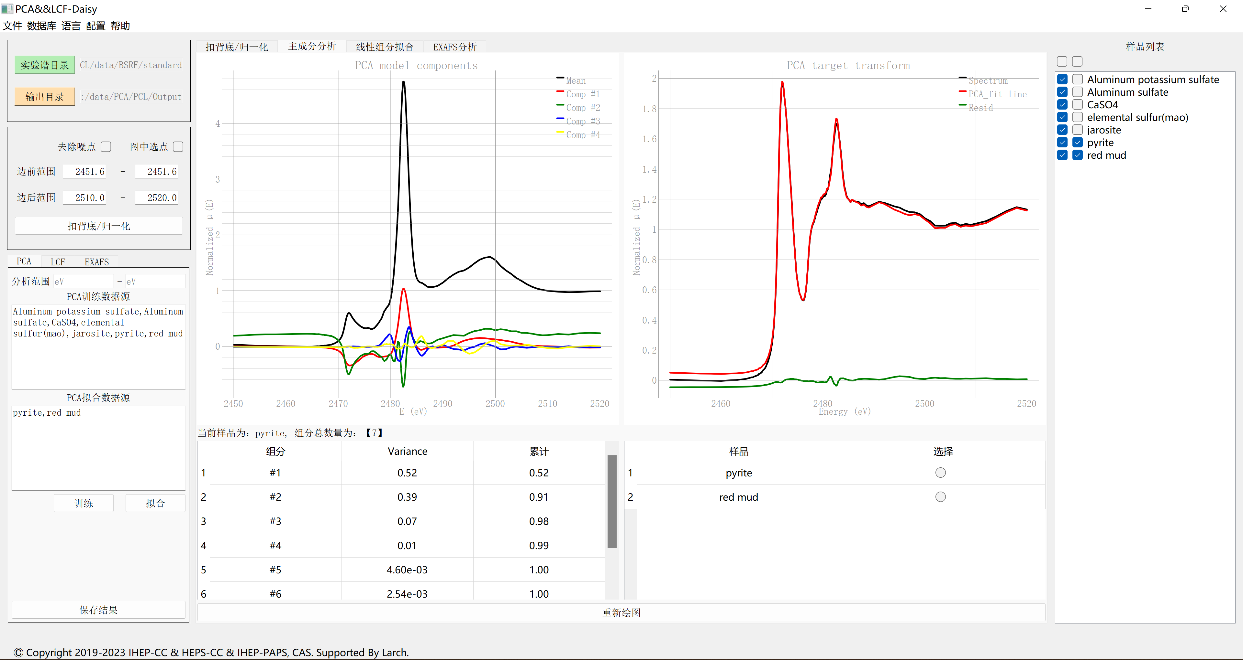
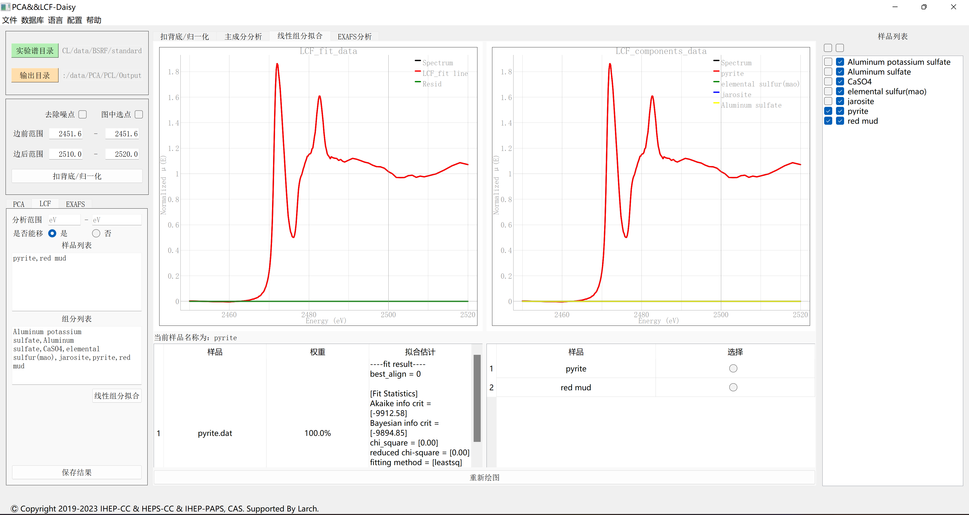
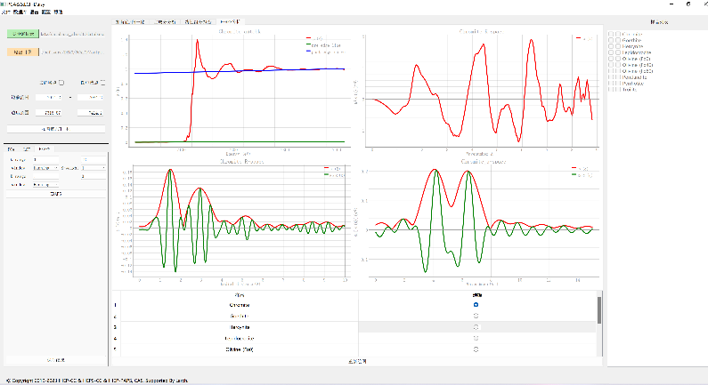
PCA/LCF-Functions
XAS basic processing, include Normalization, e0 location, Fourier transform, etc.
Principal component analysis (PCA)；
Linear component fitting (LCF)；
EXAFS exception handling.
①
②
Advantages
Automated operation;
PCA: Free selection of samples for training and fitting;
LCF: Free selection of samples and standards;
User-friendly interface simplifies operations
Multiple ways to save and export results
Batch data processing is possible;
Running status saving;(Future)
③
④

Slide 12
Summary and Future plans
Summary
Few XAS data processing software meet all needs of experimental stations and users, leading to the need for independent development;
XASCurveMatch and PCA/LCF for general XAS data processing have been developed and tested online；
XASMatch and PCA/LCF have been integrated and tested with the Daisy software framework for online data processing at HEPS-XAS line station.
Future plans
Iteratively construct a comprehensive database with standardized experimental spectra and continuously improve it by attracting user participation;
After the completion of HEPS, enable real-time data access, analysis, and spectral line matching;
Integrate additional XAS data processing algorithms based on Daisy.

Slide 13
Download our APP for windows
XASCurveMatch
PCA/LCF
Email: <liujianli@ihep.ac.cn> or <yaohd@ihep.ac.cn>

Slide 14
Thanks!
Tips:
How to determine e0? <https://bruceravel.github.io/demeter/documents/Athena/params/e0.html?highlight=edge>;
What is daisy? <You can check my colleague Hu Yu's report: Scientific application development based on the Daisy>;
What is The Materials Project? <https://materialsproject.org/>
What is HEPS? <http://english.ihep.cas.cn/heps/index.html>
Thanks for my colleagues : Haifeng Zhao, Haodong Yao, Yu Hu, Haokai Sun, Lei Wang, Shiyuan Fu.

