Slide 1
The role of strategy and evaluation in delivering effective and innovative public engagement
Ian Collier, Greg Corbett, Phill Day, Sophy Palmer
UK Research & Innovation, Science and Technology Facilities Council, Rutherford Appleton Laboratory
CHEP2023, Norfolk, VA, May 11th, 2023

Slide 2
Who am I?
Group Leader
UKRI/STFC’s Scientific Computing Department (SCD) at RAL
Work focusses on enabling computing federations
System administration background
Actively involved in PE since I joined STFC 14 years ago
Chair departmental Public Engagement Committee
Supported by National Labs PE team

Slide 3
Some Context
This talk somewhat follows on from Greg Corbett’s talk in Adelaide
https://indico.cern.ch/event/773049/contributions/3478368/
Also see Greg’s poster, “A return to in-person public engagement at STFC”, this afternoon
https://indico.jlab.org/event/459/contributions/11712/
I’ll try not to repeat too much

Slide 4
STFC’s National Labs PE
Our Vision
A society that values and participates in scientific endeavour.
Our Mission
Using our stories, community and facilities to inspire and involve people with our science and technology.

Slide 5
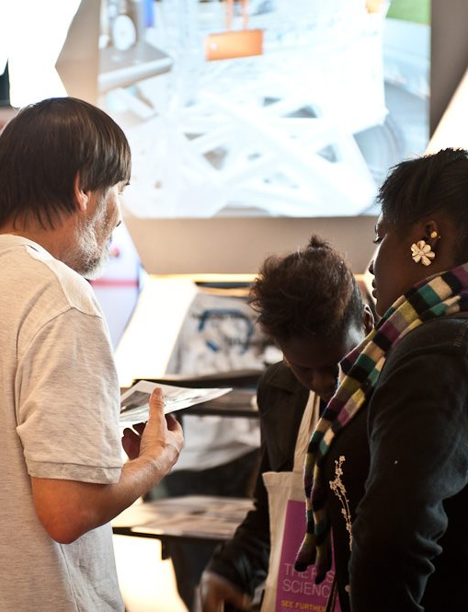
Our aims
1 Showcase STFC science and technology
Using our facilities, stories and community to inspire
2 Build the right partnerships
Improving our reach and impact
3 Develop and support STEM influencers
Creating a network of people passionate about STEM
4 Improving our reach with diverse audiences
A focus on Wonder communities – the 40% most deprived areas of the UK
5 Delivering high quality activities
Making an impact on our audiences

Slide 6
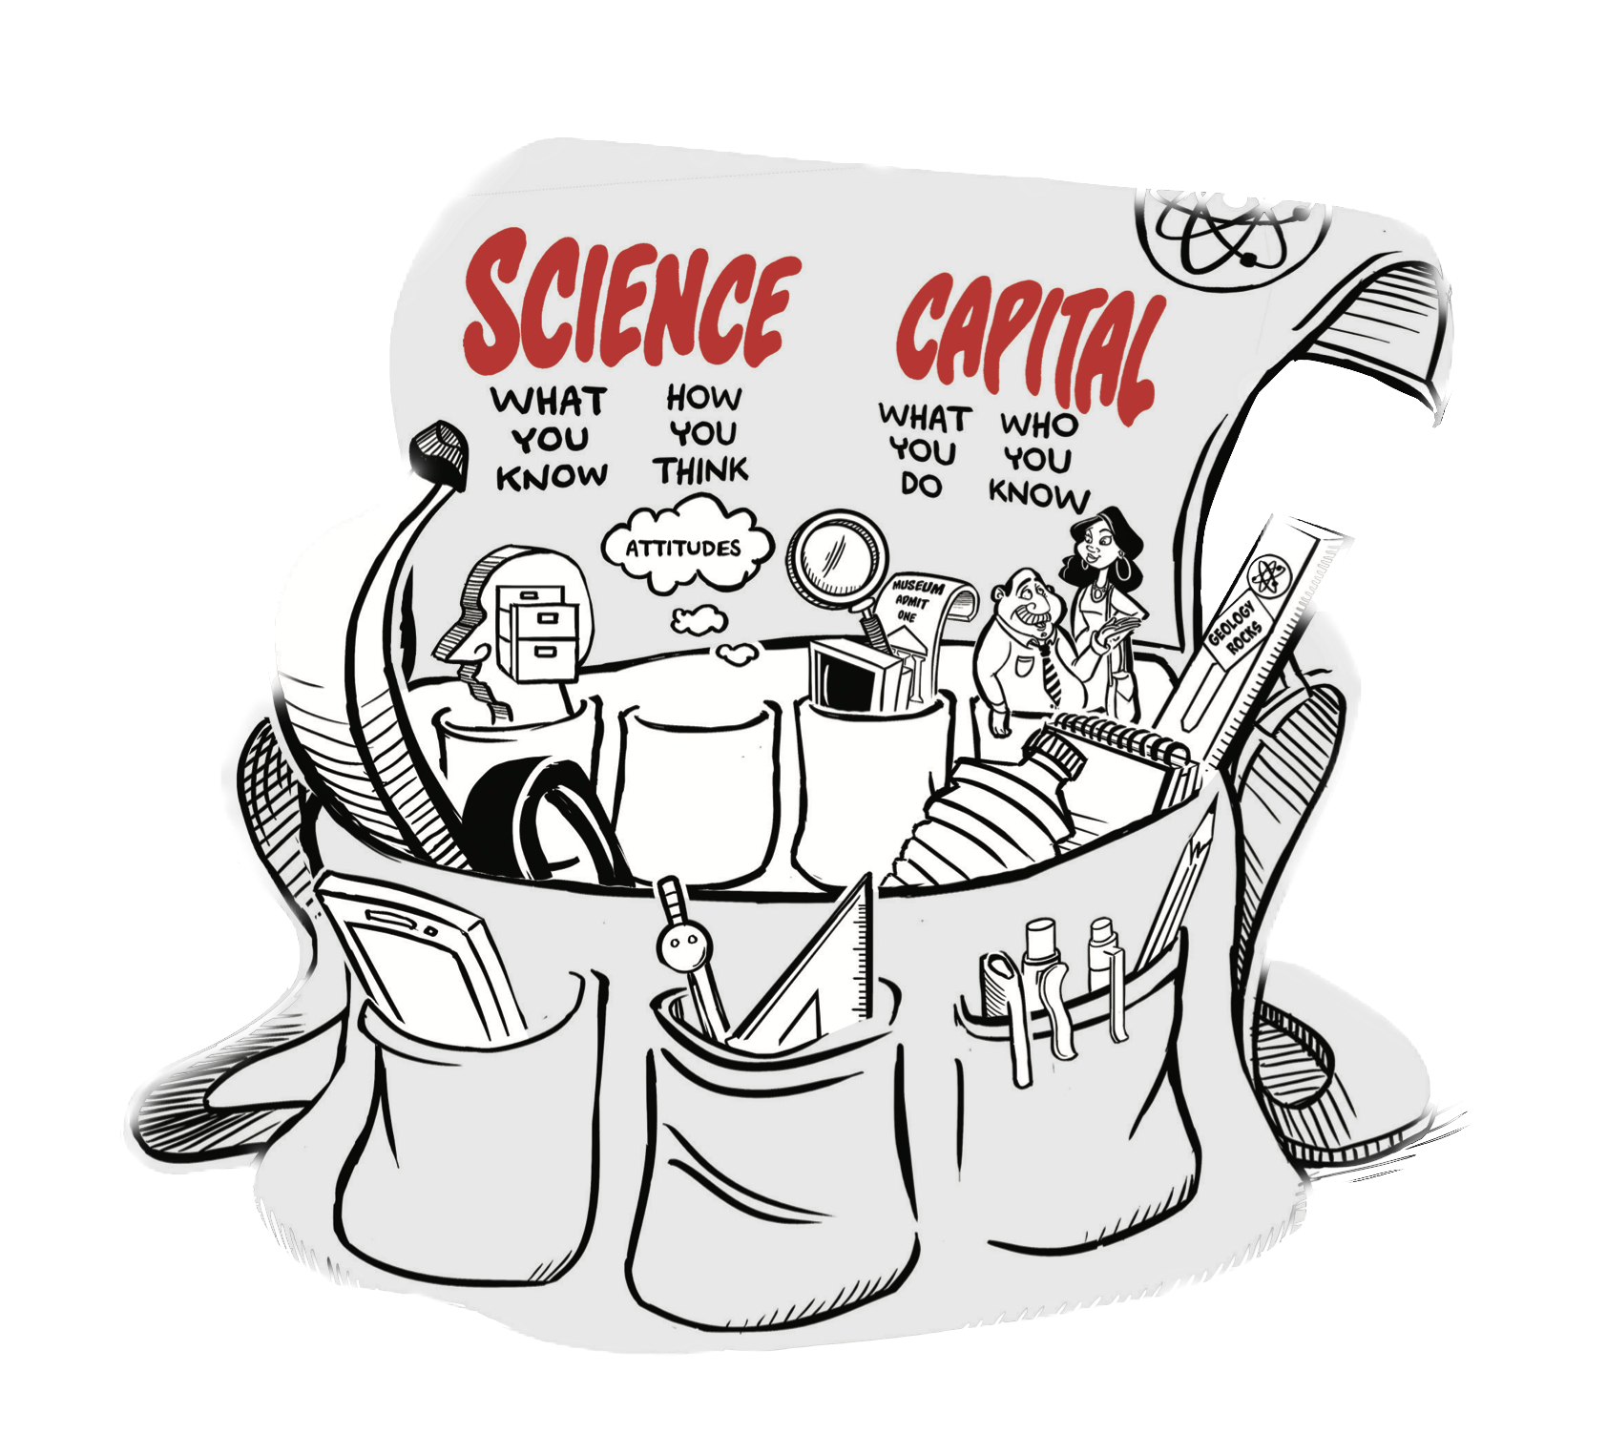
Science Capital
Concept that helps us understand why some young people participate in post-16 science and others do not.
Helps shed light on why particular social groups remain under- represented and why many young people do not see science careers as being ‘for me’.
We’re choosing to prioritise activities that do the most to increase science capital and working with communities who have lower science capital
Find out more from the STEM Learning Centre https://www.stem.org.uk

Slide 7
Public Engagement Wonder Initiative
One part of the 2016-2021 strategy was to better target our efforts
Science and technology can inspire (and should involve) people from all backgrounds.
But we know that the playing field isn’t level.
STFC’s Wonder Initiative focuses on working with participants from the 40% most socio-economically deprived areas of the UK.
Within this group, we target 8 to14 year-olds
Research shows that low science capital at this age shapes a young person’s outlook and could dissuade them from a career in science, technology, engineering or maths (STEM).

Slide 8
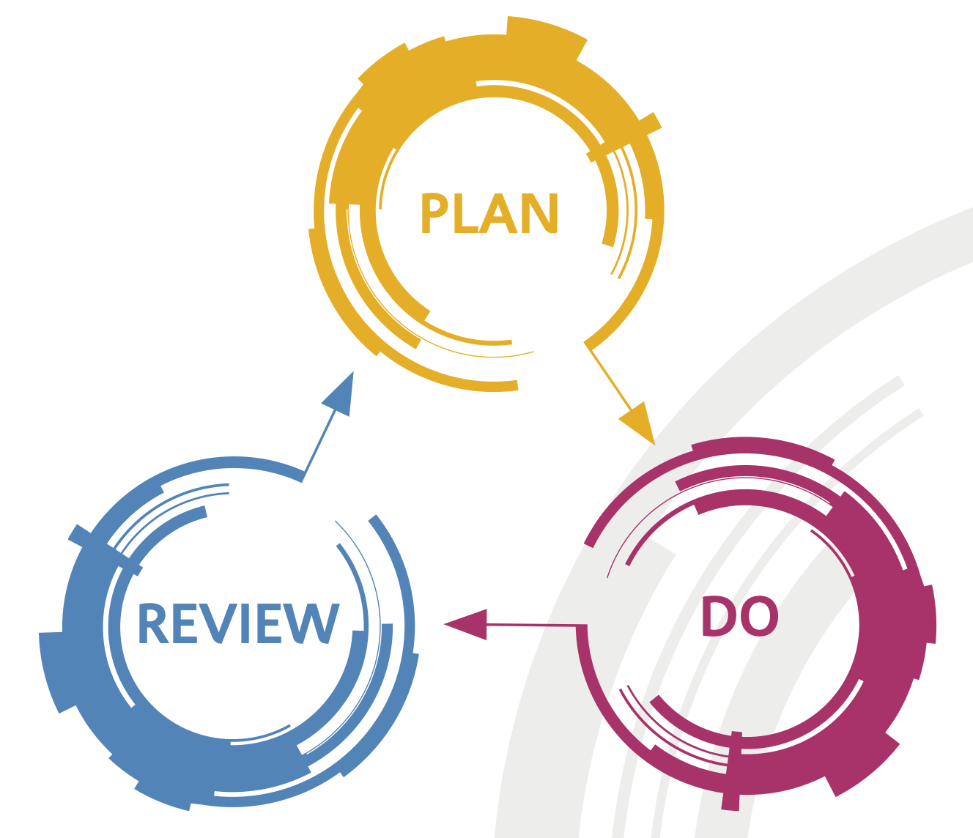
How do we know what we’re achieving?
Public Engagement Evaluation Framework
Applied ‘generic learning outcomes’ (GLOs) tailored to STFC’s purposes
Specifying what we intend the activity to achieve
Evaluating what participants will do, feel, value, understand, and the skills they acquire.
Does the activity achieve what we intend?
Part of overall move to better understand impact of our PE
Helps us be clear and consistent in how we report, improve, and celebrate our work.
Find STFC’s evaluation framework at:
http://www.stfc.ac.uk/public-engagement/strategy-and-evaluation/evaluation-and-our-evidence-base/
Notes:
The project will cover four areas:
* Content: Do specific existing activities achieve their intended outcomes?
* Audience: Who are we engaging and are they our target audience? What is the depth of their engagement? The Committee are particularly interested in engaging those with lower science capital.
* Staff: Who engages (and does not engage) within SCD, and why?
* Programme: Is the programme as a whole meeting the strategic objectives set out in 2013?

Slide 9
New approaches to PE
In 2020/2021 just as our technical work went online and remote we also had to pause face to face PE activities
A clear strategy and being used to working with the idea of GLOs helped us very quickly plan and implement new activities. We were able to significantly improve some aspects of our strategic goals.
Ran 200 events, reaching 34,000 participants
Improved reach with schools from “Wonder” areas – the 40% most deprived communities of the UK.
Outcomes:
95.3% of participants gave activities a satisfaction rating of at least 4 out of 5.
98.9% of the public audience reported the activities encouraged them to value STEM or STEM careers.
93.2% of the school students, including 97.5% of those identifying as female, said activities encouraged them to consider studying or working in STEM in the future.

Slide 10
Some examples
Remote³
Remote sensing by Remote schools in Remote environments
Already being planned before the pandemic
We were able to adapt to to be completely remote
Work Experience Python Workshop
Well established in person – pivoted to remote
Halton Coding Clubs
New project targeting schools with lower science capital near Daresbury Laboratory

Slide 11
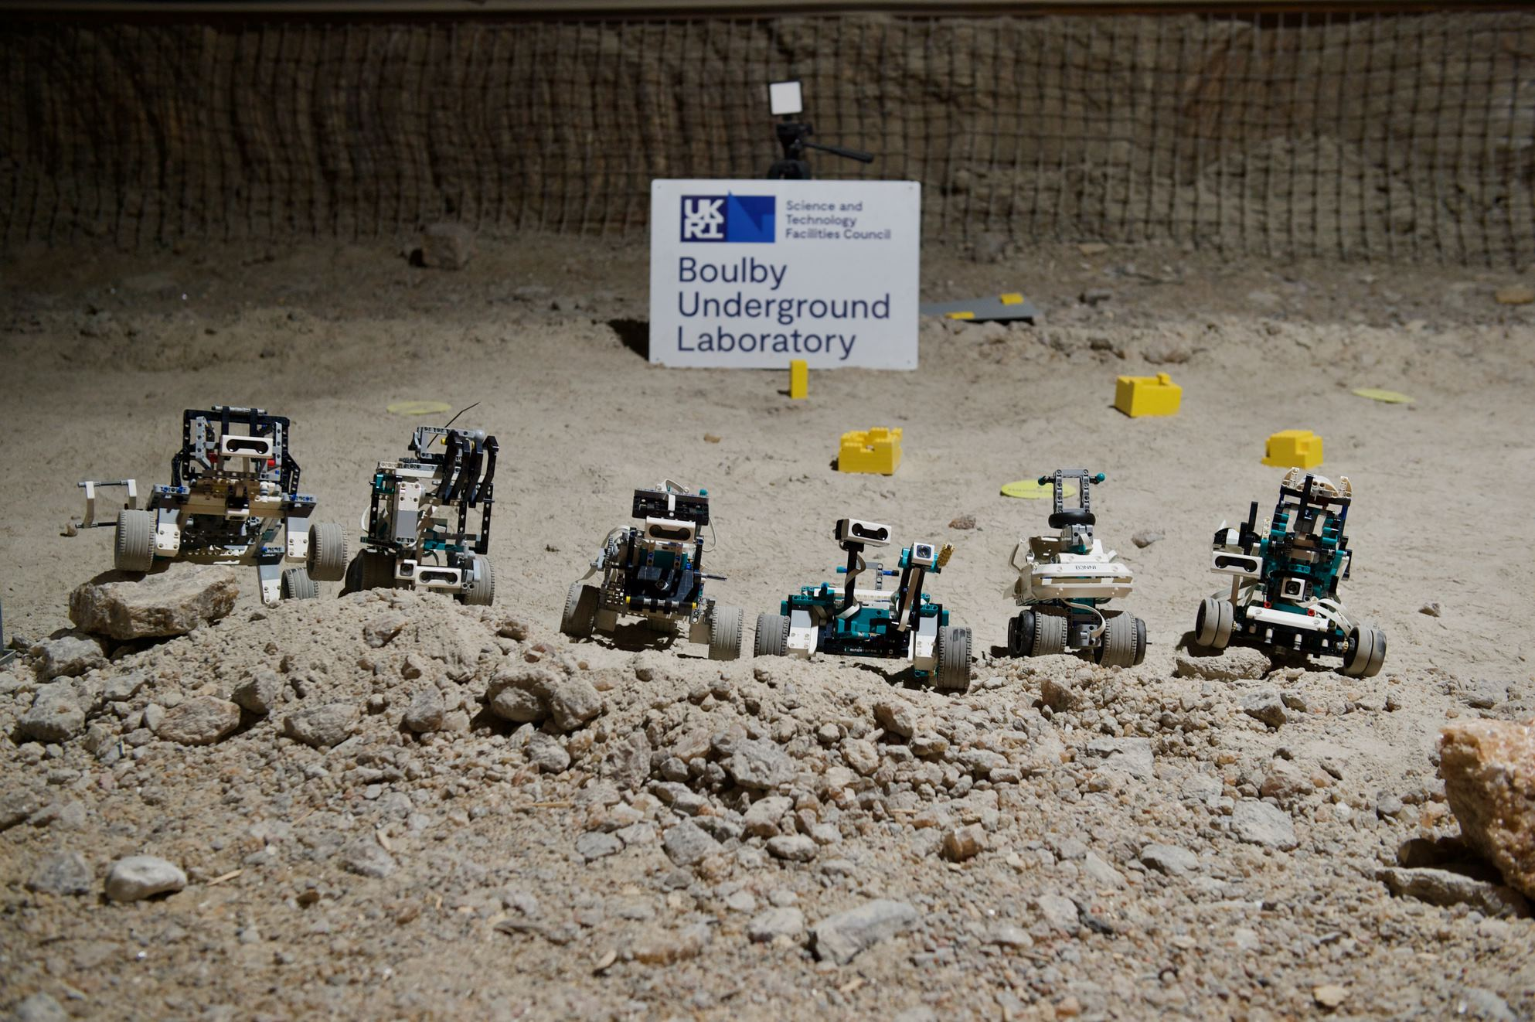
Remote³
Remote sensing by Remote schools in Remote environments
Collaboration between staff from the University of Edinburgh, from STFC's Public Engagement team, Boulby Underground Laboratory and Scientific Computing (SCD).
Remote³ provides school groups with a LEGO Mindstorms kit
They design and program their own Mars Rover
Rovers are shipped to the Boulby Underground Laboratory’s Mars Yard
Complete a series of defined space-exploration themed challenges via a live video connection.

Slide 12
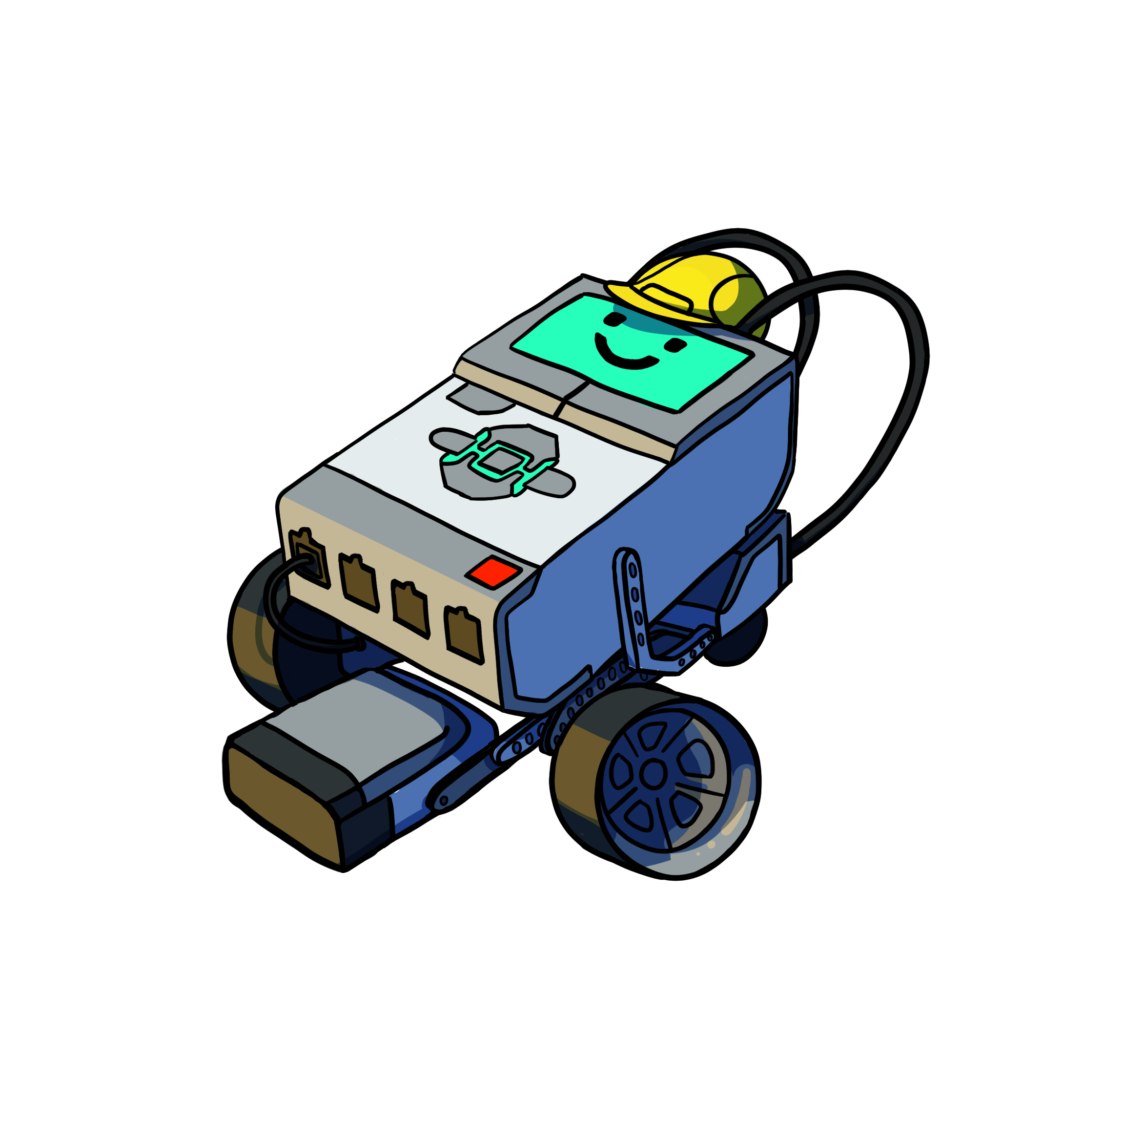
Remote³
The Teams
Brae High School
Anderson High School
Kirkwall Grammar School
Remote³ aims to support schools with lower science capital
Initially this was a selection of schools located in more-remote areas of Scotland, but for 22-23 has expanded to include schools in England
Each school receives support from a mentor – a volunteer from the University of Edinburgh, STFC Boulby, or STFC Scientific Computing
Design and programming runs over several months
Live-broadcast testing day, hosted at RAL Space, at the Rutherford Appleton Laboratory
Partnership, providing sustained support to young people who would be unlikely to visit our facilities in person
Sir E. Scott School
Dornoch Academy
Plockton
High School
Mintlaw Academy
Inverurie Academy
Carluke High School
Lockerbie Academy
Boulby Underground Laboratory

Slide 13
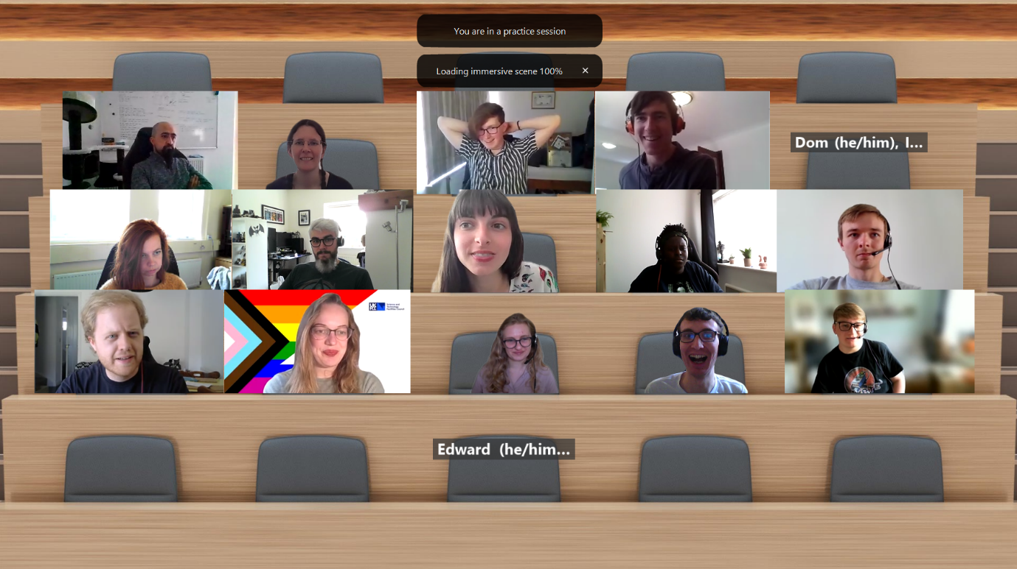
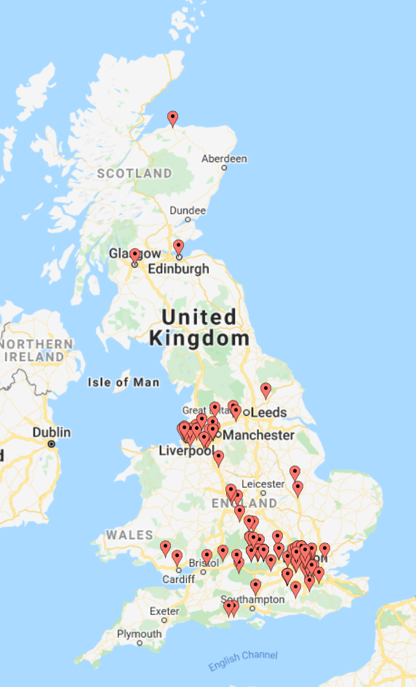
Work Experience Python Workshop
Preparation for work experience placements
Used to be in person for 10-20 (teenage) participants
Translated to jupyter notebooks running on STFC cloud
Now reaching 70-100 participants each year
Much broader geographic reach
Participants no longer need be able to get to the lab
The jupyter based materials also work really well in person
The framework (we call Monty) being used for other topics
Notes:
Also a series of webinars
Being a supervisor is an especially good opportunity for early career staff (they can work in pairs if they’d like) – supported experience of people and project management

Slide 14
The Halton Project: What we are doing
Engaging Primary School pupils and teachers
Appropriate, exciting child-friendly resources promoting engineering, computing, coding, creativity, and innovation throughout KS1 and KS2 (elementary school)
Training for teachers to embed provision in schools (with further activities for teachers post visit)
Resource sharing network between schools
Engaging Secondary School pupils and teachers through
Pre-recorded online content generated by our staff
Online STEM Ambassador engagement
Promotion of Work Experience opportunities
Utilising partnership work to provision additional out of school opportunities in Halton
Coding Clubs funded by HBC, led by MakoCreate, supported by our staff
Community Centre and Childrens Centre STEM events focussed on families with children enabling access where financial and/or confidence barriers might be a problem
Notes:
Replace this guidance text with your own bullet pointed content.
For further guidance please see https://www.bdadyslexia.org.uk/advice/employers/creating-a-dyslexia-friendly-workplace/dyslexia-friendly-style-guide

Slide 15
Halton Coding Clubs
6 Code Clubs Delivered
2 per month
3 in Runcorn
3 in Widnes
Reaching 88 Young People
Of whom:
23 Female aged 8-14
60 Male aged 8-14
4 Female aged 15-18
1 Male aged 15-18
Supported by 4 STFC STEM Ambassadors and 1 Runcorn Councillor
Evaluation will allow us to measure outcomes
Indices of multiple deprivation (IMD) are widely-used datasets within the UK to classify the relative deprivation(essentially a measure of poverty) of small areas.

Slide 16
Summary
Developing a clear strategic framework has allowed PE STFC’s National Labs PE team to plan and coordinate a program of activities tailored to meet specific requirements.
Adopting a framework for evaluating our activities has allowed us to better understand if and how we are meeting those strategic priorities
Together they help us in planning innovative approaches to working with communities that were less likely/able to come to us
When we had to suspend F2F PE this structure helped us quickly pivot to new online activities
Significant improvement in reaching Wonder/lower science capital audiences
Some of the more detailed evaluation is rather harder with remote work
Emphasis on using evidence to target and improve our work
We’re now integrating the activities into a richer hybrid PE program

Slide 17
Notes:
The abstract pattern can be removed or repositioned if required. Be careful to ‘Send to Back’ so that it does not obscure any important information.

Slide 18
Science and Technology Facilities Council
@STFC_Matters
Science and Technology Facilities Council
Notes:
The abstract pattern can be removed or repositioned if required. Be careful to ‘Send to Back’ so that it does not obscure any important information.

