Slide 1
Building a Global HEP
Software Training Community
Kilian Lieret^{1,2}, Wouter Deconinck, Peter Elmer^{1,2}, Sudhir Malik³, Alexander Moreno⁴, Stefan Roiser⁵, Jason Vaetch⁶, Michel Hernandez Villanueva⁷
for the IRIS-HEP/HSF Training Group
¹ Princeton University ²IRIS-HEP | ³University of Puerto Rico ⁴Universidad Antonio Nariño | ⁵CERN ⁶Universität Göttingen | ⁷DESY ⁸University of Manitoba

Slide 2
O(10k)
HEP people worldwide
O(6k)
Undergrads
O(3k)
Ph.D. students
O(1k)
Postdocs
O(depressing)
Faculty
need to be trained in software engineering & computing
to tackle the computing challenges ahead
This should be a community effort!

Slide 3
Why not leave everything to the experiments?
General software skills matter as much as experiment-specific training
Experiments share a lot of software topics
Software topics are vast & evolving! (e.g., ML, GPUs, FPGAs, …)
We can cover more ground together instead of reinventing the wheel…
O(6k)
Undergrads
O(3k)
Ph.D. students
O(1k)
Postdocs
Teach prerequisites &
Democratize science
Impart best practices
Put in touch with most recent developments
We need a unified, scalable, and sustainable software training framework

Slide 4
We need a unified, scalable, and sustainable software training framework
Unified | Material and events should be centrally listed & discoverable Concentrate efforts by developing cross-experiment content A community must guide, support, and coordinate
Scalable | Material must be teachable by multiple instructors Self-study must not be an afterthought
Sustainable | Material must be open source and maintained collaboratively Incentives & recognition important motivators
The IRIS-HEP/HSF Training group is building a community around these principles

Slide 5
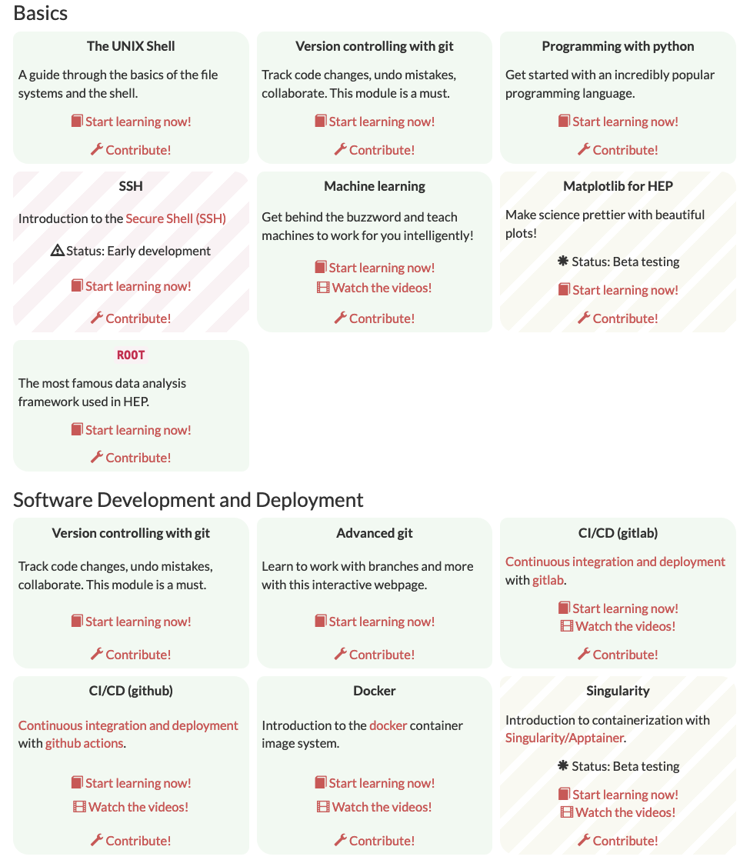
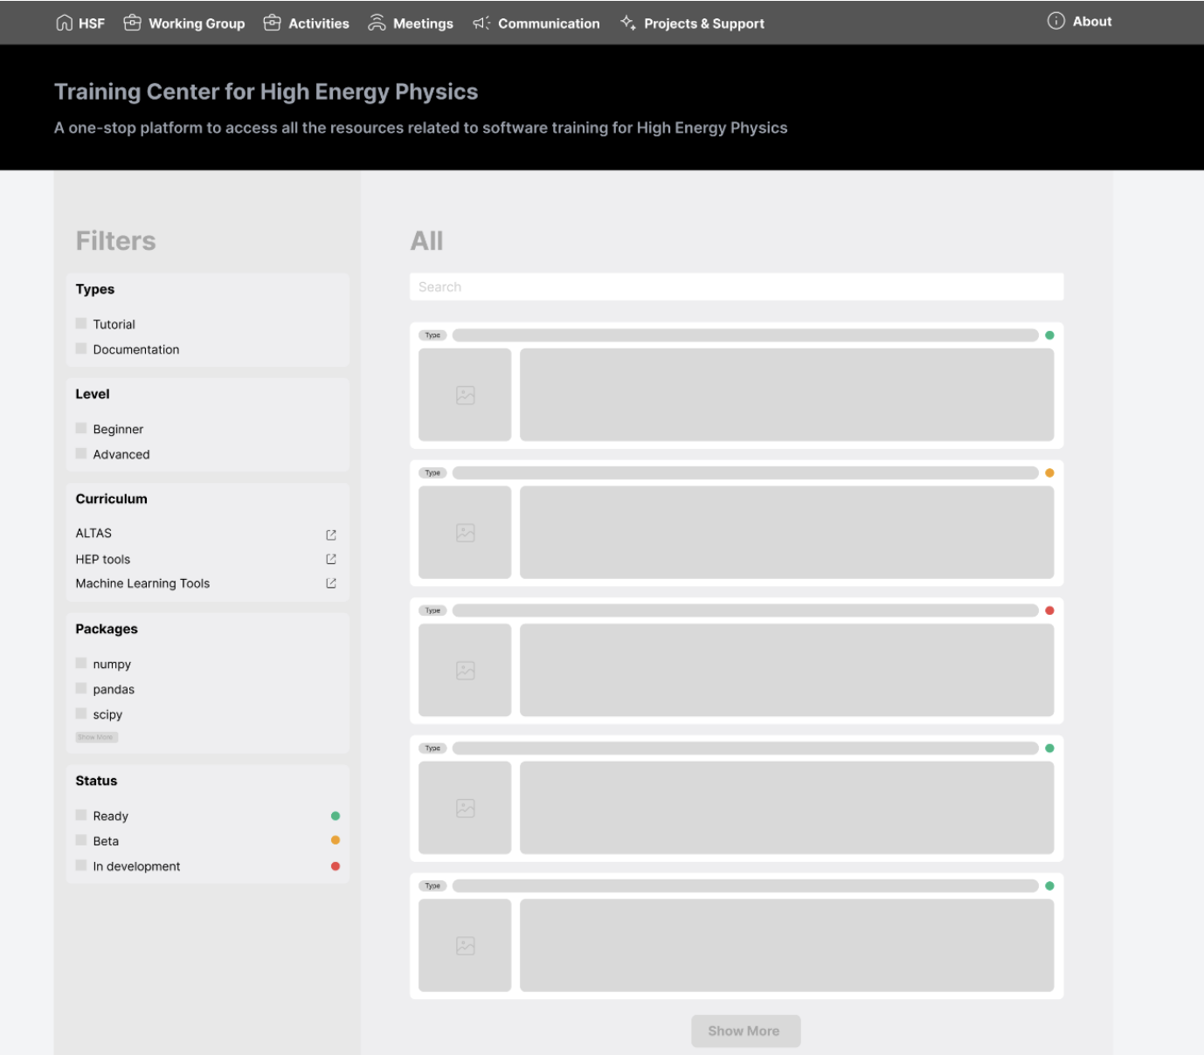
A unified Training Center for HEP
HSF Training Center currently lists 21 training modules (including material developed by IRIS-HEP/HSF, The Carpentries, and individual authors)
Goal: Training Center as a focal point for all HEP Training activities → Needs to list more → Add filters & dynamic sorting
Central list of training events (everyone can add)
Training Center v2.0
Mockup by Aniket Rana,
(aniumbott @ github)
Inspired by learn.astropy.org
Filters

Slide 6
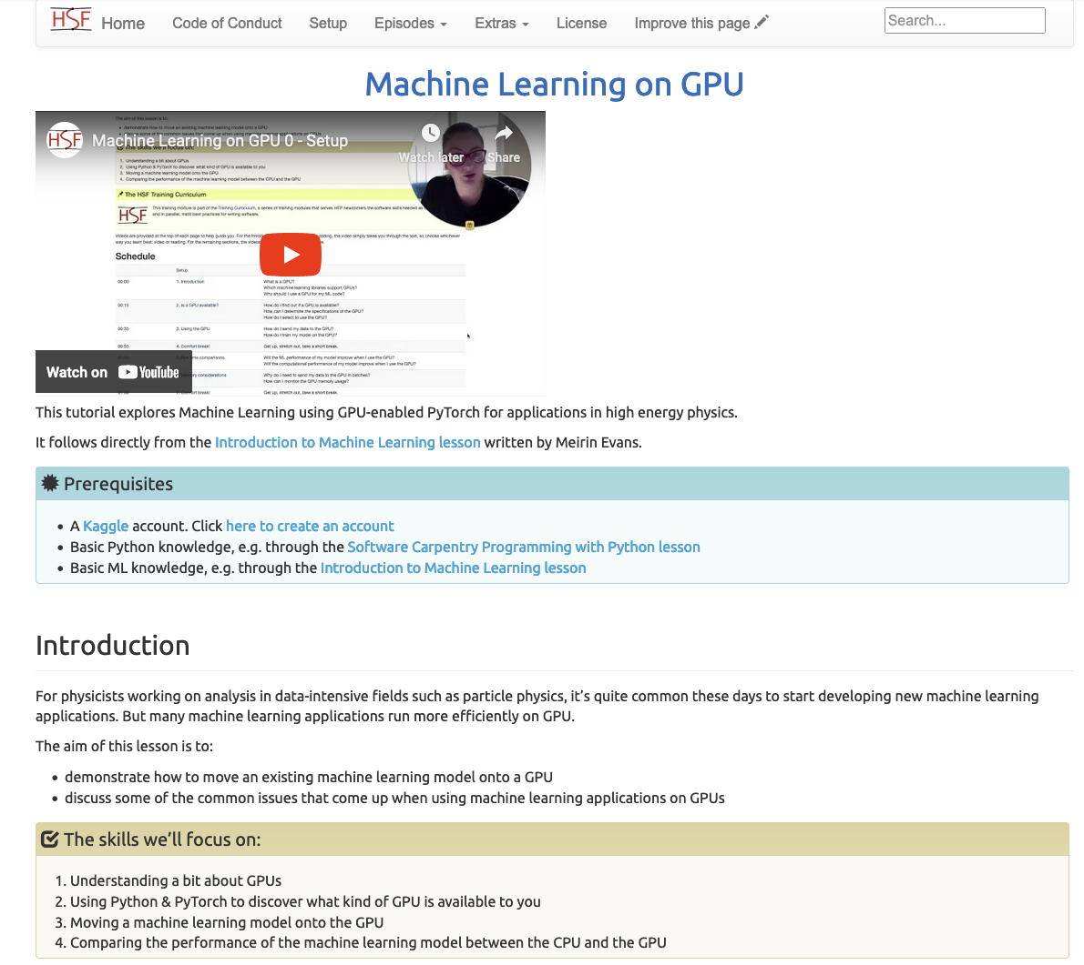
Training Modules
Most of our modules embrace the framework of The Carpentries
Built from markdown files
Rendered as a webpage with Jekyll (interesting discussion topic: The Carpentries have changed their framework recently)
Verbose and self-study ready
Other training material written with LaTeX, sphinx, JupyterBook.
< Complete video
walkthroughs!
^ Lessons build on each other

Slide 7
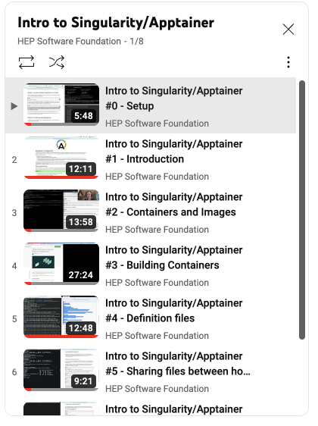
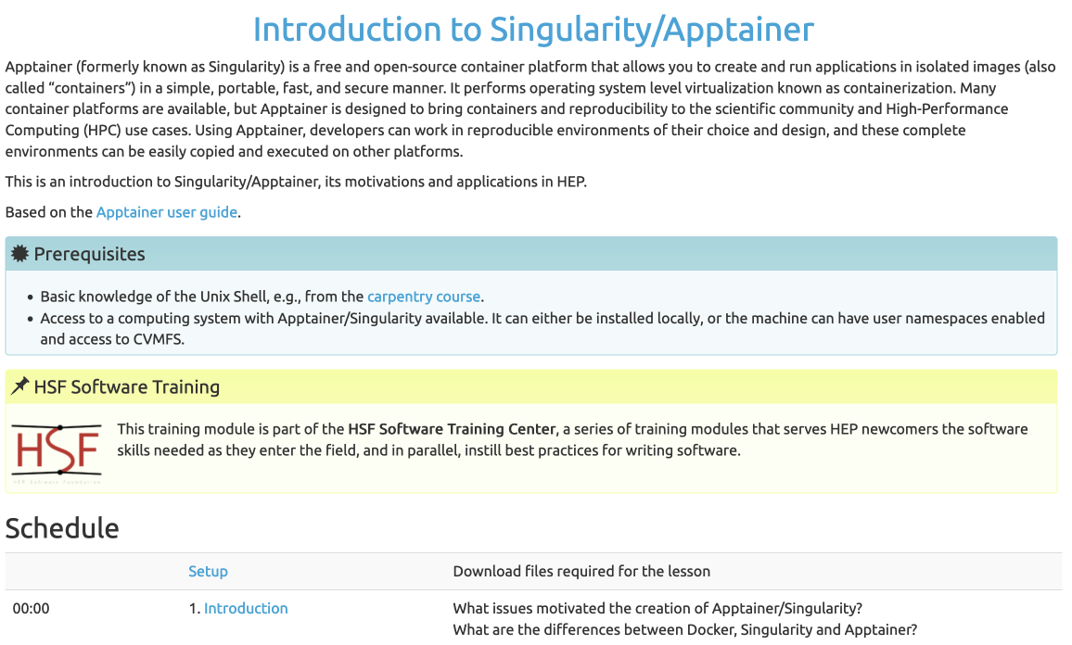
Example Workshop: Analysis Preservation
Teaching Docker, Singularity/Apptainer, CI/CD with github/gitlab, REANA (soon)
Emphasis on self study with videos + live lectures
Small-group virtual mentoring sessions
24h support on slack
Bundling 5 Modules

Slide 8
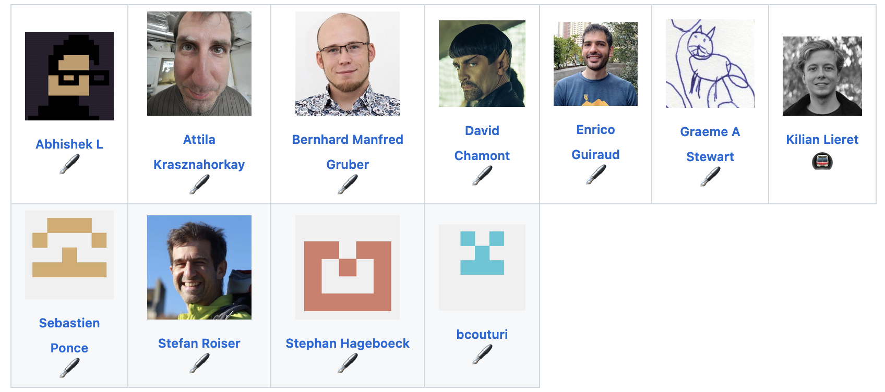
Example Workshop: C++ Training
542 slides, 688 pages, > 1k commits
Has been taught in-person, virtual and hybrid
Life lectures and exercise sessions
Full videos available
Next events:
7th: May 15-19 @ JLAB
8th: Aug 28 - Sep 1 @ Manchester
…
6 events till now
Originally developed by S. Ponce, now community effort

Slide 9
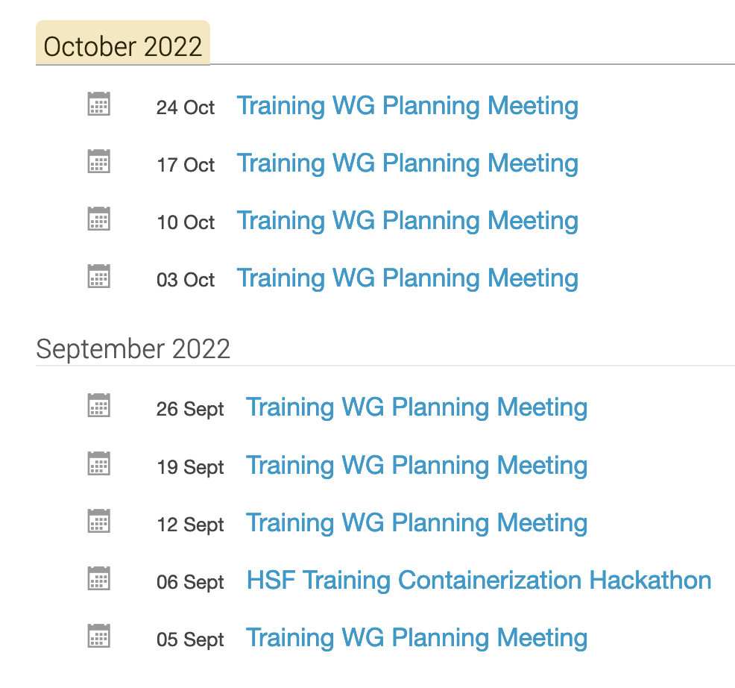
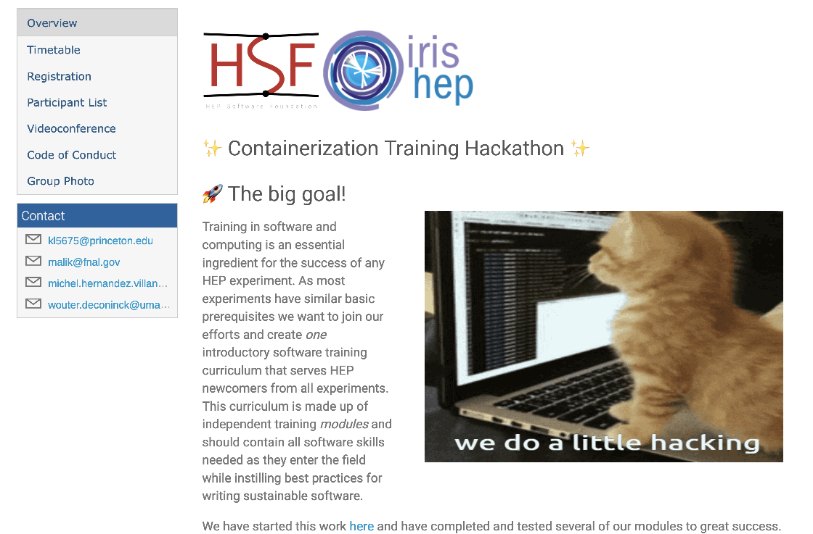
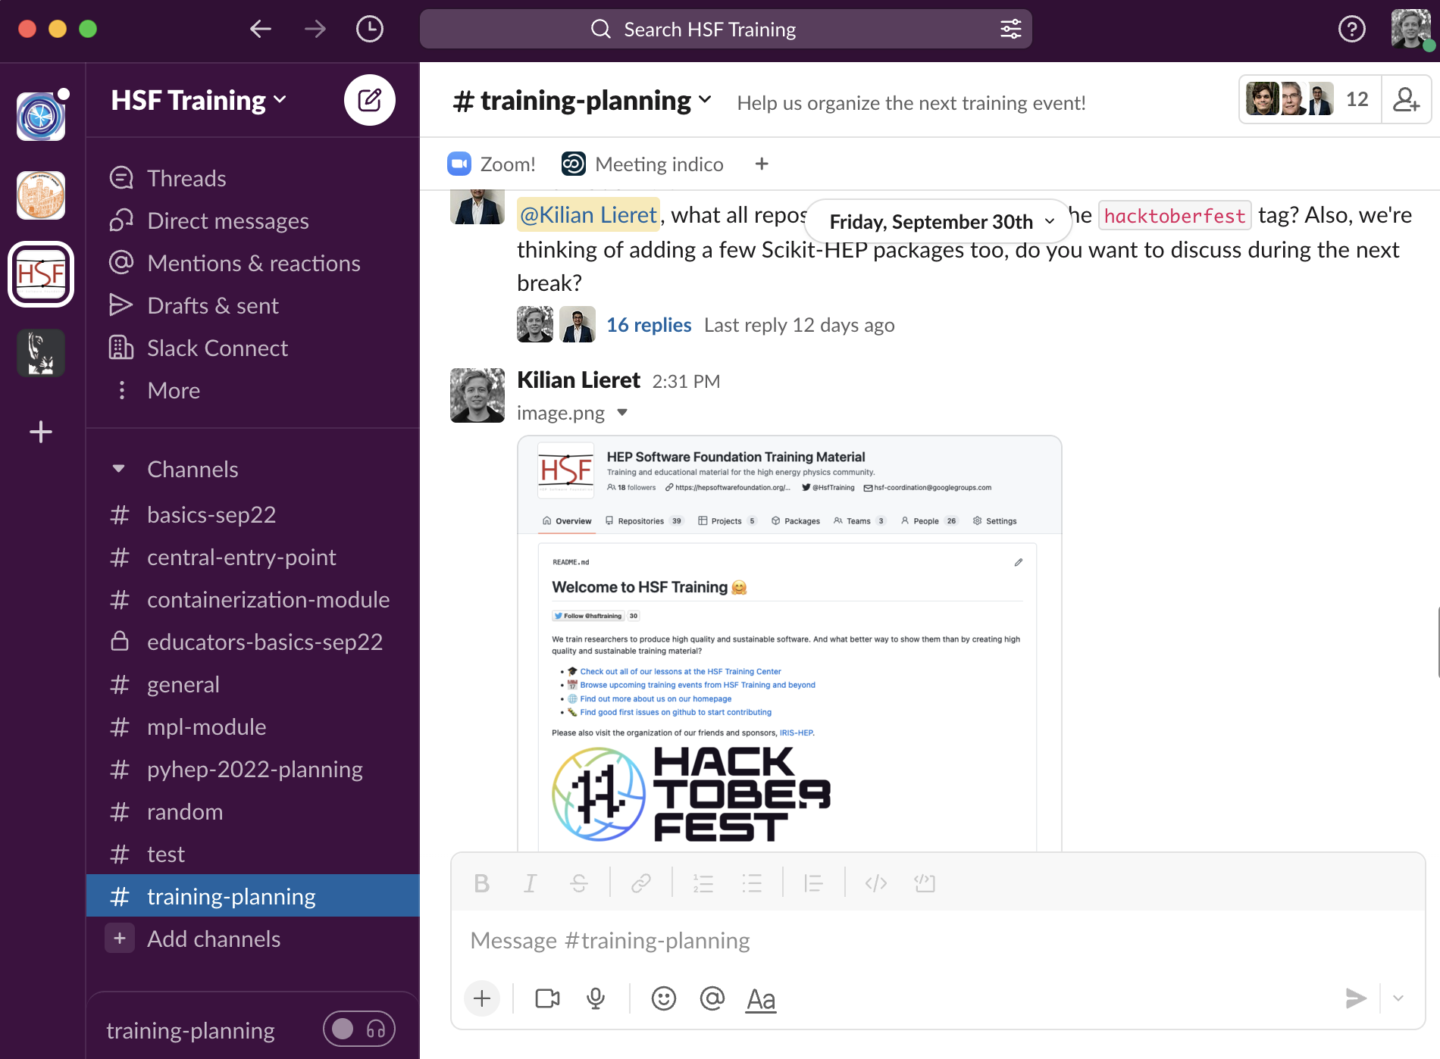
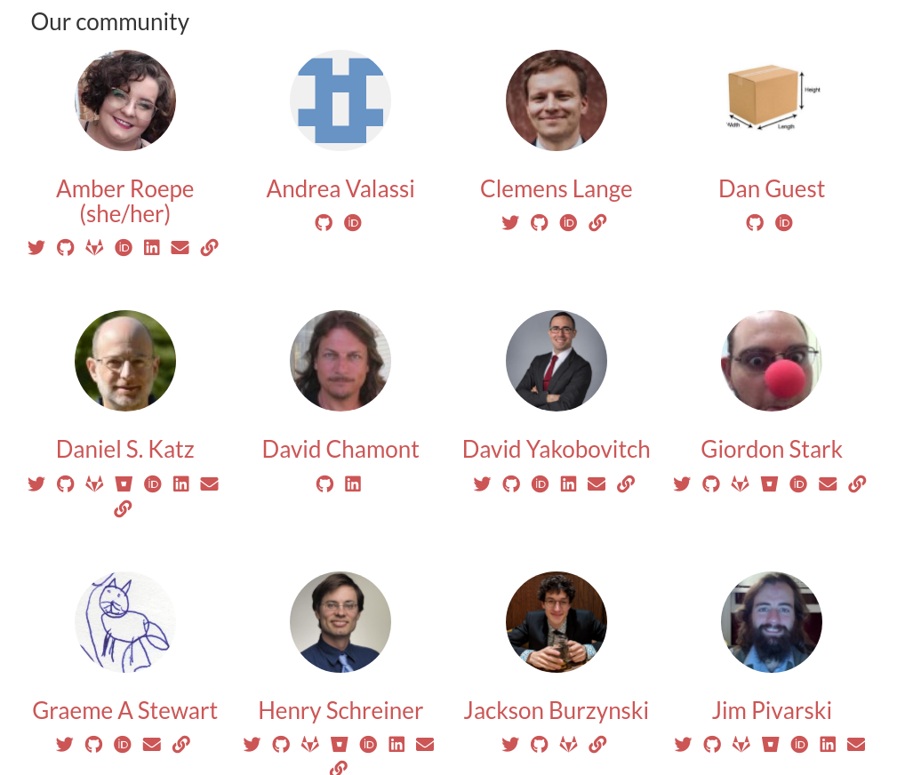
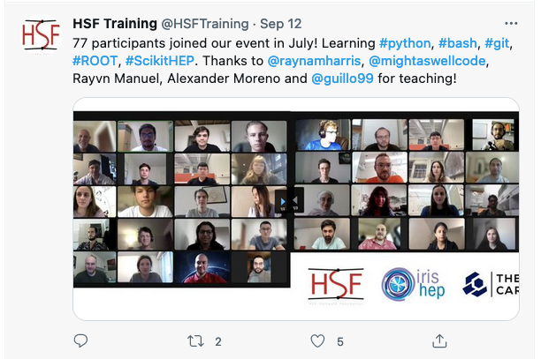
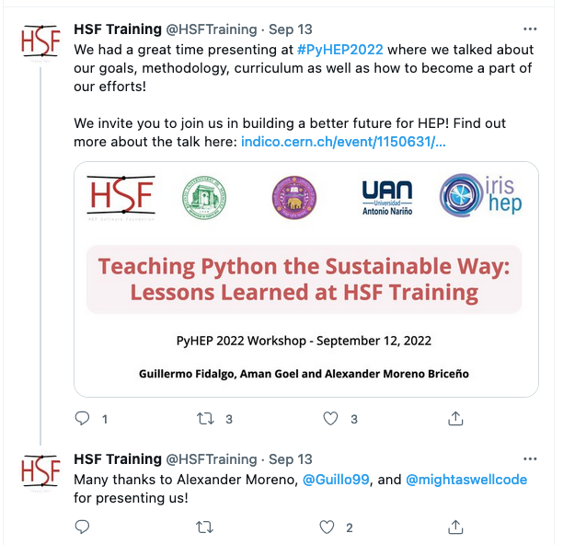
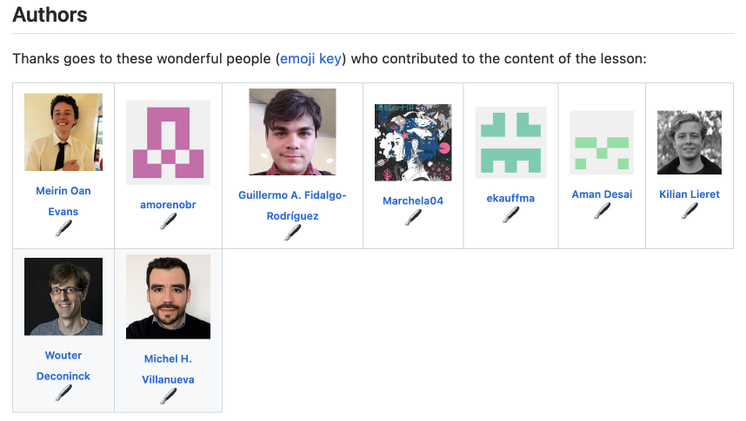
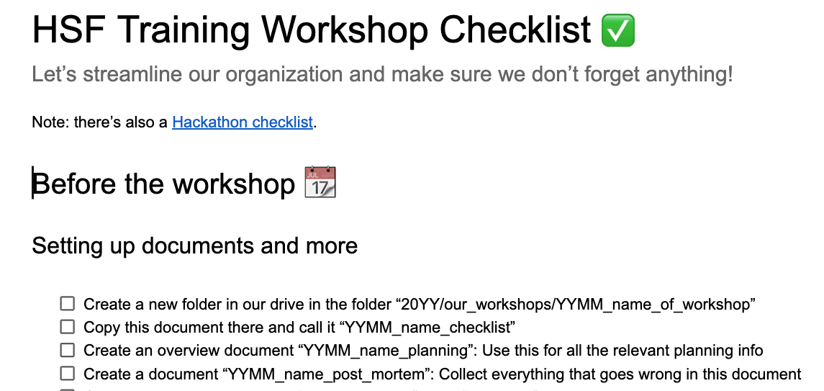
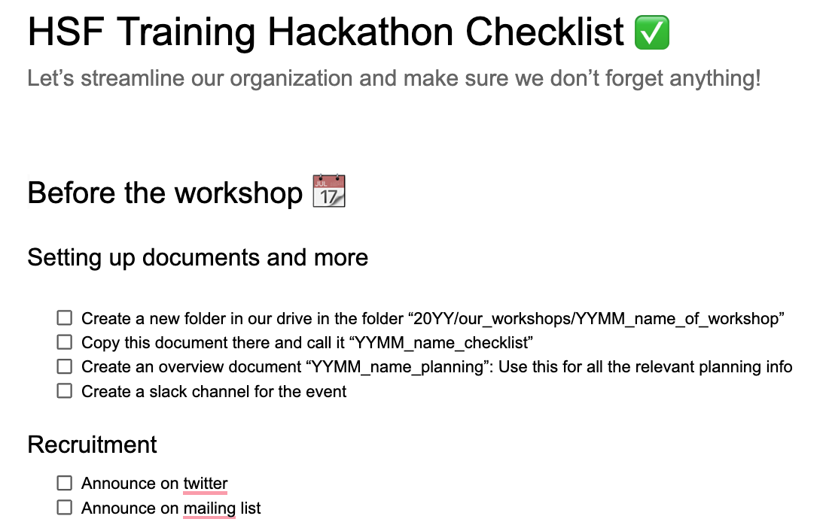
Building a community
Monthly Hackathons
Platforms
Weekly meetings
Community pages
Increasing our reach
Recognition
How-to guides
@hsftraining

Slide 10
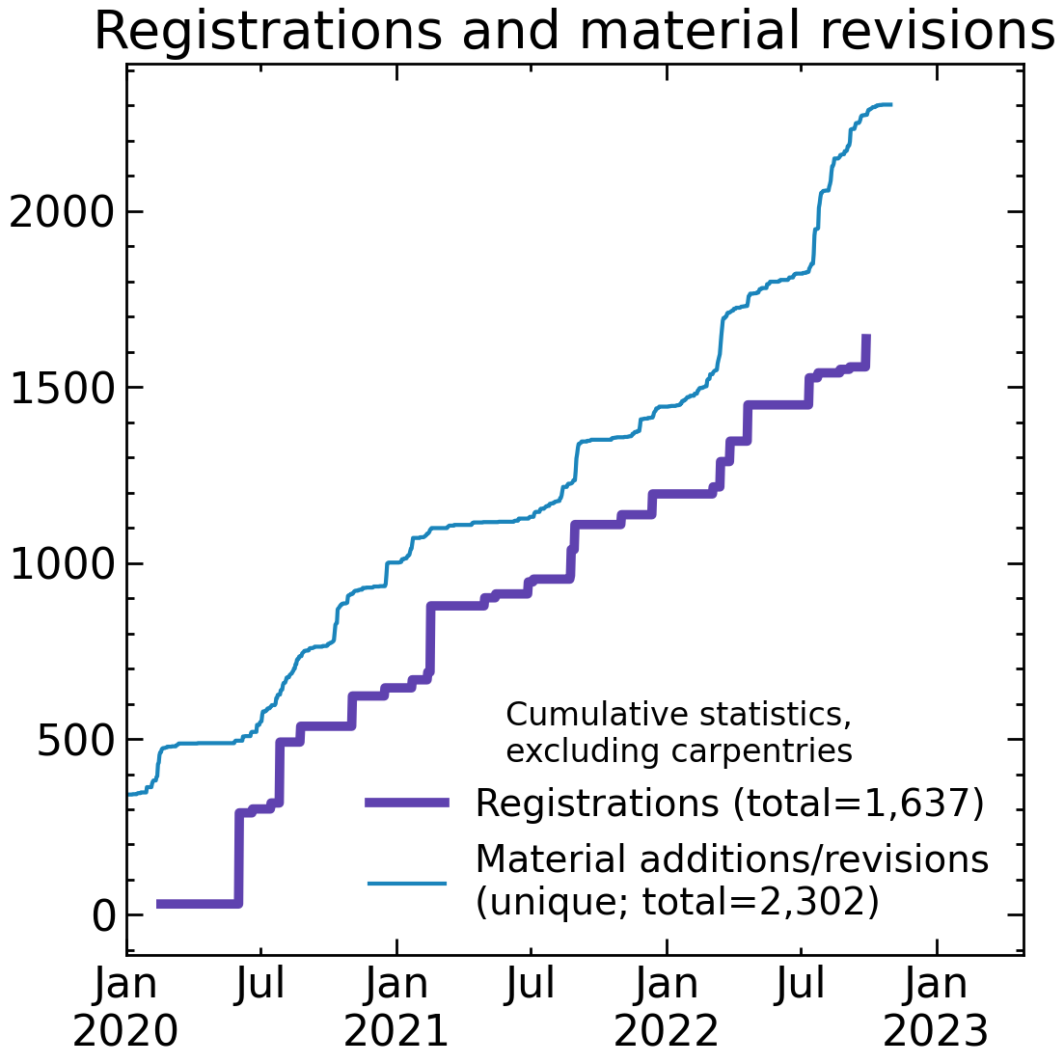
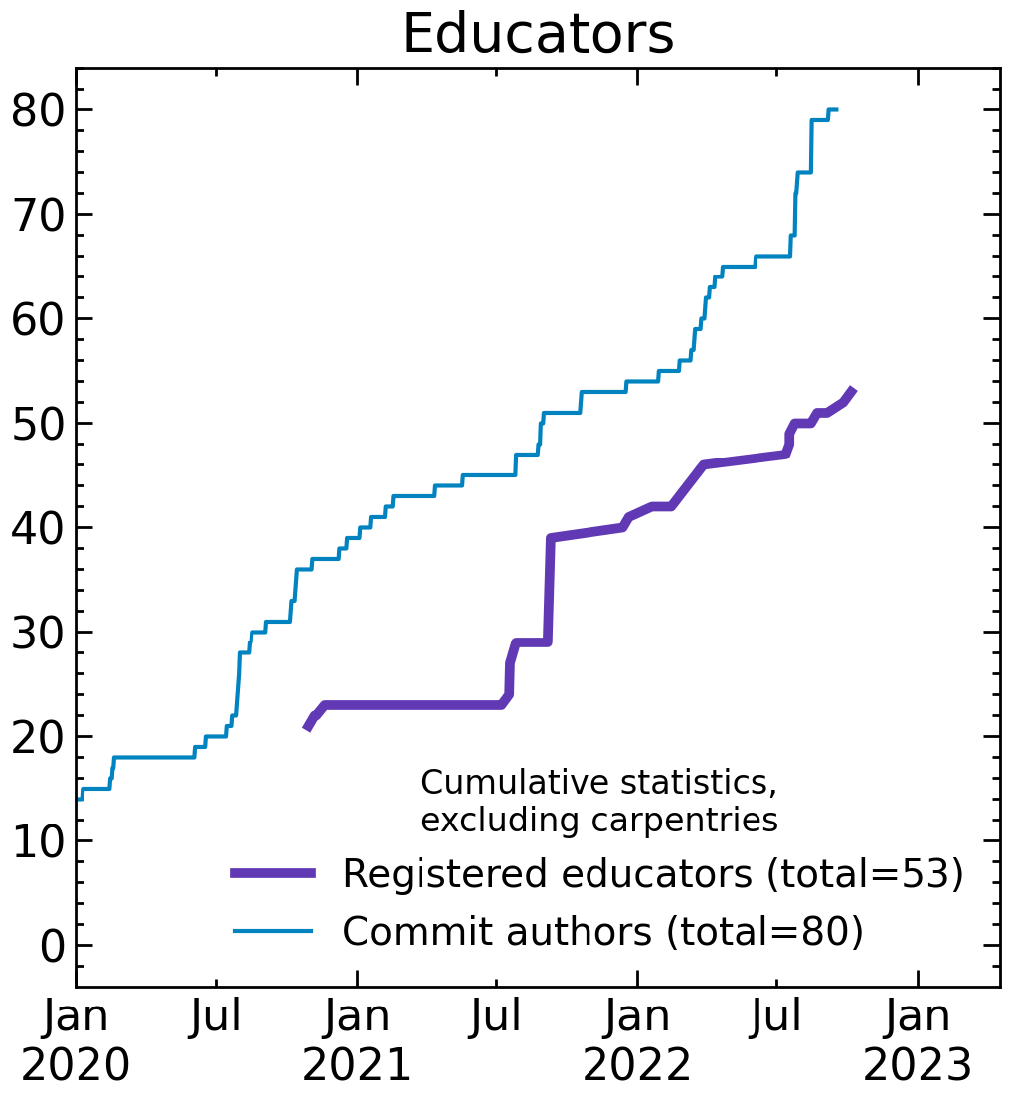
We scale!

Slide 11
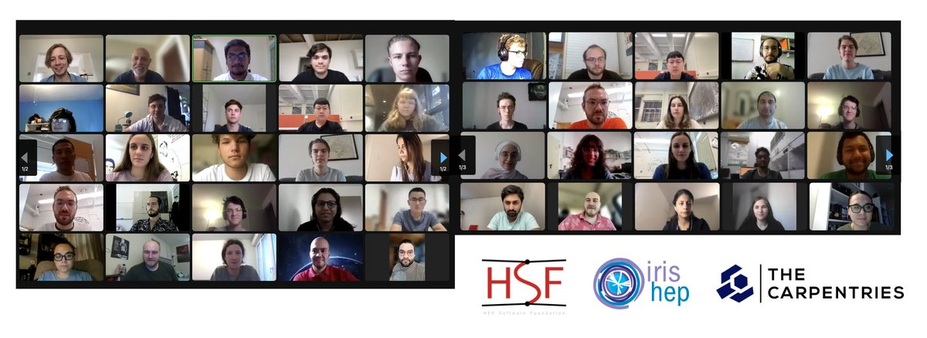
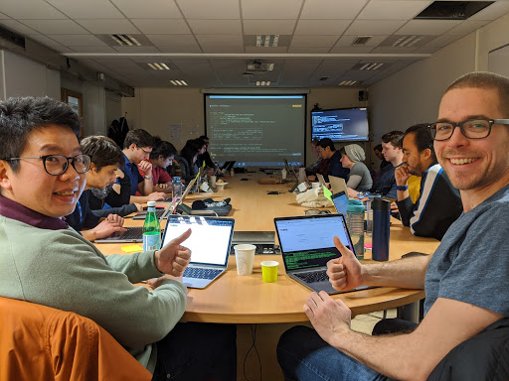
Conclusion
We have established a community of educators working on cross- experiment training material
Join us to
Make your training discoverable
Avoid reinventing the wheel
Ensure sustainable maintenance
Get help with logistics & advertisement
Covering most basics/intermediate needs, now aiming at expanding intermediate/advanced training → Seeding small groups to develop it
Fill our survey to participate: bit.ly/state-of-training

Slide 12
Join us!
Take the survey: bit.ly/state-of-training
@hepsoftfound
@hsf-training
hepsoftwarefoundation.org

