Slide 1

International Particle Physics Outreach Group
Engaging the World With Science
Sahal Yacoob, University of Cape Town
On behalf of the IPPOG Collaboration, slides (mostly) from Steven Goldfarb
CHEP 2023, Norfolk Virginia USA, 11 May 2023

Slide 2

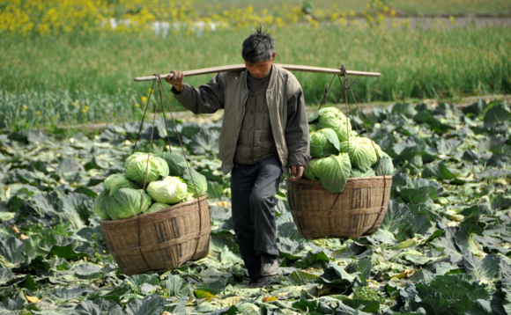
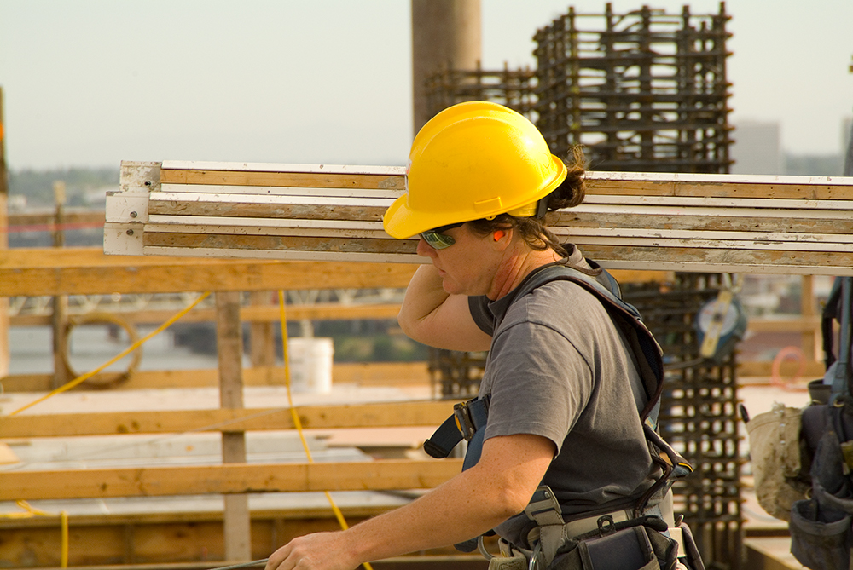
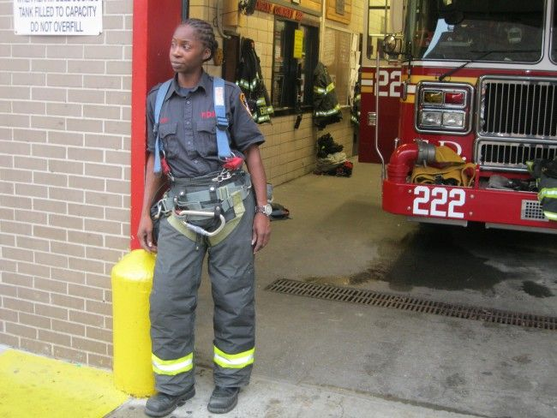
Why?

Slide 3
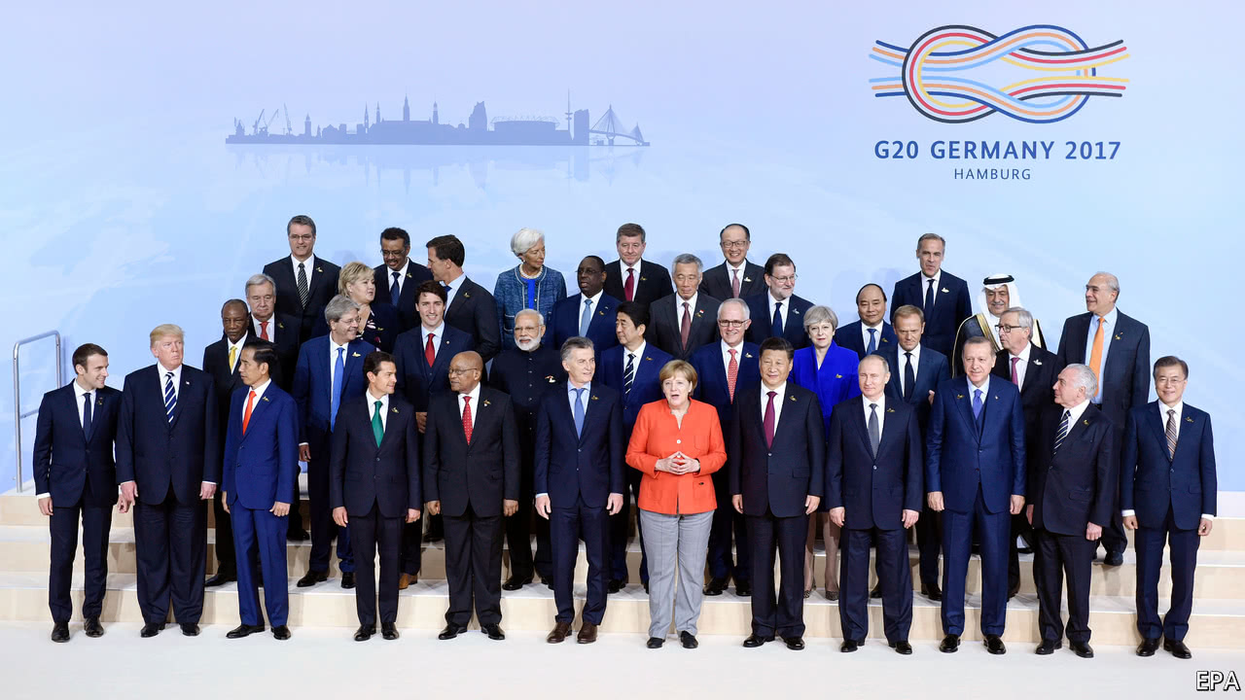
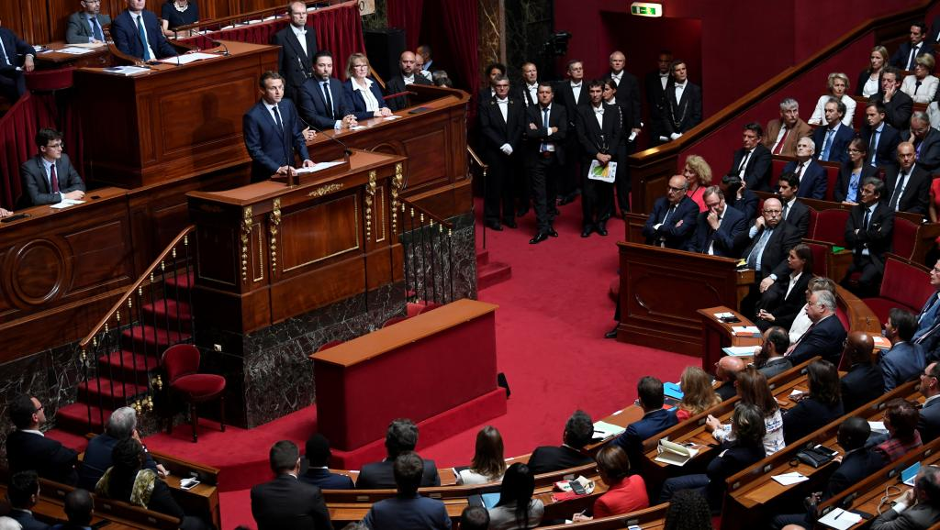
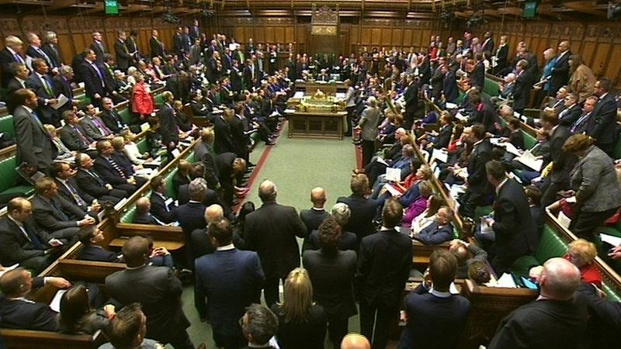
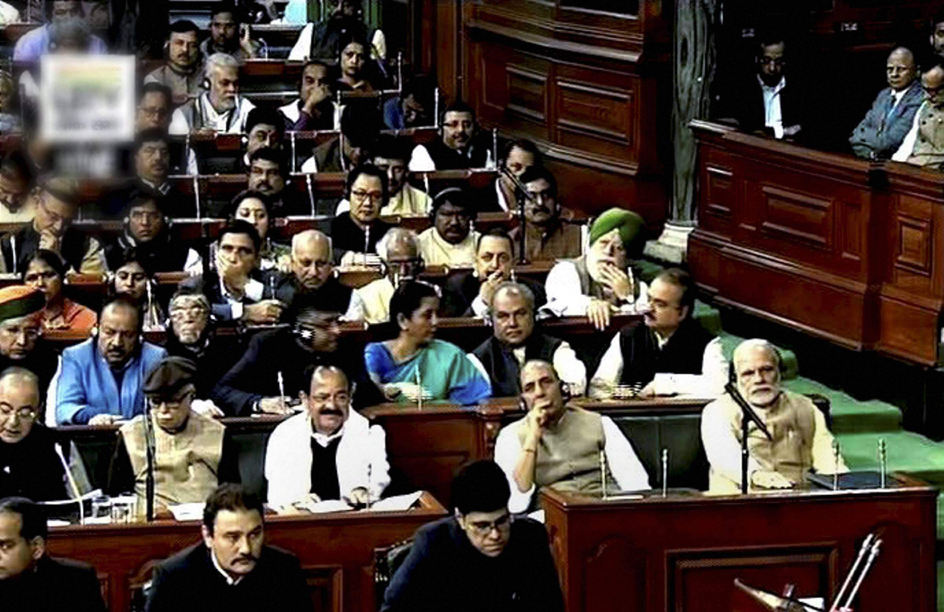
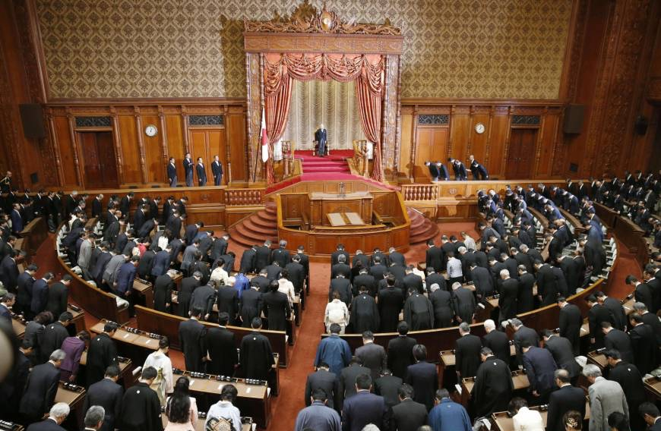
How much is it worth ?

Slide 4
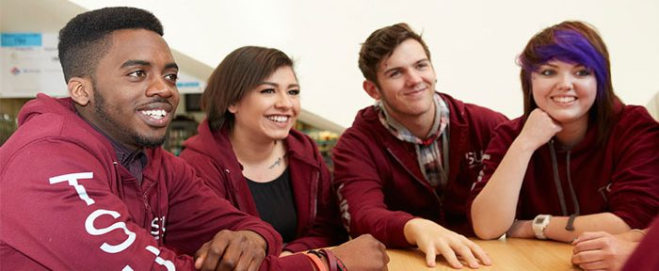
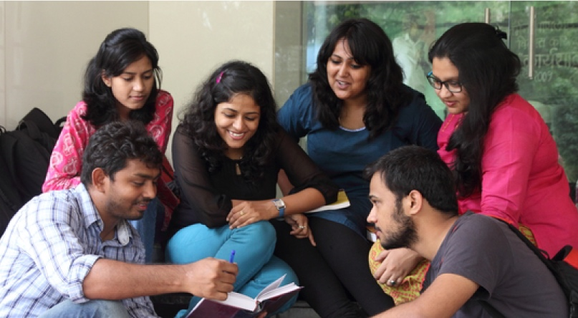
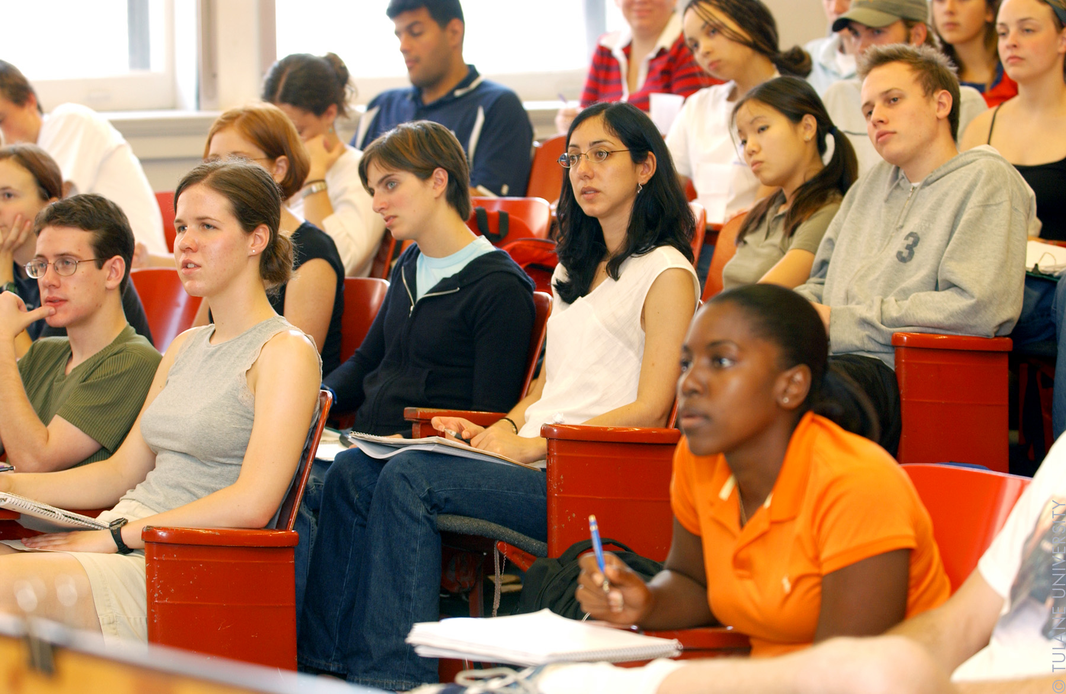
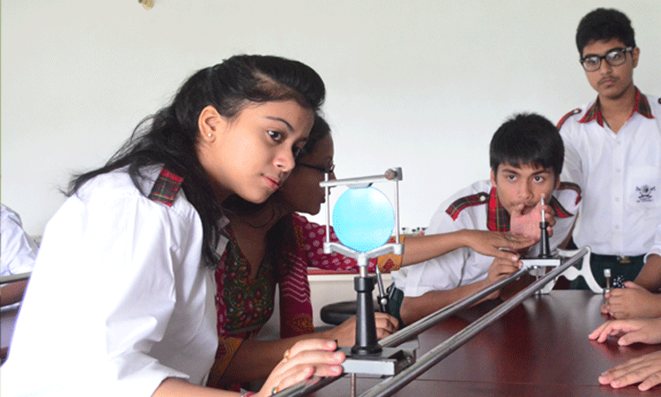
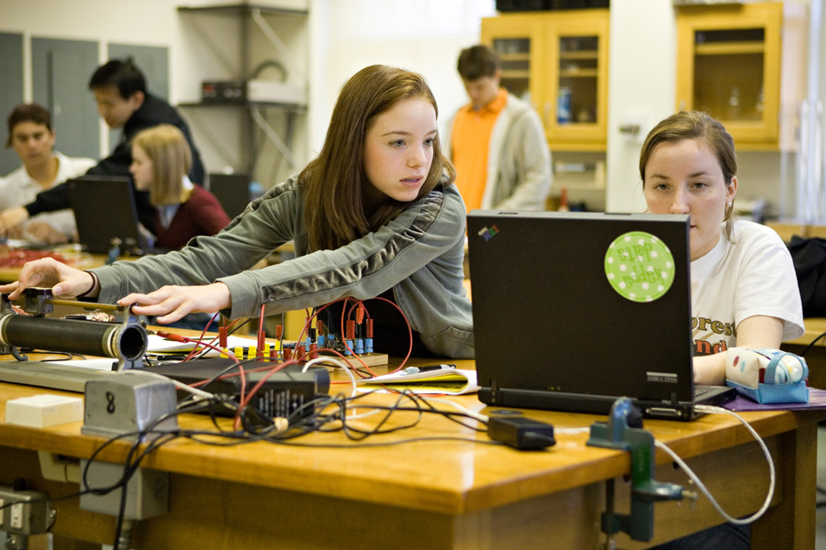
Who to believe?
What to do?

Slide 5
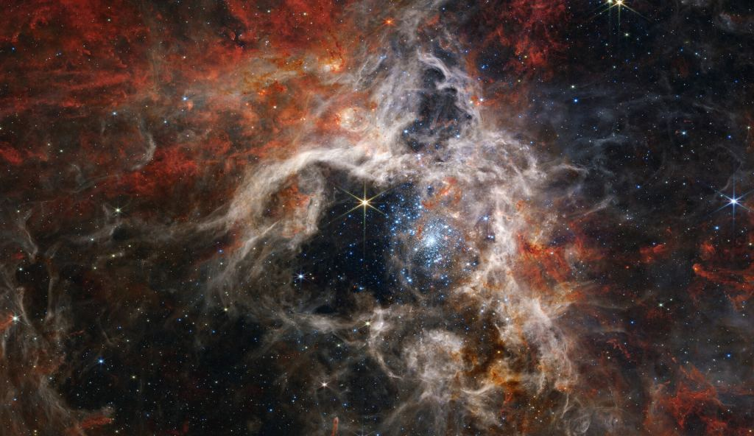
What are the answers they see?

Slide 6
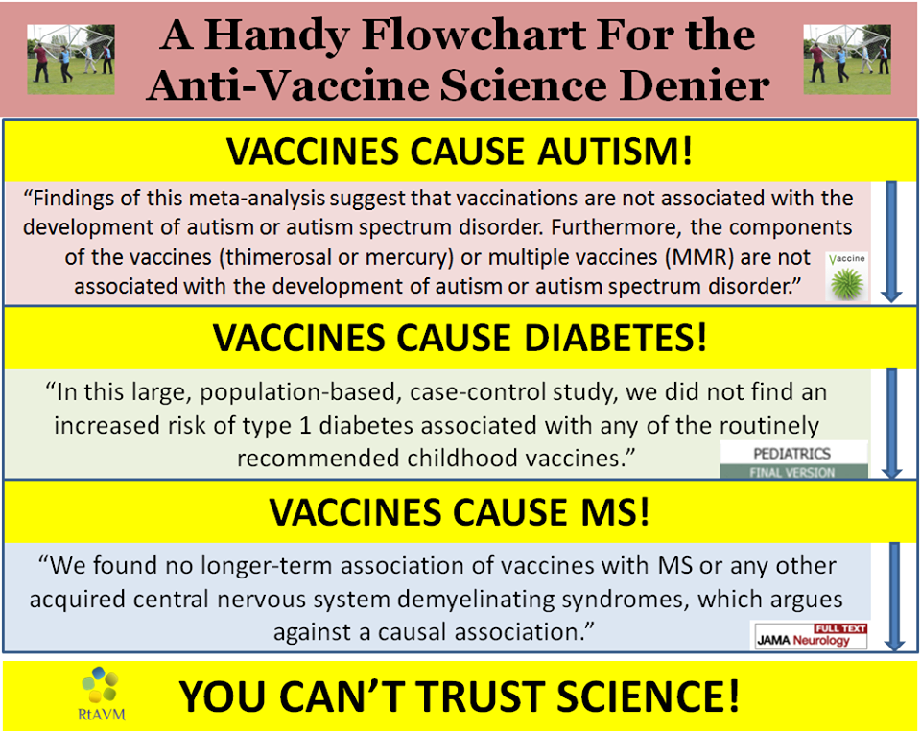
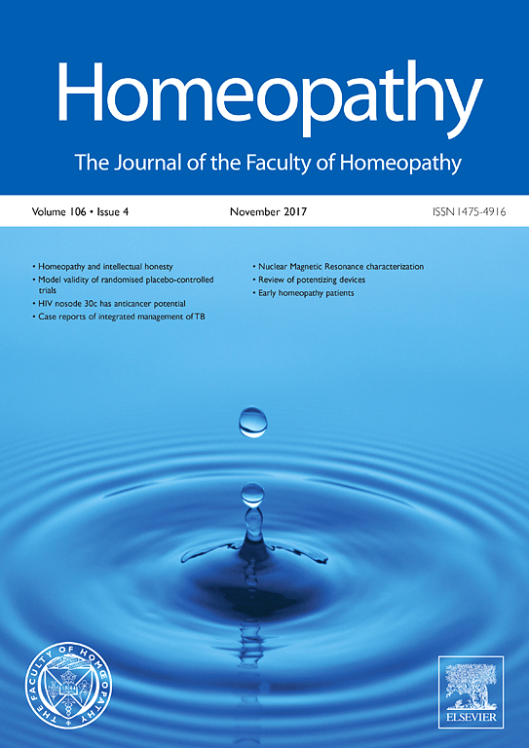
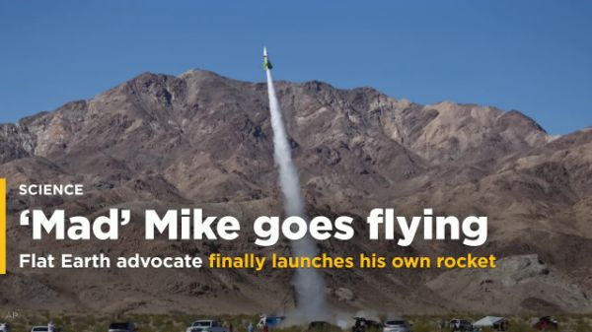
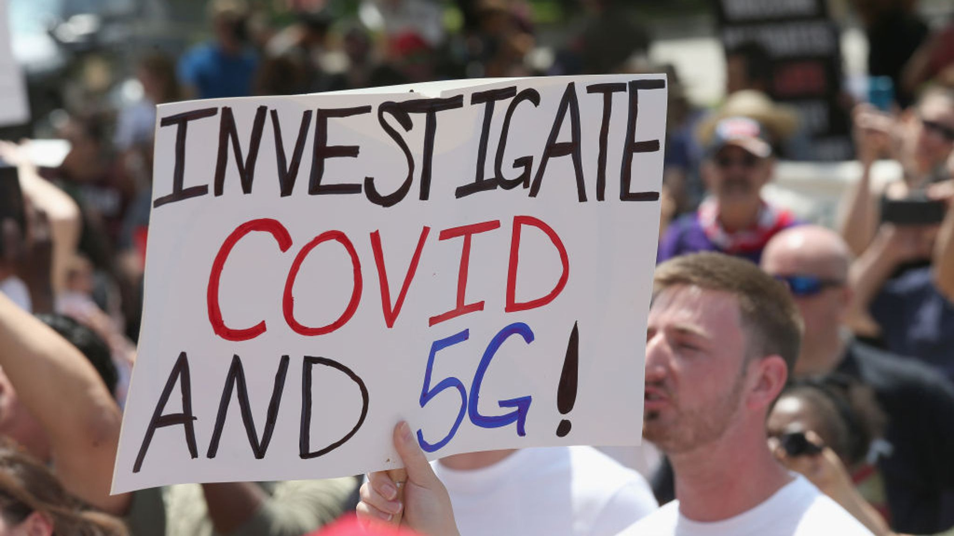
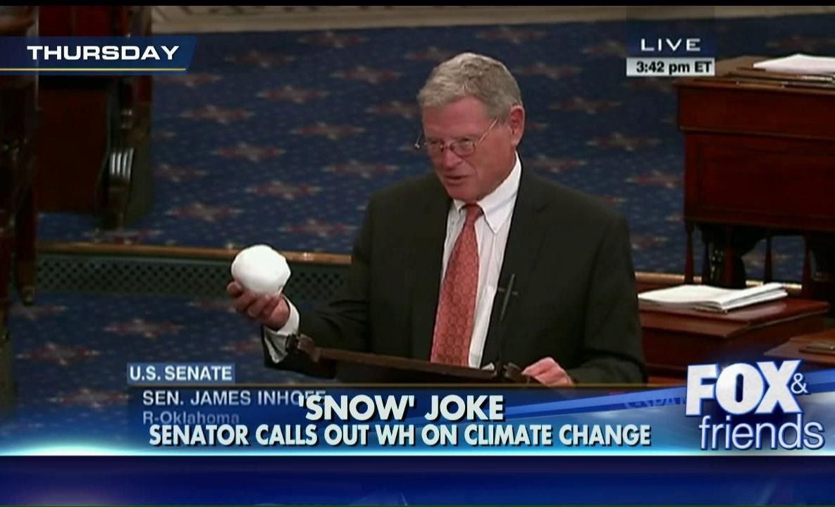
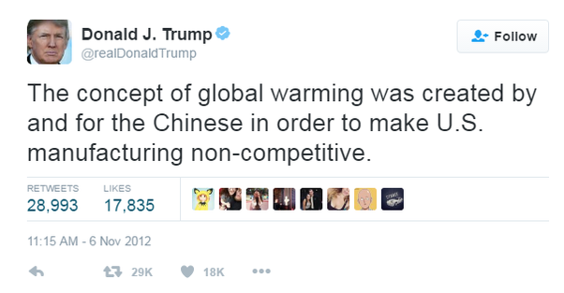
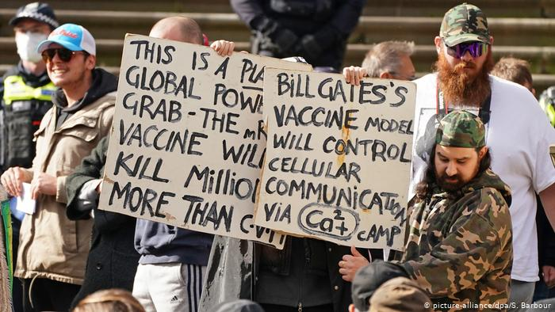
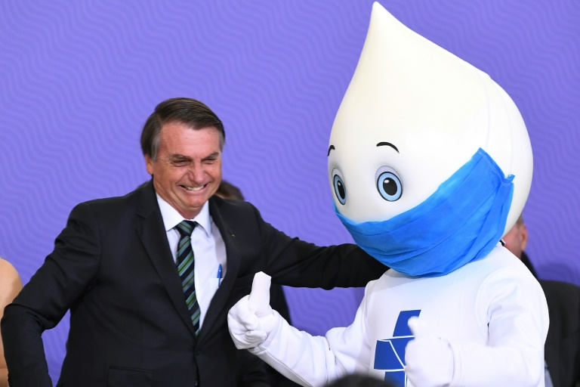
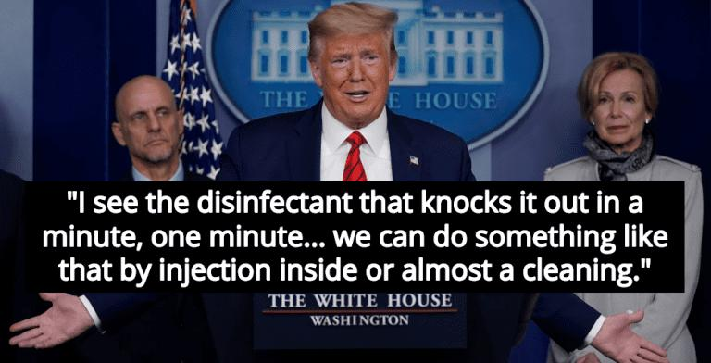
“More and more studies show that kids are actually stoppers of the disease and they don’t get it and transmit it themselves, so we should be in a posture of — the default should be getting back to school kids in person, in the classroom.”
— Education Secretary Betsy DeVos, in an interview on “The Conservative Circus” (iHeart radio), July 16

Slide 7
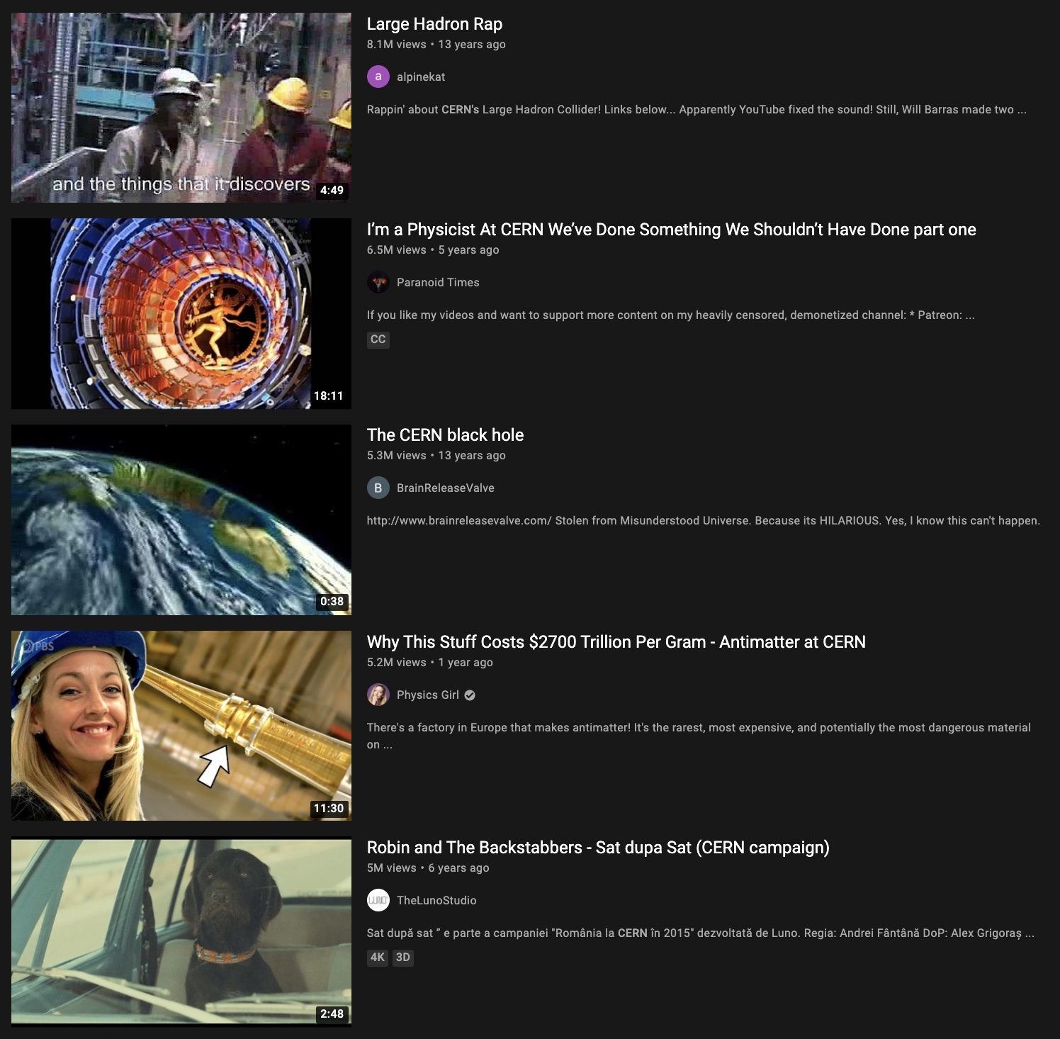
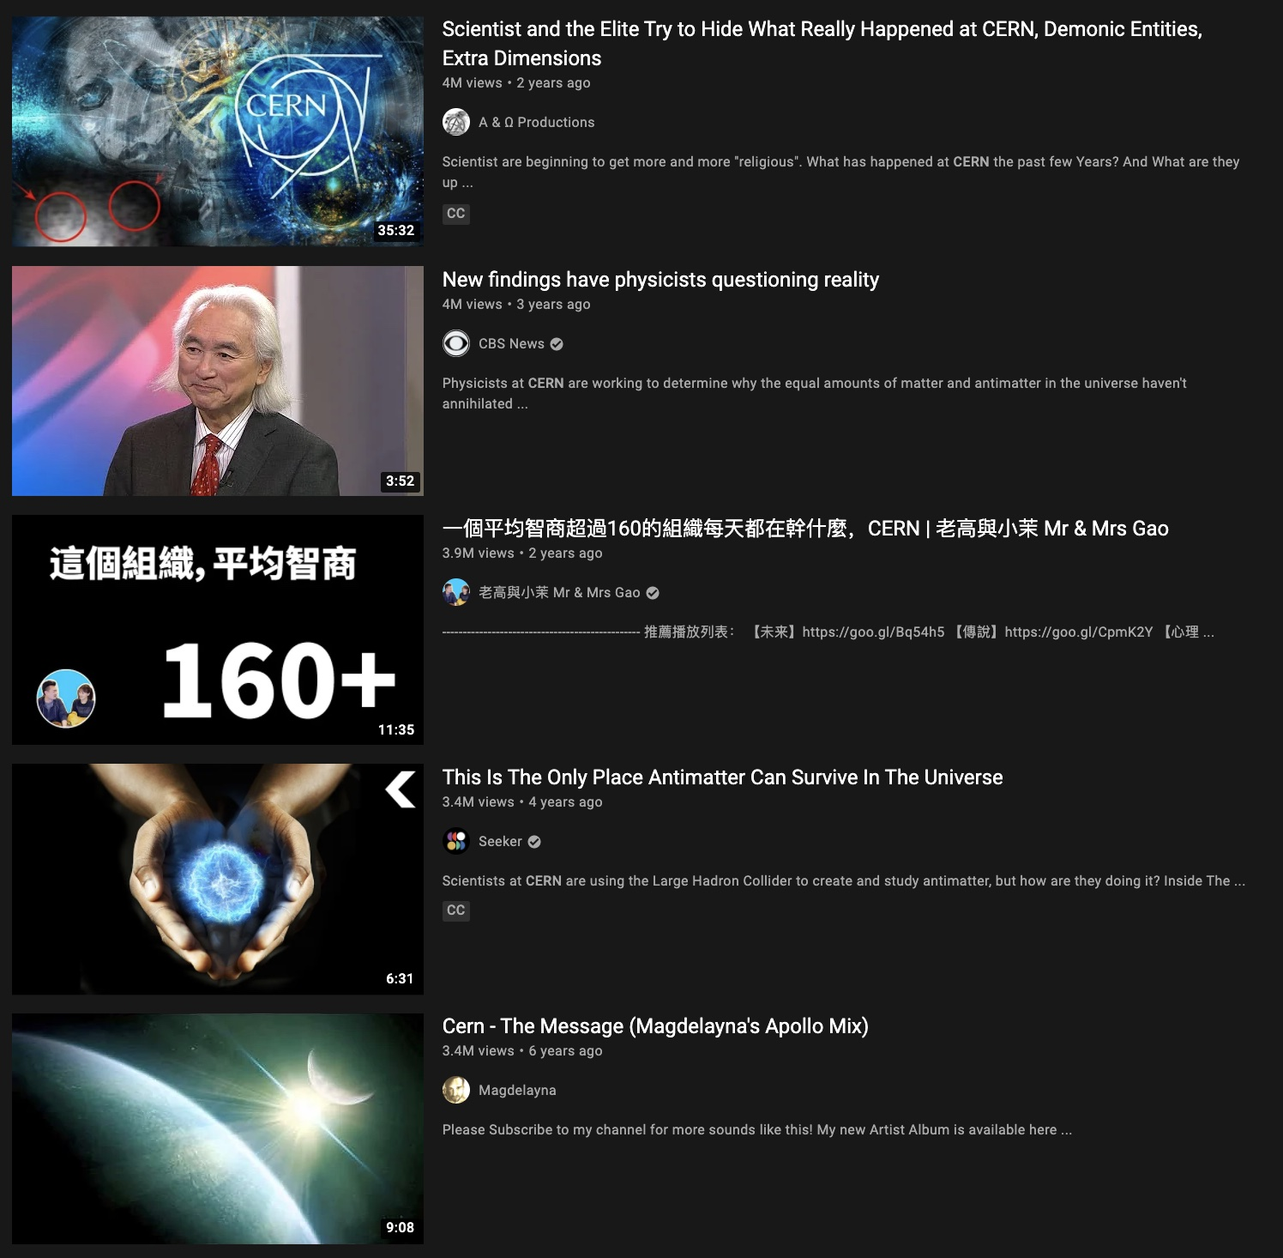

Slide 8
Yet, in this environment,
we have big plans…

Slide 9
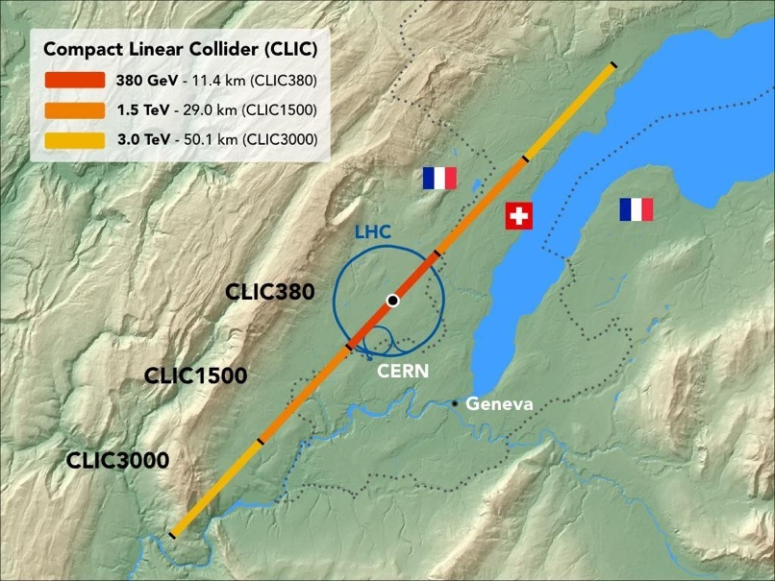
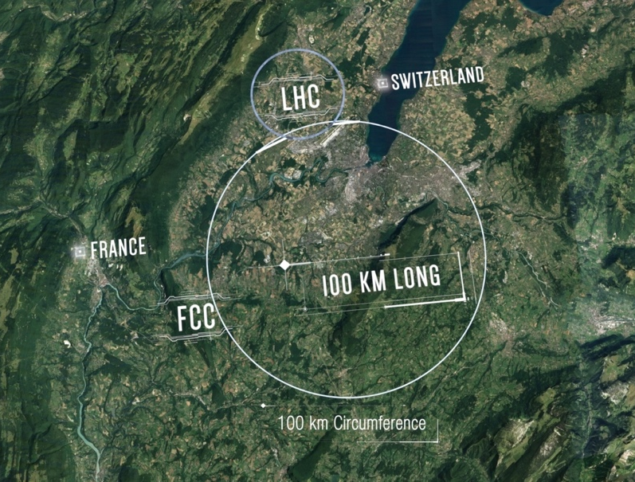
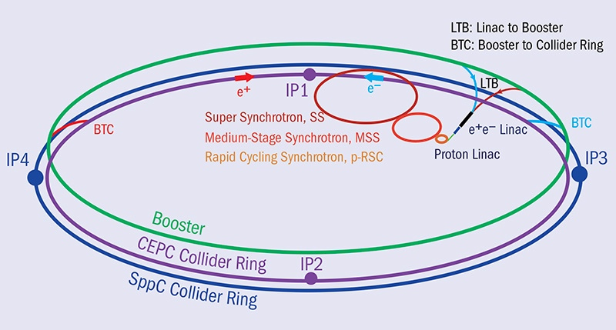
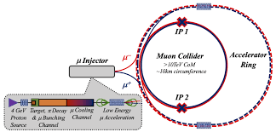
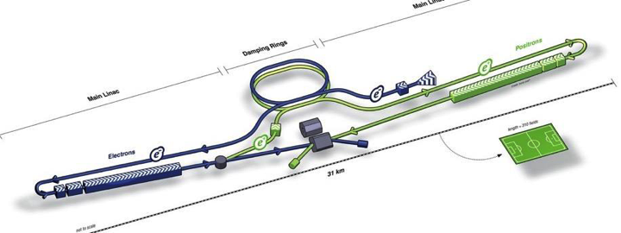
Future Plans for Particle Physics
CLIC
FCC
CEPC / SppC
IMC
ILC

Slide 10
Future Plans for Particle Physics

Slide 11
How do we prepare for this?

Slide 12
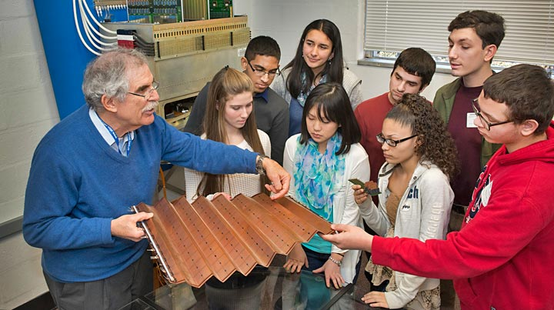
Education, Outreach, Communication
Communication (EPPCN, Interactions,…)
  Develop messages & strategies
  Optimise platforms & networks
  Create effective material
  Implement and evaluate
Education & Outreach (IPPOG)
  Establish Understanding of scientific process
  Instil Appreciation of fundamental research
  Build Trust with communities
  Train Next Generation of scientists
The Education, Outreach & Communication we do today lay the foundation for tomorrow’s support and secure the next generation of scientists.

Slide 13
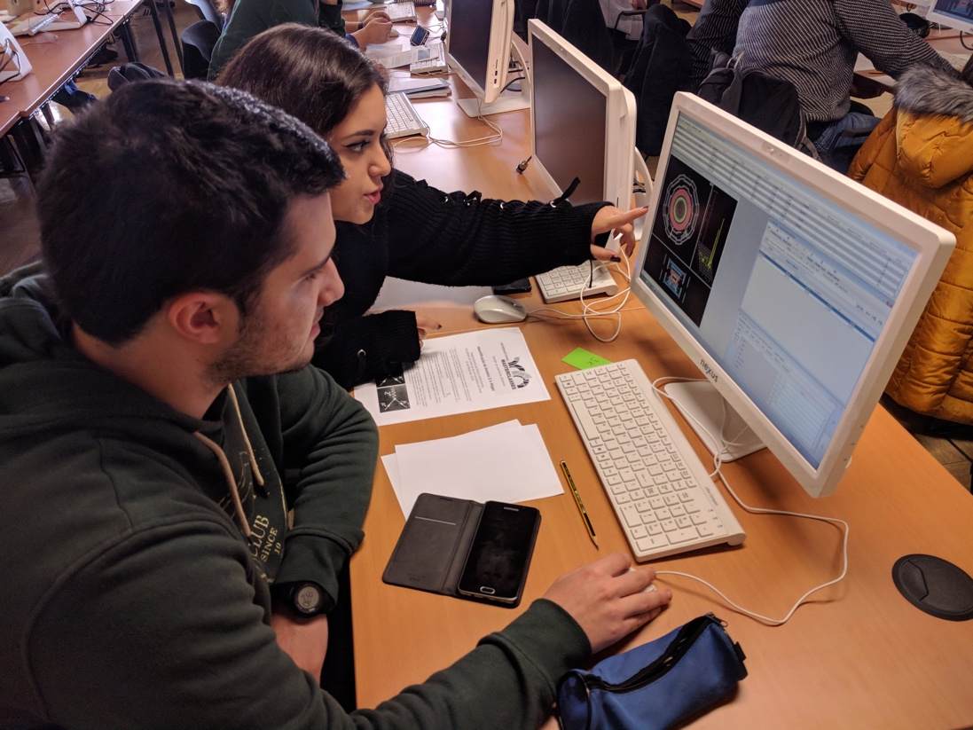
IPPOG
International Scientific Collaboration
  Active Researchers with Experience and/or Interest in Education & Public Engagement
  Experts in Communication & Education
Organise Global Activities
  International Particle Physics Masterclasses
  World-Wide Data Day, International Cosmic Day, etc.
Support Local Activities
  Sharing of expertise, best practices, material database
  Resources to support events, kick-start activities
Search the RDB | IPPOG (cern.ch)

Slide 14
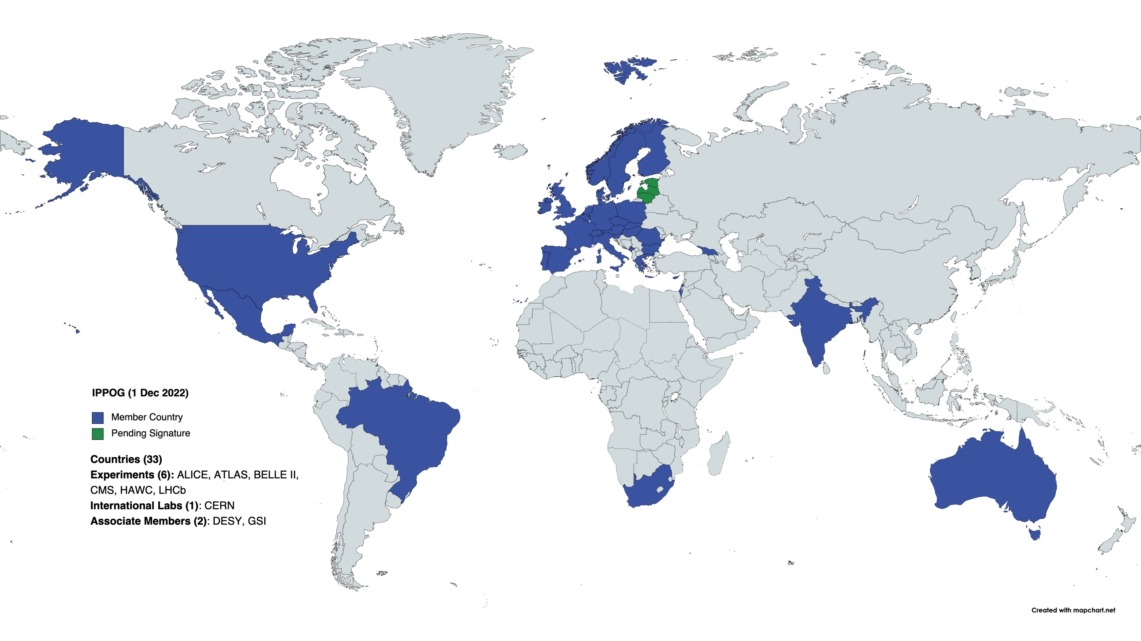
IPPOG Membership
33 Countries, 6 Collaborations, 1 International Lab, 2 National Labs

Slide 15
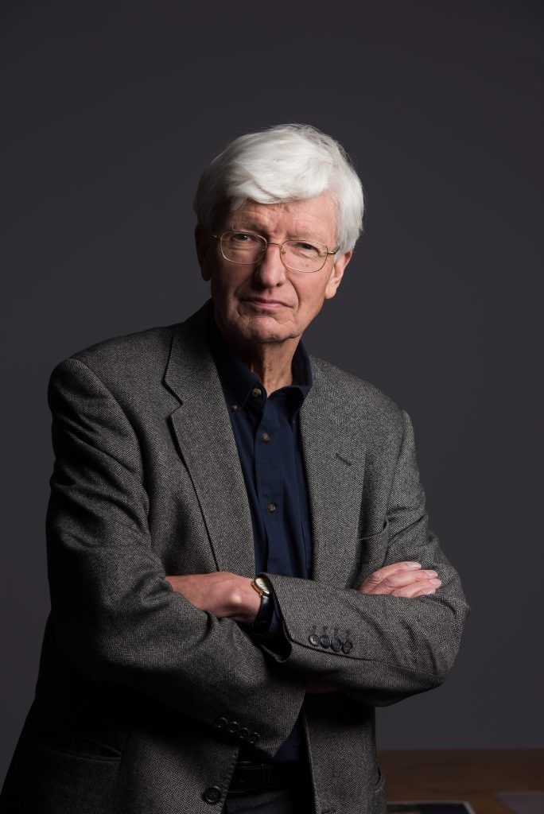
IPPOG Timeline
1997 Birth of European Particle Physics Outreach Group (EPOG)
  formed under the joint auspices of ECFA and EPS-HEPP
2005 Birth of International Particle Physics Masterclasses
  now in over 60 countries worldwide
2011 Global Expansion to IPPOG
  Israel, Australia, USA, South Africa, Brazil, India, Mexico,…
2016 Formal Scientific Collaboration
  Memorandum of Understanding
2022 Celebrating 25 Years of Outreach Excellence
  Most recent new members: India, Cyprus, Mexico
“…the particle physics community has a moral obligation to inform the public on its activities. To do this well, experiences must be shared among countries in view of the need to optimize the use of resources.”
- Chris Llewellyn-Smith, CERN Director General, 1997

Slide 16
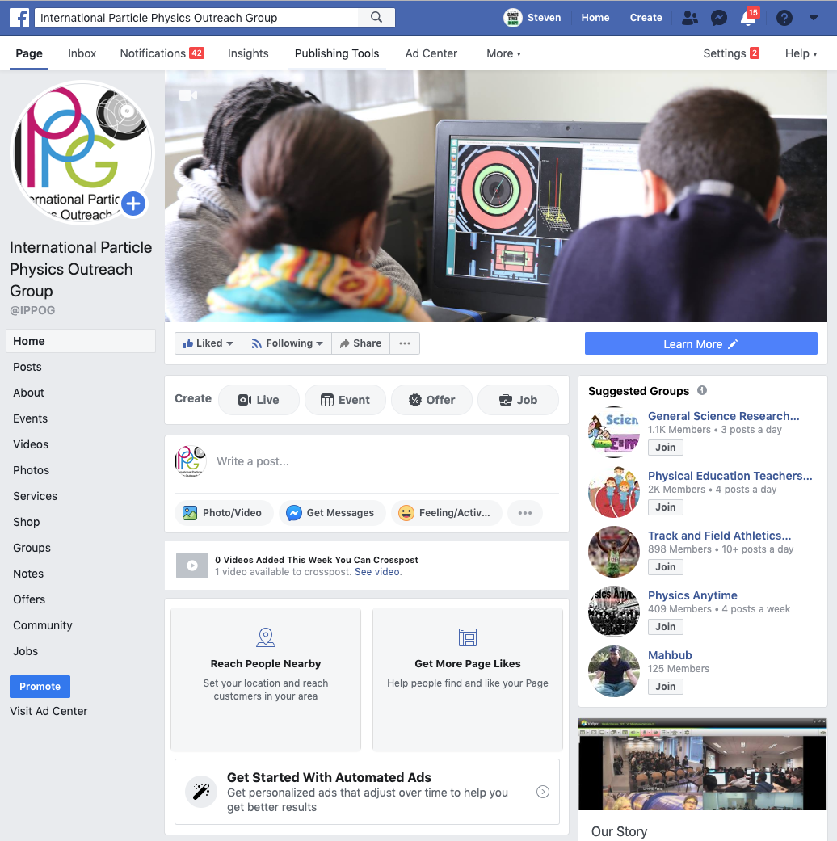
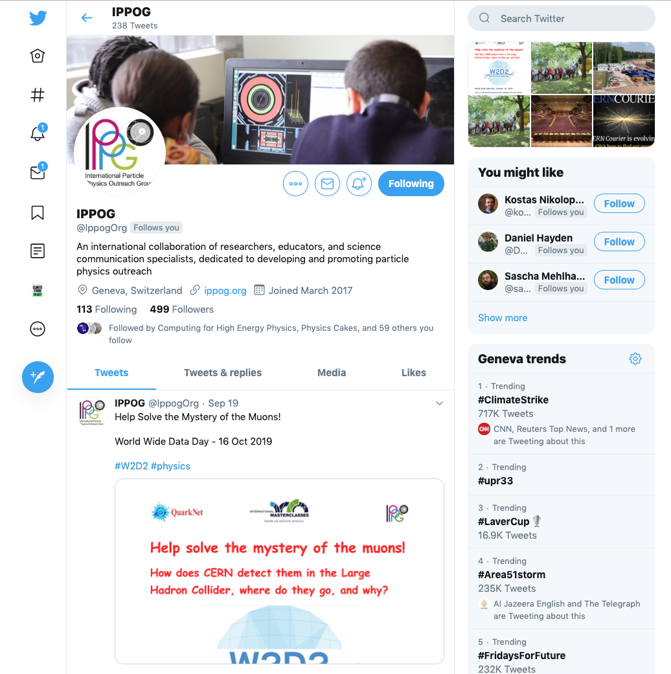
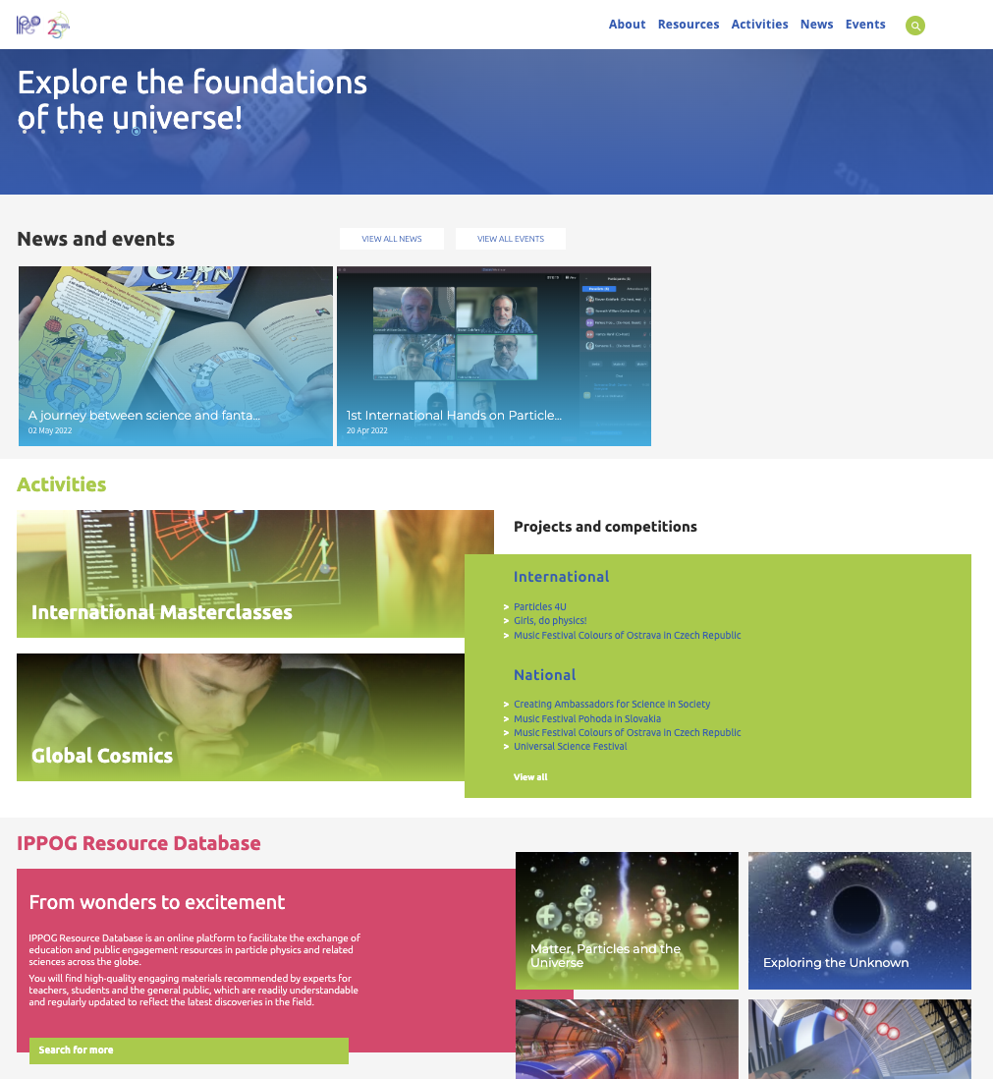
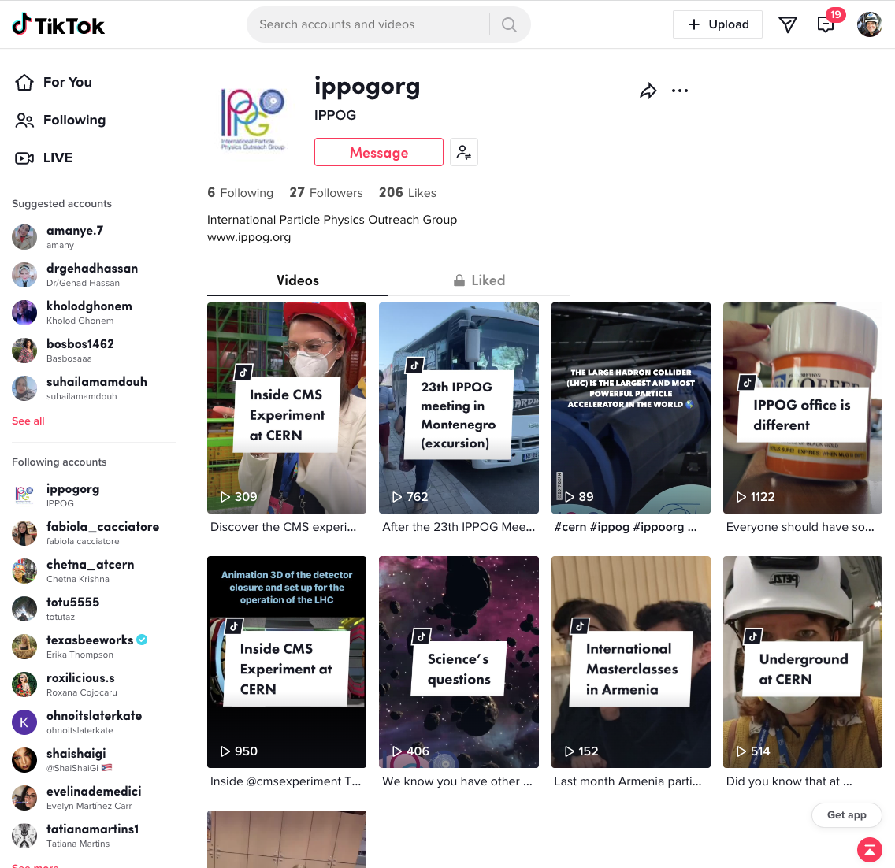
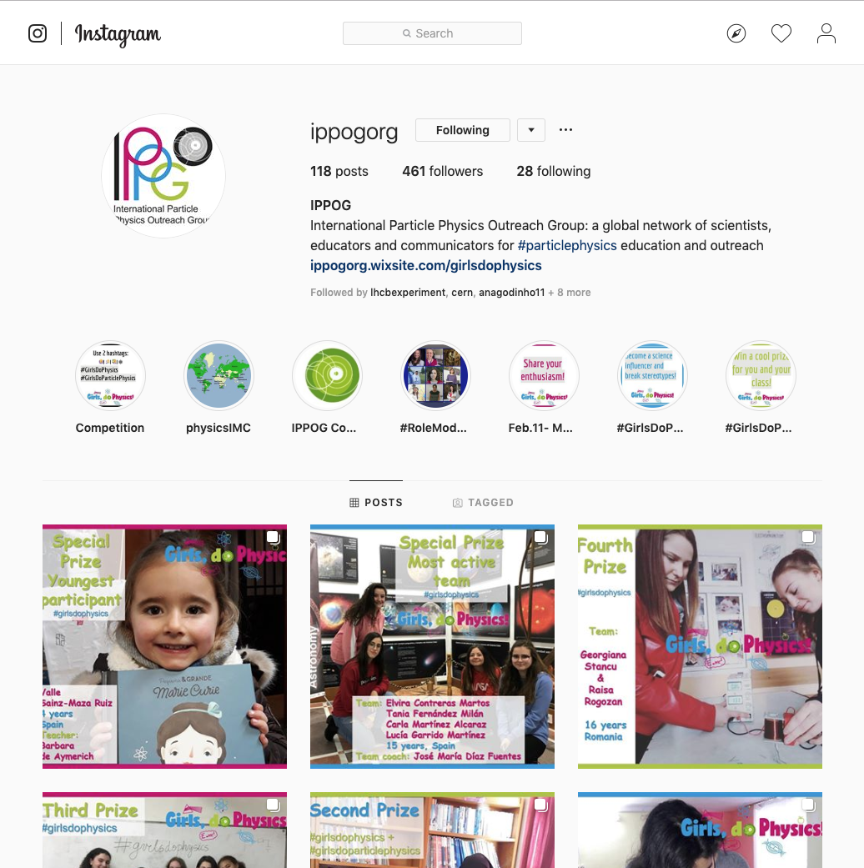
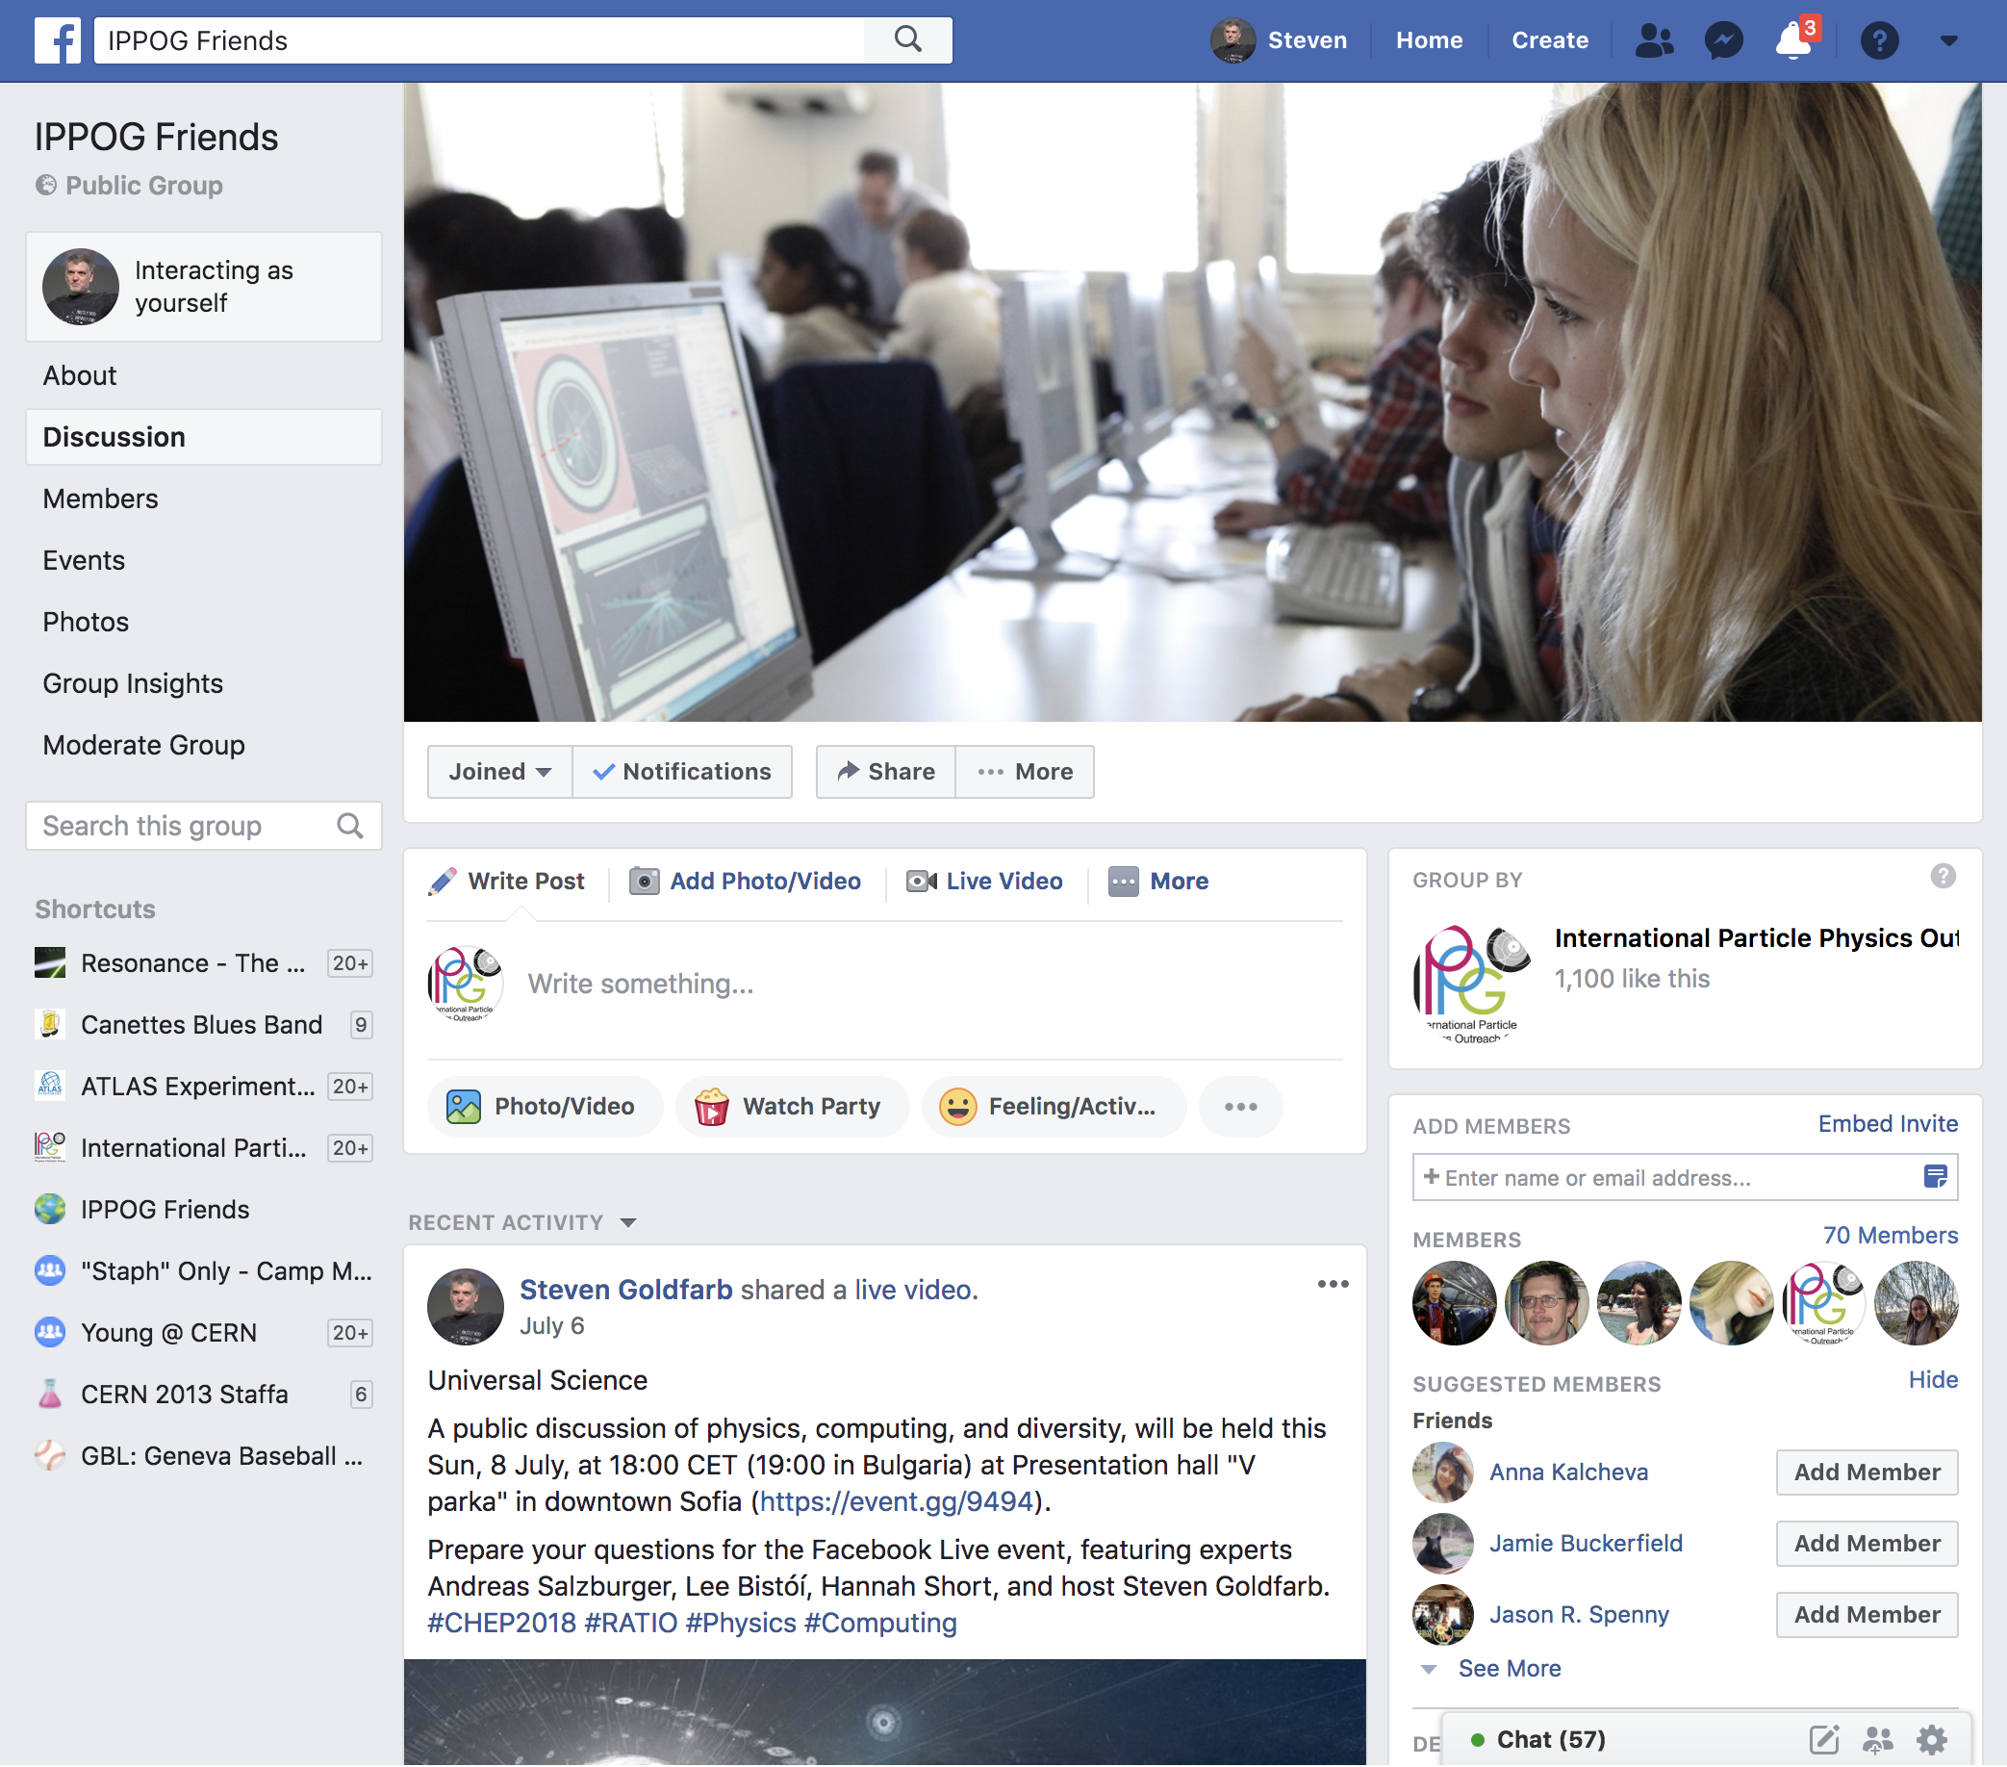
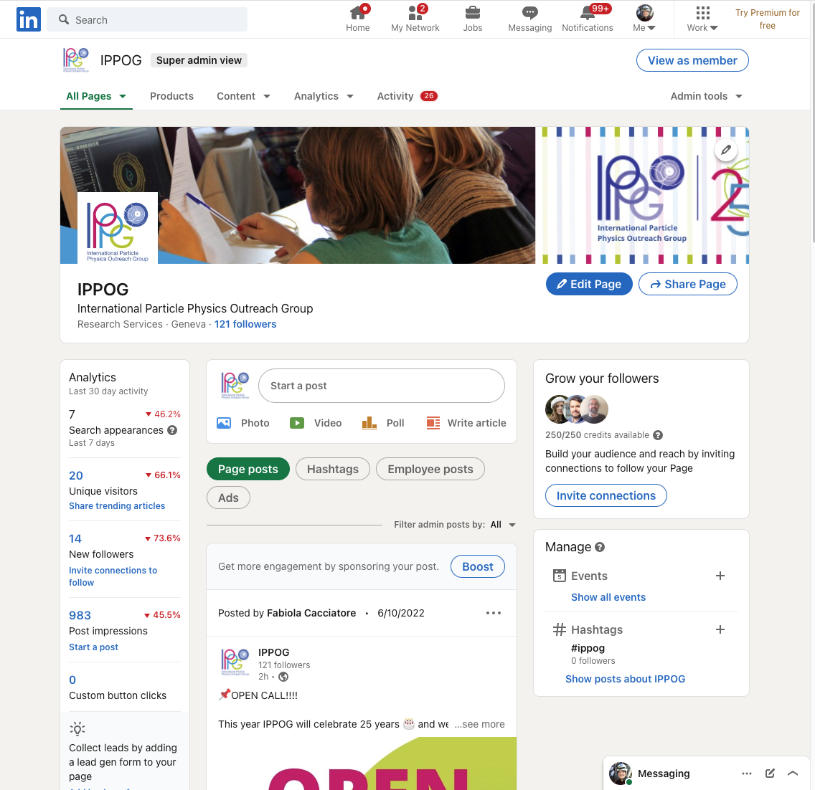
Communication Platforms
International Particle Physics Outreach Group
https://ippog.org
https://facebook.com/ippog
https://facebook.com/groups/friends.ippog
https://twitter.com/ippogOrg
https://instagram.com/ippogOrg
https://tiktok.com/@ippogOrg
https://linkedin.com/company/ippog

Slide 17
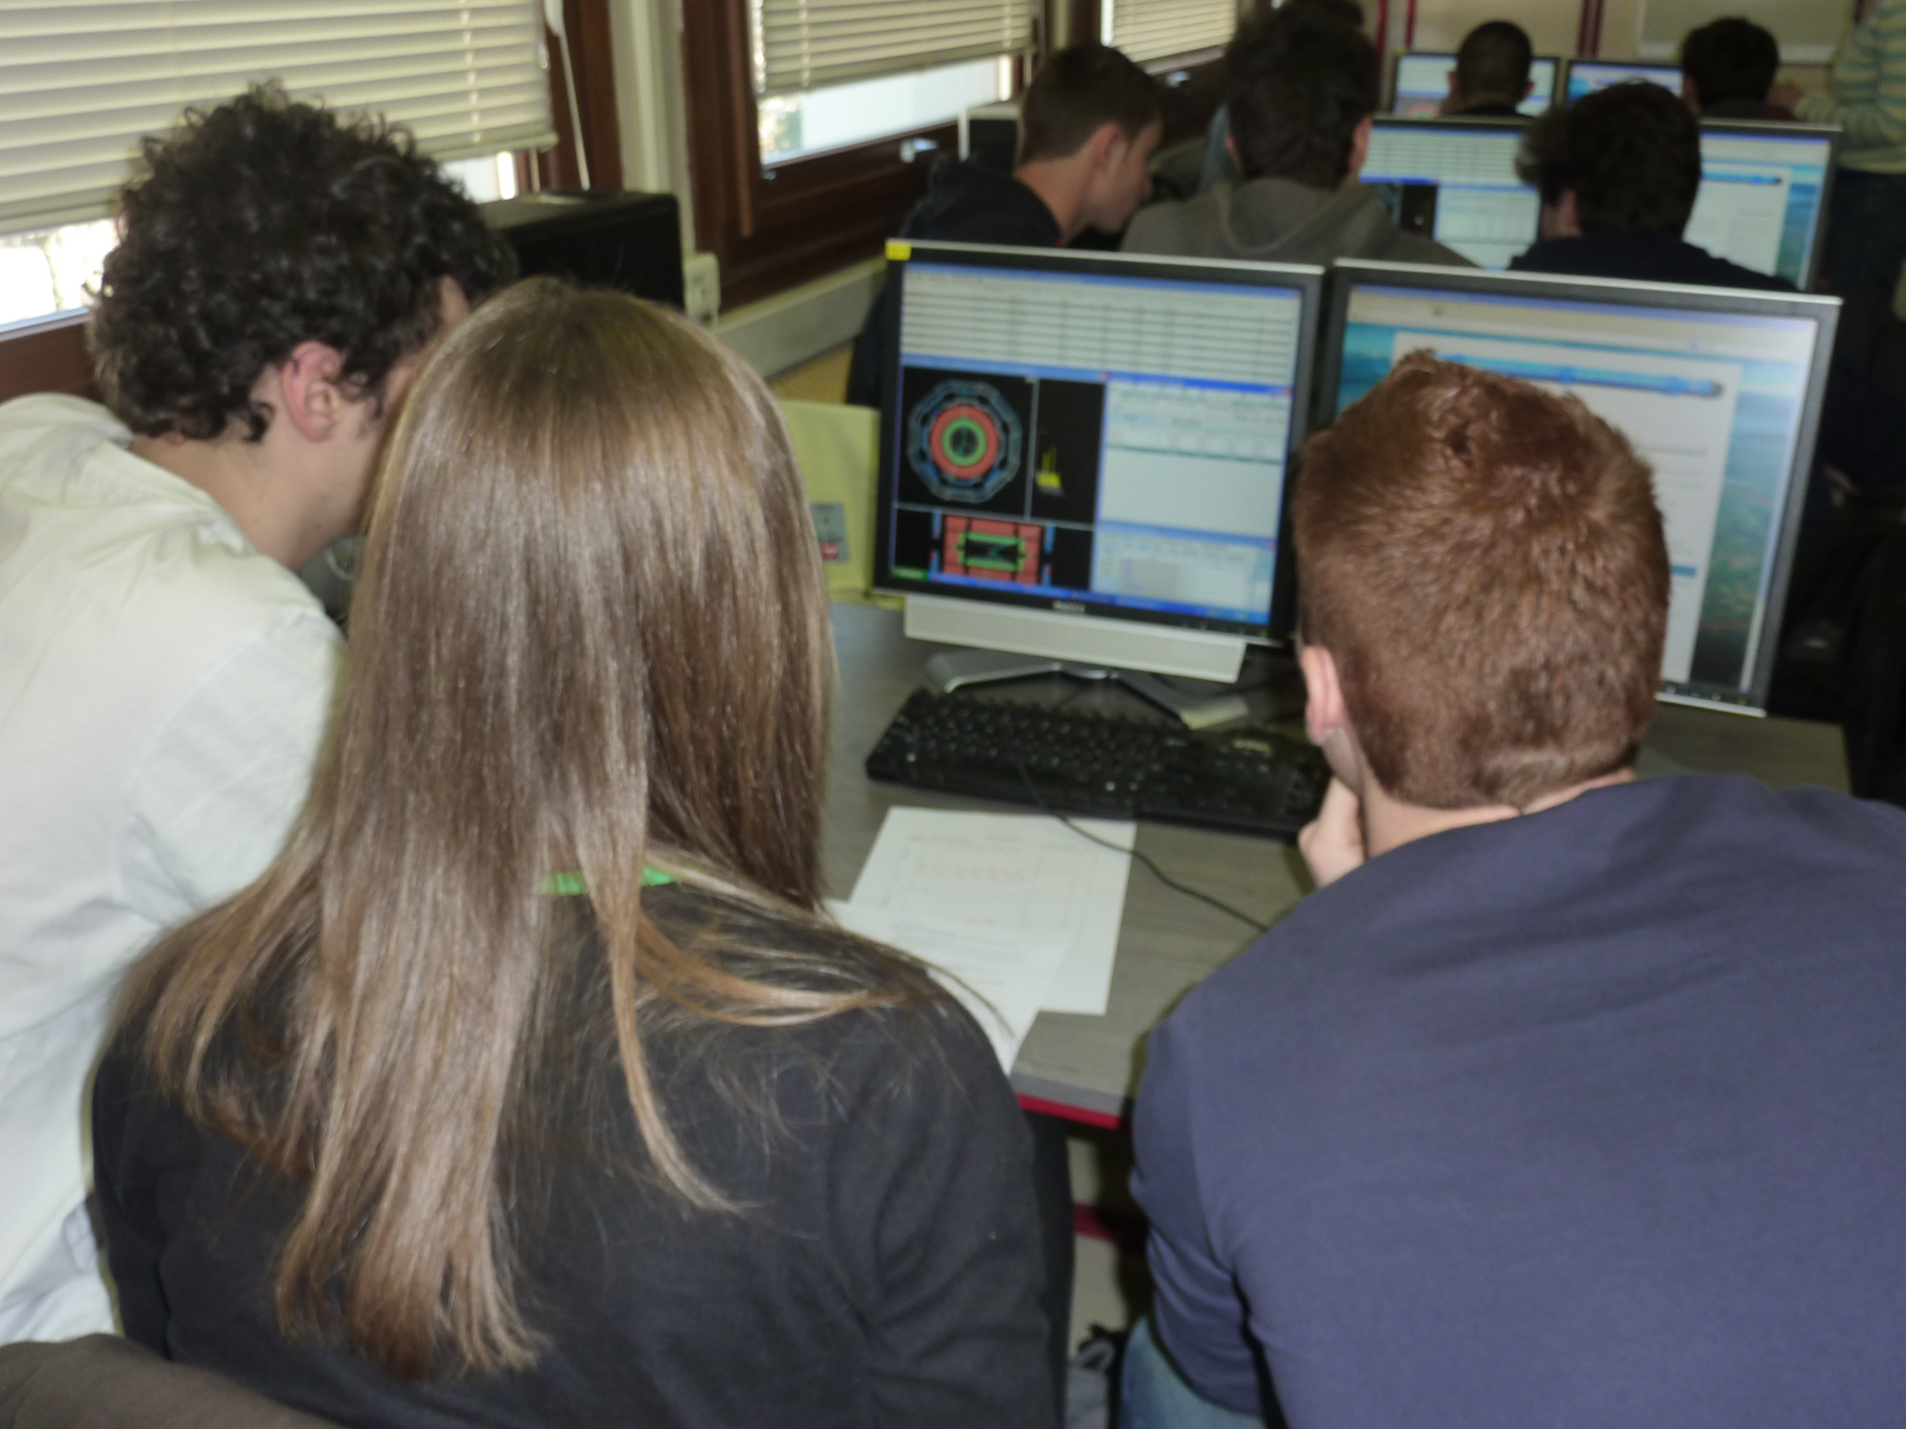
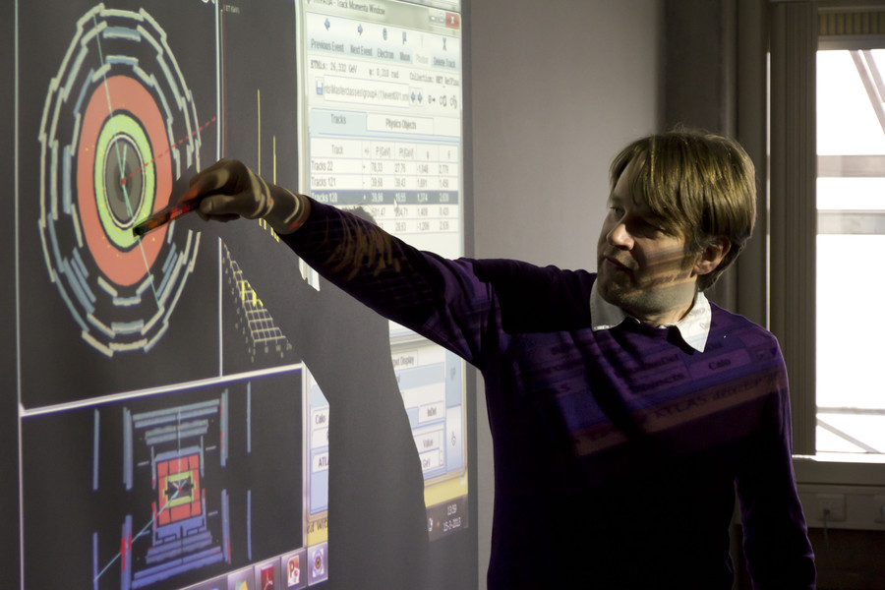
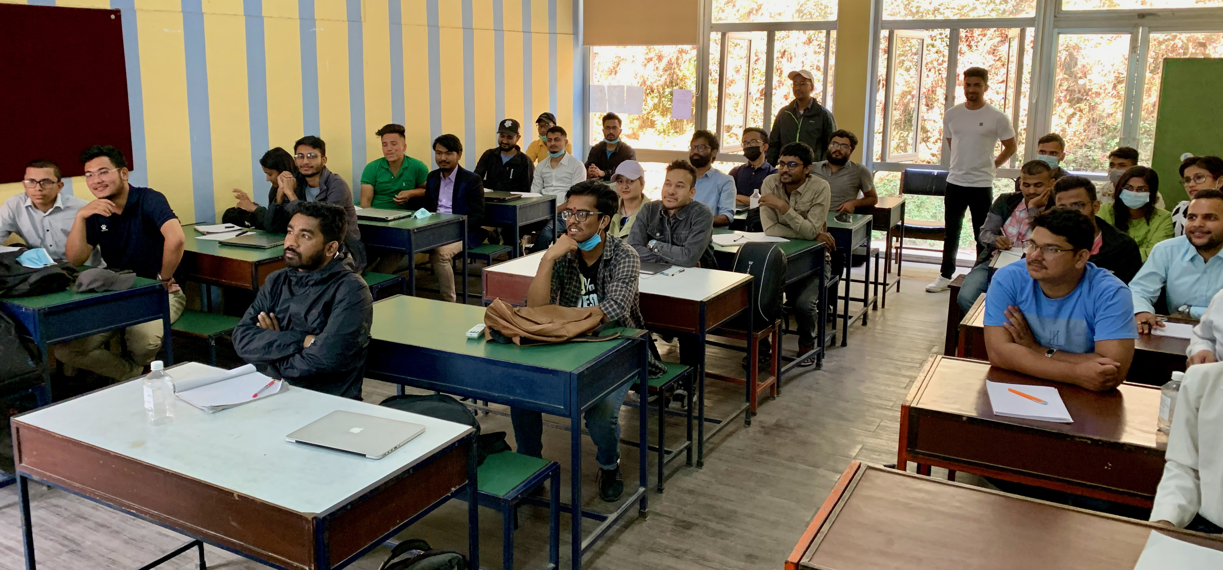
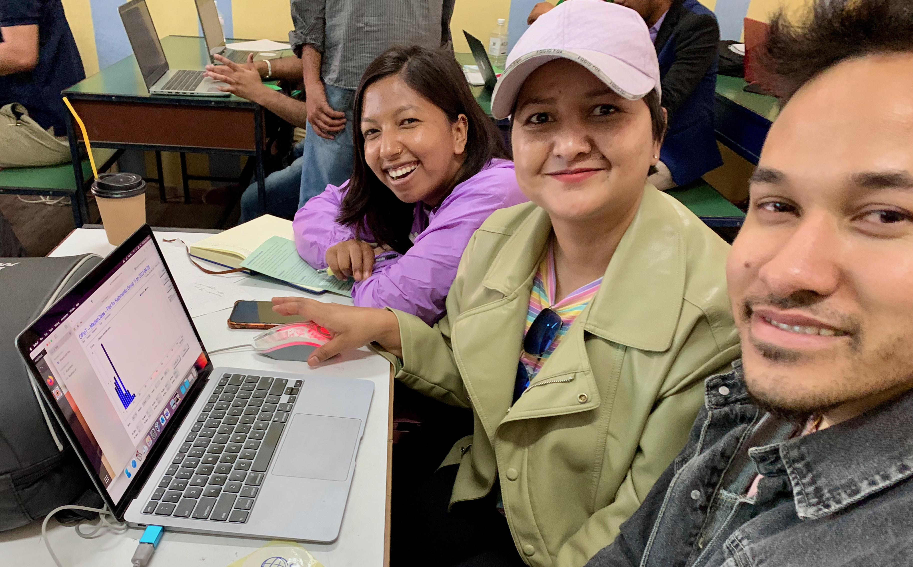
International Particle Physics Masterclasses
The Flagship of IPPOG
  Students become “Researchers for a Day”
  Invited to research institute or university
  Use analysis tools to examine real data
  Worldwide videoconference w/other students
2019
  60 countries, 220 labs, 14,000 students
2022 (24 Feb - 9 Apr)
  11 Feb (UN Day for Women & Girls in Science)
  CERN: 191 (94 ATLAS, 51 CMS, 22 LHCb, 24 ALICE)
  FNAL: 32 (22 CMS, 10 ATLAS, 9 MINER𝜐A)
  KEK: 11 (11 Belle II)
  GSI: 28 (28 Hadron Therapy)

Slide 18
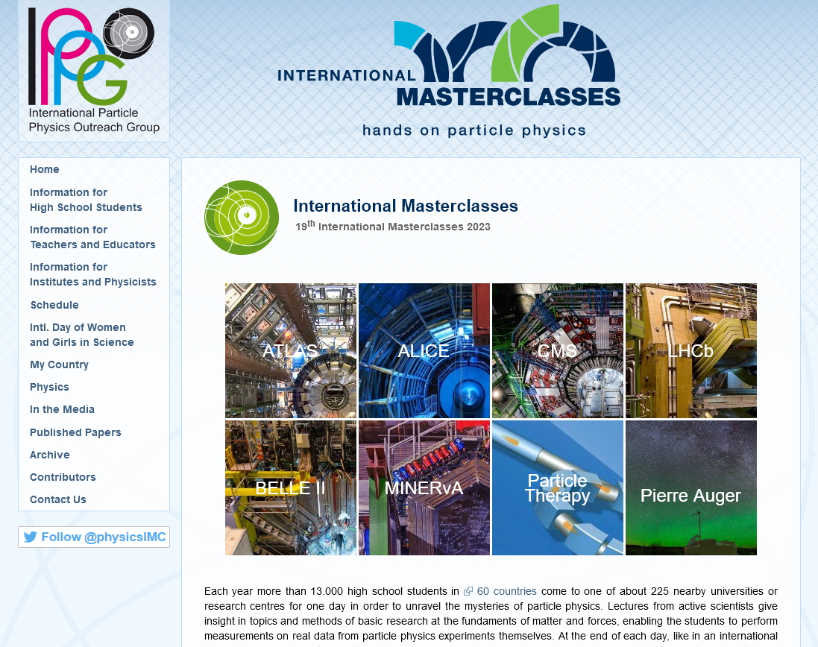
International Particle Physics Masterclasses
2019
  60 countries, 220 labs, 14,000 students
2022
  11 Feb (UN Day for Women & Girls in Science)
  CERN: 191 (94 ATLAS, 51 CMS, 22 LHCb, 24 ALICE)
  FNAL: 32 (22 CMS, 10 ATLAS, 9 MINER𝜐A)
  KEK: 11 (11 Belle II)
  GSI: 28 (28 Hadron Therapy)
2023
  10 Feb (UN Day for Women & Girls in Science)
  CERN: 211 (99 ATLAS, 56 CMS, 26 LHCb, 20 ALICE)
  FNAL: 40 (29 CMS, 11 ATLAS, 8 MINER𝜐A, 2 NO𝜐A)
  KEK: 16 (16 Belle II, 12 Pierre Auger)
  GSI: 30 (30 Hadron Therapy)

Slide 19
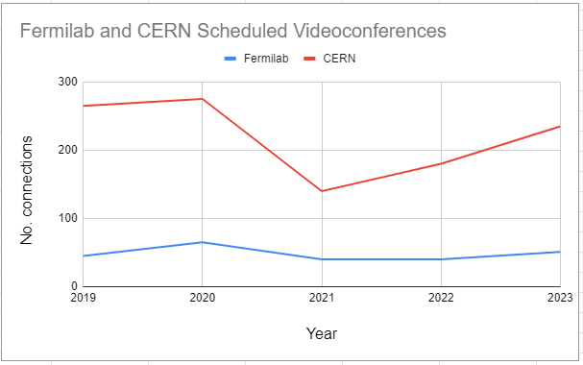
Annual Usage Evolution

Slide 20
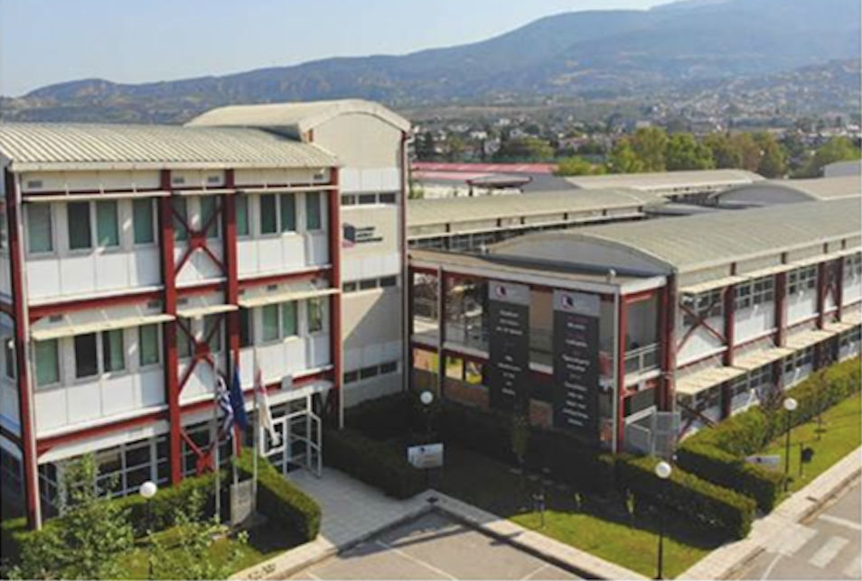
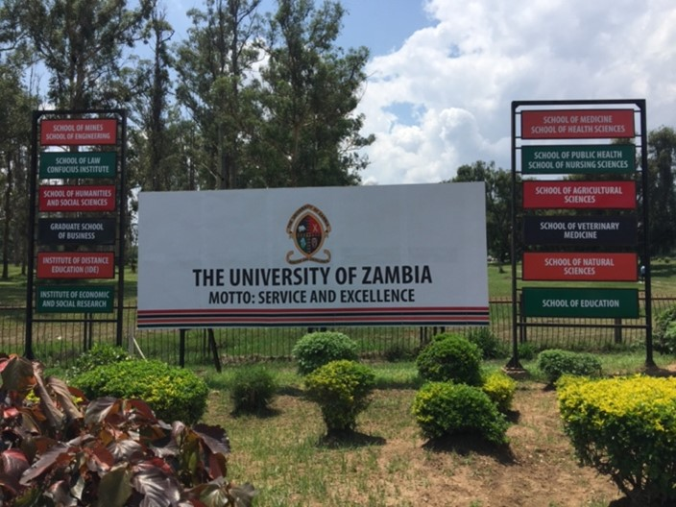
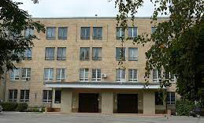
New IMC participants in 2023
Hellenic Open University
Patra, Greece
profile
University of Zambia
Lusaka, Zambia
profile
Quito, Ecuador
Escuela Politécnica Nacional, profile
  Near Quito: Cuenca, Montelibano
Maputo, Mozambique
Universidade Eduardo Mondlane
Ben Guerir, Morocco
Mohammed VI Polytechnic University
Kharkiv National University
Kharkiv, Ukraine
profile

Slide 21



Global Cosmics
High School Initiatives Exploring Cosmic Rays
  Sabine Hemmer (INFN), Carolin Schwerdt (DESY)
  International Muon Week (15-19 Mar 2021)
    16 sites / 7 video meetings (organised by QuarkNet)
    World-wide project: measure average speed of muons
  International Cosmic Day (22 Nov 2022)
    93 institutions worldwide (organised by DESY)

Slide 22




World-Wide Data Day (W2D2)
Oct 2019/2021 (24h)
  Participating groups: 48/43
  Students: 969/590
  Moderators: 8 / Videoconfs: 15
Measurement
  Students worldwide analyse data from LHC events
  Data analysis at school, physics discussion in VC
  Measurement used in Chile, Mexico, Namibia workshops in 2018
  Great growth in Mexico: 9 groups
  Measurement stable
https://quarknet.org/content/world-wide-data-day

Slide 23

CERN’s Beamline 4 Schools
IPPOG Participation
  Local Contacts to Schools
  Help Remove Language Barrier
  Give Guidance for Physics, Feasibility

Slide 24
CERN’s Beamline 4 Schools
IPPOG Participation
  Local Contacts to Schools
  Help Remove Language Barrier
  Give Guidance for Physics, Feasibility

Slide 25






Public Events & Festivals
Colours of Ostrava
Czech Rep, 2019-2022
http://universalscience.web.cern.ch
Sofia, Adelaide, Lisbon, Online 2018-2022
Pohoda Festival
Slovakia, 2019
Music of Physics
Montreux, U.K., Sofia, Nepal, 2018-2022

Slide 26



Sharing Ideas & Best Practices
23rd IPPOG Meeting
  Podgorica, Montenegro, 11-13 May 2022
  Working Group Meetings & Reports:
    Expanding Masterclasses to New Countries, Exhibits & Public Events, Explaining Particle Physics, Applications for Society, Diversity & Inclusion
  Workshop: “Masterclasses for different targets”
    Middle School, Public, Journalists
24th IPPOG Meeting
  CERN, Geneva, 26-28 Oct 2022
  Masterclass for non-scientific CERN staff
  17 Success Stories, 5 Working Groups
  Panel discussion on future facilities
    FCC, DUNE, Intl Muon Collider, Podcast
Intensive 2.5-Day Meetings

Slide 27
Computing

Slide 28
Thanks for the (computing) support
CERN Document Server (CDS)
CERN Open Data Portal
Containers
It’s not AI/ML, there are no Qubits, high-throughput, or cutting edge technology
  Except that to many people --- it is!
  And … it will eventually lead to better progress

Slide 29
Future Challenges
From the European Particle Physics Strategy Update 2020
Exploring the fundamental properties of nature inspires and excites. It is part of the duty of researchers to share the excitement of scientific achievements with all stakeholders and the public. The concepts of the Standard Model, a well-established theory for elementary particles, are an integral part of culture. Public engagement, education and communication in particle physics should continue to be recognised as important components of the scientific activity and receive adequate support. Particle physicists should work with the broad community of scientists to intensify engagement between scientific disciplines. The particle physics community should work with educators and relevant authorities to explore the adoption of basic knowledge of elementary particles and their interactions in the regular school curriculum.
The International Particle Physics Outreach Group (IPPOG) has been established as a structural collaboration between countries to streamline particle physics education at the high-school level and its role could be further augmented to that of providing public engagement material.
The particle physics community is highly active in public engagement, and the overall enthusiasm of the general public for the field testifies to the effectiveness of these actions. This high level of public engagement should be sustained, in both its bottom-up and top-down forms. Many of the public engagement activities rely on the efforts of individuals, and should be seen as an integral part of being a scientist and be properly valued in terms of career advancement. European funding agencies are urged to systematically and explicitly accompany research funding by providing resources for public engagement activities.

Slide 30
Thank you!

