Slide 1
EOSC-CZ plans for physical sciences
Jiří Chudoba
CHEP 2023, Norfolk, Virginia

Slide 2
EOSC
European Open Science Cloud (EOSC) – initiative to promote Open Science
Open Science
Open access to scientific results
Open access to primary (where possible) resources
Shared knowledge
Multidisciplinary cooperation
Reuse of data and results
Data is the key item in the Open Science concept
FAIR (Findable, Accessible, Interoperable, Reusable)

Slide 3
EOSC
Goals
provide framework for long term data storage
tools for data management
tools for data access management
tools for data (re)analysis
Federated principle
independent development and maintenance of individual components
requires common interfaces and standards
connects individual components into one aggregate

Slide 4
EOSC CZ
Implementation architecture in the Czech Republic
document published in 2021 by EOSC platform at the MEYS (CZ ministry)
defines basic components and implementation principles
National Data Infrastructure
National Metadata Directory
National Repository Platform
Coordination Committee established in 2022
advisory board for MEYS
Several calls for projects in total values 100 MEuro
2 specific Integrated projects already started for National Metadata Directory
CARDS (National technical library) – metadata
EOSC CZ project for e-INFRA.CZ – hardware for metadata (and much more)

Slide 5
National Repository Platform
Key components
Provides storage capacity
Defines standards and interfaces
System for creation and integration of repository instances (tenants)
distributed repositories serving for specific groups
possibility to include existing repositories
supports specific metadata, tools and access methods
access control defined by data owner
Project under preparation, expected to start in 2024

Slide 6
Scientific clusters
8 clusters to prepare specific projects
Bio/Health/Food
ENVRI
Physics
Material Sciences and Technology
AI and Digital Science
Humanities and Arts
Social Sciences
Sensitive Data
Call expected in 2024
Already now discussions with NRP project

Slide 7
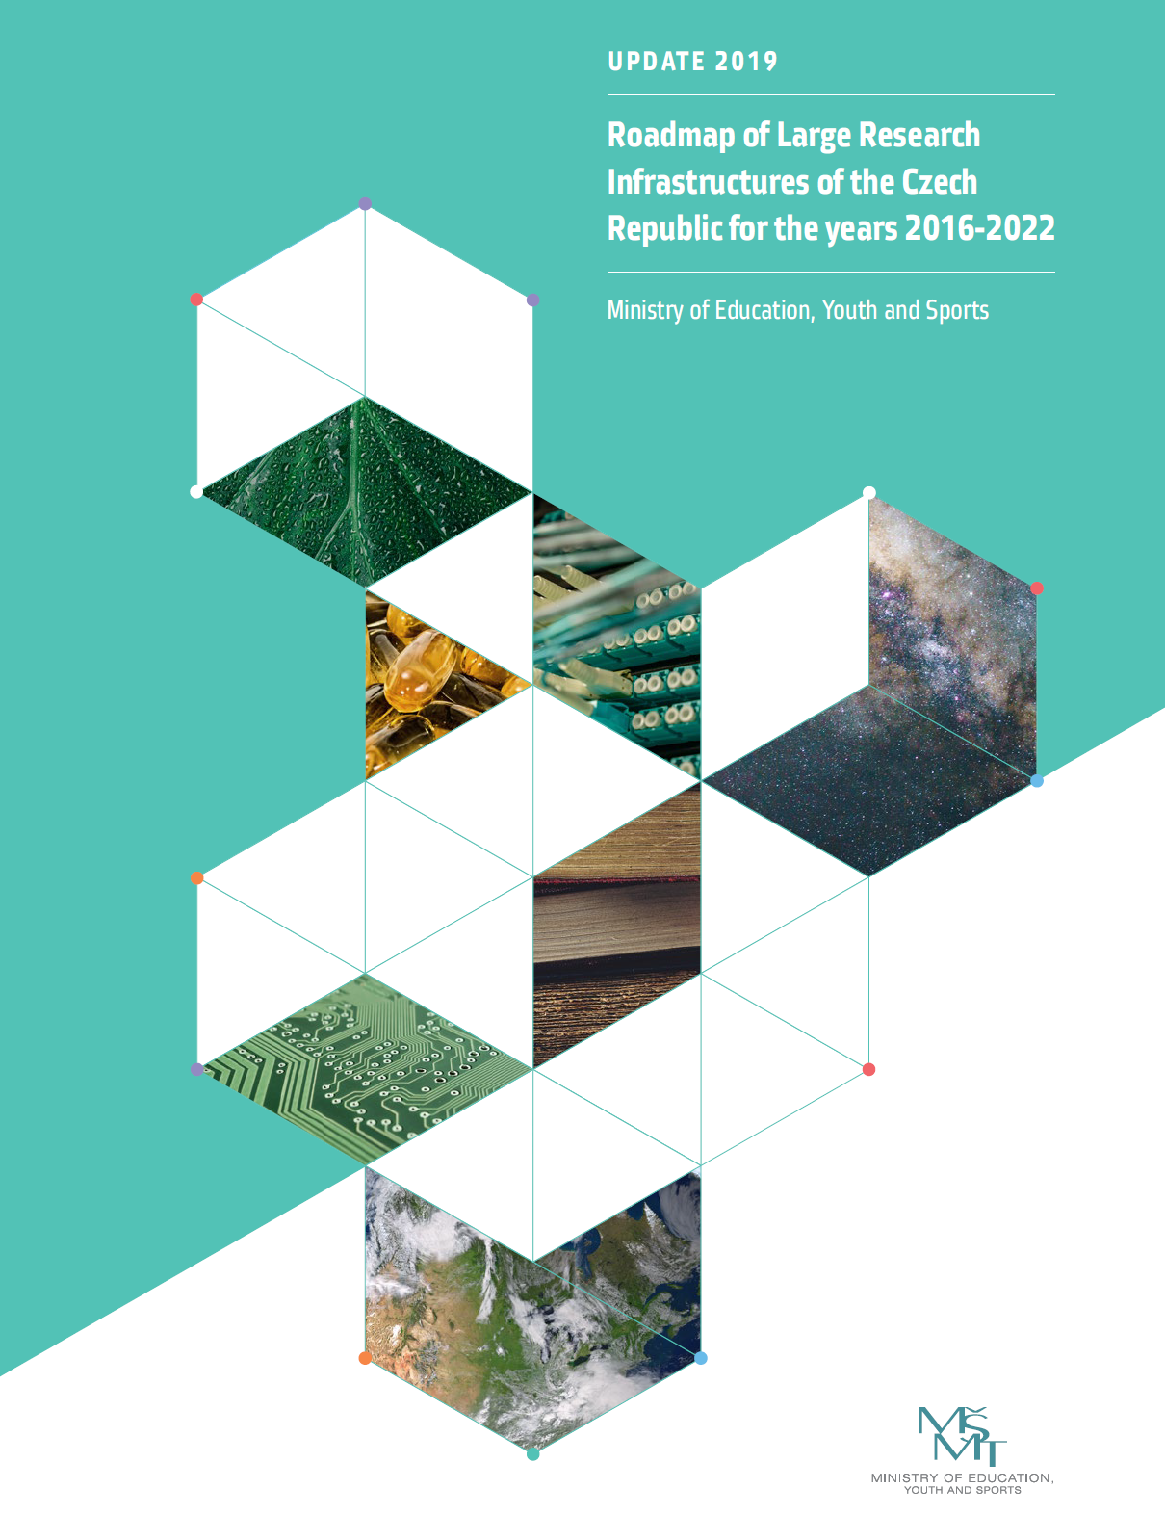
Physics cluster
Large research infrastructures
Long term projects in the Roadmap document
CERN, FERMILAB, BNL, FAIR, CTA (Cherenkov Telescope Array), Pierre Auger Observatory, EST (European Solar Telescope), ESS (European Spallation Source), ...
ELI (Extreme Light Infrastructure) ERIC
Many small groups

Slide 8
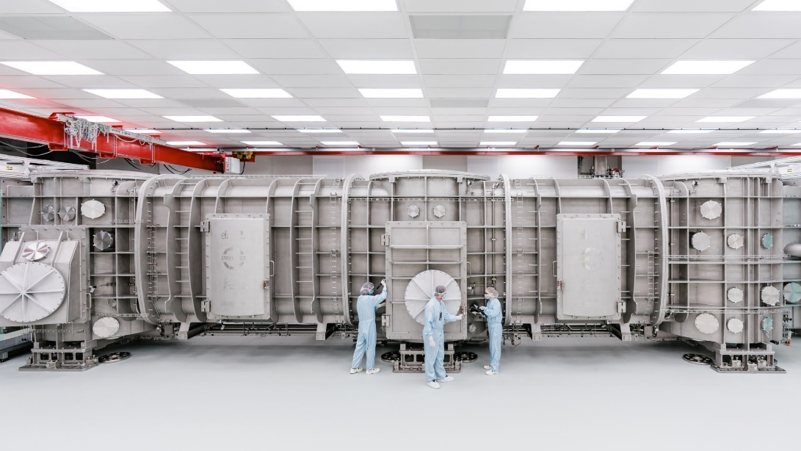
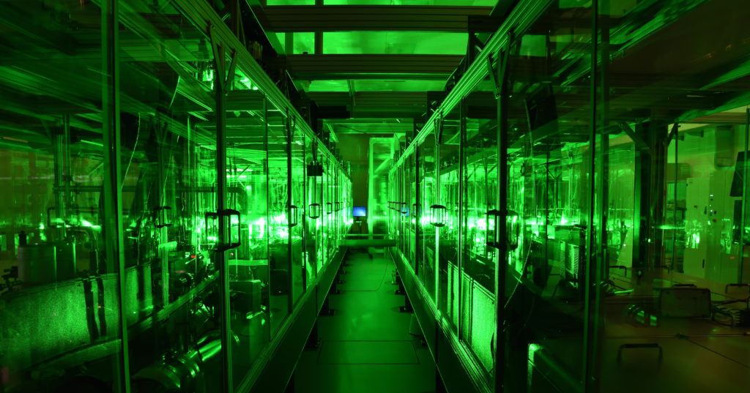
Examples from Physics cluster
Extreme Light Infrastructure
small to intermediate groups using laser beamlines
groups from different fields (from material physics to biology)
several PB of data expected when fully operational
Notes:
add picture with beamlines

Slide 9
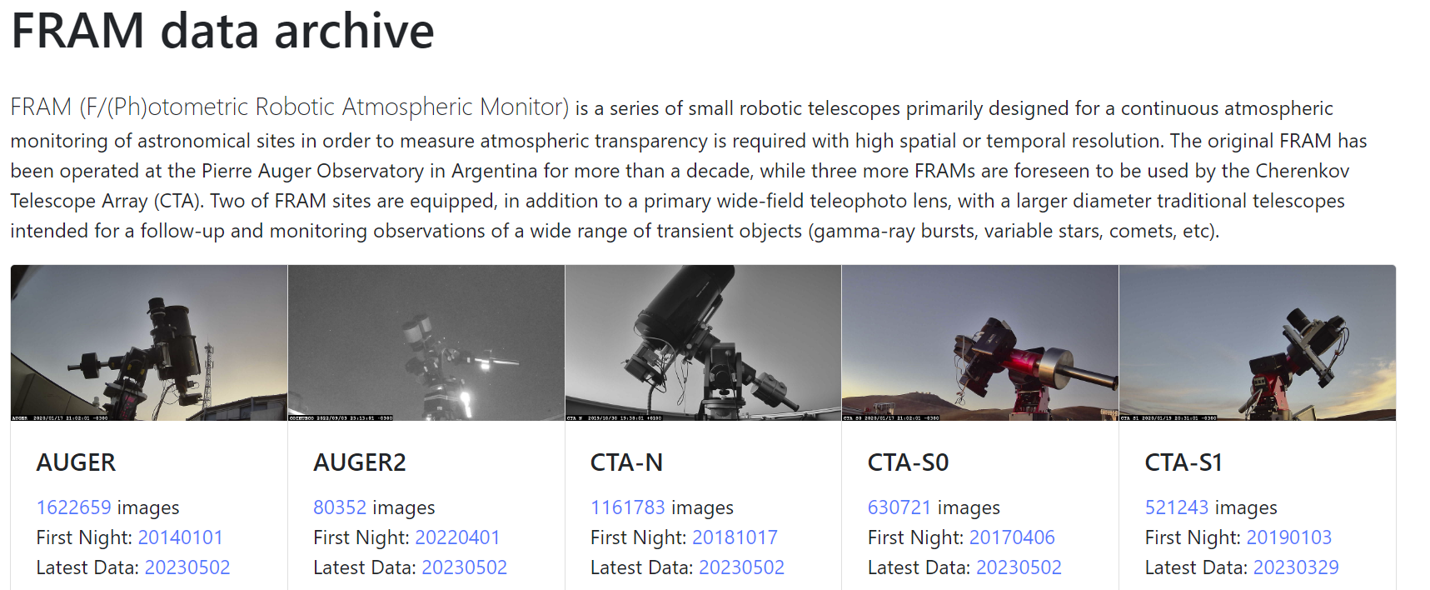
Examples from Physics cluster
Robotic Telescope
5 telescopes in operation (for Pierre Auger Observatory and CTA)
1 picture / minute, 30 MB / picture
about 100 GB per night from 5 telescopes
currently 100 TB in archive available via fram.fzu.cz

Slide 10
Examples from Physics cluster
Solar Physics
FITS format
Public data shortly after verification
Standards for metadata
About 200 TB per year
Combined observations of Sun eruptions from two telescopes in the Czech Republic and one on Canary Islands. 150 GB in 2 hours

Slide 11
CERN
The right example and inspiration for other groups
Open data portal
LHC and other data available
documentation, examples
event displays
Zenodo
CERN Data Centre-backed research data repository for the long-tail of science
DOI assignment
upload, curation and sharing of the data through a web interface

Slide 12
Opportunities
Resources for Data stewards
professionals to be trained
to help big and small groups
share experience
Transfer of knowledge from large international collaborations to local groups
Actively participate in CERN open data activities
Collaboration with other national EOSC activities

Slide 13
Questions?
This presentation partially used information from EOSC CZ public presentations
See http://eosc.cz for more information

