Slide 2
BrainSlug, Rundeck & StackStorm
Managing Batch worker node lifecycle & maintenance
(work by Ankur Singh, Priyanshu Khandelwal, slides by Ben Jones)

Slide 3
LxBatch @ CERN
Primary compute platform for CERN production workload
350 daily active submitters
WLCG grid submission
+ “Local” submission by experiments, groups, projects at CERN
High Throughput Computing Workload that can fit on one computer (aka “embarrassingly parallel”)
Batch system uses HTCondor, developed at CHTC Wisconsin

Slide 4
Infrastructure Evolution
Managing scale with APIs & automation:
2008 20,000 cores bare metal
2012 -> OpenStack VM workers
2017 -> fleet of 20k VMs
Now: 5k bare metal machines ~275,000 cores
Reduced number of nodes, but we have 10x cores since 2010
Less homogenous: el7 -> el9, hybrid, non x86 arch
Return to bare metal
Eliminate “virtualization tax” ✅
Reduce total number of nodes ✅
Have to manage hardware break-fix 🚩
(cf Arne’s bare metal talk from Tuesday)

Slide 5
Farming
Cattle vs Pets a familiar analogy, but even ”disposable” cattle need some management
Interrupted jobs (usually) rescheduled, but this can be inefficient -> lost CPU time
Not all jobs at CERN are managed by sophisticated experiment frameworks
If we need to intervene: if jobs can finish them let them
…and take any other jobs that will complete in the meantime
This means that problem resolution or discretionary interventions become asynchronous, and thus arduous without automation
Moo ?

Slide 6
Automation tools
Brain Slug: an agent that runs on a worker node
State transitions
Actions for state transitions
Rundeck: runbook automation
Simple sequential tasks
Ability to delegate responsibility to execute tasks
StackStorm
IFFT for DevOps* * I hate that word is it dead yet

Slide 7
Brainslug
Small state-machine daemon to control worker node state
CERN CC machine state stored in “roger”, state changes propagated on message bus
Brainslug provides hooks to roger state changes
Examples:
Start / Stop draining
Reboot if drained
Transition to different state after reboot
{ ”drain”: { “targetdate”: $(date +%s) }, “power”: { “targetdate”: $(( $(date +%s) + 3600 * 24 * 7)), “policy”: ”asap”, } }

Slide 8
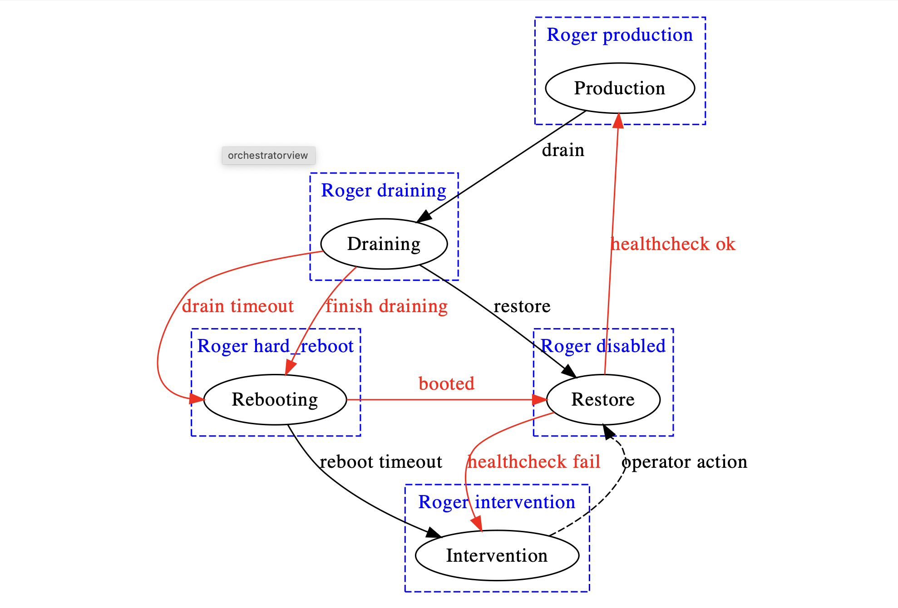
Basic brainslug flow
Allows for single command / API update to drain & reboot a machine
Options for state change after intervention, or time delay
API allows for integration with Rundeck & Stackstorm

Slide 9
Rundeck for break/fix
Data Centre admins get hardware alarms, and can schedule break / fix interventions
Via brainslug, Rundeck job can drain machines for target intervention date
After intervention, break / fix team can reenable
No coordination / oversight needed with batch service owners

Slide 10
Stackstorm for automatic remediation

Slide 11
StackStorm ?
Automation toolset
Python based, OSS project
Extensible with “packs” – upstream library exchange covering many common components
Sensors for actionable events
Rules route to Actions or Workflows
Policies for concurrency control
ChatOps, Webhooks, Cron etc all built in

Slide 12
StackStorm Example workflows (in use at CERN)
No_Contact handling for batch worker nodes
Sensor: no_contact
Workflow: handle_no_contact
Actions: brainslug_get_state, dns, ping, ssh_check_status, reboot, powercycle, raise_ticket
Escalate to a human only if necessary
Automatic HTCondor job throttling if AFS volumes are overloaded
Sensor: hot_volume
Workflow: handle_afs_throttling
Actions: count_user_jobs, condor_set_ceiling, condor_trim_userjobs
Try to reduce impact of badly behaved jobs before they cause problems for other users

Slide 13
No_Contact replace manual process
Reduce human intervention where it’s not needed
If you can write a detailed procedure, you can write a StackStorm workflow….

Slide 14
Prevent AFS overloads
Move from a manual last-ditch recovery to (hopefully) job shaping to avert crisis

Slide 15
There is some complexity…
Microservices architecture
Helm charts available that could help
Have to decide if scale of problem is worth the investment
Availability of “packs” means that many integrations are already done
“There are no solutions, only trade-offs”

Slide 16
backup slides

Slide 17
no_contact workflow

