Slide 1
Artificial Intelligence for Improved Facilities Operation
Speaker
Milan Jain, Data Scientist Pacific Northwest National Laboratory

Slide 2
Project Team
Jan Strube
Physicist
Milan Jain
Data Scientist
Vinay Amatya Computer Scientist
Beau Harrison
Software Engineer
Kyle Hazelwood
Physicist
Bill Pellico
Physicist
Brian A Schupbach
Electrical Engineer
Other Team Members:
PNNL: Malachi Schram (now at JLab), Gihan Panapitiya (until Aug.), Md Hasibul Jamil (Summer Intern)
FNAL: Denise Finstrom, Tia Miceli, Mike Wesley, Dennis Nicklaus, CY Tan, Donovan Tooke
Kiyomi Seiya
Physicist
Jason St. John
Data Scientist
Zongwei Yuan
2

Slide 3
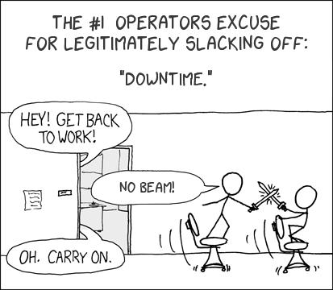
Project Goals
Automated identification of downtime causes
Improves bookkeeping / study of overall system health
Actionable prediction of downtime duration
Allows reduction in power at downstream systems
Reliable forecasting of downtime occurrence
Enables scheduling corrective actions
©Randall Munroe, xkcd.com
Notes:
And why it is important?
Let’s look at the operations of the fermilab accelerator complex,
Around 200K+ controllable devices, their inter-operating software, and the independent safety systems
are constantly monitored by personnel and by threshold-triggered automated alarms
to ensure the high performance of the accelerator complex as a user facility, and provide a high-rate of distilled information.
However, even during normal beam operations, the operations staff are notified of approximately 15,000 alarms daily, as well as additional status indicators, which can go significantly higher during study periods and in some phases of operations.
Once operators are sure that there is an outage, they need to gather information about the outage by visually analyzing data from devices they think are related to the outage one by one and this list of devices is often an outcome of their intuition and past experience.
The time spent by human operators on pattern-hunting to validate and understand the anomalous conditions today takes up a significant part of their time-to-respond to a beam outage.
and this downtime because of an outage is directly proportional to energy wastage and affects overall efficiency.
What is needed is a scalable near real-time AI-enabled decision-support system
that can automatically
(1) predict anomalies
(2) label anomalies, and
(3) highlight patterns related to an outage through interactive visualizations

Slide 4
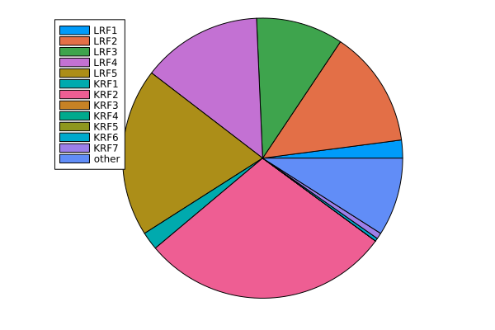
Unplanned Linac Downtime
Time Period: Mar 2021 – Dec 2021
Total number of downtimes: 155
Breakdown by subsystem of fault
Month | #Faults | Total Duration (hours) | Average Duration (mins)
03/2021 | 51 | 16.23 | 19
04/2021 | 36 | 9.59 | 16
05/2021 | 22 | 6.49 | 18
06/2021 | 3 | 1.1 | 22
12/2021 | 43 | 12.47 | 17
Notes:
Between Mar 2021 and Dec 2021, 155 major downtimes were noticed with an average downtime of 19-20 mins. Total duration here indicates the total downtime in hours for that specific month. The pie charts indicate the distribution of these by the subsystem as labeled by the operators.

Slide 5
Research Questions
Modeling
Training
Data Loading & Processing
Data Preprocessing
Inference
Can we reliably predict the occurrence and duration of beam outages?
How much in advance?
With what accuracy?
Deployment
Can we reliably label different types of beam outages automatically?
With what accuracy?
Notes:
Now, the question is:
Can we reliably predict the occurrence and duration of beam outages?
If yes, then how much in advance and with what accuracy?
And once predicted, can we automatically label those outages and with what accuracy?
One might think that developing a deep learning model is all we need but in reality, in the bigger picture of operationalizing ML in the control room, modeling is only a part of the process which includes
Data preprocessing
Building the data pipeline for model training,
Training the models,
And deploying trained model for near real-time inference
And in this talk, I will rather be talking about the challenges we faced and the progress we have made in providing AI-enabled semiautonomous operations.
====
Okay, so what should we do – implement and train a deep learning model – nooo -- this is where we part away from other projects.
We are not just looking for a model that can predict the anomalies but also making the system operational, which includes

Slide 6
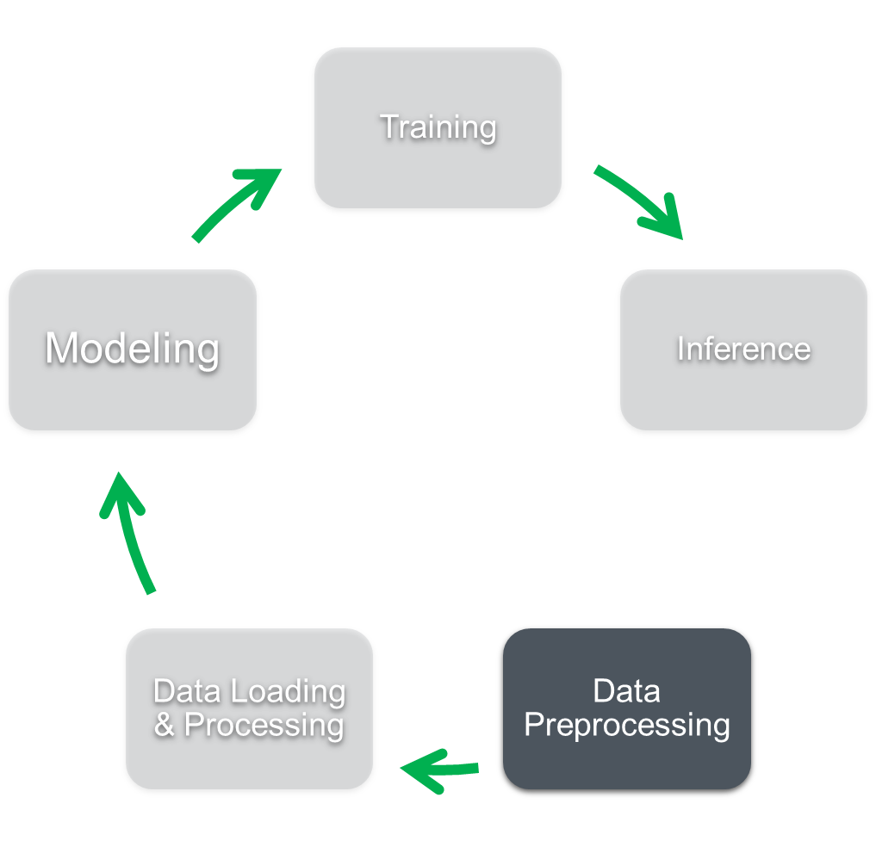
Data Preprocessing
T: Timestamp
$V_{i}$: Values of $i^{th}$ device
HDF5
Parquet (all frequencies)
Parquet (per frequency)
Device-1
Device-n
T | $$V_{1}$$
$$V_{n−1}$$ | $$V_{n}$$
66 ms
$$h_{1}$$
T | $$V_{1}$$
T | $$V_{n}$$
$$h_{1}$$
$$h_{1}$$
T | $$V_{1}$$ | $$V_{n_{66}}$$
$$h_{24}$$
$$h_{24}$$
$$h_{24}$$
File Size: 583 MB
File Size: 17 MB
File Size: 8.3 MB
File Size (70% reduction)
Reading Speedup (30X)
Time: 17.45 s
Time: 1.25 s
Time: 0.58 s
Notes:
The challenges begin right at the data:
The raw data we receive are hourly HDF5 files where each file has data from every device as a pandas data frame with two columns: one for timestamp and one for values
We transformed HDF5 files into Apache parquet format with snappy compression and combined multiple data frames into a single frame indexed by a reference time clock which reduces the files size from 583MB to 17MB. Synchronizing the time scales is required for modeling purposes, however, this makes data sparse because all devices are now resampled to 15Hz. If a device was originally sampled at 1Hz originally, in this frame, the data will be stored at 15Hz in this format. which is relatively faster to read and write.
To remove this redundancy, we created multiple snappy files – one for each sampling frequency and further reduced the size from 17MB to 8MB. In total, we were able to reduce the file size by 70%.
Not only this optimization reduced the file size but also significantly reduced the reading time from 17s to a fraction of second – a speedup of 30x.
Right now, this is only data from ~2800 device from Linac, to extend this for an even bigger system, we will need better compression and speedup, and data compression using ML/AI – such as autoencoders – could be a way to go.

Slide 7
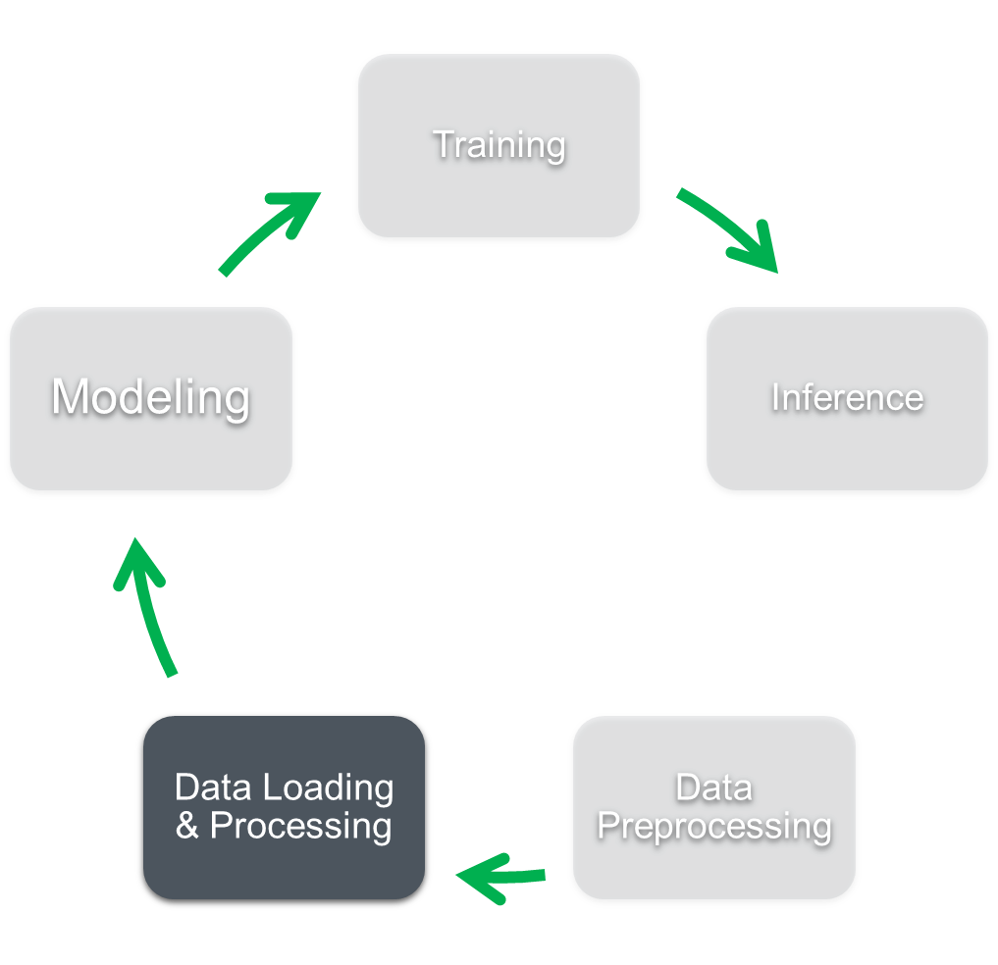
Building the Data Pipeline
Data Loading
Data Preprocessing
Batching & Shuffling
Data Pipeline
Impossible to fit complete data into the memory
Developed in Tensorflow using tf.data API
Read data file
Vectorized windowing
Iterate over rows (to create and process windows)
flat map
Yield windows
Baseline
Interleave
Interleave with Flat Map
Notes:
The next step is to build a data pipeline to train the DL model because it is impossible to fit data for more than a month into the GPU memory.
A data pipeline will include data loading, data preprocessing, and batching and shuffling and should yield data as required.
We used tensorflow tf.data API to build the pipeline.
The baseline pipeline begins with data loading and then iterates over each row to create, process, and yield windows of data for training. However, the data files are read sequentially since we don’t want to jumble the timestamps.
In the next version, we built an interleaved version – where we read the files parallelly and sync them before iterating over the data to create, process, and yield the windows.
However, iterating over the data to create, process, and yield windows was consuming the most amount of time. Therefore, in our next iteration, we vectorized windowing and yielded all windows in a single array and applied flat_map method on top of it to yield one window at a time.

Slide 8
Building the Data Pipeline
Data Loading
Data Preprocessing
Batching & Shuffling
Data Pipeline
Key Insights
Improved data pipeline speed by 10x
16 CPUs achieving the desired concurrency – not improving further with 32 and 64 CPU cores
Data Reading & Processing | 66 ms – 170 devices |  |  | 1 s – 580 devices
 | Time (s)
# Data Files (1h) | 1 | 10 | 100 | 1 | 10 | 100
Flat Map WI (with interleave) | 1.41 | 8.26 | 70.61 | 0.48 | 2.58 | 20.89
Flat Map | 1.41 | 14.38 | 143.93 | 0.45 | 4.05 | 46.74
Array (with interleave) | 5.89 | 77.92 |  | 0.75 | 5.62 | 61.77
Array | 6.25 | 72.16 |  | 0.69 | 7.06 | 72.69
Baseline | 7.07 | 82.34 |  | 0.73 | 7.49
10x Speedup
Notes:
And here are the results.
Through these optimizations, we were able to speed-up the baseline pipeline by 10x on 15 Hz devices. The rows here compare all five data pipeline optimizations.
The baseline iterates over the pandas data frame.
Array iterates over a numpy array instead of a pandas data frame to create and process windows
Interleaving on top of this didn’t help much because iterations were time consuming.
However, once we used vectorized windowing and applied flat_map, we noticed a significant improvement.
And combined with interleaving, we were able to speed up the data pipeline by 10x.

Slide 9
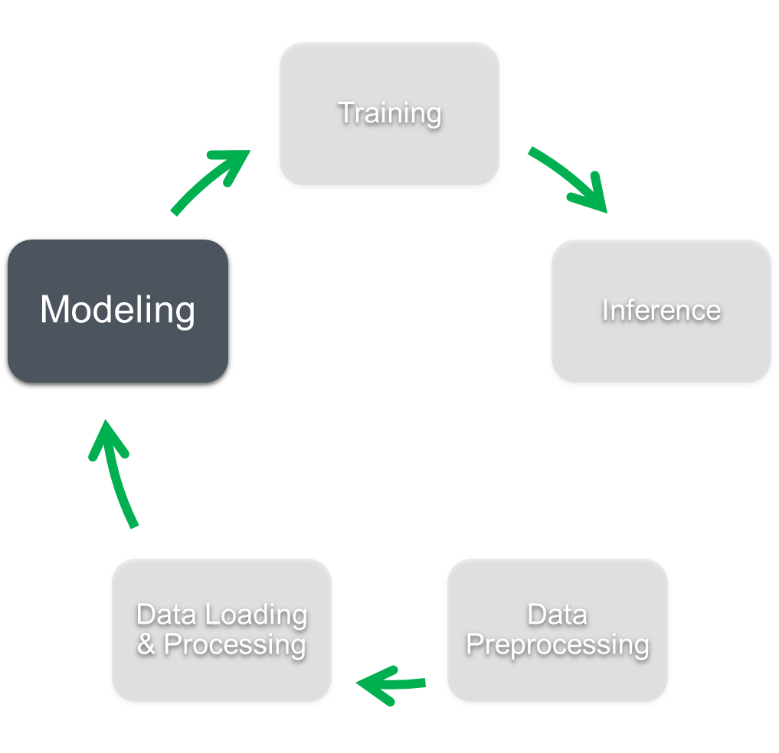
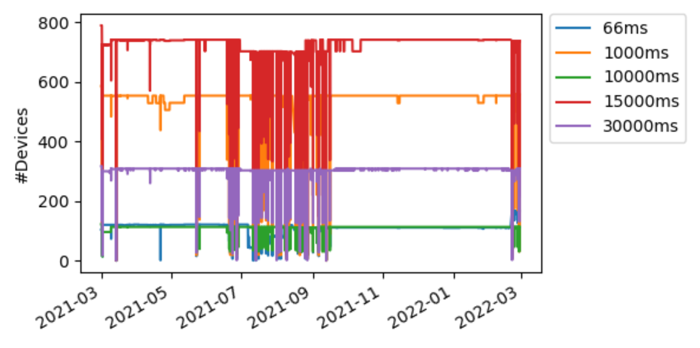
Modeling - Messy Real World Data
Time Period: 03/2021-02/2022
Linac
2809
1509
1369
Total Number of Devices
Data Logged at Multiple Frequencies
After Filtering by SME
Dynamic Logging of Devices
Unique Single Freq Devices
Changing System Settings/ Configurations
Sampling Rate | #Devices
66 ms | 158
1000 ms | 290
10000 ms | 78
15000 ms | 586
30000 ms | 257
Missing & Noisy Data
Notes:
Once data preprocessing and data pipeline were fixed, we filtered 1369 devices from 2800 devices based on inputs from subject matter experts.
Even with this filtered list of devices, modeling is challenging and to explain why, let’s look at these two graphs:
The graph on the top shows the number of devices logged between March 2021 and Feb 2022 in hourly files. The different colors here indicate different frequencies.
From this plot, you will notice two key issues:
Data is logged at multiple frequencies and the model should have the ability to handle data sampled at different frequencies – which is not the case with widely used models.
Not all devices are logged every time. For some reason, devices drop off which is different than missing data because in this case not just a few samples but data for one whole hour is missing.
The second plot on the bottom shows % of data in each file – the y-axis is between 0 and 1, 1 indicating 100% and it clearly shows that missing data is also a concern.
Another important challenge is the challenge of changing configurations/settings between the experiments which makes it hard for an unsupervised anomaly detection model to differentiate between anomaly and changing configuration.

Slide 10
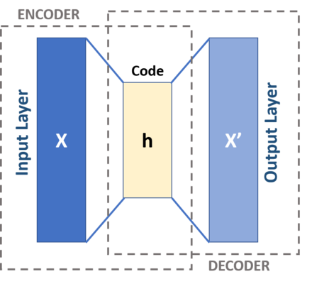
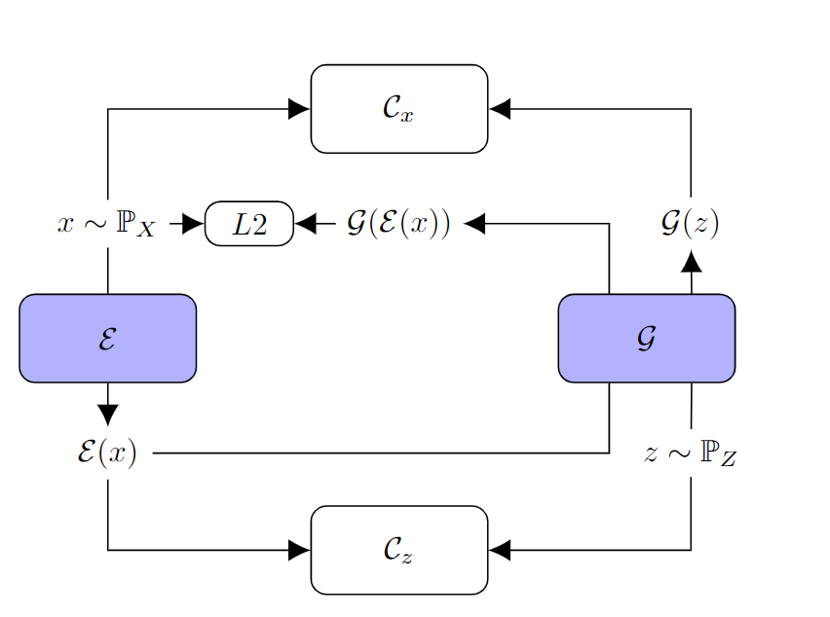
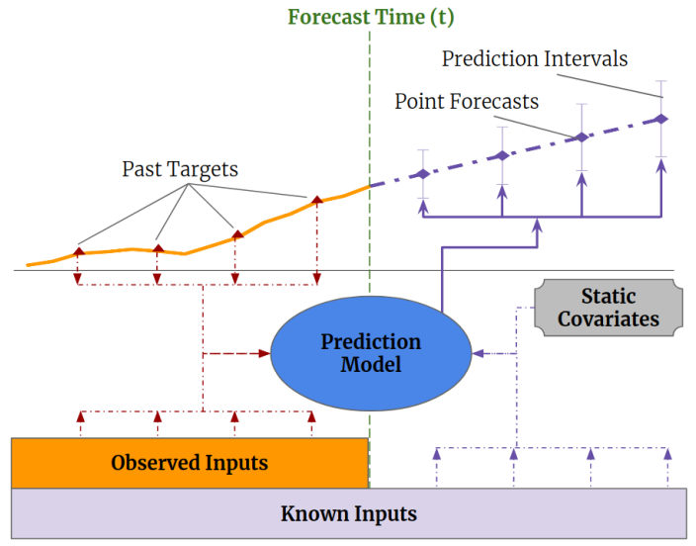
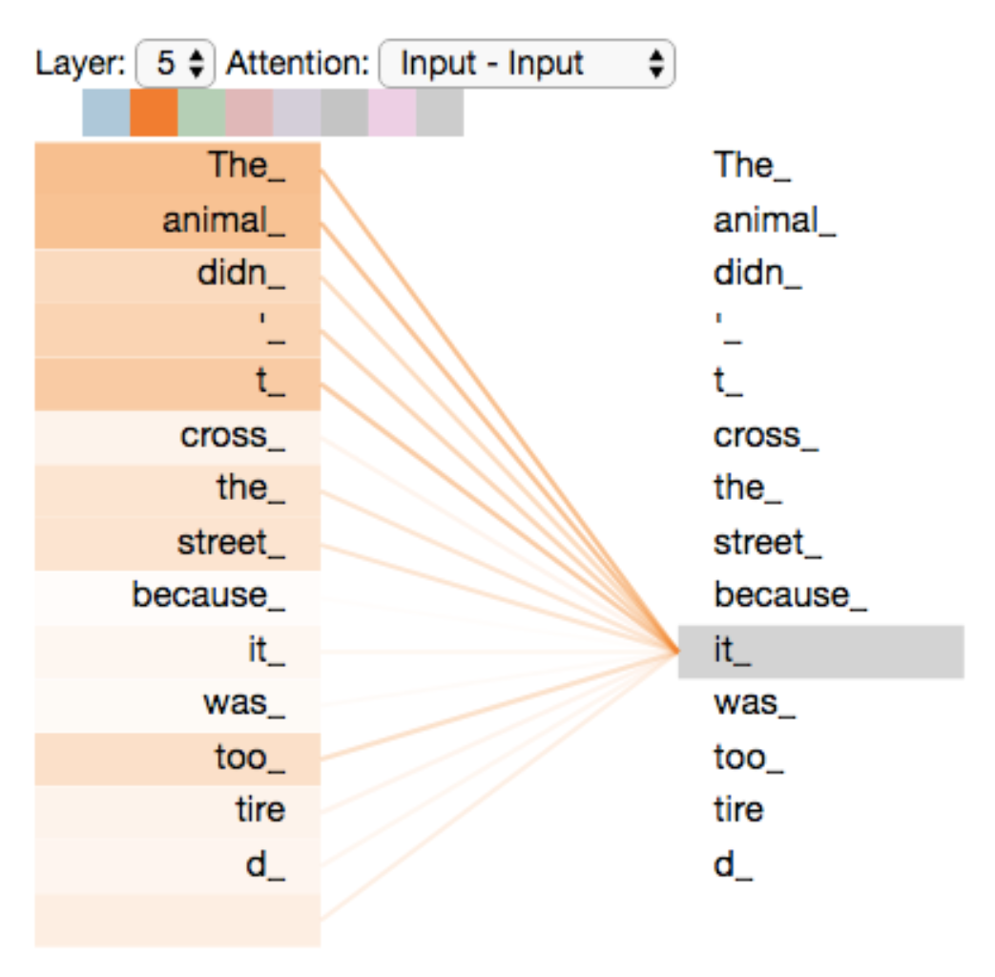
Different Modeling Approaches
Unsupervised Anomaly Detection
time
1
LSTM Autoencoder
TADGAN
Frequency-1
$$∑$$
Anomaly Score
time
LSTM-AE
TADGAN
$$∑$$
Anomaly Score
Frequency-n
LSTM-AE
all devices
TADGAN: Timeseries Anomaly Detection using Generative Adversarial Network
3
TFT: Temporal Fusion Transformer
2
Supervised Anomaly Prediction
look back
look forward
TFT
all devices
bit permits
Notes:
We began with unsupervised anomaly detection – the first model being an LSTM autoencoder for each device.
The autoencoder recreates the input signal and reconstruction error is used to compute the device-level anomaly score. The device-level anomaly scores are then aggregated to get a system-level anomaly score and later a threshold is applied to this system-level anomaly score to detect anomalies.
Pro: (1) it can handle dynamic logging – if the device is missing, we can simply ignore its anomaly score.
(2) it is highly parallelizable and (3) it can easily handle multiple frequencies.
Con: (1) It is difficult to manage multiple modules and (2) it cannot model correlation between devices.
Therefore, next, we tried TADGAN: a generative adversarial network for time series anomaly detection where
a Generator E is serving as an Encoder which maps the time series sequences into the latent space, while Generator G is serving as a Decoder that transforms the latent space into the reconstructed time series.
There is a Critic Cx that distinguishes between real-time series sequences from X and the generated time series sequences from G(z),
And a Critic Cz that measures the goodness of the mapping into the latent space.
In this model, one TADGAN is trained for one frequency, and frequency-level anomaly scores are combined together to get a system-level anomaly score. Akin to LSTM autoencoder, thresholding is applied to detect anomalies.
But again, detect anomalies and not predict. To enable the predictive abilities, next we explored supervised anomaly detection that exploits bit permits – these are alarm signals that notify operators that something is off.
The idea here is to use data from devices for the last 60 seconds to predict bit permits for the next 30 seconds.
For supervised anomaly prediction, we used TFT – temporal fusion transformer which makes use of attention.

Slide 11
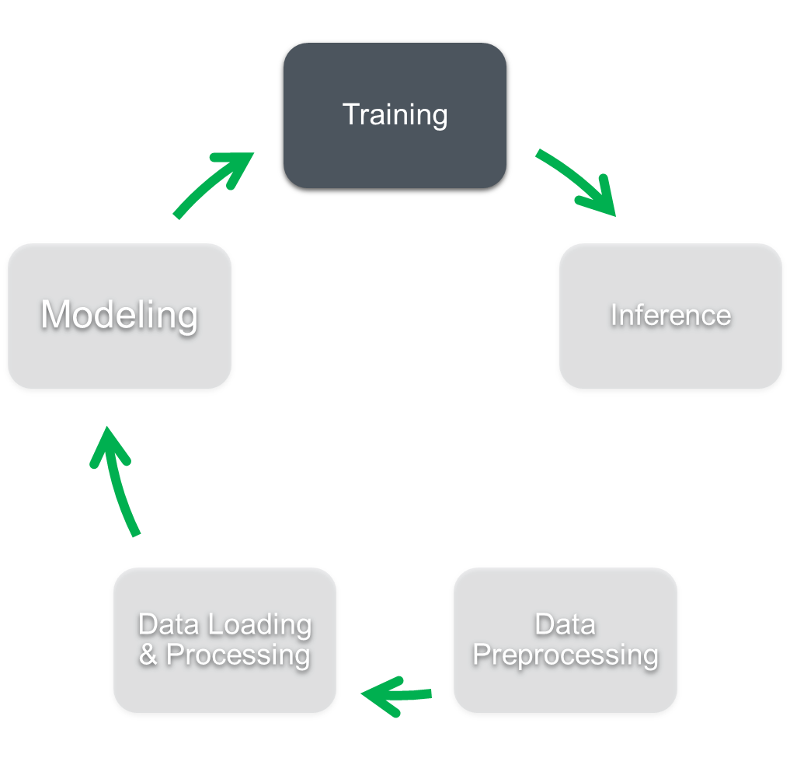
Results
 | Performance Metrics (Training) |  |  |  |  |  | Runtimes
 | True Positive | False Negative | False Positive | Precision (Purity) | Recall (Efficiency) | F1-Score | Training CPU Time (h) | Inference Time (s)
Thresholding | 126 | 29 | 1016 | 0.11 | 0.81 | 0.19 | - | <1
U-LSTM-AE (25) | 127 | 28 | 155 | 0.45 | 0.82 | 0.58 | 0.13 | 72
M-TADGAN | 146 | 9 | 85 | 0.63 | 0.94 | 0.75 | 1.28 | 21
M-Transformer | 147 | 8 | 60 | 0.71 | 0.95 | 0.81 | 1.83 | 13
Model Training
Training Period: 2 months (05/2021-06/2021)
Test Period: 6 months (03/2021-06/2021; 12/2021)
Training Setup: NVIDIA A100 GPU (1), FP32, 16 CPU Cores
Batch Size: 1024 (~15 min); Look Back: 1 min; Look Forward: 30 sec
Train time and inference time measured for one batch of data
Key Insights
Transformer though is computationally expensive to train but offers the best accuracy of 80%
Known future temporal inputs significantly reducing the false positives
Notes:
We trained all these models on 2 months of training data and tested them on 6 months of data.
Thresholding is subtracting the mean and using the residual as the anomaly score.
Our analysis indicates the supremacy of transformer architecture. It not only achieves high accuracy but is actually predicting faults 30 sec in advance.

Slide 12
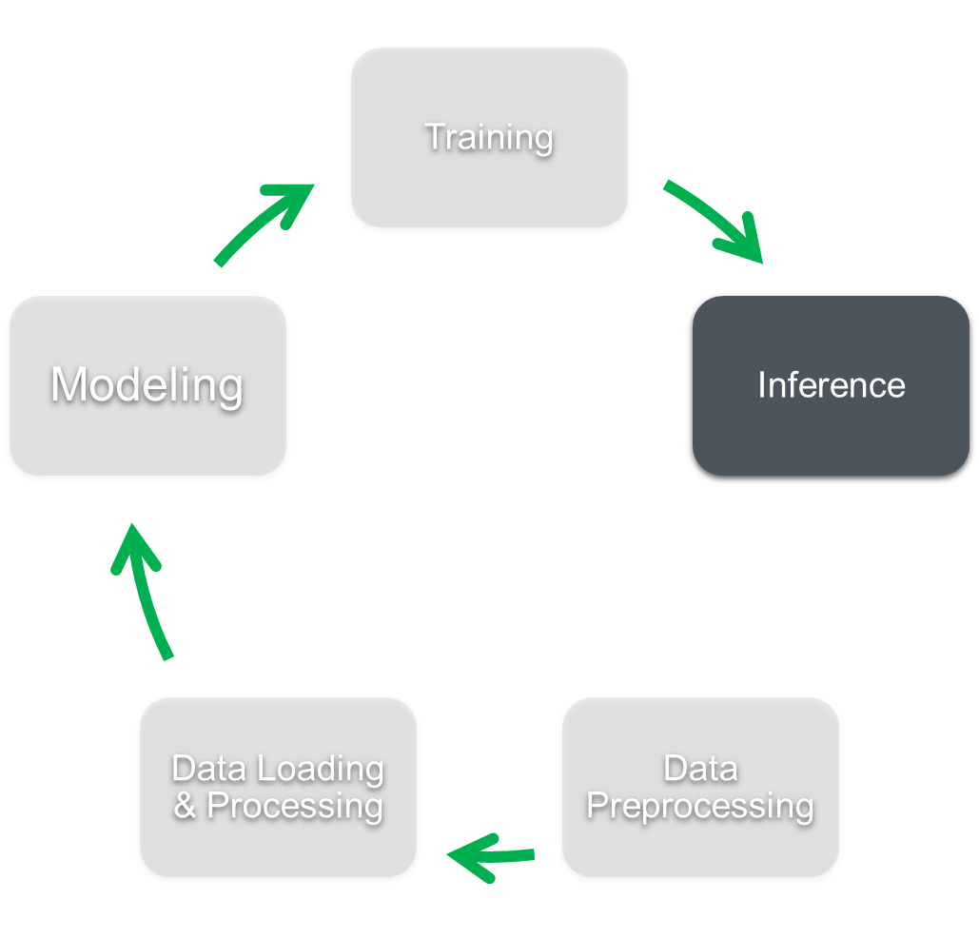
Approaching (near-)real-time inference
Goal: Generate anomaly score <1s
Time to read 600 devices: ~2 s
Using the Python acsys library
Time to align the time stamps: ~1 s(!)
This is gratuitous for data at <= 15 Hz, and we will keep working to improve this
Time for inference (single window): 0.05 s
Inference time is measured on GPU but eventually, inference will be run on a CPU and the time will increase and therefore requires further optimization.
More work needed to enable a tighter loop
(Truly) Parallel reading of devices
In progress!
Notes:
Everything until now was offline but for operationalizing ML, things need to go online and use the trained model to infer system health in near real-time.
Real time inference includes: reading the data, time aligning all the devices with the reference clock, and inferring using the trained model. As of now, our near real-time inference takes 5-6 seconds.
Time to read and time to align are our real bottlenecks and our team is working on reading the data directly from the devices and reducing this overhead. Our initial trials show that it is possible to do reading and alignment in 1 tick at 15Hz through parallelization.

Slide 13
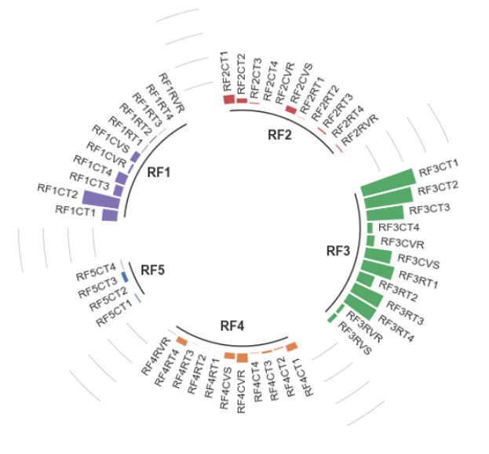
Unsupervised Fault Labeling
Different outages have distinct signatures in the various sub-systems.
We can use these signatures for unsupervised clustering to develop a data-driven outage labeling.
Contours are hand-drawn for illustration. Optimization of contours for efficiency/purity under study.
13
Notes:
Another work in progress is unsupervised fault labeling
The circular bar chart here shows device-level anomaly scores for two different faults. It is evident from the plots that the outage on the left is associated with RF1 and RF3 substations and the outage on the right is associated with the RF2 substation.
We are currently working on leveraging this behavior to develop a ML model to automatically label the anomalies. The plot on the bottom is using T-SNE – a visualization technique to visualize device-level anomaly scores for 4 different faults in 2 dimensions. The contours are hand-drawn for illustration but it shows its ability to bring similar instances together. Optimization of contours for efficiency/purity is under study.

Slide 14
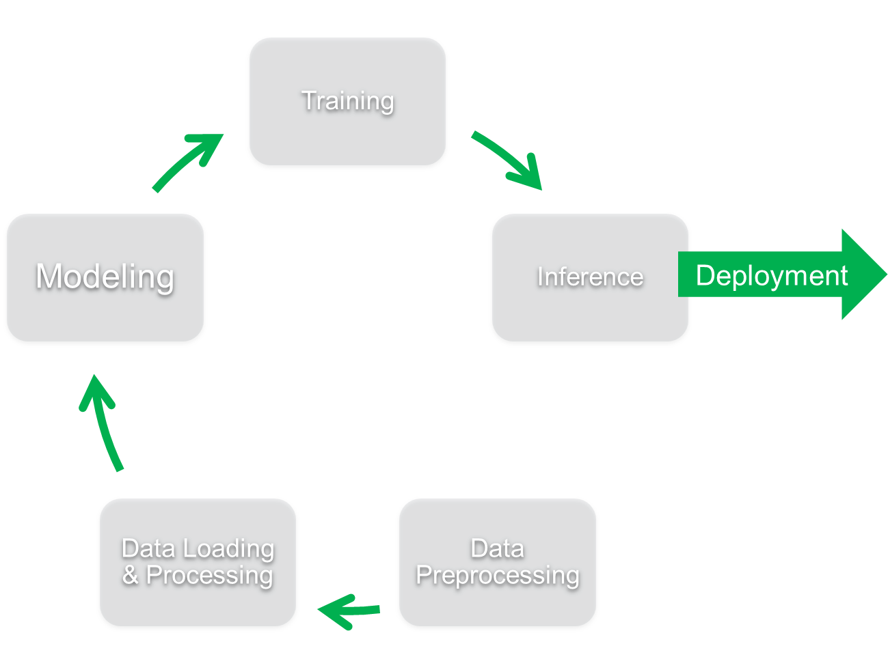
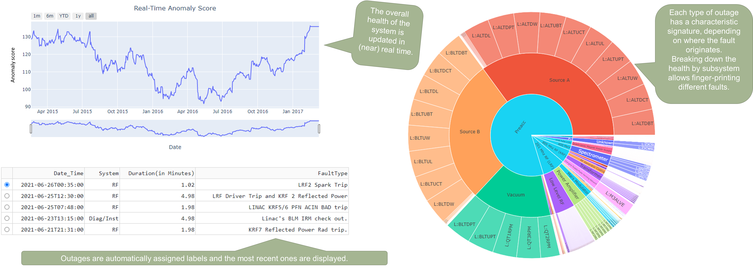
Mock-up for visualizing data inference in (near-)real time
Notes:
This is our UI to visualize the system health in near real-time. The line chart shows the system health (system level anomaly score). The table on the bottom indicates anomalies identified in near real-time, along with the projected duration and label.
The interactive pie chart on the right allows operators to have a complete view of what led to the anomaly. Operator can click on a subsystem and the pie chart will show devices associated with that subsystem.
Unlike the current system, where operators are analyzing some specific devices based on their intuition and past experience, the interactive visualization will provide them with a holistic view of the system condition and understand key attributes that led to the fault.

Slide 15
Summary and Conclusion
The collaboration between data scientists at PNNL and accelerator scientists at FNAL has been very fruitful
This starts building an enduring capability with cross-disciplinary scientists
Real-life data sets contain a lot of features that need to be learned in long-term projects
We had some initial successes with proof-of-principles and are now working to operationalize these ideas
There are no out-of-the-box solutions at this scale
Going from lab experiment to production-ready requires a lot of scrutiny
We look forward to continued collaboration to help make this a success
Notes:
To conclude, the collaboration between data scientists at PNNL and accelerations scientists has been very fruitful in operationalizing ML for the control room.
One key take away for us has been that real-life data sets contain a lot of features that need to be learned in long-term projects
In this talk, I presented some initial success in building the proof-of-principals and optimizing weak links of this pipeline
At this scale, there are no out-of-the box solutions and going from lab experiment to production ready requires a lot of scrutiny.
However, with collaborations, continued discussions, and exchanging ideas at forums like CHEP 2023, we can make AI-enabled semiautonomous operations a success across facilities.

Slide 16
[TADGAN] Alexander Geiger, Dongyu Liu, Sarah Alnegheimish, Alfredo Cuesta-Infante, and Kalyan Veeramachaneni. Tadgan: Time series anomaly detection using generative adversarial networks. In 2020 IEEE International Conference on Big Data (Big Data), pages 33–43. IEEE, 2020.​
[TFT] Bryan Lim, Sercan Ö. Arık, Nicolas Loeff, and Tomas Pfister. "Temporal fusion transformers for interpretable multi-horizon time series forecasting." International Journal of Forecasting 37, no. 4 (2021): 1748-1764.​

