Slide 1
Medusa Multithread 4-body decay fitting and simulation software
Alessandro Maria Ricci¹,
A. A. Alves Junior², D. Brundu³, A. Contu³, F. Dordei³, P. Muzzetto³
¹ University of Pisa and INFN Section of Pisa,
² Institute for Astroparticle Physics – Karlsruhe Institute of Technology (IAP/KIT),
³ INFN Section of Cagliari
CHEP 2023, Norfolk, Virginia (USA), 8-12 May 2023
Contact: alessandro.ricci@df.unipi.it

Slide 2
Content
The scientific case
Medusa
Use case: $B_{s}^{0}\left({\overline{B}}_{s}^{0}\right)→J/ψφ→μ^{+}μ^{−}K^{+}K^{−}$ decay at LHCb
Signal-only model
Amplitudes and angular distributions
Coefficients in the time functions
Flavour tagging
Experimental artifacts and simultaneous fit
Probability Density Function (PDF)
Validation
Performance
Conclusions and distribution

Slide 3
The scientific case
Among the biggest computational challenges for High Energy Physics (HEP) experiments, there are the increasingly larger datasets that are being collected, which often require correspondingly complex data analyses.
In particular, the PDFs used for data modelling become more and more complicated, with hundred of free parameters.
The optimization of such models involves a significant computational effort and a considerable amount of time, of the order of days, before reaching a result.
The current strategy to increase overall performance is to parallelize the software in order to benefit from the large performance gains that can be achieved with multithreading in CPU and/or GPU.
Despite ongoing modernization efforts, a large fraction of the software used in HEP is inherited. It consists of libraries of single threaded, mono-platform routines.

Slide 4
Medusa
Medusa is a C++ 14 compliant application to perform physics data analyses of generic 4-body decays in massively parallel platforms on Linux systems.
Medusa is highly based on Hydra v3.0 (link), a C++ 14 compliant and header only library that hides most of complexities of writing parallel code for different architectures.
Hydra provides a collection of containers and algorithms commonly used in HEP data analysis, which can transparently exploit enabled devices for OpenMP, CUDA, and TBB, allowing the user to re-use the same code across a large range of available multi-core CPU and GPU.
Medusa wants to be a set of ready-made models to perform data analysis, as the CP-violating phase model in $B_{s}^{0}\left({\overline{B}}_{s}^{0}\right)$ decay, and ready-made multithread functions, as the Fadeeva functions, to accelerate the develop of new models.

Slide 5
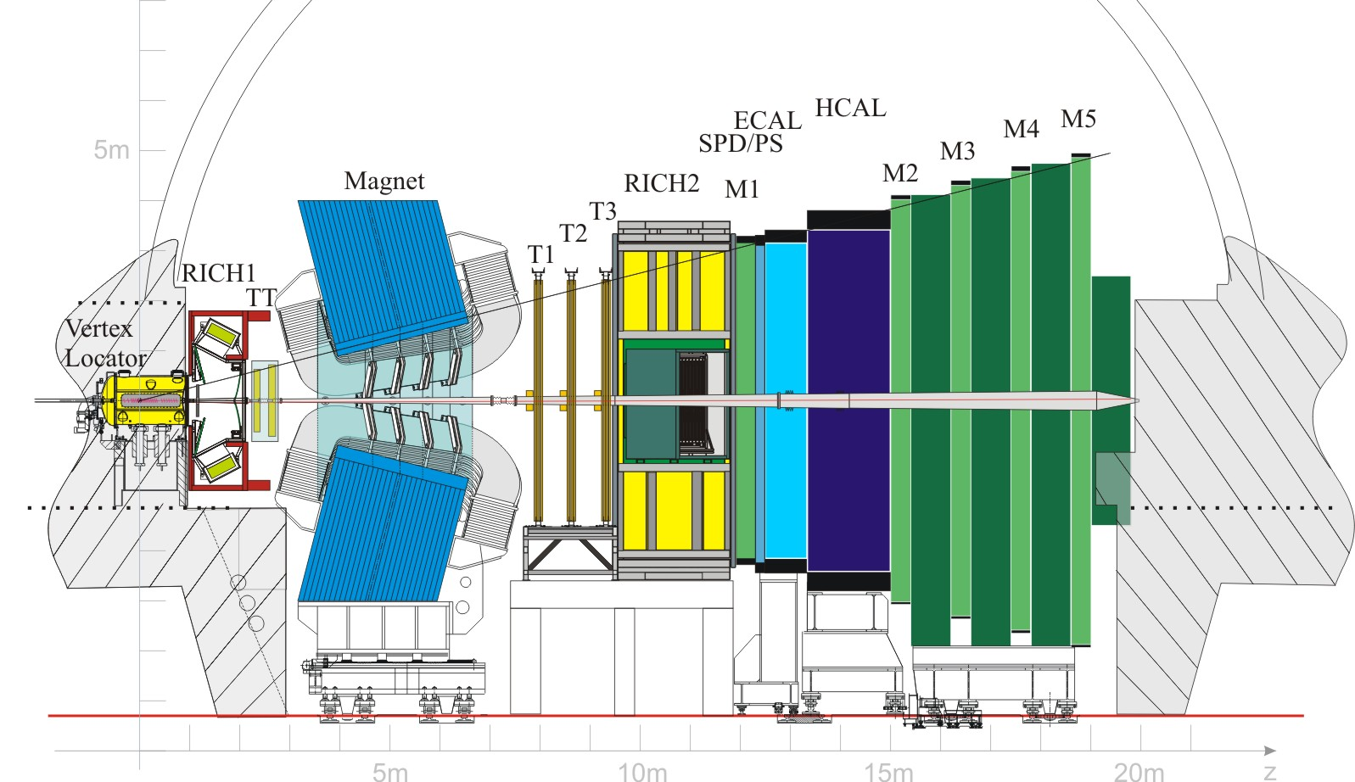
Use case: $B_{s}^{0}\left({\overline{B}}_{s}^{0}\right)$ decay at LHCb
Medusa has been tested through the measurement of the CP-violating phase $φ_{s}$ in $B_{s}^{0}\left({\overline{B}}_{s}^{0}\right)→J/ψφ→μ^{+}μ^{−}K^{+}K^{−}$ decay, one of the golden channels for this type of research at LHCb.
Between 2015 and 2016, LHCb Collaboration collected a sample of about 209000 events.
For extracting the phase $φ_{s}$ is necessary to perform a maximum-likelihood fit with 32 free parameters, by using a model which includes both the signal and the background.
This model must include the modeling of the distribution of the $B_{s}^{0}$-decay times, of the decay angles, of the so-called flavour tagging to distinguish between $B_{s}^{0}$ and ${\overline{B}}_{s}^{0}$ mesons and other experimental artifacts.

Slide 6
Signal-only model
The full time- and angle-dependent decay rate is (Eur. Phys. J. C (2019) 79, 106 , Eur. Phys. J. C (2020) 80, 601 and Stemmle, Ph.D. Thesis, Heidelberg, Germany, 2019):
$$\frac{d^{4}Γ}{dt dθ_{μ} dθ_{K} dφ}∝ \sum_{k=1}^{10}{A_{k}h_{k,q}\left(t\right)f_{k}\left(θ_{μ}, θ_{K}, φ\right)}$$
Signal-only model
$$h_{k,1}\left(t\right)=\frac{3}{4π}e^{−Γt}\left(a_{k}\cosh{\frac{ΔΓ t}{2}}+b_{k}\sinh{\frac{ΔΓ t}{2}}+c_{k}\cos\left(Δm t\right)+d_{k}\sin\left(Δm t\right)\right) for B_{s}^{0}$$
$$h_{k,−1}\left(t\right)=\frac{3}{4π}e^{−Γt}\left(a_{k}\cosh{\frac{ΔΓ t}{2}}+b_{k}\sinh{\frac{ΔΓ t}{2}}−c_{k}\cos\left(Δm t\right)−d_{k}\sin\left(Δm t\right)\right) for {\overline{B}}_{s}^{0}$$
Free parameters: $Γ=\frac{Γ_{H}+Γ_{L}}{2},$ $ΔΓ=Γ_{L}−Γ_{H},$ $Δm=M_{H}−M_{L}.$

Slide 7
Coefficients in the time functions
Coefficients in the time functions $h_{k,1}\left(t\right)$ and $h_{k,−1}\left(t\right)$ with the polarization dependent CP violation.
Free parameters: $λ_{0},\frac{λ_{∥}}{λ_{0}},\frac{λ_{⊥}}{λ_{0}},\frac{λ_{S}}{λ_{0}},φ_{0},\left(φ_{∥}−φ_{0}\right),\left(φ_{⊥}−φ_{0}\right) ,\left(φ_{S}−φ_{0}\right)$, $δ_{0},\left(δ_{∥}−δ_{0}\right),\left(δ_{⊥}−δ_{0}\right) ,\left(δ_{S}−δ_{⊥}\right)$.

Slide 8
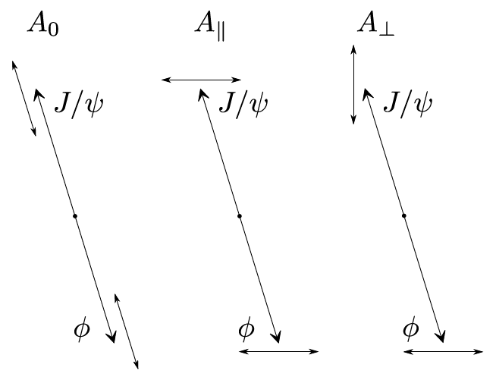
Amplitudes and angular distributions
Figure on the left: angular distribution in the helicity basis describing the decay geometry.
Figure on the right: polarization amplitudes of the system $J/ψφ$. The short arrows indicate the spin orientation of the two vector mesons.
Table: definition of the polarization amplitudes $A_{k}$ and the angular functions $f_{k}\left(θ_{μ}, θ_{K}, φ\right)$.
Free parameters: $A_{0}^{2},A_{⊥}^{2}, A_{S}^{2}$.

Slide 9
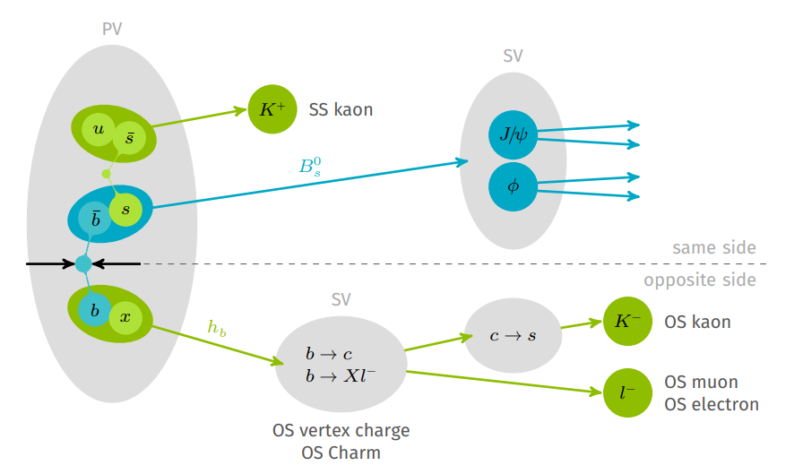
Flavour tagging
In LHCb, the tagging algorithms (taggers) can be divided into two classes.
The opposite-side (OS) taggers rely on the fact that b quarks are predominantly produced in $b\overline{b}$ pairs and try to infer the initial flavour from the decay chain of the respective other b quark.
The same-side (SS) taggers exploit the charge of particles that are created in association with the fragmentation of the signal b quark.
Each tagger returns 2 values:
$$q=1 \left(B_{s}^{0}\right), 0 \left(no tagged\right), −1 \left({\overline{B}}_{s}^{0}\right)$$
$$η=mistag probability$$
$p_{0},Δp_{0},p_{1},Δp1$ are free parameters.
$$ω\left(η\right)=\left(p_{0}+\frac{Δp_{0}}{2}\right)+\left(p_{1}+\frac{Δp1}{2}\right)\left(η−\left\langle η\right\rangle \right) for B_{s}^{0}$$
$$\overline{ω}\left(η\right)=\left(p_{0}−\frac{Δp_{0}}{2}\right)+\left(p_{1}−\frac{Δp1}{2}\right)\left(η−\left\langle η\right\rangle \right) for {\overline{B}}_{s}^{0}$$

Slide 10
Experimental artifacts and simultaneous fit
The signal-only model has 18 free parameters. Flavour tagging adds 4 free parameters.
We need to consider other experimental artifacts: decay-time resolution, decay-time and angular acceptances, S-wave.
Decay-time resolution, decay-time and angular acceptances increase the model complexity without raising the number of free parameters.
The S-wave is composed of $K^{+}K^{−}$-couples, which originate from the direct decay $B_{s}^{0}\left({\overline{B}}_{s}^{0}\right)→J/ψK^{+}K^{−}$. This contribution has a different angular distribution and then must be separated from the signal-only model.
The S-wave is split in the 6 $m_{KK}$-bins: $\left[990−1008 \right], \left[1008−1016\right], \left[1016−1020\right], \left[1020−1024\right],\left[1024−1032\right], \left[1032−1050\right]\frac{Mev}{c^{2}}.$
The 2 S-wave associated parameters, $A_{S}^{2}$ and $δ_{S}−δ_{⊥}$, are left free to vary in each bin.
This brings to a simultaneous fit on 6 $m_{KK}$-bins with 20 free parameters in common between the bins and 2 specific for each bin. Hence, totally we have 32 free parameters.
Finally, the background is considered by associating a weight to each event, which indicates the probability that the event is a signal or background.

Slide 11
Probability Density Function (PDF)
$$PDF_{y,c}^{j}\left(t,Ω | q^{OS},q^{SS},η^{OS},η^{SS}, δ_{t}\right)=$$
$m_{KK}$-bins for S-wave
$$\frac{1}{N_{q^{OS},q^{SS},y,c}^{η^{OS},η^{SS},δ_{t},j}}\sum_{k=1}^{10}{{\tilde{A}}_{k}^{j}f_{k}\left(Ω\right)ε_{y,c}\left(t\right)}$$
Cubic Spline for time acceptance
Effective Gaussian for time resolution
$$\left\{\left[\left(1+q^{OS}\left(1−2ω^{OS}\left(η_{OS}\right)\right)\right)\left(1+q^{SS}\left(1−2ω^{SS}\left(η_{SS}\right)\right)\right)∙h_{k,1}\left(t\right)+\left(1−q^{OS}\left(1−2{\overline{ω}}^{OS}\left(η_{OS}\right)\right)\right)\left(1−q^{SS}\left(1−2{\overline{ω}}^{SS}\left(η_{SS}\right)\right)\right)∙h_{k,−1}\left(t\right)\right]⊗G\left(t|σ_{eff}\left(δ_{t}\right)\right)\right\}$$
Tagging coefficients

Slide 12
Normalization Factor
$m_{KK}$-bins for S-wave
Cubic Spline for time acceptance
$$N_{q^{OS},q^{SS},y,c}^{η^{OS},η^{SS},δ_{t},j}=$$
Coefficients for angular acceptance
$$\int_{t=0.3 ps}^{15 ps}{\sum_{k=1}^{10}{{\tilde{A}}_{k}^{j}ε_{y,c}\left(t\right)ω_{y,c}^{k}}}$$
Tagging coefficients
Effective Gaussian for time resolution
$$\left\{\left[\left(1+q^{OS}\left(1−2ω^{OS}\left(η_{OS}\right)\right)\right)\left(1+q^{SS}\left(1−2ω^{SS}\left(η_{SS}\right)\right)\right)∙h_{k,1}\left(t\right)+\left(1−q^{OS}\left(1−2{\overline{ω}}^{OS}\left(η_{OS}\right)\right)\right)\left(1−q^{SS}\left(1−2{\overline{ω}}^{SS}\left(η_{SS}\right)\right)\right)∙h_{k,−1}\left(t\right)\right]⊗G\left(t|σ_{eff}\left(δ_{t}\right)\right)\right\}dt$$
The normalization factor can be analytically computed, but the computation is expensive.

Slide 13
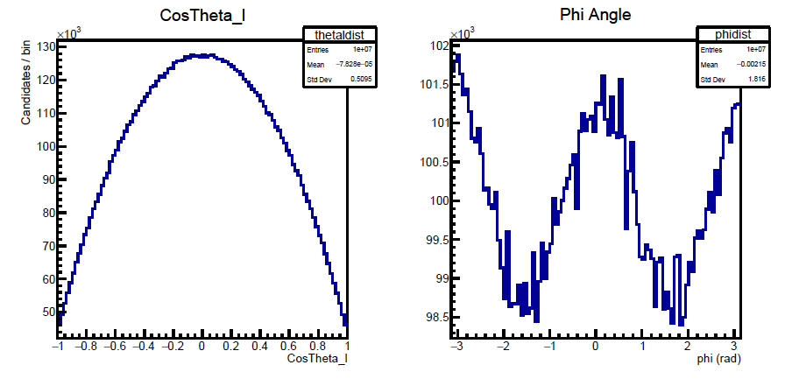
Validation
Difference between LHCb and Medusa | Statistical uncertainties in LHCb
$$φ_{s}^{LHCb}−φ_{s}^{M}=0.0009$$ | $$δφ_{s}^{LHCb}=0.043$$
$$λ_{0}^{LHCb}−λ_{0}^{M}=−0.013$$ | $$δλ_{0}^{LHCb}=0.045$$
$$Γ^{LHCb}−Γ^{M}=0.00055$$ | $$δΓ^{LHCb}=0.0024$$
$${ΔΓ}^{LHCb}−{ΔΓ}^{M}=−0.0007$$ | $$δΔΓ^{LHCb}=0.0077$$
$${Δm}^{LHCb}−{Δm}^{M}=0.029$$ | $$δΔm=0.060$$
$$A_{⊥}^{2,LHCb}−A_{⊥}^{2,M}=−0.0035$$ | $${δA}_{⊥}^{2,LHCb}=0.025$$
$$A_{0}^{2,LHCb}−A_{0}^{2,M}=0.0011$$ | $$δA_{0}^{2,LHCb}=0.018$$
$$\left(δ_{⊥}^{LHCb}−δ_{0}^{LHCb}\right)−\left(δ_{⊥}^{M}−δ_{0}^{M}\right)=0.031$$ | $$δ\left(δ_{⊥}^{LHCb}−δ_{0}^{LHCb}\right)=0.15$$
$$\left(δ_{∥}^{LHCb}−δ_{0}^{LHCb}\right)−\left(δ_{∥}^{M}−δ_{0}^{M}\right)=0.029$$ | $$δ\left(δ_{∥}^{LHCb}−δ_{0}^{LHCb}\right)=0.083$$
The comparison has been done with the results reported in LHCb-ANA-2017-028.

Slide 14
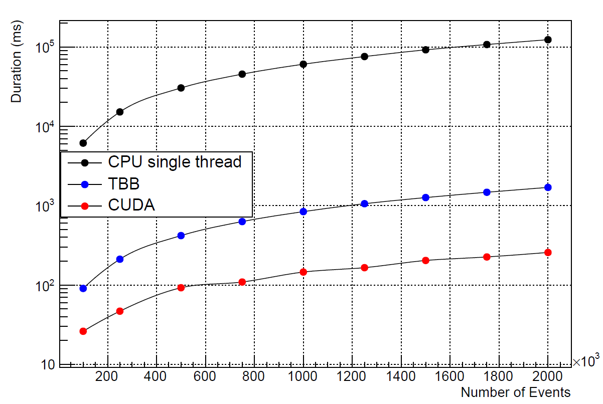
Performance
System | Time/call (ms)
AMD EPYC 7452 @ 1.50 GHz (1 Threads) | 30424
AMD EPYC 7452 @ 1.50 GHz (128 Threads) | 419
NVIDIA A100 | 92
The table summarizes the time spent to perform the objective function (FCN) evaluation with 500k events.

Slide 15
Conclusions
HEP experiments collect ever-larger datasets and their analyses get more and more complex. Moreover, the PDFs used for data modelling become more and more complicated, with hundred of free parameters.
Not rarely, a computation spends hours to reach a result, which very often needs to be re-tuned.
Medusa is a multithread 4-body decay fitting and simulation software created to speed up the physics data analysis.
As a use case, we used the measurement of CP-violating $φ_{s}$-phase in $B_{s}^{0}\left({\overline{B}}_{s}^{0}\right)→J/ψφ→μ^{+}μ^{−}K^{+}K^{−}$ decay, one of the golden channel for this type of research at LHCb.
The evaluation time of the objective function (FCN) with 500000 events is about 92 ms on CUDA, which is about 330 times faster than a non-parallelized software.
The compilation times also have been optimized. The GCC compiler spends about 1 minute to create the executable for TBB and OpenMP and NVCC about 4 minutes for CUDA.

Slide 16
Distribution
Medusa will be released on GitHub as open-source software under GPL v.3.0 license soon.
If you are interested in the software, you can contact:
andrea.contu@cern.ch
francesca.dordei@cern.ch
alessandro.ricci@df.unipi.it, alessandro.ricci@pi.infn.it
davide.brundu@cern.ch

Slide 17
Thank you for the attention!

Slide 18
Backup

Slide 19
CP-violating phase $φ_{s}$
Typically, the phase of the transition amplitude $A$ can be split into a strong phase $δ$, which does not change sign, and a weak phase $φ$, which changes sign under CP transformation:
$CPA=CP\left|A\right|e^{i\left(φ+δ\right)}=\left|A\right|e^{i\left(−φ+δ\right)}$.
The heavy and light eigenstates are:
$\left|\left.B_{s,H}^{0}\right\rangle \right.=p\left|\left.B_{s}^{0}\right\rangle \right.+q\left|\left.{\overline{B}}_{s}^{0}\right\rangle \right.$, $\left|\left.B_{s,L}^{0}\right\rangle \right.=p\left|\left.B_{s}^{0}\right\rangle \right.−q\left|\left.{\overline{B}}_{s}^{0}\right\rangle \right.$
Given the transition amplitudes $A_{J/ψφ}=\left.\left\langle J/ψφ\right.\right|H\left.\left|B_{s}^{0}\right.\right\rangle$ and ${\overline{A}}_{J/ψφ}=\left.\left\langle J/ψφ\right.\right|H\left.\left|{\overline{B}}_{s}^{0}\right.\right\rangle$, we have
$$λ_{J/ψφ}=\frac{q}{p}\frac{{\overline{A}}_{J/ψφ}}{A_{J/ψφ}}=\left|λ_{J/ψφ}\right|e^{iφ_{s}}$$
The CP is violated if $φ_{s}≠0$.

Slide 20
Normalization factor
$$\int_{t=0.3 ps}^{15 ps}{\sum_{k=1}^{10}{{\tilde{A}}_{k}^{j}ε_{y,c}\left(t\right)ω_{y,c}^{k}∗rPDF\left(t\right) dt}}→\sum_{k=1}^{10}{{\tilde{A}}_{k}^{j}ω_{y,c}^{k}\int_{t=0.3 ps}^{15 ps}{ε_{y,c}\left(t\right)∗rPDF\left(t\right)}dt}$$
$$\sum_{k=1}^{10}{{\tilde{A}}_{k}^{j}ω_{y,c}^{k}\int_{t=0.3 ps}^{15 ps}{\left(a_{i}t^{3}+b_{i}t^{2}+c_{i}t+d_{i}\right)∗rPDF\left(t\right) dt}→}$$
$$\sum_{k=1}^{10}{{\tilde{A}}_{k}^{j}ω_{y,c}^{k}}\left[\sum_{i=1}^{7}{\left(a_{i}\int_{t_{i}}^{t_{i+1}}{t^{3}∗rPDF\left(t\right) dt}\right)}\sum_{i=1}^{7}{\left(b_{i}\int_{t_{i}}^{t_{i+1}}{t^{2}∗rPDF\left(t\right) dt}\right)}+\sum_{i=1}^{7}{\left(c_{i}\int_{t_{i}}^{t_{i+1}}{t∗rPDF\left(t\right) dt}\right)}+\sum_{i=1}^{7}{\left(d_{i}\int_{t_{i}}^{t_{i+1}}{rPDF\left(t\right) dt}\right)}\right]$$

Slide 21
Normalization Factor
$$a_{i}\int_{t_{i}}^{t_{i+1}}{t^{p}∗rPDF\left(t\right) dt}→a_{i}∗C_{tag}∗\int_{t_{i}}^{t_{i+1}}{t^{p}∗h_{k,q}\left(t\right)⊗G\left(t|σ_{eff}\left(δ_{t}\right)\right)dt}→$$
$$\frac{3{C_{tag}σ}_{eff}a_{i}p!}{8π\sqrt{2}}\frac{{\left(\sqrt{2}σ_{eff}\right)}^{p}}{2^{p}}\sum_{j=0}^{p}{\frac{1}{j!\left(p−j\right)!}\left[a_{k}\left(K_{j}\left(z_{1}\right)M_{p−j}\left(x_{1},x_{2};z_{1}\right)+K_{j}\left(z_{2}\right)M_{p−j}\left(x_{1},x_{2};z_{2}\right)\right)+b_{k}\left(K_{j}\left(z_{1}\right)M_{p−j}\left(x_{1},x_{2};z_{1}\right)−K_{j}\left(z_{2}\right)M_{p−j}\left(x_{1},x_{2};z_{2}\right)\right)+qc_{k}\left(K_{j}\left(z_{3}\right)M_{p−j}\left(x_{1},x_{2};z_{3}\right)+K_{j}\left(z_{4}\right)M_{p−j}\left(x_{1},x_{2};z_{4}\right)\right)+\frac{qd_{k}}{i}\left(K_{j}\left(z_{3}\right)M_{p−j}\left(x_{1},x_{2};z_{3}\right)−K_{j}\left(z_{4}\right)M_{p−j}\left(x_{1},x_{2};z_{4}\right)\right)\right]}$$

