Slide 1
An Active Learning application in a dark matter search with ATLAS PanDA and iDDS
Christian Weber, Rui Zhang, Tadashi Maeno, Wen Guan, and Torre Wenaus
behalf of the ATLAS Computing Activity
May 9th, 2023
CHEP 2023
Notes:
Hello!
I am Christian Weber on behalf of the ATLAS Computing Activity
with our application of Active Learning in a dark matter search with ATLAS PanDA and iDDS

Slide 2
Beyond Standard Model physics parameters
Hidden Abelian Higgs Model
New Scalar $S$, new vector boson $Z_{d}$
Five different parameters:
$m_{S}$ - new scalar mass
$m_{Z_{d}}$ - new vector boson mass
$Γ_{Z_{d}}$ - decay width of the new vector boson
$ε$ – mixing between Standard Model $Z$ and $Z_{d}$
$κ$ – mixing between Higgs Boson $H$ and $S$
In general, we would like to know what the associated cross section limits are for each combination of parameter values, or which combinations are excluded.
Notes:
Let me start with the talks titular dark matter search, which proceeds within the context of the Hidden Abelian Higgs Model,
which presumes two new particles, a new Scalar S, and a new vector Boson Zd,
and that allows processes like these here, where a Higgs decays to two Zd via mixing with the new Scalar, or where the Higgs decays into a Z-Zd pair, via mixing of the Z with the Zd.
In either case the Z and Zd’s are presumed to decay standard model particles - leptons in our case
These processes are parameterized by 5 different new BSM parameters.
And the motivation for our work here is as follows:
In general, we would like to know what are the exclusion limits in terms of production cross section for either process, for any point in the phase space spanned by the two new masses, coupling constants and the decay with.

Slide 3
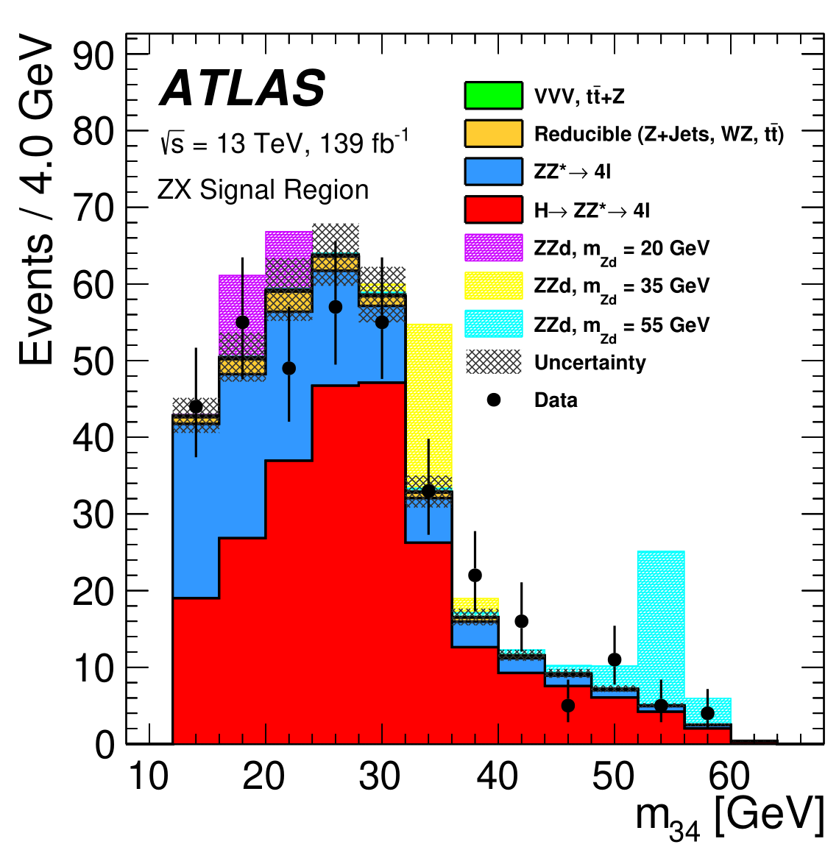
Cross section limit calculation
Generate Monte Carlo (MC) Events for
Standard Model backgrounds do this once using Standard Model parameters
Signal process under the given signal model do once for every point in parameter phase space
Apply selection for backgrounds and signal
Profile Likelihoods for each simulated signal to find upper limits on the cross section $σ$
$$ℒ\left(σ\right)=\prod_{i}{Pois\left({Data}_{i}|B_{i}+S_{i}⋅σ\right)}$$
$S_{i}$, $σ$ dependent on physics parameters $m_{S}\text{, }m_{Z_{d}}\text{, }Γ_{Z_{d}}\text{, }ε\text{ , }κ$
JHEP03(2022)041
Notes:
For a given combination of theory parameter that is a relatively simple process, which goes like this: You generate Monte Carlo Events
Once for your Standard Model backgrounds
And than once for each combination of theory parameter that you are interested in
You apply selection your backgrounds and signal to land in some statistically sensitive signal region
Construct the relevant likelihood for your given signal in the signal region, and profile it to find the limit on the cross section which is then valid for that given set of theory parameters.

Slide 4
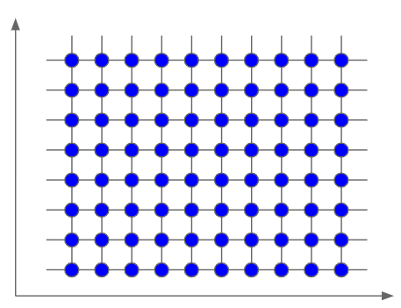
Limits in multidimensional parameter space
Process for calculation of limits in phase space conceptionally simple, e.g., do a ‘grid search’
Select boundaries in $m_{S}\text{,} m_{Z_{d}}\text{,} Γ_{Z_{d}}\text{,} ε\text{,} κ$
Generate grid of signal samples
And calculate cross section limits for each sample
Bonus: with theory predictions one can infer contours between excluded and not excluded regions of parameter space
Problem:
Generating Monte Carlo samples is computationally expensive
$$ε$$
$$m_{Z_{d}}$$
Notes:
Doing this than for the full phase space of theory parameters is conceptually very simple
You select boundaries along each of your 5 parameters, mS, mZd, $Γ_{Z_{d}}\text{,} ε\text{,} κ$
You generate a sufficiently dense set of signal samples
And calculate the cross-section limits for each signal sample as in the previous
The problem with this approach is that the Monte Carlo Event production is computationally very expensive

Slide 5
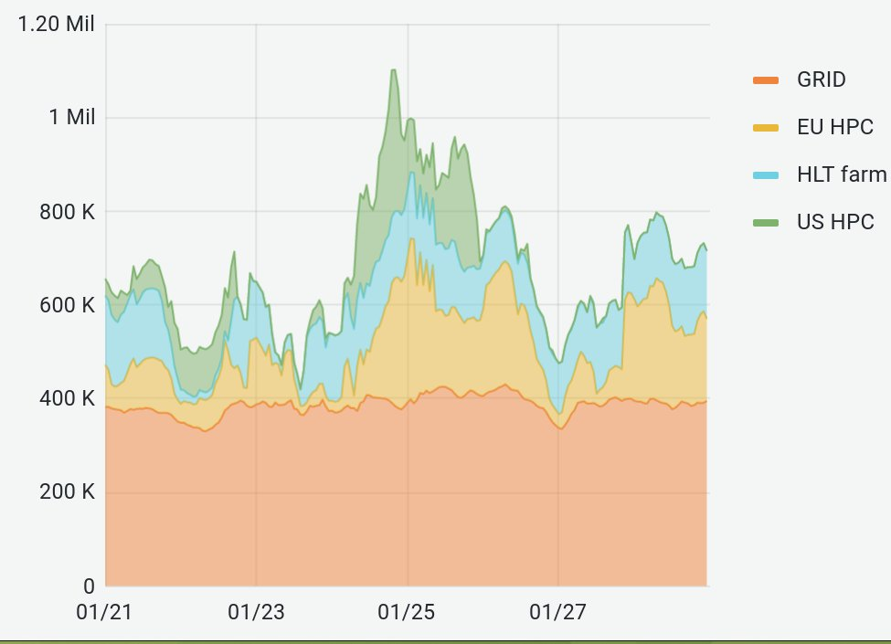
Monte Carlo Simulation
CPU resources available to the ATLAS experiment in late January 2023
Monte Carlo (MC) Event simulation is very computationally intensive
$\sim$15h calculation time for 100 simulated events on a single CPU core
Might need around ${10}^{5}$ events or more per signal sample
Using a grid of 10 values in two dimensions would require ${10}^{7}$ events, about $\sim 2$k CPU months
Estimate is for fast calorimeter simulation, full calorimeter simulation requires even more computational resources
#CPU cores
time [Month/Day]
ATLAS experiment
Notes:
For example, for our process of interest it takes a bit more than half a day to simulate 100 events on a single CPU core
For a regular analysis you might want around 10^5 events or more per signal samples
Then with a two-dimensional search grid and 10 steps along each dimension you’d require 10^7 events
If you are willing to wait a month for your results, you would need about 2k CPU cores for that.
Here on the right, you see the number of CPU cores available for the ATLAS grid during a particularly good week, which happened earlier this year
And if you look at the y-axis you’ll see that 2k CPU would barely register, which is fine.
But if you want to do a three-dimensional scan, you’d already need 20k CPU cores, a four-dimensional scan would require 200k cores, for a five dimensional one … well you see how this becomes very quickly, very untenable.
And these estimates are for fast calorimeter simulation, full simulation is even more computationally intensive

Slide 6
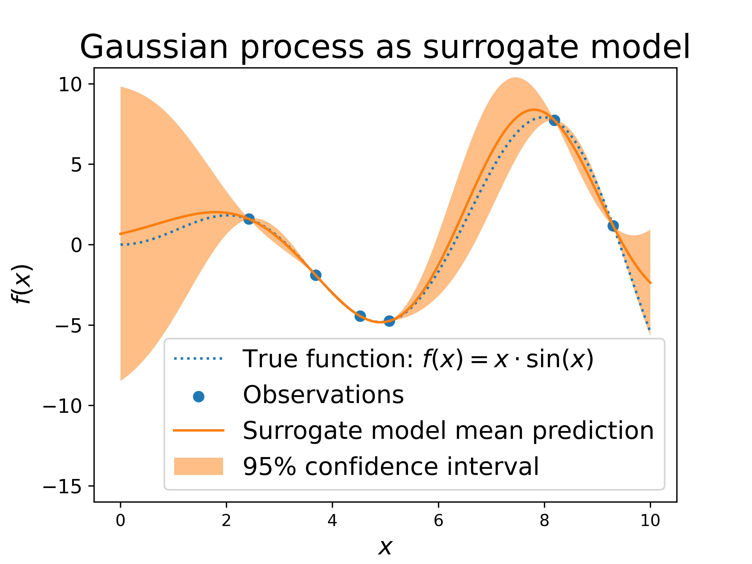
Active Learning
An iterative process to collect new labelled data for optimization tasks
We developed a system to work around the computational constraints by using an Active Learning approach that includes
Surrogate model that approximates the function mapping physics parameters onto exclusion limits $m_{S}\text{,}m_{Z_{d}}\text{,}Γ_{Z_{d}}\text{,}ε\text{,}κ → σ_{m_{S}\text{,}m_{Z_{d}}\text{,}Γ_{Z_{d}}\text{,}ε\text{,}κ}$
An acquisition function that determines which points in the physics parameter space, e.g. $m_{S}\text{,}m_{Z_{d}}\text{,}Γ_{Z_{d}}\text{,}ε\text{,}κ$, to explore next based on the surrogate model
Notes:
To manage this unfavorable scaling
We developed a system to work around the computational constraints by using an Active Learning approach that includes
A Surrogate model that approximates the function mapping physics parameters onto exclusion limits and
An acquisition function that determines which points in the physics parameter space to explore next based on the surrogate model

Slide 7
Active Learning Application
Our system builds on ATLAS grid infrastructure to enable the application of the active learning in the exploration of the parameter phase space
It is realized via the intelligent data delivery service (iDDS) that allows a docker container instance to effect the simulation Monte Carlo samples on the ATLAS grid, run an analysis on REANA, and exchange data between them
The iDDS is a computing service that allows for on-demand data transformation and granular data delivery within the ATLAS grid
PanDA is the Production and Distributed Analysis workload management system for the ATLAS grid
REANA is a platform enabling workflow preservation and reuse of data for analysis
See also yesterday’s talk: Distributed Machine Learning with PanDA and iDDS in LHC ATLAS
iDDS
Notes:
Our system builds on ATLAS grid infrastructure to enable the application of the active learning in the exploration of the parameter phase space
It is realized via the intelligent data delivery service (iDDS) that allows a docker container instance to effect the simulation Monte Carlo samples on the ATLAS grid, run an analysis on REANA, and exchange data between them
The iDDS is a computing service that allows for on-demand data transformation and granular data delivery within the ATLAS grid
PanDA is the Production and Distributed Analysis workload management system for the ATLAS grid
REANA is a platform enabling workflow preservation and reuse of data for analysis

Slide 8
Surrogate Model
Surrogate Model: Gaussian Process
Non-parametric model, yielding probability distribution over possible functions that fit a set of points.
Assumes output $f(x)$ is a random variable for each input $x$ and $p\left(f\left(x_{1}\right),f\left(x_{2}\right), …\right)$ is a multivariate gaussian: $p\left(f(\vec{x})\right)=N\left(f\left(\vec{x}\right)| \vec{μ},K\right)$ mean vector $μ_{i}=E\left(x_{i}\right)$ covariance matrix $K_{ij}=k\left(x_{i},x_{j}\right)$ kernel $k$, many options, common choice: Radial Basis Function kernel $k\left(x_{i},x_{j}\right)=\exp\left(−\frac{{\left(x_{i}−x_{j}\right)}^{2}}{2l^{2}}\right)$
Notes:
As a surrogate model we are using a Gaussian Process
Which is a Non-parametric model that yields a probability distribution over possible functions that fit a set of points.
You can see an example Gaussian Function here on the right. The blue-dashed line is some true function, the red points are the ones that we try to fit via the Gaussian Process, whose mean is shown by the red dotted line, and the green shaded regions are the 95% confidence intervals of the Gaussian Process
The underlying assumption is that the output of the Gaussian Process is a random variable for each given input, and that each set of these inputs is a multivariate gaussian
It is defined by its mean vector and its covariance matrix, which is in turn defined by its kernel function, for which there are many choices,
But one common one is the Radial Basis function kernel, which itself is a gaussian

Slide 9
Surrogate Model & Acquisition Function
Acquisition Function: Probability of improvement
Assume we want to find the minimum of an underlying true function, via optimizing surrogate model
$f\left(x^{∗}\right)$ is current minimum, then choose next value to sample for surrogate model, such that $PI\left(x\right)=Prob\left(f\left(x\right)−f\left(x^{∗}\right)<0\right)$ is maximal
$PI\left(x\right)$ calculable as $f\left(x\right)$ is a gaussian distribution with mean $μ\left(x\right)$, and standard deviation $σ\left(x\right)$ $PI\left(x\right)=Φ\left(\frac{f\left(x^{∗}\right)−μ(x)}{σ\left(x\right)}\right)$ $Φ$ – Gaussian cumulative distribution function
See ‘Active Learning for Excursion Set Estimation’ by Kyle Cranmer et al. for an entropy-based acquisition function
Notes:
Given our Surrogate Model, the Acquisition function determines where we should sample new points from the True function to improve the surrogate model optimally
For example, assume what we would like to find the minimum of an underlying True function, via optimization of our surrogate model
Presume you know the location of the current global minimum of the surrogate model, then you can ask for every other point over which the surrogate model is defined, what is the probability that I will find a model value that is even smaller
This is easily calculable, as the Gaussian Process for each point along X is a Gaussian distribution with well defined mean and standard deviation. And you can calculate that via the Cumulative Gaussian Distribution function, plot this as a function of the mass her in this case, and find where that distribution is maximal, and then use that location to sample another point from the true function
And before I go on to show to show how that works, I just wanna point out that this is just but one option for an acquisition function, there are many more, some much smarter and more appropriate for a given problem, like the one entropy-based acquisition function here described Kyle Cranmer

Slide 10
Iterative feedback & learning
start with 7 random initial points
7 initial points + 1 predicted point
7 initial points + 2 predicted points
7 initial points + 3 predicted point
Notes:
And these figures show how the iterate process can work in practice.
You start out on the top left with 7 randomly selected points, you train your Gaussian Process on them
Calculate the probability of improvement for each possible mass, find the maximum there
On the top right you add this point then to your training of the Gaussian Process, find the maximum probability of improvement,
Repeat on the lower left 7 random points + the two prediction ones,
And repeat again on the lower right, at which point the minimum of the surrogate model coincides with the true function’s minimum within 2%

Slide 11
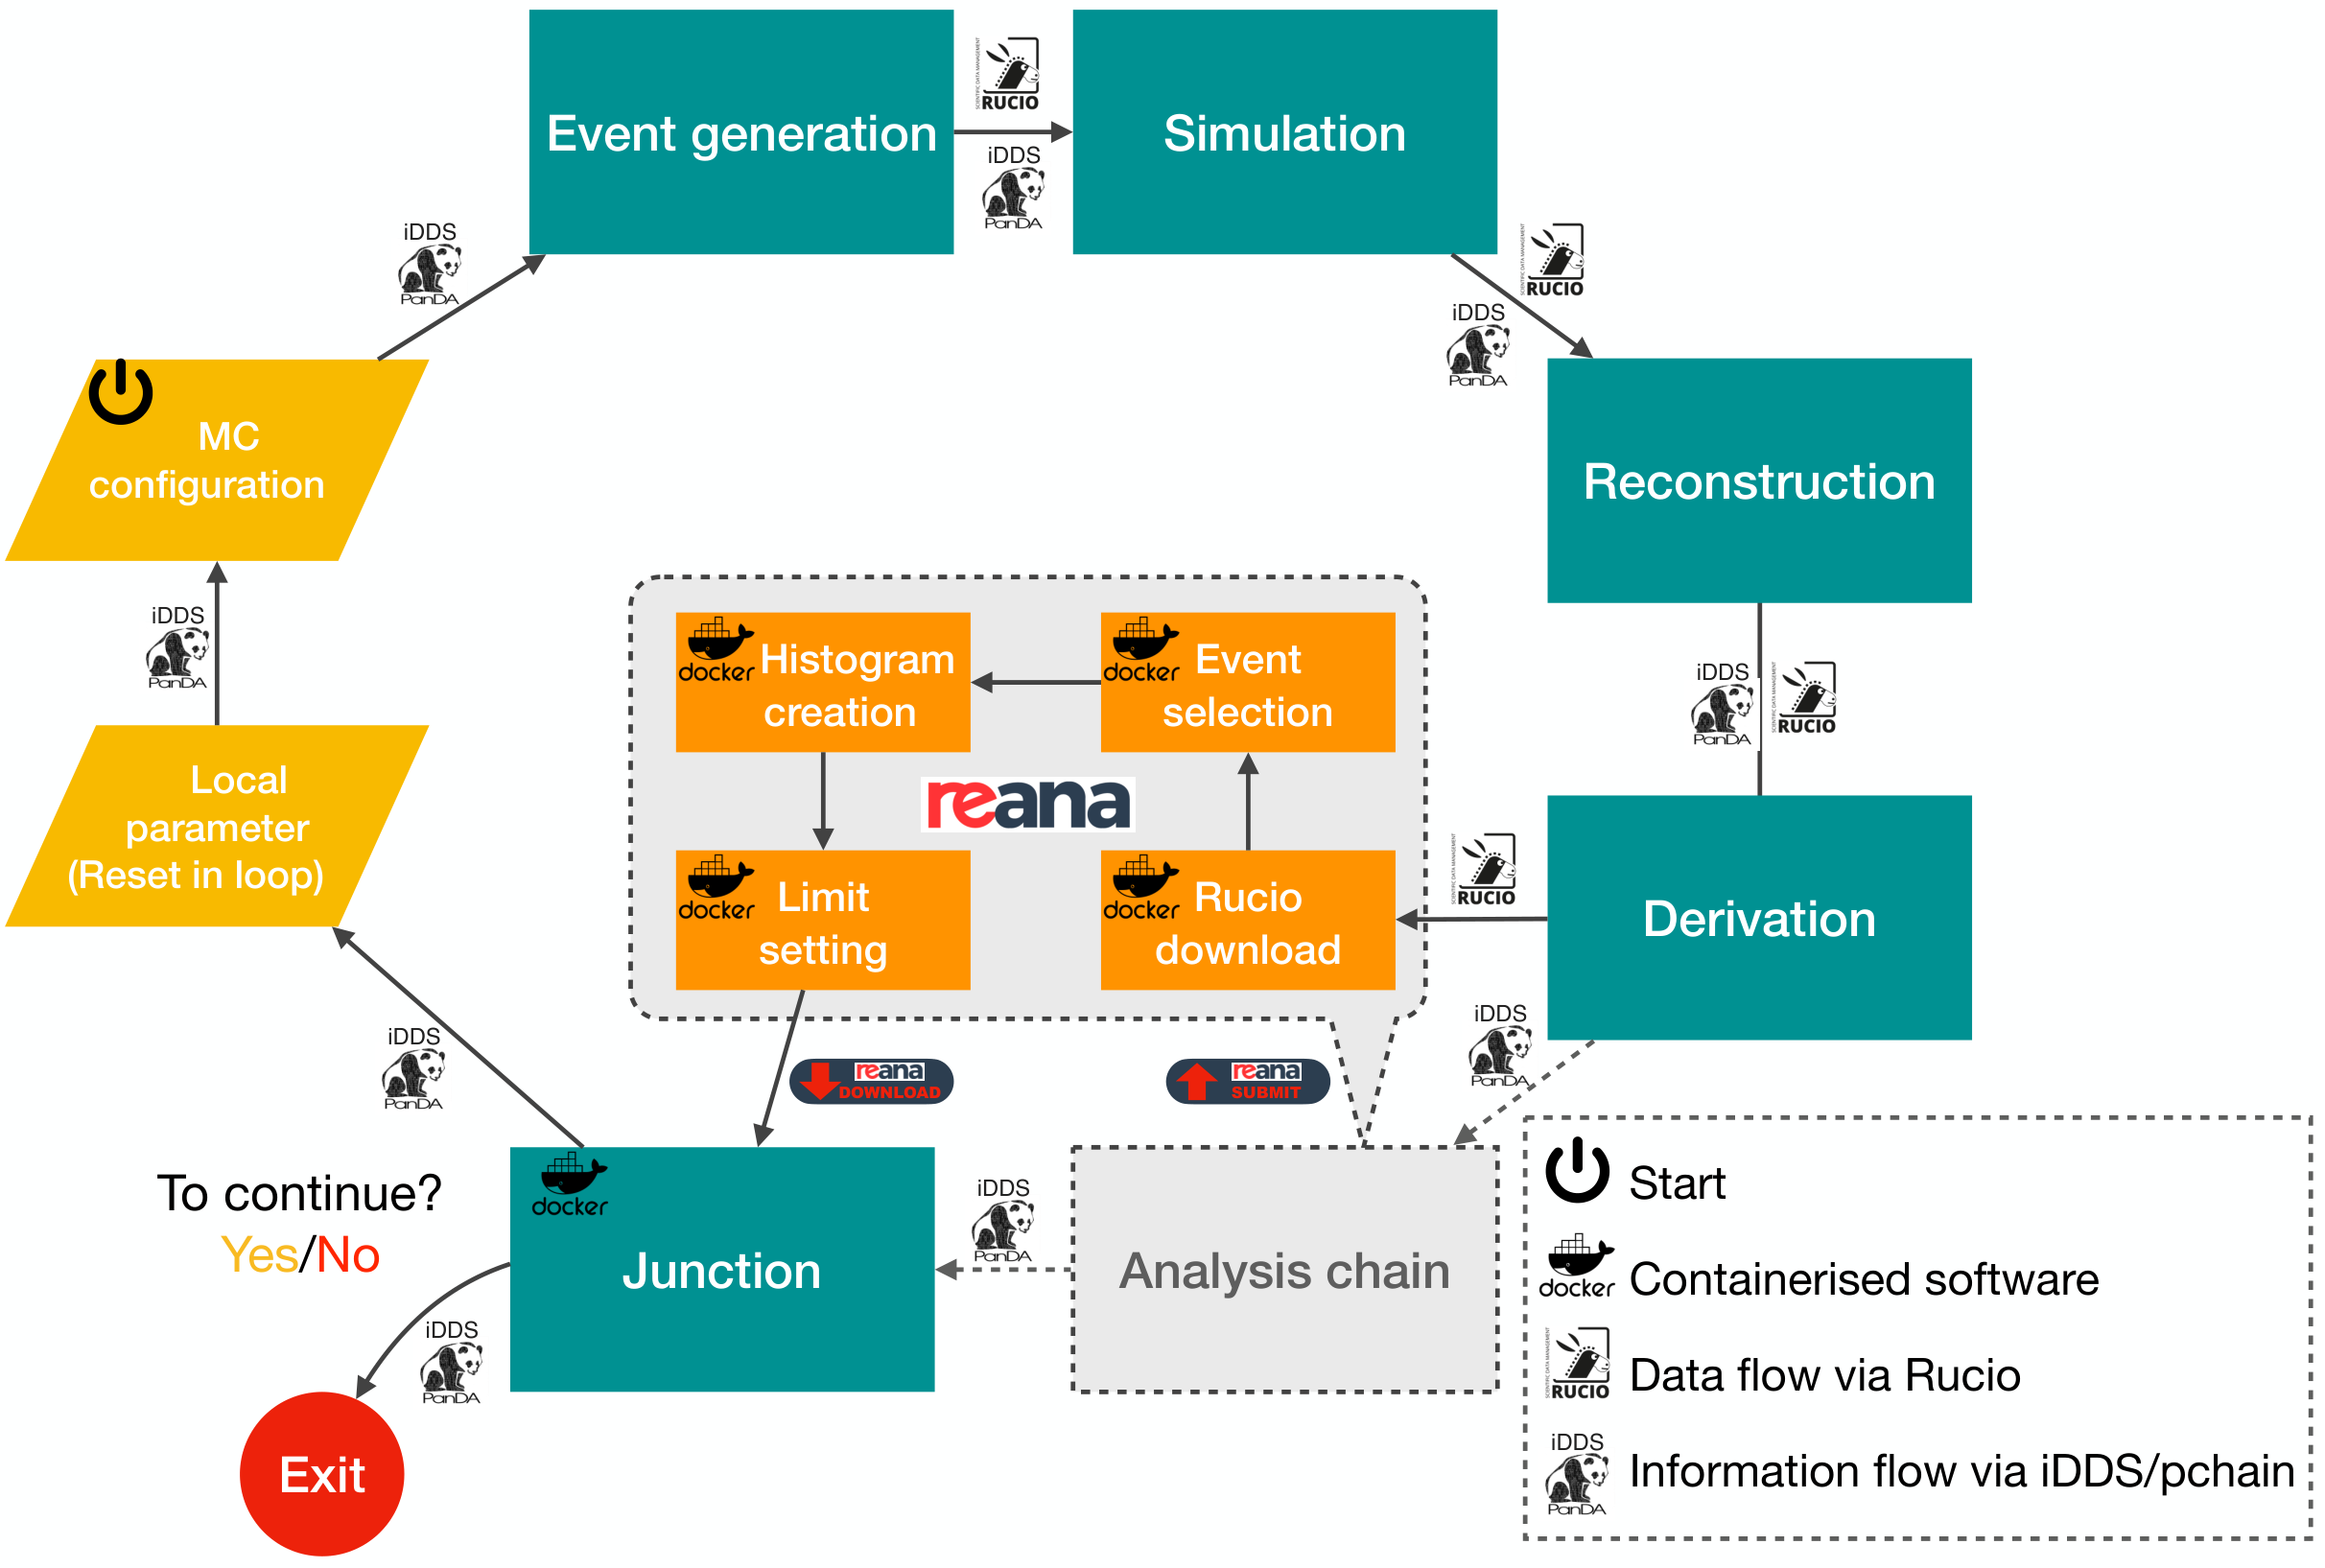
Production Interface
Notes:
This diagram here then shows the components and flow of our active learning application.
We start of here at the junction step, where a container with the active learning logic runs
It selects one or more points of the parameter space we want to explore
We have then a parameterized Monte Carlo Event Generation Configuration file that is then used to generate one Generation Configuration for each phase space point we want to explore
These are then used to Genereate the relevant events, which then pass through the ATLAS steps of Simulation, Reconstruction, and Derivation,
These derivation files are then transferred to REANA with Rucio where the actual analysis runs
There we do the relevant Analysis steps of Event selection, histogram creation, and eventually limit setting. The cross section limits are then transferred back to the active learning step,
Where they are then used to improve the surrogate model, which is then used to select new points to explore, from which the process continues
This can go on until a fixed number of iterations has been reached, or some other condition is fulfilled

Slide 12
Dark Matter Search
Demonstrate active learning pipeline on one of the analysis channels from JHEP03(2022)041:
Search for Higgs bosons decaying into new spin-0 or spin-1 particles in four-lepton final states with the ATLAS detector with 139 ${fb}^{−1}$ of $pp$ collision data at $\sqrt{s}$ = 13 TeV
Low-mass (LM) | $H→Z_{d}Z_{d}→4μ$ | $$01 GeV<m_{Z_{d}} <15 GeV$$ | targeting Higgs portal
High-mass (HM) | $H→Z_{d}Z_{d}→4ℓ$ | $$15 GeV<m_{Z_{d}}<60 GeV$$ | targeting Higgs portal
Single $Z$ boson (ZX) | $H→ZZ_{d}→4ℓ$ | $$15 GeV<m_{Z_{d}}<55 GeV$$ | targeting hypercharge portal
Focusing on ZX channel
Original analysis performed 1D scan in $m_{Z_{d}}$
Extend to 2D scan in $m_{Z_{d}}$ and $ε$
JHEP03(2022)041
Notes:
This brings me then to our dark matter search,
Which is based on this analysis here, that was published last year in JHEP.
It feated three different analysis chanells, searching for Higgs to ZdZd decays, and one looking for Higgs to ZZd
We are focusing on the ZZd one, this one was originally performed in a 1D scan along the Z-d mass
And we extended it into two dimensions, alond mZd and the kinematic mixing parmeter epsilon

Slide 13
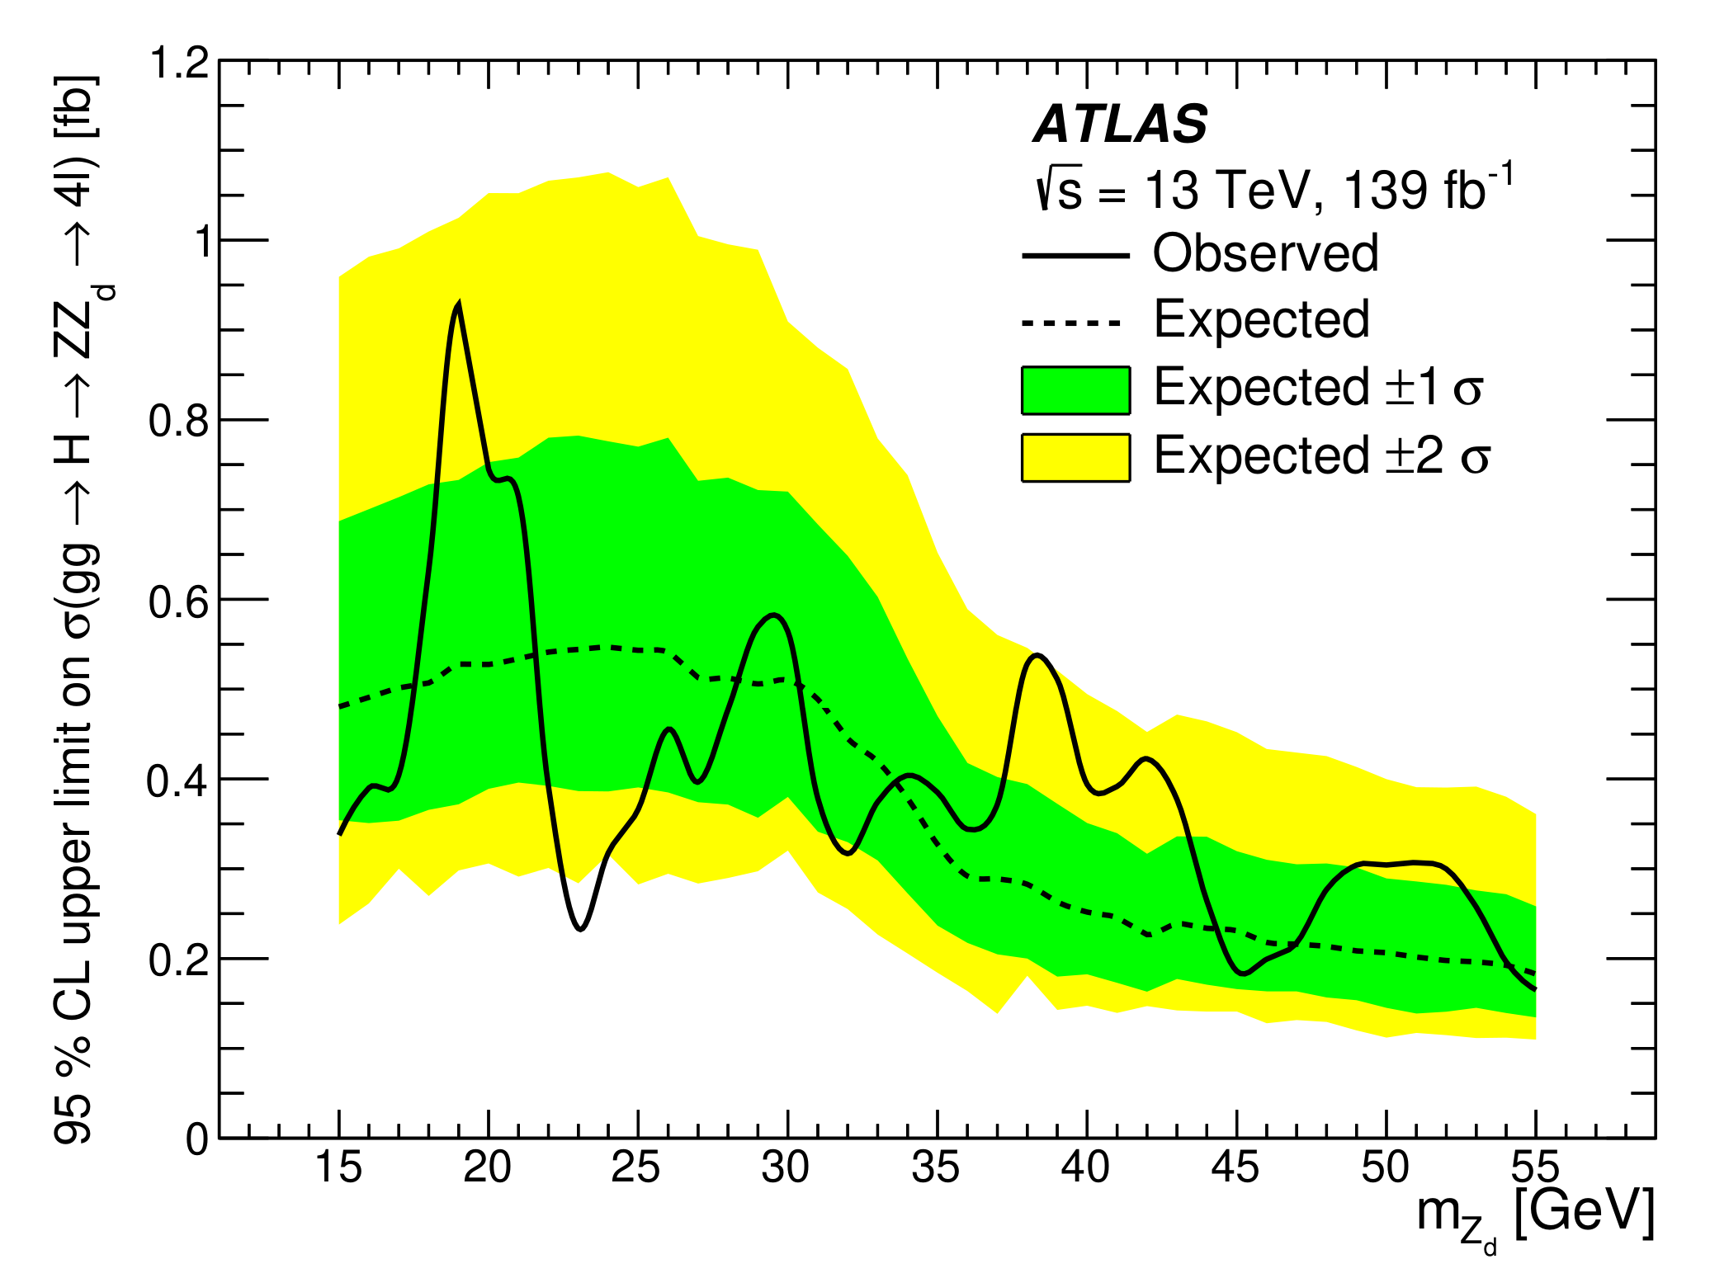
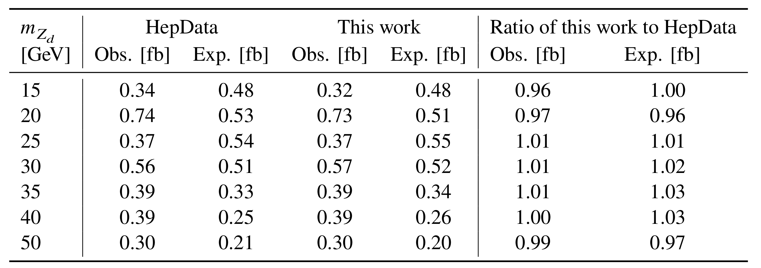
Verify MC Production & Analysis Chain
JHEP03(2022)0412
Slight difference in MC Production and Analysis setup with respect to published analysis at: JHEP03(2022)041
Slightly different MC production setup
Smaller amount of MC statistics 10k vs $\sim$200k
Check against published cross section limit values on HEPData
Agreement within $4\%$ - good!
JHEP03(2022)041
Notes:
The setup that we used different slightly with respect to the published analysis in terms of the Monte Carlo production setup and analysis details, predominantly a reduced MC statistics, to reduce the computational load for this study.
So in a fist step we recreated the limits that were featured in the published analysis and compared to compare them to the ones produced with our pipeline, which are both shown in the table here
The second and third columns show the observed and expected limits respectivelive taken from HEP data
The furth and fifth show the equivalent values from our current study, and the last two present the relevant ratios
Which show that our results here and the published ones are in agreement within 4%, which is good enough for our purposes here

Slide 14
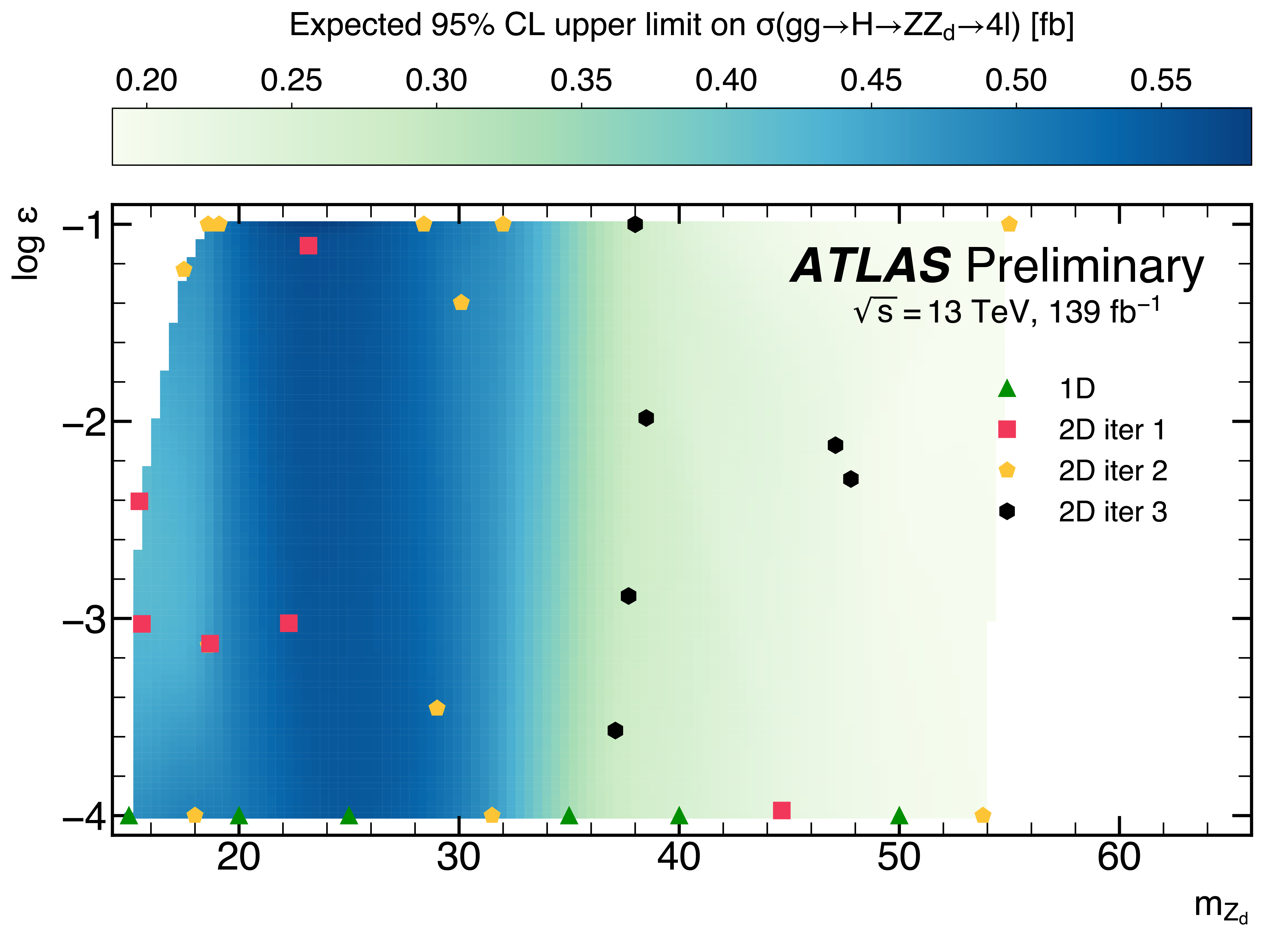
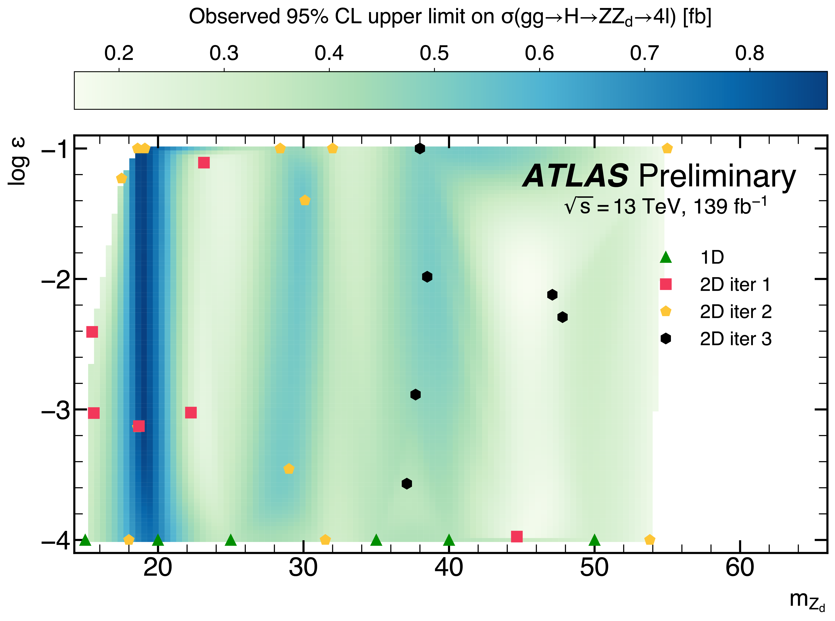
2D Demonstration
Parameter phase space bounded by
$15≤m_{Z_{d}}≤55$ GeV
${10}^{−4}≤ε≤{10}^{−1}$
Run in 4 iterations with 30 points total
ATL-PHYS-PUB-2023-010
Notes:
We performed then the iterative active learning process, over 4 iterations with 30 points samples in total
The Zd mass was bounded to be between 15 and 55 GeV,
The kinematic mixing parameter to be between 10^-4 and 10^-1
The left plot shows the expect limits on the Higgs to ZZd to 4l cross section, and the right hand plot the observed equivalent
We started out with the 7 points from the 1D study of the previous slide
The 1st 2d iteration is shown in the red squares, the 2nd iteration in the yellow pentagrams, and the list one in the black hexagons.
The 2d results are then interpolated via a cubic spline

Slide 15
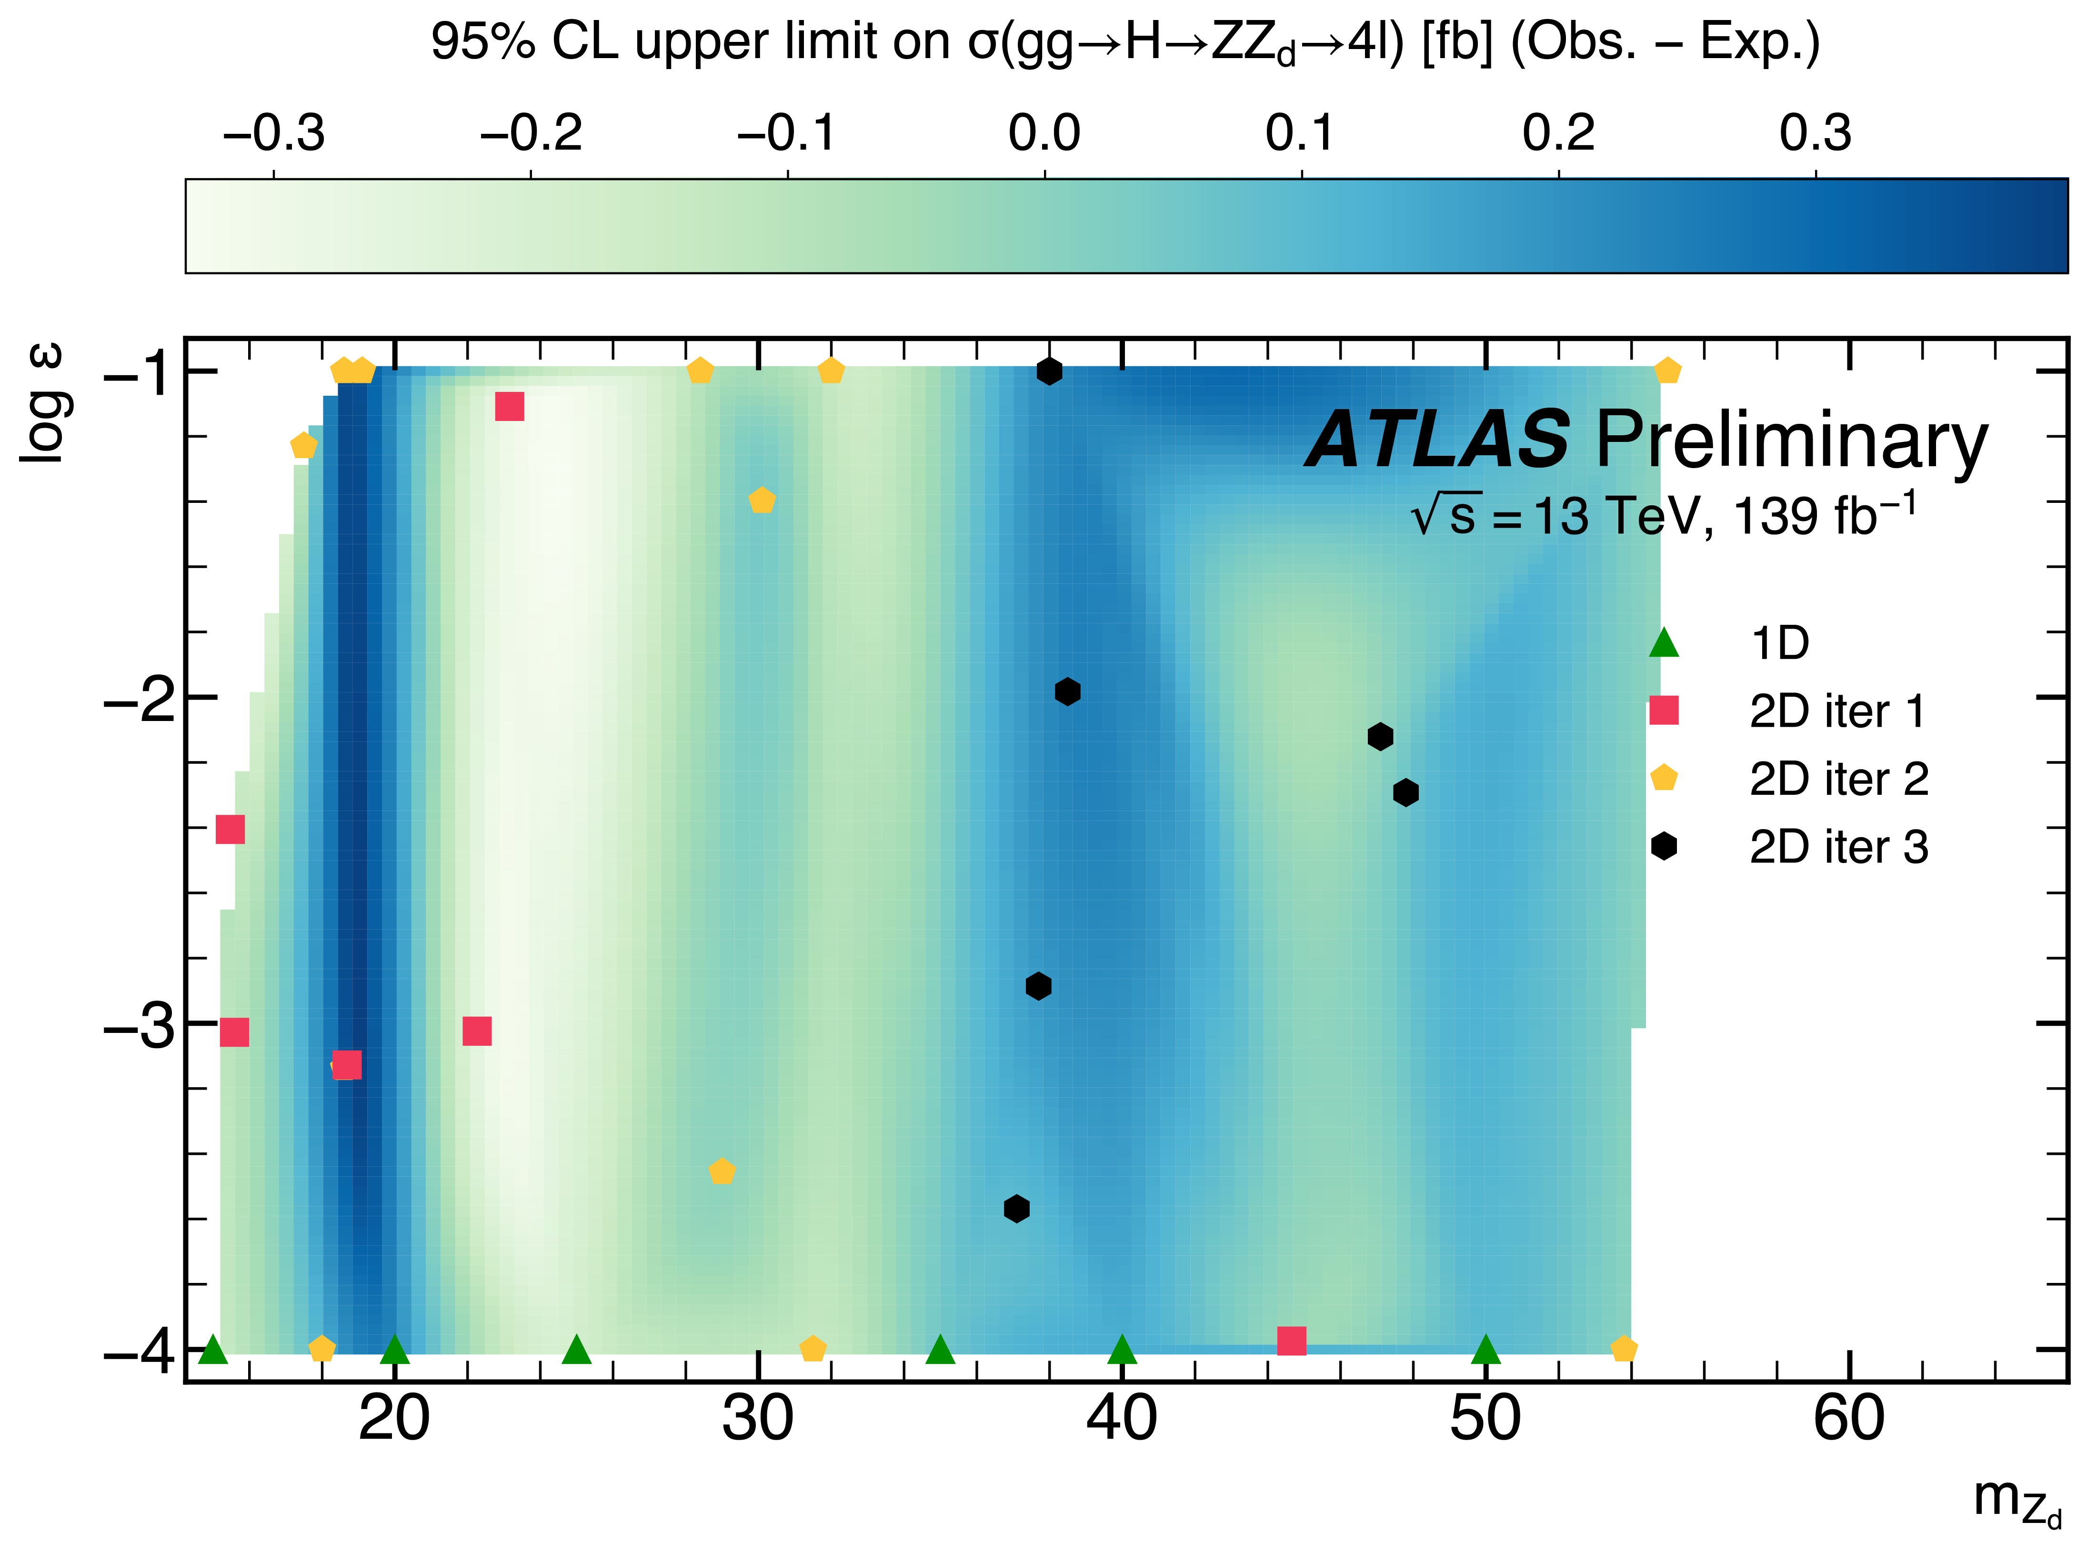
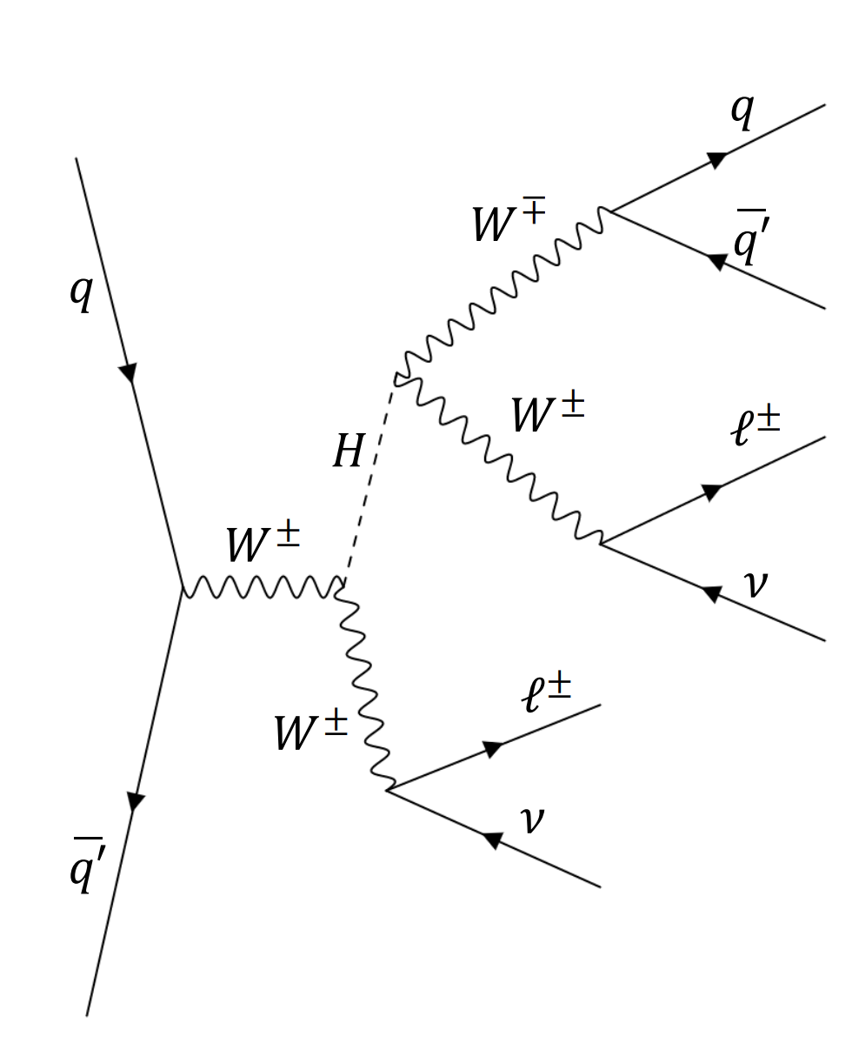
Conclusion
Demonstrated active learning driven re-analysis for published dark sector analysis – see ATLAS PubNote ATL-PHYS-PUB-2023-010
Extended ZX analysis channel from 1D to $2D$ parameter space in $m_{Z_{d}}$ and $ε$
Preparing second demonstrator based on heavy Higgs Boson search
3D parameter space
theory predictions to prioritize exclusion contours
Many other applications and possibilities for this tool and workflow
Another ATLAS application of active learning using a different tool: Active Learning reinterpretation of an ATLAS Dark Matter search constraining a model of a dark Higgs boson decaying to two $b$-quarks ATL-PHYS-PUB-2022-045
ATL-PHYS-PUB-2023-010
A search for heavy Higgs bosons decaying into
vector bosons in same-sign two-lepton final states in $pp$ collisions at $\sqrt{s}$=13 TeV with the ATLAS detector arXiv:2211.02617
Talk later today at 17:30 by Zubair in Track 9 ”Efficient search for new physics using Active Learning in the ATLAS Experiment”
Notes:
So to conclude,
We Demonstrated and active learning driven re-analysis for published dark sector analysis – which is now available in this pubnote here
Therein we extended the ZX analysis channel from 1D to $2D$ parameter space in $m_{Z_{d}}$ and $ε$
And we are preparing a second demonstrator for our service based on a heavy Higgs Boson search, featuring a 3D parameter space, and theory predictions to prioritize finding exclusion contours
There many other applications and possibilities for this tool and workflow
And before I yield the floor I would like to point out this ATLAS application of active learning using a different tool
About which Zubair will later talk today. So I am looking forward to his talk.
Thank you

Slide 16
The End.
Thank you!

