Slide 1
Improving ROOT I/O Performance for Analysis
CHEP 2023, Norfolk, U.S. May 8, 2023
Canal, Philippe (FNAL) Blomer, Jakob (CERN) Naumann, Axel (CERN)

Slide 2
Introduction
Many of the improvements are thanks to
Josh BenDavid & Chris Jones
Using 100s of cores (and threads) brings a slew of new challenges.
Will describe a series of improvements accelerating by order of magnitude
Reading via RDataFrame
Writing using TBufferMerger
Including several re-usable lessons learned
Picture From newtechnorthwest
This Photo by Unknown Author is licensed under CC BY
Notes:
In an example I was investigating for this talk, I uncovered 4 layers of issues and did not even get to the bottom.

Slide 3
Amdahl’s law is harsh at 256 threads
Result on a smallish CMS analysis test with 256 threads:
78x speedup in elapsed time
Reduces wall time from 25 minutes to 19 seconds
Increases CPU usage from 400% to 4000%.
Change in a single function (TBufferFile::ReadClassBuffer)
Use Read and Write part of global Read/Write lock
Reduce critical section (write lock) down to the (rare) one time initialization
Keep rest of the hotspot under ‘only’ the read lock.

Slide 4
Atomics are easy, right?
Not so fast. Still need an (implicit) synchronization.
2.2x improvement (40M obj write on 32 threads: 322s down to 141s)
Avoid multiple calls to std::atomic::load
Use more relaxed memory order
Switched from memory_order_seq_cst (sequentially-consistent ordering, default) to std::memory_order_relaxed
auto value = fAtomic.load(); if (!value) … some initialization … return value ? value : kDefault;
if( !fIsInit.load(std::memory_order_relaxed) )
{
std::lock_guard(mutex); if (!fIsInit.load())
// Actual one-time initialization
}
Relaxed operation: no synchronization or ordering constraints imposed on other reads or writes, only this operation's atomicity is guaranteed.
Works here as spurious execution of ”then” will be harmless thanks to lock and recheck.
Notes:
https://github.com/root-project/root/pull/6062
Reduce contention on some atomics in core/meta and io
Show the influence (with a graph) of selecting the atomic load memory model
The results below are dramatic enough to be revelant event-though they are just one 1 with 2 jobs running at the same time, one with N threads and another with 32-N threads on a 32 real core machine (so the machine is always at full capacity).
memory_order_relaxed Relaxed operation: there are no synchronization or ordering constraints imposed on other reads or writes, only this operation's atomicity is guaranteed (see Relaxed ordering below)
memory_order_seq_cst A load operation with this memory order performs an acquire operation, a store performs a release operation, and read-modify-write performs both an acquire operation and a release operation, plus a single total order exists in which all threads observe all modifications in the same order (see Sequentially-consistent ordering below)

Slide 5
Making multiple line static initialization thread safe
Dangerous
Thread safe
static bool isinit = false;
static std::vector<size_t> lengths;
if (!isinit) {
for (...) {
lengths.push_back(...);
}
isinit = true;
}
return lengths;
static std::vector<size_t> lengths{ []() {
std::vector<size_t> create_lengths;
for (...) {
create_lengths.push_back(...);
}
return create_lengths;
}() };
return lengths;
Notes:
TClassEdit: make usage of static cache container thread safe
Interesting to present the static + lambda initialization
auto initLengthsVector = []() {
std::vector<size_t> create_lengths;
for (int k=0; remove[k]; ++k) {
create_lengths.push_back(strlen(remove[k]));
}
return create_lengths;
};
static std::vector<size_t> lengths{ initLengthsVector() };

Slide 6
Speeding-up TFile
8x reduction in elapsed time in a RDF benchmark reading one column from 4000 files with 1M entries and using 256 threads
New TFile::Open option to skip global registration, RDF uses this option by default
TFile::Open no longer reprocess identical TStreamerInfo.
Another 2x by improving TFile::Open’s plugin mechanism
Increase pre-calculation (pay upfront, avoid synchronization later)
Increase caching to avoid calls to locking checks
Use local mutex rather than global lock (required attention to avoid dead lock)
Yet another 2x Skip registration of TFile’s UUIDs
Breaks the very rare case where a TRef points to the TFile object
Cpu usage from 1557% to 14271%
2x in time 9x in CPU usage
Bottleneck switches from mutex to spin locks

Slide 7
Additional speedups
9x in a realistic RDataFrame CMS based example with many branches
Disable garbage collector for TBranch within RDF
7% speedup in a medium sized test filling histograms from CMS NanoAOD with RDF and 256 threads.
New (optional) TBB-based internal counter for ROOT main to Recursive Read/Write Lock

Slide 8
It gets complicated
TClassTable: fixed data race between dlopen and other uses
Opening a library register what classes it contains
If done from multiple threads, it fills the same containers at the ‘same time’
Required fine grained lock because:
dlopen itself take a lock so there is risk of dead locks
User might hold ROOT global lock
Required to only include elementary actions
Even simple ‘error handling function’ can both take the global lock and recursively call TClassTable.
gDirectory is a thread local variable that points to a TFile that can be deleted by another thread
Requires extremely challenging intercommunication between threads.
This Photo by Unknown Author is licensed under CC BY
Notes:
Re-enable registration of thread-local gDirectory to gROOT.
Reenable the cleanup of gDirectory in other threads upon file deletion.

Slide 9
Multiple writer into a single file
Client / Thread
Client / Thread
Client / Thread
TBufferMerger / Server
Final File

Slide 10
TBufferMerger
TBufferMerger
Data Queue
Data Buffer
Data Buffer
Data Buffer
Data Buffer
Data Buffer
Worker Thread
Write()
Worker Thread
Write()
Merge()
Worker Thread
Write()
Worker Thread
Write()
Worker Thread
Data Buffer
Write()
Data Buffer
Disk

Slide 11
TBufferMerger when per-thread-time < merging-time*threads
TBufferMerger
Data Queue
Data Buffer
Data Buffer
Data Buffer
Data Buffer
Data Buffer
Worker Thread
Write()
Worker Thread
Write()
Merge()
Worker Thread
Write()
Data Buffer
Worker Thread
Write()
Data Buffer
Data Buffer
Worker Thread
Data Buffer
Write()
Data Buffer
Disk

Slide 12
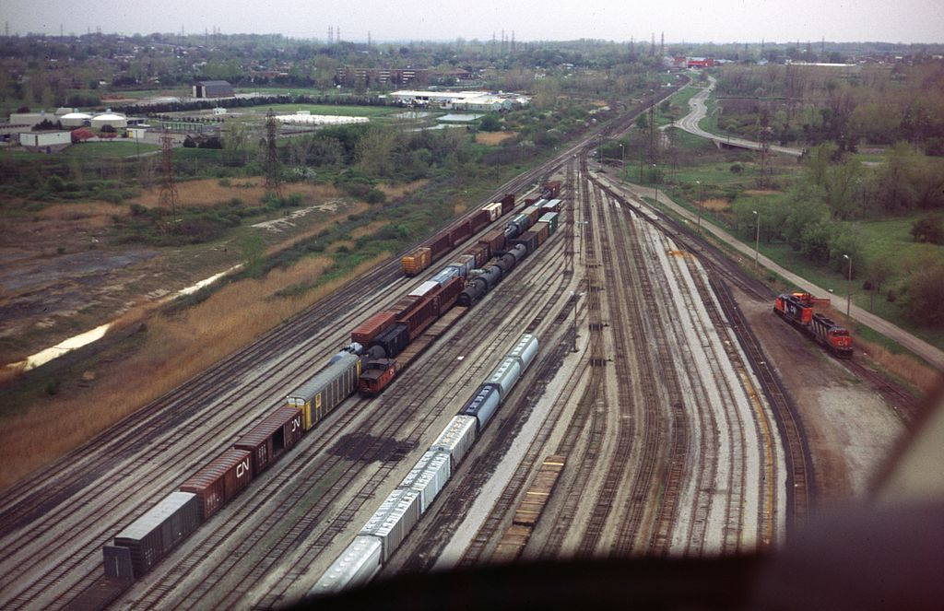
Taming the flood
Problem might appear in case of fast data producer and very high thread count (and high branch count)
Make the merging step as fast as possible:
Keep the in-memory TTree alive avoid compression and streaming back and forth
Optimize the main code paths
Trade off crash recovery safety for speed (no intermediate snapshot of meta data)
Reduce size of critical section
RNTuple merging will be even faster ( scale with just number of clusters rather than also number of branches)
Provide ways to monitor queue size to allow framework to suspend work
Auto-backup will be incorporated in upcoming release.
Test:
Reading and writing 1000+ branches ran longer than user patience.
New version: 11s with 1 thread, 8s with 6 threads with 50 events per chunk (and 22s for 500 events)
This Photo by Unknown Author is licensed under CC BY-SA
Notes:
This set of improvements to TBufferMerger (and more) was inspired by the terrible performance of the parallel merging (and fast merging in general) in the case where the TTree has a very large number of branches (1000+).
Where in the original version a TBufferMerger with a file with 1000+ branches and only 50s and ran with any number of threads would take more than 3m (did not wait until the end) the new version takes 11s with 1 thread, 8s with 6 threads and 22s with 6 thread when increased to 500 events. (using the CMS file ../data//250202_181_RECO.root).

Slide 13
Summary
Improvements made thanks in very large parts to submission of running challenging examples and even to actual code contributions from user(s).
Amdahl’s law is very noticeable at 256 threads
Broad-strokes enabling of thread safely can sometimes be enough but source of noticeable slowdown at high thread count.
But still, existing code can be significantly improved with a few (some simple and some not so simple) techniques.
A RDataFrame scenario with 256 threads ran O(100x) faster
This Photo by Unknown Author is licensed under CC BY

Slide 14
Backup Slides
May 8, 2023
ROOT I/O --- CHEP 2023
14

Slide 15
Old Fashion Arrangement
Client
Client
Server
Final File
Client
Fast Merging

Slide 16
Node used for many of the test
128core/256 thread cpu (dual EPYC 7702)
1TB RAM
raid0 array of gen4 nvme ssd's (in synthetic benchmarks the array can push 100Gbytes/sec in sequential reads)
NIC is 100gbps (relevant for the cases where we test network reads from eos/xrootd, ceph etc, though all of the comparisons are running from the local ssd array unless explicitly stated otherwise)

Slide 17
Fast Merging
ROOT Files can be ‘fast’ merged by ‘only’
Copying/appending the compressed data (baskets)
Updating the meta data (TTree object)
In first approximation we reach disk bandwith
Actually … half … since we read then write.
Leverage this capability and use in-memory file to add support for multiple writers to the same file
Data just written once, hence reaching disk bandwith
Multi-thread in production
MPI in production

Slide 18
With Parallel Merging
Client
Client
Client
Server
Final File

Slide 19
TBufferMerger
TBufferMerger
Data Queue
Data Buffer
Data Buffer
Data Buffer
Data Buffer
Data Buffer
Worker Thread
Write()
Worker Thread
Write()
Merge()
Worker Thread
Write()
Data Buffer
Worker Thread
Write()
Data Buffer
Data Buffer
Worker Thread
Data Buffer
Write()
Data Buffer
Disk

Slide 20
One sort-of breaking change
Skip registration of TFile’s UUIDs
2x elapsed time reduction on a RDF benchmark reading one column from 4000 files with 1M entries and using 256 threads:
Baseline: Percent of CPU this job got: 1557% Elapsed time: 0:49.89
Improved Percent of CPU this job got: 14271% Elapsed time: 0:21.11
Breaks the very rare case where a TRef points to the TFile object
which was already not properly supported in multi-thread
2x in time 9x in CPU usage
Bottleneck switches from mutex to spin locks

Slide 21
Additional Note
TFile WriteCache
Allow delaying and coalescing the write at the cost of more memory
Not often used as gain is minimal on a single disk and memory often tight
FastMerge additional features:
Reorganize how the baskets are laid out on the file
And could be improve to:
Delay, coalesce or even distribute the actual writing

Slide 22
What about dead locks?
Many times, we encountered the pattern:
Take local lock
Do critical things
Call some seeming innocuous function (eg. `Error`, `dlopen`)
However, the ’innocuous’ function might also take a long live mutex (ROOT global mutex, etc.)
AND if those critical section happens to call back to the above function, well … game over.
Examples:
ROOT’s DefaultErrorHandler
TClassTable vs dlopen
Thread One Thread Two
Take lock A ….
… Take lock B
Request lock B …
… Request lock A
Waiting forever Waiting forever
Notes:
https://github.com/root-project/root/pull/11384
(probably to minor to mention. Maybe interesting-ish in the set of commit to get to the right impl)
Extra protection for the unlikely case where gEnv is nullptr Update gErrorIgnoreLevel only if gEnv is available ErrorHandler: test gEnv value only once

Slide 23
TBufferMerger
Data Producer
MemFile
Data Producer
MemFile
MemFile
Final Output (disk)
MemFile
MemFile
Data Producer
MemFile
Data Producer
MemFile
Thread or Process
Data Producer
MemFile
Data Producer
MemFile

Slide 24
TBufferMerger
Data Producer
MemFile
Data Producer
MemFile
Final Output (disk)
MemFile
MemFile
MemFile
Data Producer
MemFile
Data Producer
MemFile
Thread or Process
Data Producer
MemFile
Data Producer
MemFile

Slide 25
TBufferMerger – increasing rate
Data Producer
MemFile
Data Producer
MemFile
Final Output (disk)
MemFile
Data Producer
MemFile
Merging in
Thread or Process
Data Producer
MemFile

Slide 26
TBufferMerger – Merger keeps up
Data Producer
MemFile
Final Output (disk)
Final Output (disk)
MemFile
Data Producer
MemFile
Merging in
Thread or Process
Data Producer
MemFile

Slide 27
TBufferMerger – increasing rate
Data Producer
MemFile
Data Producer
MemFile
Final Output (disk)
MemFile
Final Output (disk)
MemFile
MemFile
MemFile
Data Producer
MemFile
Data Producer
MemFile
Merging in
Thread or Process
Data Producer
MemFile

Slide 28
TBufferMerger when per-thread work < merging*threads
Data Producer
MemFile
Data Producer
MemFile
MemFile
MemFile
MemFile
MemFile
Final Output (disk)
MemFile
MemFile
MemFile
Final Output (disk)
Data Producer
MemFile
Data Producer
MemFile
Merging in
Thread or Process
Data Producer
MemFile
Data Producer
MemFile
Time to produce ”one” TMemFile is constant
Time to merge increase with number of threads
Notes:
Problem if time to merge output of N threads take longer than the work time of a single thread

Slide 29
Reduce lock contention in TUrl::GetSpecialProtocols()
By reducing length of critical section

