Slide 1
Large scale dynamic web deployment for CERN, experience and outlook
Joachim Valdemar Yde, Web Team
Rajula Vineet Reddy, Infrastructure Team
9 May 2023

Slide 2
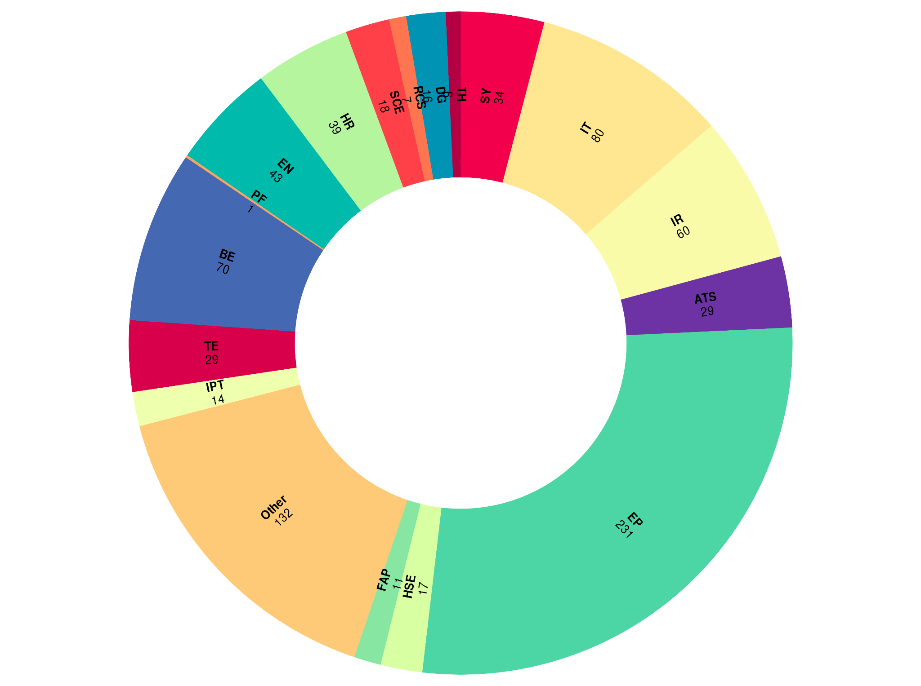
CERN’s Online Presence
837 production
websites

Slide 3
CERN’s Online Presence
Internal and external audience
(day-to-day operations, press releases, announcements, collaboration, etc.)
837 production
websites

Slide 4
CERN’s Online Presence
Internal and external audience
(day-to-day operations, press releases, announcements, collaboration, etc.)
837 production
websites
Different owners and users
(each website has unique requirements, audience(s), traffic, and resources)

Slide 5
CERN’s Online Presence
Internal and external audience
(day-to-day operations, press releases, announcements, collaboration, etc.)
Centralised infrastructure
(run latest versions, apply security patches, meet design and communication guidelines)
837 production
websites
Different owners and users
(each website has unique requirements, audience(s), traffic, and resources)

Slide 6
CERN’s Online Presence
Internal and external audience
(day-to-day operations, press releases, announcements, collaboration, etc.)
Centralised infrastructure
(run latest versions, apply security patches, meet design and communication guidelines)
837 production
websites
Different owners and users
(each website has unique requirements, audience(s), experience, traffic, and resources)
Standardised configuration
(provisioning, backups, service
integrations, authentication, etc.)

Slide 7
Infrastructure Overview
Website
(Kubernetes pod)

Slide 8
Infrastructure Overview
Resources of each site
Website
(Kubernetes pod)

Slide 9
Infrastructure Overview
Resources of each site
Content Management System Controllers
Website
(Kubernetes pod)

Slide 10
Infrastructure Overview
Resources of each site
Database integration
Content Management System Controllers
SSO integration
Website
(Kubernetes pod)

Slide 11
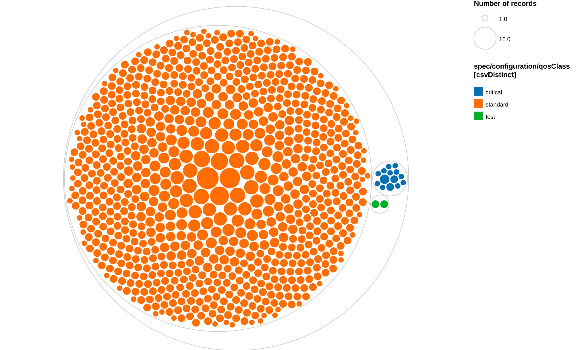
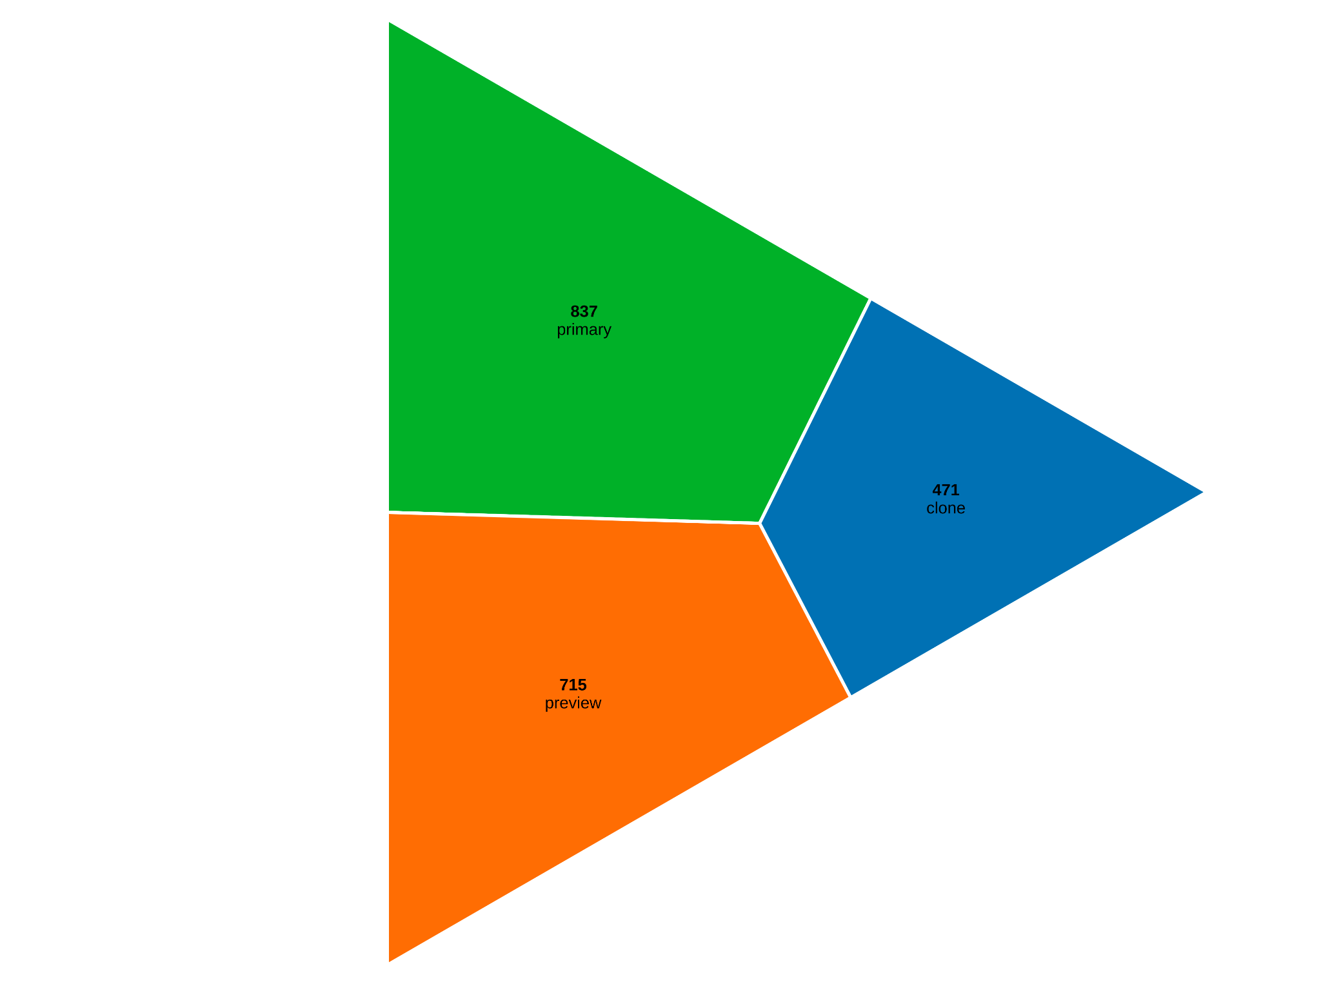
Infrastructure Snapshot
Quality of Service
Type of website

Slide 12
CERN Custom Distribution
Standardization
Centralized development and bug fixes
Ease of operations
CERN design guidelines
Installing extra modules
Upstream Core
Software (and base modules)
CERN Themes & Profiles
Custom Scripts
Gitlab Repository: https://gitlab.cern.ch/drupal/paas/cern-drupal-distribution

Slide 13
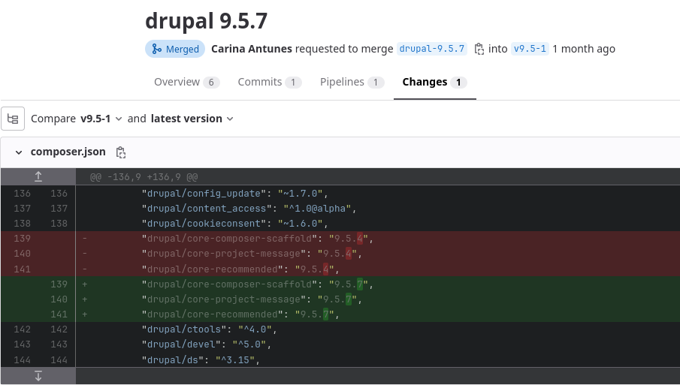
Rolling out a New Release
Update the CERN distribution
New version available
CI build and testing

Slide 14
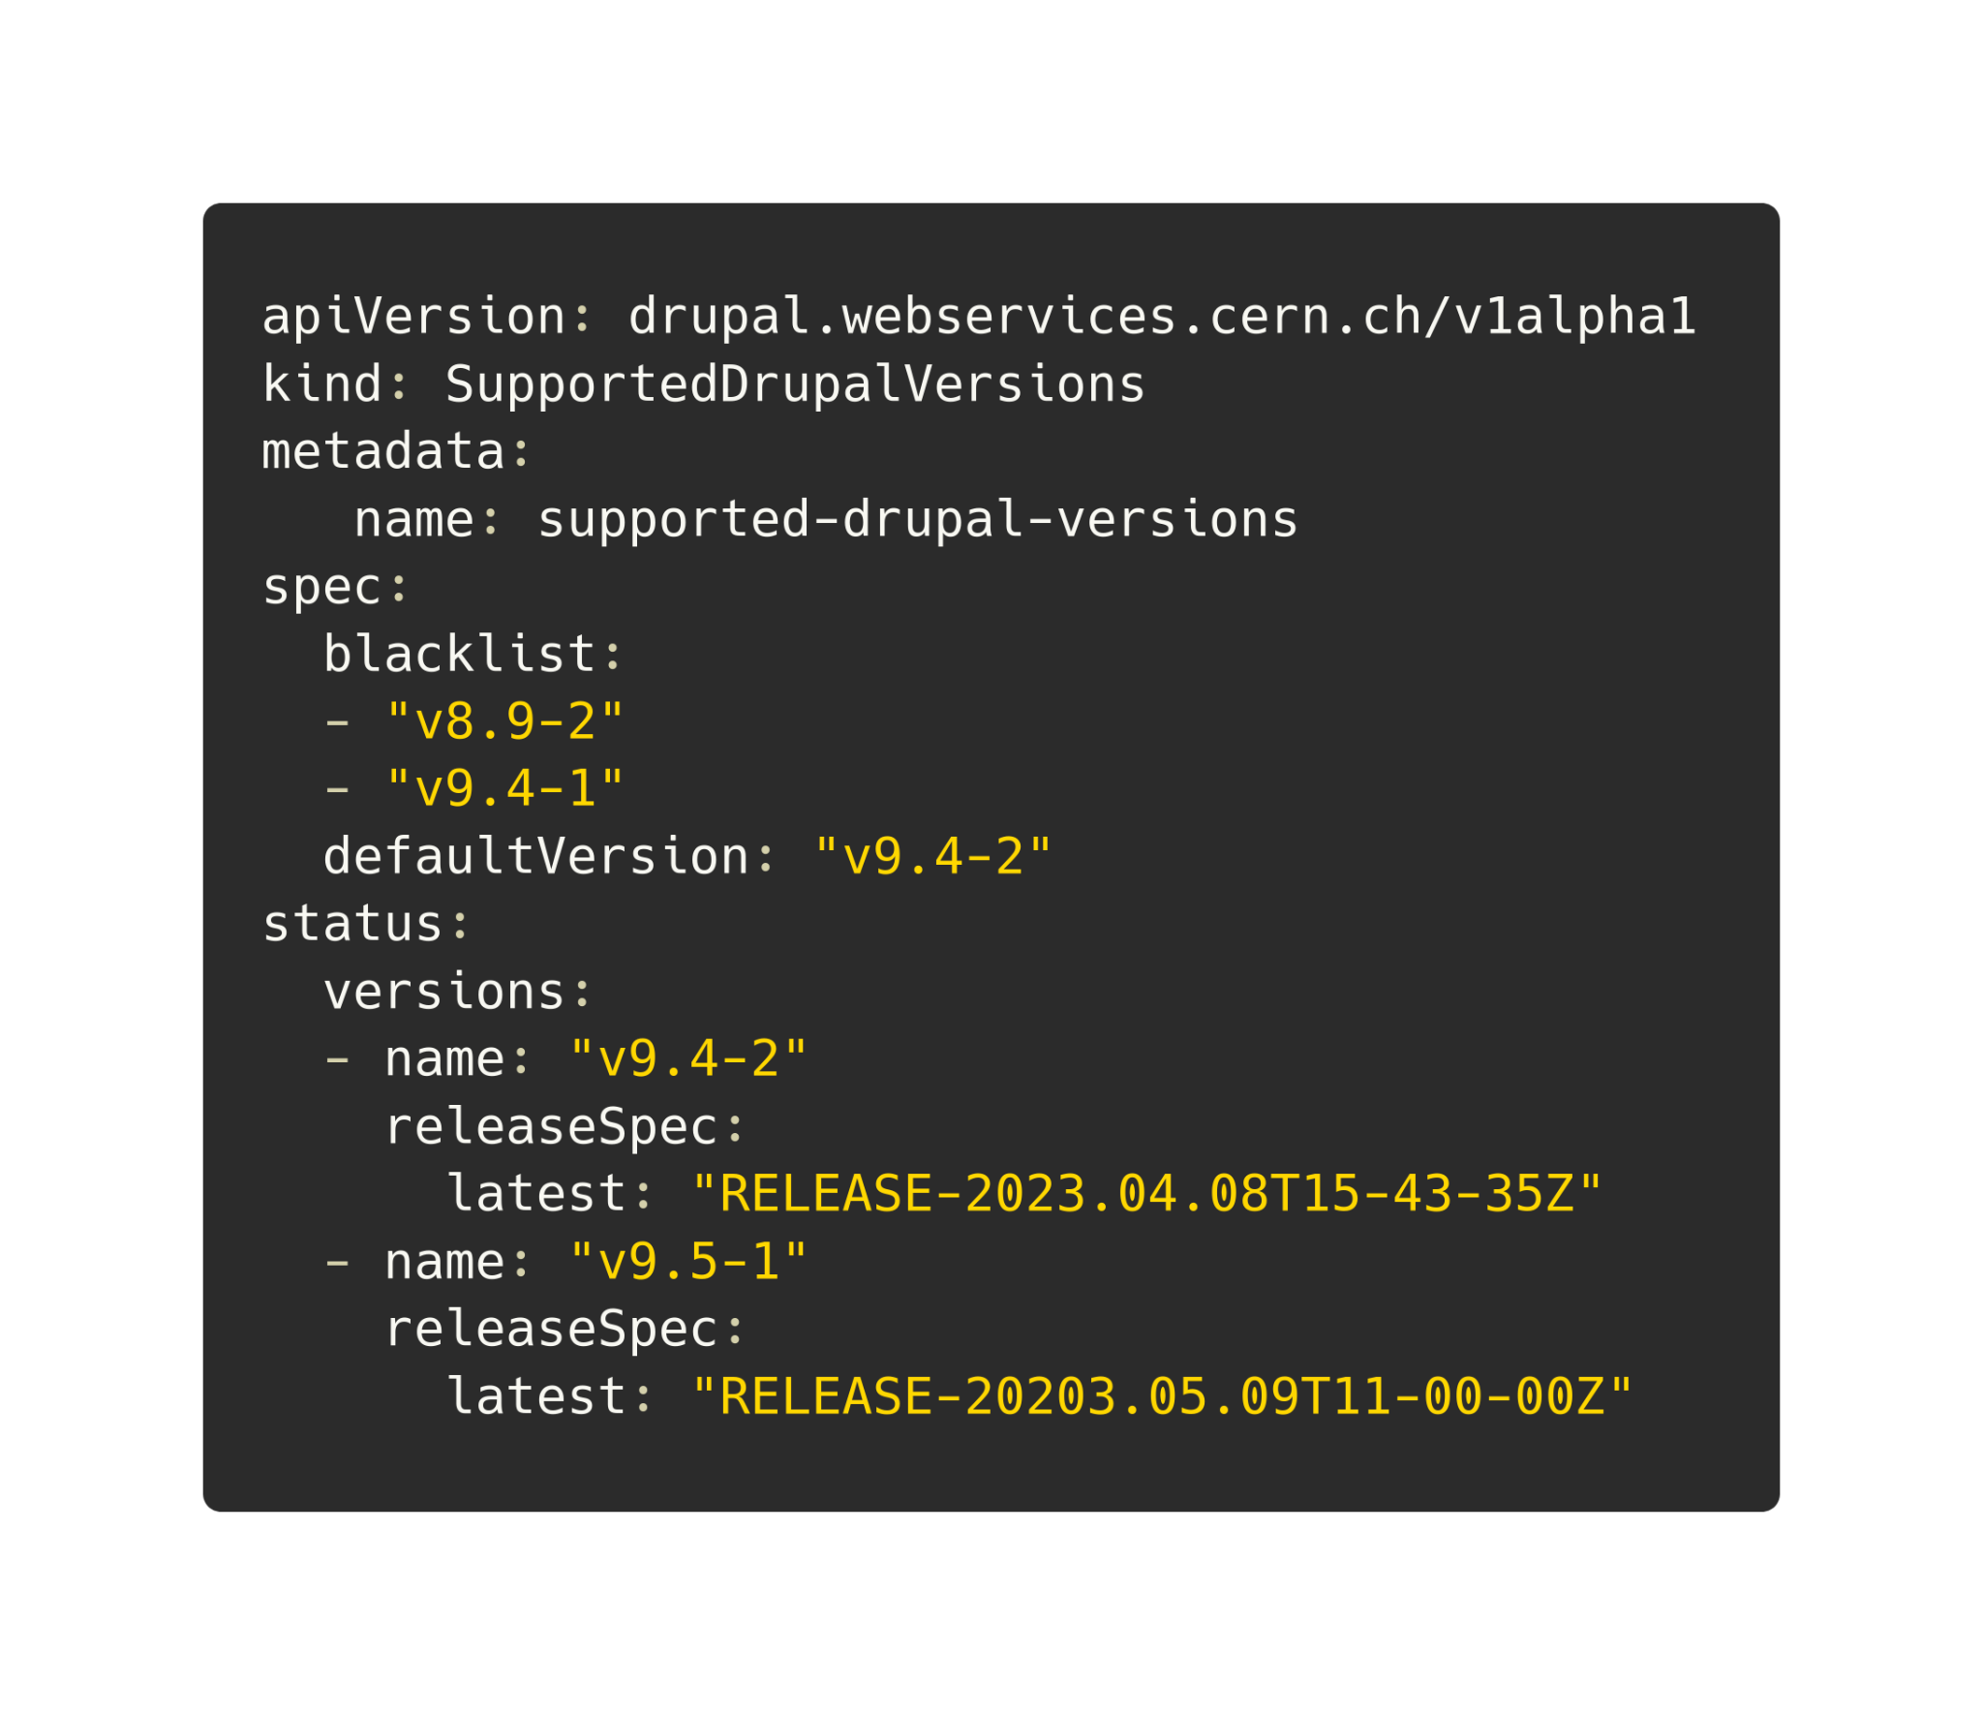
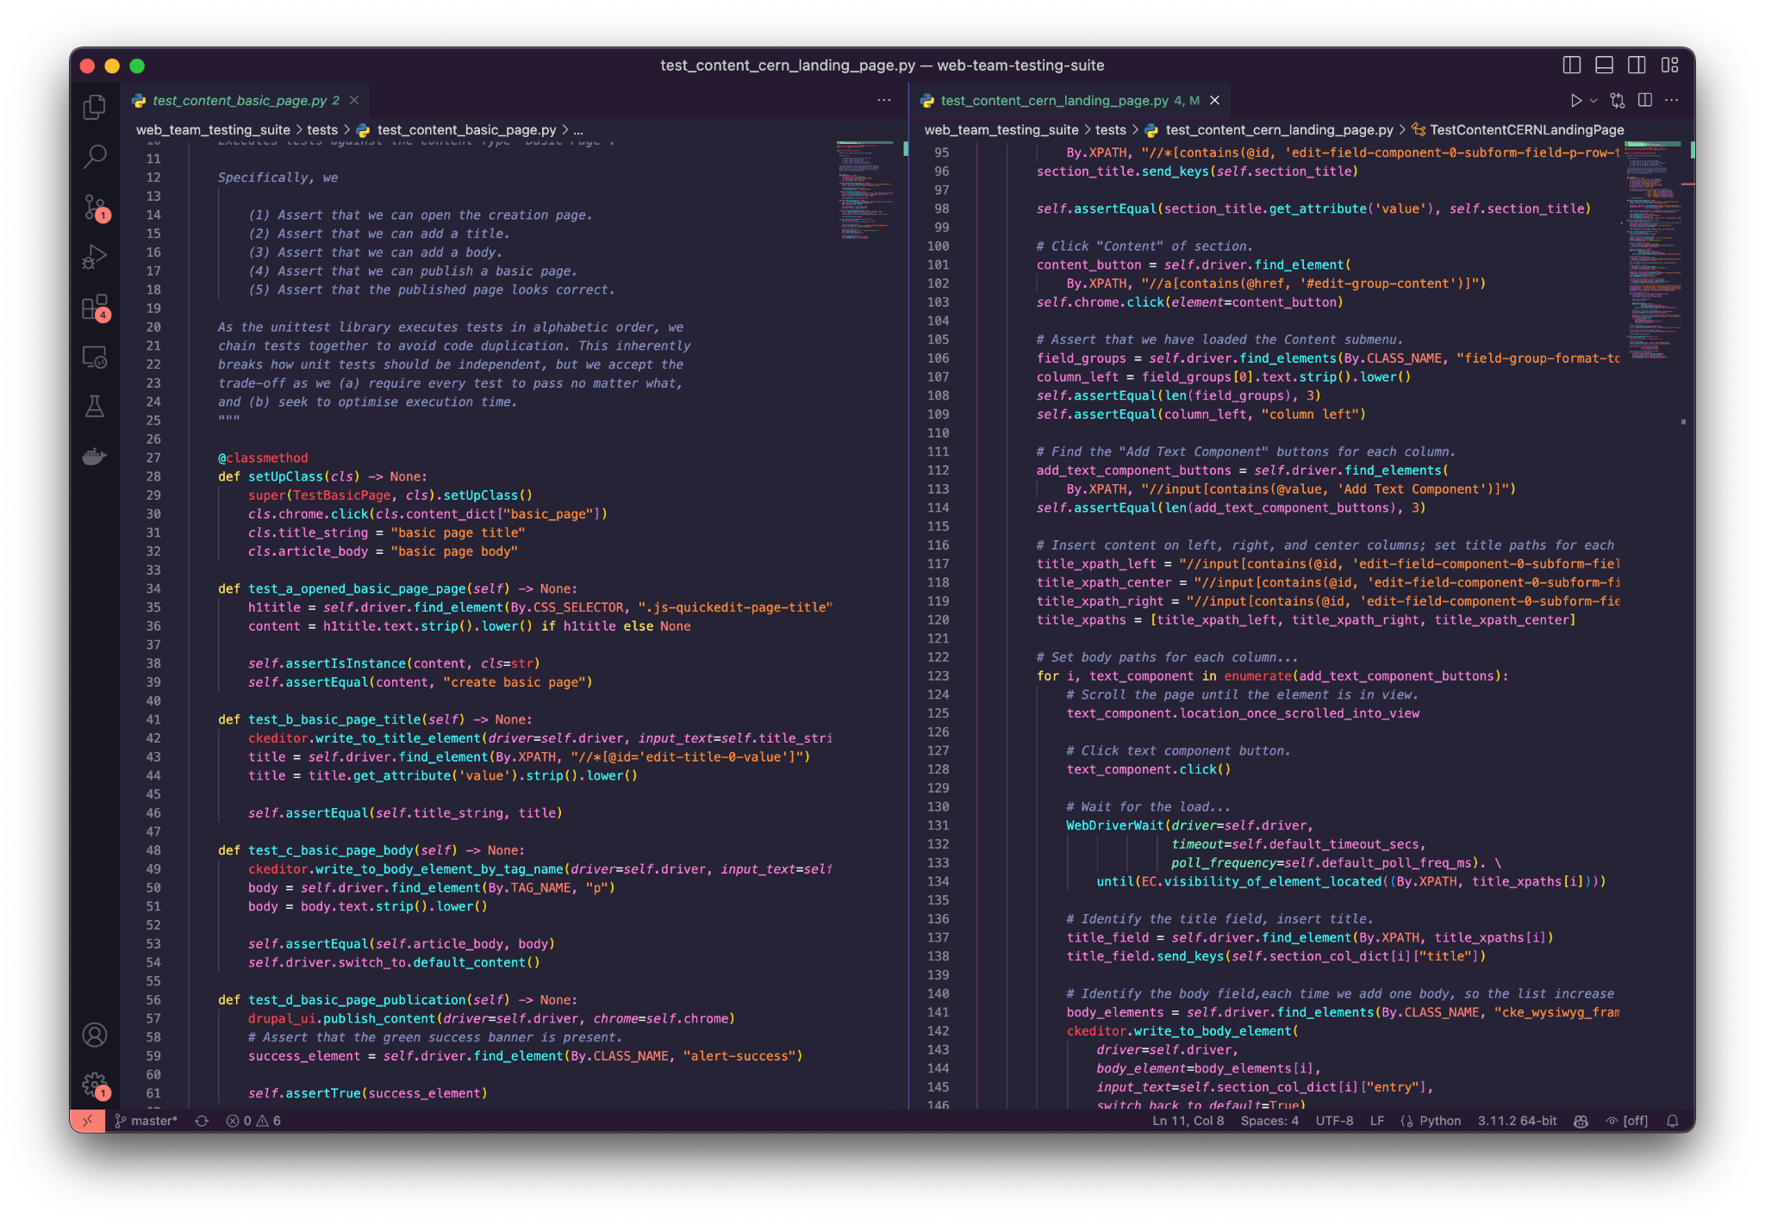
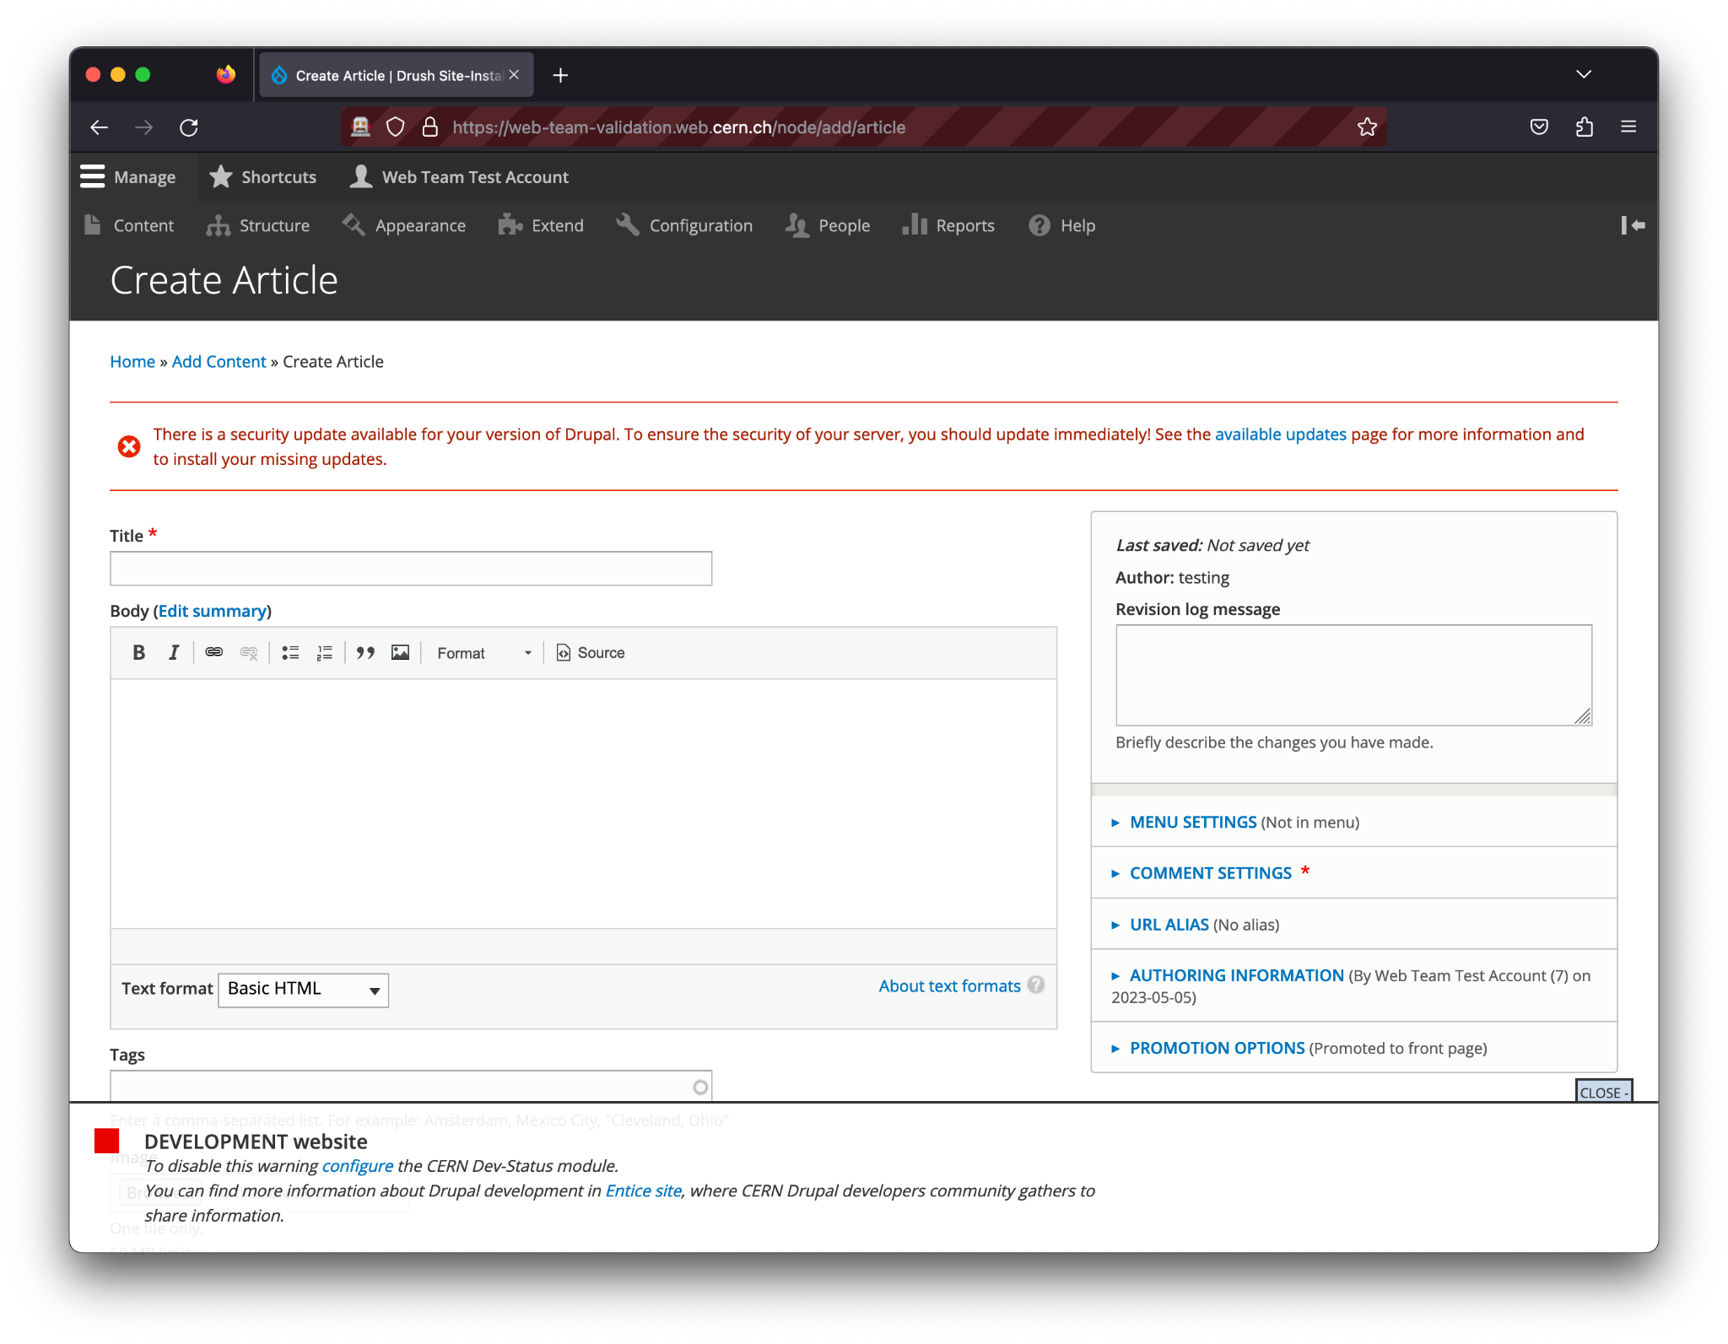
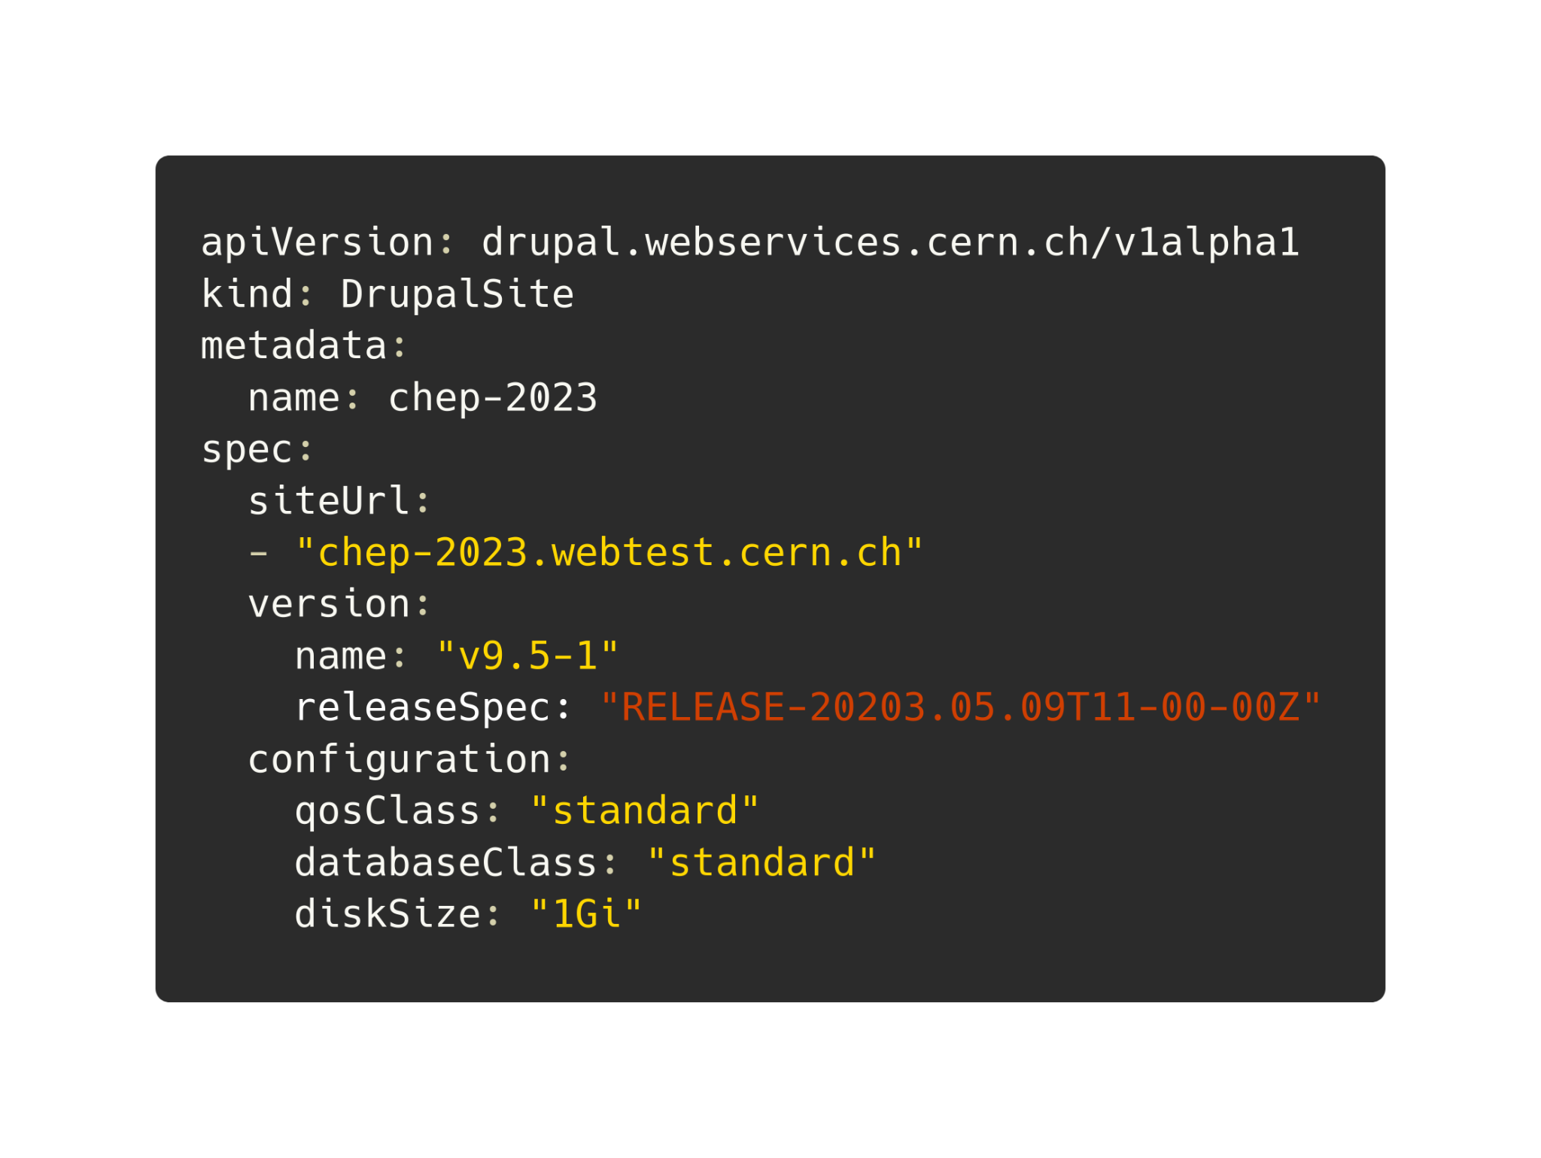
Rolling out a New Release
Git merge
Automated browser testing
Release tag
Updating the CR
Controller rolls out a new pod without downtime

Slide 15
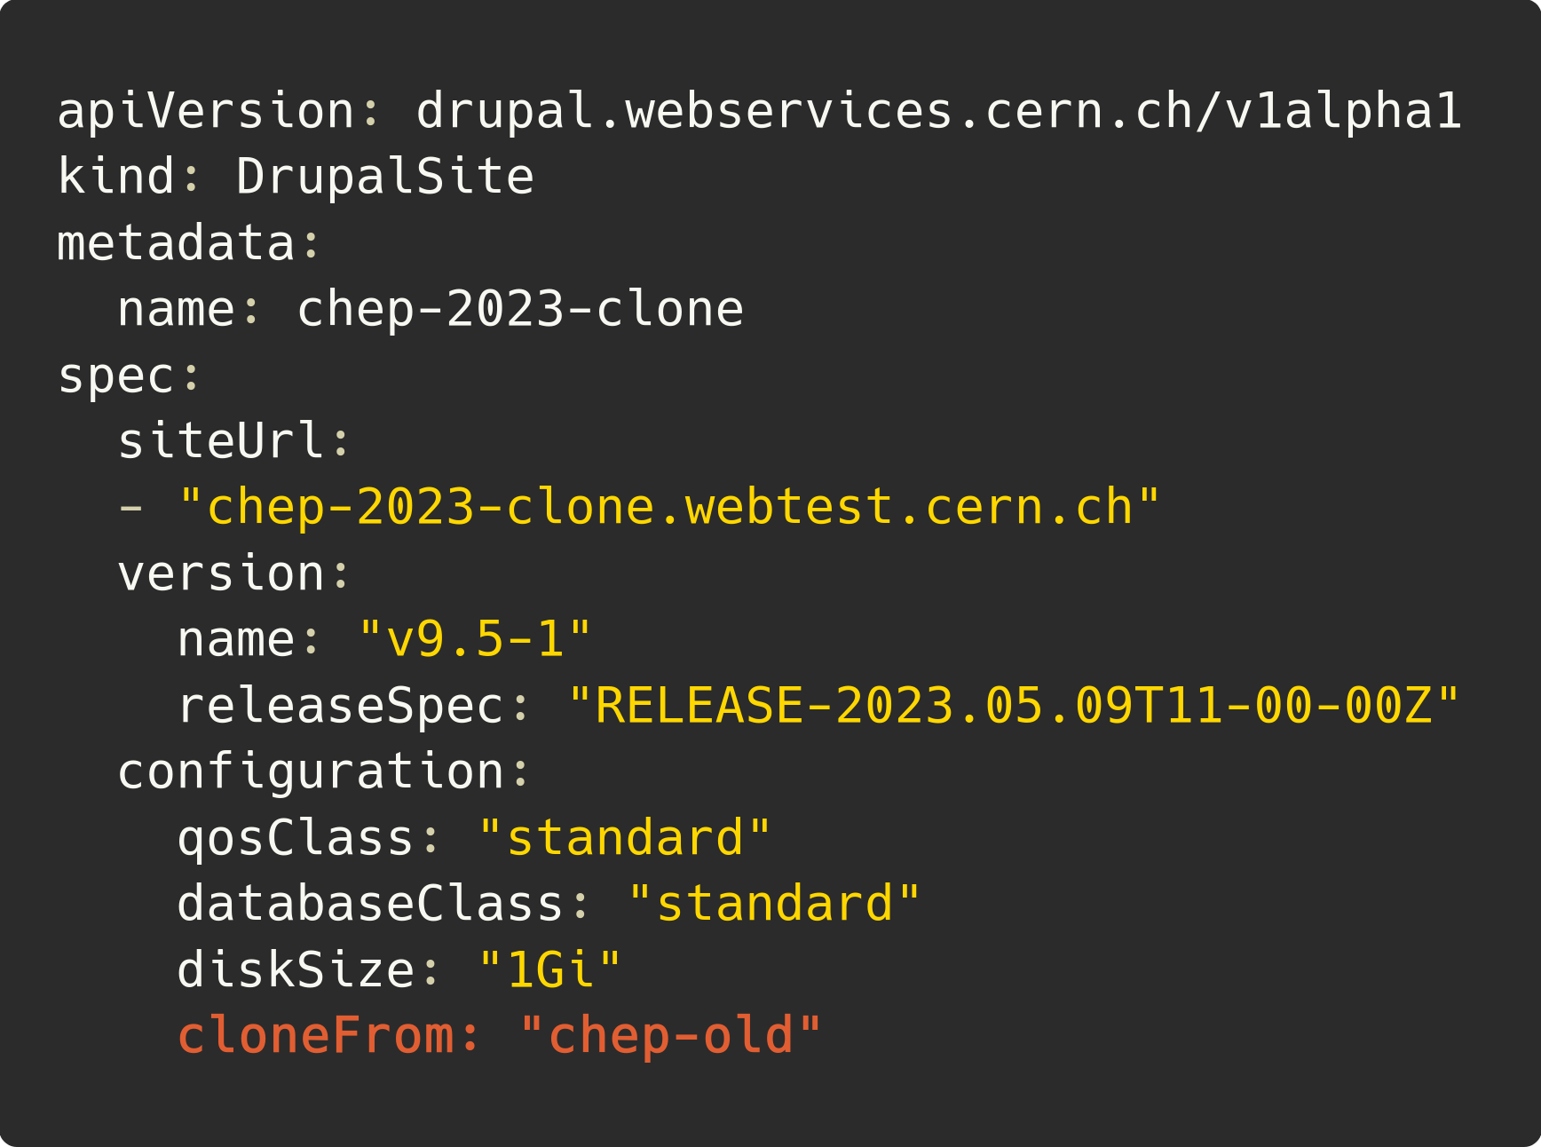
Migration Campaigns
.web.cern.ch
.webtest.cern.ch

Slide 16
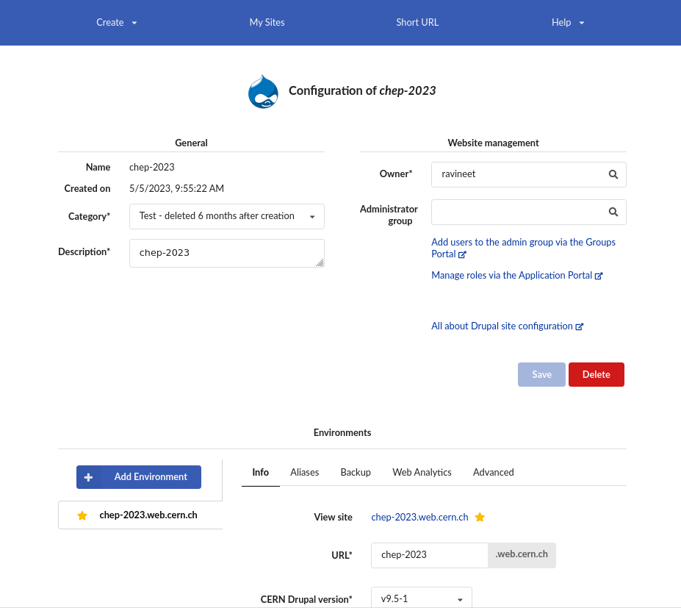
User Interface
Quality of Service
Extra Configuration
Web Services Portal
Cloning
Backups and Restores
Notes:
Our Infrastructure has these crucial features that have proved quite useful for us as cluster admins and also for the users. Automating and letting users be able to do this by themselves, reduced the manual effort on us

Slide 17
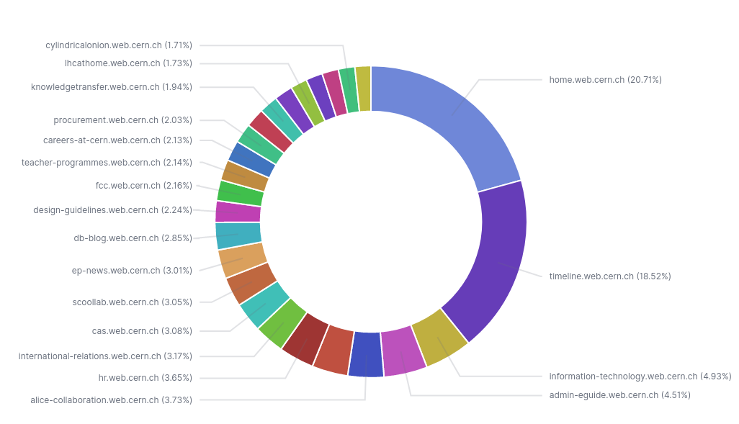
Traffic
Top 25 sites ordered by unique IP visits in the last 30 days Note: This is as of 04/05/2023 and does not include traffic to ‘.cern’ domains

Slide 18
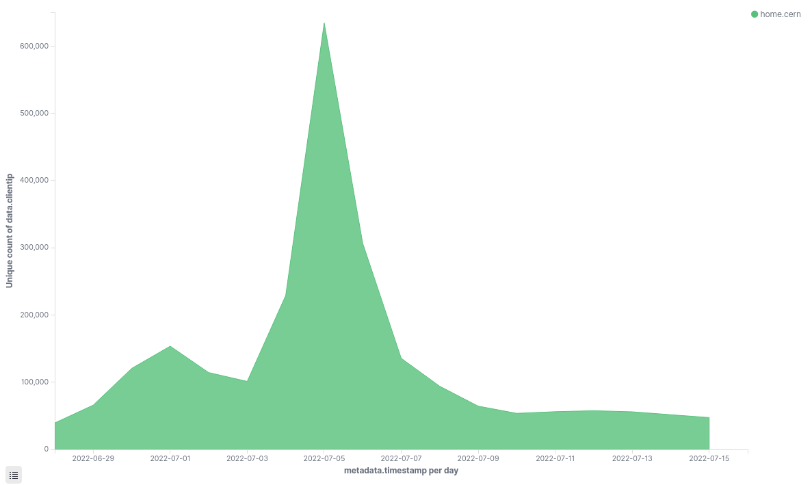
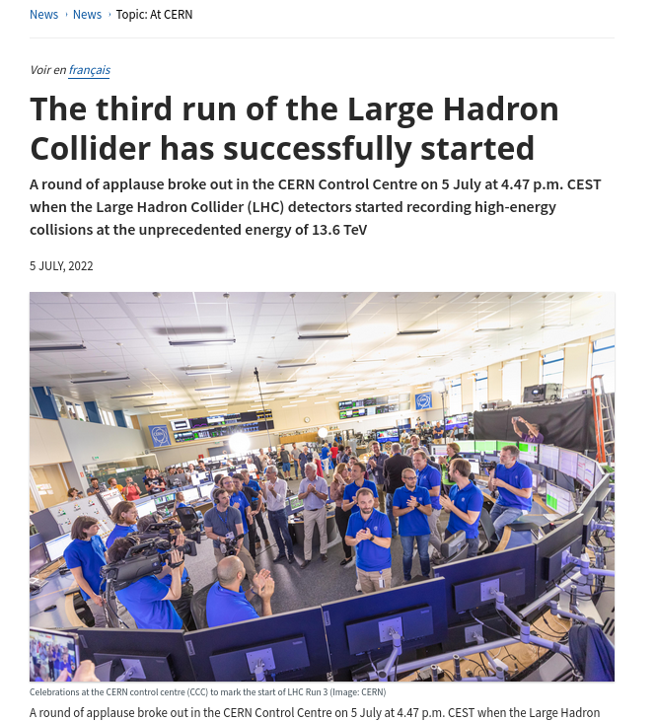
Special Events
Infra handled the traffic without any extra preparation
While maintaining a response time under the SLA
Notes:
Give context & say other services were slowing down

Slide 19
Learnings
Upgrades are now automated and seamless
Improved transparency through monitoring and alerts
Users acclimatising to the new infrastructure took time
Underestimated the technical debt imposed on users
End-user involvement should have been prioritised earlier
Heavy lifting done by the controller doing the operations
Ability to adopt infrastructure to other Content Management Systems
Notes:
The move to the new infrastructure was also a golden opportunity to really interact with the broader community and receive solid feedback to the benefit of everyone: Do not shy away from engaging with users, especially not if they are frustrated. They all have valuable insights into how you can improve your service even further.

Slide 20
Thank you!
Questions?

Slide 21
References
CERN Drupal Distribution - https://gitlab.cern.ch/drupal/paas/cern-drupal-distribution
Drupalsite Operator - https://gitlab.cern.ch/drupal/paas/drupalsite-operator/
Past publications - https://drupal.docs.cern.ch/publications/
Icons - https://remixicon.com

