Slide 1
Modern Software Development for JUNO offline software
Xingtao Huang, Teng Li, Weidong Li, Tao Lin, Jiaheng Zou
lintao@ihep.ac.cn
CHEP 2023
Norfolk, Virginia, USA
May 8-12, 2023

Slide 2
Outline
Introduction
Modern software development for JUNOSW
Development using CMake and Git
Deployment using junoenv, container, and Gitlab runner
Summary and plan

Slide 3
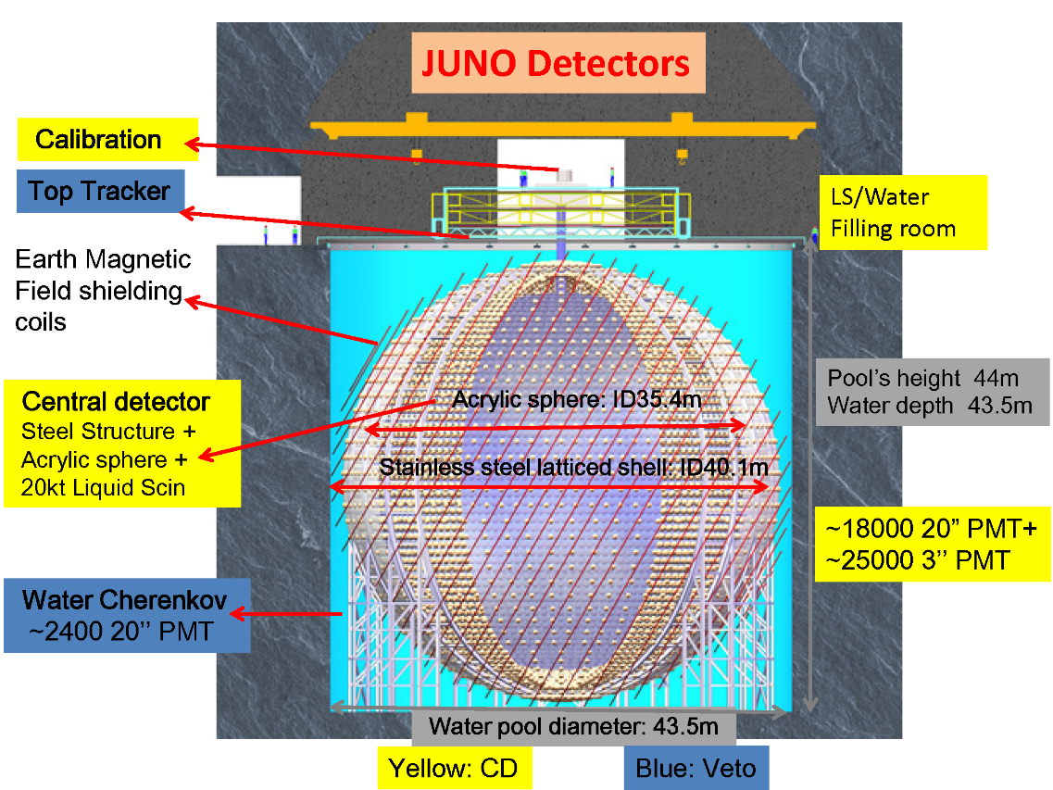
Introduction
JUNO: Jiangmen Underground Neutrino Observatory
Rich physics program [1]
Neutrino Mass Ordering and Precise measurement of 3 oscillation parameters
Reactor neutrinos, Supernova burst neutrinos, Geo neutrinos, Atmospheric neutrinos, and Solar neutrinos
JUNO detector
700 m deep underground
Central detector: 20 kton LS with 3%@1MeV of energy resolution.
Water Cerenkov detector and Top Tracker
Lifetime: 20+ years
[1] JUNO Collaboration, Prog.Part.Nucl.Phys. 123 (2022) 103927

Slide 4
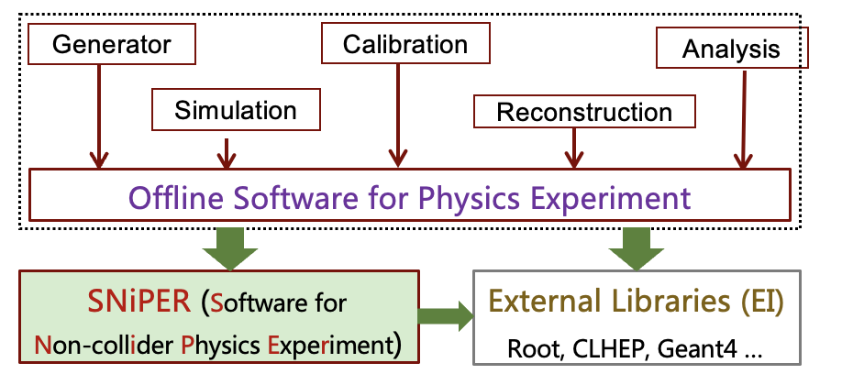
JUNOSW: JUNO offline software
The development of JUNOSW (originally called JUNO offline) starts in 2012.
Operating System
SL5 -> SL6 -> CentOS 7
Compiler
GCC 4.1.2 -> 4.4.7 -> 4.9.4 -> 8.3.0 -> 11.2.0
Build tool and version control
CMT -> CMake
SVN/Trac -> Git/Gitlab
Applications: SNiPER Algorithms
Core Software: SNiPER framework, ROOT I/O, Database, etc.
External Libraries: ROOT, Geant4, Boost, Python, etc.
For details, see Xingtao’s talk.

Slide 5
Modern software development in JUNOSW
Following the best practices from HSF [1], the migration to CMake/Git had been done for JUNOSW.
Use CMake to reduce the building time and support the different use cases for online and offline environments.
Adopt the git-based workflow to improve the code quality with code review and CI.
To migrate smoothly, helper scripts have been developed.
Development
CMake Macros
build.sh script
git-junoenv
CMake
GitLab
Git
junoenv
Docker
Gitlab Runner
Deployment
[1] HSF-CWP-2017-13: Software Development, Deployment and Validation. arXiv:1712.07959

Slide 6
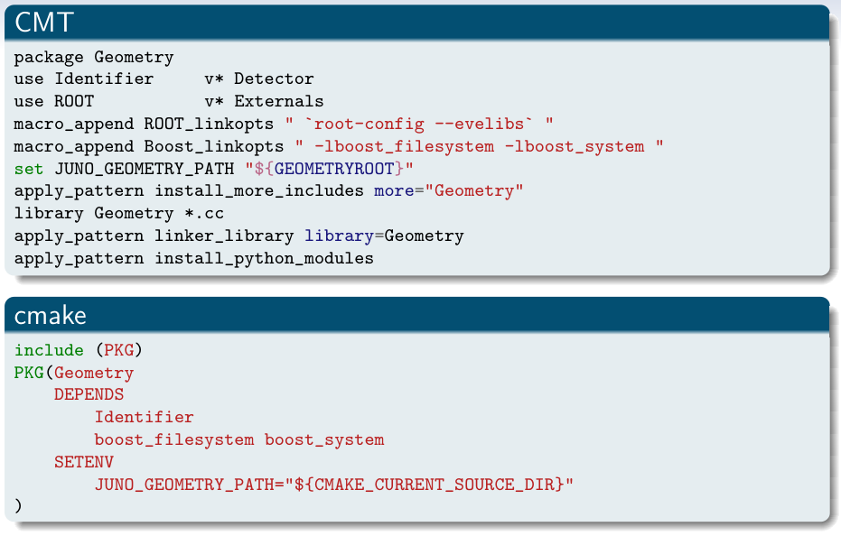
CMake (1)
When moving from CMT to CMake, follow the instructions in Modern CMake [1].
CMake macros and functions are developed to simplify the usage of CMake.
All the packages in JUNOSW are built in the same manner.
The source code files under “src” are automatically used to build the library.
Targets are used to describe the dependencies.
Extra environment variables could be set.
[1] Modern CMake: https://cliutils.gitlab.io/modern-cmake/

Slide 7
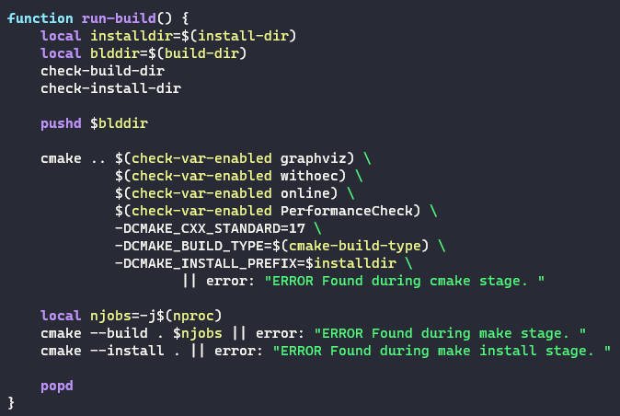
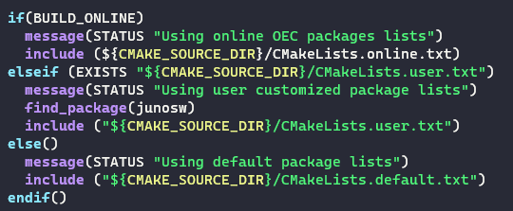
CMake (2)
In order to support both online and offline environments, the following strategies are used:
A script called “build.sh” is used for both cases. Use the environment variable to switch the build mode.
When the online mode is detected, the main CMakeLists.txt will load CMakeLists.online.txt instead of CMakeLists.default.txt.
Generator expressions are used to control the build flags.

Slide 8
git-junoenv
When using SVN and CMT, developers could check out and build some packages instead of the whole project.
In order to support this feature, a shell script called git-junoenv is developed to extend git, managing the packages to be checkout and built.
The core part is still the sparse checkout in git. The git ls-files is used to list the available packages.
When a package is checked out, it will be also registered in CMakeLists.user.txt. When building the project, CMake will use CMakeLists.user.txt.
$ git junoenv init-project junosw && cd junosw # get the junosw without packages
$ git junoenv list-pkgs # list all the available packages
$ git junoenv add-pkg Reconstruction/OMILREC # checkout a package

Slide 9
junoenv (1)
It is a collection of shell scripts to deploy external libraries and JUNOSW.
Modularized by bash functions, which are inspired by ENV [1].
About 50+ external libraries are supported. About 30+ libraries are deployed.
Patches for the external libraries are also maintained in the same project.
The versions are collected for each release.
[1] ENV, developed by Simon Blyth, https://juno.ihep.ac.cn/~blyth/env/notes/

Slide 10
junoenv (2)
When deploying the software into CVMFS, the prefix is different from the original prefix when building software.
However, we can’t run “make install” again on the CVMFS server.
Use the paths with the same length and replace the prefix path
Inspired spack [1]
Solves the problems when the libraries or files are hardcoded with full paths.
Use “sed” to replace the paths for both libraries and software links.
[1] spack: https://github.com/spack/spack

Slide 11
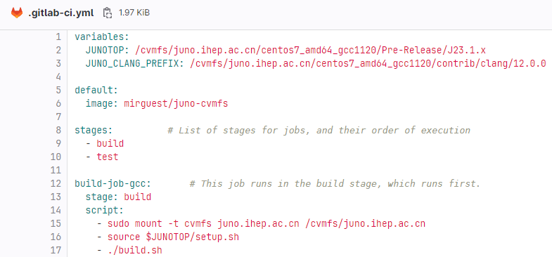
Docker image
Two types of Docker images are prepared
Lightweight image with CVMFS clients installed.
Full image with all the external libraries installed.
 | Lightweight image | Full image
Use cases | CI; Develop in users’ computer (need network) | Develop in users’ computer (offline)
Image size (compressed) | 372.87 MB (CentOS 7) | 17.29 GB (CentOS 7) 20.37 GB (Ubuntu 22.04)
Privileged in Docker | Needed (required by CVMFS) | Not necessary
The lightweight image is used in the Gitlab CI.
CVMFS is mounted first. Then the runtime environment is setup.
When the external libraries are upgraded, the CI could access them by using the latest release.

Slide 12
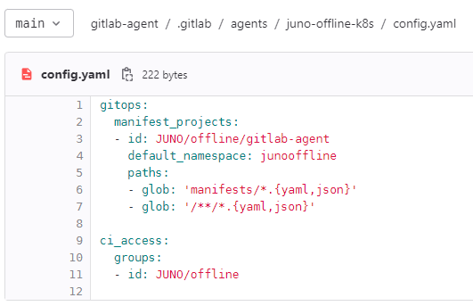
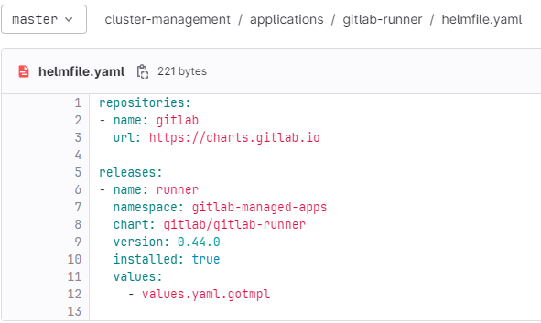
Gitlab Runner
Gitlab Group Runners are deployed in a self-hosted Kubernetes cluster.
Gitlab agents are used to connect Gitlab and Kubernetes. Then the Gitlab runners are managed by the Gitlab agents.
All the configurations are managed in GitLab repositories.

Slide 13
Summary and plan
Modern development and development for JUNOSW
CMake macros are developed and a high-level script is used by users.
git-junoenv is developed to partially check out and build packages.
junoenv is used to deploy JUNOSW and external libraries.
Docker and Kubernetes are also used to support CI.
Plan: evaluate the migration from junoenv to spack
Spack is a package management tool, which has already been adopted in the Key4hep [1].
We hope to benefit from spack, including the reuse of the existing libraries and validation of the software stack by other experiments. This could be important when moving to new operating systems or architectures in the future.
[1] Valentin Volkl, vCHEP 2021, Building HEP Software with Spack

Slide 14
Abstract
The Jiangmen Underground Neutrino Observatory (JUNO), under construction in South China, primarily aims to determine the neutrino mass hierarchy and the precise measure oscillation parameters. The data-taking is expected to start in 2024 and plans to run for more than 20 years. The development of JUNO offline software (JUNOSW) started in 2012, and it is quite challenging to maintain the JUNOSW for such a long time. In the last ten years, tools such as Subversion, Trac, and CMT had been adopted for software development. However, there are some new requirements, such as how to reduce the building time for the whole project, how to deploy offline algorithms to an online environment, and how to improve the code quality with code review and continuous integration. To meet the further requirements of software development, modern development tools are evaluated for JUNOSW, such as Git, GitLab, CMake, Docker, and Kubernetes. This contribution will present the software development system based on these modern tools for JUNOSW and the functionalities we have achieved: CMake macros are developed to simplify the build instructions for users; CMake generator expressions are used to control the build flags for the online and offline environments; a tool named git-junoenv is developed to help users partially checkout and build the software; a script is used to build and deploy the software on the CVMFS server; a Docker image with CVMFS client installed is created for continuous integration; a GitLab agent is set up to manage GitLab runners in Kubernetes with all the configurations in a GitLab repository. In late 2022, the migration had been done.

