Slide 1
Version control and DevOps for accelerator and experiments: experience and outlook
Ismael Posada Trobo
CHEP 2023 – Norfolk, Virginia (US) - 09th May 2023

Slide 2
GitLab Infrastructure at CERN – Quick Overview
GitLab has been running at CERN since 2012
Key infrastructure at CERN, suitable for our needs!
Widely used at CERN and outside CERN for collaborators
More than 17k active users
More than 120k projects
More than 5k jobs/hour
Several externalized components:
PostgreSQL: Database on Demand Service (provided at CERN).
GitLab Pages: OpenShift 4 (deployed at CERN).
Gitaly (repo data): custom solution using CephFS storage (provided by the Storage Team at CERN).

Slide 3
GitLab Infrastructure at CERN – Initial stage
Custom non-supported infra (pre-migration)
18 nodes OpenShift 3 infrastructure.
Custom containerized solution based on Helm
Custom Omnibus solution
Custom Gitaly (git data) deployment
End of life of key components
OpenShift 3 in June 2022.
NFS file system for git data end of support in November 2022.

Slide 4
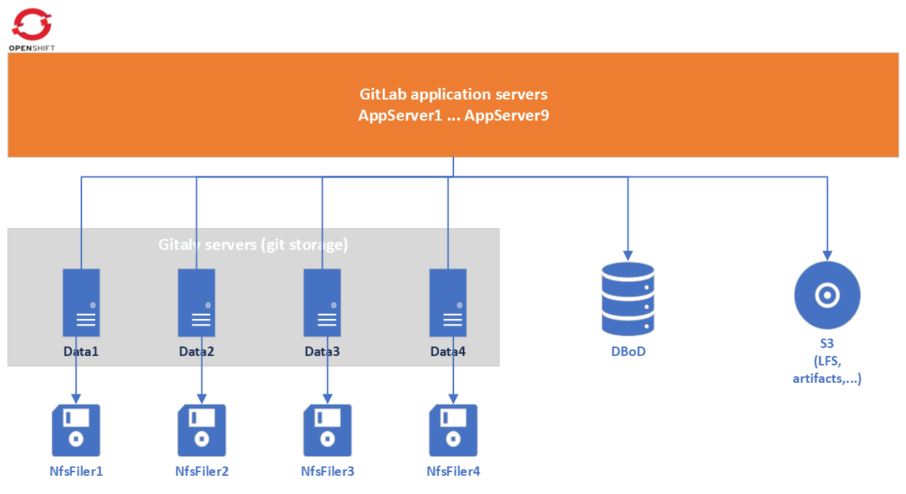
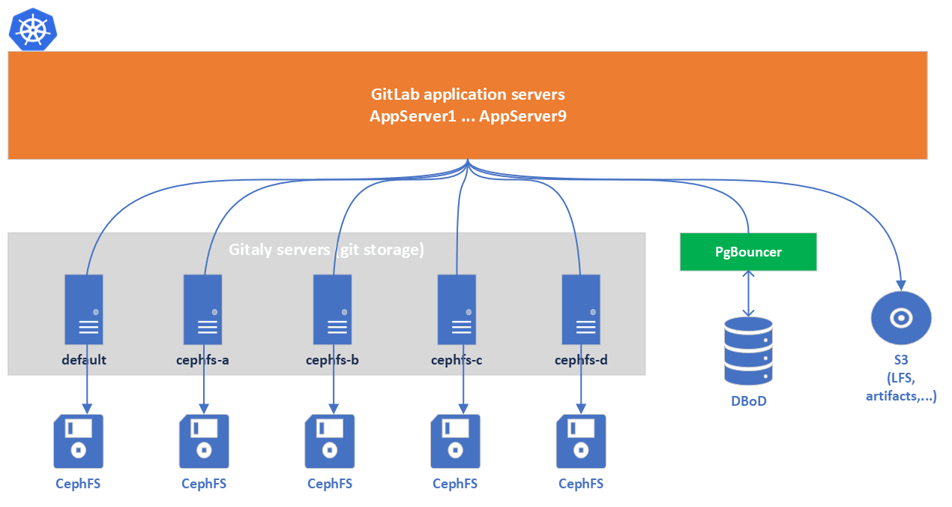
Migration – How we made it?
Both infrastructures running at the same time
3 stages
Move GitLab application first
Move git repos on a later stage
Git repos were accessed from any of the infrastructures!
Stabilization
Road to a Cloud Hybrid infrastructure
18 nodes Magnum Kubernetes.
Official supported containerized solution based on Helm.
CephFS file system for git data.

Slide 5
Moving GitLab application - Migration
Move GitLab application first
Magnum Kubernetes infra just running redis.
Gitaly connected through NodePort and Endpoints.
Switch off OpenShift 3 GitLab application, preserving redis running.
Send redis data over from one infra to another.
Reload redis in Magnum Kubernetes to pick up the desired data.
Bring up GitLab application on Magnum Kubernetes.
It works!
But…

Slide 6
Moving GitLab application - Errors, bugs, pitfalls (I)
Several components misconfigured → indentation problems
No notifications sent from GitLab
GitLab LDAP sync misbehaving
Thousands of projects lost their ownership.
Several of them luckily mitigated with default values.
Kerberos keytab misconfiguration for 1 server
Not supported by GitLab yet! → Custom solution.
Duplicate value in Active Directory.
Some users experiencing problems while connecting through Kerberos.

Slide 7
Moving GitLab application - Errors, bugs, pitfalls (II)
Moving from HAProxy to Nginx web server
No migration path for configuration
Random users getting 403 error page (uploading artifacts)
Several hardcoded values upstream
client_max_body_size accommodated.
Random users getting 400 error page (cookies too large)
large_client_header_buffers accommodated.
GitLab application bugs discovered
Webhooks showing wrong git_ssh_url
Reported and fixed by GitLab at https://gitlab.com/gitlab-org/charts/gitlab/-/merge_requests/2782
GitLab exporter component not connecting through Redis sentinel
Reported to GitLab at https://gitlab.com/gitlab-org/charts/gitlab/-/issues/3813

Slide 8
Moving Git repos - Migration
Move git repos on a later stage
Gitaly storages inter-communicated.
Use of NodePort and Endpoints for cross-cluster communication.
GitLab Workhorse pointing to the root hostname
Ignition… 🚀

Slide 9
Moving Git repos - Errors, bugs, pitfalls (I)
The apocalypse 💥
Migrated first 400 projects from NFS to CephFS.
All good, no issues.
Migrated rest of the 100k projects in bulk…
Hit Kernel bug ➔ corruption of repositories started.
Maintenance mode? 😱
Upgrade kernel in place? 🥷
Creation of a NodeGroup with specific version of the kernel? 🏅

Slide 10
Moving Git repos - Errors, bugs, pitfalls (II)
Rediscover of an ancient issue, affecting ATLAS experiment
Identified gc.pruneExpire defaulting to 2 weeks (was 2 days)
Project with millions of loose objects
https://git-scm.com/book/en/v2/Git-Internals-Maintenance-and-Data-Recovery
At the same time, ATLAS experiment projects were performance offenders.

Slide 11
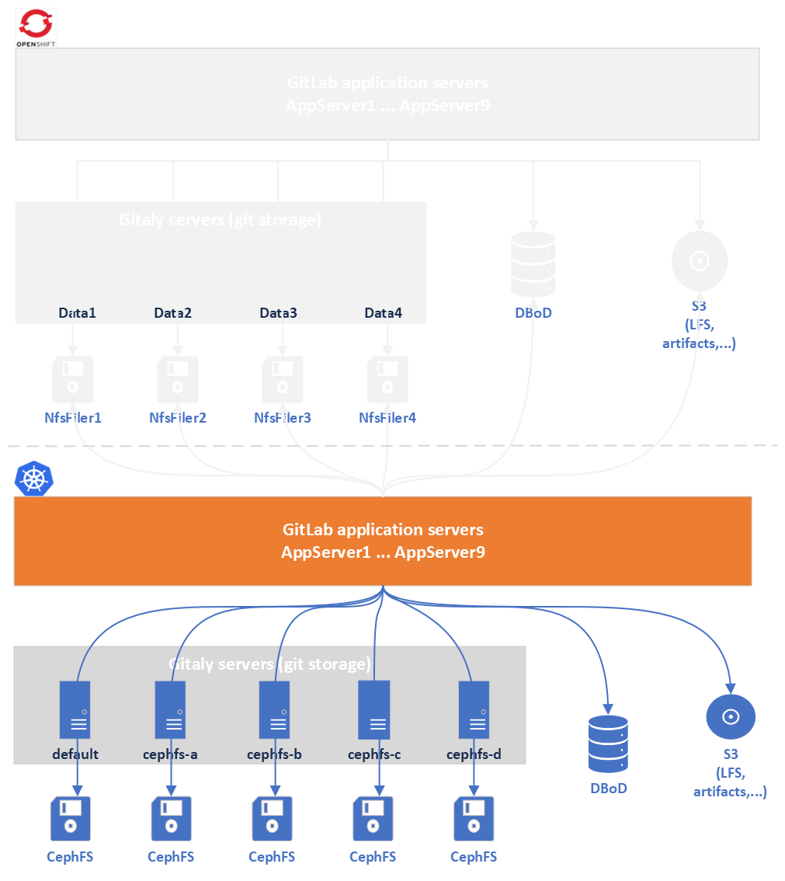
Stabilization
We have survived!
GitLab application and repository data fully functional
Monitoring system improved

Slide 12
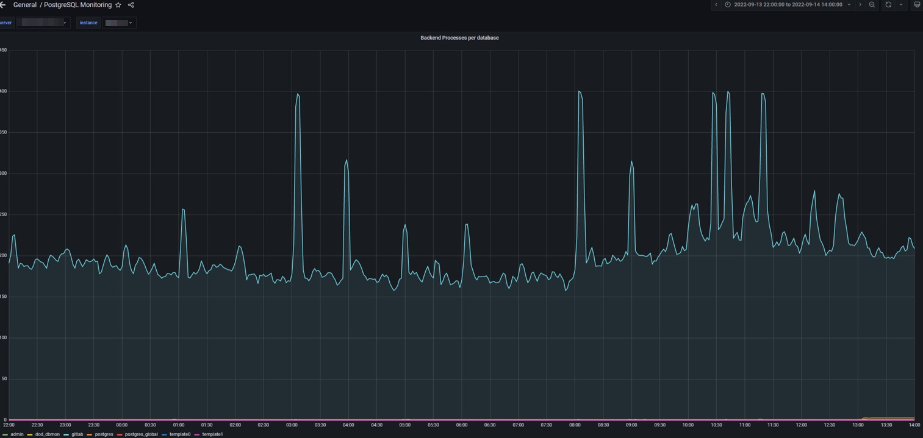
Stabilization
But… suspicious peaks in the database happening more often and suddenly.

Slide 13
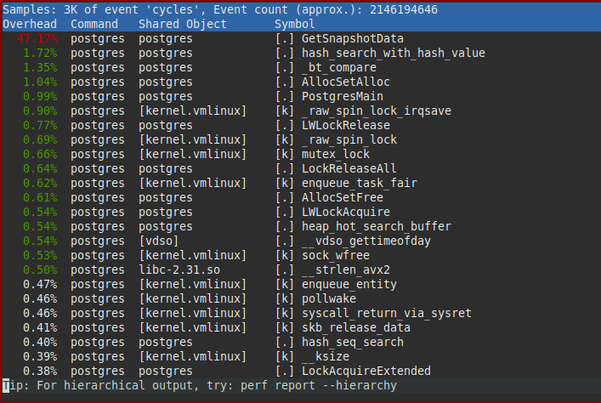
Stabilization
In brief, what was the bottleneck?

Slide 14
Stabilization
In brief, what was the bottleneck?
Snapshot scalability issue

Slide 15
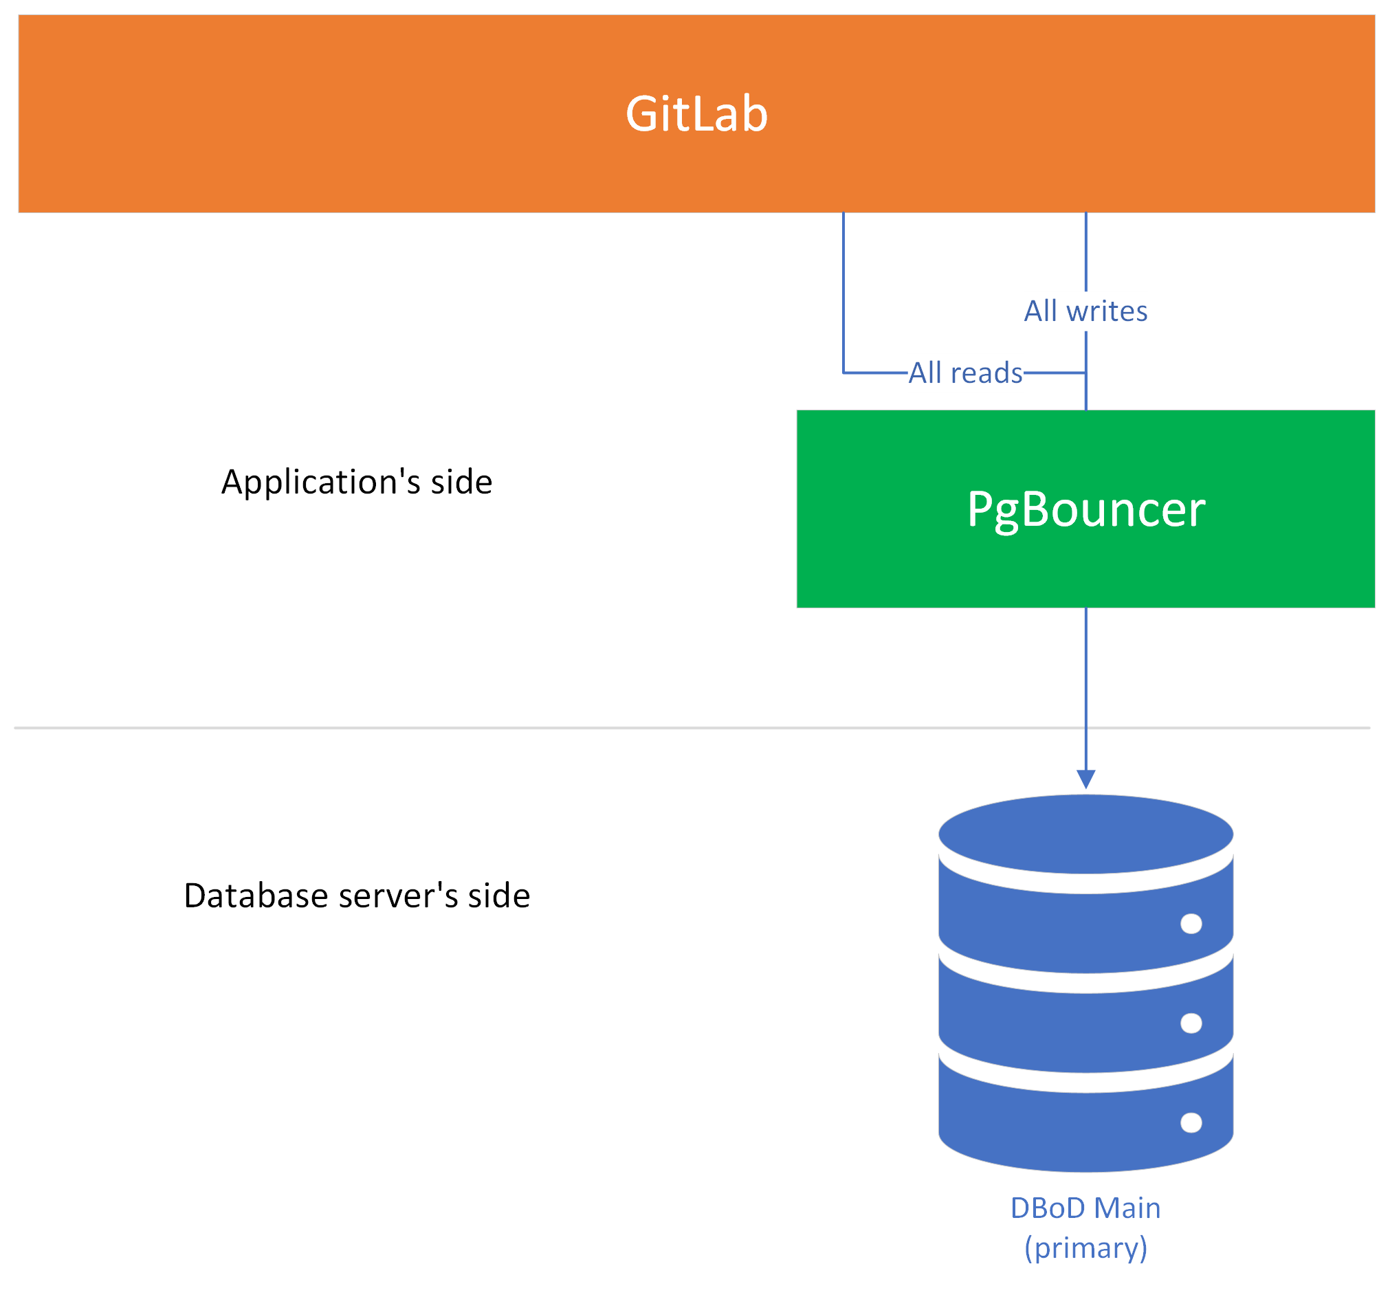
Connection scalability issues - Transaction pooling
PgBouncer to the rescue
Lightweight connection pooler for PostgreSQL.
“Middleman” between app and database server.
Modes
Session
Assigns 1 client connection to a dedicated session.
Transaction
Creates a new connection for each transaction, returning the connection to the pool when transaction is complete
Statement
Caches prepared statements, reusing them for multiple client connections.

Slide 16
Connection scalability issues - Transaction pooling
Lack of an official PgBouncer Helm chart provided by GitLab
Created our own
pgbouncer / PG Bouncer Helm Chart · GitLab (cern.ch)
pgbouncer / PG Bouncer Image · GitLab (cern.ch)
Contribution to GitLab (foreseen for v16.1)
Add PgBouncer Helm Chart (!2973) · Merge requests · GitLab.org / charts / GitLab Chart · GitLab
“Click-and-go” solution for Kubernetes
Includes monitoring

Slide 17
Connection scalability issues - Transaction pooling
Reserve pool size 18x3 = 54 (total max pool size 336)
Default pool size 94x3 = 282
Min pool size 21x3 = 63

Slide 18
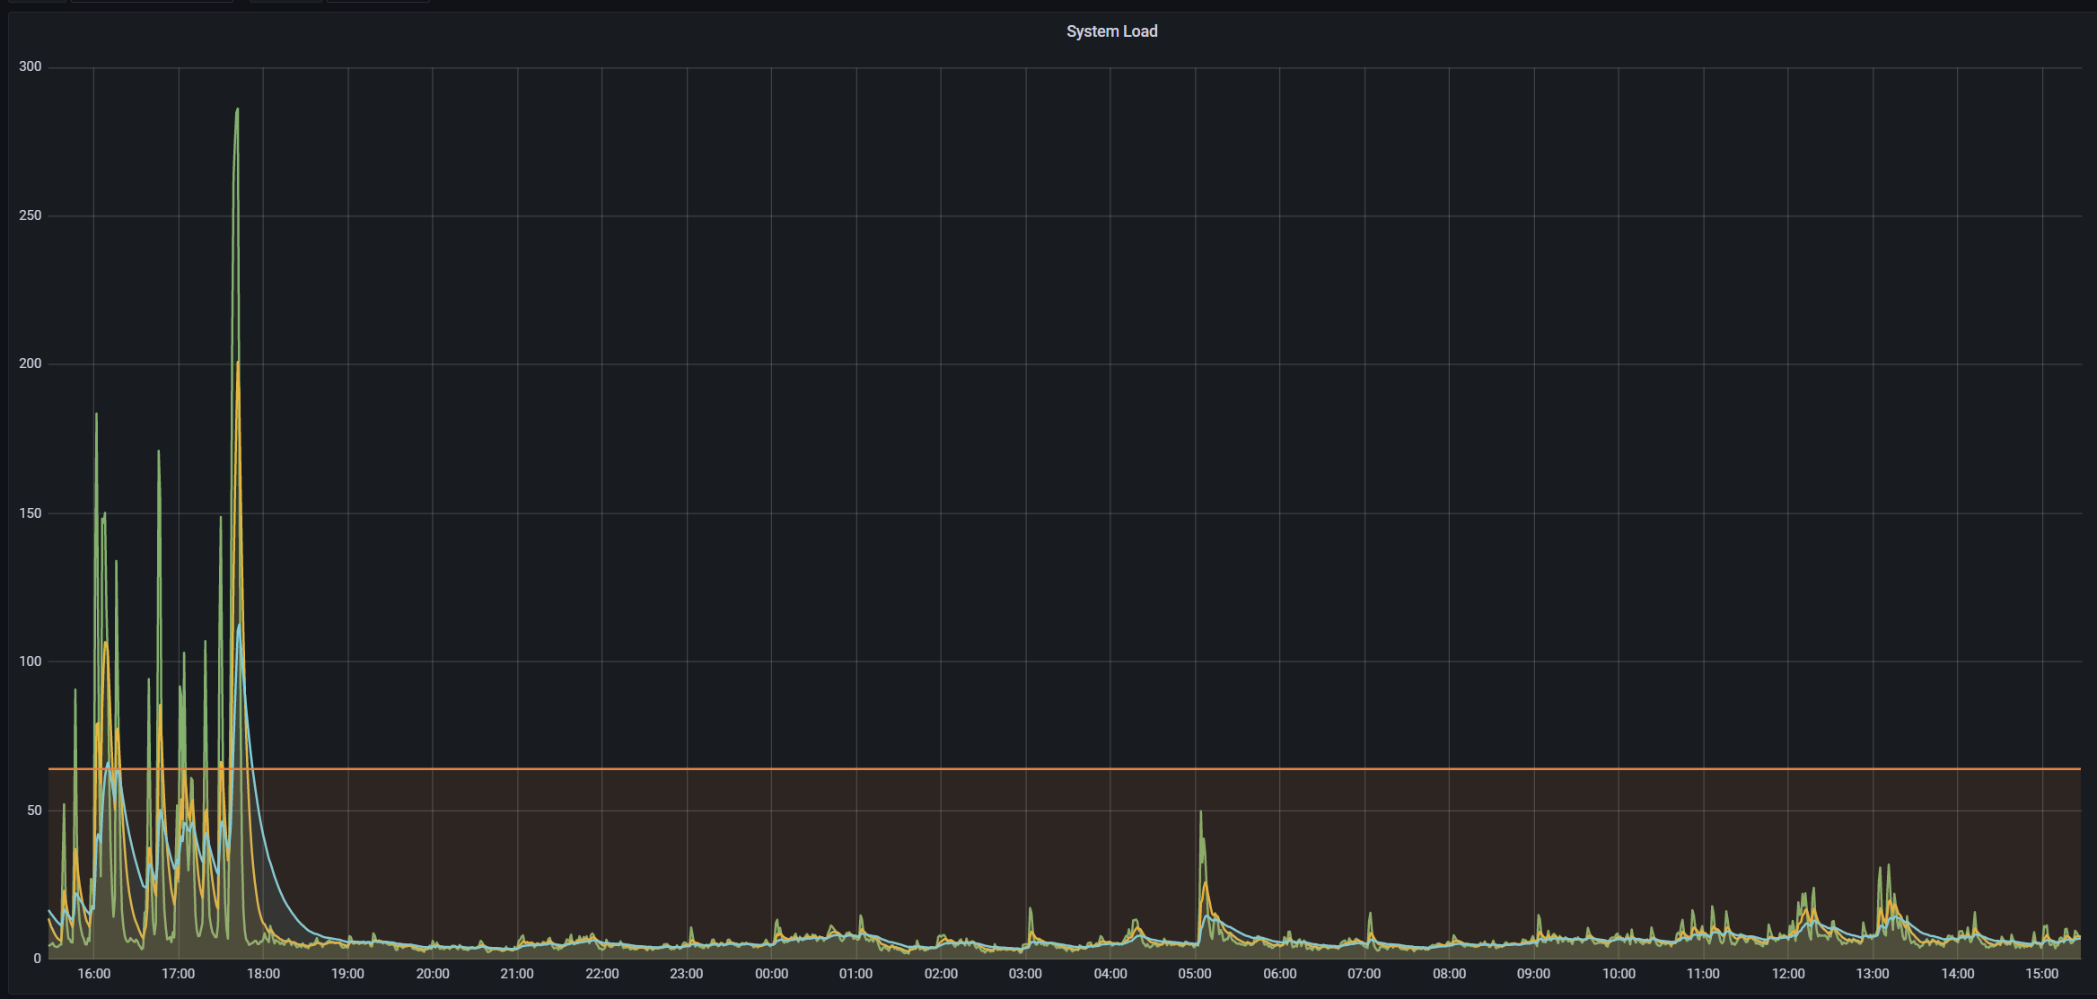
Connection scalability issues - Transaction pooling
PgBouncer on-air

Slide 19
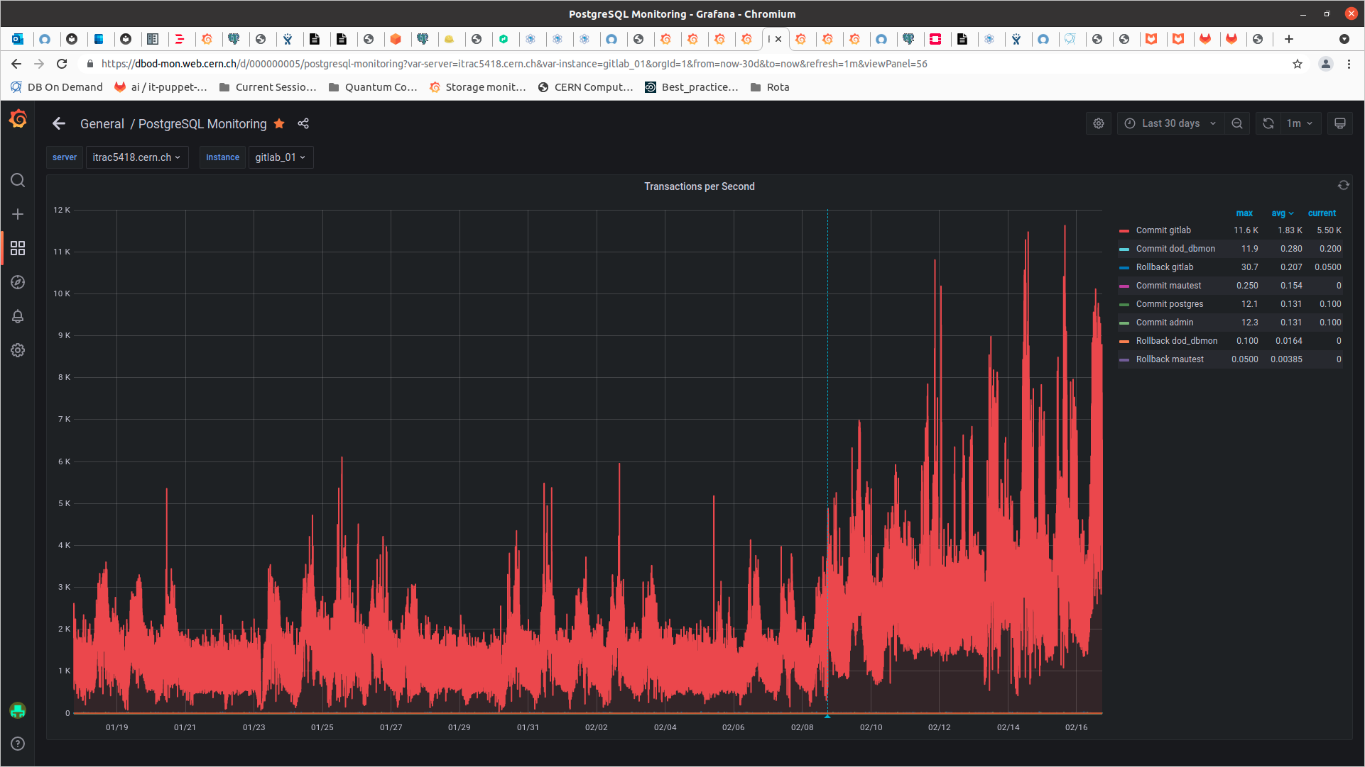
Connection scalability issues - Transaction pooling

Slide 20
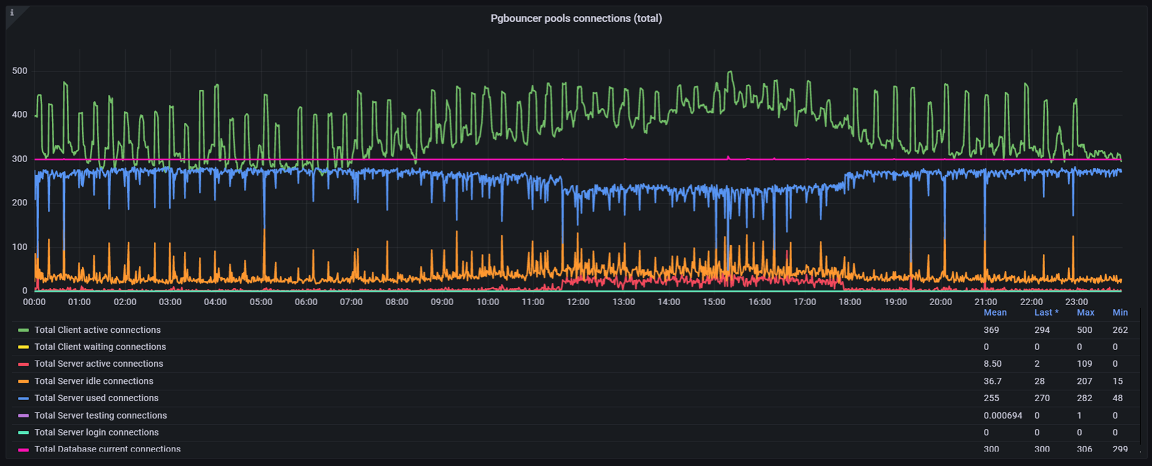
Connection scalability issues - Transaction pooling

Slide 21
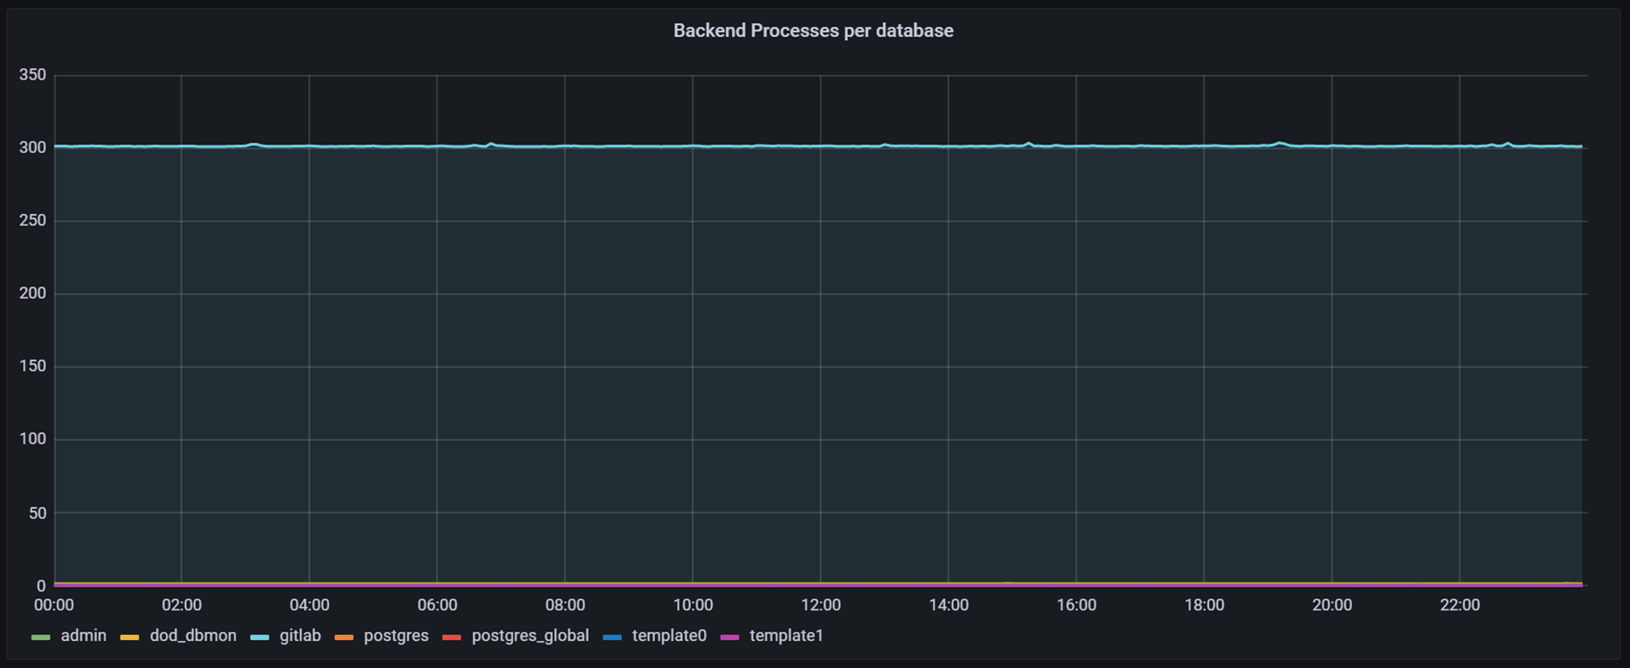
Connection scalability issues - Transaction pooling

Slide 22
Connection scalability issues

Slide 23
Connection scalability issues
But …

Slide 24
Connection scalability issues - Transaction pooling
Reserve pool size 18x3 = 54 (total max pool size 336)

Slide 25
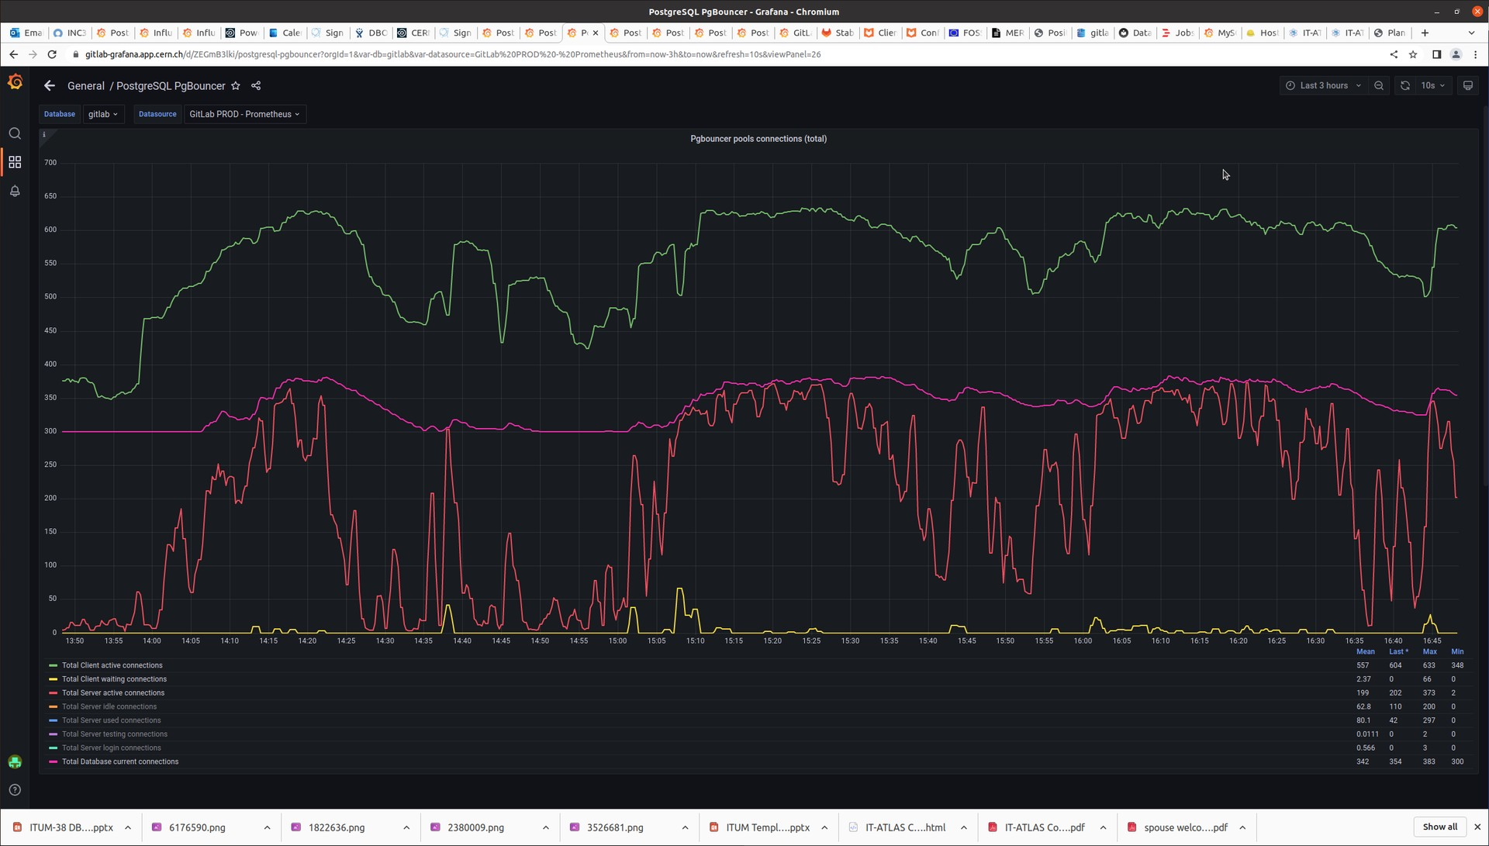
Connection scalability issues - Transaction pooling
Reserve pool size 18x3 = 54 (total max pool size 336)
Need some throttling?

Slide 26
Throttling the infrastructure
Throttling – Rate limits
Misuse and/or abuse from some users: Too many requests – Error 429
Infinite loops hammering the API
Set rate limits for reqs/sec
Huge number of jobs triggered simultaneously
Rate limits for the maximum number of jobs triggered per project.

Slide 27
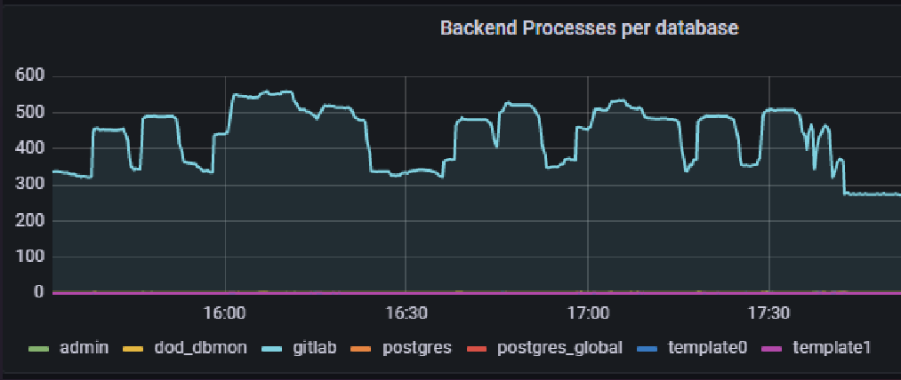
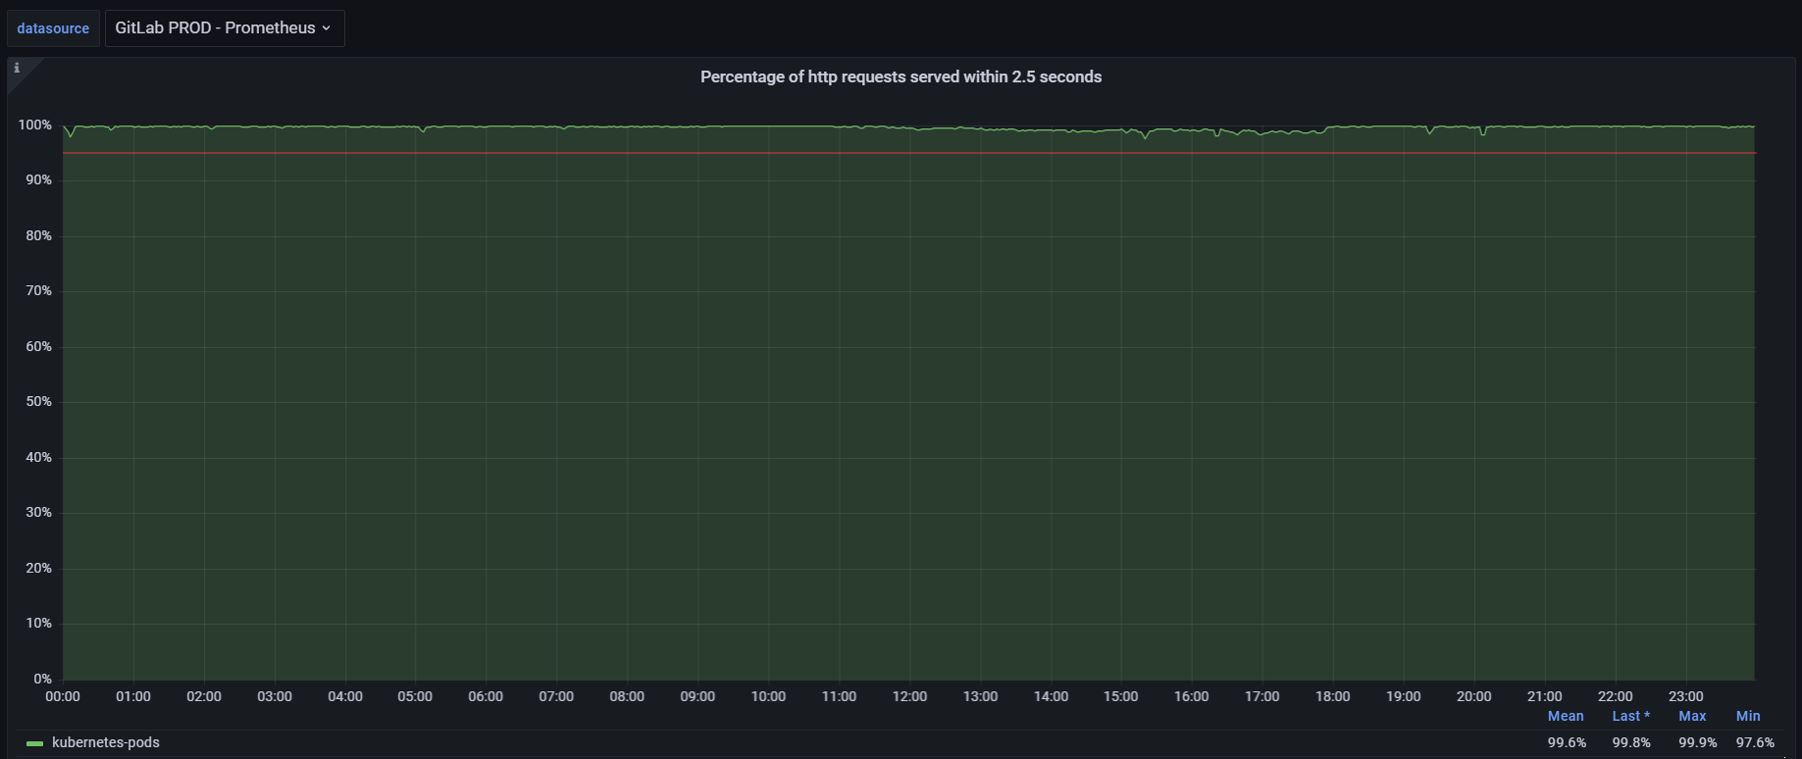
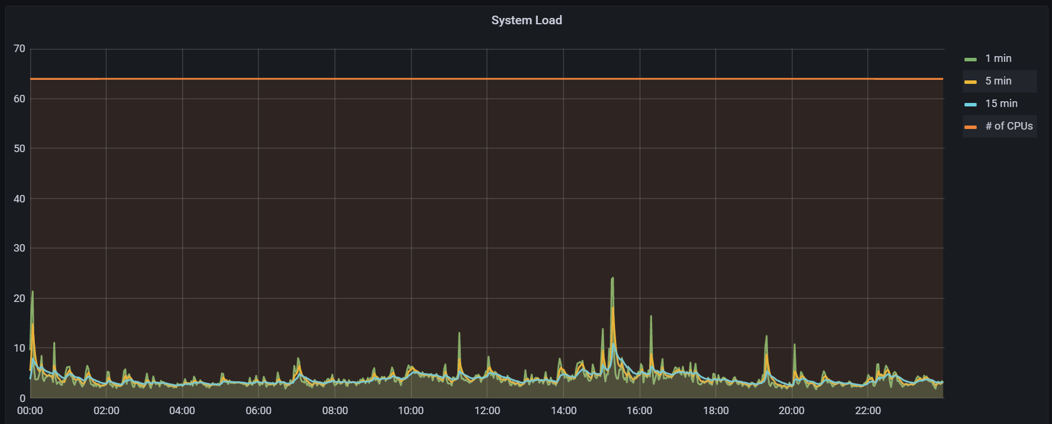
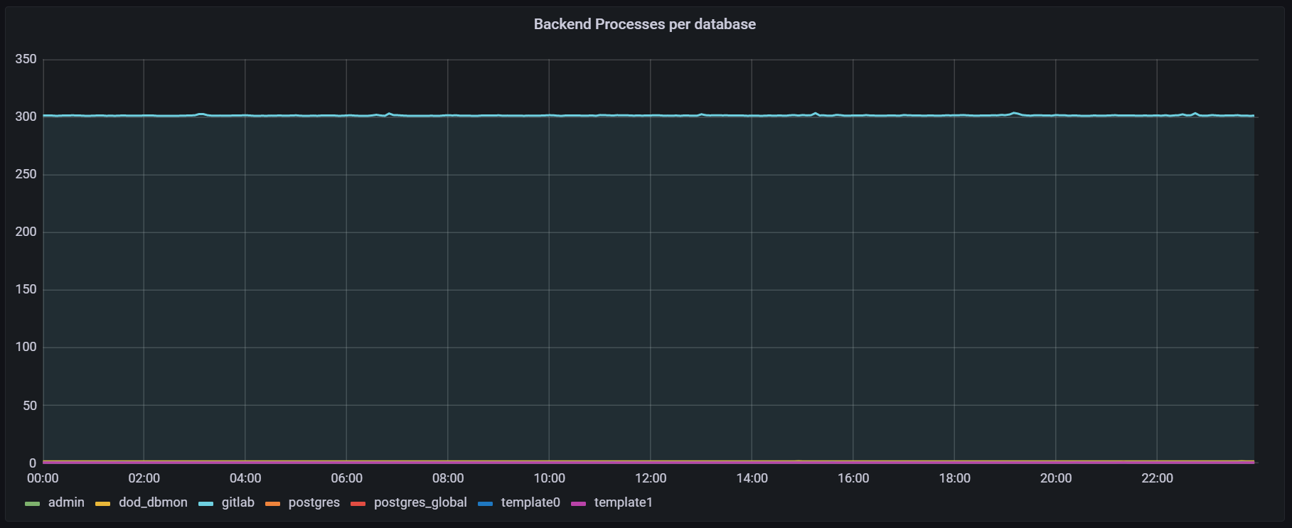
Seeing the light at the end of the tunnel…
Long journey from…
… to

Slide 28
Conclusion
Our Version control system performs extremely well now. All the effort put in place within all investigations, is translated into a more reliable, efficient and performing infrastructure CERN benefits from…
…but we as users need to use it responsibly, follow best practices, do not leave unused stuff behind and make sure we do not abuse of resources.
All in all, in harmony, this will allow us to get ready for current and future challenges and further improvements of our beloved GitLab infrastructure.

