Slide 1
JIRIAF
JLAB Integrating Research Infrastructure Across Facilities
V. Gyurjyan, C. Larrieu, D. Laurence, G. Heyes

Slide 2

Outline
Introduction
Design architecture
Workflow colocation and interference detection
Time-critical workflow migration from JLAB to NERSC
Conclusion

Slide 3
Project scope
Combining geographically diverse computing facilities
  Dynamic provisioning and use of unallocated or idled compute resources
  Relocation of computing workflows
Challenges of heterogeneous, distributed, and opportunistic compute resource provisioning
  Resource management and scheduling
  Data transfer and latency
  Security and privacy

Slide 4
Strategies and Requirements
Minimize existing workflow modifications
Collaboration across sites
Identifying beneficial science workflows

Slide 5
Opportunistic Resource Profile

Slide 6
Controlling Carbon Footprint
Improving operational efficiency of data centers can potentially delay compute resource expansion, controlling the carbon footprint of a computing facility.
Server Electricity Consumption
0.150 KW/Hour
JLAB Farm
Average Yearly Carbon Footprint
Co₂ Emissions (Pounds)
Cooling Per Server
0.120 KW/Hour
2.17M
0.9M
2.07M
Coal
Natural Gas
Petroleum
Co₂ Emissions Per KWh (Pounds)
2.21
0.92
2.11
Coal
Natural Gas
Petroleum

Slide 7
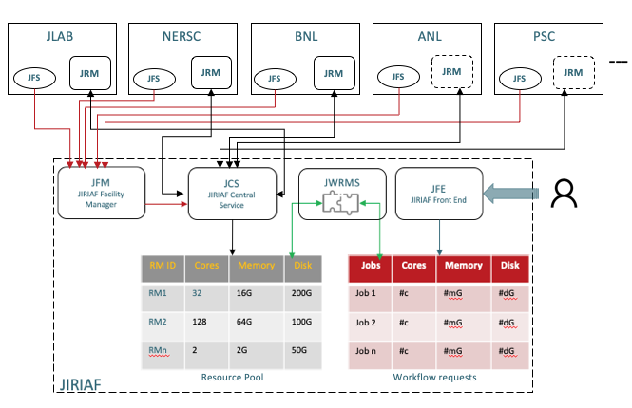
Design Architecture

Slide 8
Workflow Colocation and Interference Detection
Ability to utilize unused/idled resources by colocating multiple data-processing applications within the same server
Hardware level performance metric
Anomaly detection (e.g. unsupervised ML ADWIN algorithm)
Mitigation
  CPU hard-capping (e.g. TURNER, P., RAO, B., AND RAO, N. CPU bandwidth control for CFS. In Proc. Linux Symposium (July 2010), pp. 245–254. )
  Container management (stop, migrate)

Slide 9
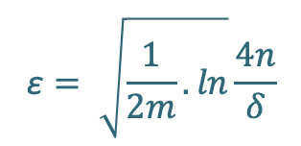


Interference Detection and Mitigation
JRM
mitigation
ADWIN
Drift detection
Mitigation
CPI stream/process
HM
HM-agent
HM-agent
HM-agent
HM-agent
Proc1
Proc1
Proc1
Proc1
Proc1
Proc2
Proc2
Proc2
Proc2
time
ProcN
ProcN
ProcN
ProcN
node1
node2
node3
nodeN
Initialize Window W for each t > 0
Do
W←W ∪ {x_{t}}
Repeat
Drop elements from the tail of W
until |μˆW₀ − μˆW₁ | ≥ ε_{cut} holds
For every split of W into W = W₀ · W₁
output μˆW
m = $\frac{2}{\frac{1}{n0} + \frac{1}{n1} }$
Harmonic mean
$$\text{ε}= \sqrt{\frac{1}{2m}.ln}\frac{4n}{δ}$$
$$δ ∈(0,1)$$

Slide 10
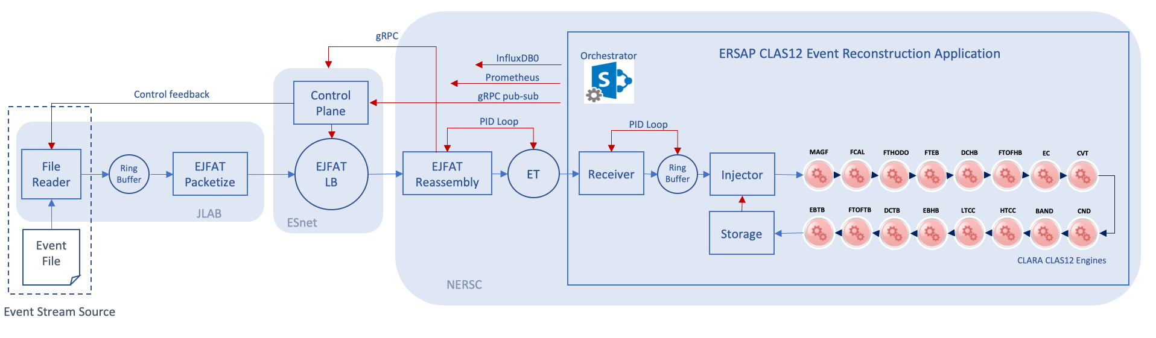
Concept Validation Experiment
CLAS12 Data-Stream processing at NERSC. Stage 1

Slide 11
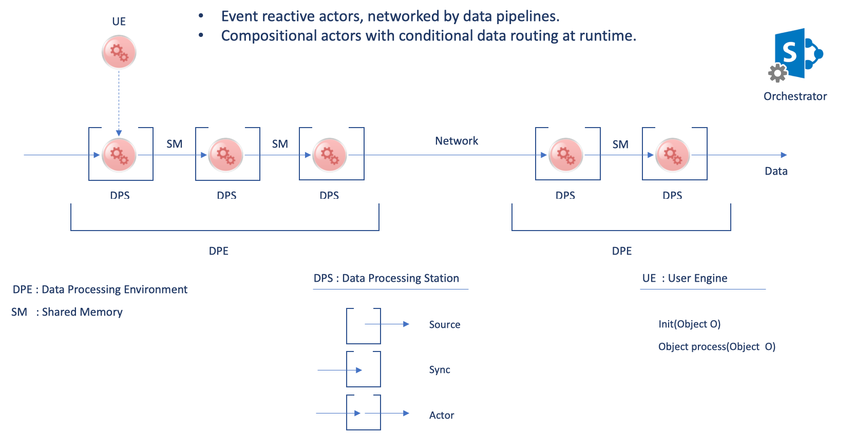
ERSAP
Flow-Based Programming paradigm
Data flows through asynchronous, concurrent processors (“black box” actors)
Actors communicate via data chunks (called information packets or data-quanta)
Data-quanta are traveling across predefined connections, where connections are specified externally to the processors.
Data is pushed through actors, while actors are reacting on passing data quantum.
Actors are performing independent, well-defined functions
Simple reconfigure

Slide 12
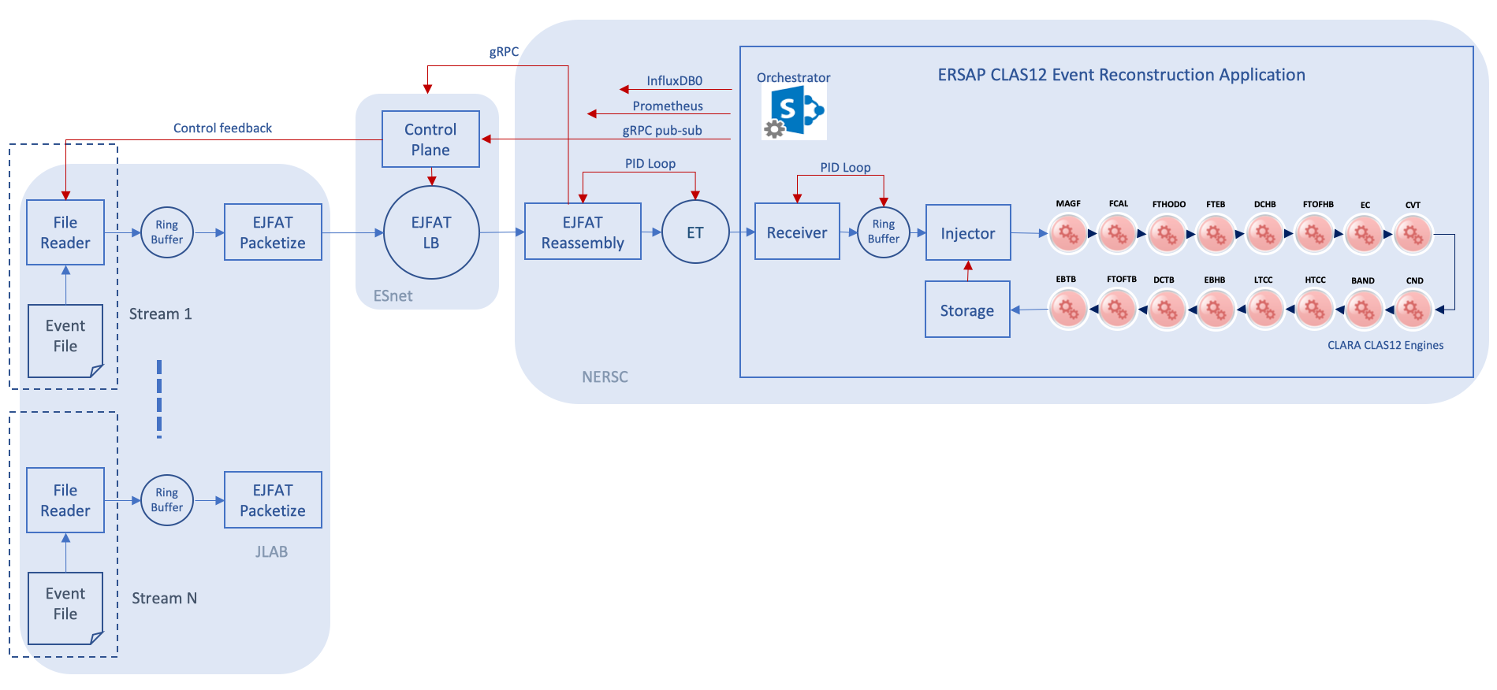
Concept Validation Experiment
CLAS12 Data-Stream processing at NERSC. Stage 2

Slide 13
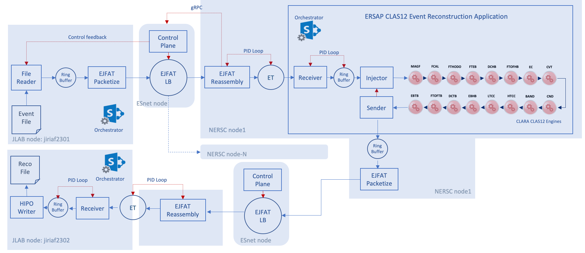
Concept Validation Experiment
CLAS12 Data-Stream processing at NERSC. Stage 3

Slide 14
Conclusion
Rollover between computing facilities
Operational resilience
Load balancing
Migration of workflows
Continuity of operations

Slide 15
Thank You

