Slide 1



WLCG Transition from X.509 to Tokens:
Status and Plans
CHEP 2023
Tom Dack
STFC, UKRI
On behalf of the
WLCG Authorisation Working Group

Slide 2
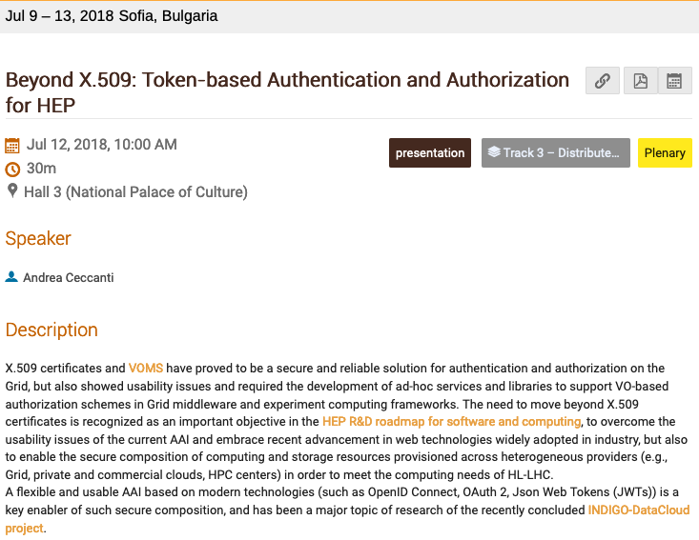
… five years ago
Andrea Ceccanti presented the WLCG’s initial plans for token migration

Slide 3
Motivations for Change
Industry Standards
  Tokens are widely adopted in industry, leading to software which already supports tokens, and many standard libraries when integration is needed
Ease of Use
  X.509 certificates are difficult to handle for users, and unfamiliar to those entering
  Prevalence of Token flows in industry/social applications makes the workflow easier to learn
Flexible Authentication
  Hard to integrate identity federations with VOMS, where a token infrastructure brings us steps closer towards this
Finer Grained Access Control
  Tokens provide direct routes for AuthZ relying on user attributes or capabilities
Security Benefits
  The usage of audiences and scopes allows restricting tokens to specific jobs or services with greater levels of flexibility

Slide 4
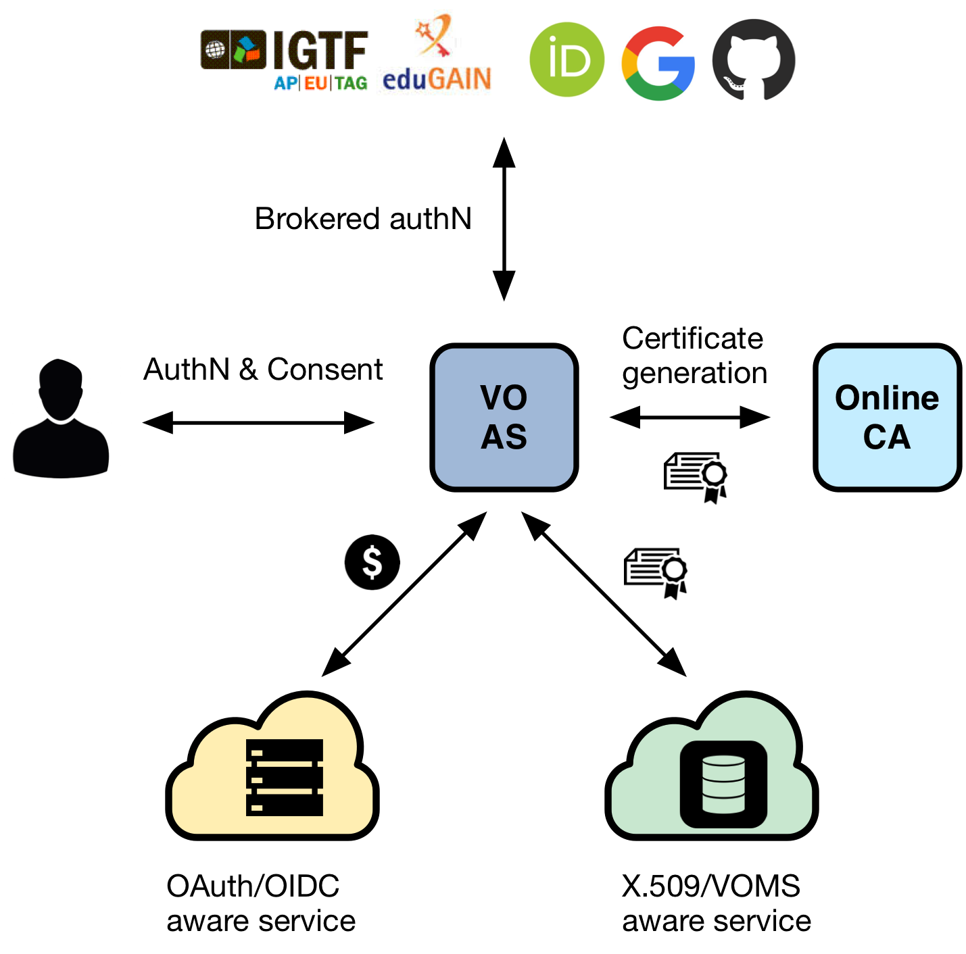
Token Based AAI for WLCG
VO Scoped Token issuers, which can:
  Support multiple authentication mechanisms
    Currently supporting CERN SSO or X.509
  Provide users with a persistent VO-Scoped identity
  Expose identity information, attributes and capabilities to services via JWT tokens and standard OAuth & OpenID Connect protocols
  Integrate with existing VOMS-aware services
  Support both Web and non-Web access, delegation, and token renewal
WLCG uses INDIGO IAM as its issuer

Slide 5
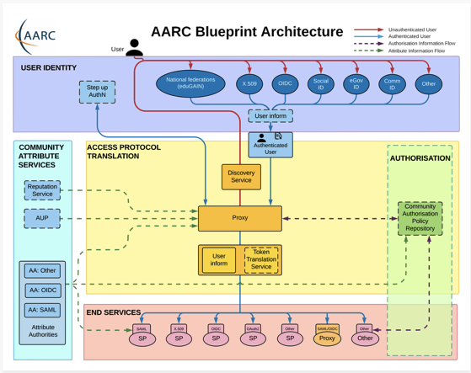
WLCG Token Infrastructure Design
CERN SSO configured as sole Identity Provider, enables identity verification via HR DB (match CERN PersonID)
Follows the AARC Blueprint:
https://aarc-community.org/architecture/ but not all AEGIS recommendations

Slide 6
WLCG Token Infrastructure Design
CERN Person ID is checked against CERN HR DB. Affiliation with Virtual Organisation (experiment) is verified, as well as end dates.
If the check is OK, the membership
is approved.
CERN SSO releases:
● Name,
● Email,
● CERN Person ID (indicates
HR has performed ID check),
● CERN Kerberos Principal
● ...
Currently LHC experiment members can have CERN accounts, and so all access is via CERN SSO or Linked X.509, but aim is to work towards removing this need in future
Similar to VOMS-Admin

Slide 7
WLCG Token Infrastructure Design
Groups initially imported from VOMS, and then managed and configured within IAM
Outbound communication of user information to end services, which can be used to establish authorization.
VOMS proxies can still be used for as long as they are needed.
The WLCG Common JWT Profiles document defines the token profile for tokens issued by the WLCG infrastructure.
This includes WLCG specific claims and scopes.

Slide 8
Token uptake in WLCG and beyond
IAM instances are in production for the four LHC experiments
  Contents are automatically replicated from VOMS-Admin
    Modulo known issues with workarounds
  IAM VOMS endpoints have been in production use by ATLAS and CMS for over a year, alongside the legacy VOMS services
ATLAS must, and CMS & SAM ETF can use tokens to submit pilot jobs to HTCondor CEs
  These jobs still use X.509 VOMS proxies for data management, etc.
  In particular the CEs on OSG, which only support tokens since May 2022
  Still rely on X.509 for ARC-CEs
For ALICE, LHCb, Belle-II, … these matters are currently WIP
DUNE and Fermilab are progressing with tokens from CILogon
  This supports the WLCG token profile, with DUNE using WLCG tokens
  Hashicorp Vault is used to store refresh tokens, with htgettoken as a user interface

Slide 9

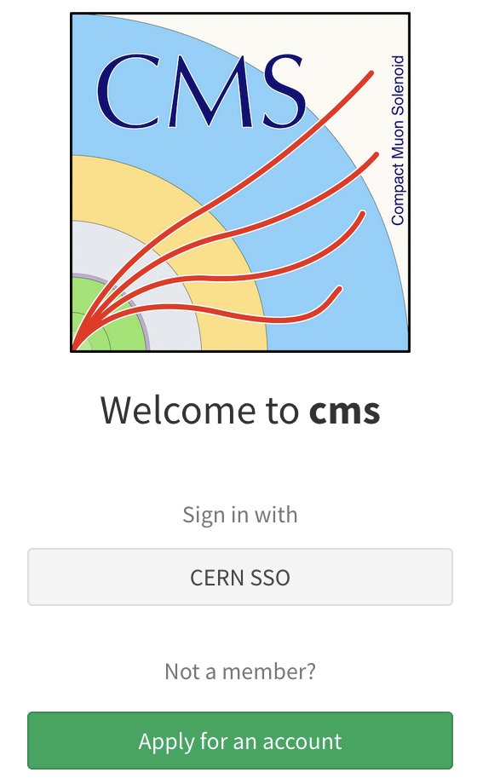
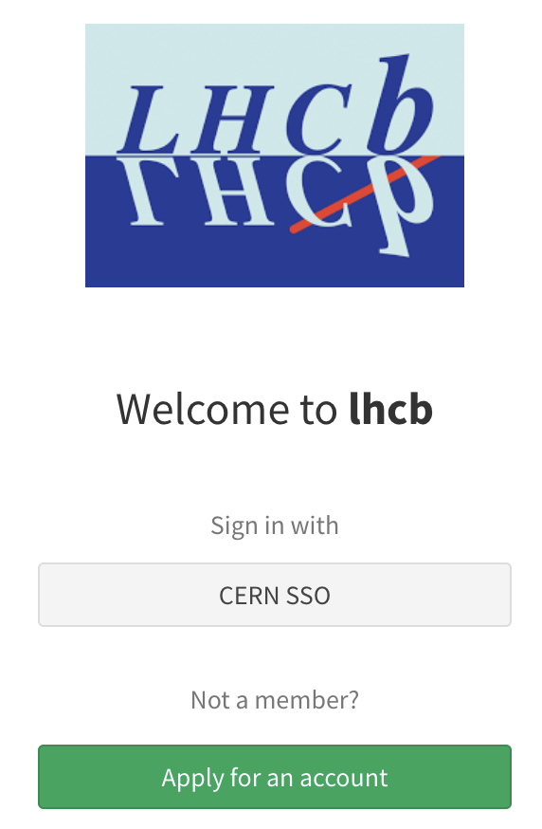

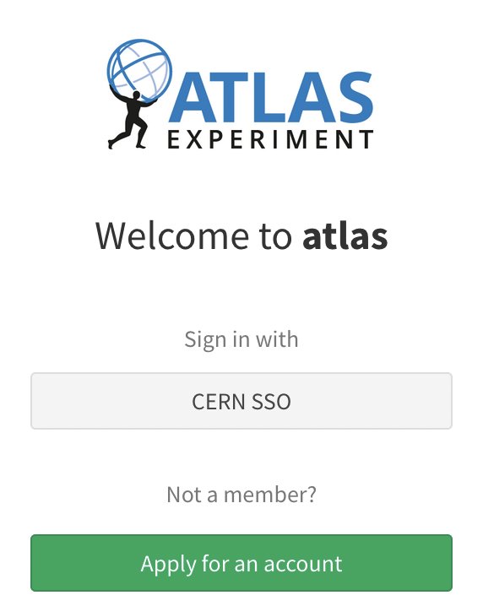
WLCG INDIGO IAM Deployments
IAM Dashboard: https://<experiment>--auth.web.cern.ch
VOMS endpoint: https://voms-<experiment>-auth.app.cern.ch

Slide 10
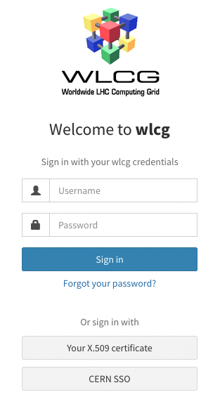
WLCG INDIGO IAM Deployments
Plus the WLCG Testing Instance, which is run by CNAF:
wlcg.cloud.cnaf.infn.it
IAM Dashboard: https://<experiment>--auth.web.cern.ch
VOMS endpoint: https://voms-<experiment>-auth.app.cern.ch

Slide 11




Deployment Technical Details
Deployed on CERN’s Openshift infrastructure
IAM runs in Docker containers
Configuration managed using CERN’s gitlab
Logs sent to Elasticsearch
Deployment managed by Kubectl
Sectigo certificate for IAM dashboard
CERN Grid Host Certificate for VOMS endpoint
  CERN’s CP/CPS was updated to allow this with EUGridPMA approval

Slide 12
Token Transition Status
From the Token Transition Timeline:
M.2 (Dec 2022) DIRAC versions supporting job submission tokens deployed for concerned VOs
  LHCb have upgraded to v8.0 and validated job submission to HTCondor and ARC CEs with tokens
  Currently planned for Belle-II in summer
M.3 (Feb 2023) VOMS-Admin is switched off for one or more experiments
  Supporting work underway, but pushed back to allow for further IAM development to improve on VO use-cases and concerns
M.4 (Mar 2023) HTCondor installations at EGI sites have been upgraded to supported versions > 9.0.x
  Work in progress, but expected date postponed.
M.5 (Mar 2023) End of HTCondor support for GSI Auth (link)
  Postponed to May
M.6 (Mar 2023) Some storage endpoints provide support for tokens
  Several CMS production storage services already pass token tests
  A number of early adopters within ATLAS
For further details on M.4 and M.5, see the March GDB update presentation

Slide 13
Token Transition Status
From the Token Transition Timeline:
M.7 (Feb 2024) Rucio / DIRAC / FTS have sufficient token support in released versions to perform DC24 using token authorization.
  Currently WIP
M.8 (Mar 2024) Sufficient storage endpoints support tokens to allow DC24 to be done using only tokens.
  Having WLCG token support ready in time for DC24 is a major current emphasis
M.9 (Mar 2025) Grid jobs use tokens for reading and stageout.
  Requiring changes also inside the job pilots

Slide 14
Conclusions and outlook
Though the token transition timeline has seen some delays, progress has been steady in many areas concerned
The main milestones at this time are about:
The switch to HTCondor CE versions that no longer support GSI
  Several scenarios to smooth the transition for legacy use cases
Integration and deployment ready to run DC24 using tokens only
  Aim for production-quality infrastructure at the majority of sites
  (preferably all T0/1 plus the big T2 sites)
To be continued as we work towards:
  M.10 (Mar 2026) Users no longer need X509 certificates!
    There is a longer gap between M.9 (Mar 25) and M.10 (Mar 26), so as to allow the development of scenarios and workflows to ensure a smooth user transition

