Slide 1
Collaborative Operational Security
David Crooks (UKRI STFC)
david.crooks@stfc.ac.uk

Slide 2
CHEP 2019
Romain’s plenary, “Tackling modern cyberthreats together is the only way forward”
We are a viable market for cybercriminals and are targeted by Nation States actors
Connecting and defending as a community is the only way forward
Collaborative Operational Security, CHEP 2023, Norfolk VA

Slide 3
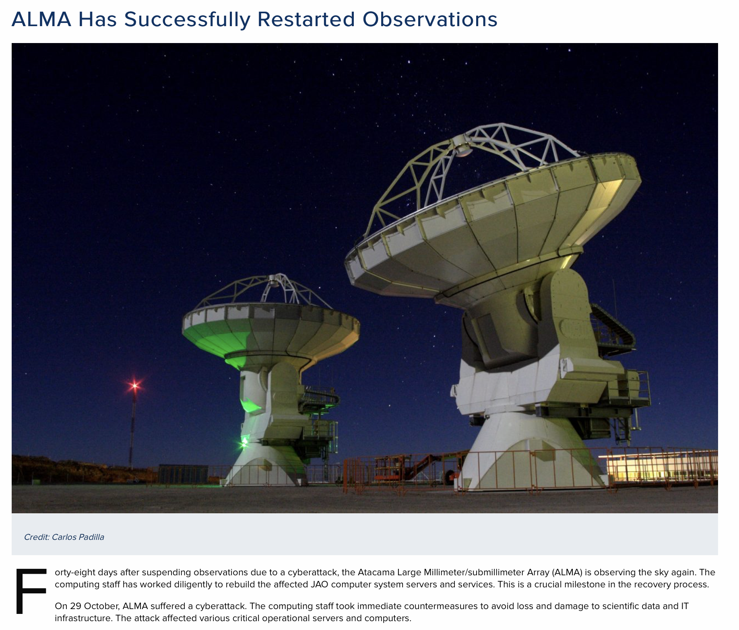
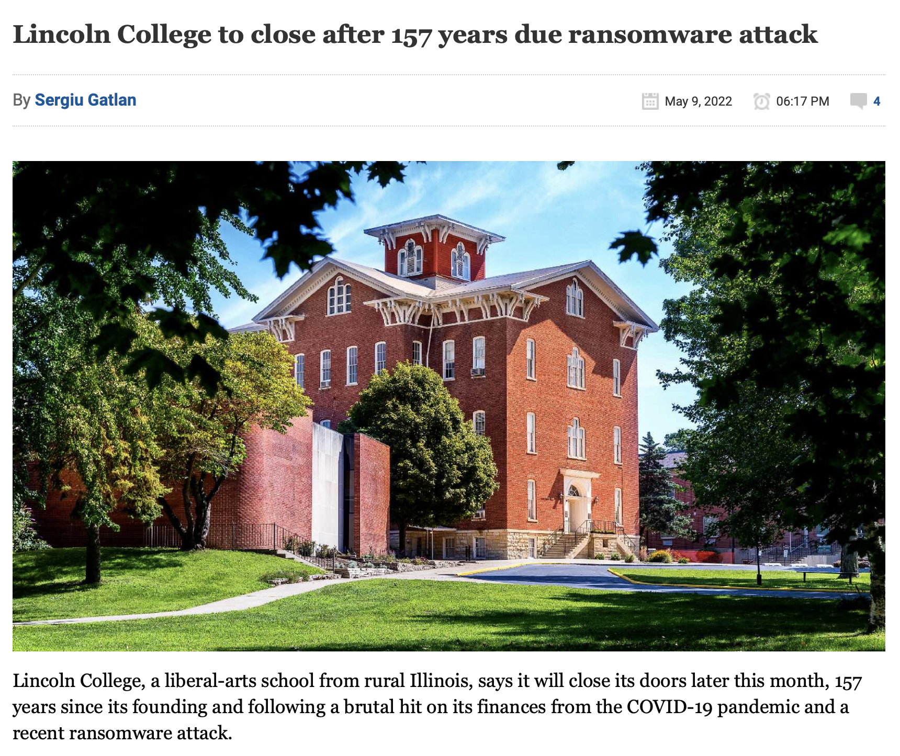
Fast forward to today
Considerable increase in risk from ransomware attacks
Phishing continuing to be frequently used vector
For many organisations, drastic increase in cybersecurity priority
Affirms WLCG strategy
Collaborative Operational Security, CHEP 2023, Norfolk VA

Slide 4
Fast forward to today
Considerable increase in risk from ransomware attacks
Phishing continuing to be frequently used vector
For many organisations, drastic increase in cybersecurity priority
Affirms WLCG strategy
Collaborative Operational Security, CHEP 2023, Norfolk VA

Slide 5
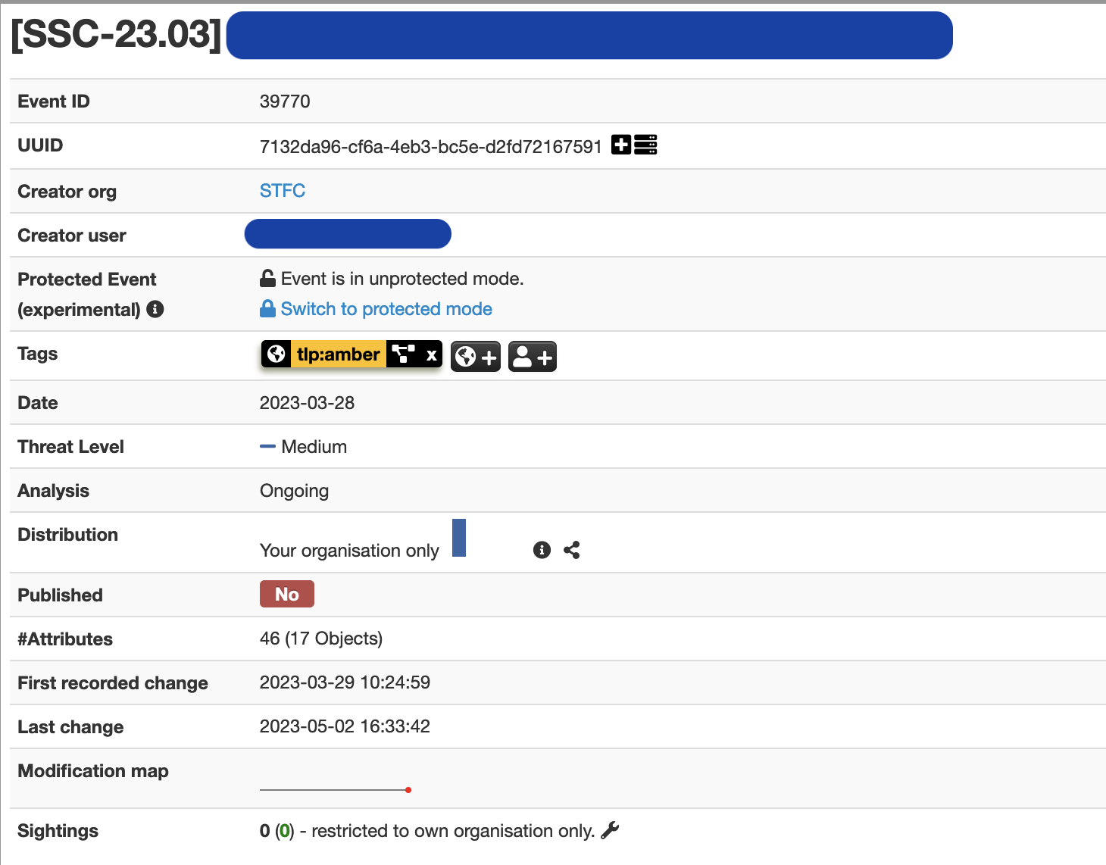
Collaboration, threat intelligence and monitoring
Core principles: we must
collaborate
share information between ourselves
deploy capabilities to make active use of this information
To make use of intelligence, must deploy network monitoring
How do we involve everyone?
More on that later
Collaborative Operational Security, CHEP 2023, Norfolk VA

Slide 6
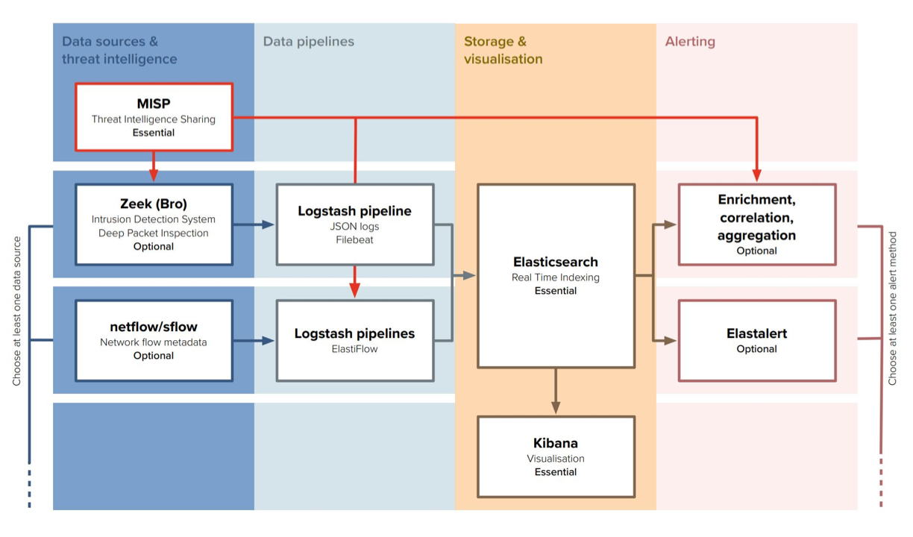
The need for multiple approaches to monitoring
We have two environments when considering fine-grained network monitoring
Facilities with the resources and in-house experience to deploy full Security Operations Centres
Much larger number of smaller sites where it is not practical to deploy the same capabilities
majority of sites in WLCG
Collaborative Operational Security, CHEP 2023, Norfolk VA

Slide 7
The need for multiple approaches to monitoring
We have two environments when considering fine-grained network monitoring
Facilities with the resources and in-house experience to deploy full Security Operations Centres
Much larger number of smaller sites where it is not practical to deploy the same capabilities
majority of sites in WLCG
Collaborative Operational Security, CHEP 2023, Norfolk VA

Slide 8
Large scale SOC deployment status [1]
STFC:
Phase 1 of STFC SOC will monitor RAL (Harwell Campus)
New team in place, preparatory work complete and starting deployment
Traffic from LHCOPN link now being monitored with Zeek
Nikhef:
Recently updated to monitor all Nikhef links
Hardware upgrades are underway as a result
Collaborative Operational Security, CHEP 2023, Norfolk VA

Slide 9
Large scale SOC deployment status [2]
CERN:
Migrated from Elasticsearch to Opensearch
New data sources added
Revamp of Incident Response Toolkit
USATLAS:
AGLT2 and MWT2 SOC instances operational in July 2023
Both AGLT2 and MWT2 have purchased NVIDIA Bluefield-2 100G dual-ported NICs
Looking to have the capture hosts, Zeek and MISP hosts EL9 based.
Collaborative Operational Security, CHEP 2023, Norfolk VA

Slide 10
Scaling full size deployments?
These large scale SOC deployments give vital security monitoring capabilities, particularly when deployed at large national facilities
Especially when backed with in-house analysts who can use the resulting intelligence most effectively
Share this experience with the broader community
But we’ve discussed: this doesn’t scale to all sites, especially not at the pace we need to improve our capabilities
Collaborative Operational Security, CHEP 2023, Norfolk VA

Slide 11
pDNSSOC
What we can do is focus on a particular type of intelligence that can be collected and analysed in a lightweight way: DNS
Correlate DNS logs with threat intel from MISP as an “80%” SOC: pDNSSOC
provides a turn-key solution to detect and respond to security incidents
Merch available!
Collaborative Operational Security, CHEP 2023, Norfolk VA

Slide 12
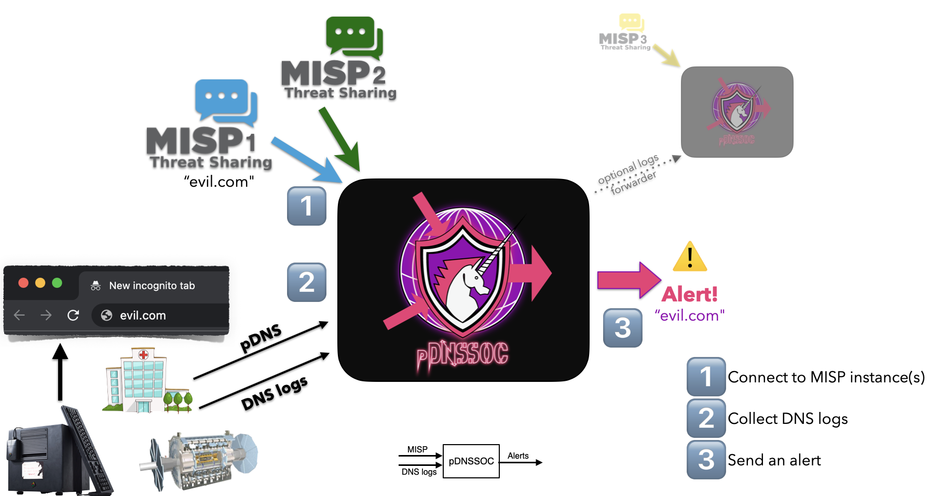
pDNSSOC outline
Collaborative Operational Security, CHEP 2023, Norfolk VA

Slide 13
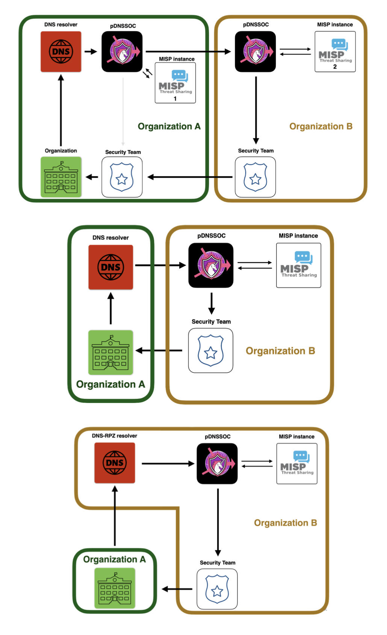
Types of pDNSSOC deployment
Federation:
The organization forwards pDNS data using a pDNSSOC forwarder.
You can detect the intrusion at different levels while respecting the TLP.
Collaboration:
The organization forwards DNS/pDNS logs.
You cannot block the requests but you get the alerts.
Responsive:
The organization use your DNS resolver.
You host the DNS + RPZ (you can block requests) and pDNSSOC (you get the alerts).
Collaborative Operational Security, CHEP 2023, Norfolk VA

Slide 14
Getting started with pDNSSOC
If you want to operate a pDNSSOC server
Start with https://github.com/CERN-CERT/pDNSSOC
Contact wlcg-security-officer@cern.ch to explore nesting with other pDNSSOC instances
If you want to benefit from pDNSSOC but have limited resources
Explore how you can collect/send DNS logs or privacy-preserving pDNS data
Contact wlcg-security-officer@cern.ch to identify a suitable pDNSSOC instance
Collaborative Operational Security, CHEP 2023, Norfolk VA

Slide 15
Full-size SOCs, pDNSSOC and operational security
WLCG strategy now follows two strands:
Broad based use of pDNSSOC to give significant benefit to largest set of sites
Full SOC stacks particularly at large national-scale facilities and those with in-house experience and requirements
How do we use these capabilities and threat intelligence in practice?
Operational security teams + trust groups
Collaborative Operational Security, CHEP 2023, Norfolk VA

Slide 16
International operational security
EGI CSIRT starting to incorporate threat intelligence events into incident response procedures
Will allow us to share Indicators of Compromise for a given incident live in addition to existing email broadcasts
SAFER: closed operational security trust group focused on fighting computer misuse and defending the academic, research, and education mission as a global community
In a WLCG context, this provides a forum where we can directly interact with
US partners and DoE labs National CERTs
Private security vendors
Ease threat intelligence information sharing
Additional expertise and skills in case of severe intrusions
Collaborative Operational Security, CHEP 2023, Norfolk VA

Slide 17
Upcoming meetings
At CHEP!
SOC BoF on Thursday 2-3.30 in 'Coral Sea Boardroom' (2nd floor)
Please make a note of your area of interest: https://cern.ch/chep-soc-bof
This summer!
SOC Hackathon taking place w/c 14th August in UK
1 day status workshop + 4 days technical hackathon across 4 rooms
https://indico.cern.ch/event/1268239/
pDNSSOC focused meeting at CERN 1-2 June - with DNS pioneer Paul Vixie!
https://indico.cern.ch/event/1283744
Collaborative Operational Security, CHEP 2023, Norfolk VA

Slide 18
How to get involved
We need your help in broadening our technical development community to continue to make progress
What can you get involved with: something for everyone
Deploying full SOCs including ongoing operations
Deploying pDNSSOC collectors and structuring pDNSSOC processing centres
Building training and documentation resources
SOC WG mailing list + keybase community
Sign up for account at https://keybase.io and send username to DavidC
Happy to talk over coffee and hope to see you at the BoF:
https://cern.ch/chep-soc-bof
Collaborative Operational Security, CHEP 2023, Norfolk VA

