Slide 1
SkyDriver
A SaaS Solution for Event Reconstruction
Ric Evans
Research Software Engineer
UW-Madison
IceCube / WIPAC
CHEP 2023

Slide 2
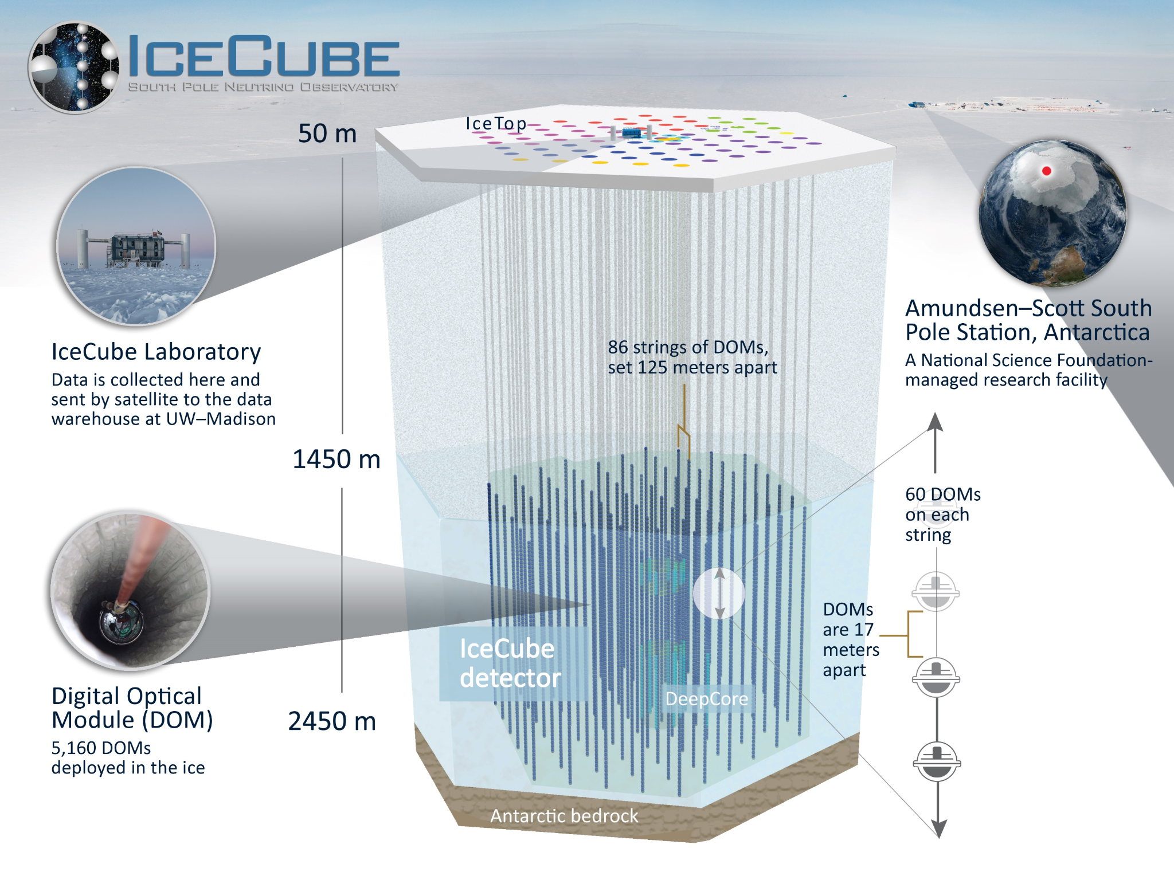
IceCube Neutrino Observatory
The IceCube Neutrino Observatory is a cubic kilometer neutrino telescope located at the geographic South Pole focused on the search for > 1 TeV astrophysical neutrinos.

Slide 3
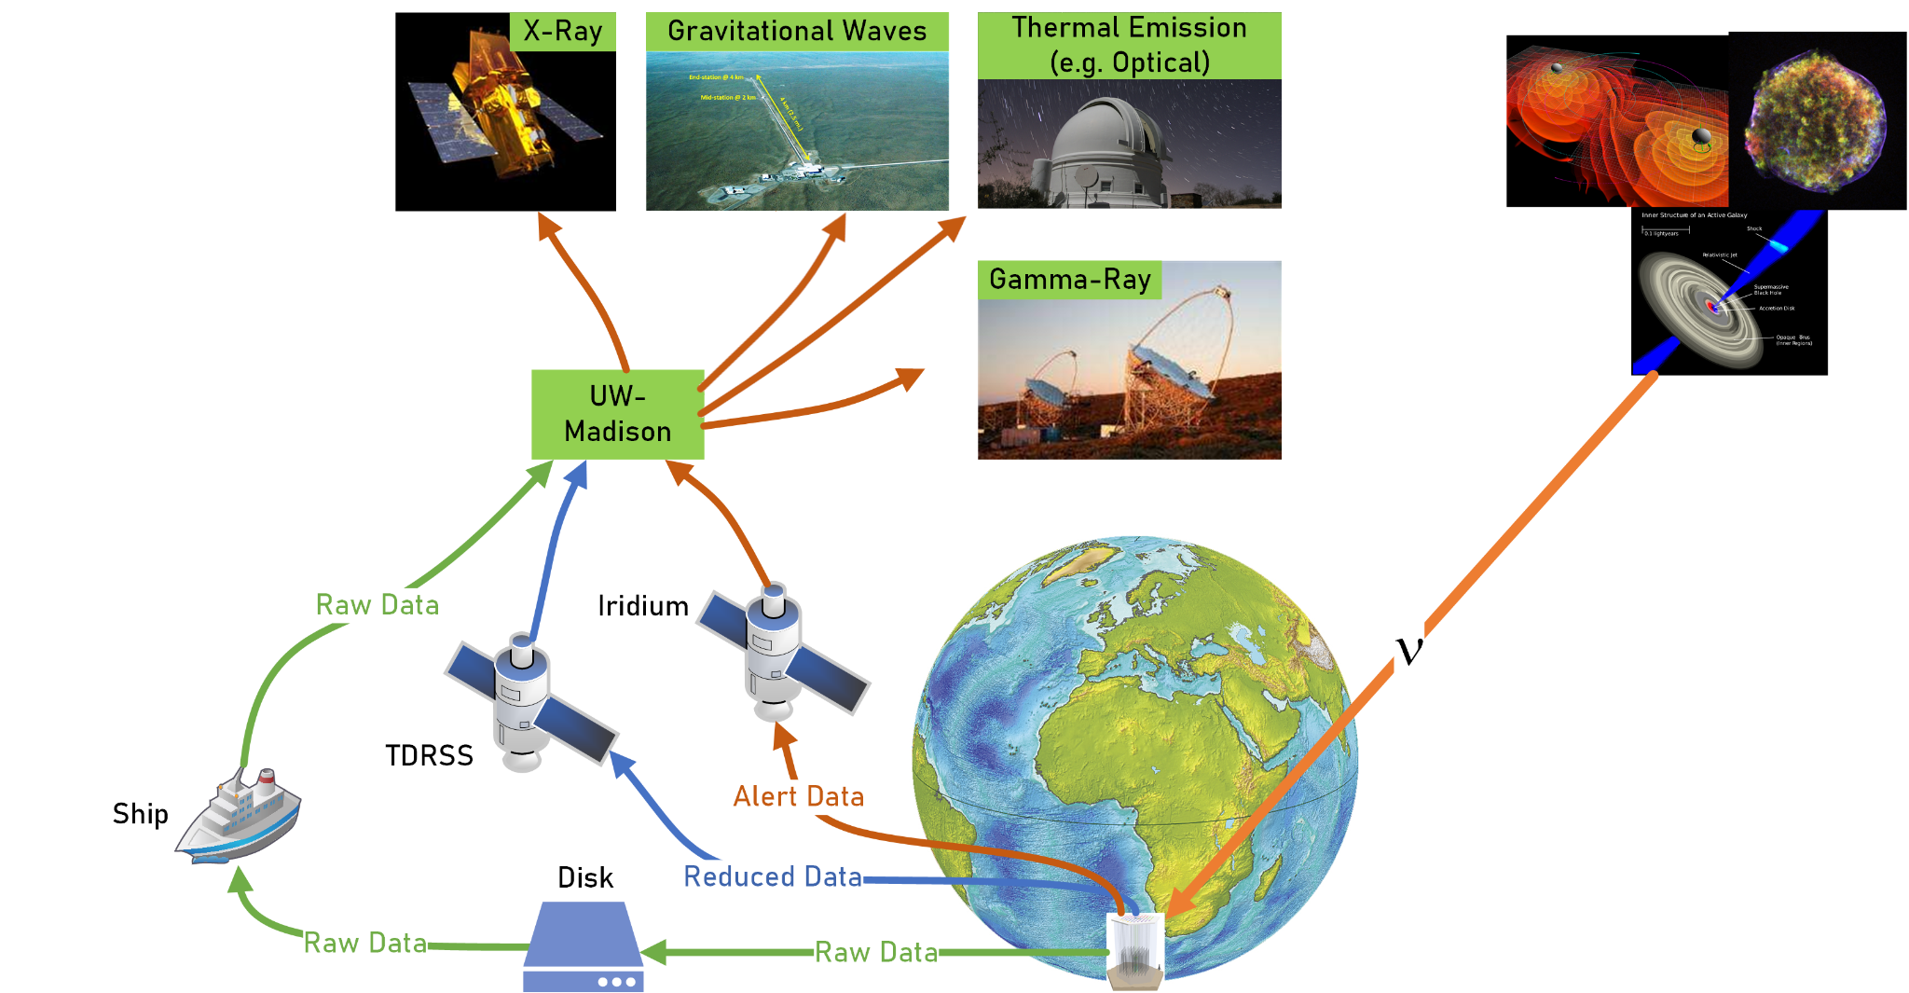
A neutrino is detected by IceCube!
Where did it come from?
Where do we need to point other telescopes for immediate follow-up observations?
Real Example: Blazar TXS 0506+056 (2017-09-22)

Slide 4
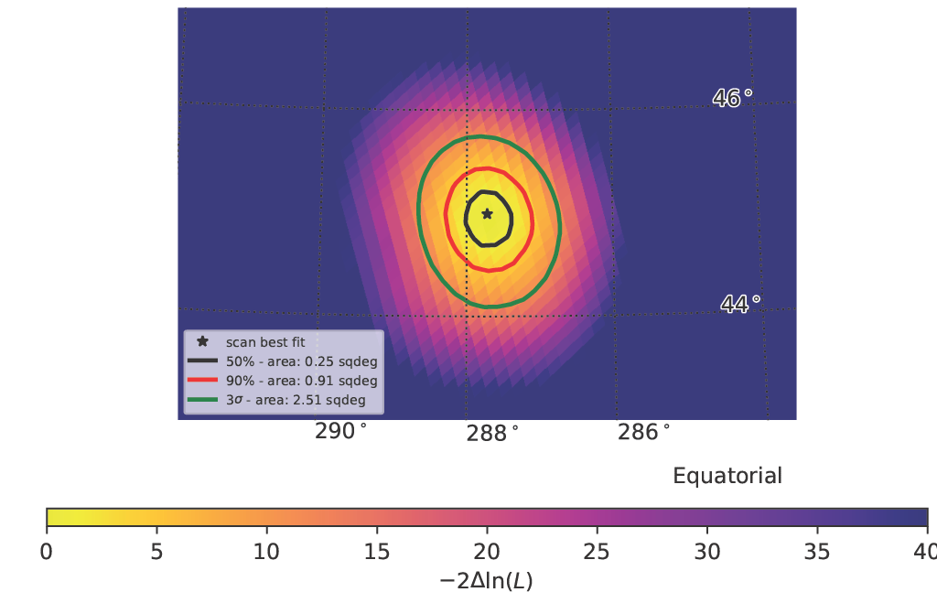
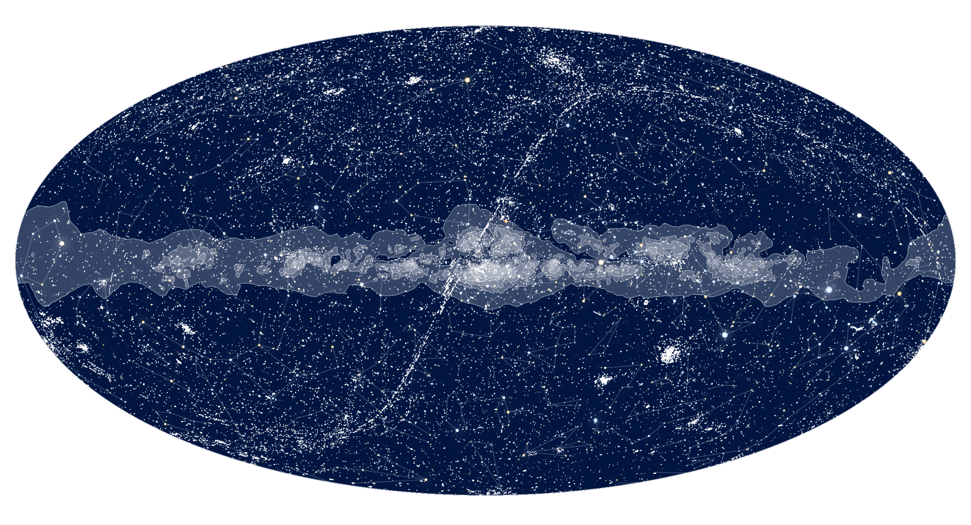
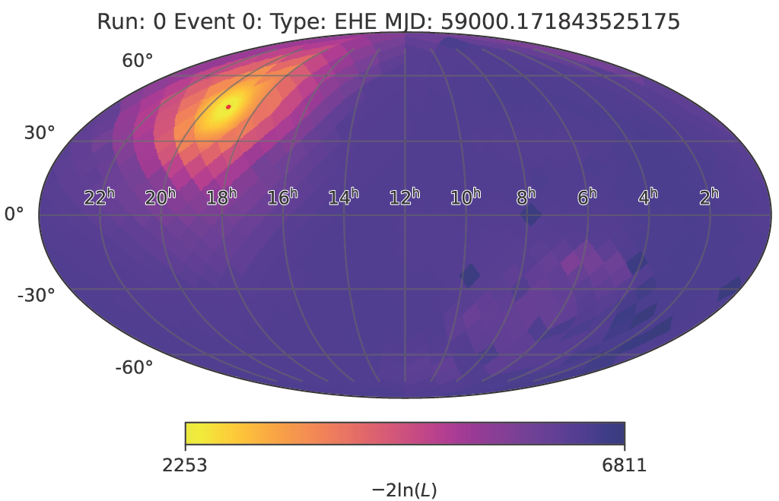
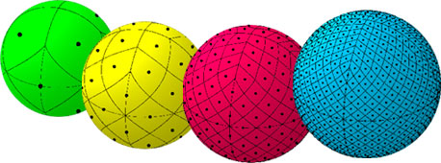
We need to reconstruct a Sky Map
Most accurate and detailed directional reconstruction comes by scanning across the sky in varying granularity: O(10k) pixels
“night sky”
Split sky into constant surface area pieces, pixels
Test each directional hypothesis against likelihood
Create directional likelihood map
Gives most probable direction and error
HEALPix algorithm

Slide 5
Skymap Scanner
The Starting Point

Slide 6
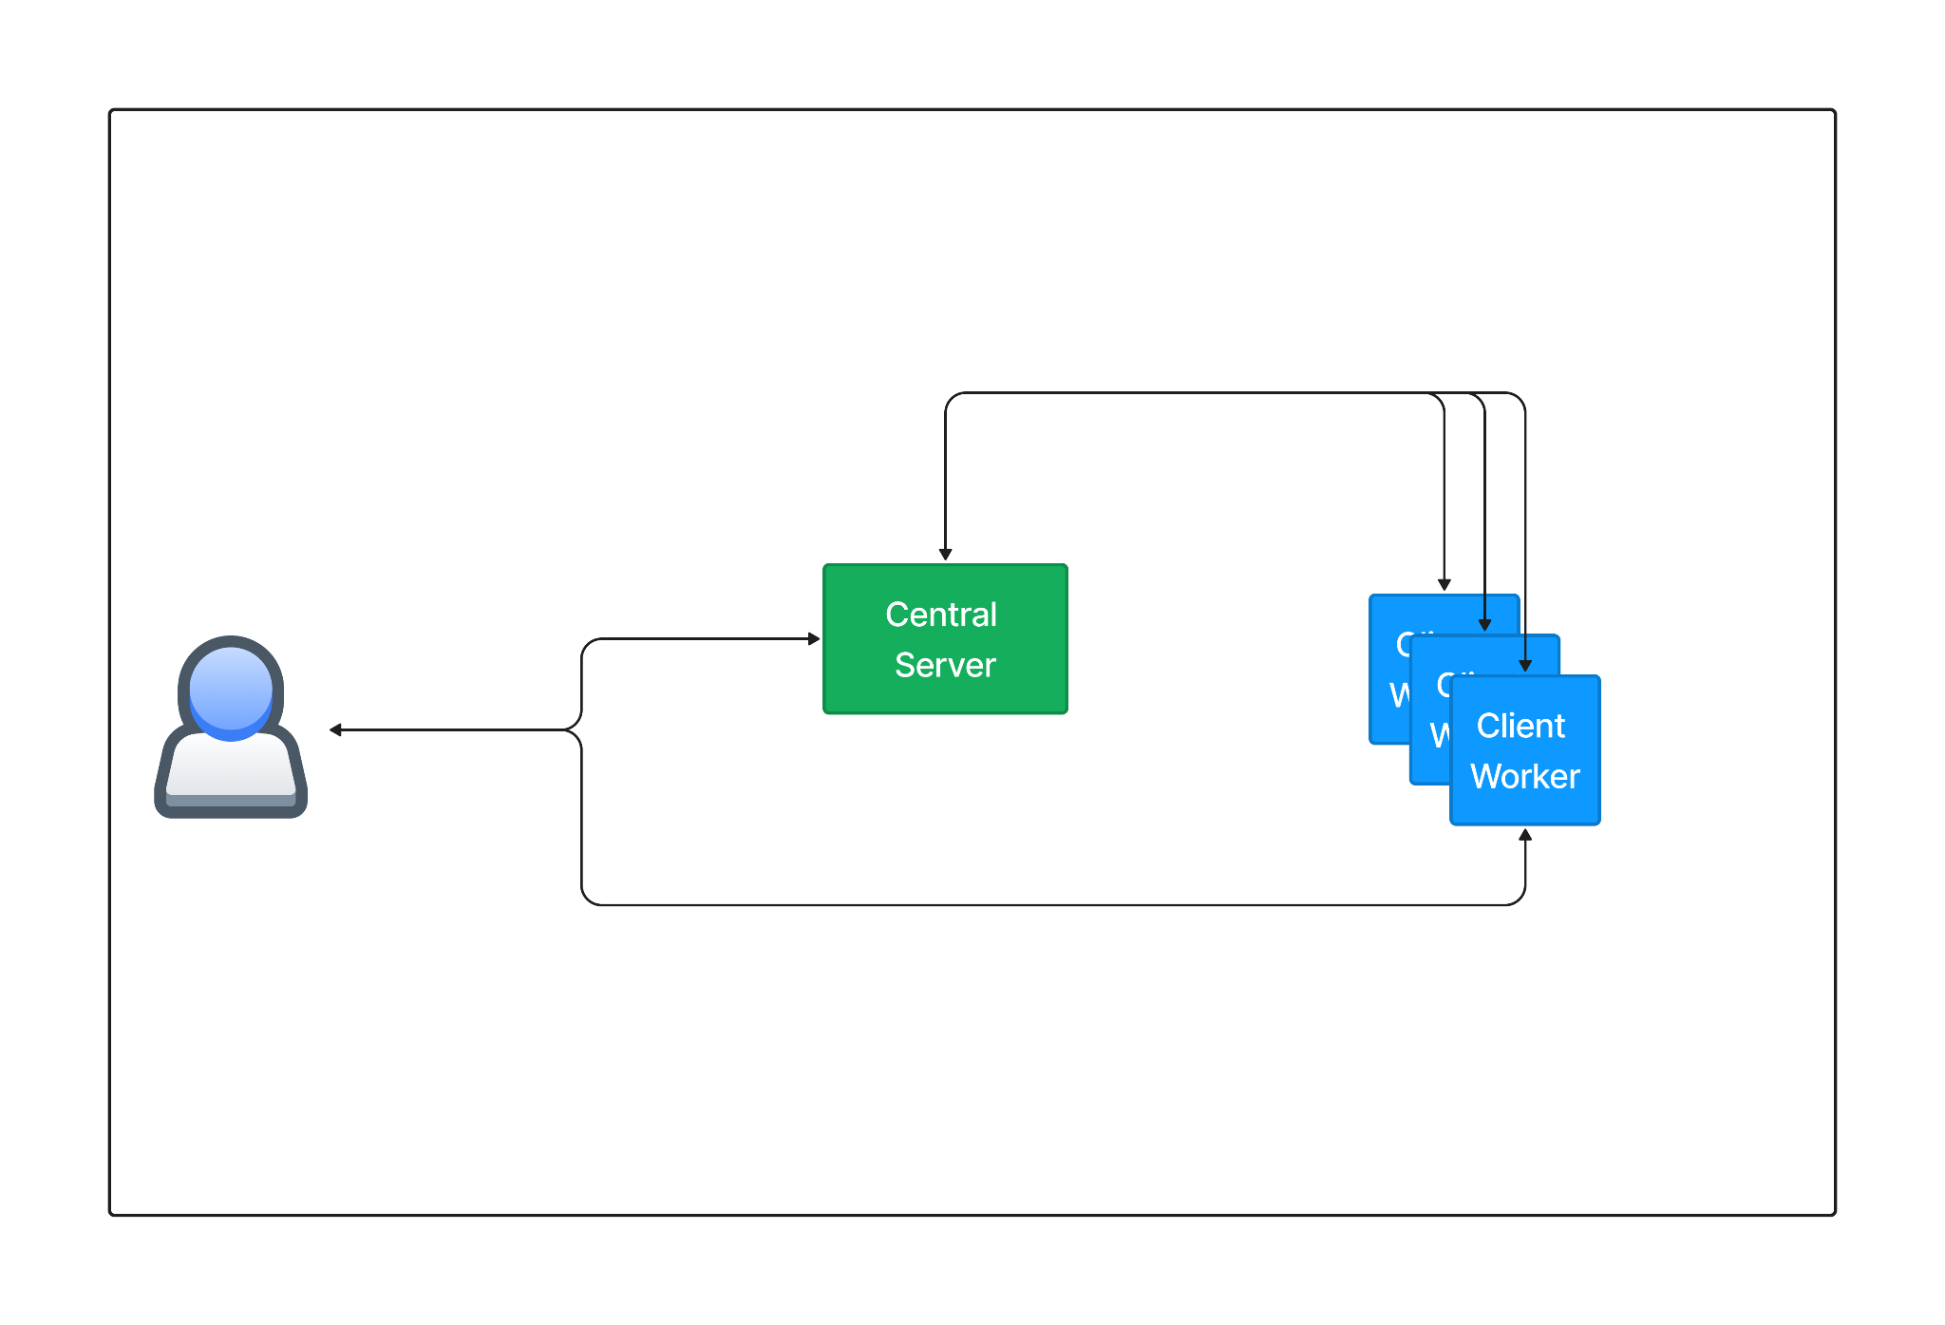
Skymap Scanner – 2 Pieces
1 Central Server - generates pixels, collects likelihood statistics on each pixel, and ultimately constructs a skymap
N Client Workers - computes statistics on subset of pixels, one at a time

Slide 7
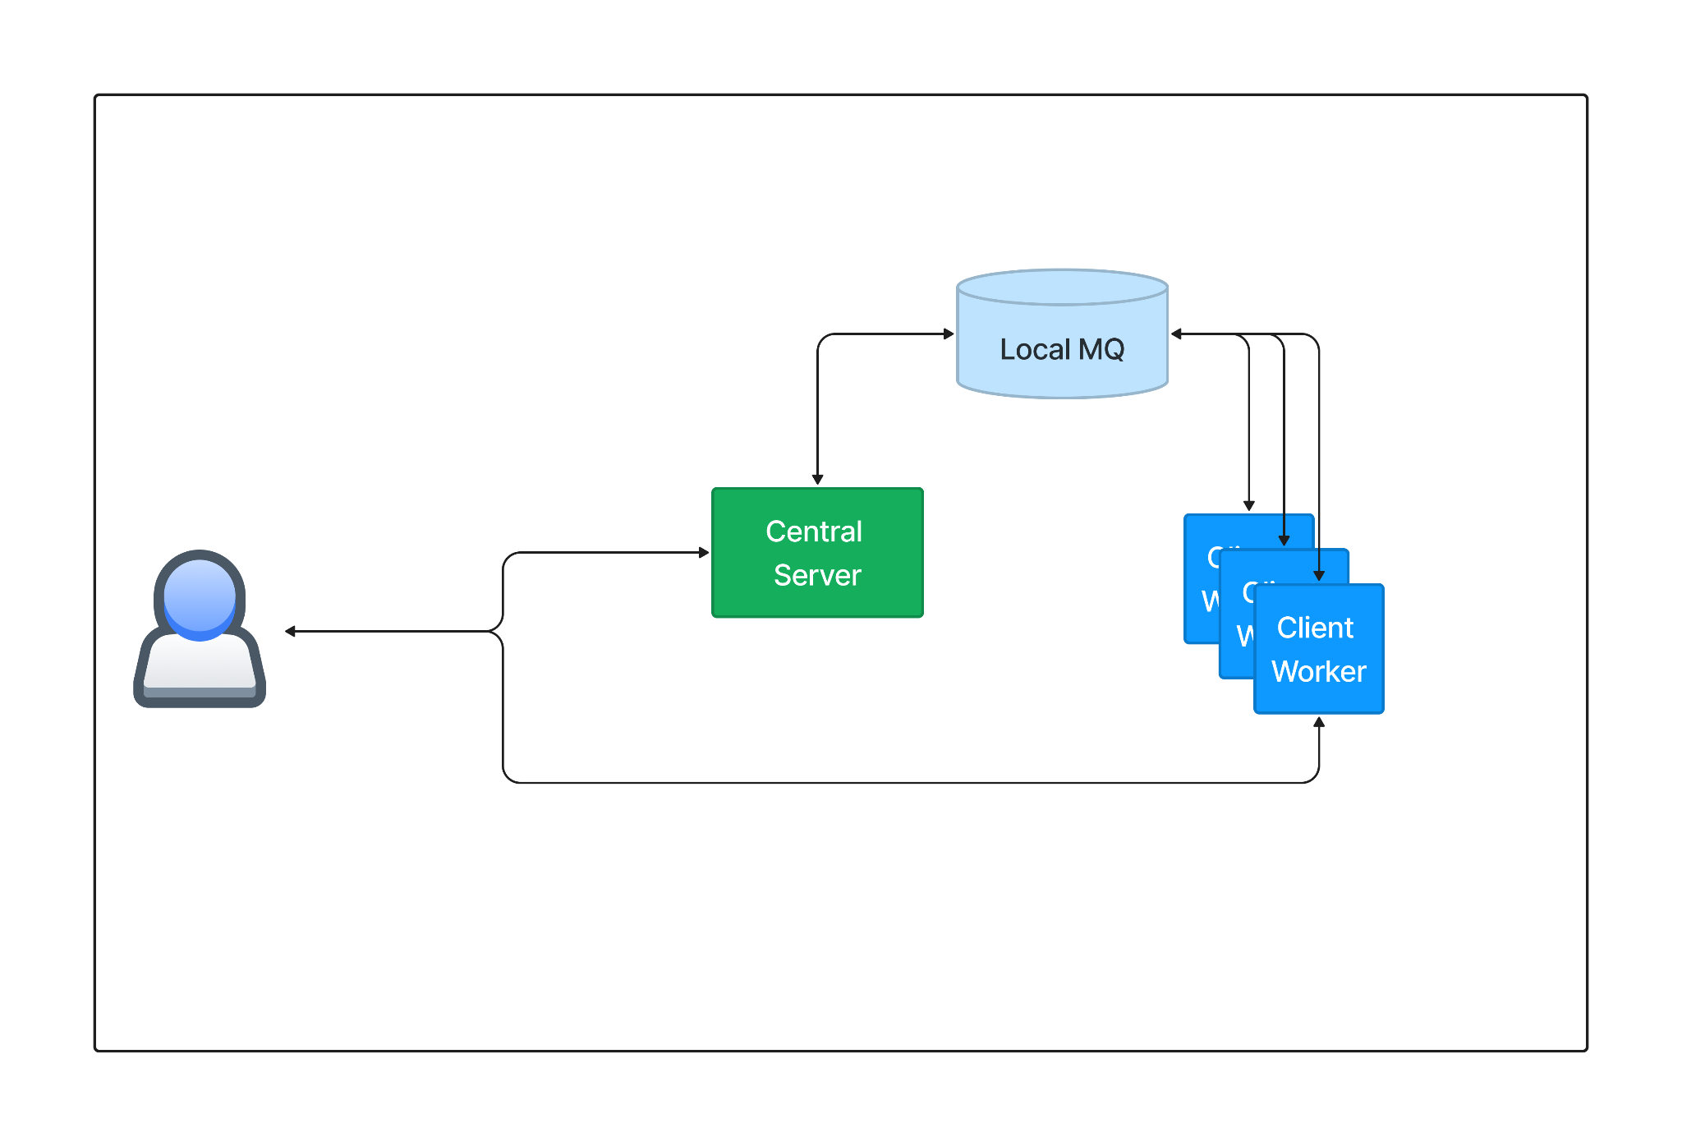
Skymap Scanner – Queueable Pixel Data
The reconstruction/statistical test of each pixel is computationally independent
This allows any client worker to analyze any pixel, in any order
But a local message queue (0MQ) & manual setup does not scale well…
Notes:
0MQ: scaling issues and it is fire and forget. Doesn't work well in an WAN-environment and where resources might disappear

Slide 8
The SkyDriver Journey
Building an Automated & Scalable Reconstruction-as-a-Service Solution

Slide 9
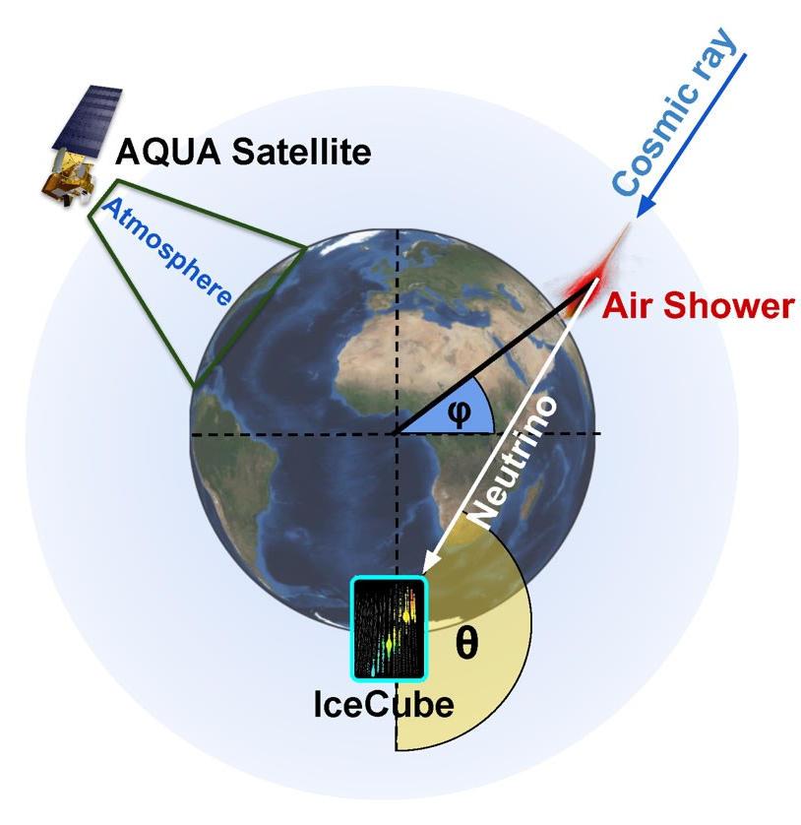
The Problem
CASE 1:
Real-time Scans
FAST & Resource Intensive -> High Priority
O(10k+) CPUs, spun up ASAP
CASE 2:
Historical Catalog & Simulation
Steady/Predictable -> Lower Priority
Varying # of CPUs, subject to availability

Slide 10
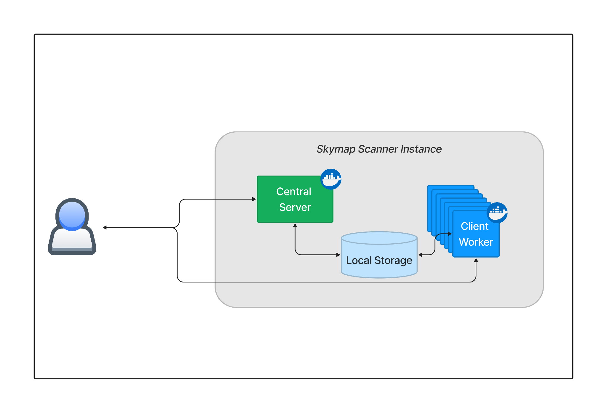
Step 1: User-Configurable
Modular Central Server and Client Workers
Swappable sky map reconstruction algorithms at runtime
Containerized Releases
Provides version control

Slide 11
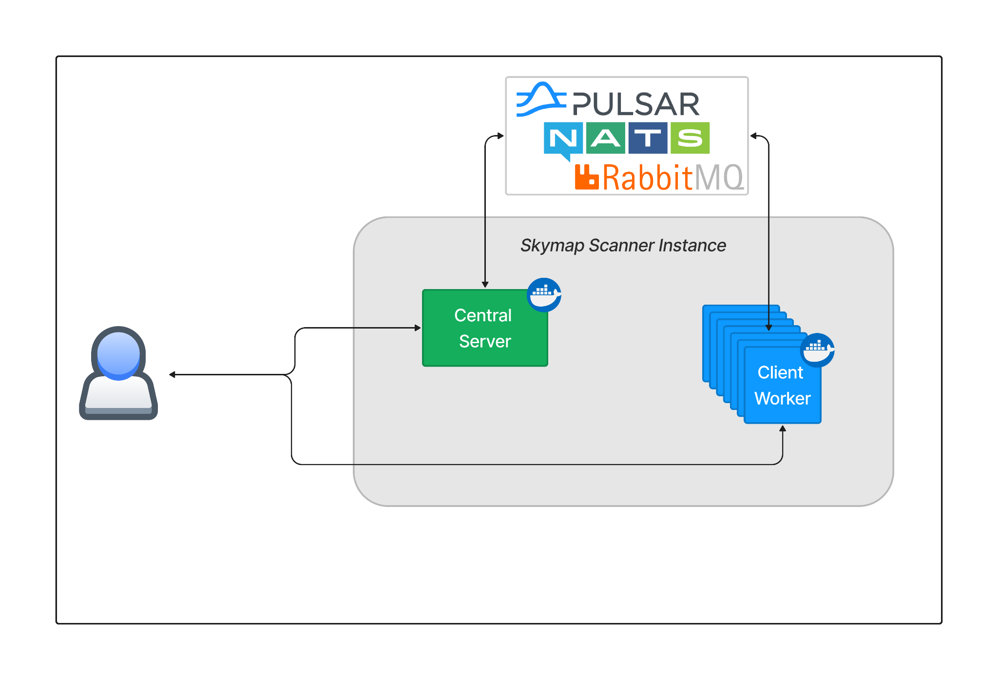
Step 2: Remote-Accessible MQ Broker
A remote-accessible message broker transfers pixels/stats between server and client workers, with native load balancing – workers can be anywhere!
Auto-retries, message broker native failsafes, and management tools
The OMS-MQClient supports interchangeable brokers:
Apache Pulsar, NATS.io, RabbitMQ
2 Message Types: Pixel & Likelihood Stats
pypi.org/project/oms-mqclient/
Notes:
“Why not Kafka?” -> Easy answer is that we want each consumer to get different events, which is harder to do in Kafka.

Slide 12
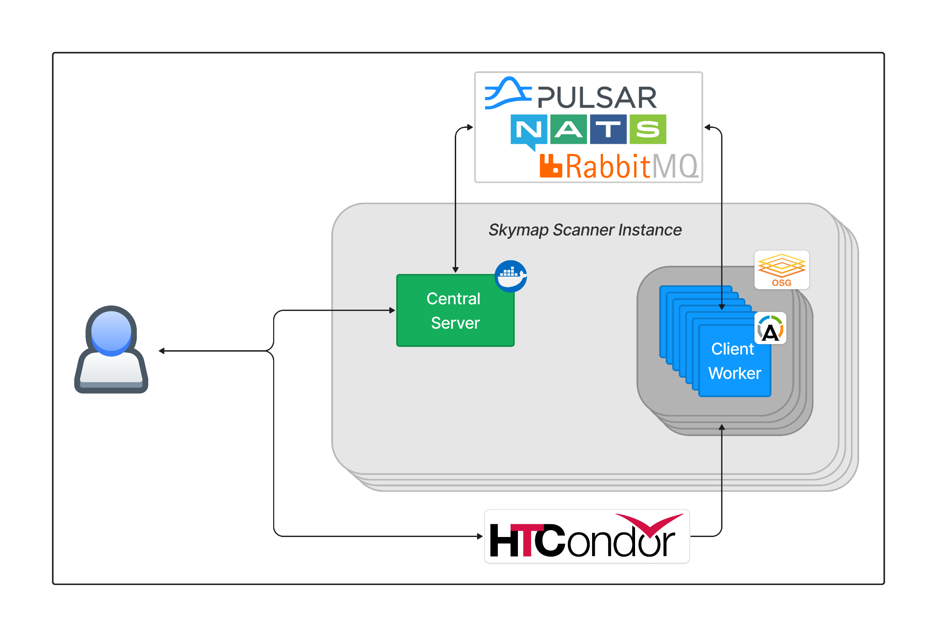
Step 3: Increased Scalability – 3 Vectors
Instance Scalability - Concurrent Scans
Possible with globally unique queues
More scans
Workforce Scalability
Provided by HTCondor + OSG
Faster Scans + Seamless Worker Failover
Pixel Resolution Scalability, # of Messages (Pixels)
Enables Automated CI Testing

Slide 13
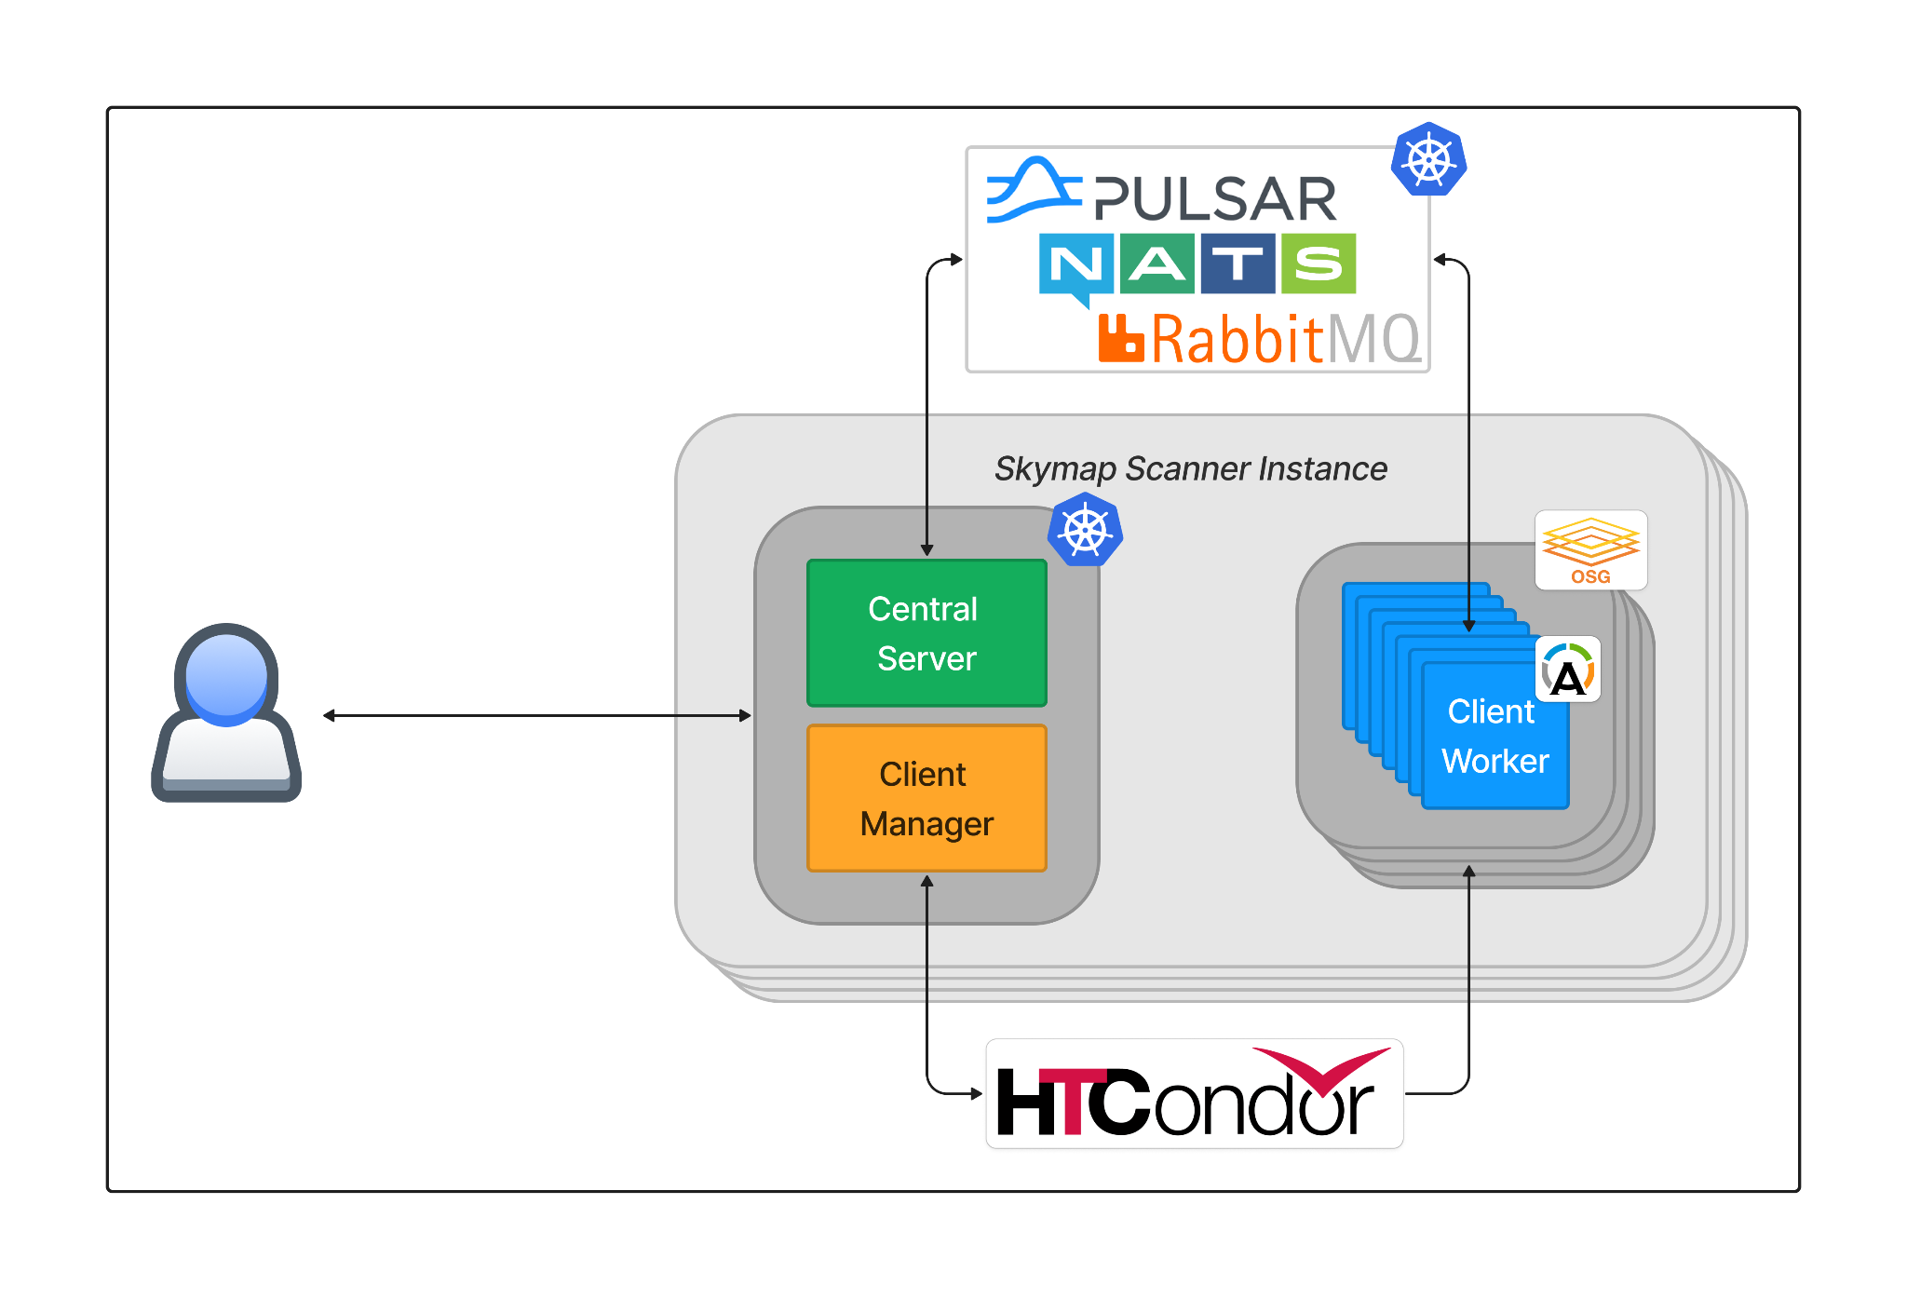
Step 4: Automated Orchestration
Central servers and client managers are hosted on Kubernetes cluster
Additional scalability and risk management
Larger resource pool = Faster Computation

Slide 14
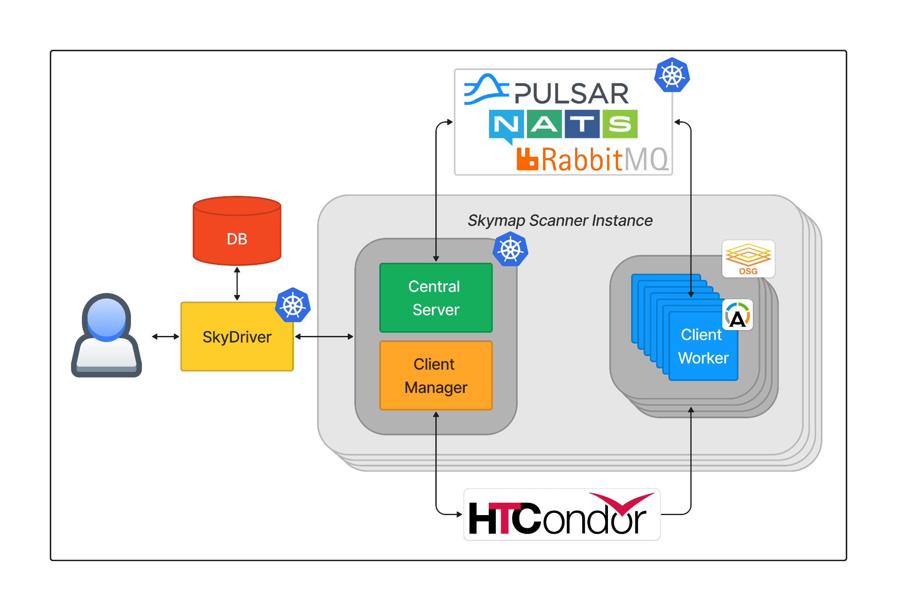
Step 5: User Interface + DB
Now accessible from any computer, no internal knowledge needed
Allows automated scanning
Stores metadata, progress stats, and scan results

Slide 15
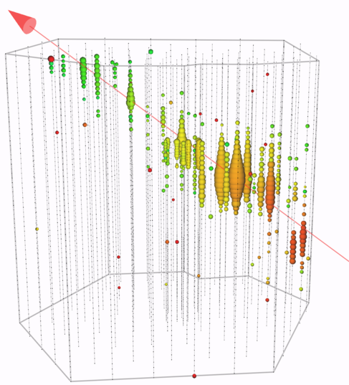
SkyDriver

Slide 16
The Event Workflow Management System (EWMS) Journey
A Generalized Massively-Scalable Task Service

Slide 17
Generalizing the Solution - EWMS
Event Reconstructions via Messages
Tasks via Messages

Slide 18
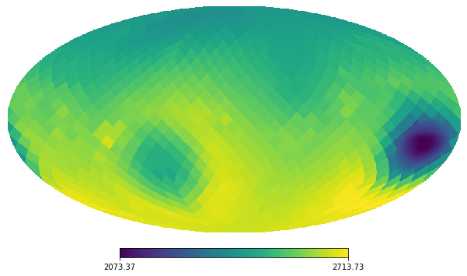
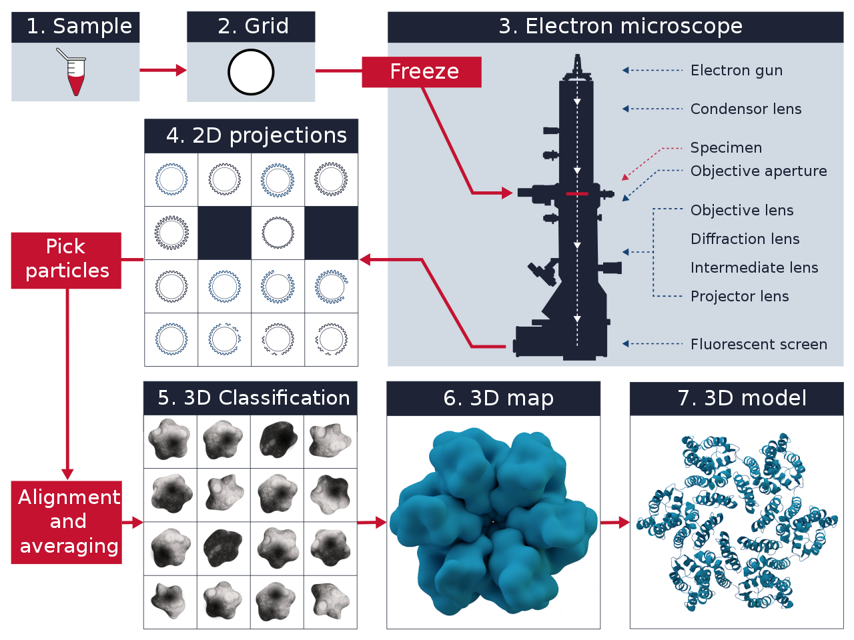
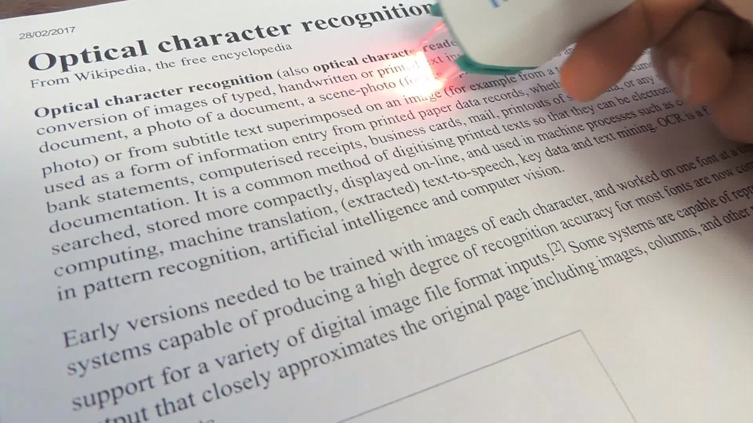
EWMS - Example Workflows
Astronomical observations (images)
Cryogenic electron microscopy (cryo-EM) data
Optical Character Recognition on pages in a book
and more!

Slide 19
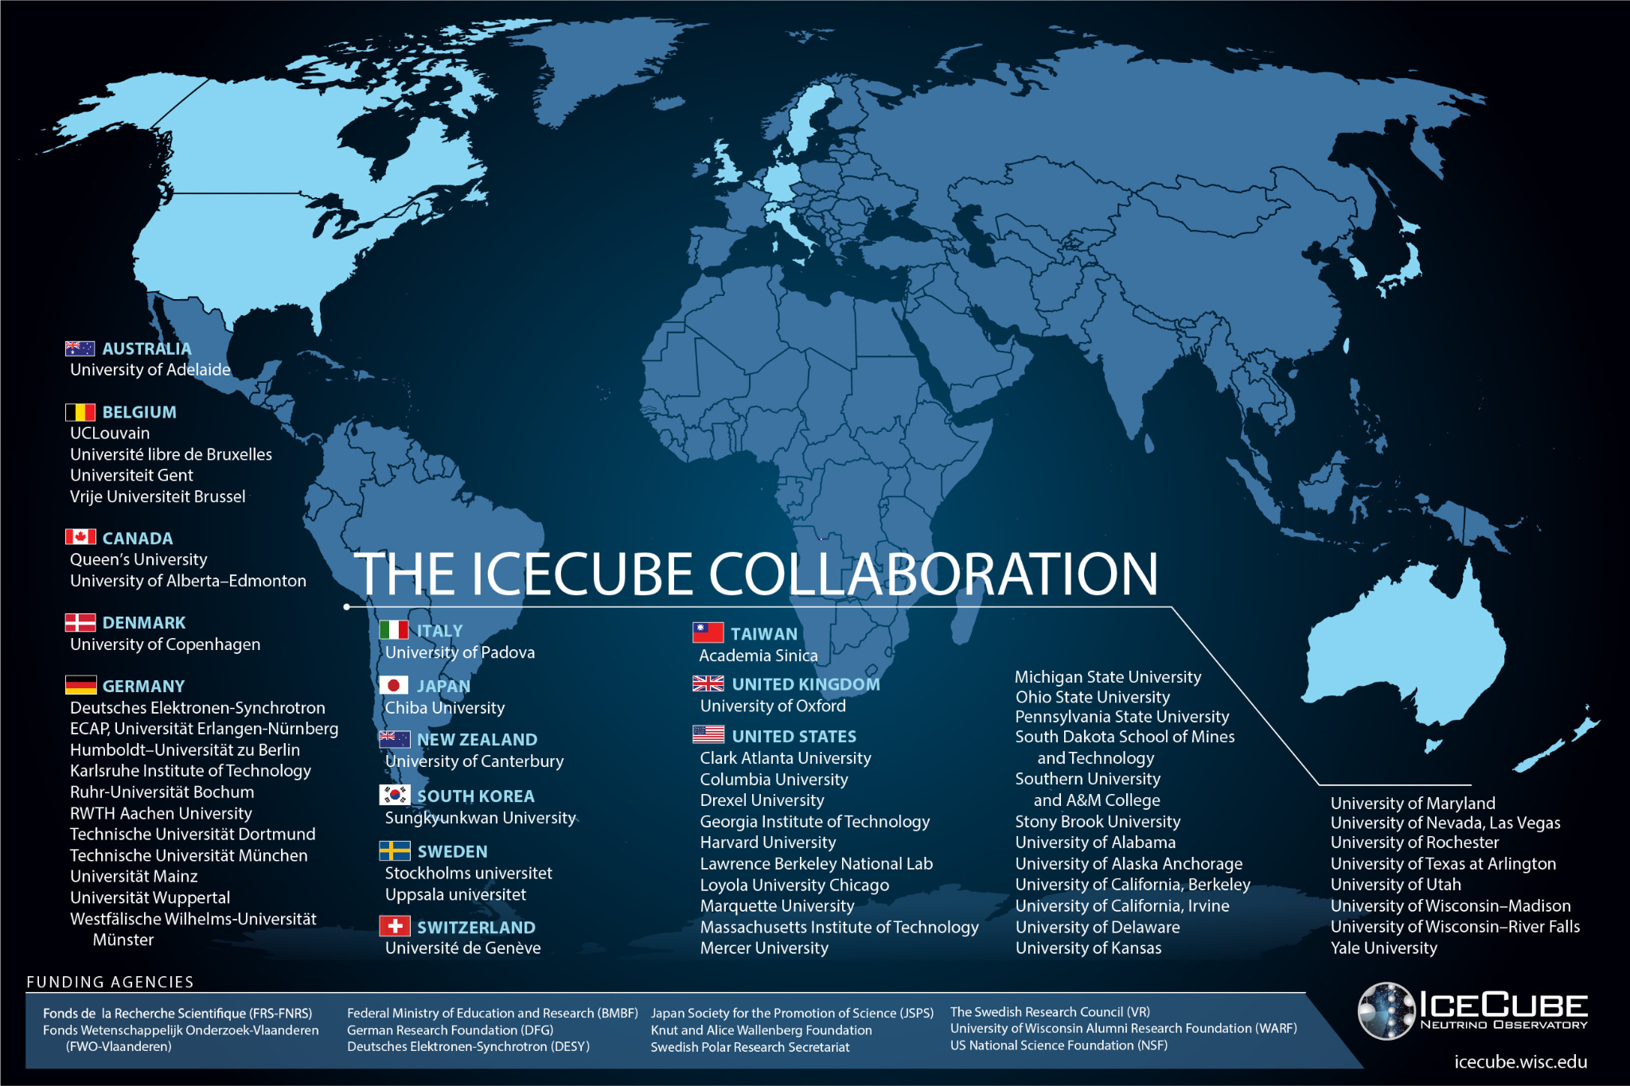
Acknowledgments
I’d like to acknowledge the following people for their contributions to SkyDriver and EWMS
Benedikt Riedel
David Schultz
Massimiliano Lincetto
Tianlu Yuan
Miron Livny
Claudio Kopper
Erik Blaufuss
Brian Bockelman
Christina Lagunas
Robert Stein
National Science Foundation Funding
OAC #2103963
OPP #2042807

Slide 20
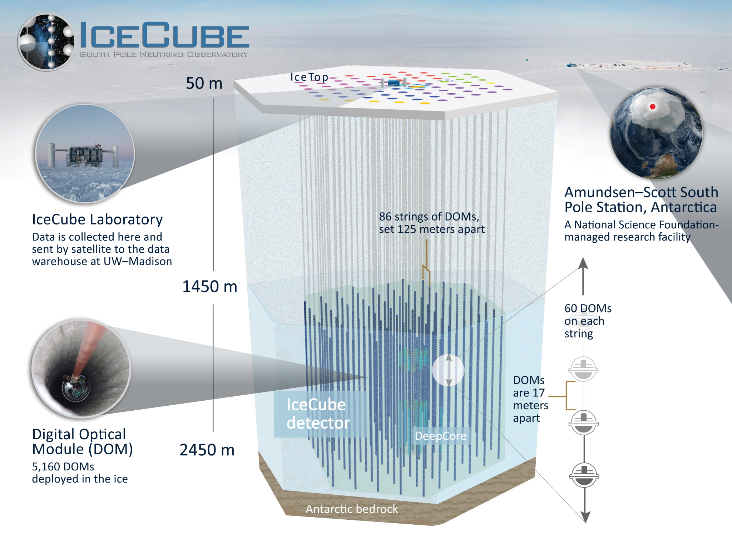
Questions?

Slide 21
SkyDriver – EWMS Overview
SkyDriver - IceCube-specific application that talks to “EWMS”
An interface for a user (or automation service) that allows launching a new Skymap Scanner instance (a “scan”)
Skymap Scanner Server - a prototype WMS
Distributes events and processes results
SkyDriver “clientmanager” - a prototype TMS
Launches HTCondor jobs and removes jobs when scan completes
Skymap Scanner Client - a prototype Task Pilot
Processes events with physics “scanner” code
Message Broker Service - raw DDS message queue
A service for distributing atomized events, from server to client(s) and client(s) to server (currently rabbitmq)

Slide 22
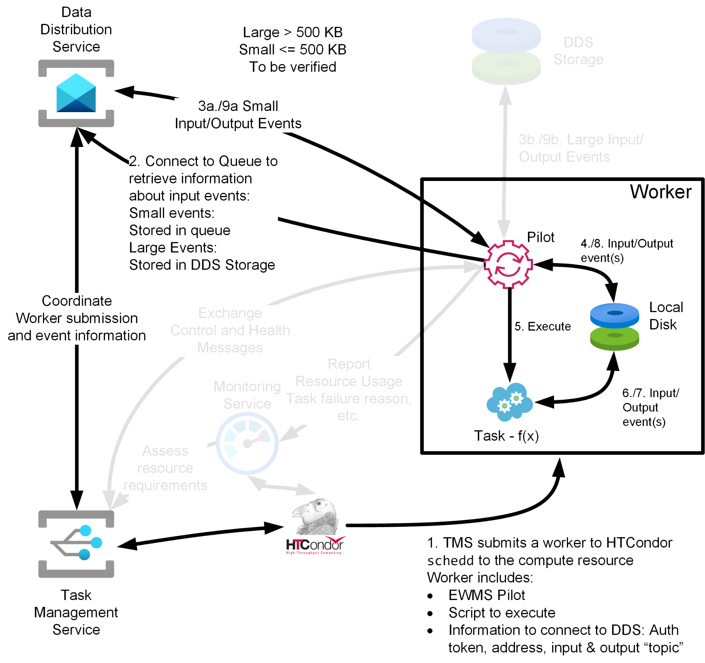
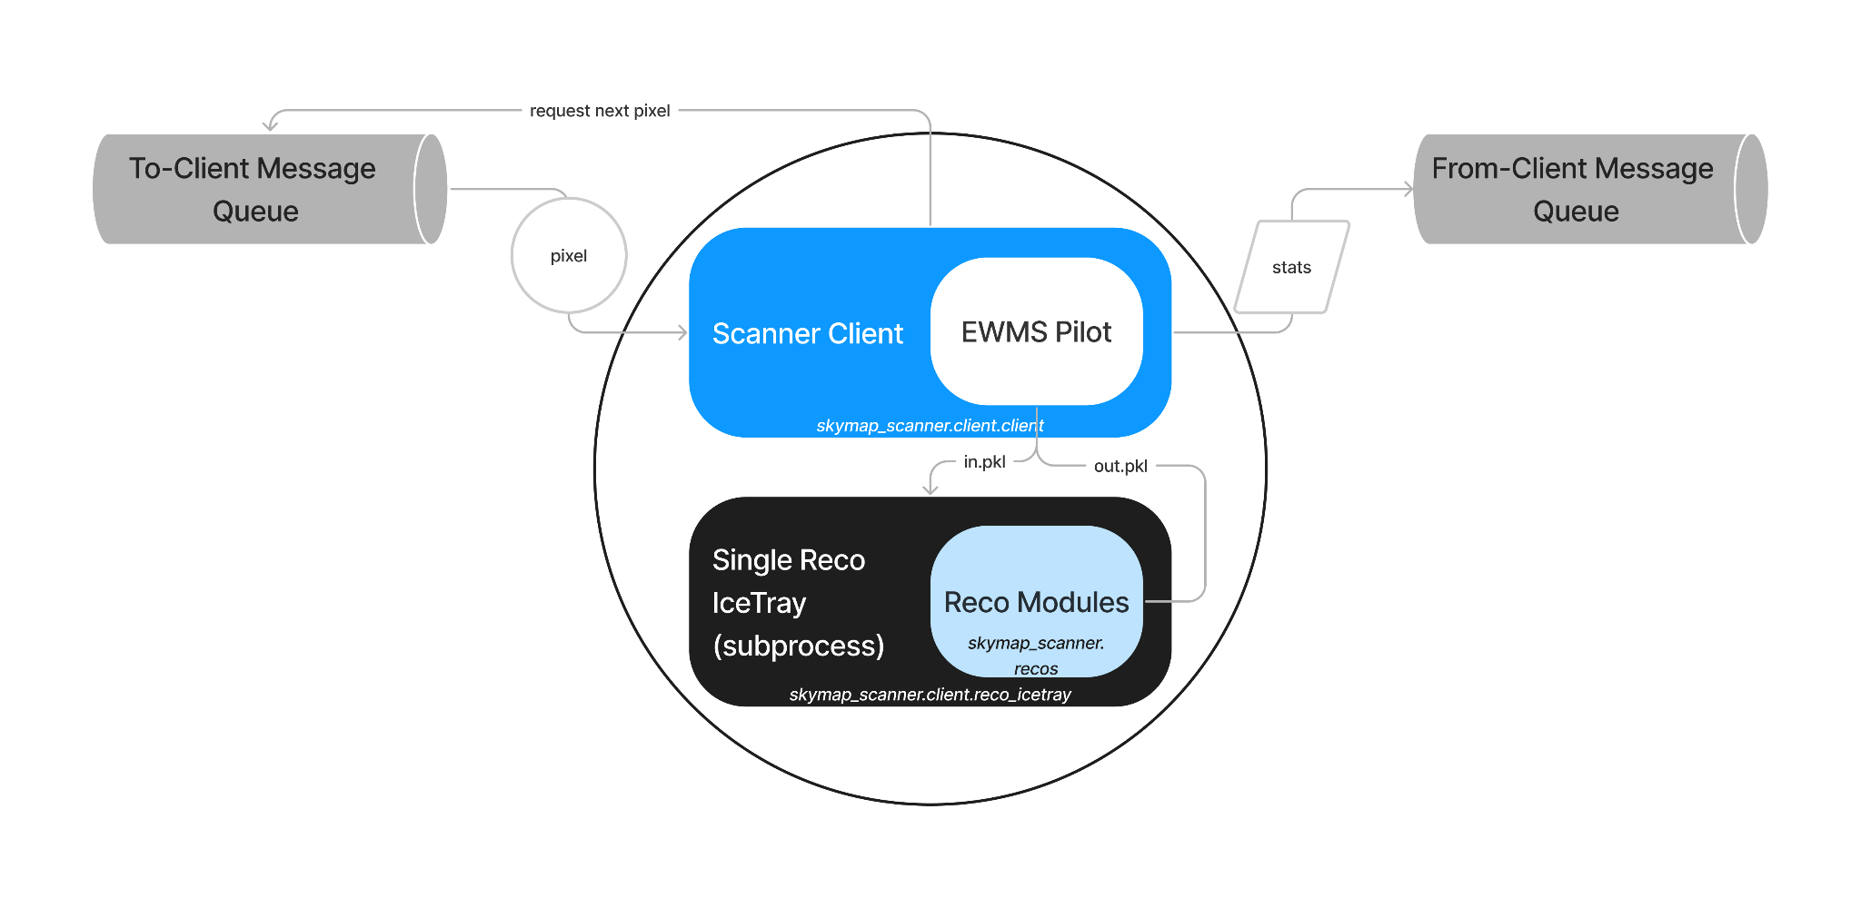
SkyDriver – Worker / Scanner Client POV

