Slide 1
Distributed Machine Learning with PanDA and iDDS in LHC ATLAS
Wen Guan (BNL), Christian Weber (BNL), Rui Zhang (WISC)
Tadashi Maeno (BNL) and Torre Wenaus (BNL) on behalf of the iDDS team and ATLAS
26th International Conference on Computing in High Energy & Nuclear Physics (CHEP 2023)
May 8-12, 2023
Notes:
Good Morning,
I am Christian Weber,
giving this talk about Distributed Machine Learning with PanDa and IDDS in LHC ATLAS
in place of Wen Guan, who was not able to make it here today.
That said

Slide 2
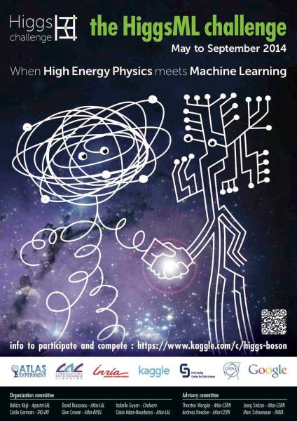
Distributed Machine Learning (ML) for ATLAS
Motivations of Distributed Machine Learning
Access to multiple remote large scale resources
GPUs, HPCs, Clouds
Meeting large scale AI/ML requirements
Speed up the training and optimization by orders of magnitude
Make more complex and resource intensive AI/ML applications accessible
Support complex AI/ML workflows
A single complex workflow can present requirements for which a single resource is not optimal
Goals of Distributed Machine Learning
Transparently schedule workload to distributed resources, scalable to various huge resource requirements
Orchestrate between tasks in a workflow, to automate the workflow
In traditional analyses, manual operations are required to analyze the results to submit new tasks when a task finishes
ATLAS’ Higgs ML Challenge
Notes:
Machine Learning has become quickly an integral part in ATLAS.
We use it to define signal regions, identify B-jets (check), to parametrize our detector calorimeter response to speed up Monte Carlo Event simulation, to identify signal and backgrounds in analyses, do anomaly detection and so on
Training these models requires adequate resources, and access to the relevant, often large, datasets.
Hence there is an increased interest in ATLAS to support distributed machine learning.
Similarly, to our more common distributed computing scenarios, this makes the relevant hardware in HPCs and the cloud more readily available for the user and allows them to speed up their tasks by accessing more GPUs or other resources than they would otherwise be able to.
To be successful, any distributed machine learning platform must be flexible to support complex AI and ML workflows to accommodate all usage scenarios,
They must transparently schedule the relevant workloads to the available resources,
Be sufficiently scalable to accommodate even very large resource requirements,
And lastly orchestrate automatically between workflow tasks, such that ideally no recurring user input is required.

Slide 3
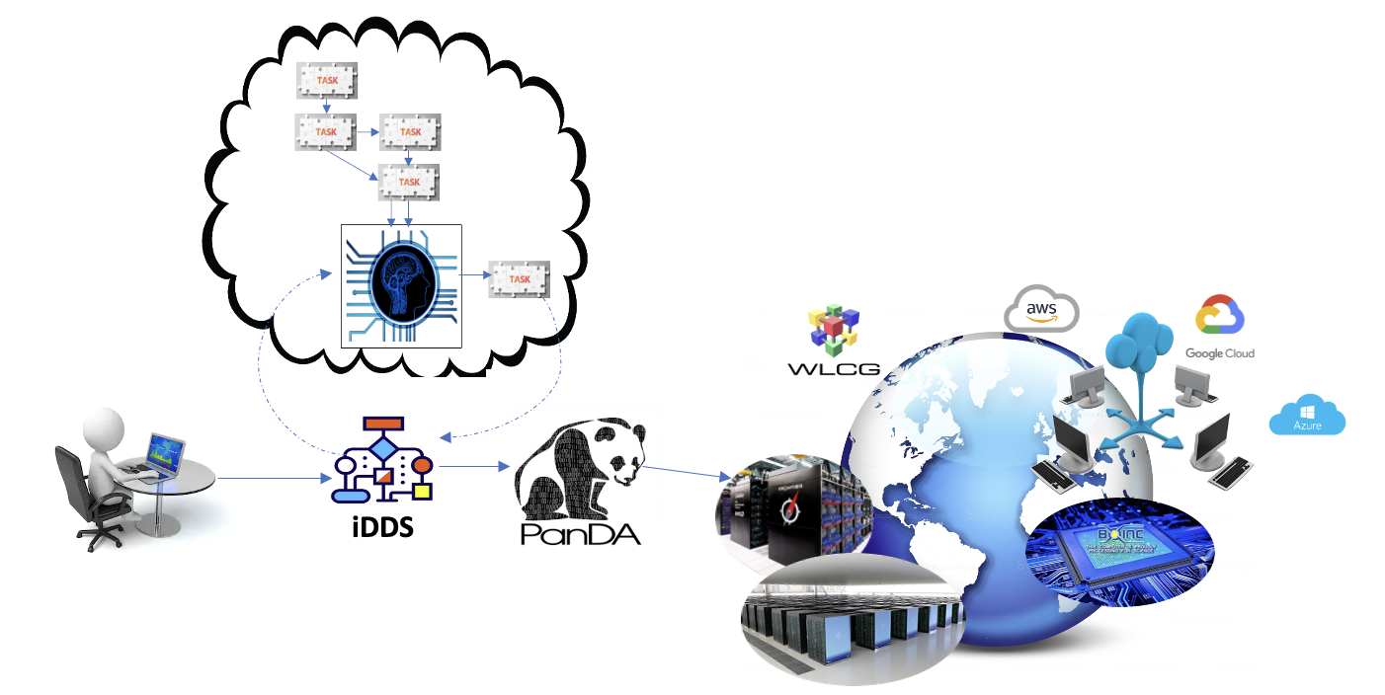
Distributed ML with PanDA and iDDS in ATLAS
PanDA as an engine for large scale AI/ML
PanDA is powerful to schedule jobs to distributed heterogeneous resources
Large scale
Transparent to users for different computing resources
Smart workload routing
iDDS (intelligent Data Delivery Service) orchestrates the workflow for automation
Generic workflow orchestration
Directed Acyclic Graph (DAG) management.
Condition workflow and Loop workflow management
Complex workflow orchestration
Collect results from previous tasks
Analyze the results with user predefined jobs
Generate new tasks/jobs based on the analyses
CHEP2023 Talk: F. Barreiro Megino, Utilizing Distributed Heterogeneous Computing with PanDA in ATLAS
Notes:
To accommodate these requirements, we are making use of Panda and iDDS, the Intelligent Data Delivery Service.
PanDA, the Production and Distributed Analysis systemp, is a data-driven workload management system for large scale data processing,
that is in part used as workload management system for the ATLAS grid.
For our purposes here it schedules jobs to distributed GPUs and CPUs.
Fernando will talk about it in more detail on Thursday, and I hope you will have a chance to attend his presentation.
The iDDS on the other hand is a computing service that allows for on-demand data transformation and granular data delivery within the ATLAS grid.
For our distributed machine learning purposes here, it works to orchestrate the relevant workflows

Slide 4
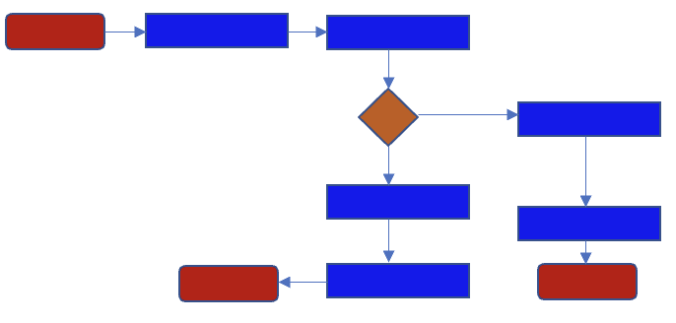
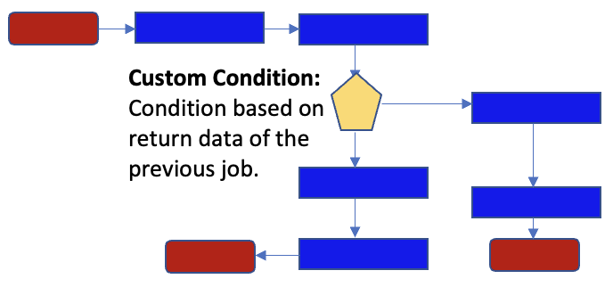
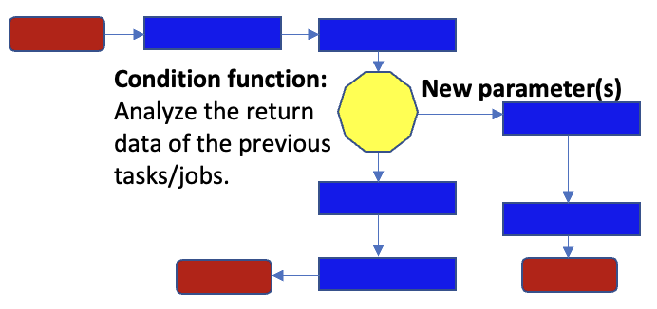
Workflow Orchestration
iDDS orchestrates the workflow, to automate the task/job chain in the workflow
Generic workflow orchestration (DAG, Loop workflow, Condition workflow)
Mainly based on the status of the previous task/job, e.g. whether it’s finished or failed
Complex workflow orchestration
Not only based on the status of the previous task/job, but also depends on the return data from the previous task/job ---> Custom condition
Even complicated cases, e.g. we may need an external job to analyze the return data from the previous tasks/jobs, to generate new conditions with/without new parameter(s) for new jobs ----> Condition function
Generic DAG
DAG with custom condition
DAG with condition function
Notes:
Which, can vary in in complexity.
For example, with the iDDS you can of course have relatively simple Workflows that can be represented by directed acyclic graphs,
where you have multiple steps in a Workflow with a junction steps in between, initiating for example two separate independent task chains that both have access to the outputs of the pre-junction steps.
You can however also have more complex workflows.
This is achieved by the junction step being able to accommodate conditions based on the previous job's outputs, which can then determine what chain of continuing tasks are to be execute.
Even complicated conditions that require the execution of external jobs to evaluate are supported.

Slide 5
Complex Workflow Orchestration
iDDS complex workflow orchestration requires two points
Return data from the previous tasks/jobs
Condition function can be customized
Return data of previous tasks/jobs
iDDS provides APIs for a job to report the return data to iDDS, an example format is a pair of {parameter: result}
The condition function can also use some data management tools, such as Rucio, to download the files produced by previous jobs
Condition function
An interface to be able to execute external jobs to analyze the return data from the previous jobs, to generate new conditions, and also with new parameters for next jobs
The external job can be some predefined methods, such as some predefined Bayesian methods
The external job can also be user-defined methods
The external job normally will be executed in an iDDS internal cluster pool (to optimize the turnaround time). It can also be scheduled to other resources
Notes:
Regardless though of how complex the conditions are, workflow orchestration with the iDDS generally requires two elements:
Return data from the previous job and
A Condition function to evaluate over the returned data.
For the former the IDDS provides an API such that jobs can report their results back to the IDDS
For example, these can be sets of parameter-value pairs
These values can be, among others, Rucio Dataset IDs. This is particularly relevant, as the condition function is able to access data management tools, like Rucio, to download results of previous jobs
The condition function then provides an interface to execute external jobs to analyze previous job’s returned data and generate new conditions for the next job - with new parameters if necessary.
These external jobs can take the form of predefined methods, for example some Baysian inference, or arbitrary user defined ones. In either case the jobs are normally executed within an IDDS internal cluster pool to optimize turnaround time, but scheduling to other resources is also supported.

Slide 6
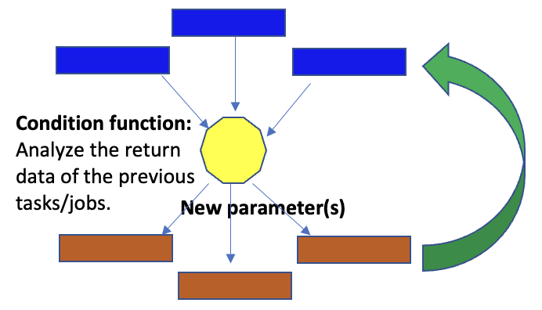
Workflow orchestration for Distributed ML
Iterative regression structure for Distributed ML with condition function
Condition function
Multiple inputs from distributed jobs
Multiple new parameter outputs for a bunch of new jobs
Threshold to trigger the condition function, e.g. when a job finishes or 50% jobs finish
Iterative loop supports
By customizing the condition function, different use cases can be supported
E.g. with the Bayesian Optimization method as a condition function to optimize hyperparameters for a ML task
Distributed ML use cases in ATLAS
Distributed HyperParameter Optimization (HPO)
Monte Carlo Toy based Confidence Limits
Active Learning
Notes:
We exploit this flexibility of the condition function to enable distributed machine learning by choosing to have it multiple inputs and multiple outputs.
This allows to submit and analyze batches of jobs for multiple new parameters at once.
The threshold for triggering the condition function can be customized too. For example, it can trigger when a single job finishes, or when 50% of a given job-set is completed.
Iterative evaluation of the condition function is also supported, this can be used to optimize the parameter determination.
Different use case are then supported by tailoring the condition function appropriately.
For example, by choosing appropriate condition functions, we are able to support the calculation of Monte Carlo Toy based Confidence Limits, as well as Active learning applications
By using Bayesian optimization in the condition function, we can use the IDDS to find optimal hyperparameters for Machine Learning tasks in a distributed way

Slide 7
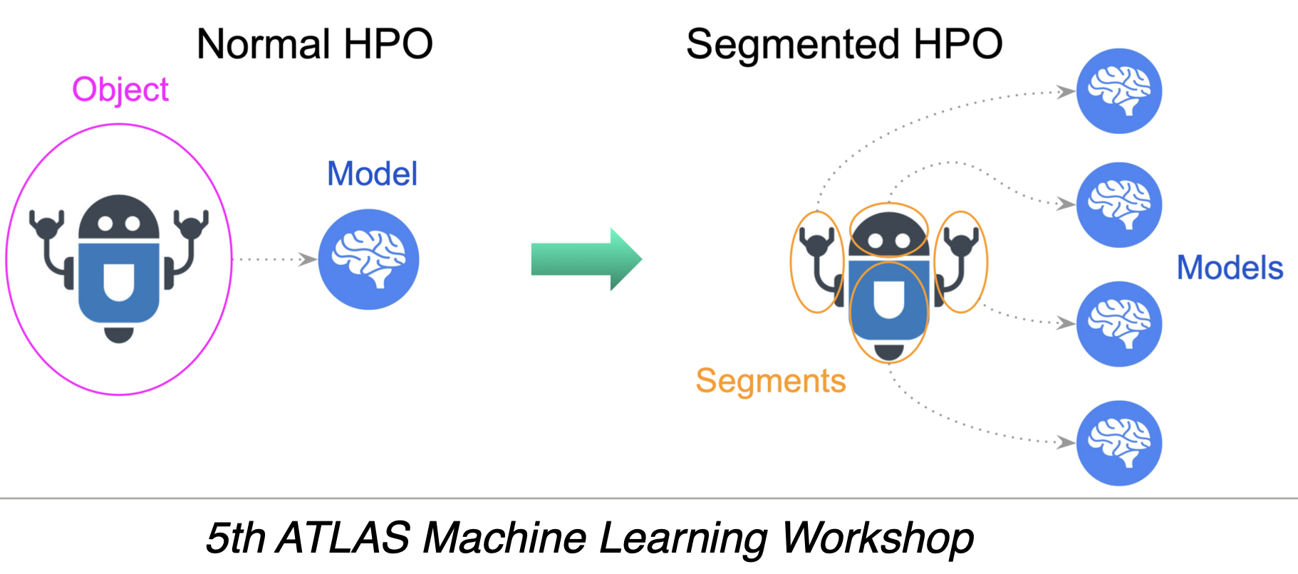
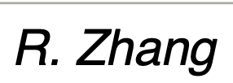
Distributed HyperParameter Optimization (HPO)
Provide a full-automated platform for HPO on top of distributed heterogeneous computing resources
Hyperparameters are generated centrally in iDDS
PanDA schedules ML training jobs to distributed heterogeneous GPUs to evaluate the performance of the hyperparameter
iDDS orchestrates to collects the results and search new hyperparameters based on the previous results
Applied for ATLAS FastCaloGAN
The HPO service is in production for FastCaloGAN, part of the production ATLAS fast simulation AtlFast3
With hyperparameters to tune various models targeting different particles and 𝜂 slices
Distributed GPUs, HPCs, commercial cloud
Ref: FastCaloGAN, AML workshop, IML, ATLAS S&C week
Used in ATLAS, however not specific to ATLAS
Notes:
For the latter, our service provides a fully automated platform for Hyperparameter Optimization, using distributed heterogeneous computing resources.
For that hyper parameters are centrally generated in iDDS, and PanDA schedules Machine Learning jobs at the relevant computing resources.
Once these jobs a re done, the iDDS collects the results and schedules new jobs based on the obtained results with PanDA
This has been applied already in the ATLAS FastCaloGAN – a part of the ATLAS fast simulation framework AtlFast3
Where out Distributed Machine Learning service was used to optimize the relevant hyperparameters for different particle types and slices of pseudo rapidity, using distributed GPUs, HPC clusters and commercial cloud resources.
However, all of this is not specific to ATLAS, despite having demonstrated there so far.

Slide 8
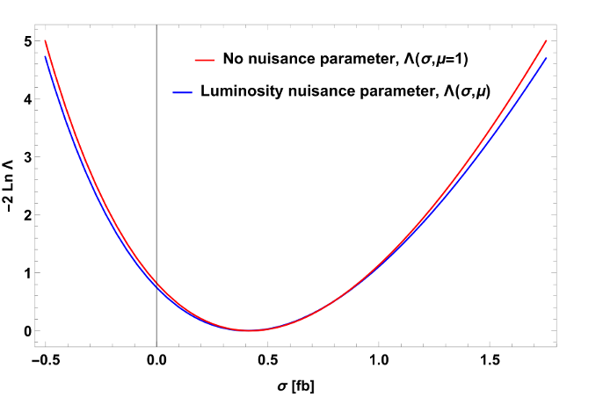
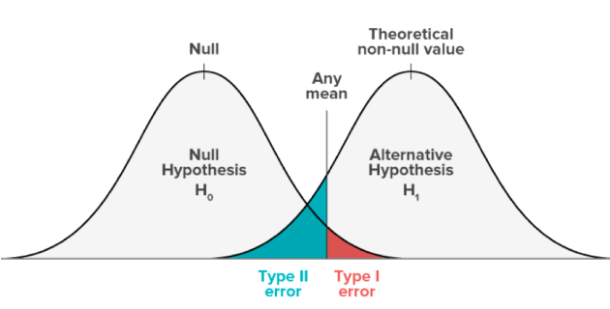
Monte Carlo Toy based Confidence Limits
Confidence Limits in Analyses
Exclude some ranges of relevant phase space for future processing
Show that obtained results are meaningfully different from what could have obtained by chance
A Monte Carlo (MC) Toy based confidence limits workflow requiring computationally intensive grid scans
Automate the workflow of Toy limits calculation and aggregation
Point of Interest (POI) generation based on the search space and results aggregation to generate new POIs in iDDS
Distributed Toy limits calculation to distributed resources with PanDA
Notes:
Another application that we demonstrated is the calculation of Monte Carlo Toy Based confidence limits.
This is a part of Hypothesis testing, where we want to ascertain whether results for a given phase space are meaningfully different from what could have been optioned by chance.
For that a resource intensive scan over the parameter of interest is required.
This involves the generation of a set of pseudo random numbers from known distributions and performing an optimization over a high-dimensional parameter space to find the global minimum.
Dependent on the desired precision we have to do this up to tens of millions of times,
So this is a very computationally intensive process.
With our service we enable the utilization of distributed computing resources for this task, along with automated results aggregation and post processing. Reducing the users work overhead.

Slide 9
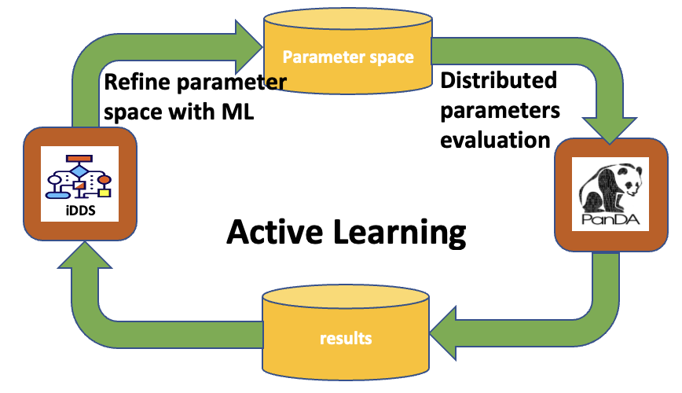
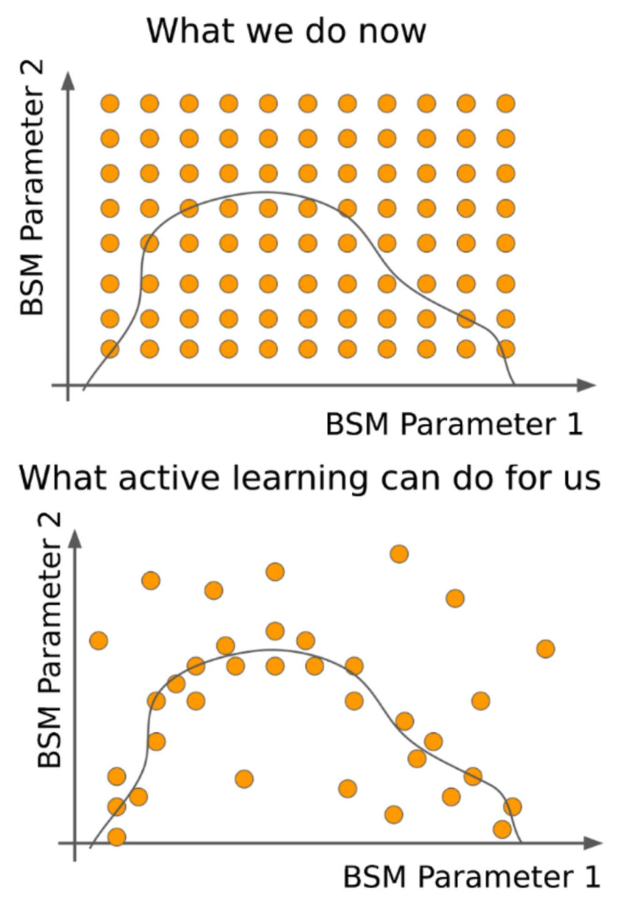
Active Learning
An iterative ML assisted technique to boost the parameter search in New Physics search space
The Active Learning technique we are applying was developed by Kyle Cranmer et al, “Active Learning for Excursion Set Estimation”, ACAT 2019
Redefine the parameter space for the next iteration based on the previous results with ML, more efficient than a single-step processing
Optimize the parameter space points for evaluation to maximise the information gain from each evaluation
Distributed computing resources for parameter evaluation
Automate the multi-steps processing chain with PanDA and iDDS for ATLAS
Integrated REANA (Reusable Analyses) with PanDA for learning processing
iDDS orchestrates the workflow to trigger new tasks/jobs based on the previous results
Active Learning via iterative regression
on a limit surface
Notes:
An application for our service that I am perusing currently involves active learning, which is an iterative ML assisted technique to improve the exploration of theory parameter spaces in new physics searches.
The technique that we are using was developed by Kyle Cranmer.
And the underlying idea is that in a given analysis, there is a mapping from the theory’s parameters to the cross section that we can measure and constrain.
We construct then a Machine Learning derived model to approximate that mapping. This model can then be iteratively improved by sampling cross section limits from the parameter space.
The sampling location can be chosen such that the information gained in a given evaluation is maximized, and to speed up the process and utilize distributed computing resources multiple locations can be sampled concurrently
We are using PanDA and IDDS to automate this multiple step process, and we have integrated REANA, a platform for analysis reuse, with Panda to enable the relevant phase space sampling.

Slide 10
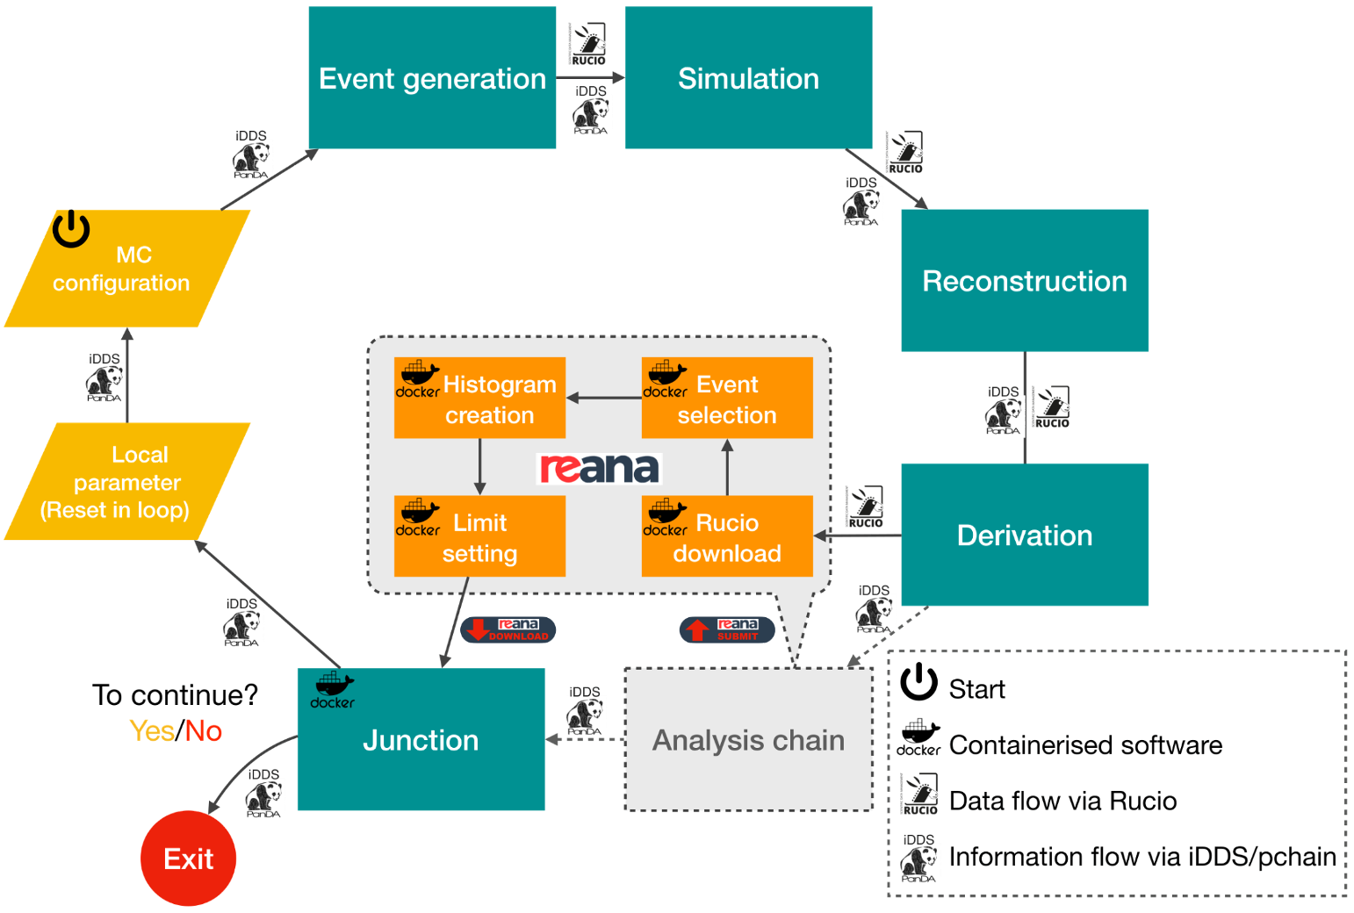
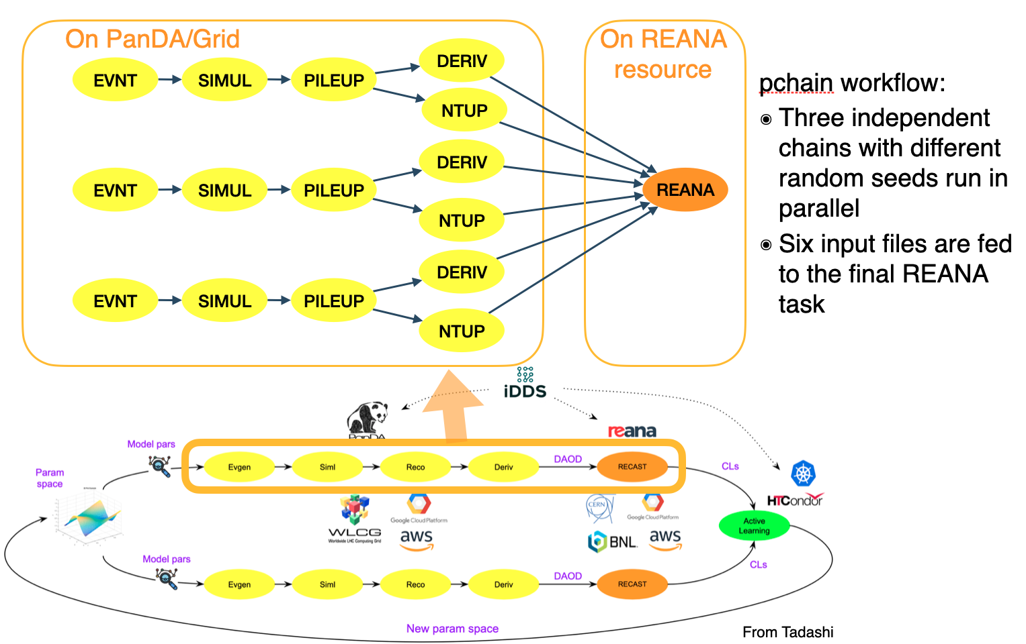
Active Learning for ATLAS
Applied the Active Learning service in the H → ZZ_{d} → 4ℓ dark sector analysis
Avoids a complex interpolation scheme, costly in development and validation
Apply Bayesian Optimization to refine the parameter space
Greater efficiency, scalability, automation enables a wider parameter search (instead of 1D, 2D or even 4D on large scale resources) and improved physics result
Has demonstrated active learning driven re-analysis for dark sector analysis
ATLAS PUB NOTE in progress
R. Zhang
CHEP2023 Talk: C. Waber, et al. An Active Learning application in a dark matter search with ATLAS PanDA and iDDS
Notes:
We have demonstrated this Active Learning service in the reanalysis of a Dark Sector Higgs to ZZd search.
There the use of Bayesian Optimization and surrogate functions avoids a complex interpolation scheme.
Both are flexible enough to allow the extension of the analysis search space into extra dimensions of theory parameter space, beyond what the original analysis targeted.
This I further enabled by the automated nature of our service, where the condition function can select new points to evaluable and submit them via Panda unsupervised, allowing the process to proceed in an iterative fashion
An ATLAS Pubnote on this topic will become public tomorrow, in time for my talk tomorrow, where I will get into more detail on this topic. I hope some of you will able to attend.

Slide 11
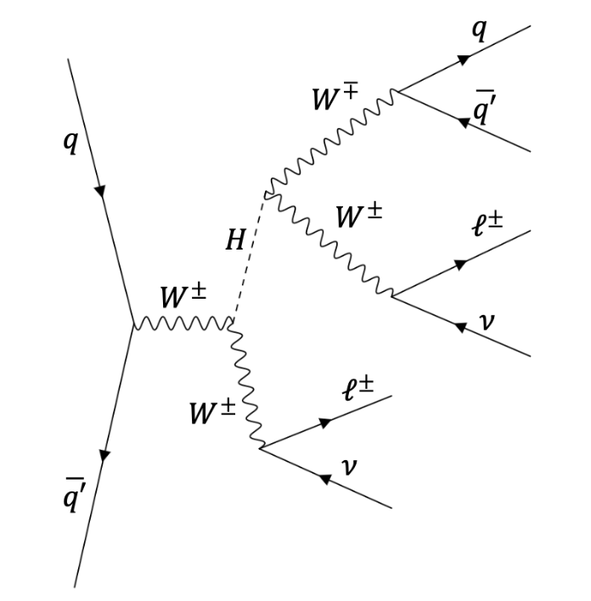
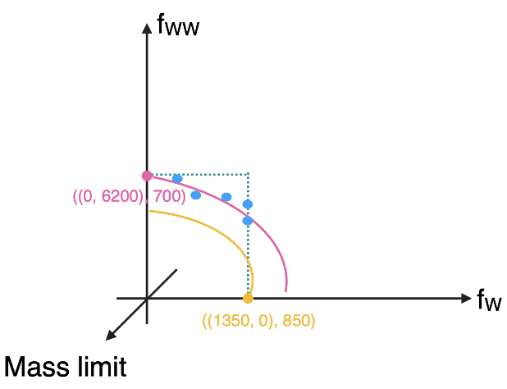
Active Learning for ATLAS
Applying for generic Heavy Higgs → WW search
It’s important to understand the characteristics of the mH-fw-fww space
It’s too expensive to sample the 3D space points with the traditional way
Active Learning may be possible
Draw a contour in fw-fww plain for a given mH
Sample the 3D space points
Under R&D at the moment
Notes:
And we are not stopping at the Higgs to ZZd search..
Informed by the work we did for it, we are preparing a second demonstrator for the active learning service, based on a Heavy Higgs to WW search.
The relevant process here is dependent on the heavy Higgs mass and two coupling parameters.
This 3-dimensional parameter space provides even greater physics motivation for the pursuit of active learning than the dark-Z example did.
For this application, the search space is already too large to explore with via grid scan, but we expect that the Active Learning will enable us to sample the relevant phase space more optimally and thus allow us to fully extract the relevant exclusion contours for the underlying theory.

Slide 12
Conclusion and future plans
Distributed Machine Learning workflow with PanDA and iDDS
PanDA as an engine for large scale AI/ML. It utilizes distributed heterogeneous computing resources to support user workflows
iDDS orchestrates the workflow. It automates the chain in the workflow
An integrated service for Distributed Machine Learning
Different use cases applied in ATLAS, however the work is not specific to ATLAS
Future plans
Generalize the services as a contribution to the HEP AI/ML ecosystems
Apply new technologies, such as Platform-as-a-Service (PaaS) and Function-as-a-Service (Faas), to enhance the user ability and experience
Improve user interfaces with Jupyter.
Notes:
So to conclude,
We demonstrated PanDa as an engine for large scale AI and ML tasks, exploiting distributed heterogenous computing resources for user workflows.
IDDS orchestrates the workflow, automating the chain of jobs
Together they are providing an integrated service for distributed machine learning.
And while we have demonstrated various use cases within ATLAS, it is not specific to it.
From here we are planning to generalize the service as a contribution to the HEP AI/ML ecosystem
And apply new technologies, such as Platform-as-a-Service (PaaS) and Function-as-a-Service (Faas), to enhance the user’s ability and experience, and to improve the relevant jupyter interface in pursuit said goal.
Thank you!

Slide 13
The end.
Thank you!

