Slide 1
JUNO Distributed Computing System
Xiaomei Zhang
Institute of High Energy Physics
On behalf of JUNO DCI group
CHEP2023, May 8

Slide 2
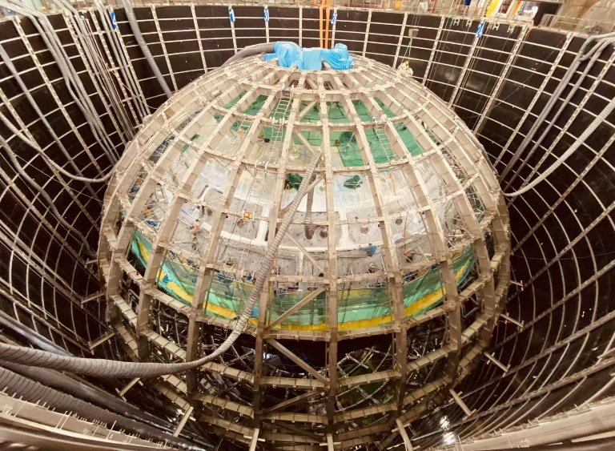
JUNO
A multi-purpose neutrino experiment
  Measure neutrinos (solar neutrinos, supernova neutrinos, atmospheric, geo .... ) mass hierarchy and mixing parameters
  Located at Guangzhou, China
  Expect to take data in 2024
JUNO-TAO is a satellite detector
  Precisely measure reactor energy spectrum, improve sensitivity of JUNO on mass hierarchy study
Data volume expected
  Raw: 2.4PB/year (JUNO+TAO)
  MC+Rec: 600TB
Photo taken in 2023.2

Slide 3
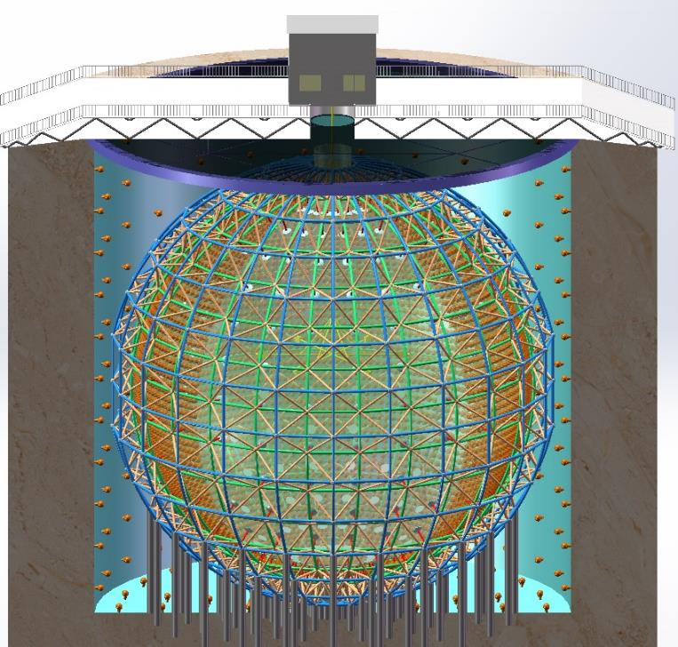
Data centers and Computing model
Online System
IHEP Center
raw data, prompt reconstruction, calibration, simulation, analysis
Raw data flow
France Center
Russia Centers
Italy
Center
copy of raw data, rereco, simulation, analysis
MC data flow
Five data centers: IHEP, CC-IN2P3, INFN-CNAF, JINR, MSU
Raw data flows from Online to IHEP which then immediately distributes to other centers
1st Reconstruction and Calibration will run in IHEP
MC Simulation, 2nd Reconstruction and Analysis are expected to run in all data centers
Other centers provide a backup to JUNO data (CNAF/JINR 100%, IN2P3 1/3)

Slide 4
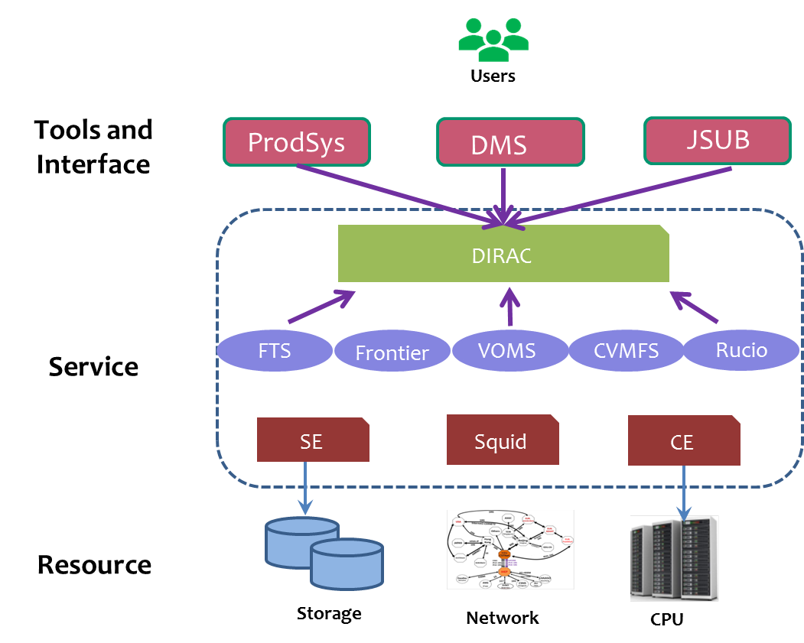
System Architecture
JUNO distributed computing system was built to take care of data processing and data distribution in grid environment
DIRAC is core of the system
    Organize heterogeneous resources
    Provide framework for workload management (WM) and data management (DM)
    Integrate necessary middleware and services
Other WLCG services used
    VOMS/IAM, authentication and authorization
    FTS, file movement
    CVMFS, software distribution
Experiment tools and Interface (details in later slides)
    JUNO-specific systems developed to meet the requirements of JUNO data placement and processing
    All codes were migrated to python3

Slide 5
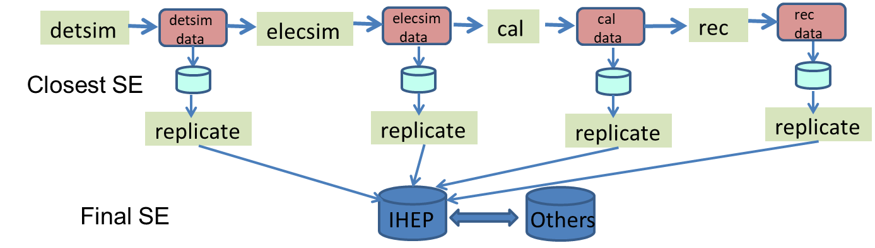
ProdSys 1/2
Implemented as a data-driven pipeline system, designed to
  submit JUNO production tasks (simulation, re-reconstruction…) in grid env
  manage workflow and dataflow in the tasks automatically
Each JUNO production task is composed of several steps
  Detector simulation (detsim), Electronics simulation (elecsim) , PMT Reconstruction (cal), Event Reconstruction (rec), Replication of output to destination sites
All steps or part of them can be connected to each other with data to form a pipeline, chained and started through ProdSys

Slide 6
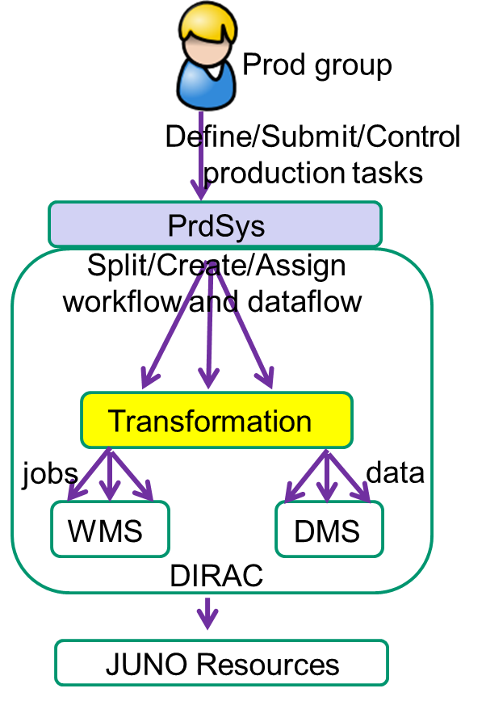
ProdSys 2/2
ProdSys is implemented based on DIRAC
  Frontend Accept user requests and create JUNO workflow and dataflow
  Transformation system (TS) Transform JUNO workflow and dataflow into a pipeline
  DIRAC File Catalogue (DFC) Provide query of metadata and file status which is used to trigger the process
  Jobs and file transfers are submitted to DIRAC WMS and DMS
Prodsys regularly used in JUNO MC simulation tasks
Same mechanism will be used for JUNO 2nd reconstruction
  Real data -> Cal -> Rec -> Destination SEs

Slide 7
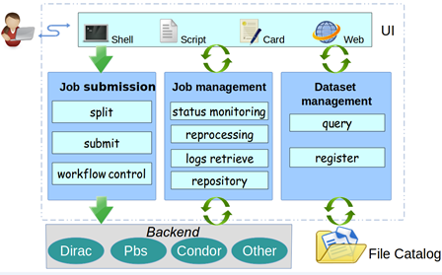
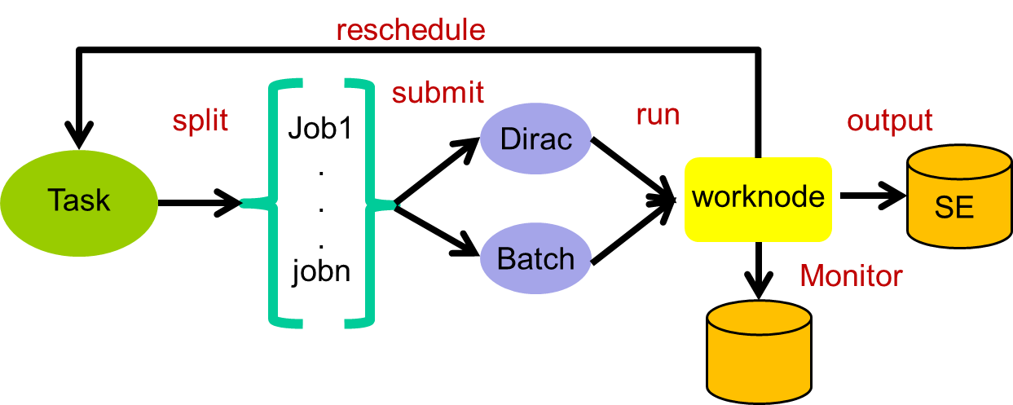
JSUB
JSUB – a lightweight user job submission tool, developed in python
  Ease process of physics analysis and small number of simulation for JUNO users
  Automatically take care of life cycle of user analysis in grid env
Main common function packages in JSUB
  Job splitting and submitting, Job management, dataset operation, backend, UI
  User Steering file is written in YAML
Main features
  Extensible with multi-experiments and multi-backends
  Support fast submission with DIRAC parameter job submission feature
  Support flexible splitters with multi parameters to split tasks into subjobs

Slide 8
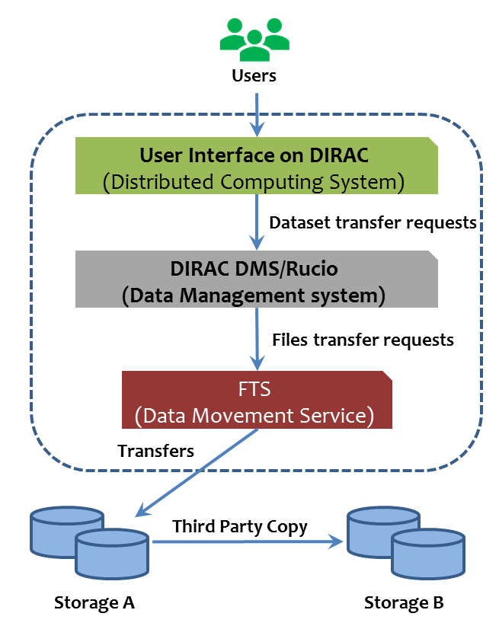
Data management
User Interface with interactive console and commands
  Provide a global data view
  Create and manage dataset
  Submit and manage transfer requests
DIRAC Data Management System (DIRAC DMS)
  DFC: metadata and replicas catalogue
  Request Management System and Transformation System: split dataset into file transfers and arrange in queue
  Interface to available file transfer tools
Rucio is under evaluation
Data Movement Service – FTS
  Take care of file transfers

Slide 9
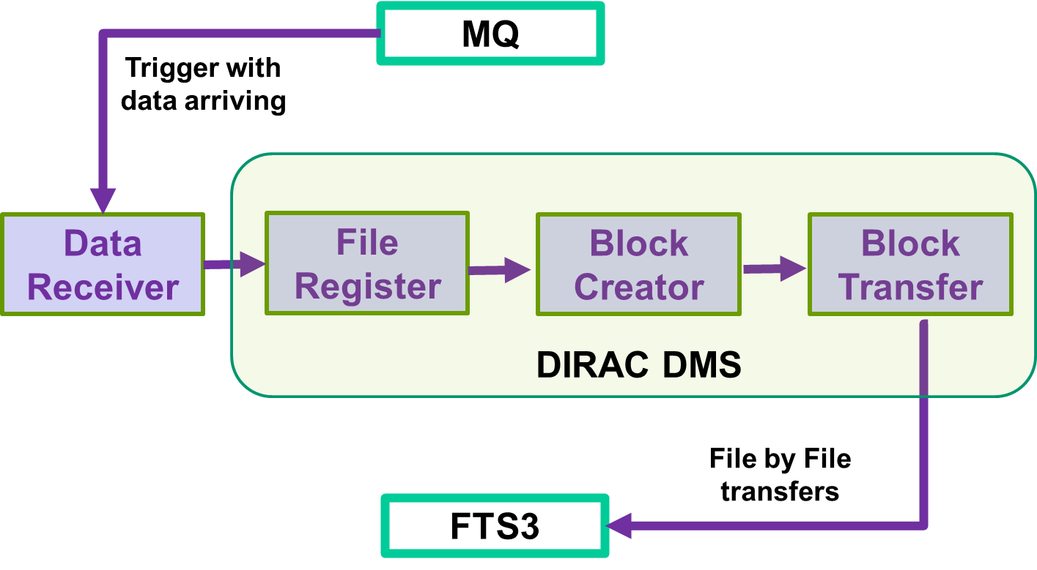
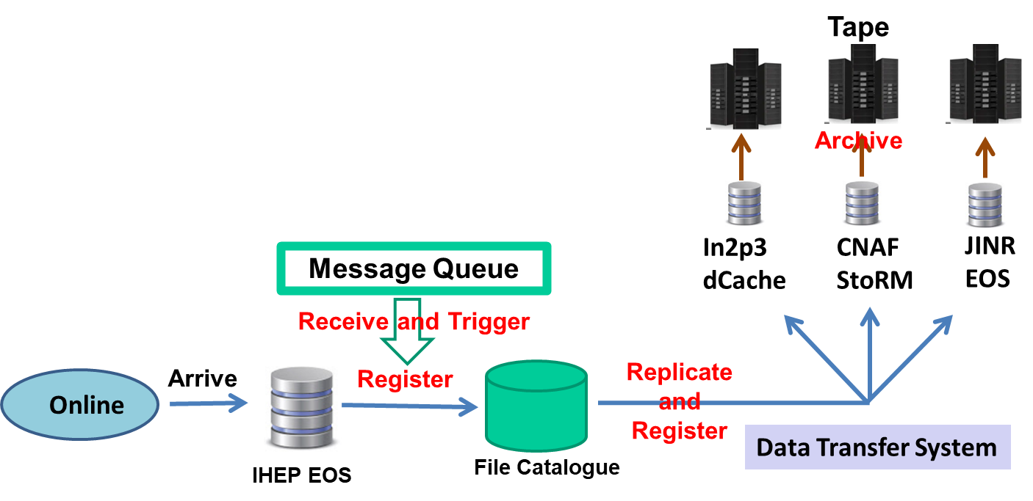
Raw data transfer system
Aim to take care of raw data distribution to data centers
  Receive data information from Message Queue to trigger the whole process
  Register data in DFC
  Replicate data to data center and register in DFC
  Archive in tape and register in DFC
  Validate data and monitor status
It consists of four modules, implemented based on DIRAC DMS
  Data Receiver, File Register, Block Creator, Block Transfer
  Transfers and validation are based on blocks which are grouped by data receiving date

Slide 10
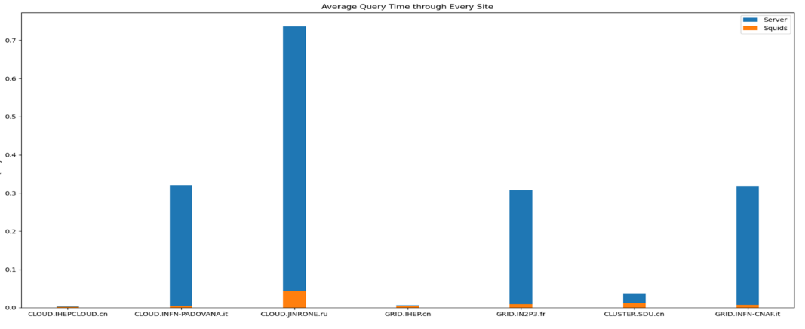
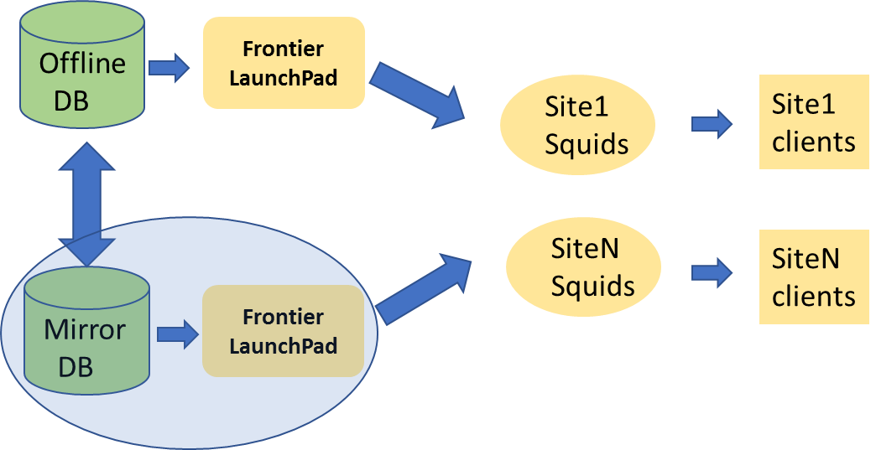
Offline Condition DB access
JUNO uses MySQL to store condition data
Frontier/Squid infrastructure has been set up in grid env
  Help avoid high load in central DB and speed up access to condition data
Frontier server was deployed in IHEP and JINR, connected to DB
Tests done with jobs has proved system is functioning
  Show > 10 times better with cache access than direct DB access
Tests to simulate production-like environment will be done this year

Slide 11
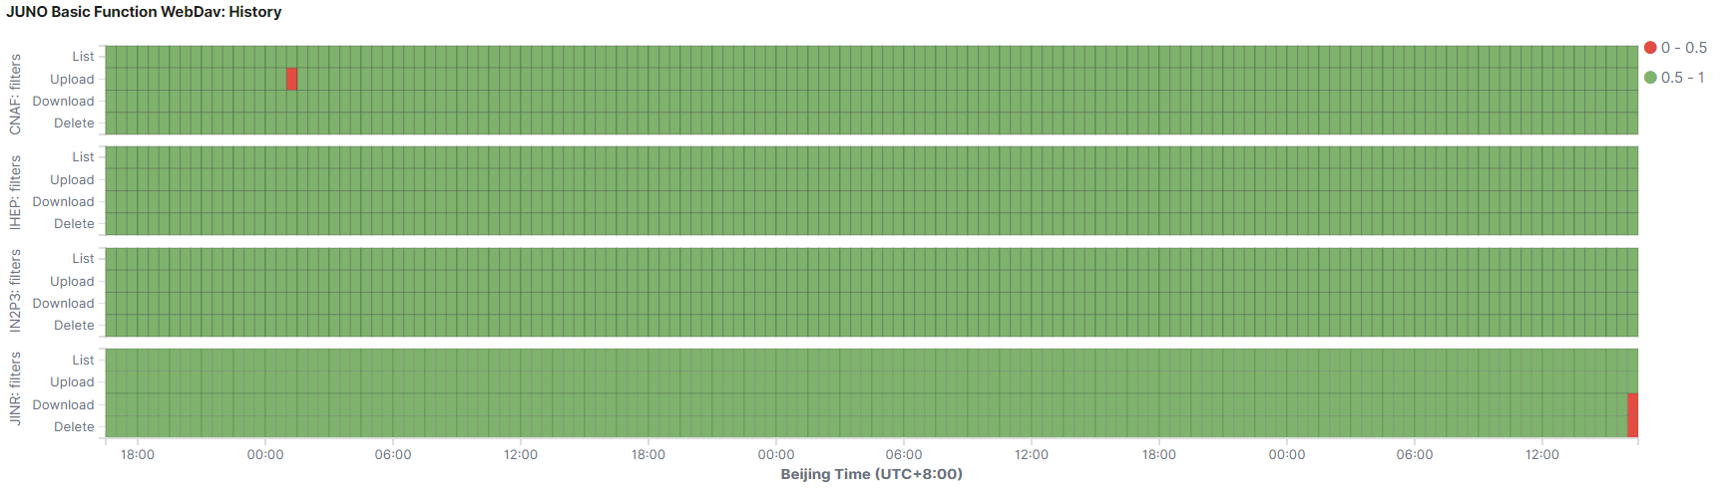
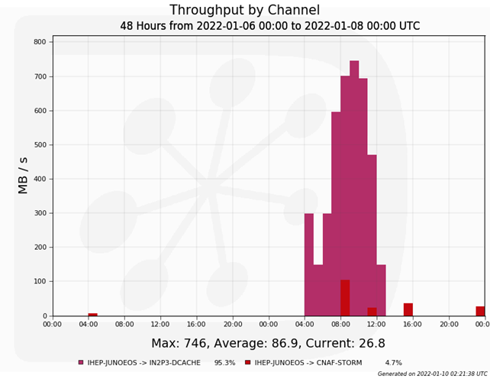
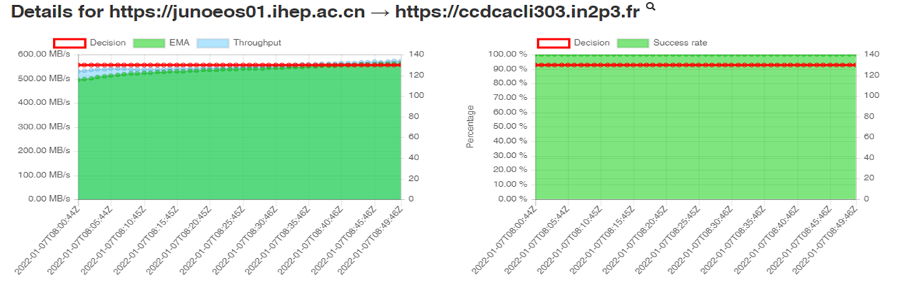
HTTP TPC
All SEs has completed migration from Gridftp to HTTP TPC
TPC daily monitoring has been developed using ES+kibana
Pressure tests has been done with DIRAC DMS+FTS
  Maximum speed can reach limitation of network bandwidth (IHEP EOS -> IN2P3 dCache)
  Problem found on communications between StoRM and EOS, updating to EOS5 to solve
More pressure tests are planned this year

Slide 12
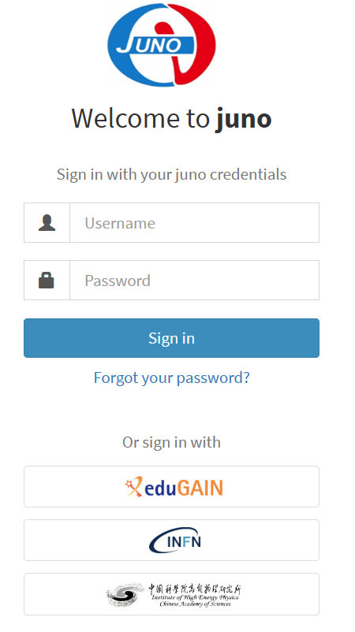
Token-based AAI
  Migration from X509-based AAI to token-based AAI is on-going for JUNO DCI
Status:
  IAM service has been set up: https://iam-juno.cloud.cnaf.infn.it/login
  IHEP SSO is connected
  Connections to eduGAIN are in progress
    CNAF and IHEP are working
    IN2P3 and JINR in testing
  Some site CEs and SEs already supported token
  More to do:
    Push IAM service to be in production in parallel with VOMS
    Migrate DIRAC to the version supporting both certificate and token
    Complete CEs and SEs support of token

Slide 13
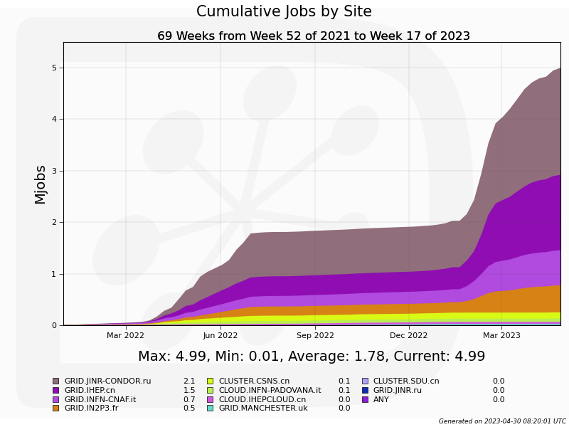
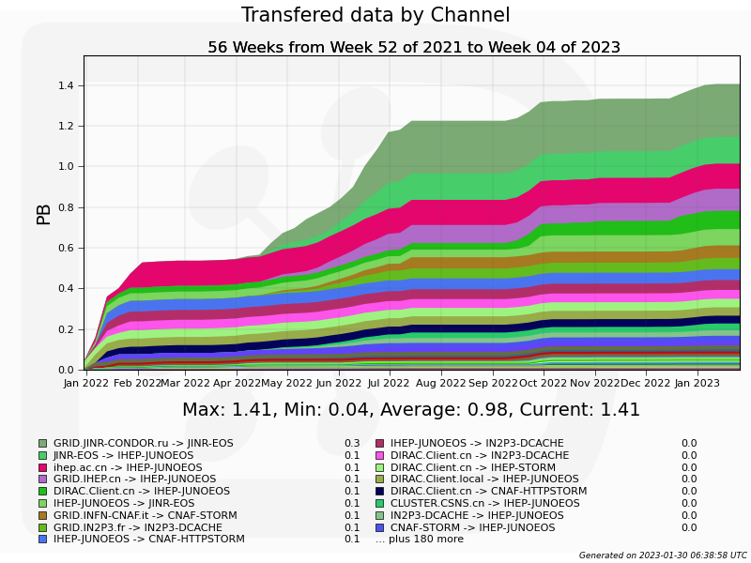
System in production 1/2
~5M Jobs are submitted and run with ProdSys since beginning of 2022
  ~5.18MHS06 Normalized CPU time
DM has been used for massive file registration and file transfer
  1.4PB data transferring
  In DFC, ~2PB data and 16M files registered and visible to users

Slide 14
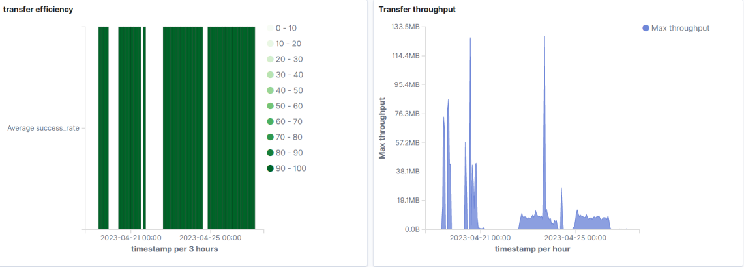
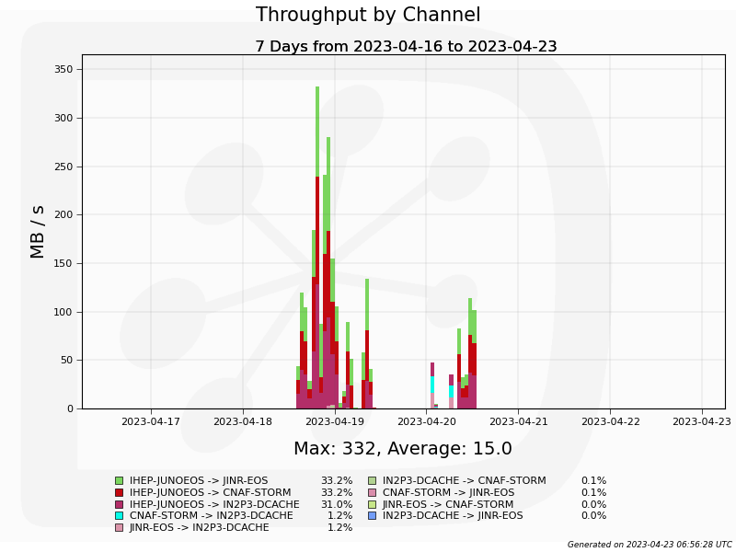
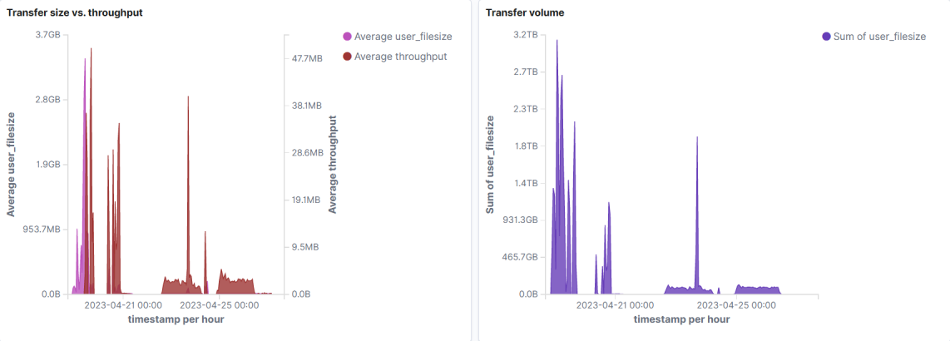
System in production 2/2
Raw data transfer system has started testing with commissioning data
Plan to use FTS Monitoring dashboards for transfer
  Infrastructure is set up
    FTS->ActiveMQ->logstash->ES->Kibana/Grafara
DIRAC Accounting will be used for history view

Slide 15
Summary and Plan
As a medium-size experiment, JUNO has successfully set up distributed computing system using existing WLCG middleware with quite limited manpower
The system meets the requirements of JUNO computing model, successfully used in some of JUNO production activities
Pressure testing on production-like environment will be carried out soon to prepare for data-taking in 2024

Slide 16
Thank you!

