Slide 1
An interdisciplinary Digital Twin Engine for science
CHEP 2023
Paul Millar, Patrick Fuhrmann, Dijana Vrbanec, Liam Atherton, Marica Antonacci, Diego Ciangottini, Andrea Manzi, Daniele Spiga
2023-05-08

Slide 2
Content project cheat sheet high level objectives digital twin use cases project structure resources timeline

Slide 3
Prelude: What is a Digital Twin?
A digital twin is a virtual replica or simulation of a physical object, system, or process, created and maintained using real-time data, advanced analytics, and machine learning algorithms. This digital representation enables continuous monitoring, analysis, and optimization of its real-world counterpart, facilitating better decision-making, improved efficiency, and reduced operational risks. Digital twins are widely used in various industries such as manufacturing, transportation, energy, and healthcare for predictive maintenance, product design, and performance optimization.
Digital Twin Simulation
Digital twins and simulations are both virtual model-based simulations, but some key differences exist. Simulations are typically used for design and, in certain cases, offline optimization. Designers input changes to simulations to observe what-if scenarios. Digital twins, on the other hand, are complex, virtual environments that you can interact with and update in real time.
They are bigger in scale and application.

Slide 4
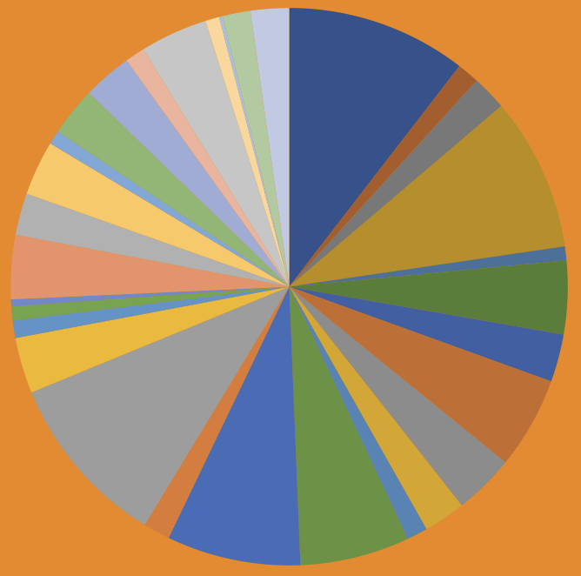
The typical Project Cheat Sheet
36 months
from
Sep 22
To
Aug 25
30 Partners
with
1500 PMs
Coordinated by
EGI
2 + 2 + 3 DT
Use Cases
from
HEP
Astro
Climate
Environment
Budget
12 M Euros

Slide 5
High level objecties
Validation
Design and specifications
DT applications
Creation of a prototype digital twin engine:
Resulting DTE Blueprint Architecture must be
Interdisciplary
Co-Designed (Providers and Communities)
Resulting Platform must be
Open Source with
TRL 6 (prototype model) to 7 (prototype pilot)
And it must be based on
Open Standards
with the capability to integrate with application specific DT’s
Digitial Twin
Application
Integration
Software Releases
DTE blueprint architecture

Slide 6
digital twins and scientific use cases

Slide 7
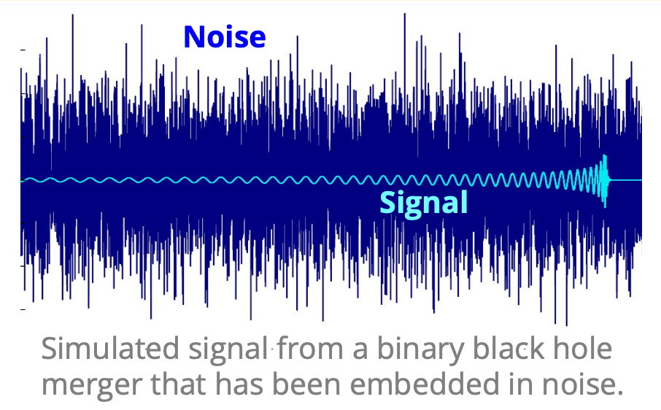
Radio astronomy and GW astrophysics
DT of the VIRGO Interferometer
It is meant to realistically simulate the noise in the detector, in order to study how it reacts to external disturbances and, in the perspective of the Einstein Telescope, to be able to detect noise “glitches” in quasi-real time, which is currently not possible. This will allow sending out more reliable triggers to observatories for multi-messenger astronomy.
DT for noise simulation of next-generation radio telescopes
Meant to provide DTs to simulate the noise background of radio telescopes (MeerKat) will support the identification of rare astrophysical signals in (near-)real time. The result will contribute to a realisation of "dynamic filtering" (i.e. steering the control system of telescopes in real-time).
Dynamic
Archiving
Distributed
Computing
Dynamic
Filtering
Regional
Computing
Central
Computing
Archives
Data Products

Slide 8
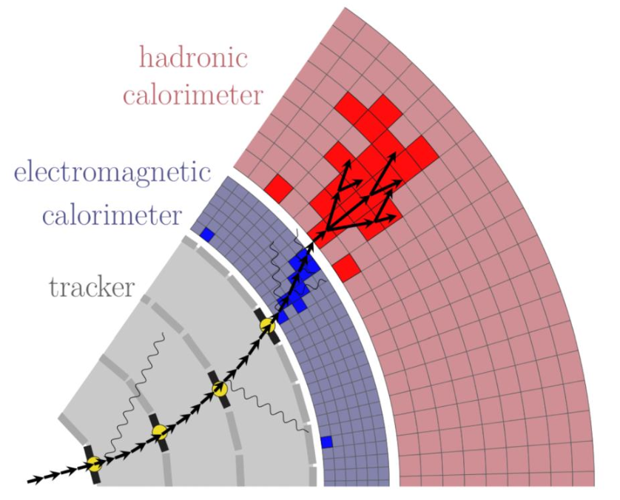
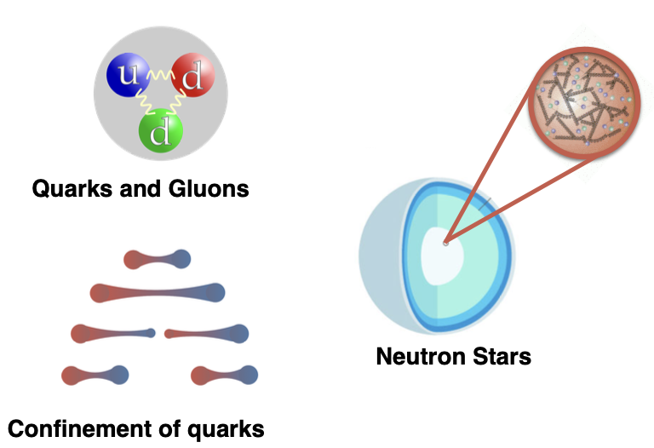
DT in High Energy Physics
DT of Large Hadron Collider (LHC) detector components
Seeking for strategies to face the increase in the need for simulated data expected during the future High Luminosity LHC runs. The primary goal is to provide a fast simulation solution to complement the Monte Carlo approach. Faster and deeper cycles of optimisation of the experiment parameters in turn will enable breakthroughs in experimental design.
DT of the Standard Model in particle physics
Competitive results in Lattice QCD require the efficient handling of Petabytes of data, therefore the implementation of advanced data management tools is mandatory. On the side of algorithmic advancement, ML algorithms have recently started to be applied in Lattice QCD. The goal is to systematize the inclusion of ML for large scale parallel simulations.

Slide 9
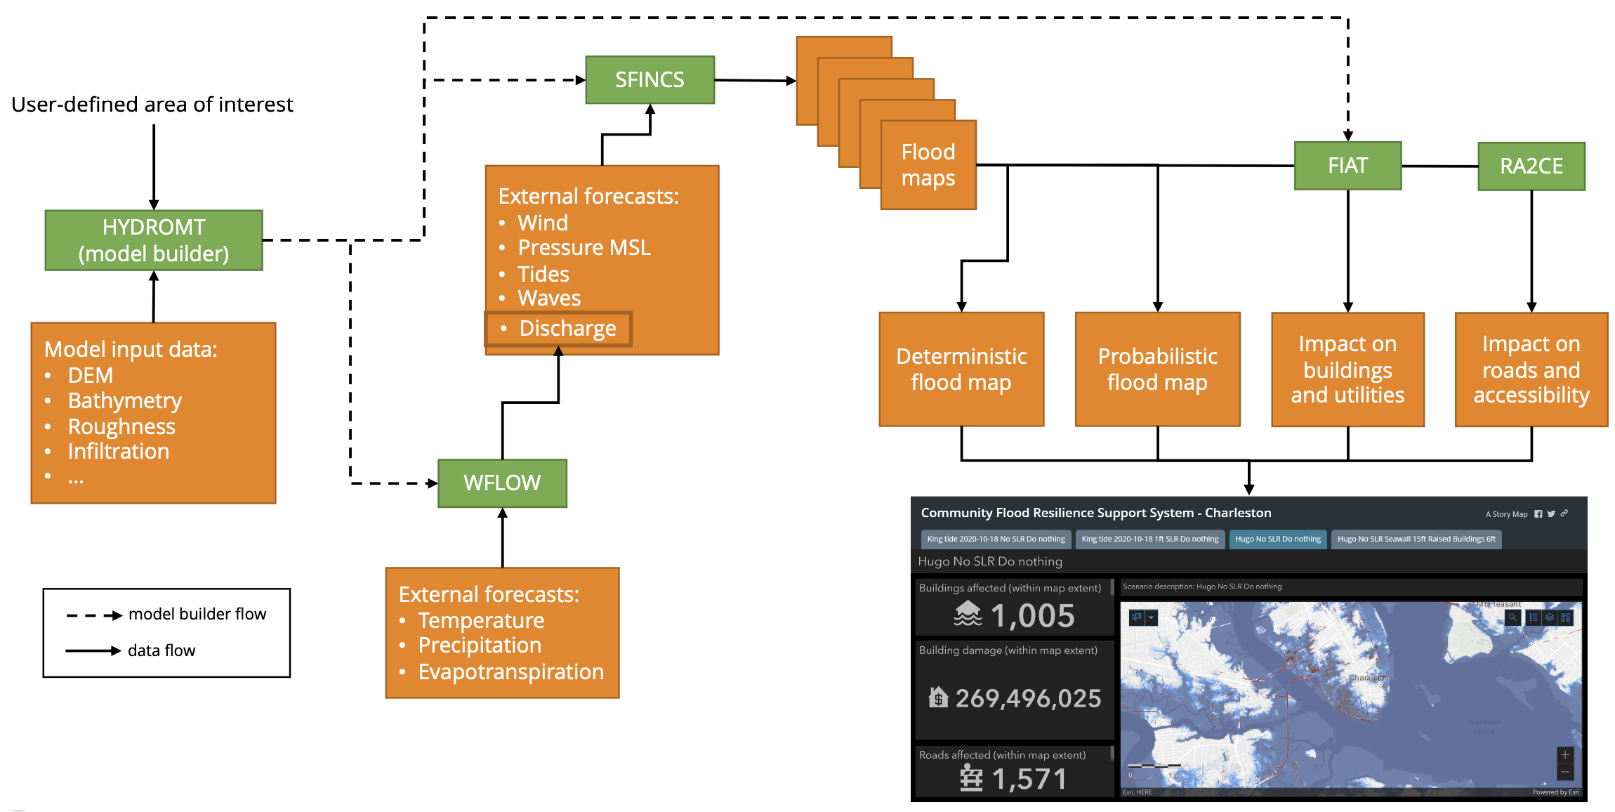
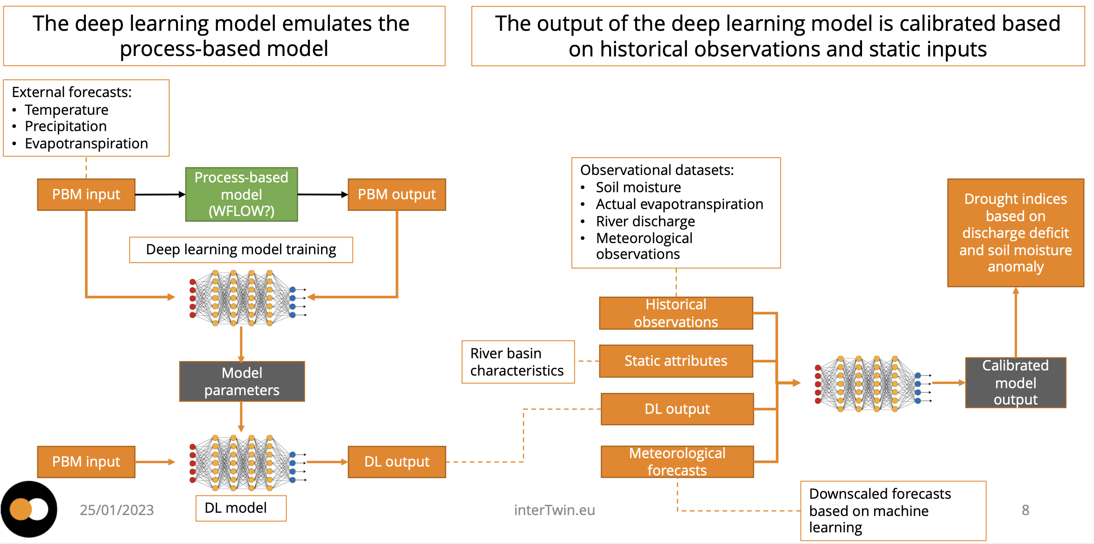
Three use cases on Extreme Events on Earth
DT for Extreme Events on the Earth
Climate Change Future Projections of Extreme Events as storms and fire;
Early Warning for Extreme Events of floods and droughts;
Climate Change Impacts of Extreme Events of storms, fire, floods and droughts.
Digital Twin for Flood Early Warning in coastal and inland regions
Digital Twin for Drought Early Warning in alpine regions

Slide 10
structure of project

Slide 11
interTwin Component Architecture
DT Applications
DT Applications
DT Applications
DT Applications
DT Applications
DT Applications
DTE Thematic Modules
Thematic Modules
Environmental Sciences
Thematic Modules
HEP / Astro / Astro Particle
Thematic Modules
Other Sciences
Quality Verification
Workflow Composition
Real-time data acquisition and processing
DTE Core Modules
Big Data Analytics
AI / ML
Data fusion
Software
Orchestrator
Federated data management
DTE Infrastructure
Hardware
Quantum
HPC
HTC & Cloud
Data Repositories

Slide 12
zooming in ….

Slide 13
And a zoom into the DTE Infrastructure
Compute Orchestration
Federated Data Management
Software
INDIGO DC PaaS Orchestrator
FTS
Infrastructure Manager
DTE Infrastructure
Middleware
Quantum
HPC
HTC & Cloud
Data Repositories
Hardware
Orchestration
Federated Datamanagement
Continuum Integration
PaaS Orchestrator + Infrastructure Manager elaborating deployment requested expressed in TOSCA to be extended to deal AI based orchestration.
Based on ESCAPE Data Lake architecture and services, Rucio, FTS and HTTP accessed caches/storages. Data lake concept extended to HPC facilities
Single-sign-on in simulation and modelling tasks to access data and different compute facilities,
Offloading to HPC.
Data repositories and computation with containers on HTC, Cloud and HPC

Slide 14
what resources do we have?

Slide 15
Pilot Compute Resources for HPC, HTC and Cloud
Cloud
EODC
EGI
KBFI
HTC
GRNET
UKRI
TU Wien
Different classes of resources with different requirements!
PSNC
Juelich
EuroHPC
HPC

Slide 16
zooming in further ….

Slide 17
Infrastructure architecture in more detail
Compute Orchestration
Federated Data Management
INDIGO DC FaaS Orchestrator
FTS
Infrastructure Manager
Only assumes local execution engine for containers
Community
Service
Offloader
Local Engine : Kubernetes, HT Condor, LSF, Slurm .. You name it.
Cloud
Containers are delivered by CVMFS
Example: Jupyter HUB on the CSO and Jupyter Lab’s on the rersources.
API
Edge Service API
Edge Service API
Edge Service API
Specific Drivers
Resources
Cloud
HTC
Quantum
HPC
ESCAPE Data lake and content delivery network
Notes:
Implementation and synergy : Daniele S’s talk with concrete examples of the connections. / CNAF Tier I extention

Slide 18
timeline

Slide 19
Updated Roadmap
Project Year 1
Project Year 2
Project Year 3
05.2023
DTE Design and
specifications
1st Software Releases
DTE blueprint architecture
10-12.2023
10.2024
Deliverables: Software releases for all use cases and modules
Deliverable: DTE blueprint architecture, functional specifications and requirements analysis v3
Deliverables: Report on requirements for all use cases
DTE blueprint architecture
DTE blueprint architecture
2nd Software Releases
01.2024
01-04.2025
Deliverable: DTE blueprint architecture, functional specifications and requirements analysis v1
Deliverable: DTE blueprint architecture, functional specifications and requirements analysis v2
Deliverables: Final Software releases for all use cases and modules
04.2024
Validation
Validation
07-08.2025
Deliverables: First version of the thematic module
Deliverables: DT application development and integration report Report on software architecture concepts based on DestinE and InterTwin Final Architecture design of the DTs capabilities
09.2024
Design and specifications
2023
Deliverables: Updated report on requirements for all use cases
2024
2025

Slide 20
Thank you!
www.intertwin.eu
info@intertwin.eu
intertwin_eu
intertwin

