Slide 1
Experimental Physics Software and Computing Infrastructure
EIC Software Overview
David Lawrence
Thomas Jefferson National Accelerator Facility
for the ePIC Collaboration
Notes:
This talk is scheduled for 15 minutes
https://indico.jlab.org/event/459/contributions/11457/

Slide 2
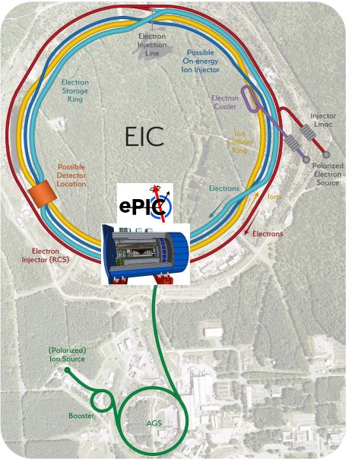
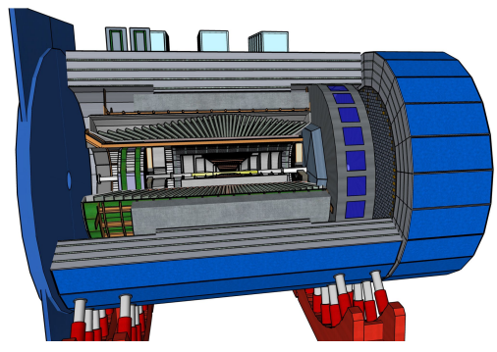
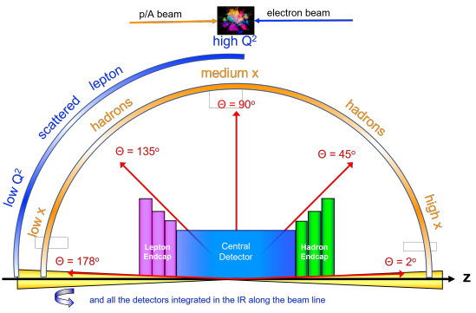
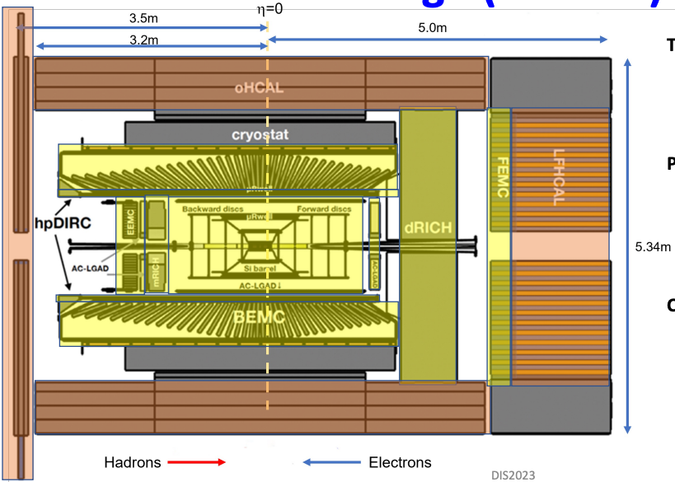
Introduction
The goal of the EIC is to provide us with an understanding of the
internal structure of the proton and more complex atomic nuclei that
is comparable to our knowledge of the electronic structure of atoms
themselves, which lies at the heart of modern technologies.
@ BNL
Notes:
For the following, see image on slide 5
Need to include far forward/backward parts (100m long)
Need updated picture of central detector. (n.b. not available in sketchup)

Slide 3
Software for the Realization of the Experiment
Our software design is based on lessons learned in the worldwide NP and HEP community and a decision-making process involving the whole community. We are guided by our Software Statement of Principles: https://eic.github.io/activities/principles.html
We will continue to work with the worldwide NP and HEP community.
Modular Simulation, Reconstruction, and Analysis Toolkit using tools from the NP-HEP community
EDM4eic data model based on EDM4hep and podio.
Geometry Description and Detector Interface using DD4hep.
MC Event Generators
Detector Simulations in Geant4
Readout Simulation (Digitization)
Reconstruction
in JANA2
Physics
Analyses
Continuous Integration for Detector and Physics Benchmarks and Reproducibility
We are providing a production-ready software stack throughout the development:
Milestone: Software enabled first large-scale simulation campaign for ePIC.
We have a good foundation to meet the near-term and long-term software needs for ePIC.
slide by Markus Diefenthaler

Slide 4
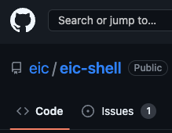
EIC Software Overview
The software stack is (necessarily) deep
The number of packages means the possible version number combinations is vast
Production and nearly all development done via container (eic-shell)
https://github.com/eic/eic-shell
singularity v3+
apptainer v1+
docker
Currently using C++17 standard (will switch to C++20 soon)
Python used for higher-level
geant4
python
boost
root
fmt
spdlog
JANA2
podio
edm4hep
edm4eic
dd4hep
acts
logging
reconstruction framework
data model + I/O library
geometry (recon+simulation)
curl --location https://get.epic-eic.org | bash ./eic-shell
tracking
/cvmfs/singularity.opensciencegrid.org/eicweb
new build published every 12 hours
Not to mention generators (pythia, BeAGLE, …)
Notes:
The message of this slide is two-fold: 1.) We use containerization to manage the versions and therefore provide a development and production environment that can be run anywhere. 2.) We are using C++ and python as the primary languages.

Slide 5
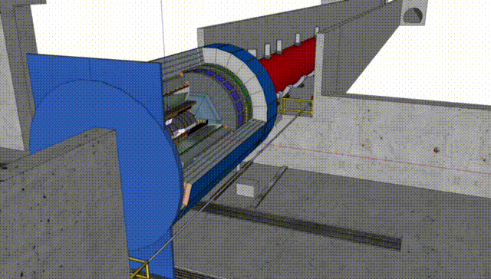
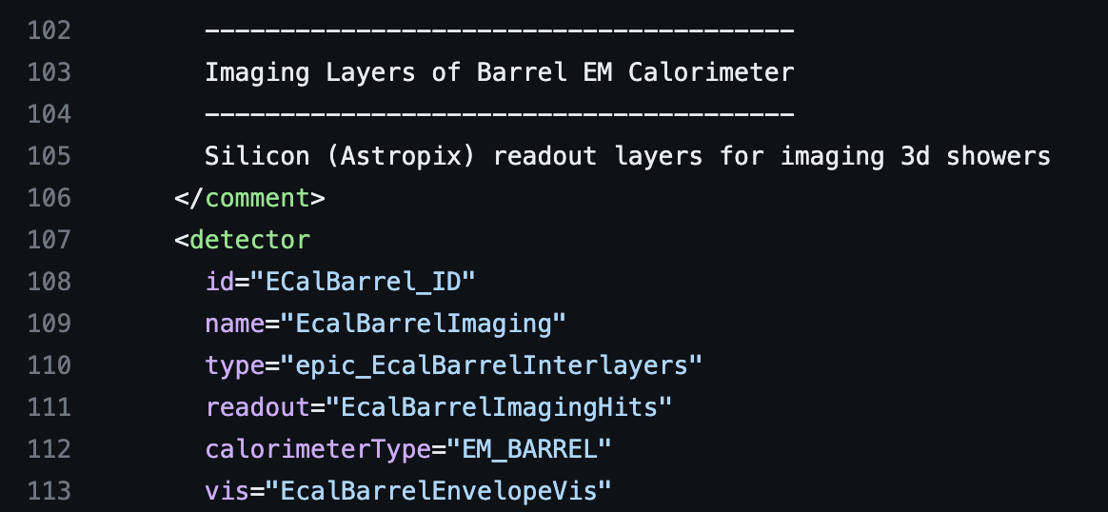
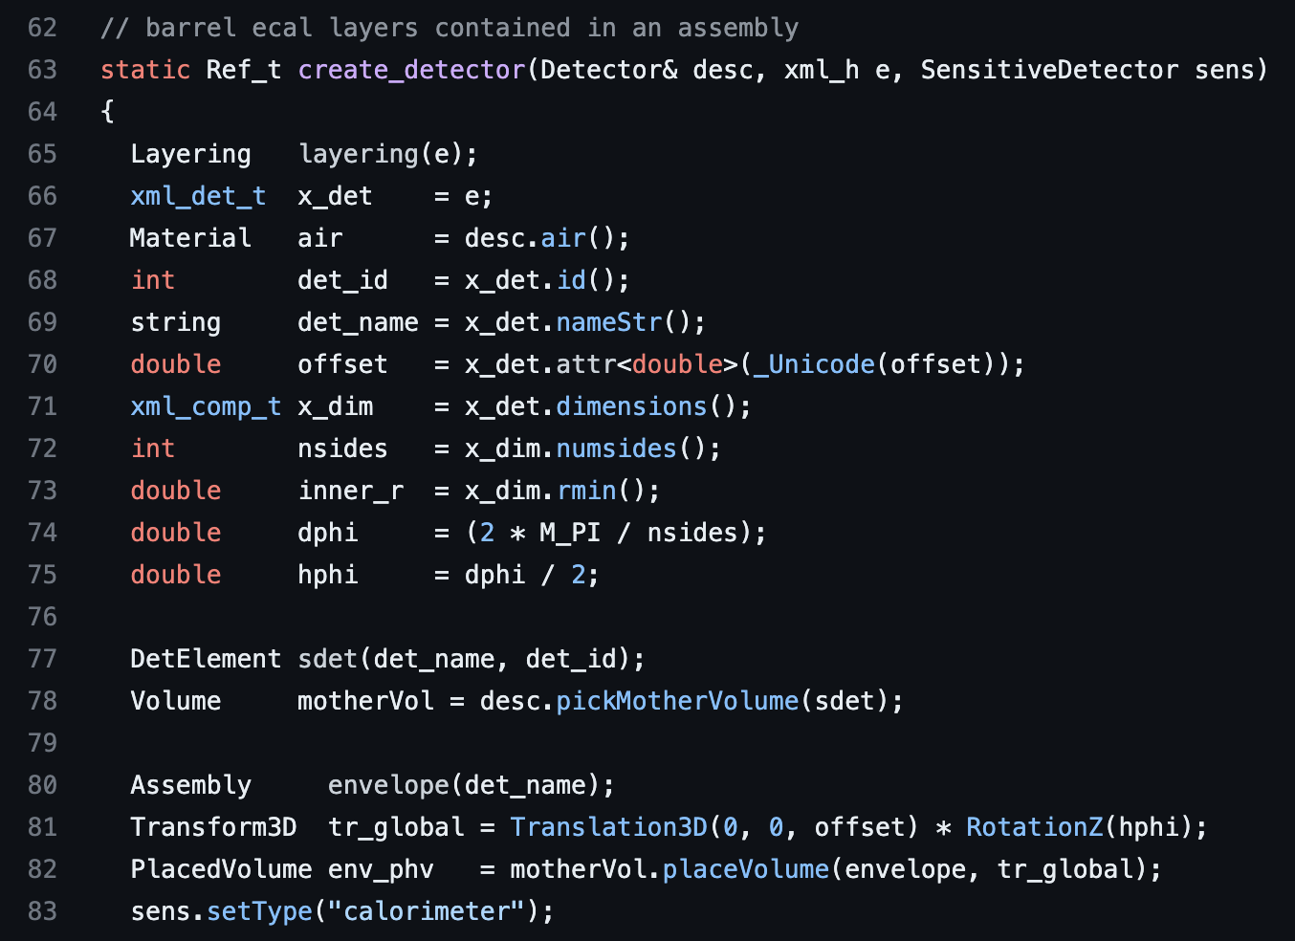
Geometry - DD4Hep
XML
Geometry defined using DD4HEP
https://github.com/AIDASoft/DD4hep
DD4hep provides a geometry description that is used for both simulation and reconstruction
XML
ePIC specific: npsim (python)
https://github.com/eic/npsim
EIC physics
Optical photon settings
etc.
C++
Integrated PODIO (see next slide)
Parameters defined in XML that can be accessed at runtime
Detector types implemented in C++ using root TGeo
Notes:
DDSIM is the name of the python module that npsim uses to run the actual geant4 simulation. npsim just adds a layer that allows customization for our physics. It is a copy of the ddsim script with our own customizations. ddsim can be viewed as a minimal example.

Slide 6
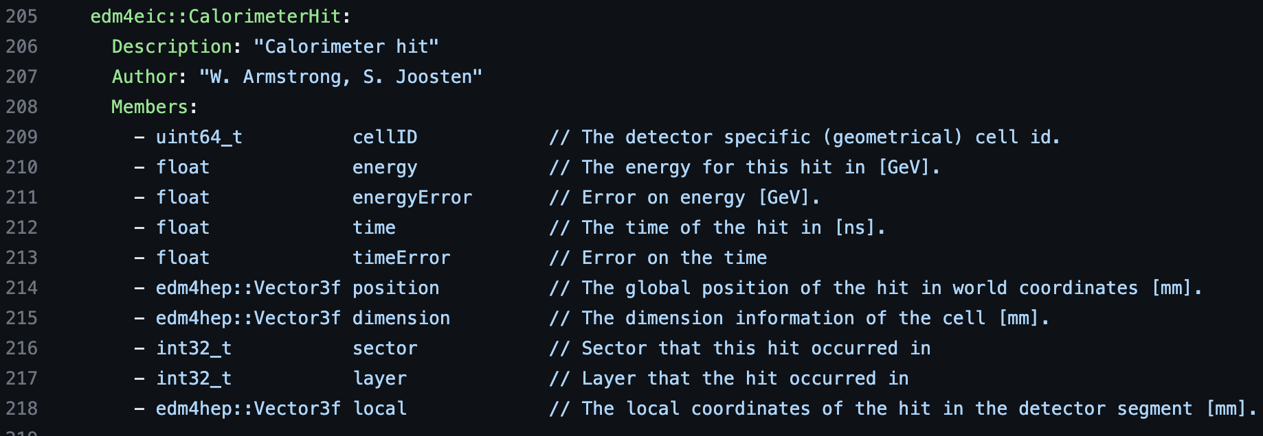
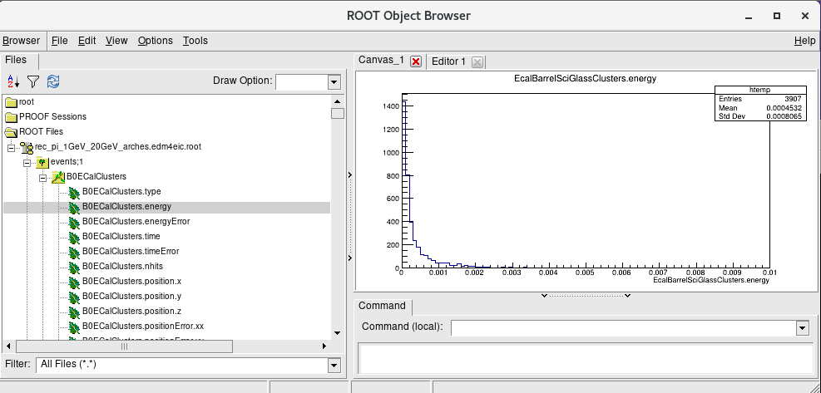
Data Model and I/O - PODIO
https://github.com/AIDASoft/podio
“Plain Old Data” I/O
helpful for exchange with outside software (e.g. AI/ML)
Data model defined in yaml
Maps objects to ROOT TTrees
example structure defined in edm4eic.yaml
Core Data model is EDM4hep (https://github.com/key4hep/EDM4hep)
“A generic event data model for future HEP collider experiments”
Supports 1-1, 1-many, and many-many associations
e.g. reconstructed particle can be associated back to generated particle
EIC-specific Data model is EDM4eic (https://github.com/eic/EDM4eic)
Augments EDM4hep
Changes propagated upstream to EDM4hep where appropriate
Notes:
Note that there will be some unique aspects of EIC that will require EDM4eic.
Note that DM are non-trivial to get right. EDM4hep helped a lot.

Slide 7
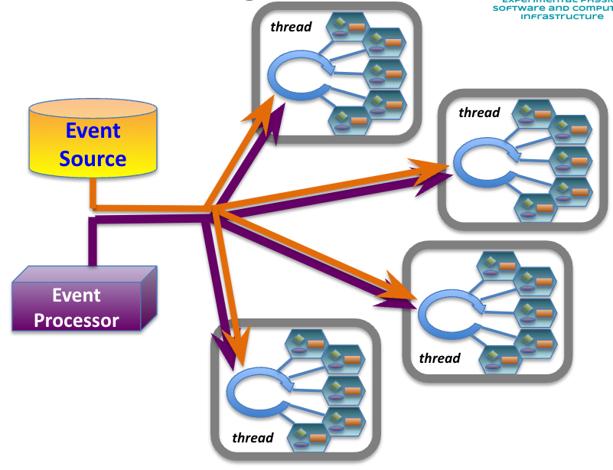
Reconstruction Framework - JANA2
JANA is a C++ multithreaded framework project with nearly 2 decades of experience behind it
JANA2 is a recent rewrite incorporating more modern coding and CS practices and improving on the original using lessons learned
Streaming DAQ and heterogeneous hardware support strongly considered in redesign
Active development and support
EICrecon implements algorithms for ePIC in JANA2 https://github.com/eic/EICrecon
JANA2
Documentation: https://jeffersonlab.github.io/JANA2/
Example projects: https://github.com/JeffersonLab/JANA2_Examples
https://github.com/fJeffersonLab/EIC_JANA_Example/tree/TObject_example
Publications:
https://arxiv.org/abs/2202.03085 Streaming readout for next generation electron scattering experiments
https://doi.org/10.1051/epjconf/202125104011 Streaming Readout of the CLAS12 Forward Tagger Using TriDAS and JANA2
https://doi.org/10.1051/epjconf/202024501022 JANA2 Framework for Event Based and Triggerless Data Processing
https://doi.org/10.1051/epjconf/202024507037 Offsite Data Processing for the GlueX Experiment
Notes:
Old JANA2 PODIO example project. Obsolete now that we have full integration in JANA2, including frames:
https://github.com/JeffersonLab/EIC_JANA_Example/tree/PODIO_example
Other Publications:
https://pos.sissa.it/070/062 Multi-threaded event processing with JANA
https://iopscience.iop.org/article/10.1088/1742-6596/219/4/042011 The JANA calibrations and conditions database API
https://iopscience.iop.org/article/10.1088/1742-6596/1525/1/012032 JANA2: Multithreaded Event Reconstruction
https://iopscience.iop.org/article/10.1088/1742-6596/119/4/042018 Multi-threaded event reconstruction with JANA

Slide 8
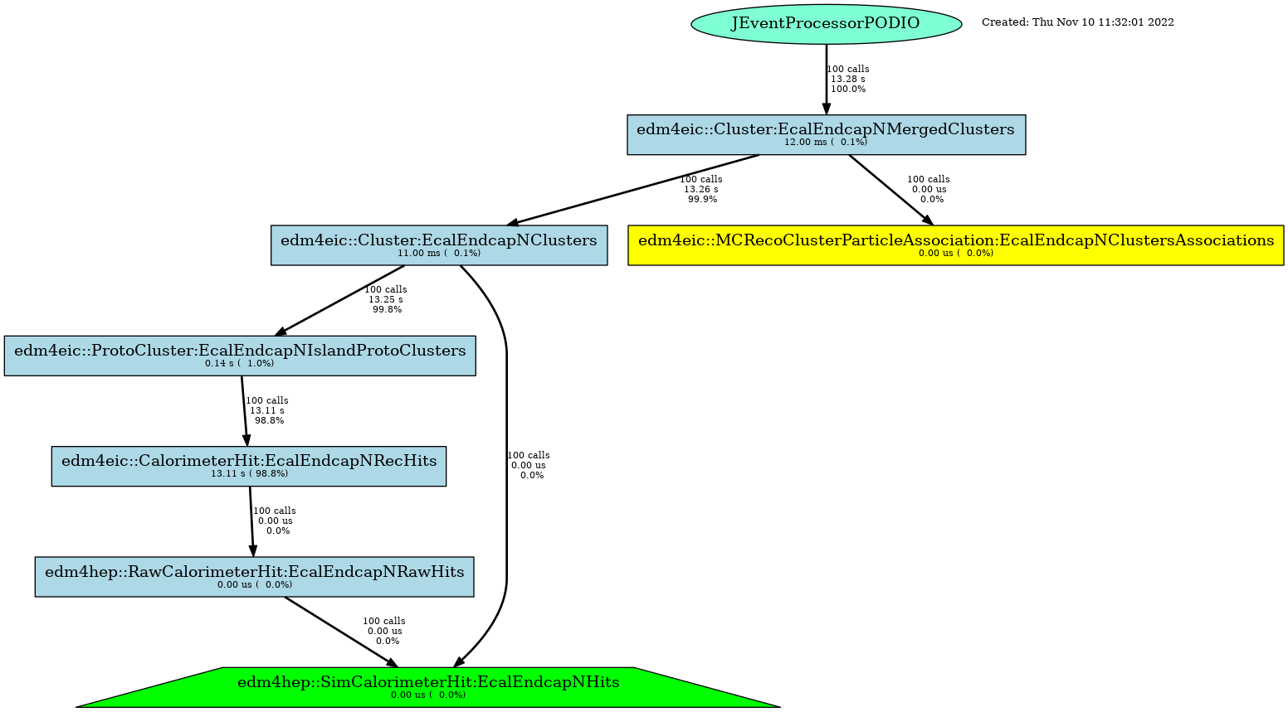
Reconstruction Framework - JANA2
Full recon graph (too large to show fully on slide)
JANA is an on-demand system where requests for high-level objects trigger algorithms down to source objects on an event-by-event basis
JANA2 works with any C++ object, TObject, and recently, full support for PODIO objects and collections has been added
Notes:
Walk through the on-demand nature of this how runtime requests for data objects flow from top to bottom while the data objects flow from bottom to top.
Note how this could improve efficiency in high-level trigger applications
Note that JANA2 is the only framework currently implementing all PODIO features

Slide 9
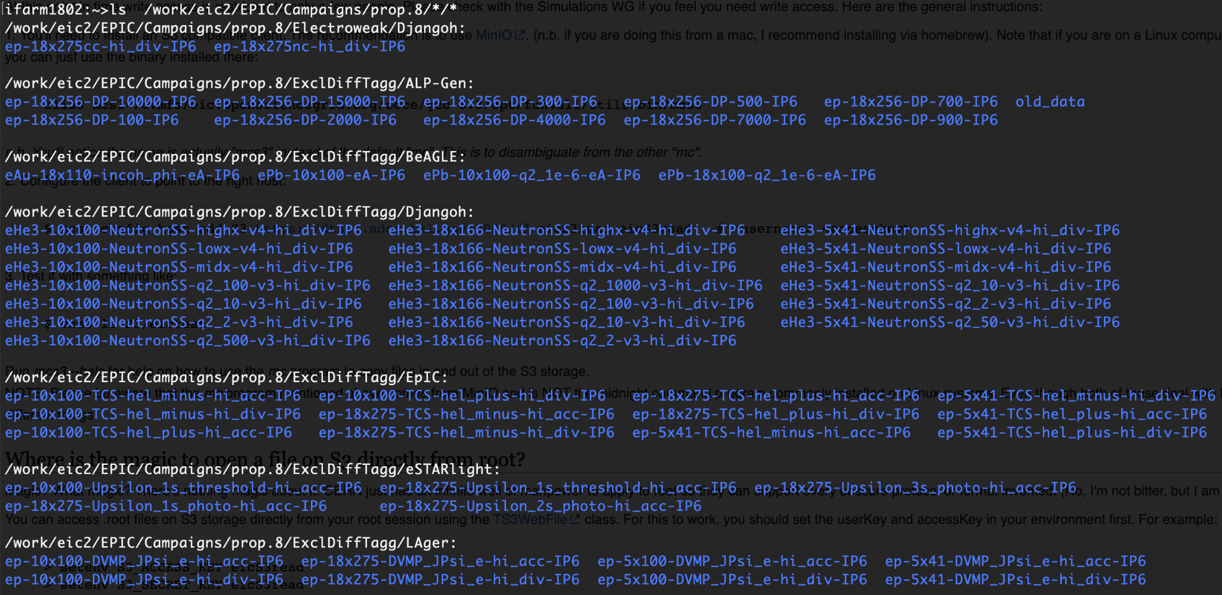
ePIC Software Aiding in Detector Design
Sub-detectors actively undergoing review
Performance studies use variations of standard geometry for different detector designs and standard simulation
Barrel EM Calorimeter Studies of two design options
SciGlass EMCal Results (from D. Kalinkin, 4/3/2023)
partial list of generator*beam configurations in simulation campaign
Imaging EMCal Results (from M. Zurek, 4/6/2023)

Slide 10
Summary and Outlook
The Software Stack being developed for the EIC ePIC detector includes pieces from both Nuclear and High Energy Physics communities
GEANT4, ROOT, PODIO(EDM4hep), JANA2
Containerization used heavily, even at development stage
cvmfs used for distribution (spack used for 3rd party)
containers with ARM architecture also provided
Support for streaming and near real-time construction is an early goal
Multi-architecture system is anticipated and supported
Expect use of A.I. in all stages
Work is well underway and will be included in production
We are guided by our Statement of Software Principles
https://eic.github.io/activities/principles.html
More ePIC Talks …
Algorithms: Framework- and Experiment-independent algorithms at EPIC
Sylvester Joosten May 9, 2023, 11:00 AM Hampton Roads III
https://indico.jlab.org/event/459/contributions/11419/
User-Centered Design for the Electron-Ion Collider
Markus Diefenthaler May 8, 2023, 12:00 PM Marriott Ballroom VI-VII
https://indico.jlab.org/event/459/contributions/11523/
epic-analysis: Common Physics Analysis Software for the EIC
Christopher Dilks May 9, 2023, 3:00 PM Marriott Ballroom IV
https://indico.jlab.org/event/459/contributions/11556/
AI4EIC Hackathon: PID with the EPIC dRICH
Karthik Suresh May 9, 2023, 5:15 PM Marriott Ballroom III
https://indico.jlab.org/event/459/contributions/11697/
Artificial Intelligence and Machine Learning for EPIC: an Overview
Cristiano Fanelli May 11, 2023, 11:15 AM Chesapeake I-II
https://indico.jlab.org/event/459/contributions/11720/

Slide 11
Backups

Slide 12
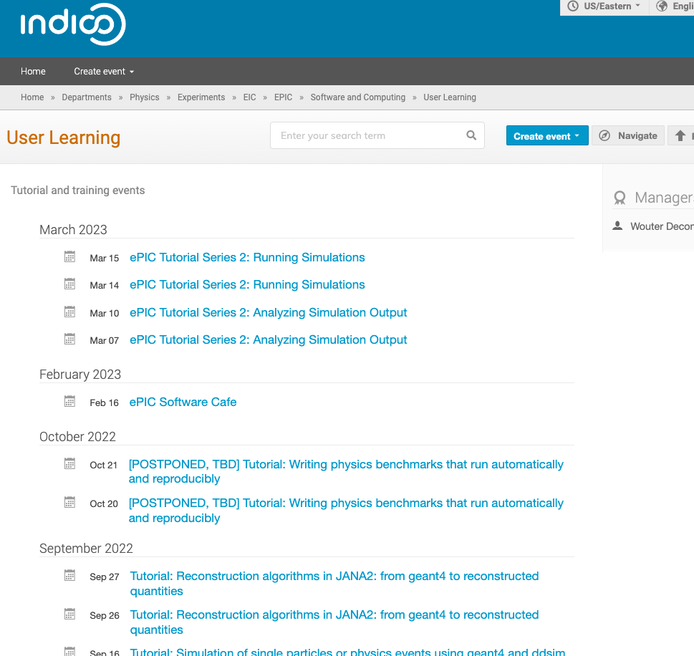
Documentation
https://eic.github.io/EICrecon/#/
https://indico.bnl.gov/category/443/
github pages
tutorials

Slide 13
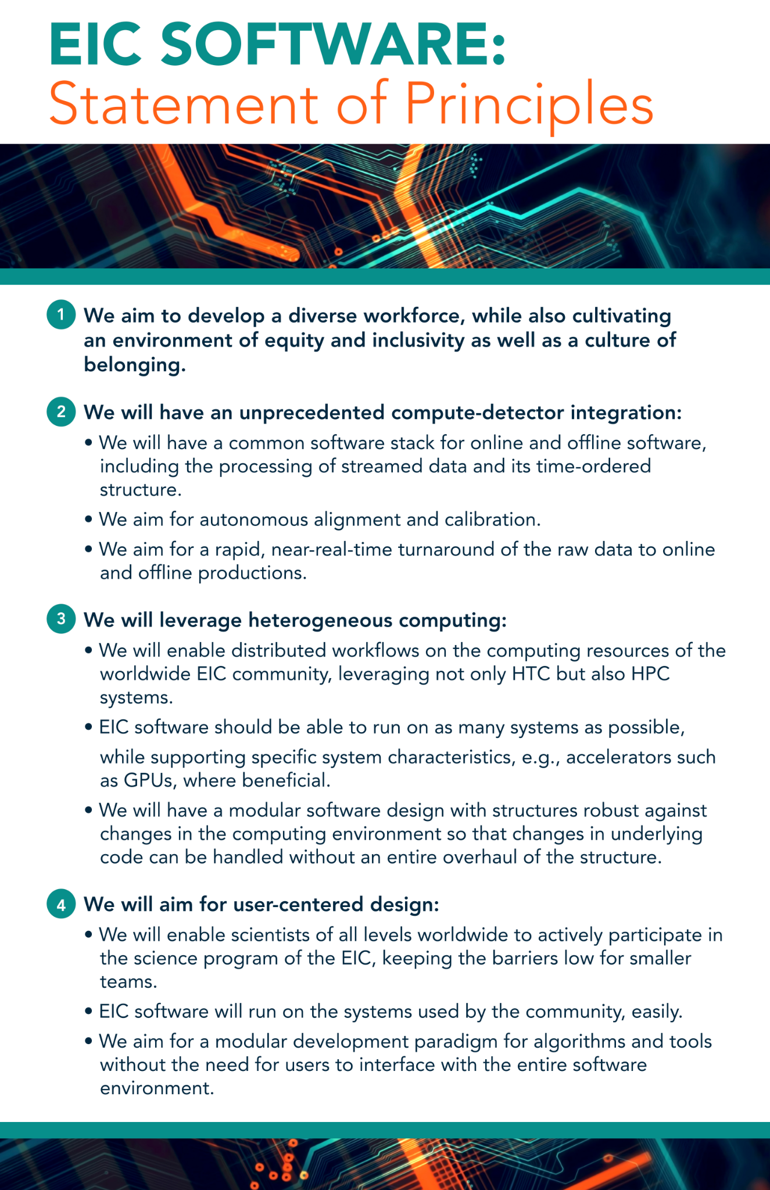
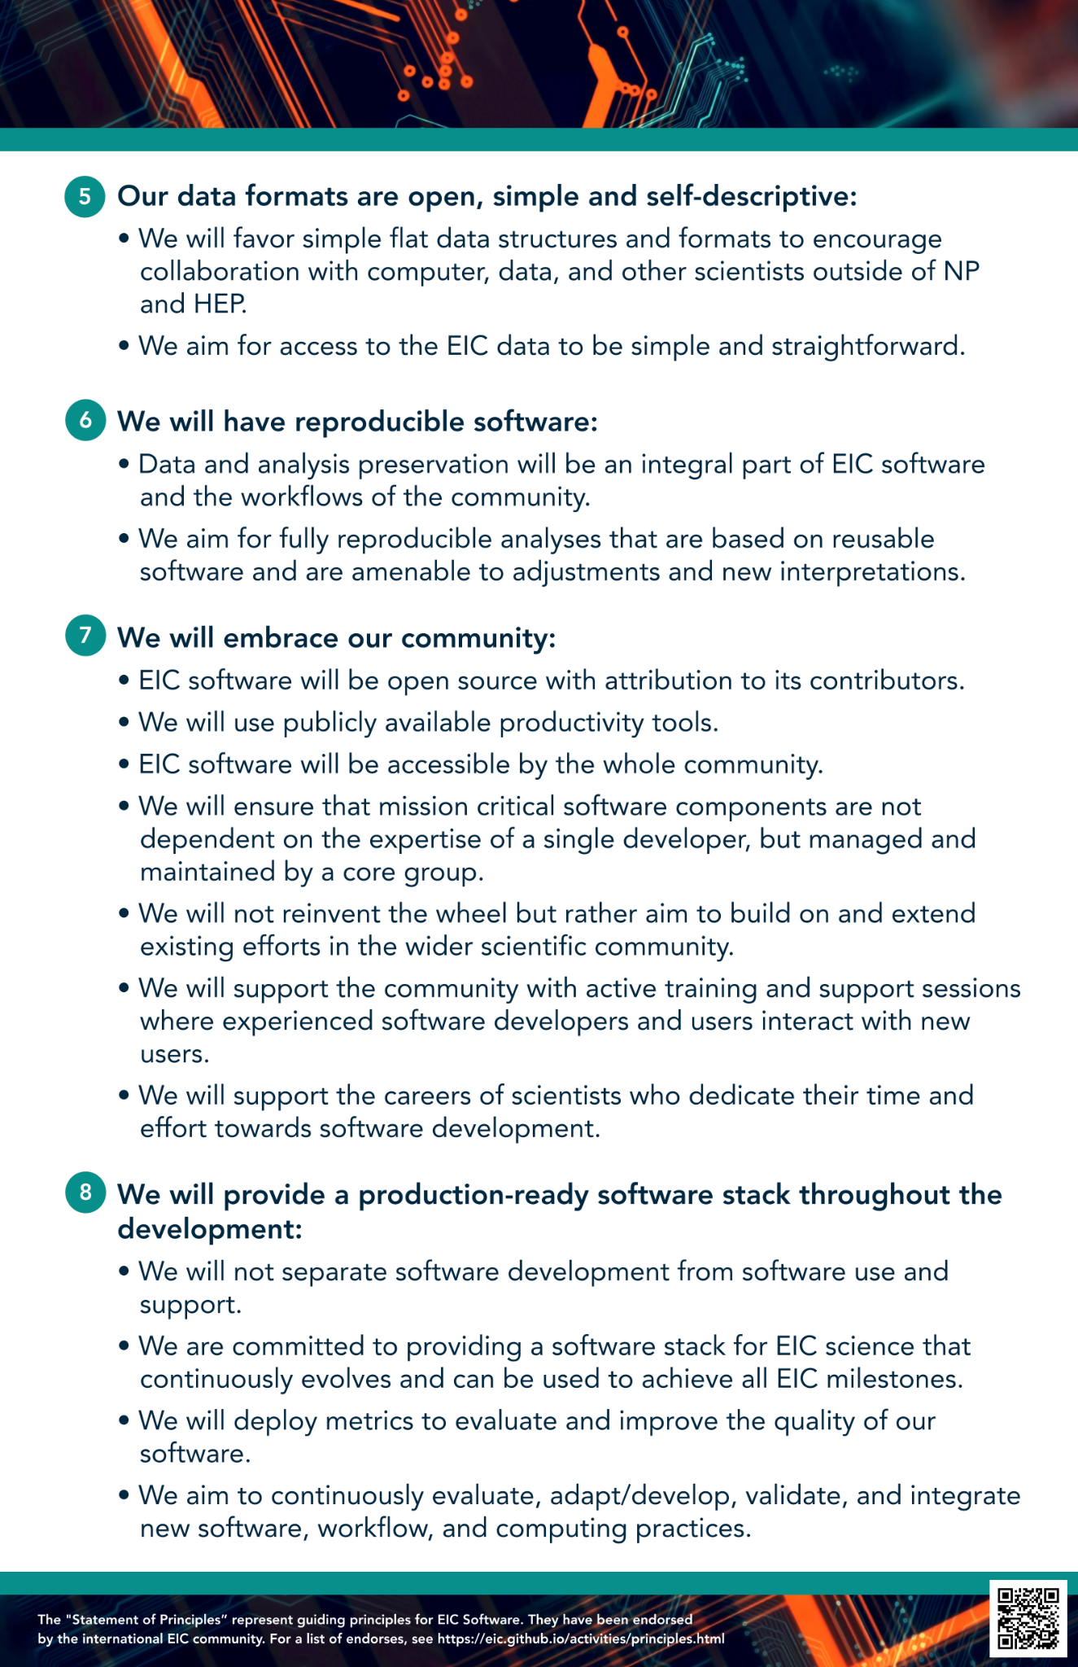

Slide 15
Abstract
Development of the EIC project detector "ePIC" is now well underway and this includes the "single software stack" used for simulation and reconstruction. The stack combines several non-experiment-specific packages including ACTS, DD4hep, JANA2, and PODIO. The software stack aims to be forward looking in the era of AI/ML and heterogeneous hardware. A formal decision making process was implemented to choose the components that involved everyone in the collaboration that was interested. This talk will present an overview of the software stack currently used for development of the ePIC detector and on which we expect to execute the experiment.
https://indico.jlab.org/event/459/contributions/11457/
Hampton Roads III 15min total (13+2?) - last talk of session

