Slide 1
THE EXA.TRKX PROJECT PARTICLE PHYSICS WITH GRAPH NEURAL NETWORKS
Paolo Calafiura On behalf of the Exa.TrkX Project Special thanks to: V Hewes, Xiangyang Ju, Daniel Murnane, Andrew Naylor,Tuan Pham, and many other Exa.TrkX friends and collaborators
exatrkx.github.io
Notes:
Past work, current work, and work that remains to be done

Slide 2
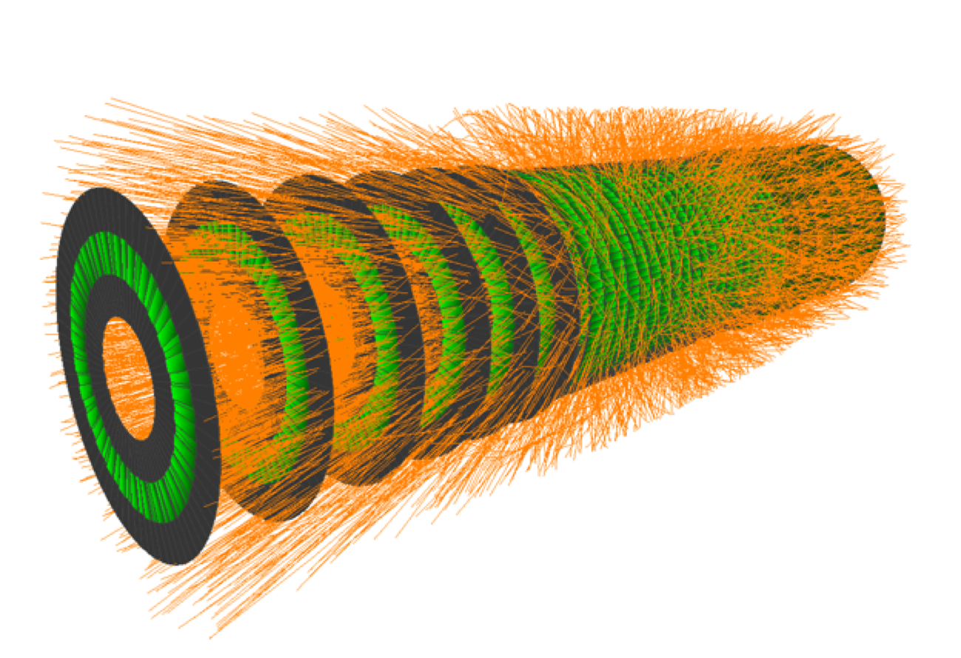
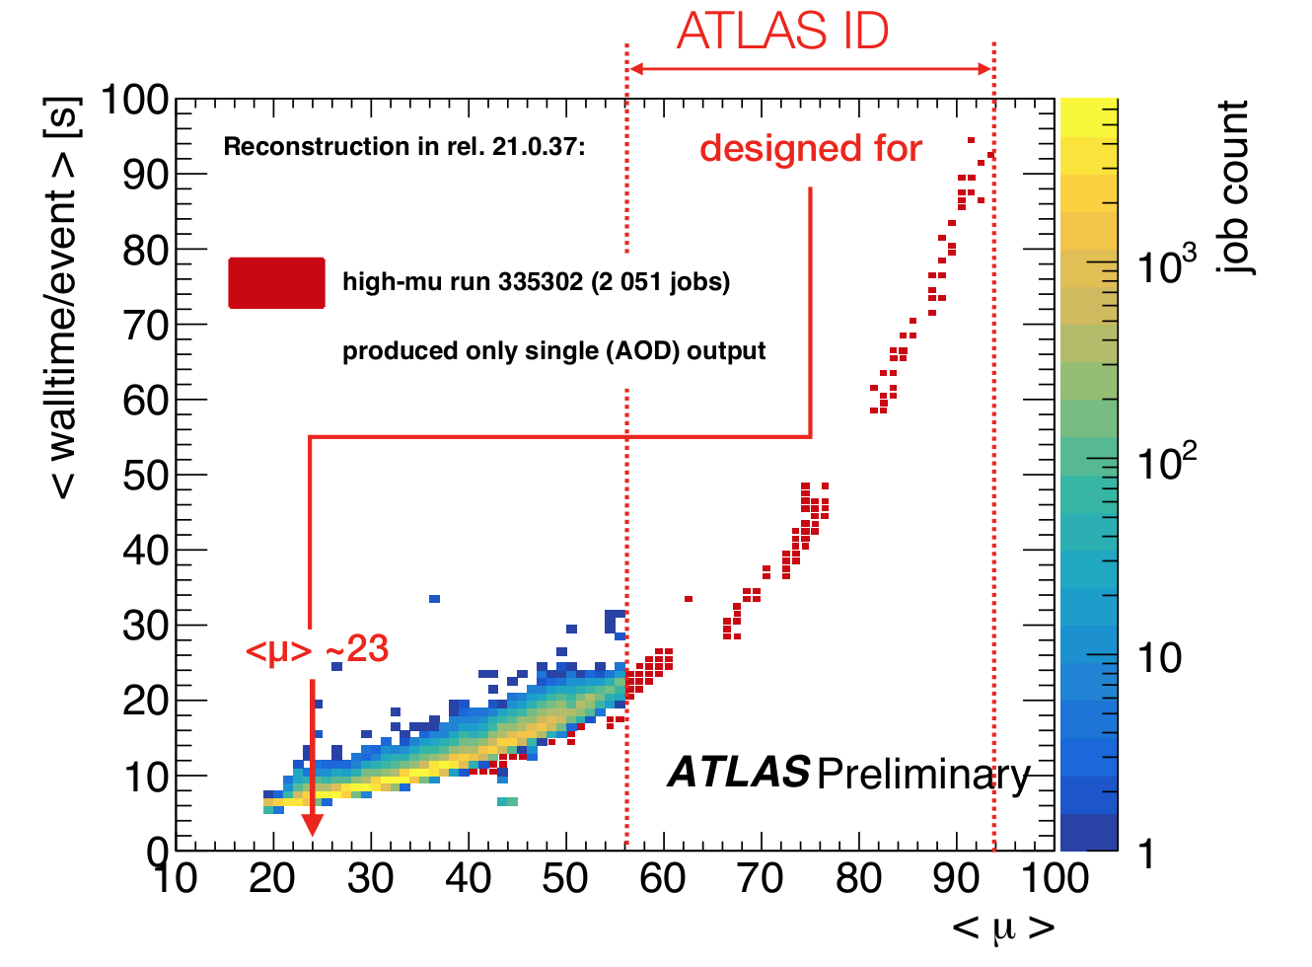
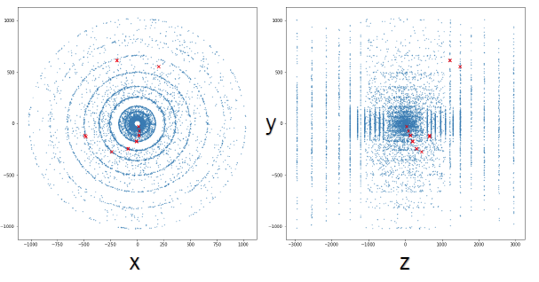
CTD 2015: Formulating the Challenge
Reconstruct interesting tracks in a full HL-LHC event, in O(1) second, with high track efficiency and purity
2017 Prototype challenge @ CTD 2017: 2D hits, toy detector, 20 tracks/event
2018: Accuracy TrackML Challenge (Kaggle): 3D hits, “HL-LHC” detector, 10K tracks/event
2019: Throughput TrackML Challenge (Codalab): as above, with CPU time added to score
Today: TrackML datasets and tools have become a benchmark for all sorts of tracking R&D
Andi Salzburger - CHEP 2018

Slide 3
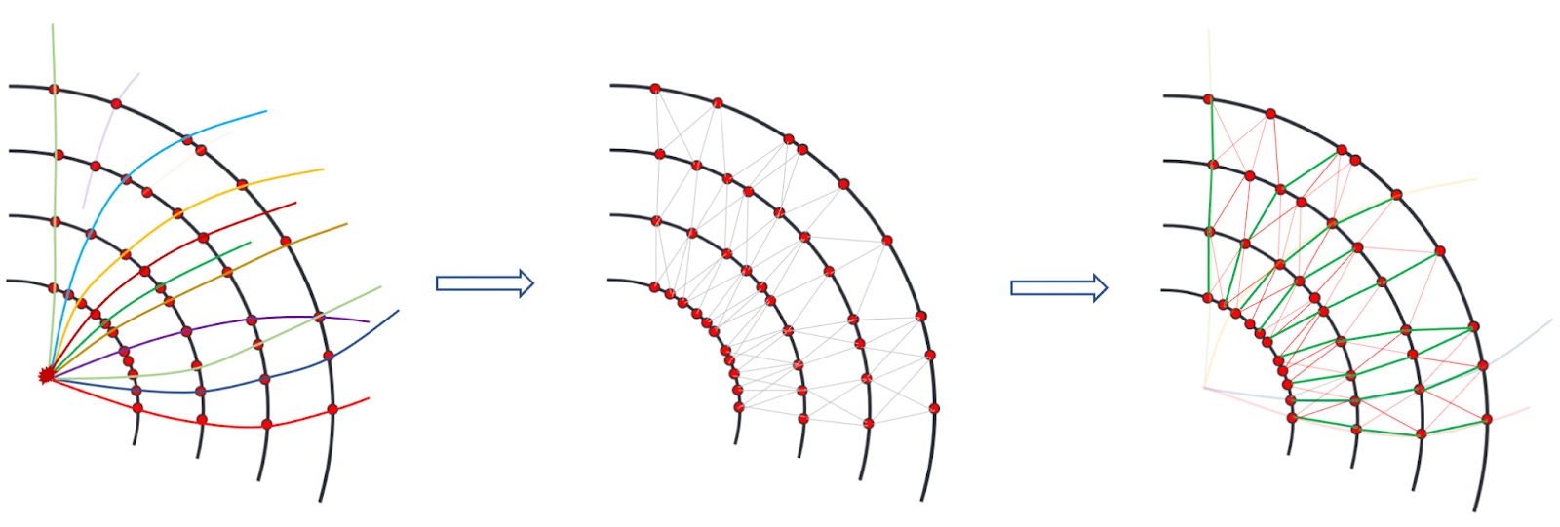
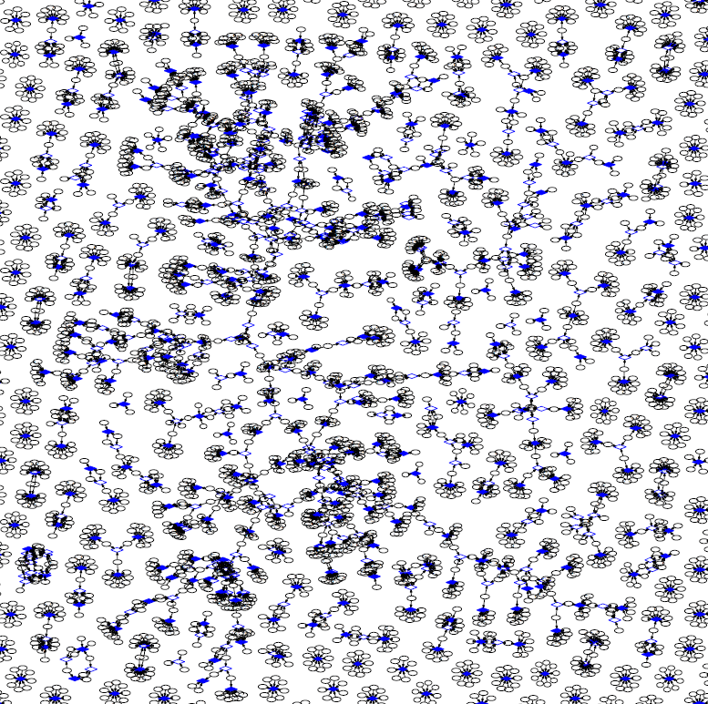
CTD 2017 - The Inspiration: Events as Graphs
Ferenc Sikler CTD 2017 CTD 2019
The Exa.TrkX approach:
Treat each hit as a node
A node can have features (e.g. position, energy deposit, etc.)
Nodes can be connected by edges, that represent the possibility of belonging to the same track
Bipartite graph: Hits and Tracks as nodes, Edges as potential assignments

Slide 4
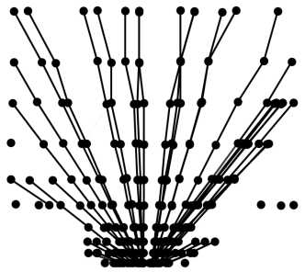
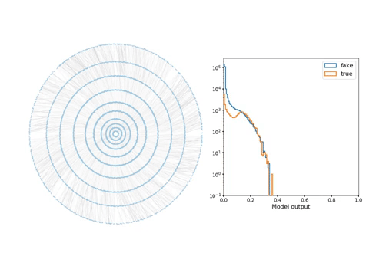
CTD 2018 - The Innovation: Tracking with GNNs
GNN edge classification
Steve Farrell - CTD 2018
Xiangyang Ju - CTD 2019

Slide 5
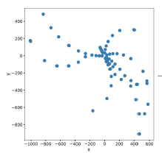
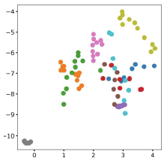
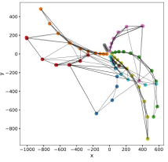
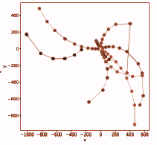
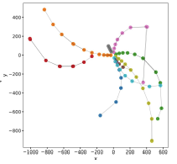
The Exa.TrkX Track Finding Pipeline
Point Cloud
Find Neighbours
Build Graph
Filter & Classify
Segment & Analyze
This is the “typical” Exa.TrkX geometric learning workflow
Experiments’ unique challenges have produced a range of innovations specific to each

Slide 6
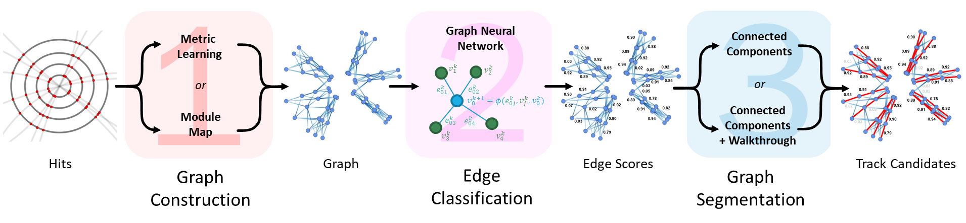
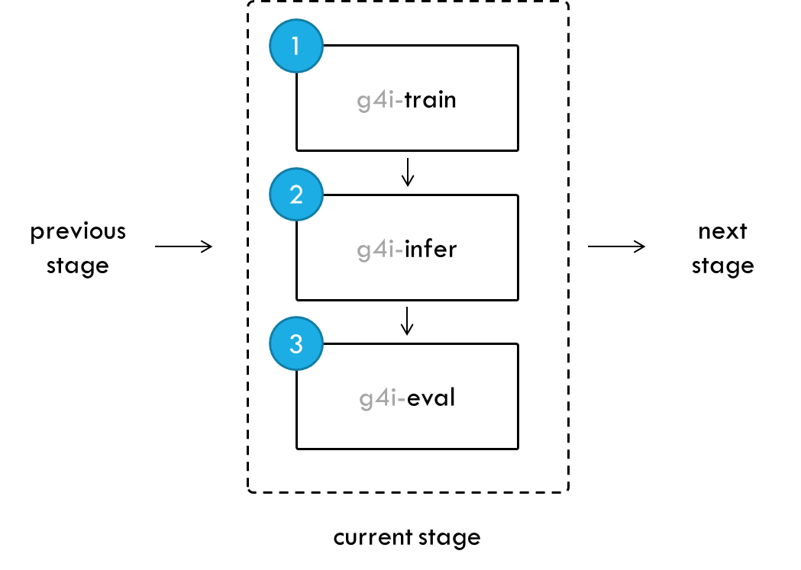
A realization: The ATLAS GNN4ITK Common Framework
CTD 2022 - Charline Rougier
Common Framework helps with collaboration, reproducibility, and -hopefully- adoption https://github.com/GNN4ITkTeam/CommonFramework

Slide 7
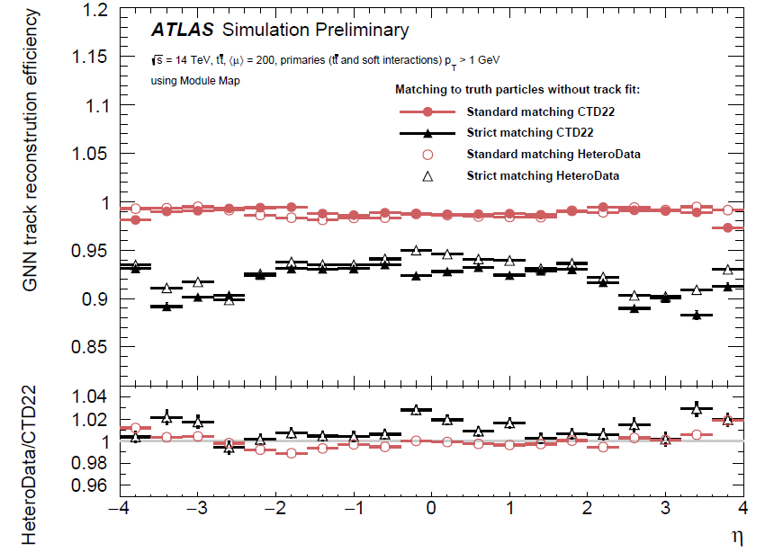
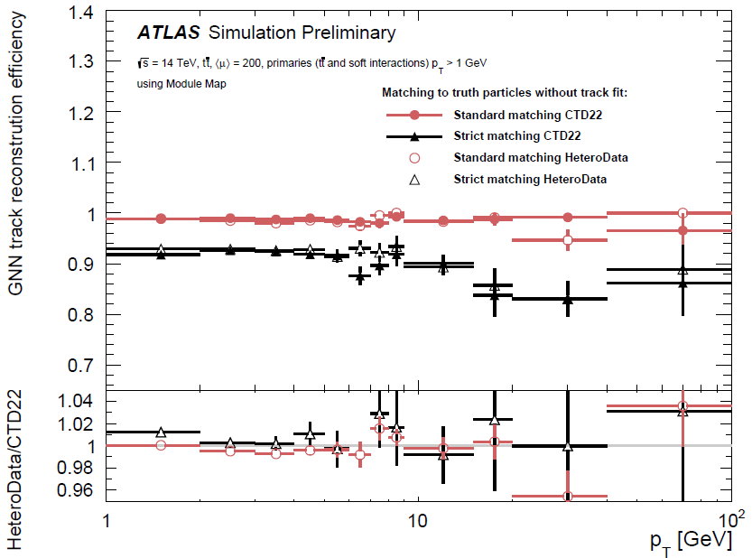
Tracking for HL-LHC: ATLAS ITk
Satisfyingly flat performance!
Satisfyingly flat performance!
(X. Ju, 8 May, 14:45)
Achieved high tracking efficiency and low fake rate

Slide 8
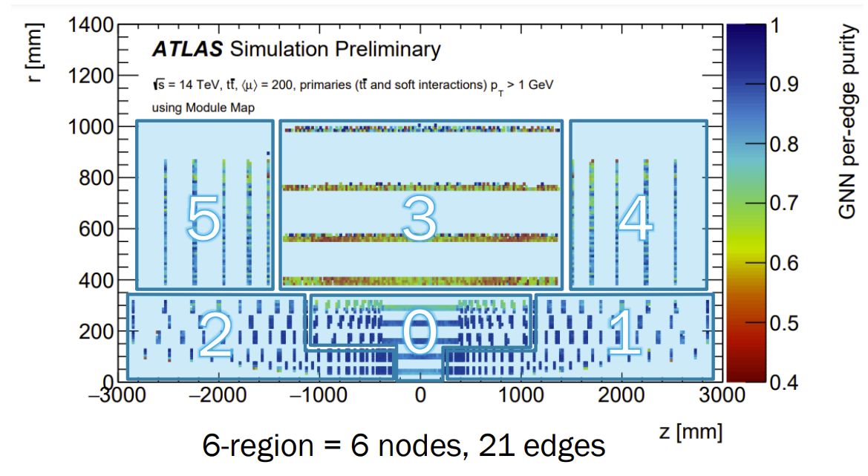
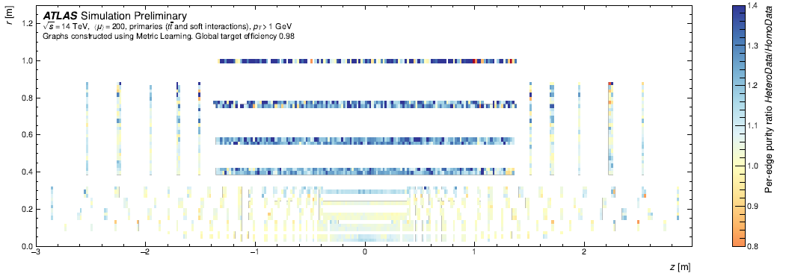
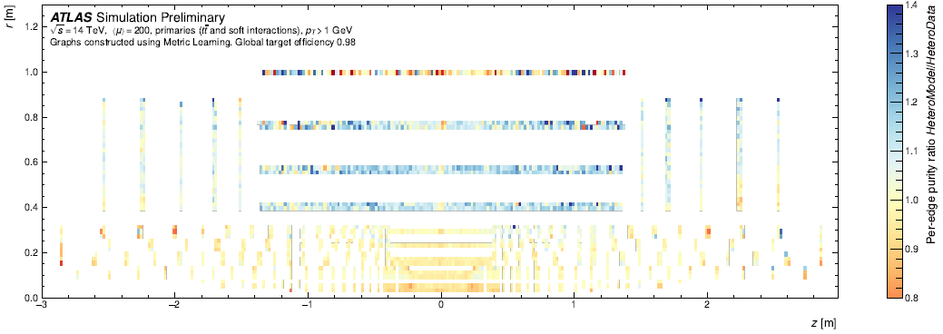
Recent Progress: Handling Hardware Heterogeneity
Different performance across ATLAS ITk
Pixel spacepoints vs Strip clusters
Solution: Encode different points with Heterogeneous GNN (D. Murnane, CTD 2022)
Recovers performance lost in a homogeneous GNN (S. Caillou, 9 May, 15:00)
Hetero Data
Hetero Model
+23%
+11%
-1%
Overall 94% edge purity @ 95% efficiency

Slide 9
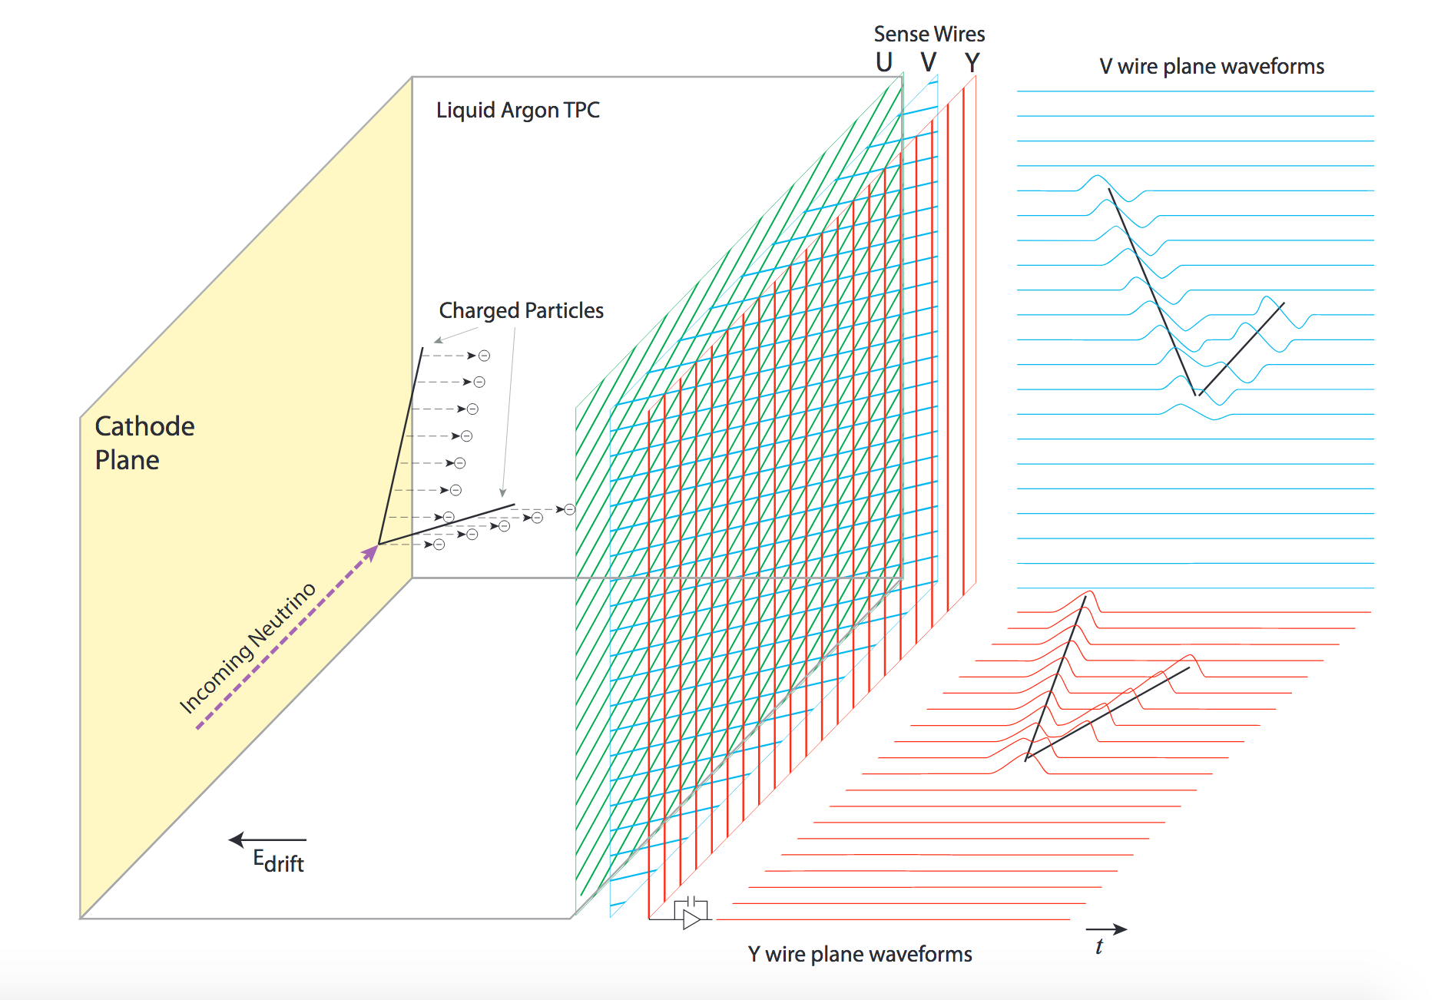
Tracking for Liquid Argon TPCs
Liquid Argon Time Projection Chambers (LArTPCs) currently a heavily utilised detector technology in neutrino physics.
At FNAL: MicroBooNE, Icarus, SBND.
Future: DUNE (70kT LArTPC deep underground, plus near detector).
Charged particles ionize liquid argon as they travel.
Ionisation electrons drift due to HV electrode field, and are collected by anode wires.
Wire spacing ~3mm – high-resolution detector.

Slide 10
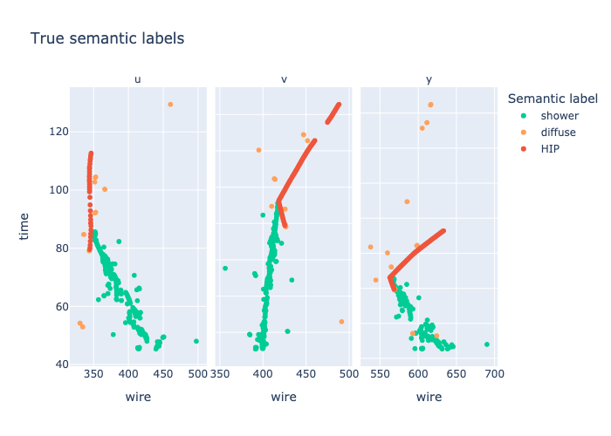
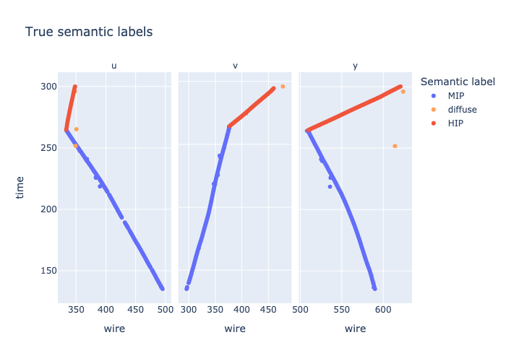
Exa.TrkX Goal: Classify Hits by Particle Type
These event displays
show ground truth

Slide 11
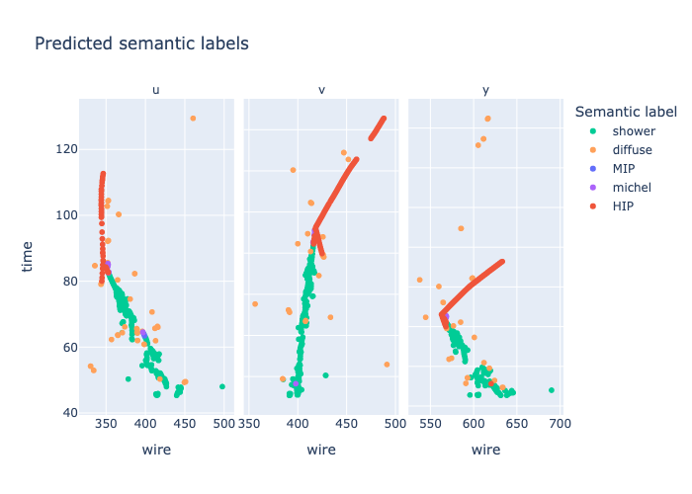
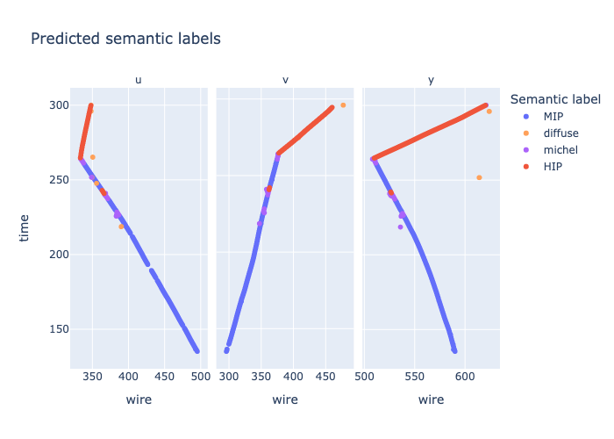
Exa.TrkX Goal: Classify Hits by Particle Type
These event displays
show model output

Slide 12
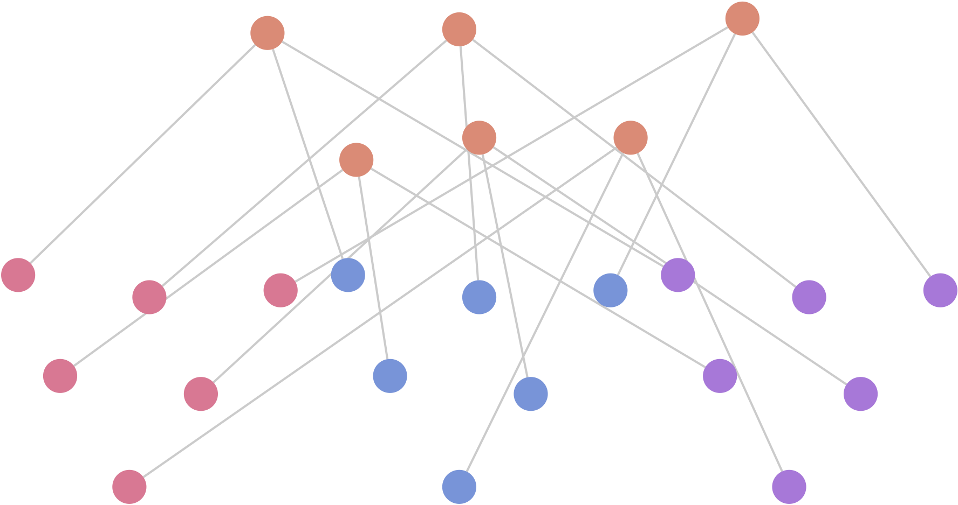
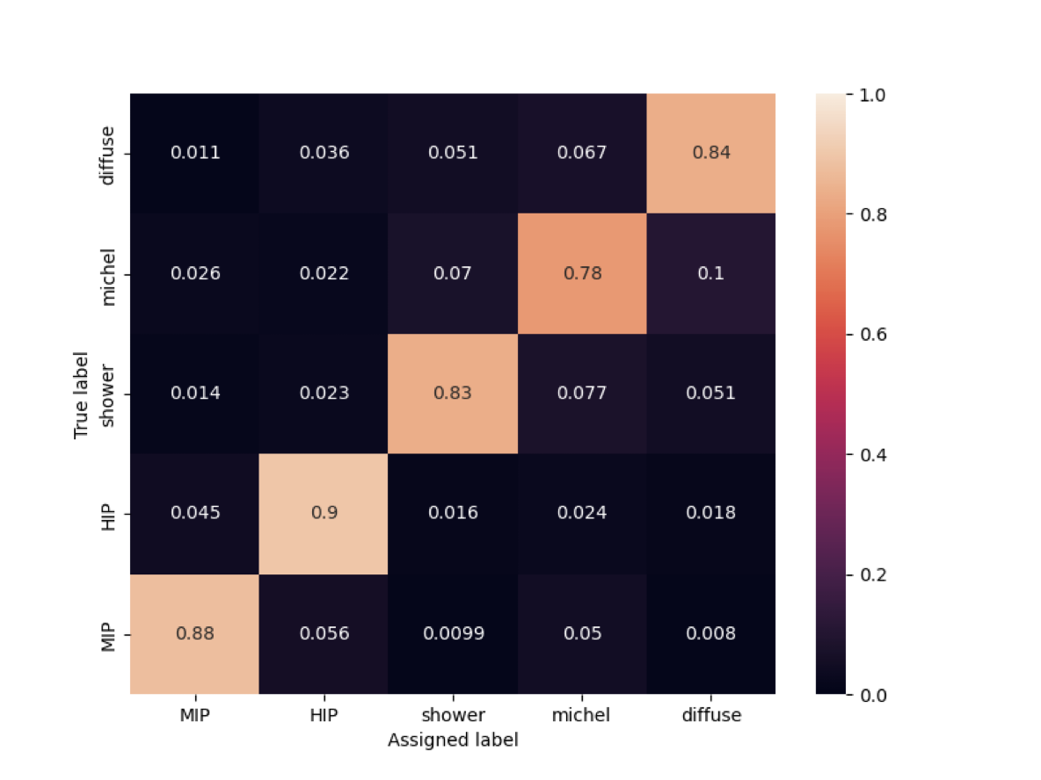
NuGraph2 performance
Current model achieves 86% accuracy in semantically labeling 2D detector hits.
With 3D connections, consistency of representations between views is now around 98%, compared to ~70% without).
Model memory footprint ~500 kB
Inference on CPU ~0.12 s / event
Inference batched on GPU ~0.005 s / event
V Hewes, 9 May , 12:15

Slide 13
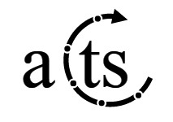
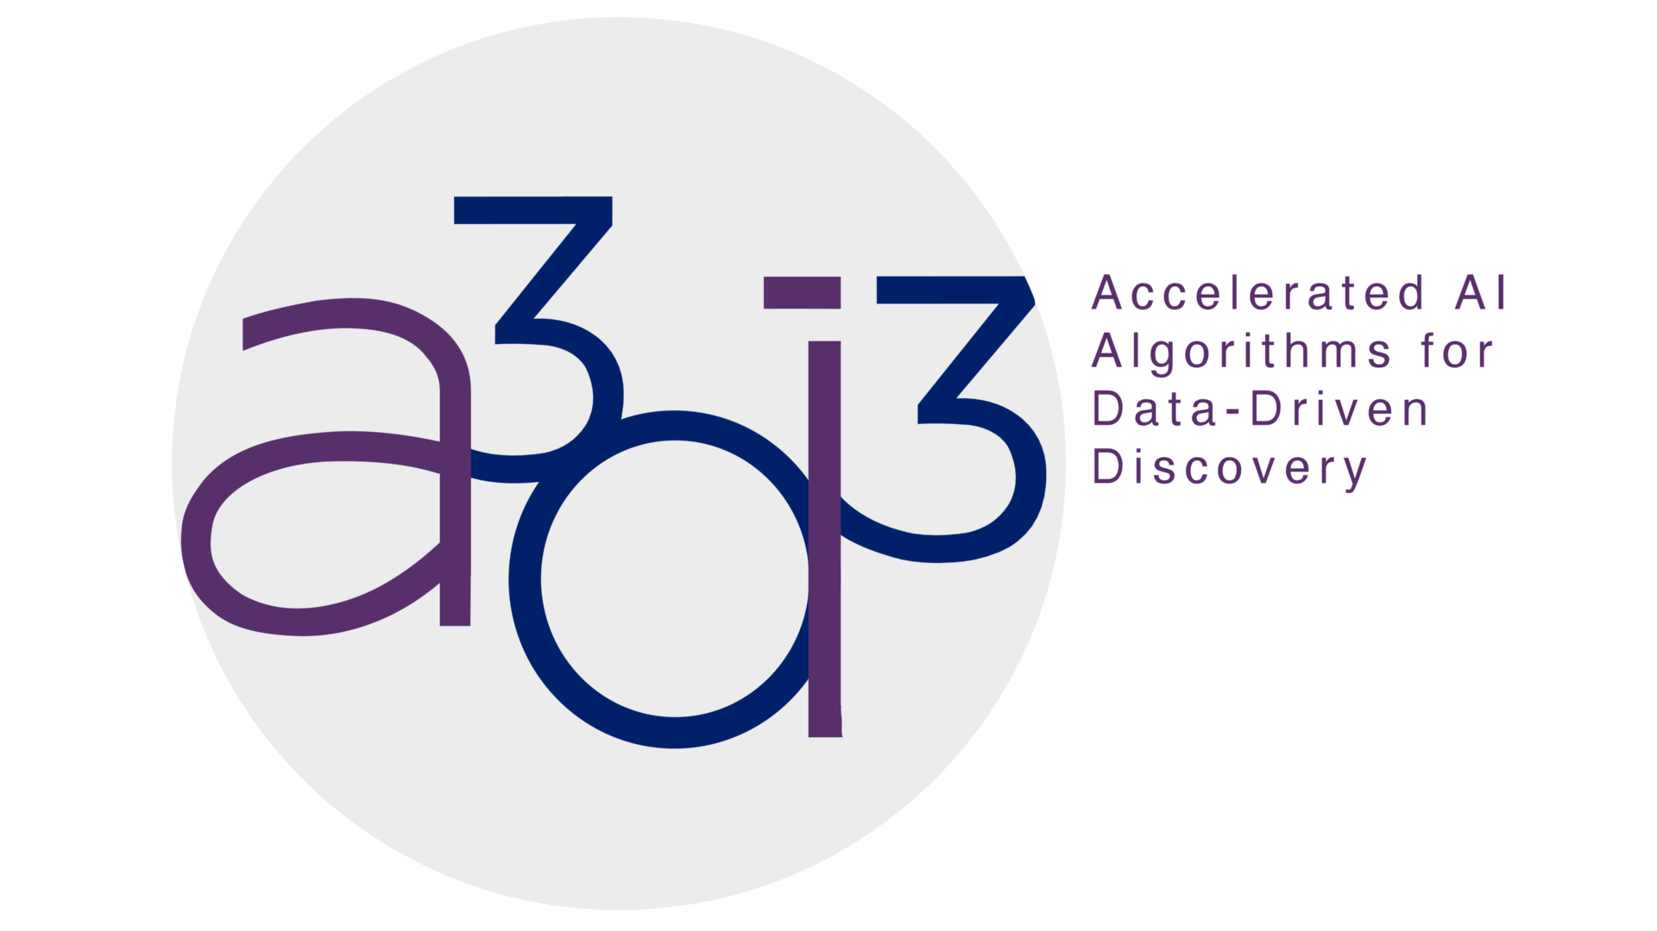
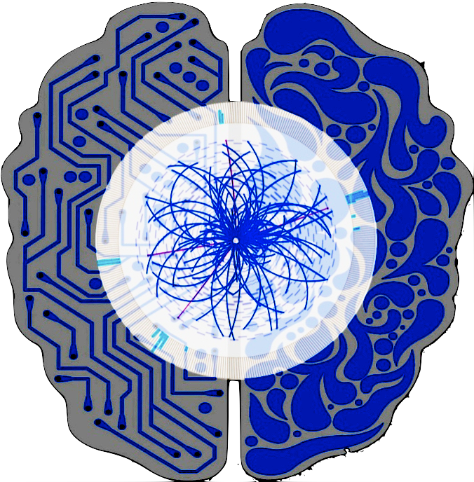
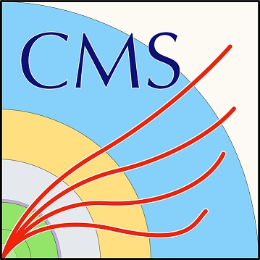
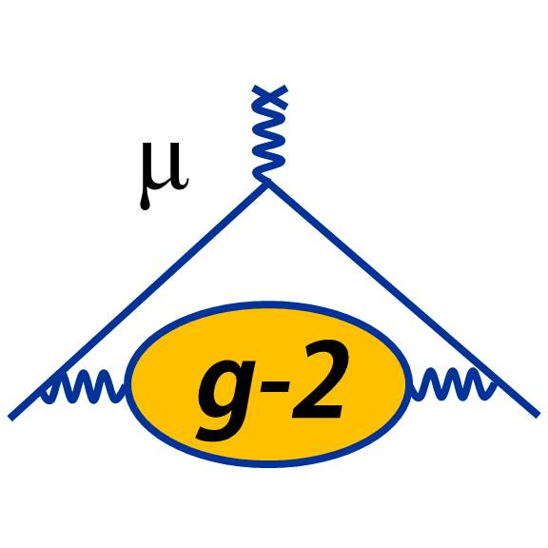
An Open Collaboration
TrackML
NuML
Princeton
SPRACE
L2IT
UChicago
Cincinnati
Youngstown
Krakow
Weizmann
CalTech, FNAL, LBNL
Tsing Hua
ExaLearn
UIUC
SLAC
UWashington
UW Madison
Northwestern
FastML Lab
Uppsala
LArTPC

Slide 14
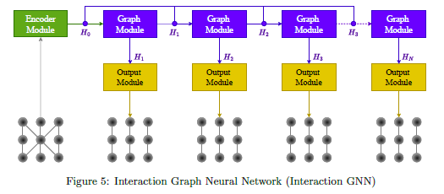
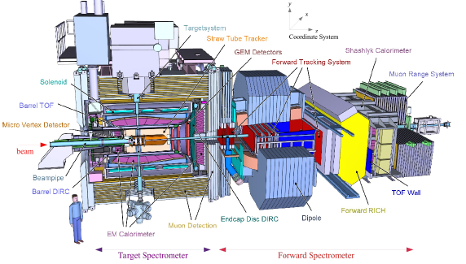
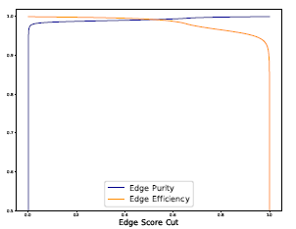
Contributed: Straw Tube Tracking for the PANDA experiment
CTD 2022
Built on Exa.TrkX pipeline

Slide 15
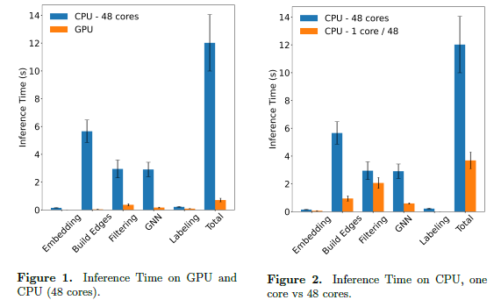
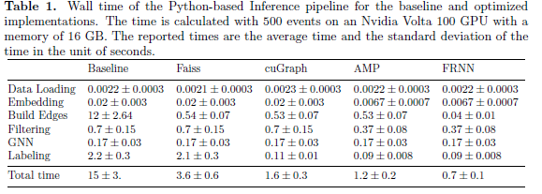
Contributed: Optimizing the ITk Computing Performance
CPU
GPU
CPU
Intel Xeon 8268s NVIDIA V100
Lazar et al ACAT 2021
CTD 2022
TrackML
Data
EPJ C 2021
Achieved ~linear scaling vs # hits
Sped up GPU inference 20x
< 1s wall-clock on GPUs
Now dominated by Filtering MLP & GNN
CPU inference 15x-200x slower
Parallelized, not yet optimized
Notes:
Filtering done with MLP creates steps with v100
Faiss: build graph radius cut
cuGraph: GPU connected components
AMP: automatic mixed precision
FRNN: ExaTrkX developed fixed radius nearest neighbour algorithm

Slide 16
Contributed: Exa.TrkX as a Service
CTD 2022: Exa.TrkX as a Service
Collaboration with A3D3, NERSC, NVIDIA. Recently started work with ATLAS/GCP project
Functional prototypes, Optimization starting
Compute Node
Grid/Local Compute Farm
Nvidia Triton Server
A100
GPU
A100
GPU
A100
GPU
A100
GPU
gRPC Load Balancer
CPU
Compute Node
CPU
WLAN
CPU
Nvidia Triton Server
A100
GPU
A100
GPU
A100
GPU
A100
GPU
Andrew Naylor
Notes:
Plots showing

Slide 17
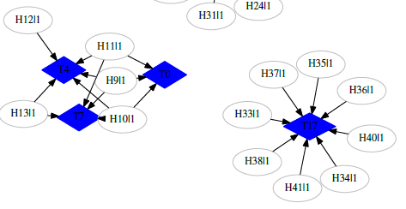
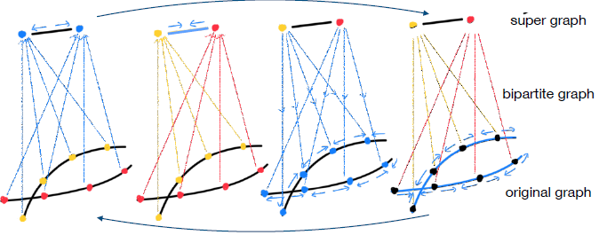
Back to the Future: Hierarchical GNNs
Ryan Liu - ACAT 2022
Tracks
Hits
HGNNs features:
Direct representation of high-level concepts (“track”)
Multi-scale information pooling
Long-range interactions even across missing edges
Tested on small “TrackML-1GEV” events (~1K particles/10K spp)
Scaling to higher densities to be understood

Slide 18
Summing Up Geometric Deep Learning for High-Energy and Nuclear Physics
ExatrkX Intensity Frontier
2026?
Segmentation and classification
Object clustering
Partial heterogeneity
2D → 3D mapping
HDF5 → ML composable interfaces
HepTrkX
Future Work
Full heterogeneity across detectors
Raw-to-particle hierarchical models
Multi-task, -modal generalist PR engine
2023
ExatrkX Energy Frontier
GNN edge classification
Large graph memory handling
Graph segmentation algorithms
High-throughput nearest neighbors
Metric Learning
Multi-stage pipeline software
2018

Slide 19
Thanks for your attention!
https://exatrkx.github.io/
Related talks this week:
Physics Performance of the ATLAS GNN4ITk Track Reconstruction Chain https://indico.jlab.org/event/459/contributions/11414/ - X. Ju, 8 May 2023, 14:45
Graph Neural Network for 3D Reconstruction in Liquid Argon Time Projection Chambers https://indico.jlab.org/event/459/contributions/11733/ - V Hewes, 9 May 2023, 12:15
End-to-End Geometric Representation Learning for Track Reconstruction https://indico.jlab.org/event/459/contributions/11743/ - D. Murnane (P. Calafiura), 9 May 2023, 14:00
An Object Condensation Pipeline for Charged Particle Tracking| https://indico.jlab.org/event/459/contributions/11741/ - G. deZoort, K. Liriet, 9 May 2023, 14:15
Track reconstruction for the ATLAS Phase-II HLT using GNNs on FPGAs https://indico.jlab.org/event/459/contributions/11375/ - S. Dittmeier, 9 May 2023, 14:30
Novel fully-heterogeneous GNN designs for track reconstruction at the HL-LHC https://indico.jlab.org/event/459/contributions/11713/ - S. Caillou, 9 May 2023, 15:00

Slide 20
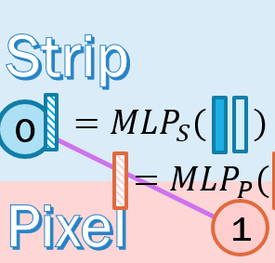
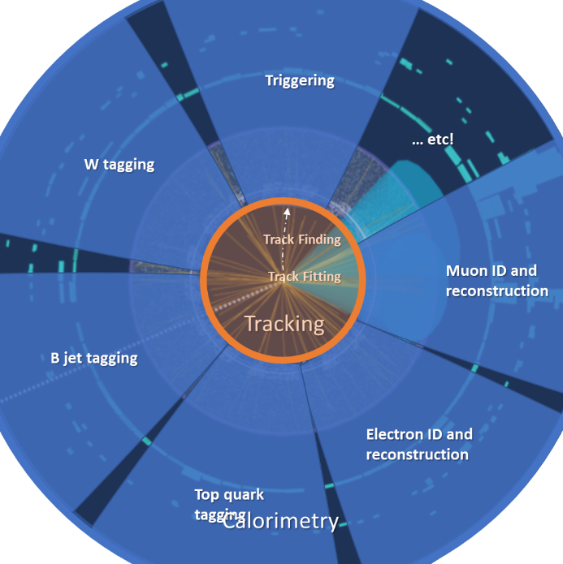
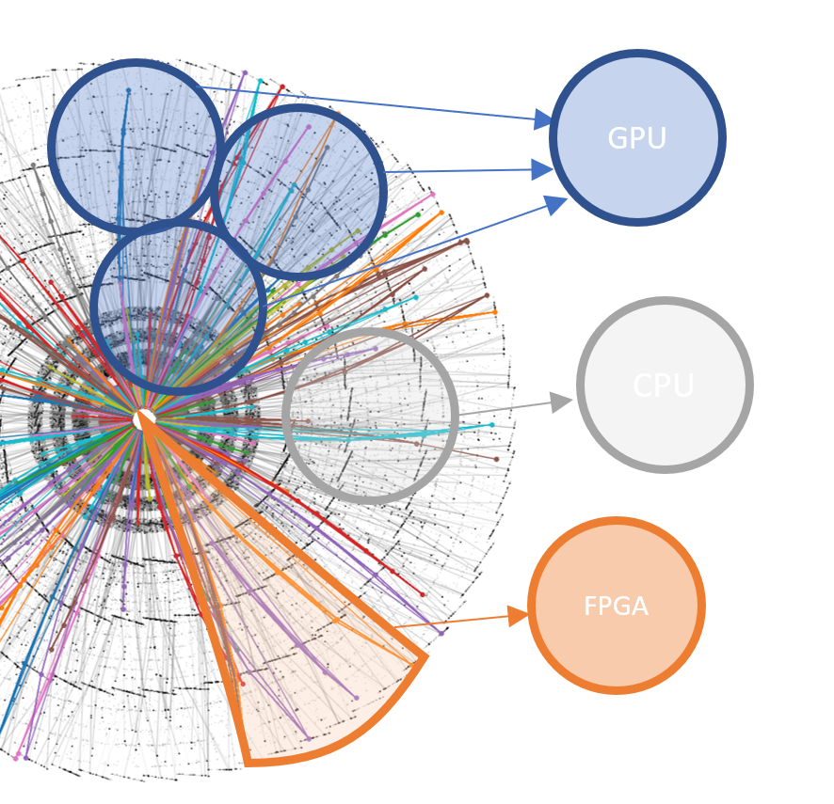
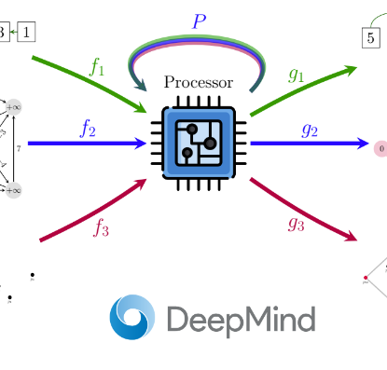
Backup
Heterogeneity
Composability
Parallelism
Generalisability
Notes:
Point out Rapids connection in parallelism / graph sampling project

Slide 21
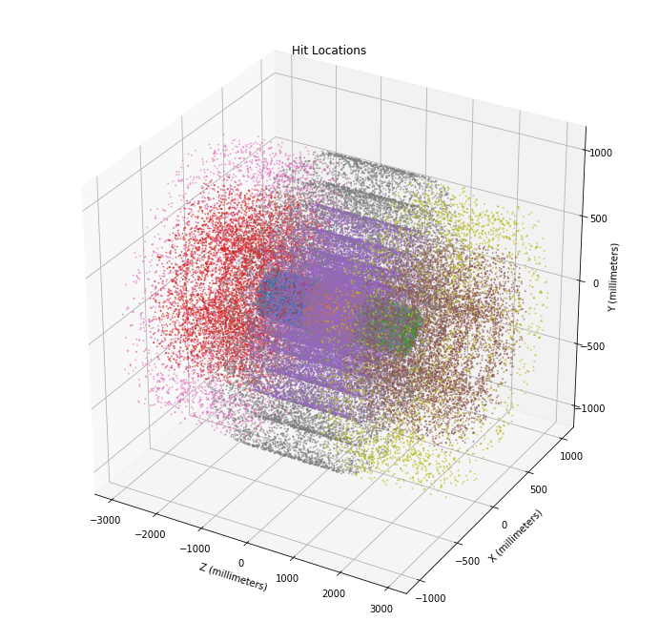
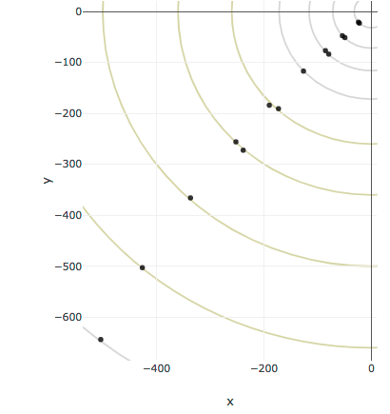
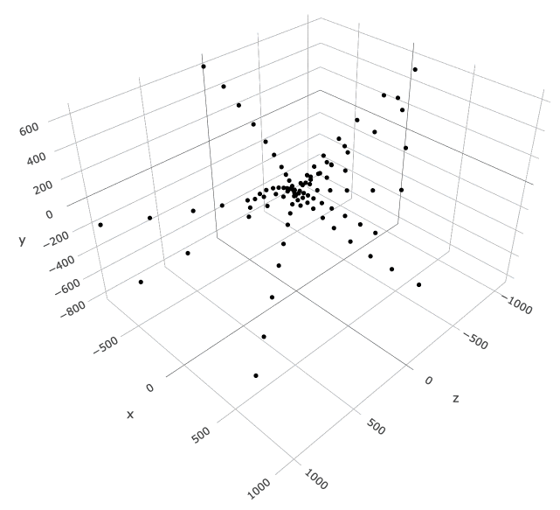
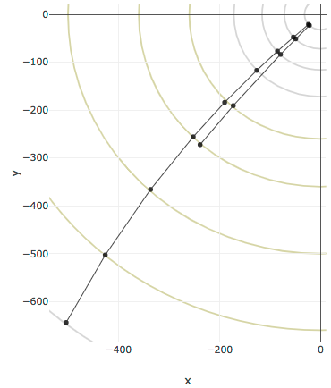
Particle tracking in HEP experiments
Pattern recognition from measurements (hits) to reconstructed particle trajectories (tracks).
Track fitting determine the parameters of the particle trajectory from a set of hits.
Notes:
In HEP experiments, particle trajectories need to be reconstructed.
During pattern recognition, we can start with a cloud of 3D spacepoints, called hits. The goal is then to assign hits to zero or one particles, hence recreating track candidates.

Slide 22
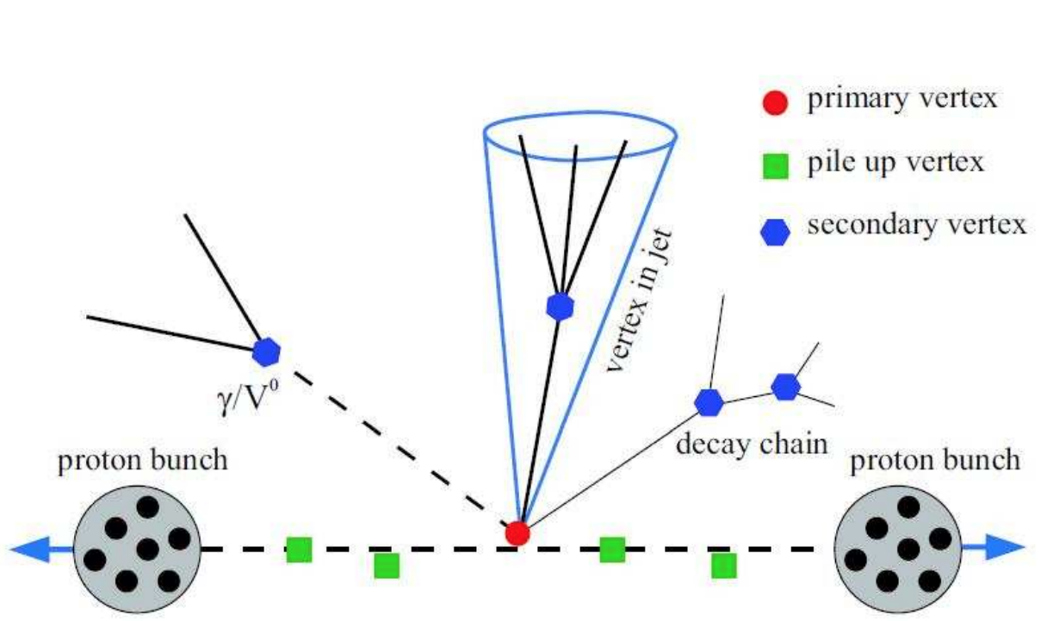
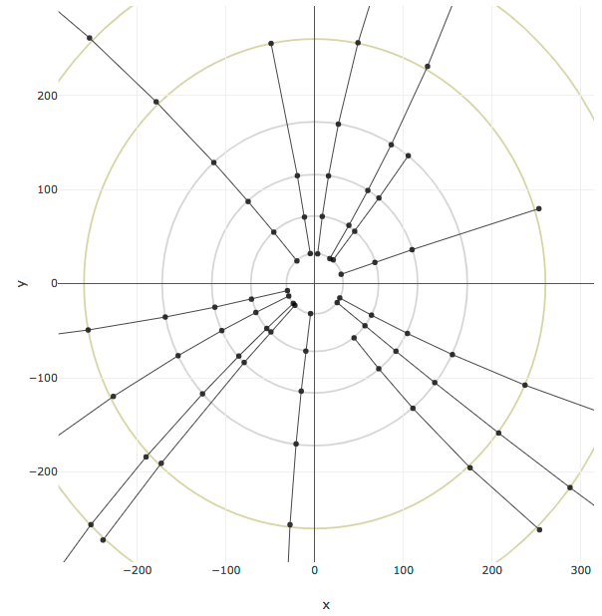
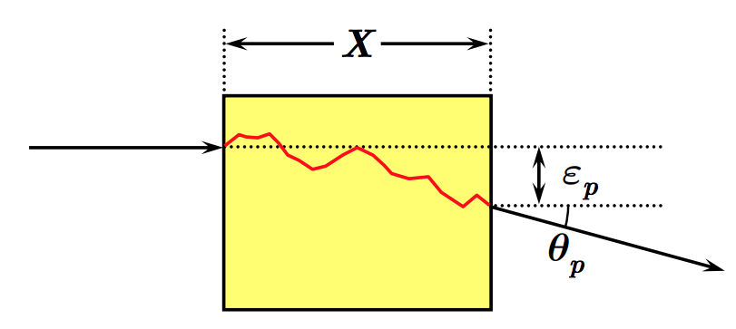
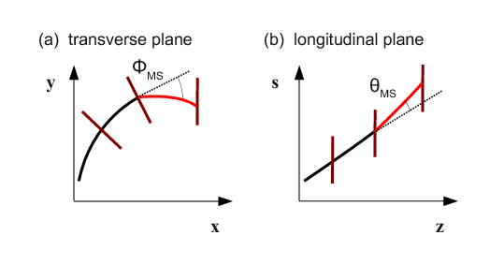
Why is tracking hard ?
real world
hard scattering, secondary vertices, decay...
collisions at the center of the detector
interaction region
multiple scattering
perfect solenoid magnets...
holes, double hits and measurements errors
...helices in X-Y, straight lines in R-Z
complete tracks,
good measurements
→ algos complex and imperfect !
perfect world
Notes:
To reconstruct tracks, we can rely on some properties of the system.
collisions are located in the center of the interaction zone
thanks to solenoid magnets, the particles bends, so that they trace nice arc of helices in the transverse plane and straight lines in the R-Z plane
the particles are correctly detected
But if this were always true, we wouldn’t have any challenge.
In real world,
particle can arise from pretty much anywhere in the detector, due to secondary collision, particle decay and hard scattering.
When they go through a material, their trajectories can change significantly due to multiple Coulomb scattering.
particles can pass through undetected, creating holes, be detected multiple times or two particles can leave only one measurements.

Slide 23
Graph networks beyond tracking
Recent IML topical meeting dedicated to Particle Flow reconstruction

Slide 24
Experiment Integrations
What’s been accomplished
What’s next
Integrated into ACTS (a Common Tracking Software), and available for general usage
Collaboration with PhD students in ACTS to performance validation tests
Integrated into official ATLAS simulation and validation framework
Allows for apples-to-apples comparison of timing and physics performance
Beginning integration with workflows of other HEP communities, such as FPGA-based trigger system
Plot courtesy of Benjamin Huth, ACTS, University of Regensburg
Notes:
Mention that this comparison was done by Benjamin.

Slide 25
Case Study: Composability
Common Framework across HEP domains
What’s been accomplished
What’s next
Working with trigger community to apply Exatrkx GNN pipeline to region-based online tracking
Instead of building full online tracking, planning a project of end-to-end GNN trigger
No need for link-prediction, simply perform graph classification on whole event, training to the trigger menu of the HL-LHC Event Filter
Similarly, planning on node-level and subgraph-level regression tasks, such as classifying particle types and track parameters
Synergy here with neutrino experiment GNNs, which are used to performing particle type classification

Slide 26
Case Study: Composability
Common Framework across HEP domains
What’s been accomplished
What’s next
To handle different detectors and experiments
Would aim to combine training structure of LHC-like and DUNE-like experiments
To handle different training tasks
Currently allow point-cloud to track candidate
Several stages in between allow for point-cloud to graph, and graph to link prediction
Would like to handle more tasks and data structures

Slide 27
Case Study: Parallelism
Graph partitioning and message passing
What’s been accomplished
What’s next
Memory limits our GNN performance. Running on multiple GPU would open new possibilities.
While speeding up training and inference…
In collaboration with the RAPIDS2 SCIDAC-4 Institute, and Youngstown State University, we want to investigate graph data parallelism, an active research area. Our goals include:
Develop message passing schemes to parallelize and speed up edge-level and graph-level prediction tasks for large graphs.
Evaluate and adapt various graph sampling and partitioning approaches to HEP tracking data and prediction tasks.
Our graphs change structure with every event, making the problem even more challenging.
https://doi.org/10.1007/978-981-16-6054-2_6

Slide 28
Towards a General Physics Processor
Clear synergy with neutrino GNN framework ambitions
Have started collaboration with Petar Velickovic @ DeepMind
We are interested in reducing the number of different models used for different tasks, and instead get model that is greater than the sum of the parts
Petar has research interest in GNN-based generalist processors – related to “Foundation Models”, or “Unified Models”
Beginning with a GNN that can complete two separate tasks with the same central processor
Arxiv:2209.11142, Velickovic et al.
Physics Processor

Slide 29
NuGraph2
Detector hits
Developed NuGraph2, a message-passing GNN for particle ID.
Semantically label detector hits according to particle type.
Developed by ExaTrkX in collaboration with the University of Chicago Data Science Institute.
Originally developed for the DUNE far detector.
Current application utilises MicroBooNE open dataset.
Utilise PyG for graph convolutions and PyTorch Lightning as model backbone.
Encoder
Message-passing
backbone
Hit ID

Slide 30
Potential future work: NuGraph3
Plans for a potential next-generation NuGraph3 involve leveraging the existing model backbone to train multiple decoders simultaneously:
Binary signal/background classifier to distinguish signal (ie. beam) hits from background (ie. cosmic) hits.
Instance segmentation to cluster together hits into particles, which provides full particle reconstruction.
Hierarchical graph network for particle flow on reconstructed particles.
Encoder
Message-passing
backbone
Clustering
Filtering
Hit ID

Slide 31
Common abstraction for neutrino experiments
Although the details of many neutrino physics experiments vary, the majority of them share a common paradigm at a high level.
NOvA
MicroBooNE
Shared structure
Neutrino generator
(GENIE)
Neutrino generator
(GENIE)
Event information
Particle simulation
(Geant4)
Particle simulation
(Geant4)
True particles
True light
depositions
True ionization
electrons
True energy
deposits
Photoelectrons
on APDs
Pulses on
TPC wires
Detector hits

Slide 32
NuML & PyNuML
Beyond the GNN architecture itself, many of the tools developed have broad utility beyond our specific workflow.
The NuML package is a toolkit for writing physics event records to an HDF5 file format.
This file format is generic and can be shared across many experiments.
The PyNuML package is designed to provide a generic, accessible, efficient and flexible solution for many of the necessary tasks in leveraging ML for particle physics.
Define particle ground truth labels for Geant4-simulated particles.
Arrange detector hits into ML objects, ie. graphs, CNN pixel maps, etc.
Efficiently preprocess ML inputs in parallel in HPC environments using MPI.
Tools developed in collaboration with Northwestern University through SciDAC’s data institute, RAPIDS.

Slide 33
MicroBooNE open data release
ExaTrkX's NuML pipeline was used as the backbone of the MicroBooNE experiment's recent open data release (https://github.com/uboone/OpenSamples).
An HDF5 dataset was released containing raw tables of simulated particles, detector hits etc.
This data release enables open development of machine learning algorithms by making low-level simulation available to a broader machine learning community.
ExaTrkX’s tools provide a powerful interface for accessing these files.

Slide 34
GNN4ITK COMMON FRAMEWORK
September, 2022
October-December, 2022
Today

Slide 35
A GNN4ITK STAGE
PyG Dataset
Input directory
Here is the graph construction stage, for example
Each stage takes an input dataset of PyG (or CSV) events
The input data is tested to ensure it is well-constructed, and then processed
Each stage produces a saved Pytorch model, an inferred dataset, and a set of plots to evaluate performance
Every stage configuration is tattooed onto the data and model artifacts it produces: simple but gives full history of training pipeline
Opinionated in structure, but can add new stages with any custom behavior
Graph Construction
Module Map
An Example
Stage
Input testing
Truth and weight building
PyLightning
Metric Learning
g4i-train
g4i-infer
g4i-eval
Stage directory
Saved Model
PyG Dataset
Performance Plots

Slide 36
EXAMPLE DATAFLOW
Each stage has parent class that provides convenience methods for testing input data, reading, building truth, and defining how it runs with g4i-[train,infer,eval]
Each model in a stage (e.g. AthenaReader) inherits from this class and runs custom code
A model can also inherit from Pytorch Lightning, then g4i knows how to handle this automatically
EventReading
GraphConstruction
EdgeClassification
Athena Reader
PyG Data
Module Map
PyLightning
PyG Data
Filter
Events (csv)
PyLightning
Input testing
Truth and weight building
CSV Data
Input testing
Truth and weight building
Input testing
Truth and weight building
PyLightning
HomoGNN
Config (yaml)
ACTS Reader
Metric Learning
PyLightning
Config (yaml)
Config (yaml)
HeteroGNN
Saved Model
Saved Model

Slide 37
MACHINE LEARNING DIRECTIONS HIERARCHY AND POINT CLOUD ML
Hierarchical GNNs
Idea: include “track-like” nodes, and match hit nodes to track nodes
Shown to be able recover excellent performance even on inefficiently constructed graphs 🡪
Point Cloud ML (i.e. dynamic GNNs)
Proven technology on jet tagging (paper @ Neurips)
Early studies in tracking show good end-to-end track building performance
Liu R, DM, Calafiura P, Ju X @ ACAT22

