Slide 1
JUNO Offline Software for Data Processing and Analysis
Ziyan Deng, Wenxing Fang, Xingtao Huang, Teng Li, Weidong Li, Tao Lin, Zhengyun You, Jiaheng Zou
on behalf of the JUNO offline software team
May 8-12 , 2023
1

Slide 2
Contents
JUNO Experiment
JUNO Software (JUNOSW)
Framework
Event Data Model
Geometry Management System
Event Display Tools
Database System
Analysis Framework
Data Processing and Analysis Chain
Summary

Slide 3
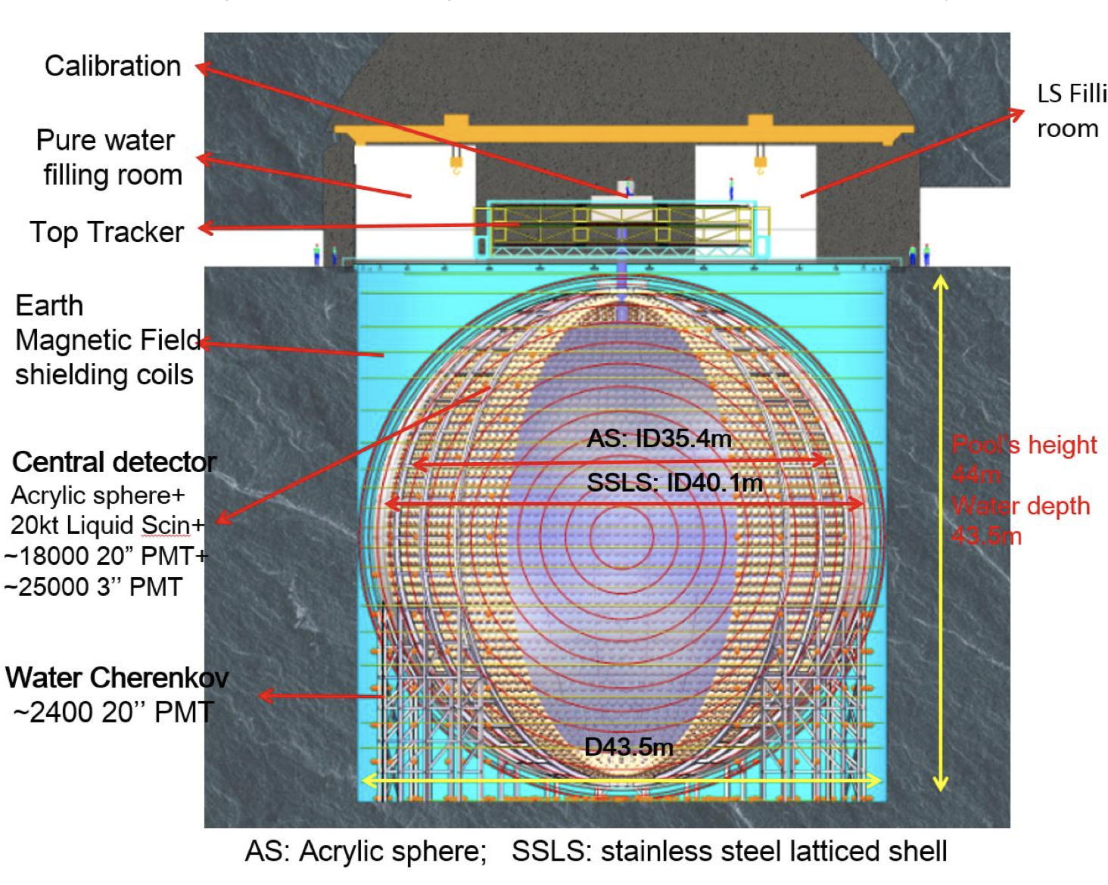
Jiangmen Underground Neutrino Observatory (JUNO)
JUNO is a multiple-purpose neutrino experiment currently under construction in southern China
Large fiducial volume: 20 kton liquid scintillator detector
Excellent energy resolution :3% energy resolution at 1MeV
Rich physics programs:
“JUNO physics and detector”, Progress in Particle and
Nuclear Physics, Volume 123, March 2022, 103927
Reactor neutrinos: Mass Hierarchy and precision measurement of oscillation parameters
﻿﻿Supernova neutrinos
﻿﻿Geoneutrinos
﻿﻿Solar neutrinos
﻿﻿Atmospheric neutrinos
Status:
Finished civil construction in Dec. 2021
Detector assembling goes smoothly now
Expected to start data taking in 2024

Slide 4
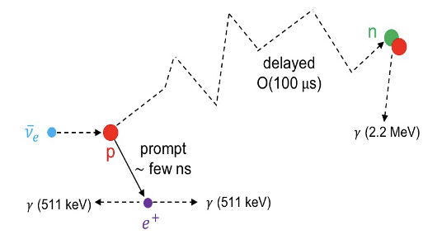
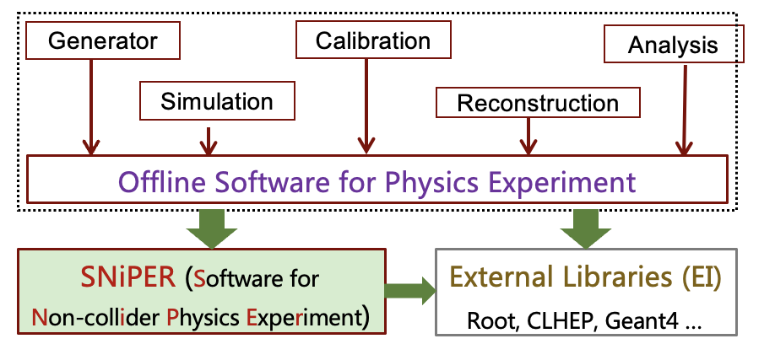
JUNO Software (JUNOSW)
Data processing and analysis of neutrino experiments is different from the one of the collider experiments, i.e. reactor neutrino is detected with the Inverse Beta Decay (IBD)
M.C. production: Event splitting and mixing -> one neutrino event splits a prompt
and a delayed event -> complicate relations
Physics analysis : time and vertex coincidence between the
prompt and delayed events -> event buffering
Large data volume and rare signal: 2 PB/year * 20 years; only ~60 reactor neutrinos per day
JUNOSW (originally called as JUNO offline) has been developed based on NuWa ( the offline software of the Daya Bay experiment) from scratch since 2012.
Core Software: Framework, Event Data Model, Geometry Management, Database System, Analysis Framework
Applications: simulation, calibration, reconstruction and analysis
Modern management technologies: C++17, python3, cmake, gitlab (https://code.ihep.ac.cn/JUNO/offline/junosw)
“Modern Software Development for JUNO offline software” by Tao Lin on May 9

Slide 5
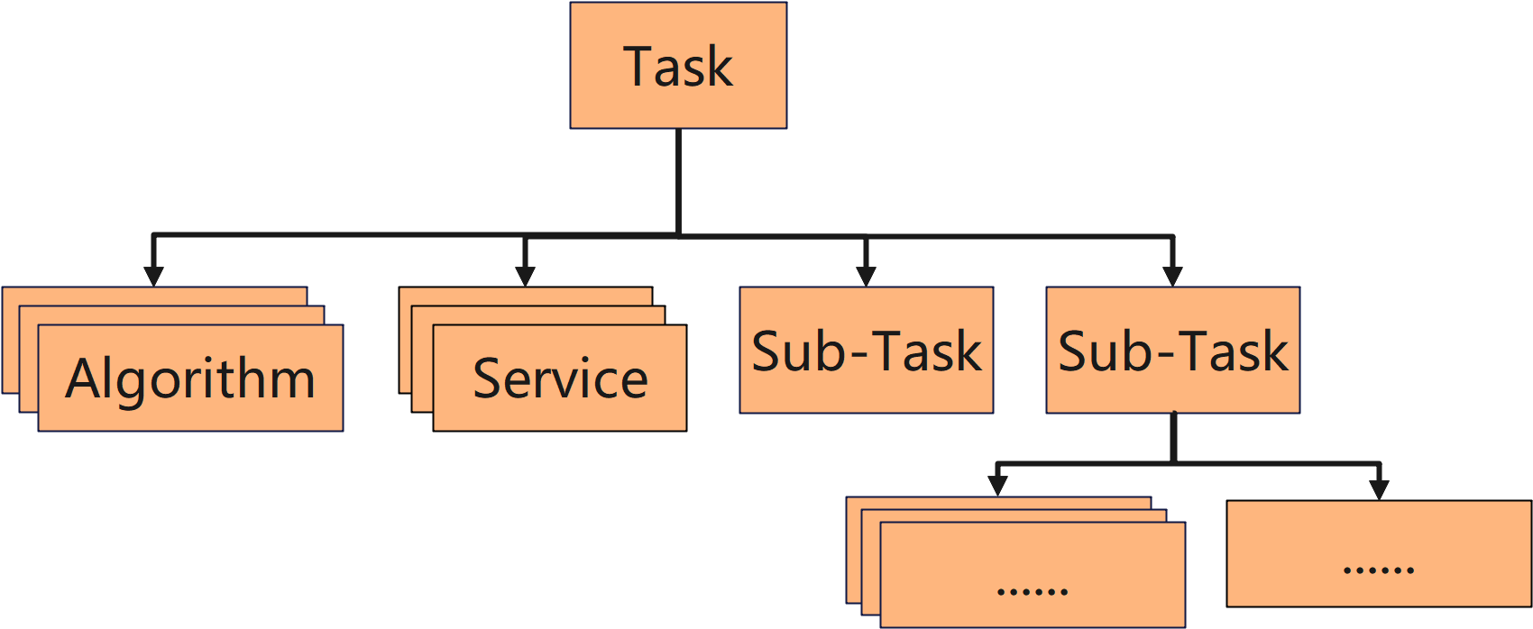
SNiPER Framework
SNiPER (Software for Non-Collider Physics Experiment) : a general-purpose software framework
Light weighted: only dependent on Boost.Python
Highly modularized and extensible
Originally developed for JUNO, but also adopted by several experiments: LHAASO, STCF, HERD, nEXO, etc.
Key components
Algorithm: an unit of event data proceeding
Service: an unit for common functions that can be called by users, anywhere when necessary.
Task: a lightweight application manager to assemble specific algorithms, service as well as sub-tasks.
Data Buffer: a central place in memory for holding and sharing multiple events
J. H. Zou et al 2015 J. Phys.: Conf. Ser. 664 072053

Slide 6
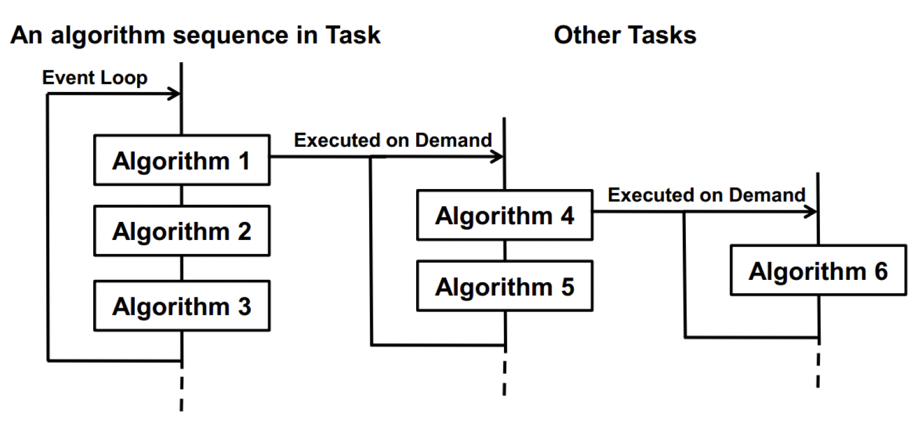
SNiPER Framework
SNiPER (Software for Non-Collider Physics Experiment) : a general-purpose software framework
Light weighted: only dependent on Boost.Python
Highly modularized and extensible
Originally developed for JUNO, but also adopted by several experiments: LHAASO, STCF, HERD, nEXO, etc.
Key components
Algorithm: an unit of event data proceeding
Service: an unit for common functions that can be called by users, anywhere when necessary.
Task: a lightweight application manager to assemble specific algorithms, service as well as sub-tasks.
Data Buffer: a central place in memory for holding and sharing multiple events
J. H. Zou et al 2015 J. Phys.: Conf. Ser. 664 072053

Slide 7
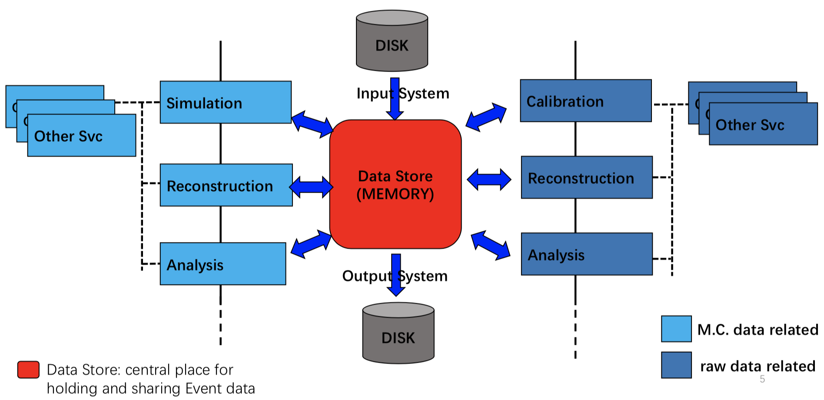
SNiPER Framework
SNiPER (Software for Non-Collider Physics Experiment) : a general-purpose software framework
Light weighted: only dependent on Boost.Python
Highly modularized and extensible
Originally developed for JUNO, but also adopted by several experiments: LHAASO, STCF, HERD, nEXO, etc.
Key components
Algorithm: an unit of event data proceeding
Service: an unit for common functions that can be called by users, anywhere when necessary.
Task: a lightweight application manager to assemble specific algorithms, service as well as sub-tasks.
Data Buffer: a central place in memory for holding and sharing multiple events
J. H. Zou et al 2015 J. Phys.: Conf. Ser. 664 072053

Slide 8
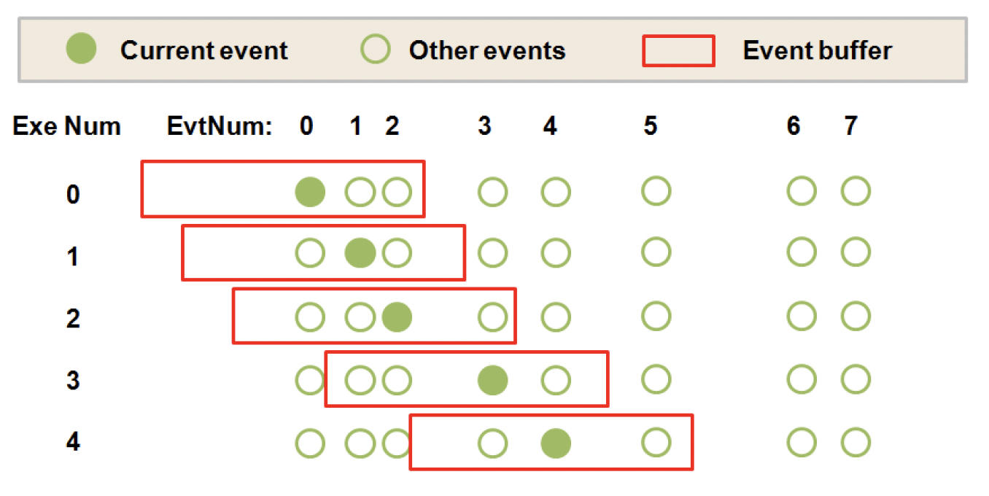
SNiPER Framework
SNiPER (Software for Non-Collider Physics Experiment) : a general-purpose software framework
Light weighted: only dependent on Boost.Python
Highly modularized and extensible
Originally developed for JUNO, but also adopted by several experiments: LHAASO, STCF, HERD, nEXO, etc.
Key components
Algorithm: an unit of event data proceeding
Service: an unit for common functions that can be called by users, anywhere when necessary.
Task: a lightweight application manager to assemble specific algorithms, service as well as sub-tasks.
Data Buffer: a central place in memory for holding and sharing multiple events
J. H. Zou et al 2015 J. Phys.: Conf. Ser. 664 072053

Slide 9
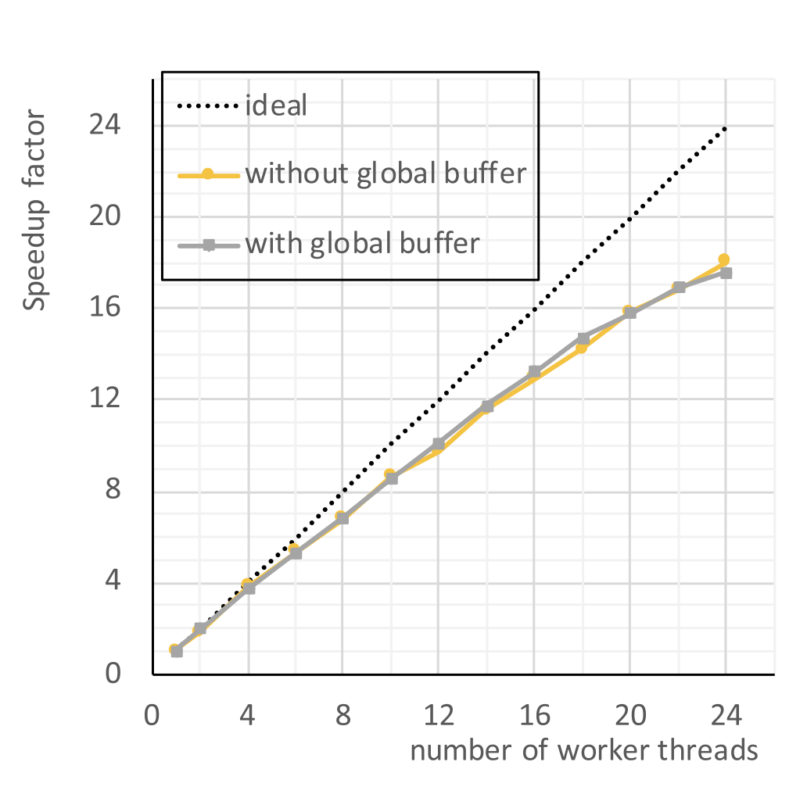
Multi-threaded SNiPER (MT.SNiPER)
MT.SNiPER supports concurrent task of event processing based on the TBB
A thread-safe Global Buffer is designed and implemented with a ring and configurable capacity and cordon
All events in the Global Buffer are sorted by their time stamps
Allow the dedicated Input Task, Worker Task, Output Task to put, take, and popup events at the same time in different threads
Events are concurrently processed in different Worker Tasks
The multi-threaded simulation and reconstruction have
been working very well
J.H. Zou et al., J. Phys. Conf. Ser. 1085, 032009 (2018)
T. Lin et al., EPJ Web of Conferences 214, 02008 (2019)

Slide 10
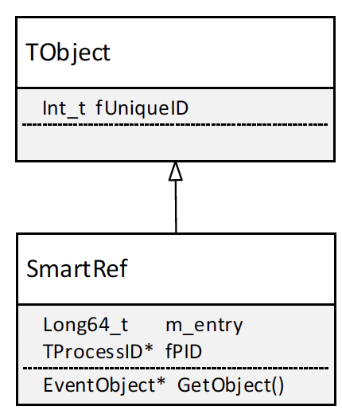
Event Data Model
Event Data Model (EDM) defining event objects for different processing stages and correlations between different event objects takes very important roles on the whole data processing and analysis
JUNO EDM is based on ROOT and takes advantage of its intrinsic powerful functions, persistency, IO streamer, scheme evolutions, run time type Information etc.
All EDM classes are derived from TObject
Two layer design (Header and Event) of EDM classes are adopted to speed up event selection
The Header holds light-weighted features (tag) of events while the Event holds heavy data
A smart references (SmartRef) based on GUUID is developed to build correlations between Header and Event
SmartRef also provides a lazy-loading mechanism to dramatically reduce I/O burden
T. Li et al., J. Phys. Conf. Ser. 762 (2016) 012001
T. Li et al., Chinese Physics C 41(6): 066201

Slide 11
Event Data Model
EvtNavigator is developed to serve as the catalogue for EDM objects
EvtNavigator also uses SmartRef to correlate EDM objects
A event-index mechanism based on Global UUID is implemented to facilitate cross-file correlation analysis
Provide the way to trace the MC truth of readouts at the event/particle/hit level with the help of external associations

Slide 12
Event Data Model
EvtNavigator is developed to serve as the catalogue for EDM objects
EvtNavigator also uses SmartRef to correlate EDM objects
A event-index mechanism based on Global UUID is implemented to facilitate cross-file correlation analysis
Provide the way to trace the MC truth of readouts at the event/particle/hit level with the help of external associations

Slide 13
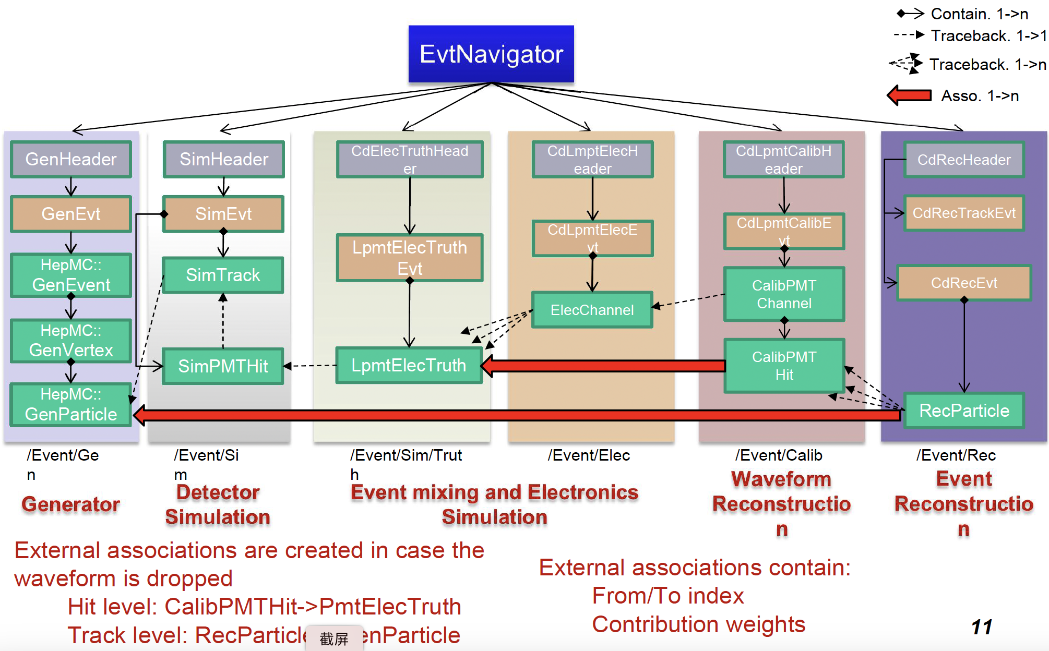
Event Data Model
EvtNavigator is developed to serve as the catalogue for EDM objects
EvtNavigator also uses SmartRef to correlate EDM objects
A event-index mechanism based on Global UUID is implemented to facilitate cross-file correlation analysis
Provide the way to trace the MC truth of readouts at the event/particle/hit level with the help of external associations

Slide 14
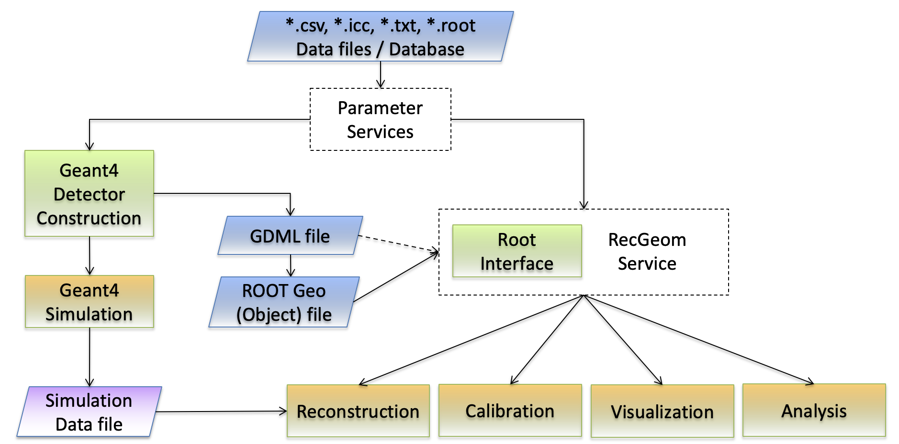
Geometry Management System (GMS)
GMS is developed to provide a consistent and detailed detector description for different applications
Input from single source of geometry data : currently from ROOT file, plan to read from DB
Export from Geant4 detector construction into GDML/ROOT TGeo file format
Perform automatic conversion with Files – Geant4 – GDML – ROOT – Applications with different services
Parameter Service
RecGeom Service
K. J. Li et al., NIM A 908 (2018) 43–48
Geometry information depending on different level of request
Some information not supported by GDML can be retrieved from Parameter Services
Optical Surface
Matrixes

Slide 15
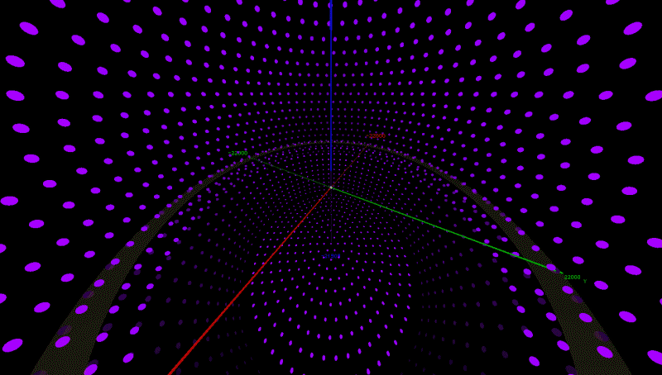
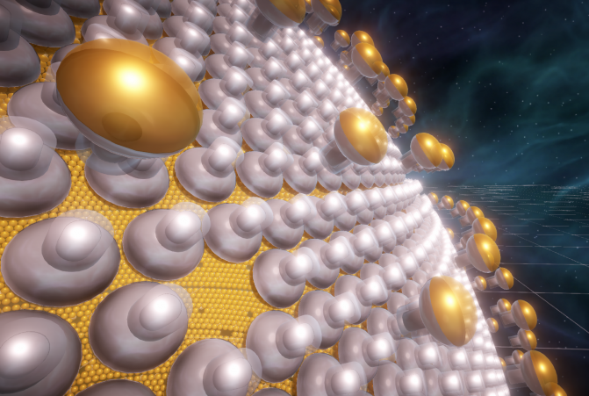
Event Display
Root based Event Display: SERENA (Software for Event display with Root Eve in Neutrino Analysis)
Unity based Event Display: ELAINA (Event Live Animation with unIty for Neutrino Analysis)
J. Zhu et al., JINST 14 (2019) 01, T01007

Slide 16
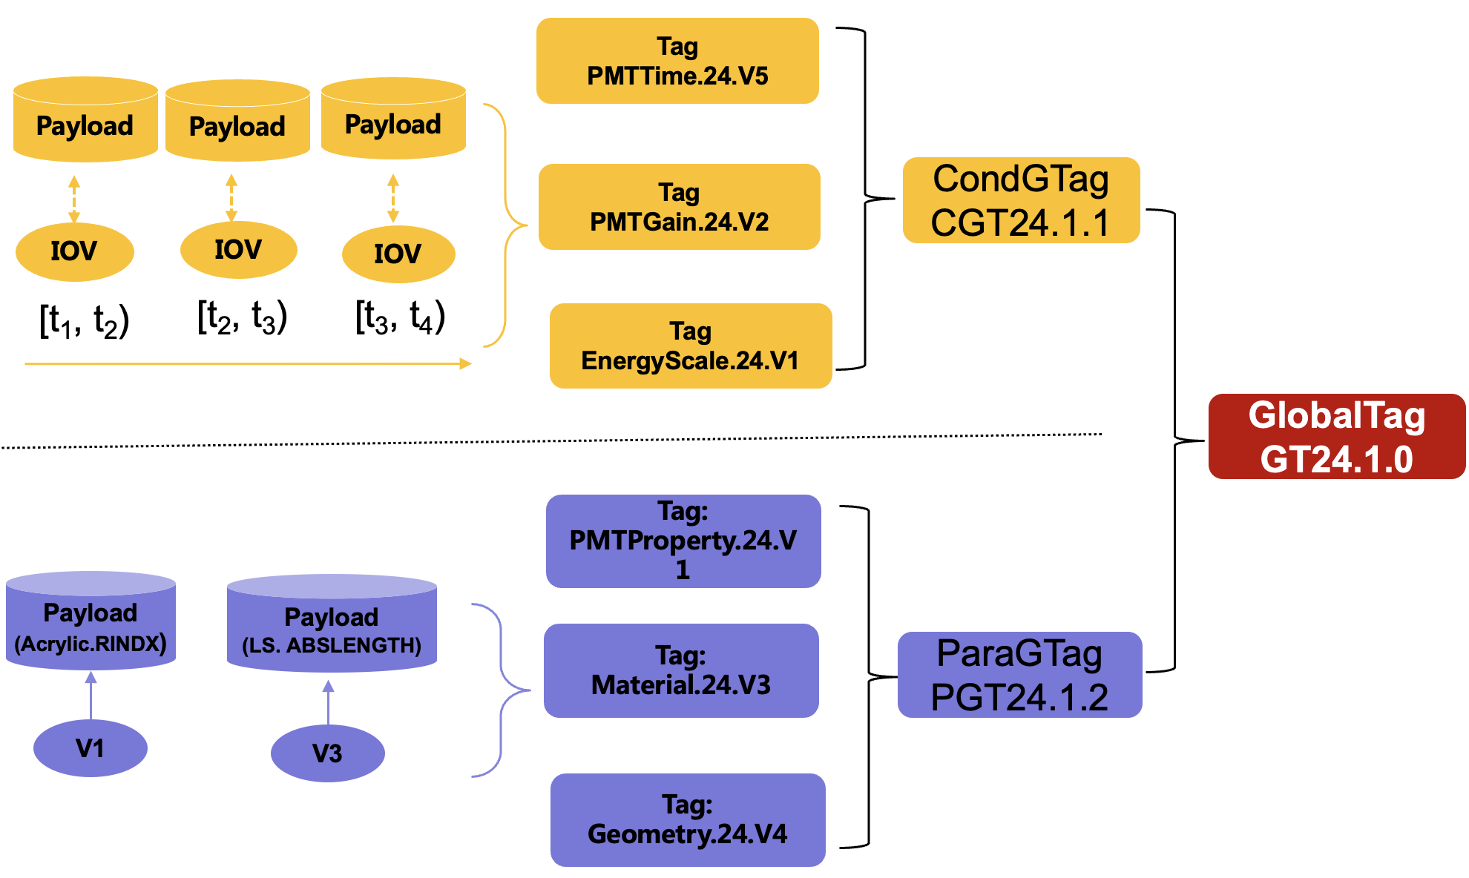
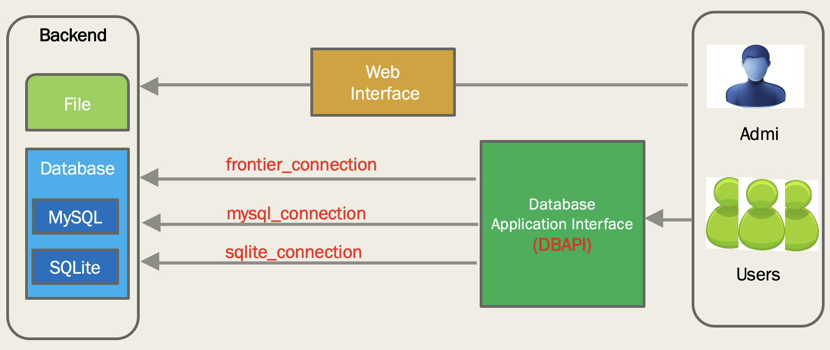
Database System
OfflineDB is developed to unify management of Conditions Data and Parameter data
Two types of data are stored in Payloads in their suitable formats and deployed in CVMFS
Meta data are managed with DB tables: Payload, IOV, Version, Tag and GlobalTag
A GlobalTag combines the tag of Conditions data and Parameter data
Three backups are implemented to meet different applications
MySQL for quickly testing of database
Frontier+Squid for massive data production
SQLite for online event classification (OEC)
X.T. Huang et al., EPJ Web of Conferences 245, 04030 (2020)

Slide 17
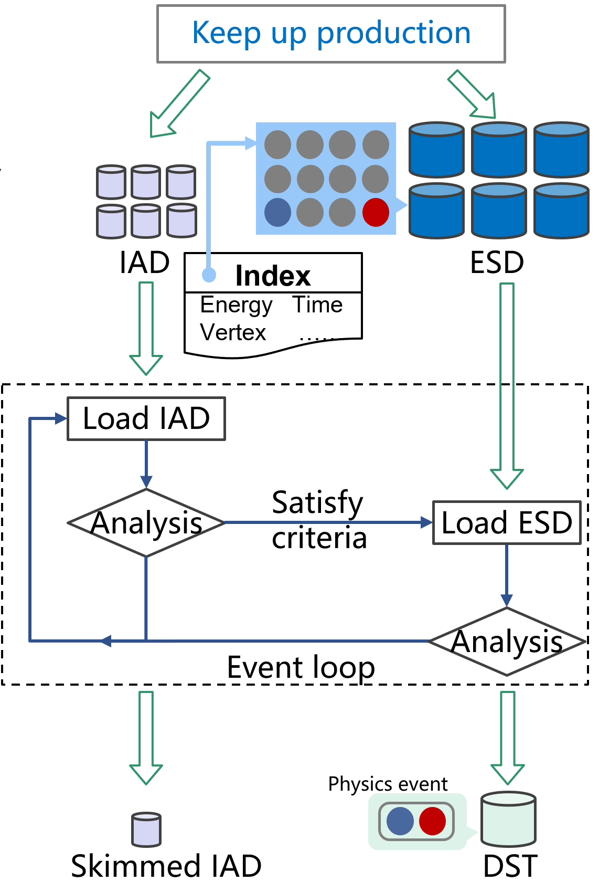
Analysis Software Framework
Challenges of data analysis
Time correlation analysis (a prompt signal and a delayed signal within varying time window)
Rare signals (1kHz event rate, but only ~60 reactor neutrinos per day)
Developed analysis software framework with an Indexing Technique
The Indexed Analysis Data (IAD) consists of two parts:
A pointer to the associated Event Summary Data (ESD)
A collection of key reconstructed variables needed by the analysis
Analysis work flow
Step1: perform event pre-selection within the IAD stream based on its key variables
Step2: navigate back to the associated ESD and perform further selection in the ESD stream
Time correlation analysis could be applied in both steps

Slide 18
Analysis Software Framework
Multi-threading in Analysis
One data input thread reads IAD blocks and puts them in the global buffer
Multiple worker threads
get IAD blocks from global buffer and convert them to a collection of IAD event objects
perform two-level event selections and run analysis algorithms
One or two data output threads
write skimmed IAD event objects into a file
write Data Summary Type (DST) objects into another file
Input thread
Worker
Worker
Worker
Data flow of multi-threading

Slide 19
Integration of machine learning-trained models
A python based datastore is developed for data sharing between C++ and Python
Popular ML libraries are integrated into JUNOSW in C++ for inference with three solutions:
Python API for SNiPER Algorithm in python
Native C/C++ APIs: TensorFlow, PyTorch
Open standard for ML: ONNX + ONNX Runtime (C++)
Python APIs
SNiPER Python
Algorithms
Trained Models
Native C++ APIs
PyData Store
SNiPER C++
Algorithms
ONNX Models
ONNX Runtime C++ APIs
T. Lin et al., Integration of machine learning-trained models into JUNO's offline software, ACAT2022

Slide 20
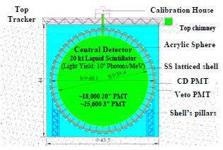
Data Processing and Analysis Chain
MCHITS (Monte-Carlo Simulated Hits Data)
In ROOT format, contains GenEvt, SimEvt
RAW (Raw Data from DAQ and OEC)
In byte-stream format. Also contains the OEC result.
RTRAW (ROOT RAW)
In ROOT format (with EvtNavigator).
Sorted; contains ElecEvt, TrigEvt, OecEvt; may contain GenEvt and SimEvt for simulated data.
ESD (Event Summary Data)
In ROOT format (with EvtNavigator), contains CalibEvt, RecEvt
DST (Data Summary Type)
Contains information of physical events, Flexible definition and file format, Does not contain relationships
IAD (Indexed Analysis Data) (Auxiliary data)
Contains the address to the RAW/ESD and the necessary physics variables
Physics generators
+ Geant4 Simulation
Data
Trigger + OEC
Simulation
RAW
MCHITS
Format conversion from byte-stream to ROOT
Event Mixing
+ Digitization
RTRAW
Independent Reconstruction
or
Joint Reconstruction
IAD
ESD
DST

Slide 21
Summary
The JUNO offline software (JUNOSW) has been developed with modern technologies to meet the specific requirements of JUNO experiment and other non-collider experiments
Data processing framework, SNiPER, supports buffering and management of multiple events, event splitting and mixing, TBB-based multi-threading, and integration of machine learning etc.
ROOT based event data model to character data representations at different processing stages and complicated relationships between them.
Unified detector geometry management system to support multiple applications including simulation, calibration, reconstruction and detector visualization.
Unified database system to manage the conditions data and parameter data
Event index based correlation analysis framework to support selection of sparse physics events from the large volume of data.
The JUNO data processing and analysis chain was completed and has been used by several rounds of M.C. data challenge on either local computing clusters or the distributed computing infrastructure.

Slide 22
Thanks for your attention!

