Slide 1
AtlFast3
The new fast simulation in ATLAS
Michele Faucci Giannelli,
on behalf of the ATLAS collaboration
12-05-2023

Slide 2
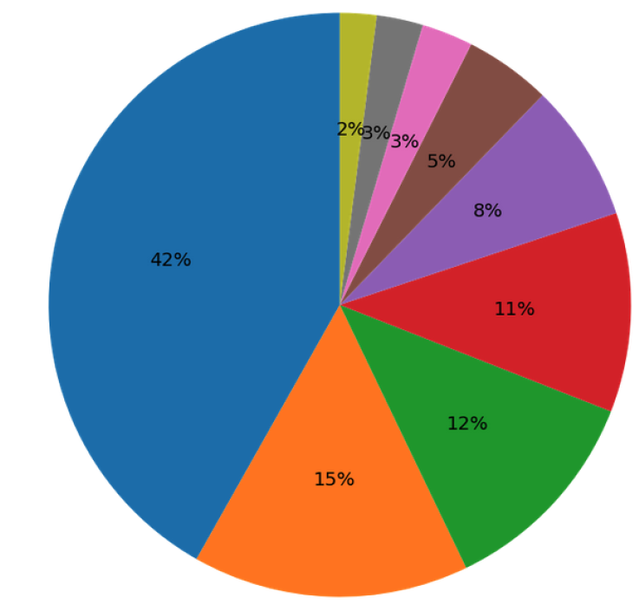
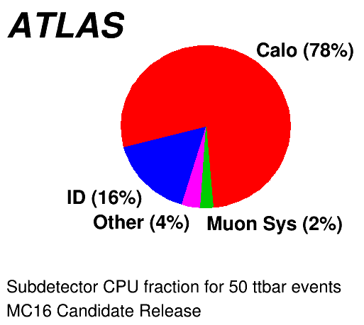
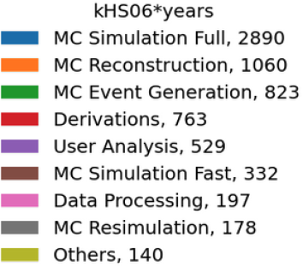
Simulation in ATLAS
Monte Carlo production takes almost 70% of the GRID CPU time used by ATLAS on the GRID: this is dominated by full simulation done in GEANT4
The GEANT4 simulation is dominated by the simulation of the calorimeters

Slide 3
Motivation for fast simulation
We need more MC samples but we will not get more money to buy computers in line with the LHC increase in instant luminosity
The slowest part in the long MC production chain is the simulation and in the simulation the slowest part is the showering in the calorimeters
ATLAS developed a fast calorimeter simulation in Run2 (AFII) but it does not reproduce Full Simulation well enough
  In particular boosted objects
Bonus: AFII requires different calibrations, so if we could match G4 we could save a lot of resources to the collaboration
  But keeping different calibrations for full and fast is ok as long as more analyses can use the fast simulation samples
→ We need to speed up MC production
→ a fast calorimeter simulation
→a better fast calorimeter simulation

Slide 4
Comput Softw Big Sci 6, 7 (2022)
AF3 in Run2

Slide 5
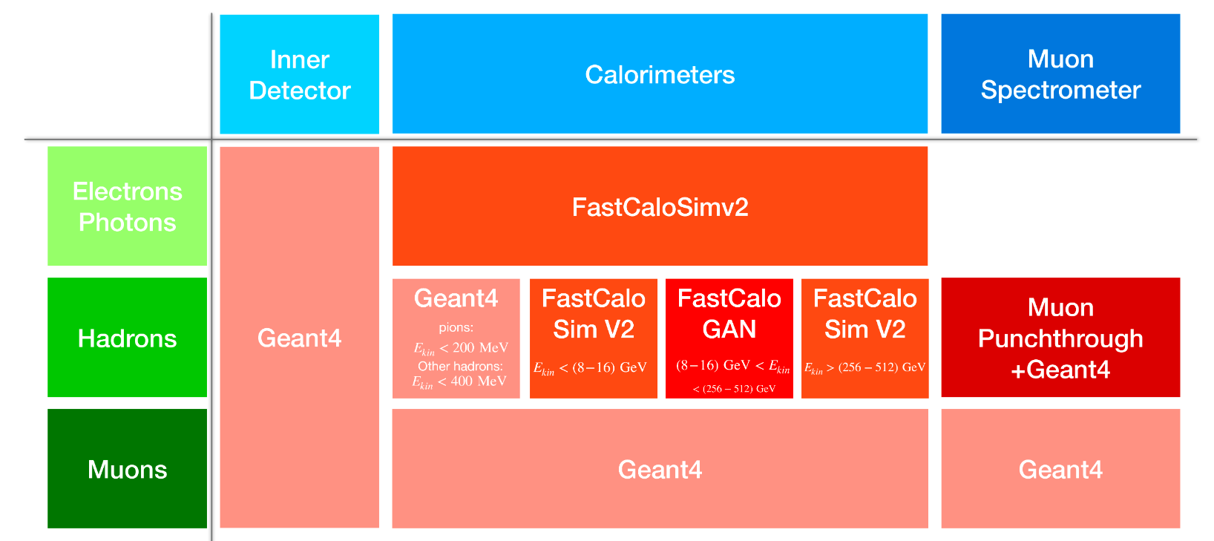
AF3 configuration

Slide 6
Fast simulation strategy
To simulate all particles interacting in the calorimeter system we parametrise photons, electrons and pions
  All hadrons share the pion parametrisation with a correction for the mass
The ATLAS calorimeter system is divided in 100 slices in η
  In each slice we have 17 energy points from 64 MeV to 4 TeV (in powers of two)
For each particle/energy/η point a Geant4 sample is produced at the calorimeter surface
  Noise and other imperfections removed to parametrise on “perfect” calorimeter showers
The FastCaloSimV2 and FastCaloGAN parametrisation are derived from these samples
  Both strategies define custom voxels to group the energy in the detector to avoid handling the complex and non homogeneous calorimeter structure
At simulation time, hits are produced in the calorimeter based on the chosen parametrisation for that particle
  Several corrections are applied

Slide 7
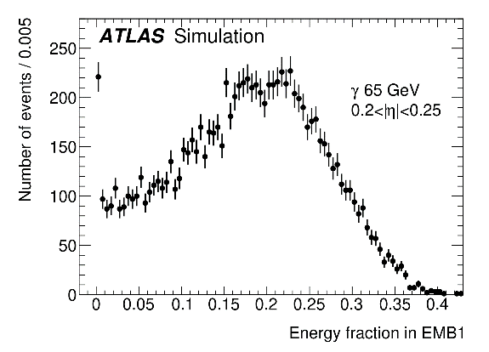
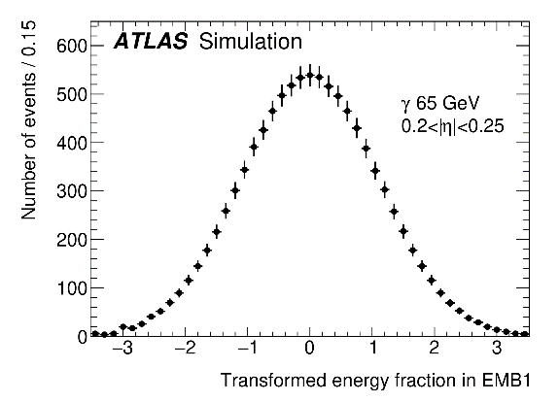
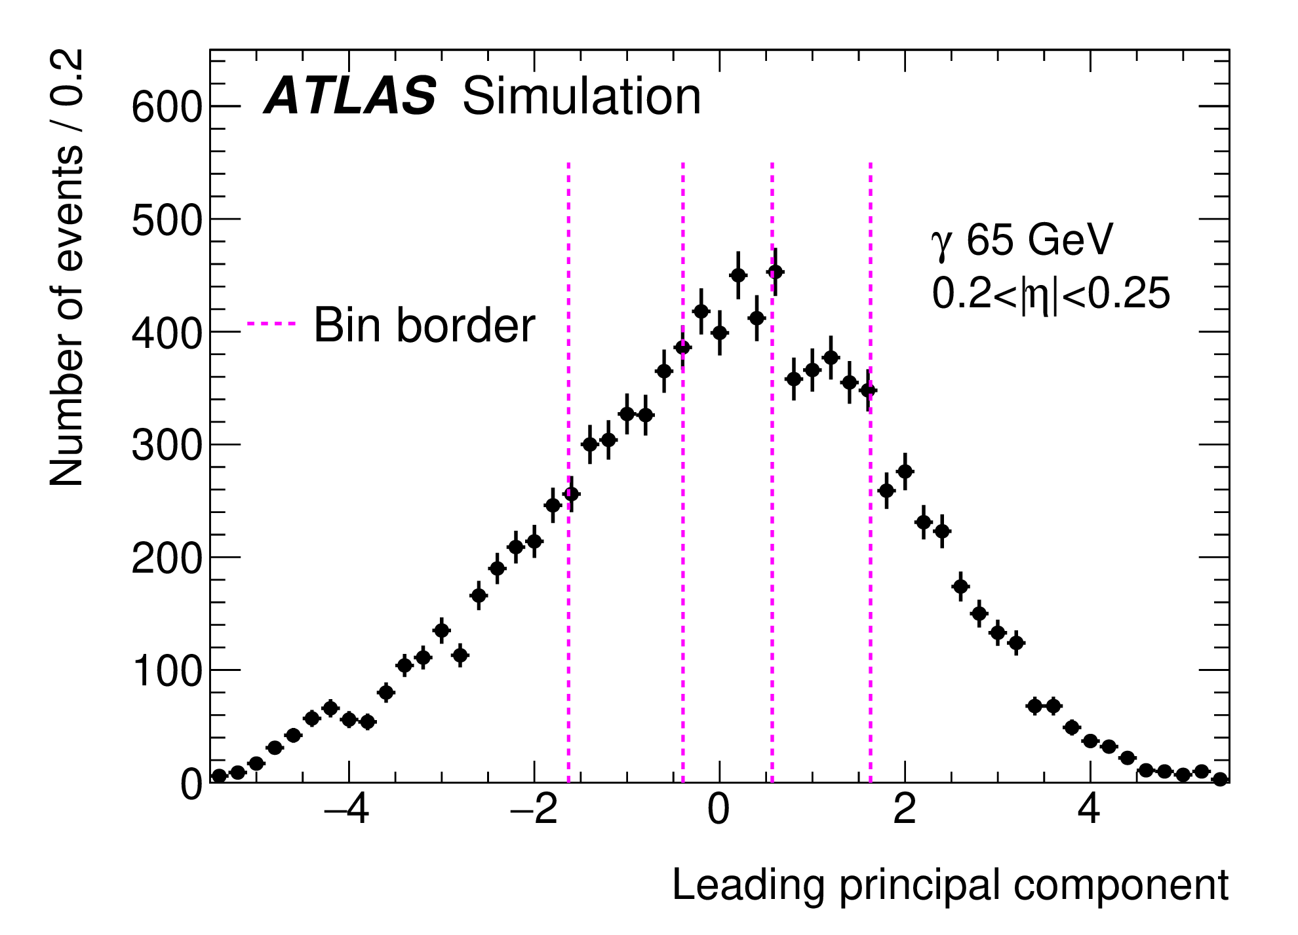
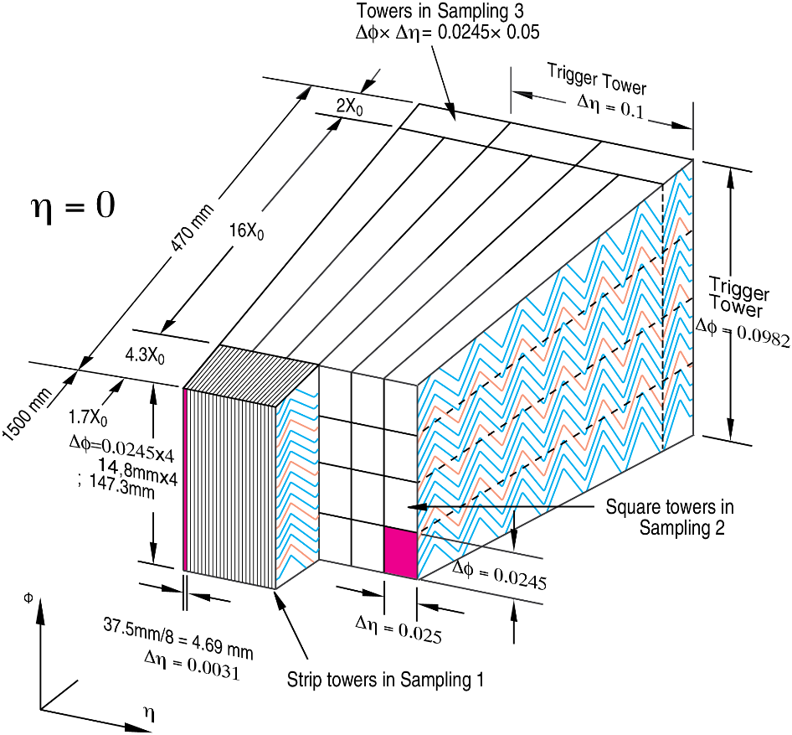
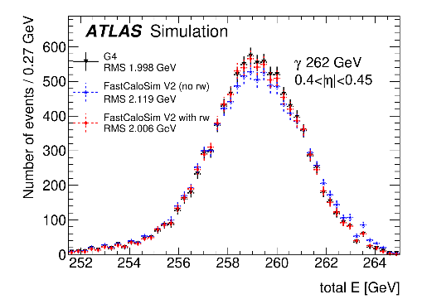
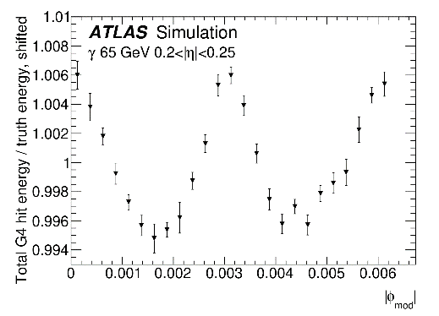
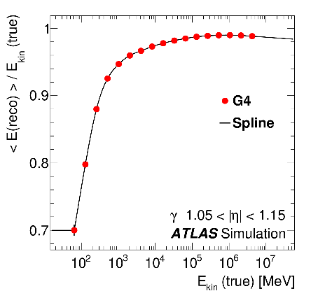
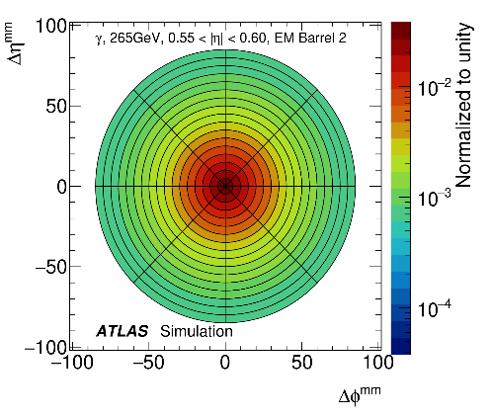
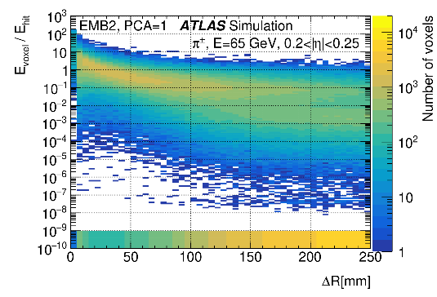
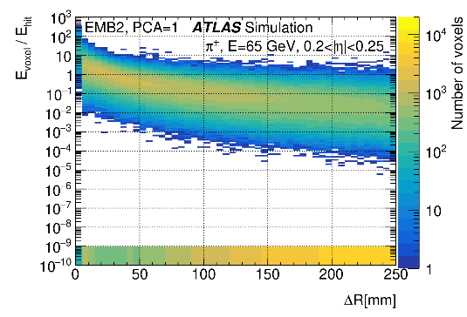
FCSV2 in one slide
Principal Component Analysis for energy parametrisation
Probabilistic reweight
PhiMod correction
Energy interpolation
FCSHit to G4Hits energy correction
G4
Weighted hits
Lateral shape parametrisation

Slide 8
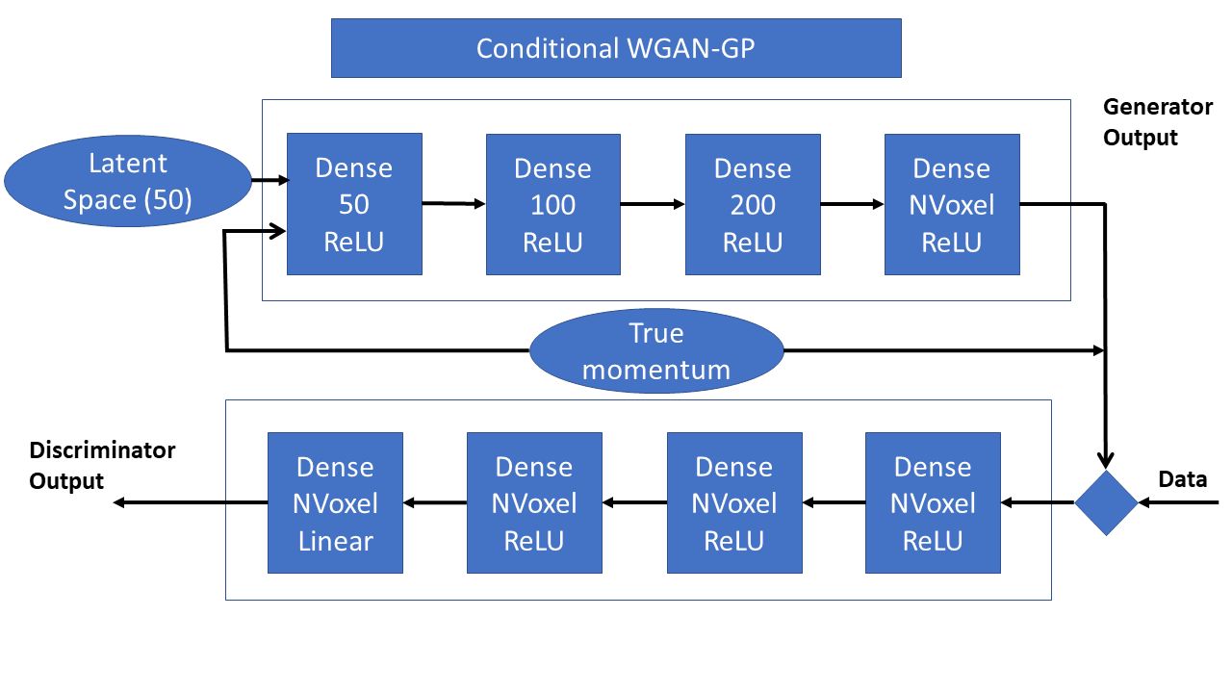
The GANs
For each particle and η a GAN is trained on all energies
  300 GAN are trained in total
A similar structure is used for all GANs

Slide 9
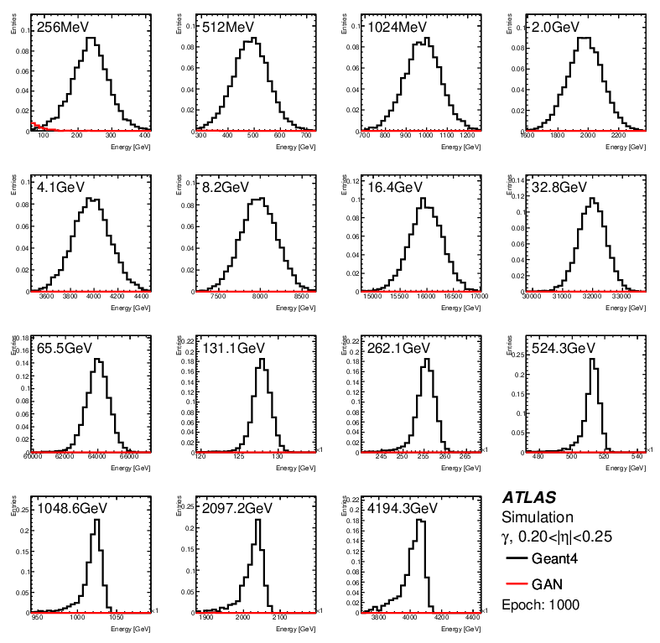
Training

Slide 10
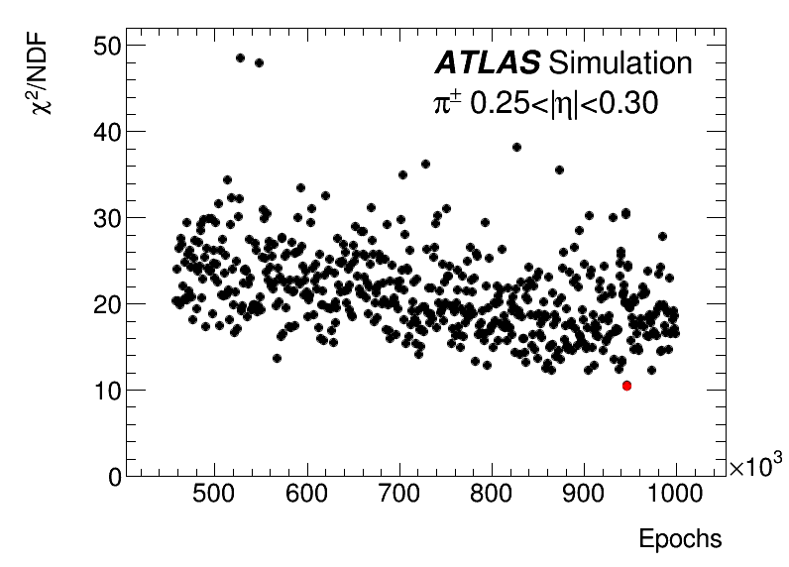
A summary of the training
Chosen epoch

Slide 11
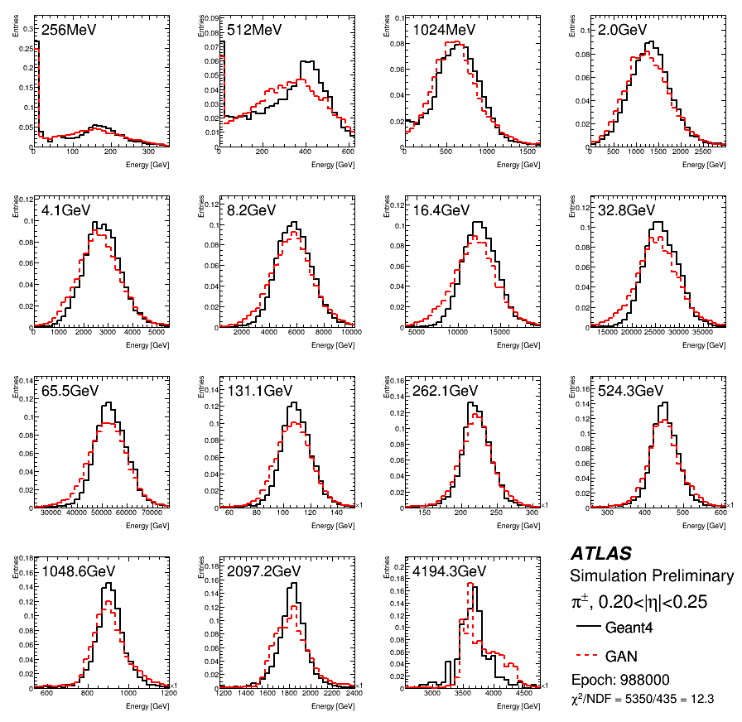
Pions in barrel

Slide 12
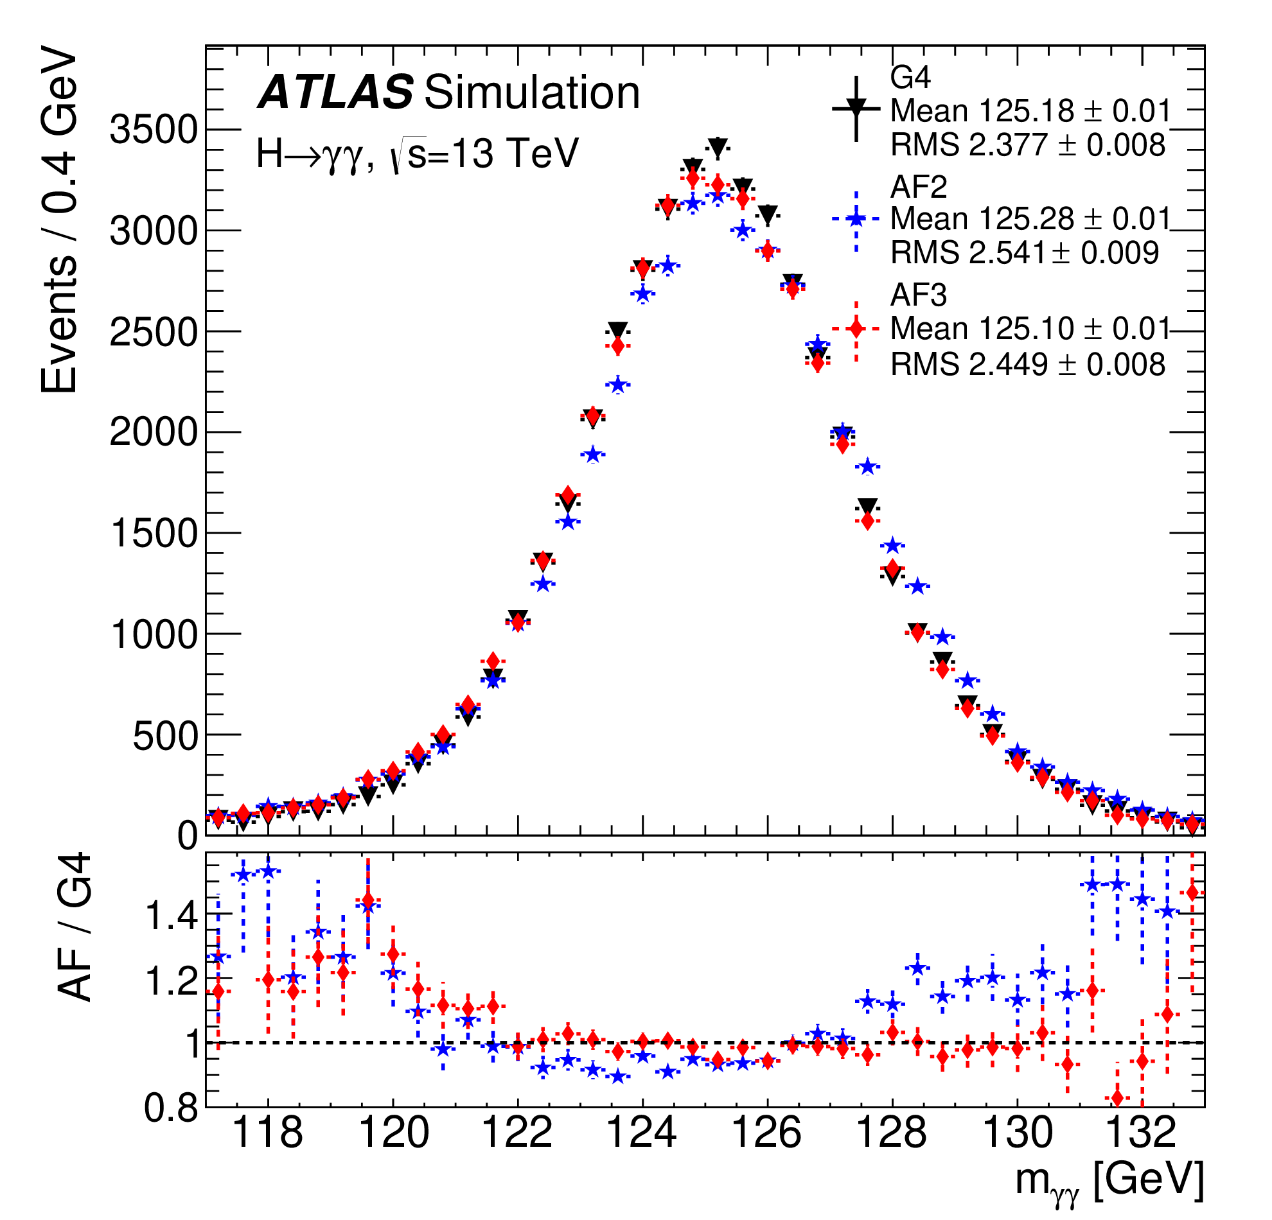
AF3 performance: Higgs→γγ

Slide 13
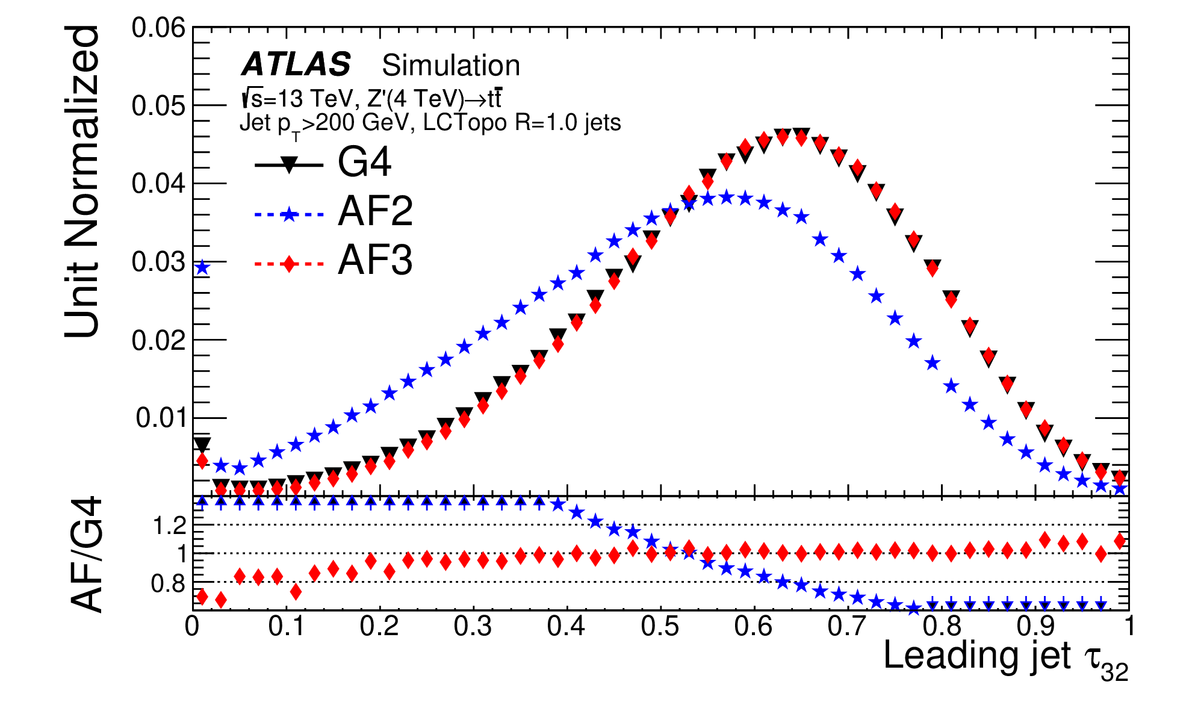
AF3 performance: boosted jets

Slide 14
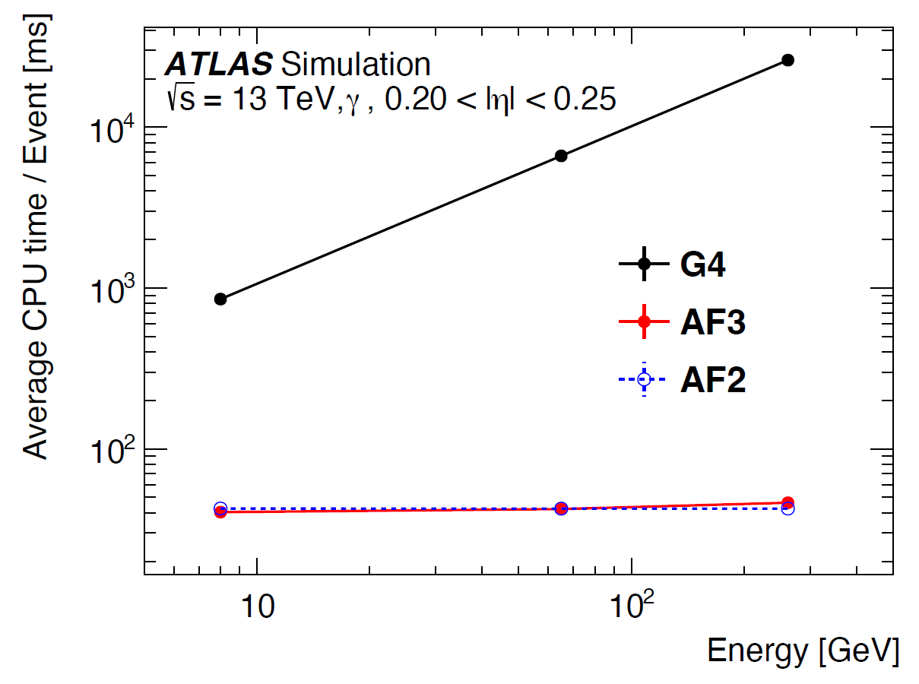
Simulation time

Slide 15
Aka FAstcaloganv2
Improvements for Run3

Slide 16
FastCaloGAN optimisations
More granular voxelisation for a more accurate voxel-to-cell energy assignment
  This is further improved by exploiting energy-independent lateral shower profile
New Tensorflow provide more stable and faster training
Hyper parameter optimised for each GAN
  Bigger networks
  High batchsize
Split e/gamma in high and low energies samples
  2 GANs are trained in each η
Improved voxel-to-cell energy assignment exploiting energy-independent lateral shower profile

Slide 17
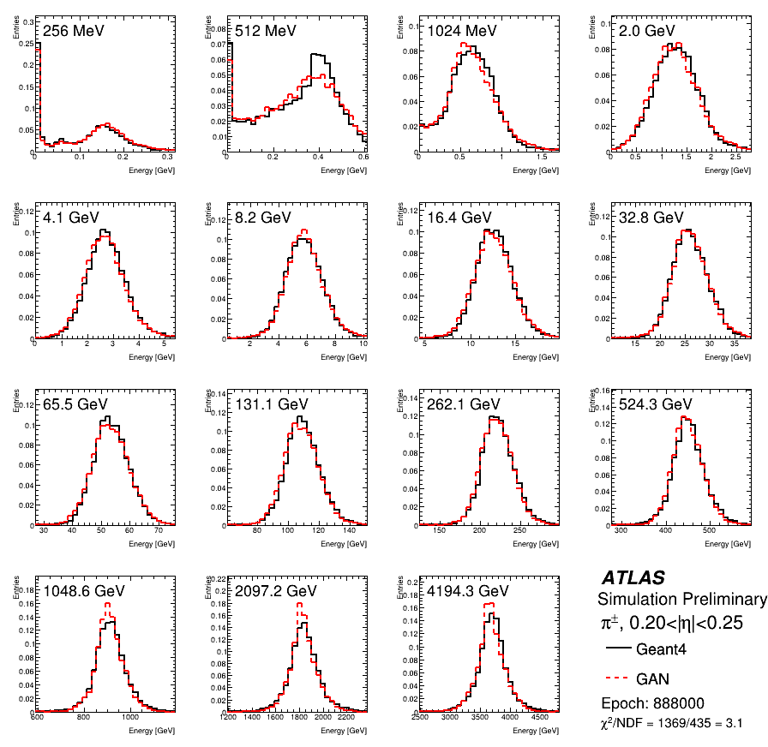
Best GAN for pions: v1 vs v2
V1
V2
Chi2 = 12.3
Chi2 = 3.1

Slide 18
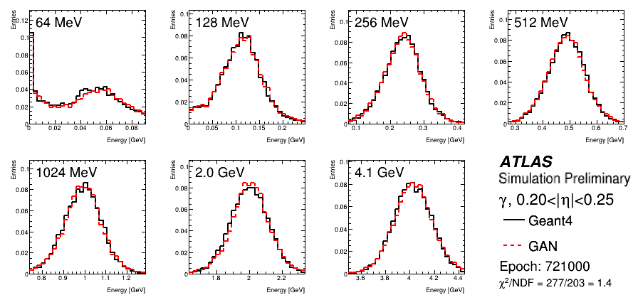
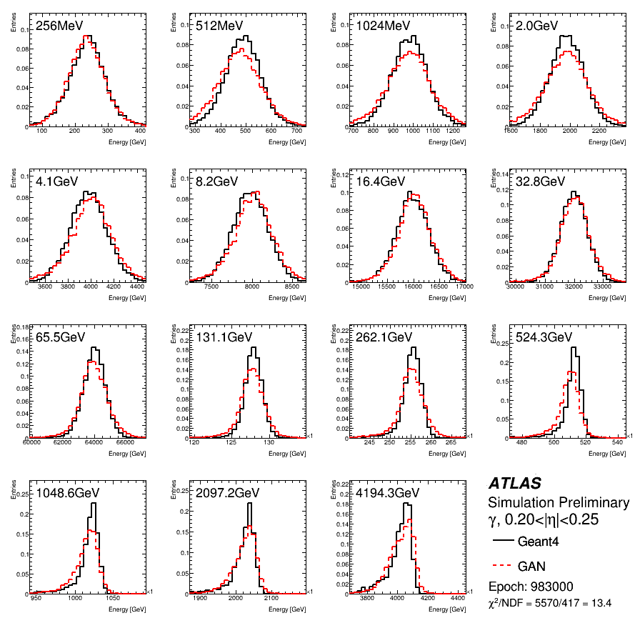
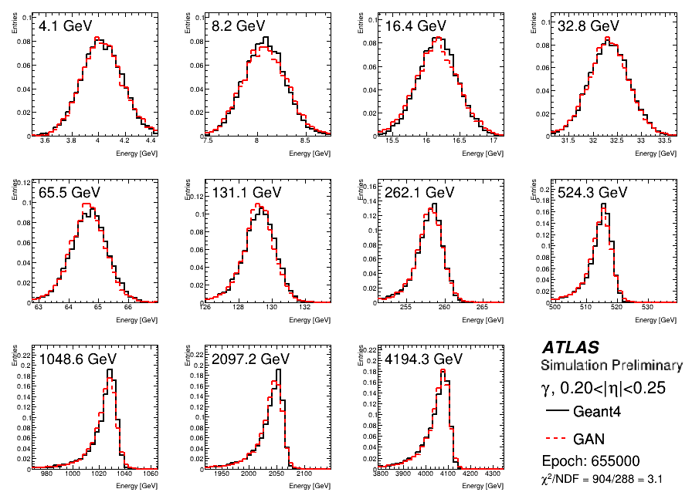
Best GAN for photons
V1
Chi2 = 13.4

Slide 19
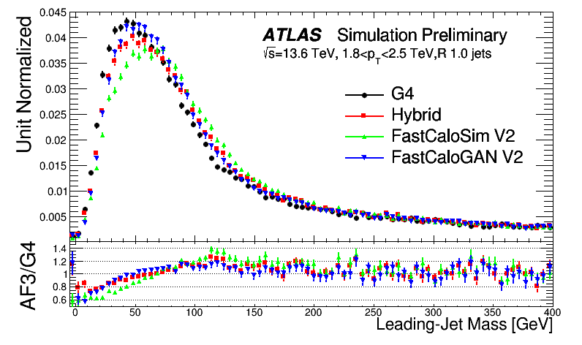
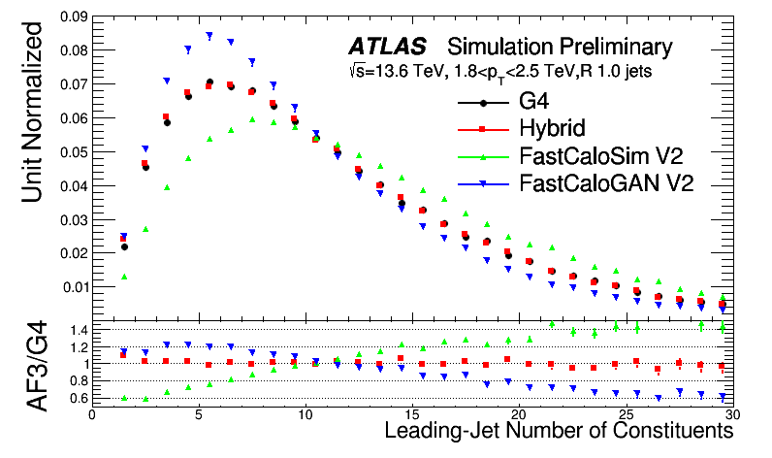
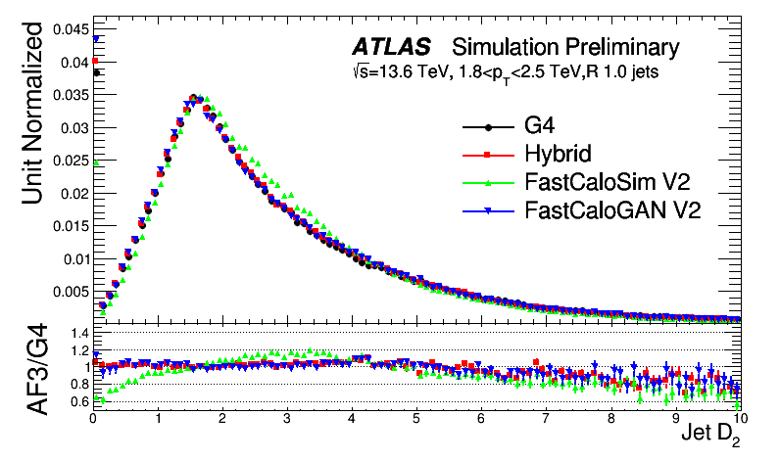
Jet performance in Run3

Slide 20
Conclusion
AtlFast3 is a significant improvement w.r.t. AtlFast2 in reproducing key variables used in analysis
  This is crucial to allow a wider use of fast simulation required to match the collected luminosity in Run3
FastCaloGAN is a critical ingredient in the mix of tools that allows to simulate the jet sub-structure with high accuracy
FastCaloGAN V2 was developed for Run3 and further improves the accuracy of the simulation
There is still room for improvement and we will continue to explore new models to further improve the simulation in ATLAS
  We released the public dataset used for the #calochallenge and will consider adopting tools that will achieve high performance

Slide 21
Backup

Slide 22
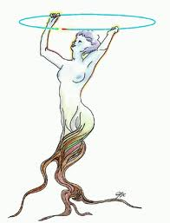
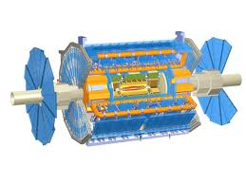
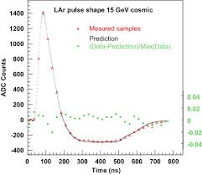
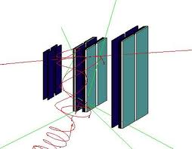
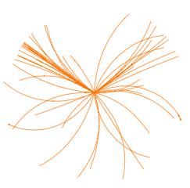
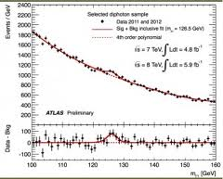
What is Simulation?
Simulation Group Responsibility
Event
Generation
Detector
Simulation
Digitization
Reconstruction
Rootification
EVGEN
HITS
DIGITS
ESD/AOD
TTree/THist
RDOs
Analysis
µ times

Slide 23
The training sample
The single-particle samples have
  detailed hits to better map ATLAS cells
  without z-vertex spread
  without noise
  without parts of the electronic cross talk
Events generated by momentum
  But used the Ekin for the simulation
The statistics in the high energy region is lower than at low energies
  10k events up to 256 GeV
  Drop to 1k events for 4 TeV samples

Slide 24
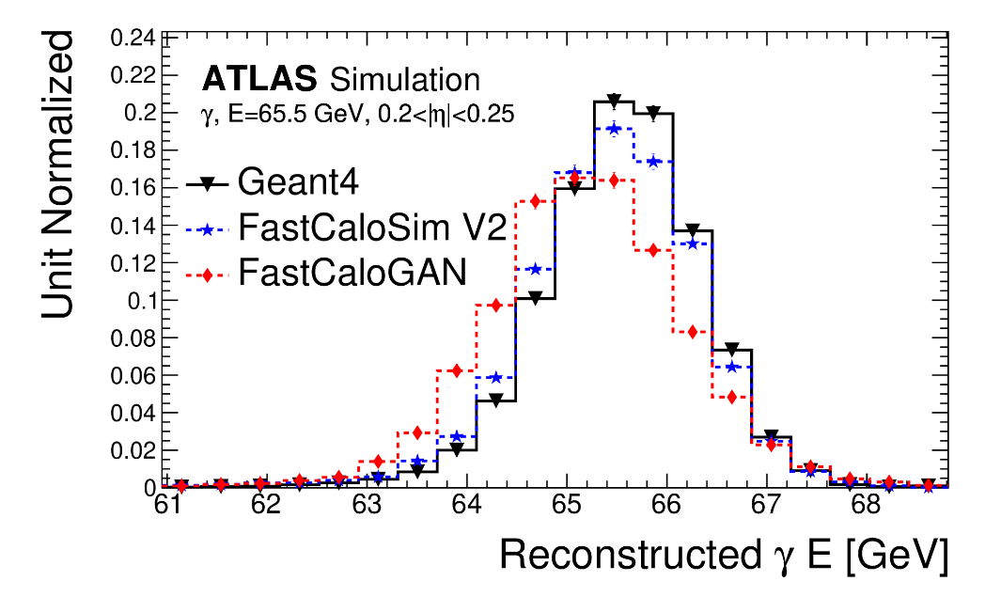
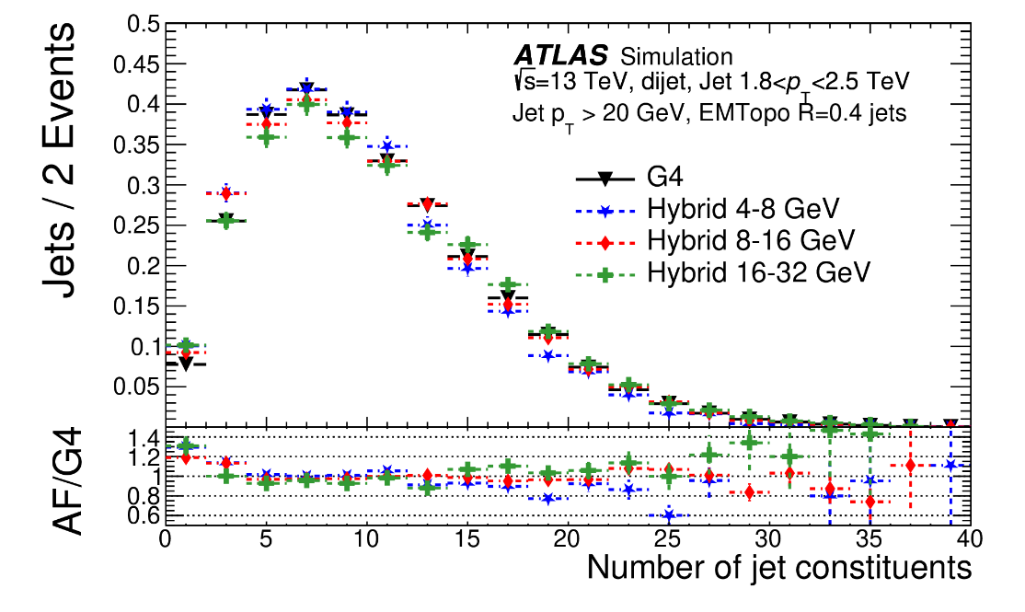
Combination of FCSV2 and FastCaloGAN
FCS/G4 hits difference and the missing φ modulation correction prevented the use of FastCaloGAN for e/gamma showers
For pions, several transition points between FCV2 and FastCaloGAN were tested.
The number of jet constituents was the main figure of merit.

Slide 25
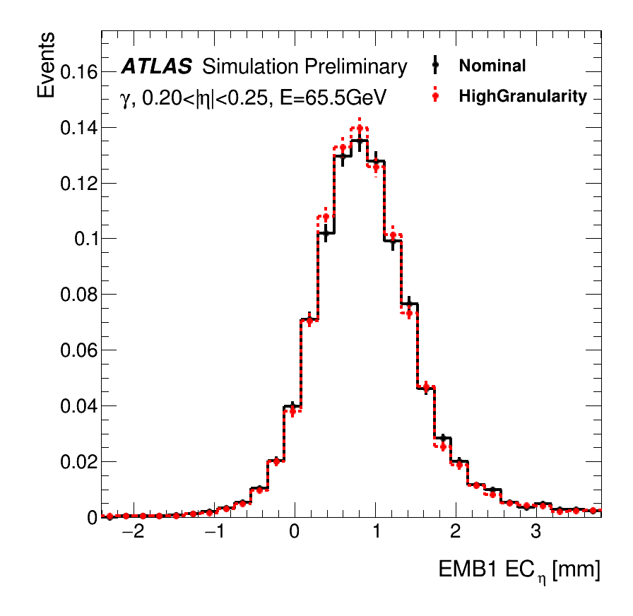
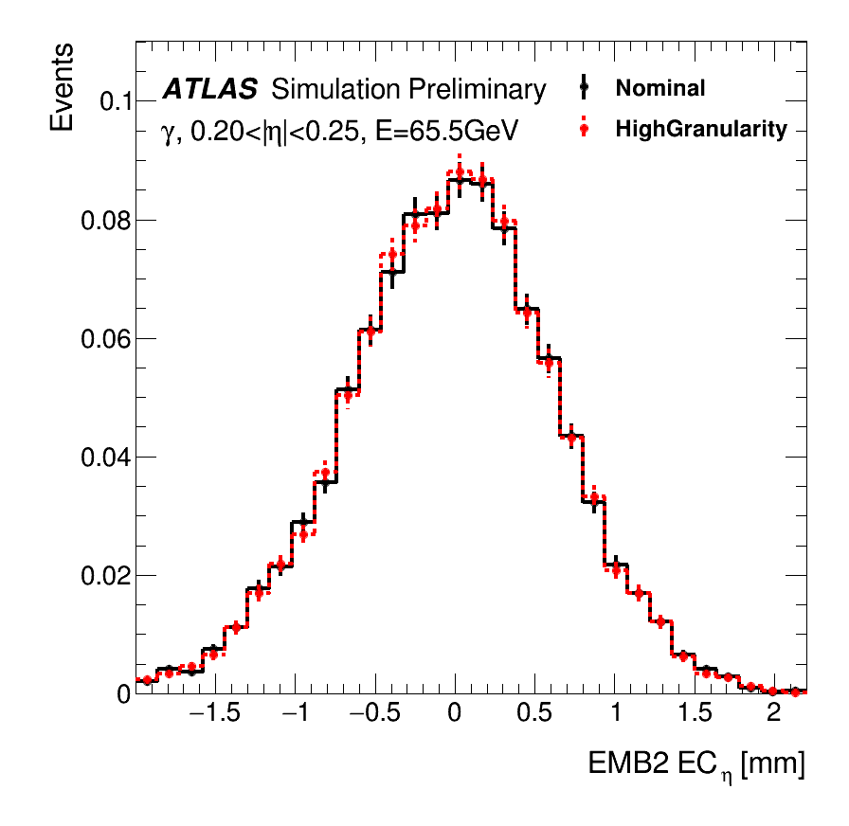
Plots from PUB note
Energy centroids well reproduced for both layers

Slide 26
Shift of EMB1 EC_{η}
The larger volume on the right of the direction of photon causes the shift observed in the EC. EMB2 less affected because there is a compensation between early excess on the left and deeper volume on the right

Slide 27
Strategy of FastCaloGAN
Use the 4500 single-particle samples produced by the FCS team
  3 particles (γ, e⁻, π±), 100 η slices, 15 energy points
  Energies from 256 MeV to 4 TeV (in powers of two)
Define a GAN for each particle in each η slice → 300 GANs
Train each GAN on a custom voxelised detector
  The not homogeneous ATLAS calorimeter cell structure would require different GAN architectures as a function of η
  The voxelisation allows to sue a single, generic, GAN structure
Select best iteration based on total energy distribution of each sample
Convert the selected generator into LWTNN
Simulate hits in Athena inverting voxelisation
Compare with Geant4 using high-level observables for single-particle and di-jet samples after reconstruction

Slide 28

Voxelisation
Hits are transformed from ATLAS (x,y,z) coordinates to cylindrical (r, α, R) coordinates
  R is not use, as hits are grouped in layers
  Same procedure used in FCSV2 with two differences:
    Alpha is not symmetrised (we want to keep the correlations between voxels)
    # of bins in alpha is 10 instead of 8
    We do apply both symmetrisation by charge and in η
GAN cannot be trained on hits, so they are grouped in areas in the (r, α) plane in each layer
  each volume in the (r, α, layer) space is called a voxel
Voxels are optimised to:
  Have enough energy to avoid large event-by-event fluctuations
    Binning in α only for layers with a large energy deposits (i.e. EMB1 and EMB2)
  Contain all the energy in a shower
  Reproduce the Energy Centroids in η and φ
$$EC_{η}=\frac{\sum_{i}{E_{i}η_{i}}}{E}$$

Slide 29
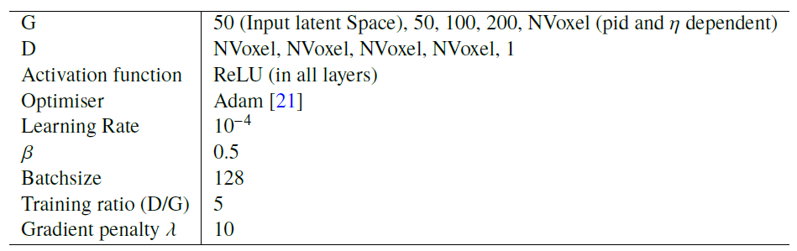
The GANs
enerator
iscriminator
NVoxel depends on PID and η

Slide 30
Additional training information 1/1
Normalised all events by the true momentum
Normalised all labels by the highest momentum
  Momentum is used as conditioning label
Training using all samples together was not producing good results
  But we could train a GAN on a single sample
We decided to use a training strategy in which a single sample is trained for 50k epoch and then additional samples are added to the training mix every 20k epochs
Training order:
  32 GeV, 64 GeV, 16 GeV, 128 GeV,…

Slide 31
Additional training information 2/2
Training is carried out for 1M epochs
Checkpoints are saved every 1k epochs
  Allows the selection of the best epoch in a second step for a flexible selection criteria
We used the GPUs on HTCondor and the training time was ~8h per GAN → 100 day GPU time to train the full detector

Slide 32
Choice of best epoch
The training of a GAN is not a minimisation process, so there is no assurance that a later epoch will give a better result than an earlier one
  You could see “fluctuations” during the training
Choosing an epoch is non-trivial, we have to compromise on many distributions
For this version of FastCaloGAN, we used the total energy of the 15 samples. The χ² between G4 and the generated events is calculated for all sample. The sum of the χ² is used as figure of merit.
The epoch with the smallest χ² is used

Slide 33
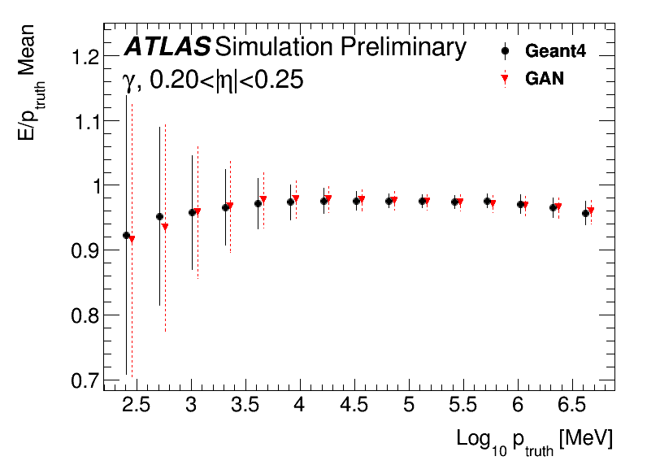
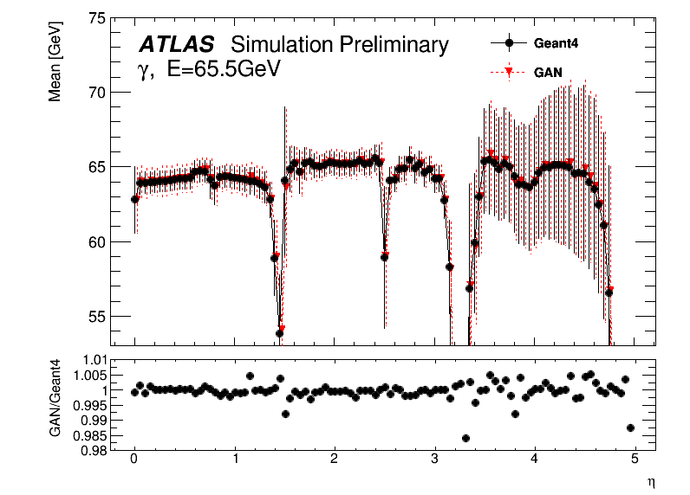
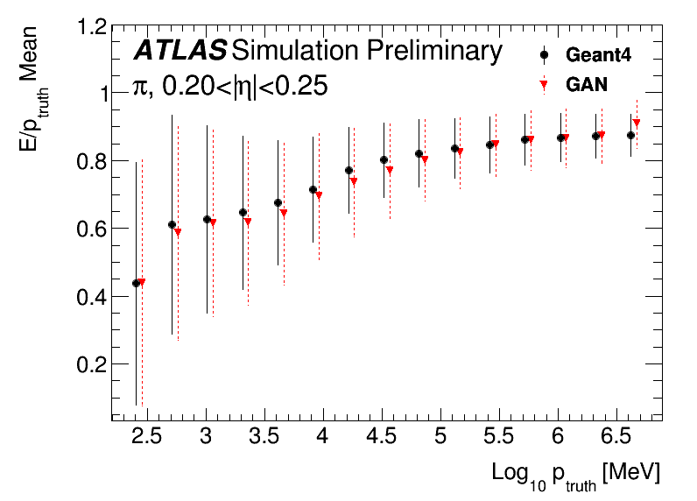
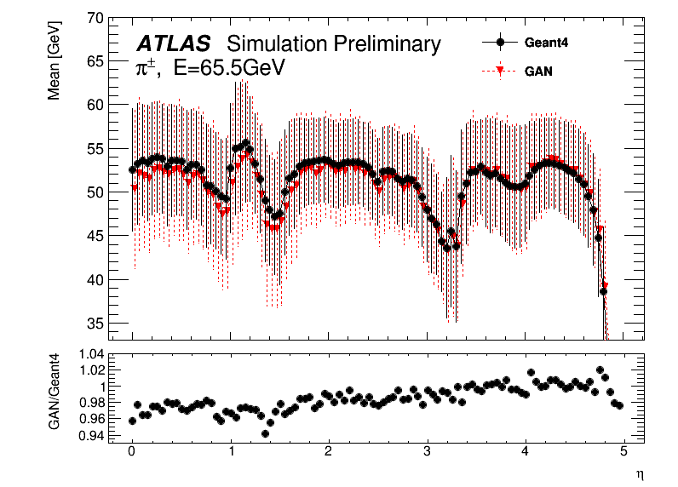
Performance of the GANs
Differences within a few %

Slide 34
Voxelisation: different binning
Layers with binning in α (10 bins used)
Layers with no binning in α
Hits in layer

Slide 35
Voxel to hit
The voxelisation must be inverted in the Athena service by producing hits
  Performed using LWTNN
Hits are generated by sampling the area of each voxel
Depending on the layer, the areas is divided in step of 1 or 5mm along both r,α coordinates
  A maximum of 100 hits are produced to reduce the simulation time
The energy in the voxel is divided uniformly among the different hits
Simulation time for a pion at the calo surface is 2-3 orders of magnitude smaller than Geant4
  70ms vs 6s for 65 GeV or 162s for 2 TeV
Memory consumption is small
  We could easily add more GANs, i.e. other hadrons

Slide 36

Voxelisation inversion
The total energy in a voxel is divided into a grid so that it is better mapped to the cells of the calorimeter
ATLAS Calorimeter cells

Slide 37
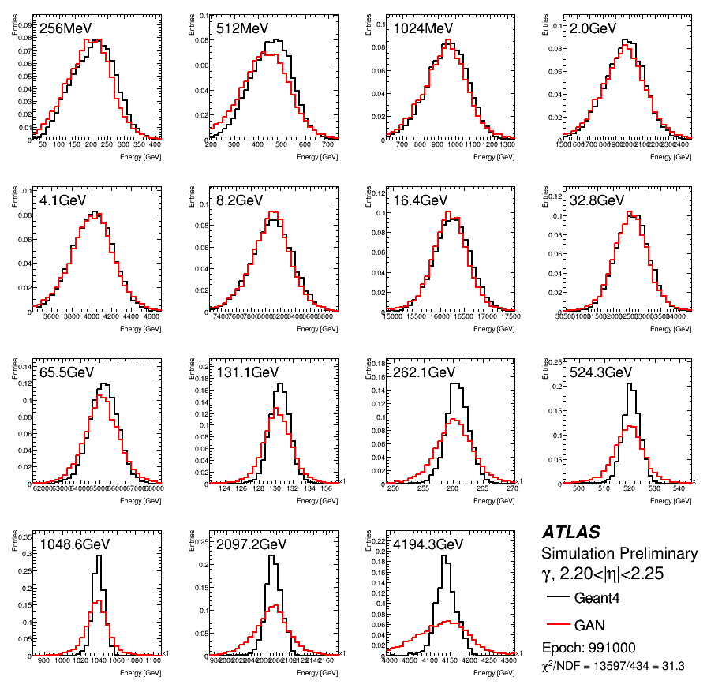
Photons in endcap region

Slide 38
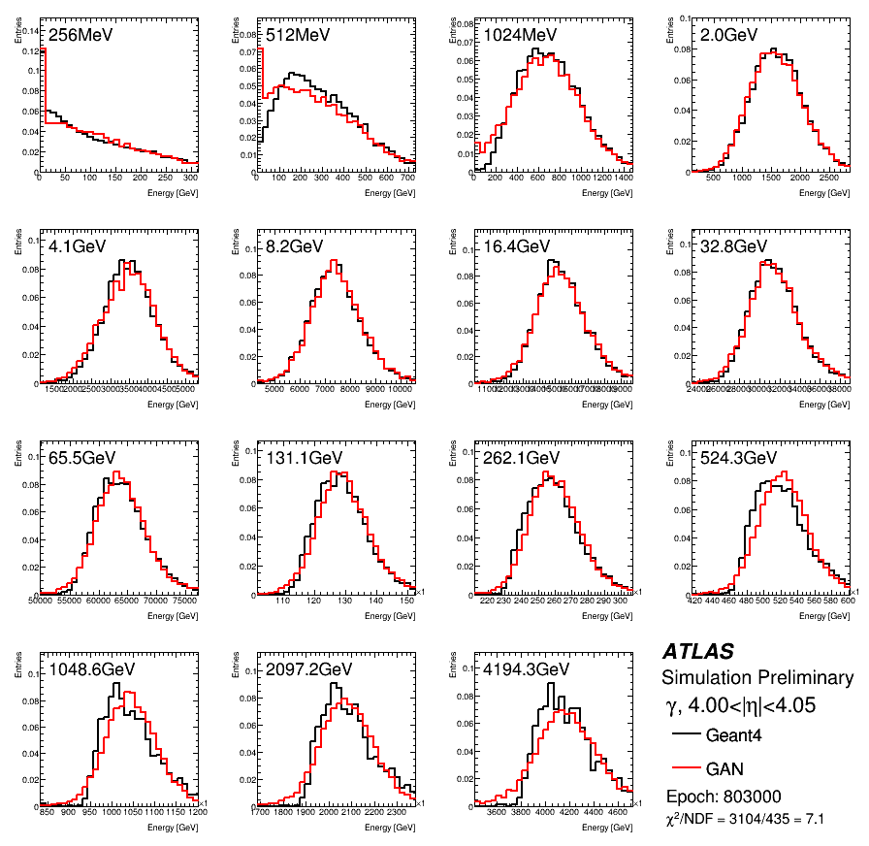
Photons in FCAL

Slide 39
Integration in Athena
NB: All figures until now are done at voxel level
To assess the real performance of FastCaloGAN, integration in the ATLAS Athena is required
This is done through a conversion of the generators from TF to Keras and then LWTNN
The LWTNN inputs are open by the FastCaloGAN simulation service
Simulation time for a pion at the calo surface is 2-3 orders of magnitude smaller than Geant4
  70ms vs 6s for 65 GeV or 162s for 2 TeV
Memory consumption is small
  We could easily add more GANs, i.e. other hadrons

Slide 40
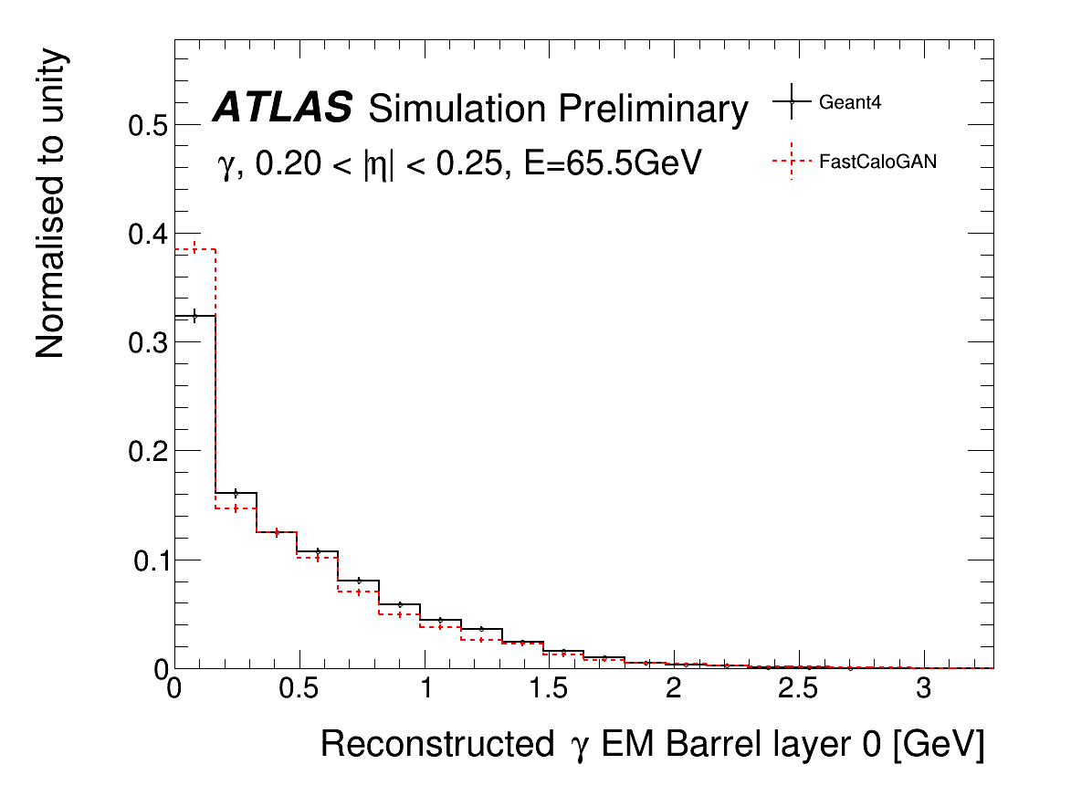
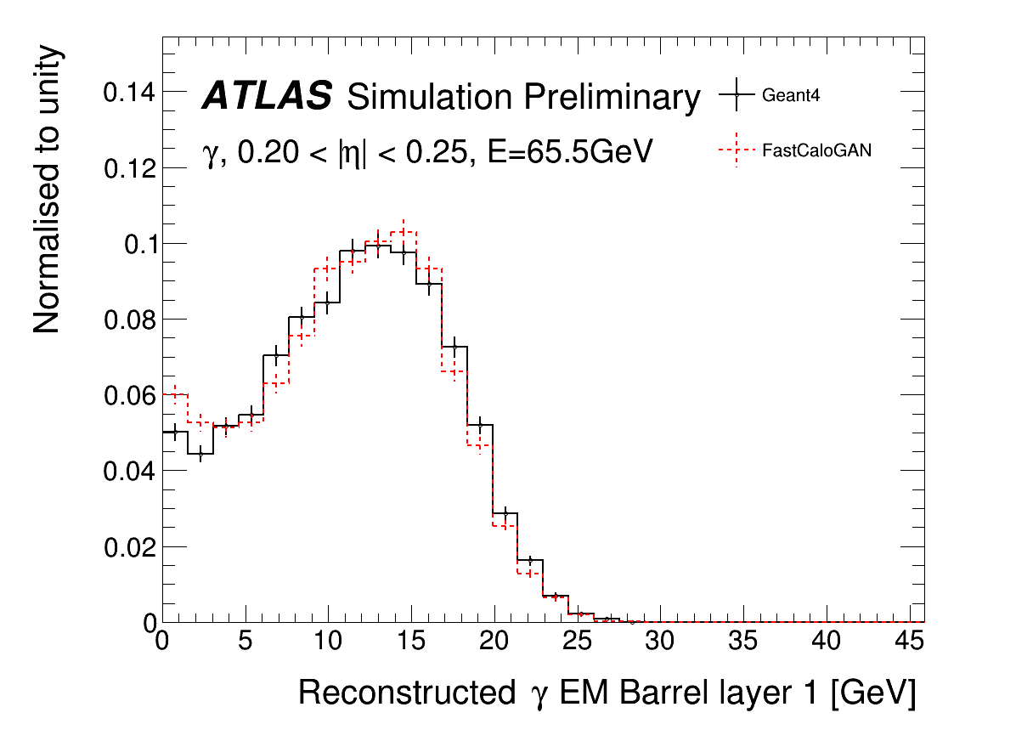
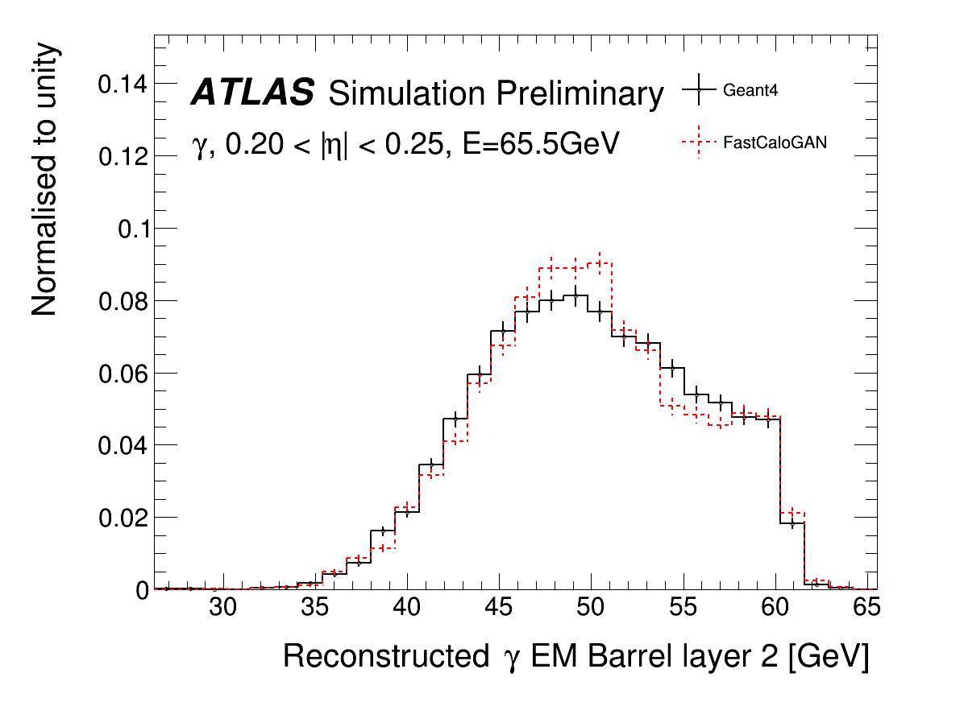
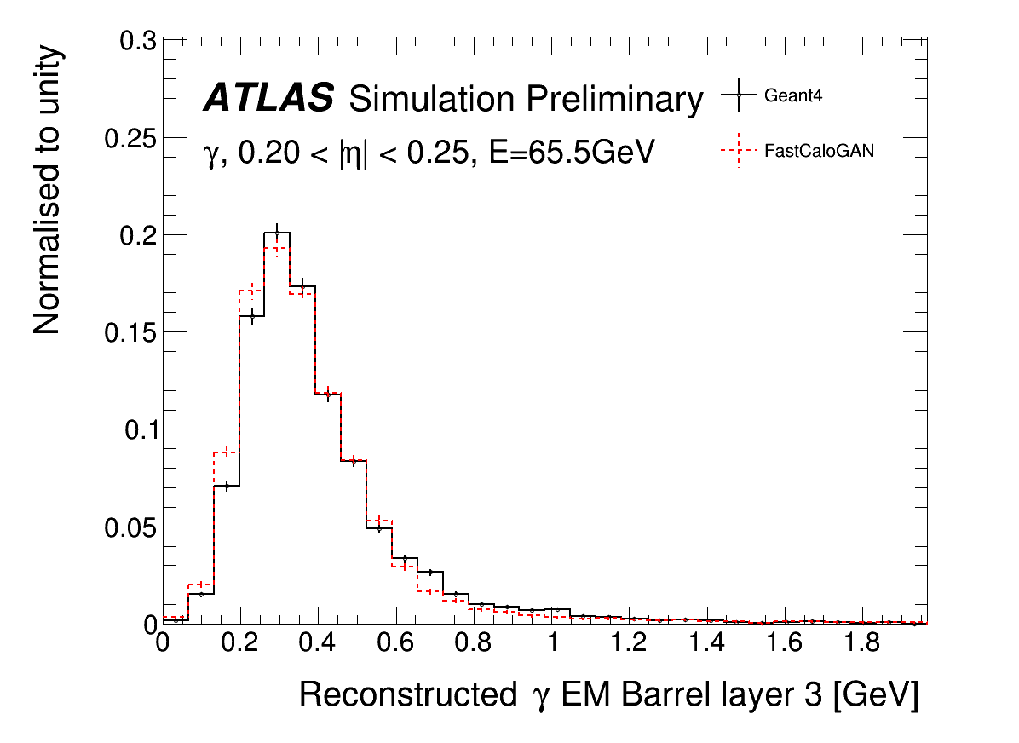
Photons: energy per layer

Slide 41


Photons total energy
Reconstruction
Energy of sum of voxels
Energy of cluster
The discrepancy is due to a difference in the energy deposited between the “standard” Geant4 hits used in ATLAS and the detailed hits used in FCS
  Easy to fix by rescaling the total energy, implemented in Run3

Slide 42


Position resolution
Resolution along eta is very good
Along phi the agreement is poor due to the missing correction for the accordion structure of the LAr calo, but this is corrected in AF3

Slide 43



Pions
Good position resolution
The total energy is wider but compatible with voxel-level performance

Slide 44



Pions: sub-structure
All distributions are similar to Geant4
The discrepancy at small λ² is the only significant difference

Slide 45




Performance on di-jets events

Slide 46


Energy correction due to accordion
There is a small dependence on the impact position in the accordion structure of the LAr
This cannot be emulated as we do not use the detailed geometry in AF3
The dependence is considered in the Full simulation (Geant4) reconstruction.
AF3 deposit directly the corrected energy, hence requires a dedicated calibration

Slide 47


Other hadrons
Pions are used to simulate all hadrons, an additional energy correction is applied to correct the energy deposited in the calorimeters

Slide 48



Simplified geometry correction
The simulated hits are assigned to cells using a simplified geometry that does not match the detector geometry
The probability for a cell mis-assignment is used to displace a hit before assigning to a cell
Hit shift

Slide 49




High energy pions

Slide 50

AF3 performance: taus

Slide 51

AF3 performance: jet mass

Slide 52

MPT

Slide 53
Run3

Slide 54
From prototype to mature tool
Optimisation of voxelisation
  The energy of FCSHits is rescalted to G4Hits
Optimisation of GAN HP and architecture
  GAN trained on phi-mod corrected inputs, as in FCSV2
Exploit new development in TF
  Moving from TF1 to TF2
  Strategies to reduce the training time
Improve hit-to-cell energy assignment

Slide 55
FastCaloGAN optimisations
Improved voxelisation strategy
Changed the FastCaloGAN v1 approach of having identical GANs for all particles in all detector regions
  It was good for a prototype!
Now several parameters are optimised for each GAN:
  Generator size (much bigger for pions)
  Activation functions (swish for high energy e/gamma)
  Lambda
  Batchsize
  Learning rate
  Split e/gamma showers in high and low energies samples, so now 2 GANs are trained
Interestingly, the particle and energy range have more impact than the detector region
New Training strategy: pre-train one GAN in each detector region and then train all other GANs in that region from the best iteration of that GAN
Most GAN code was rewritten for TensorFlow2, improving the stability and reducing the time required to train the GANs
Improved voxel-to-cell energy assignment exploiting energy-independent lateral shower profile

Slide 56
New voxelisation: more bins!
AF3 paper
New binning
Better to map the cells when inverting the voxelisation in the service
More difficult to learn for the GANS as there are more voxels
Better to parametrise the shower shape

Slide 57
Using GANs in the Athena SW
Inference and hit generation has a significant impact on performance of reconstructed objects
Improving voxel-to-cell energy assignment has an impact
Hits are no longer generated in a grid;
  the alpha direction is randomised
  Along the radial direction hits are generated according to a pdf

Slide 58

FastCaloGAN v2 performances

Slide 59


Photon shape

Slide 60

Pions
Distance of shower centre from the calorimeter surface

