Slide 1
26th International Conference on Computing in High Energy and Nuclear Physics.
Scientific application development based on the Daisy Framework
Yu Hu, Shiyuan Fu (On behalf of HEPSCC)
Institute of High Energy Physics, CAS

Slide 2
Outline
HEPS Introduction
Demand and Challenges of scientific data and software system
The architecture and design of the framework
The status of the system
Summary

Slide 3
Outline
HEPS Introduction
Demand and Challenges of scientific data and software system
The architecture and design of the framework
The status of the system
Summary

Slide 4
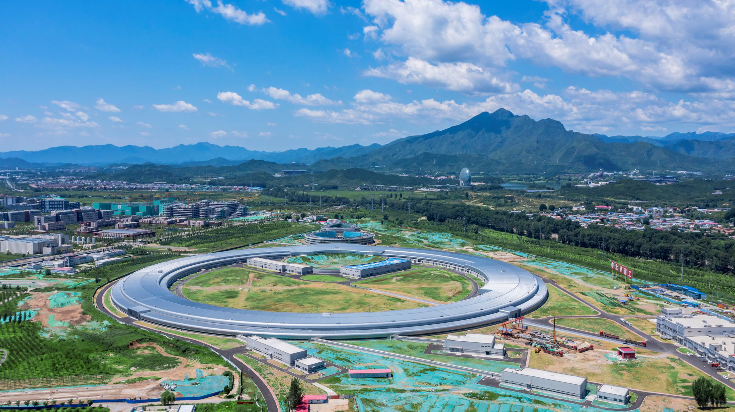
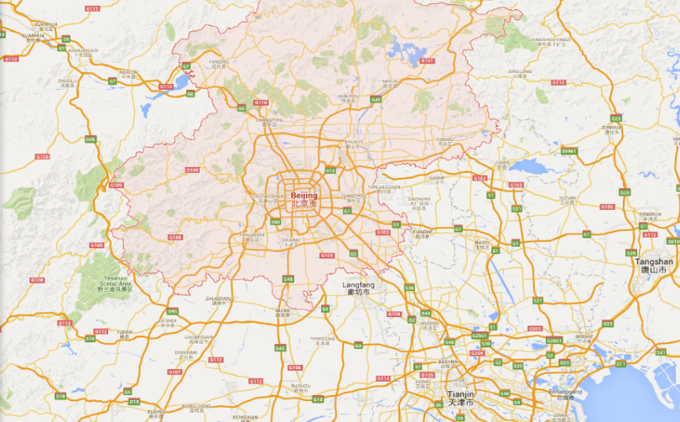
High Energy Photon Source (HEPS)
New light source in China — High energy, high brightness
Located in Beijing - about 80KM from IHEP
Officially approved in Dec. 2017
The construction was started at the end of 2018
The whole project will be finished in mid-2025
Main parameters | Unit | Value
Beam energy | GeV | 6
Circumference | m | 1360.4
Emittance | pm∙rad | < 60
Brightness | phs/s/mm²/mrad²/0.1%BW | >1x10²²
Beam current | mA | 200
Injection |  | Top-up
HEPS
80 km
IHEP
Beijing

Slide 5
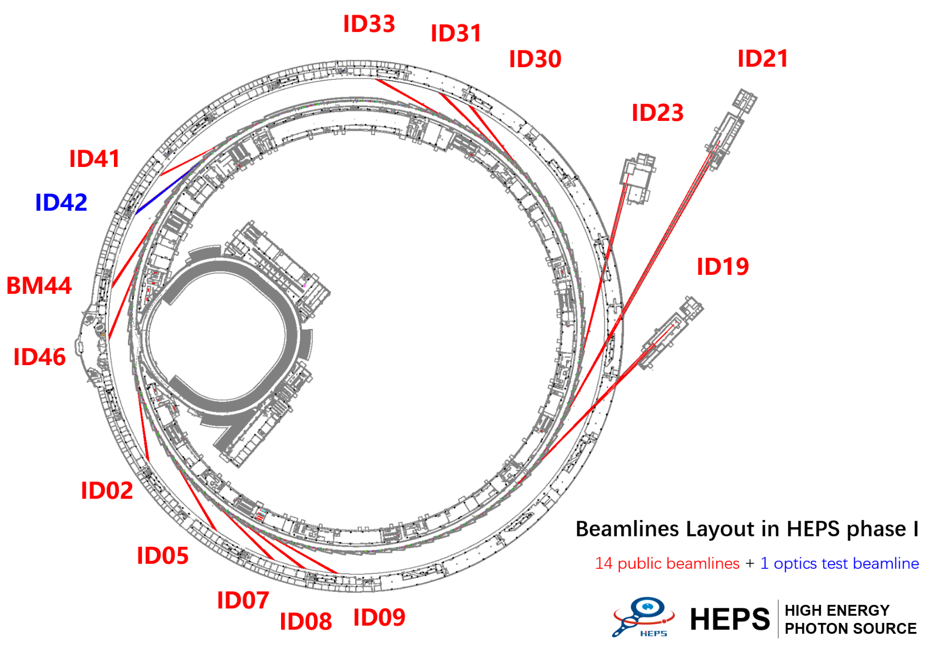
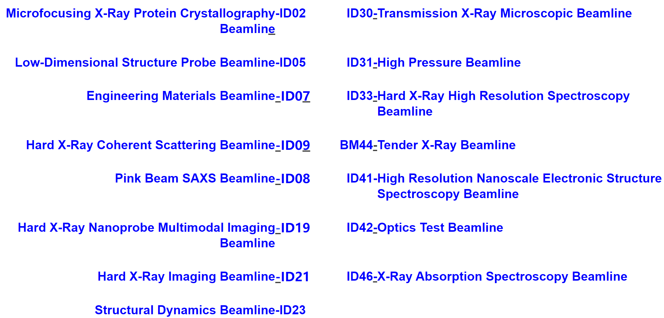
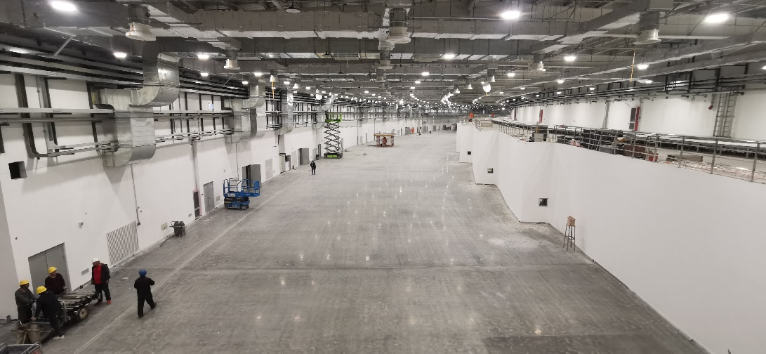
Beamlines in HEPS phase I
14 public beamlines + 1 optics test beamline in Phase I
Can accommodate over 90 beamlines in total
Experiment Hall

Slide 6
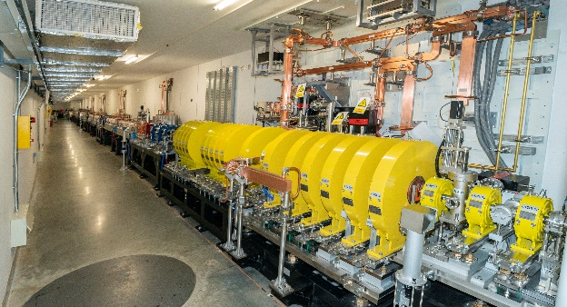
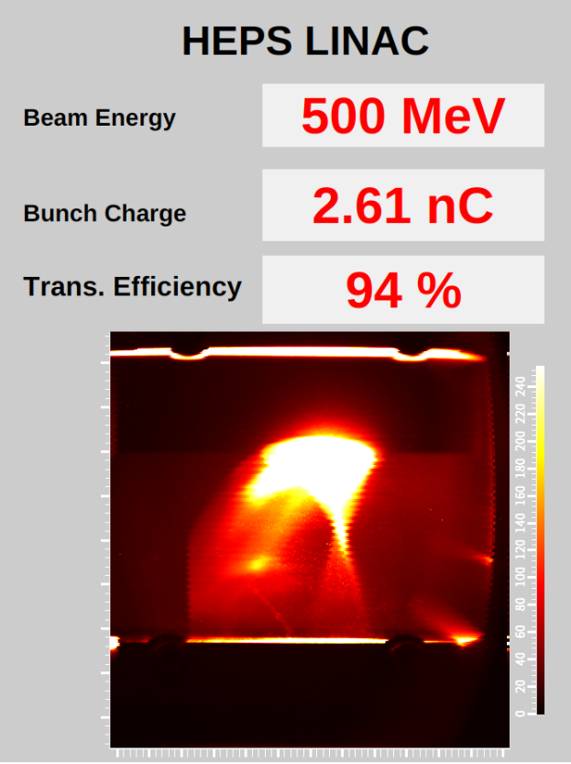
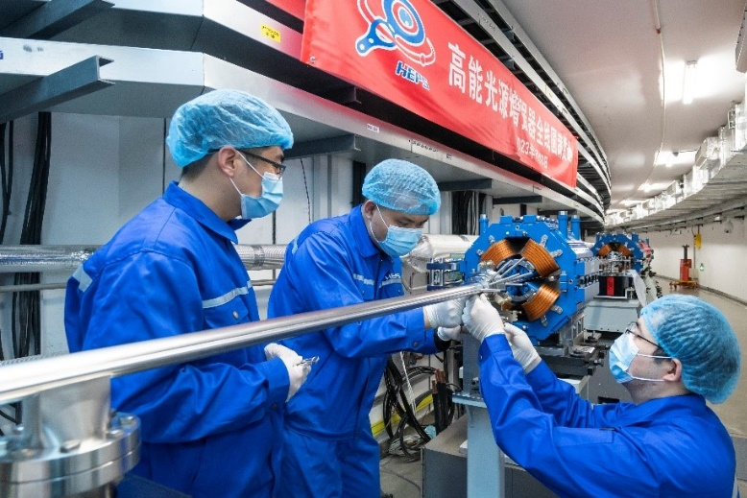
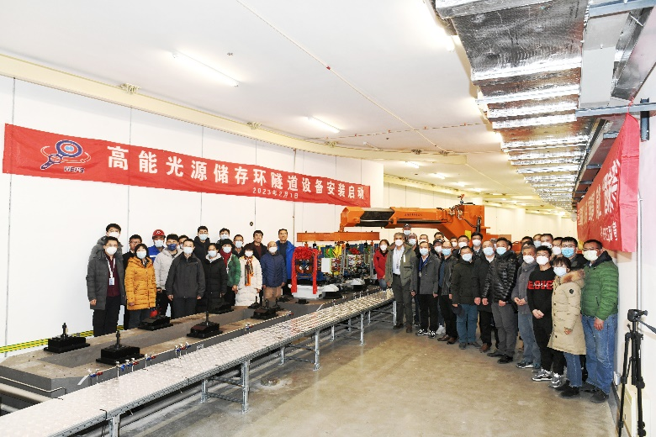
Progress of the HEPS project
The construction of the civil structure completed. Now at the stage of equipment installation
2023.01, HEPS booster installation completed
2023.02, Start installation of storage ring
2023.03, HEPS achieved the first electron beam accelerated to 500 MeV.

Slide 7
Outline
HEPS Introduction
Demand and Challenges of scientific data and software system
The architecture and design of the framework
The status of the system
Summary

Slide 8
Data Challenges @HEPS
Increased source brightness
More raw data in greater detail and less time
X-ray detector capabilities constantly improving:
Increased dynamic range, faster readout rates, larger pixel arrays
Bigger frames, higher frame rates => more raw data
>200PB raw data per year for Phase I (15 beamlines)
More than 90 beamlines volume in total
Data volume of HEPS Beamlines:
Beamlines | Burst output（TB/day） | Average output（TB/day）
B1 Engineering Materials Beamline | 600.00 | 200.00
B2 Hard X-ray Multi-analytical Nanoprobe (HXMAN) Beamline | 500.00 | 200.00
B3 Structural Dynamics Beamline | 8.00 | 3.00
B4 Hard X-ray Coherent Scattering Beamline | 10.00 | 3.00
B5 Hard X-ray High Energy Resolution Spectroscopy Beamline | 10.00 | 1.00
B6 High Pressure Beamline | 2.00 | 1.00
B7 Hard X-Ray Imaging Beamline | 1000.00 | 250.00
B8 X-ray Absorption Spectroscopy Beamline | 80.00 | 10.00
B9 Low-Dimension Structure Probe (LODISP) Beamline | 20.00 | 5.00
BA Biological Macromolecule Microfocus Beamline | 35.00 | 10.00
BB pink SAXS | 400.00 | 50.00
BC High Res. Nanoscale Electronic Structure Spectroscopy Beamline | 1.00 | 0.20
BD Tender X-ray beamline | 10.00 | 1.00
BE Transmission X-ray Microscope Beamline | 25.00 | 11.20
BF Test beamline | 1000.00 | 60.00
Total average: |  | 805

Slide 9
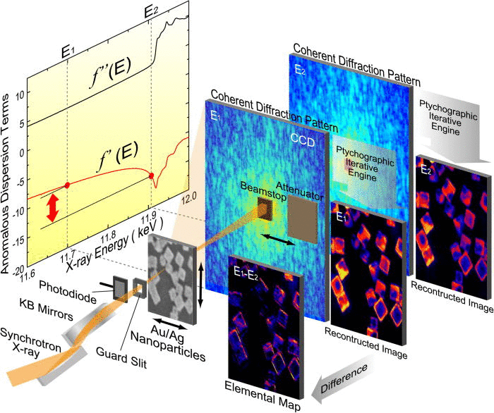
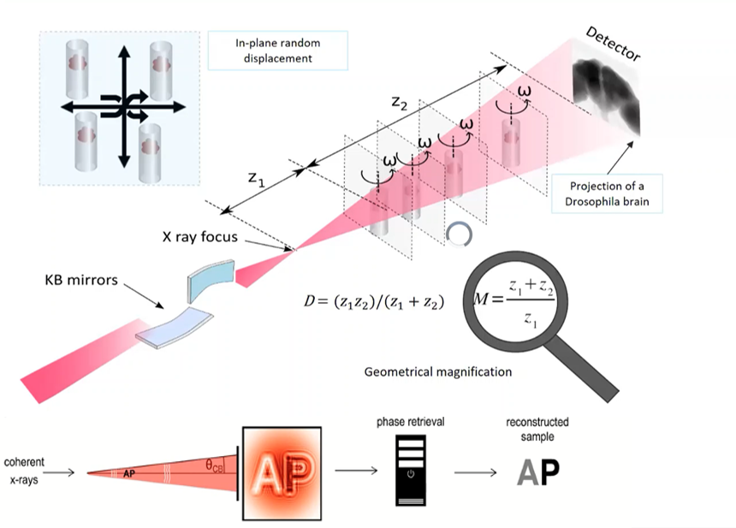
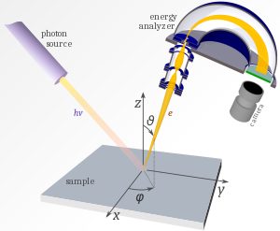
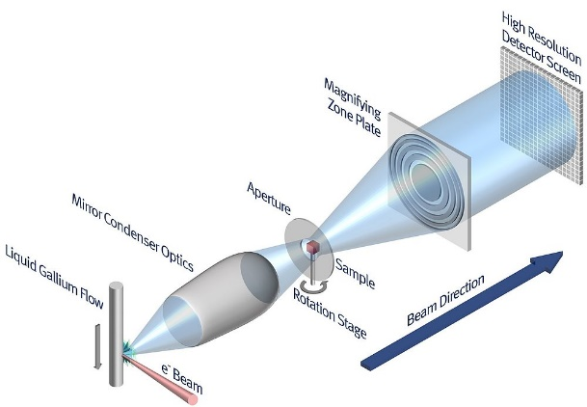
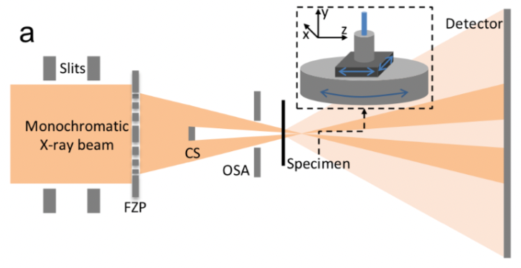
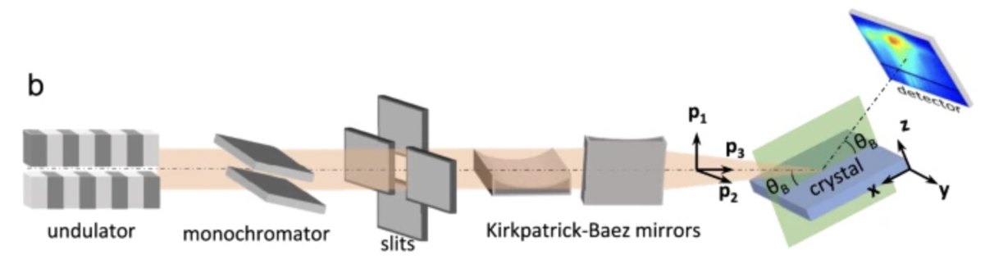
Data Challenges @HEPS
New and more complex experiments
Multi-modal experiments that combine data from multiple samples, techniques, and facilities
In situ and in operando experiments require real-time feedback and autonomous control
Data throughput and volume vary greatly with beamlines and scientific goals
Fluorescence mapping
Nanoholotomography
ARPES
Ptychography
CT
Nano CT
Bragg
ptychography

Slide 10
Data Challenges @HEPS
Analysis and management of large datasets at synchrotron photon sources is becoming progressively more challenging
Development and integration of advanced analysis and management tools is needed
Provide storage, organization and management of massive scientific data
Provide the common underlying software framework to support the diversified development of scientific software and algorithms
During the experiment, provide real-time analysis and fast feedback to guide the experiment steering and optimize the data acquisition
After the experiment, process the massive offline data, accelerate the scientific discovery
Provide the scalable distributed heterogeneous computing power, meet the diverse computing requirements of different scientific goals

Slide 11
Outline
HEPS Introduction
Demand and Challenges of scientific data and software system
The architecture and design of the framework
The status of the system
Summary

Slide 12
Full data lifecycle software system
(Daisy)
Software framework and system for the full data life cycle of advanced photon source
Promoting the intelligence and automation of the full lifecycle of photon source experiments
Implement the tracking and management of scientific data throughout the full lifecycle
Support the development of new advanced data analysis methods and software, as well as the integration of existing algorithm and software into the framework.

Slide 13
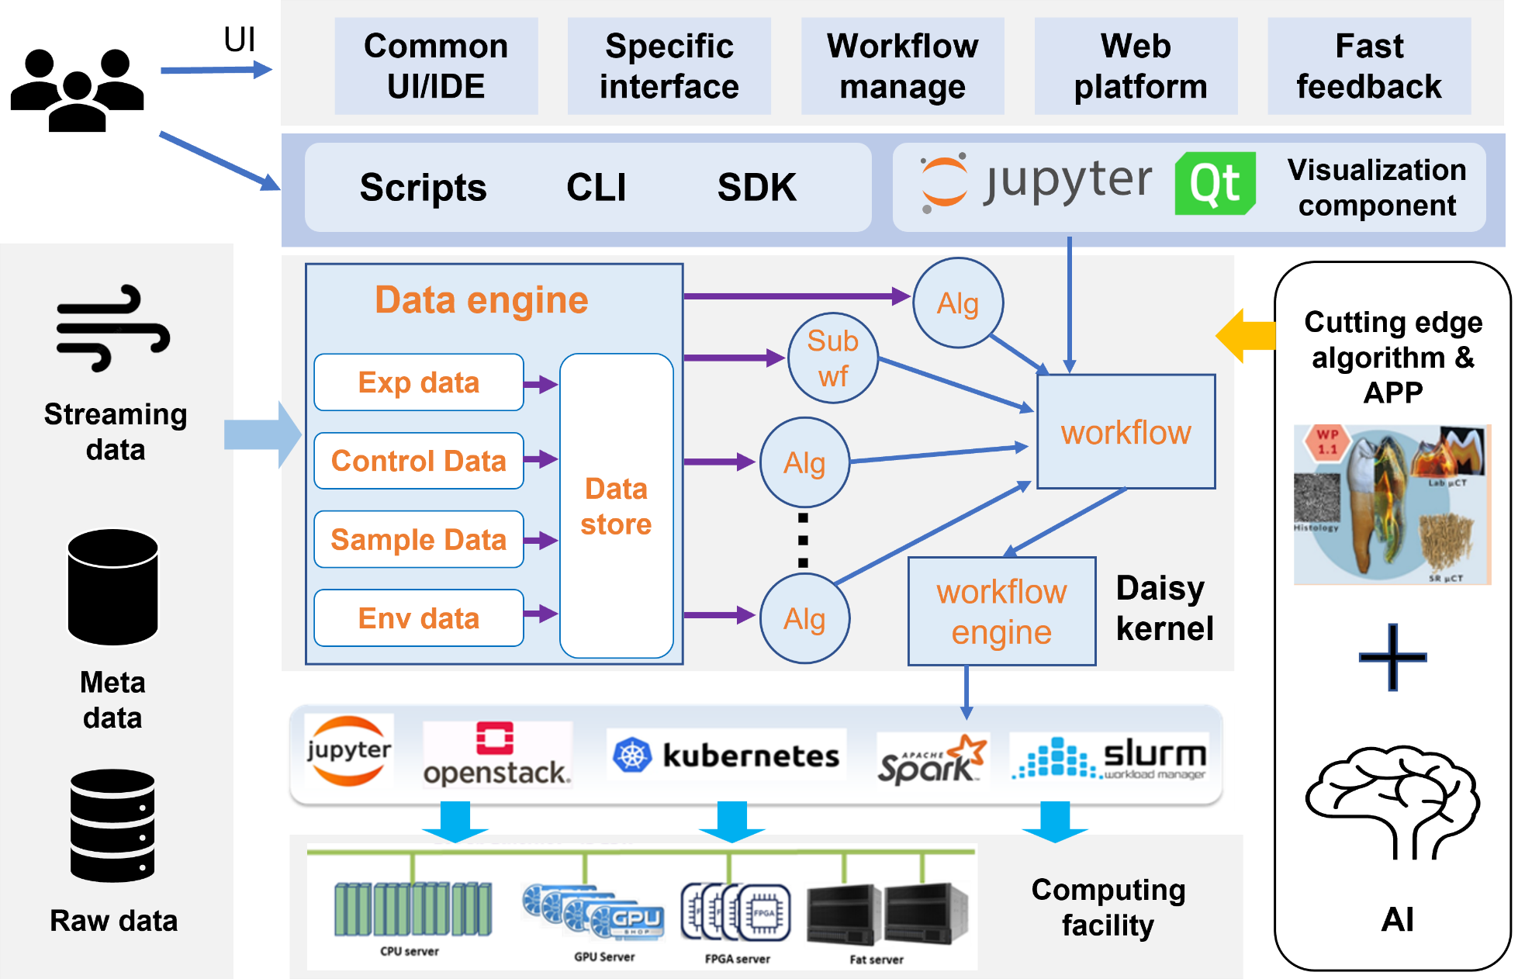
Data analysis software framework—Daisy
Kernel of the framework
Derivative technology modules to meet the data processing requirements of new generation photon sources
Data object management module for high-throughput data I/O, multimodal data exchange, and multi-source data access.
Scalable cluster computing power support for data processing with different scales, different throughputs, and low latency
Interface and developing environment for scientific software integration and development
Domain specific App and flexible general workflow management system based on the framework

Slide 14
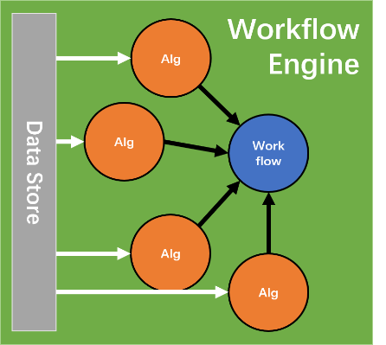
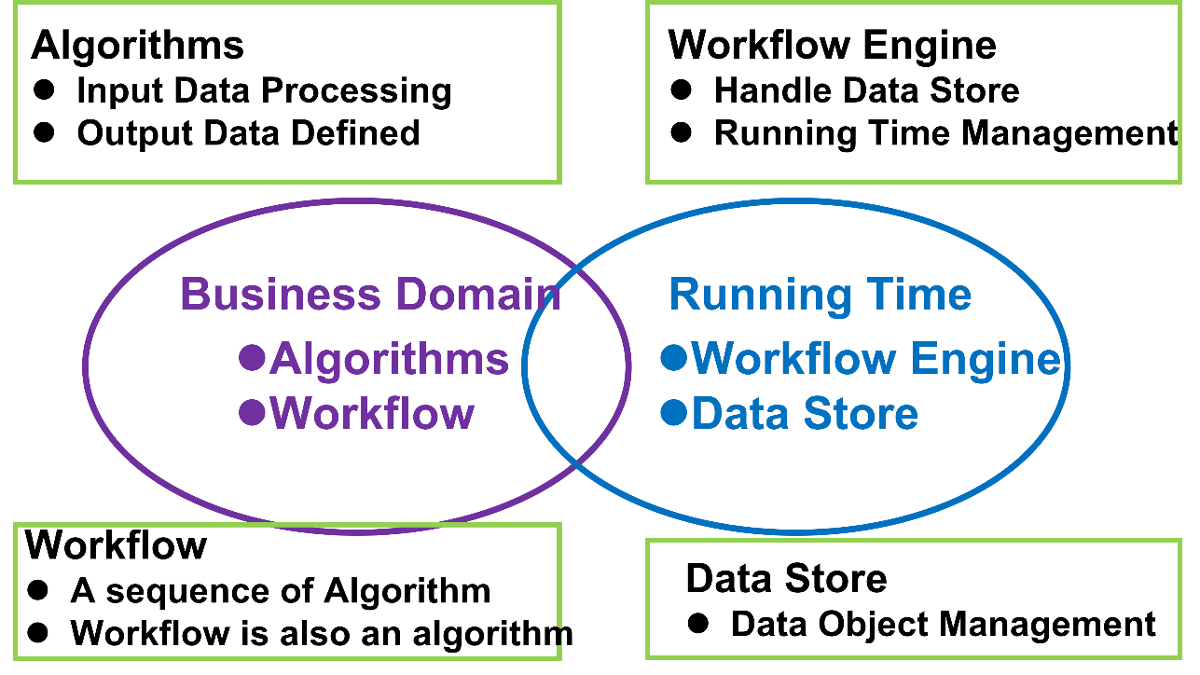
Kernel of the Daisy framework
Extract domain models independent from technology, and establish relationships between models to form a domain architecture
Four core modules are provided:
Algorithm: The smallest unit in framework, defining the domain model, basic data processing module, support integration of third-party libraries.
Workflow: Defines the domain architecture, execute processing tasks by calling a series of algorithms, supporting nesting.
Workflow Engine: Manages the runtime environment and the distribution of the algorithm modules. Uncouple the process task from the computing environment.
Datastore: Manages the creation and transmission of data objects between algorithms.

Slide 15
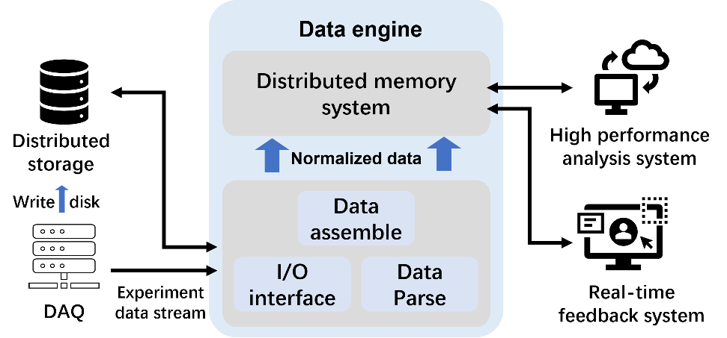
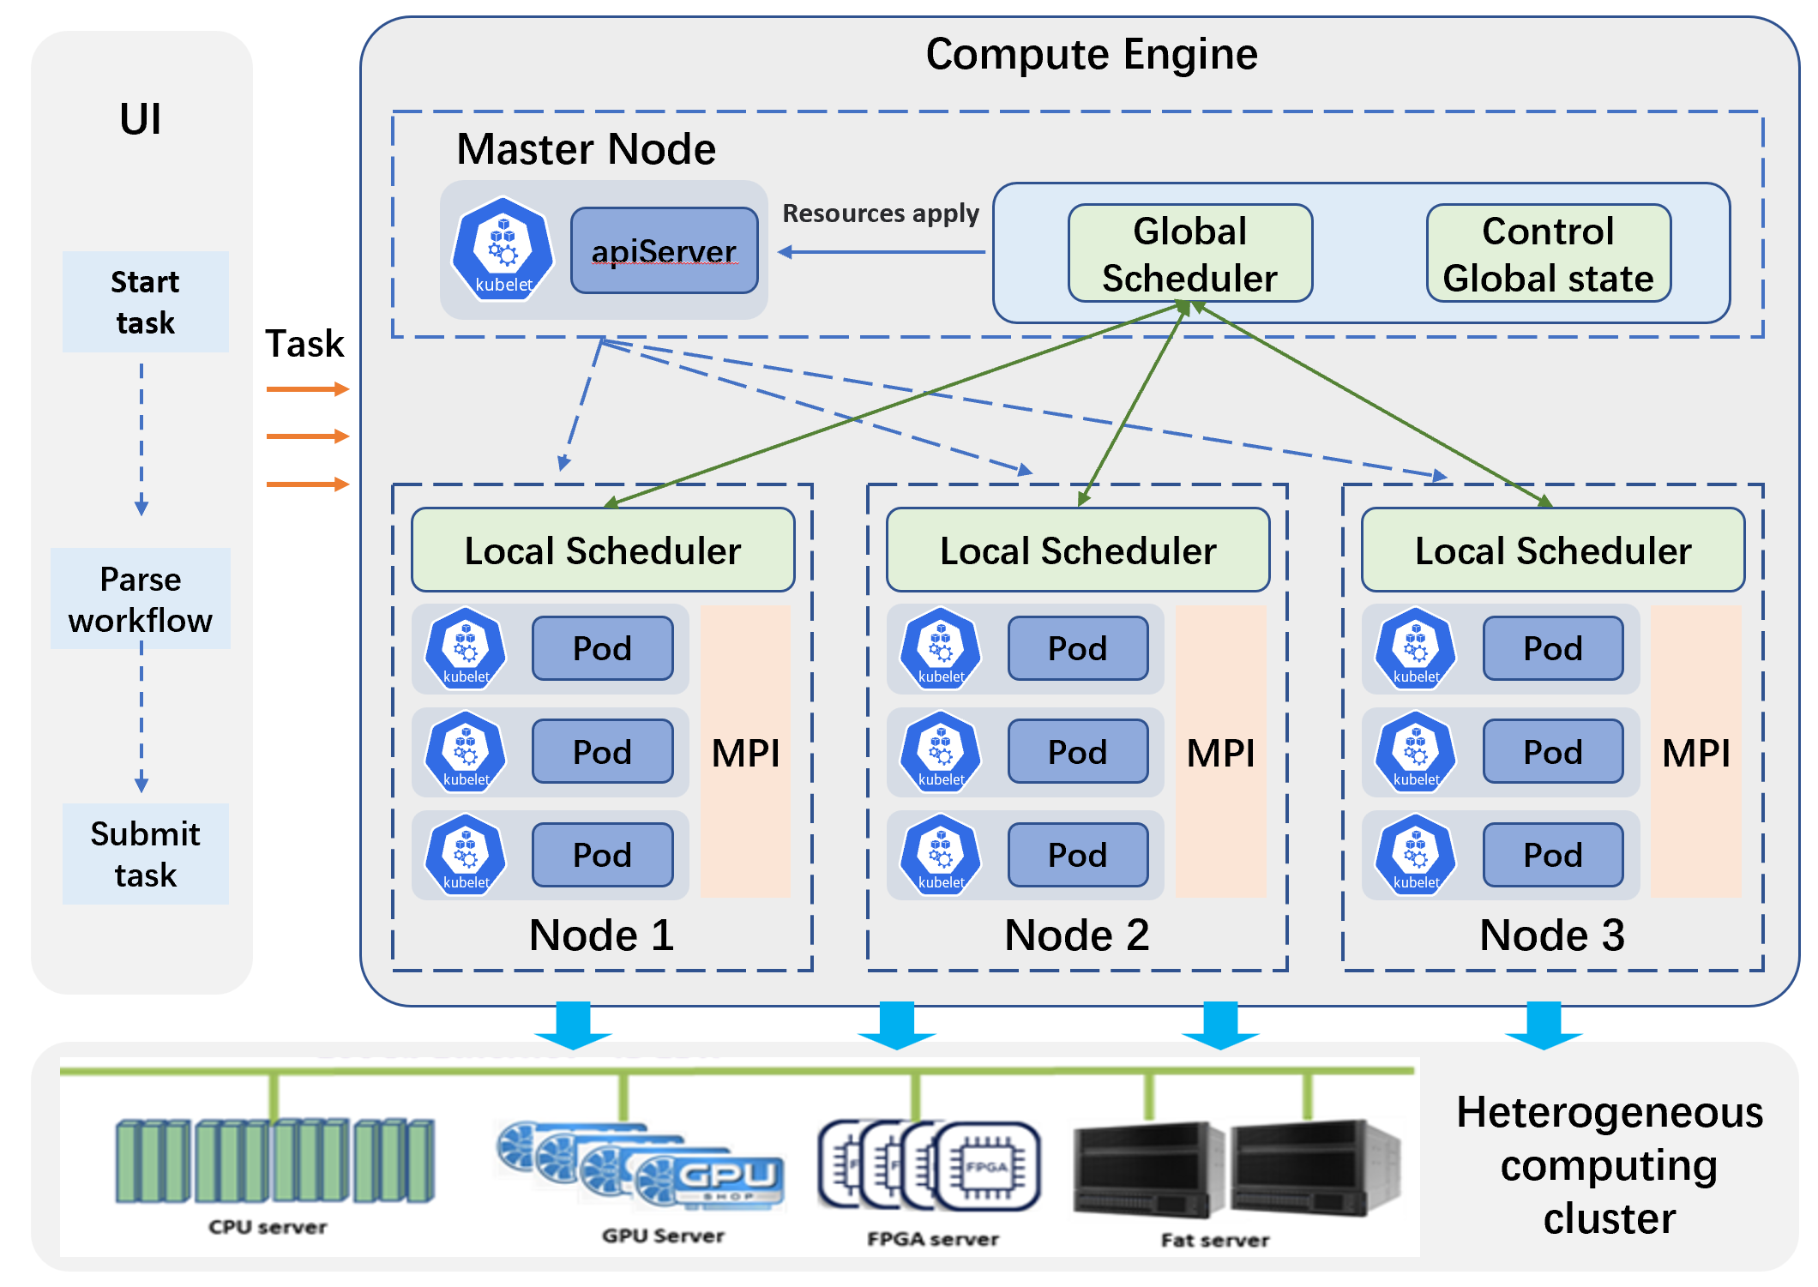
High performance modules
Data object management
Unified I/O interface to shield the difference of underlying architecture and data structure
Support the I/O of stream data besides disk file, for real time, high throughput data process
Employ asynchronous parallel, distributed memory, adaptive storage parameters and compression to optimize the I/O
Heterogeneous distributed computing power support
High performance numerical analysis computing library to speed up the computing hot spots
Provide a unified flexible programming interface API for computing models, to reduce the complexity of parallel programming
Distributed computing task scheduler to achieve better efficiency

Slide 16
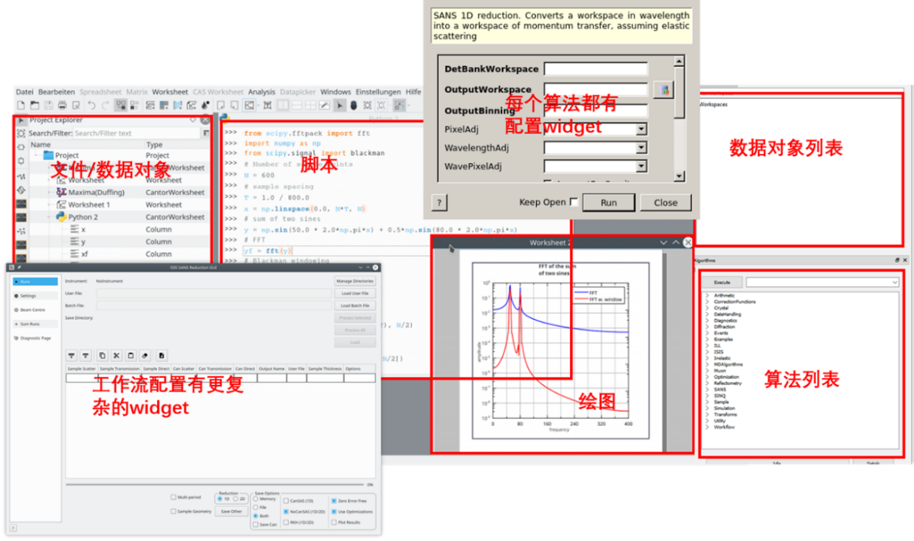
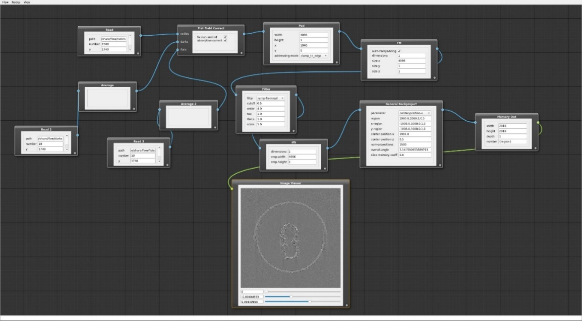
User interface for scientific applications
Variety of user interfaces to support different scientific applications
Data visualization interface
Integrated development environment interface
Specific scientific interface
Web data analysis platform
Script and command line interfaces
Provide a variety of reusable common widgets, support secondary development
Widgets for analysis, drawing, browsing, configuration, object list……
Workflow management system, for flexible and general data process task
App and Web GUI, support interactive workflow creating, import, export and operation monitoring
Follow the Common Workflow Language(CWL) standard

Slide 17
Outline
HEPS Introduction
Demand and Challenges of scientific data and software system
The architecture and design of the framework
The status of the system
Summary

Slide 18
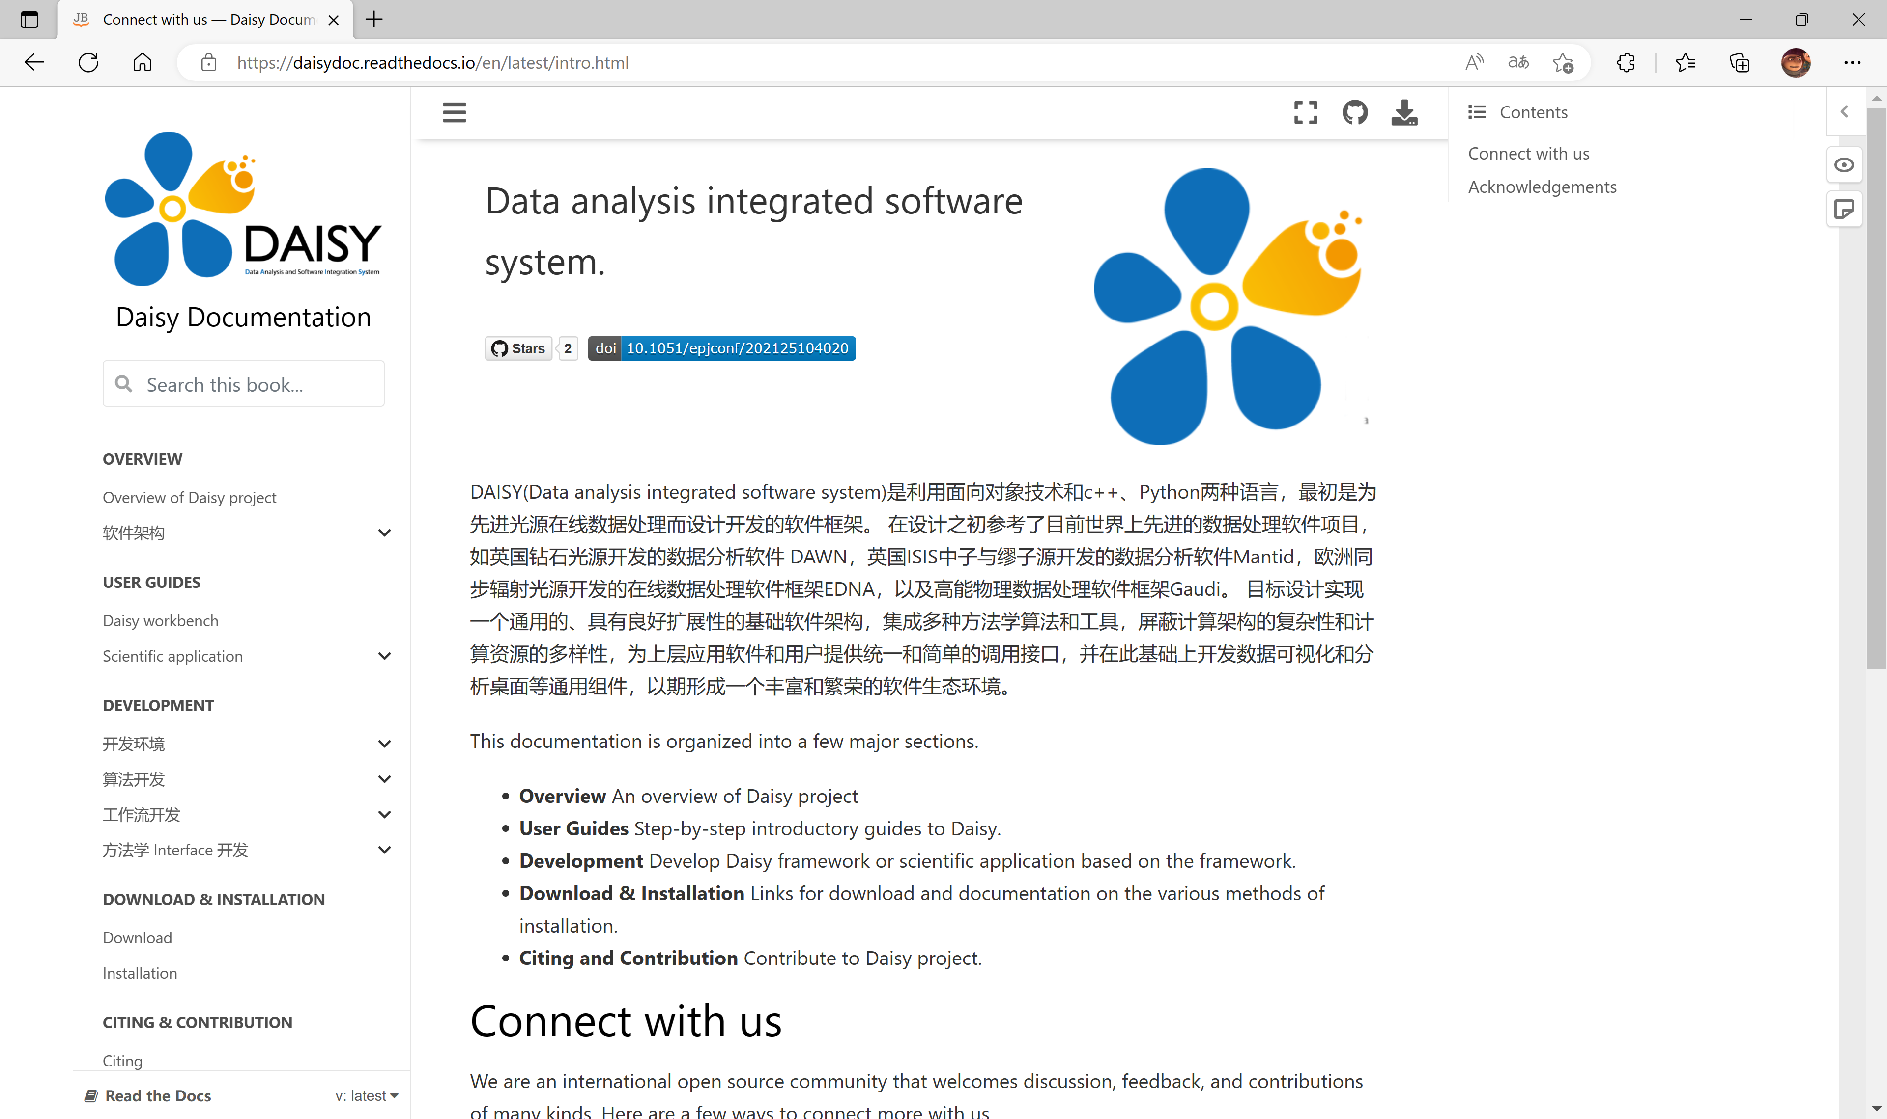
Daisy framework
The basic software framework of general scientific data processing Daisy is designed and implemented
Four types of basic interfaces are provided ：
Algorithm and workflow module: Implement domain model and processing task
Workflow engine and datastore module: Manage the software runtime environment and data objects
Provide several types GUI: general-purpose GUI, domain specific GUI, user development IDE, web platform
Open source, user documentation provided
Integrated several scientific software and algorithms, developed several domain specific GUI
User documentation ：
https://daisydoc.readthedocs.io
Yu Hu et al. EPJ Web of Conferences 251, 04020 (2021).

Slide 19
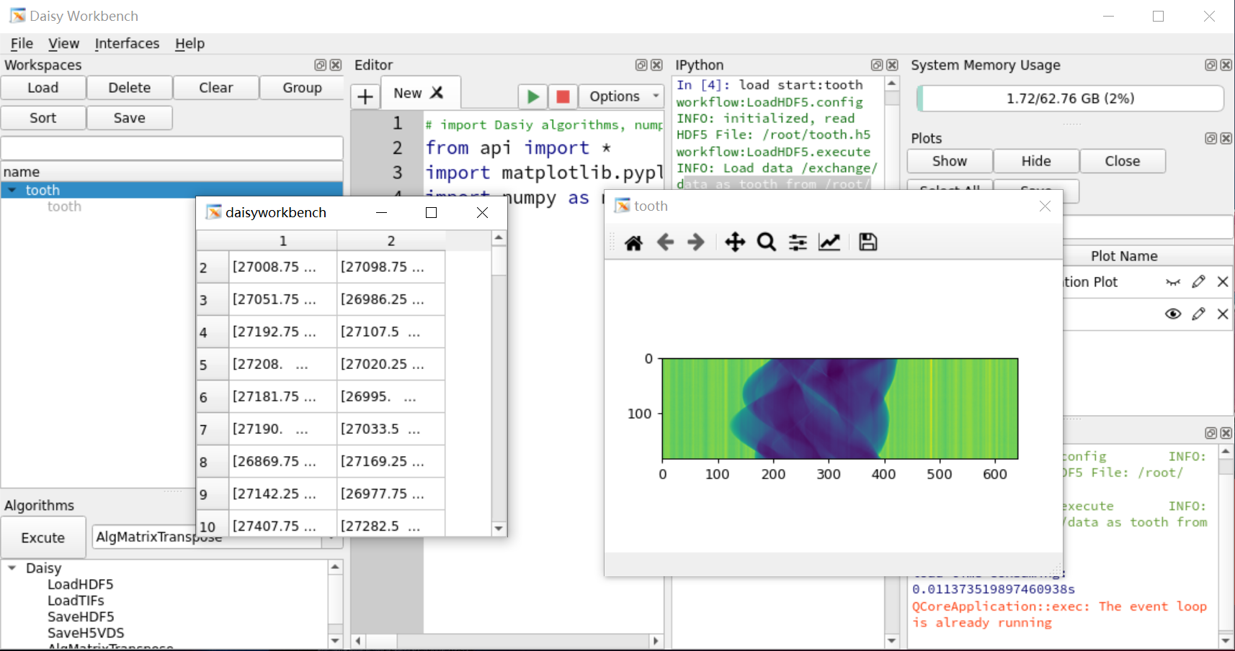
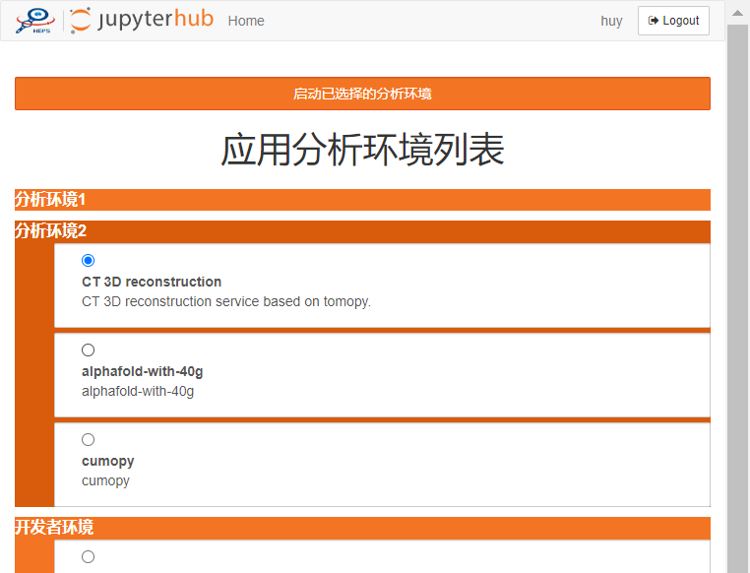
Daisy graphical user interface
Daisy workbench:
General-purpose GUI based on PyQt5
Include data object list, algorithm list, data view/visualization, and IDE for developers
Interfaces of custom GUIs for a variety of scientific techniques
Web data analysis platform:
Based on the jupyterlab ecosystem
Container encapsulates the computing environment
Scalable computing resource
Terminal and web scientific APP

Slide 20
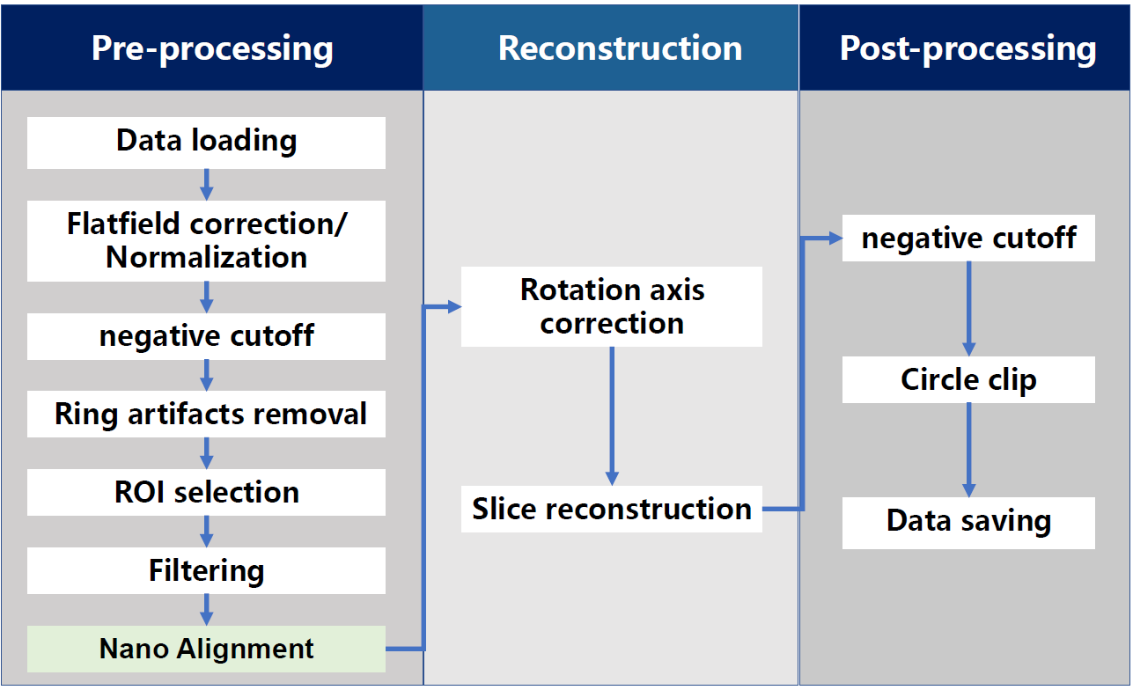
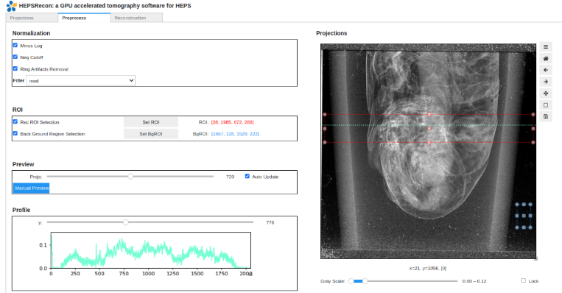
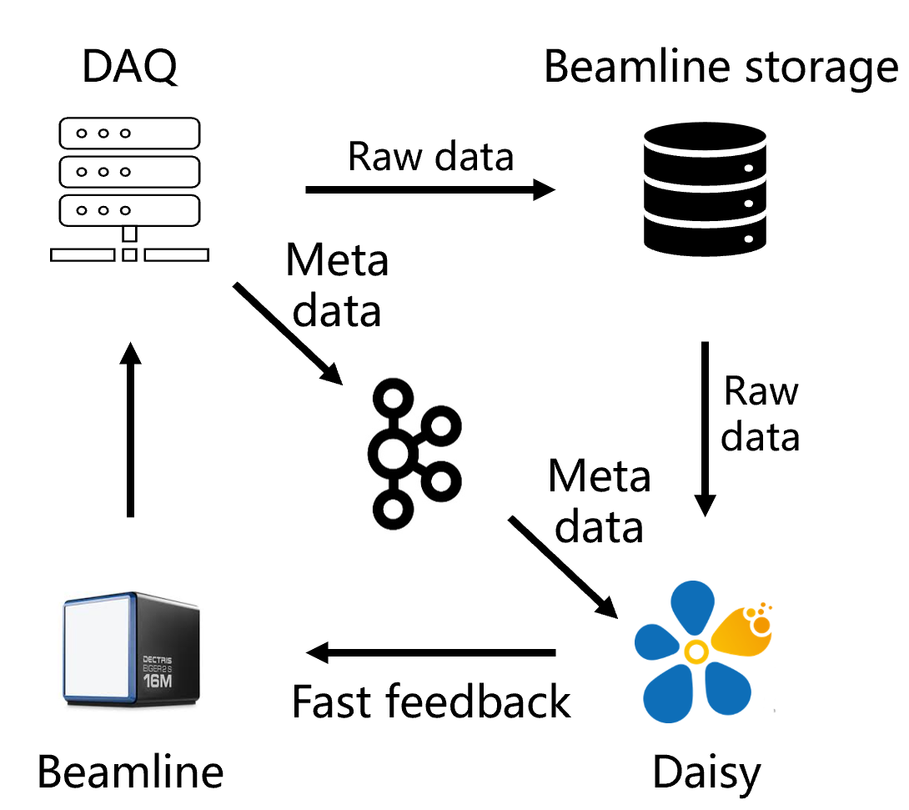
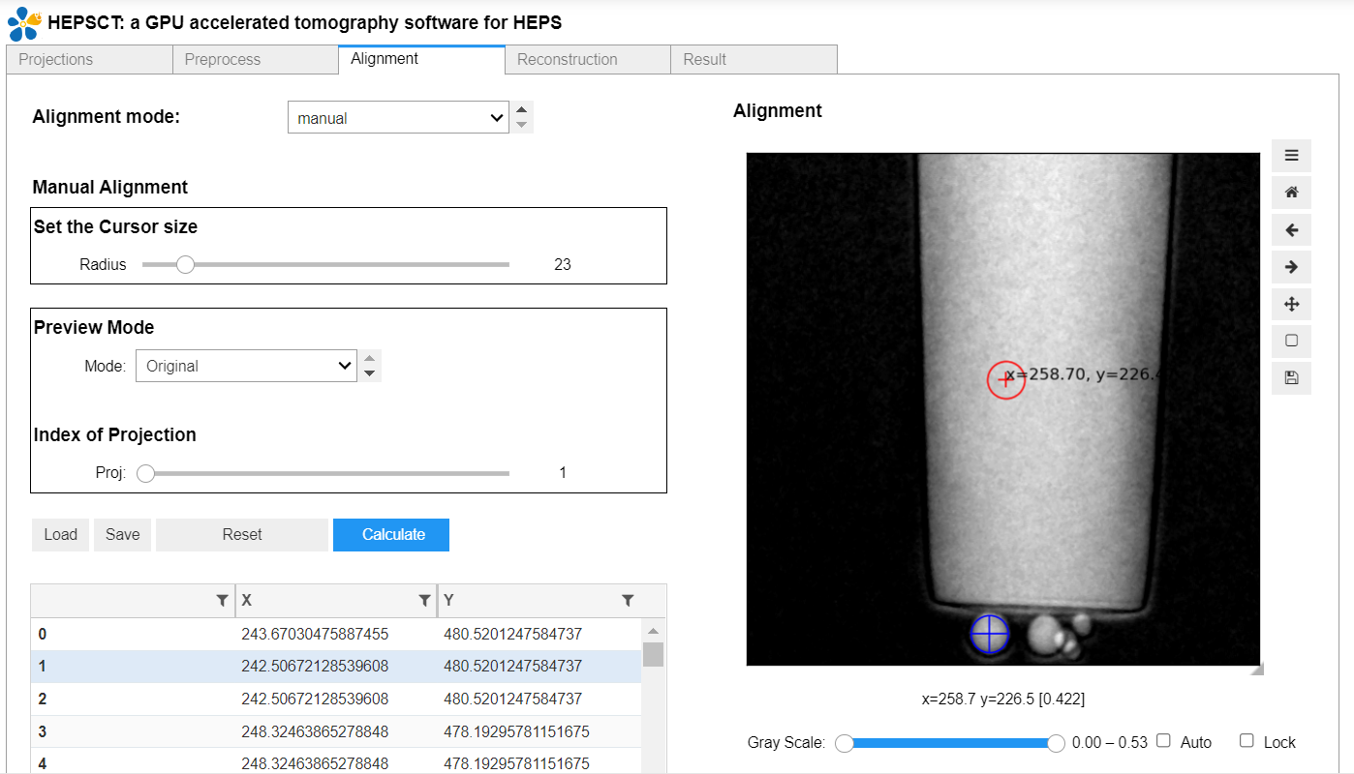
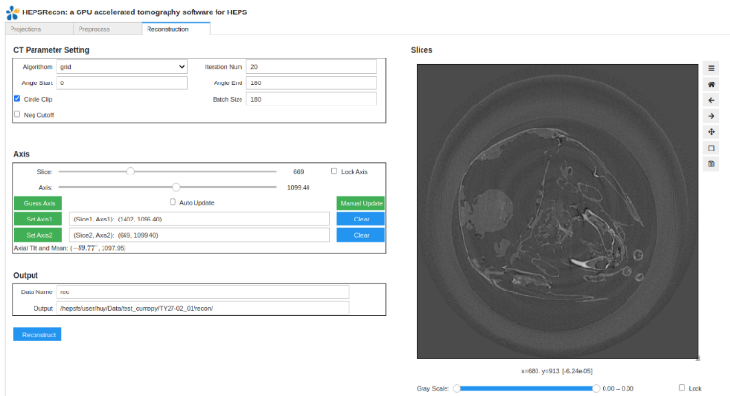
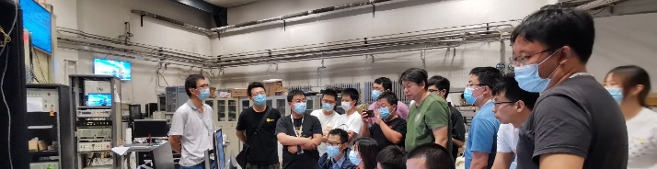
Web based application for X-ray CT
Web-based interactive data processing interface, integrates self-developed software HEPSCT
Implement the reconstruction of micro CT and nano CT with different data formats (HDF5，tiff)
Deployed on the Web data analysis platform，will support multiple beamlines of HEPS
Validated on the BSRF 3W1A test bed. Implemented the automated data processing pipeline with DAQ system and HEPS-B7 beamline
Distributed CT data processing method is being developed
Preprocess
workflow
Nano alignment
Slice reconstruction

Slide 21
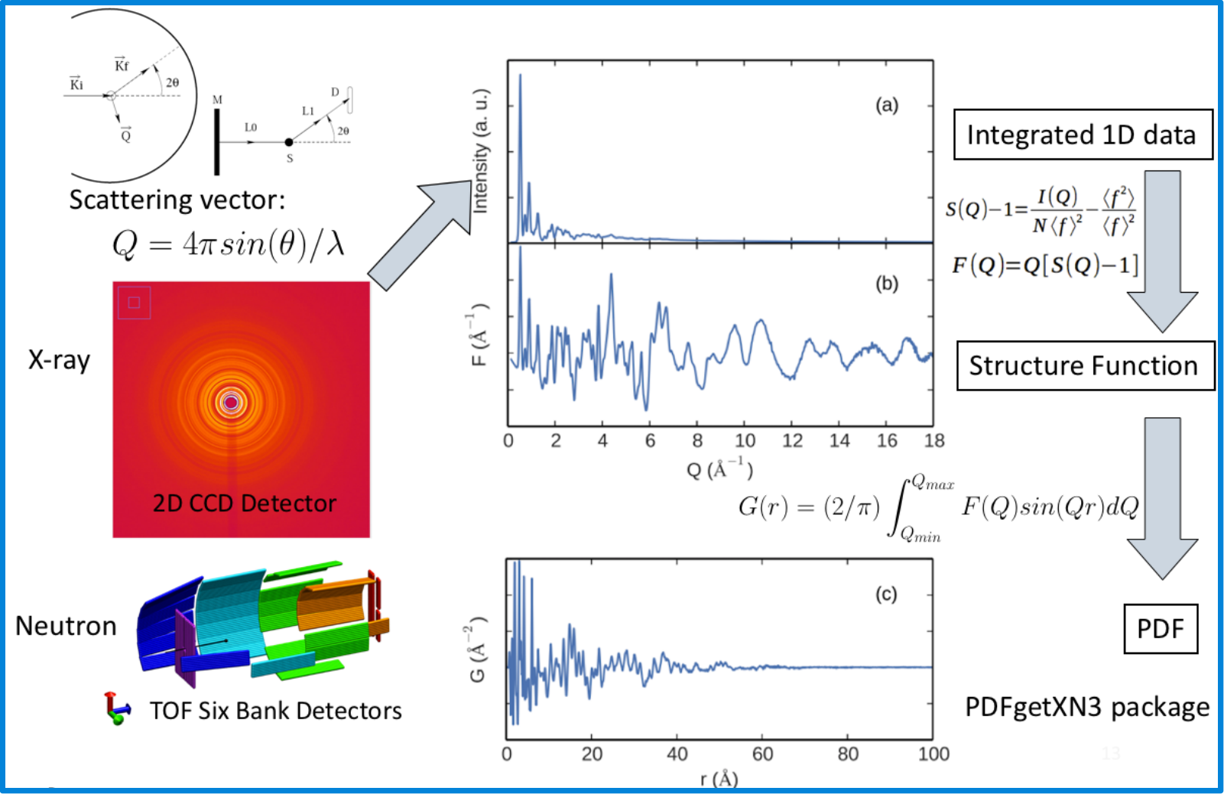
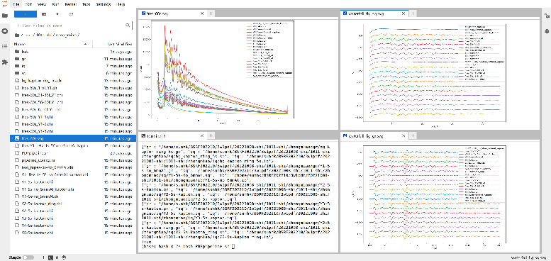
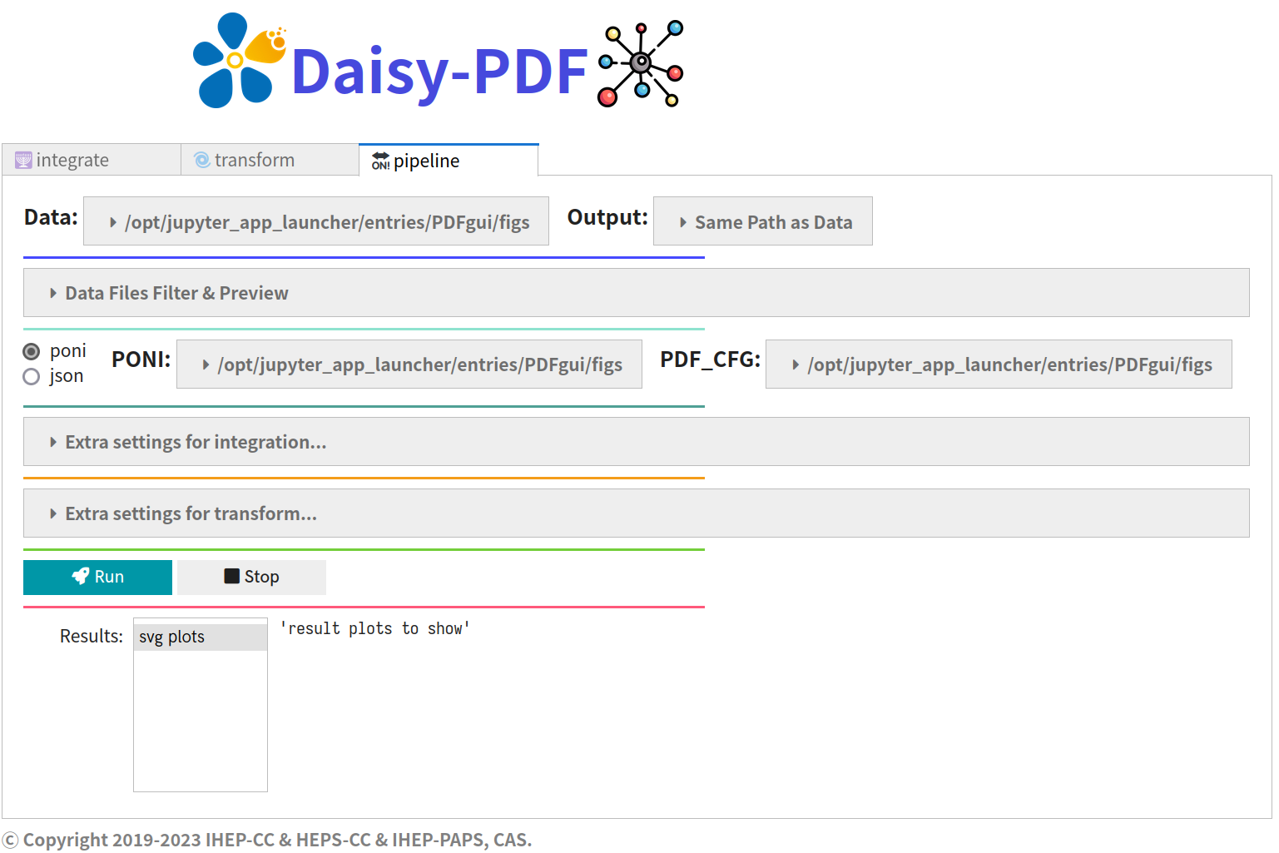
Application for Pair distribution function(PDF)
Serve for total scattering experiment
Developed PDFHEPS python package, integrated several scientific software, such as PyFai and PDFgetX3
Implement a pipeline from raw data to PDF，include background reduction, masking, azimuth integration and PDF data transform
A web-based GUI also provided for interaction and data visualization
More function will provide in the future, such as Similarity Mapping, Structure Mining via machine learning
Workflow
Web GUI

Slide 22
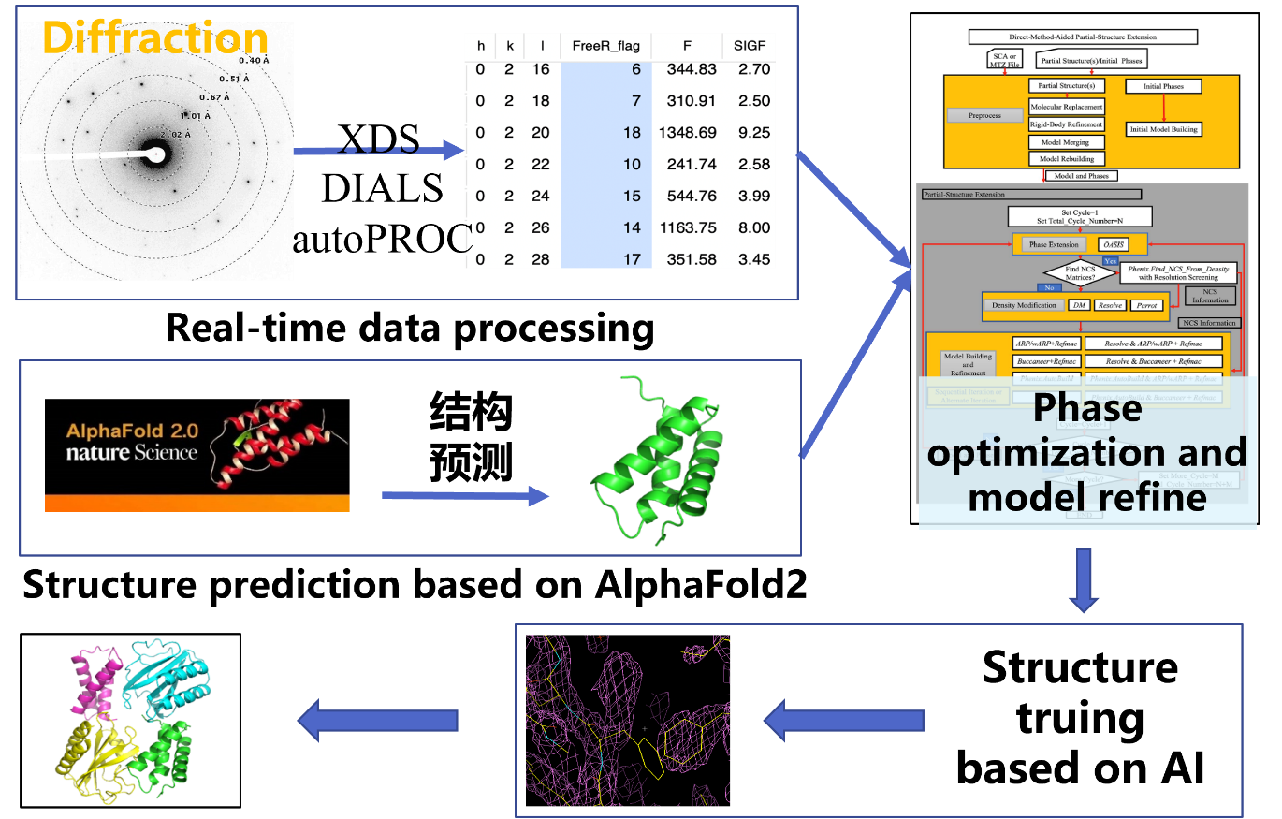
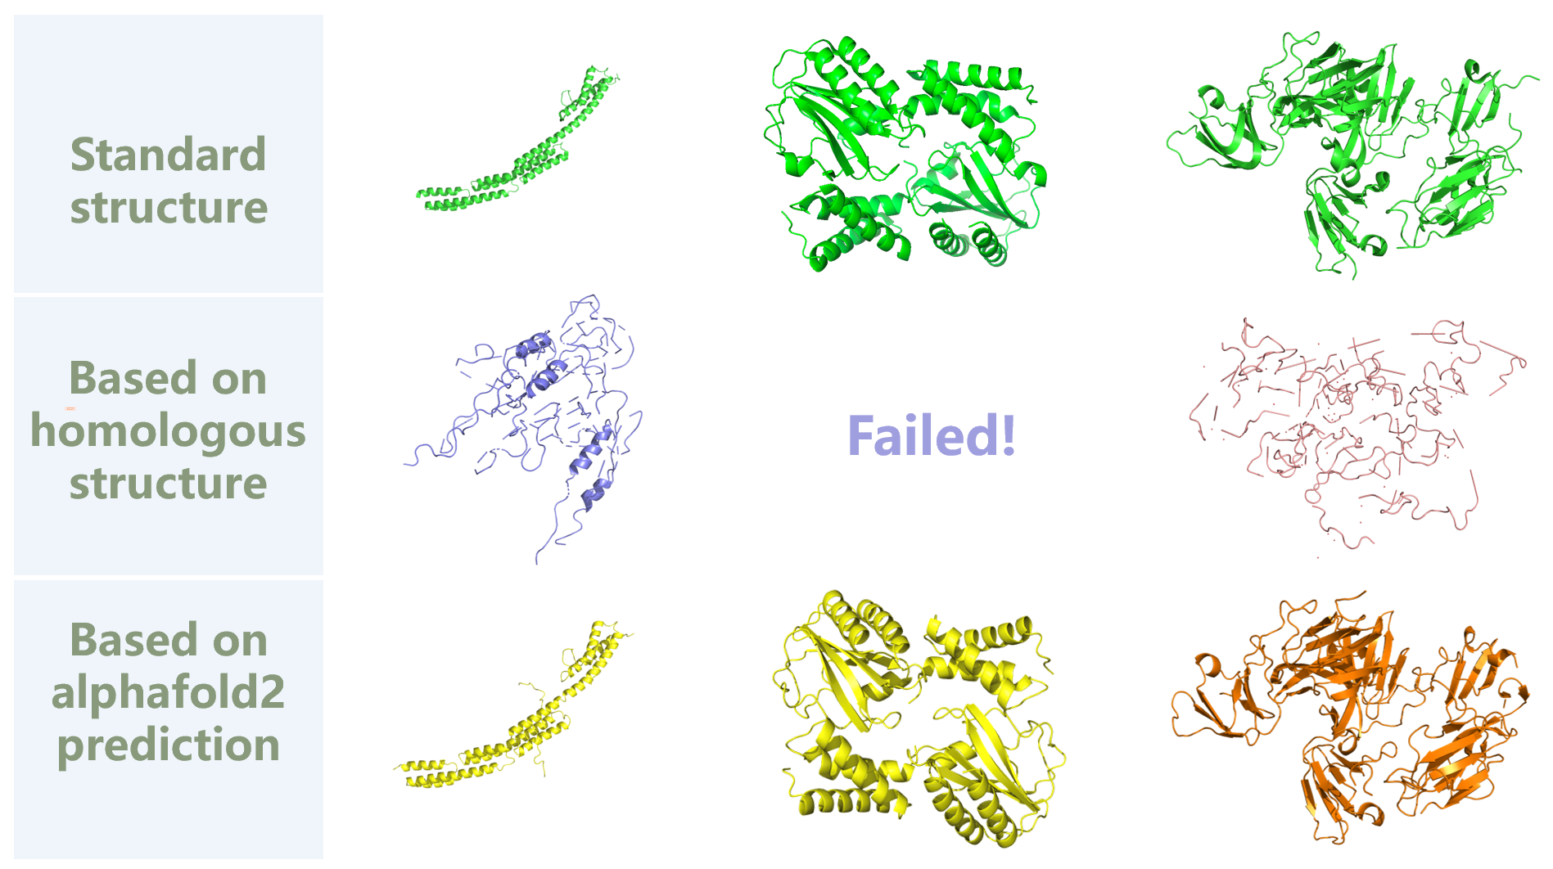
AI-based application for biological macromolecule
Automatic pipeline based on direct method, structure prediction and AI
Include 3 modules: data processing, structure prediction, model building
Module of structure truing based on AI will be added in the future
Based on alphafold2, the success rate and accuracy of macromolecular structure reconstruction get improved

Slide 23
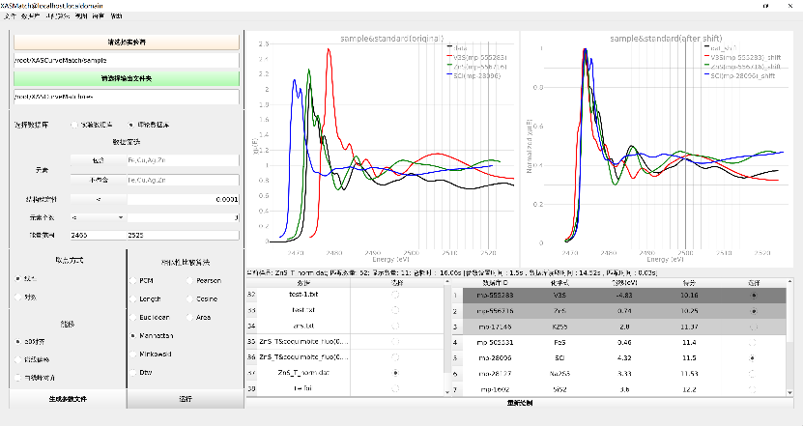
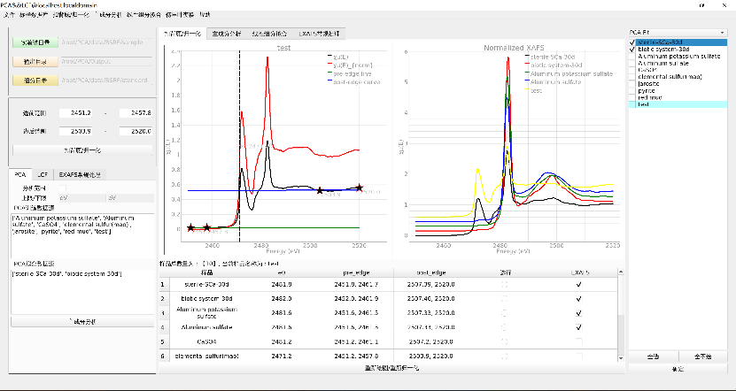
Applications for X-ray absorption spectroscopy
Based on PyQt5, for spectroscopy components analysis
XASMatch
Fast matching of experimental spectroscopy from database
Integrate multiple matching and energy shift methods, support multiple input databases
PCA&&LCF
Spectroscopy components analysis via PCA and LCF method
Automatic pipeline, batch processing, multi-standard spectroscopy input
XASMatch
PCA&&LCF

Slide 24
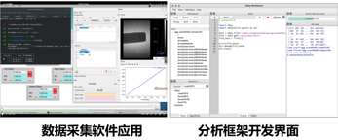
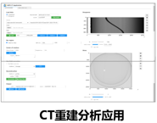
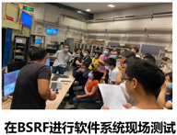
HEPS CC system integration/Test bed/Production
Set up testbed, integrate full data lifecycle software systems to verify the system interfaces, run in the real experimental environment, move to production gradually.
1
Oct, 2020, BSRF 1W1A
Simple verification of the data management system
Network bandwidth is 1Gb/s
Beamline storage: 2TB NAS, Dell EMC NX3240, NFS file system
Central storage: 80TB disk array, Lustre file system
Metadata ingest, catalogue, data transfer, data service
2
3
July, 2021, BSRF-3W1 test beamline
Network bandwidth updated to 10Gb/s
Beamline storage & Central storage: 80TB disk array, Lustre file system
Integrate DAQ system, data management system, analysis software framework, computing cluster
June, 2022, BSRF 4W1B
Running in production environment
Network bandwidth updated to 25Gb/s
Beamline storage: Huawei Ocean Store 9950
Central storage: 80TB disk array, Lustre file system
Follow real experiment process, provide Pymca to do analyzing
Data acquisition Analysis framework Interface CT reconstruction Integration test at BSRF
Notes:
为了验证在真实的实验过程中，HEPSCC组提供了存储、算力和开发的软件是否能正常运转，并逐步将成果转向生产。我是HEPSCC系统集成验证的负责人。整个集成工作分为三步来实现：在20年10月，在bsrf的漫散射线站搭建最简易验证环境，验证了数据管理及传输流程；21年7月在3w1测试线站继续集成了计算系统、数据获取和分析软件、验证了整个技术方案的可行性。今年6月专用光期间，我们将整套软硬件方案转到荧光站生产环境，提供全流程服务，目前已经稳定运行。这给我们充足的信心，这套方案未来可直接在HEPS生产环境运行（1分钟），接下来我们只需要在这个基础上不断迭代和优化

Slide 25
Outline
HEPS Introduction
Demand and Challenges of scientific data and software system
The architecture and design of the framework
The status of the system
Summary

Slide 26
Summary
The system design has been finished
Cooperation with other facilities and community is ongoing
The basic framework has been stable and tested on the test bed
Based on the framework, scientific software integration and application development are ongoing
The development of scientific software ecosystem also needs the support and participation of user community
Thanks！

Slide 27
HEPS-CC

